Slide 1
That Was Easy!! Ridiculously Simple Tools for Preceptors
Lawrence Carey, PharmD
Associate Chair, Department of Pharmacy Practice
Director of Experiential Education
Temple University School of Pharmacy

Slide 2
Objectives: Pharmacists
List 3 logistical issues that pharmacy students struggle with while on clinical rotations.
Recite 3 free technologies available for preceptors to place useful information for students to access.
Reflect upon the utility of using games or polling systems to improve information retention.

Slide 3
Objectives: Technicians
List 3 uses of online technologies that will assist students during an institutional pharmacy rotation.
Delineate methodologies that will enhance technician training during new employee orientation.

Slide 4
Disclosure Statement
I, Lawrence Carey, have no conflicts of interest or financial relationships to disclose.

Slide 5
Setting the Table
For some students, the rotation you precept may be the student’s first experience in that practice venue
In addition to their rotation anxiety, other logistical issues come to the forefront
Where do I park?
Where will I put my belongings?
Will I find my way to where I need to be on time?

Slide 6
The Biggest Concern
I have no idea what to expect!

Slide 7
Student Perceptions of Rotations
“I learned a ton at this site.”
“It was like drinking water from a fire hose.”
“The preceptor guided my learning.”
“I felt the preceptor didn’t really know what to do with me.”
“My expectations from my preceptor were clear.”
“There was no plan to guide the rotation.”

Slide 8
Why Use Technology?
United States Department of Education’s 2010 National Education Technology Plan
“Assessment technologies, such as simulations, collaborative environments, virtual worlds, games, and cognitive tutors, can be used to engage and motivate learners while assessing complex skills”
Pharmacy education has traditionally lagged behind other disciplines
Aburahma et al. Educational games as a teaching tool in pharmacy curriculum. Amer J Pharm Ed 2015;79(4).

Slide 9
Why Use Technology in Experiential Education?
Provision of clear goals
Provision of immediate feedback
Great for formative assessment

Slide 10
Tools to Use

Slide 11
Some Free Programs to Direct Learning
Dropbox
Socrative
Poll Everywhere
Doceri for iPad

Slide 12
Dropbox

Slide 13
Dropbox
A file sharing service that you may already be aware of (or using)
Utility for rotations
Rotation students can share a folder with you
Serves as a repository for documents that can be given as pre-reading
Use for accessing pre-rotation quizzes for self-assessments before they get to your rotation

Slide 14
Example: Shared Student Folder

Slide 15
http://www.dropbox.com

Slide 16
Socrative

Slide 17
Socrative
A real-time polling program
Two versions: one for students, one for instructors
You can post questions and have your students compete against one another, or have your single student self-assess themselves

Slide 18
The Socrative Dashboard

Slide 19
Examples of Socrative Work

Slide 20
http://www.socrative.com

Slide 21
Poll Everywhere

Slide 22
Poll Everywhere
Similar to Socrative
This program is good for immediate feedback
Very good for topic discussions
http://www.polleverywhere.com

Slide 23
Doceri for iPad

Slide 24
Example of the Doceri Whiteboard

Slide 25
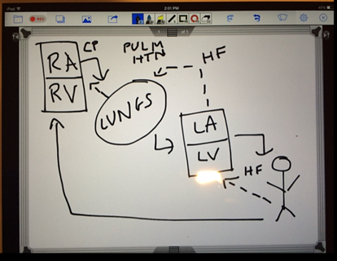
An Example of Doceri Work
→

Slide 26
Advantages of Doceri
Can illustrate concepts very nicely
Can also edit documents, record discussions, and replay those discussions if desired
Can share documents/drawings with others
So, if you want your student to have a copy of the illustration of the cardiac cycle, you can do that easily via email
Free iPad version in the App Store, fee-based Windows and desktop versions at http://www.doceri.com

Slide 27
Other Miscellaneous Tools
Jeopardy Games
https://jeopardylabs.com
Hangman
This is done when a student can’t remember a one word term like a uncommon generic drug name or a disease
Wheel of Pharmtune
Developing; spin a wheel, pick a question category

Slide 28
Summary
There are plenty of free tools available to enhance student learning
It also makes the rotation more enjoyable for you
It may take a little bit of work upfront
Once completed, it can be very useful
With this generation of students, gaming and visuals attract their attention…
So, use it to your advantage!

Slide 29
Questions?

