Slide 1
Navigating New Indications for Rivaroxaban with the COMPASS Study
Kylee Gross, PharmD
PGY-2 Geriatric Pharmacy Resident
LECOM/Millcreek Community Hospital
KGross@lecom.edu
October 26, 2019

Slide 2
Learning Objectives
Pharmacists:
Evaluate evidence to support use of rivaroxaban in chronic coronary artery disease (CAD) and peripheral arterial disease (PAD)
Discuss implications of findings of the COMPASS study for treatment of patients with chronic CAD and PAD
Technicians:
Identify potential side effects of rivaroxaban in chronic CAD and PAD

Slide 3
Background

Slide 4
Cardiovascular Disease
CAD – high risk for major adverse cardiovascular (CV) events
PAD of the lower extremities – high risk for major adverse CV and limb events
Limb ischemia and amputation
Antiplatelet agents used for prevention of vascular complications
Aspirin or P2Y12 inhibitors
Anticoagulants have been found to be superior for prevention of major CV events
Carry unacceptable risk of bleeding

Slide 5
Rivaroxaban
Inhibits platelet activation and fibrin clot formation via direct, selective and reversible inhibition of factor Xa in both intrinsic and extrinsic coagulation pathways
FDA approved indications:
Prevention of stroke and systemic embolism in patients with nonvalvular atrial fibrillation (AF)
Treatment of venous thromboembolism (VTE), including deep vein thrombosis (DVT) and pulmonary embolism (PE)
Thromboprophylaxis of DVT, which may lead to PE in patients undergoing hip or knee replacement surgery
Reduction in the risk of recurrence of DVT and PE in patients at continued risk

Slide 6
Rivaroxaban
Inhibits platelet activation and fibrin clot formation via direct, selective and reversible inhibition of factor Xa in both intrinsic and extrinsic coagulation pathways
FDA approved indications:
Prevention of stroke and systemic embolism in patients with nonvalvular atrial fibrillation (AF)
Treatment of venous thromboembolism (VTE), including deep vein thrombosis (DVT) and pulmonary embolism (PE)
Thromboprophylaxis of DVT, which may lead to PE in patients undergoing hip or knee replacement surgery
Reduction in the risk of recurrence of DVT and PE in patients at continued risk
Reduction in risk of major CV events in patients with chronic CAD or PAD

Slide 7
COMPASS Trial
Cardiovascular Outcomes for People Using Anticoagulation Strategies

Slide 8
COMPASS Trial
Subgroup analysis: Rivaroxaban with or without aspirin in patients with stable peripheral or carotid artery disease
Rivaroxaban with or without Aspirin in Stable Cardiovascular Disease
Published in the Lancet in January 2018

Slide 9
Study Design
Phase 3, multicenter, double-blind, randomized, placebo-controlled trial
27,395 patients with a stable atherosclerotic vascular disease
Randomized 1:1:1 to receive:
Subgroup of 7,470 patients with PAD and CAD
Rivaroxaban 2.5 mg twice daily
+ aspirin 100 mg daily
(n= 2,492)
Rivaroxaban 5 mg twice daily
(n= 2,474)
Aspirin 100 mg daily
(n= 2,504)

Slide 10
Study Outcomes
Efficacy
CV: composite of CV death, stroke, and myocardial infarction
PAD: composite of major adverse limb events (MALE), composite of major adverse CV events (MACE), and composite of MACE and MALE, including major amputations
Safety
Major bleeding

Slide 11
Statistical Considerations
90% power to detect a 20% relative risk reduction (RRR) of MACE for each of the rivaroxaban groups compared to aspirin alone
PAD analysis was a pre-specified subgroup
Trial planned to be continued until at least 2,200 participants had a confirmed primary outcome
Terminated early for efficacy in favor of rivaroxaban + aspirin after 23 months

Slide 12
Results
Efficacy: CV
Efficacy: PAD
Rivaroxaban 2.5 mg twice daily
+ aspirin 100 mg daily
Aspirin 100 mg daily
Rivaroxaban 2.5 mg twice daily
+ aspirin 100 mg daily
Aspirin 100 mg daily

Slide 13
Results
MACE

Slide 14
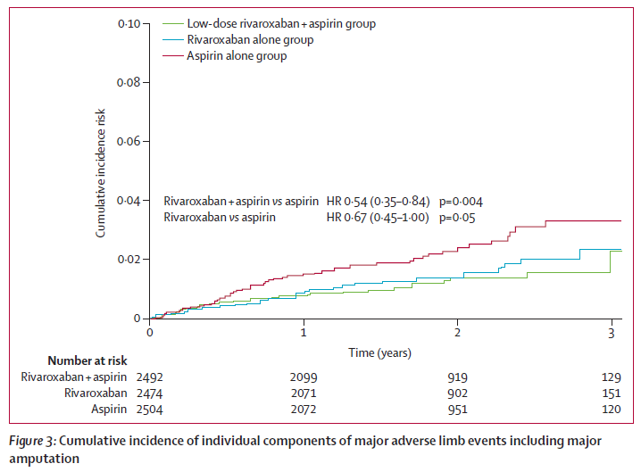
Results
MALE

Slide 15
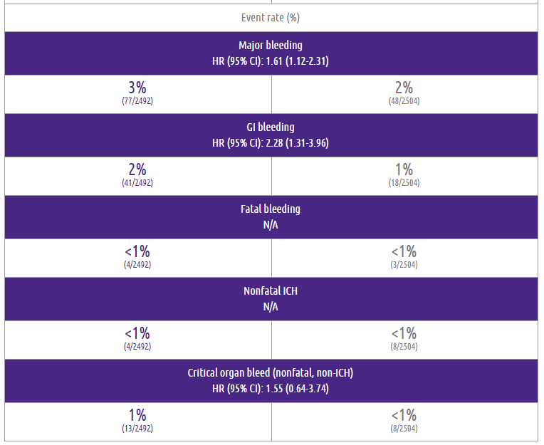
Results
Rivaroxaban 2.5 mg twice daily + aspirin 100 mg daily | Aspirin 100 mg once daily
Safety
Number needed to harm for major bleeding event= 85

Slide 16
Conclusions
Risk of MACE was significantly lower with the combination of rivaroxaban plus aspirin than with aspirin alone
Risk of major bleeding was significantly higher with the combination of rivaroxaban plus aspirin than with aspirin alone
Rivaroxaban alone did not result in a significantly lower risk of major adverse cardiovascular events than aspirin alone
Rivaroxaban alone resulted in a significantly higher risk of major bleeding than aspirin alone

Slide 17
Implications for Clinical Decision-Making
COMPASS Trial

Slide 18
Current Guideline Recommendations
2011
AHA/ACCF Secondary Prevention and Risk Reduction Therapy for Patients With Coronary and Other Atherosclerotic Vascular Disease: 2011 Update
Antiplatelet therapy is recommended in preference to anticoagulant therapy with warfarin or other vitamin K antagonists to treat patients with atherosclerosis
2016
AHA/ACC Guideline on the Management of Patients With Lower Extremity Peripheral Artery Disease
Anticoagulation should not be used to reduce the risk of cardiovascular ischemic events in patients with PAD
2018
FDA approves rivaroxaban, in combination with aspirin, to reduce the risk of major CV events in patients with chronic CAD or PAD

Slide 19
Discussion
Strengths
Limitations
Sample size
Inclusive
Pre-specified subgroup analysis
Modified ISTH criteria for major bleeding
High rate of statin and ACEi/ARB use
Composite outcomes
Early termination
Randomized proton-pump inhibitor use
Low event rate
Low absolute risk reduction

Slide 20
Discussion
There is a need for effective and safe antithrombotic regimens to prevent MACE and MALE in patients with PAD
Lack of large clinical trials
COMPASS results suggest that low-dose anticoagulants and aspirin have additive effects in patients with arterial vascular disease
Despite increase in major bleeding, there was no excess in fatal or critical organ bleeding
Mostly gastrointestinal
COMPASS results show promising advance in the management of patients with PAD
FDA approval of rivaroxaban in combination with aspirin to reduce risk of major CV events in CAD and PAD

Slide 21
Summary
Net clinical benefit of rivaroxaban plus aspirin should be carefully considered for prevention of major adverse cardiac and limb events in patients with chronic PAD
Most likely to provide benefit in the following patients:
High risk of MACE and/or MALE
Low risk of major bleeding
No changes to evidence-based guideline recommendations

Slide 22
Learning Assessment

Slide 23
Learning Assessment
Pharmacists
True or False?
Rivaroxaban resulted in a statistically significant reduction in major adverse CV events in patients with chronic PAD in comparison to low-dose aspirin.

Slide 24
Learning Assessment
Pharmacists
True or False?
Rivaroxaban resulted in a statistically significant reduction in major adverse CV events in patients with chronic PAD in comparison to low-dose aspirin.
False

Slide 25
Learning Assessment
Pharmacists
True or False?
Rivaroxaban 2.5 mg twice daily + aspirin 81 mg daily is the optimal choice of therapy for reduction in risk of major CV events in a patient with a past medical history significant for CAD and hemorrhagic stroke.

Slide 26
Learning Assessment
Pharmacists
True or False?
Rivaroxaban 2.5 mg twice daily + aspirin 81 mg daily is the optimal choice of therapy for reduction in risk of major CV events in a patient with a past medical history significant for CAD and hemorrhagic stroke.
False

Slide 27
Learning Assessment
Technicians
Fill in the blank:
_______ is the most concerning potential side effect for a patient picking up a new prescription for rivaroxaban and asking where the baby aspirin is located.

Slide 28
Learning Assessment
Technicians
Fill in the blank:
Bleeding is the most concerning potential side effect for a patient picking up a new prescription for rivaroxaban and asking where the baby aspirin is located.

Slide 29
Navigating New Indications for Rivaroxaban with the COMPASS Study
Kylee Gross, PharmD
PGY-2 Geriatric Pharmacy Resident
LECOM/Millcreek Community Hospital
KGross@lecom.edu
October 26, 2019

Slide 30
References
Xarelto [package insert]. Titusville, NJ: Janssen Pharmaceuticals, Inc.; 2019.
Eikelboom, J. W., Connolly, S. J., Bosch, J., Dagenais, G. R., Hart, R. G., Shestakovska, O., . . . Yusuf, S. (2017). Rivaroxaban with or without Aspirin in Stable Cardiovascular Disease. New England Journal of Medicine, 377(14), 1319-1330. doi:10.1056/NEJMoa1709118
Anand, S. S., Bosch, J., Eikelboom, J. W., Connolly, S. J., Diaz, R., Widimsky, P., . . . Chioncel, O. (2018). Rivaroxaban with or without aspirin in patients with stable peripheral or carotid artery disease: an international, randomised, double-blind, placebo-controlled trial. The Lancet, 391(10117), 219-229. doi:https://doi.org/10.1016/S0140-6736(17)32409-1
Smith, S. C., Benjamin, E. J., Bonow, R. O., Braun, L. T., Creager, M. A., Franklin, B. A., . . . Taubert, K. A. (2011). AHA/ACCF Secondary Prevention and Risk Reduction Therapy for Patients With Coronary and Other Atherosclerotic Vascular Disease: 2011 Update. A Guideline From the American Heart Association and American College of Cardiology Foundation Endorsed by the World Heart Federation and the Preventive Cardiovascular Nurses Association, 58(23), 2432-2446. doi:10.1016/j.jacc.2011.10.824
Gerhard-Herman, M. D., Gornik, H. L., Barrett, C., Barshes, N. R., Corriere, M. A., Drachman, D. E., . . . Walsh, M. E. (2017). 2016 AHA/ACC Guideline on the Management of Patients With Lower Extremity Peripheral Artery Disease. A Report of the American College of Cardiology/American Heart Association Task Force on Clinical Practice Guidelines, 69(11), e71-e126. doi:10.1016/j.jacc.2016.11.007

Slide 31
Patient Characteristics

Slide 32
Efficacy Outcomes

Slide 33
Safety Outcomes

Slide 34
Outcomes

Slide 35
Subgroup Analysis

