Slide 1
Good Research Practice
Kelly Dornin-Koss, Director, ECS-HSR
Melissa Miklos, Associate Director, HRP
Maggie Soncini, ECS-HSR Coordinator
Notes:
January 1, 2017 - NIH Good Clinical Practice Training Mandate - for many years GCP was associated with FDA regulated research, but the NIH as well as the University of Pittsburgh believe that the principles of GCP are applicable to all Clinical Trials.
.
GCP training aims to ensure that:
the rights, safety, and well-being of human subjects are protected
clinical trials are conducted in accordance with approved plans with rigor and integrity
data derived from clinical trials are reliable

Slide 2
Objectives
To provide an overview of Good Research Practice as they relate to:
  Good Clinical Practice (GCP) and the NIH adoption of GCPs
  PI Responsibilities
  Protocol Development and PittPRO
  Informed Consent
  Study Documentation

Slide 3
Continuing Education Information
Accreditation Statement:
In support of improving patient care, the University of Pittsburgh is jointly accredited by the Accreditation Council for Continuing Medical Education (ACCME), the Accreditation Council for Pharmacy Education (ACPE), and the American Nurses Credentialing Center (ANCC), to provide continuing education for the healthcare team.
Physician:
The University of Pittsburgh School of Medicine designates this live activity for a maximum of 2.5 AMA PRA Category 1 Credits™. Physicians should claim only the credit commensurate with the extent of their participation in the activity.
Nursing (CNE)
The maximum number of hours awarded for this Continuing Nursing Education activity is 2.5 contact hours.
Other health care professionals:
Other health care professionals will receive a certificate of attendance confirming the number of contact hours commensurate with the extent of participation in this activity.
Conflict of Interest Disclosure:
No planners, members of the planning committee, speakers, presenters, authors, content reviewers and/or anyone else in a position to control the content of this education activity have relevant financial relationships to disclose.
Disclaimer Statement
The information presented at this CME program represents the views and opinions of the individual presenters, and does not constitute the opinion or endorsement of, or promotion by, the UPMC Center for Continuing Education in the Health Sciences, UPMC / University of Pittsburgh Medical Center or Affiliates and University of Pittsburgh School of Medicine. Reasonable efforts have been taken intending for educational subject matter to be presented in a balanced, unbiased fashion and in compliance with regulatory requirements. However, each program attendee must always use his/her own personal and professional judgment when considering further application of this information, particularly as it may relate to patient diagnostic or treatment decisions including, without limitation, FDA-approved uses and any off-label uses.

Slide 4
https://cce.upmc.com/content/good-research-practices-41322

Slide 5
What are GCPs?
GCP is defined as a standard for the design, conduct, performance, monitoring, auditing, recording, analysis and reporting of clinical trials or studies
Notes:
They are founded on:
Nuremburg Code
Belmont Report
The Declaration of Helsinki
Federal regulations
International Council on Harmonization (ICH) Guidelines
You can see that they are very broad in scope

Slide 6
What are the Foundations of GCPs?
They are founded on:
  Nuremburg Code
  Belmont Report
  The Declaration of Helsinki
  Federal Regulations
Notes:
Ill talk a little about the regulations that we have here in the US and then you can understand why we relie on the ICH

Slide 7
US Federal Regulations
Food and Drug Administration (FDA)
Apply to products regulated by the FDA
Federal Policy Regulations
Apply to research sponsored by the DHHS, (e.g., the NIH and its subsidiaries) behavioral and biomedical
Applicable regs found in title 21 CFR 11, 50, 54 56, 312, 314,600, 601, 812, 814 of regulations
Found in title 45 CFR 46
Notes:
While it would be nice if we only had one set of regulations to deal with surrounding human subject research, in the United States, there are two sets of regulations for the conduct of human subject research.
Biologic products
Drugs
Electronic products
Food and color additives
Medical devices
Tobacco

Slide 8
Federal Departments under the Common Rule
Department of Agriculture (Title 7)
Department of Energy
National Aeronautical Space Administration
Department of Commerce (Title 15)
Consumer Product Safety Commission
International Development Agency
  Agency for International Development
Department of Housing and Urban Development (Title 24)
Department of Justice
Department of Defense
Department of Education (Title 34)
Department of Veterans Affairs (Title 38 Part 16)
Environmental Protection Agency
Department of Health and Human Services
National Science Foundation
Department of Transportation (Title 49)
Central Intelligence Agency
Notes:
Although the federal policy regulations are known as the Common Rule since multiple agencies adopted them in 1991, each particular agency may have unique requirements.
Department of Defense
Department of Justice
Environmental Protection Agency

Slide 9
Federal Policy Regulations
Research: a systematic investigation, including research development, testing and evaluation, designed to develop or contribute to generalizable knowledge
Human Subject: a living individual about whom an investigator (whether professionals or student) conducting research obtains Information or biospecimens through intervention or interaction with the individual, and uses, studies, or analyzes the information or Obtains, uses, studies, analyzes, or generates Identifiable private information
FDA Regulations
Clinical Investigation: any experiment that involves a test article and one or more human subjects
Human Subject: an individual who is or becomes a participant in research either as a recipient of the test article or as a control. A subject may be either a healthy human or a patient
Notes:
NEED IRB APPROVAL
The 46.102(e) (HHS 2017) definition of human subject now references “information and biospecimens” (replacing “data”) and adds at 46.102(e)(1)(ii) “obtaining, using, studying, analyzing, or generating identifiable private information or identifiable biospecimens” as trigger events. 46.102(e)(1)(i) clarifies that investigators may “obtain” (possess) information and biospecimens without triggering the human subject definition until they use, study, or analyze the information or biospecimens.
Research” has been expanded to list activities that are specifically deemed not to be research (for example, journalism, certain scholarly activities such as: oral history; public health surveillance; criminal justice or criminal investigative activities; and activities in support of intelligence, homeland security, defense, or other national security missions).
For purposes of this part, the following activities are deemed not to be research:
Scholarly and journalistic activities (e.g., oral history, journalism, biography, literary criticism, legal research, and historical scholarship), including the collection and use of information, that focus directly on the specific individuals about whom the information is collected.
Public health surveillance activities, including the collection and testing of information or biospecimens, conducted, supported, requested, ordered, required, or authorized by a public health authority. Such activities are limited to those necessary to allow a public health authority to identify, monitor, assess, or investigate potential public health signals, onsets of disease outbreaks, or conditions of public health importance (including trends, signals, risk factors, patterns in diseases, or increases in injuries from using consumer products). Such activities include those associated with providing timely situational awareness and priority setting during the course of an event or crisis that threatens public health (including natural or man-made disasters).
Collection and analysis of information, biospecimens, or records by or for a criminal justice agency for activities authorized by law or court order solely for criminal justice or criminal investigative purposes.
Authorized operational activities (as determined by each agency) in support of intelligence, homeland security, defense, or other national security missions.

Slide 10
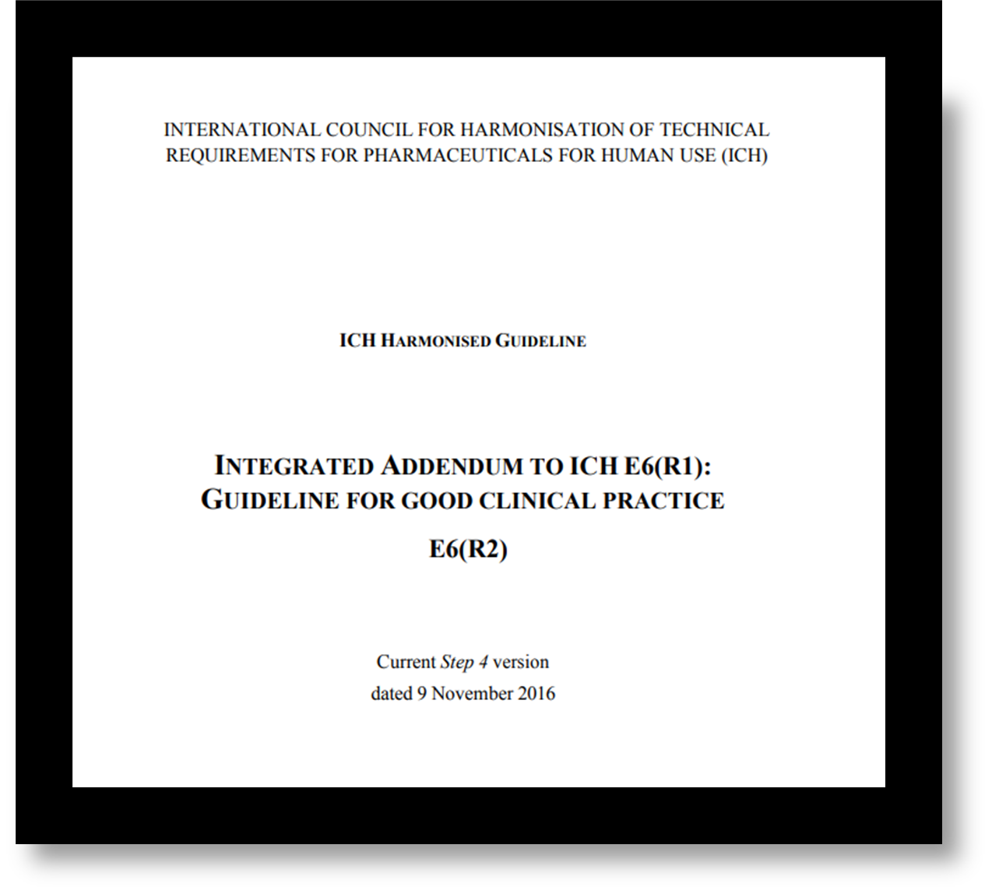
Why Do We Need GCPs in addition to the Regulations?
The objective of the ICH is to provide a unified standard for the EU, Japan and US to facilitate the mutual acceptance of trial data
They provide more details than our regulations
They define and outline the responsibilities of key principles in clinical research, the IRB, the investigator, and the sponsor
Notes:
To provide a unified standard to facilitate the To provide a unified standard to facilitate the mutual acceptance of clinical data by the mutual acceptance of clinical data by the regulatory authorities regulatory authorities
The guidelines are intended to provide the medical research community with “an international ethical and scientific quality standard for designing, conducting, recording, and reporting trials that involve human subjects.”
(a) Disposition of drug. An investigator is required to maintain adequate records of the disposition of the drug, including dates, quantity, and use by subjects.
4.6.3 The investigator/institution and/or a pharmacist or other appropriate individual, who is designated by the investigator/institution, should maintain records of the product's delivery to the trial site, the inventory at the site, the use by each subject, and the return to the sponsor or alternative disposition of unused product(s). These records should include dates, quantities, batch/serial numbers, expiration dates (if applicable), and the unique code numbers assigned to the investigational product(s) and trial subjects. Investigators should maintain records that document adequately that the subjects were provided the doses specified by the protocol and reconcile all investigational product(s) received from the sponsor.
Sec. 312.61 Control of the investigational drug.An investigator shall administer the drug only to subjects under the investigator's personal supervision or under the supervision of a subinvestigator responsible to the investigator. The investigator shall not supply the investigational drug to any person not authorized under this part to receive it.

Slide 11
13 Principles of GCP
Conduct study ethically
Weigh risks to benefits
Protect subjects
Have adequate information to support proposed study
Protocol of sound design
Conduct study in accordance with IRB approved protocol
Care and decisions of subjects by qualified MD or dentist
Each person must be appropriately qualified
Freely given consent
Record and store data to permit accurate reporting
Respect the privacy and confidentiality of the subject
Assure quality of every aspect of the trial
Investigational products produced according to GMP and used in accordance with the protocol
Notes:
12 out of the 13 principles apply to all research
2.1 Clinical trials should be conducted in accordance with the ethical principles that have their origin in the Declaration of Helsinki, and that are consistent with GCP and the applicable regulatory requirement(s).
2.2 Before a trial is initiated, foreseeable risks and inconveniences should be weighed against the anticipated benefit for the individual trial subject and society. A trial should be initiated and continued only if the anticipated benefits justify the risks.
2.3 The rights, safety, and well-being of the trial subjects are the most important considerations and should prevail over interests of science and society.
2.4 The available nonclinical and clinical information on an investigational product should be adequate to support the proposed clinical trial.
2.5 Clinical trials should be scientifically sound, and described in a clear, detailed protocol.
2.6 A trial should be conducted in compliance with the protocol that has received prior institutional review board (IRB)/independent ethics committee (IEC) approval/favourable opinion.
2.7 The medical care given to, and medical decisions made on behalf of, subjects should always be the responsibility of a qualified physician or, when appropriate, of a qualified dentist.
2.8 Each individual involved in conducting a trial should be qualified by education, training, and experience to perform his or her respective task(s).
2.9 Freely given informed consent should be obtained from every subject prior to clinical trial participation.
2.10 All clinical trial information should be recorded, handled, and stored in a way that allows its accurate reporting, interpretation and verification.
2.11 The confidentiality of records that could identify subjects should be protected, respecting the privacy and confidentiality rules in accordance with the applicable regulatory requirement(s).
2.12 Investigational products should be manufactured, handled, and stored in accordance with applicable good manufacturing practice (GMP). They should be used in accordance with the approved protocol.
2.13 Systems with procedures that assure the quality of every aspect of the trial should be implemented.

Slide 12
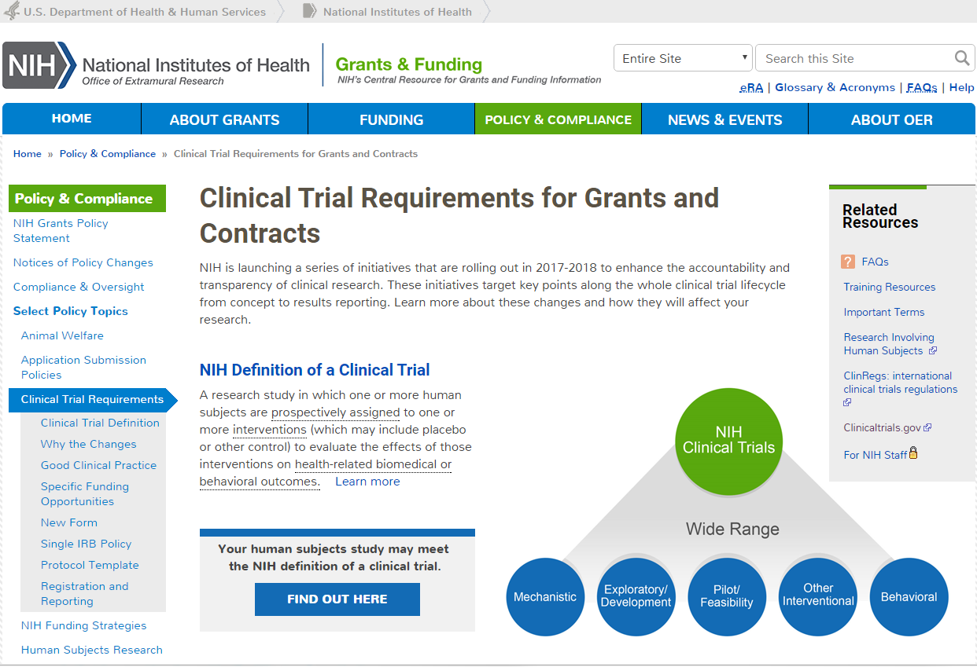
Notes:
In 2014, the NIH changed their definition of a clinical trial
Jan 2017 – GCP training
Sept – 2017 case histories changed
Jan 2018 – Clinical Trials.gov
Jan 2019 – this definition of clinical trial is now include in our revised Common Rule
Forms E

Slide 13
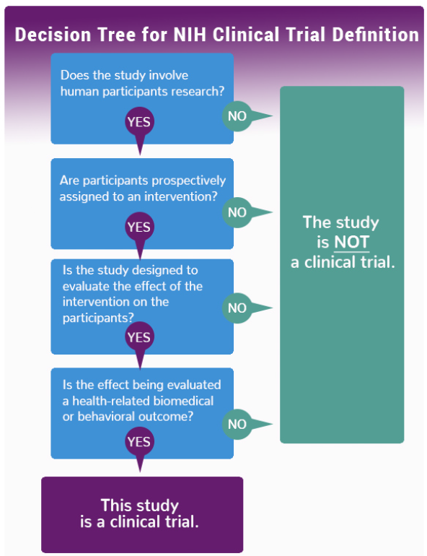
Notes:
delivery systems (e.g., telemedicine, face-to-face interviews);
strategies to change health-related behavior (e.g., diet, cognitive therapy, exercise, development of new habits);
treatment strategies;
prevention strategies; and,
diagnostic strategies.

Slide 14
PI Responsibilities and Tips for Protocol Development
April 11, 2022
Melissa Miklos, MSL, CIP
Associate Director, Human Research Protection (HRP)
mgm12@pitt.edu

Slide 15

What you say, you must do and what you do, you must say
Start with a well-written protocol
Do not repeat information in sections
Review for consistency
Ask if each procedures is necessary and realistic

Slide 16




General Points to Consider
Write broadly, provide flexibility
IRB needs to be able to determine risk/benefit, not be able to conduct the studies
Consent forms are not required to follow a particular format. Templates are recommendations

Slide 17

Preparation is Key
Staffing
Training
Materials
Equipment
Validated instruments
Budget planning

Slide 18
PI Responsibilities
Ultimately responsible for ALL aspects of study conduct and for the study’s
RIGOR, REPRODUCIBILITY and RELIABILITY
Ensure the study is conducted according to the approved protocol, signed agreements and regulations and risks minimized
Any significant deviations from funded grant discussed with and approved by Program Office, if applicable
Protect the rights, safety, and welfare of all individuals participating in the research (subjects, family members, research team, community)
Ensure compliance with local, state, federal and international rules and regulations
Control drugs, biological products, and devices used in the study
Evaluate, document, and submit reportable new information
Maintain adequate research records
Residents and Fellows can serve as PI → Must identify a Faculty Mentor

Slide 19



Delegation of Study Related Duties
Common practice for investigators to delegate certain study-related tasks to employees, colleagues, or other third parties (individuals or entities not under the direct supervision of the investigator
When tasks are delegated, the investigator is responsible for providing adequate training and supervision of those to whom tasks are delegated
Investigator is accountable for regulatory violations resulting from failure to adequately supervise the conduct of the clinical study

Slide 20
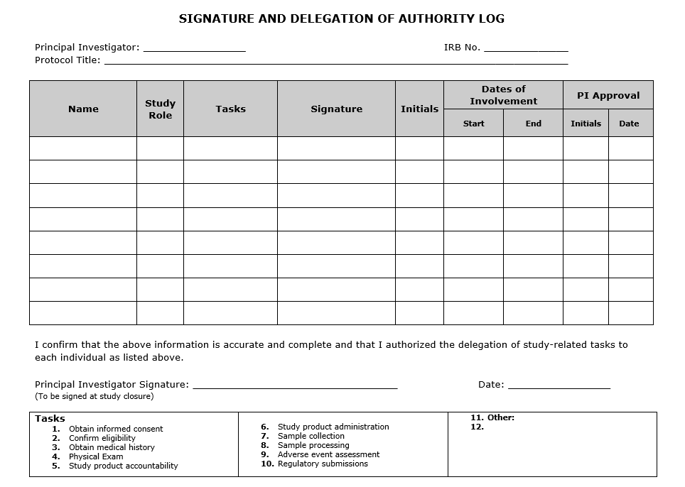
Study Conduct
Train staff on SOPs
Assign tasks
Ensure understanding of performance of tasks
Adequate credentials to perform task
Adequate access to perform task
Notes:
Certain instruments require a certain level of education to deliver (don’t have Bachelors level research assistant conduct tests that should be don’t by Masters level investigators)
Make sure you have appropriate expertise (are you doing neuropsych testing? Who is doing analysis?)
Do your Pitt people have access to UPMC systems and records? Contact UPMC for permissions

Slide 21

Good Study Oversight Practices
Hold regular meetings with your research team, including data and safety monitoring
Maintain IRB approval and review protocol regularly to assess changes
Ensure proper training of your staff
Obtain written consent from your study participants
Develop Manual of Operations
Document study procedures
Review and report adverse events and unanticipated problems should they occur
Review and Update ClinicalTrials.gov
Implement ongoing quality assurance initiatives

Slide 22
Good Study Oversight Practices
Questions?
Hold regular meetings with your research team, including data and safety monitoring
Maintain IRB approval and review protocol regularly to assess changes
Ensure proper training of your staff
Obtain written consent from your study participants
Develop Manual of Operations
Document study procedures
Review and report adverse events and unanticipated problems should they occur
Review and Update ClinicalTrials.gov
Implement ongoing quality assurance initiatives

Slide 23



Recruitment and Consent

Slide 24
Recruitment of Subjects
HIPAA permits access to PHI, for the purpose of identifying potential research subjects, under the ‘Preparatory to Research Exception.’
Reviewing MR to ID Subjects | Obtaining Limited PHI from a Referring Physician | Obtain Written Authorization to share PHI outside Covered Entity
No waiver required Must have normal access Incorporate process in “Recruitment” section of PittPRO Must state access to PHI is accessed for preparation, it will not leave the Covered Entity, the PHI is necessary for the research | No waiver required Clinician speaks to subject to determine interest Clinician introduces researcher Shared PHI limited to relevant information Clinician document permission in MR or other approved area | PI must be faculty or staff Research receiving contact info need not be a UPMC professional or staff member Recruitment section should outline sharing process Include written authorization form Include how the clinicians will describe and discuss with subject Verbal can be approved with waiver
Must be a part of the same covered entity

Slide 25
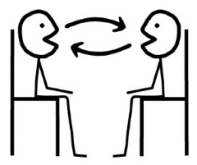



Recruitment and Advertisements
Direct Discussion: Face to Face interaction with a potential subject
Previous Subjects: Unless they explicitly declined further contact, previous subjects can be called
Mailings: Written info sent or given to subject from a known provider, clinic or program rep
Advertisements: Posted in public areas with instruction on how potential subject takes action

Slide 26



Recruitment and Advertisements
Pitt+Me: Database of people who provide info and agree to be contacted for studies
Social Media: Can post ads, links other information. Restrictions apply for privacy protection
Community Outreach: Health fairs, community events, advocacy groups, schools, churches, etc
Notes:
Pitt + Me consent allows for examination of medical records

Slide 27
Screening, Recruiting, Determining Eligibility §116(g)
An investigator can obtain information or biospecimens for screening, recruiting, or determining eligibility without informed consent:
  Information is obtained through oral or written communication with the prospective subject or LAR, or
  The investigator will obtain private identifiable information or identifiable biospecimens by accessing records or stored identifiable specimens
Consistent with FDA regulations and HIPAA
IRB must approve the procedure as a part of the recruitment plan

Slide 28
An investigator shall obtain the legally effective informed consent of the subject or the subject's legally authorized representative
Prior to the process, consider who should be present. While a specific person has to sign, others may participate in the process
  Healthy adult = self
  Child = parent
  Decisionally impaired adult = LAR
  Physically impaired adult = self

Slide 29
Think About Consent Process 45 CFR 116
Written Informed Consent | Traditional consent form Must obtain the written informed consent of the subject or the subject’s legally authorized representative
Waiver to Document Consent | Written informed consent is not obtained Verbal consent process takes place May include scripts or other visual aids Researcher documents subject’s willingness in research record
Full Waiver of Informed Consent | Consent is not obtained from any subjects in the study Researcher must justify criteria

Slide 30

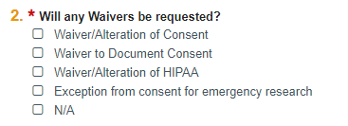
Waivers: few options, many applications
Waiver/Alteration of Informed Consent
Waiver to Document Informed Consent
Waiver of HIPAA
Emergency Exception from Informed Consent

Slide 31
OHRP eConsent Guidance
Electronic informed consent refers to the use of electronic systems and processes that may employ multiple electronic media, including text, graphics, audio, video, podcasts, passive and interactive Web sites, biological recognition devices, and card readers, to convey information related to the study and to obtain and document informed consent
Method for providing copy to participant (does not have to be signed)
Consistent for parental permission and assent
Emphasis on process over form
https://www.hhs.gov/ohrp/regulations-and-policy/guidance/use-electronic-informed-consent-questions-and-answers/index.html

Slide 32
21 CFR 11:
Electronic Records; Electronic Signatures
Generally applies to electronic records created, modified, maintained, archived, retrieved, or transmitted under an FDA regulated study
For electronic signatures and their associated electronic records that meet this part, FDA will consider the electronic signatures equivalent to full handwritten signatures, initials, and other general signings as required by agency regulations
Printed name of signer, date and time, responsibility

Slide 33




What methods are there?
Signature on electronic device
Validated signature through password protection
Exchange of traditional consent form through electronic means
REDCap or Qualtrics
DocuSign, Adobe
Be sure to discuss methods in Electronic Data Management

Slide 34

Click to Continue
Does not meet the definition of an eSignature
Requires a waiver to document informed consent
  Check “waiver to document consent: in Study Scope #2
  Justify need and upload script on Waiver to Document page
  Describe steps on Consent Process page
REMEMBER: consent process still takes place. Only difference is no signature is obtained
Notes:
Definition of eSignature: Electronic sound, symbol or process attached to or logically associated with a record and executed or adopted by a person with the intent to sign the record

Slide 35
Conducting visits remotely
Method depends on the sensitivity of the information to be disclosed during the visit and if it will be recorded
  Data Security:
  Recording storage
  Up-to-date anti-virus protection
  Storage in Pitt/UPMC cloud or University-managed server
  NOT one size fits all approach!
Pitt licensed versions:
MS Teams
Zoom (request HIPAA compliant version )
Vidyo (UPMC)

Slide 36

Let’s think about HIPAA
Use of PHI requires written authorization
Absence of written authorization requires alteration justification
PHI is rarely exchanged during consent process (i.e. platform does not need to be HIPAA compliant)

Slide 37

Remember…
Regardless of medium, consent MUST include the required elements
Engagement still needs to occur, process happens, memorialization of the process is different
If assent is required, be sure it is included in the process

Slide 38
Remember…
Questions?
Regardless of medium, consent MUST include the required elements
Engagement still needs to occur, process happens, memorialization of the process is different
If assent is required, be sure it is included in the process

Slide 39

Let us help you!
Request a consultation with an IRB reviewer
  Prior to building your IRB submission
  Tell us what you want to do and we will help to guide you through the process
  Working with the IRB early will streamline the process and help to avoid common mistakes
  For expedited/exempt protocols, consult will be assigned to your reviewer
  askIRB@pitt.edu

Slide 40



How do I submit?
Set up HSConnect account with Pitt credentials when possible
(DO NOT use Gmail, etc. if you need to switch your account, contact HSConnect)
Complete CITI training or link completed CITI training from another institution to Pitt account (https://www.citi.pitt.edu/)
Responsible Conduct of Research
Human Subjects Protection
Good Clinical Practice
Build submission in PittPRO and submit for approval
(same username and password as HSConnect and CITI)

Slide 41
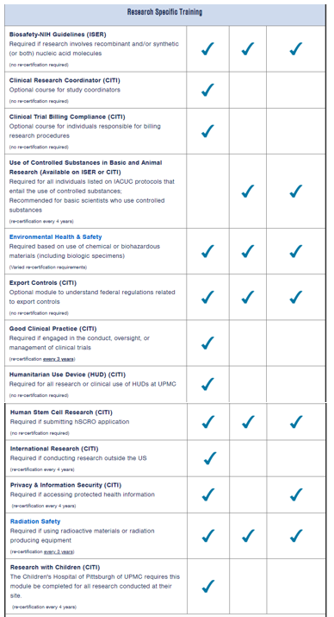
Other Research Training
https://www.orp.pitt.edu/training/training-table-list
(highlighted column is Human Subject Research)

Slide 42
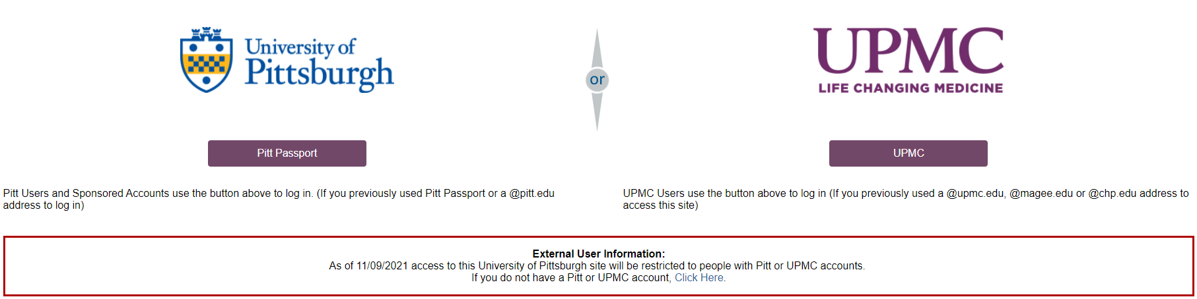
Accessing PittPRO
Sign in using Pitt or UPMC credentials
Use email address and password used to complete CITI modules
https://www.hrpo.pitt.edu/pittpro-external-user

Slide 43
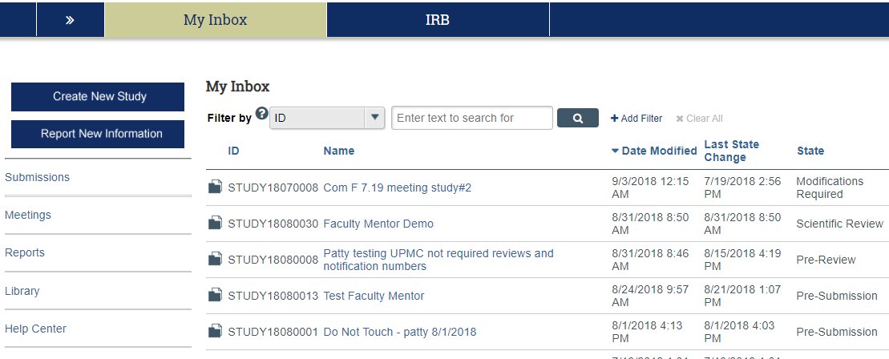
How do I create a study?

Slide 44
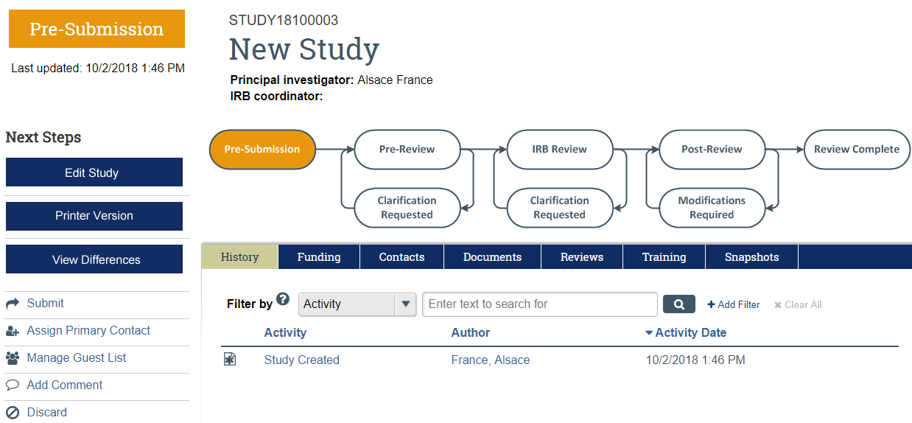
New Study Created

Slide 45
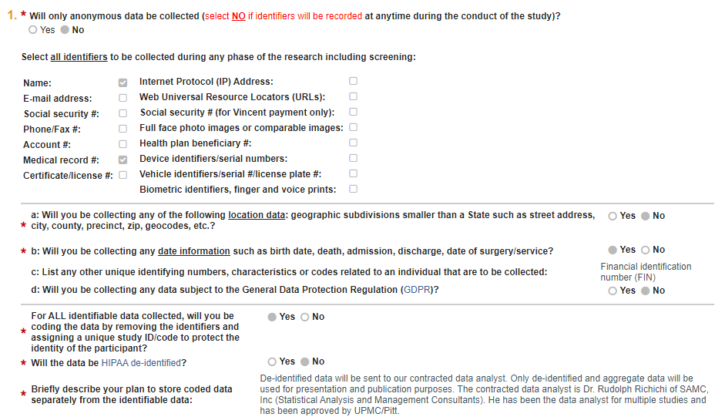
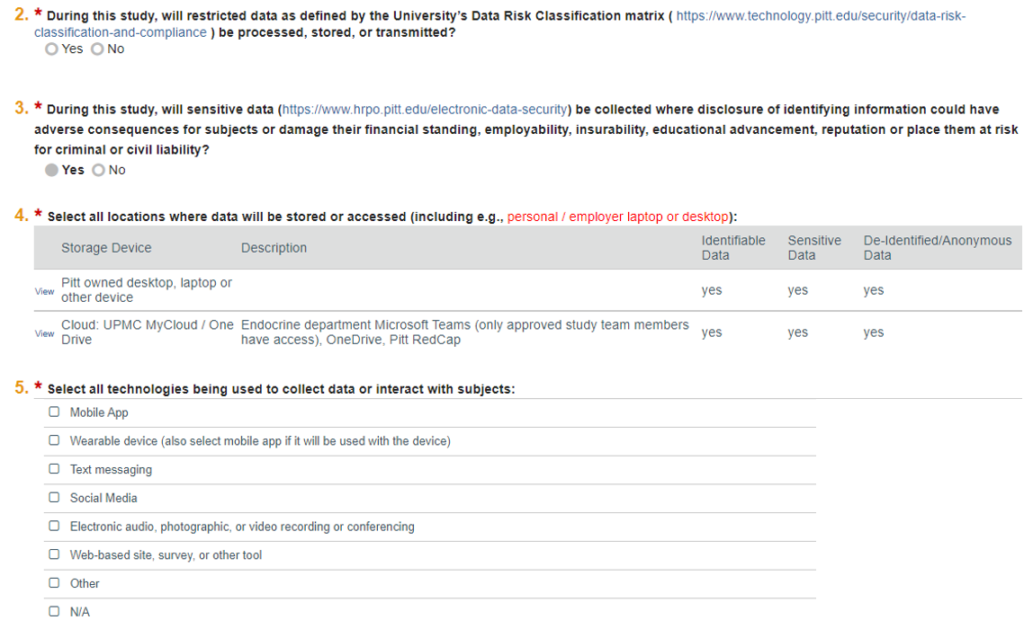
PittPRO Electronic Data Management
PittPRO asks a series of comprehensive questions to address the sensitivity and security of what is collected, how it is collected, where is it transmitted, and how it is stored
Data Risk Classification & Compliance: https://www.technology.pitt.edu/security/data-risk-classification-and-compliance
Notes:
This section recently updated for questions #2 and #2 regarding restricted and sensitive data. The questions link to Pitt IT’s classifications to help when answering the question.
What data is involved (MR data is sensitive)
Where is the data coming from?
How will it be transmitted?
Who will need access to the data?
Where can I store the data?
What do I do with it when I’m done?

Slide 46



Don’t forget to hit submit!
Make sure you elaborate, if you collaborate
  The IRB will determine if agreements are necessary
To help your review to be quick, proofing may help do the trick
  Protocols are often returned because of missing documents, incomplete sections, and placeholders that are left behind
Notes:
If you need it in a snap, don’t give us crap!

Slide 47





When can I get started?
After FINAL approval is granted by IRB (or activation for ceded projects)
A formal letter is generated by PittPRO
Fiscal approval is received (if applicable)
Retrospective approval cannot be granted

Slide 48

Call us early and often
412-383-1480
Main IRB number
askirb@pitt.edu
General IRB questions
irb.reliance@pitt.edu
Central IRB questions (aka sIRB)
Orp_support@pitt.edu
Technical Issues

Slide 49
Call us early and often
Questions?
412-383-1480
Main IRB number
askirb@pitt.edu
General IRB questions
Irb.reliance@pitt.edu
Central IRB questions (aka sIRB)
orp@pitt.edu
Technical Issues

Slide 50

Break time!

Slide 51
Informed
Consent Process
Maggie Soncini
University of Pittsburgh
Office of Research Protections
Education and Compliance Support
mls130@pitt.edu

Slide 52
General Requirement for informed consent
Except as provided elsewhere in this policy:
(1) Before involving a human subject in research covered by this policy, an investigator shall obtain the legally effective informed consent of the subject or the subject’s legally authorized representative.
DHHS Part 46, Subsection 116

Slide 53
Regulatory Resources
21 CRF 50
45 CRF 46.116
45 CRF 46.117
International Conference on Harmonisation
Section 4.8
Department of Health & Human Services
Food and Drug Administration

Slide 54
Consent Process
Common Misconception
Although the consent document is an important part of the consent process
The consent process involves much more than obtaining a signature on a form

Slide 55
Consent process
Provide information
Opportunity for questions
Time to consider
Assess Comprehension

Slide 56
Consent process must be undertaken
Prior to completing any research procedures
Written consent must be obtained

Slide 57
Consent Document
The federal regulations require the inclusion of basic and additional elements in the consent document
21 CFR 50.25 (a) / 45 CFR 46.116 (b)
21 CFR 50.25 (b) / 45 CFR 46.116 (c)

Slide 58
Basic Elements
A statement that the study involves research
Description of potential risks or discomforts
Description of potential benefits
Alternatives that may be advantageous

Slide 59

Basic Elements
5) Confidentiality of records
6) Compensation or medical treatments in the event of a research-related injury
7) Explanation of who to contact:
        Research-related questions
        Rights of research subjects
        Research-related injury
        Emergency contact

Slide 60
Basic Elements
Statement that participation is voluntary
  Right to refuse without loss of benefit
  Subject may discontinue at any time
9) Statement regarding identifiable private information or biospecimens

Slide 61
Additional Elements
1) Statement regarding currently unforeseeable risks to subject (or to the embryo or fetus in the event the subject may become pregnant)
2) Circumstances leading to termination of subject’s participation by investigator without regard to subject’s consent
3) Consequences of subject’s decision to withdrawal from research

Slide 62
Additional Elements
4) Any additional costs to the subject incurred through participation
5) Approximate number of subjects expected to be enrolled
6) Statement that significant new findings will be provided to the subject

Slide 63
Additional Elements
7) Biospecimens – Used for commercial profit?
8) Disclosure of clinically relevant research results
9) Whole genome sequencing

Slide 64


Slide 65
Key Information
Research / Voluntary Participation
Purpose / Duration / Procedures
Foreseeable Risks or Discomforts
Reasonably Expected Benefits
Alternative Procedures

Slide 66
Building the Consent Document
Enhance comprehension by:
Using charts or bulleted lists
Avoid scientific/technical terms
6th grade reading level
Spell check the document
Copy/paste with care

Slide 67
Building the Consent Document
Always spell check your document
Copy and paste from other documents with caution
Identify member(s) of the research team to proofread the consent document

Slide 68
Consent Process Considerations
WHO
Should be involved
WHEN
Receive the consent document
WHERE
Will the consent process take place

Slide 69
Consent Process
Principal Investigator
Task can be delegated
Qualified by training and experience
Listed as an investigator or identified as being involved

Slide 70
Human Research Protection Office irb.pitt.edu
Policies & Procedures – Chapter 13 – Informed Consent
Policy – Greater than minimal risk study involving a drug, device or surgical procedure
A licensed physician investigator must obtain consent

Slide 71
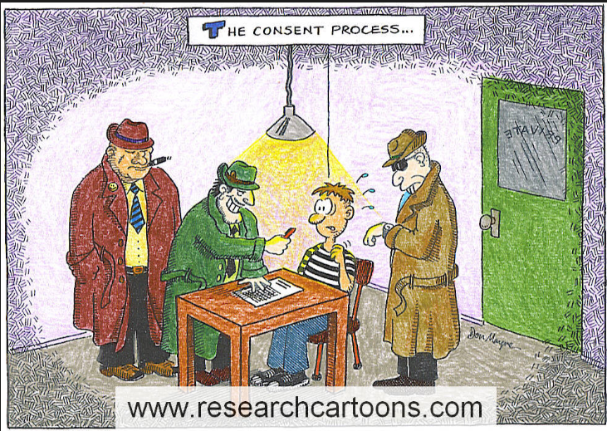

Slide 72

Questions?

Slide 73
Assessing Comprehension
Evaluate subject’s understanding of:
Study purpose
Risks of participation
Intervention
Duration of participation/
time commitment
Procedures
Who to call with questions or emergencies

Slide 74
Teach Back Method
What is the purpose of the study?
What are some of the risks of study participation?
Consider asking the subject to define terms such as placebo-controlled or randomized

Slide 75
Written Consent
The current version of the consent document that has been approved by the IRB should be used to obtain written informed consent
Signatures should be recorded at the time of consent
Narrative note describing the consent process

Slide 76
Signatures
Federal regulations require that the subject (or legally authorized representative) sign the consent document
University of Pittsburgh requires that an investigator sign the consent document
Individuals must print their name and date their own signatures

Slide 77
Signatures
Adult Participants
Pennsylvania –
Anyone 18 years or older may sign for themselves
Adults unable to provide consent because of an emergent situation or a decisional impairment, consent of a legally authorized representative is required (proxy consent)

Slide 78
Child Participants
Pennsylvania – anyone under the age of 18 years is considered a minor
Consent must be obtained from the biologic or adoptive parent(s) or from a legal guardian as established by the court

Slide 79
Child Participants
For greater than minimal risk research without direct benefit to the child, permission must be obtained from both parents unless one parent is deceased, unknown, incompetent, or not reasonably available, or when only one parent has legal responsibility for the care and custody of the child (45 CRF 46.406)
Not reasonably available does not mean the absence of the second parent

Slide 80
Narrative Note of Consent
Food and Drug Administration requires documentation of informed consent in the subject’s case history
Develop a template or include in a progress note
Document the specifics of the consent process

Slide 81
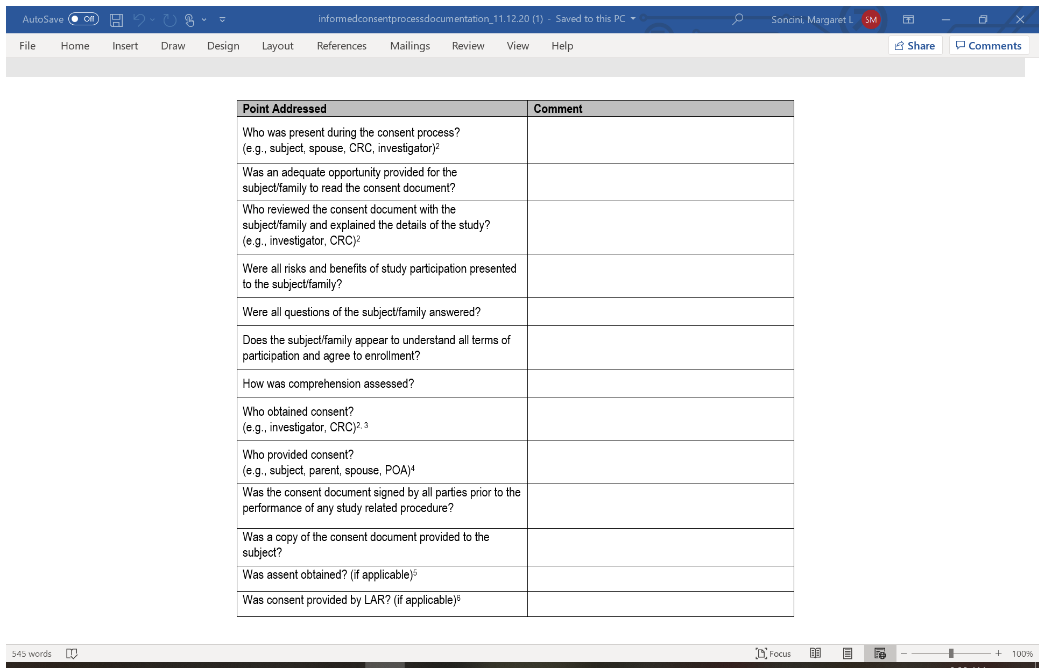
Consent Process Documentation www.ecshsr.pitt.edu

Slide 82
Original Consent Document
Maintain with research records
Should not be given to the subject
Should not be placed in the medical record

Slide 83
Time to Reconsent?
Reconsent
Subject turns 18
Risk (new or change in frequency/severity)
Change in study procedures
New Findings

Slide 84
Consent Posting Requirement
ClinicalTrials.gov - Study Record
Two acceptable websites:
To be posted after the trial is closed and
no later than 60 days after last study visit
Regulations.gov - Docket Folder

Slide 85
Summary
The informed consent process is one of the primary ethical requirements of human subject research
The consent process involves more than obtaining signatures
Written consent must be obtained prior to conducting research procedures

Slide 86

10 Minute Break

Slide 87

Study Documentation
Kelly Dornin-Koss
Notes:
Study documentation is crucial to the conduct of research.
It is crucial because if you don’t have it, you are exposing subjects to risk without any prospect of benefit to the subjects
As I indicated earlier, the FDA regulations and the federal policy regulations don’t specify details on how documentation should be maintained, that is why we turn to the International Council of Harmonization for Guidance on this topic. The ICH Guidelines refers to this as essential trial documents. I like the way they have it organized as it is organized in documents that are necessary before, during and after the conduct of the study.
In the conduct of FDA inspections, inadequate or inaccurate study documentation is the most frequent finding. While you may say, I’m not involved in FDA regulated trials, trust me, inadequate study documentation is universal

Slide 88
Study Documentation
Document what was done
Document what wasn’t done
Notes:
If a subject missed a visit, document this just don’t wait until the next visit explained what happened.
If you ordered all of your blood work and the lab failed to do a certain component – document this
If something couldn’t be done because a piece of equipment wasn’t working, document this

Slide 89
Study Documentation
Study Documentation
Source Documents
Regulatory Files
Notes:
Source documents tell the story of your subjects. Regulatory files are going to tell the story of your protocol

Slide 90
Source Documents
The original recording of any observations made or data generated about a subject during participation in a clinical trial.
Notes:
Various formats shape and forms – sticky note

Slide 91

Source Documents
Confirm:
  The completeness and accuracy of data collection and
  The study was conducted according to the protocol and ethically.
Notes:
Examples of exercise testing

Slide 92
Prior to enrollment:
Review protocol thoroughly
Prepare data collection / case report forms and compare to protocol
Notes:
I hope that there isn’t anyone not using data collection tools because you need to think about the definition of research….a systematic investigation. Without sufficient data collection tools, how can your research lead to generalizable knowledge?

Slide 93
Criteria | Comments | Met Y or N
Age 18-80 years
Scheduled for surgery
No history of alcohol abuse
No alcohol in previous 24 hours
No recreational drug use in last 6 months
Not currently taking NSAIDS
No history of renal failure (creatinine level < 1.3mg/dL)
Not pregnant
No significant medical history
Notes:
When you have data collection tools, go above the bare minimum, e.g. don’t just say yes or no, list DOB, if no etoh in 24 hours, list the date and time of last intake. If not pregnant, When was the date of their last menstrual period? What type of birth control are they using? for urine test, list date done, results, who performed the test, lot # expiration date. Evaluate this at every visit as applicable
If medical records are going to be reviewed, it should be outlined in the consent form and the PittPRO application. Also individuals confirming eligibility should be delegated this task on the DAL. If a criterion is verified by subject report, document self-report on the eligibility checklist to substantiate that this is the original recording of that data.
Review your inclusion and exclusion criteria and ensure that it is clear and that expectations are conveyed to all staff.
If a subject is to arrive in a fasting state – then document the last oral intake and confirm this.
If a subject is to have normal laboratory values for the study – specify when and where labs will be collected. I have seen cases where a research team used clinical labs that were > 6 months old for a study. Perhaps this would be OK for a normal healthy control but it might not be the case for someone with an unstable medical condition.
Discuss the what if scenarios. If HTN of > 150/90 is an exclusion criteria and a subject presents for a screening visit with a BP of 164/92 – then what are you going to do? Will you have the subject rest for 30 minutes and re-take his/her pressure?
Are you going to accept self-report by the subject or do you need to review past medical history to confirm the eligibility? If you need to review medical records, make sure this is included in the consent form.
Do you need two people to sign off on eligibility is met?
Make sure if you have a double sign off and one is by the PI that it is a thoughtful and not a perfunctory review (we have seen cases where the form is signed off by the PI on June 1st but additional testing to confirm eligibility was done on June 5th

Slide 94
Criteria | Assessment Instrument | Comments
Age 18-80 years | Phone Screen
No history of alcohol abuse | SCID
No alcohol in previous 24 hours | Self Report
No recreational drug use in last 6 months | SCID
Not currently taking NSAIDS | Demographic Form
No history of renal failure (creatinine level < 1.3mg/dL) | Baseline labs
Not pregnant | Urine test
Eligibility Criteria
https://www.nimh.nih.gov/funding/clinical-research/nimh-clinical-research-education-support-and-training-crest-program.shtml
Notes:
If medical records are going to be reviewed, it should be outlined in the consent form and the PittPRO application. Also individuals confirming eligibility should be delegated this task on the DAL. If a criterion is verified by subject report, document self-report on the eligibility checklist to substantiate that this is the original recording of that data.
This form is nice because it conveys the source of the information, i.e. it was not just verbal, where did the information originate from?
Don’t just check a box yes or no. - birth control methods used
Not only should you record the age of the subjects but you should record the date of birth.
With regards pregnancy testing, how are you going to do it? Blood, urine verbal report. If urine, you should also record date, results, lot # and expiration date of kit
When was the date of their last menstrual period? What type of birth control are they using? Evaluate this at every visit as applicable

Slide 95
Maintain separate research records for each study subject
Maintain all study information in an organized manner
Notes:
Not in medical records - can be by survey

Slide 96

You should be able to easily reference all vital study information.
Notes:
The FDA could just show up at your door step. Give Julia example

Slide 97
Study Subject records organization
By visit with checklist and accompanying documents
By type of assessments
Separate sections for reports, adverse events, etc.
Notes:
I can tell you how I typically like to see them and that is my visit, e.g. baseline, visit one

Slide 98
Supportive Documentation should include:
Original signed informed consent document
Assessment tools – questionnaires, surveys, etc.
Health records as applicable
Laboratory results
Imaging reports – MRI, CT
Electrocardiograms
Notes:
Keep the full copy of the consent document, not just the signature page. With regards to laboratory values, look at how protocol is worded, be aware if it states normal labs if something is slightly out of range may cause issue with your sponsor. the Pis should be reviewing them and it is a best practice to indicate whether there are any CS or NCS results.
With regards to ekgs, how are they going to be evaluated? Will they be sent to the cardiologist for evaluation or will the PI be evaluating them?
NIMH wanted lab reports reviewed sign and date within 24 hours.

Slide 99
Additional tips
Subject documents should be labeled
Subject ID
Date
Signature or initials of study team member/rater
Never obliterate entries on source documents
Single line through incorrect entry
Initial & date correction (LID – line, initials, date)
Add narrative note as needed.
Closely Evaluate and Have Mechanisms in Place to document stopping rules
Make sure all research team members are aware of them
Make sure they are addressed and documented in real time
Notes:
Maintain records as indicated in the consent document

Slide 100
Concomitant Meds
IRB#: |  |  | Study Title:
Investigator: |  |  | Subject ID:
Has the subject used a Concomitant Medication during the study? No Yes, complete below
Medication Name | Indication or Reason for Use | Dose (units) |  | Frequency | Route | Start Date | Stop Date | Check if ongoing at end of study
Notes:
Central nervous system depressant

Slide 101
Adverse Events
Unanticipated Problems
Non-compliance
Evaluate
Evaluate and take action for participant safety
Assess
Assess if reporting is necessary
Which agencies
Reporting timelines
Maintain
Maintain records
Notes:
Adverse event: An unfavorable medical occurrence, which may include abnormal signs (for example, abnormal physical exam or laboratory finding), symptoms, or disease, temporally associated with, but not necessarily considered related to, the subject’s participation in the research study. Not all adverse events meet IRB reporting guidelines.

Slide 102
IRB Reporting Requirements
The IRB Requires the reporting of:
  Adverse Events and unanticipated events which meet the definition of an unanticipated problem involving risks to human subjects or others
  Non-compliance which:
    Significantly adversely effects the rights or welfare of participants
    Significantly compromises the quality of the research data
    May represent serious or continuing non-compliance

Slide 103
Adverse Events
An unfavorable medical occurrence, which may include abnormal signs (for example, abnormal physical exam or laboratory finding), symptoms, or disease, temporally associated with, but not necessarily considered related to, the subject’s participation in the research study.
Not all adverse events meet IRB reporting guidelines.
Notes:
Elevated glucose
The FDA defines a serious adverse event (SAE) as one when the patient outcome is one of the following:
Death
Life-threatening
Hospitalization (initial or prolonged)
Disability - significant, persistent, or permanent change, impairment, damage or disruption in the patient's body function/structure, physical activities or quality of life.
Congenital anomaly
Requires intervention to prevent permanent impairment or damage

Slide 104
Unanticipated Problem Involving Risks to Human Subjects or Others
Unexpected in terms of nature, severity, or frequency
Related, or possibly related, to a subject’s participation in the research
Places subjects or others at a greater risk of harm (including physical, psychological, economic or social harm) than was previously known or recognized
Notes:
Not all adverse events meet the definition of an unanticipated problem involving risks to human subjects or others, for example, a low neutrophil count in a person receiving chemotherapy is an adverse event but in my experience it is an event that is expected. So lets explore more examples.
Elevated glucose
Example of neutropenia
Cardiac event that occurs in 20% (2 of 10 subjects) when it is listed as a rare event
Example of CRC being robbed, unencrypted laptop stolen with PHI on it
Expected event – neutropenia – low white blood count after chemo
Even those that are expected may be unexpected in terms of frequency Vs – torrsades de pointes – 5 % risk but 15 of 30 subjects have it then reportable
Example – Theta Burst Stimulation – is suppose to have minimal side effects and improve mood – but you see increased agitation, anxiety – for something that would need tracked but decrease in bp that required tx would need reported
Any accidental or intentional deviations from the IRB approved protocol that involves risks, missed safety labs, incorrect dosing
Others – research coordinator – going into a home
Any other untoward event that affects the welfare or privacy, confidentiality or other rights of research subjects or members of their family, e.g. lost or stolen lap top

Slide 105
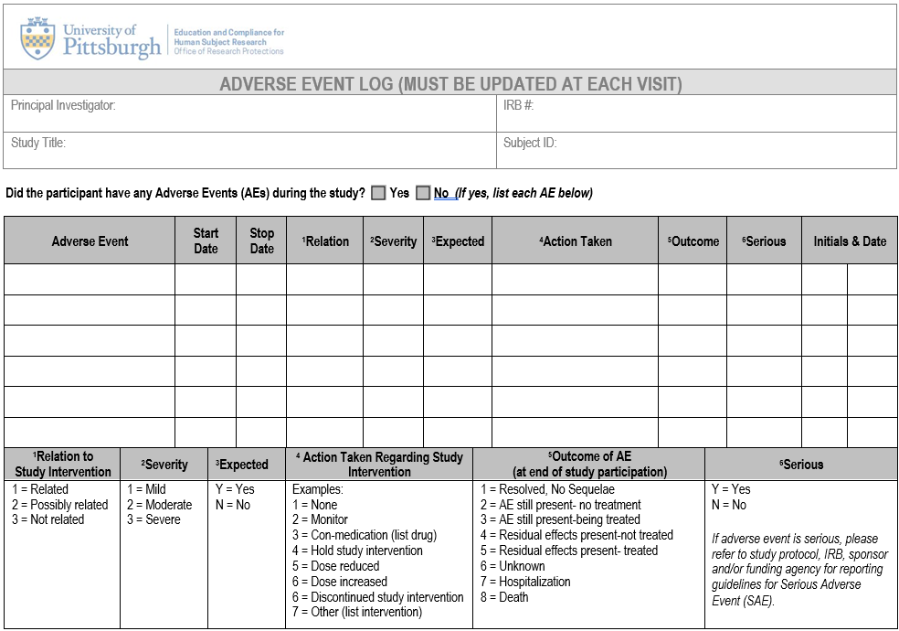
Notes:
The FDA defines a serious adverse event (SAE) as one when the patient outcome is one of the following:
Death
Life-threatening
Hospitalization (initial or prolonged)
Disability - significant, persistent, or permanent change, impairment, damage or disruption in the patient's body function/structure, physical activities or quality of life.
Congenital anomaly
Requires intervention to prevent permanent impairment or damage
From DIADS
Mild – Grade 1 Symptoms causing no or minimal interference with usual social and functional activities
Moderate Grade 2 – symptoms causing greater than minimal interference with usual social activities
Severe grade 3 – symptoms causing inability to perform usual social and functional activities
Grade 4 – life threatening.

Slide 106
IRB Reporting Requirements
The IRB Requires the reporting of:
  Non-compliance which:
    Significantly adversely effects the rights or welfare of participants
    Significantly compromises the quality and integrity of the research data (i.e. negatively impacts the ability to draw conclusions from the study data)
    May represent serious and continuing non-compliance
Notes:
Not too long ago, the IRB revised their reporting policies for reporting non-compliance. Previously, all deviations were required to be reported.
State that reporting requirements will vary. While it was thought that having a single IRB would reduce regulatory burden, it really places more burden on the research teams as they must know the reporting requirements of each institution.
We did amend our reporting requirements in an effort to make our reporting requirements more consistent with those across the country. Even though there may be differences in the timing of reporting non-compliance, I think for the most part that most institutions would agree that enrolling an ineligible subject is something that meets reporting requirements.
Failing to obtain consent as required by the IRB approved protocol
Implementing protocol modifications without obtaining prospective IRB approval
Some things may not be as evident to the research community.
Conducting research during a lapse of IRB approval
Initiating research procedures prior to obtaining consent
Having research activities performed by individuals not sufficiently trained or credentialed

Slide 107
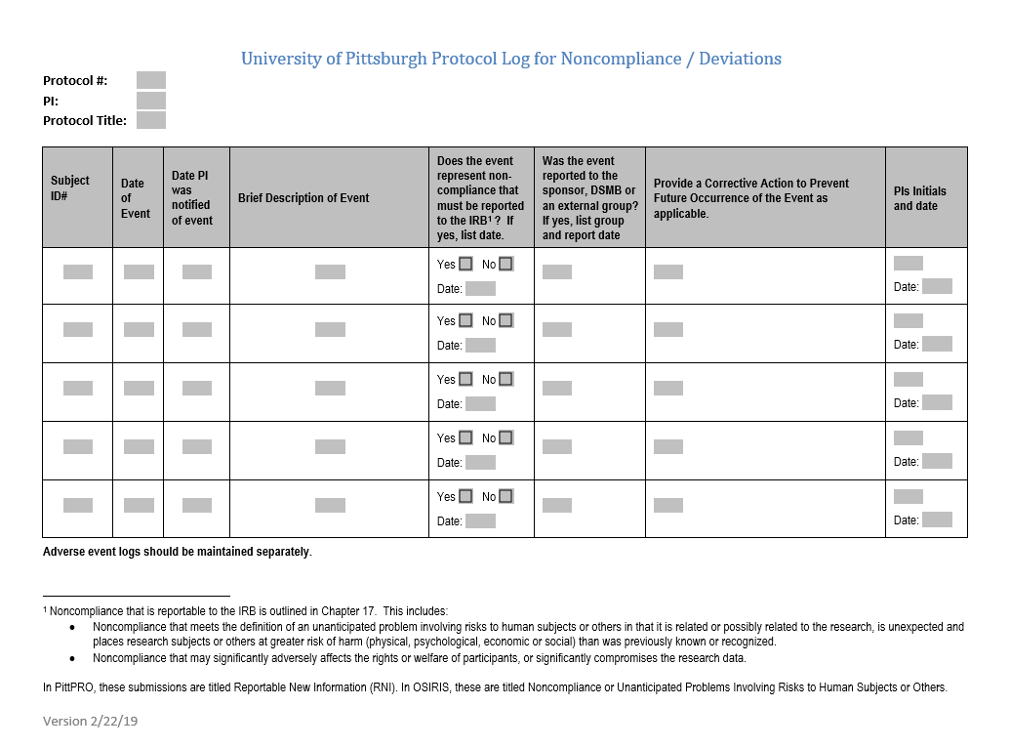
University of Pittsburgh Protocol Log for Non-Compliance
Protocol #: PI: Protocol Title:
Notes:
Non-Compliance Log requirements are mandatory for:
Greater than minimal risk studies
Studies that meet the federal definition of a “clinical trial”
Studies for which reporting is required by the funding agency
Non-Compliance logs are not required to be submitted at annual review but must be available upon request. Non-Compliance Logs are recommended but non-mandatory for all other studies.
Again requirements will vary across the country, some institutions require that you submit these to the IRB at the time of continuing review.
Examples of non-compliance that are not reportable but should be documented in a log:
Obtaining consent using an outdated consent form when there were no substantive differences between the consent form that was used and the consent form that should have been used (i.e., dates in the footer)
But if I used the outdated consent form because my IRB approval had lapsed this is something that would require reporting.
Protocol deviations that do NOT adversely affect the rights and welfare of human subjects or significantly compromise the quality of the research data
Subject non-compliance that doesn’t involve risk or alter the data
Performing non-safety related research procedures outside the protocol specified window, i.e., involuntarily administering a questionnaire outside of the protocol specified window.
^{[1]} Non-compliance that is reportable to the IRB is outlined in Chapter 17. This includes:
Non-compliance that may represent serious or continuing non-compliance with the federal regulations in that it significantly adversely affects the rights or welfare of participants, or significantly compromises the research data or
Non-compliance that meets the definition of an unanticipated problem involving risks to human subjects or others in that it is related or possibly related to the research, is unexpected and places research subjects or others at greater risk of harm (physical, psychological, economic or social) than was previously known or recognized.
In PITTPro, these submissions are titled Reportable New Information (RNI) Reports.

Slide 108
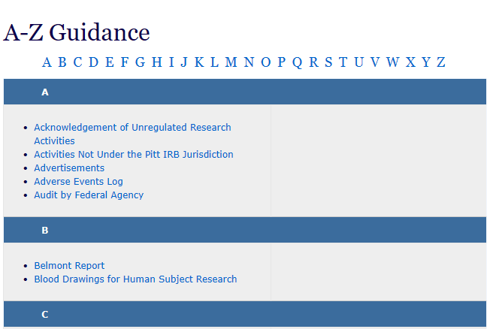
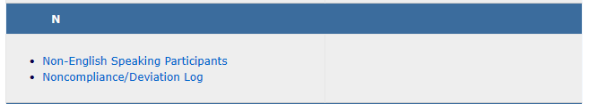
Email
Ask the IRB

Slide 109
Additional tips
Create a Study Disposition Form
This would be used to document the subjects final date of study participation
Notes:
This would also document the subject’s outcome, i.e. completed, withdrew, lost to follow-up

Slide 110
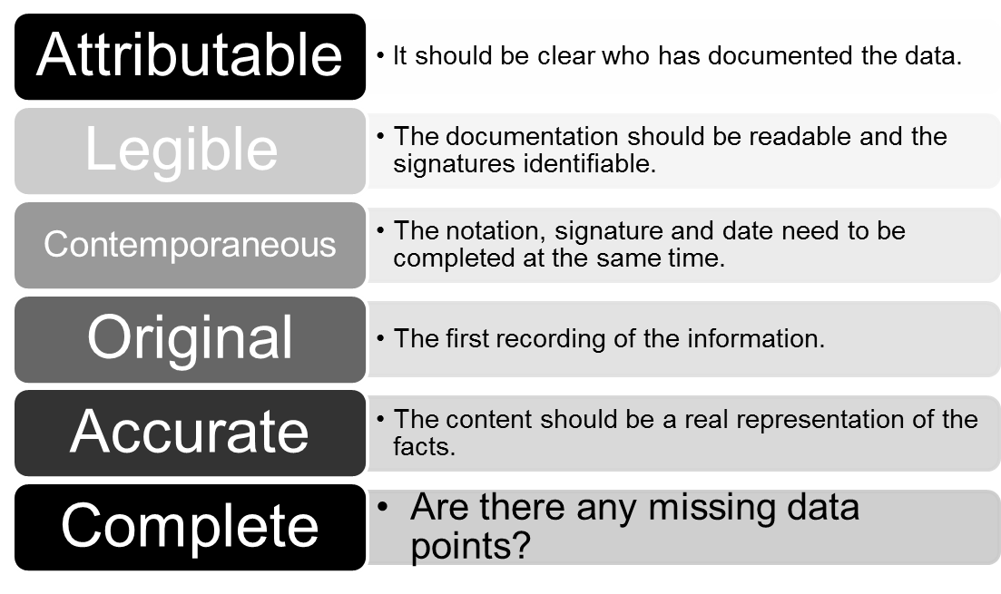
The Data Should Follow the ALCOA-C Principle
Notes:
Late entries are not a good substitute for prospective documentation

Slide 111

Document
Document
Document
Notes:
If it wasn’t documented, it wasn’t done

Slide 112
Regulatory Files
Regulatory files contain all supportive
study documentation for the study.

Slide 113
Regulatory File Contents
Protocol – sequential versions
Informed consent document – sequential versions
IRB / HRPO correspondence and approvals
Serious and unexpected adverse events and unanticipated problems
Sponsor correspondence
Delegation of authority log / signature list
Documentation of protocol and ethics training
Data and safety monitoring
CVs, licenses, certifications
Notes:
Many people may have used OSIRIS to maintain copies of their protocol. Now OSIRIS is going away. I would encourage you to maintain electronic files.
CVS – some sponsors may require a new CV every two years, every three years but all versions of CVs and licenses should be maintained. These demonstrate the qualification of the research team throughout the course of the study.

Slide 114
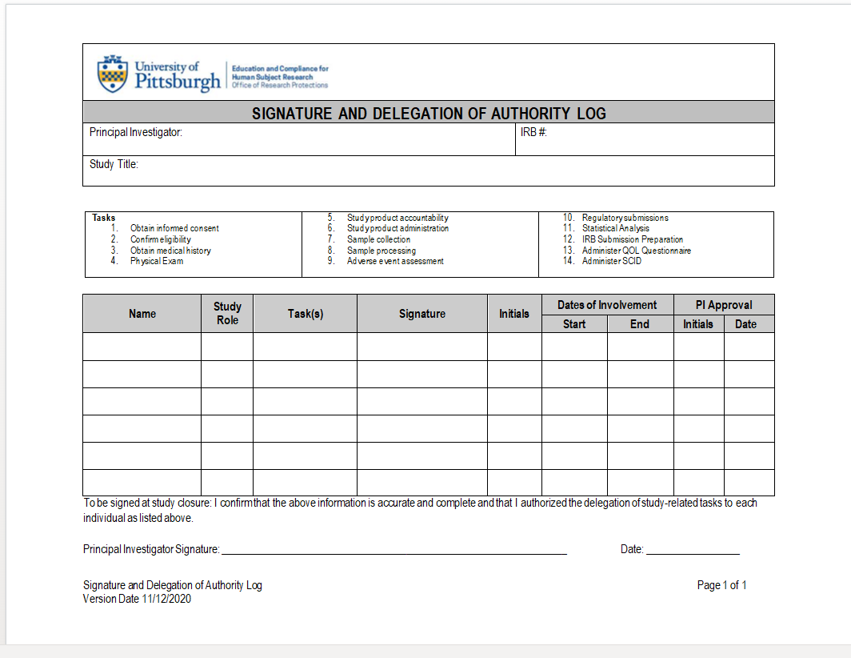

Slide 115
Regulatory File Contents (cont’d)
Investigator’s Brochure, package insert, Investigational product information
Monitoring visit log
Site initiation visit and interim monitoring visit reports
Drug and Device Accountability records
Financial disclosure forms
Laboratory certifications and range of normal values https://path.upmc.edu/links.htm

Slide 116
Regulatory File Contents (cont’d)
Include Documentation / Correspondence with Oversight Entities
Food and Drug Administration
Investigational Drug Service
Radioactive Drug Research Committee / Human Use Subcommittee
Biosafety (rDNA) Office
Scientific review committee
NIH
Notes:
You would also want to maintain correspondence with any other entities associated with your study.

Slide 117
Central Files
Central department filing – studies conducted within one division or department.
Include a note indicating the location of these files / responsible party.
May encompass:
CV’s
Professional licenses
Training certificates
Laboratory certifications and range of normal values
Staff training records
Notes:
CVs and License throughout entire course of study - NIMH wanted signed CVs every two years.

Slide 118
Other Regulatory File Items
Document conversations – phone or email - with sponsor and regulatory agencies
Who initiated the contact
Topic of discussion
Resolution
Maintain electronically or in regulatory files
Notes:
CVs and License throughout entire course of study - NIMH wanted signed CVs every two years.

Slide 119
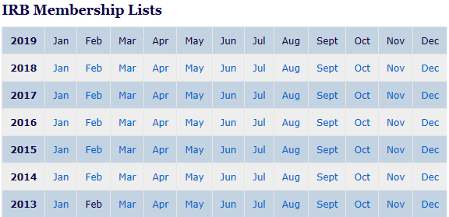
Other
Regulatory File Items
FWAs
IRB Member Lists
Notes:
NIMH wanted FWAs and IRB member lists
If you are using a commercial IRB, they may send you a list of the IRB members who reviewed the study.

Slide 120

Notes to File
Are not a substitute for good, prospective, and complete source documents
Identify a problem
Should not be a common practice
Notes:
Can be used in both research subject records as well as the regulatory files

Slide 121

Note to file
Describe:
  A summary of the issue
  The action that was taken to address the issue
  The root cause
  Actions to prevent recurrence
  Date and signature
Notes:
Should also include protocol number and title,
Use of outdated consent form from January to April - why it happened (many copies were made of the consent document) , what was done to prevent problem (removed all printed versions of consent documents) action (now require that consent forms be printed from electronic application. TO make sure corrective action is effective, you may want to do a QA check to confirm most recent consent document is being used. But if it was continuing for months may be reportable

Slide 122

Organization Tips
File information
  In chronological order
  Immediately upon receipt
  Separate into sections or folders or binders with labels

Slide 123
Record Retention
Retain
Retain all essential study documents – regulatory and study subject records
Keep
Keep all documents in a secure location
Do not destroy
Do not destroy documents without written authorization from the sponsor

Slide 124
Record Retention Times
University of Pittsburgh | FDA | ICH
7 years | 2 years after FDA approval of drug or device or study is abandoned and 5 years after biologic is manufactured | 2 years after approval from last ICH region or 2 years after study abandoned
Pediatric subjects – must maintain until the subject age 25
Notes:
Data should be stored securely for at least seven years after completion of the project, submission of the final report to a sponsoring agency, or publication of the research, whichever comes last
Per JB, if people who are doing minimal risk studies where there is no chance of injury ask, I tell them to maintain it for the 7 year period rather than until age 25 since it is based in tort law.

Slide 125
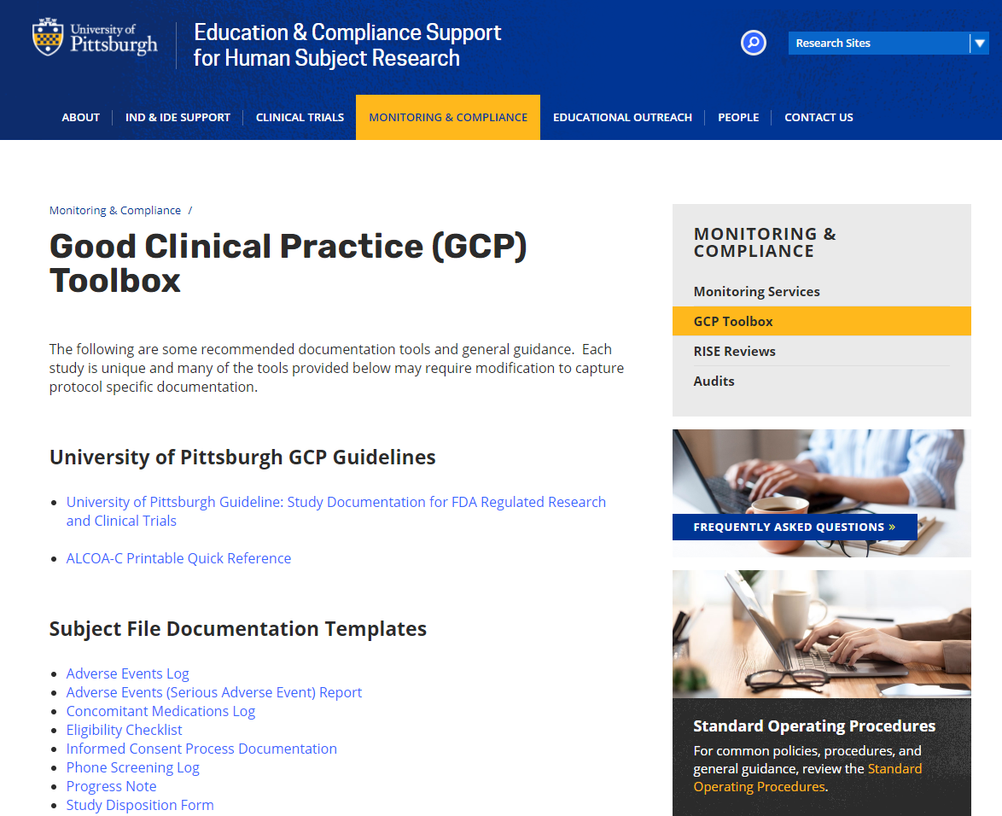

Slide 126

Questions????

Slide 127
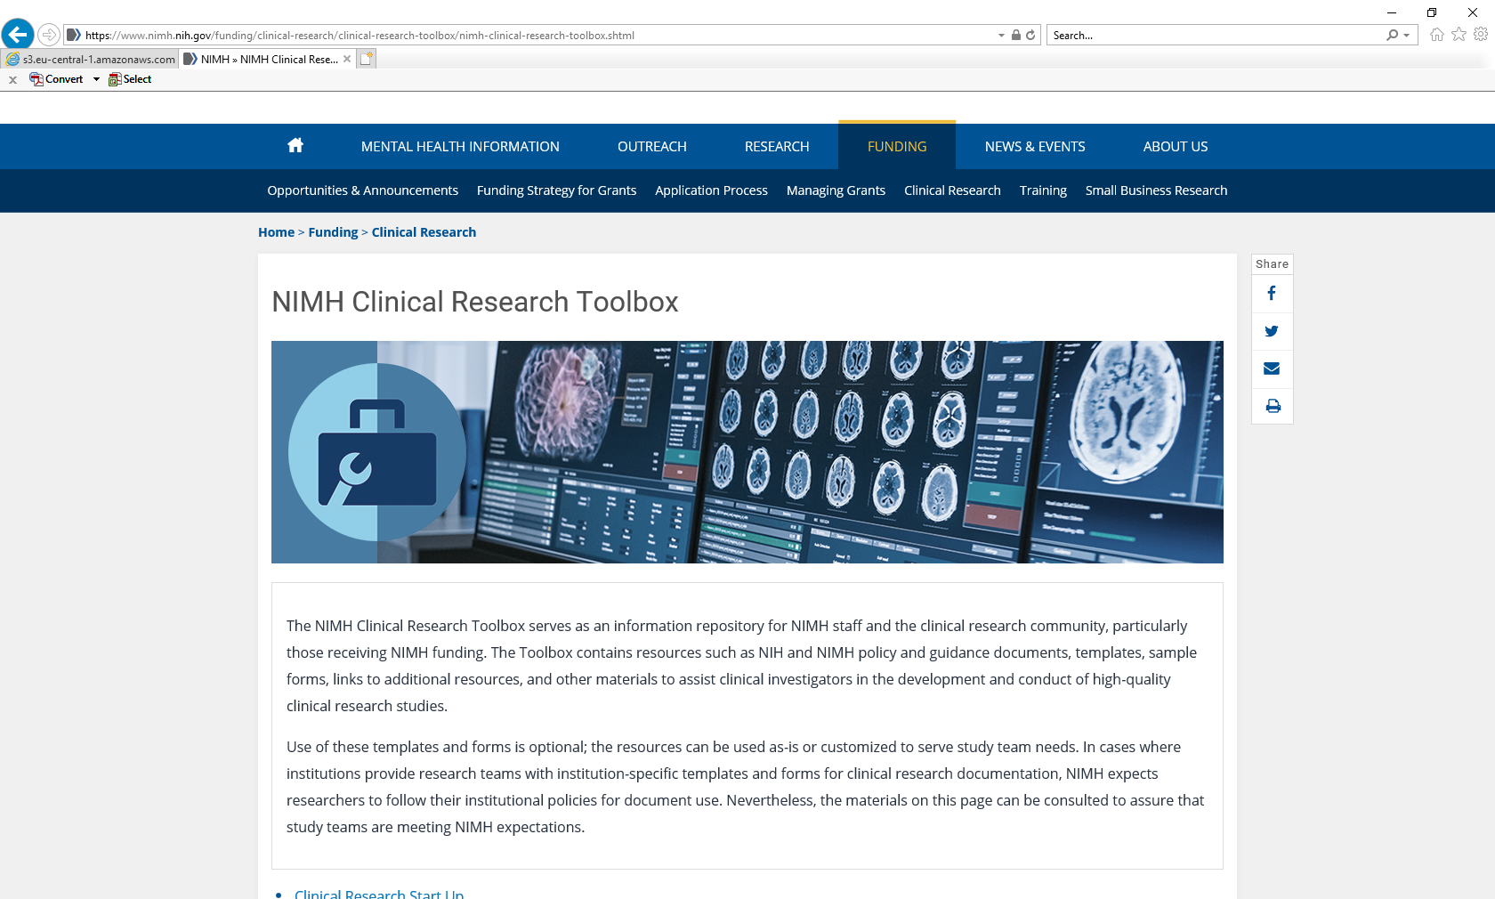
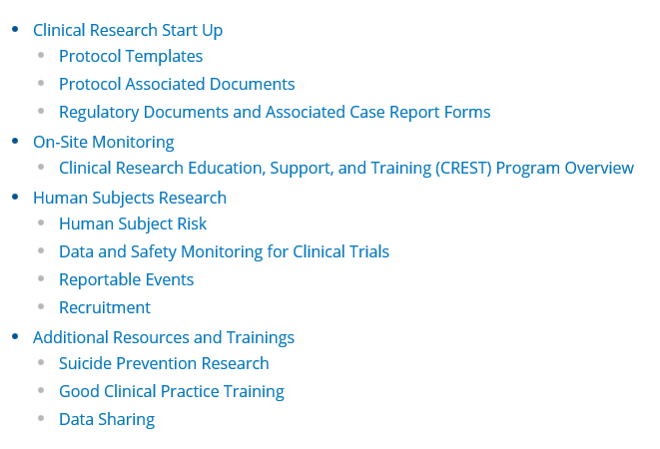
NIMH Clinical Research Education, Support, and Training (CREST) Program
https://www.nimh.nih.gov/funding/clinical-research/clinical-research-toolbox/nimh-clinical-research-toolbox.shtml
Notes:
NIMH Toolbox includes templates of suggested forms to use for the best management of your study.

