Slide 1
Record your Attendance by SMS Text
To enable the SMS texting feature, login to your account @ http://cce.upmc.com .
Click the “Mobile” tab to add your ten-digit mobile phone.
Receive credit instantly by texting the following code:
VABWEG
to
412-312-4424
Code MUST be texted by today at 11:59pm.

Slide 2
Don’t Cloze this Chapter: Clozapine for Suicidality in Schizophrenia and Schizoaffective Disorder
Harrison Ferro
PGY2 Pharmacy Resident
UPMC Western Psychiatric Hospital
1

Slide 3
Disclosures
No members of the planning committee, speakers, authors, content reviewers and/or anyone else in a position to control the content of this education activity have relevant financial relationships with any entity producing, marketing, reselling, or distributing healthcare goods or services, used on, or consumed by, patients to disclose.
2

Slide 4
01
Background on Schizophrenia, Schizoaffective Disorder, and Clozapine
02
Clinical Trials Evaluating Suicidality Benefit of Clozapine
Outline
03
Long-Term Cohort Studies Evaluating Suicidality Benefit of Clozapine
04
Take-Aways and Conclusion
3

Slide 5
Objectives
Identify suicide risk and suicide rates of patients with schizophrenia and schizoaffective disorder
Describe clozapine’s anti-suicidality benefit in schizophrenia and schizoaffective disorder
Identify superiority of clozapine to differing antipsychotics for suicide prevention in schizophrenia and schizoaffective disorder
4

Slide 6
Abbreviations
First Generation Antipsychotic | FGA
Second Generation Antipsychotic | SGA
Long-Acting Injectable Antipsychotic | LAIA
Treatment Resistant Schizophrenia | TRS
Electroconvulsive Therapy | ECT
Cognitive Behavioral Therapy | CBT
Cardiovascular Disease | CVD
Odd Ratio | OR
Hazard Ratio | HR
5

Slide 7
01
Background on Schizophrenia, Schizoaffective Disorder, and Clozapine
6

Slide 8
Schizophrenia Spectrum Disorders
Schizophrenia
Schizoaffective Disorder
Unspecified schizophrenia or psychotic disorder
Schizophreniform
Schizotypal personality disorder
Diagnostic and Statistical Manual of Mental Disorders 5th Edition
7
Notes:
Comment on schizophrenia vs schizoaffective

Slide 9
Schizophrenia
Chronic mental illness involving
Delusions
Hallucinations
Disorganized thinking
Grossly disorganized or abnormal motor behavior
Negative Symptoms
Diminished emotional expression
Avolition
Alogia
Anhedonia
Asociality
Diagnostic and Statistical Manual of Mental Disorders 5th Edition
8
Notes:
Comment on schizoaffective
DSM5
Avolition: lack of motivation
Alogia: lack of speech
Anhedonia: lack of pleasure
Asociality: lack of social interest

Slide 10
Mortality in Schizophrenia
Mortality Causes
Suicide
CVD
Diabetes
Substance Use
Smoking
Piotrowski et al, 2017
9
Notes:
Schizophrenia itself is one of the most disabling illnesses
Shorter lifespan of 15-25 years compared to general population
https://www.psychiatria-danubina.com/UserDocsImages/pdf/dnb_vol29_no2/dnb_vol29_no2_108.pdf

Slide 11
Suicide Prevalence in Schizophrenia
An estimated half of patients with schizophrenia have suicidal thoughts
Nearly 20-40% of patients with schizophrenia attempt suicide in their lifetime
Estimated 5-10% of patients with schizophrenia die from suicide
Those without mental health disorders have a suicide prevalence of about 0.3-1%
Palmer et al, 2005
10
Notes:
https://jamanetwork.com/journals/jamapsychiatry/fullarticle/208392

Slide 12
Risk Factors for Suicide in Schizophrenia
Early in disease course
Duration of untreated psychosis
Relapse of psychosis
Young or older age
Lack of support of solitude lifestyle
Higher cognition and education
Male
Substance use
Prior suicide attempt
Ventriglio et al, 2016
Popovic et al, 2014
11
Notes:
Distinguish between suicide risks with general population
Estimated 2x higher risk of suicide in the first 5 years of diagnosis
https://www.frontiersin.org/articles/10.3389/fpsyt.2016.00116/full
https://onlinelibrary.wiley.com/doi/10.1111/acps.12332
https://www.psychiatrist.com/read-pdf/20496/
Early in disease course: <5 years from diagnosis
Duration of untreated psychosis: suicide risk increases as lack of treatment continues
Younger/older age: older age with loss of function after living normal life
Higher education: might better formulate a plan

Slide 13
Schizophrenia Phases and Suicide
Prodromic Phase
Distress due to new-onset symptoms of schizophrenia
Lack of treatment or access to care
Untreated Psychosis
Lack of treatment or access to care
Acute Psychosis and Treatment
Positive symptoms
Fear, stigma, loss
Recovery Phase
Negative symptoms – loss of role/function
Ventriglio et al, 2016
12
Notes:
Update clicks – too many clicks
https://www.frontiersin.org/articles/10.3389/fpsyt.2016.00116/full

Slide 14
Suicide Prevention and Treatment
Antipsychotics
Clozapine > SGA/FGA
Antidepressants
ECT
CBT
Psychosocial interventions
Donker et al, 2013
13
Notes:
https://bmcpsychology.biomedcentral.com/articles/10.1186/2050-7283-1-6

Slide 15
Clozapine
Second-generation or atypical antipsychotic
Indications:
Treatment resistant schizophrenia
Acute suicidality in schizophrenia or schizoaffective disorder
Efficacy: Most efficacious antipsychotic
D2
5HT₂A
Receptor Activity
A1
Kane Criteria
Failure of 2 antipsychotics at an adequate dose and duration
H1
M₁/M₃
Clozapine Package Insert, FDA. Novartis.
14
Notes:
Kane criteria: failure of two antipsychotics before initiating clozapine – 4 weeks at adequate dose or 2 weeks if inpatient

Slide 16
Boxed Warnings
Severe Neutropenia
Increased mortality in elderly patients with dementia-related psychosis
Myocarditis
Seizures
Orthostatic Hypotension
Clozapine Package Insert, FDA. Novartis.
15

Slide 17
Clozapine Initiation
Inpatient
Outpatient
Initiate at 12.5-25 mg once daily
Initiate at 12.5-25 mg once daily
Increase by 25-50 mg daily
Increase by 12.5-25 mg every 1-2 days
Target dose of approximately 300 mg total daily dose after 2 weeks of treatment
Maximum of 900 mg total daily dose
Clozapine Package Insert, FDA. Novartis.
16
Notes:
Doing for both schizophrenia and suicidality is the same for initiation per package insert
Continue for at least 6 months before considering treatment failure

Slide 18
Where It All Started…
Reduction of Suicidality During Clozapine Treatment of Neuroleptic-Resistant Schizophrenia: Impact on Risk-Benefit Assessment
Design: Prospective cohort study to evaluate if clozapine reduced suicidality in 88 patients with treatment resistant schizophrenia and schizoaffective disorder
Outcomes: Baseline suicidality compared to 6 months to 7 years after initiating clozapine
Suicidality Assessment
No suicidal thoughts
Suicidal thoughts
Suicidal threats/plans
Acts of self-harm
Suicide attempt
Meltzer et al, 1995
17
Notes:
Suicidality assessed as:
No suicidal thoughts
Suicidal thoughts
Suicidal threats/plans
Acts that resulted in self-harm but were not a suicide attempt
Suicide attempt

Slide 19
Reduction of Suicidality During Clozapine Treatment of Treatment Resistant Schizophrenia
Results:
Significant decrease in suicidality (p = 0.0002)
51/88 (58%) – same level of suicidality
35/81 (39.8%) – less suicidality
2/81 (2.3%) – more suicidality
Number of patients with no suicidality increased from 47 to 77 patients
Number of suicide attempts decreased from 22 (25%) to 3 (3.4%) [86.4% decrease]
Number of suicide attempts with a high-probability of success decreased from 5 to 0
Mean dose of 500 mg of clozapine, time to effect of 6 weeks
Clozapine may be effective for suicidality in treatment-resistant schizophrenia
Meltzer et al, 1995
18
Notes:
Where did dose come from? Was 500 mg the target, was time to effect 6 weeks from start or 6 weeks from hitting target dose – no comment on target dose.
https://ajp.psychiatryonline.org/doi/epdf/10.1176/ajp.152.2.183
Patients studied from 1986 to 1993 – DSM 3 criteria, so dated
Baseline suicidality: (1 month prior to start/hospitalization)
183 patients at baseline but 70 discontinued treatment (nonadherence > ADRs > lack of efficacy > agranulocytosis or other), 6 excluded (reason not listed), 19 transferred to other facilities
Suicidality assessed at 6 weeks, 3 months, 6 months, and every 6 months thereafter, or any readmission – mean f/u time of 3.5 years
Suicidality assessed as: - rated on scale of 0-7 for each
No suicidal thoughts
Suicidal thoughts
Suicidal threats/plans
Acts that resulted in self-harm but were not a suicide attempt
Suicide attempt
Probably of suicide attempt assessed by method – risk of lethality to determine if high vs low probably of success (scale of 0-7)
Patients seen weekly and provided group therapy
No control group or other treatment group

Slide 20
Question 1
Which of the following is true regarding suicide in schizophrenia?
Suicidal thoughts are rarer than the general population
Suicide rates are higher in those with schizophrenia compared to the general population
Untreated psychosis is a protective factor for suicidality in schizophrenia
Treatment of psychosis eliminates suicide risk in patients with schizophrenia
19
Notes:
B

Slide 21
02
Clinical Trials Evaluating Suicidality
20

Slide 22
Clozapine Treatment for Suicidality in Schizophrenia: International Suicide Prevention Trial (InterSePT)
Design
Comparison
Outcomes
Multicenter, randomized, international, 2-year trial
Patients with schizophrenia and schizoaffective disorder
Clozapine vs olanzapine
980 patients with high suicide risk
30% of patients with treatment resistant schizophrenia
Suicide attempts
Hospitalizations to prevent suicide
Ratings of much worsening of suicidality from baseline
Measured with Clinical Global Impression of Suicide Severity (CGI-SS)
21
Meltzer et al, 2003
Notes:
https://pubmed.ncbi.nlm.nih.gov/12511175/
Meltzer et al, 2003 – led to indication for suicidality
High risk for suicide was defined as any one of the following: (1) a history of previous attempts or hospitalizations to prevent a suicide attempt in the 3 years before enrollment,(2) moderate to severe current suicidal ideation with depressive symptoms, or (3) command hallucinations for self-harm within 1 week of enrollment. Treatment resistance was not a requirement for inclusion in this study
No difference in baseline characteristics between groups, including prior suicide attempts

Slide 23
InterSePT: Clozapine vs Olanzapine Results
Clozapine compared to olanzapine:
Reduced hospitalizations: 82 vs 107 (p = 0.05)
Fewer rescue interventions: 118 vs 155 (p = 0.01)
Reduced required concomitant antidepressant treatment: 221 vs 258 (p = 0.01)
Nonsignificant difference in death: 5 vs 3 (p = 0.73)
Greater discontinuation with olanzapine due to lack of anti-suicidal response: 6 vs 0 (p = 0.03)
Fewer suicide attempts: 34 vs 55 (p = 0.03)
Suicidal behavior: significantly less (HR 0.76, p = 0.03)
Overall: Significant reduction in 2-year event rate: 32.2% vs 24%, NNT 12
Meltzer et al, 2003
22
Notes:
https://pubmed.ncbi.nlm.nih.gov/12511175/
Significance defined as 20%
27% with treatment resistant schizophrenia
Psychiatrist making assessment was masked to treatment – olanzapine patients were given weekly appointment to mimic clozapine monitoring
30% of patients with treatment resistant schizophrenia, so can include both standard and treatment resistant patients

Slide 24
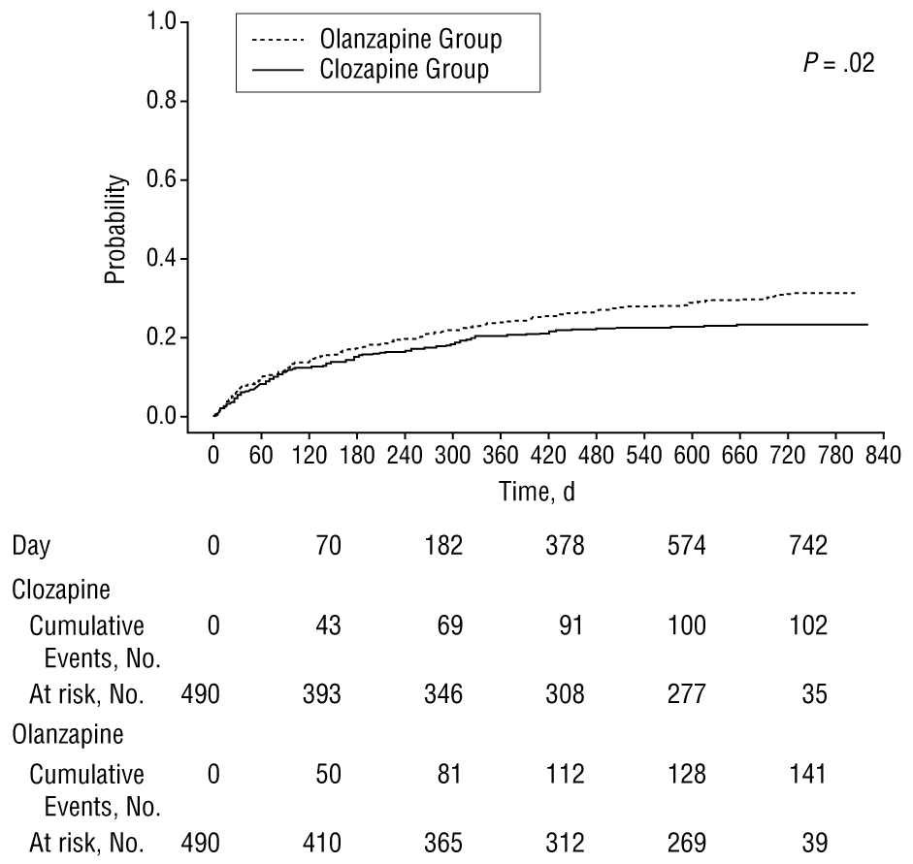
InterSePT Implications
Limitations
Open label
Comparison to olanzapine only
Patients were previously started on medications
Time to effect assessment
Frequent health-care exposure
Outcomes resulted in FDA-approved labeling for acute treatment of suicidality in schizophrenia or schizoaffective disorder
Median dose: 274 mg
Dose range: 119 – 429 mg
Median time to effect unknown:
Significance not assessed at individual visits
May suggest superiority to olanzapine
23
Figure 1: Meltzer et al, 2003
Notes:
Cumulative significance assessed
Specific
Comment on comparison to olanzapine

Slide 25
Comparative Efficacy Between Clozapine and Other Atypical Antipsychotics for Depressive Symptoms in Schizophrenia: a Sub-analysis of the CATIE Trial
CATIE trial evaluated the efficacy of differing antipsychotics
Phase I: perphenazine compared to olanzapine, risperidone, quetiapine, ziprasidone
Phase IB: Patients who discontinued perphenazine and randomized to olanzapine, quetiapine, or risperidone
Phase 2E: Patients who discontinued treatment in Phase I or IB randomized to clozapine or treatment not utilized previously
99 patients: 49 clozapine, 19 olanzapine, 15 quetiapine, 16 risperidone
Nakajima et al, 2014
24
Notes:
Nakajima etal, 2014
Objective: Evaluate antidepressant effects of antipsychotic treatment
https://www.ncbi.nlm.nih.gov/pmc/articles/PMC4308551/
Included patients with an inadequate response to atypical antipsychotics or perphenazine

Slide 26
CATIE 2E Sub-analysis
Results – Efficacy assessed with Calgary Depressive Scale for Schizophrenia
Clozapine demonstrated significant efficacy compared to quetiapine for depression, hopelessness, self deprecation, guilty areas of reference, pathological guilt
No significant difference between clozapine and quetiapine for anti-suicidal effects (p = 0.07)
No significant difference in efficacy for depressive symptoms in clozapine compared to olanzapine or risperidone
Clozapine 332 mg
Risperidone 4.8 mg
Quetiapine 642 mg
Olanzapine 23.3 mg
Bottom line: Clozapine is superior to quetiapine for depression in schizophrenia, but not olanzapine or risperidone
25
Nakajima et al, 2014
Notes:
Calgary Depression Scale for Schizophrenia (CDSS)
https://medworksmedia.com/product/calgary-depression-scale-for-schizophrenia-cdss/
9 question assessment to assess depression in schizophrenia, 1/9 questions assesses suicidality
The CDSS is a measure of depression specifically designed to assess depressive symptoms separately from negative symptoms in patients with schizophrenia. Validated in independent studies and recommended as the gold standard for assessing depression in schizophrenia for clinical trials. The PANSS was used to assess severity of schizophrenia symptoms
Suicidality difference was not assessed between clozapine and risperidone/olanzapine as the total score was not significantly different, so the analysis was not conducted
Open label
Patients allowed antidepressants – 40-50% of patients in each group received (no sig difference)
No schizoaffective disorder
Variable treatment duration – only includes 3 month and 6 month scores
Dosing (mean)
Clozapine: 332 mg
Olanzapine: 23 mg
Risperidone: 4.8 mg
Quetiapine: 642 mg

Slide 27
CATIE 2E Sub-analysis
Limitations
Clozapine was open label, but dual antipsychotics not permitted
Variable treatment duration: 18 months total or 6 months in phase 2E
Only included patients with schizophrenia
Outcomes assessed with depression scale
Did not exclusively include patients with high suicide risk
Baseline suicidality not assessed
Patients had greater baseline severity of schizophrenia and possibly more of treatment resistant population included
High dropout rate
Nakajima et al, 2014
26
Notes:
Calgary Depression Scale for Schizophrenia (CDSS)
https://medworksmedia.com/product/calgary-depression-scale-for-schizophrenia-cdss/
9 question assessment to assess depression in schizophrenia, 1/9 questions assesses suicidality
The CDSS is a measure of depression specifically designed to assess depressive symptoms separately from negative symptoms in patients with schizophrenia. Validated in independent studies and recommended as the gold standard for assessing depression in schizophrenia for clinical trials. The PANSS was used to assess severity of schizophrenia symptoms
Suicidality difference was not assessed between clozapine and risperidone/olanzapine as the total score was not significantly different, so the analysis was not conducted
Open label
Patients allowed antidepressants – 40-50% of patients in each group received (no sig difference)
No schizoaffective disorder
Variable treatment duration – only includes 3 month and 6 month scores

Slide 28
Clozapine Versus Haloperidol on Impulsive Aggression and Suicidality in Chronic Schizophrenia Patients
Design
Outcomes
Open-label, nonrandomized | 6-months
44 patients
18 clozapine, 26 haloperidol
Clozapine 300-500 mg daily compared to Haloperidol Decanoate 150-300 mg monthly LAIA
Change in rating score on physical aggression and self item of Overt Aggression Scale (OAS)
Change in suicidality on suicide item of the Hamilton Rating Scale for Depression (HAM-D)
Change in rating score on OAS and on the Impulsivity Scale (IS) for impulsiveness and aggression
27
Spivak et al 2003
Notes:
https://pubmed.ncbi.nlm.nih.gov/12934974/
https://www.psychiatrist.com/read-pdf/5738/
Spivak et al, 2003
PDF saved in folder: The Effects of Clozapine Versus Haloperidol on Measures of Impulsive Aggression and Suicidality in Chronic Schizophrenia Patients: An Open, Nonrandomized, 6-Month Study
Only adjunctive treatment (open-label) was for PRN benztropine or EPS management
Symptoms assessed with HAMD- looked at suicide component
Open label not listed as limitation as the open label was only for PRN meds for benztropine or other meds for EPS
Conclusion: patients may be less likely to attempt suicide with clozapine compared to haloperidol

Slide 29
Clozapine Versus Haloperidol: Results
 | Clozapine |  | Haloperidol
Assessment | Baseline | 6-Month | Baseline | 6-Month
OAS Physical Assessment Against Self | 2.1 ± 1.2 | 0 ± 0 | 1.3 ±1.2 | 0.9
HAM-D Suicide Item | 2.2 ± 1.1 | 0 ± 0 | 2.4 ± 1.1 | 1.1 ± 0.9
Significantly greater reduction on all outcomes with clozapine
Correlation between reduced impulsive-aggressive behavior and reduction in suicidality
No suicide attempts in either group
Limitations
Treatment-resistant patients only
Variable dosing
Variable inpatient stay between groups: 12 weeks clozapine vs 6 weeks haloperidol
Outcome measurement method – HAM-D
Outcomes assessed at baseline and 6-months only – time to effect
Strengths
High suicidality – multiple suicide attempts in all patients
Adjunctive medications discontinued
Spivak et al, 2003
28
Notes:
Flesh out OAS description – look to see what type, if any, self harm
Only adjunctive treatment (open-label) was for PRN benztropine or EPS management
Symptoms assessed with HAMD- looked at suicide component
Open label not listed as limitation as the open label was only for PRN meds for benztropine or other meds for EPS
Allows for assessing suicidality after hospitalization but not long term
Adjunctive medications discontinued: antipsychotics, mood stabilizers, antidepressants, anxiolytics in first 15 days
Conclusion: patients may be less likely to attempt suicide with clozapine compared to olanzapine

Slide 30
Summary of Clinical Trials
Trial and Comparison | Population | Outcomes | Outcome Measurement
InterSePT Clozapine vs olanzapine | Schizophrenia TRS Schizoaffective disorder | Clozapine superior to olanzapine for suicidality | CGI-SS Suicide attempts Hospitalizations for suicide attempt
CATIE-2E Clozapine vs risperidone, quetiapine, and olanzapine | TRS | Clozapine superior to quetiapine for depressive symptoms, but not suicidality Clozapine equally efficacious as risperidone and olanzapine for depressive symptoms | Calgary Depressive Scale for Schizophrenia
Spivak Clozapine vs haloperidol | TRS | Clozapine superior to haloperidol for suicidality | HAM-D OAS
29

Slide 31
Question 2
Which of the following is true regarding suicidality prevention with clozapine based on randomized trials?
Equal efficacy to olanzapine
Time to effect of 6 months
Superior efficacy compared to haloperidol
Reduced efficacy compared to quetiapine
30
Notes:
C

Slide 32
03
Long-Term Cohort Studies Evaluating Suicidality
31

Slide 33
Impact of Clozapine on Completed Suicide
Design: Cohort of 45,917 Veterans Affairs patients with schizophrenia
1415 treated with clozapine
397 short-term treatment
1018 long-term treatment
2,830 non-clozapine matched control
Results
250 deaths in non-clozapine group: 23 suicides
95 deaths in clozapine group: 10 suicides
Overall mortality lower in clozapine treated group
Limitations
Unknown treatment for non-clozapine group
Unknown dosing for clozapine
Objective: identify benefit for clozapine in suicide prevention in schizophrenia
32
Sernyak et al, 2001
Notes:
https://ajp.psychiatryonline.org/doi/full/10.1176/appi.ajp.158.6.931
Sernyak et al, 2001
VA cohort showing no benefit… sad
44,502 not treated with clozapine
Short-term = less than a year, long-term = greater than a year
Nonsignificant difference between suicide

Slide 34
Medication and Suicide Risk in Schizophrenia: A Nested Case-Control Study
Matched cohort of 4000 patients with schizophrenia or schizoaffective disorder
Antipsychotics
FGA | SGA
Fluphenazine | Clozapine
Flupentixol | Olanzapine
Haloperidol | Risperidone
Chlorpromazine | Olanzapine
Perphenazine | Ziprasidone
Pimozide
Prochlorperazine
Thioridazine
Trifluoperazine
84 deaths due to suicide within 5 years of diagnosis
70% suicide risk reduction in patients prescribed SGA – clozapine, olanzapine, risperidone, or ziprasidone compared to those not
Non-significant lower risk of suicide observed with clozapine compared to other SGAs
Reutfors et al, 2013
33
Notes:
https://www.sciencedirect.com/science/article/pii/S0920996413005008?via%3Dihub
Reutfors et al, 2013
Source population: Swedish National Patient Register from 1984-2000
Patients 18-64
Patients matched to a control with the same diagnosis within a year, age +/- 5 years

Slide 35
Mortality and Self-Harm in Association with Clozapine in Treatment Resistant Schizophrenia
Matched cohort of 2,370 patients followed until death, self-harm, or date of June 1st, 2013
Assessed outcomes of death and self-harm in patients treated with clozapine compared to non-clozapine treatment
Self-Harm:
Non-clozapine treatment associated with non-significant higher rate of self harm (HR 1.36) compared to clozapine
All-Cause Mortality
Greater risk of all-cause mortality in non-clozapine treatment and no treatment compared to clozapine
7-9 years
Clozapine may not reduce self-harm, but may improve all-cause mortality
Wimverley et al, 2017
34
Notes:
https://ajp.psychiatryonline.org/doi/10.1176/appi.ajp.2017.16091097?url_ver=Z39.88-2003&rfr_id=ori:rid:crossref.org&rfr_dat=cr_pub%20%200pubmed
Wimberley et al, 2017
DANISH
Treatment resistant patients only
Used rx fill for clozapine as TRS rationale, but that technically doesn’t mean they were diagnosed with it
Non-clozapine treatment could be no antipsychotic, monotherapy antipsychotic, or polytherapy antipsychotic
Non-significant higher risk of death with non-clozapine antipsychotic compared to clozapine
Can’t see other antipsychotics
Some patients were inpatient

Slide 36
Mortality, Attempted Suicide, Re-hospitalization, and Prescription Refill for Clozapine and Other Antipsychotics in Sweden – A Register-Based Study
Design:
Cohort of 26,046 patients with schizophrenia or schizoaffective disorder
3-year follow-up period
Results:
Reduced odds of death by suicide (OR 0.45) and attempted suicide (OR 0.44) with clozapine vs haloperidol
Reduced risk of death by suicide in patients prescribed clozapine or risperidone
Not significant after adjusting for previous inpatient care, attempted suicide, and antidepressant use
Weitoft et al, 2014
35
Notes:
https://onlinelibrary.wiley.com/doi/10.1002/pds.3567
Weitoft et al, 2014
Assessed between 2006-2009, age 18-79
Data obtained from national patient register in Sweden
Bold in chart are significant
Longer period without treatment increased the risk of death by suicide

Slide 37
Sweden Cohort Results
Suicide Deaths (222 of 25,318)
Medication | Deaths | OR
Olanzapine | 19 (0.6%) | 0.44
Risperidone | 19 (0.7%) | 0.53
Clozapine | 13 (0.6%) | 0.45
Perphenazine | 12 (0.9%) | 0.77
Aripiprazole | 2 (0.3%) | 0.19
Flupentixol | 5 (0.9%) | 0.76
Quetiapine | 9 (1.2%) | 1.00
Ziprasidone | 2 (0.6%) | 0.46
Haloperidol | 12 (1.2%) | 1.00 (ref)
No medication | 82 (1.3%) | 1.03
Suicide Attempts (831 of 25,325)
Medication | Suicide Attempts | OR
Olanzapine | 87 (2.6%) | 0.61
Risperidone | 71 (2.5%) | 0.60
Clozapine | 42 (2.0%) | 0.44
Perphenazine | 48 (3.6%) | 1.03
Aripiprazole | 26 (3.6%) | 0.63
Flupentixol | 17 (2.9%) | 0.83
Quetiapine | 46 (6.1%) | 1.24
Ziprasidone | 24 (6.5%) | 1.35
Haloperidol | 36 (3.4%) | 1.00 (ref)
No medication | 174 (2.8) | 0.64
Weitoft et al, 2014
36

Slide 38
11-Year Follow-Up of Mortality in Patients with Schizophrenia: A Population-Based Cohort Study: FIN11 Study
Cohort of 66, 881 patients with schizophrenia followed after discharge
Compared mortality with first generations to second generations
Perphenazine, thioridazine, and haloperidol
Clozapine, olanzapine, risperidone, and quetiapine
Figure 1A: Tiihonen et al, 2009
Clozapine resulted in lowest risk for a suicide compared to all other antipsychotics
Tiihonen et al, 2009
37
Notes:
https://www.sciencedirect.com/science/article/pii/S014067360960742X?via%3Dihub
Tiihonen et al, 2009
1996 to 2006 – Finland register, published 2009
These patients may not have been matched!

Slide 39
Summary of Cohort Studies
Trial and Comparison | Population | Outcome | Outcome Measurement
Sernyak – VA Cohort (n = 4,245) Clozapine vs unknown antipsychotics | Schizophrenia Unspecified if TRS | No difference in suicidality | Suicide rate Mortality rate
Reutfors – Sweden Cohort 1 (n = 4,000) Clozapine vs FGA/SGA | Schizophrenia Unspecified if TRS Schizoaffective disorder | No difference in suicidality reduction than SGA | Suicide rate
Wimberley – Danish Cohort (n = 2,370) Clozapine vs unknown antipsychotics | TRS | Non-significant reduced self harm, but significant mortality reduction | Suicide rate Morality rate
Weitoft – Sweden Cohort 2 (n = 26,046) Clozapine vs FGA/SGA | Schizophrenia TRS Schizoaffective disorder | Clozapine superior to haloperidol for suicidality and suicide attempts Equal efficacy to SGAs | Suicide rates Suicide attempts
Tiihonen – Finland Cohort (n = 66,881) Clozapine vs FGA/SGA | Schizophrenia TRS | Clozapine superior to FGA/SGA for suicidality | Suicide rate Mortality rate
38

Slide 40
Question 3
Which of the following is true regarding suicidality outcomes in long-term cohort studies involving clozapine?
Clozapine has demonstrated superiority compared to both second- and first-generation antipsychotics
Clozapine has demonstrated a benefit in all long-term studies
Clozapine’s suicidality benefits have only been observed in non-treatment resistant schizophrenia
Clozapine’s benefits for suicidality have only been observed when used as adjunctive treatment in schizophrenia
39
Notes:
A

Slide 41
04
Take-Aways and Conclusion
40

Slide 42
Evidence for Use
Efficacy
Clozapine for Suicidality
Limitations
Ideal World
Evidence for use of clozapine for acute suicidality appears modest
May reserve for TRS given risks
Strongest evidence demonstrated in one RCT comparing clozapine to one SGA
Trial size
Enrolling patients
Assessing outcomes
RCT comparing clozapine to SGA/FGA assessing suicidality using validated scale such as Columbia-Suicide Severity Rating Scale
Diagnostic and Statistical Manual of Mental Disorders 5th Edition
41
Notes:
Comment on when to suggest using – use in none TRS?

Slide 43
Dosing and Time to Effect
Consideration:
Clozapine titration itself may take 1-2 weeks
Expect benefit at/after 4 weeks at a therapeutic dose
Clozapine initiation
Target dose of 300-500 mg
Time to effect of 6 weeks to 6 months
42
Notes:
Earliest may be 6 weeks, but we say it took between 120-180 days to first see a difference in intercept

Slide 44
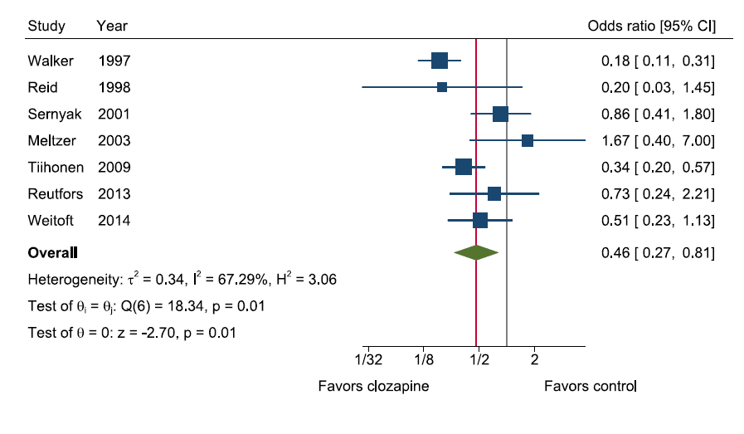
Clozing it Out
Suicidality affects many with schizophrenia
Clozapine may offer a benefit for those with suicidality
When comparing some of the included literature, a systematic review found a reduced odds of suicide with clozapine (p = 0.007)
Large heterogeneity between studies
Wilkinson et al, 2021
43
Notes:
https://onlinelibrary.wiley.com/doi/epdf/10.1002/da.23222

Slide 45
Possible Benefit Compared to:
Clinical Trials
Cohort Studies
Olanzapine
Haloperidol
Perphenazine
Fluphenazine
Quetiapine
Quetiapine
Thioridazine
Haloperidol
Risperidone
Recall the limitations of the trials in outcome measurements
Repeated measures not utilized across trials
Olanzapine
44

Slide 46
Question 4
DD, a 26-year-old male with a past medical history of schizophrenia and hypertension presents to the emergency room after a suicide attempt via wrist cutting. He has been managed on aripiprazole 20 mg daily for 5 years since his first episode of psychosis after failure with risperidone. He has been admitted to an inpatient unit for safety. Which of the following is an appropriate option for management of schizophrenia and DD’s suicidality?
Discontinue aripiprazole and initiate clozapine at 100 mg at bedtime
Increase aripiprazole to 25 mg daily
Discontinue aripiprazole and initiate clozapine at 25 mg daily
Continue aripiprazole and add-on clozapine at 50 mg daily
45
Notes:
C

Slide 47
Questions? Clozapine for Suicidality in Schizophrenia and Schizoaffective Disorder Harrison Ferro PGY2 Pharmacy Resident UPMC Western Psychiatric Hospital
46

Slide 48
References
Diagnostic and Statistical Manual of Mental Disorders, 5th Edition. APA. 2022.
Piotrowski P, Gondek TM, Królicka-Deręgowska A, Misiak B, Adamowski T, Kiejna A. Causes of mortality in schizophrenia: An updated review of European studies. Psychiatr Danub. 2017 Jun;29(2):108-120.
Palmer BA, Pankratz VS, Bostwick JM. The Lifetime Risk of Suicide in Schizophrenia: A Reexamination. Arch Gen Psychiatry. 2005;62(3):247–253.
Ventriglio A, Gentile A, Bonfitto I, Stella E, Mari M, Steardo L, Bellomo A. Suicide in the Early Stage of Schizophrenia. Front Psychiatry. 2016 Jun 27;7:116.
Popovic D, Benabarre A, Crespo JM, Goikolea JM, González-Pinto A, Gutiérrez-Rojas L, Montes JM, Vieta E. Risk factors for suicide in schizophrenia: systematic review and clinical recommendations. Acta Psychiatr Scand. 2014 Dec;130(6):418-26.
Donker, T., Calear, A., Grant, J.B. et al. Suicide prevention in schizophrenia spectrum disorders and psychosis: a systematic review. BMC Psychol 1, 6 (2013).
Clozapine Package Insert. FDA. Novartis.
Meltzer HY, Okayli G. Reduction of suicidality during clozapine treatment of neuroleptic-resistant schizophrenia: impact on risk-benefit assessment. Am J Psychiatry. 1995 Feb;152(2):183-90.
Meltzer HY, Alphs L, Green AI, Altamura AC, Anand R, Bertoldi A, Bourgeois M, Chouinard G, Islam MZ, Kane J, Krishnan R, Lindenmayer JP, Potkin S; International Suicide Prevention Trial Study Group. Clozapine treatment for suicidality in schizophrenia: International Suicide Prevention Trial (InterSePT). Arch Gen Psychiatry. 2003 Jan;60(1):82-91.

Slide 49
References
Nakajima S, Takeuchi H, Fervaha G, Plitman E, Chung JK, Caravaggio F, Iwata Y, Mihashi Y, Gerretsen P, Remington G, Mulsant B, Graff-Guerrero A. Comparative efficacy between clozapine and other atypical antipsychotics on depressive symptoms in patients with schizophrenia: analysis of the CATIE phase 2E data. Schizophr Res. 2015 Feb;161(2-3):429-33.
Spivak B, Shabash E, Sheitman B, Weizman A, Mester R. The effects of clozapine versus haloperidol on measures of impulsive aggression and suicidality in chronic schizophrenia patients: an open, nonrandomized, 6-month study. J Clin Psychiatry. 2003 Jul;64(7):755-60.
Michael J. Sernyak, Rani Desai, Marilyn Stolar, and Robert Rosenheck. Impact of Clozapine on Completed Suicide. American Journal of Psychiatry 2001 158:6, 931-937
Reutfors J, Bahmanyar S, Jönsson EG, Brandt L, Bodén R, Ekbom A, Osby U. Medication and suicide risk in schizophrenia: a nested case-control study. Schizophr Res. 2013 Nov;150(2-3):416-20.
Wimberley T, MacCabe JH, Laursen TM, Sørensen HJ, Astrup A, Horsdal HT, Gasse C, Støvring H. Mortality and Self-Harm in Association With Clozapine in Treatment-Resistant Schizophrenia. Am J Psychiatry. 2017 Oct 1;174(10):990-998.
Ringbäck Weitoft G, Berglund M, Lindström EA, Nilsson M, Salmi P, Rosén M. Mortality, attempted suicide, re-hospitalisation and prescription refill for clozapine and other antipsychotics in Sweden-a register-based study. Pharmacoepidemiol Drug Saf. 2014 Mar;23(3):290-8.

Slide 50
References
Tiihonen J, Lönnqvist J, Wahlbeck K, Klaukka T, Niskanen L, Tanskanen A, Haukka J. 11-year follow-up of mortality in patients with schizophrenia: a population-based cohort study (FIN11 study). Lancet. 2009 Aug 22;374(9690):620-7.
Wilkinson, S. T., Trujillo Diaz, D., Rupp, Z. W., Kidambi, A., Ramirez, K. L., Flores, J. M., Avila-Quintero, V. J., Rhee, T. G., Olfson, M., & Bloch, M. H. (2022). Pharmacological and somatic treatment effects on suicide in adults: a systematic review and meta-analysis. Depression and Anxiety, 39, 100– 112.

Slide 51
Record your Attendance by SMS Text
To enable the SMS texting feature, login to your account @ http://cce.upmc.com .
Click the “Mobile” tab to add your ten-digit mobile phone.
Receive credit instantly by texting the following code:
VABWEG
to
412-312-4424
Code MUST be texted by today at 11:59pm.

