Slide 1
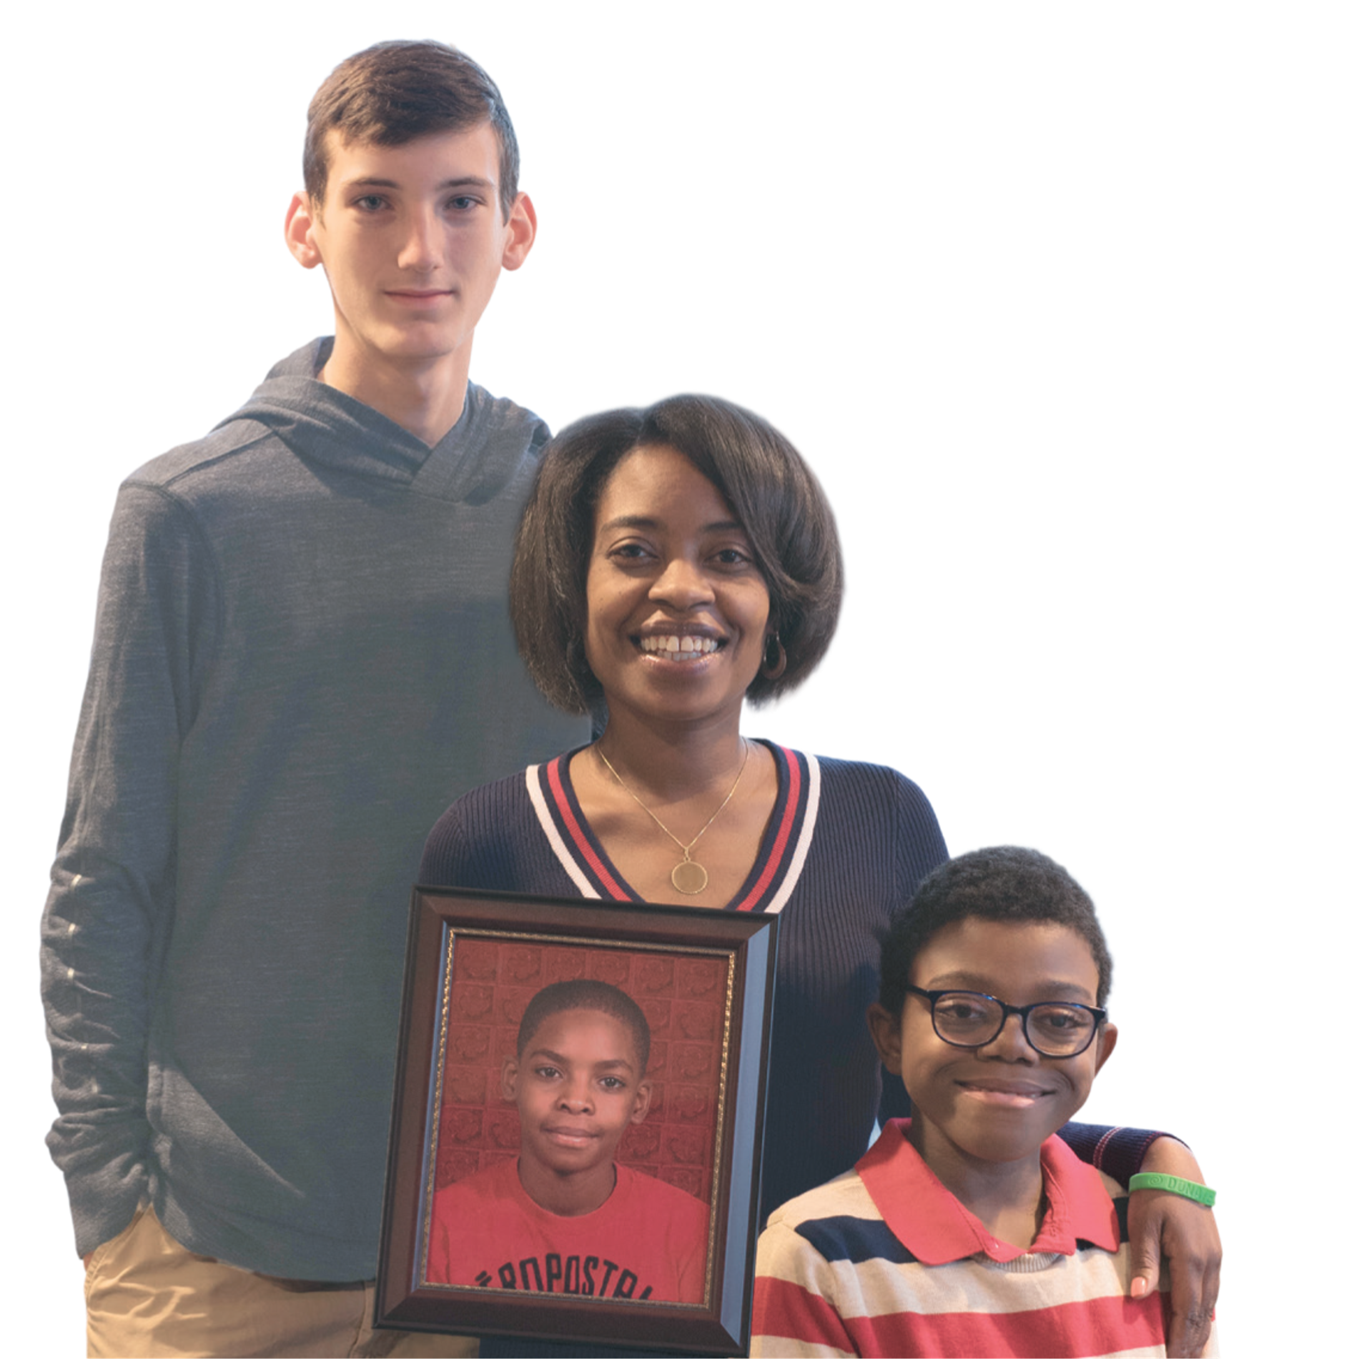
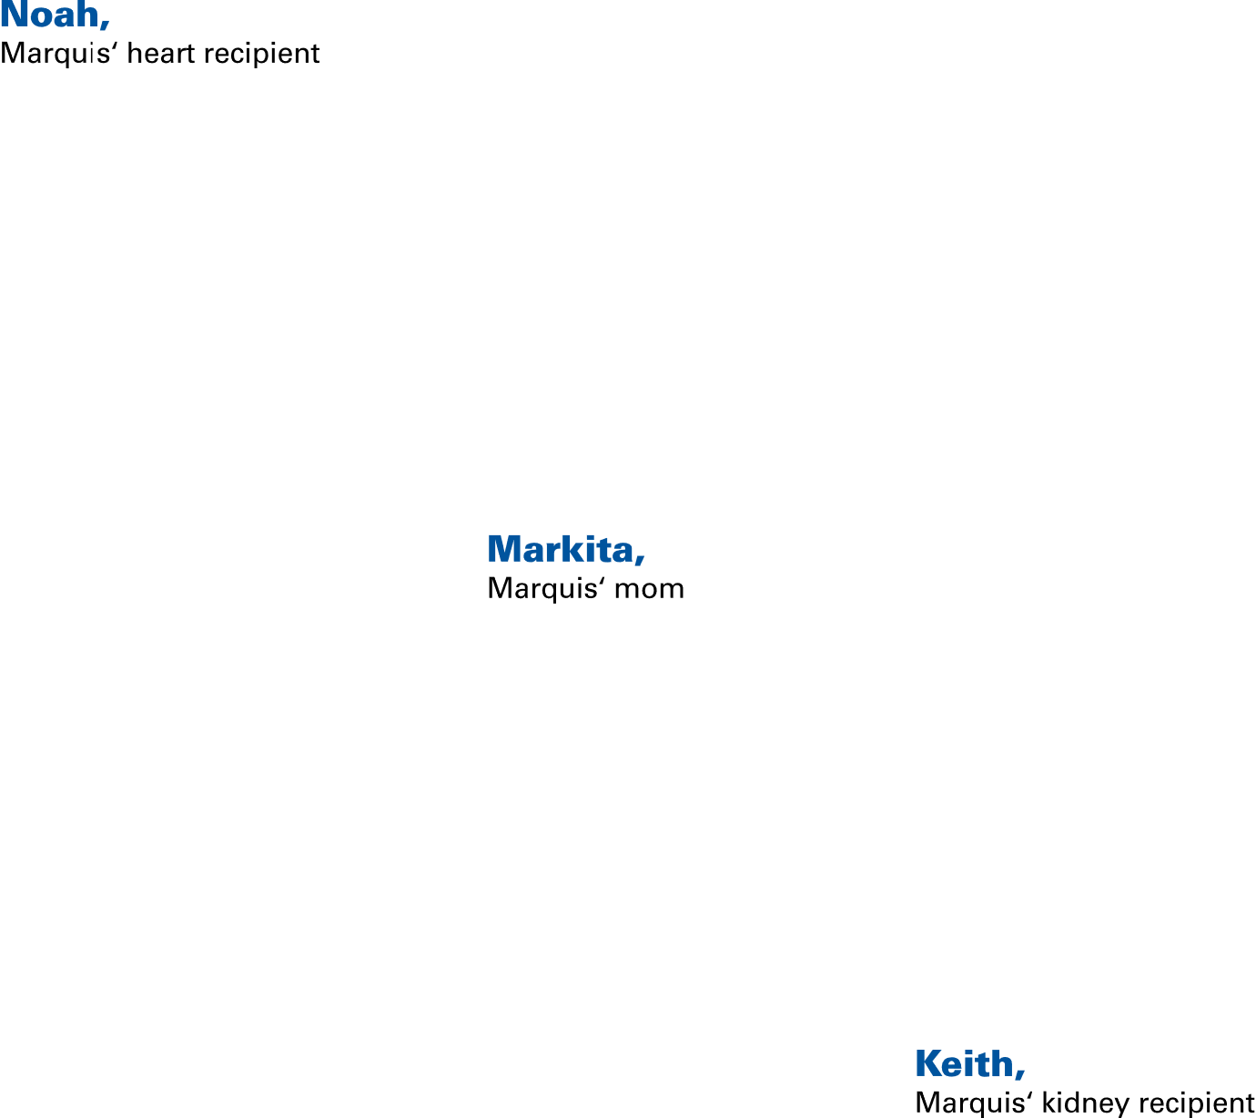


Collaborating for Life – The Donation Process
Presented by:
Christina Sarge
Hospital Services Coordinator
Marie Magyar
Transplant Coordinator
When Markita said yes to organ donation, she found comfort knowing that her son Marquis would give others a second chance at life.
See their story: donors1.org

Slide 2
Program Objectives
You will be able to identify some of the reasons families become confused about brain death.
You will be able to utilize techniques to help you communicate brain death more effectively.
You will be able to facilitate an effective transition to the discussion with the organ procurement coordinator.

Slide 3
Questions to Consider…
What do we need to do to preserve the opportunity for families in our care?
What do you envision as being the most important clinical practices for you to support the organ donation process?
What’s the most important thing you can do to support grieving families of potential organ donors?

Slide 4

Donation: A Seamless Operation Working Together
Notes:
We are grateful for the opportunity to work with you to provide the opportunity for donation for families and save lives through donation and transplantation.
To do so we need to have seamless processes in place.
These systems need to account for:
Timely notification of all potential organ donors
Family support and communication
Appropriately timed family conversations
And coordination of the overall donation process.

Slide 5
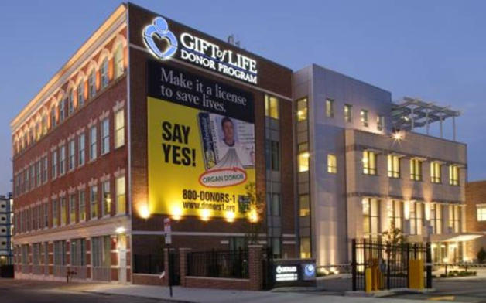
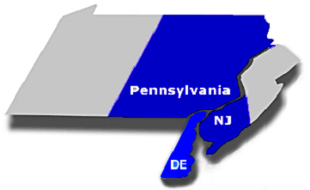
Gift of Life Donor Program
Philadelphia, Pennsylvania USA
Non-Profit OPO/Tissue Recovery/Eye Bank
Established in 1974
Largest OPO in the United States
Federally designated OPO (by Medicare) for eastern PA, Southern NJ & Delaware
- 125 Acute Care Hospitals
  - 14 Transplant Centers, 38 Programs
  - 11.3 Million Population
705 organ donors in 2021, resulting in 1,732 organ transplants; highest volume in the U.S. – 62 donors/MM and 153 transplants/MM; 2,399 tissue donors, including 1,348 musculoskeletal donors and 1,894 cornea donors
More than 55,000 organs coordinated for transplantation and over 2,000,000 tissue allografts
Accredited by: Association of Organ Procurement Organizations (AOPO); American Assoc. of Tissue Banks (AATB) & Eye Bank Assoc. of America (EBAA); UNOS/OPTN member OPO
Notes:
Let me tell you about Gift of Life.
For those of you who are new or unfamiliar with us, you may be surprised to learn that Gift of Life was one of the first Organ Procurement Organizations in the United States and is the largest OPO in the US.
We serve as a link between acute care hospitals, transplant centers, families facing end of life decisions and people awaiting transplants.
We are fortunate to be in one of the most giving regions in the country. Last year we coordinated the highest number of donors in the U.S. (664 organ donors).
With 20 people dying each day while waiting for a life-saving organ transplant, we are proud to have coordinated more than 50,000 organs for transplantation since our start in 1974.

Slide 6
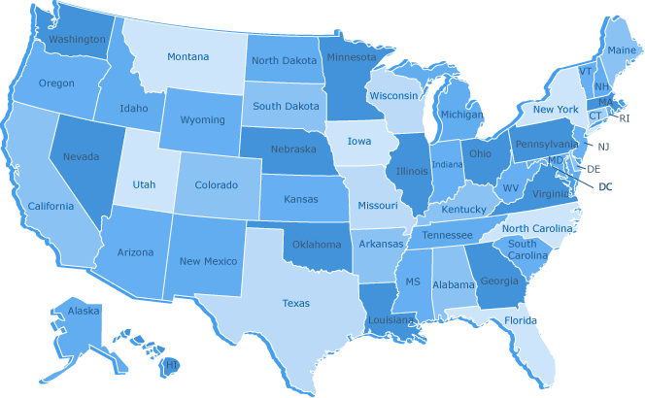
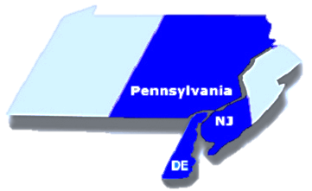
Organ Transplant
Waiting Lists
-Candidates -
September 2022*
105,839 Total Waiting in U.S.
Regional Waiting List
4,547 Kidney
  406 Liver
  94 Lung
  99 Heart
  122 Kidney - Pancreas
  22 Pancreas
  2 Heart – Lung
  0 Intestine
5,177 Total Waiting In Our Region
Source: Based on OPTN data as of September 1, 2022. Count based upon candidates.
Candidates - A patient who is waiting at more than one center, or for multiple organs, is counted as only one candidate.
Totals may be less than the sums due to patients included in multiple categories.
Notes:
The challenge we face is that there are just not enough organs.
There are nearly 106,000 patients on the national waiting list and more than 5,000 are from our region alone.
The support you provide the potential donor’s families in the ICU helps them and also provides hope to the patients/families that are waiting for the gift of life.
Facilitator’s Note: This waiting list reflects the actual number of patients or candidates waiting for organ transplants, according to data from UNOS. A patient who is waiting at more than one center, or for multiple organs, would be counted as only one candidate. The list above does not reflect the number of registrations since, according to UNOS, one patient who is waiting at more than one center, or for multiple organs, will have multiple registrations. Contact Beatrice McQuiston, ext 1229 for most recent wait list data

Slide 7

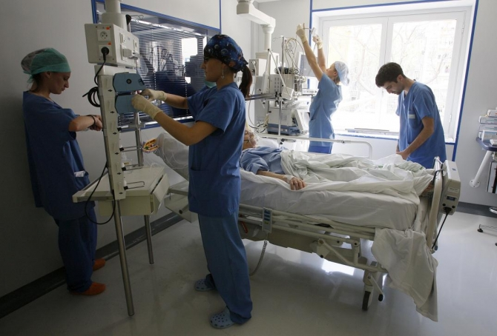
Organ Donation:
A High-Acuity, Low-Frequency Event
What is our responsibility to the family?
What is our responsibility to waiting recipients?
What can we learn from our experience caring for patients and families at the end of life?
Notes:
7
Organ Donation is a high-acuity, low- frequency event
What is our responsibility to those on the waiting list when this rare event occurs?
What can we learn from preparation for other high-acuity, low frequency events that can help us improve our practices when we have a potential organ donor in our care?

Slide 8

Call Gift of Life on all Vent-Dependent Patients
w/a Suspected Non-Recoverable Injury/Illness
To preserve the organ donation option,
call 1-800-KIDNEY-1 using the following criteria:
(regardless of age, medical history, current hospital course, hemodynamic status)
1. At the first indication the patient has suffered a suspected non-recoverable
injury/illness (any loss of reflexes, HTP/TTM, VV ECMO)
2. Prior to neuro consult/brain death examination
3. Prior to discussion of DNR status, W/D or limiting life-sustaining therapies
4. Patient has suffered: Cardiac Arrest, Anoxia, Stroke, or Head Trauma
Call Gift of Life – 1-800-KIDNEY-1
(1-800-543-6391)
In collaboration with the care team, Gift of Life will initiate the donation discussion and partner with the team to develop a family communication plan.
Notes:
Regardless of the donation pathway (donation after brain death or donation after cardiac death), it’s important for you to refer patients who fit this criteria as soon as possible.
The criteria for a timely referral is at “the first indication of a non-survivable neurological injury or illness, or anoxic event, in the mechanically ventilated patient.”
This will give us the time we need to come to the hospital, take a discreet position on the unit, and review the patient’s chart to determine the medical suitability for organ donation.
Once medical suitability has been determined, we may leave the unit and follow the case by phone.
Only under certain circumstances do we ask to speak with families about donation opportunities. We’ll talk about these details later in the presentation.
Facilitator: Questions to generate discussion may include:
What does a non-survivable “neuro injury” look like clinically?
Why is it important to call Gift of Life so early in the patient’s clinical course?
What obstacles do you perceive staff may have to notifying Gift of Life? How did you handle them? What ideas do you have for handling them?
What experiences can you share regarding the timing of the referral (late or early)?

Slide 9
Gift of Life Triage for Patient Deaths
Cardio-Respiratory Death
Loss of cardiac function
Loss of respiratory function
Non-Recoverable Brain Injury/Illness
(Ventilator Dependent)
Irreversible loss of all brain & brain
stem function in absence of metabolic or pharmacologic inhibitors
or
Family is discussing withdrawal of life-sustaining measures
Potential Tissue Donor
Potential Organ & Tissue Donor
Corneas, Heart Valves, Skin,
Long Bones, Saphenous Veins
Heart, Lungs, Liver, Pancreas, Intestine, Kidneys & Tissues
Call 1-800-KIDNEY-1
Notes:
Nearly every patient who dies can potentially help others through organ and tissue donation.
We receive approximately 48,000 referrals annually. These patient deaths are further evalauted for tissue (on the left) and organ (on the right) donation.
The majority of the calls we receive meet the criteria on the left where patients are pronounced dead based on cardiopulmonary cessation. Upon receiving the call we’ll begin our screening & evaluation for potential tissue donation.
The right side of this slide hilights our triage process for evaluating potential organ donors. These patients may also be tissue donors.
It is important for us to receive these referrals in a timely manner and in accordance with the clinical triggers for referral. Even one missed referral of a potential organ donor is significant for those patients on the waiting list.
In fact, only 1-2% of all deaths (those patients who are ventilator-dependent with non-survivable neuro injuries or illnesses) have the potential to become organ donors.

Slide 10
Medical Record Review Analysis
Potential Organ Donor Outcomes
2020
N= 1,026 (from 91 hospitals)
ME Declined (3) <1%
ARREST/OTHER (108) 11%
FAMILY NOT ASKED (17) 2%
Donation
Did Not
Occur
(407)
40%
Donors
(619) 60%
FAMILY DECLINED (278) 27%
Potential Organ Donor = all donors + BD, MS organ referrals + BD, MS not referred age < 75 years.
Notes:
Thought we evaluated about 48,000 patients as potential organ and/or tissue donors, you can see that during 2017, in all of the hospitals we serve, that there were only 1,008 potential organ donors.
You can see that 565 did donate/ and our conversion rate was 56%.
In the blue and reflected in the bar to the right, are those scenarios where no organ donation happened. There were 443 potential organ donors who did not move on to donation.
You can see that 30% in the green resulted in families saying “No”;
1%, or 3 families, were never offered the opportunity because we never received the patient referral.
In yellow – you can see that 128 patients suffered cardiac arrest and died before we could coordinate the donation process.
If you look at the green section at the bottom, you’ll note that this is our largest opportunity for improvement – to reduce the number of families who say “no”

Slide 11
Partnership for Organ Donation Harvard School of Public Health
Two Comprehensive Studies:
1. Relationship Between Understanding Brain Death and Consent Rates for Donation
“Explaining Brain Death: a Critical Feature of the Donation Process”; Franz, et al.. (Journal of Transplant Coordination 1997;7:14-21)
2. Factors Affecting Organ Donation Consent Rates
“Improving the Request Process to Increase Family Consent for Organ Donation”; Gortmaker, et.al. (Journal of Transplant Coordination 1998; 8:210-217)
Notes:
To learn more about the factors influencing whether or not families choose to donate researchers asked two questions: how important is it for families to understand brain death and what are the process variables that most influence the donation process.
This slide summarizes two landmark studies in organ donation.
Now that we have a good handle on the national and local statistics on organ donation, how the process is unfolding here at Christiana and what public opinion in the US is regarding organ donation – I thought it would be helpful to quickly walk through the results of the studies that form the foundation of our practice.

Slide 12
“MY RELATIVE WAS BRAIN DEAD”
PERCENT RESPONSE
YES
95%
YES
97%
(n.s.)
(n = 164)
Franz, et al. Explaining Brain Death: a Critical Feature of the Donation Process. Journal of Transplant Coordination 1997;7:14-21
Notes:
The Partnership for Donation, in conjunction with the Harvard School of Public Health published a study which correlated family’s understanding of brain death
with their likelihood to donate.
The study included 164 families who were contacted by phone 4 to 6 months after being approached about donation. They were asked a series of questions about brain death and donation with the results divided into two groups, based on family authorization for donation. When asked if they were told their loved one was brain dead, there was no significant difference in the groups.

Slide 13
IS A PERSON DIAGNOSED AS BRAIN DEAD
IN A COMA OR DEAD?
PERCENT RESPONSE
COMA or Didn’t Know 37%
COMA or Didn’t Know 55%
DEAD 63%
DEAD 45%
(p < .027)
(n = 164)
Franz, et al. Explaining Brain Death: a Critical Feature of the Donation Process. Journal of Transplant Coordination 1997;7:14-21
Notes:
However, when the family was questioned about their understanding of brain death, a significant difference emerged between the groups.
Families who authorized donation were more likely to understand brain death and that their loved one had died.
Notice here that 55% of families who declined donation either thought that their loved one was in a coma or weren’t clear if he or she was dead.

Slide 14
WOULD YOU STILL MAKE THE SAME CHOICE ABOUT ORGAN DONATION TODAY?
NO/Don’t Know 6%
PERCENT RESPONSE
NO/Don’t Know 34%
YES
94%
YES
66%
(p < .001)
(n = 164)
Franz, et al. Explaining Brain Death: a Critical Feature of the Donation Process. Journal of Transplant Coordination 1997;7:14-21
Notes:
Another compelling finding from this study emerged when these families were asked to reflect upon their decision to donate.
Researchers provided the families with a detailed explanation of brain death and asked them to reflect upon their original decision about donation.
After receiving this explanation, 34% of those families who originally declined donation, conveyed that they would have made a different decision regarding donation.
This is the first empirical demonstration of a relationship between understanding of death and donation authorization rates and can translate into additional lives saved through transplantation.
This is the first empirical demonstration of a relationship between understanding of death and donation authorization rates and can translate into additional lives saved through transplantation.

Slide 15
Factors Affecting Organ
Donation Consent Rates
(n=707)
Setting is appropriate*
Setting is not appropriate
Request is decoupled**
Request is not decoupled
OPO & hospital staff approach
OPO approach
Hospital staff approach
* Appropriate setting defined as private family consultation room
** Decoupled request defined as a temporal separation between discussion of death
and first mention of donation
Source: “Improving the Request Process to Increase Family Consent for Organ Donation”;
Gortmaker, et.al. (Journal of Transplant Coordination 1998; 8:210-217)

Slide 16
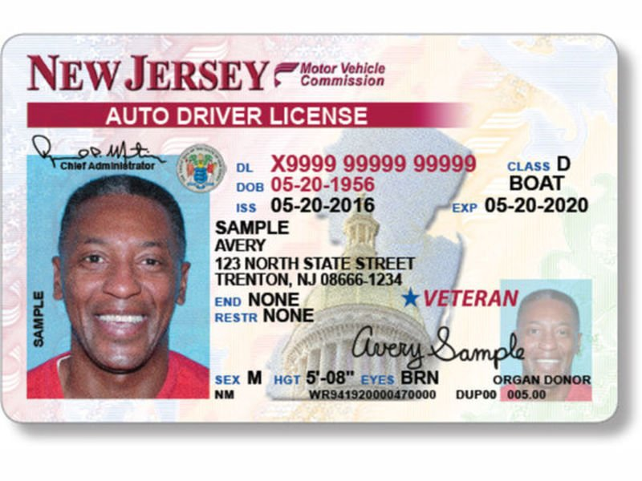
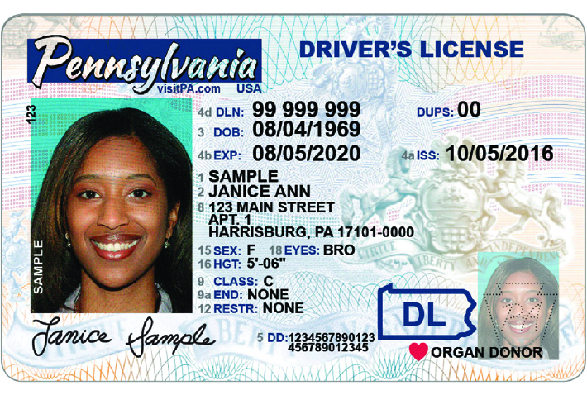
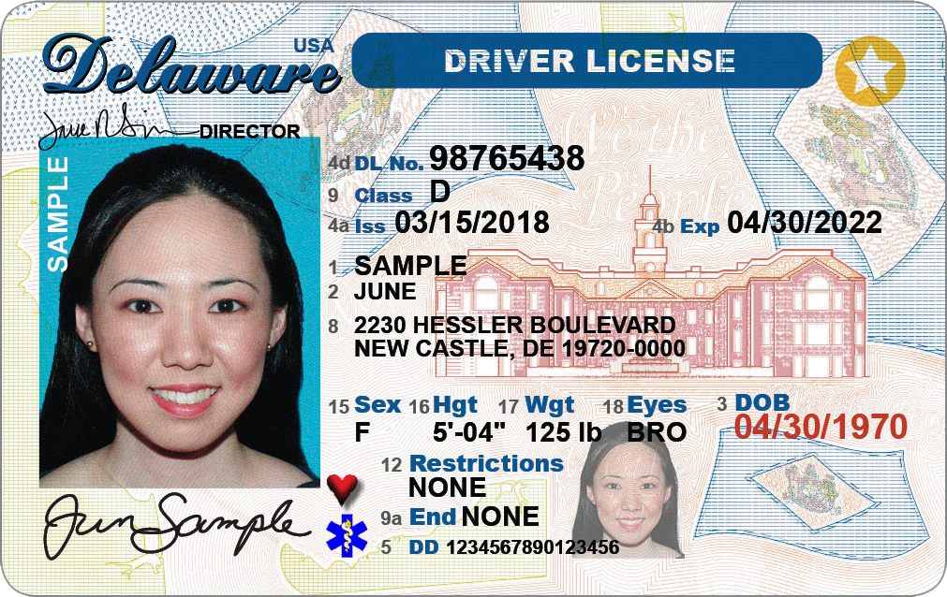



Drivers’ License Registries
Delaware
Notes:
All 50 states have donor registries via the driver’s license.
In PA, NJ and DE, the driver’s license is a legal gift document.
It shows that the individual made their wishes known regarding organ and tissue donation.

Slide 17
Gift of Life Donor Program
Clinical Practice In Presence of Driver’s License,
or State Issued ID Card Donor Designation
Gift of Life coordinator accesses secured DMV 24-hour hotline to ascertain status of donor designation
(+) Donor Designation communication to care team
When Gift of Life coordinator initiates family discussion, it is explained that “your loved one has already made this decision”
The entire donation process is explained to the family
  Questions/Concerns are addressed
Any decision to act on legal gift document is made in conjunction with care team, GLDP and hospital leadership
Notes:
Let’s discuss how the process works.
When we receive patient referrals, one of the first things we do is to find out the patient’s donor designation status.
If the designation is present, then we communicate that to the care team.
When the time is appropriate to meet with the family, we share the information with them.
Our experience has shown that most families are relieved to hear their loved one made the decision and want to respect their wishes.
We provide full disclosure regarding the donation process; answer any questions the family may have, and support them throughout the entire process.
As an advocate for the donor and transplant recipients, we are fully interested in providing patient autonomy which comes from the decision they made.

Slide 18
How Does The Process Work ?
Tissue Donation
Clinical Assessment
Transplantable
Tissues
Brain Death
Patient Management
Organ Donation
Referral Information
Notes:
Let’s look at how organ and tissue donation process works.

Slide 19
Team Huddle
Ensures Optimal Communication with Care Team and Family
Criteria for Team Huddle: After medical suitability has been determined Shift change Family/care team are discussing DNR or withdrawal of support Family brings up donation Brain death has been determined Patient is hemodynamically unstable At the request of the care team or Gift of Life Coordinator | Participants: Gift of Life Coordinator Bedside Nurse Treating Physician Resident Support Staff (when appropriate) Pastoral Care Social Work Respiratory Care Other
A Gift of Life Coordinator (with a designated member of the care team) will facilitate the team huddle at important junctures of the case.
Points for Discussion
Patient Status, Clinical Plan, Donation Options,
Family Communication/Support, Next Steps

Slide 20
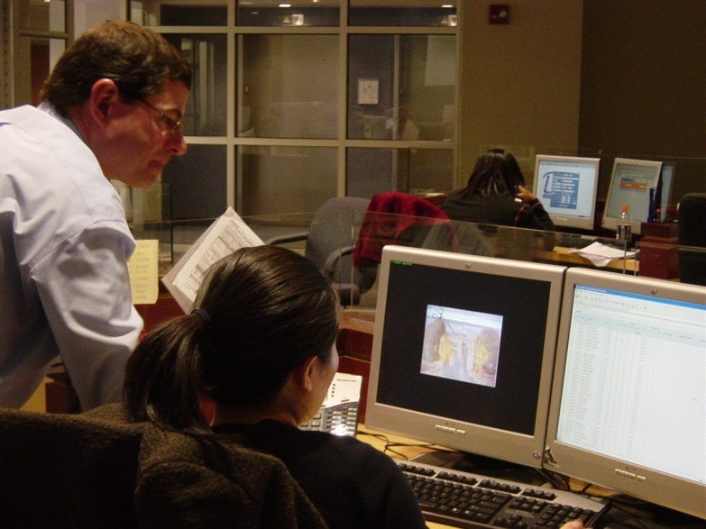
Gift of Life Referral Response
Gift of Life will:
Evaluate the patient
Determine scope of the gift
Contact the donor registry
Identify the legal next of kin
In Collaboration with the Care Giving Team to:
      Determine family communication plan
      (no early mention of donation)
      Preserve donation options
      Support the family
Notes:
Upon each organ donor referral to KIDNEY-1, we will travel to the hospital to do the following:
Communicate with the attending physician
Evaluate patient’s chart and clinical course; evaluate medical suitability for donation
Determine options for scope of patient/family gift
Contact donor registry to determine patient’s designation
Identify Legal NOK using the Uniform Anatomical Gift Act hierarchy
Collaborate with the care giving team and attending physician to determine a family communication plan
Work with the care team to preserve donation options for family, i.e. DNR status, maintain patient hemodynamics
Once introduced to the family, we will help you provide them with information and support.

Slide 21
Organ Donation Can Occur in Two Ways
Donation After Brain Death (DBD)
Organs are surgically recovered following the determination of death utilizing neurological criteria.
Circulation is intact at the time of organ recovery.
Donation After Cardiac Death (DCD)
Organs are surgically recovered following
the determination of death, by neurological
or cardiopulmonary criteria.
Circulation is not intact at the time of organ recovery.

Slide 22
Organ Donation Process
Vent-Dependent Pt with a Non-Recoverable Neurological Injury/Illness
Care Team Determines Grave Prognosis
Donation After
Brain Death
Neuro
Exam
Donation After
Cardiac Death
Exam c/w brain death
Death pronounced on neuro criteria
Exam Not c/w brain death
Care Team / Family discussion re: grave prognosis and W/D
Approach family about donation
(GLDP And Care Team)
Approach family about donation
(GLDP And Care Team)
Support family through decision making
Maintain pt hemodynamic support
Support family through decision making
Maintain pt hemodynamic support
Patient transferred to OR
Surgical recovery
Patient transferred to OR for W/D
Death pronounced on cardio-pulm criteria
Surgical recovery

Slide 23
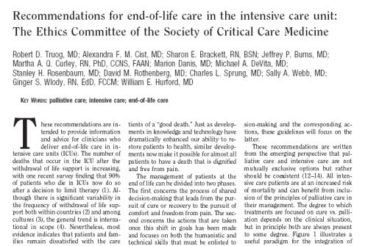

Incidence of Deceleration of Care
“The number of deaths that occur in the ICU after the withdrawal of life support is increasing, with one recent survey finding that 90% of patients who die in ICU’s now do so after a decision to limit therapy.”
Source: Critical Care Med. 2001 Vol. 29 No. 12
Notes:
This journal article from the Critical Care Medicine shows that 90% of patients who die in ICU’s do so after there has been a decision to discontinue life sustaining therapy
When this scenario occurs, we will collaborate with the healthcare team to organize a plan for talking with the family prior to the withdrawal of therapies.
Families are typically not aware that by making this decision, their opportunity for organ donation could be compromised.

Slide 24
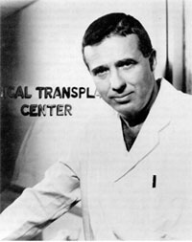
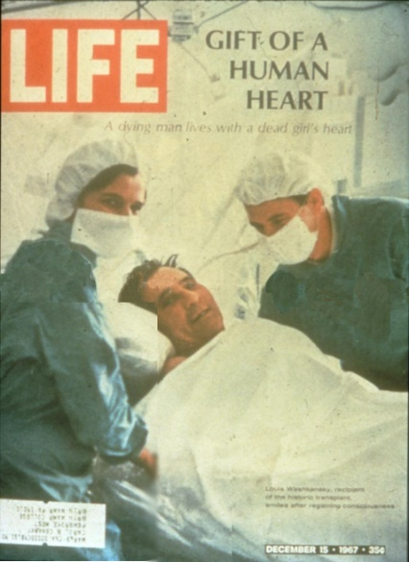
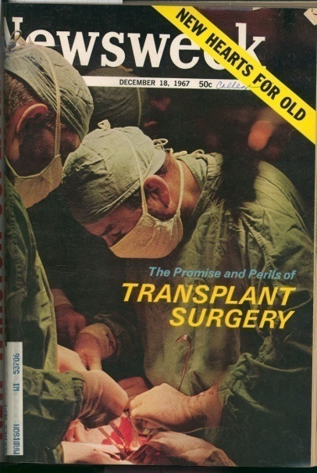
Transplantation and DCD: Historical Perspective
1951- Hume, Kidney transplant
1963 - Starzl, Liver transplant
1967 - Barnard, Heart transplant
1968- Harvard Committee: Brain death criteria established
1970’s- Acceptance of brain death criteria
1990’s- Re-evaluation of DCD
Notes:
Donation after cardiac death is not new. It is the foundation of modern day organ transplantation.
Organs were routinely recovered through DCD donation prior to the establishment of brain death criteria in the late 60’s, early 70’s.
We revisited this method of organ recovery in 1995 to meet the needs of families who wanted to donate, but who’s loved one did not fulfill strict brain death criteria.
Nationally, there has been explosive growth in DCD donation since 2004. Perhaps due in part to the Organ Donation Breakthrough Collaborative, an IHI initiative aimed at dramatically and rapidly improving performance in organ donation.

Slide 25
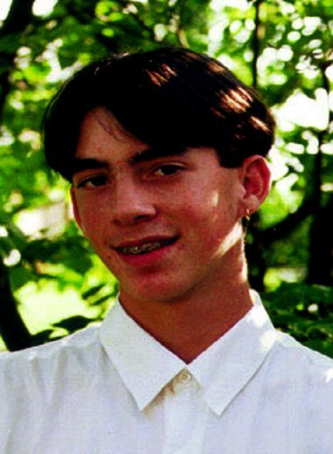
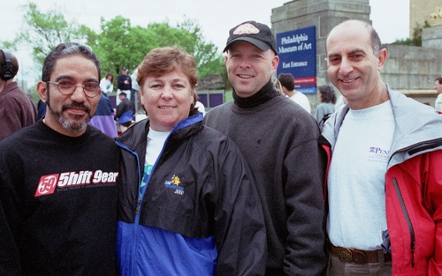
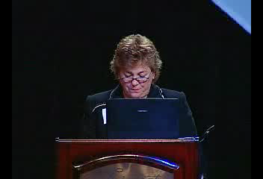
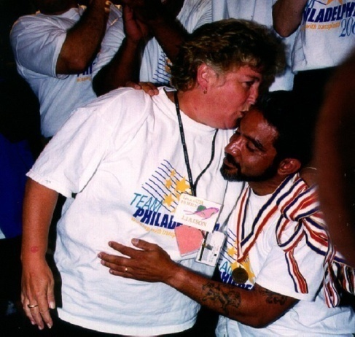
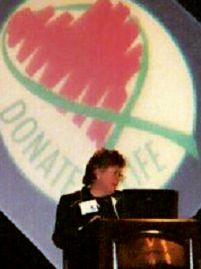
A Mother’s Perseverance
Changed Gift of Life’s Practice
“We knew Michael wasn’t brain dead,
but we also knew he was not going to survive. It was important for us
to be able to donate…
not because we believed in it…
but because it was Michael’s wish.”
Susan McVey-Dillon Michael’s Mother, 1995
Notes:
This is a picture on the Left of our first DCD donor. His name was Michael McVey. He was 14 years old. He was an 8th grade student. His older sister had just learned about donation when she got her driver’s learners permit. The family had just discussed donation two weeks before Michael died. His mother, Susan, knew that Michael wanted to be a donor.
Michael sustained head trauma after he fell from a rope swing in an abandoned warehouse near his home. He initially seemed fine but later that evening, his mom found him unresponsive in the bathroom.
Michael was not brain dead. He could not be a brain dead donor. His mother made “ the hardest decision of her life”, to withdraw lifesustaining therapies. She said saying yes to donation was an easy decision.
We were notified and we are charged with making this happen for Michael, Susan and her family. By working with the family and the hospital staff, Michael became our first DCD.
Facilitator’s note: Images across bottom: #1 (far left) – Santos, Michael’s liver recipient; mother, Susan; John Edwards, transplant coordinator; Dr. Shaked, transplant surgeon, #2 – Susan McVey Dillon speaking at National Breakthrough Collaborative meeting; #3 – Susan and Santos, #4 – Susan making presentation at National Breakthrough Collaborative.

Slide 26
Donation After Circulatory
(Cardiac) Death (DCD)
Definition:
A procedure whereby organs are surgically recovered following pronouncement of death based on “irreversible cessation of circulatory and respiratory functions.”
Controlled
Death & organ recovery
can be predictably
controlled following the withdrawal of life support.
Uncontrolled
Cardiac arrest is unplanned.
Timing of other aspects of
organ recovery are not
controlled.
Notes:
Donation after Circulatory (Cardiac) Death can be broken down into two (2) different types: Controlled and Uncontrolled
Controlled DCD refers to the scenario when the timing of the withdrawal of support is planned by the family and health care team, and coordinates with the time that the OR is available to accommodate the recovery of organs.
Uncontrolled DCD is a scenario where the patient arrests before the recovery can occur. To preserve the opportunity for donation, chest compressions and ventilation may be initiated prior to, en route or while in the OR suite. Even though chest compressions and ventilation are being done, they are not being done as a patient resuscitation effort. The purpose (as understood and carried out via family authorization) is to maintain perfusion until we can get to the OR

Slide 27
Gift of Life Donor Program
DCD Characteristics
1995 – 2020
Controlled vs. Uncontrolled
(14%)
n=1,682
(86%)
Source: Based on Gift of Life Donor Program data through December 31, 2020.

Slide 28

What is Donation after
Circulatory (Cardiac) Death (DCD)?
        Vent-dependent patient with a non-recoverable
        neurological injury or illness; no chance for survival
        Neuro exam is not consistent with brain death
        Family elects to withdraw support or DNR is initiated
        after discussion with physician
Family conversation: thorough explanation; informed authorization
Treating physician, ICU RN, respiratory therapist take patient to the OR for withdrawal of support (duplicated as if in ICU)
Pronouncement of death by treating physician via cardio-pulmonary criteria
After 5 minutes, transplant team enters room; starts organ recovery
Notes:
For DCD, although the patient may be ventilator dependent and have a non-recoverable neuro injury or illness, the neuro exam is not consistent with brain death.
The family and care team discusses the grave prognosis, and the family elects to withdrawal of support.
In consultation with the care team, the family is approached prior to the actual withdrawal of life support about their opportunity for donation.
In conjunction with the care team, Gift of Life determines if the patient meets DCD criteria.
If the criteria are met and the family has chosen donation, the patient is transferred to the OR for the withdrawal of life support.
After pronouncement by the physician/designee and a 5 minute waiting period is observed, the surgical recovery process begins (transplant teams enter the OR).
Organs recovered most frequently are the kidneys. Under certain circumstances, the liver, pancreas and lungs can be recovered as well. With the advent of new perfusion technology, hearts may even be an option.

Slide 29
Patient Evaluation for DCD
Age
Weight
ABO
Past Medical History
History of Present Illness
Current Clinical Condition
Organ Function
Respiratory Assessment
  Respiratory Rate
  Tidal Volume
  Minute Ventilation
  Negative Inspiratory Force (NIF)
  Changes in Hemodynamics & Oxygen Saturation
  Length of Time off Ventilator
Notes:
As part of our evaluation for medical suitability for DCD, we may ask the care team to conduct some tests to help us predict if the patient will die within a timeframe to allow for donation.
This typically consists of respiratory parameters and an assessment of the patient’s hemodynamic status.
These values can help predict the probability that the patient will expire within a reasonable timeframe that will allow for organ donation.

Slide 30
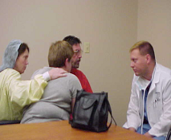
Clinical Considerations:
Family Discussion
Discussions about withdrawal of support and organ donation are independent of each other
Considerations for Informed Consent
Heparin administration
Organs may be unsuitable for transplant
Family presence in the OR
Patient may not arrest within required timeframe for donation
Note: A separate consent is required for any invasive procedure
Notes:
As a routine part of the informed consent process, this slide captures the elements of disclosure
Our aim is to have families fully informed and understand the process as well as the outcomes of the process
1. The family may choose to be present in the OR or place of withdrawal. We will try to accommodate these requests.
2. Certain medications may be administered to protect the viability of the organs and improve the post-recovery function.
3. Upon visualization, organs may not be suitable for transplantation.
In the event that their loved one does not expire within the time frame allowing for donation, a plan is put in place to bring the patient back to the unit where care and comfort measures are continued.

Slide 31
DCD Clinical Considerations
Pronouncement of Death
Physician/designee pronounces death the way they normally would
  Based on cardio-pulmonary criteria;
  Pronouncing physician is NOT associated with the transplant team
Transplant team is NOT permitted in OR until death has been pronounced
IOM guidelines are followed (5 min. waiting period)
Note: In the event the patient does not die in a timeframe that allows for successful organ recovery, the patient will be returned to pre-determined area and comfort care and family support will be continued.
Notes:
When the patient is taken to the OR for the withdrawal of support, typically the ICU nurse, physician/designee, and some times a respiratory therapist accompany us and the patient.
Operating room nurses may remain in the room or excuse themselves during the withdrawal phase
Once death is declared, a five minute wait period is observed. At this time, the transplant recovery surgeon and team enter the OR
If the family will be present with their loved one in the OR, they need to know that they must say their final good-byes during the 5 minute wait period.
(Note: The physician may pronounce as soon as asystole occurs and observe a five minute wait period after pronouncement, or may pronounce five minutes after asystole occurs. In either case, the five minute wait period pertains to the time immediately after asystole is noted. Check the hospital’s policy to see if it specifies this procedural detail.)

Slide 32

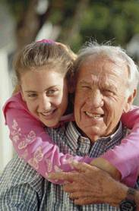
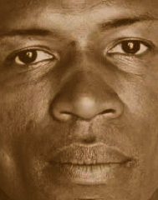


Family Communication:
Achieving Optimal Interactions & Open Dialogue
Information
Decision-making
Emotional & Spiritual

Slide 33
Framework for Family Discussions on Death and Donation
Phases of Communication for Families of Potential Organ Donors
Phase I ______ has suffered severe damage to his/her brain. We are doing everything we can, but it’s possible that s/he may not recover. (Show pictures of CT scan, etc.) | Phase II Despite everything we are doing, things are getting worse. There is nothing more we can do to help him/her recover. | Phase III It looks like ______’s brain has been completely destroyed and s/he appears to be dead. We have begun a series of tests to confirm this. We want to be extremely thorough and careful to ensure that we are absolutely correct. (timeframe provided for testing) | Phase IV We have finished the testing and found that _________ has died @ ___.
1-800-KIDNEY1
Hospital staff introduces GLDP coordinator
Phase V
This is ____________, who works with our team. S/he is a specialist who works with families such as yours.

Slide 34
Brain Death Pronounced: Family Verbalizes Understanding
  Patient has been pronounced brain dead; family has been given this news and time of death. Verbalizes understanding that the patient is dead.
Decision made to
Limit, Decelerate or WD Treatment
  The family indicates that they want to limit, decelerate, or withdraw medical treatment (action may compromise or limit opportunity for donation).
Family
Mentions
Donation
  The family mentions donation or expresses an interest in talking about donation.
Six Scenarios that Trigger
A Donation Discussion
HCT
Mentions
Donation
  Any health care team member mentions donation or initiates a donation conversation (not optimal practice).
Pulmonary or Hemodynamic Instability
(On the Verge of Coding)
  The patient suffers pulmonary and/or hemodynamic instability, which may result in compromising the family’s donation opportunity.
Family Understands Death/ Non-Survivable Nature of Injury
(…hold no hope for survival)
  The family indicates that they understand patient has died and/or that they have no hope for patient’s meaningful survival (can occur prior to formal brain death pronouncement or prior to final withdrawal meeting).

Slide 35
Families give the gift of life...
if only we give them the opportunity.

Slide 36
Play Video – Ted Talk – Dr. Moritsugu
https://youtu.be/O78i-C94oSw

Slide 37

Determination of Brain Death
<Enter Physician Name>
UPMC North Central

Slide 38
So, what is Brain Death?
According to the Uniform Determination of Death Act, an individual who has sustained an irreversible cessation of all brain function, including the brain stem, is dead.
Brain Death Pronouncement = Death

Slide 39
Brain Death is not…
Coma
“Persistent Vegetative State (PVS)”
“Locked-In” Syndrome

Slide 40

Historical Perspective
Prior to the advent of mechanical respiration, death was defined as the cessation of circulation and breathing.

Slide 41
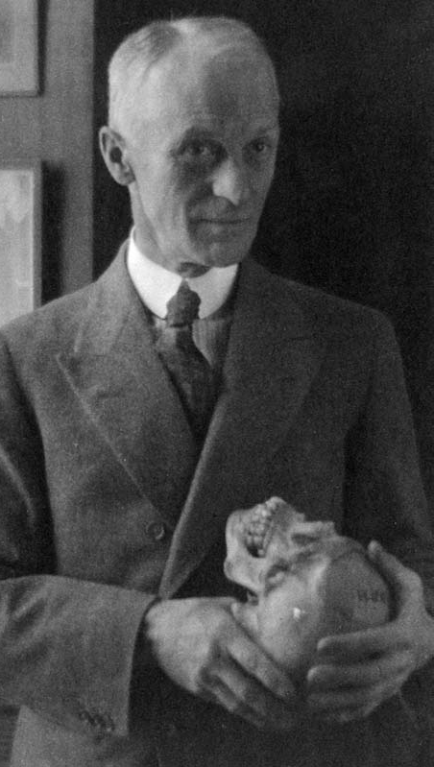
Historical Perspective
Late 1800s to early 1900's:
First accounts of “cessation of respiration” after experimentally inducing increased intracranial pressure also noted clinically in patients with increased intracranial pressure, by the father of modern neuro-surgery, Harvey Cushing, MD.
The respiratory arrest would inevitably lead to cardiac arrest, but was not described as brain death as that concept did not yet exist.

Slide 42
Historical Perspective
1950's:
Physicians saw patients in a state “beyond coma”
1959 – “death of the nervous system” and “coma dépassé”
1960's:
1963 – the term “brain dead” used by a Belgian surgeon to describe a patient with a heartbeat from whom a kidney was procured and then transplanted
1968 – Irreversible Coma/Brain Death / Harvard Ad Hoc Committee standards for brain death

Slide 43
Historical Perspective
1980's:
Because of a lack of uniformity in brain death statute, the Presidential Commission for the Study of Ethical Problems in Medicine and Biomedical and Behavioral Research issued a report in 1981, Defining Death: Medical, Legal and Ethical Issues in the Determination of Death, which detailed a comprehensive set of clinical circumstances and a battery of tests to identify brain death
Uniform Determination of Death Act (UDDA), developed by the National Conference on Uniform State Laws, in cooperation with the American Medical Association (AMA), the American Bar Association (ABA), and the President's Commission.

Slide 44
Historical Perspective
Uniform Determination of Death Act (UDDA):
Act reads: “An individual who has sustained either:
irreversible cessation of circulatory and respiratory functions, or
irreversible cessation of all functions of the entire brain, including the brain stem, is dead.”
Acts as a model for individual state laws governing the determination of death.
It has been applied in all 50 states.

Slide 45
Brain Death Confirmation
Once the patient meets clinical criteria for brain death, the patient is pronounced and is medico-legally certified as deceased
Multiple complications frequently follow brain death, and without support, cardio-pulmonary arrest inevitably follows
    Diabetes insipidus leading to polyuria and hypernatremia, as well as hypovolemic shock and vasopressor requiring hypotension
    The pituitary gland ceases to function, and the body develops panhypopituitarism, pancytopenia, cardiac ischemia, arrhythmias, lactic acidosis, renal failure, coagulopathy…

Slide 46
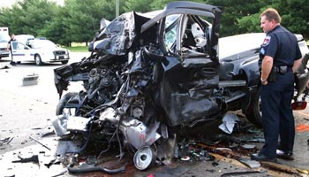
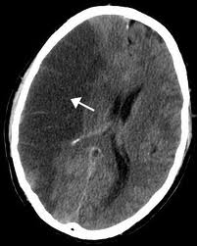

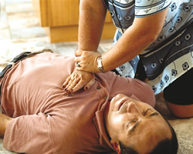
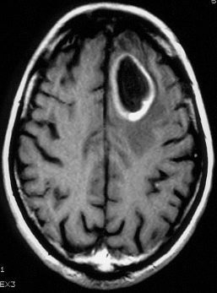
Types of Injuries or Illnesses
Resulting in Brain Death
Head trauma
Gunshot wounds, MVC, brain insults
Cerebrovascular accident
Primary brain tumor
Conditions causing cerebral anoxia
Drowning, smoke inhalation, overdose or prolonged cardiac arrest

Slide 47
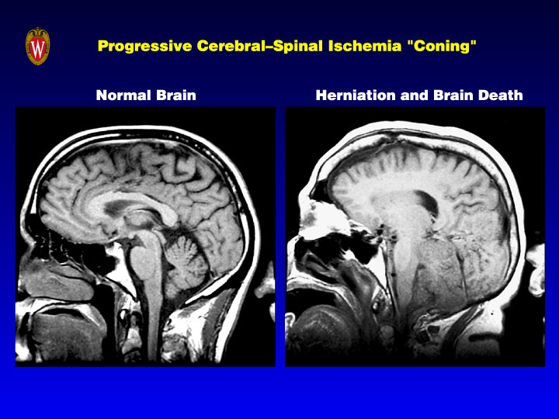
Normal Brain
Herniation & Brain Death
Courtesy: Dr. Kenneth Wood, Geisinger

Slide 48
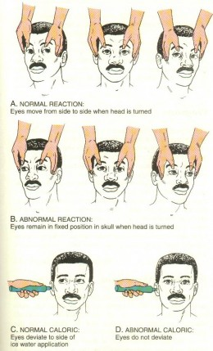
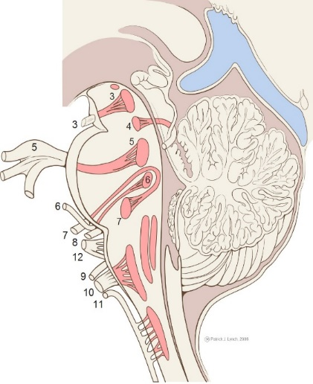
Determination of Brain Death:
Clinical Exams
Absence of brainstem reflexes:
Pupillary reactivity to light
Corneal reflex
Oculocephalic (Doll’s Eye) reflex
Cold calorics reflex
Jaw-jerk reflex
Cough and gag response
Facial grimacing or other response to painful stimuli other than reflexes

Slide 49
Diagnostic Approach to Brain Death (AAN)
No severe electrolyte acid base disturbances
Coma
No hypothermia
+
Cause of coma evidence
Clinical • Neuro-image • CSF
No drugs
Intoxication
Sedatives
Relaxants
Poisoning
No endocrine crisis
+
Clinical Neuro Exam
Absent motor response
Absent brainstem function
Apnea test PaCO2 ≥ 60 mmHg
+
Clinical Diagnosis Brain Death
Procurement
+
-
Disconnect vent
Donor?
Wijdicks Neurology 1995; 45:1003-11

Slide 50
Apnea Testing
Pre-Test Guidelines
Clinical exam consistent with brain death
  Systolic BP > 90 mm Hg
  Normal PCO2 > 40 mm Hg
  Core temperature - normothermic
  EKG, O2 Sat, & BP monitoring -”stable Vital Signs”
  No drug intoxication or poisoning
  No metabolic causes for coma
  A-line placement preferred

Slide 51
Apnea Test Procedure
Place on 100% FiO₂ for 30 minutes
Draw baseline ABG
Administer 100% O₂ via cannula at 6-12 lpm
Normalize baseline until PCO2 ≈ 40 mm Hg
Disconnect the ventilator— (Don’t Extubate!)
Perform blood gases every 5-8 minutes

Slide 52

Apnea Test Procedure
Observe for:
  Respiratory movements
  Hemodynamic instability
Reconnect to the ventilator:
  If patient becomes unstable
  If/ when PCO2 is > 60 mm Hg

Slide 53
Apnea Test Termination
Discontinue test if the following occur:
  Spontaneous respirations
  Hypotension (≤ 90mm Hg)
  Dysrrythmias
  Desaturation
If patient becomes unstable:
  Draw ABG
  Concurrently reconnect the ventilator
  Terminate the apnea test
If the apnea test was terminated and the PCO2 has not reached goal, this does not support the diagnosis of brain death

Slide 54
Apnea Test Result
    If respiratory movements are absent
    and PCO2 is > 60 mm Hg, or
    has changed by > 20 mmHg from baseline, then
Test Supports/Confirms the Diagnosis
of Brain Death

Slide 55
Ancillary Studies
Ancillary studies are not mandatory but are needed for patients in whom specific components of clinical testing cannot be reliably evaluated.
Conditions exist that preclude complete clinical evaluation, such as:
  Severe facial trauma or pre-existing deformity that precludes assessment of the pupillary light reflex
  Pre-existing pupillary abnormalities that preclude assessment of the pupillary light reflex.
  One or both tympanic membranes are ruptured precluding testing of the oculovestibular reflex.
  Conventional apnea testing cannot be performed or is indeterminate (e.g. due to ECMO or hemodynamic instability during testing).

Slide 56
Ancillary Studies
Ancillary studies are not mandatory but are needed for patients in whom specific components of clinical testing cannot be reliably evaluated.
4-Vessel Angiogram – gold standard, diagnostic
    Cerebral Blood Flow (CBF) Study – diagnostic
    EEG – 90%
    S & S – not diagnostic
    BAEP, SSEP, MEP – not diagnostic

Slide 57
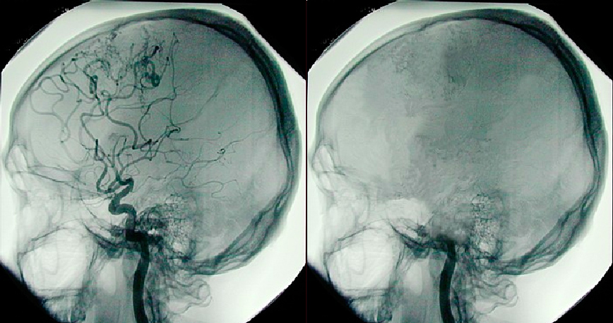
Brain death photo illustration showing blood flow at left and no blood flow at right. © Fusionspark Media Inc.

Slide 58
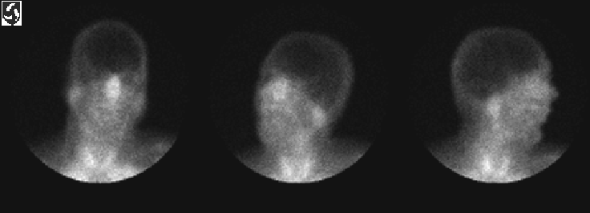
Determination of Brain Death
Ancillary Test
Cerebral Blood Flow Study
Planar View - No Flow

Slide 59
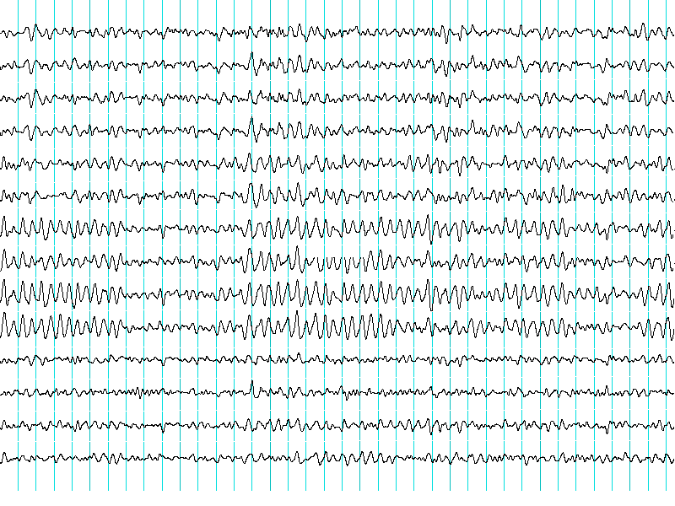
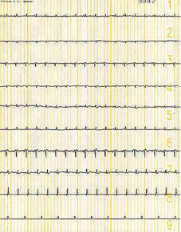
EEG
Normal
Electrocerebral Silence

Slide 60
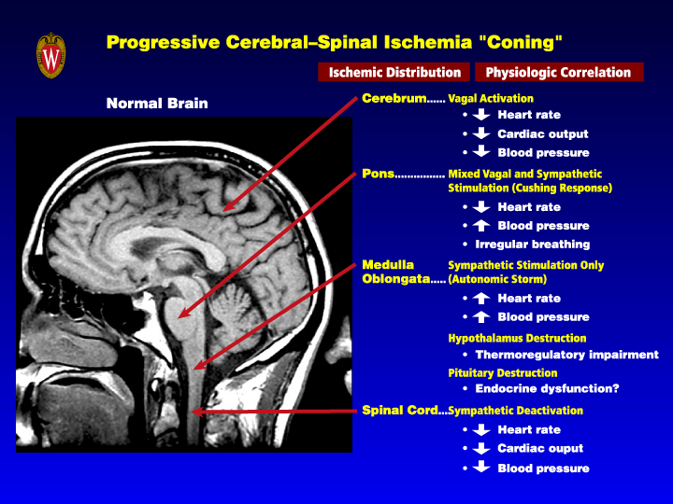

Slide 61
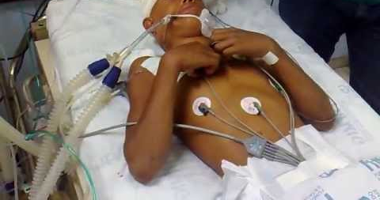
Spinal Movements and Reflexes Seen in Brain Death
Cervical Spine
  Tonic Neck flexion
  Head Turning
Upper Extremity
  Isolated Finger Jerks
  Flexion elevation of arms-hands may join
Trunk
  Opisthotonic posturing
  Sitting
  Abdominal Reflexes
Lower Extremity
  Plantar flexion of toes with percussion
  Triple flexion, Babinski ↑
Abd. Muscle
Hip Flexion
Arm/Shoulder Flexion
Shoulder
Neck

Slide 62

Approaching the family…

Slide 63
Explaining Brain Death: A Critical Feature of the Donation Process
Provide up-to-date information in small amounts
  Choose words carefully
  Explain medical equipment in simple terms/avoid medical jargon
Allow family to see clinical tests
Avoid talking to the patient once brain death has been declared as this could confuse the family
Set aside time for families to ask questions
Assess the family’s understanding
Avoid mention of donation until family understands brain death & has had time to absorb their loss

Slide 64

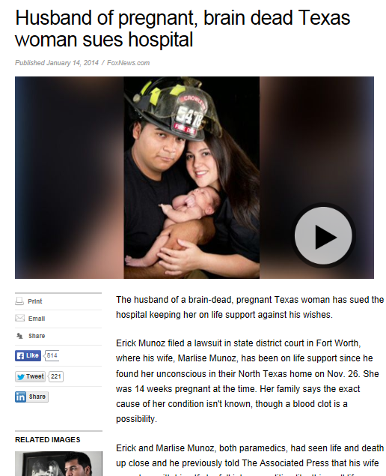
Confusion in the Media

Slide 65
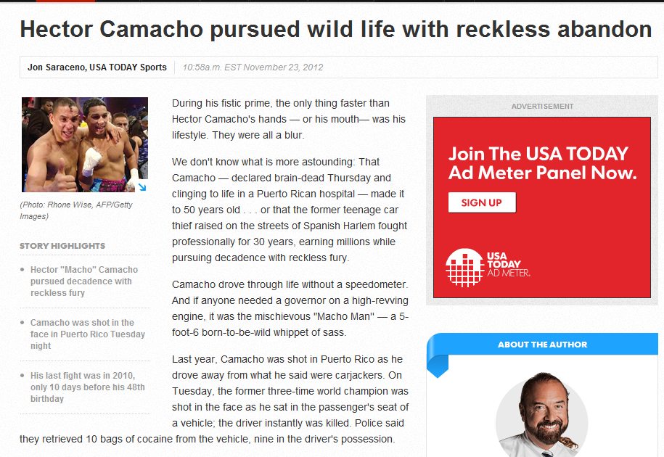




Slide 66
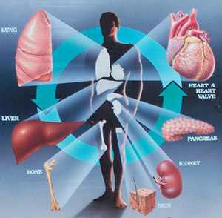
Clinical Evaluation and Management of the Potential Organ Donor
Presented by:
Marie Magyor, <Enter Credentials>,
Transplant Coordinator,
Gift of Life Donor Program

Slide 67
Questions to Run On:
How will clinical management impact the outcomes for donation and transplantation?
What interventions can we utilize to maintain patient stability?
What strategies can we implement to optimize organ function?

Slide 68

End of Life Care Considerations
Withdrawal
Vs
Deceleration
Care & Comfort
Organ
Donation
Spiritual & Cultural Needs
Notes:
Donation in an important aspect of EOL considerations and should be incorporated into discussions once family shows readiness to consider other aspects of EOL planning

Slide 69
Optimal Medical Management of the Potential Organ Donor
Continued intensity of support
Focus shift from cerebral protective strategies to optimizing donor organs for transplantation
Critical period
    Facilitates donor somatic survival
    Maintains organs to be procured best condition
    Donor management impact organ function

Slide 70
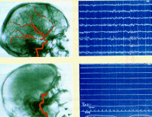
Initial Clinical Presentation of Herniation
Catecholamine Storm results in:
  - Elevated
    ICP
    HR
    BP
  - Rise in Hormones
    Epinephrine
    Norepinephrine
    Dopamine
  - ECG Changes
    Sinus tach
    Multifocal PVCs

Slide 71
Catecholamine Surge
Epinephrine
Norepinephrine
Dopamine
Cardiac Effects
Rhythm changes
50% decrease in cardiac function in the 1st 60 minutes after brain death
Vital Sign Changes
↑ICP, BP, HR
Cushing’s Response – ↑BP, ↓HR
Galinanes M, Hearse DJ (1992) Brain death induced impairment of cardiac contractile performance can be reversed by explanation and may not preclude the use of the hearts for transplantation. Circ Res 71: 1213
Notes:
If a patient is progressing to braindeath and your seeing these signs its important to closely monitor and while its important to be aggressive in managing the patient keep in mind treating the storming too aggressively may result in having to quickly switch to managing the secondary effects of herniation even more aggressively.

Slide 72
Secondary Effects of Herniation
Destruction of vasomotor center and complete vasodilation
Free water loss due to lack of ADH
Secondary diuresis and dehydration due to prior cerebral resuscitation
Loss of hypothalamic temperature regulation
Before
After
Notes:
If you see a patient go through Cushing’s Triad it is really the last effort of the brain to compensate prior to herniation.
Cushing’s Triad indicates pressure on the brain stem, rising systolic BP with widening pulse pressure, bradycardia, irregular respirations. With complete vasodilatation the patient will more than likely require pressor support (ie dopamine, neo, epi, levophed-- in that order).
Before brain death the goal of treatment is to run volume lower than normal to minimize cerebral edema. Mannitol reduces brain swelling but secondary effect of diruesis occurs.
Once brain death occurs, bolus with IV fluids. After herniation, run fluid status above normal (more in than out) to recover from fluid deficit.
Begin DDAVP or vasopressin to minimize free water loss and help prevent electrolyte (sodium) imbalances.
The body looses it’s ability to control vessel tone – thus there is global vasodiliatation (or widening of the vessels). The result is profound hypotension.
ADH (anti-diuretic hormone) if no ADH=then diabetes insipidus occurs. The kidneys loose their ability to hold onto free water (or concentrate urine). Temperature control arises from the medulla oblongata which is destroyed following brain stem herniation. This renders the patient with no ability to control body temperature. Consider BAER hugger; warmed IV solutions; etc.

Slide 73
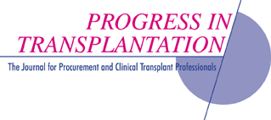
Approximately 25% of all potential brain-dead organ donors are lost due to cardiovascular collapse
Source: Phongsamran, P. Critical care pharmacy in donor management.
Progress in Transplantation. 2004; 14: 105-113.

Slide 74
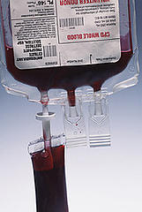
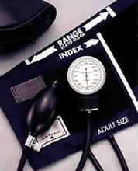
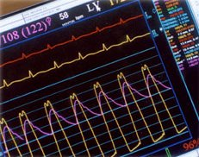
Hypotension
Cause
Hypovolemia
Loss of vasomotor tone
Actions
IV fluid replacement
Consider transfusion
Vasopressor support

Slide 75
Hypotension
Goals
Hemodynamics: CVP 2-6 Hgb > 8 Keep SBP > 100 MAP ~ 65
Interventions
Volume Replacement (SBP <100 & CVP <4) Isotonic IVF Colloids Blood Products | Blood Pressure Support (SBP <100 & CVP >4) Neo-Synephrine Dopamine Epinephrine Norepinephrine
Notes:
Isotonic fluids=0.9% NS, LR, D5W= same concentration of solutes as blood plasma, expand both intracellular fluid and extracelluar fluid spaces equally

Slide 76
Hormonal Changes
Cause
Reduced Triiodothyronine (T3) & ADH production
Actions
Replacement therapies:
  Levothyroxine replaces T3
  DDAVP/Vasopressin replaces ADH
Notes:
Posterior pituitary at the base of the brain becomes compressed and no longer produces T3 and ADH.
T3 regulates energy and controls cellular energy stores in the body.
ADH is anti-diuretic hormone responsible for regulating fluid excretion in the kidneys. If no ADH, the result is loss of the kidney’s ability to concentrate the urine and excessive fluid is excreted.
Levothyroxin (T4) is synthetic T3 – T3 is extremely expensive and T4 is comparable in terms of its efficacy.
DDAVP is a synthetic drug that mimics the action of the antidiuretic hormone. It is administered in the setting of diabetes insipidus.

Slide 77
Levothyroxine Protocol
The thyroid hormones (T3, TSH, TRH) regulate the rate and the efficiency of energy utilization within the cells.
Research has concluded that serum thyroid hormone levels drop sharply during brain stem herniation and become undetectable within hours of brain death.
The end result: acidosis, hemodynamic instability, deterioration
of organ function and a diffuse “metabolic injury” due to the lack of functioning cellular mitochondria.
The goal of thyroxine replacement is to enhance the hemodynamic and metabolic stability of the organ donor.
Notes:
Posterior pituitary at the base of the brain becomes compressed and no longer produces T3 and ADH.
T3 regulates energy and controls cellular energy stores in the body.
ADH is anti-diuretic hormone responsible for regulating fluid excretion in the kidneys. If no ADH, the result is loss of the kidney’s ability to concentrate the urine and excessive fluid is excreted.
Levothyroxin (T4) is synthetic T3 – T3 is extremely expensive and T4 is comparable in terms of its efficacy.
DDAVP is a synthetic drug that mimics the action of the antidiuretic hormone. It is administered in the setting of diabetes insipidus.

Slide 78
Electrolyte Imbalance
GOALS
GOALS
Serum Sodium Normal: < 150 mEq | Serum Potassium Normal > 3.5mEq/L
INTERVENTIONS
Serum Sodium Change IVF/0.225% NSS Monitor central pressures Consider DDAVP/Vasopressin Correct Glucose | Serum Potassium Replace via central line Monitor serum potassium
Notes:
milliequivalents per liter -(mEq/L)

Slide 79
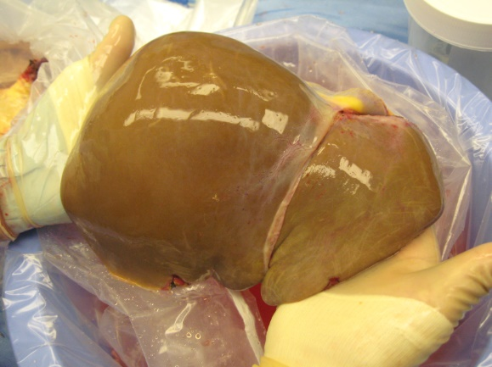
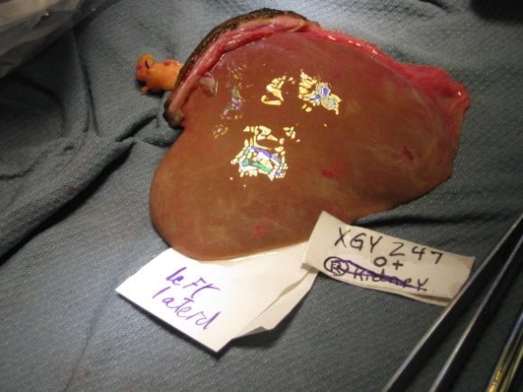
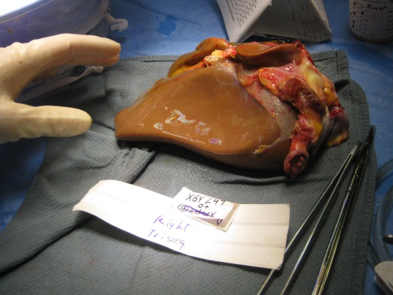
Hepatic Considerations
Admission Course – trauma, downtime, resuscitation
Diagnostics – liver panel, coags, CBC
Goals – Downward trend of LFTs, Sodium <155
Notes:
milliequivalents per liter -(mEq/L)

Slide 80
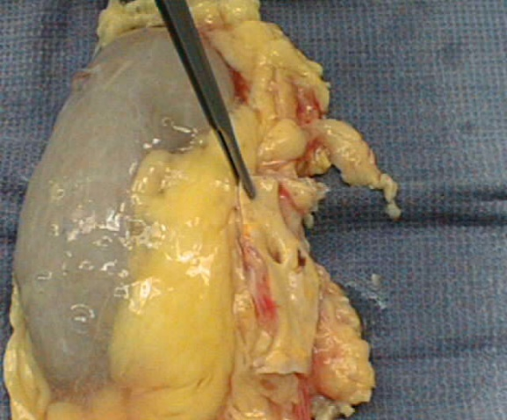
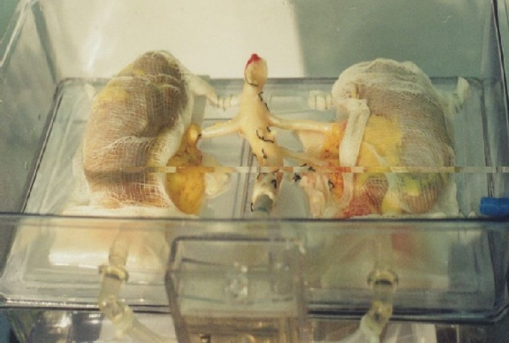
Renal Components
Admission Course – trauma, downtime, medical history
Hospital Course – Hypotension, Pressors
Diagnostics – BUN/Cr, lytes, UA, hourly outputs
Goals – u.o. of 1-3cc/kg, IVF to match u.o., +50cc

Slide 81


Pancreas
Diagnostics
  Amylase, Lipase, Glucose
Hospital Course
  IVF, Insulin
Recipient Care
“Pancreas Cocktail”
Transplant Options Whole, Islets

Slide 82
Impaired Gas Exchange
What are some donor management strategies we might suggest
to get from the x-ray on the left to the x-ray on the right?
Notes:
We talked about chest x-rays and here is a case study to review. We started with a donor in neurogenic (non cardiac) pulmonary edema and after 7 hours of donor management the heart and lungs were able to be transplanted.
Note: this slide can only be used for HD training purposes and not national conventions because it is not our case study.

Slide 83

Impaired Gas Exchange Management
GOALS
  Keep O₂ Saturation > 95%
  FiO₂ to maintain Pa O₂ 80-100 mmHg
    - On lowest FiO₂
  O₂ challenge: Pa O₂ > 300 mmHg
    - On 100%, PEEP +5 cmH2O
    - P/F ratio > 300
  Maintain pH between 7.30 – 7.45

Slide 84


Pulmonary Management
Aggressive pulmonary toileting
  - Bronchodilator therapy
  - CPT
  - Head of bed up 30º
Aggressive ventilator management
- TV 6-10cc/kg IBW, Increase resting PEEP
Frequent ABG’s; O₂ challenge testing
ET tube maintenance
- Hyperinflation of the ETT cuff
Therapeutic or diagnostic bronchoscopy, as needed
Notes:
HFCWO – High frequency chest wall occillation – Therapy vest – being considered

Slide 85

Impaired Gas Exchange
Recruiting Pulmonary Alveoli…
“Sustained Inflation Maneuver” - High levels of PEEP for a brief period of time, followed by a precipitous wean in PEEP while monitoring hemodynamics during the recruitment maneuver.
PEEP 30 x30s, 20 x20min, 10x10min, 5 x30min-> then repeat ABG
Other options: PCV, Bi-Level/APRV

Slide 86

Recruitment
Maneuver

Slide 87

A-assess
A-adjust
R-recruit
P-protect
It’s All About….
Reading The Mail

Slide 88

One Size Does Not Fit All
Slim Fit - AC mode without PEEP recruitment.
Relaxed Fit - AC mode, diuresing, PEEP recruitment.
Boot Cut - APRV because nothing else is working.

Slide 89

Cardiac Evaluation
Diagnostic Data
CPK Trends
CPK-MB %
Troponin
Non-invasive CO monitoring
Cardiac Catheterization
GOALS
EF > 45% • CO 4-8 lpm
CI 2.5-5 • UO 1-3 cc/kg/hr

Slide 90


17 Year Old Male: Anoxic Injury
What a Difference Time Can Make
HR 80, SBP 90, CVP 6
Dopamine 9.6 mcg
EF 46%
HR 85, SBP 102, CVP 9
Dopamine 8
EF 71%
8 hours
Courtesy: Wayne Babcock, CTDN

Slide 91

Aggressive Care Plan
From the moment brain death is declared, the emphasis shifts from saving the patient’s life, to maintaining the family’s option to donate by optimizing end-organ function for possible transplantation.
Oxygenation
Impaired Gas Exchange
Acid Base
Abnormalities
Hypotension
Excessive Urinary Output
DIC
Hormonal Changes
Oliguria
Electrolyte Imbalances
Hypothermia
Notes:
In order to preserve all donation options for the family the patient’s hemodynamic status needs to be maintained. These donor management essentials will optimize the donor gifts for transplantation.

Slide 92


Slide 93
Compassionate End of Life Care and the Opportunity for Organ Donation is the Family’s Right……
End of Life
Care
Organ
Donation
……and the Responsibility of all Members of the Healthcare Team
Notes:
Providing patients and families with compassionate end-of-life care and empowering them to save lives through organ donation can allow something good to come from an otherwise tragic event. The close collaboration of our two teams in support of families making end of life decisions is key to ensuring that they have an opportunity to make a decision about donation.
We value your expertise in providing end of life care as well as the relationship you’ve cultivated with the family
As you know, our expertise is in the area of organ donation. Having both teams present to support families at this time provides them with a supportive environment where all of their questions can be addressed

Slide 94
Best-Demonstrated Practices
Organ Donation Process
Timely patient referral of all vent dependent patients with non-recoverable neurological injury/illness to Gift of Life.
Gift of Life on-site at hospital to perform patient evaluation prior to any mention of donation.
Appropriately timed request . Family verbalizes understanding of brain death as death. - decoupling - no early mention of donation to family.
Collaborative family request with hospital staff and OPO staff.
Source: The Partnership for Organ Donation
Notes:
Did I mention that our SOPs are based on the findings of the partnership research? I’d like to share w/you our strategy for using these findings as a basis for standardizing our messages. A timely referral is any pt who is neuro devastated and ventilator-dependent. We advocate that the call come to us at the time a 1st neuro exam is c/w brain death. These are not pts who have already been pronounced brain dead. We will respond with an on-site evaluation 85-90% of referrals in order to further assess the patient for donation options. We believe in decoupling, or that the family clearly understands brain death before any mention of organ donation. And finally, from our experience, the best outcomes occur when OPO and hospital staff collaboratively approach the family with donation options.

Slide 95

Questions & Comments!

