Slide 1
Record your Attendance by SMS Text
To enable the SMS texting feature, login to your account @ http://cce.upmc.com .
Click the “Mobile” tab to add your ten-digit mobile phone.
Receive credit instantly by texting the following code:
KAGRUZ
to
412-312-4424
Code MUST be texted by today at 11:59pm.

Slide 2
Line Locks: too much of a good thing? Re-evaluating therapies for CVA device patency in a home infusion setting
Claire Meredith, PharmD

Slide 3
Disclosures
No members of the planning committee, speakers, presenters, authors, content reviewers and/or anyone else in a position to control the content of this education activity have relevant financial relationships with any entity producing, marketing, re-selling, or distributing health care goods or services, used on, or consumed by, patients to disclose.

Slide 4
Disclaimer
The information presented at this Center for Continuing Education in Health Sciences program represents the views and opinions of the individual presenter and does not constitute the opinion or endorsement of, or promotion by, the UPMC Center for Continuing Education in the Health Sciences, UPMC/University of Pittsburgh Medical Center or Affiliates and University of Pittsburgh School of Medicine. Reasonable efforts have been taken intending for educational subject matter to be presented in a balanced, unbiased fashion and in compliance with regulatory requirements. However, each program attendee must always use his/her own personal and professional judgement when considering further application of this information, particularly as it may relate to patient diagnostic or treatment decisions including, without limitation, FDA-approved uses and any off-label uses.

Slide 5
Objectives
Review the types of central venous catheters common to a home infusion setting
01
Describe the current roles of therapies to maintain line patency
02
Discuss emerging literature influencing protocols for central line maintenance in a home infusion setting
03

Slide 6
Table of Contents
1: Introduction to Line Types
2: Line Flushing
3: Line Locking
4: Current Flushing/Locking Protocol at this Institution
5: Line Salvage – Infection
6: Line Salvage – Thrombosis

Slide 7
Abbreviations
CVC – Central venous catheter
HITT – Heparin-induced thrombocytopenia and thrombosis
HAT – Heparin-associated thrombocytopenia
CLABSI – Central line-associated bloodstream infections
CVADs – Central venous access devices
ALT – Antibiotic lock therapy
PIV – Peripheral intravenous
TPN – Total parenteral nutrition
PICC – Peripherally inserted central catheter
CFUs – Colony forming units
RCT – Randomized control trial
PASV – Pressure-activated safety valve
SASH – Saline, administration, saline, heparin
SAS – Saline, administration, saline
CRI – Catheter related infection
t-PA – Tissue plasminogen activator
EDTA – Ethylenediaminetetraacetic acid

Slide 8
1: Introduction to Line Types

Slide 9
Line Types
Peripheral
Veins accessed in the hands, arms, or feet
Midline
Not recommended for use of vesicants or highly irritating medications
Central Catheters
Long-term therapy duration
Inserted peripherally or centrally
Increased complication rates of infiltration and phlebitis
Require frequent replacement; therefore, not common outpatient
Inserted into the antecubital (upper arm) vein
Typically, 20cm long (do not reach central veins)
Terminate within central veins of the thorax
Recommended for long durations or large quantities of IV fluids, medications, or blood products
May be used when peripheral venous access is limited
Short-term IV therapy (72-96 hours)
Therapy duration of 1-4 weeks
Common to a home infusion setting

Slide 10
Key Concerns with Peripheral and Midlines
Vesicants/Irritants:
Infiltration and extravasation are difficult to monitor for/treat in the outpatient setting
Ex. Chemotherapy, TPN >900 mOsm, antifungals, antibiotics (vancomycin, penicillins)
Duration of Therapy:
Home care patient commonly receive long-term therapies
Must account for therapeutic extensions
Line Salvage:
Cathflo® (alteplase) must not be used in peripheral lines and has minimal evidence supporting use in midlines

Slide 11
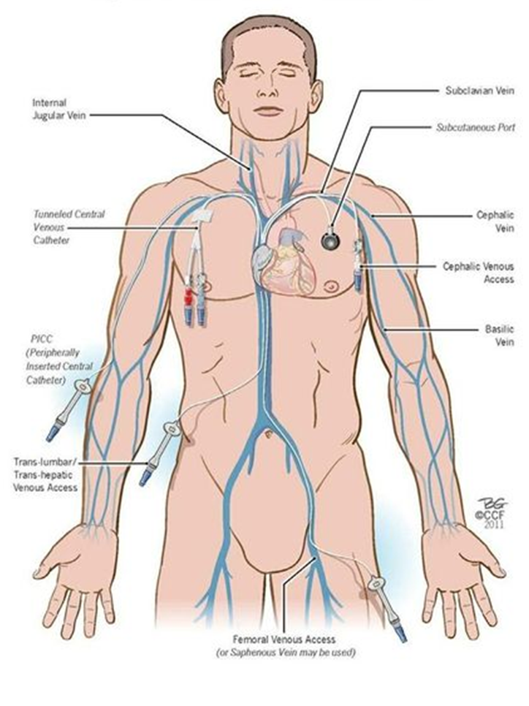
Most Common Central Venous Access Devices (CVADs)
Non-tunneled catheters
Skin-tunneled catheters
Peripherally inserted central catheters (PICCs)
Implantable ports

Slide 12
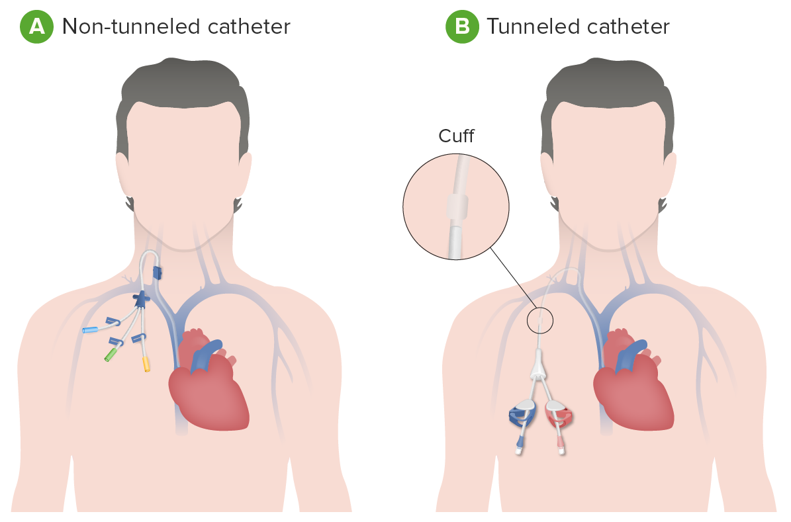
Non-Tunneled vs. Skin-Tunneled Catheters
Notes:
Discuss how skin-tunneled are surgically implanted

Slide 13
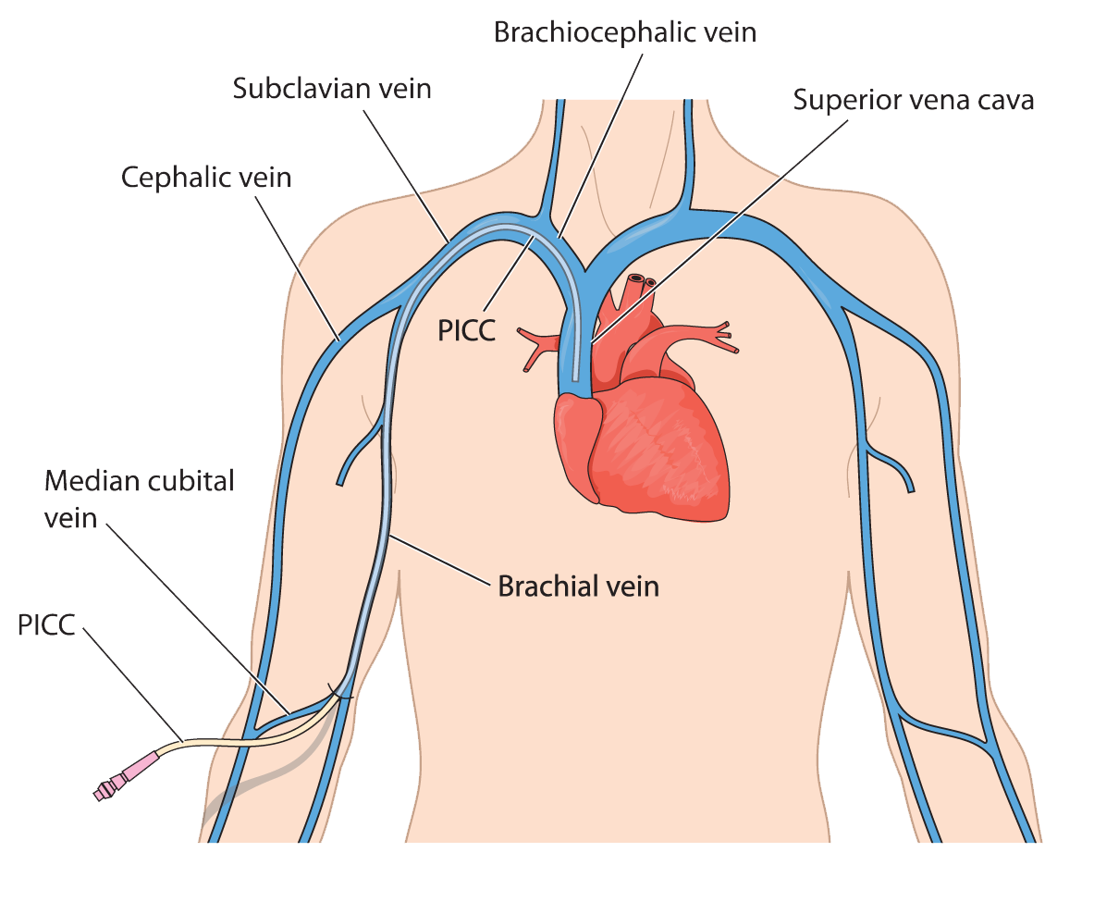
Peripherally Inserted Central Catheters (PICCs)
Location
Inserted in the basilic, brachial, or cephalic veins
Common Indications
Parenteral nutrition, antibiotic therapy, analgesics, and chronic blood transfusions
Therapy Duration
Several weeks to 6 months
Notes:
Make note that just because it says peripheral that it is a central line (it matters where the line ends)

Slide 14
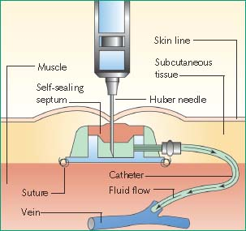
Implantable Ports
Location: Chest wall or upper arm
enters the superior vena cava, subclavian or internal jugular vein
Duration: Months to years
Indications: Long-term intermittent access – chemotherapy, infusion of blood products, etc.
Accessing Implantable Ports: Non-coring Huber needles must be used to puncture the septum
Notes:
Possibly located in the thigh, abdomen, ribs
Discuss why non-coring huber needles

Slide 15
Audience Question #1
Which of the following are central venous access devices (CVADs)?
I. Implantable port
II. PASV PICC
III. Skin-tunneled catheter
IV. Midline catheter
Answer choices:
I, III, and IV
I only
II and III
I, II, and III

Slide 16
Audience Question #1
Which of the following are central venous access devices (CVADs)?
I. Implantable port
II. PASV PICC
III. Skin-tunneled catheter
IV. Midline catheter
Answer choices:
I, III, and IV
I only
II and III
I, II, and III

Slide 17
2: Line Flushing

Slide 18
Line Flushing
Purpose:
Assess/maintain patency and prevent precipitation by clearing infused therapies and blood from the catheter lumen(s)
Formulations/delivery systems:
Preservative-free 0.9% sodium chloride solution
Commercially available prefilled syringes preferred
When should it occur?:
Before/after each infusion
Before/after blood draws
Notes:
INS publishes these standards ~every 5 years
It is not recommended for patients to test for patency at each administration
Prefilled syringes associated with fewer CLABSI
D5W is used in situations like amphotericin B

Slide 19
Flush Characteristics
Volume:
Volume of the catheter system included add-on devices
Alternative solutions:
Bacteriostatic 0.9% sodium chloride must be limited to 30 mL daily
D5W must be followed by a 0.9% NaCl flush in cases of incompatibility
Syringe size:
Smaller syringes generate a higher injection pressure
Syringes ≥10 mL must be used on CVADs
Minimum volume of flush administered must be equal to twice the internal volume of the catheter system
Notes:
Described add-on devices (extension sets/tubing)
Bacteriostatic NS has to be limited due to the benzyl alcohol content
D5W must not be allowed to dwell because of the potential for biofilm growth
Explain why a higher injection pressure is dangerous

Slide 20
Techniques for Flushing CVA Devices
Pulsatile flushing technique:
Brief boluses of ~1 mL, followed by a short pause
More effective at removing/preventing residues, medications, and fibrin lining the walls of the catheter
Patency assessments:
Patients should assess patency at each flush administration (e.g., sluggishness, resistance)
Home health nurses should assess for blood returns via line aspiration
Patients independently maintaining long-term therapies (e.g., TPN) may assess blood returns
Positive pressure:
Maintaining pressure on the syringe plunger when detaching from the injection cap prevents blood from backing up in the line
Notes:
Pulsatile flushing was originally performed due to hypotheses of fluid dynamics; talk about turbulence

Slide 21
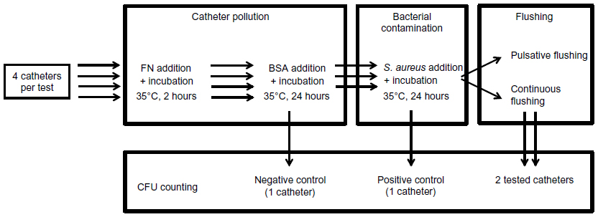
Pulsatile Flushing Technique
Catheters were contaminated with a Staphylococcus aureus broth
Catheters received:
10 successive 1 mL boluses of normal saline
A single, continuous 10 mL bolus of normal saline
No flush
Conclusions: Pulsatile flushing displayed a statistically significant reduction in the number of CFU/mL
Methods:
Ferroni et al.:
Purpose: Aimed to prove the efficacy of pulsatile flushing to prevent bacterial colonization of vascular access devices
Notes:
Staph aureus and epidermidis are most common in line infections

Slide 22
3: Line Locking

Slide 23
Line Locking
This term is often used interchangeably with flushing
Key differences are present
Purpose: Maintain line patency in-between infusions and/or reduce the risk of central line-associated blood stream infections (CLABSI)
Most common causes of line occlusion:
● Clot formation
● Drug/mineral precipitates
● Mechanical causes
The optimal locking solution:
Prevents clot formation throughout the catheter and at the tip of the catheter
Prevents deposition of microorganisms and biofilm formation
Optimal dwelling time: Dependent on the type of catheter
Ex. Unused PICC lumens (at least every 24 hours) vs. ports (weekly to monthly)

Slide 24
Line Locking with Heparin
Volume:
Lock solution volume should equal the internal volume of the CVAD and add-ons, plus an additional 20%
Instillation technique:
Slower instillation may improve retention
Barbour et al. suggests that pulsatile administration may lead to losses of heparin due to momentum
Additional research is needed to support this technique
Locking solution:
Preservative-free 0.9% sodium chloride or heparin 10 units/mL
Dependent on manufacturer directions (e.g., PASV PICC)
There is insufficient evidence to recommend one lock solution over another

Slide 25
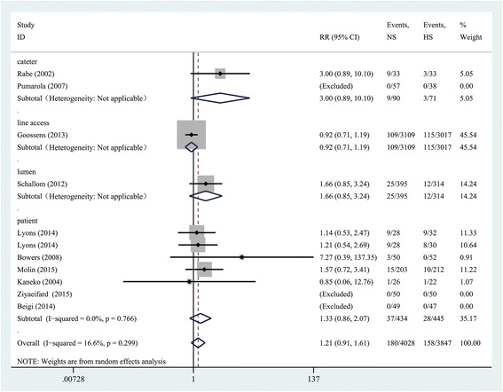
Normal Saline versus Heparin Locks
Zhong L, et al.: Meta-analysis of randomized controlled trials (RCTs) comparing the two locking solutions for patency of CVCs in adult patients
Normal saline flushes compared to various concentrations of heparin
Primary outcomes:
Catheter occlusion
Secondary outcomes:
Catheter manipulation required to maintain patency
Heparin-induced thrombocytopenia and thrombosis (HITT)
Hemorrhage
Central venous thrombosis
CLABSI
Results:
NS was equal in efficacy to using HS solution in long-term CVCs (n = 6589; RR, 0.97; 95% CI = 0.76 to 1.23; P = 0.796)
NS is less effective than HS solution in short-term CVCs (n = 1286; RR, 1.52; 95% CI = 1.02 to 2.27; P = 0.041)
Notes:
Interpret statistics, discuss how to read a forest plot

Slide 26
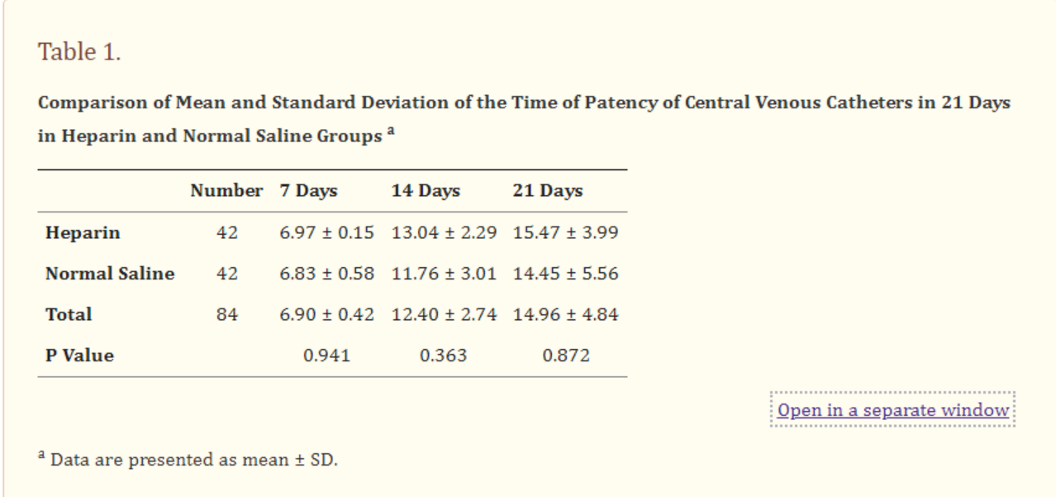
Normal Saline versus Heparin Locks - Continued
Heudari Gorji, et al:
Methods:
Patients were divided into 2 groups and administered either:
3 mLs of heparin 10 units/mL
10 mLs of a normal saline
Results:
There was no statistical difference between using heparin and normal saline in maintaining 21-day catheter patency.
Double-blind randomized trial
OR
Primary outcomes:
Incidence rates of catheter occlusion over the course of 21 days

Slide 27
What if Heparin is not needed/contraindicated?
Valved catheters
Pressure-activated safety valve (PASV) PICC
Groshong ®
Heparin-induced thrombocytopenia and thrombosis (HITT)
Discontinue locking solutions containing heparin
Initiate locking with normal saline flushes (or antibiotic lock solutions that do not contain heparin)
Notes:
Are valved systems cost-prohibitive?

Slide 28
Valved Catheters – PASV PICC
Valve placement: Proximal end of the catheter, at the end of the exposed lumen
Operation:
When exposed to positive pressure (injection), the valve opens, allowing solutions to flow through the catheter
When exposed to negative pressure (aspiration), the valve opens to allow blood influx through the catheter

Slide 29
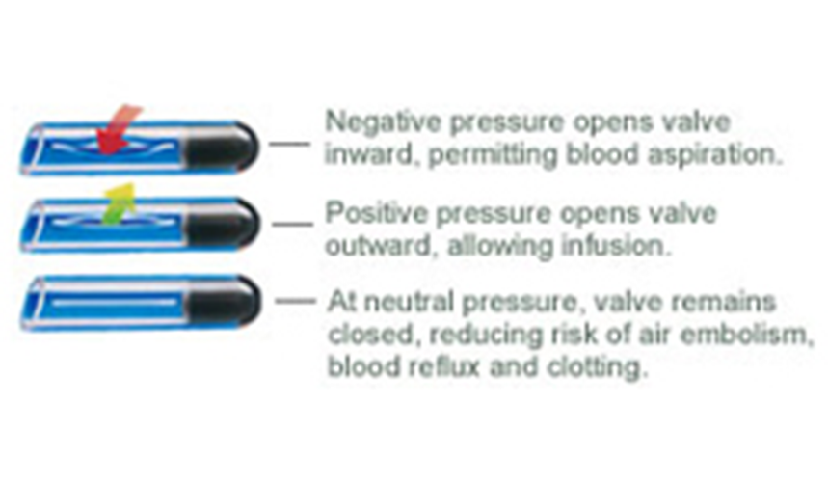
Valved Catheters - Groshong®
Valve placement: Distal end of the catheter, within the patient’s SVC
Operation:
When exposed to positive pressure (injection), the valve opens, allowing solutions to flow through the catheter
When exposed to negative pressure (aspiration), the valve opens to allow blood influx through the catheter
Negative pressure opens valve
inward, permitting blood aspiration
Positive pressure opens valve
outward, allowing infusion.
At neutral pressure, valve remains
closed, reducing risk of aim embolism,
blood reflux and clotting.
Notes:
Add text box for image

Slide 30
The ‘ELeCTRiC’ Study
Purpose: Compare occlusion rates of PICCs using valve technology to open ended PICCs
Methods: Patients initiated on dual lumen PICCs in the ICU were randomized to either:
Open ended non-valved (Cook)
Groshong® catheter
PASV catheter
Results (rate ratios of occlusions):
Cook catheter relative to Groshong® = 1.32 (95% CI 0.77 to 2.28)
PASV catheter relative to Cook = 1.26 (95% CI 0.74 to 2.15)
PASV catheter relative to Groshong® = 1.67 (95% CI 0.96 to 2.90)
Conclusion: Valved PICCs do not appear to influence PICC occlusion rates
Notes:
Discuss weaknesses of this study; flushing protocols for each catheter was not indicated, the authors acknowledged that additional studies are needed

Slide 31
HITT Secondary to Heparin Locks
Type I HITT (aka heparin-associated thrombocytopenia):
Non-immune mediated, mild reaction
May occur as early as the first day of therapy
Type II HITT:
Immune, antibody-mediated, serious reaction
Usually occurs after 5 to 14 days of therapy
Case report: Refaai et al.
Delayed-onset heparin-induced thrombocytopenia as a consequence of heparin locks
Patient had a PICC line, administered 100 unit/mL locks
Symptoms appeared at day 14 of therapy
Considerations relative to home infusion:
Most heparin locks between 10-100 units/mL are not aspirated
Patient monitoring is reduced relative to inpatient settings

Slide 32
Additional Heparin Concerns
Mishra S, Horswill AR: Extracellular DNA in binding to cell surface-localized proteins and promoting staphylococcus aureus biofilm formation
Sodium heparin solution increases biofilm cell retention but does not initiate attachment, in vitro
Stimulation occurs via a novel pathway, possible facilitation of cell-to-cell adhesion
Green et al.: Heparin-binding motifs and biofilm formation by candida albicans
Sodium heparin solution of 10 units/mL displayed biofilm formation in CVCs
A postulated mechanism is facilitation of cell-to-cell-adhesion

Slide 33
Overall Considerations for Heparin Locks
Determine if heparin is needed
1
Understand contraindications to heparin therapy
2
Examine for a past history of line infections
3
Recommend alternative strategies when needed
4

Slide 34
Audience Question #2
Which of the following is not a growing concern for the use of heparin locks in the home infusion setting?
Additional patient education is needed
Interference with CMP/BMP laboratory results
Increased likelihood of biofilm formation
Additional risk of bleeding events

Slide 35
Audience Question #2
Which of the following is not a growing concern for the use of heparin locks in the home infusion setting?
Additional patient education is needed
Interference with CMP/BMP laboratory results
Increased likelihood of biofilm formation
Additional risk of bleeding events

Slide 36
4: Current Flushing/Locking Protocol at this Institution

Slide 37
Infusion Nurses Society (INS)
Infusion Therapy Standards of Practice:
Evidence-based standards published by INS
Widely cited and used to develop clinical protocols
Intended for use in any setting where infusion occurs
Standards of Practice Committee:
Group of international nurses with expertise in vascular access device (VAD) planning, placement, and management
Reviewed by up more than 200 international, interdisciplinary professionals
Provides expertise in the following areas:
Infusion therapy practice
Patient and clinician safety
Infection prevention and control
Infusion equipment
Vascular access device selection and placement
Vascular access device management
Vascular access device complications
Other infusion devices
Infusion therapies

Slide 38
SASH Method
**REMINDER**
Recommended for patients without:
Valved catheters
AND
Contraindications to heparin (i.e., HITT)
AND/OR
History of line infections despite adequate aseptic technique

Slide 39
SAS Method
**REMINDER**
Recommended for patients with:
Valved catheters (e.g., PASV PICC, Groshong®)
AND/OR
Contraindications to heparin
AND/OR
History of recurrent line infections

Slide 40
5: Line Salvage - Infection

Slide 41
Etiology of line infections
Possible sources:
Migration of microbes down the catheter tract during catheter insertion/dwell time
Catheter hub/lumen manipulation during routine use
Endogenous microorganisms in the bloodstream
Contaminated infused solutions
Risk factors: Combination of host and catheter factors
Chronic illness
Duration of catheter
Type of catheter (e.g., non-tunneled)
Previous bloodstream infections
Type of therapy (e.g., TPN)
Immune deficiency
Catheter-site care
Location of placement
Conditions of catheter insertion
Notes:
Explain how the lipid and dextrose content of TPN specifically increased risk (also TPN is associated with longer duration, especially outpatient)
While it’s not frequently mentioned, note that understanding of the patient is another outpt risk factor (need effective teaches)

Slide 42
Who is a Candidate for Salvage?
Type of access:
Ford, et al. - Retrospective observational study of ambulatory patients
Patients with ports have increased odds of salvage versus PICCs (aOR 3.24 [95% CI 1.15–9.17])
Single-lumen CVCs have an increased odds of salvage versus multilumen CVCs (aOR 2.00 [95% CI 1.00–3.99])
Patients without the following complications:
Tunnel infection
Port abscess
Septic thrombosis
Endocarditis
Osteomyelitis
Notes:
Explain why this makes sense

Slide 43
Outpatient Catheter Salvage
Caroff, et al.: Retrospective study of home infusion patients with CLABSI
Population:
263 home infusion patients
Central venous port and cancer diagnosis
34 patients treated for line salvage
Results:
Rate of CLABSI relapse – 12.9% in salvage patients and 7.5% in control patients (p=0.36)
Relapse did not occur for patients with relapse secondary to S. aureus

Slide 44
Organisms and Treatment
Most common organisms that cause CLABSI:
Coagulase-negative Staphylococci
S. aureus
Enterococci
Candida species
Klebsiella species
Escherichia coli
Enterobacter species
Pseudomonas species
Treatment:
Attempt catheter salvage in patient with an uncomplicated CLABSI in a long-term CVAD if:
The CVAD is colonized with coagulase-negative Staphylococcus or Enterococcus
Combined use of systemic antibiotics and antibiotic locks

Slide 45
Antibiotic Lock Therapy (ALT)
Ideal characteristics:
Appropriate spectrum of activity
Ability to penetrate/disrupt a biofilm (antibiotic concentration are generally 100-1,000 times higher than standard concentrations)
Compatibility with anticoagulants
Prolonged stability
Low risk of toxicity and adverse events
Low potential for resistance
Cost-effective

Slide 46
Antibiotic Lock Therapy (ALT) - Continued
Most common to home infusion:
Gentamicin
Vancomycin
Duration of therapy:
INS guidelines: Abbreviated courses of 72 hours may be appropriate
Infectious Diseases Society of America (IDSA): Comparative clinical data for 10-14 days of therapy
Prophylaxis dependent on indication (TPN, history of line infections, etc.)

Slide 47
Duration of Therapy – Antibiotic Locks
Historically, duration of ALT falls within 10-14 for treatment of a line infection
RCTs in this area are lacking
Tendas, et al.: Limited trial examining the success rate of infection resolution from a 72-hour course of ALT for 26 infectious episodes
Design: Patients were treated with antibiotics according to the type of infection, and ALT was retained for 12-hour time periods
Results:
Resolution of infection in 81% of catheter related infections (CRI)
Reinfection rates of successful catheter treatment were 54% at 100 days from ALT and 66% at 180 from ALT
Conclusions:
Shorter durations of therapy may be adequate to treat line infections, while reducing the risks of complications that may result from an extended course
Comparative trials are needed to assess efficacy, safety, and cost considerations of ALT
Notes:
Authors indicated that this study was not adequately powered or controlled, rely on clinical significance

Slide 48
ALT Technique
Instill the antibiotic lock after the line is flushed with normal saline
Allow the antibiotic lock to dwell until next infusion or dwell time is completed
Using a 10 mL syringe, aspirate the volume of the antibiotic lock instilled, plus an additional 1-2 mL
Flush the line in a pulsatile fashion with normal saline
Instill the antibiotic lock
Administer infusion therapy and flush the line with normal saline

Slide 49
Audience Question #3
Which patient is the best candidate for ALT?
A patient with a Groshong® with a biofilm containing Candida species
An endocarditis patient with a double lumen PICC colonized with coagulase-negative Staphylococci
A patient receiving 5-fluorouracil via an implanted port with vancomycin susceptible Enterococcus
A patient receiving TPN via an implanted port with new signs of abscess near the port site

Slide 50
Audience Question #3
Which patient is the best candidate for ALT?
A patient with a Groshong® with a biofilm containing Candida species
An endocarditis patient with a double lumen PICC colonized with coagulase-negative Staphylococci
A patient receiving 5-fluorouracil via an implanted port with vancomycin susceptible Enterococcus
A patient receiving TPN via an implanted port with new signs of abscess near the port site

Slide 51
Other Locking Therapies
Ethylenediaminetetraacetic acid (EDTA)
Taurolidine
Citrate
TauroLock™
Ethanol

Slide 52
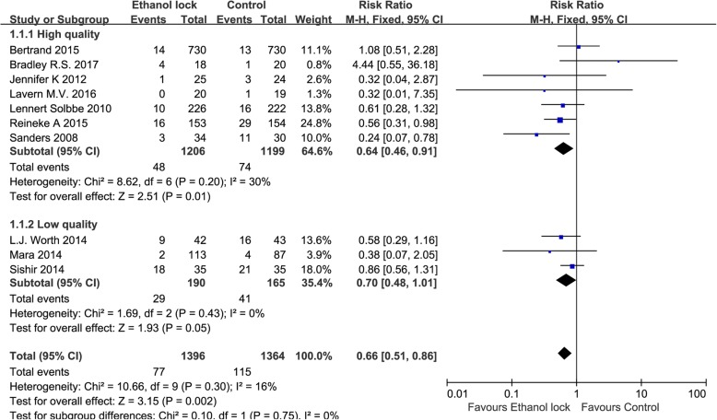
Alternative Options to ALT: Ethanol Locks
Used to reduce biofilm formation and antimicrobial growth
Zhang, et al.: Meta-analysis of RCTs analyzing the incidence and treatment CLABSI
Inclusion criteria:
Indwelling CVC
The intervention group received ethanol locks, and the control group received heparin/NaCl locks
Studies were RCTs
Pooled results:
Ethanol locks significantly decreased the incidence of CLABSI (RR 0.66, 95% CI 0.51–0.86).
Ethanol locks significantly prevent CLABSI (RR 0.61, 95% CI 0.42–0.89).

Slide 53
Considerations for Ethanol Locks
Current FDA-approved formulation is cost-prohibitive
Alternate sourcing poses operational changes
Coverage for CLABSI prophylaxis not widely recognized by insurance

Slide 54
EDTA Locks
Current role:
Used as a lock solution in hemodialysis catheters
No current evidence for use with patients receiving parenteral nutrition at home
Data for use: Multicenter RCT – American Journal Kidney Disease
Incidence of catheter colonization in EDTA group versus heparin group was significantly reduced (incidence rate ratio [IRR], 0.13; 95% CI, 0.003-0.94; P=0.02)
Incidence of CLABSI in EDTA group versus heparin group was not significantly different (IRR, 0.40; 95% CI, 0.08-2.09; P=0.3)
Overall considerations:
EDTA has antimicrobial and anticoagulant activities
Additional research is needed for the home infusion setting

Slide 55
Sodium Citrate Locks
Current role:
Used in combination with other microbial agents for prevention of thrombosis and CLABSI
Data for use: Meta-analysis - American Journal of Kidney Disease
Antimicrobial locks containing citrate were superior to heparin locks alone at preventing catheter-related infections
Sodium citrate alone failed to show superiority to heparin at preventing catheter complications
Overall considerations:
Limited evidence for use in CVADs
Although there is some evidence of antimicrobial effects at concentrations of 30%, concentrations are generally limited to 4%

Slide 56
TauroLock™
Purpose:
Bactericidal and fungicidal lock solution that prevents CLABSI and occlusion
Indication:
Approved for use in all CVCs (not approved in the U.S.)
Components:
Taurolidine, heparin, citrate, and urokinase
Taurolidine – bactericidal agent with activity against, gram positive, gram negative, and some fungal organisms
Data for taurolidine use: Double-blind RCT – American Journal of Clinical Nutrition
Patients were randomized to locking solutions containing taurolidine 1.35%, sodium-citrate 4%, or heparin 100 units/mL
Significant reduction in CLABSIs (p = 0.0052) in patients receiving taurolidine compared to heparin, without a difference in occurrence of mechanical complications
Future considerations:
Developing option for patients receiving home parenteral nutrition and oncology therapies
Multiple RCTs underway investigating safety and efficacy outcomes
Notes:
Urokinase is an enzyme used to dissolve blood clots

Slide 57
Line Salvage - Thrombosis

Slide 58
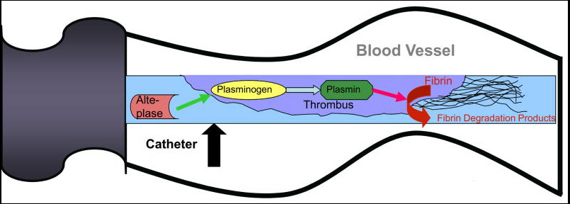
Cathflo®Activase® (Alteplase)
Only thrombolytic agent available to restore catheter function
Tissue plasminogen activator (t-PA)
Enzyme that binds to fibrin in a thrombus
Converts plasminogen to plasmin → local fibrinolysis
Indications
Restoration of function to CVADs
Concerns of use
Cost – Many insurances do not cover the cost (~$100/mg out of pocket)
Safety – This medication has not been adequately studied in patients with increased bleeding risk
Notes:
Has been used off-label in midlines, though not recommended

Slide 59
Current Cathflo® Protocol
Instill Cathflo®
Dwell for 30 minutes
Check for blood return
If needed, dwell for additional 90 minutes
Check blood return

Slide 60
Summary
Central lines common to a home infusion setting due to length of treatment (weeks to months)
Type of line chosen depends on patient factors, including the type of therapy
Most common home infusion CVADs: PICCs, implanted ports
Line flushing is a vital part of catheter maintenance
Pulsatile technique with 0.9% sodium chloride is preferred
Line locking ensures line patency and prevention of complications
Choice of lock solution depends on patient-specific factors
Institutional protocols are developed based on consensus group standards (e.g., INS)
Each institution is responsible for tailoring infusion protocols to ensure patient safety

Slide 61
References
Cheung E, et al. Venous access: a practical review for 2009. Can Fam Physician. 2009;55(5):494-496.
Hadaway L, Mermel LA. Midline Catheters: Could They Replace a Central Vascular Access Device?. J Infus Nurs. 2022;45(4):220-224. doi:10.1097/NAN.0000000000000471
Rizk E, et al. Alteplase for the treatment of midline catheter occlusions: a retrospective, single-cohort descriptive study. Br J Nurs. 2022;31(14):S6-S16. doi:10.12968/bjon.2022.31.14.S6
Gorski LA, Hadaway L, Hagle ME, et al. Infusion Therapy Standards of Practice, 8th Edition. J Infus Nurs. 2021;44(1S Suppl 1):S1-S224. doi:10.1097/NAN.0000000000000396
Gorski LA. The 2016 Infusion Therapy Standards of Practice. Home Healthc Now. 2017;35(1):10-18. doi:10.1097/NHH.0000000000000481
Boord C. Pulsatile Flushing: A Review of the Literature. J Infus Nurs. 2019;42(1):37-43. doi:10.1097/NAN.0000000000000311
Ferroni A, Gaudin F, Guiffant G, et al. Pulsative flushing as a strategy to prevent bacterial colonization of vascular access devices. Med Devices (Auckl). 2014;7:379‐383. doi:10.2147/MDER.S71217
McGah PM, Gow KW, Aliseda A. Leakage of central venous catheter locking fluid by hemodynamic transport. ASAIO J. 2014;60(4):443-451. doi:10.1097/MAT.0000000000000089
Heidari Gorji MA, et al. Comparison of the effects of heparin and 0.9% sodium chloride solutions in maintenance of patency of central venous catheters. Anesth Pain Med. 2015;5(2):e22595. Published 2015 Mar 30. doi:10.5812/aapm.22595
BioFlo PICC [clinician reference tool]. Angiodynamics; Latham, NY. 2013.
Groshong peripherally inserted central catheter [disclaimer]. Bard. Avalable at: http://www.quidditymedia.co.uk/access/vad_devices/piccspec.html
Johnston AJ, et al. The effect of peripherally inserted central catheter (PICC) valve technology on catheter occlusion rates--the 'ELeCTRiC' study. J Vasc Access. 2012;13(4):421-425. doi:10.5301/jva.5000071

Slide 62
References - Continued
Mishra S, Horswill AR. Heparin Mimics Extracellular DNA in Binding to Cell Surface-Localized Proteins and Promoting Staphylococcus aureus Biofilm Formation. mSphere. 2017;2(3):e00135-17. Published 2017 Jun 21. doi:10.1128/mSphere.00135-17
Green JV, Orsborn KI, Zhang M, et al. Heparin-binding motifs and biofilm formation by Candida albicans. J Infect Dis. 2013;208(10):1695-1704. doi:10.1093/infdis/jit391
Refaai MA, et al. Delayed-onset heparin-induced thrombocytopenia, venous thromboembolism, and cerebral venous thrombosis: a consequence of heparin "flushes". Thromb Haemost. 2007;98(5):1139-1140.
Goossens GA. Flushing and Locking of Venous Catheters: Available Evidence and Evidence Deficit. Nurs Res Pract. 2015;2015:985686. doi:10.1155/2015/985686
Gaynes R, Jacob JT. Intravascular catheter-related infection: Epidemiology, pathogenesis, and microbiology. In: Post TW, ed. UpToDate; 2022. Accessed November 12, 2022. https://www.uptodate.com
Mermel LA, Allon M, Bouza E, et al. Clinical practice guidelines for the diagnosis and management of intravascular catheter-related infection: 2009 Update by the Infectious Diseases Society of America [published correction appears in Clin Infect Dis. 2010 Apr 1;50(7):1079. Dosage error in article text] [published correction appears in Clin Infect Dis. 2010 Feb 1;50(3):457]. Clin Infect Dis. 2009;49(1):1-45. doi:10.1086/599376
Weiner LM, Webb AK, Limbago B, et al. Antimicrobial-Resistant Pathogens Associated With Healthcare-Associated Infections: Summary of Data Reported to the National Healthcare Safety Network at the Centers for Disease Control and Prevention, 2011-2014. Infect Control Hosp Epidemiol. 2016;37(11):1288-1301. doi:10.1017/ice.2016.174
Justo JA, Bookstaver PB. Antibiotic lock therapy: review of technique and logistical challenges. Infect Drug Resist. 2014;7:343-363. Published 2014 Dec 12. doi:10.2147/IDR.S51388
Zhang P, et al. Ethanol locks for the prevention of catheter-related bloodstream infection: a meta-analysis of randomized control trials. BMC Anesthesiol. 2018;18(1):93. Published 2018 Jul 24. doi:10.1186/s12871-018-0548-y
Ford WJH, Bundy DG, Oyeku S, et al. Central Venous Catheter Salvage in Ambulatory Central Line-Associated Bloodstream Infections. Pediatrics. 2021;148(6):e2020042069. doi:10.1542/peds.2020-042069

Slide 63
References - Continued
Tendas, A., et al. Controversies on Antibiotic Lock Technique Duration Experience with a 3-Day Course for Hematological Patients. Infection Control & Hospital Epidemiology. 2011. 32(4), 408-410. doi:10.1086/659257
Noelting J, Jurewitsch B, Allard JP. Non-Antibiotic Antimicrobial Catheter Lock Solutions in Patients on Home Parenteral Nutrition. Nutrients. 2018;10(9):1165. Published 2018 Aug 25. doi:10.3390/nu10091165
Kanaa M, et al. Cathasept Line Lock and Microbial Colonization of Tunneled Hemodialysis Catheters: A Multicenter Randomized Controlled Trial. Am J Kidney Dis. 2015;66(6):1015-1023. doi:10.1053/j.ajkd.2015.04.047
Wouters Y, Theilla M, Singer P, et al. Randomised clinical trial: 2% taurolidine versus 0.9% saline locking in patients on home parenteral nutrition. Aliment Pharmacol Ther. 2018;48(4):410-422. doi:10.1111/apt.14904
Zhao Y, Li Z, Zhang L, et al. Citrate versus heparin lock for hemodialysis catheters: a systematic review and meta-analysis of randomized controlled trials. Am J Kidney Dis. 2014;63(3):479-490. doi:10.1053/j.ajkd.2013.08.016
Weijmer M.C., et al. Randomized, clinical trial comparison of trisodium citrate 30% and heparin as catheter-locking solution in hemodialysis patients. J. Am. Soc. Nephrol. 2005;16:2769–2777. doi: 10.1681/ASN.2004100870.
Pironi L, Boeykens K, Bozzetti F, et al. ESPEN guideline on home parenteral nutrition. Clin Nutr. 2020;39(6):1645-1666. doi:10.1016/j.clnu.2020.03.005
Cathflo®Activase® (Alteplase)[prescribing information]. Genetech, Inc: South San Francisco, CA. 2019.
Baskin JL, Pui CH, Reiss U, et al. Management of occlusion and thrombosis associated with long-term indwelling central venous catheters. Lancet. 2009;374(9684):159-169. doi:10.1016/S0140-6736(09)60220-8

Slide 64
Record your Attendance by SMS Text
To enable the SMS texting feature, login to your account @ http://cce.upmc.com .
Click the “Mobile” tab to add your ten-digit mobile phone.
Receive credit instantly by texting the following code:
KAGRUZ
to
412-312-4424
Code MUST be texted by today at 11:59pm.

