Slide 1
HIV, HBV, HCV
Ken Ho
3/30/2023

Slide 2
Outline
HBV
HCV
HIV
Epidemiology
Natural History
Testing
Treatment

Slide 3
Hepatitis B – Key Facts
Effective vaccine available
About 2 in 3 people with hepatitis B do not know they are infected
In 2020 the rate of newly reported cases was almost 12 times higher in Asian Pacific Islander persons than among non-Hispanic White persons.
Hepatitis B is a leading cause of liver cancer

Slide 4
Natural History

Slide 7
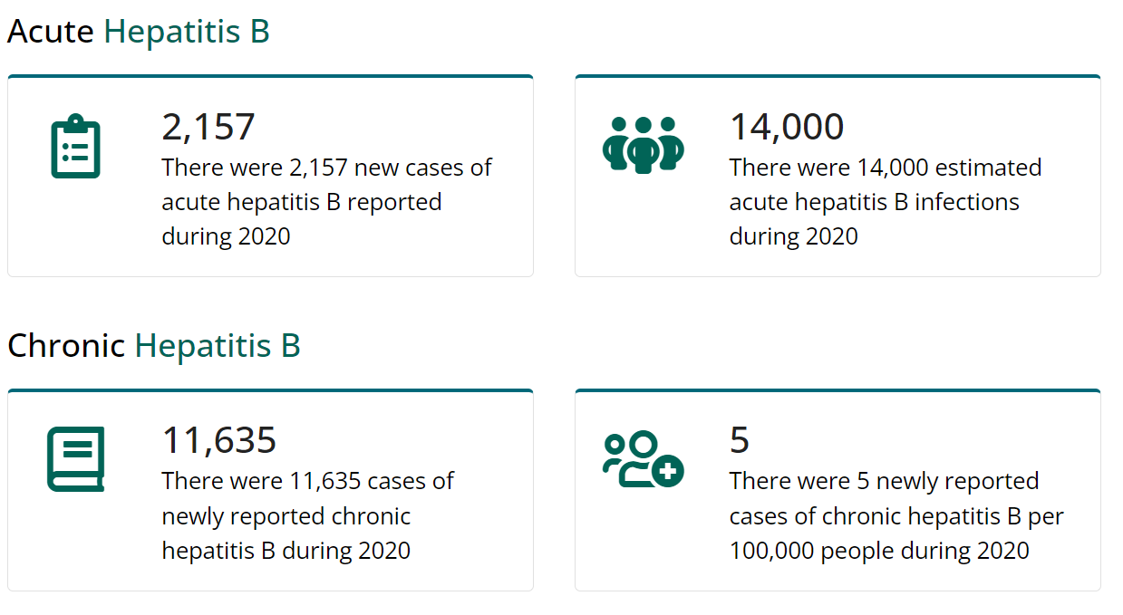
HBV Incidence in the US
In 2020, a total of 2,157 cases of acute hepatitis B were reported to CDC, for an overall incidence rate of 0.7 cases per 100,000. CDC estimates 14,000 acute hepatitis B cases occurred in 2020
1,752 hepatitis B-associated deaths among US residents were reported (0.45 cases per 100,000)
New hepatitis B infections are highest among people aged 30-59 years because many people at risk in this group have not been vaccinated as recommended.

Slide 8
Who should be screened for hepatitis B infection?
Adults
Clinicians should screen all adults aged 18 years and older for HBV infection at least once during their lifetime using the triple panel test which includes hepatitis B surface antigen (HBsAg), antibody to hepatitis B surface antigen (anti-HBs), and total antibody to hepatitis B core antigen total anti-HBc)
Infants
Clinicians should test all infants born to pregnant people who are HBsAg positive or have other evidence of HBV infection for HBsAg and anti-HBs seromarkers, at 9-12 months of age or 1-2 months after vaccine series completion if the series is delayed
Pregnant people
Clinicians should screen all pregnant people for hepatitis B surface antigen (HBsAg) during each pregnancy, preferably in the first trimester, regardless of vaccination status or history of testing (11).

Slide 10
Triple Testing (and then some)
Hepatitis B surface antigen (HBsAg): high levels during acute or chronic HBV
Hepatitis B surface antibody (anti-HBs): recovery and immunity from hepatitis B virus infection. Also develops if successfully vaccinated against hepatitis B
Total antibody to hepatitis B core antigen (anti-HBc): Appears at the onset of symptoms in acute hepatitis B. Indicates previous or ongoing infection with hepatitis B virus.
IgM antibody to hepatitis B core antigen (IgM anti-HBc): Positivity indicates recent infection with hepatitis B virus (<6 mos)

Slide 11
Interpreting HBV Testing

Slide 12
Transmission
HBV is transmitted from a person who has HBV infection to a person who is not infected through activities that involve percutaneous (i.e., puncture through the skin) or mucosal contact with infectious blood or body fluids (e.g., semen and saliva)
Vertical transmission
sexual contact with an infected partner
injection drug use that involves sharing needles, syringes, or drug-preparation equipment
contact with blood from or open sores
exposures to needle sticks or sharp instruments
sharing certain items that can break the skin or mucous membranes (e.g., razors, toothbrushes, and glucose monitoring equipment), potentially resulting in exposure to blood

Slide 13
Hepatitis B Treatment
There are no medications available for recently acquired (acute) HBV infection
Chronic HBV can be treated with antiviral medications
TDF
TAF
Peg‐IFN‐α‐2a
Adefovir

Slide 14
What are the hepatitis B vaccines licensed for use in the United States?
Single-antigen hepatitis B vaccines
Engerix-B
Recombivax HB
Heplisav-B (2 doses for adults)
Three-antigen hepatitis B vaccines
PreHevbrio (13)
Combination vaccines
Pediarix: Combined hepatitis B, diphtheria, tetanus, acellular pertussis (DTaP), and inactivated poliovirus (IPV) vaccine
Twinrix: Combined hepatitis A and hepatitis B vaccine
Vaxelis: Combined DTaP, IPV, Haemophilus influenzae type b, and hepatitis B vaccine

Slide 15
Other Questions
If there is an interruption between doses of hepatitis B vaccine, does the vaccine series need to be restarted?
No. The provider does not need to restart the series, but should consider the following:
If the vaccine series was interrupted after the first dose, the second dose should be administered as soon as possible.
The second and third doses should be separated by an interval of at least 8 weeks.
If only the third dose is delayed, it should be administered as soon as possible.
Is it harmful to administer an extra dose(s) of hepatitis B vaccine or repeat the entire vaccine series if documentation of vaccination history is unavailable?
Administering extra doses of single-antigen hepatitis B vaccine is not harmful.

Slide 16
FAQ
Can anti-HBs levels following vaccination decline over time?
Yes. Following vaccination, anti-HBs levels decline over time. Anti-HBs ≥10 mIU/mL is considered a correlate of vaccine-induced protection for people who have completed an approved vaccination series.
Immunocompetent people with anti-HBs level ≥10 mIU/mL 1–2 months after vaccination, even if anti-HBs levels decline to <10 mIU/mL beyond that time
Are booster doses of hepatitis B vaccine recommended?
Booster doses are not recommended for vaccinated immunocompetent people
For patients on hemodialysis, if annual testing for antibody to hepatitis B surface antigen (anti-HBs) shows a decline to <10 mlU/mL, a booster dose should be administered.
For other immunocompromised people (including those with HIV, hematopoietic stem-cell transplant recipients, and people receiving chemotherapy), the need for booster doses has not been determined. When anti-HBs levels decline to <10 mIU/mL, annual anti-HBs testing, and booster doses should be considered for those with an ongoing risk for exposure.

Slide 17
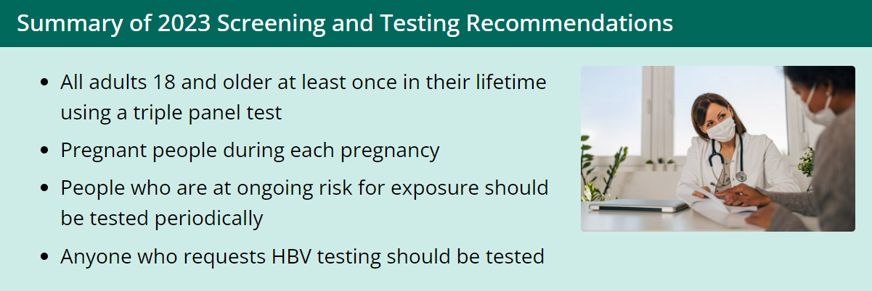
Hepatitis B

Slide 19
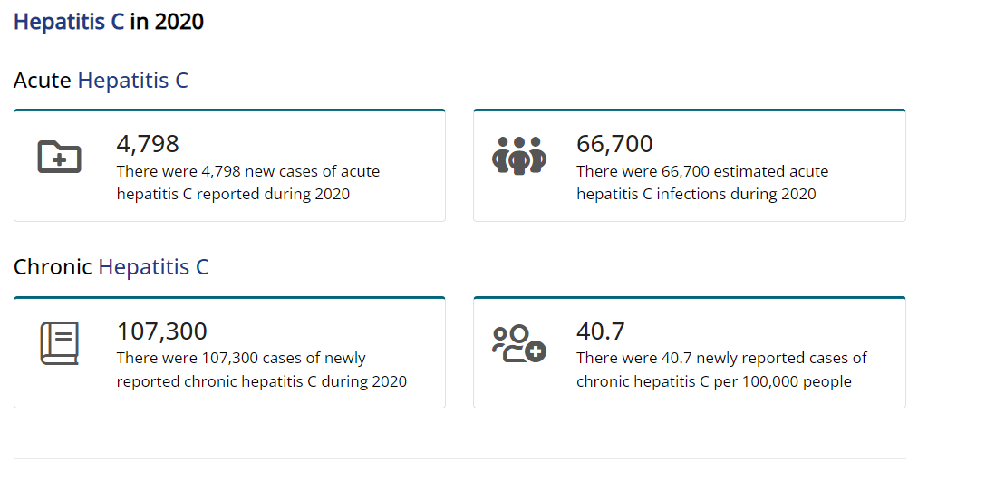

Slide 21
Screening for hepatitis C
Anyone who has ever injected or inhaled illicit drugs
Anyone who has abnormal liver function test results with no identified cause
Babies born to mothers with hepatitis C
Health care and emergency workers who have been exposed to blood or accidental needle sticks
People with hemophilia who were treated with clotting factors before 1987
People who have undergone long-term hemodialysis treatments
People who received blood transfusions or organ transplants before 1992
Sexual partners of anyone diagnosed with hepatitis C infection
People with HIV infection
Anyone born from 1945 to 1965
Anyone who has been in prison

Slide 23
Spontaneous clearance?
Approximately half of people who test anti-HCV positive do not have current chronic infection (clearance after acute infection)
Only those with current infection as evidenced by a positive HCV RNA test need treatment.
Factors that are predictive of spontaneous clearance of HCV include having jaundice, elevated ALT level, and hepatitis B virus surface antigen (HBsAg) positivity; younger age, being female; being infected with HCV genotype 1; and having certain host genetic polymorphisms, most notably those near the IL28B gene

Slide 24
Chronic HCV Sequelae
What are the chances of someone with HCV infection developing cirrhosis or liver cancer?
Of every 100 people infected with HCV, approximately 5–25 will develop cirrhosis within 10–20 years. P
Patients with cirrhosis have a 1%–4% annual risk of hepatocellular carcinoma and a 3%–6% annual risk of hepatic decompensation

Slide 25
Tests for Liver Damage
Magnetic resonance elastography (MRE)
Noninvasive alternative
Stiff liver tissue indicates the presence of scarring of the liver (fibrosis) as a result of chronic hepatitis C.
Transient elastography
noninvasive test, transient elastography is a type of ultrasound that transmits vibrations into the liver and measures the speed of their dispersal through liver tissue to estimate its stiffness.
Liver biopsy
Typically done using ultrasound guidance, this test involves inserting a thin needle through the abdominal wall to remove a small sample of liver tissue for laboratory testing.
Blood test
A series of blood tests can indicate the extent of fibrosis in your liver

Slide 27
HCV Treatment
Direct-acting antiviral (DAA) tablets
Safe and effective
Clearance of infection in more than 90% of people.
8 to 12 weeks
There are 3 classes of currently recommended DAA medications:
NS3/4A protease inhibitors
NS5A polymerase inhibitors
NS5B polymerase inhibitors

Slide 28
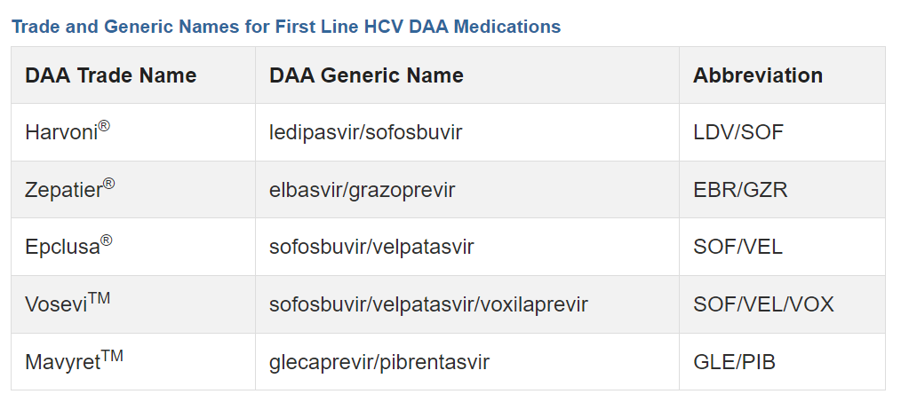

Slide 29
Treatment Considerations
Cirrhosis versus no cirrhosis
Compensated versus decompensated cirrhosis
History of prior HCV treatment
Renal function
HCV Genotype

Slide 30
PA DOH Viral Hepatitis Elimination Program
Long-term Goal 1: Ensure all Pennsylvanians know their hepatitis B and C status
Improve diagnostic tools and systems for hepatitis B and C.
Expand pharmacy scope of practice to include hepatitis B and C education, vaccination and screening.
Improve provider knowledge and uptake of United States Preventive Services Task Force and Centers for Disease Control and Prevention's hepatitis B and C screening guidelines.
Ensure all pregnant people are tested for hepatitis B and C during pregnancy, and gestational parents living with hepatitis B and/or C are appropriately reported and referred for follow-up care.
Ensure all children born to hepatitis B and/or C-positive gestational parents are vaccinated for hepatitis B, and all infected children are appropriately referred for follow-up care.
Long-term Goal 2: Ensure all Pennsylvanians living with hepatitis B and/or C access sustainable, appropriate medical care and treatment

Slide 31
Hepatitis Treatment
Long-term Goal 1: Ensure that every individual living with hepatitis B and C in Pennsylvania receives treatment.
Short-term goals:
Streamline, reduce, or remove health insurance hepatitis C prior authorization, broaden liver score assessments to those recommended by American Association for The Study of Liver Diseases, and remove genotype testing requirement for hepatitis C treatment.
Eliminate barriers to Medicaid reimbursement of hepatitis C- related services in Pennsylvania drug and alcohol treatment facilities.
Reduce hepatitis B treatment costs and improve access to treatment by addressing adverse drug tiering issues.
Long-term Goal 2: Expand the number of hepatitis B and hepatitis C treatment providers in Pennsylvania.
Short-term goals:
Document the number of hepatitis B treatment providers in Pennsylvania.
Expand hepatitis B treatment training opportunities for providers.
Document the number of hepatitis C treatment providers in Pennsylvania.
Expand hepatitis C treatment training opportunities.
Long-term Goal 3: Significantly reduce stigma surrounding hepatitis B and C among patients and healthcare providers.
Short-term goal:
Educate providers regarding current American Association for The Study of Liver Diseases /Infectious Disease Society of America guidelines that support treatment of people who use drugs to benefit the individual's health as well as the public's health reducing rates of transmission.

Slide 32
HIV
HIV (human immunodeficiency virus) is a RNA virus that attacks the body’s immune system. If HIV is not treated, it can lead to AIDS (acquired immunodeficiency syndrome).
No vaccine or cure current exists
HIV can be controlled with medical treatment
People with HIV who get effective HIV treatment can live long, healthy lives and protect their partners

Slide 34
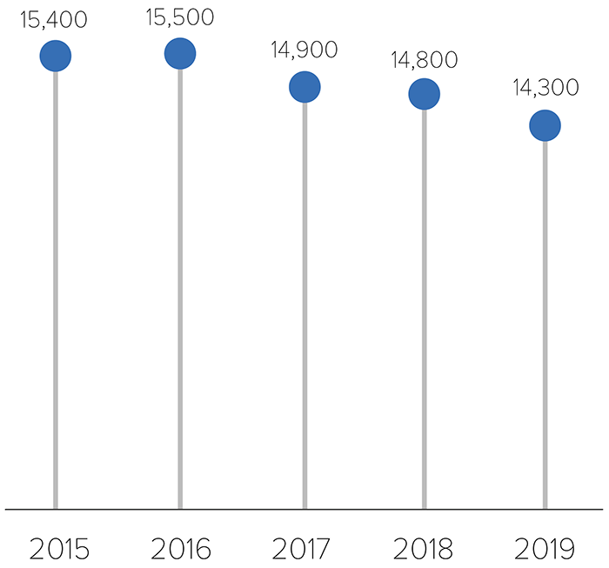
Estimated HIV Infections Among Black/African American People in the US, 2015–2019
https://www.cdc.gov/hiv/group/racialethnic/africanamericans/incidence.html

Slide 35
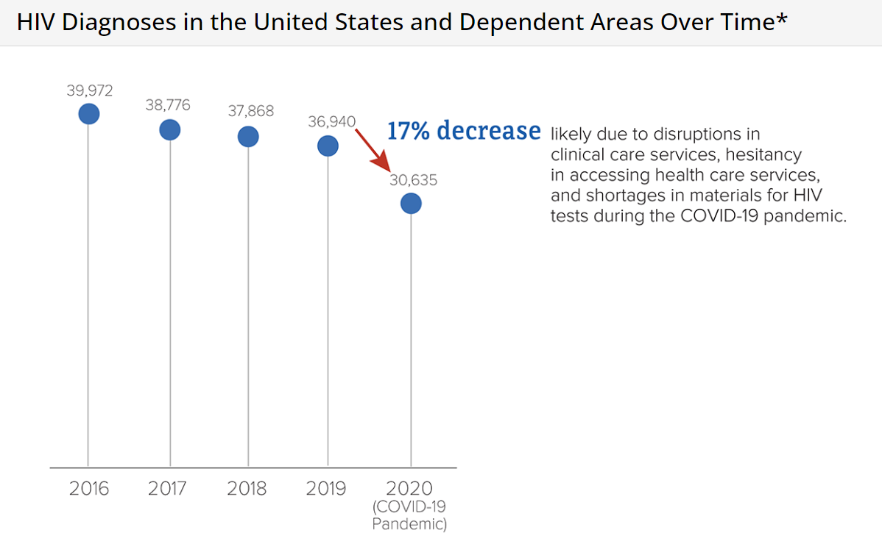

Slide 36
Epidemiology

Slide 37
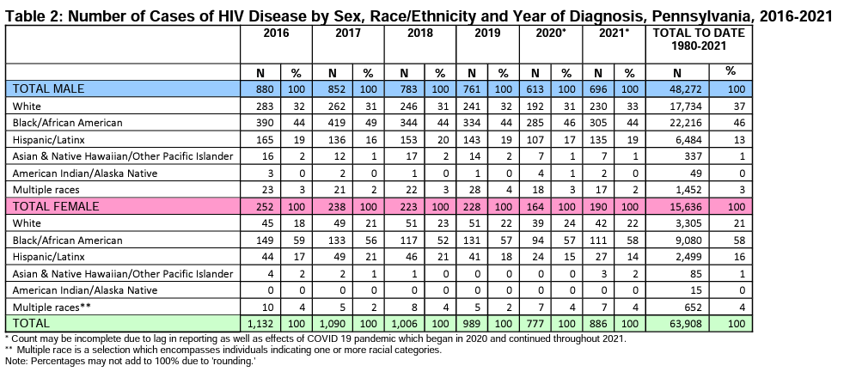

Slide 38
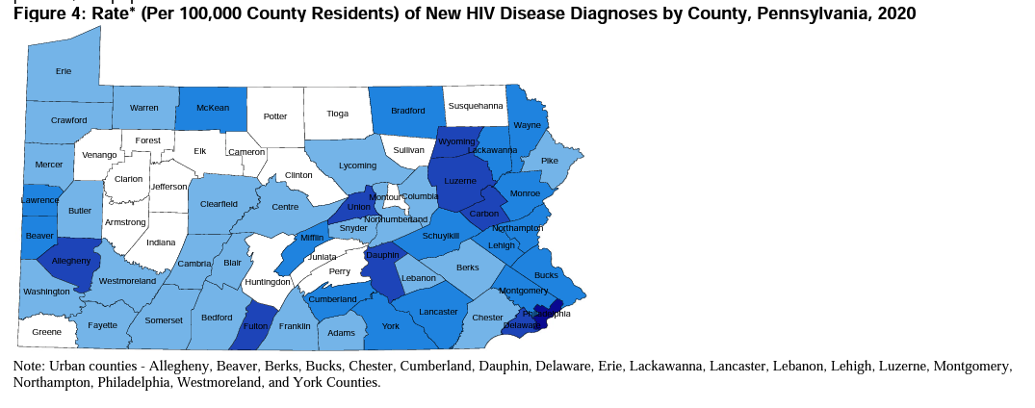

Slide 39
HIV Testing
United States Preventative Services Task Force recommended routine screening in individuals ages 15-65 as of May 2013
Opt out screening in Pennsylvania
Types of HIV tests
Oral testing
Rapid blood tests
Blood versus
Home test kits now available
4th and 5th generation HIV testing (picks up HIV earlier)

Slide 40
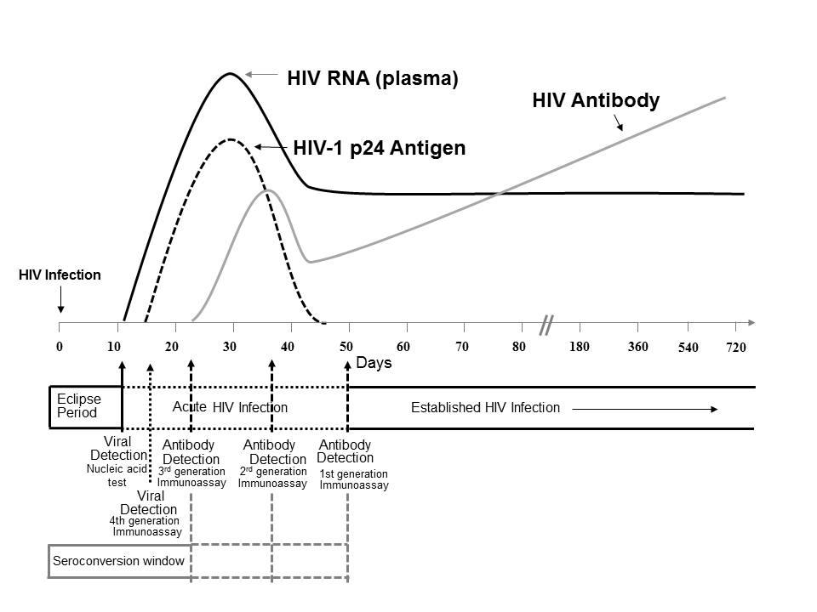

Slide 41
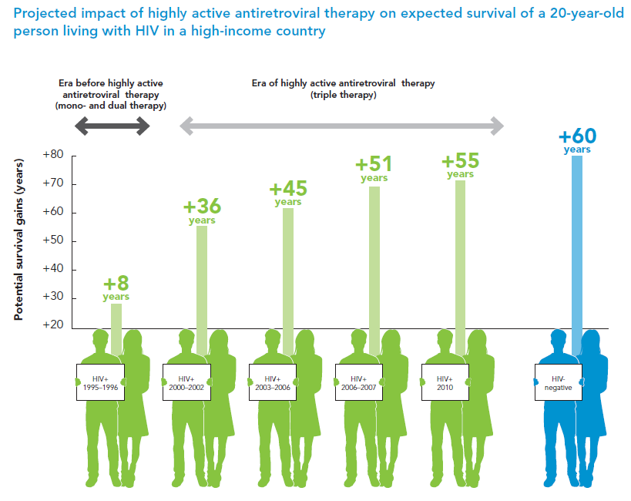

Slide 42
Goal: Virologic suppression
Survival benefit
Public health impact
Undetectable = Untransmittable

Slide 43
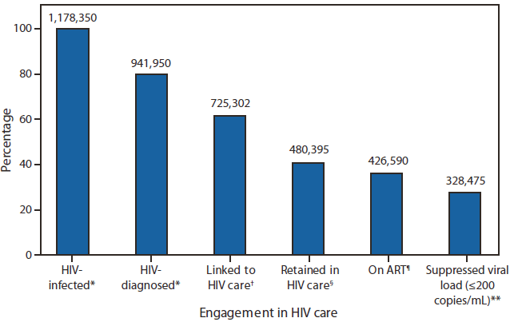
HIV Care Continuum
This percentage has improved!!

Slide 44
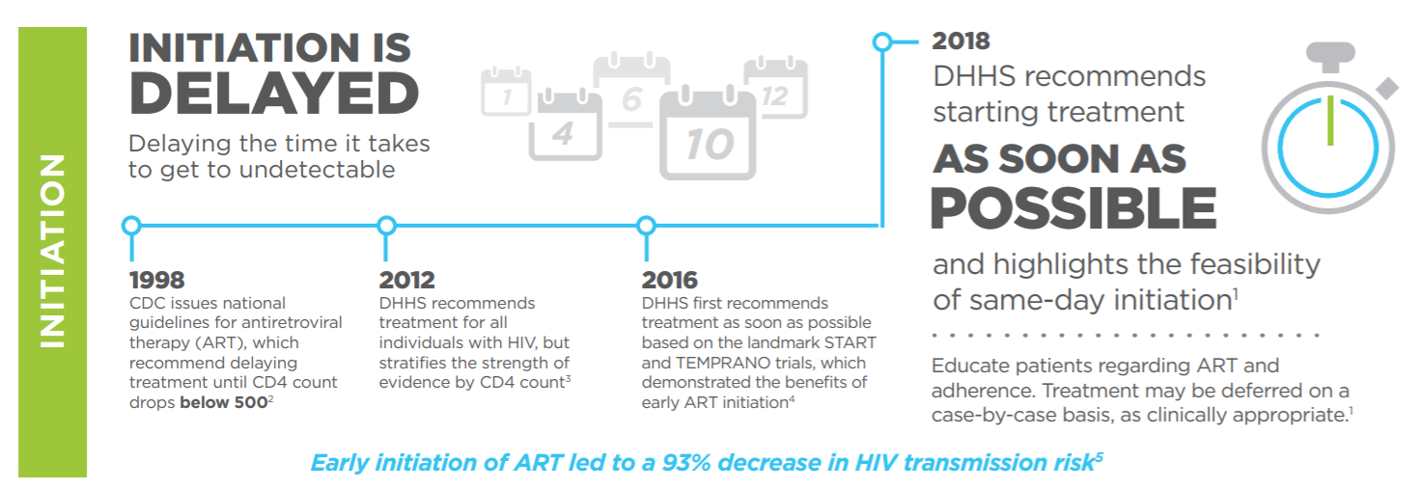
State of the ART

Slide 45
State of the ART

Slide 46
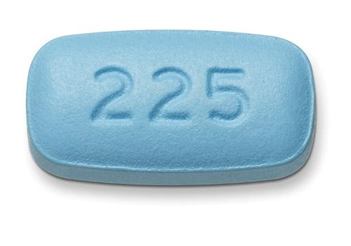
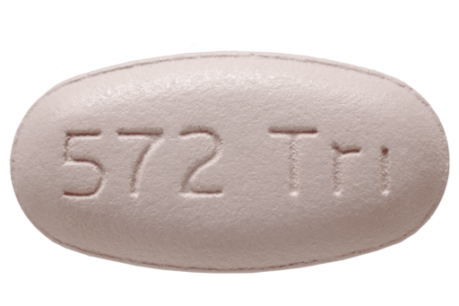
HIV Treatment
Multiple one pill once a day regimens for treatment of HIV (integrase based, improved safety, fewer side effects)
Two drug regimens now also available
Long acting injectable agents (once a month or every other month)

Slide 47
PrEP in Pinch
Discussed with anyone with significant risk for HIV, offered to anyone who asks for PrEP
Oral options:
once daily FTC/TDF, FTC/TAF
Safety monitoring: quarterly HIV testing, initial screening for HBV, 6-12 month creatinine monitoring
Preventative monitoring (screening for STI)
Encourage adherence, quarterly assessments

