Slide 1
MMRC
PQC
Virtual Meeting
March 16, 2023
Notes:
Good morning and welcome

Slide 2
Continuing Education Information
In support of improving patient care, this activity has been planned and implemented by the University of Pittsburgh and The Jewish Healthcare Foundation. The University of Pittsburgh is jointly accredited by the Accreditation Council for Continuing Medical Education (ACCME) and the American Nurses Credentialing Center (ANCC), to provide continuing education for the healthcare team. 1.00 hour is approved for this course.
As a Jointly Accredited Organization, University of Pittsburgh is approved to offer social work continuing education by the Association of Social Work Boards’ (ASWB) Approved Continuing Education (ACE) program. Organizations, not individual courses, are approved under this program. State and provincial regulatory boards have the final authority to determine whether an individual course may be accepted for continuing education credit. University of Pittsburgh maintains responsibility for this course. Social workers completing this course receive 1.00 continuing education credit.

Slide 3
Disclosures
No members of the planning committee, speakers, presenters, authors, content reviewers and/or anyone else in a position to control the content of this education activity have relevant financial relationships with any entity producing, marketing, re-selling, or distributing health care goods or services, used on, or consumed by, patients to disclose.

Slide 4
Disclaimer
The information presented at this Center for Continuing Education in Health Sciences program represents the views and opinions of the individual presenters, and does not constitute the opinion or endorsement of, or promotion by, the UPMC Center for Continuing Education in the Health Sciences, UPMC / University of Pittsburgh Medical Center or Affiliates and University of Pittsburgh School of Medicine. Reasonable efforts have been taken intending for educational subject matter to be presented in a balanced, unbiased fashion and in compliance with regulatory requirements. However, each program attendee must always use his/her own personal and professional judgment when considering further application of this information, particularly as it may relate to patient diagnostic or treatment decisions including, without limitation, FDA-approved uses and any off-label uses.

Slide 5
Agenda
Welcome – Sara Nelis, RN, PA PQC Project Manager, Jewish Healthcare Foundation
QI Workshop: Key Interventions for Connecting Across the Continuum of Care – Jennifer Condel, SCT(ASCP)MT
Discussion – facilitated by Jennifer Condel, SCT(ASCP)MT
Wrap-Up & Next Steps – Sara Nelis, RN
Notes:
Good morning and welcome! I’m Sara Nelis, the project manager for the PA perinatal quality collaborative. Thank you for taking time out of your day to join us for this virtual session.
Today, we’ll be exploring key interventions from our substance use and substance exposed newborn driver diagrams.
Jennifer Condel, our QI coach leader will be sharing quality improvement tools and techniques to help your team set up for success from the start.
We will have time at the end for questions, so please don’t hesitate to share your thoughts and questions!

Slide 6
Key Interventions for Connecting Across the Continuum of Care
Jennifer Condel, SCT(ASCP)MT
Jewish Healthcare Foundation

Slide 7
SEN Goals & Plans
Increase the percent of newborn care teams educated on post-discharge services from 70% to 80% of participating hospitals
Increase the percent of newborn care teams educated on the criteria for Plans of Safe Care from 70% to 80% of participating hospitals
Maintain at least 75% of newborns with NAS receiving non-pharmacotherapy bundled treatments (impacting at least 350 newborns per year)
Increase the percent of newborns with NAS who were referred to appropriate follow-up services at discharge from 85% to 95% (impacting at least 350 newborns per year)
Increase the percent of hospitals with a protocol to close the loop on the referral status with the post-discharge services and supports from 30% to 50%
Notes:
Reminder: The PA PQC is also setting initiative-specific goals which could be viewed as "state-wide" goals.
Highlighted continuum of care

Slide 8
Substance Exposed Newborn (SEN): Driver Diagram
Aims
5. Increase referrals to and engagement in outpatient family care services, including physical, behavioral, and social services
Establish Family Care Plans Prior to Discharge
Partner with families and social/child services to establish family care plans (Plans of Safe Care) according to federal, state, and county guidelines
Use Cuddler Program to free up parent for treatment
Substance Exposed Newborn (SEN) Survey: Structure Measures (Reported Quarterly)
11. Has your newborn care team (providers, nurses, and social workers) been educated on the criteria for Plans of Safe Care, their role in establishing and initiating the Plans of Safe Care, and how to explain it to families in accordance with your hospital’s, county’s, and state’s guidelines and policies?
Yes, policies and education completed
No, working on it
No, have not started
https://www.whamglobal.org/pa-pqc-initiatives
Notes:
Pulling from driver diagram and correlate structure measure

Slide 9
Substance Exposed Newborn (SEN): Driver Diagram
https://www.whamglobal.org/pa-pqc-initiatives
Aims
5. Increase referrals to and engagement in outpatient family care services, including physical, behavioral, and social services
Support Engagement in Family Care Plans
Refer SENs to appropriate follow-up services prior to discharge, including but not limited to Early Intervention (EI) Services, lactation support, and home visits, and close the loop on those referrals
Follow-up with outpatient providers to ensure that the family care plans are adopted and engagement in outpatient care
Follow the dyad for up to 15 months
Substance Exposed Newborn (SEN) Survey: Structure Measures (Reported Quarterly)
13. Has your neonatal care team (providers, nurses, and social workers) created a protocol for closing the loop on the referral status with the post-discharge services and supports?
Yes, policies and education completed for: (Check all that apply)
early intervention
home visiting services
physicians experienced in working with NAS
high-risk infant follow-up clinic / developmental assessment clinic
If yes, does this process also include notifying the family’s outpatient primary provider?
No, working on it
No, have not started
12. Has your newborn care team been educated on the criteria, protocols, and best practices for referring substance-exposed newborns and families to post-discharge services and supports?
Yes, policies and education completed for: (Check all that apply)
early intervention
home visiting services
physicians experienced with NAS
high-risk infant follow-up clinic / developmental assessment clinic
No, working on it
No, have not started
Notes:
Pulling from driver diagram and correlate structure measure

Slide 10
Substance Exposed Newborn (SEN):
Process and Outcome Measures and Specifications (Reported Quarterly)
Measure | Numerator (Out of the Denominator) | Denominator | Data Source
6. Percent of newborns with NAS who were referred to appropriate follow-up at discharge | Number referred to follow-up services at discharge | Number of NAS cases during the measurement quarter | EHR Data, Hospital data form, and/or PADOH NAS Notification Form
7. Percent of NAS who were readmitted to the hospital within 30 days of discharge (New balancing measure) | Number of newborns with an NAS diagnosis code who were readmitted to the hospital within 30 days of discharge | Single term newborns with NAS discharged alive from the hospital | EHR
8. Percent of NAS with an emergency department visit within 30 days of discharge (New balancing measure) | Number of newborns with NAS who utilized the emergency department within 30 days of discharge | Single term newborns with NAS discharged alive from the hospital | EHR
Notes:
Process and outcome measures

Slide 11
Maternal Substance Use Goals & Plans
Increase the percent of hospitals with trauma-informed protocols in the context of substance use from approx. 10% to 20%
Increase the percent of hospitals with a system in place to provide naloxone to at risk patients prior discharge from 8% to 30%
Increase the percent of hospitals from 60% to 70% with established perinatal care pathways for SUD that coordinate services across multiple providers up to 1 year postpartum
Maintain at least 90% of pregnant individuals being screened for substance use with a validated screen (impacting at least 30,000 individuals per year)
Notes:
Reminder: The PA PQC is also setting initiative-specific goals which could be viewed as "state-wide" goals.
Highlighted continuum of care

Slide 12
Maternal Substance Use: Driver Diagram
READINESS – Every UniT
Aims
Increase education among patients related to substance use
Increase education among healthcare team members to address stigma related to substance use
Form a Multi-Disciplinary Team
Engage appropriate partners to assist pregnant and postpartum people and families in the development of family care plans, starting in the prenatal setting
Establish a multidisciplinary care team to provide coordinated clinical pathways for individuals experiencing SUD
Ensure Access to Resources for all Identities
Develop and maintain a set of referral resources and communication pathways between obstetric providers, community-based organizations, and state and public health agencies to enhance services and supports for pregnant and postpartum families for social determinants of health needs, behavioral health supports, and SUD treatment.
Have evidence-based substance use resources that are inclusive for people of all backgrounds, race, ethnicity, gender, social class, language, ability, and other personal or social identities and characteristics.*
https://www.whamglobal.org/pa-pqc-initiatives
Notes:
Pulling from driver diagram and correlate structure measure

Slide 13
Maternal Substance Use: Driver Diagram
READINESS – Every UniT
Aims
Increase education among patients related to substance use
Increase education among healthcare team members to address stigma related to substance use
Form a Multi-Disciplinary Team
Engage appropriate partners to assist pregnant and postpartum people and families in the development of family care plans, starting in the prenatal setting
Establish a multidisciplinary care team to provide coordinated clinical pathways for individuals experiencing SUD
Maternal Substance Use Survey: Structure Measures (Reported Quarterly)
14. Has your site established specific prenatal, intrapartum and postpartum care pathways (algorithms) for substance use that facilitate coordination among multiple providers during pregnancy and the year that follows?
Multiple Choice:
Yes (in place)
No (working on it)
No (have not started)
Notes:
Pulling from driver diagram and correlate structure measure

Slide 14
Maternal Substance Use: Driver Diagram
READINESS – Every UniT
Aims
Increase education among patients related to substance use
Increase education among healthcare team members to address stigma related to substance use
Ensure Access to Resources for all Identities
Develop and maintain a set of referral resources and communication pathways between obstetric providers, community-based organizations, and state and public health agencies to enhance services and supports for pregnant and postpartum families for social determinants of health needs, behavioral health supports, and SUD treatment.
Have evidence-based substance use resources that are inclusive for people of all backgrounds, race, ethnicity, gender, social class, language, ability, and other personal or social identities and characteristics.*
Maternal Substance Use Survey: Structure Measures (Reported Quarterly)
13. Has your hospital developed referral relationships with any SUD treatment services in your area/county?
Multiple Choice:
Yes (in place)
No (working on it)
No (have not started)
If yes, please indicate which recovery treatment services (Check all that apply)
Programs offering Medications for Opioid Use Disorders (MOUD)
Residential treatment
Inpatient treatment
Outpatient behavioral health counseling
Peer support (e.g., certified recovery specialist (CRS) or other peer support specialists)
12-step programs
Notes:
Pulling from driver diagram and correlate structure measure

Slide 15
Maternal Substance Use: Driver Diagram
RECOGNITION & PREVENTION – Every Patient
Aims
3. Increase universal screening and follow-up for substance use among pregnant and postpartum individual
Screen all pregnant and postpartum individuals for substance use and co-occurring needs
Screen all pregnant and postpartum people for substance use using validated self-reported screening tools and methodologies during prenatal care and during the delivery admission
Screen each pregnant and postpartum person for co-occurring medical and behavioral health needs (e.g., HIV, Hepatitis B and C, behavioral health conditions, physical and sexual violence, Sepsis, Endocarditis), and provide linkage to community services and resources
Screen for structural and social drivers of health that might impact clinical recommendations or treatment plans, and provide linkage to resources
Maternal Substance Use Survey: Structure Measures (Reported Quarterly)
13. Has your hospital developed referral relationships with any SUD treatment services in your area/county?
If yes, please indicate which recovery treatment services (Check all that apply)
14. Has your site established specific prenatal, intrapartum and postpartum care pathways (algorithms) for substance use that facilitate coordination among multiple providers during pregnancy and the year that follows?
Notes:
Pulling from driver diagram and correlate structure measure

Slide 16
Maternal Substance Use: Driver Diagram
Response – Every Event
Aims
1. Increase prenatal and postpartum individuals with SUD who initiate SUD treatment (including Medication for OUD)
Link all pregnant and postpartum individuals with SUD to substance use treatment programs (including Medication for OUD)
Establish specific prenatal, intrapartum and postpartum care pathways that facilitate coordination among multiple providers during pregnancy and the year that follows (Question 14)
Assist pregnant and postpartum people with SUD to receive evidence-based, person-directed SUD treatment that is welcoming and inclusive in an intersectional manner, and discuss readiness to start treatment, as well as referral for treatment with warm hand-off and close follow-up (Question 13)
Maternal Substance Use Survey: Structure Measures (Reported Quarterly)
13. Has your hospital developed referral relationships with any SUD treatment services in your area/county?
If yes, please indicate which recovery treatment services (Check all that apply)
14. Has your site established specific prenatal, intrapartum and postpartum care pathways (algorithms) for substance use that facilitate coordination among multiple providers during pregnancy and the year that follows?
Notes:
Pulling from driver diagram and correlate structure measure

Slide 17
Maternal Substance Use:
Process and Outcome Measures and Specifications (Reported Quarterly)
Measure | Numerator (Out of the Denominator) | Denominator | Data Source
3. Percentage of pregnant and postpartum individuals diagnosed with OUD who initiate Medication for Opioid Use Disorders (MOUD) | Number who filled a prescription for or were administered or ordered an MOUD (buprenorphine or methadone) for OUD at any time during or after the pregnancy | Number of individuals with a delivery and OUD diagnosis in the quarter | EHR Data & Claims Data (based on Rx)
4. Percentage of individuals diagnosed with OUD receiving postpartum care | Cumulative number who received a postpartum visit with a provider on or between 1 and 84 days after delivery | Cumulative number of individuals with a delivery at least 84 days ago who are diagnosed with OUD | Claims Data / EHR data
5. Percentage of pregnant individuals with a positive substance use screen who received an appropriate follow-up action for alcohol or other drug use (New Maternal Substance Use Measure) | Deliveries in which patients received brief intervention(s) and follow-up care on or up to 30 days after the date of the first positive screen (31 days total) | Deliveries during the measurement period that had a positive finding for substance use at any time during pregnancy (using an age-appropriate standardized screening tool) | EHR Data
6. Percentage of postpartum individuals with a positive substance use screen who received an appropriate follow-up action for alcohol and other drug use (New Maternal Substance Use Measure) | Deliveries in which patients received follow-up care on or up to 30 days after the date of the first positive screen (31 days total) | Deliveries 84 days prior to the start and end of the measurement period, with a positive finding for substance use during the 84-day period following the date of delivery (using an age-appropriate standardized screening tool) | EHR Data
Notes:
Correlate to process and outcome measures

Slide 18
Discussion
Jennifer Condel, SCT(ASCP)MT
Jewish Healthcare Foundation

Slide 19
Quality Improvement
Project Planning
Notes:
Good to start with a definition (https://www.ahrq.gov/ncepcr/tools/pf-handbook/mod4.html)
“In health care, quality improvement (QI) is the framework we use to systematically improve the ways care is delivered to patients.
Processes have characteristics that can be measured, analyzed, improved, and controlled.
QI entails continuous efforts to achieve stable and predictable process results, that is, to reduce process variation and improve the outcomes of these processes both for patients and the health care organization and system.
Achieving sustained QI requires commitment from the entire organization, particularly from top-level management.”

Slide 20
QI Project Plan
Identify the problem or need
Root Cause Analysis of Current Condition
Visualize Current State
Target and Ideal Condition
Design and Test

Slide 21
Notes:
On this template, we are asking for QI project plan elements

Slide 22
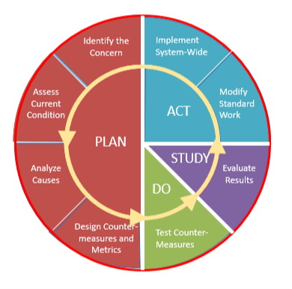
An Organized Approach to Quality Improvement
PLAN - DO - STUDY - ACT
Take action based on what you learned
Adopt, Adapt, Abandon
Identify your goal
Understand the current state
Design experiment/interventions
Identify metrics
Predict results
Review the test
Analyze results
Assess learnings
Reducing waste while increasing value.
Test the change
Carry out a small-scale experiment
Collect data
Notes:
To do this requires a systematic approach to address the challenges and design flaws.
PDSA cycle-within each phase of the cycle are multiple components…if interested can provide additional information. For purposes of our discussion, PDSA
-
To establish a culture of quality improvement, the organization must adopt a common language and align around a standard approach to problem solving. The Plan-Do-Study-Act cycle and the scientific method are often familiar approaches to quality improvement in health care. A challenge for many organizations is consistent adherence to a quality improvement methodology.
-A3 Thinking, adopted from lean methodology, is rooted in PDSA and the scientific method, aligning with the base understanding of quality improvement principles for many working in health care. As a standardized and systematic approach to examining problems, A3 Thinking also challenges teams to apply lean work design principles to address opportunities for improvement.
-By applying a systematic and standardized approach to quality improvement thinking, organizations create a safe and reliable learning environment in which staff and ideally patients and families, are empowered to identify opportunities for improvement to support organizational goals.
-A3 Thinking and lean healthcare principles aim to create a balanced system that strives to provide the highest value, in the timeliest and most cost-effective way. In the following modules, we will explore in more detail each step of A3 Thinking.

Slide 23
PDSA Thinking: The Foundation of Quality Improvement
An approach to standardizing problem solving
A way of engaging and organizing teams to continuously identify and act upon opportunities for improvement
Applied to process changes as well as behavior changes, and to problems big and small
Supports deep examination of problems
Notes:
-foundational to lean quality improvement and facilitates a standardized approach to problem solving. It engages teams and organizations in a new way of thinking and doing.
-I am sure many of you, like myself, have developed skills in taking a more reactive or ‘damage control’ approach to addressing problems. A3 Thinking however, promotes deeper examination and proactive thinking that engages teams to address organizational problems to a level that the likelihood of recurrence is greatly diminished.

Slide 24
Rooted in the Scientific Method
Identify the problem logic
1
Gather data (objective observation)
2
Gain consensus among stakeholders
Root cause analysis process focused
3
Establish a hypothesis (X will happen if these countermeasures are implemented)
4
Conduct an “experiment” by implementing countermeasures
5
Verify the hypothesis (measurement)
Notes:
Rooted in scientific method which provides the needed structure to systematically evaluate and address problems.
This structure relies on problem identification and data gathering to understand the problem context and determine its root cause(s). A hypothesis can then be established with a defined countermeasure to trial, followed by analysis of the results to determine if that countermeasure should be adopted, adapted or abandoned.
This quote, often attributed to W. Edwards Deming, “Every process is perfectly designed for the results that it gets” summarizes the challenges and opportunities of quality improvement. Without applying a structured approach to problem solving, we may end up band aiding the downstream symptoms verses understanding and addressing the upstream systematic level challenges.
Hypothesis: A specific change in an activity, connection or pathway will improve cost, satisfaction, timing, quality by a specific amount.
Signs of a Problem: The actual result is different from the expected results.
Responses: Learn how the activity was actually performed or the connection or pathway was actually operated. Determine the true effects of the change. Redesign the change.
Identify the problem
Gather data (observation)
Root cause analysis
Establish a hypothesis (X will happen if these countermeasures are implemented)
Conduct an “experiment” by implementing countermeasures
Verify the hypothesis (measurement)

Slide 25
“Every process is perfectly designed to get the results that it gets.”
- W. Edwards Deming
https://pbs.twimg.com/media/CiKBaINUoAET1zS.jpg
Notes:
-One thing is clear, As Einstein said, “we cannot solve our problems with the same thinking we used when we created them.”
-This leads us to the application of PDSA thinking for problem solving and work design principles.

Slide 26
Design safe and reliable systems anchored on the principles of excellence to meet the needs of the people served in that system
Notes:
-Gaining consensus within and across departments is critical to breaking down the silos that often exist in health care and prevent the ability to meet the system needs and those in the system.
-PDSA Thinking is anchored on the principles of striving for excellence at each level of the system. Teams can use this systems thinking approach to identify potential upstream and downstream factors that would impact the ability to design safe and reliable systems.

Slide 27
Quality Improvement is an enterprise-wide, 24/7 commitment
Matt Gubba @MattGubba Jul 7, 2016
Notes:
Implementing an organizational culture rooted in continuous quality improvement is a journey, a 24/7 commitment. It is not a simple, straight trajectory as pictured here. I would anticipate for most of us, our journeys are represented by the image on the right; a series of successes and challenges along the path toward the intended goal.

Slide 28
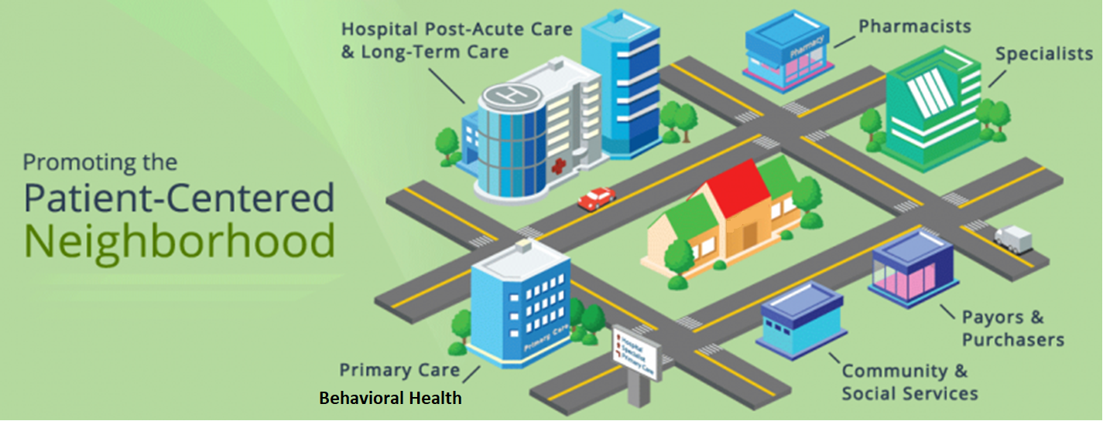
Continuum of Care Requires Systems Thinking
Promoting the
Health Care Neighborhood
Supporting Health in Our Communities
Home
Integrated systems
Integrated multi-disciplinary care teams
https://image.slidesharecdn.com/condolucihivupdate-170512201430/95/treatment-update-modernizing-the-hiv-care-delivery-model-14-638.jpg?cb=1494620178
Notes:
Systems thinking to achieve the ideal
-Expanding on this level of systems thinking and applying it to the overall health system and culture, consider for example this image promoting a health care neighborhood as an ideal health care system.
-In this neighborhood, care is delivered across health care entities through an extensively integrated network of care providers and community social services to coordinate resources without fragmentation to meet a patient’s needs in a safe and effective environment improving health outcomes for patients and ultimately decreasing the potential for error and patient harm by creating an efficient system for staff and providers to work.

Slide 29
Visualizing the Work: Maternal Care Community
Prenatal
Pregnancy
Post Partum
How do we look at our roles ?
Starting point for everyone
Processes of how care is received, delivered and managed
Elements to show how we work differently
Your place in the birthing biosphere
Our roles in addressing maternal health inequities
Notes:
Consider the maternal community and partnerships

Slide 30
Problems are solved one step at a time – each attempt gets you closer to success
PDSA Thinking is Iterative and Continuous
PDSA
PDSA
IDEAL
PDSA
Current
Condition
Defect-free, one-by-one, on demand, delivered immediately, no waste, safe
Notes:
30
-Applying A3 Thinking helps teams to ‘stay on track’ and maintain a strategic, continuous improvement focus by addressing problems that align with strategic goals.
-Through a team-based, iterative approach, each PDSA cycle is planned, launched and analyzed, yielding valuable information to plan for the next PDSA cycle and so on, with each cycle moving the team and organization closer to their ideal.

Slide 32
What is Standard Work?
Documentation of the current best practice
Standard work is the foundation of continuous improvement.
We can’t improve a process unless we know how it happened in the first place.
Notes:
Where to start?
To clearly define roles and activities within the workflow, can use standard work principles and tools
What is standard work and how does it support the reliability of workflow

Slide 33
We Need data!

Slide 34
SET targets and envision success
Specific
Be specific about what want to accomplish; who
What does your goal target?
Measurable
How are you to measure it?
Concrete criteria for measuring progress and reaching the end goal
Attainable
Is the goal set achievable?
Realistic and possible for your team to reach
Realistic or Relevant
Time- bound
Does the expected result align to your business plan?
By when will you reach your goal?
matter
Notes:
What is a SMART Objective?
The “SMART” acronym stands for “specific,” “measurable,” “attainable,” “relevant,” and “timely.”
Specific
focused and identify a tangible outcome/want to achieve. Without being specific, run the risk of being too vague and far more difficult to achieve. answer the six “W” questions:
Who: Who is involved in this goal?
What: What do you plan to accomplish?
Where: Is there a target location for this goal?
When: Narrow down a realistic timeline.
Which: Note any requirements and constraints involved with this goal.
Why: Hone in on your purpose and benefits of accomplishing your goal.
Measurable
Establishing criteria for measuring progress is key to staying on the path to achieving/can easily measure, ask yourself the following:
How many/much?
How will I know if I’ve reached my goal?
What is a solid indicator of progress?
Attaching a number gives you a concrete benchmark to strive toward.
Attainable
It’s great to have big objectives, but keeping them realistic will help set you up for success. Should be something you’re both willing and able to work towards. Try asking yourself: Do I have the capabilities and resources to realistically achieve this goal? If not, what am I missing?
Relevant
core initiative and matter to you and your organization/team.
Timely
have a timeline and target end date. If not on pace to hit your end goal, you’ll be able to identify areas you could be doing more to ensure you reach your goal by the end of the year.
Specific and measured goals are the key to success. With your new SMART goal, you’ll have a clear target to aim for, can quickly evaluate whether you’re on track to achieving your goal or falling short, and can celebrate the achievement when it happens because it was realistic and relevant to your business. Using a structure like the SMART formula can help you succeed in whatever you set out to do. If you find that you’re lacking the tools to crush your goals, reach out to our team and let us help you today!

Slide 35
Substance Exposed Newborn (SEN): Example
PA PQC Aim:
5. Increase referrals to and engagement in outpatient family care services, including physical, behavioral, and social services
Establish Family Care Plans Prior to Discharge
Partner with families and social/child services to establish family care plans (Plans of Safe Care) according to federal, state, and county guidelines
Use Cuddler Program to free up parent for treatment
Healthcare Team Project Plan SMART Objective:
Establish a referral process with social service organization (name) based on Plans of Safe Care within the next 9 months.
Healthcare Team Project Plan SMART Objective:
Increase the number of social service organizations with established referral processes from one organization to three based on Plans of Safe Care within the next 9 months.
Notes:
Pulling from driver diagram and correlate structure measure

Slide 36
Data: Measure Change for Improvement
How will we know that change is an improvement?
Outcome Measures- what is your ultimate goal
• The voice of the customer or patient.
• Reflects the problem you are trying to solve.
• Describes how your overall system is performing.
Process Measures- how will you get there
• Steps logically linked to outcome of interest.
• Addresses how key parts of the system is performing.
Balancing Measures
• Describes what happens to the system as processes and outcomes have changed.
• What are the unintended consequences or alternate explanations?
Notes:
Shown: focus area + driver diagram with key interventions + these measures

Slide 37
Examining the Current Condition
Direct Observation and Analysis
Notes:
To gain a better understanding of the problem and its context, we will examine the current condition by first discussing the important skill and tool of observation.

Slide 38
The Power of Observation…
New eyes to see
Impacted by perspectives, experiences, expectations—
focus on the facts
Watch how work is actually occurring
Capture events as they unfold
In-depth and detailed understanding of current state vs.
standard work
Roles and responsibilities
Crosses silos
Helps to tell the story (patient and staff)
Gives context to the numbers
Prevents jumping to solutions
Solves the right problem
“You can observe a lot just by watching. -Yogi Berra
Notes:
Observation is the first tool in your Lean toolbox.
We watch every day. But what we see is impacted by our perspective, our experiences, our expectations. Observation aims to focus on the facts and provide objectivity.
Have you ever wondered what your work looks like from the customer’s point of view? What part of your work do they experience? How do they experience it? What does it feel like to them? They fill in a lot of blanks when you’re not in their direct line-of-sight.
Direct observation gives you an in-depth and detailed understanding of the current process as it is actually performed–not how it should be done or how someone says it is done (standard work). Workers and supervisors can often describe how the process generally works or how it is supposed to work, but deviations from this general or hypothetical conception usually hold the key to addressing the real problem. It is an opportunity to understand the activities or work and responsibilities across teams and departments.
Remember Dr. Shannon discussion about putting the data into a human element- what are the circumstances around those numbers? Observation is data. It helps to identify, what the patient need is and how it was approached as well as what did it take for the staff member(s) to meet that need.
.

Slide 39
What do you observe?
Notes:
3 mins
Let’s practice watching work happen in this video and identify what type of wastes you see? Click the play button in the bottom left corner of the slide to begin the video.

Slide 40
What did you see?
Notes:
Was it easy to identify the wastes in this video? Probably, particularly because it not a healthcare example and could be considered a must simpler process. It focuses on the customer goal of ideally ‘wrapping chocolates’ which if an error occurred, would be less impactful to the customer.
In this video, all types of waste were present. It was a good example of ‘minds ignored’. Do you think this occurred because of the environment in which Lucy and Ethel were working? Did the supervisor allow them to speak up when they encountered problems? If she would have, perhaps the process could have been improved. An important reminder for the role of leadership.

Slide 41
Stability = Reliable
Stability is defined as the capability to produce consistent results over time. In other words, the process is reliable.
The first step in improving a process is to create a basic level of stability
Stability is a necessary platform for continuous improvement
As each experiment improves the process, the level of stability will also improve
Notes:
-Variability, often in the form of ‘waste’ or non-value-added work, can significantly contribute to an unstable and therefore unreliable system. We will discuss in more detail the concepts of value and non-value-added work in the Eliciting, Verifying and Responding to Concerns module.
-Think back to Dr. Shannon’s comments regarding his hospital’s unreliable processes and variations or workarounds in staff workflow across multiple aspects of conducting a central line insertion. As a result, patients were harmed, and staff were frustrated and discouraged. Consider your own experiences in navigating this type of health care environment.
-Identifying and eliminating or reducing high levels of variability is a critical first step to not only creating stable processes but laying a foundation for quality improvement.
-A3 Thinking can help a team systematically reach a level of stability or standardization such that it becomes momentum for ongoing continuous improvement. As processes evolve through iterative experimentation, variability is designed out, processes and therefore the system, becomes more reliable.

Slide 42
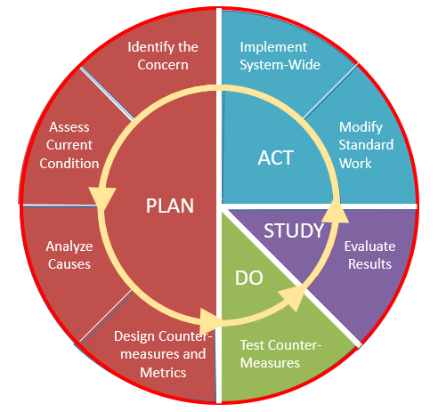
Data are essential to each step in the process improvement journey.
“80% of primary care sites now have active diabetes care reminders.”
“Diabetes testing, outcomes, and P4P payments are below expectations.”
“Automated diabetes care reminders have been added to
all of diabetes care protocols.”
“32% of diabetes patients had missing or overdue testing.”
“In the last three months we reduced overdue testing from 32% to 15% and increased P4P by $4000.”
“Implement a diabetes test reminder system at time of care to reduce overdue testing by 1/3 in the next 3 months.”
“Staff are unaware of >90% of overdue tests when patients are seen.”
Notes:
Switch to senior example
Validation of concerns and clarification of problems require intensive data collection and analysis.
>[click]The specific data needed will change depending on the PDSA step involved.
>[click]Once a countermeasure has been implemented, measurement of output and outcomes is key.

Slide 43
Defining the Problem Approach
Problem
What is the problem or need?
How do we know this is a problem?
Scope
Who is experiencing the problem?
Where is the problem occurring?
Who owns the problem (Executive in Charge)?
Why is it important to solve
When and how often is the problem happening?
Team
Who has an interest in the problem (Stakeholders)?
Who can make decisions about the problem (Management)?
Who is directly involved in the problem (Front-line)?
Notes:
Once we have identified a problem we want to get a deeper understanding to help drive improvements. Be sure to state the problem explicitly and with concise language. State only the facts, don’t interject subjective opinions. There are three areas will help. First, ensure the problem is clearly defined. Ask yourself, what is the problem that you are experiencing? How do we know this is a problem? Why is it important to solve?
Second, define the scope, identify the finite details of what is being experienced. . Who is experiencing the problem? Where is the problem occurring? When is the problem happening?
Third, define the team to support the improvement efforts. Who owns the problem? Who has interest or concern in the problem ? Who can make decisions about the problem to help remove potential barriers? Who is involved in the problem at the front-line, the people who do the work daily that will know how to solve the problem ?
Remember, your problems are not “the” problem. There could be a variety of causes, so don’t prematurely suggest solutions.

Slide 44
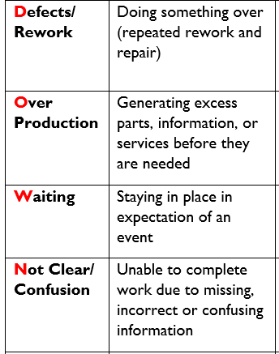
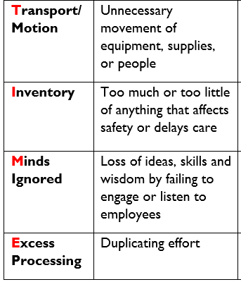
“Waste” Means Activities that Do Not Deliver Value
Notes:
In the prior module, you learned about identifying opportunities through the DOWNTIME mnemonic for the principal causes of waste that we look for in organizational processes.
>The provides a grounding through the lens of a value perspective for the customer or patient, and the staff working in that environment.

Slide 45
Understanding the current condition
Process Mapping
Notes:
Process mapping provides an opportunity to share an understanding of the current condition visually with all involved

Slide 46
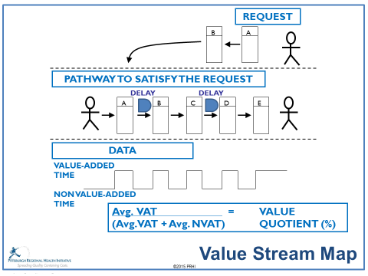
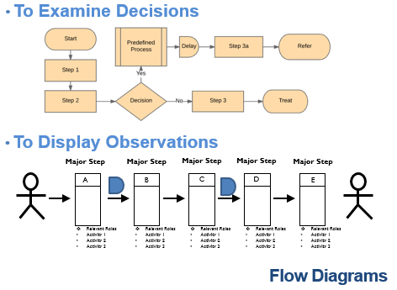
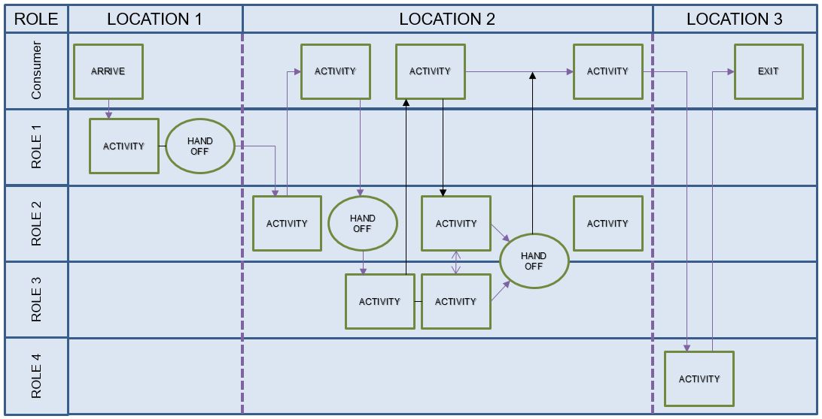
Types Of Process Maps
Highlights Decision Process
Examines Time Use
Shows Sequence and Decisions
Indicates Work Process
Flow Diagram
Displays Motion and Distance
Clarifies Individual and Team Roles
Notes:
Types of Maps
We regularly use different types of maps to visually represent work. Each of these maps has some special advantages: to highlight decision-making, examine time use, assess environmental challenges, and clarify roles.

Slide 47
Process Map Template: Mapping Your Workflow
Major Step
A
Major Step
B
Major Step
C
Major Step
D
Role
Activity 1
Activity 2
Activity 3
Role
Activity 1
Activity 2
Activity 3
Role
Activity 1
Activity 2
Activity 3
Role
Activity 1
Activity 2
Activity 3
Process Map Symbols
Major step in the process
Recognized benefit
Delay in the process
Opportunity for Improvement
Guiding Principles for Mapping
Rule 1: Specify each step
Rule 2: Communicate directly
Rule 3: Follow simple and direct pathways.
Rule 4: Let staff members and data drive process improvements.
Notes:
We will focus on this process map.
How can you build reliability into the workflows for staff and the patient to know the why, how and when for the success of their work and to trust the outcomes of those workflow processes for quality patient care?
This occurs through the design of the workflow or process map. Here is an example of workflow template.
Key components are: clearly defining the roles to do the work, the tasks/activities necessary to successfully complete the work and the process goals and expectations
Visual representation of the information for including in daily work (accessible, clear)
The map can look different but all need to reflect who is doing what work, what the work is, why they are doing the work and the goals
-------------------------------------------------
The list of directions serves a limited purpose that might be just right for the driver, but the map showing the route offers similar information as well as opportunities to make the journey more valuable.
Rule 1 addresses how people work: All activities must be highly specified as to content, sequence, timing and expected outcome.
Rule 2 addresses how people communicate: All communications must be highly specified and direct, with clear yes-no signals back and forth.
Rule 3 addresses how pathways are constructed: The pathway for every service or product must be pre-defined, highly specified, simple and direct – with no loops or forks.
Rule 4 addresses how improvements are made: All improvements must be made using data-driven scientific methods, as close to the work as possible, by the people who do the actual work and under the guidance of a teacher or coach.

Slide 48
Benefits of Process Mapping
Creates a visual document
Explores work across departments (learn about each other’s work)
Generates a deeper understanding of work
Unites a team in improvement (explore complicated process)
Identifies opportunities for improvement (working & not working)

Slide 49
Root Cause Analysis
Deep examination

Slide 50
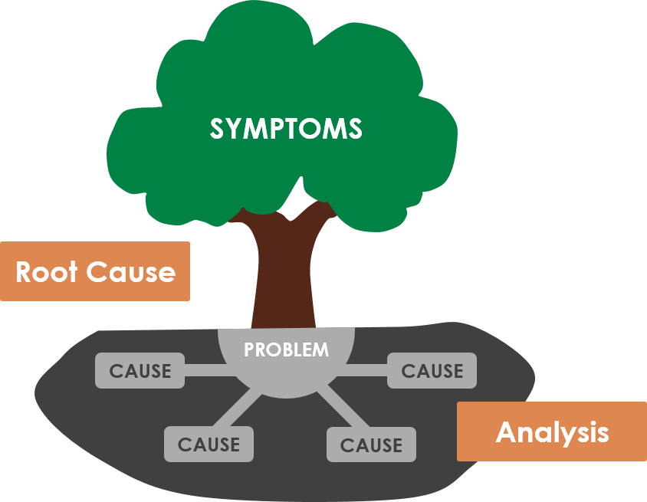
Root Cause Analysis: Key Points
Listen to the people on the front lines, especially staff and consumers
Explore each suggestion, rather than judging it
Identify the causes of the problem not the symptoms
Tools: fishbone diagram, 5 WHY’s
WHY, not Who
It’s the process, not the people
Addressing symptoms will allow continued recurrence of the problem
What we see
As a result…
What we don’t
Because…
Addressing the root cause aims to eliminate the problem
Notes:
Root Cause Analysis in Summary
Positive impact can have a ripple effect (up and downstream)
How contribute to the response
Be adaptable
How work together as a team (own interests and perspectives)
Many people, concurrent A3s work across roots

Slide 51
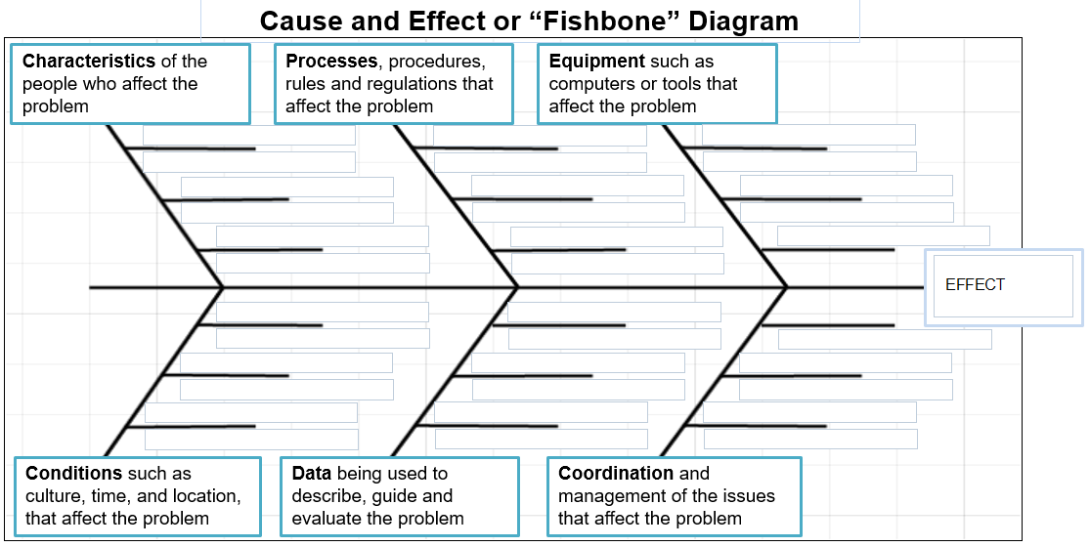
Cause and Effect or “Fishbone” Diagram
Notes:
Cause and Effect or “Fishbone” Diagram
Here is what a Fishbone diagram looks like. [click] fish [click]We start by writing the effect in the box to the far right. For most situations I like to use these six labels for the spines of the diagram. [read them]
In some cases you may want to use different labels that better fit the problem at hand…that’s fine. This is a brainstorming method: that means that we don’t criticize any of the causes suggested by the team. But be sure to point out that you don’t want personal blame on the diagram: you just want system factors could impact the problem.

Slide 52
Cause and Effect or “Fishbone” Diagram
Causes
Causes
Notes:
Root Cause Analysis Tools: Fishbone
Brainstorming with a purpose !!
RCA is a tool that works only when it is part of a philosophy that respects each of the people in the process and looks for ways to make the process better, without blame.
Most errors have many little causes that combine to create the problem. We need to explore all the issues that might have contributed to the error before we try to prevent it. Plan to involve all of the care team as well as patients in discussing possible causes of the error. The fishbone diagram helps to organize the ideas collected at the Root Cause Analysis brainstorming session.
[click] Here is a root cause analysis that our staff at PRHI did as a result of our recent observations. At your next training session you will improve upon our initial effort
The factors that cause the problems that affect the quality of our work:
People Processes
Equipment
Conditions
Data
Coordination

Slide 53
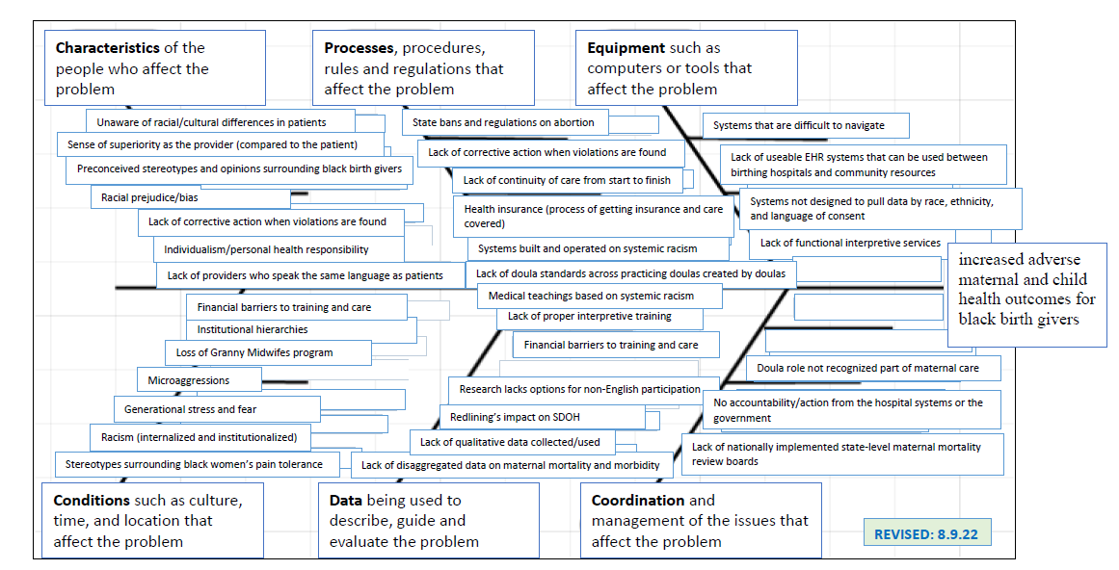
Root Cause Analysis Example
Notes:
Honed in on a few to practice the problem scope team tool (float in)
Here are themes that have arisen from discussions

Slide 54
Action Planning
Action Plan Template
Notes:
-Effective management depends on a shared understanding of project design and expectations. This requires action planning to communicate action items, responsibilities and results, as well as barriers.
-The action plan should be used as an integral part of every team meeting to communicate status updates and changes to activities of work. As a documented communication tool, the action plan supports structured meeting discussion to foster accountability and provide opportunities to discuss and address obstacles.
-Changes in priorities and staffing inevitably interfere with due dates but building this into the team dynamics supports the implementation, spread and sustainability of a culture of quality.

Slide 55
Summary
Quality improvement
Plan-Do-Study-act

Slide 56
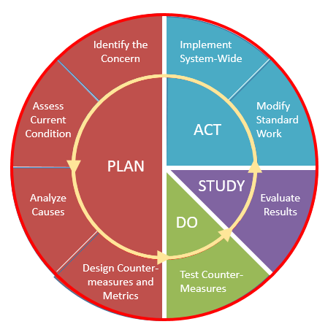
Value is improved one step at a time
Try again
Learn
Each PDSA gets you closer to success
Reflect on results
Improvement
Causes
Try
PDSA
PDSA
IDEAL
Target Conditions
PDSA
Defect-free, one-by-one, on demand, delivered immediately, no waste, safe
Current
Condition
Notes:
56
-A learning organization would also have adopted system-wide application of iterative PDSA Thinking to maintain a strategic, continuous improvement focus to address problems that align with strategic goals on the path to the IDEAL. The repeated PDSA cycles enable a learning organization to adapt to change through real-time learning, experimenting, reflecting on results, and trying again.

Slide 57
Value of PDSA Thinking
Rooted in the scientific method
Standardized and systematic approach to iteratively address problems
Organizational culture driven by leadership actively engaged in continuous improvement
Deeper examination of problems by team members at all organizational levels
Builds system stability and reliability using lean design principles
QI Tool
This is hard work!
Core Values:
Continuous improvement
Respect for people
“Everyone, every day, closer to better”
Notes:
-few key points on PDSA Thinking.

Slide 59
Wrap Up & Next Steps
Sara Nelis, RN
Project Manager
Jewish Healthcare Foundation

Slide 60
QI Participation Reminder for Q1 2023
Milestone 1: Attend a Virtual Session
Milestone 2: Submit a Quality Improvement (QI) Report Out, showing work related to implementing Key Intervention(s) April 30, 2023
Milestone 3: Complete a PA PQC quarterly survey for the initiative April 30, 2023
Milestone 4: Submit at least one quarter’s worth of aggregated data for a PA PQC process or outcomes measure(s) through Life QI April 30, 2023
Milestone 5: Communicate and celebrate your team’s impact! April 30, 2023
https://www.whamglobal.org/pa-pqc-initiatives/criteria-for-quality-improvement-awards

Slide 61
2023 Theme: Continuum of Care
Recruitment: January to March 2023
Implementation: April 2023 to March 2024
Sustaining: April 2024 to March 2025
Please complete the Annual Enrollment Survey by March 31 →
Notes:
As a reminder, the focus for the 2023-2024 implementation period is the continuum of care and making meaningful connections with outpatient and community organizations from the prenatal period all the way through the newborn and postpartum period.
Please remember that each team will need to complete the annual enrollment form no later than March 31st. By submitting this survey, your team will be committing to being an active participant in the PA PQC. This is also when your team will be selecting one or more initiatives to engage in for the April 2023 to March 2024 period.

Slide 62
Upcoming Learning Opportunities
Annual Meeting
May 4, 8:30 a.m. to 4:30 p.m.
In-person only!
Speak Up! Training – March 23 & 30
NAS Symposium presented by Mercer County Children & Youth, Sharon, PA – May 19
https://www.whamglobal.org/member-content/register-for-sessions
https://www.whamglobal.org/member-content/additional-events
Notes:
The Annual meeting is being held at the Harrisburg Hilton on May 4th and will mark our return to a completely in-person event! We have lots of exciting things in the works for you and look forward to having time to network and collaborate in person. Please plan to bring your peoject plan to the meeting so teams can share during their regional breakout.
Mercer County’s NAS symposium is approaching and you can find more details on the additional events page.

Slide 63
Credentialing Guidelines:
PLEASE complete the electronic evaluations by Thursday, March 23rd
Please indicate on the evaluation which CEUs you are requesting: CME, CNE or Social Worker credits.
The UPMC Center for Continuing Education will follow up with you, via email, after Thursday, March 23rd notify you about how you can claim your credits.
https://www.surveymonkey.com/r/98WCBB6

