Slide 1
Neuro Devices

Slide 2
EVD vs Codman

Slide 3
Brain Spaces

Slide 4
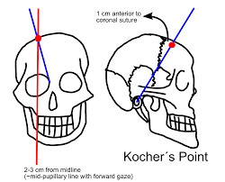
Landmarks for Placement
Notes:
Be respectful to the surgeons and ask preferences. Limit amount of people and infection risk.

Slide 5
EVD Placement

Slide 6
EVD Placement

Slide 7
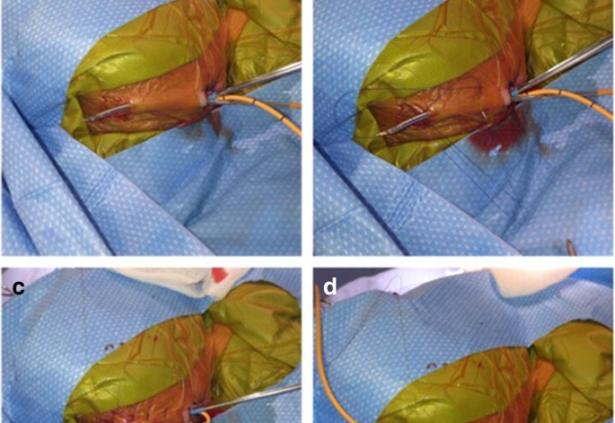
Tunneling the EVD

Slide 8
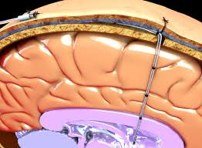
Codman

Slide 9
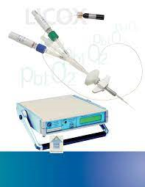
Licox

Slide 10
Placing the Codman in the Licox

Slide 11
Neurosurgery Considerations
They don’t use the same stuff at Presby
They are placing the devices and used for neurocritical care management
Self priming in most hospitals
Codman and Camino differences
Medical Management vs. Surgical

Slide 12
Nursing Considerations
Sedation
Prep of equipment
DO NOT PRIME EVD UNTIL SURGEON READY TO START!
Time Out
Documentation
Cultures and Care
Antibiotics and lab values

Slide 13
Documentation
EVD orders and documentation
Codman documentation
Licox documentation
LD documentation

Slide 14
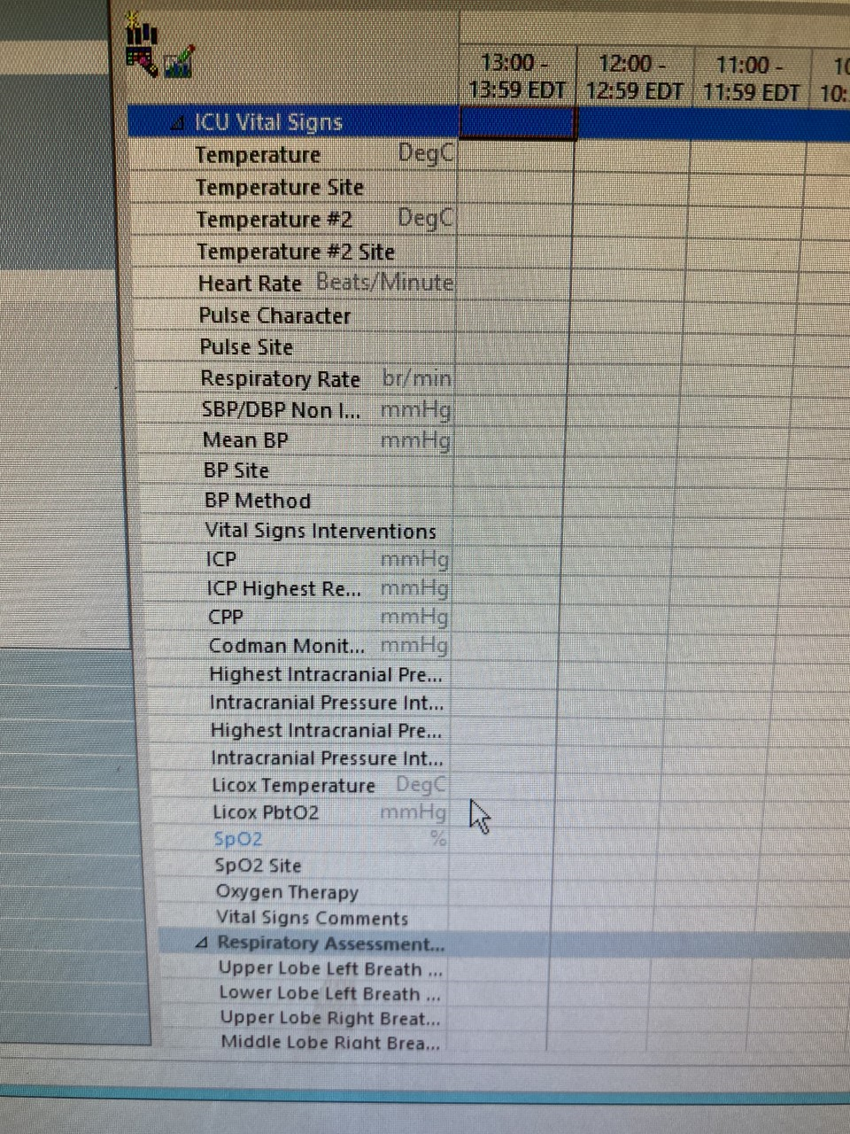
EVD/Codman Documentation
ICU detailed for site and care
ICU frequent for ICP, Highest ICP, CPP

Slide 15
EVD Set-Up
Must add transducer and Prime through
Use sterile saline and prime sterile
Use sterile Drape not towel
Only prime system just before procedure

Slide 16
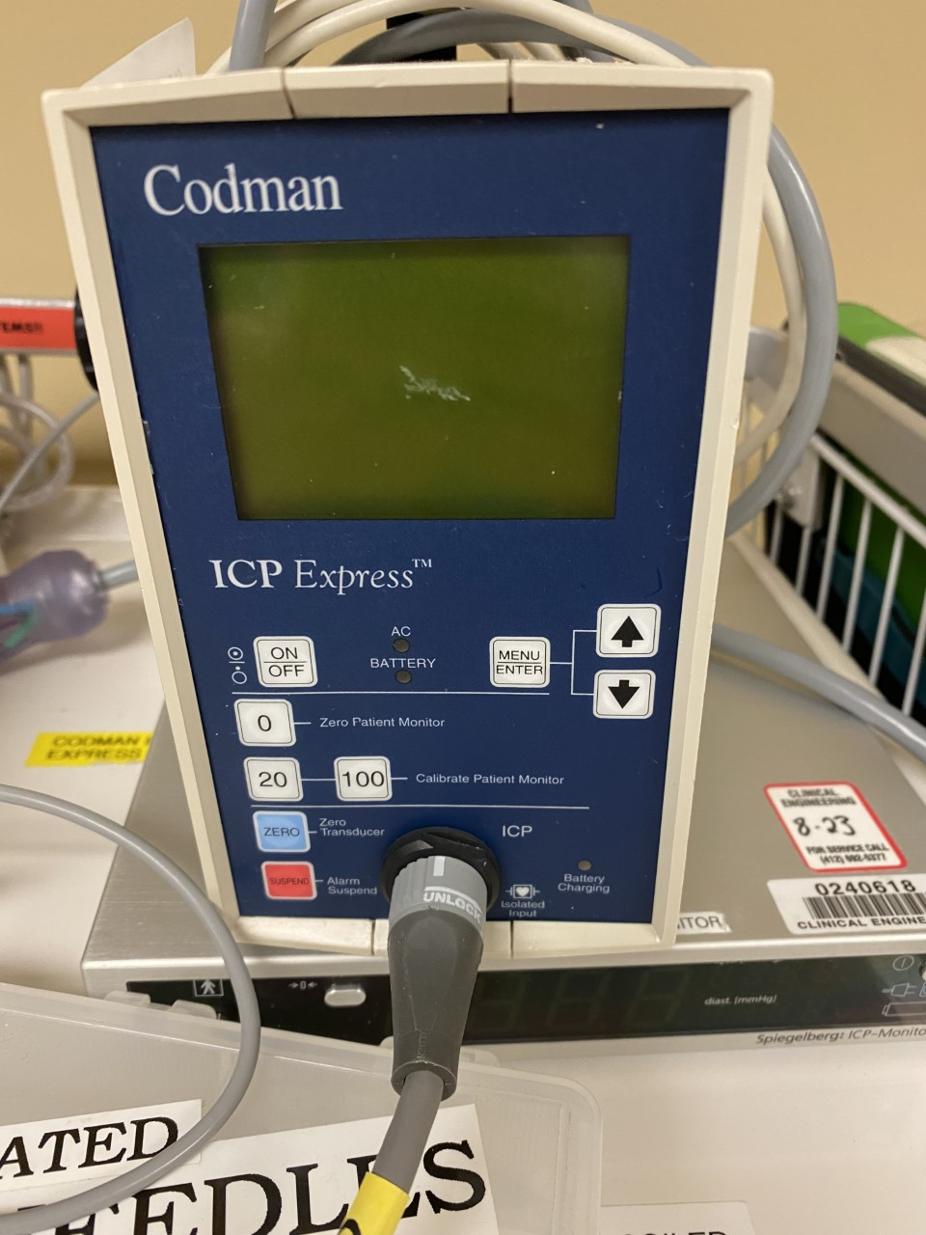
Codman Set-up
Must zero to patient monitor When zero to bedside monitor will ask hit 20/100. Then zero transducer prior to insertion. This is zeroed in sterile water just prior to insertion.
Zero Codman every 4 hours and PRN
When have a continuous ICP monitoring (Codman) have RT add ETCO2 monitoring to the bedside monitor. If needed and pt. intubated can remove RR to monitor.

Slide 17
Licox Documentation and Set Up
Must keep the smart card for monitor
With new monitor must zero Licox to patient monitor (label as SP)
Need the extra cassette for enough ports to attach Licox
Licox temperature is accurate immediately
Licox PO2 may take up to 8-12 hours to calibrate and be accurate
NOT MRI safe

Slide 18
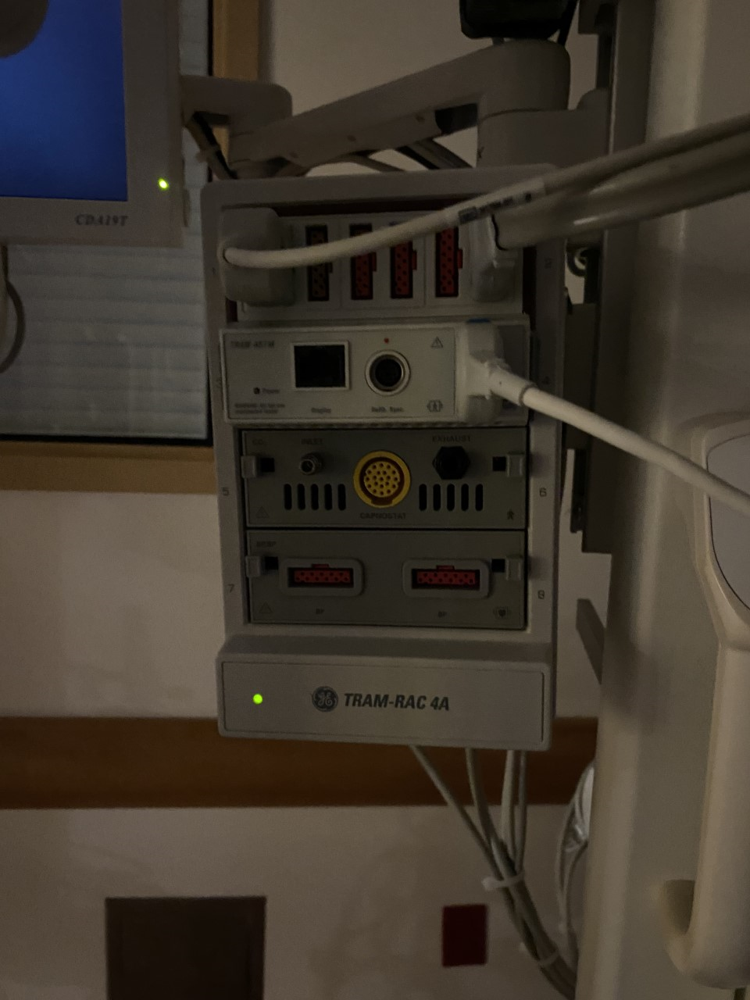
Monitor Set-Up
ETCO2
Licox

Slide 19
LD documentation and Care
Why do we use LD?
Open to drain volume
How to level
Order for LD

Slide 20
CSF Cultures
Done Daily when ordered
Change CSF bag when ¾ full or if infectious changed daily
Done sterile
Must document
Minimum 2 cc
1 in CSF tube for lab (protein, cell count, glucose)
1 in CSF tube for culture

Slide 21
Overview ICP management
Always HOB 30 degrees unless indicated
Sedation (no benzos/ketamine)
Paralysis
Barbs?
CO2 management
Temperature management
Sodium management
Mannitol (typically prior to PICU)

Slide 22
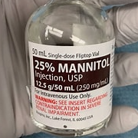
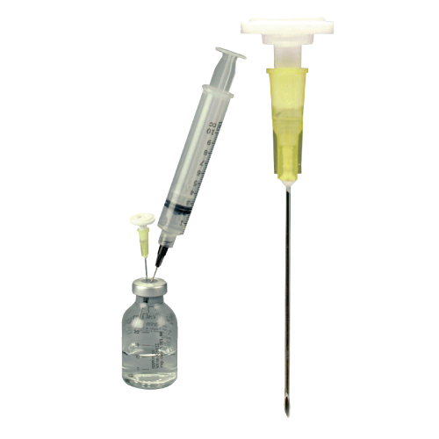
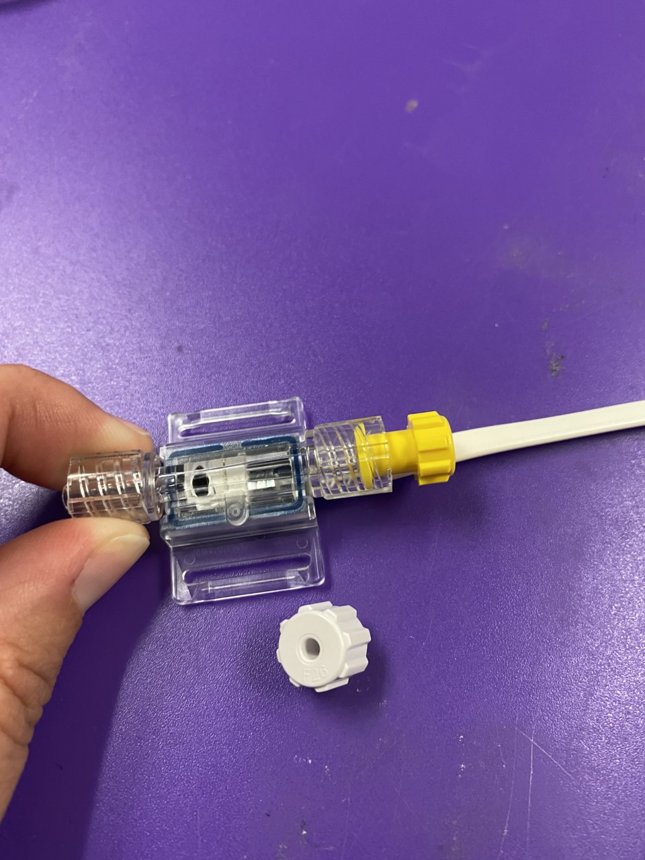
Nursing Tips
Mannitol- calculate dosing
Filter
3%-Accudose 4
EVD during transport
Transducer is MRI safe
Transducer must have dead-end

Slide 23
Trouble Shooting
Is the EVD clamped?
Is the EVD zeroed?
Is there a dead-end on transducer?
Is there a visual obstruction?
Is there tidaling?
What happens when there is no drainage? What is the ICP?
Flushing the system?

Slide 24
When to Call Neurosurgery
When the trouble shooting is unsuccessful and EVD is not functional
When ICP remains high after medical management
When EVD is clamped and there is ICP spikes
When there is leaking at the site
When the site looks infected or drainage

Slide 25
Clamping
Clamping for a trial is to determine when the drain can come out.
Clamping should remain that the EVD is clamped at the buretrol to prevent drainage yet allow read of ICP.
Clamping at the patient will prevent the ICP monitoring.

Slide 26
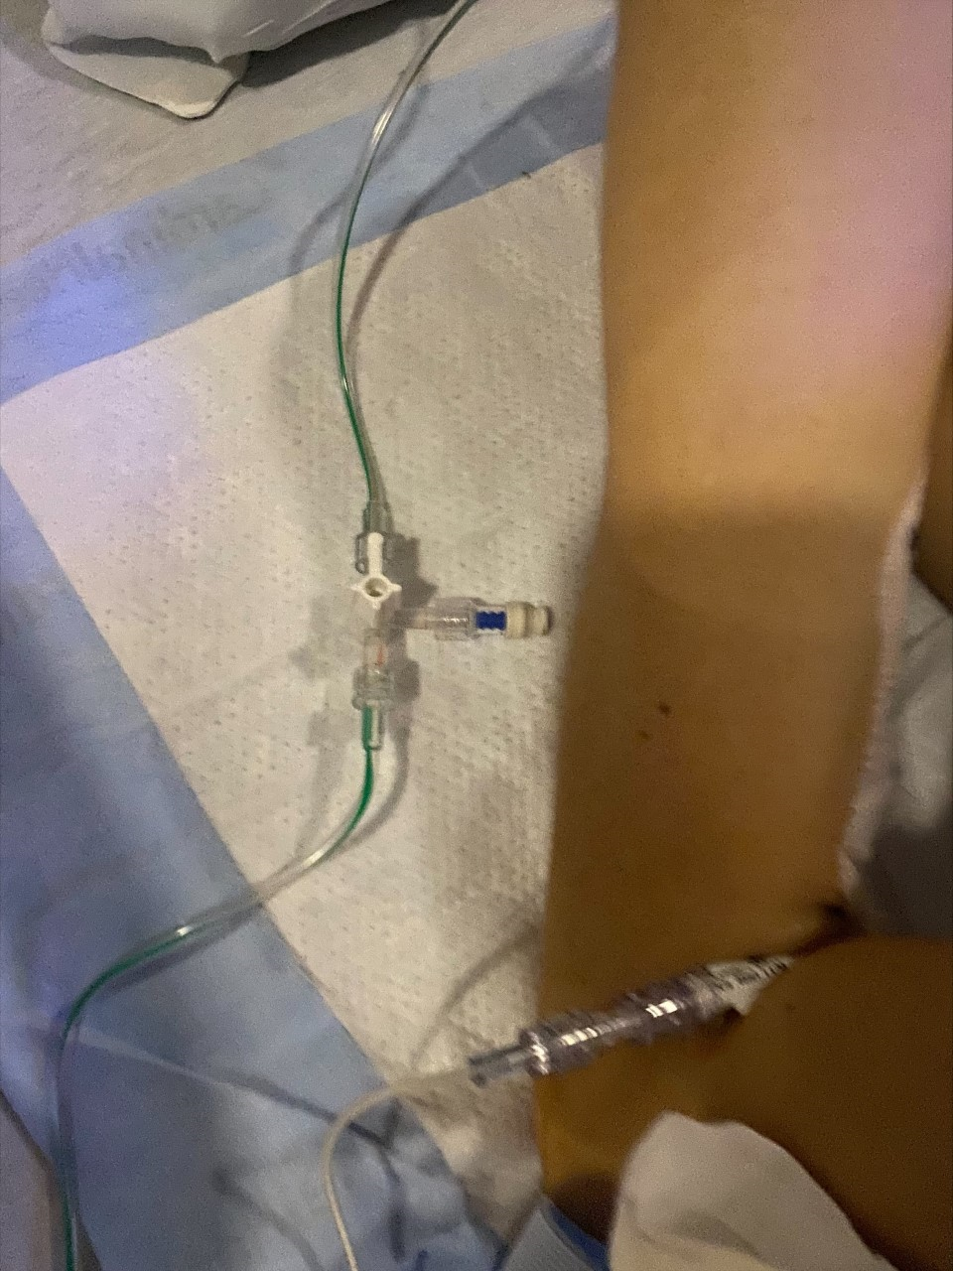
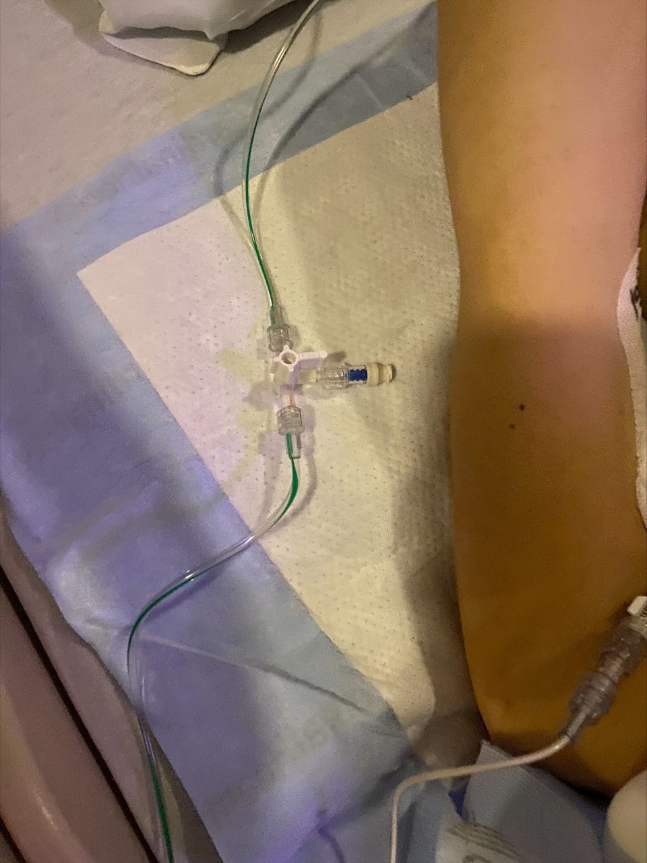
Clamping images

Slide 27
New Stuff at Presby

Slide 28
New Stuff at Presby

Slide 29
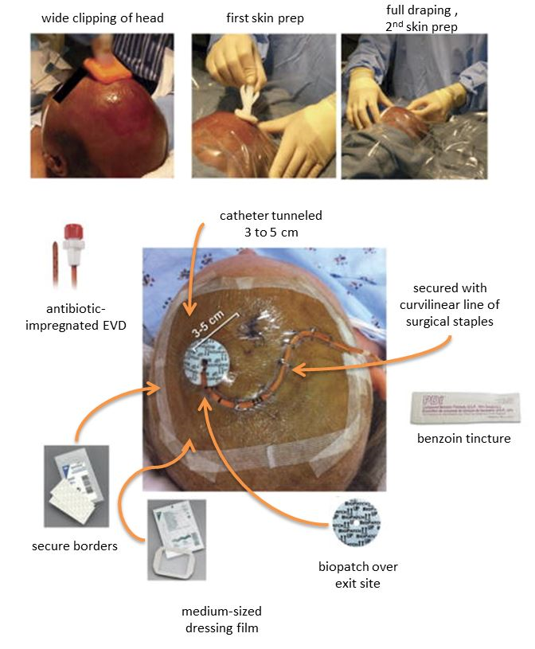
Potential Future Care
Standardizing EVD dressing Care

