Slide 1
Perinatal & Neonatal Loss
Audrey Wrobel, LSW (she/her)
Social Worker & Bereavement Coordinator

Slide 2
Disclosures
No members of the planning committee, speakers, presenters, authors, content reviewers and/or anyone else in a position to control the content of this education activity have relevant financial relationships with any companies whose primary business is producing, marketing, selling, reselling, or distributing healthcare products used by or on patients.

Slide 3
Objectives
Build skills to effectively and compassionately care for patients who experience perinatal loss.
Identify resources available to families who experience perinatal loss.
Gain a better understanding of grief in perinatal loss.
Understand how to support families who experience pregnancy after loss.

Slide 4
Perinatal and Neonatal Loss
Perinatal loss: loss at any stage of pregnancy or a newborn death.
Ectopic pregnancy, early term losses/miscarriage (< 20w gestation), stillbirth (> 20w gestation), newborn death (< 28 days of life).
Neonatal loss: death of infant > 28 days of life.
Parents and their families may grieve for the loss of a child even if there is not a physical body to see and to hold.
“She wasn’t just expecting a baby; she was expecting the rest of her life.”
Gunderson Health System, 2023
Baby Loss Advisor Baby Doulas, 2023

Slide 5
Perinatal and Neonatal Loss Complicated and Layered Grief
Loss of…
A Person/Child
A Lifetime
Hopes, Dreams and Plans
Ability to Actively Parent
Watching Partner/Family with the Baby
Family Constellation
Control of Body

Slide 6
Baby or a Part of Life?
75%
Limbo & Kobler, 2010; Côté-Arsenault & Dombeck, 2001

Slide 7
Perinatal Loss at Magee
Units provide excellent bereavement support and aid in memory-making
MWH Social Work provided support and resources during admission
No formal anticipatory, outpatient, or post-discharge grief support offered at MWH
“Grief reactions may be compounded by secondary losses, such as the loss of support from the child’s medical team” (Lichtenthal et. al., 2015)
Abrupt end to care experienced as abandonment
Contact from healthcare professionals has an impact on parents’ bereavement adjustment (Raitio, Kaunonen, & Aho, 2015)

Slide 8
Bereavement Coordinator
Engage with perinatal loss families
Provide bereavement support, grief education, and resources
Refer to appropriate organizations/providers
Disposition planning
Provide long-term outpatient follow-up (24 months post-loss)
Perinatal loss 20+ weeks gestation
Not yet including TFMR and TA patients
Coordinate Magee’s Perinatal Loss Remembrance Ceremony
Spring and Winter ceremonies

Slide 9
Perinatal Supportive Care
Neonatologist, Neonatal Nurse Practitioner, Social Worker
Support during the pregnancy
Formation of parent-child bond
Anticipatory Grief
Resources
Intrapartum Care Planning
Birth and Parenting Preference Plan
Comfort Care

Slide 10
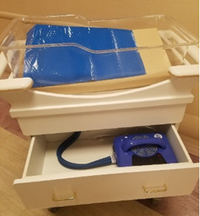
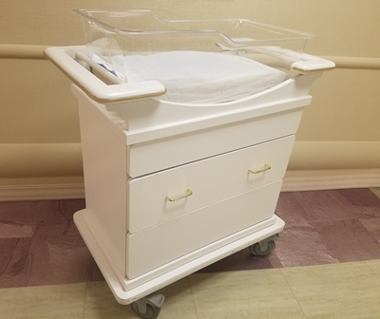
Identifying a Loss Patient
Room Cards
Cuddle Cots
Crib that has been outfitted with a cooling system which slows the natural death process to allow families to spend more time with their baby
Perinatal Loss
Gundersen Medical Foundation, 2012
CMO
Developed by ICU and Palliative Care Team
Twin Loss
Newcastle Health System

Slide 11
Supporting the Bereaved Family: Saying “Hello”
Encourage parents to parent
Seeing and holding baby
Dressing and changing baby
Bathing baby
Tucking in baby
Singing, telling stories, dancing
Baptism/Prayer Service
Introduce baby to others
Participate in memory-making
Memory-making
Pictures
Handprints/footprints
Locks of hair
Molds
Creative outlets (bead bracelets, drawings, artwork)

Slide 12
Memory-Making
Magee works with many generous donors who provide us with kits for memory-making.
Still Remembered Project
Bridget’s Cradles
Queen B Project
Mr. Boxes
Magee Knitters
Comfort Cub (NICU): weighted bear
Still Remembered Project
Bridget’s Cradles
Comfort Cub

Slide 13
Pictures
History of photography
Trained nurses can offer to take pictures of the baby, parents with the baby, and other family members with the baby.
Pictures are offered even in the presence of significant anomalies.
Some photos can be printed immediately and given to families. Photographs are sent to Now I Lay Me Down To Sleep for editing and distribution to families.

Slide 14
Pittsburgh Bereavement Doulas
Provide physical, emotional, and informational support during labor and birth
Early-term Loss (miscarriage), Stillbirth, Life-Limiting Diagnosis
FREE service
CONTACT:
Director, Heather Bradley: 412-901-9568
www.pittsburghbereavementdoulas.com

Slide 15
Communication Strategies
Goal is not to “fix”; goal is to be with and support grief.
DOs:
Use baby’s name, compliment baby’s features
Remain genuine and demonstrate empathy
Supportive statements: “My heart aches for you right now”. “I’m so sad for you.” “I’m here to listen.”
“I wish” statements: “I wish your baby didn’t have this condition.” “I wish things were different.”
Use concrete terms: death, died, will die
Compassionate silence
Appropriate physical touch (with consent)
Identify and include support persons
Gunderson Health System, 2023

Slide 16
Communication Strategies (cont.)
DONTs:
Ignore baby in the crib
Moralizing statements
“Everything happens for a reason.”
“At least” statements
“At least you’re young and can have more children.” “At least you have another baby.” (twin loss)
Dominate the conversation
Make choices for the family
Gunderson Health System, 2023

Slide 17
Respectful Disposition
< 16 Weeks Gestation | > 16 Weeks Gestation
Take baby home (State burial laws) | Take baby home (Transit Permit through Funeral Director/Registrar)
Funeral Home for Burial or Cremation | Funeral Home for Burial or Cremation
Hospital Disposition (Will not receive remains) | Hospital Disposition (Will not receive remains)
Autopsy is free to the patient at Magee (genetic testing is not free)
Emma’s Footprints, TEARS Foundation (provides financial assistance)
UPMC Policy: HS-WH0002

Slide 18
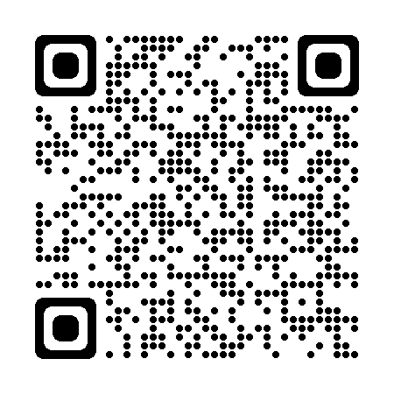
Taking Their Baby Home
Historically common for families to care for their deceased loved ones at home
Amish
Therapeutic benefits:
Expressing their love
Introduce to friends and family
Creating shared memories
Process:
Contact funeral home for “Burial Transit Permit” OR local Registrar (they need copy of the death certificate to issue)
Health.PA.Gov to download “List of Local Registrars”
Copy given to family for transport
Morgue has small coffins to give to families and unit can supply ice
PBD: Hugs at Home
Pittsburgh Bereavement Doulas, 2023

Slide 19
Grief in Perinatal and Neonatal Loss
Grief is a normal, healthy, unique, and universal response to loss
Physical, behavioral, affective, cognitive, spiritual responses
“Grief is not a sign of weakness…it is the price of love.”
PPD screening for bereaved parents
Multitude of emotions vs stages
Finding continued bond with the deceased
Grief can be delayed but not denied
Disenfranchised grief
Providing tools vs solutions
Support system, hydrating/fueling, sleeping, movement
Gunderson Health System, 2023
Baby Loss Advisor Baby Doulas, 2023

Slide 20
Grief: Perinatal and Neonatal Loss (cont)
Grief and the family
Mother vs Father grief
Grandparent grief
Sibling Grief
Highmark Caring Place
Supporting families
Telling their story
Finding ways to honor their baby
Don’t automatically or too freely offer to medicate their pain
VALIDATE
Ensure they have memories
Connection to resources: support group, grief counselor
Gunderson Health System, 2023
Baby Loss Advisor Baby Doulas, 2023

Slide 21
Pregnancy After Loss
Being pregnant and welcoming a new baby can be a bittersweet time to many parents who have experience pregnancy or infant loss
Disbelief, doubt, emptiness, excitement, fear, guilt, hope, joy, regret, relief
Tips for HCP
Pause: Take a moment to review history; be fully present; provide reassurance and take time to answer questions (may have to repeat)
Acknowledge: Ask about previous loss; understand the complexity of the relationship between the patient and her body (may have a hard time trusting her body – guilt)
Listen: Take time to understand emotional needs; convey empathy
Support: Provide emotional support, one baby does not replace another; connect to support groups
Pregnancy After Loss Support, 2023

Slide 22
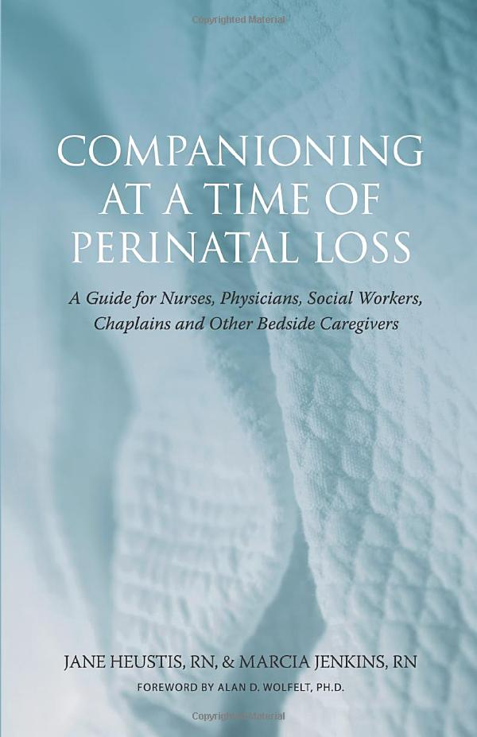
How Can We Help?
We Can Never Say the “Right” Thing
Companioning, Dr. Alan Wolfelt
Companioning is about curiosity; it is not about expertise.
Companioning is about walking alongside; it is not about leading or being led.
Companioning is about being present to another person’s pain; it is not about taking away or relieving the pain.
Companioning is about going to the wilderness of the soul with another human being; it is not about thinking you are responsible for finding the way out.
Heustisk, Jenkins, & Wolfelt, 2005

Slide 23
Questions?
wrobelaj2@upmc.edu / 412-641-1178

Slide 24
References
Baby Loss Advisor Baby Doula Workshop. (2023). www.babylossfamilyadvisors.org
Côté-Arsenault, D., & Dombeck, M. T. (2001). Maternal assignment of fetal personhood to a previous pregnancy loss: Relationship to anxiety in the current pregnancy. Health Care for Women International, 22(7), 649-665.
Gunderson Health System. (2023). Perinatal Death. www.resolvethroughsharing.org
Heneke. (2019). Tips for healthcare providers when treating the mom experiencing pregnancy after loss (PALS). Pregnancy After Loss Support. www.pregnancyafterlosssupport.org
Heustis, J., Jenkins, M., & Wolfelt, A. D. (2005). Companioning at a time of perinatal loss: A guide for nurses, physicians, social workers, chaplains and other bedside caregivers. Companion Press.
Levick, J., Fannon, J., Bodemann, J., Munch, S., & Ahern, K. (2017). NICU bereavement care and follow-up support for families and staff. Advances in Neonatal Care, 17(6), 451-460.
Lichtenthal, W. G., Sweeney, C. R., Roberts, K. E., Corner, G. W., Donovan, L. A., Prigerson, H. G., & Wiener, L. (2015). Bereavement follow‐up after the death of a child as a standard of care in pediatric oncology. Pediatric blood & cancer, 62(S5), S834-S869.
Limbo, R., & Kobler, K. (2010). The tie that binds: Relationships in perinatal bereavement. MCN: The American Journal of Maternal/Child Nursing, 35(6), 316-321.
Newcastle Health System. (2023). The Butterfly Project. https://www.neonatalbutterflyproject.org/
Pittsburgh Bereavement Doulas. (2023). www.pittsburghbereavementdoulas.com
Raitio, K., Kaunonen, M., & Aho, A. L. (2015). Evaluating a bereavement follow‐up intervention for grieving mothers after the death of a child. Scandinavian Journal of Caring Sciences, 29(3), 510-520.

