Slide 1
An Innovative Educational Strategy to Influence Cultural Competence Utilizing Clinical Simulation with Diverse Standardized Patients Tiffany S Johnson DNP, MSNEd, RN Assistant Professor Carlow University

Slide 2
Dimensions of Diversity Wheel
Jamboard
Notes:
I would like to start with a ice breaker.
This Wheel represents the types of diversity that can exist in any environment.
Often times, the categories can overlap representing intersectionality
Look at the wheel and think of
5 things that describe who they are—the top five things they think of when they think to describe themselves.
Invite participants to locate their characteristics on the Diversity Wheel, place characteristics anonymously on the jamboard?
How did you identify yourself and what they noticed when they tried to put their characteristics into the areas of the wheel.
Identify as 39 year old female, AA, middle class, with a DNP
https://jamboard.google.com/d/1uHOtcMQWo7c5P1WH4Fd3M9UaYYZnzLGr076yV3sr_qo/viewer?f=0
This Wheel represent the various types of diversity, Which leads me into the reason why I choose this project and it is essential for nurses and students to develop CC

Slide 3
Background
Increase in racial and ethnic diversity in the US (Ozkara, 2015; Foronda et al., 2018)
Challenges
Culturally competent care (Foronda et al., 2018)
Patient safety events (Agency for Healthcare Research and Quality, 2019)
Notes:
The racial and ethic diversity is increasing in the US.
There are challenges to the healthcare field to meet the needs of the increase in the diverse population.
The Nursing Workforce Survey in 2017 indicates that 26.7% of nurses identify with a minority background.
Various authors state that the increase of diverse populations and lack of diverse nurses has caused challenges to healthcare team related to meeting the needs of diverse patients; nursing school graduates are not always prepared to implement cultural competence upon completing nursing school.
Therefore, it is essential for nurses to deliver CC nursing care.
Patient safety events occur due to a lack of CC

Slide 4
Why?
Misunderstanding
Assumptions
Misinterpretation
Lack of awareness
Notes:
I am a full-time faculty member at a small liberal arts university in Pittsburgh, Pa in the USA where Most of the students are 1st generation college students. Upon hire, joined the curriculum committee for the undergraduate nursing program that I taught. I discovered a lack interventions related to CC and a deficiency in self awareness in nursing students. This is topic that I am passionate about. Due to the # of students being 1st generation, the increase in diversity in the US and Lack of diverse nurses, I felt it was essential to attempt to increase the levels of CC in all nursing students at the local university.
As I stated in the previous slide Lack of CC can cause patient safety events. Examples include:
A consent form not being obtained due to lack of communication from a patient because there was not a male around.
A nurse assuming that a patient does not want blood products just because they are Jehovah’s Witness
A nurse misinterprets silence from a patient and does not appropriately assess a patient.
Nurses rely on children to serve as interpreters putting them in a position to tell the patient they have cancer.

Slide 5
Definition of Terms
Cultural Competence
Cultural Humility
Cultural Competmility
(Campinha-Bacote, 2002;Harkess & Kaddura, 2015 p. 211;Tervalon & Murray Garcia, 1998)
Notes:
Definition of terms
Cultural Competence- Knowledge, attitudes and skills needed to enhance cross –cultural communication and appropriate, significant interactions with others
CH- lifelong commitment focused on self-evaluation and self-critique to redress the power of imbalances in the patient-physician dynamic and to develop mutually beneficial and non-paternalistic clinical and advocacy partnerships with communities on behalf of individual and defined populations
competmility- combines cultural competence and cultural humility that includes the five contrasts of culturally competent care

Slide 6
Constructs of Cultural Competence
Cultural Desire
Cultural Skill
Cultural Awareness
Cultural Knowledge
Cultural Encounters
Notes:
CD- commitment and drive to care for diverse populations
CS- ability to complete a cultural assessment and consider cultural needs
CA- self reflection of personal views and biases
CK- active process of seeking information
CK- interactions of people with diverse backgrounds

Slide 7
Cultural Competence
Nurse Educator
Patient
Nurse
Notes:
This is essential to all healthcare providers.
As a nurse educator, it is essential to instill this concept in nursing students and provide students will the knowledge , skills and attitude to be able to care for patients of diverse cultures. Including racial and ethnic values that inform healthcare beliefs.
As a nurse or any healthcare professional it is vital to understand who your patients are and have the knowledge to be able provide them the culturally appropriate care
As a patient it is important feel confident that healthcare providers are familiar with this concept. Patients of diverse cultures can be hesitant to advocate for their healthcare needs.

Slide 8
Standardized Patients
Standardized Patient
Diverse Standardized Patient
Notes:
Weisenbrg states that, a Standardized patient- independent professionals trained to depict patient scenarios for the instruction and assessment of clinical skills in healthcare students (Wisenberg, 2017).
A diverse standardized patient is an individual that includes any or a combination of the following criteria: veteran status, gender, race, ethnicity, disability, age, sexual orientation, religion, or socioeconomic status.

Slide 9
PICOT Question
Over a 3-month period, does the use of clinical simulation using diverse standardized patients influence the levels of cultural competence in senior nursing students?

Slide 10
Available Knowledge
Cultural Assessment
Oral Presentations
Guest Speakers
Case Studies
Journal Articles
Cultural Immersion
Role Play
Pamphlets
Care plan
(AACN, 2019)

Slide 11
Available Knowledge Continued
Cultural Competence Interventions have varied (Fioravanti et al., 2018; Foronda et al., 2018; Glenn & Claman, 2020; Harkess & Kaddoura, 2015; Ndiwane & Theroux, 2014; Ozkara, 2019; Ozkara, 2015; San, 2019; Weideman et al., 2016).
Immediate feedback (Drevdhal, 2017)
Therapeutic relationships (Byrne 2019; Min- Yu Lau et al. 2016)
Notes:
There are various EB interventions to influence CC. I choose clinical simulation due to the ability for students to be able to practice in a risk free environment
Fioravanti and other authors have indicated the structure of the simulation has varied. It has included traditional simulation along with lectures, video recorded presentations of patients with diverse background , cultural sensitivity training programs with simulation, role play, and mannikins used for simulation
According to Drevdhal, the use of simulation allows students receive immediate feedback which improves knowledge, skills and confidence (Drevdhal, 2017)
According to Bryne and Min- Yu Lau student are able to create therapeutic relationships, increasing the levels of cultural competence, cultural empathy, cultural awareness, cultural knowledge, cultural desire, cultural encounter, and cultural skill (Byrne 2019; Min- Yu Lau et al. 2016).

Slide 12
Intervention
Pre-simulation
Simulations
Debriefing
Notes:
Students were expected to complete presimulation work. These materials were placed on universities learning management system in a group site folder that specifically contained the materials for each simulation
The work involved students completing a cultural assessment that allowed students to reflect on personal biases, reading journals articles regarding culturally competent care and reading articles related to cultural practices of both the Asian and Latino background
The students were expected to complete the work prior to each simulation.
One simulation included an individual of Asian descent was a patient who was going a vaccination clinic to have a COVID-19 vaccination administered. The patient was hesitant because they wanted to use herbs to protect their immune system instead of receiving the vaccination. Students were expected to give the patient education regarding the vaccination while respecting the patients' cultural values.
The second simulation was a newly diagnosed Diabetic Hispanic patient that spoke limited English. The patient did not complete the necessary treatment and required education regarding the new diagnosis. The students were expected to consult a medical interpreter for the patient.
Following the simulations, students were expected to reflect on the experience by discussing the influence of the patient's culture on their care. Furthermore, the students were expected to reflect positive interactions and opportunities for improvement.

Slide 13
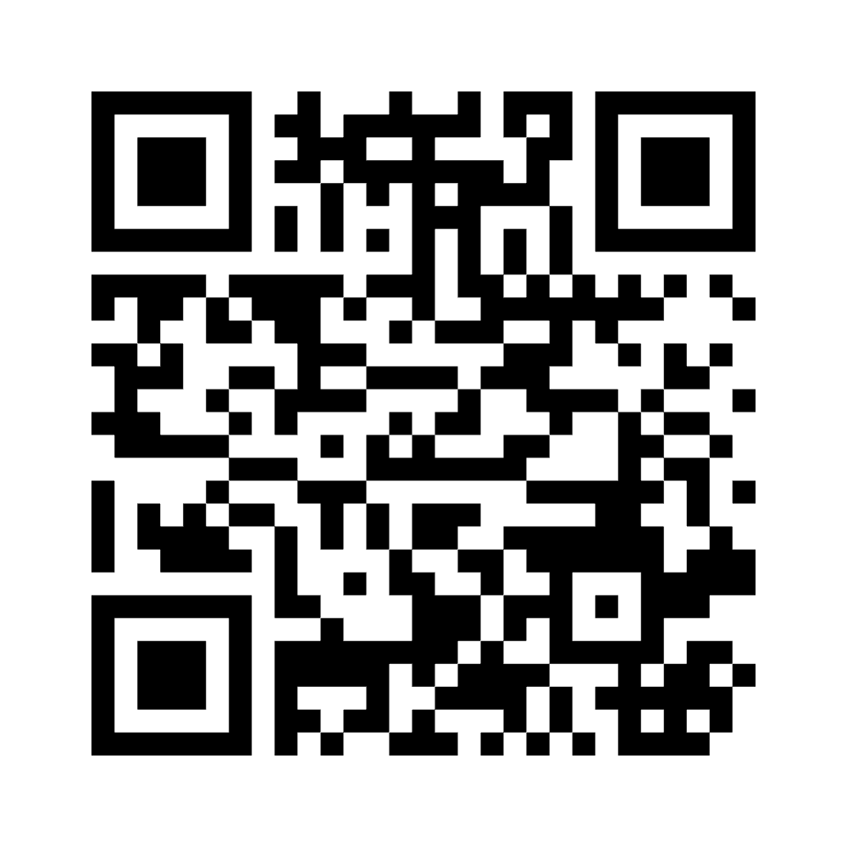
Pre-Simulation
Cultural Assessment
Videos
Journal Articles
Notes:
Cultural Assessment- https://www.menti.com/aln44xjce93c
Journal Articles related to cultural practices of Asian and Hispanic Culture
Common Traidtions and Values of Each cultural

Slide 14
Cultural Assessment
What kinds of contact have I had with persons from different groups? Do I assume that others have the same values and beliefs that I have?
What makes me feel proud about my group affiliations? Am I ethnocentric in my attitudes and behavior? What would I change about my group affiliations if I could? Why?
Have I ever experienced the feeling of being rejected by another group? Did this experience heighten my sensitivity to other cultures or cause me to denigrate others different from myself?
When I was growing up, what messages did I get from parents and friends about people from groups different from mine? Do these attitudes cause me any difficulty today?
What are the major stereotypes I hold about people from different groups? Do these biases help or hinder me in developing cultural sensitivity?
To work effectively with people from different cultural groups, what do I need to change about myself?
Notes:
We have our students complete this as freshman and again as seniors to see if perspectives change. We encourage you to complete a cultural assessment every 5 years to see if there are any perspective changes on views

Slide 15
Simulations & Debriefing
Telehealth- New Diabetic Hispanic patient, primary language Spanish
Vaccination Clinic-Asian Patient, non-western medicine
Debriefing- Reflect on experience
Simulation
Notes:
One simulation included an individual of Asian descent was a patient who was going a vaccination clinic to have a COVID-19 vaccination administered. The patient was hesitant because they wanted to use herbs to protect their immune system instead of receiving the vaccination. Students were expected to give the patient education regarding the vaccination while respecting the patients' cultural values.
The second simulation was a newly diagnosed Diabetic Hispanic patient that spoke limited English. The patient did not complete the necessary treatment and required education regarding the new diagnosis. The students were expected to consult a medical interpreter for the patient.
Following the simulations, students were expected to reflect on the experience by discussing the influence of the patient's culture on their care. Furthermore, the students were expected to reflect positive interactions and opportunities for improvement.
https://carlow.hosted.panopto.com/Panopto/Pages/Viewer.aspx?id=7c8ff43c-4f7b-4851-8cf5-af2e0112bdc0

Slide 16
Telehealth Simulation Continued
The patient is a Mexican patient who is 65-year-old and newly diagnosed with type 11 diabetes this week. Was discharged from the hospital yesterday with consults for home care nurse (for diabetic teaching) and social work (to evaluate home environment and support resources). The daughter or son (depending on student) is with patient during home visit and reports patient has been “acting weird”. Patient has flat affect. The patient is drowsy, but easily aroused, sitting in chair with television on. Room is unkempt, dishes are filled in sink and diabetic supplies noted sitting on couch unopened. Social worker from homecare in patients living room when student nurse enters home to start homecare visit. Social worker will talk to student nurse and let them know what services they can offer for patient and son or daughter to assist.
Notes:
CC can be infused into any simulation or case study. There were cues throughout the simulation materials that are essential for the students to recognize the CC.
It is essential to not group race together. Hispanics can be from a number of different
The patients name was a common sir name of the Mexican culture.
Patient spoke Spanish, students had to call a medical interpreter
Males being concerned about being able to meet the needs of the family
Fear it will cause hypoglycemia
Feel like they are a burden on family

Slide 17
Cultural Competence Infused in Simulations
Cultural Knowledge
Cultural Skill
Cultural Desire
Cultural encounters
Cultural Awareness
Notes:
CK- Reading articles about the appropriate culture
CS- interacting with the standardized patient, respecting their views, and recognizing that the standardized patient may be making choices based on their cultural values or health practices.
CD- simulations about the patients increase their desire to learn more about patients with diverse backgrounds.
CE- provide an opportunities for the students to interact with patients of diverse cultures
CA- completing the personal cultural assessment and reading literature about the specific cultures

Slide 18
Tool
Inventory for Assessing Cultural Competence Among Healthcare Professionals-Student Version (IAPCC-SV) –Pre/Post Test
Demographic Survey
Notes:
The tool that was used to evaluate the data was the inventory for assessing cultural competence among healthcare professionals- student version
IAPCC-SV was developed by Dr. Campinha-Bacote and corresponds to her model. Her model, theory and tool were used in this EBRP
This tool has been used for decades and has been proven to be reliable and valid
In a study completed by Fike and other authors, the results indicate internal consistency (Cronbach's alpha) was .861, and comprehensive test and retest reliability were .938.

Slide 19
Analysis
Increase in overall scores.
Increase in subscales cultural knowledge, cultural skill and cultural encounters
Demographic Survey
Notes:
Following completion of the simulations, and an analysis was performed indicating…..
Statistically significant increase in self-reported pre and post test overall scores
And a Statistically significant increase in the self reported subscale scores for knowledge, skill and encounters.
Demographic Survey- There was not enough variation in the data addressing the demographics: race, residence outside of US, or other languages spoken to appropriately analyze the data.

Slide 20
Results
43 Students
Pre/Post Test
Match Paired T-Test
Notes:
43 Students initially participated in the study
3 were excluded for not completing Pre survey
2 additional students were not included in the Total score and Encounters analyses are they did not answer a question needed to determine post score in these categories.
Therefore, 38 students were used in the final data analysis that completed both the pre and post test
A match paired t test was performed
Yielding a statistically significant difference between both the self reported pre and post- test overall mean scores. (for CC) of the IPACC-SV of (p<0.0001).
The second analysis showed statistically significant increase in the subscales of cultural knowledge, cultural skill and cultural encounter.
The increase for cultural knowledge was (p0.001), for cultural skill was( p<0.0001) and cultural encounter was (p0.0001).
Cultural awareness may not have been influenced by the lack of pre-simulation work and Cultural Desire may not have been influenced by just 2 simulations
The results indicate a positive correlation between the use of clinical simulation with diverse standardized patients and the constructs of cultural competence

Slide 21
Discussion & Interpretation
Levels of cultural competence
Patient-centered care
Decreases health disparities & medical errors
Effective Communication
Comfort
Transcultural self-efficacy
Cultural sensitivity
Quality care
Notes:
Clinical simulation utilizing diverse standardized patients increases the levels of cultural competence and this intervention allows nursing faculty to deliver a innovative educational experience to enhance student learning.
It allows the student to gain insight, understanding, a better level of communication, comfort, transcultural self- efficacy, cultural sensitivity and decreases healthcare disparities
The art of nursing focuses on patient centered care. The simulation allowed students to focus on the patient by adapting the care to the patient based on their ethnic background
Making adaptions to the patient's care based on their culture decreases health care disparities and decreases medical errors.

Slide 22
So what for nursing?
Improves patient outcomes
Decreases medical errors
Increases patient satisfaction

Slide 23
What to do in practice?
4 C’s of Culture
Consider the problem?
Cause of the problem?
How they are coping with the problem?
How concerned they are with the problem?
Notes:
You may ask the patient, What do you think is wrong? What is worrying you?
What do you think caused the problem? How did this happen?
How serious is the problem for you?
How concerned are you?

Slide 24
LEARN Model
Listen
Explain
Acknowledge
Recommend
Negotiate
(Berlin & Fowkes, 1983)
Notes:
Listen with empathy
Provide Culturally relavant information and explain your perception
Acknowledge the other persons strengths then pointing out deficits
Recommend options, respect choices
Negotiate agreement

Slide 25
RESPECT Model
Rapport
Empathy
Support
Partnership
Explanations
Cultural Competence
Trust
(US Department of Health and Human Services- Office of Minority Health, 2020)
Notes:
R- connect on social level, see their point of view, suspend judgement
E- pt. has to come to you for help, seek understanding the rationale, acknowledge and legitimize feelings
S- barriers to care and compliance, help overcome barriers, involve family
P- flexible, negotiate roles when necessary
E-Check often for understanding, verbal clarification techniques
C- respect beliefs, understand views the may be define but cultural and ethnic stereotypes, be aware of your own cultural perceptions, know your limitations, understand personal style
T- Recognize self disclosure may be difficult for some patients, conscious work to establish trust

Slide 26
Personal Journey
Conversations
Activities
Read
Professional Development
Cultural Immersion
Use Models
Notes:
I challenge you all
Start with a conversation with someone you may not know. Family traditions? Celebrations? What food is served?
Play games, role play- I purchased a game called Diversophy that we started to implement at faculty meetings to learn more about each other
Journal Articles
Professional Development Seminars
Spend time with other cultures

Slide 27
What’s Next?
Sustainability
Implement
Evaluate
Notes:
Sustain the project in the course
Implement CSDSP in programs like PT/OT, CRNP, PA
Evaluate Patient outcomes

Slide 28
Conclusions
Health disparities
Diverse standardized patients
Experiential learning
Practice
Transferable
Sustainability
Patient outcomes
Medical errors
Notes:
The delivery of culturally competent care affects health disparities and decreases medical errors.
Limited literature on improving CC by utilizing DSP
Experiential learning opportunity
Allows students to practice nursing care before real encounters
It is recommended that Faculty members include the ongoing use of simulation with diverse standardized patients.
Clinical simulation utilizing DSP can be used across various healthcare professions for face- to face interaction versus online modules
Further research is needed to evaluate patient outcomes.

Slide 29
Quote
Strength lies in differences not in similarities
–Stephan Covey

Slide 30
References
Abdul- Raheem, J. (2018). Cultural Humility in Nursing Education. Journal of Cultural Diversity, 25(2), 66-73.
Agency for Healthcare Research and Quality. (2019, December 27). Cultural competence and patient safety. Retrieved from: https://psnet.ahrq.gov/perspective/cultural-competence-and-patient-safety
American Association of Colleges of Nursing. (2019, August 1). Toolkit for resources for culturally competent education for baccalaureate nurses. Retrieved from: https://www.aacnnursing.org/Portals/42/AcademicNursing/CurriculumGuidelines/Cultural-Competency-Bacc-Tool-Kit.pdf
Byrne, D. (2020). Evaluating cultural competence in undergraduate nursing students. Teaching and Learning in Nursing, 57-60.
Foronda, C., & MacWilliams, B. (2015). Cultural humility in simulation: A missing standard? Clinical Simulation in Nursing, 11(6), 289-290. doi:https://doi.org/10.1016/j.ecns.2015.04.002
Foronda, C., Baptiste, D.-L., Pfaf, T., Velez, R., Reinholdt, M., Sanchez, M., & Hudson, K. (2018). Cultural competency and cultural humility in simulation-based education: An integrative review. Clinical Simulation in Nursing, 42-60. doi:https://doi.org/10.1016/j.ecns.2017.09.006
Glenn, A., & Claman, F. (2020). Using low-fidelity simulation to enhance cultural awareness and emotional intelligence in nursing students. Nursing Education Perspectives, 41(1), 63-64. doi:10.1097/01.NEP.0000000000000425

Slide 31
References
Harkess, L., & Kaddoura, M. (2015). Culture and cultural competence in nursing education and practice: The state of the art. Nursing Forum, 513, 211-222.
Melnyk, B., Fineout-Overholt, & Ellen. (2019). Evidence-Based Practice in nursing and healthcare. Philadelphia: Wolters Kluwer.
Ozkara, E. (2019). Effect of the diverse standardized patient simulation (DSPS) cultural competence education strategy on nursing students' transcultural self-efficacy perceptions. Journal of Transcultural Nursing, 30(3), 291-302. doi:10.1177/1043659618817599
Ozkara, E. (2015). Using clinical simulation to enhance culturally competent nursing care: A review of the literature. Clinical Simulation in Nursing, 228-243. doi:http://dx.doi.org/10.1016/jecns.2015/01.004
San, E. (2015). Using clinical simulation to enhance culturally competent nursing care: A review of the literature. Clinical Simulation in Nursing, 228-243.
San, E. (2019). Effect of the diverse standardized patient simulation cultural competence education strategy on nursing students' transcultural self-efficacy perceptions. Journal of Transcultural Nursing, 291-302.
Smith, B., & Silk, K. (2011). Cultural competence clinic: An online, interactive simulation for working effectively with Arab American muslin patients. Academic Psychiatry, 312-319. Retrieved from http://ap.psychiatryonline.org
The United States Census Bureau. (n.d.). Quick facts of the United States. Retrieved from: https://www.census.gov/quickfacts/fact/table/US/PST045219

Slide 32
Questions?

Slide 33
Contact Information
Tiffany S. Johnson DNP, MSNEd, RN
Assistant Professor
Carlow University
3333 Fifth Avenue
Pittsburgh, Pa 15213, USA
Phone +1-412-390-5289
Email:tjohnson@carlow.edu

