Slide 1
EpicCare Sprint Trial: Department Name

Slide 2
What is a “Sprint”?
2-week team-based approach promoting optimization and efficient use of Epic within the clinic through observation, training and build
Co-led by EHR operations, IT, and provider informaticists
Using qualitative & quantitative data to document gains in efficiencies
We are here to help!
Notes:
A Sprint is a 2 week process where we look to optimize how Epic is being used throughout the clinic.
It’s a collaborative effort between everyone in the office, the ehr team, IT and we have a few physicians that are providing input and helping us with what training points to focus on.
We are collecting both qualitative and quantitative data to document how the office is gaining from this effort. Like what improvements have been made and how the improvements helped. You will see some of that information in the surveys that we send prior to the sprint and after the sprint. The surveys help us gauge where and how we can make improvements.

Slide 3
Why Sprint optimization?
Address practitioner burnout
Epic training refresher for staff
Improve clinic proficiency with Epic tools
Reinforce workflows
Identify Epic workflow and/or build issues
High visibility rounding
Notes:
Why should your office participate in a Sprint Optimization? There are several reasons why, but a good focus here is to address provider burnout and really just burnout with any of the staff in the office. It's also a great epic training refresher for the people that have been working with epic. We can also help with customizations, tips and tricks and build customized user preferences to improve efficiency. We also look at how the office flows from the time a patient checks in, to the rooming process, to the time the patient checks out, this helps to identify any workflow issues that maybe causing you or your staff to fall behind.

Slide 4
Sprint Collaboration
System Coordinators
Epic Training
Improvement Specialists
Physician Champions
EHR Operations
Clinic Staff
Practice Managers
Practitioners
Notes:
This is just another look at everyone that is involved in the Sprint.
We of course have everyone from your office involved, then the other teams involved are the Improvement Specialists, Coordinators, Epic Training Team and Physician Champions to collaborate to make this Sprint run smoothly and efficiently.
I do want to point out that our teams will meet at the end of the week to go over the observation and interventions. We use this time to talk through any issues/concerns, discuss current workflows/process, training points and put together the intervention plan.

Slide 5
Sprint Team – On Site
Nicole Gostowski
EHR Ops Project Manager
Dr. Jennifer Berliner,
Physician Champion
Jesse Duff,
Improvement Specialist
Amanda Desko,
EHR Ops System Coordinator, Sr.
Amber McGarvey
EHR Ops System Coordinator, Sr.
EHR Ops System Coordinator
Notes:
We will have 2 teams on-site, The improvement specialist and the coordinators.
Dr. Berliner might pop in to see how everything is going

Slide 6
Physician and APP Schedules
Week 1: Observation Week
1:1 scheduled sessions (2-3 hours per provider)
Week 2: Intervention Week
1:1 scheduled sessions (2-3 hours per provider)
First hour observation of documentation in action – with patients if possible
Second hour blocked w/o patients to observe charting and address questions/concerns
Session can be split up – before/after clinic or lunch break
Schedule is blocked w/o patients for f/u optimization
Notes:
This is a quick look at what the 2-week Sprint will look like for your Practitioners schedule.​
The first week of the Sprint is the Observation time. The trainers will have 2 hour 1:1 sessions scheduled with each of the practitioners. 1 hour of the observation is schedule while the practitioner is seeing patients. We use this time to observe how they are reviewing the chart, how they are documenting and really just finding areas where we think we can help improve efficiency. The other hour of the observation is blocked time away from patient care work to focus on how or if they are utilizing the tools in Epic, completing In Basket tasks, Pre-Charting, Documenting, or whatever they do on a normal office day. We also use this time to run through a checklist and it give the practitioners the time to ask questions and discuss areas that they are wanting more training on. ​
​
Week two is the Intervention week. This is when we move into the training phase. And again these are all 1:1 scheduled sessions with the practitioners. We ask that 2 hours be blocked without patients. This allows the practitioners and trainers to work together without interruptions so they can really focus on what we observed from that first week and begin the training, weather its customizations, building note templates, building macros, preference lists, walking through workflows, working through In Basket shortcuts, and answer any questions they may have. ​

Slide 7
Office Staff Schedules
Week 1: Observation Week
No time needs to be blocked for staff observation
Week 2: Intervention Week
The training team will decide how best to perform week 2 follow-up optimizations once they observe staff.
Sprint team will observe each staff throughout the week in action
Might consist of 1:1 time, lunch and learns, etc.
Notes:
The rest of the office staff will work in a similar manner as the physicians do for the observations​
The first week for the office staff will be the Observation time. The trainers will have 1-2 hour 1:1 sessions scheduled with each of the staff. The observation is scheduled while the staff are doing their routine tasks, weather it is checking a patient in or rooming a patient. We do not block time for these observations. We observe the flow of their everyday normal tasks and focus on finding areas where we think we can help improve efficiency. We do not have any prescheduled intervention times for the rest of the office, only because we found that the trainers are usually able to show the staff helpful tips or workflows during the observation time. However, if anyone feels they need an extra 1:1 training or if we need to do a group training, we would be happy to get that scheduled after the observation

Slide 8
Sprint Schedule
Monday 4/18 | Tuesday 4/19 | Wednesday 4/20 | Thursday 4/21 | Friday 4/22
 | Dr. Thiel (Obs.) - 1 hour w/ pts = 10:45am - 1 hour w/o pts = 11:45am - Jesse Duff - Amanda Desko Dr. Jones (Obs.) - 1 hour w/ pts = 11:30am - 1 hour w/o pts = 12:30pm - Jesse Duff - Megan McCluskey Donna Deakin (Obs.) - 2 hours shadowing = 8:00am - Amanda Desko | Dr. Sandulli (Obs.) - 1 hour w/ pts = 2:30pm - 1 hour w/o pts = 3:30pm - Jesse Duff - Amanda Desko Jamie Seliga (Obs.) - 2 hours shadowing = 10:00am - Megan McCluskey Marcy Schott (Obs.) - 2 hours shadowing = 1:00pm - Megan McCluskey | Pamela Riley (Obs.) - 2 hours shadowing = 10:00am - Amber McGarvey Erica Wright (Obs.) - 2 hours shadowing = 8:00am - Amber McGarvey Shaquala Lewis (Obs.) - 2 hours shadowing = 1:00pm - Amber McGarvey Merina Pradhan (Obs.) - 2 hours shadowing = 3:00pm - Amber McGarvey | Kathleen Miles (Obs.) - 2 hours shadowing = 8:00am - Amanda Desko Lauren Lakomy (Obs.) - 2 hours shadowing = 10:00am - Megan McCluskey Dana Demino (Obs.) - 2 hours shadowing = 1:00pm - Amanda Desko Dr. Gallo (Obs.) - 1 hour w/ pts = 2:00pm - 1 hour w/o pts = 3:00pm - Jesse Duff - Megan McCluskey
Monday 4/25 | Tuesday 4/26 | Wednesday 4/27 | Thursday 4/28 | Friday 4/29
Dr. Bump (Obs.) - 1 hour w/ pts = 3:25pm - 1 hour w/o pts = 4:15pm - Jesse Duff - Amber McGarvey Dr. Ehrenberger (Obs.) - 1 hour w/ pts = 12:00pm - 1 hour w/o pts = 1:00pm - Jesse Duff - Amber McGarvey |  | Dr. Thiel (Int.) - 2 hour w/o pts = 10:45am & 2:15pm - Jesse Duff - Amanda Desko Dr. Sandulli (Int.) - 2 hour w/o pts = 8:30am - Jesse Duff - Megan McCluskey | Dr. Jones (Int.) - MUH - 2 hour w/o pts = 3:00pm - Jesse Duff - Megan McCluskey Dr. Gallo (Int.) - 2 hour w/o pts = 1:00pm - Jesse Duff - Megan McCluskey | Dr. Bump (Int.) - 2 hour w/o pts = 9:15am & 11:00am - Jesse Duff - Amber McGarvey Dr. Ehrenberger (Int.) - 2 hour w/o pts = 1:00pm - Jesse Duff - Amber McGarvey
Notes:
This is a copy of what the schedule looks like. Its little bit small but it gives you an idea of what the schedule looks like for the 2 weeks. Every day we'll have people from our teams on-site doing the observations and interventions. The first week is the observation week and the second week in orange is the scheduled interventions with the physicians and APPs.
We will be sending the schedule to your manager once we have it finalized

Slide 9
Current Practice Concerns
Reduce number of “clicks”/ shortcut tips and tricks
Personalized views in the encounter
Identify required vs optional actions
Reconciling outside information
Med Rec process (internal)
Supplement/vitamin ordering
“Reason for visit” workflow
Haiku/Canto workflows
Notes:
We like to give our trainers a heads of any concerns that they can focus on. So we got a list of the top concerns from your office. And If you have other epiccare concerns that are not listed, feel free to jot them down so you can address them with your trainer.

Slide 10
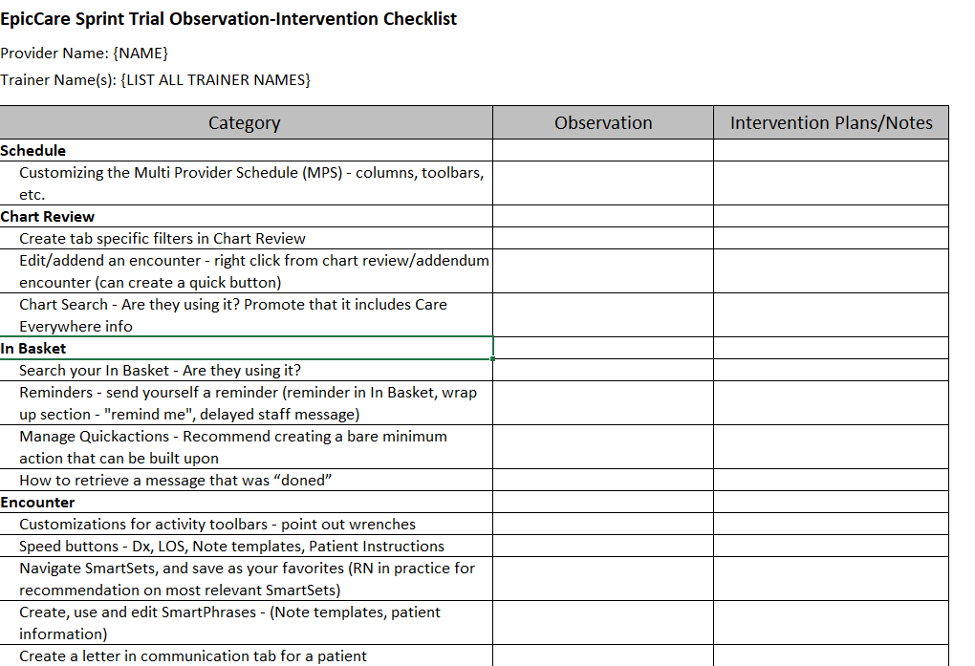
Trainers will be tracking observations for intervention planning
Notes:
This is the tracker that the trainers will be using while they're on site. The tracker goes through different sections like the schedule customizations, In Basket tools ect. The tracker is really they're just to make sure we are hitting all the key points in the observation; we can make notes and ask questions or address questions with our teams. The trainers will also be using this tracker for the training phase to focus on areas where they actually need help and to know the areas the users are already efficient in. We will also be sending this tracker to all of the staff to review before the observation. They can use this tracker to cross things off that they are already efficient in, mark areas where they would like training in and they can jot down notes to address with the trainer.​

Slide 11
Survey Reminder
Brief PRE and POST sprint surveys will be distributed to all.
PRE-Sprint
Survey
Available Now!
Link to Survey
POST-Sprint Survey
Available in May
Link will be emailed
Notes:
We will be sending everyone a pre sprint survey that will need to be completed before the observation and then we will be sending a 1- and 3-month post sprint survey for everyone to complete. We ask that everyone complete the surveys so we can make improvements along the way, give everyone a good experience and hopefully a great outcome with the Sprint Optimization.

Slide 12
Any Questions?
We are excited to
get started!

