Slide 1
BH Hellos
January 18, 2024

Slide 2
Agenda For the Day
Open with Sanctuary Model and Reflections
Setting the Stage to Discuss Cultural Humility (Presentation and Group Discussion)
BH Fellow Organization Spotlight
Community Organizations Serving Allegheny County (Panel)
Reflections (Small Group Discussion)
Drum Circle
Reflections and Reminders

Slide 3
Welcome
Sanctuary Model
Please share your name, role, and organization
How are you feeling today?
What do you need from the group/anyone in the room?
What will you bring to the group?
Share an example of a valuable cultural humility training or area of interest related to cultural humility
Notes:
Sarah Pesi

Slide 4
Reflections
What have been your experiences returning to your workplaces after your participation in the December session?
Have you been able to apply any strategies from our last session?

Slide 5
Hello Neighbor: Cultural Competency
Rachel Vinciguerra (she/her), Director of National Programs MSW, MID
www.helloneighbor.io ₁

Slide 6
Introductions
What is your favorite dish and why?
www.helloneighbor.io

Slide 7
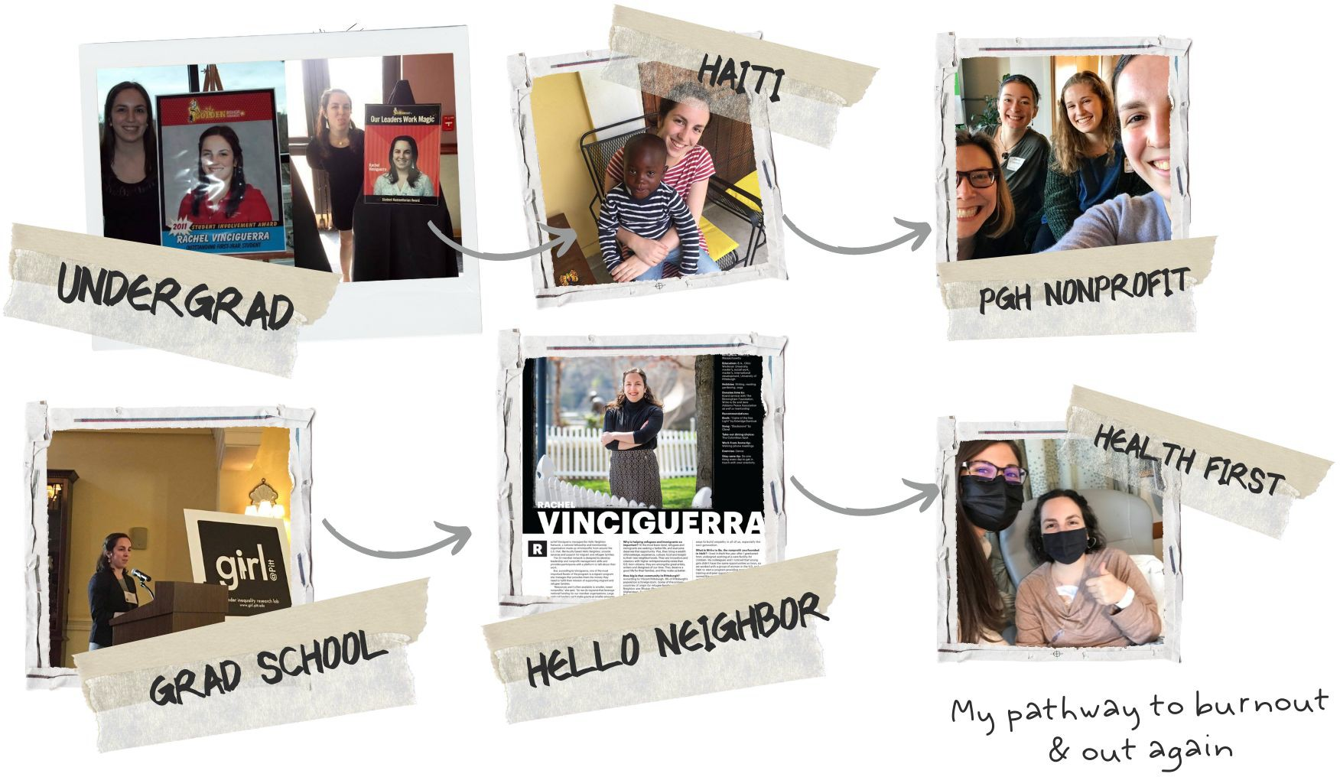
Repair the World SWSG
Consulting Youth, gender equality & social inclusion
Volunteer management,
trauma-informed care, foster care
MID/MSW from Pitt
www.helloneighbor.io

Slide 8
Mission & Vision
Mission
Hello Neighbor works to improve the lives of recently resettled refugee and immigrant families by matching them with dedicated neighbors to guide and support them in their new lives.
Vision
Hello Neighbor envisions a welcoming, inclusive, and vibrant Pittsburgh and America, whose newest neighbors can realize their dreams of success and prosperity. We aspire to see communities where everyone is valued for their diverse perspectives and are empowered to rebuild their lives with dignity and respect.
www.helloneighbor.io

Slide 9
Values
REFUGEE-FIRST MINDSET: We believe that all of our work should start with the best interests of the refugees that we serve as voiced by them.
CROSS-CULTURAL SENSITIVITY: We believe in having a thoughtful approach toward the refugee families we support. We know the best answers come from really listening to the needs of the community and that trauma-informed care impacts programmatic support.
DIGNIFIED STORYTELLING: We believe in protecting the privacy and dignity of refugee families by sharing their stories in a respectful way. We strive to be mindful of and sensitive to the journeys and trauma these stories may represent.
CULTIVATING COMMUNITY: We believe the most important aspect of our program is the human connection and trust that comes from mentor/mentee relationships. Listening and connecting over shared experiences helps to foster a community that transcends cultures.
INCLUSIVE SUPPORT: We believe in welcoming and standing beside all refugees and immigrants— regardless of race, religion, age, national origin, citizenship status or sexual orientation—and honoring their experiences and voices with a spirit of acceptance and belonging.
www.helloneighbor.io

Slide 10
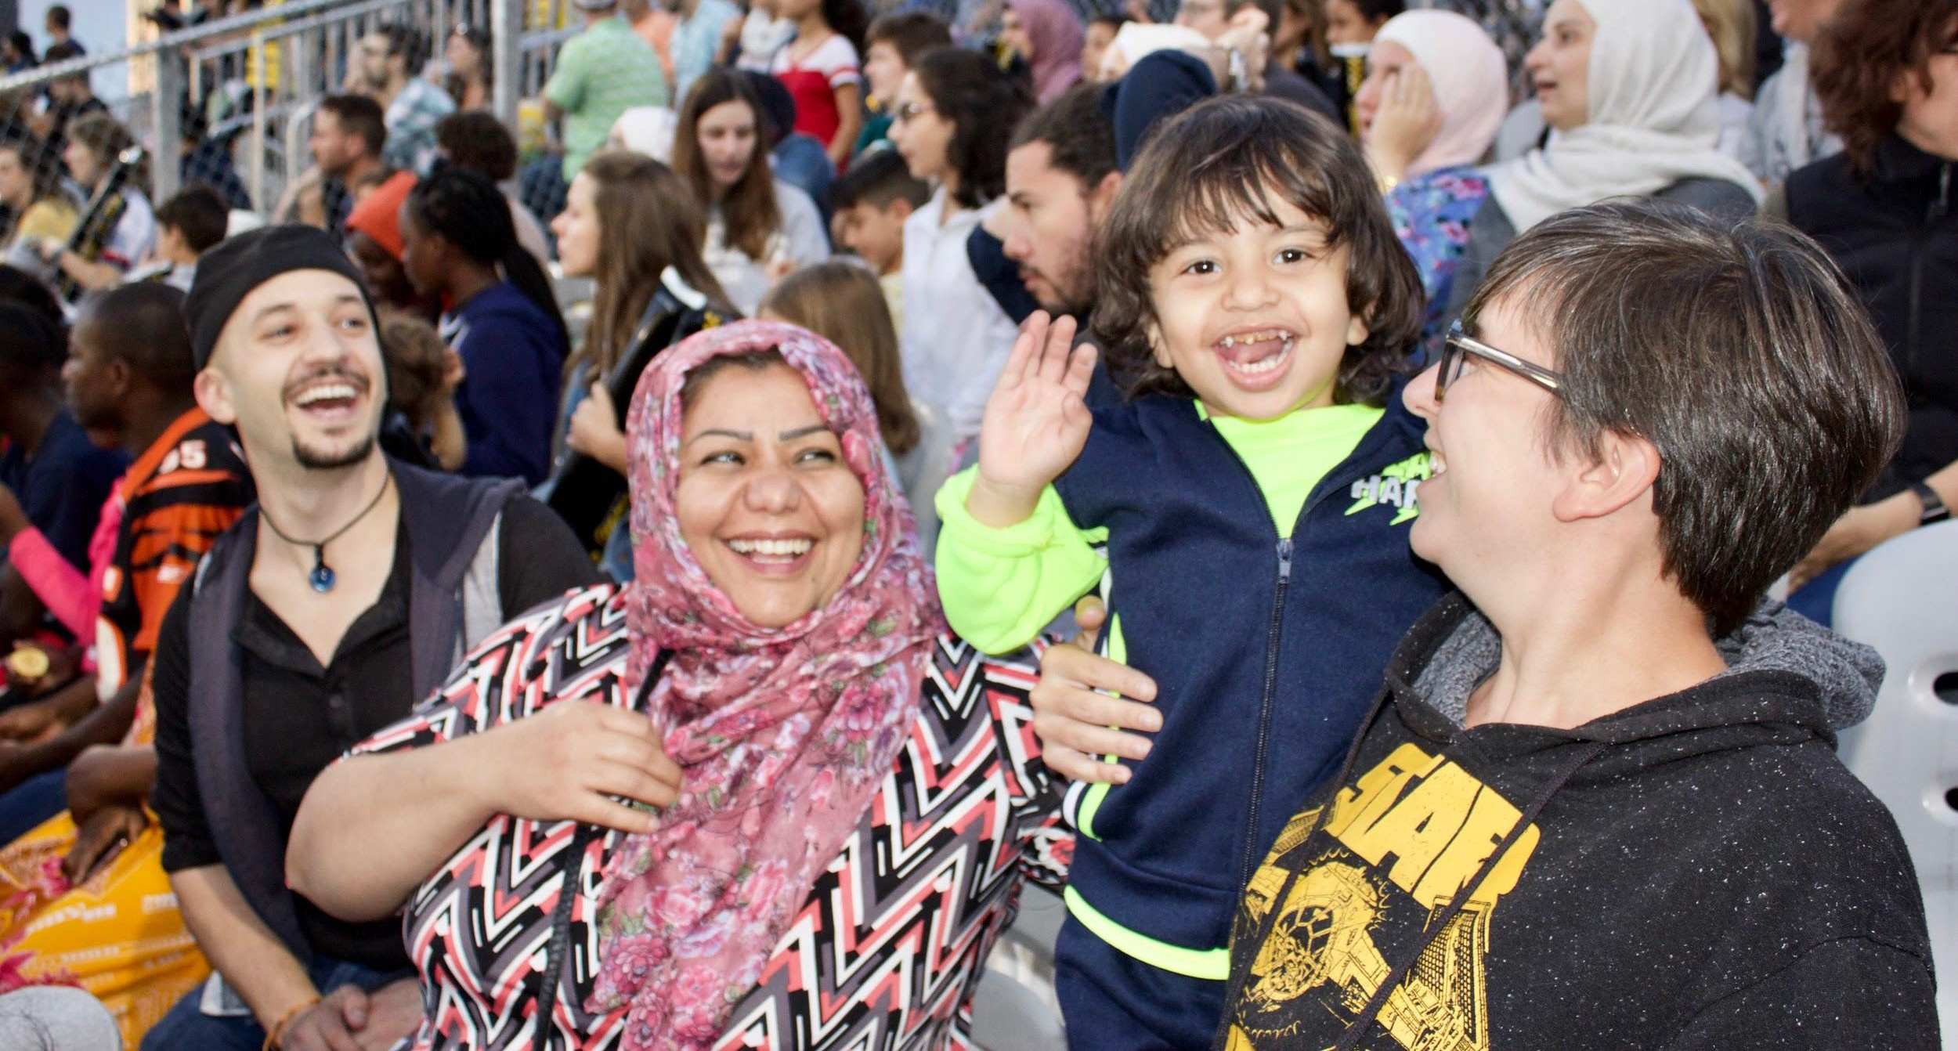
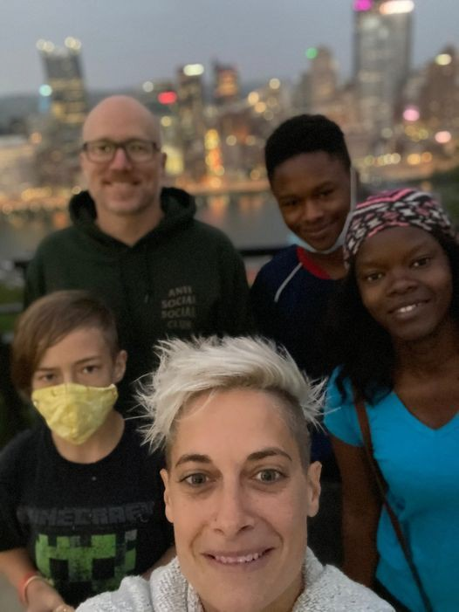
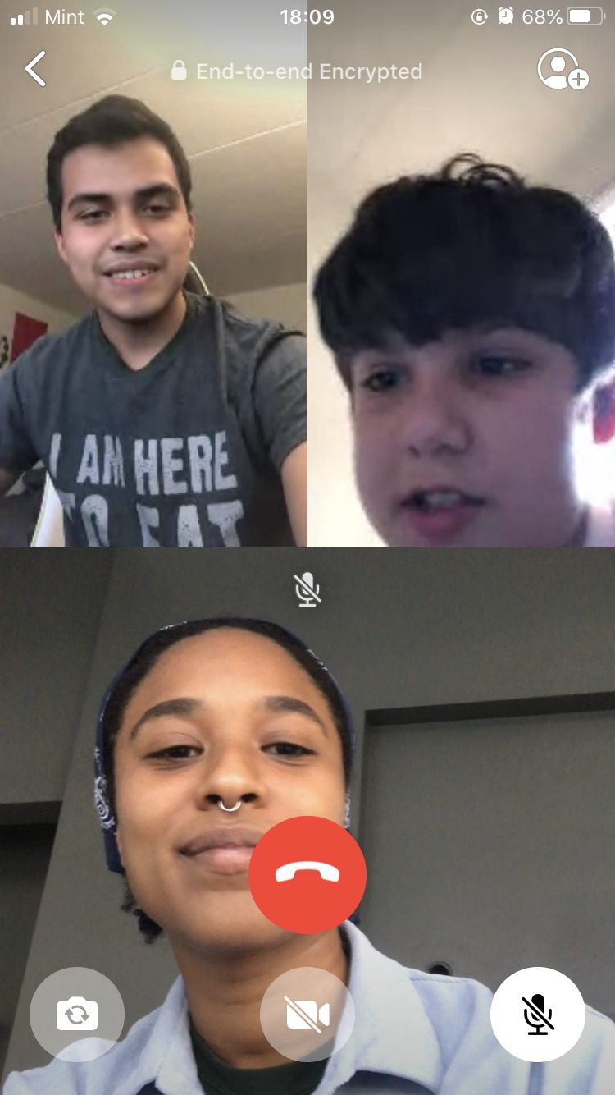
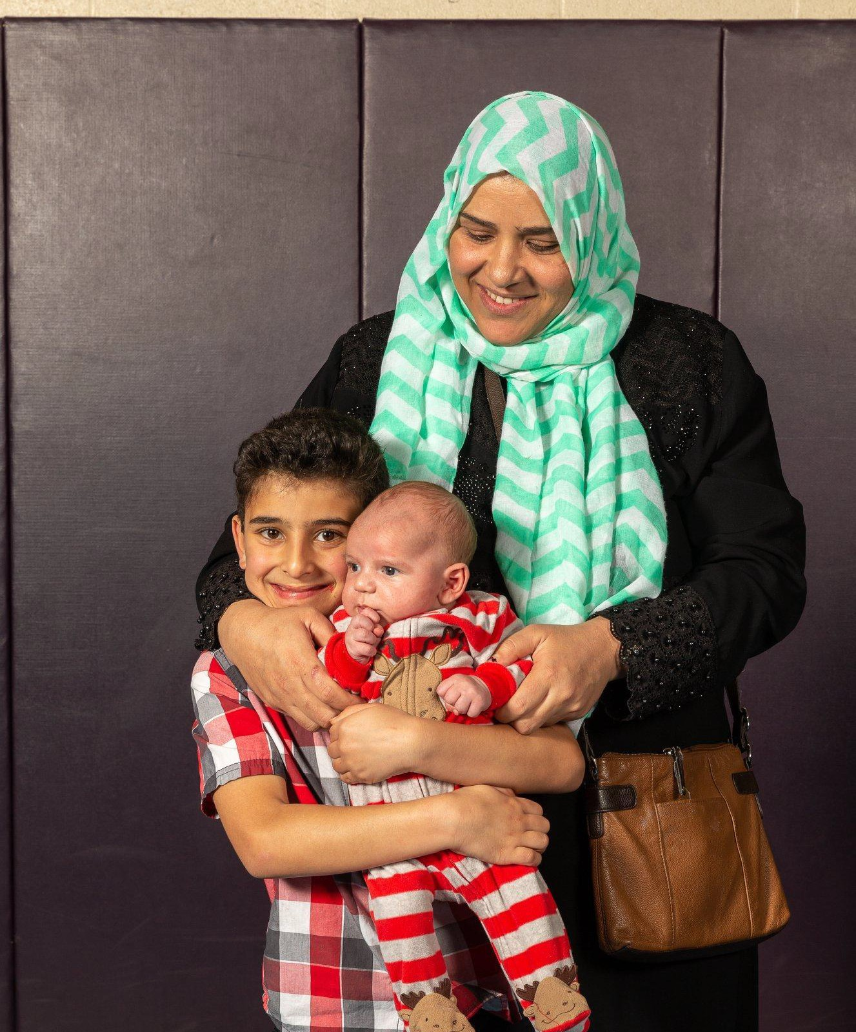
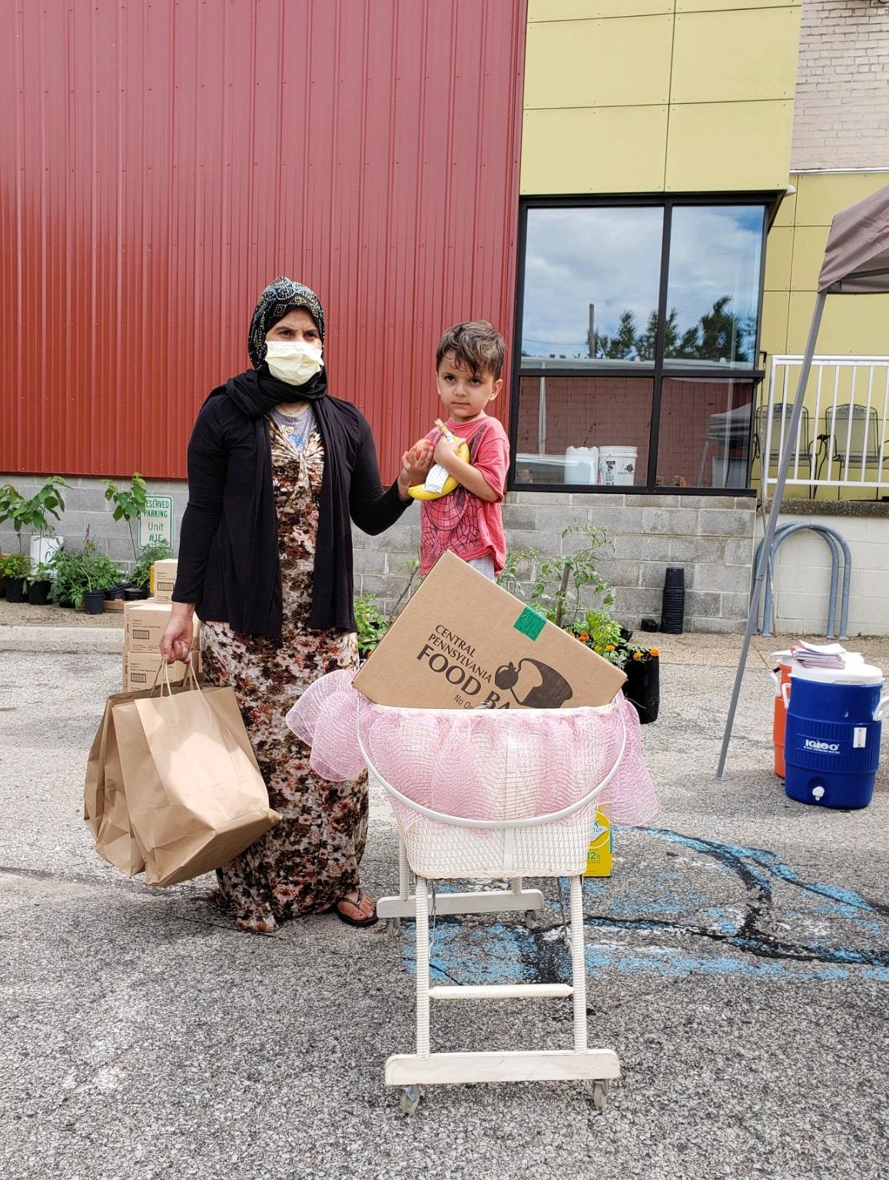
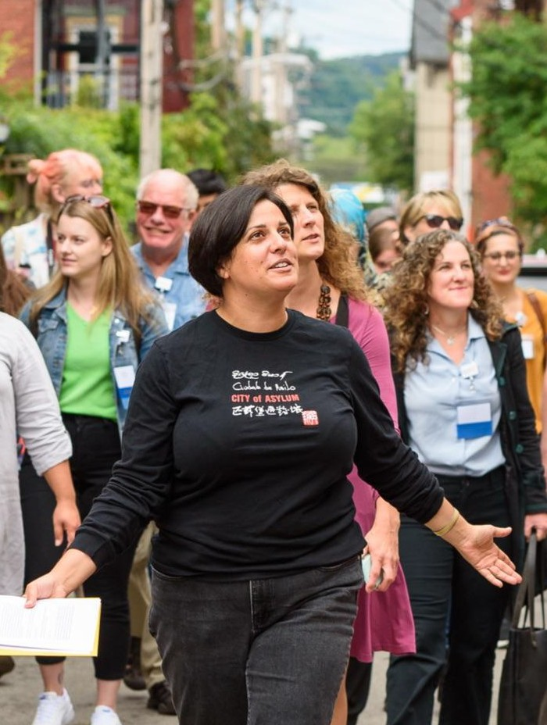
Hello Neighbor History
FAMILY MENTORSHIP | STUDY BUDDY | SMART START | RESETTLEMENT | NETWORK
Founded in 2017
www.helloneighbor.io

Slide 11
Cultural Humility
“Cultural humility refers to the attitude and practice of working with clients at the micro, mezzo, and macro levels with a presence of humility while learning, communicating, offering help, and making decisions in professional practice and settings. According to Tervalon and Murray-Garcia (1998), “Cultural humility incorporates a lifelong commitment to self-evaluation and self-critique, to redressing the power imbalances in the patient–physician dynamic, and to developing mutually beneﬁcial and non-paternalistic clinical and advocacy partnerships with communities on behalf of individuals and deﬁned populations” (p. 117). As Hook, Davis, Owen, Worthington, and Utsey (2013) suggested, cultural humility is a way of maintaining an interpersonal stance that is other-oriented.”
-National Association of Social Workers
www.helloneighbor.io

Slide 12
Culture
Any identity that is signiﬁcant to a person, something that structures how we see the world (beliefs, norms, shared values, similar socialization patterns, common communication, dress, diet)
Race
Ethnicity
Religion
Socioeconomic status
Sexual identity
Gender
Country of origin
Addiction history
Trauma survivorship
Ability
www.helloneighbor.io

Slide 13
Core Principles
Commit to compassionate self-awareness and inquiry within a supportive community of practitioners
Be open and teachable
Keep top of mind the social structures that shape client reality
-adapted from The New Social Worker
www.helloneighbor.io

Slide 14
Self-Awareness
Clear and ever-evolving understanding of yourself, your identities, your power dynamics in a setting
-strategies: reﬂection practices, collaboration with colleagues & feedback
Openness to Learn
The assumption you have something to learn from everyone, you don’t know or understand everything
-strategies: put yourself in situations where you are not the expert, get good at receiving feedback, do some research!
www.helloneighbor.io

Slide 15
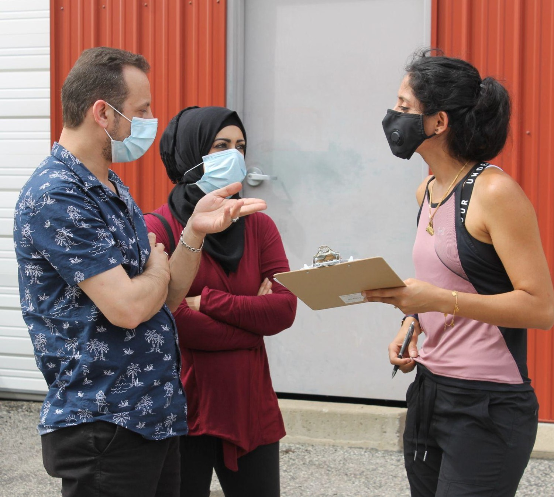
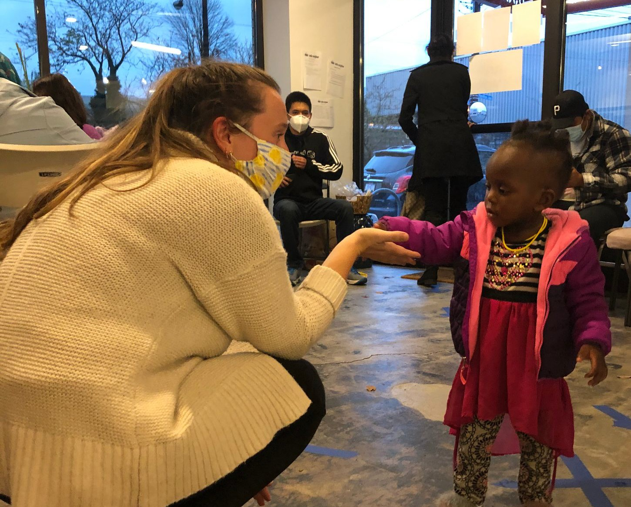
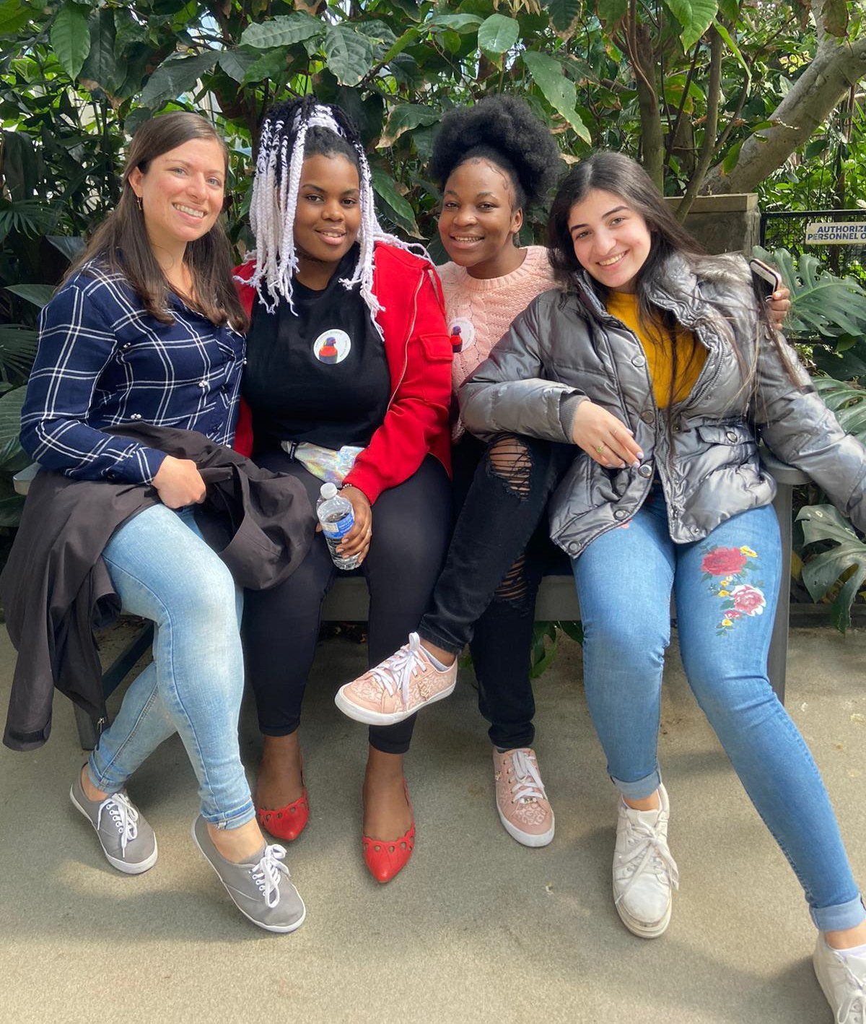
Hello Neighbor Team
www.helloneighbor.io

Slide 16
Positioning & Empathy
You are the expert in the behavioral health process
The client is the expert in their experience
Even if you have shared identities, everyone is unique
Empathy is connecting to the emotion underneath an experience rather than the experience itself
-healthy distance between your feelings and the feelings of the client help preserve your ability to support them and not burnout
www.helloneighbor.io

Slide 17
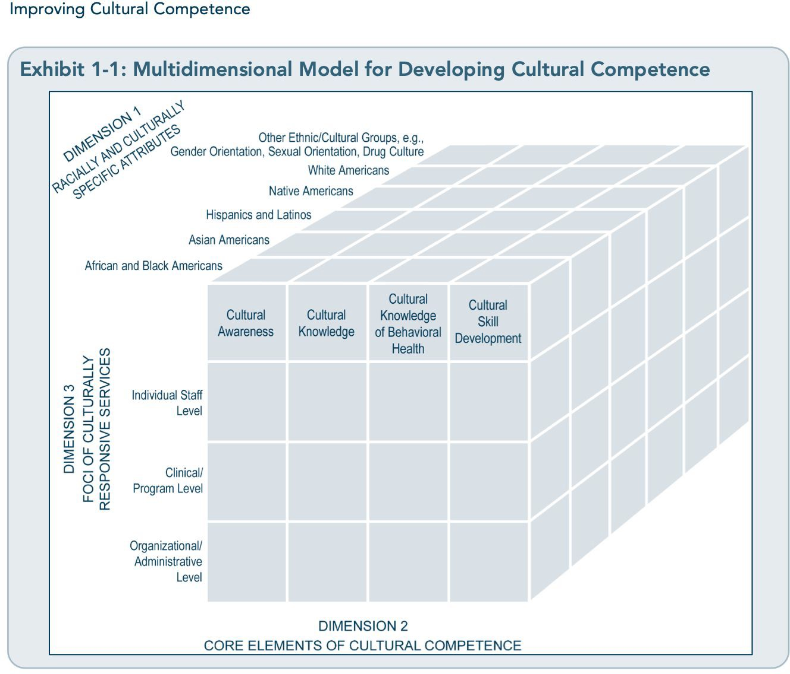
SAMHSA (Improving Cultural Competence)
www.helloneighbor.io

Slide 18
Example: Fatima
You are delivering services in the home to 5 Afghans. In the middle, one person stands up and yells “you don’t keep your promises, I need medication now.” And participants start speaking in Dari among themselves. And someone says “I need an Afghan provider, not you!”
www.helloneighbor.io

Slide 19
Ways to Address
Acknowledge and validate feelings with empathy and patience: this is really frustrating
Seek to understand: let’s step outside for a moment, I’d like to understand how you are feeling, there’s something under the surface you may be missing!
Explain situation: you are in a difﬁcult situation, it’s important for us to understand your needs before we can provide medication
www.helloneighbor.io

Slide 20
Example: Smart Start at local hospital
Women delivering babies may require a woman provider coming from some cultures
Smart Start worked with the hospital to put up signs on the door to notify physicians
www.helloneighbor.io

Slide 21
Things to consider
Client needs for providers (incl. interpreters) of particular genders based on religion, ethnicity or other social expectations
Translation and interpretations of mental health, in some languages it is translated as “crazy doctor” consider “wellbeing in general” or “someone to talk to”
www.helloneighbor.io

Slide 22
Some speciﬁc examples from Freshta Taeb
Problematic to ask Afghans their “ethnicity” better to ask what language they speak
Afghan is the person, Afghani is a currency
Gesture of welcoming to offer or receive hot green tea brewed in cardamom (can be rude to turn down tea)
Foods: consider if halal is needed
Polychronic v. monochronic views of time
Polychronic: more ﬂuid, more value on present
Monochronic: more structured, more value on future
Individualistic v. collective societies
www.helloneighbor.io

Slide 23
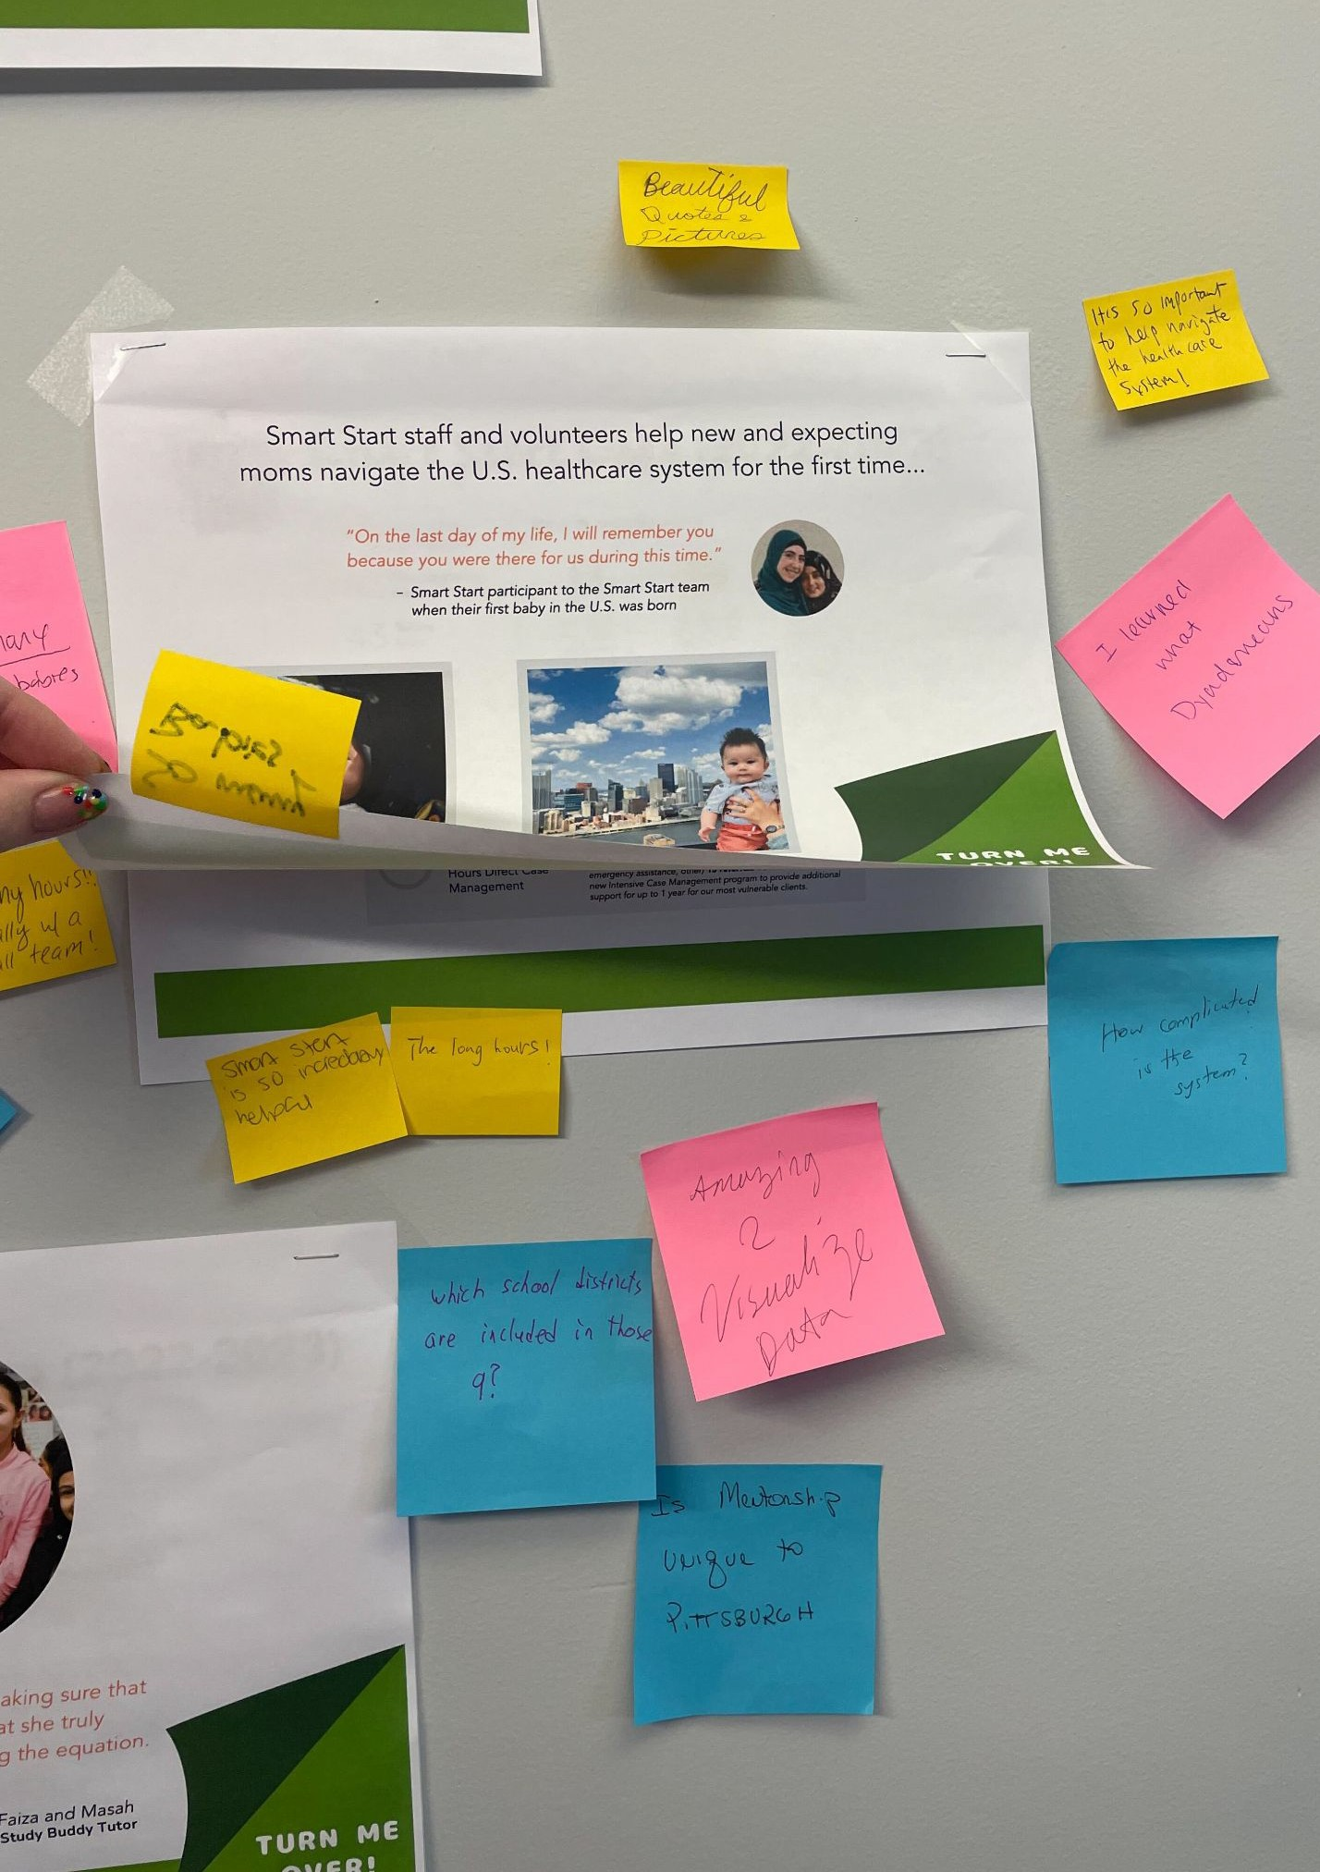
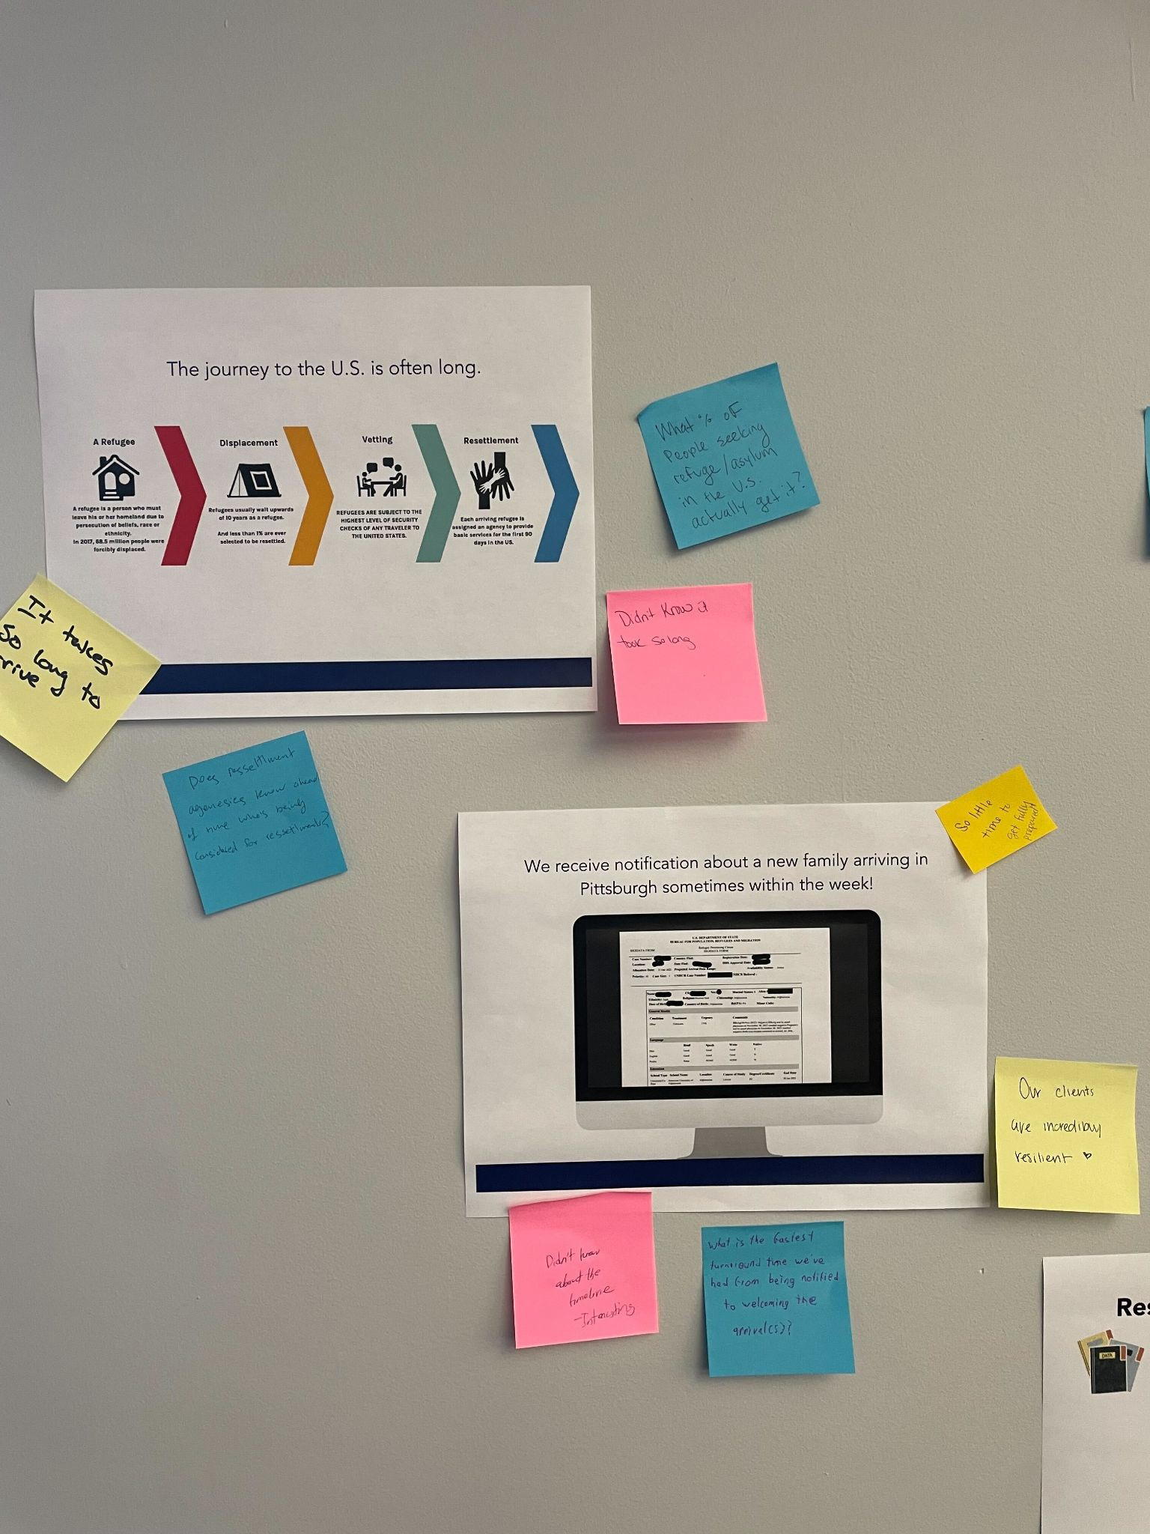
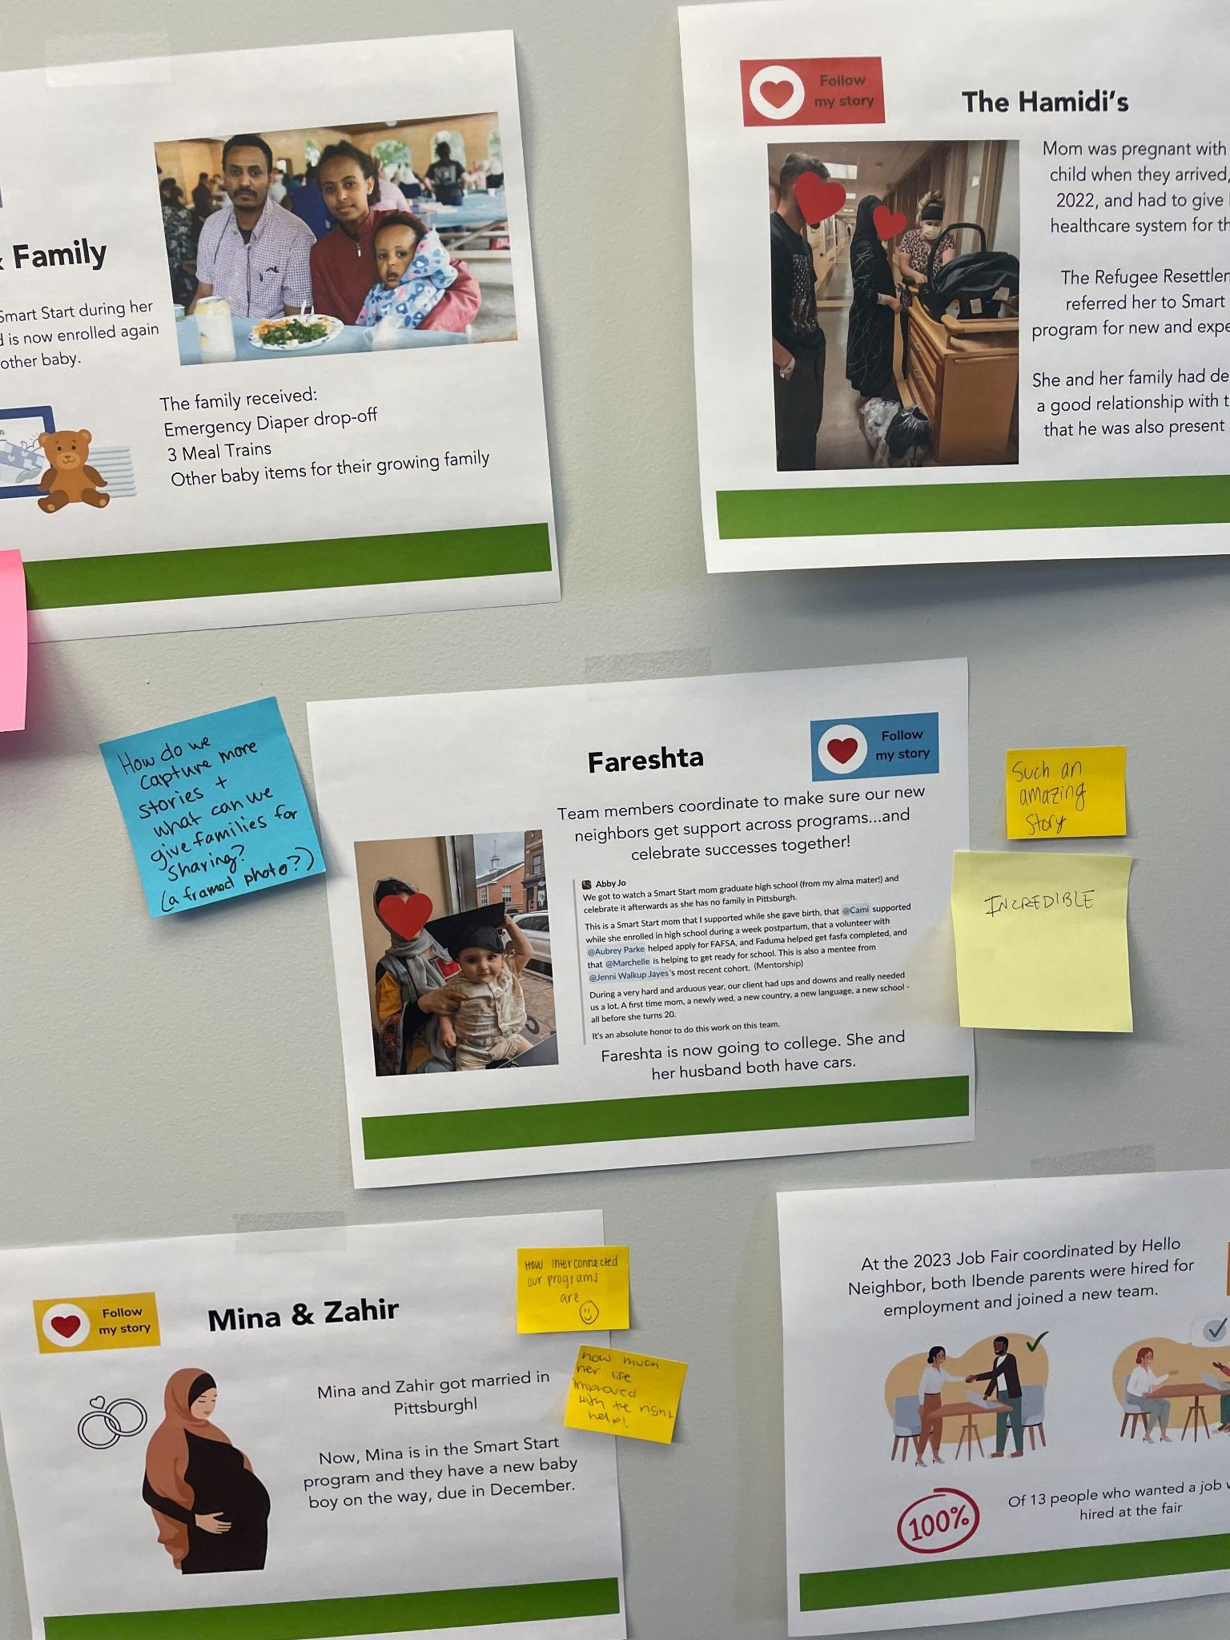
Data-walk!
Check out the stations and learn about what Hello Neighbor does!
www.helloneighbor.io

Slide 24
As You Walk
Yellow sticky note: what stands out
Pink sticky note: something new you learned/observe about a client
Blue sticky note: an open-ended question you could ask to learn more about someone
Discussion
What did you notice across the galleries about family and individual experiences?
What would you like to explore in future sessions around this topic?
www.helloneighbor.io

Slide 25
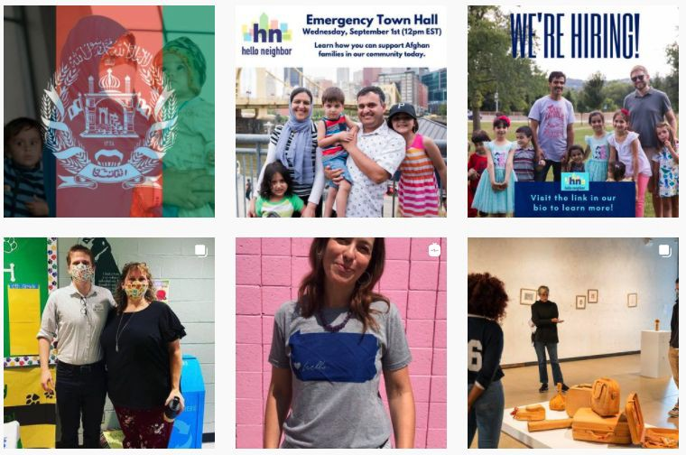
Stay Informed
Stay up to date with the latest news, updates and stories by visiting our website, subscribing to the Hello Neighbor newsletter, or following us on social at @helloneighborhq.
www.helloneighbor.io
21

Slide 26
Thank you!
Director of National Programs Rachel Vinciguerra (she/her) rachel@helloneighbor.io

Slide 27
Improving Cultural Competence: https://store.samhsa.gov/sites/default/files/d7/priv/sma14-4849.pdf

Slide 28
Break

Slide 29
Behavioral Health Fellow Spotlight

Slide 30
Lunch Break

Slide 31
A Space for Us: Community Building for Black Mental Wellness
Courtney Abegunde
Steel Smiling
9/13/2023
Notes:
Good morning Western Behavioral Health. My name is Courtney Abegunde and I am so thrilled to be here with you to talk about my work building communities for Black mental wellness. But before I can tell you where I'm at with this, I think it's important to tell you where I've been. One of the greatest habits I picked up here at Western is to start with gratitude and appreciation, for the people and the efforts it takes to make things happen. And I'm going to really lean into this because as you'll hear in my talk today, oftentimes there's no movement forward without and acknowledgement and recognition of the past. So, today I'll start with that appreciation.
Thank you Comprehensive Recovery Services for employing me for 7 amazing years. I did some of the most amazing work of my career with some of the most brilliant and compassionate people I've ever met. There are too many of you to individually list, and so I'm going to brag for a few minutes about the amazing work we did together and which I know you continue with rigor today.
As was mentioned already, I had 3 (ish) jobs while working at Western and CRS.
First, I was a Research Coordinator to the TRENDS study.
I'm grateful for that role because it was a crash course in the complex needs of folks diagnosed with serious mental illnesses and their families.
I learned that despite significant reductions in national average rates of smoking, high rates of smoking persist in individuals with Schizophrenia and other SMI, and these folks are more likely to smoke larger quantities with greater challenges quitting.
TRENDS was a first practical example of identifying a health disparity and problem solving around the unique needs of the individuals we were hoping to help. Individuals diagnosed SMI may need additional support around quitting, and interventions should account for their unique circumstances (comorbidities, multiple medications, characteristics of mental illness that likely compound the problem- negative symptoms like low motivation, lack of pleasure/loss of interest, etc). This would be a common theme across the work at CRS.
…. Honestly I was super distracted while at TRENDS. I was supposed to be focused simply on the trial and the protocol. Research coordinators know this... recruitment, protocol, reporting, numbers numbers numbers- when I was so much more focused on our subjects' lives, their history, how they were doing, and what's being done to help. I needed to get back to treatment and care.
And so I was thrilled with the opportunity to move to the STEP clinic. STEP was (and is) doing incredible work toward proactively addressing the all encompassing impacts of serious mental illness with the Coordinated Specialty Care model.
Recognizing that comprehensive early intervention can improve quality of life, first-episode psychosis programs like STEP are leaning into comprehensive care in mindful, practical, and methodical ways- Evidence based therapies for psychosis and medication management, supported employment, peer support, family support/psychoeducation, blended service coordination, and clinical pharmacy integrated and under one roof. STEP gave me a big assignment- figure out how to help people show up to their intakes. We established a sort of referral warm line, and started engagement as early as possible. If you went to the ED for a psychotic episode and were referred to STEP around 2017-20, I was on your butt. I was calling, I went to the unit, I collaborated on the treatment teams inpatient, I got releases for natural supports early, we talked psychoeducation, support for successful functioning, and maintaining hope. I'm grateful for this time because I learned about presenting problems and their ties to cultural perceptions of illness. I started asking questions like "What's your take on what’s going on, and what does this mean for you and your family?".
I thought I was being proactive and assertive at STEP, and then I went to Western Psych Community Treatment Teams, where they put the Assertive in Assertive Community Treatment.
If STEP was on 100 with the throttle, CTT was on 1000.
CTT shaped my concepts for teamwork and leadership, grounding shared decision making in dignity and respect, motivational interviewing/stagewise care, and psych rehab/skills acquisition. Team Leads at CTT are tasked with helping the team hold the model together and keeping it all moving like clock work. This is an incredible lift always, but especially during a pandemic. Thank you CTT for always reminding me to stick with what works and that the proof is in the pudding- the ACT model lays a good foundation, and when things are feeling out of alignment getting back to basics is all we need. CTT teams aren't just clinicians, they are advocates, detectives, collaborators, problem solvers, solution focused agents of care. They are the savviest people I have ever met and I'm grateful for some of the best advice I've ever received: start with appreciation (or a celebration), and when in doubt, google it.
So how does this all relate to why I'm here today?
The reality is that I was spending all of this time working on aggressive and comprehensive treatments plans, researching methods at increasing engagement and treatment follow through. I was realizing there's more at work here than perceived lack of motivation. I learned that people who look like me are less likely to reap benefits from these programs because of barriers to care (access, transportation, stigma, racism). I learned Black folks are more likely to encounter care through emergency services or involuntarily through forced hospitalization or imprisonment. I learned that opportunities for mental wellness support are less likely to be located in Black neighborhoods. Further, when Black folks do enter the health care system, Blacks are more likely to be misdiagnosed and less likely to receive evidence based treatments. Further, I was becoming more concerned with a lack of Black representation in our field, and how that leads to less understanding of Black issues, needs, preferences in care.
The route of all this was popularly conceptualized as a need for cultural competence and subsequent calls for routing out and addressing implicit biases. This felt like tedious work. Everyone seemed so at ease with using words like bias and culture, but this seemed to just touch the surface of what was happening. I was growing increasingly frustrated and concerned that implicit bias training was not actually helpful, that it did not address the problem at hand or help us really examine inequities in a way that would lead to actionable solutions. It also seemed like the pressure was on healthcare workers to rid ourselves of bias, when in reality it seemed more like something that needed to be rigorously checked, and not left to promises of its absence. It felt like I was spinning my wheels and that "cultural competence" and "DEI" were red herrings that allowed the unnamed problem to be addressed. DEI conversations at this time were more likely to say "bias" than "racism".
Community organizers sometimes talk about the moments in life that radicalized them- the moments that cause you to lose your patience with change and building consensus. Because lives are at stake. There are two events that radicalized me- The murder of George Floyd and my family's personal experiences with medical racism during the illness and eventual passing of my father in law, may he rest in everlasting peace.

Slide 32
Racism is a Public health problem
In 2018, Milwaukee, WI becomes the first community to declare racism a public health problem.
By August 2021, 209 declarations were adopted in 37 states (Allegheny County Council declared May 2020)
Aims varied: identifying activities to increase diversity and increase anti-racism efforts across leadership, staffing, or contracting; Pursuing partnerships with community groups who address racism, policy advocacy at the local/state/federal levels, and advocacy for policies to improve health for communities of color.
Advancing Racial Equity | Analysis: Declarations of Racism as a Public Health Crisis, American Public Health Association, October 2021
Notes:
Historical adversity, which included slavery, sharecropping, and race-based exclusion from health, educational, social, and economic resources, translates into the socioeconomic disparities experienced by African Americans today.
Socioeconomic status, in turn, is linked to mental health: Poor mental health is more common among those who are impoverished than among those who are more affluent.
Also related to socioeconomic status is the increased likelihood of African Americans becoming members of high-need populations, such as people who are homeless, incarcerated, or have substance abuse problems, and children who come to the attention of child welfare authorities and are placed in foster care.
The social determinants of health (SDH) are the non-medical factors that influence health outcomes. They are the conditions in which people are born, grow, work, live, and age, and the wider set of forces and systems shaping the conditions of daily life. These forces and systems include economic policies and systems, development agendas, social norms, social policies and political systems.
The SDH have an important influence on health inequities - the unfair and avoidable differences in health status seen within and between countries. In countries at all levels of income, health and illness follow a social gradient: the lower the socioeconomic position, the worse the health.
The following list provides examples of the social determinants of health, which can influence health equity in positive and negative ways:
Income and social protection
Education
Unemployment and job insecurity
Working life conditions
Food insecurity
Housing, basic amenities and the environment
Early childhood development
Social inclusion and non-discrimination
Structural conflict
Access to affordable health services of decent quality.
Research shows that the social determinants can be more important than health care or lifestyle choices in influencing health. For example, numerous studies suggest that SDH account for between 30-55% of health outcomes. In addition, estimates show that the contribution of sectors outside health to population health outcomes exceeds the contribution from the health sector.
Addressing SDH appropriately is fundamental for improving health and reducing longstanding inequities in health, which requires action by all sectors and civil society.

Slide 33
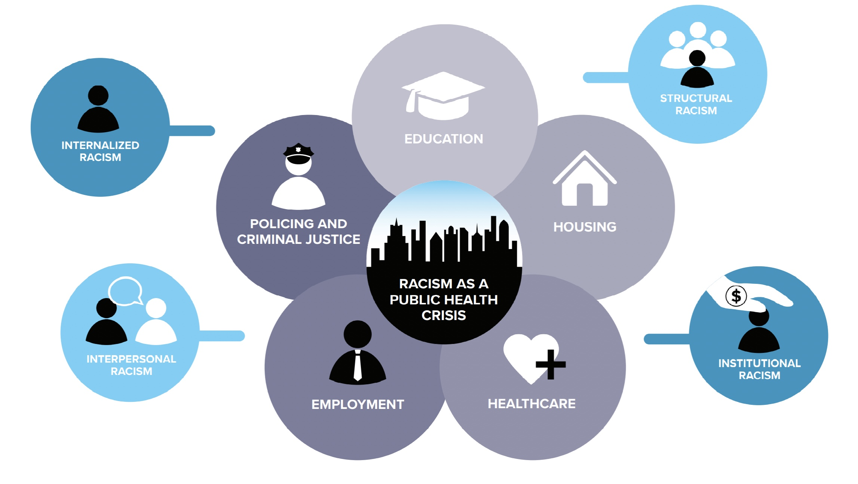
Notes:
Racism is a form of oppression based on race. Oppression takes into account agent and target group membership, and considers who is positioned to hold power and who is positioned to not hold power (or whose power is removed).
White supremacy is a vehicle of racism- the belief that white people are inherently superior to other races, and in practice is enacted through social norms and institutional practices, and also includes 4 types of racism.
Institutional racism: Policies, practices, procedures, and culture of an institution or system that work better for white people and cause harm to people of color. Regardless of intent, the actual impact is the main point.
Example: Admissions restrictions, closure and privatization of hospitals, "patient dumping"
Structural racism: The history, culture, and current reality of racism across institutions and/or systems; the overlapping web of multiple institutions. Policies in practice that reinforce that Black lives don’t matter.
Example: Healthcare is provided primarily based on an individual's ability to pay (or availability of insurance) rather than on medical need. Black people have less access to affordable healthcare due to lower SES on average, so needed treatment is forgoed leading to worse health outcomes.
Interpersonal racism: Prejudice, bias, discrimination, individual and relational acts of racist violence.
Example: Race based bullying, assault, threats, jokes, microaggressions, etc.
Internalized racism: The internalization of racist stereotypes, values, images, and ideologies. This can be broken down into Internalized Racial Inferiority (acceptance of white supremacy into internal views of self and others: colorism, anti-Blackness) or Internalized Racial Superiority (acceptance of white supremacy into superior definition of self, rooted in historical positioning of superiority over other races. This manifests in the privileges, advantages, and power).

Slide 34
Racism is a public health problem
What does this mean for communities?
What does this mean for mental health?
What does this mean for community health workers?
Where do we go from here?

Slide 35
Healing Justice
“Healing justice...identifies how we can holistically respond to and intervene on generational trauma and violence, and to bring collective practices that can impact and transform the consequences of oppression on our bodies, hearts and minds.”
Collective healing and well-being; and
Transforming institutions and relationships that cause harm.
Needs Statement,
Kindred Southern Healing Justice Collaborative, 2014
Notes:
Intergenerational trauma is the impact of severe trauma across generations with evidence of biological and social mechanisms of passing down generations through DNA, memory, cultural messages/conditioning, family narratives and culture, aggressions and microaggressions, and internalized racism.
Healing Justice de-centralizes whiteness, and asserts collective healing and well-being requires centering the needs of the marginalized.
It equally asserts that part of the work is transforming systems that cause harm.
It includes incorporating pieces of the self that have been lost due to intrapersonal racism, and calls on a return to Black traditions of care that have been forcibly removed from and devalued in favor of dominating perceptions of healing over time.

Slide 36
Community care is...
Sharing mental health journeys and tips
Reminders to take medication
Rides to an appointment
Attending an appointment
Advocating for quality care
Cooking together
Childcare
Researching helpful mental wellness tools together
Support groups
Notes:
So what does that look like in practice?

Slide 37
Embracing silenced wellness traditions
Mutual aid,
Healing circles,
Community Conversations,
Peer Support,
Doulas and Midwives,
Religious and spiritual practices,
Aromatherapies and natural herbs
Diet and nutrition
Creative expression (hip hop, mural art, etc.)

Slide 38
Mental Health Literacy
"Knowledge and beliefs about mental disorders which aids in their recognition, management or prevention."
The ability to recognize specific disorders or different types of psychological distress;
Knowledge and beliefs about risk factors and causes;
Knowledge and beliefs about self-help interventions;
Knowledge and beliefs about professional help available;
Attitudes which facilitate recognition and appropriate help-seeking; and
Knowledge of how to seek mental health information
Jorm, AF, 2000, Mental Health Literacy- Public Knowledge and Beliefs About Mental Disorders, British Journal of Psychiatry

Slide 39
Social Justice- Informed Mental Health Literacy (SJM)
"We define SJM as, “Mental health education framed in the social-historical context of inequality that aids in the skills building, healing and liberation of communities.” We created Social Justice Informed Mental Health Literacy (SJM) because traditional mental health literacy models fail at contextualizing how the histories of racism, misogynoir, and homophobia influence mental health stressors and outcomes today. For example, it is not enough to simply state that Black people report higher levels of psychological distress than whites [3], we have to address the historical context that has created this reality. From our desire to affirm the legacy of Black people’s experiences with psychology, SJM was born."
Yolo Akili Robinson, RYT, Founder & Executive Director of BEAM (Black Emotional & Mental Health Collective)
Huffington Post | Why Black Mental Health Literacy Matters

Slide 40
Social Justice- Informed Mental Health Literacy (SJM)
"In addition to the definition, BEAM has created principles for SJM, built upon the pioneering work of multicultural and Black feminists and womanists. These principles state that in relation to Black communities an SJM approach must:
Validate and give voice to the legacy of harm in Black communities.
Affirm and acknowledge the historic and present-day resilience, defiance, coping skills and strategies in Black communities.
Coach community members on how to offer first-responder support to mental health challenges and crises.
Cultivate skills that promote agency in engaging mental health professionals and basic knowledge of mental health interventions/treatments and systems.
Facilitate consciousness-raising and direct action to address social inequities and conditions that impact Black mental health––such as transphobia, racism, ableism, misogynoir, HIV/AIDS, and homophobia.
Advocate and organize for accessible, innovative models of mental healthcare.
Equip community members with knowledge and tools that support healthy mental health coping skills and healing."
Yolo Akili Robinson, RYT, Founder & Executive Director of BEAM (Black Emotional & Mental Health Collective)
Huffington Post | Why Black Mental Health Literacy Matters

Slide 41
Steel Smiling seeks to bridge the gap between community members and mental health support through education, advocacy, and awareness.
Mapping, supporting, resourcing the Black Mental Health Ecosystem
An "Organization in residence" of Neighborhood Allies

Slide 42
Beams to Bridges
Programming includes comprehensive classroom and community mental health training- Mental health overview including review of common mental health concerns (anxiety, depression, trauma, substance use, relationships and conflict resolution), available treatments and how to find help, how to provide support during a mental health crisis including Mental Health First Aid for Adults and Youth, facilitating mental health conversations, fostering community conversations, and meeting resource providers.
Program tenets: Healing justice framework with emphasis on sharing experiences and healing through collective support.
Participants receive a stipend for participation and emergency financial support as needed
Notes:
2 cohorts graduated, about 30 participants total.
2023 is a big year because we've spent significant time revising the curriculum for launch in April at the Kingsley Association.
Beams to Bridges is for community members looking to increase their understanding of their individual and community experiences with mental health. Some community members may be interested in organizing support groups or entering the mental health workforce. Steel Smiling supports community members to find work or volunteer opportunities when interested

Slide 43
Black Mental Health Fund
Screening for mental health needs and preferences for support (treatment, community benefits, support programming)
Financial support for those who need it
Over $400,000 in treatment services paid since March 2020
Referrals to Steel Smiling peer support
Individual services or Community based support groups (Men's x Fatherhood Initiative group at the Kingsley Association, Senior group at Macedonia FACE, Chill sessions at Center of Life)
Referrals please call (412) 532-9458

Slide 44
How culture is related to mental health treatment
Cultural identity of the person. Note the person's ethnic or cultural reference groups. For immigrants and ethnic minorities, also note degree of involvement with culture of origin and host culture (where applicable). Also note language ability, use, and preference (including multilingualism).
Cultural explanations of the person's illness. Identify the following: the predominant idioms of distress through which symptoms or the need for social support are communicated (e.g., “nerves,” possessing spirits, somatic complaints, inexplicable misfortune), the meaning and perceived severity of the individual's symptoms in relation to norms of the cultural reference group, any local illness category used by the individual's family and community to identify a condition (see the “Cultural Concepts of Distress” section of this appendix), the perceived causes or explanatory models that the individual and the reference group use to explain the illness, and current preferences for and past experiences with professional and popular sources of care.
Cultural factors related to psychosocial environment and level of functioning. Note culturally relevant interpretations of social stressors, available social supports, and levels of functioning and disability, including stresses in the local social environment and the role of religion and kin networks in providing emotional, instrumental, and informational support.
Cultural elements of the relationship between client and clinician. Indicate differences in culture and social status between client and clinician, as well as any problems these differences may cause in diagnosis and treatment (e.g., difficulty communicating in the client's first language, eliciting symptoms or understanding their cultural significance, negotiating an appropriate relationship or level of intimacy, determining whether a behavior is normative or pathological).
Overall cultural assessment for diagnosis and care. Conclude cultural formulation by discussing how cultural considerations specifically influence comprehensive diagnosis and care.
Excerpt from the Center for Substance Abuse Treatment (US). Improving Cultural Competence. Rockville (MD): Substance Abuse and Mental Health Services Administration (US); 2014. (Treatment Improvement Protocol (TIP) Series, No. 59.) Appendix E, Cultural Formulation in Diagnosis and Cultural Concepts of Distress. Available from: https://www.ncbi.nlm.nih.gov/books/NBK248426/
Notes:
Sometimes when I talk about culture, people will say "you have more culture than me". And I struggle with that.
This is an "othering" of POC that centers whiteness as the norm and anything else as othered, exotic, or strange. The reality is that we all have a culture albeit different experiences of culture. Culture goes beyond race, and includes but is not limited to age, education, legal history, location, medical hx, language, preferences, traditions, holidays, etc.
My encouragement to everyone listening is to take a deep dive into as many personal aspects of your culture that you can. Understanding our own cultures and histories helps us develop appreciation and humility for all cultures.
Thank you.

Slide 45
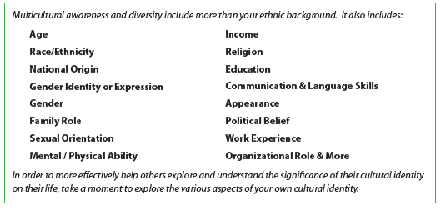
Reflecting on Culture
“Multicultural competence involves more than learning the history of particular cultural groups. While gaining knowledge is beneficial, so also is increasing one’s self-awareness and other awareness, evaluating one’s personal beliefs, attitudes and understanding, as well as opportunities to develop self-confidence in the application of multicultural competence skills and effective practices in areas such as social justice.”
Essential Cultural Self-Assessment, Lambers Fishers, LMFT, M. Div, 2018
Questions for reflection:
What aspects of your culture are most important to you and why?
What values and beliefs related to your culture do you recall learning from family? From society?

Slide 46
THANK YOU

Slide 47
Small Group Discussion
What are you processing from today’s discussions thus far? Did anything surprise you?
What are your experiences working with people from different cultures?
How can you as a leader use this information with your organization?

Slide 48
Wrap Up
Reminders:
Next training: Thursday, February 8, 2024, 9:00 am- 1:00 pm, In-person
(will send reminder)
Please take a few minutes to complete a brief session survey:
CEU survey link will be emailed
We value your feedback in helping us to
develop your program!

Slide 49
Reflections

