Slide 1
Community Spotlight: Community Care Behavioral Health
Behavioral Health Fellows Program
January 11, 2024
Laura Fiore, LCSW
Child and Adolescent Program Manager - Allegheny County

Slide 2
Remember Medicaid? It’s called HealthChoices in PA (or Medical Assistance or Community Care in many counties!)
Medicaid is an insurance program funded by the United States government, jointly by the state and federal levels. This insurance option:
was created through the Social Security Act of 1965
is intended for individuals and families with low incomes and resources
groups served include low-income parents, children, seniors, and people with disabilities
is administered at the state level as a carve out (meaning a specialized behavioral health managed care organization (BH MCO) manages the mental health and drug and alcohol services separate from a physical health managed care organization (PH MCO)
services covered may differ from state to state
the Pennsylvania Department of Human Services (DHS) is the Medicaid Authority for Pennsylvania

Slide 3
HealthChoices
The “choice” in HealthChoices refers to the member’s choice of physical health plan. Members who do not choose a physical plan are assigned a “default” physical health insurer.
The member’s county of eligibility determines the behavioral health plan that will cover the member’s behavioral health service costs. Community Care provides behavioral health coverage for the HealthChoices coverage in 43 of the 67 counties within Pennsylvania. Other behavioral health managed care organizations in PA include, Carelon Health of PA, Inc., PerformCare, Magellan and CBH.

Slide 4
BH-MCO Territory
Erie
Warren
Mckean
Potter
Tioga
Bradford
Susquehanna
Crawford
Wayne
Forest
Cameron
Sullivan
Wyoming
Lackawanna
Venango
Elk
Lycoming
Pike
Mercer
Clarion
Clinton
Luzerne
Jefferson
Columbia
Lawrence
Clearfield
Union
Montour
Monroe
Butler
Armstrong
Centre
Carbon
Snyder
Northumberland
Northampton
Beaver
Indiana
Mifflin
Schuylkill
Juniata
Dauphin
Lehigh
Allegheny
Cambria
Blair
Perry
Lebanon
Berks
Bucks
Westmoreland
Huntingdon
Washington
Cumberland
Montgomery
Bedford
Lancaster
Fayette
Somerset
Franklin
York
Chester
Philadelphia
Greene
Fulton
Adams
Delaware
Purple: Community Care Orange: Carelon Health of PA, Inc Pink: Magellan Blue: PerformCare Yellow: CBH

Slide 5
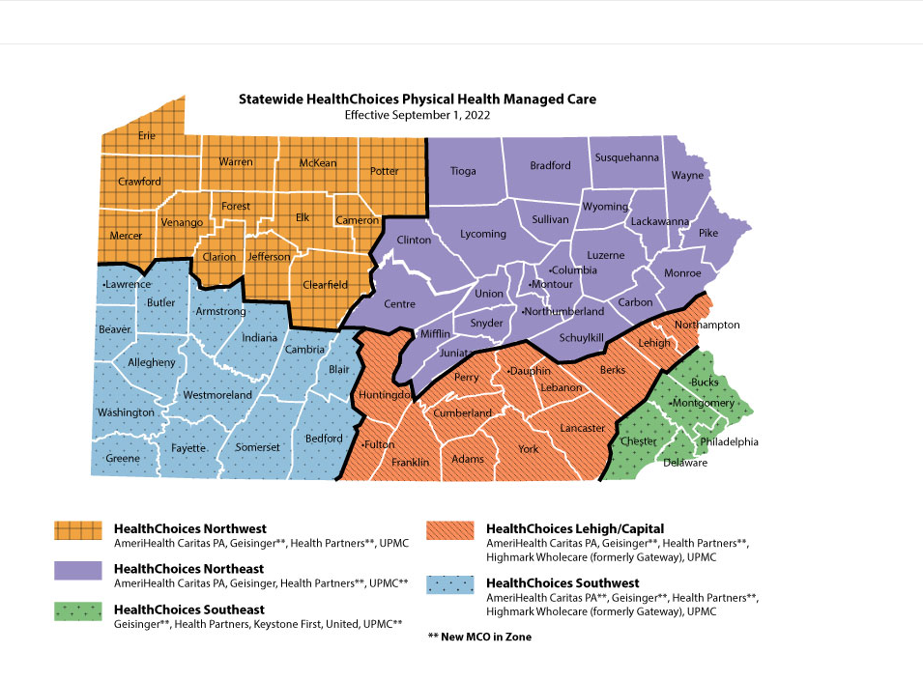
PH MCO Territory
Focus on Integrated Care: Community Care collaborates with the PH MCOs on members with both physical health and behavioral health needs

Slide 6
HealthChoices Continued
In Pennsylvania, the majority* of Medicaid coverage is available through the HealthChoices program.
There are three goals for the HealthChoices program:
To improve access to health care services
To improve the quality of care available
To stabilize Pennsylvania’s Medicaid spending
*A small number of individuals qualify for Medicaid Fee-for-Service coverage which is managed by the Bureau of Fee-for-Service programs under the Office of Medical Assistance Programs (OMAP).

Slide 7
Managed Care? What does that mean?
Managed care coverage is designed to help reduce the cost of care while ensuring delivery of the highest quality of care.
Managed care organizations collaborate with members, providers, and physical health plans to help connect members to the right services at the right time.
Community Care is a behavioral health managed care organization (BHMCO) that is contracted either with a county(ies) directly (Primary Contractor) or directly with DHS/OMHSAS.

Slide 8
Who Community Care is…
Community Care, based in Pittsburgh, is the only BH-MCO in the country to have managed care contracts in every Health-Choices region within Pennsylvania.
As part of UPMC’s Insurance Service Division, it is also the largest academic medical center-owned behavioral health insurance program that provides extensive experience working with physical health plans and implementing innovative, effective programs that meet the needs of members.

Slide 9
Community Care Membership
Community Care is a Managed Care Organization (MCO) in the state of Pennsylvania. We cover 43 counties and have a membership of over 1,340,000 people.
In Allegheny County, we have over 255,000 members

Slide 10
Community Care Mission Statement
To improve the health and well-being of the community through:
delivery of effective, cost-efficient, and accessible behavioral health services
The pillar of our programs is the belief that quality is measured by:
the improved health and well-being of the community
In conjunction with each of the counties we serve, our goal is to offer:
recovery-oriented, person-centered, accessible care that reflects contemporary best practices

Slide 11
Community Care Belief and Vision Statements
Belief Vision
Community Care’s belief is that behavioral health recovery is possible and that all individuals should have a voice in their treatment.
Our vision is to improve the quality of services for members through a Stakeholder partnership focused on outcomes.

Slide 12
Continuum of Care
Behavioral Health Services range from non-acute to acute; office based to community/home based.
Not all referrals are managed by CCBH. Some referrals are submitted directly to CCBH, others directly to the provider, or Allegheny County
CCBH managed referrals: Forms: HealthChoices Providers - Community Care (ccbh.com)
Allegheny County managed referrals: Behavioral Health - Allegheny County, PA

Slide 13
Allegheny County Child & Adolescent Behavioral Health Services
Ambulatory
Mobile
Certified Peer Support (14+)
Acute/Residential
Inpatient Mental Health
Mobile Psych Rehab (14+)
Walk in Crisis
Outpatient/School Based Outpatient
Specialized Outpatient
Site Based Psych Rehab (14+)
Social Skills Group
Intensive Behavioral Health Services
Groups
Therapeutic Preschool (2.5- 4yo)
School Based Partial Hospitalization
Partial Hospitalization (MH/SUD)
Blended Service Coordination
Mobile and Phone Crisis
Crisis Residential (14+)
Diversion and Acute Stabilization (14+)
Community Residential Rehabilitation Host Home
Residential Treatment Facility
Extended Acute Care
Joint Planning Team
Mobile Transitional Age Youth (18+)
Dual Diagnosis Treatment Team (18+)
Intensive Behavioral Health Services
Intensive Family Coaching/mobile PCIT
Multisystemic Therapy
Community Treatment Team (18+)
Community School Based Behavioral Health (CSBBH)
Individual IBHS
RESPOND (12-18yo)
SUD Rehab (14+)
SUD Intensive Outpatient (14+)
Family Based
Most Intensity Least
Notes:
Ambulatory- SUD IOP and SUD OP

Slide 14
Allegheny County Adult Behavioral Health Services
Ambulatory
Mobile
Certified Peer Support
Acute/Residential
Inpatient Mental Health
Mobile Psych Rehab
Walk in Crisis
Outpatient
Specialized Outpatient
Site Based Psych Rehab
Social Rehab
Partial Hospitalization (MH/SUD)
Mobile and Phone Crisis
Crisis Residential
Diversion and Acute Stabilization
Community Residential Rehabilitation
Long Term Residential Treatment Facility (LTSR)
Extended Acute Care
Blended Service Coordination
Mobile Transitional Age Youth (18+)
Dual Diagnosis Treatment Team (DDTT)
Community Treatment Team (18+)
SUD Rehab
SUD Intensive Outpatient
Certified Recovery Support
New Connections (BH Nursing Home Team)
Mobile Medications
Enhanced Clinical Service Coordination (ECSC)
Integrated Dual Disorders Treatment (IDDT)
Mobile MH Treatment
SUD Service Coordination
Most Intensity Least
Notes:
Ambulatory- SUD IOP and SUD OP

Slide 15
Community Care Supports
We are here to:
Answer any questions you have about behavioral health services.
Help members find doctors, counselors, and other medical professionals in their area.
Connect members to treatment and providers.
Provide resources and connections to members for any social determinants of health needs.
Our Care Management and Customer Service teams provide 24/7 support to members, providers, stakeholders.
HealthChoices Provider Line: 1-888-251-2224
Other teams supporting the contract include, but are not limited to, Quality, Network, Programs, and Training.

Slide 16
Academy + Library
Academy + Library
Online resource that is free for Community Care providers and members. Academy + Library was created for people in recovery, by people in recovery. It has courses on CommonGround, Pat Deegan’s Recovery Approach, along with videos, worksheets, educational articles, and many other wellness tools to help people with recovery.
Academy + Library: HealthChoices Providers - Community Care (ccbh.com)
Resources Supporting Recovery and Wellness
Using Medicine on the Road to Recovery
How to Take Care of Your Mental Health (or What You Can Do to Recover)
Friendship, Dating, and Connecting
Healthy Bodies and Healthy Minds
Yoga, Massage Therapy, and Other Services
Help for Work, School, and Living on Your Own
Community Care members can sign up for Academy + Library using their ACCESS card.

Slide 17
Community Care Training Department
The Training department offers a variety of trainings, learning collaboratives, and conferences
Training: HealthChoices Providers - Community Care (ccbh.com)
Includes trainings on CHC, EBPs, FWA, Population Health, Tobacco Cessation, Webinars on Various other topics
Proposed topics:
1-26-24: Generational Trauma: How suffering shapes our worldview and the inheritance of dysfunctional attachment
2/27/24: Pregnancy and Substance Use Disorders
3/7/24: Engagement and Retention in Substance Use Disorders
The Importance of Employment for Recovery and Wellness
Recovery 101 – Language & Principles

Slide 18
Mental Health America of SWPA Conference (1/26/24)
Mental Health America of Southwestern Pennsylvania is proud to once again be partnering with UPMC Health Plan/Community Care Behavioral Health to bring you a one-day virtual event highlighting:
Antiracism and Diversity help to manage Violence Risk
Supporting first responders through education, engagement, and resources
Overview of Dialectical Behavioral Therapy (DBT)
Youth Voices of Change in Mental Health
The State of Nation Post-Pandemic: What We’ve Learned From MHA Screening
Developing Resilience in Correctional Settings: Promoting Lasting Change in a Challenging Setting
Link to register:
https://www.eventbrite.com/e/2024-mha-swpa-conference-perspectives-registration-751291843127

Slide 19
CCBH.com
Provider resources - Alerts, Manual, Newsletter, FWA Compliance, Provider Reps, Incident Reporting, Quality Improvement Program, UPMC Health Plan BH Services, CHC, Act 62 Resources
Forms
Member resources – Provider Search, Health and Wellness Resources, Academy + Library, Recovery/Crisis Plan, Advance Directives, Complaints and Grievances, MATP
Clinical Innovation & Publications – Program Innovation, Performance Standards, Medical Necessity Guidelines, Medication Formularies, Information and Resources, Publications
Training – as outlined above

Slide 20
Comments/Questions

