Slide 1
This existence of ours is as transient as autumn clouds. To watch the birth and death of beings is like looking at the movements of a dance. A lifetime is like a flash of lightning in the sky; rushing by, like a torrent down a steep mountain.
— Gautama Buddha

Slide 2
Navigating Grief and Suicide as a Behavioral Health Provider
Elizabeth Schandelmeier, LCSW, APHSW-C, FT

Slide 3
Objectives
Define grief and identify types and variations and related symptoms
Discuss suicide, including assessment, treatment and management, as well as special considerations for the grieving experience
Identify strategies, techniques and resources for supporting bereaved clients, colleagues and yourself

Slide 4
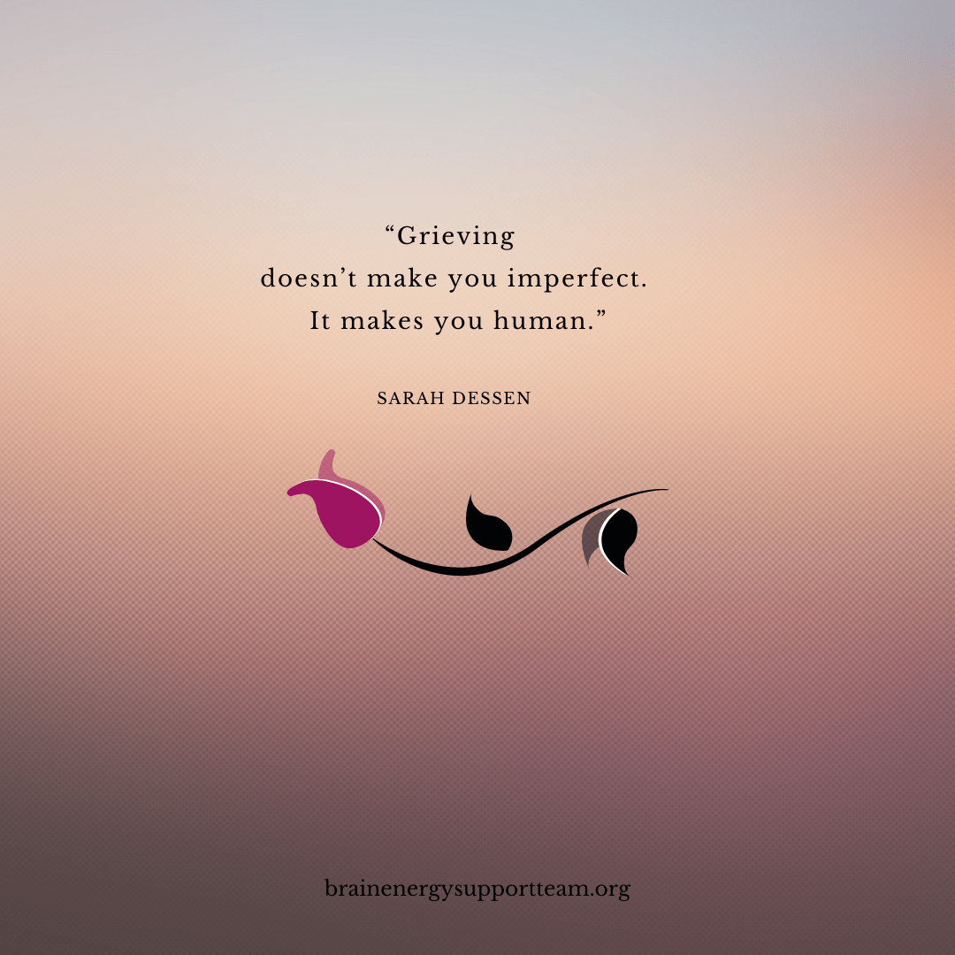
What is grief?
Grief is a normal and natural response to loss.

Slide 5
Grief can be very confusing and feel complicated...that is normal, you are not alone.

Slide 6
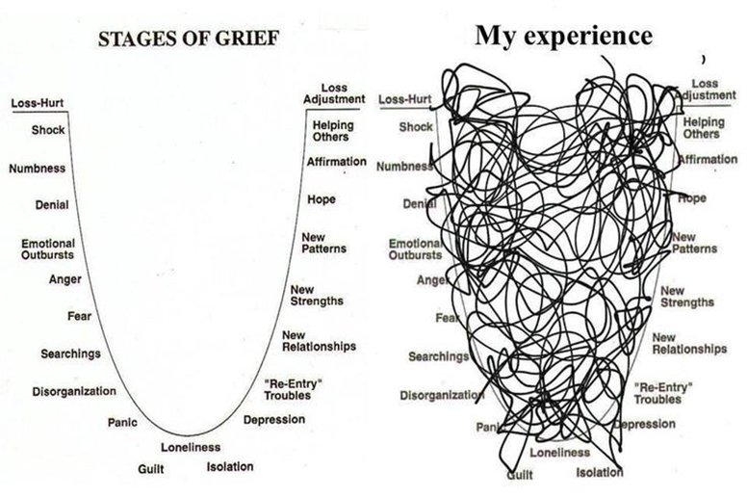
Image: http://wecandiebetter.com/stages-of-grief/

Slide 7
Grief Reactions: Physical Symptoms
Exhaustion and fatigue
Change in sleep patterns (falling asleep and staying asleep)
Difficulty focusing, fogginess, forgetfulness, “clumsiness”
Changes in appetite (increase or decrease), digestive issues
Headaches, muscle aches
Sensitivity to light and/or sound
Suppressed immune system
Tightness in chest, shortness of breath, heart palpitations
Notes:
Bereaved are always encouraged to visit their PCP for a health checkup, often bereaved have neglected their own care and follow up through the course of another person's illness, important to rule out any underlying causes for physical symptoms but also important to encouraged bereaved to shift their behavior away from caring for others and toward caring for themselves.

Slide 8
Grief Reactions: Changes in Thinking
“Disbelief,” the death or resulting changes don't seem real
Heightened emotional sensitivity
Confusion, forgetfulness, brain fog
Not able to concentrate, may affect your daily life
Challenge to sense of order, safety, and security in the world
Notes:
Important for medical professionals to be aware of this and to check in about this because the bereaved are often worried that their fogginess or memory loss are potentially due to medical or mental health issues. Sometimes the bereaved are hesitant to mention because they are embarrassed or uneasy about the thought. These symptoms are often overlooked in discussion as compared with emotional or physical symptoms.

Slide 9
Grief Reactions: Behavioral Reactions
Social withdrawal
Hyper/hypoactivity
Irritability/restlessness
Avoidance of reminders
Shifting priorities

Slide 10
Suicide Basics

Slide 11
Suicide Risk Factors
Individual Risk Factors
These personal factors contribute to risk:
Previous suicide attempt
History of depression and other mental illnesses
Serious illness such as chronic pain
Criminal/legal problems
Job/financial problems or loss
Impulsive or aggressive tendencies
Substance use
Current or prior history of adverse childhood experiences
Sense of hopelessness
Violence victimization and/or perpetration
Relationship Risk Factors
These harmful or hurtful experiences within relationships contribute to risk:
Bullying
Family/loved one’s history of suicide
Loss of relationships
High conflict or violent relationships
Social isolation
Community Risk Factors
These challenging issues within a person’s community contribute to risk:
Lack of access to healthcare
Suicide cluster in the community
Stress of acculturation
Community violence
Historical trauma
Discrimination
Societal Risk Factors
These cultural and environmental factors within the larger society contribute to risk:
Stigma associated with help-seeking and mental illness
Easy access to lethal means of suicide among people at risk
Unsafe media portrayals of suicide

Slide 12
Suicide Protective Factors
Individual Protective Factors
These personal factors protect against suicide risk:
Effective coping and problem-solving skills
Reasons for living (for example, family, friends, pets, etc.)
Strong sense of cultural identity
Relationship Protective Factors
These healthy relationship experiences protect against suicide risk:
Support from partners, friends, and family
Feeling connected to others
Community Protective Factors
These supportive community experiences protect against suicide risk:
Feeling connected to school, community, and other social institutions
Availability of consistent and high quality physical and behavioral healthcare
Societal Protective Factors:
These cultural and environmental factors within the larger society protect against suicide risk:
Reduced access to lethal means of suicide among people at risk
Cultural, religious, or moral objections to suicide

Slide 13
Suicidality Red Flags
If someone is at risk for suicide, you can watch for warning signs, including:
Talking about being a burden
Being isolated
Increased anxiety
Talking about feeling trapped or in unbearable pain
Increased substance use
Looking for a way to access lethal means
Increased anger or rage
Extreme mood swings
Expressing hopelessness
Sleeping too little or too much
Talking or posting about wanting to die
Making plans for suicide

Slide 14
SAFE-T Assessment

Slide 15
SAFE-T Assessment & Evaluation

Slide 16
Local Hotlines
re:solve Crisis Network 1-888-7-YOU-CAN (968-226) | Women's Center and Shelter of Greater Pittsburgh (412) 687-8005
Pittsburgh Action Against Rape (PAAR) Crisis Hotline 1-866-363-7273 General Phone (412) 431-5665 | Center for Victims of Violent Crime Crisis Hotline (412) 392-8582 General Phone (412) 482-3240
Womansplace, Inc. (Shelter for Female Victims of Domestic Violence) 1-866-202-5573 | Womanspace East, Inc. (Shelter for Female Victims of Domestic Violence) (412) 765-2661
United Way HelpLine (412) 255-1155 | Family Resources WARMLINE (Parenting Information) 1-877-927-6596
Allegheny County Health Department - Public Health Emergency Services (412) 687-2243

Slide 17
Hotlines, cont'd
Pennsylvania State Hotlines
Office of Mental Health & Substance Abuse Services (OMHSAS) 1-877-356-5355
Childline (PA Child Abuse Hotline) 1-800-932-0313
National Hotlines
National Hopeline Network (Crisis or Suicidal Thoughts) 1-800-784-2433
Al-Anon/Alateen (Monday - Friday, 8 AM - 6 PM EST) 1-888-425-2666
The Alcohol Hotline 1-800-622-2255
National Child Abuse Hotline 1-800-422-4453
National Domestic Violence Hotline 1-800-799-SAFE (7233)
National Victim Center (Victims of Violent Crimes) 1-800-394-2255
Gay & Lesbian National Hotline (Monday - Friday, 4 PM - 12 AM EST; Saturday, 12 PM - 5 PM EST) 1-888-843-4564
National Health Information Center 1-800-336-4797
National Poison Control 1-800-222-1222
National Suicide Prevention Lifeline 1-800-273-TALK (8255)
RAINN (Rape Abuse & Incest National Network) 1-800-656-HOPE (4673)

Slide 18
Grief and Suicide: Special Considerations
Traumatic Grief
Underlying condition (mental health/medical)
Immediate action may be appropriate
Language (died from or by suicide)

Slide 19
Grief and Suicide: Special Considerations
Traumatic aftermath
sudden, sometimes violent, unexpected
survivors may need to deal with the police or handle press inquiries
recurring thoughts of the death/circumstances
may develop post-traumatic stress disorder (PTSD)
Stigma, shame, and isolation
stigma attached to mental illness
many religions specifically condemn the act as a sin
survivors may be reluctant to acknowledge or disclose the circumstances of such a death
family differences over how to privately or publicly discuss the death undermine a family's ability to provide mutual support.
Mixed emotions
victim and "perpetrator" are one
feelings anger, rejection, and abandonment may be particularly acute
Need for reason, the "why", the "what ifs"
Increased risk for survivors

Slide 20
Grief and Suicide: Supporting Clients
TALKING POINTS
Ask clients what they know and how they feel
Give accurate information about suicide
Do not talk about the method
Avoid blaming and scapegoating
Address anger: one can be angry at someone’s behavior and still care deeply
Address feelings of responsibility
Encourage help-seeking behavior and self-care

Slide 21
Grief and Suicide: Group Settings
Discourage speculation/rumors/gossip
Do not provide details
Protect the client’s privacy – confidentiality regulations continue to apply even after the death of a patient
Focus on remembering the client, discussing feelings and reactions, and promoting help seeking behavior
Validate the feelings of the group – mixed reactions, fears of “being next,” signs of traumatic stress
Gently redirect conversations with irrelevant or potentially hurtful statements
Emphasize that there is always help available when someone needs it.
Provide immediate individual response immediately to any client who appears to be especially impacted by the news
Pay attention to clients who might be at increased suicide risk

Slide 22
Grief and Suicide: Family Contact
Contacting family directly to extend condolences Unless the client was in a residential level of care and it is necessary to notify the family of the passing, it might not be advisable to contact the family without an invitation or in the absence of a signed consent. Although regulations do not expressly prohibit clinical providers from contacting the family of a deceased client, there are still confidentiality issues (see About Confidentiality). Also, families might be experiencing their own grief process and not be receptive to the counselor’s attempts to reach out, even when they are well-meaning. On the other hand, many families do welcome a call, a card, or the opportunity to meet with the professional caregiver. In addition, contact with family can help clinicians’ own sense of closure [26], though clinicians should consider the possibility that the family may express anger or blame the clinician for the suicide of their loved one [27]. One school of thought encourages clinicians to avoid contact with family to protect themselves and the agency from legal repercussions. Another school of thought suggests that distance from family members may instead increase the likelihood of litigation [28]. Attending the wake or funeral service Always be cognizant and respectful of the family’s wishes. It is advisable to ask for permission from the family of the deceased prior to attending. Staff members who attend a memorial or funeral service must not disclose that they were involved in the deceased’s treatment. If a staff member wants to attend a memorial service for the deceased, first discuss the matter in clinical supervision. The decision to attend a funeral should always be made with the foreknowledge and approval of the staff member’s supervisor and/or manager, and there should be a policy in place about whether to provide staff with time off to attend. ABOUT CONFIDENTIALITY • Is the family aware that their loved one was in treatment? • Is there a signed consent on file? • Has the provider had previous contact with the family? • Would attending the funeral or sending a card violate confidentiality? • Families may not always understand the complexities of confidentiality - what do you think the family expects you to do?

Slide 23
Grief and Suicide: Supporting Colleagues
TIPS FOR CONDUCTING A SUCCESSFUL INSTITUTIONAL DEBRIEFING ✓ ✓ ✓ ✓ ✓ ✓ ✓ Keep the conversation factual and the tone non-accusatory: it is important to not place staff on the defensive. Ask open-ended questions: this encourages staff to contribute more to the conversation. Keep things simple: debriefings answer the “who, what, when, where” of a patient death. Avoid going into details of the death, and avoid sharing suspicions or spreading rumors. Keep the meeting short: a debriefing should take between 30 minutes to an hour. As you prepare for debriefing, identify your own feelings and reactions and understand that the person communicating the news sets the tone for subsequent communications. Be prepared for a wide range of reactions, including no reaction at all.

Slide 24
Grief and Suicide: Supporting Yourself

Slide 25
Twin Bereavement
WHAT IS TWIN BEREAVEMENT? When clinicians lose a client to suicide, they can experience an episode of twin bereavement: in addition to the personal grief reaction, the loss can impact their professional identity and their relationship with colleagues and their clinical work [14]. Clinicians may experience insecurities about their own competence or feel that the work is too sad and too emotionally draining to continue. Sometimes clinicians, especially trainees or less seasoned professional caregivers, consider leaving the field. A 2017 study found that 10% of surveyed psychiatrists stopped accepting potentially suicidal clients [15]. Hypervigilance in relation to any perceived suicide risk is one of the most common early responses reported by clinician-survivors who continue to work with suicidal clients [16]

Slide 26
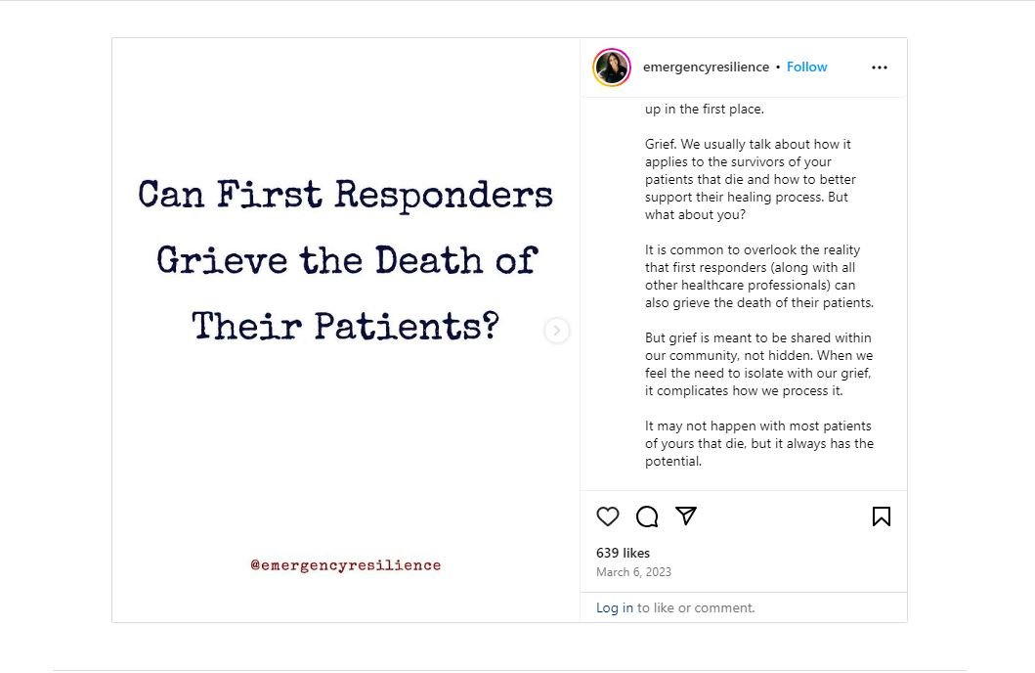
Disenfranchised Grief

Slide 28
What can we do?
Acknowledge the death AND your grief (both are real)
Give yourself time to grieve
Identify, express and experience your feelings
Adapt your routine to accept changes in your schedule
Find meaning in the death

Slide 29
Grief and Suicide: Memorials
Contacting family directly to extend condolences Unless the client was in a residential level of care and it is necessary to notify the family of the passing, it might not be advisable to contact the family without an invitation or in the absence of a signed consent. Although regulations do not expressly prohibit clinical providers from contacting the family of a deceased client, there are still confidentiality issues (see About Confidentiality). Also, families might be experiencing their own grief process and not be receptive to the counselor’s attempts to reach out, even when they are well-meaning. On the other hand, many families do welcome a call, a card, or the opportunity to meet with the professional caregiver. In addition, contact with family can help clinicians’ own sense of closure [26], though clinicians should consider the possibility that the family may express anger or blame the clinician for the suicide of their loved one [27]. One school of thought encourages clinicians to avoid contact with family to protect themselves and the agency from legal repercussions. Another school of thought suggests that distance from family members may instead increase the likelihood of litigation [28]. Attending the wake or funeral service Always be cognizant and respectful of the family’s wishes. It is advisable to ask for permission from the family of the deceased prior to attending. Staff members who attend a memorial or funeral service must not disclose that they were involved in the deceased’s treatment. If a staff member wants to attend a memorial service for the deceased, first discuss the matter in clinical supervision. The decision to attend a funeral should always be made with the foreknowledge and approval of the staff member’s supervisor and/or manager, and there should be a policy in place about whether to provide staff with time off to attend. ABOUT CONFIDENTIALITY • Is the family aware that their loved one was in treatment? • Is there a signed consent on file? • Has the provider had previous contact with the family? • Would attending the funeral or sending a card violate confidentiality? • Families may not always understand the complexities of confidentiality - what do you think the family expects you to do?

Slide 30
If self-care seems impossible
Remember, you can't care for others if you don't take care of yourself
Divide duties with co-workers, family, friends, community groups, faith organizations
Eat, hydrate, sleep, exercise...repeat
Take breaks, have some fun
Connect with others, reach out for support
Ask for (and accept!) help

Slide 31
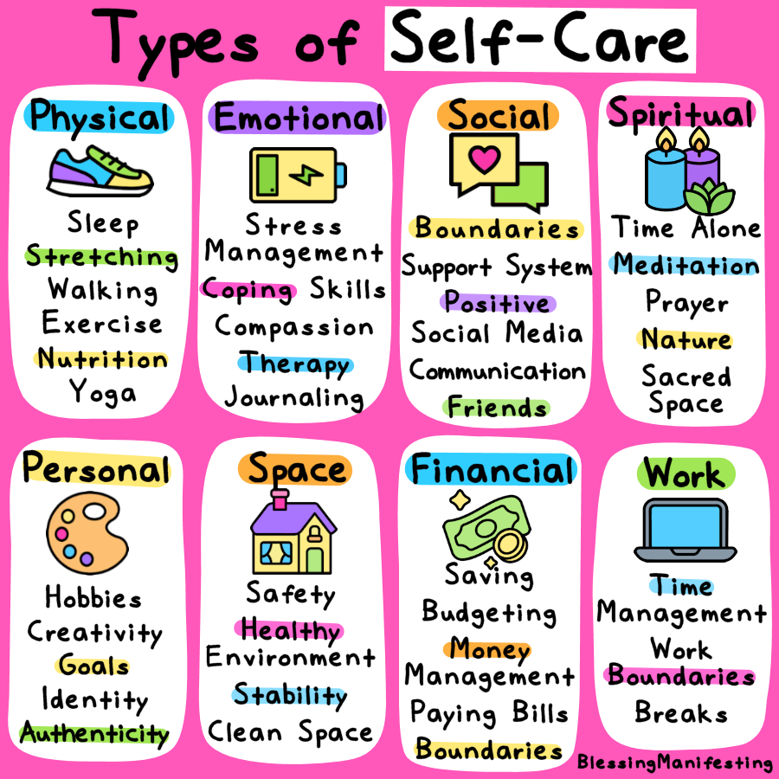
Self Care (home and work)

Slide 32
5-minute self-care ideas (that are not about self-improvement)
Clean/organize one thing
Have a good cry
Read some good news
Put on lotion
Cut or paint your fingernails
Light candles
Play your favorite song
Laugh (at anything!)
Go off the grid
Breathe​
Step outside​
Journal​
Sing and dance​
Stretch​
Shower​
Close your eyes​
Text a friend​
Say thank you​
Color or draw

Slide 33
What else can I do?
Is there a physical cause of your anxiety/depression/emotions? Impact of medications or medical procedures?
Talk to the people around you.
Remember gut/brain connection, be mindful of your digestive system
Breathe
Seek help (EAP, counselor, therapist, social worker, palliative team)

Slide 35
Ideas for Work
Feeling overwhelmed or sad? Know who to call (your manager or a particularly comforting colleague)
Find ways to refuel
Breathe deeply
Climb a flight of stairs (or several)
Look out of a window
Smile
Find a quiet space and visualize a comforting place
Look at a cat meme, find a way to laugh
Be acutely aware of your professional boundaries
Do your best work
Notes:
Breathe and laugh, life is short

Slide 36
Team Care at Work
Regularly scheduled moments of remembrance: Daily/weekly/monthly/annual, candle lighting, moment of silence each morning or change of shift, reading names of deceased, sharing of stories once per month, celebration of life with tea and cookies, the main goal is to bring staff together to connect them in their shared grief space as an established routine that staff can expect, look forward to, and count on
Memorial "garden": This could be an outdoor space for reflection or an indoor planter with succulents, ask staff to paint/use marker to write the initials of the patient on a small stone for collection and placement in a container garden with sand or small plants or even in a jar as a centerpiece for a daily/weekly/monthly moment of remembrance
Grief jar: Staff could be invited to write a thought when motivated or pick a thought when in need from a jar or a box, notes to each other for encouragement, support, understanding, shared grieving, "we are all here together, you are not alone" type of messages to each other to form shared connection over loss
Grief book: Staff could write notes about deceased patients, favorite memories or stories, that could either be collected into a single volume to be shared with the patient's family or could be collected and kept at the clinic where staff could continue to add to the book as patients die, a sort of legacy journal documenting the history of caring that has taken place.
Collage: The clinic could establish a wall or bulletin board or some space that is dedicated to an established memorial symbol (a certain flower, heart, bird shape, etc.), staff could write a small message on the back and hang them as a remembrance
If a series of support sessions would be helpful, UPMC EAP
Regular ritual to generally acknowledge the cumulative losses that are inevitable (perhaps weekly or monthly, whichever seems appropriate) as well as having more specific events to recognize the death of individual patients and the impact on staff.

Slide 37
Grief Mindful Awareness Activity
Take a few minutes to sit in a quiet, peaceful, comfortable location where you will not be interrupted. This might be by a lake, in a wooded area or flower garden, or your favorite chair at home. Take some deep breaths, close your eyes, and when you are ready, turn your attention to any losses that you have experienced. This might be the death of someone close to you, the death of a patient, the end of a friendship or relationship, a decline in health status for yourself or someone else, a lost career opportunity, the effects of a natural disaster. Think back over the past month, year, or longer.
What comes up for you? Is there a loss that readily comes to mind?
Are you surprised by the particular loss that comes to mind or well aware of it?
How recent is the loss?
Is there more than one loss that feels particularly salient?
How painful is the loss?
What emotions do you feel as a result of that loss?
What thoughts do you have about the loss?
What physical sensations are you experiencing as you think about the loss? If you have more time or
during another quiet time, continue to explore your feelings related to loss:
In what ways (both negative and positive) does the loss affect your daily life?
How are you supported by others related to this loss? Is your loss disenfranchised, i.e., hidden from others?
What do you need to help integrate this loss into your life? Acknowledge this loss to yourself? More time to experience and work through the pain of the loss? Share your thoughts and emotions with someone else? Honor the deceased individual or your loss experience through an activity such as writing; building something; planting a tree, shrub, or flowers; creating a work of art; singing a song; or playing music?
If this exercise brings up particularly unsettling thoughts and emotions, what can you do right now to help yourself feel more at peace as you continue over time to cope with the loss? What characteristics, skills, and resources do you have that give you strength as you move through the grieving process?

Slide 38
Cultural Considerations Grief is a common denominator...the expression of grief is not.
Collective, community, family, or individual experience
Language to describe loss
Support providers (family, friends, faith and religious community/leaders, therapist)
Sense of familial duty or sacrifice
Faith, spirituality, philosophy, or atheism/agnosticism
Access to resources
Views on loss/dying/death and what comes next
Norms about how to express grief (stoic, emotional)
Outward expression may differ from internal experience

Slide 39
Cultural Considerations Grief is a common denominator...the expression of grief is not.
Collective, community, family, or individual experience
Language to describe loss
Support providers (family, friends, faith and religious community/leaders, therapist)
Sense of familial duty or sacrifice
Faith, spirituality, philosophy, or atheism/agnosticism
Access to resources
Views on loss/dying/death and what comes next
Norms about how to express grief (stoic, emotional)
Outward expression may differ from internal experience

Slide 40
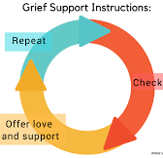
Supporting Someone Who is Grieving
Use appropriate and concise language (actualizing the death)
Allow time, do not set limits on the grief experience
Explore transformation and growth over time
Encourage the identification, expression, and experience of all feelings
Encourage adaptation to living without the deceased and finding meaning in the death, one’s own life and the future

Slide 41
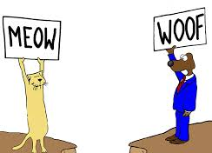
Recognize Potential Communication Barriers
Cultural misunderstandings, including language, family system/structure, decision-making process, accepted medical strategies/expectations, bias (perceived or otherwise)
Denial or disagreement
Emotion, including fear, guilt, and injustice
Education level, health literacy, previous experience with medical system
Language, including use of medical jargon or technical terms
Access to resources, especially those that may result in barriers to treatment or support
Other underlying issues
Notes:
These are places where we can all do better, things to keep in mind during discussion.

Slide 42
Interventions and Strategies
Normalize the grief experience
Listen, sometimes it is helpful to be quiet
Be compassionate and empathetic, remember that this is the person’s experience to live with
Use an informed biopsychosocial, strengths-based approach to empower the person to ask for help
Customize interventions to the person’s background, gender, resources, and needs (as defined by the person)
Consider coping style, personality, previous losses, access to and availability of support resources, as well as medical, psychiatric, and trauma history

Slide 43
Interventions and Strategies Cont'd
Be mindful of timing (assistance too early/too late reduces effectiveness)
Develop follow-up that is appropriate to the needs of the bereaved and follows best practices (programs with cut-offs are less effective than those with less frequent and longer term contact)
Use initial contact to develop rapport and provide psychoeducation allowing the bereaved to take the lead
Develop a strategy for identifying and engaging “high-risk” mourners

Slide 44
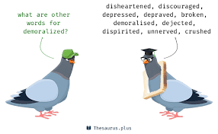
Target Demoralization
Demoralization: despair, helplessness, sense of isolation experienced through illness, treatment, and terminal prognosis
Acknowledge and ameliorate emotional or physical stressors
Normalize patient’s stress response by acknowledge suffering and seeking to enhance and support dignity
Use bedside interviewing to discern existential and other major concerns and vulnerabilities
Take into consideration the needs of the family system (i.e., patient, caregiver, others in the circle of support), as well as the relationships between them
Suggest support groups targeted to specific populations (e.g., caregiver fatigue, specific cancer diagnoses, children’s experience)

Slide 45
Potential Red Flag Circumstances
Guilt or shame
Cumulative losses
Psychiatric history
Conflicted or ambivalent relationship with deceased
Isolated or alienated family/support network
Type of death (sudden, violent death; suicide; highly medicalized death: ICU stay, technology [e.g., dialysis, feeding tubes, intubation]; quality of medical intervention [e.g., communication, level of care, support received])
Notes:
Talk through this slide, point out that age of patient or whether there are children involved are not necessarily red flag issues

Slide 46
What can I say?
Ask about their person and their story
“I don’t know”
“I am here to do X,Y,Z”, be concrete
Use empathetic and supportive statements
Validate their feelings
Nothing – just listen
Notes:
Telling the truth can be harder than it sounds, I don’t know should be followed by “but I can find out”, be concrete, empathize but do not own, “I wish we could do more”, “I hear that you feel frustrated”, “of course you are crying, this is a very sad day filled with terrible news, sometimes silence is more valuable than words, its ok to tell funny or sad stories

Slide 47
What shouldn’t I say?
“I know how you feel” (hint: you don’t)
Platitudes (they don’t help)
Faith-based or spiritual comments
Anything that implies taking sides
Anything that implies fault

