Slide 1

This existence of ours is as transient as autumn clouds. To watch the birth and death of beings is like looking at the movements of a dance. A lifetime is like a flash of lightning in the sky; rushing by, like a torrent down a steep mountain.
— Gautama Buddha

Slide 2
Grief, Loss and Bereavement
Elizabeth Schandelmeier, LCSW, APHSW-C

Slide 3
Objectives
Define grief and identify types and variations
Discuss and differentiate between Prolonged Grief Disorder DSM v ICD; compare Grief/Depression/Adjustment Disorder/PTSD; review bereavement models
Identify strategies, techniques and resources for supporting bereaved clients, colleagues and yourself

Slide 4
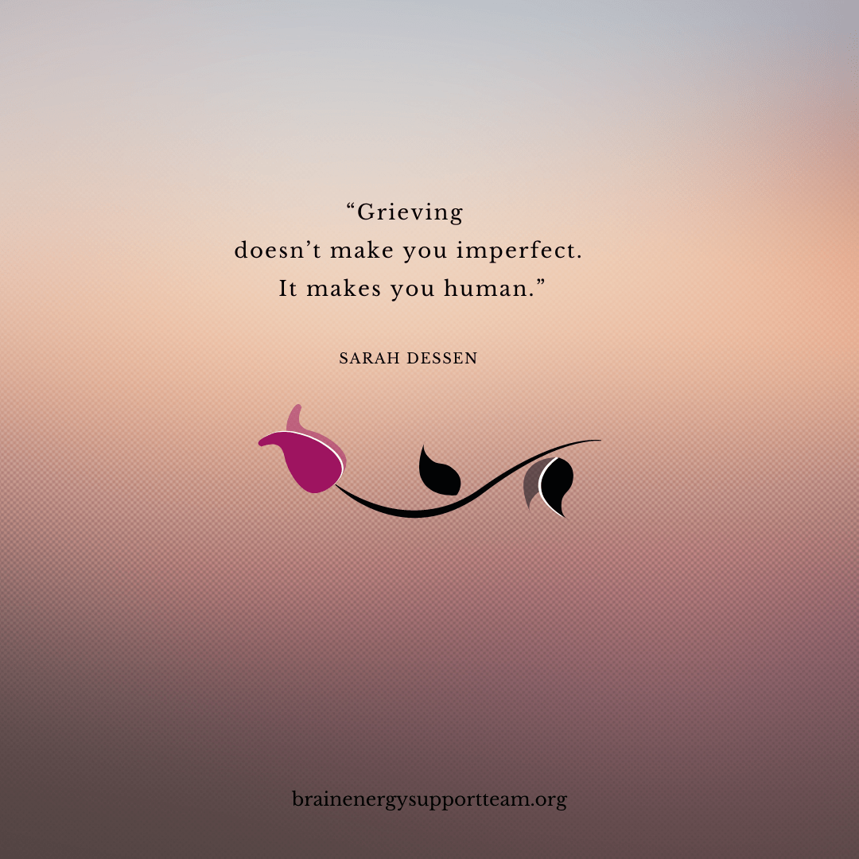
What is grief?
Grief is a normal and natural response to loss.

Slide 5
What is grief?
Natural and normal response to loss
Can include death and non-death related losses
Can describe anticipatory, preparatory and twilight losses
Not typically pathological, generally predictable/patterned
Cultural expression
Periods of grief
Grief: initial reaction to a loss
Mourning: process of adapting to a loss
Bereavement: period after a loss during which mourning occurs

Slide 6
Types of Grief
“Normal” vs. “complicated” vs. “pathological” (Prolonged Grief Disorder)
Anticipatory: circle of support, apprehension, concern for comfort, denial, dread, confusion, guilt, shame
Preparatory: the dying, existential or spiritual crisis, legacy concerns, curiosity/fear about the dying process
Twilight: Long-term period between diagnosis and end of life
Collective/Cultural/Inherited: shared societal/cultural/familial losses
Cumulative: multiple losses
Disenfranchised: unacknowledged losses
Traumatic: circumstances surrounding the death
Secondary: “hidden” impacts of a death (i.e., finances, friendships, home, safety/security)
Delayed: process of grieving is "put on hold" for some amount of time
Suffocated: grief reactions that are punished (i.e., “acting out” or being told to “move on”)
Notes:
Speak to "complicated grief", stems from persistent complex grief disorder but used inappropriately and without a clear definition, often "diagnosed" either before a death or shortly after rather than at the 6 or 12 month mark

Slide 7
Twilight Grief
Period of long-term decline that starts between diagnosis (sometimes before) and end-of-life
Often includes fear, limited social support, care partner fatigue, guilt, frustration, shifting relationships & identities, impaired communication
Significant changes to physical, mental, and emotional health & ability
Reflects lived ambiguous losses, not anticipatory loss
Can feel melancholy but also sparkles with moments of beauty and joy
Notes:
Jenna

Slide 8

Twilight Grief and Living Losses
Financial independence/security
Shifting identity and relationships/ care obligations, intimacy/sexuality
Impact on career, aspirations
Reduced social opportunities
Control over your life and freedom
The relationship "that was"
Physical health (sleep, food, self-care, medical care)
Emotional and mental health strain
Sense of self and identity
Hobbies, time on your own

Slide 9

Grief Reactions
Similar to intense stress or crisis response
Typically include:
  Emotional responses
  Physical symptoms
  Cognition shifts
  Behavioral reactions

Slide 10

Grief Reactions: Emotional Responses
Sadness
Guilt and shame
Anxiety
Emancipation/liberation
Relief
Anger
Loneliness
Notes:
These are examples, not an exhaustive list

Slide 11
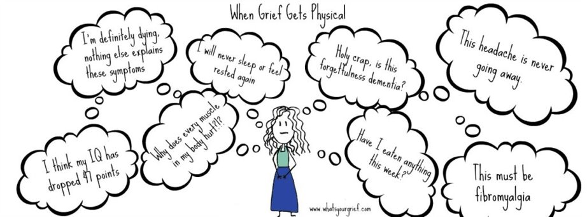
Grief is also physical

Slide 12
Grief Reactions: Physical Symptoms
Exhaustion and fatigue
Change in sleep patterns (falling asleep and staying asleep)
Difficulty focusing, fogginess, forgetfulness, “clumsiness”
Changes in appetite (increase or decrease), digestive issues
Headaches, muscle aches
Sensitivity to light and/or sound
Suppressed immune system
Tightness in chest, shortness of breath, heart palpitations
Notes:
Bereaved are always encouraged to visit their PCP for a health checkup, often bereaved have neglected their own care and follow up through the course of another person's illness, important to rule out any underlying causes for physical symptoms but also important to encouraged bereaved to shift their behavior away from caring for others and toward caring for themselves.

Slide 13
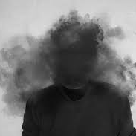
Grief Reactions: Cognition Shifts
“Disbelief,” initial inability to integrate loss into daily life
Heightened emotional sensitivity/lability
Confusion, forgetfulness, brain fog, preoccupation
Functional impairment (usually minor and temporary)
Heightened sense of “presence”
Challenge to sense of order, safety, and security in the world
Notes:
Important for medical professionals to be aware of this and to check in about this because the bereaved are often worried that their fogginess or memory loss are potentially due to medical or mental health issues. Sometimes the bereaved are hesitant to mention because they are embarrassed or uneasy about the thought. These symptoms are often overlooked in discussion as compared with emotional or physical symptoms.

Slide 14
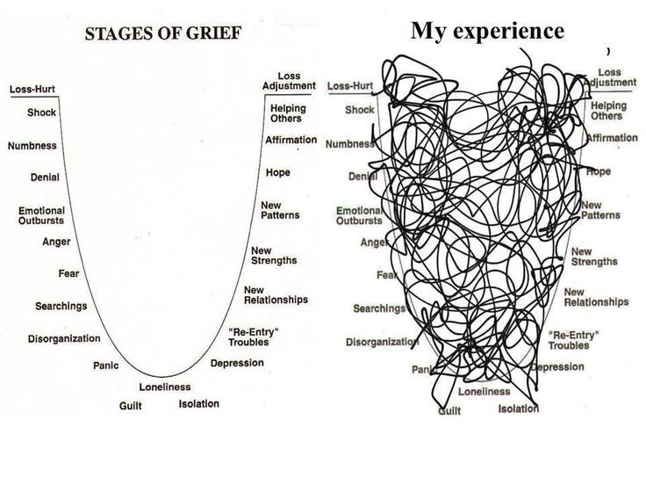
Things to remember…
Grief contributes to disorganized thinking at a time when organized thinking is required
Notes:
Remember, you are likely participating in a family’s worst day ever

Slide 15
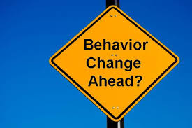
Grief Reactions: Behavioral Reactions
Social withdrawal
Hyper/hypoactivity
Irritability/restlessness
Avoidance of reminders of the deceased
Task-oriented behaviors

Slide 16
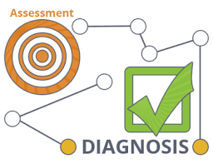
Diagnosing Grief: It's Complicated

Slide 17
Kübler-Ross, Stages of Grief (denial, anger, bargaining, depression, acceptance, finding meaning)
Worden's Tasks of Mourning (accept the reality, process the pain, adjust to a world without the deceased [external, internal, spiritual], create enduring connection)
Stroebe and Schut Dual Process Model (Oscillate between loss-oriented coping and restoration-oriented coping and between coping and not coping with the loss. Cannot attend to both dimensions at the same time)
Neimeyer Meaning Reconstruction (learn how to develop a meaningful life without the deceased by assimilating and accommodating the loss)
Klass, Silverman, Nickman Continuing Bonds (Challenges models of grief that end in a detachment from the deceased and suggests a paradigm in which it is normal for the bereaved to continue their bond with the deceased, considered other cultures)
Models of Bereavement
Notes:
Seeking to shift grief away from the idea of a linear model to one that accommodates chaos.

Slide 18
Companion Publications Defining Pathological Grief (Prolonged Grief Disorder)
ICD (11)
International Classification of Diseases
DSM (TR-5)
Diagnostic and Statistical Manual of Mental Disorders
  Written by WHO and NCHS
  Provides codes for insurance reimbursement for all health conditions, including mental disorders
  Developed by psychiatrists and approved by APA
  Provides definitions and criteria for mental disorders
Notes:
Point out exact name of publications, this marks pathologization of grief as a "disease" or "mental disorder"

Slide 19
Name | Source | Locations | Implemented
Persistent Complex Bereavement Disorder | DSM-5 | Section II: Trauma- and Stressor-Related Disorders Section III: Emerging Measures and Models/Conditions for Further Study | 2013
Prolonged Grief Disorder | DSM-5-TR | Section II: Depressive Disorders | 2022
Adjustment Disorder with Depressed Mood | ICD-10 | Reaction to severe stress and adjustment disorders | October 2015 (US)
Prolonged Grief Disorder | ICD-11 | Disorders specifically associated with stress | 2022
Notes:
Point out shift in DSM from trauma/stressor related disorder to depressive disorder (reflected in the new definition) and shift in ICD from stress or adjustment disorder to specifically stress disorder

Slide 20
Relevant Changes to DSM-5 from DSM-IV
Removal of multiaxial system
Elimination of the “Bereavement Exclusion” for Major Depressive Disorder
In DSM-IV, an individual who experienced a death and who had a depressed mood could not be diagnosed with MDD unless symptoms persisted beyond two months
Replaced by a note offering guidance on differentiating grief from MDD​ (Bereavement Exclusion)

Slide 21
Elimination of the Bereavement Exclusion
Reasons to eliminate the exclusion:
  Remove implication that bereavement only lasts 2 months
  Recognize bereavement as a stressor that can precipitate a depressive episode
  Bereavement-related MDD is genetically influenced and is associated with similar personality characteristics, patterns of comorbidity, and risks of chronicity and recurrence as non–bereavement-related MDD
  Bereavement-related MDD responds similarly to psychosocial and pharmacologic treatments as non–bereavement-related MDD
  MDD can occur in a person who is experiencing another stressor yet that stressor does not preclude a diagnosis
  Risk of stigmatization outweighs the potential for treatment and the prevention of suicide
From APA:
APA, 2013b; Kavan & Barone, 2014
Notes:
This is a major point of discussion and controversy regarding defining grief as a pathology and if it is to be defined as such, then how to classify, disagreement is reflected in the different standards proposed by the newest versions of both the ICD and the DSM. Shifting DSM away from trauma to depressive disorder diagnosis while trying to differentiate grief from depresssion.

Slide 22
Maintaining the Bereavement Exclusion
Bereavement-related depression is different from MDD. Bereavement-related depressive symptoms were not associated with increased risk of future depression
Literature review found no support for removing the exclusion. No increased risk of suicide among persons with excluded bereavement-related depression
Eliminating the exclusion will result in an increase in the number of people with normal grief inappropriately diagnosed with MDD
  Stigma of mental illness
  Unnecessary prescription of antidepressant medications and associated adverse effects
Notes:
Important to note that there is some disagreement about whether psychoactive medications are an effective treatment for non-pathological grief responses

Slide 23

When DSM-IV-TR updated to DSM-5, the bereavement exclusion shifted to a Trauma- and Stressor-Related Disorder
DSM-5 (Persistent Complex Bereavement Disorder) updated to DSM-5-TR, Prolonged Grief Disorder is now classified as a Depressive Disorder
ICD-11, Prolonged Grief Disorder has been reclassified from an Adjustment Disorder to a Disorder Specifically Associated with Stress

Slide 24
Differential Diagnoses
Criteria | Standard Bereavement | Prolonged Grief Disorder | Major Depressive Disorder | Adjustment Disorder | Post-Traumatic Stress Disorder
 |  | DSM-5-TR | DSM-5 | DSM-5 | DSM-5
Time | Forever? | Death ≥ 12 months ago Symptoms experienced ≥ 1 month | ≥ 2 weeks | Stressor ≥ 3 months ago | After experiencing or witnessing traumatic event. Usually within 3 months Symptoms experienced ≥ 1 month
Pattern | Waves or pangs of grief associated with thoughts or reminders of deceased Becomes less intense as time passes | Intense yearning or longing for deceased or preoccupation with thoughts or memories of deceased ≥ 3 other symptoms | Persistent depressed mood or loss of interest or pleasure in nearly all activities ≥ 5 other symptoms | Disproportionate marked distress Significant impairment | Presence of intrusion symptoms, avoidance, negative changes in thinking and mood, and changes in physical and emotional reactions Clinical presentation varies by individual
Affect | Feelings of emptiness and loss Occasional positive emotions and humor | Intense yearning or longing | Persistent depressed mood Pervasive unhappiness | Intense sorrow Reactive distress Hopelessness | Intense psychological distress Persistent inability to experience positive emotions Anger, aggressive verbal or physical behavior

Slide 25

How Can I Help People Who are Grieving?

Slide 26
Support for Decision Making
All hospice is palliative care, but not all palliative care is hospice
Palliative Service
Care for people with serious illness, no prognosis required, can be curative
Expanded focus includes the family, patient at center
Interdisciplinary team (doctor, nurse, social work, spiritual care, other specialists)
Palliate = relieve symptoms (medical, physical, emotional, spiritual)
Can help people define "quality of life" for themselves or those they are caring for
Can serve as a bridge between specialists
Can facilitate decision making
Hospice
Philosophy of care, not a physical place
End of life care, prognosis 6 months or less if left to "natural course"
Full symptom management (emotional, spiritual, physical) with no curative treatment of disease
Medications assisting with comfort are allowed
Focus on patient's circle of support
Interdisciplinary team, including volunteers
Aim to provide highest quality of life for as long as possible, does not seek to hasten death

Slide 27
Select Bereavement Screening Tools
Prigerson Inventory of Complicated Grief (ICG), 19-item inventory to isolate symptoms of uncomplicated grief
Brief Grief Questionnaire (BGQ), 5-item self-report or interview instrument for screening complicated grief developed for a study of individuals seeking support after the 9-11 terrorist attacks
Prolonged Grief Disorder (PG-13-Revised) Scale, revision of Inventory of Complicated Grief (ICG) to 13-item scale to assess intensity of grief and to diagnose PGD according to proposed criteria (DSM-5-TR and ICD-11)
Pandemic Grief Scale (PGS) is a self-report mental health screener of dysfunctional grief due to a COVID-19 loss
Grief Impairment Scale or GIS, 5-item screening instrument to assess the impact of loss on cognitive, behavioral, health, social role and interpersonal domains

Slide 28
Cultural Considerations
Grief is a common denominator...the expression of grief is not.
Collective, community, family, or individual experience
Language to describe loss
Support providers (family, friends, faith and religious community/leaders, therapist)
Sense of familial duty or sacrifice
Faith, spirituality, philosophy, or atheism/agnosticism
Access to resources
Views on loss/dying/death and what comes next
Norms about how to express grief (stoic, emotional)
Outward expression may differ from internal experience

Slide 29
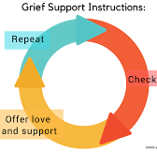
Supporting Someone Who is Grieving
Use appropriate and concise language (actualizing the death)
Allow time, do not set limits on the grief experience
Explore transformation and growth over time
Encourage the identification, expression, and experience of all feelings
Encourage adaptation to living without the deceased and finding meaning in the death, one’s own life and the future

Slide 30
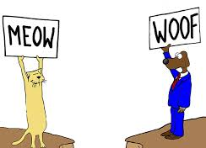
Recognize Potential Communication Barriers
Cultural misunderstandings, including language, family system/structure, decision-making process, accepted medical strategies/expectations, bias (perceived or otherwise)
Denial or disagreement
Emotion, including fear, guilt, and injustice
Education level, health literacy, previous experience with medical system
Language, including use of medical jargon or technical terms
Access to resources, especially those that may result in barriers to treatment or support
Other underlying issues
Notes:
These are places where we can all do better, things to keep in mind during discussion.

Slide 31
Bereavement Support
Use SW and IDT to assess for emotional and physical stressors
Refer to appropriate disciplines as needed
Provide active, empathetic listening
Normalize and validate feelings
Discuss and explore coping strategies
Notes:
Don't feel that you have to be able to do it all, call on your team for varied perspective and resources

Slide 32

Interventions and Strategies
Listen, sometimes it is helpful to be quiet
Be compassionate and empathetic, remember that this is the person’s experience to live with
Use an informed biopsychosocial, strengths-based approach to empower the person to ask for help
Customize interventions to the person’s background, gender, resources, and needs (as defined by the person)
Consider coping style, personality, previous losses, access to and availability of support resources, as well as medical, psychiatric, and trauma history

Slide 33
Interventions and Strategies Cont'd
Be mindful of timing (assistance too early/too late reduces effectiveness)
Develop follow-up that is appropriate to the needs of the bereaved and follows best practices (programs with cut-offs are less effective than those with less frequent and longer term contact)
Use initial contact to develop rapport and provide psychoeducation allowing the bereaved to take the lead
Develop a strategy for identifying and engaging “high-risk” mourners

Slide 34
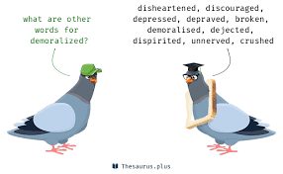
Target Demoralization
Demoralization: despair, helplessness, sense of isolation experienced through illness, treatment, and terminal prognosis
Acknowledge and ameliorate emotional or physical stressors
Normalize patient’s stress response by acknowledge suffering and seeking to enhance and support dignity
Use bedside interviewing to discern existential and other major concerns and vulnerabilities
Take into consideration the needs of the family system (i.e., patient, caregiver, others in the circle of support), as well as the relationships between them
Suggest support groups targeted to specific populations (e.g., caregiver fatigue, specific cancer diagnoses, children’s experience)

Slide 35
Vulnerability | Targeted Questions
Confusion | “How are you making sense of what you are going through?”
Isolation | “On difficult days, who can you talk to?”
Despair | “On difficult days, what keeps you going?”
Helplessness | “What concerns you most? How have you kept this illness from taking charge of your life?”
Meaninglessness | “For whom or for what does it matter that you continue to live?”
Cowardice | “Have there been moments when you felt tempted to give up but didn’t?” “How did you make a decision to persevere?”
Gratitude | “Are there moments when you can feel joy despite the sorrow you have been through?”

Slide 36

Potential Red Flag Circumstances
Guilt or shame
Cumulative losses
Psychiatric history
Conflicted or ambivalent relationship with deceased
Isolated or alienated family/support network
Type of death (sudden, violent death; suicide; highly medicalized death: ICU stay, technology [e.g., dialysis, feeding tubes, intubation]; quality of medical intervention [e.g., communication, level of care, support received])
Notes:
Talk through this slide, point out that age of patient or whether there are children involved are not necessarily red flag issues

Slide 37
What can I say?
Ask about their person and their story
“I don’t know”
“I am here to do X,Y,Z”
Use empathetic and supportive statements
Validate their feelings
Nothing – just listen
Notes:
Telling the truth can be harder than it sounds, I don’t know should be followed by “but I can find out”, be concrete, empathize but do not own, “I wish we could do more”, “I hear that you feel frustrated”, “of course you are crying, this is a very sad day filled with terrible news, sometimes silence is more valuable than words, its ok to tell funny or sad stories

Slide 38

What shouldn’t I say?
“I know how you feel” (hint: you don’t)
Platitudes (they don’t help)
Faith-based or spiritual comments
Anything that implies taking sides
Anything that implies fault

Slide 39
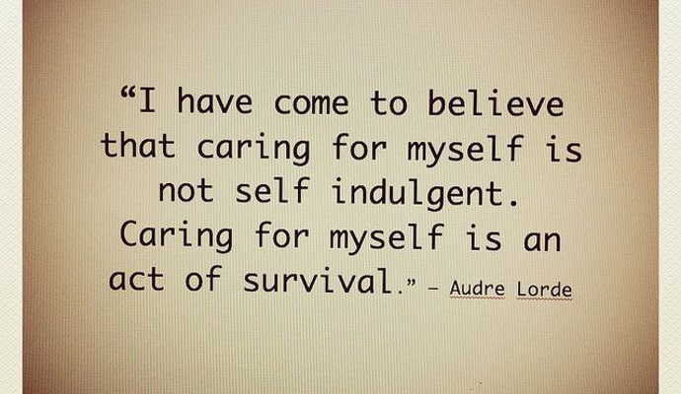

Slide 40
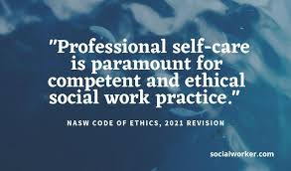
Self Care at Work
Feeling overwhelmed or sad? Know who you should talk to.
We can only give what we have, find ways to refuel
  Breathe deeply
  Move your body
  Get outside/take a moment to look out a window
  Find a quiet space and visualize a comforting place
Be acutely aware of your professional boundaries
Do your best work
Notes:
Breathe and laugh, life is short

Slide 41
If self-care seems impossible
Remember, you can't care for others if you don't take care of yourself
Divide duties with colleagues, family, friends, community groups, faith organizations
Eat, hydrate, sleep, exercise...repeat
Take breaks, have some fun
Connect with others, reach out for support
Ask for (and accept!) help

Slide 42
5-minute self-care ideas (that are not about self-improvement)
Clean/organize one thing
Have a good cry
Read some good news
Put on lotion
Cut or paint your fingernails
Light candles
Play your favorite song
Laugh (at anything!)
Go off the grid
Breathe​
Step outside​
Journal​
Sing and dance​
Stretch​
Shower​
Close your eyes​
Text a friend​
Say thank you​
Color or draw

Slide 43
Bereavement Referral Resources
Bereavement support groups
Most are available to community members at large
Many are specialized according to loss (e.g., cancer-related, child loss, survivor of suicide, etc.)
Hospice bereavement services
Not a reimbursed Medicare expense
Services vary between hospice agencies and locations
Psychotherapy
Psychiatry
Notes:
Depending on where you are, resources may be radically different or nonexistent

Slide 44
References
American Psychiatric Association. (2013a). Diagnostic and statistical manual of mental disorders (5th ed.). Arlington, VA: Author.
APA. (2013b). Highlights of changes from DSM-IV-TR to DSM-5. https://psychiatry.msu.edu/_files/docs/Changes-From-DSM-IV-TR-to-DSM-5.pdf
APA. (2013c). Section III. https://www.psychiatry.org/File%20Library/Psychiatrists/Practice/DSM/APA_DSM-5-Section-III.pdf
APA. (2020). View and comment on recently proposed changes to DSM–5. https://www.psychiatry.org/psychiatrists/practice/dsm/proposed-changes (accessed November 2020)
APA. (2021a). DSM–5: Frequently asked questions. https://www.psychiatry.org/psychiatrists/practice/dsm/feedback-and-questions/frequently-asked-questions
APA. (2021b). Submit proposals for making changes to DSM–5. https://www.psychiatry.org/psychiatrists/practice/dsm/submit-proposals
Boelen, P. A., Eisma, M. C., Smid, G. E., & Lenferink, L. (2020). Prolonged grief disorder in section II of DSM-5: A commentary. European Journal of Psychotraumatology, 11(1). https://doi.org/10.1080/20008198.2020.1771008
Breitbart W., Chochinov, H. M., Alici, Y (2011). Palliative care. In J. Levenson (Ed.), Textbook of psychosomatic medicine: Psychiatric care of the medically iII (2nd ed.). American Psychiatric Publishing.
Bretherton, I. (1992). The origins of attachment theory: John Bowlby and Mary Ainsworth. Developmental Psychology, 28, 759-775. Retrieved from http://www.psychology.sunysb.edu/attachment/online/inge_origins.pdf
Centers for Disease Control and Prevention. (2015). International Classification of Diseases (ICD-10-CM/PCS) Transition – Background. https://www.cdc.gov/nchs/icd/icd10cm_pcs_background.htm
Griffith, J. L., & Gaby, L. (2005). Brief psychotherapy at the bedside: Countering demoralization from medical illness. Psychosomatics, 46(2), 109-116. https://doi.org/10.1176/appi.psy.46.2.109

Slide 45
References
Haley, E. (2018, February 14.) A grief concept you should care about: Continuing bonds. What’s Your Grief. https://whatsyourgrief.com/grief-concept-care-continuing-bonds/
Ito, M., Nakajima, S., Fujisawa, D., Miyashita, M., Kim, Y., Shear, M. K., Ghesquiere, A., & Wall, M. M. (2012). Brief measure for screening complicated grief: Reliability and discriminant validity. PloS One, 7(2), e31209. https://doi.org/10.1371/journal.pone.0031209
Jordan, J. R., & Neimeyer, R. A. (2003). Does grief counseling work? Death Studies, 27(9), 763-786. https://doi.org/10.1080/713842360
Kavan, M. G., & Barone, E. J. (2014, November 15). Grief and Major Depression – Controversy over changes in DSM-5 diagnostic criteria. American Family Physician, 90(10), 690, 694. Retrieved from https://www.aafp.org/afp/2014/1115/p690.html#afp20141115p690-t1
Kessler, D. (2019). Five stages of grief. https://grief.com/the-five-stages-of-grief/
Klass, D., Silverman, P. R., & Nickman, S. L. (Eds.). (1996). Continuing bonds: New understandings of grief. New York, NY: Routledge.
Mankad, M. (2015, October 2). ICD-10 and DSM-5: Making sense in the clinical environment. North Carolina Psychiatric Association. Retrieved from https://www.ncpsychiatry.org/assets/2015AnnualMeeting/Handouts/Friday/4_dsm-5_and_icd-10-mehul_mankad.pdf
National Child Traumatic Stress Network. (2020a). DSM-5-TR Prolonged Grief Disorder: Become an informed consumer and advocate. https://www.nctsn.org/treatments-and-practices/dsm-5-tr-prolonged-grief-disorder-informed-consumer-and-advocate
NCTSN. (2020b). DSM-5-TR draft criteria: Prolonged Grief Disorder. https://www.nctsn.org/resources/DSM-5-TR-draft-criteria-prolonged-grief-disorder
Neimeyer, R. A., Burke, L. A., Mackay, M. M., & van Dyke Stringer, J. G. (2010). Grief therapy and the reconstruction of meaning: From principles to practice. Journal of Contemporary Psychotherapy, 40(2), 73-83. https://doi.org/10.1007/s10879-009-9135-3

Slide 46
References
Prigerson, H.G., Boelen, P. A., Xu, J., Smith, K. V., & Maciejewski, P. K. (2021). Validation of the newly proposed DSM criteria for prolonged grief disorder and the PG-13-Revised (PG-13-R) scale. World Psychiatry, 20, 1-10.
Prigerson, H. G., Maciejewski, P. K., Reynolds, C. F., III, Bierhals, A. J., Newsom, J. T., Fasiczka, A., Frank, E., Doman, J., & Miller, M. (1995). Inventory of complicated grief: A scale to measure maladaptive symptoms of loss. Psychiatry Research, 59, 65-79. Retrieved from https://endoflife.weill.cornell.edu/sites/default/files/icg_publication.pdf
Newsom JT, et al. Tyrrell, P., Harberger, S., & Siddiqui, W. (2020). Stages of Dying. In StatPearls. StatPearls Publishing. Retrieved from https://www.ncbi.nlm.nih.gov/books/NBK507885/
Williams, L. (2013, September 23). Grief theory 101: The dual process model of grief. What’s Your Grief. https://whatsyourgrief.com/dual-process-model-of-grief/
Worden, J. W. (2009). Grief counseling and grief therapy: A handbook for the mental health practitioner (4th ed.). Springer Publishing Company.
World Health Organization. (2016). International statistical classification of diseases and related health problems (10th ed.). https://icd.who.int/browse10/2016/en
WHO. (2019). International statistical classification of diseases and related health problems (11th ed.). https://icd.who.int/

