Slide 1
Updates in breastfeeding 2024
SUD/NAS
Mastitis
PUMP Act
4. Safe Sleep
5. HIV
6. Donor Milk/Owen’s Law
Dottie Schell, BS, RN, CLC
Program Director, Breastfeeding Programs
PA Chapter, American Academy of Pediatrics
Devon Gilinger, MPH, CHES, CLC
Program Manager, Breastfeeding Programs
PA Chapter, American Academy of Pediatrics

Slide 2
objectives
Recognize the importance of human donor milk to premature and medically fragile infants.
Understand the new guidelines and recommendations on HIV and breastfeeding.
Recognize the value of breastfeeding for babies who are experiencing Neonatal Abstinence Syndrome.
Promote the importance of a safe sleep environment for breastfeeding babies.

Slide 3
“Breast/chestfeeding is essential for maternal and child health. We recognize that it is ‘The Great Equalizer,’ impacting health equity outcomes at all ages and stages of life. Parents today initiate breast/chestfeeding in the hospital; however, many will stop within a few days or weeks due to social or community pressures. A Breastfeeding Family Friendly Community helps to remove social and community pressures to create a healthier, more welcoming community for families.”
Love Anderson, BS, LCE, CHW
Breastfeeding Family Friendly Communities UNC
Notes:
*if needed

Slide 4
Liquid Gold
Colostrum (the first milk) is often referred to as ‘liquid gold’ due to its golden color and valuable benefits to babies’ health
Breastmilk is the ideal first food for most babies since it
Baby’s first immunization- exposure to antibodies to fight infections and boosts their immune system
Notes:
content slides

Slide 5
Breastfeeding Benefits FOR Baby
Permission from Mymilkies.com
Notes:
content slides

Slide 6
Benefits for Infants and Children
Lowers the risk of:
Gastrointestinal illness
Respiratory illness
Bacteremia & Meningitis
Juvenile Diabetes
Childhood Obesity
SIDS
Notes:
content slides

Slide 7
Breastfeeding Benefits FOR PARENT
Permission from Mymilkies.com
Notes:
content slides

Slide 8
Benefits for Breast/Chestfeeding Parent
Less postpartum bleeding
Accelerates uterine involution
Less menstrual blood loss
Supports natural child spacing
Supports postpartum weight loss
Reduction of postmenopausal hip fracture
Reduced risk of ovarian cancer
Reduced risk of breast cancer

Slide 9
Breastfeeding and Substance Use/sud
Academy of Breastfeeding Medicine Clinical Protocol #21: Breastfeeding in the Setting of Substance Use and Substance Use Disorder
The United States (US) 2021 National Survey on Drug Use and Health (NSDUH) data found that 7.7%, 10.8%, and 9.8% of pregnant women reported past-month nonprescribed substance use, tobacco product use, and alcohol use, respectively.
breastfeeding is known to reduce the severity of neonatal opioid withdrawal syndrome (NOWS), such as decreasing the need for pharmacologic treatment and length of infant hospitalization.
Previous ABM guidelines recommended that women who had nonprescribed substance use in the 30–90 days before delivery be discouraged from breastfeeding.
Now, evidence shows that most substances are eliminated in hours to days rather than days to weeks, and women who discontinue nonprescribed substance use by or during the delivery hospitalization can be supported in breastfeeding initiation.
Notes:
content slides

Slide 10
Benefits and Barriers
The benefits of breastfeeding have been well documented however, considering the high incidence of comorbid conditions, such as trauma and mental illness among pregnant and parenting people who use substances, there are certain breastfeeding benefits specific to this population. For example, parents who use substances perceive breastfeeding as a facilitator to early parent–infant bonding and breastfeeding can reduce the symptoms of postpartum depression.
However, for people with substance use and/or SUDs, some unique barriers to breastfeeding exist. This is particularly true for people with opioid use disorder (OUD) who report apprehension about the safety of breastfeeding while taking medications for OUD (MOUD), which is reinforced by the inconsistent and contradictory breastfeeding information they often receive from health care providers.
Notes:
content slides

Slide 11
Breastfeeding and Substance Use ABM Protocol #21
Academy of Breastfeeding Medicine Clinical Protocol #21: Breastfeeding in the Setting of Substance Use and Substance Use Disorder
The United States (US) 2021 National Survey on Drug Use and Health (NSDUH) data found that 7.7%, 10.8%, and 9.8% of pregnant women reported past-month nonprescribed substance use, tobacco product use, and alcohol use, respectively.
breastfeeding is known to reduce the severity of neonatal opioid withdrawal syndrome (NOWS), such as decreasing the need for pharmacologic treatment and length of infant hospitalization.
Previous ABM guidelines recommended that women who had nonprescribed substance use in the 30–90 days before delivery be discouraged from breastfeeding.
Now, evidence shows that most substances are eliminated in hours to days rather than days to weeks, and women who discontinue nonprescribed substance use by or during the delivery hospitalization can be supported in breastfeeding initiation.

Slide 12
ABM Protocol #21 Substance Use and Breastfeeding
Multidisciplinary care:
Those who have SUD or use substances during pregnancy or the postpartum period should engage in multidisciplinary prenatal and postpartum substance use care.
2. Breastfeeding initiation timing:
Individuals who discontinue nonprescribed substance use by the delivery
Hospitalization can be supported in breastfeeding initiation.
3. Perinatal breastfeeding support:
Targeted perinatal dyadic breastfeeding care such as prenatal education, inpatient and postpartum lactation support, and ongoing multidisciplinary SUD treatment can facilitate breastfeeding continuation.
Notes:
content slides

Slide 13
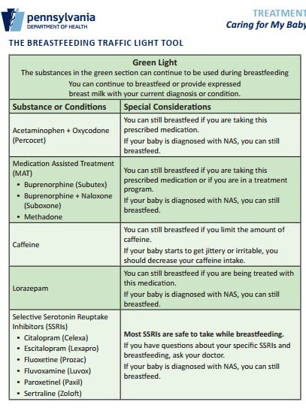
Breastfeeding Traffic Light
Notes:
content slides

Slide 14
Breastfeeding Traffic Light
Notes:
content slides

Slide 15
Breastfeeding Traffic Light
Notes:
content slides

Slide 16
Best Practices
Notes:
content slides

Slide 17
Words Matter
Person-first language maintains the integrity of individuals as whole human beings by removing language that equates people to their condition or has negative connotations. Our choice of words is important as it gives us the opportunity to remove stigma from our work and the people we serve.
Instead of Use
“drug user” “person with a substance use disorder”
“clean” “ testing negative”
“addicted baby” “ newborn exposed to substances”
Words Matter - Terms to Use and Avoid When Talking About Addiction | National Institute on Drug Abuse (NIDA) (nih.gov)
Notes:
content slides

Slide 18
Patient-centered approaches that review individualized risks and benefits are key to breastfeeding decision making among individuals who experience a substance use disorder (SUD).
Notes:
content slides

Slide 19
Strategies to help babies with NAS
Eat
Sleep
Console
Stay with your baby at the hospital as much as you can
Hold and swaddle them
Skin-to-skin contact
Keep things quiet and calm around them
Breastfeed or offer expressed breastmilk
Talk with your baby’s doctor daily to know how your baby is doing
Identify services to refer parents and infants to upon discharge
Notes:
*If needed

Slide 20
Pennsylvania Department of Health
Neonatal Abstinence Syndrome Family Guide Tool Kit
Notes:
*If needed

Slide 21
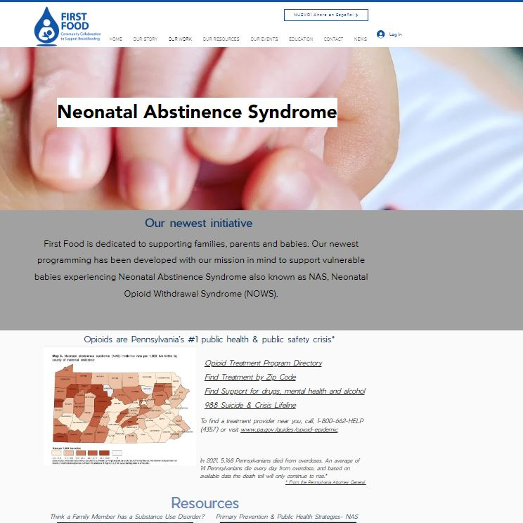
First Food’s NAS Page
Pafirstfood.org/nasprogram

Slide 22
Mastitis
Academy of Breastfeeding Medicine Clinical Protocol #36: The Mastitis Spectrum, Revised 2022
this protocol now replaces ABM Protocols #4, Mastitis, and #20, Engorgement, which will both be retired
Management of mastitis spectrum disorders includes general strategies that apply to the entire spectrum, as well as condition-specific interventions:
1. Anticipatory guidance and behavioral interventions
Reassure mothers that many mastitis symptoms will resolve with conservative care and psychosocial support.
Educate patients on normal breast anatomy and postpartum physiology in lactation.
Feed the infant on demand, and do not aim to ‘‘empty’’ breasts.
Minimize breast pump usage.
Avoid the use of nipple shields.
Wear an appropriately fitting supportive bra.
Avoid deep massage of the lactating breast.
Avoid saline soaks, castor oil, and other topical products.
Avoid routine sterilization of pumps and household items.

Slide 23
mastitis
2. Medical Interventions
Decrease inflammation and pain.
Treat hyperlactation, or breast milk ‘‘oversupply.’’
Reserve antibiotics for bacterial mastitis.
Consider use of probiotics.
Evaluate for perinatal mood and anxiety disorders (PMADs).

Slide 24
mastitis
3. Condition Specific Guidelines
*Mastitis and the following conditions can be prevented using interventions such as ice, NSAIDs and physiological breastfeeding. Additional recommendations are provided in the protocol for the following specific conditions
Engorgement
Ductal narrowing and inflammatory mastitis
Bacterial mastitis
Abscess
Galactocele
Recurrent Mastitis
Subacute mastitis

Slide 25
Providing Urgent Maternal Protections (PUMP) for Nursing Mothers Act
Covers all breastfeeding employees*
Expands coverage to ~9 million more women of childbearing age and protects all employees for one year following the birth of a child.* Many employees who were not previously covered by the 2010 federal law Break Time for Nursing Mothers are now covered by the PUMP Act, including salaried workers, healthcare workers, teachers, and agricultural workers.
2. Provides reasonable break time
The law does not specify the amount of break time. Some breastfeeding employees need 15 minutes, but others may need 30 minutes or more. Some parents might only pump twice a day, while others might pump 4-5 times. “Reasonable” break time makes accommodation for variations of personal needs.
3. Defines a private space
The workplace lactation accommodation cannot be a bathroom and must be free from intrusion and shielded from view (including security cameras).
4. Clarifies compensation
If an employee is still working, any break time spent pumping should be considered hours worked and compensated accordingly.
5. Makes exemptions for certain employers
If a company has 50 or fewer employees and compliance constitutes a “hardship” to the employer, the requirements can be waived. The burden of proof, however, is on the employer to show that enforcement of the law would cause “undue hardship.”
6. Includes the right to sue
The PUMP Act grants breastfeeding employees the right to file a lawsuit against their employer for non-compliance. Prior to making a claim against an employer, breastfeeding employees are required to notify them that they’re not in compliance. The employer then has 10 days to comply. (Note: Employees are not required to give employers 10 days to report non-space violations such as harassment or violations of break time.) Legal remedies may include employment, reinstatement, promotion, and/or monetary damages such as lost wages, emotional distress, attorneys’ fees, and lawsuit costs.
*Airline pilots and flight attendants are not currently covered by the PUMP Act.

Slide 26
Safe sleep
AAP & HealthyChildren.org Recommendations
Place infants on their backs for sleep in their own sleep space with no other people.
Use a crib, bassinet or portable play yard with a firm, flat mattress and a fitted sheet. Avoid sleep on a couch or armchair or in a seating device, like a swing or car safety seat (except while riding in the car).
Keep loose blankets, pillows, stuffed toys, bumpers and other soft items out of the sleep space.
Breastfeed if possible and avoid smoking.
2. Academy of Breastfeeding Medicine (ABM) protocol #6
All families should be counseled on safe sleep practices.
Acknowledge that bedsharing occurs both intentionally and unintentionally and is often linked to breastfeeding.
Research shows some correlation of bed sharing with increased breastfeeding exclusivity and duration.
The U.S. policy recommends that parents room-share without bedsharing.

Slide 27
SAFE sleep
A, B, C
Photo source: AAP
A (alone), B (on their back), C (in a crib)

Slide 28
Breastfeeding + safe sleep
Research shows that breastfed babies are at a reduced risk for SIDS.
Important things to share with parents:
Rooming in is recommended, but bed sharing is not.
Avoid breastfeeding on a chair or sofa.
If you bring baby into your bed for feeding or comforting, remove all items and bedding from the area.
If you fall asleep while feeding baby in your bed, place them on their back in a separate sleep area made for babies as soon as you wake up.
https://safetosleep.nichd.nih.gov/safe-sleep/breastfeeding

Slide 29
HIV + Breastfeeding Recommendations
Old Recommendation: Parents with HIV should avoid breastfeeding
New Recommendation: Patients should receive patient-centered counseling on infant feeding options and shared decision making with their providers.
The risk of HIV transmission while breastfeeding is less than 1% (but not zero) for parents with HIV on antiretroviral therapy (ART) with sustained undetectable viral load through pregnancy and postpartum.
Source: National Institutes of Health Office of AIDS Research (OAR)
Notes:
https://clinicalinfo.hiv.gov/sites/default/files/guidelines/documents/perinatal-hiv/infant-feeding-individuals-hiv-united-states-perinatal.pdf
https://vimeo.com/paaap/annapowell?share=copy

Slide 30
HIV + Breastfeeding Recommendations
When working with HIV exposed parents and infants:
Identify their desire/intention for infant feeding method.
Assess their knowledge of the risk/benefits/alternatives to breastmilk.
Educate parents with evidence-based information.
Set realistic expectations of what their breastfeeding journey will look like.
Support the choices of people with HIV to breastfeed (if they are virally suppressed) or to formula/replacement feed
Inform parents on increased risk of transmission when mixed feeding.*
Create an individualized feeding plan.
Powell, A. M., Knott-Grasso, M. A., Anderson, J., Livingston, A., Rosenblum, N., Sturdivant, H., Byrnes, K. C., Martel, K., Sheffield, J. S., Golden, W. C., & Agwu, A. L. (2023). Infant feeding for people living with HIV in high resource settings: a multi-disciplinary approach with best practices to maximise risk reduction. Lancet regional health. Americas, 22, 100509. https://doi.org/10.1016/j.lana.2023.100509

Slide 31
HIV + Breastfeeding Recommendations
When to discontinue breastfeeding
Elevated maternal viral load
Maternal or infant gastroenteritis
Mastitis (discontinue from that side/breast)
Once formula supplementation/replacement is necessary*
*combo feeding breast milk and formula increases risk of HIV transmission due to changes in the infant's gut microbiome
Powell, A. M., Knott-Grasso, M. A., Anderson, J., Livingston, A., Rosenblum, N., Sturdivant, H., Byrnes, K. C., Martel, K., Sheffield, J. S., Golden, W. C., & Agwu, A. L. (2023). Infant feeding for people living with HIV in high resource settings: a multi-disciplinary approach with best practices to maximise risk reduction. Lancet regional health. Americas, 22, 100509. https://doi.org/10.1016/j.lana.2023.100509

Slide 32
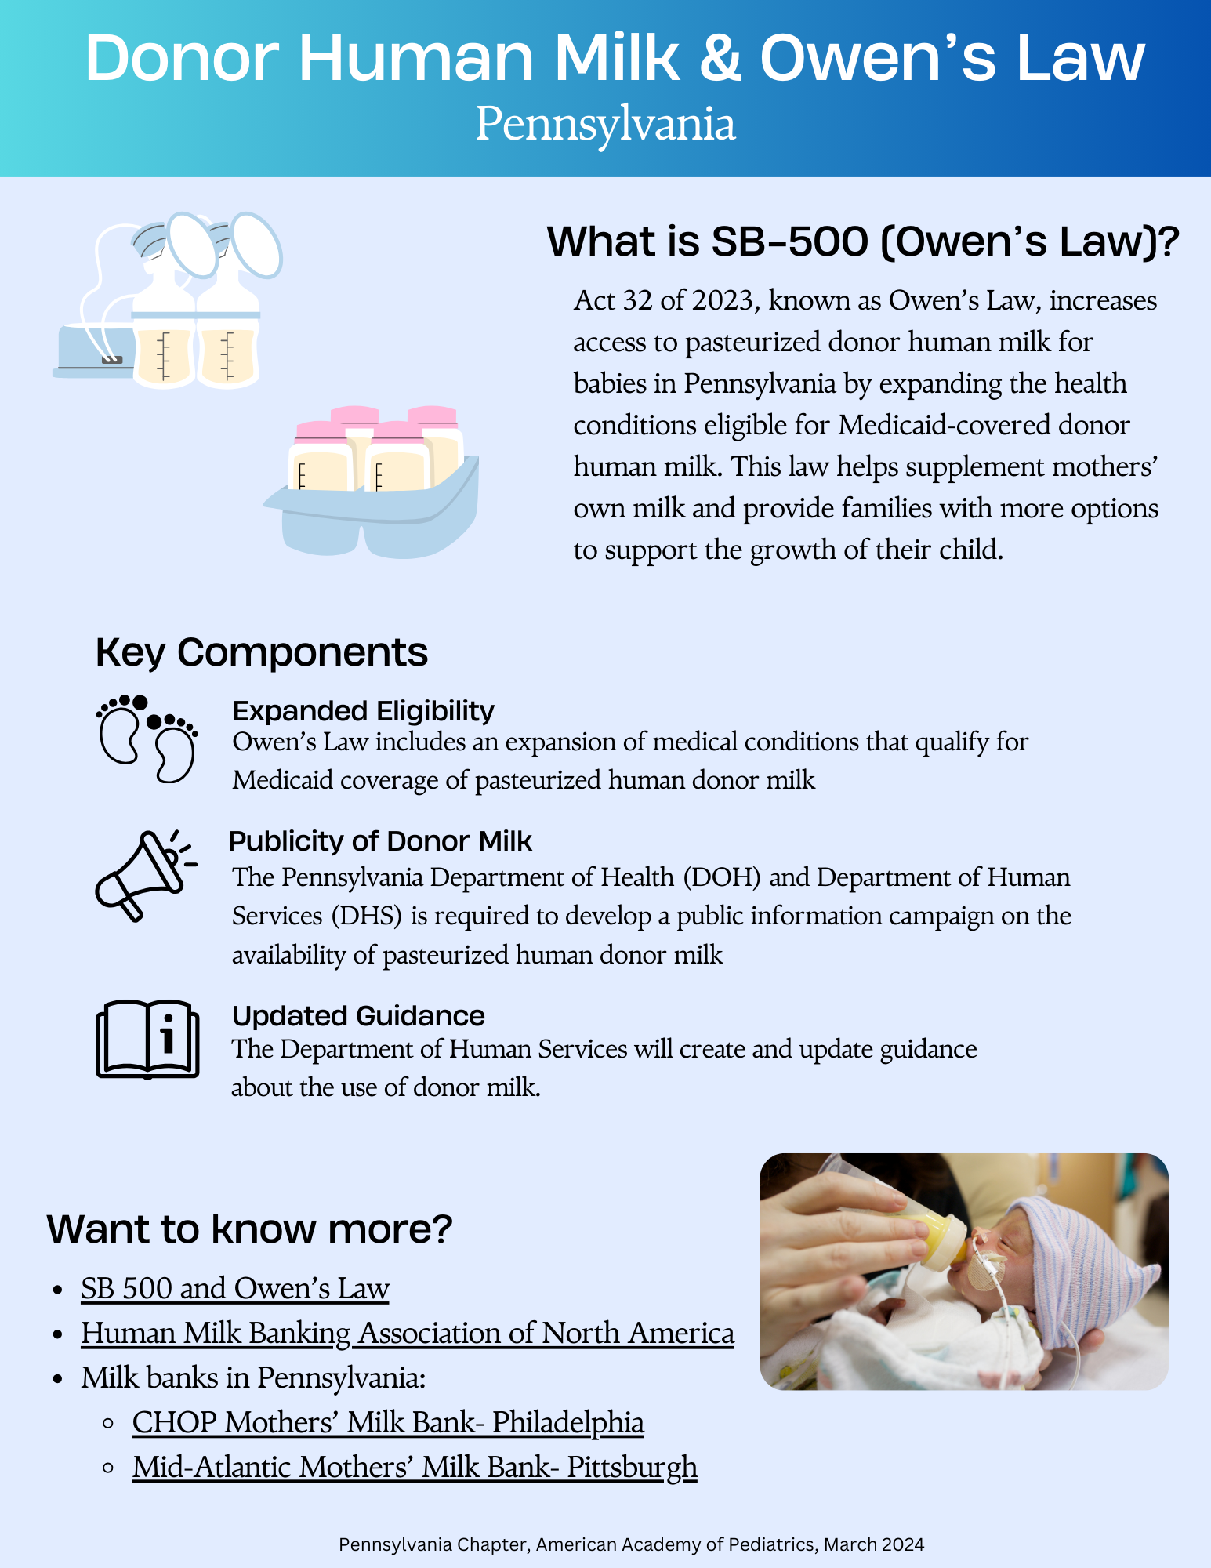
Donor milk & Owen’s Law

Slide 33
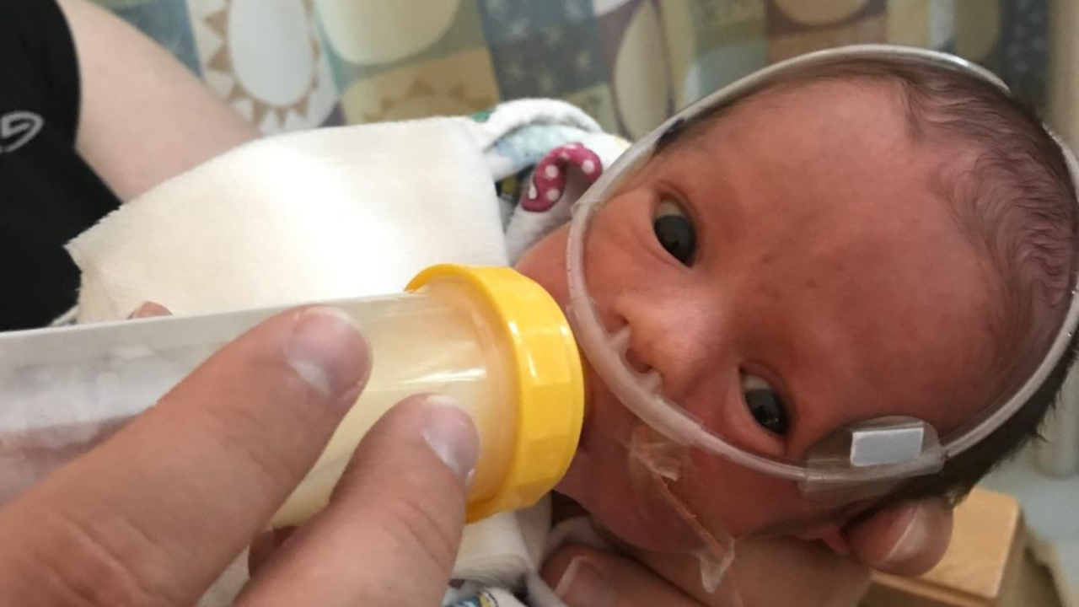
Donor human Milk
AAP: Pasteurized donor human milk is recommended for very low birth weight infants when the mother’s milk is not available or as a supplement to the mothers milk
Donor milk appears to decrease the risk of Necrotizing enterocolitis (NEC)
14 states and DC have enacted legislation regarding Medicaid or commercial insurance coverage of donor milk
Milk Banks are regulated by both the PA Department of Health and the Human Milk Banking Association of North America (HMBANA)
Photo source: handtohold.org

Slide 34
Donor human Milk
Donors are parents who have an excess supply of human milk, and they are not compensated for donating their milk.
Screening includes medical history questionnaire, statement of health from the donor’s doctor, and laboratory screening
Donors must agree to provide a minimum volume of milk
14 states and DC have enacted legislation regarding Medicaid or commercial insurance coverage of donor milk
Milk Banks are regulated by both the PA Department of Health and the Human Milk Banking Association of North America (HMBANA)

Slide 35
Milk banks in PA
Mid Atlantic Mothers’ Milk Bank
For both inpatient and outpatient babies in PA, NJ, MD, DE, WV
https://midatlanticmilkbank.org/
CHOP Mothers’ Milk Bank
For patients hospitalized at CHOP
https://www.chop.edu/services/chop-mothers-milk-bank

Slide 36
RESOURCES
https://abm.memberclicks.net/assets/DOCUMENTS/PROTOCOLS/36-mitchell-et-al-2022-academy-of-breastfeeding-medicine-clinical-protocol-36-the-mastitis-spectrum-revised-2022.pdf
https://publications.aap.org/pediatrics/article/150/1/e2022057988/188347/Policy-Statement-Breastfeeding-and-the-Use-of?autologincheck=redirected
https://www.cdc.gov/breastfeeding-special-circumstances/hcp/illnesses-conditions/hiv.html
https://www.health.pa.gov/topics/Documents/Diseases%20and%20Conditions/NAS%20Toolkit%20Book.pdf
https://handtohold.org/10-questions-about-providing-breast-milk-to-your-nicu-baby/
https://oar.nih.gov/news-and-updates/oar-updates/update-clinical-guidelines-infant-feeding-supports-shared-decision-making#:~:text=Properly%20prepared%20formula%20or%20pasteurized,load%20through%20pregnancy%20and%20postpartum.
Powell, A. M., Knott-Grasso, M. A., Anderson, J., Livingston, A., Rosenblum, N., Sturdivant, H., Byrnes, K. C., Martel, K., Sheffield, J. S., Golden, W. C., & Agwu, A. L. (2023). Infant feeding for people living with HIV in high resource settings: a multi-disciplinary approach with best practices to maximise risk reduction. Lancet regional health. Americas, 22, 100509. https://doi.org/10.1016/j.lana.2023.100509

Slide 37
QUESTIONS

