Slide 1
Supporting Pediatric Patients with Autism Spectrum Disorder
Alanna Kanawalsky, MS, CCLS
Lead Certified Child Life Specialist, Adaptive Care Team

Slide 2
Objectives
Increase knowledge of psychosocial needs related to autism spectrum disorder, developmental delays and intellectual disabilities.
Familiarize staff with language, tools and local resources to support this pediatric patient population.

Slide 3
Autism Spectrum Disorder
1 in 36 children are being diagnosed with ASD
95% of children with ASD have a comorbidity
Children with ASD have more healthcare encounters than their typically developing peers
30% of patients with ASD have at least one unmet healthcare need

Slide 4
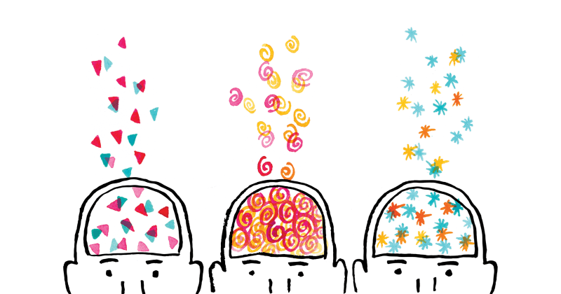
Autism Spectrum Disorder
Impaired social functioning
  Deficits in verbal communication, eye-contact, social norms
Repetitive behaviors
  Stereotypes
  Insistence on sameness
Sensory and emotional discomfort
  Significant emotion dysregulation
  20% moderate to severe levels of irritability and/or aggression (Fung et al 2016)
Challenges in executive function
No one child is the same

Slide 5
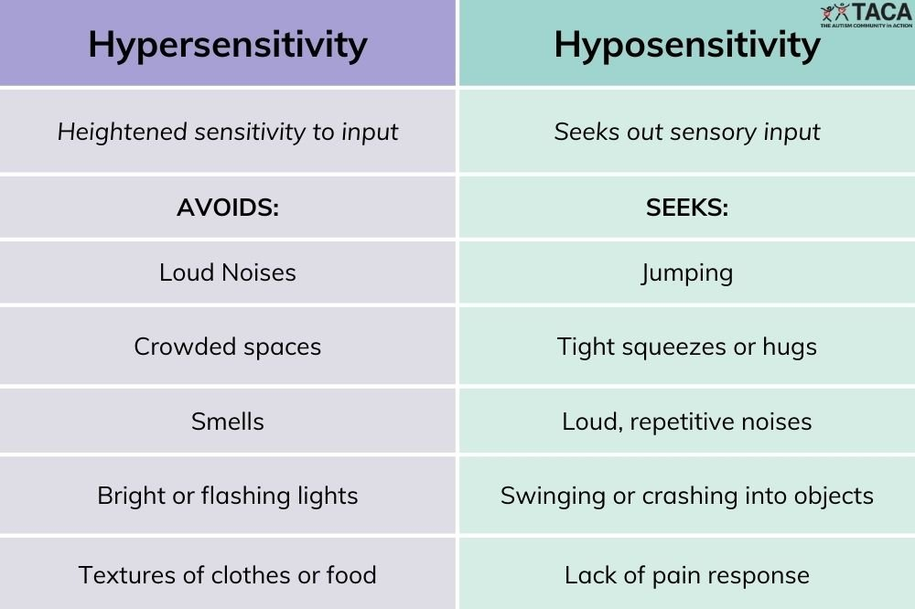
Sensitivity Differences

Slide 6
Autism in Healthcare
Fear of social interaction
generates anxiety
which causes stress.
Sensory sensitivity to sounds, sights, & touch heighten
causing overstimulation
making it almost impossible to socially interact
making it difficult to concentrate
Patients can experience stress prior to arriving at the healthcare facility
https://vimeo.com/160948522
8
Notes:
Pts experience stress from the anticipation of social interaction with the staff and described their resulting communication deficiencies as a “self-fulfilling prophecy”.
The study poses that a fear of social interaction produces anxiety which causes stress and heightened sensory sensitivities. This reduces the threshold for overstimulation, making it difficult for the patient to concentrate and difficult to socially interact

Slide 7
Autism in Healthcare
Barriers Reported by Patients & Parents
Barriers Reported by Staff & Providers
Lack of provider and staff understanding
Child’s behavior during medical encounter
Issues with environment (wait times, sensory experience, etc)
Child’s behavior during medical encounter
Uncooperative behaviors
Trouble communicating with patient

Slide 8
Autism in Healthcare:
Patient & Parent Perspective
Most Problematic Stages of a Visit:
  Communicating w/ the provider
  Physical examination
  Waiting room experience
Specific Challenges
  Being touched
  Loud noises & Bright lights
  Unable to tolerate vital measurements
8, 9
Notes:
Behaviors are often a result of boredom, anxiety or fear
-screaming, crying, tantrums, aggression, & lack of cooperation

Slide 9
Adaptive Care Plan
Assessment Categories:
Areas to Assess
Communication
Stressors
Coping
Sensory concerns
Past Healthcare encounters
Reactive behaviors to stress
Pain response
Interest/Motivator

Slide 10
Sensory Experience in the Healthcare Environment
Tactile
Gowns
ID bands
Tape
Pulse Ox
Taste/Smell
IV fluids
Alcohol wipes
PO medication
Cleaning products
Proprioception
Transitions
Stretcher
Physical Assessments
Limitations/Isolation
Auditory
Beeping monitors
Staff conversation
Humming of lights
Call bell
Visual
Bright lights
PPE
Multiple staff
Unfamiliar equipment

Slide 11
Interventions in the Healthcare Environment
Tactile
If possible, allow patient to remain in their own clothes
Allow patient to touch equipment first
“Tell, Show, Do”
Taste/Smell
Be aware of sensory concerns
Avoid stressors or complete most invasive task last
Use soap and water instead of hand sanitizer
Proprioception
Explain any movement prior
“First, then…”
Facilitate breaks as necessary
Weighted materials
Auditory
Consider an alternate waiting area
Headphones
Reduce number of staff at one time
Keep exam room door closed
Visual
Dim overhead lights
Offer sunglasses
Use visual supports to aid in transitions
Remove or cover threatening items in the room

Slide 12
Additional Considerations
Ask parent/caregiver what might improve the experience
Be patient. Allow for a slower process.
Allow gradual desensitization to the environment and medical equipment.
Be aware of sensory issues
Limit verbal and social interaction with the patient, if this is a known stressor.

Slide 13
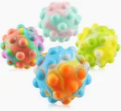
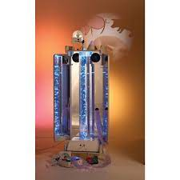
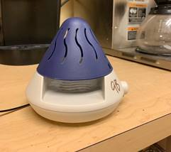

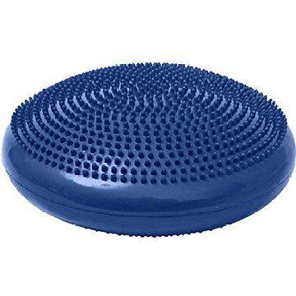
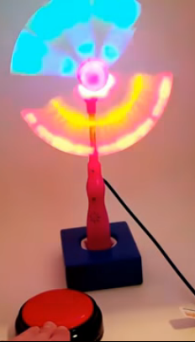
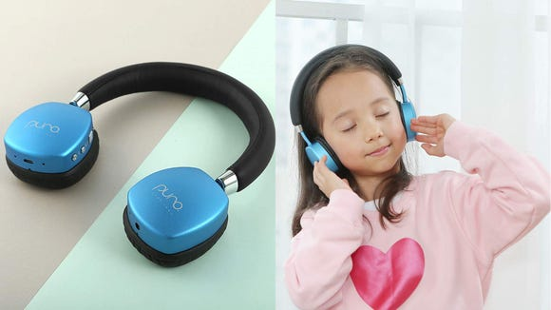
Sensory Tools & Resources
Visual
Auditory
Tactile
Oral
Olfactory
Proprioceptive Input

Slide 14
Now What?
Remove unwanted stimulation or guide the patient to a less stimulating environment
Remain calm, use concrete language
Validate and acknowledge that the patient is doing their best
Don’t ask unnecessary questions, silence is ok
Offer reassurance, encourage routine
Acknowledge their fear and show that you are there to support

Slide 15
Scenario
A 12-year-old male patient comes to the ED by ambulance. He is thrashing and screaming upon arrival, and he is in restraints.
The paramedics explain that the patient has autism. There is no caregiver present, but they are on their way.
The child is bleeding from a forehead laceration caused by a thrown object at a special needs summer camp.
How would you proceed?

Slide 16
Scenarios continued
Describe a scenario you encountered during your shift?
  Can you identify any areas for improvement?

Slide 17
References
Baio J., Wiggins L., Christense DL., et aal. Prevalence of Autism Spectrum Disorder Among Children Aged 8 Years-Autism and Developmental Disabilities Monitoring Network, I I Sites, United States, 2014. MMWR Surveill Summ 2018; 67(No. SS_6) 1-23.
Bultas MW, McMillin SE, Zand DH. Reducing barriers to care in the office-based health care setting for children with autism. Journal of Pediatric Health Care. 2016;30(1): 5-14.
Bultas MW, Johnson NL, Burkett K, Reinhold J. Translating research to practice for children with autism spectrum disorder: part 2: behavior management in home and health care settings. Journal of Pediatric Health Care. 2016;30(1): 27-37.
Fung LK, Mahajan R, Nozzolillo A, et al. Pharmacologic treatment of severe irritability and problem behaviors in autism: A systematic review and meta-analysis. Pediatrics. 2016;137(s2): e20152851k
Saqr Y, Braun E, Porter K, et al. Addressing medical needs of adolescents and adults with autism spectrum disorders in a primary care setting. Autism. 2018;22(1): 51-61.

Slide 18
QUESTIONS???
Alanna.Kanawalsky@chp.edu
CHPadaptivecare@upmc.edu

