Slide 1

Pediatric Surgical Conditions presenting in Primary care offices
Dorothy V Rocourt, MD, MBA, FACS
Associate Regional Medical Director, Pediatric Surgery
Pediatric Quality Medical Director
UPMC Children’s in Central PA

Slide 2

I have no disclosures

Slide 3
Objectives
Review three common time sensitive pediatric surgical conditions seen in the primary care office: appendicitis, intussusception, and inguinal hernia.
Review the etiology and clinical presentation for the three diagnosis.
Review critical portions of the history and physical exam and ordering pertinent laboratory tests and imaging studies.
Differentiate office from ED referrals.

Slide 4
Inguinal Hernia
Nineth most common surgical procedure
Incidence
  0.8% to 4.4% children
  3%to 5% term
  13% infants born less than 33 weeks gestation
Symptoms present mostly within the first year of life with peak presentation during first few months of life

Slide 5
Male:Female ratio 3:1
Right side most common at 60%
Left side 30%
Bilateral 10%
Family history 11.5%

Slide 6
Failure of the processus vaginalis to close results in a hernia
  Indirect inguinal is when bowel or other intra-abdominal contents enter the processus
  Hydrocele is when only peritoneal fluid is contained within the processus
  Females, the equivalent hernia passes through the canal of Nuck which corresponds to the processus vaginalis

Slide 7
Risks Factors
Prematurity
Family History
Cystic fibrosis and associated meconium peritonitis
Conditions associated with increased intra abdominal pressure
  Hydrocephalus with presence ventriculoperitoneal shunt
  Peritoneal dialysis
  Ascites
  Chronic lung disease
Connective tissue disorders
Abdominal wall defects

Slide 8
Clinical Features
Diagnosis predominantly based on history and physical exam
  Parents identify during baths or bowel movements
  Pediatricians during routine exam
Most common presentation is bulge in the groin
Incarceration
  Most commonly occurs in the first 6 months of life and less likely after 5 years of life
  Pain, irritability, abdominal distention, vomiting which may become bilious, obstipation, overlying skin redness

Slide 9
Examination
Clinical examination is the gold standard
Initial inspection of groin evaluate for asymmetry
Older child
  Elicit Valsalva with cough, blowing up balloon, laughter while standing up
Infant
  Elicit Valsalva with applying gentle pressure on abdomen, laugh or cry while laying supine
Be sure testis is palpable in the scrotum during exam to avoid false positive exam (retractile testis)

Slide 10
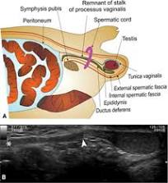
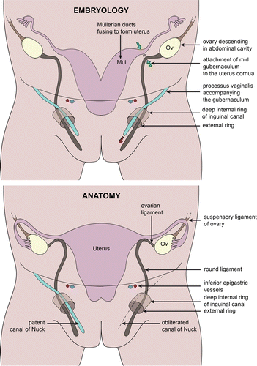
Inguinal hernia

Slide 11
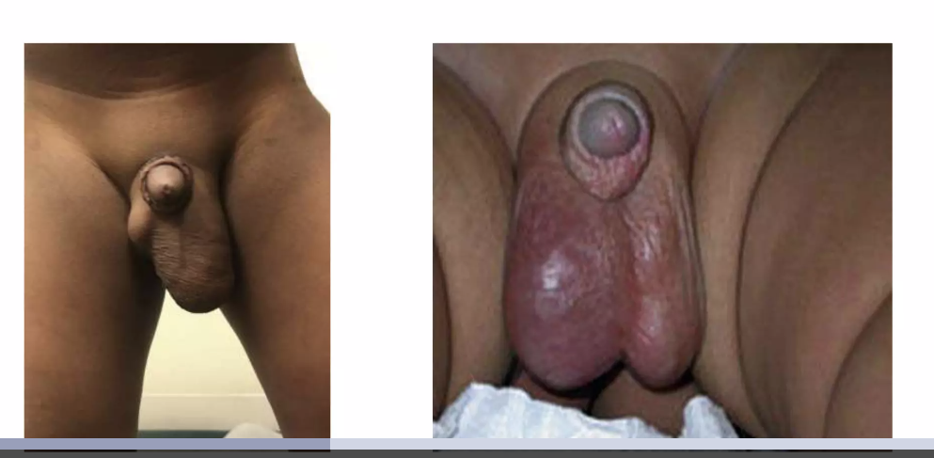
Inguinal hernia

Slide 12
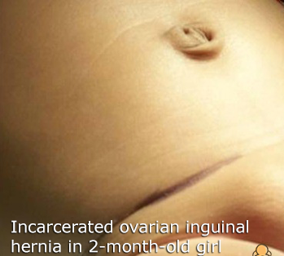
Female inguinal hernia

Slide 13
Hydrocele
Communicating
Non communicating
Intra abdominal fluid connects between abdomen and scrotum.
Clinical history
  Smaller early in the day and larger in the evening
  Able to reduce fluid into abdomen with exam
Scrotal fluid does not connect with intra abdominal fluid
Clinical history
  No change in scrotal size
  Unable to reduce fluid into abdomen with exam

Slide 14
Radiographic evaluations
US
  Sensitivity of 33% to 86% and specificity of 77% to 90% for occult hernias and can be used to diagnose suspected groin hernias not evident on clinical examination MUST be performed during VALSALVA
MRI
  Sensitivity of 91%, specificity of 92%, positive predictive value of 95%, and negative predictive value of 85% for occult hernias.
    Requires sedation for younger age group
CT
  Sensitivity = 80%; specificity = 65%
Contrast injection into hernia sac
  sensitivity of 91% and specificity of 83% for detecting occult hernias

Slide 15
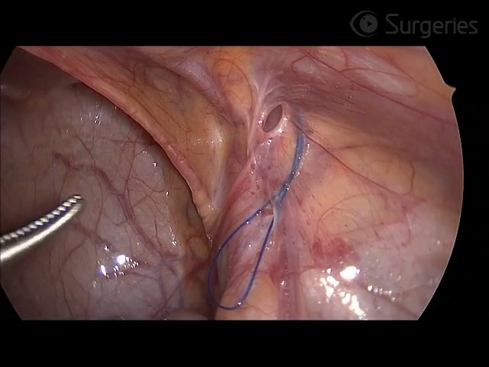
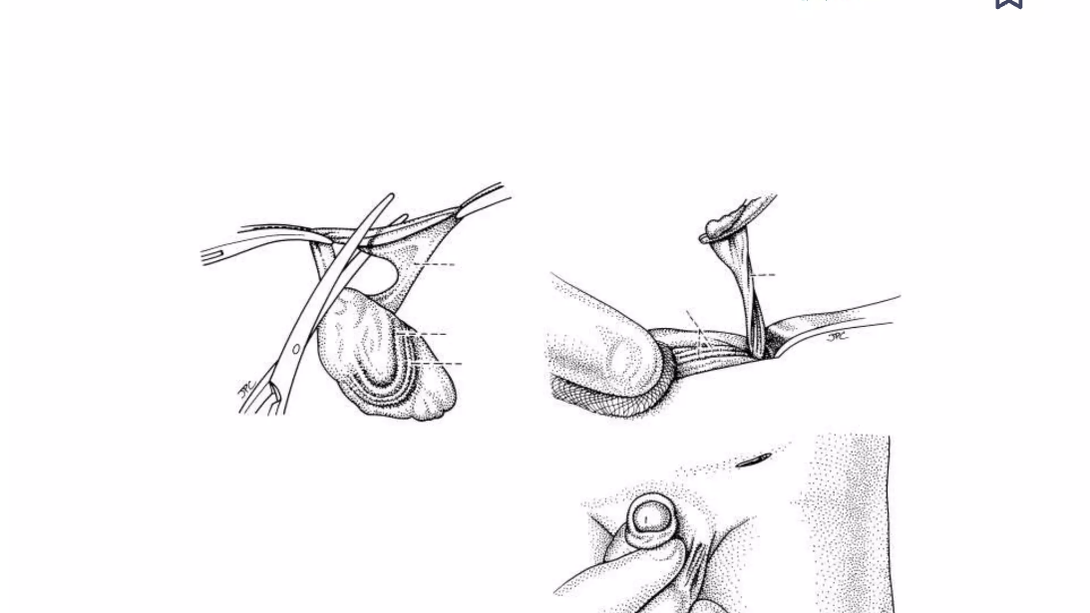
Management
Surgical correction
  Laparoscopic
  Open

Slide 16
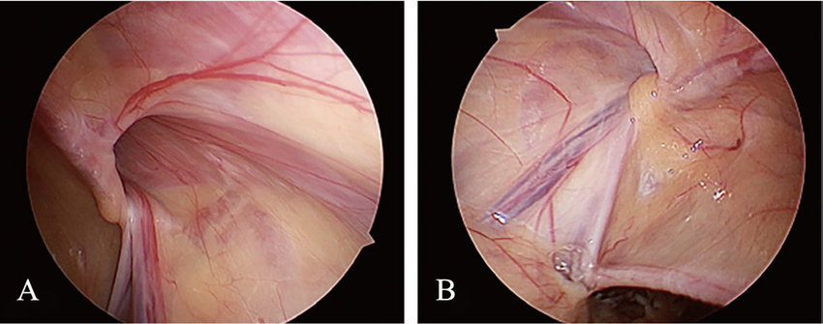
Laparoscopic view

Slide 17
Timing for surgery
Variable and inconsistent
  Weigh risks and benefits of incarceration versus anesthetic and surgical complications
THE AMERICAN ACADEMY OF PEDIATRICS| CLINICAL REPORT| OCTOBER 01 2012
Assessment and Management of Inguinal Hernia in Infants
Notes:
2005 survey of members of the American Academy of Pediatrics Section on Surgery, 63% reported routinely performing hernia repairs just before discharge from the NICU, 18% performed repairs at a specific corrected gestational age, and 5% performed repairs when it was convenient.

Slide 18
UPMC Central PA algorithm
Repair soon after diagnosis
  Repair within 2 weeks for < 1 month old child with no history of incarceration
  Repair within 24 hours if incarceration required sedation for reduction in ED
  Repair within 1 week if incarceration easily reduced in ED
  Repair most premature infants prior to discharge unless there are more pressing medical conditions

Slide 19
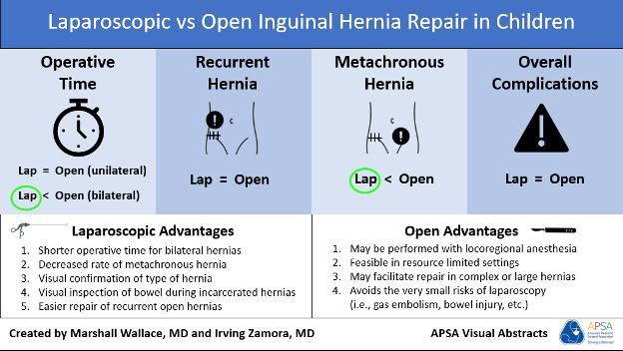

Slide 20
INTUSSUSCEPTION
Definition
Telescopic invagination of bowel leading to a bowel obstruction
Classification:
Ileocolic-most common
Ileoileal-postoperative
Colocolic

Slide 21
INTUSSUSCEPTION
Incidence:
  1.5-4 per 1,000 live births
  M:F=3:2
  Seasonal?
Etiology:
  Most idiopathic - hypertrophic Peyer’s patches
  Pre-existing polyp- <5%
  Viral illness
Age
  5-10 mo (>66% occur <1yo)
  > 2yo (10-25%) – more likely to have lead point

Slide 22
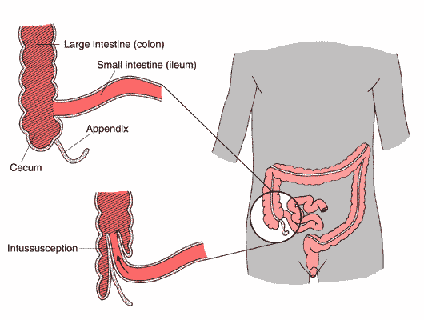
Intussusception

Slide 23
Intussusception - Presentation
Intermittent abdominal pain
Vomiting
Bloody diarrhea (currant jelly stool)
Vital signs normal early – shock late
Abdomen flat or distended (RLQ flat)
Palpable mass – sausage-shaped in RUQ or left side
Lethargy - late

Slide 24
Suspected Intussusception – Management
IV hydration/resuscitation
KUB – obstructive pattern, absence of air in RLQ
Diagnosis
  Ultrasound – pseudokidney
  Contrast enema – diagnostic and therapeutic
    Air
    Barium

Slide 25
Intussusception - Treatment
No signs of peritonitis/perforation
  Contrast enema
    Barium/Air/Water
    Up to 90% successful
    Risks
      Perforation < 3%
      Recurrent intussusception 5-10% (usually <72h)
  Surgery – if failure of enema
Signs of peritonitis/perforation - surgery

Slide 26
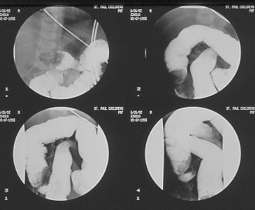
INTUSSUSCEPTION – BARIUM REDUCTION
Must see contrast flow into ileum 5-10cm to confirm reduction

Slide 27
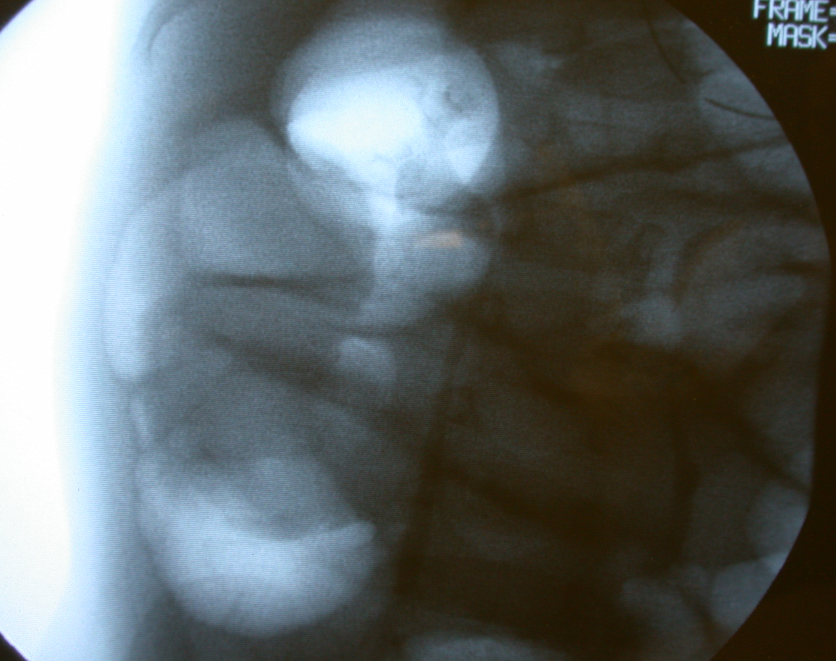
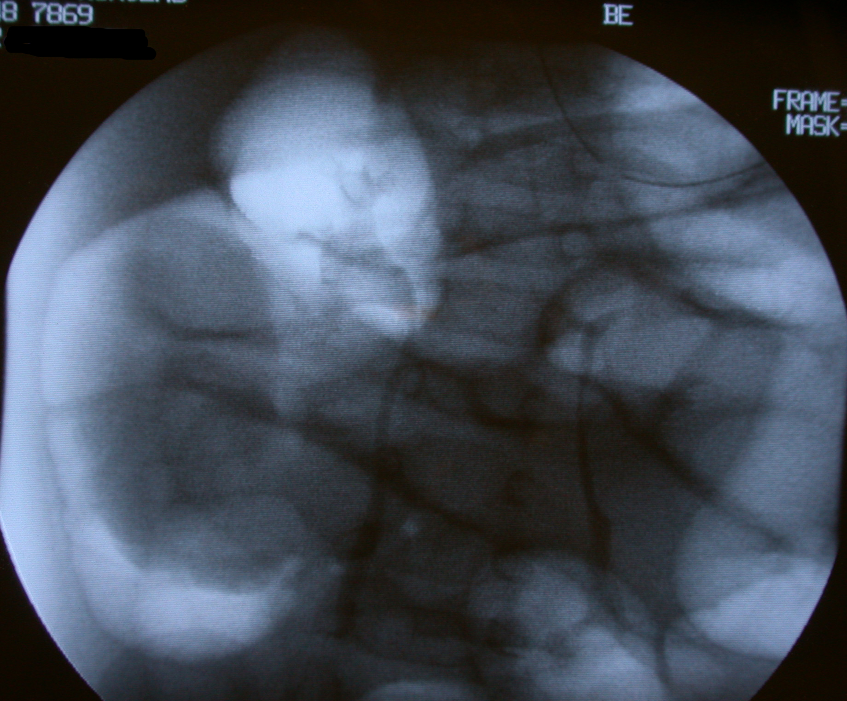
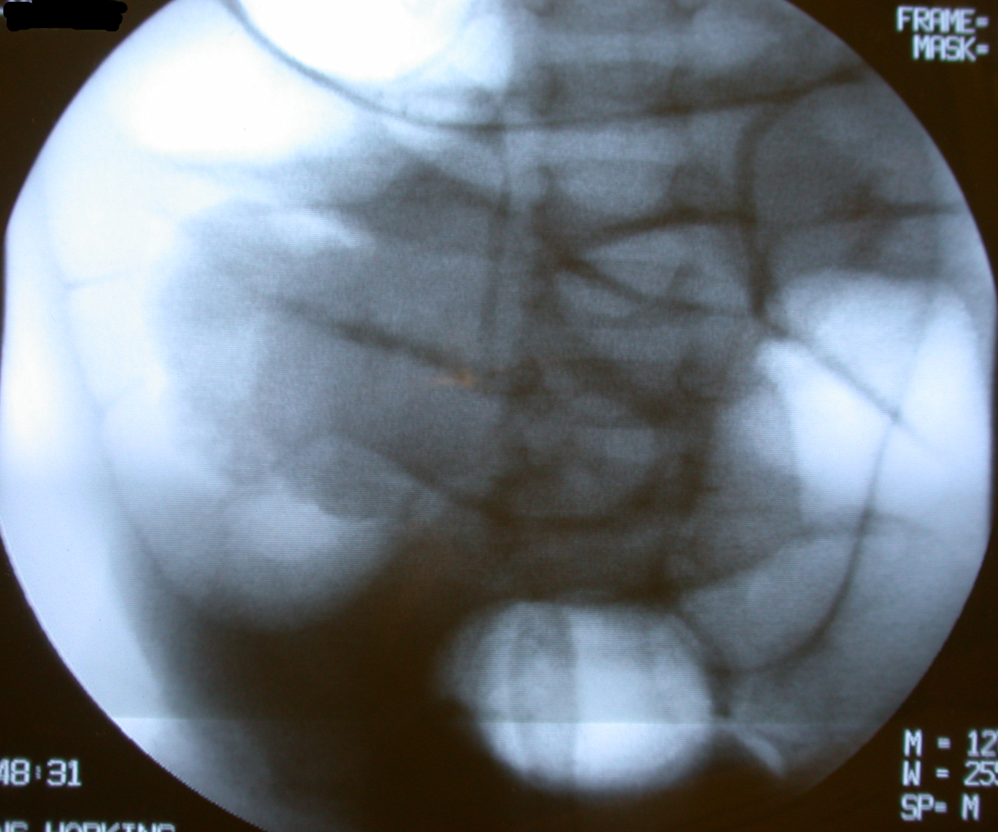
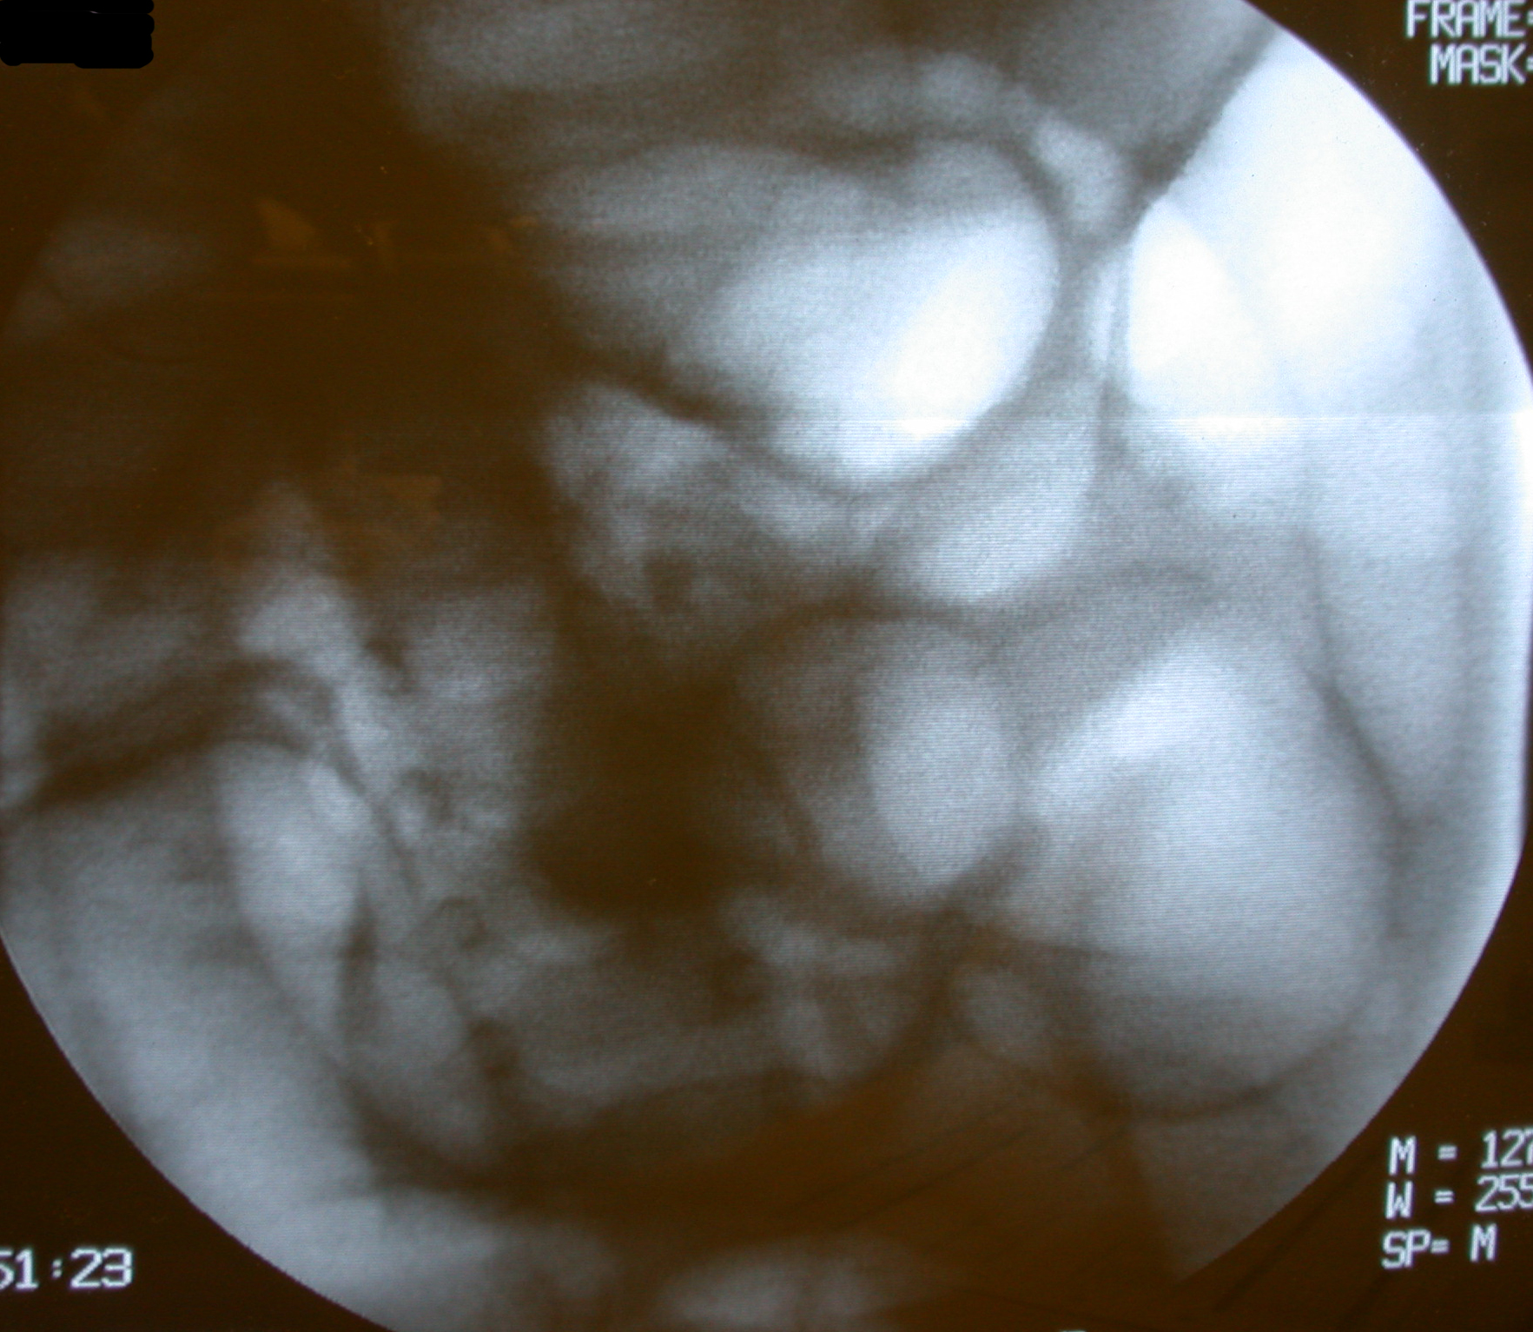
Intussusception - Air Contrast Reduction

Slide 28
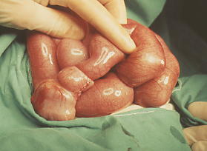
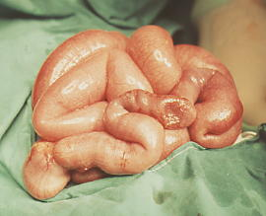
Intussusception: Operative Reduction
Recurrence 1-4%

Slide 29
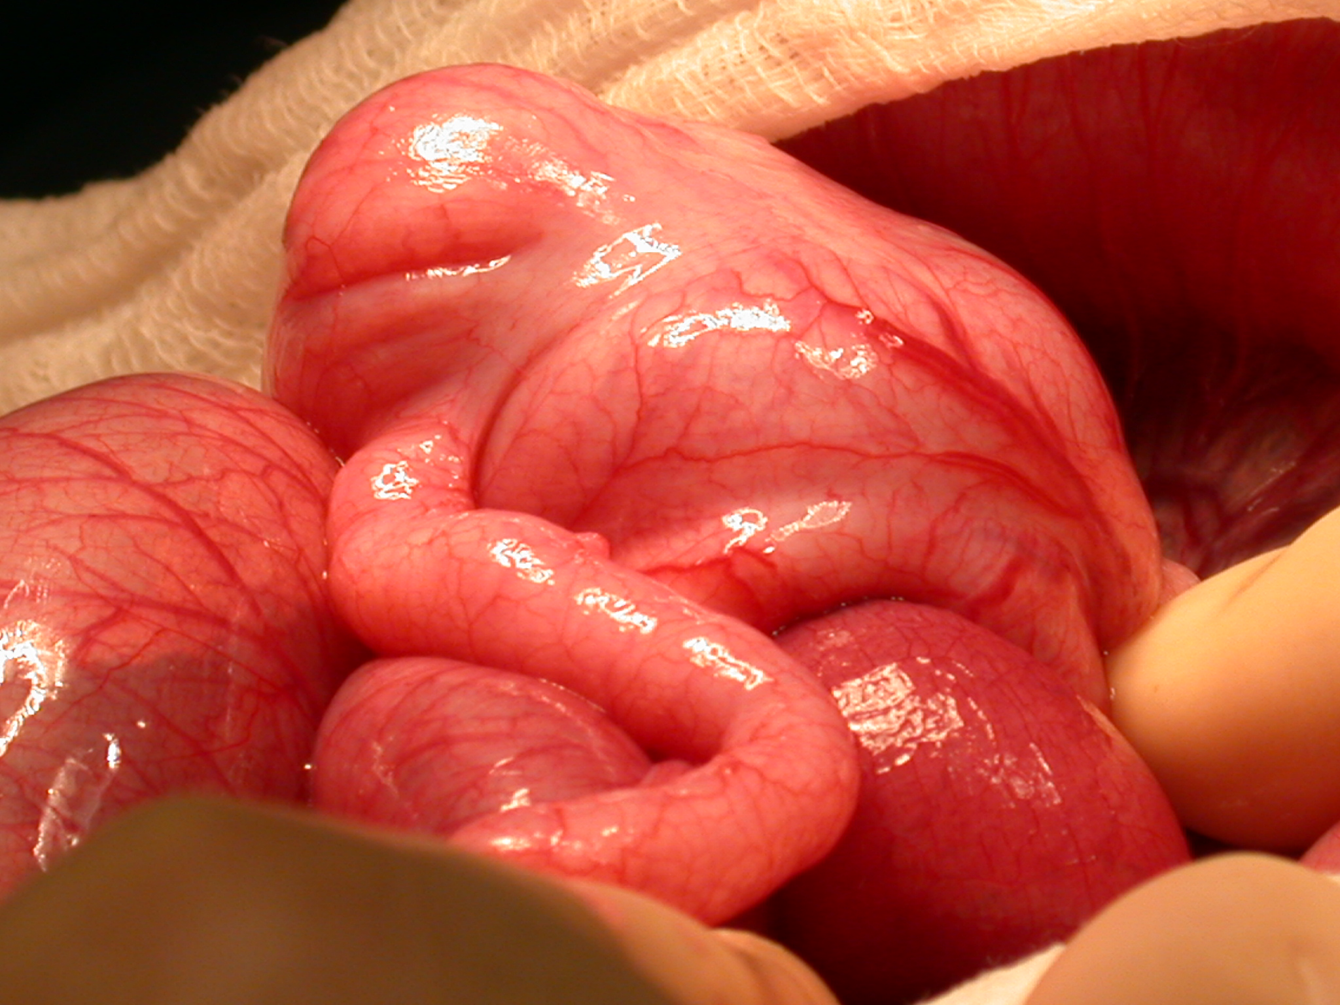
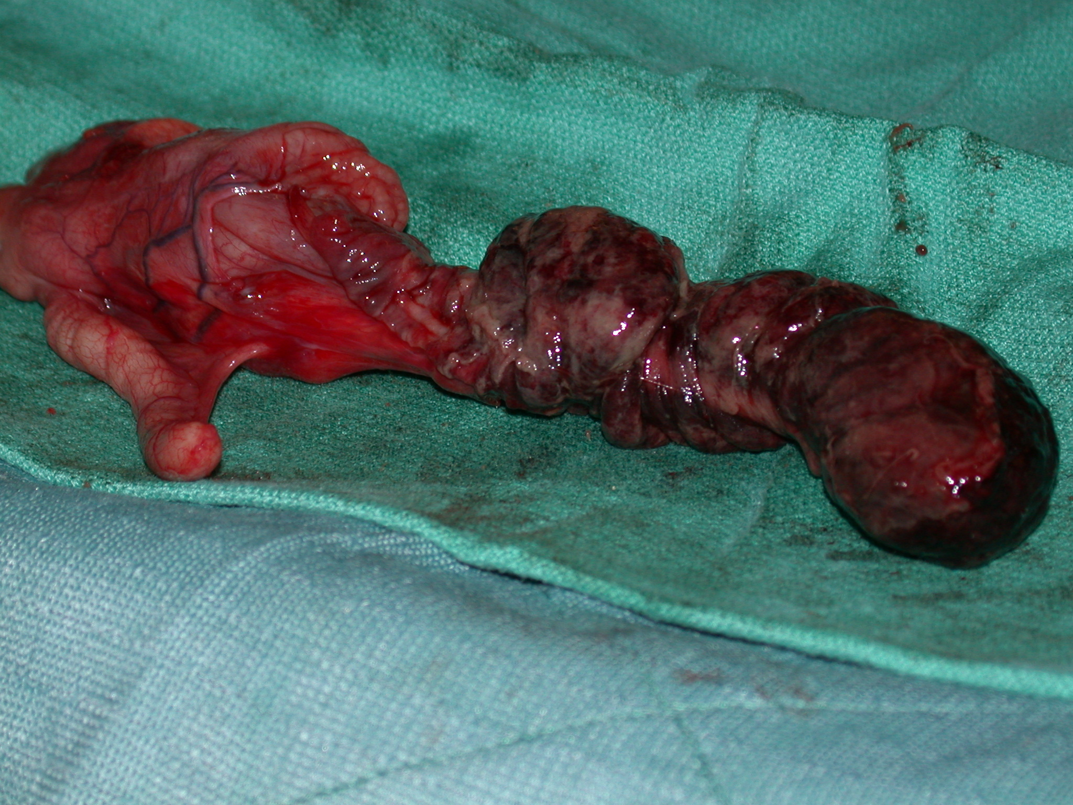
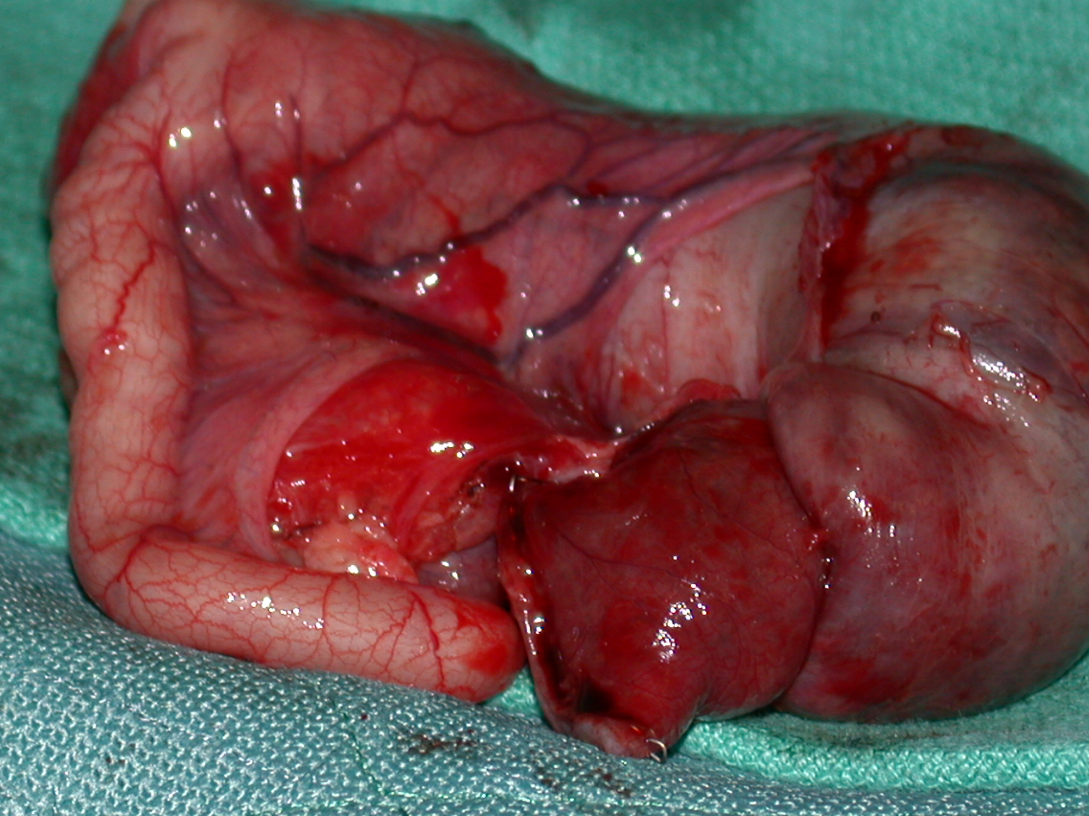
Intussusception: Operative Resection

Slide 30
Acute Appendicitis
Most common pediatric surgical procedure performed
Most common cause of acute surgical abdomen in pediatrics
Peak age is 10-12 years; males » females; worsening pain
Perforated, advanced disease more frequent in younger children

Slide 31
Pathophysiology
Obstruction of lumen
(periumbilical pain)
←
Rupture of appendix
(diffuse abdominal pain)
Distention of appendix (migration of pain to RLQ)
←
←
Ischemia of appendix
←
Arterial obstruction

Slide 32
Symptoms- Acute Appendicitis
Abdominal Pain:
  pain, often starting around the umbilicus and then shifting to the right lower quadrant (RLQ), known as McBurney's point.
  In younger children, the pain may be more diffuse
Nausea and Vomiting:
Nausea and vomiting often accompany the abdominal pain and may worsen as the condition progresses.
Fever:
A low-grade fever is common in early stages, with the temperature rising as the disease progresses.
Altered Bowel Movements:
Constipation is more common than diarrhea, though diarrhea may occasionally be seen, especially in younger individuals.
Notes:
Approximately 75% of patients with acute appendicitis present within 24 hours of the onset of symptoms.

Slide 33
Symptoms- Perforated Appendicitis
pain > 36 hours
fever > 101°,
age < 5 years,
diffuse abdominal pain
Palpable mass, intestinal obstruction, WBC > 15,000
May mimic bacterial gastroenteritis, pyelonephritis, PID, pneumonia
Notes:
The risk of appendiceal rupture can vary, with about 2% of cases rupturing around 36 hours from the onset of symptoms. This risk tends to increase by approximately 5% for every additional 12 hours that pass without appropriate medical intervention.

Slide 34
Physical Exam
Rebound tenderness: Pain when pressure is released from the RLQ.
Guarding: Involuntary muscle contraction in response to pain.
Rovsing's sign: Pain in the RLQ when palpating the left lower quadrant.
Psoas sign: Pain when the patient extends their right hip, indicating irritation of the iliopsoas muscle.

Slide 35
Laboratory studies
Acute- WBC normal to slightly elevated
Perforated – WBC > 15,000
C-reactive protein (CRP) elevated
Notes:
Good screen. The white blood cell (WBC) count and CRP concentration have a positive predictive value when used together to differentiate between uncomplicated and complicated appendicitis. A combination of a normal WBC count and a normal CRP value has a high negative predictive value for acute appendicitis.

Slide 36
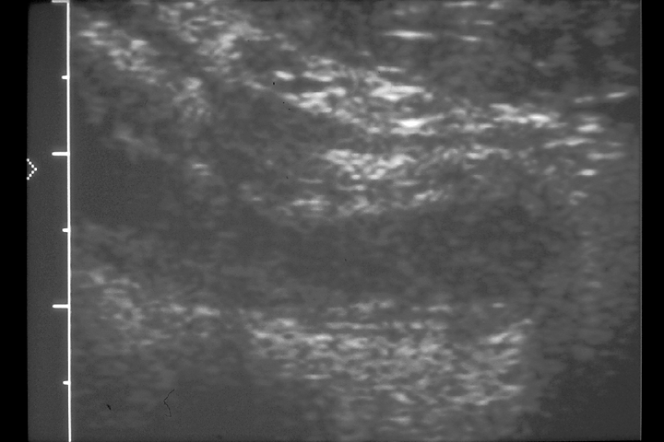
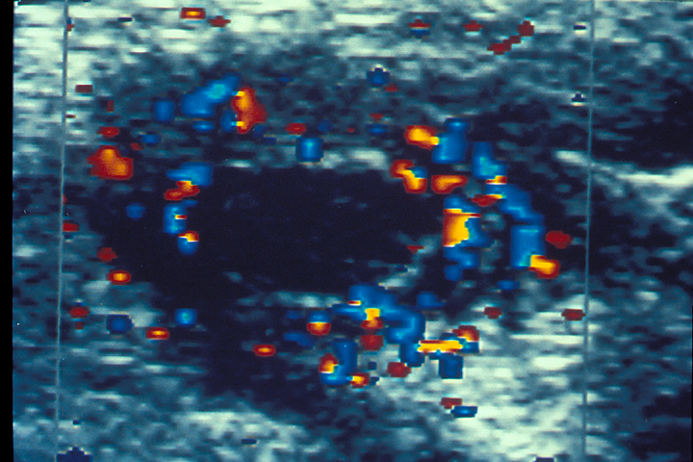
Diagnostic Imaging - Ultrasound
Advantages: Ultrasound is a non-invasive, readily available, and cost-effective imaging technique. It is particularly useful in children and pregnant women due to the absence of ionizing radiation.
Diagnostic Features: The diagnosis is confirmed by identifying an enlarged, non-compressible appendix (>6 mm in diameter) along with signs of inflammation, such as increased blood flow on Doppler imaging. However, its sensitivity can be lower in adults.
Limitations: Operator-dependent and may have difficulty visualizing the appendix in obese patients or those with excessive bowel gas.

Slide 37
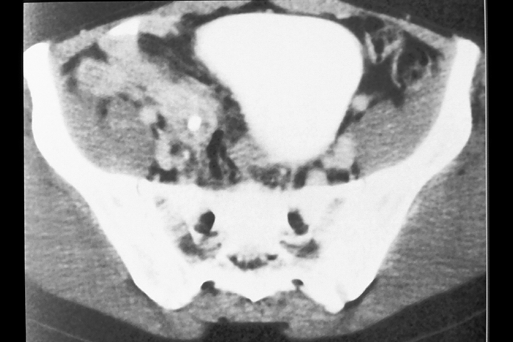
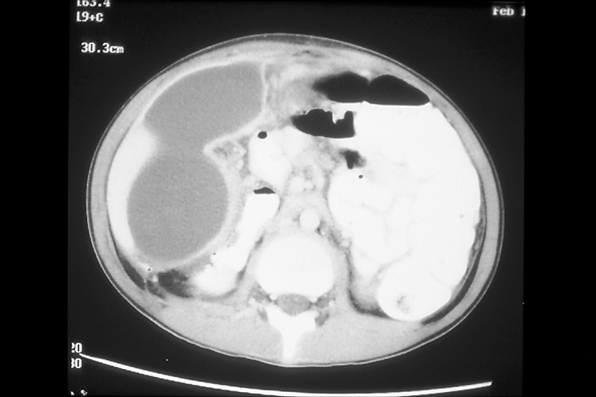
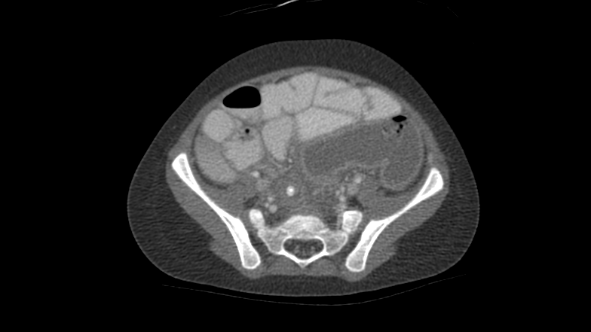
Diagnostic Imaging- Computed Tomography (CT)
Advantages: CT scans are considered the gold standard for diagnosing appendicitis in adults due to their high sensitivity and specificity. CT scans offer detailed imaging, allowing visualization of the appendix, adjacent structures, and any complications, such as perforation or abscess.
Diagnostic Features: Shows an enlarged appendix with thickened walls, fat stranding, and fluid collection around the appendix. In complicated cases, CT can identify abscess formation, perforation, or phlegmon.
Limitations: Exposure to ionizing radiation makes CT less ideal in pregnant women and children. It is also more expensive.

Slide 38
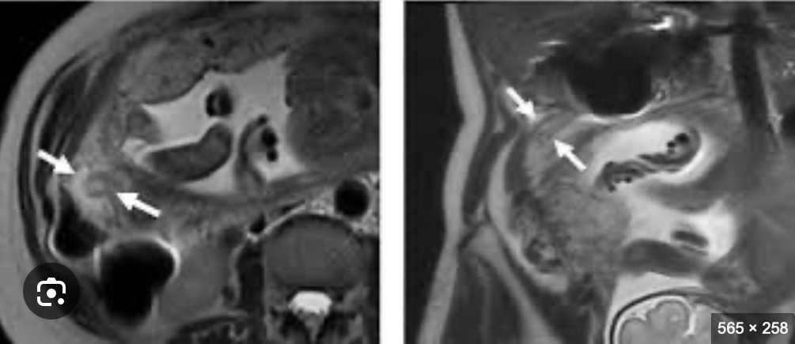
Diagnostic Imaging – Magnetic Resonance Imaging (MRI)
Advantages: MRI is an excellent alternative to CT, especially for pregnant women, no ionizing radiation. Detailed imaging similar to CT and can accurately visualize the appendix.
Diagnostic Features: Shows an enlarged appendix with surrounding fat stranding, similar to those seen on CT. MRI can also detect perforation, abscess formation, and other complications.
Limitations: MRI is less widely available and more expensive than ultrasound, and it requires the patient to remain still for an extended period, less ideal for young children.

Slide 39
Management
Surgical Approach:
Laparoscopic Appendectomy: Preferred method for most patients. Faster recovery, less postoperative pain, and a shorter hospital stay.
Open Appendectomy: In select cases of complicated appendicitis (e.g., perforation, abscess formation). May be associated with longer recovery times.
Non-Operative Management:
Antibiotic therapy alone effective in managing uncomplicated acute appendicitis. Risk of recurrence. Longer hospital stay. Surgery is still considered the definitive treatment.
Notes:
Recurrence 5% - 37% at 1 year, at 5 yr follow up 46% had appendectomy

Slide 40
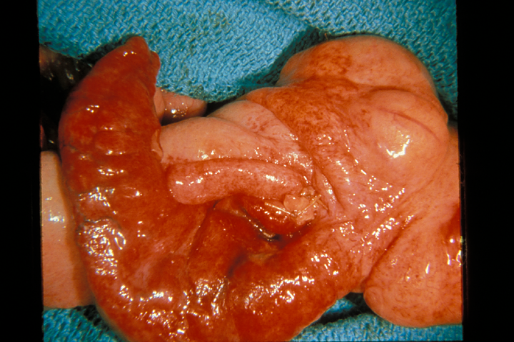
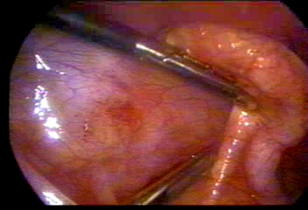
Acute Appendicitis

Slide 41
Postoperative Outcome
Acute Appendicitis
Perforated Appendicitis
Acute appendicitis has an average hospital stay <23 hours; return to school and sports in a few days
Minimal risks of wound and pelvic infection
Wound infection, abdominal abscess, prolonged ileus, intestinal obstruction, scarring of fallopian tubes
Hospitalization: 5-10 days, return to school and regular activities may be delayed by 2-4 weeks

Slide 42


