Slide 1

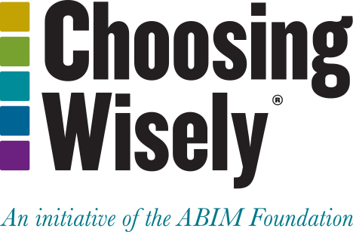
Choosing Wisely in Pediatric Orthopaedics
UPMC Cole Pediatric Update
April 2025
William Hennrikus MD
Professor Emeritus
Distinguished Educator
Penn State College of Medicine
Whennrikus@pennstatehealth.psu.edu

Slide 2


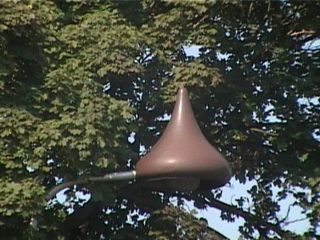
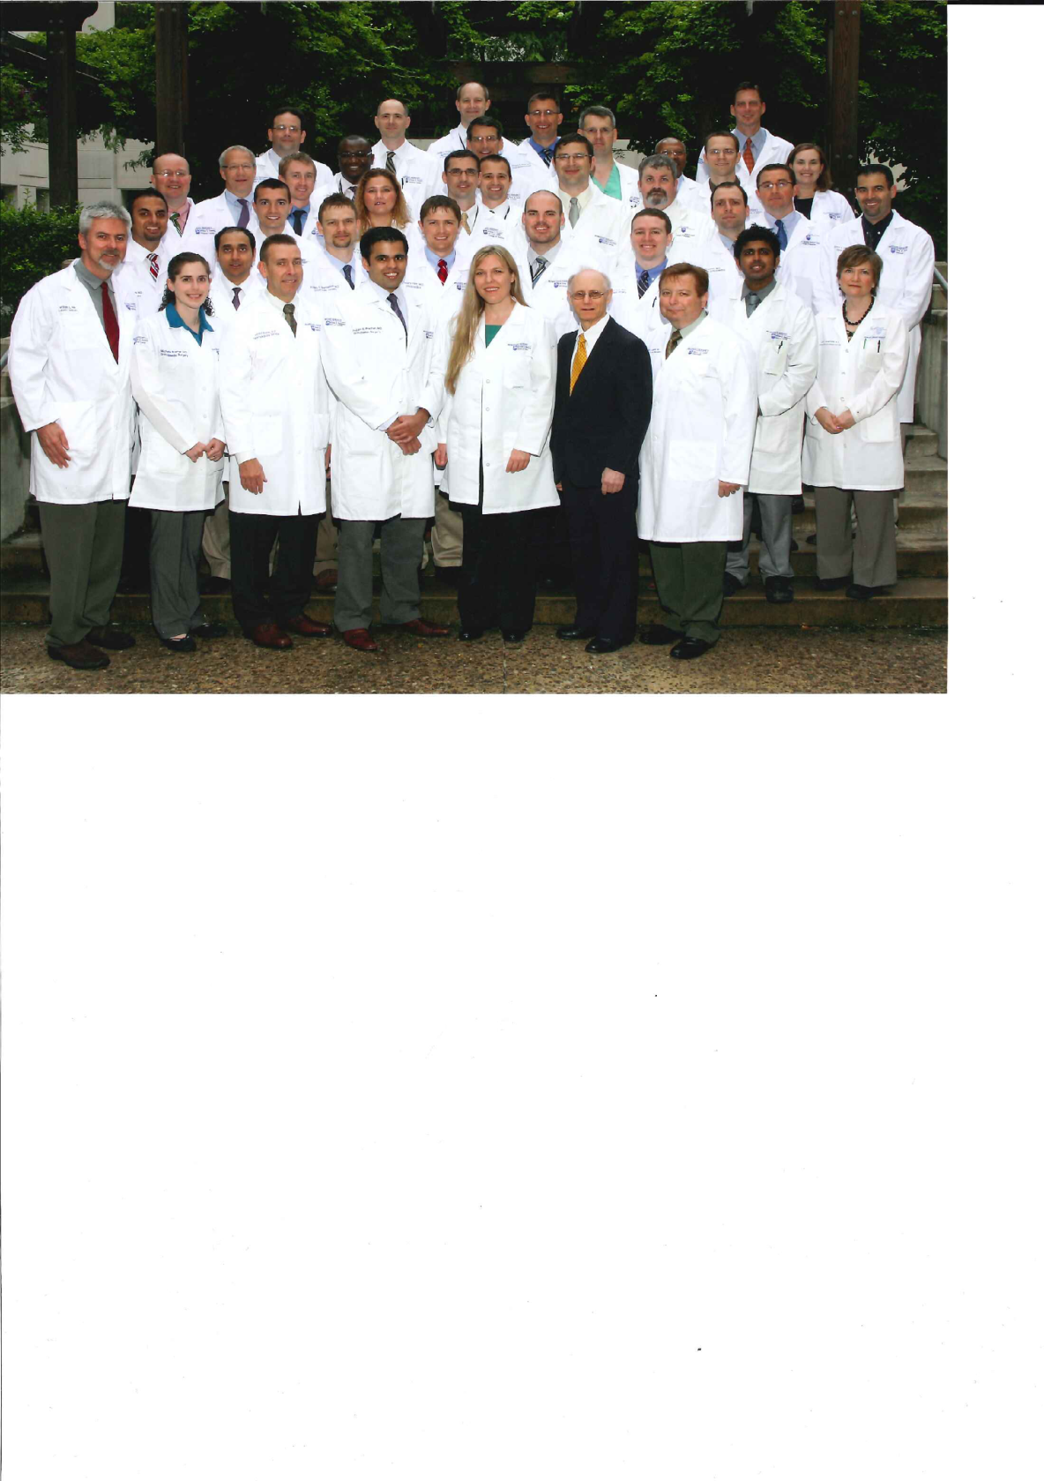
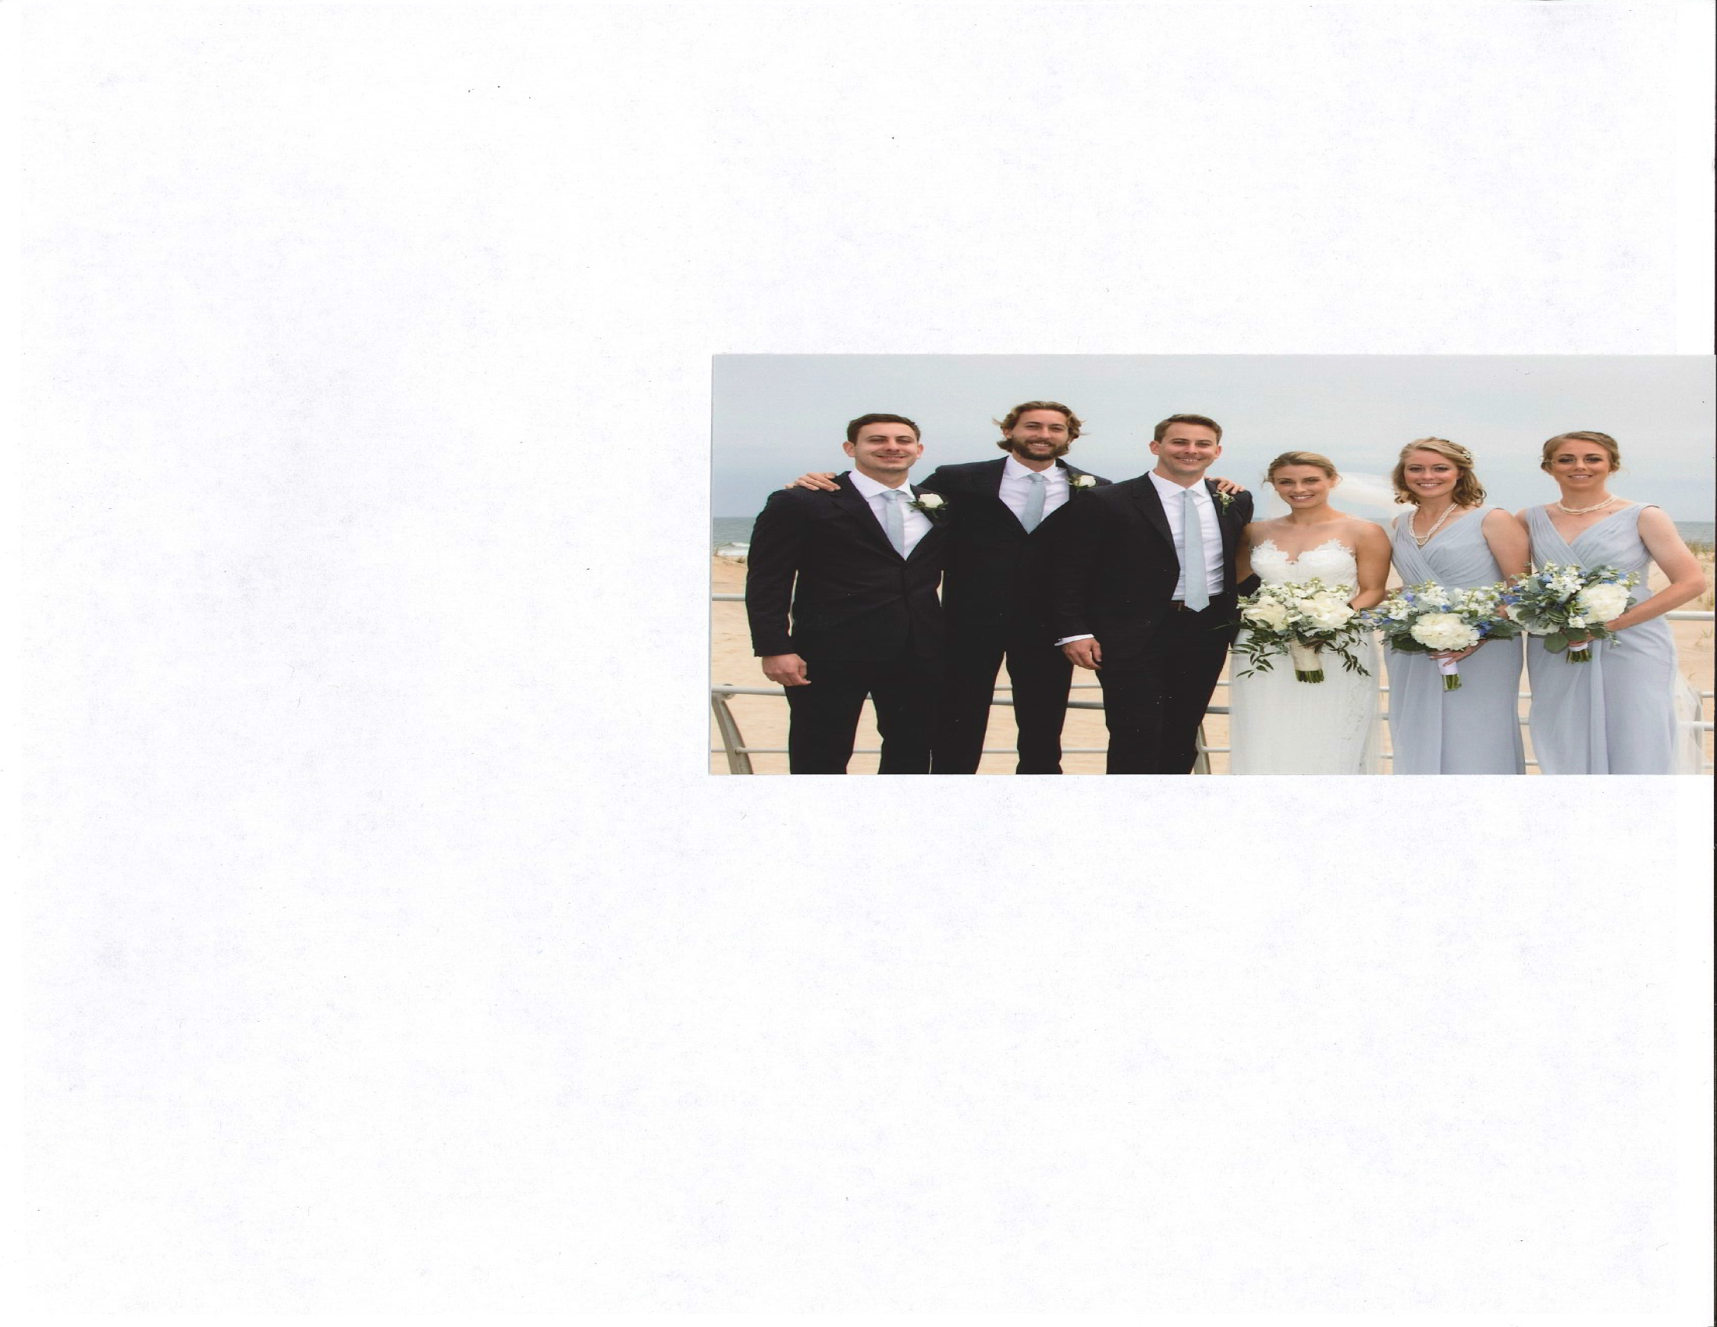
Disclosures None

Slide 3
Learning Objectives
Describe 6 pediatric orthopaedic musculoskeletal themes that doctors and patients should question in order to improve the care for children

Slide 4
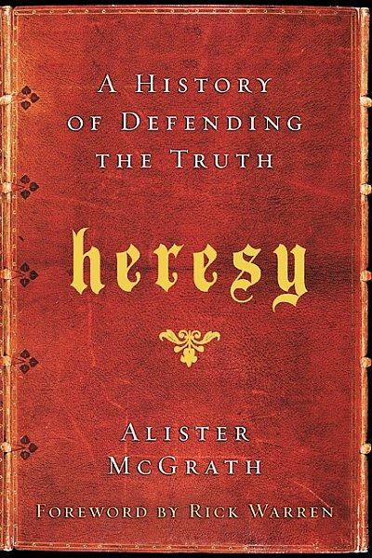
Practice Gap
Some doctors do not practice evidence based medicine

Slide 5
The Choosing Wisely® campaign is one of our most well-known initiatives. The goal of the campaign is to promote conversations between clinicians and patients by helping patients choose care that is:
Supported by evidence
Not duplicative of other tests or procedures already received
Free from harm
Truly necessary
It calls upon leading medical specialty societies and other organizations to identify tests or procedures commonly used in their field whose necessity should be questioned and discussed with patients.

Slide 6
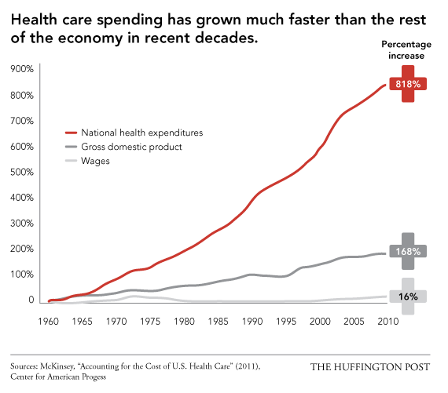

Slide 7
The Choosing Wisely effort has garnered the participation of over 70 medical specialty societies who have published more than 400 recommendations of overused tests and treatments that clinicians and patients should discuss. The campaign and society recommendations have been included in nearly 300 journal articles and more than 10,000 media articles since the program launched in 2012.

Slide 8


Value = Outcomes/ Cost Porter M NEJM 2010
Value=outcomes/costs
Value=efficiency
Value is measured by the outcomes achieved not the volume of services delivered
A shift from volume to value
Measure the cost of a patient’s entire care cycle
An attempt to control physician behavior and measure results

Slide 9
Choosing Wisely physician survey
Survey findings include:
58 percent of physicians say the doctor is in the best position to address the problem, with the government as a distant second (15 percent).
72 percent of physicians say the average medical doctor prescribes an unnecessary test or procedure at least once a week.
47 percent of physicians say their patients ask for an unnecessary test or procedure at least once a week.
70 percent of physicians say that after they speak with a patient about why a test or procedure is unnecessary, the patient often avoids it.

Slide 10
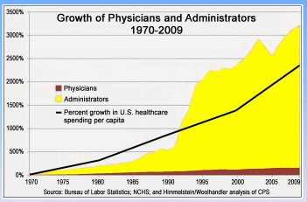

Slide 11
Choosing Wisely -- Pediatric Orthopaedics Written by AAP and POSNA 2018
Examine the hips! AP and Frog Pelvis x-ray—if any suggestion of SCFE
FFF no symptoms—no ortho visit
< 8 yo with in-toeing—no ortho visit
Infant with no risk factors and a stable PE—no ultrasound
Exam and X-ray first –MRI last
No follow up x-rays for buckle fractures

Slide 12
Pediatric Orthopaedics: Choosing Wisely 6 things that physicians and patients should question
# 1
For an adolescent with hip, groin, thigh or knee pain, limp or unilateral out-toeing gait—make sure that both hips are examined for SCFE
AP and Frog radiographs should be obtained
Explanation: SCFE often presents with insidious onset and vague hip and or knee pain with associated alterations in gait. It is important to detect SCFE early before large deformity or instability of the hip occurs.

Slide 13
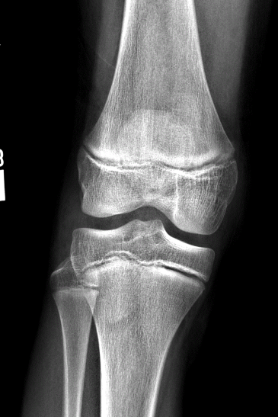
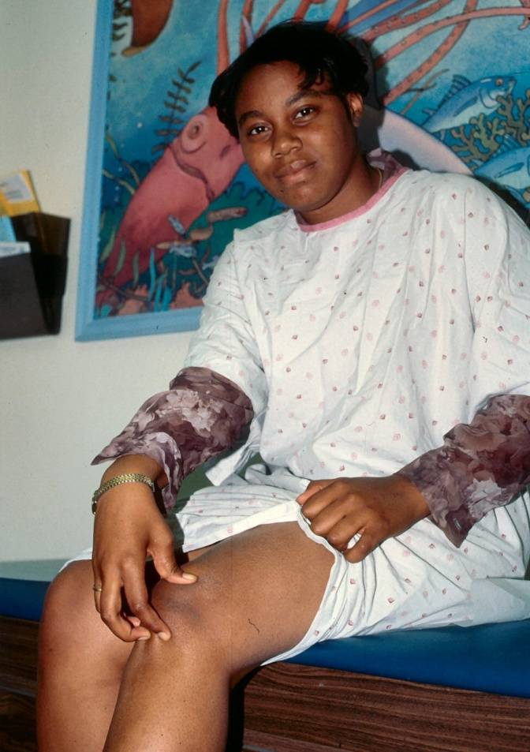
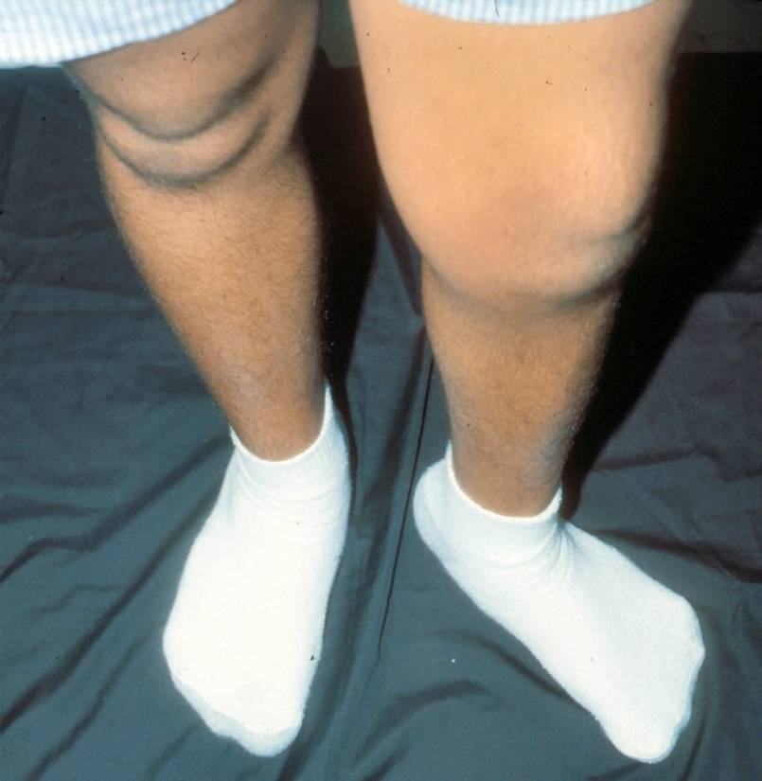
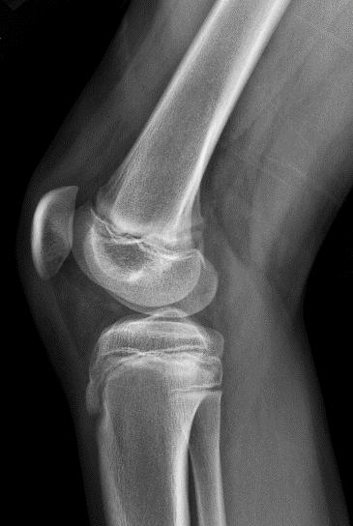
Case example: 13 yo middle school softball star. Left knee pain 2 months. Out-toe gait on the left. Knee x-rays neg.

Slide 14
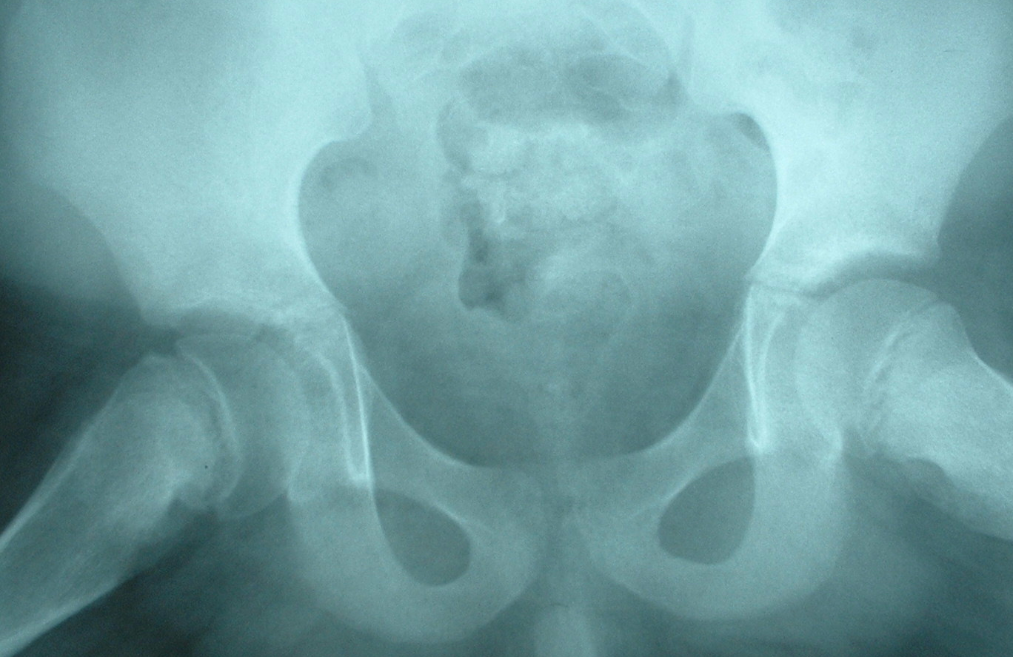

Slide 15
Delay in diagnosis of SCFE
Ave delay > 8 weeks
> 20% of patients present without hip pain but with knee pain
Delayed diagnosis leads to more severe slip, AVN, chondrolysis, arthritis
No improvement in early diagnosis during the past 25 years
Ledwith C, Fleisher G. Pediatrics 1992
Matava M, Patton C. JPO 1999
Kocher M, Bishop J. Pediatrics 2004
Green D, Reynolds R. HSS J 2005
Rahme D, Comley A. JPOB 2006
Pinkowsky G, Hennrikus W. J Pediatr 2013
Shur M, Andrs L J Pediatr 2016
Hosseinzadeh p, Iwinski H. JPO 2017
Lam A, Ostuka N et al. JCO 2018

Slide 16
Pediatric Orthopaedics: Choosing Wisely 6 things that physicians and patients should question
# 2
A child with asymptomatic flat feet does not need to be seen by an orthopaedic surgeon
Explanation: Flexible flat feet are normal physiologic variants commonly found in children and adults. The use of orthotic devices to provide support for the foot does not aid in the development of the arch.

Slide 17
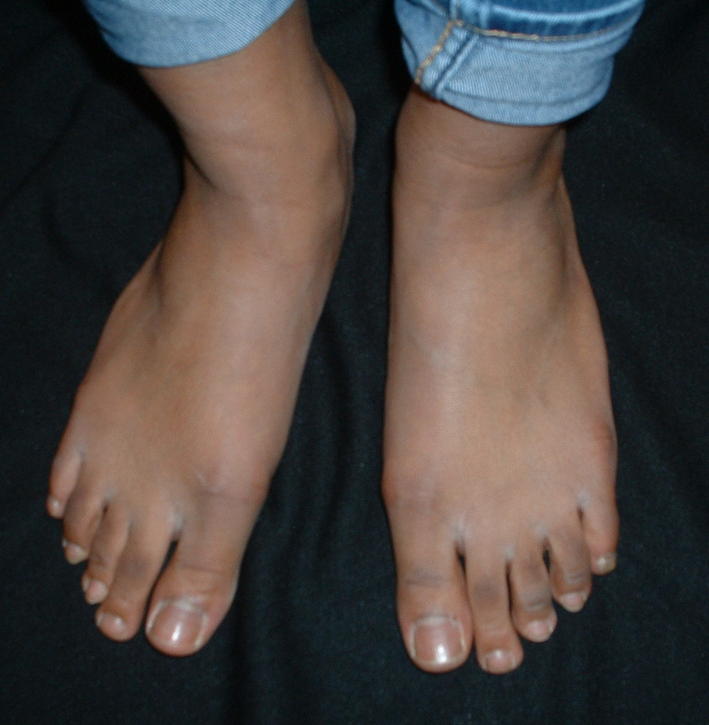
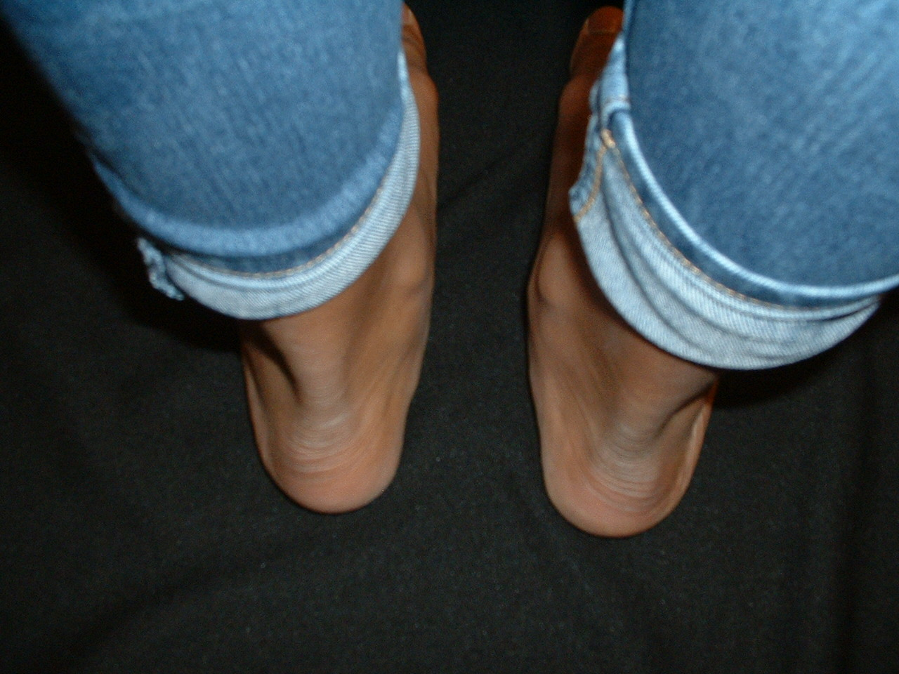
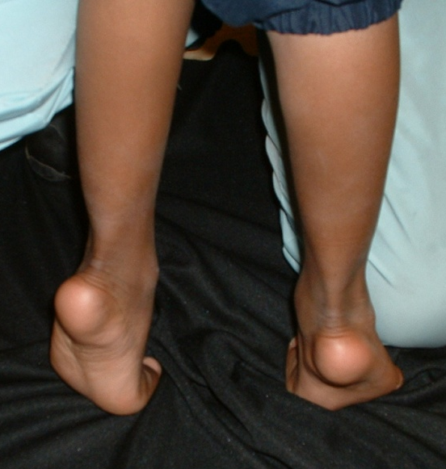
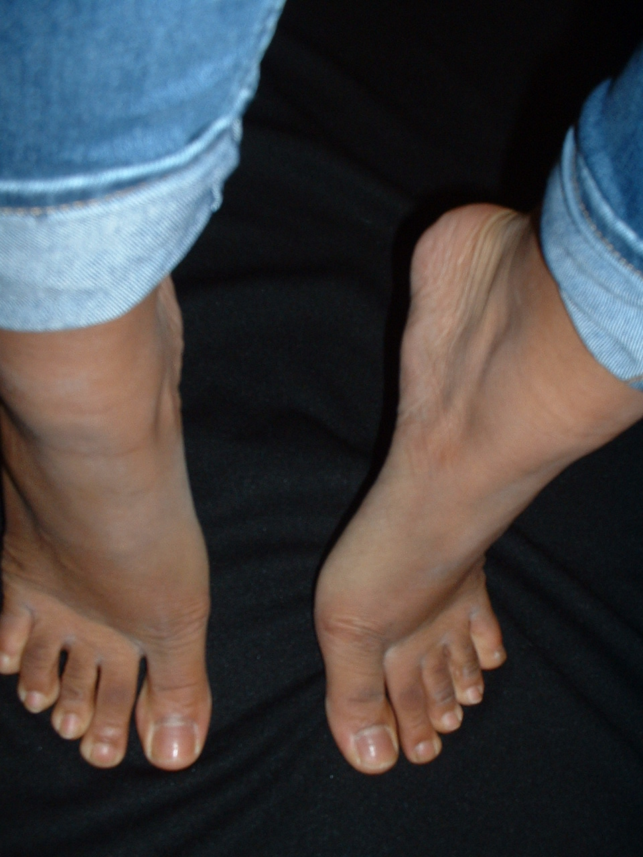
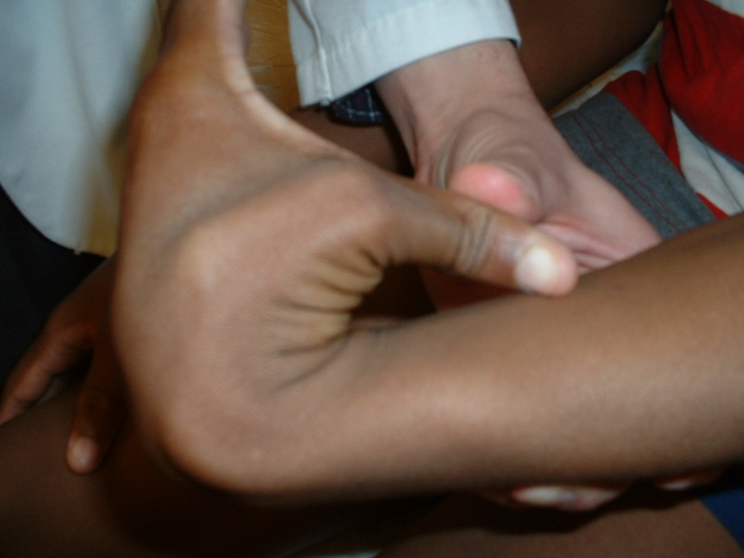

Slide 18
Flexible flat feet in children
45 % of pre-school children, 15 % of adolescents
Joint hypermobility
Many excessive and expensive treatments
Customized inserts--no
Corrective shoes—no
Surgery—no
Soft OTC inserts, home exercises—no harm
Wenger D, Mauldin D. JBJS 1989
Garcia-Rodriquez A. Pediatrics 1999
Pfeiffer M, Kotz R. Pediatrics 2006
Evans A, Rome K. Eur J Phys Reh Med 2011
Bouchard M, Mosca V. JAAOS 2014
Kanath U, Aktas E. J Orthop Sci 2016

Slide 19
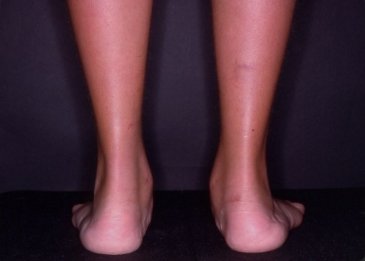
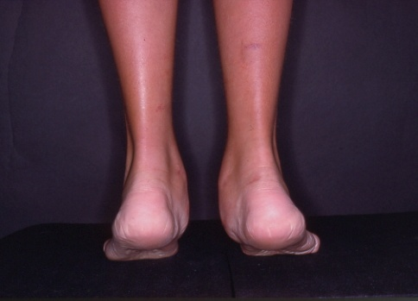
When to refer
Pain
Asymmetry
Stiffness—not flexible

Slide 20
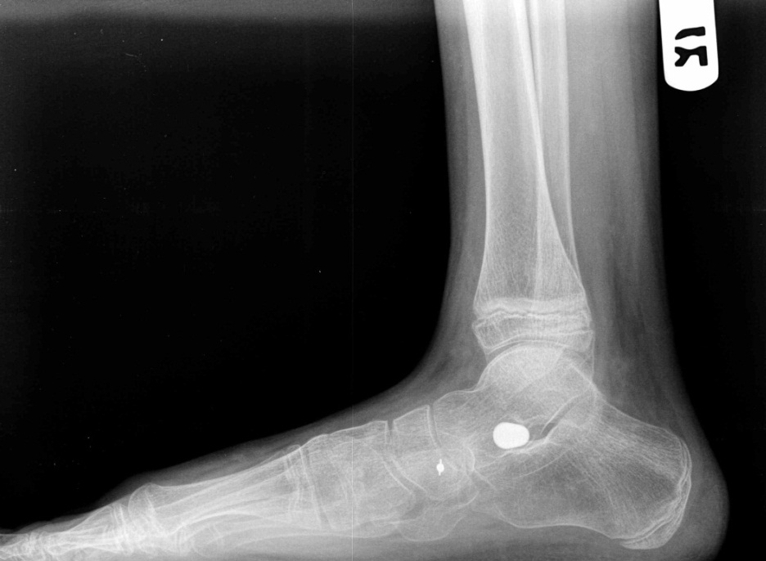
Subtalar joint arthroereisis Controversial!
Outcomes, effectiveness, safety
Crawford A, Roy D. JBJS 1990
Metcalfe S, Bowling F. Foot Ankle Int 2011
Jay R, Din N. Foot Ankle Spec 2013
Kadhim M, Miller F. JPOB 2014
De Pellegrin M Wirth T. JCO 2014
Caravaggi P, Berti L. Gait Posture 2018

Slide 21
Pediatric Orthopaedics: Choosing Wisely 6 things that physicians and patients should question
# 3
A child less than 8 years of age with simple in-toeing gait does not need to be seen by an orthopaedic surgeon
Explanation: In-toeing is a physiologic process reflecting ongoing maturation of the skeleton. It is not possible to alter the natural evolution using physical therapy, bracing or shoe inserts.

Slide 22
In-toeing
Metatarsus adductus, tibial torsion, femoral torsion
Most are benign and resolve spontaneously
Imaging rarely indicated
Shoe modifications—no
Bracing—no
Osteotomies—rarely needed-- after the age of 8
Staheli L J Fam Pract 1983
Lincoln T, Suen P. JAAOS 2003
Hsu E, Schwend R. JPO 2012
Davids J, Hardin J. JPO 2014
Sielatycki J, Hennrikus W. J Pediatr 2016
Faulks S, Brown K. JPO 2017
Rerucha C, Baird D. Am Fam Phys 2017

Slide 23
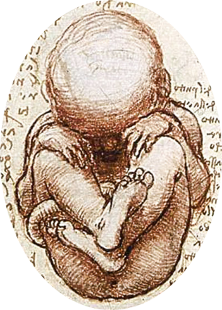
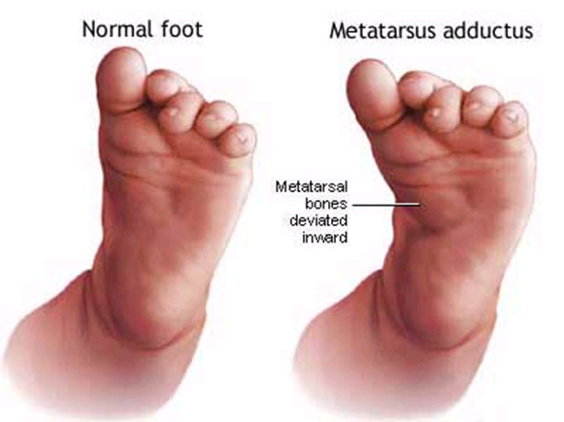
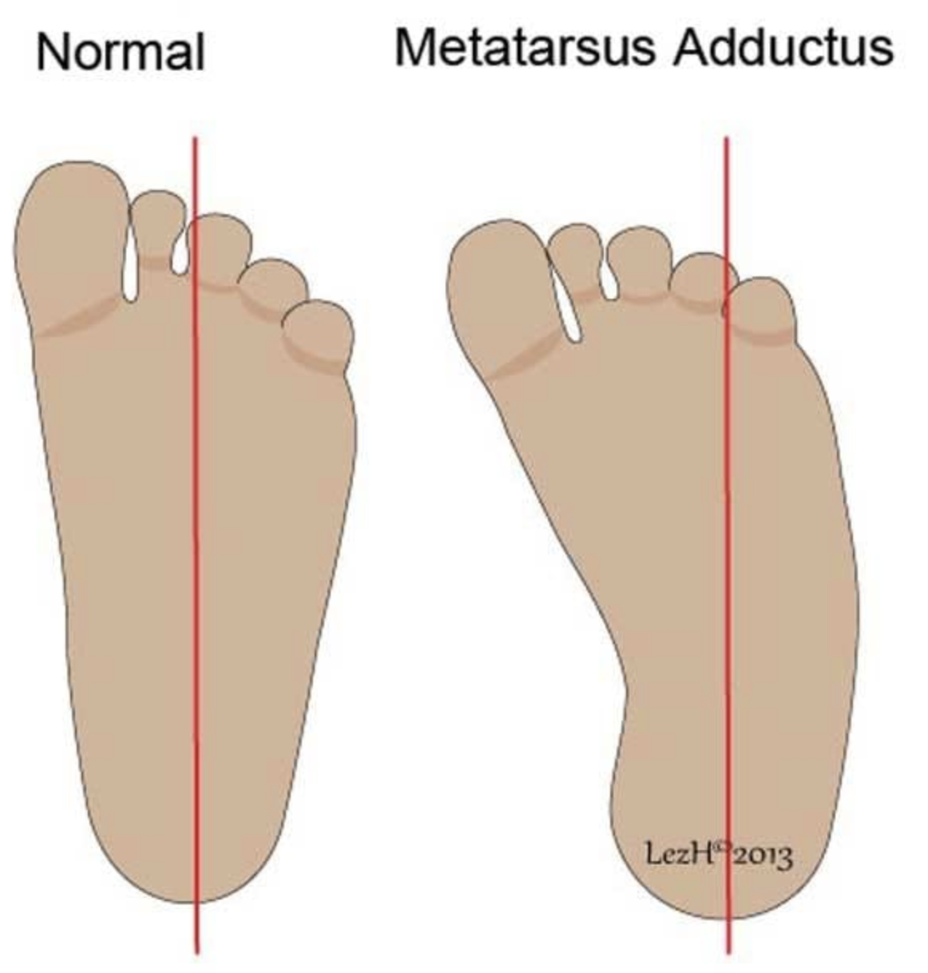
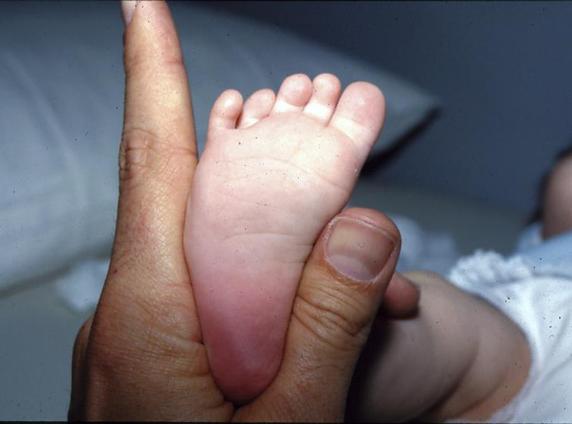
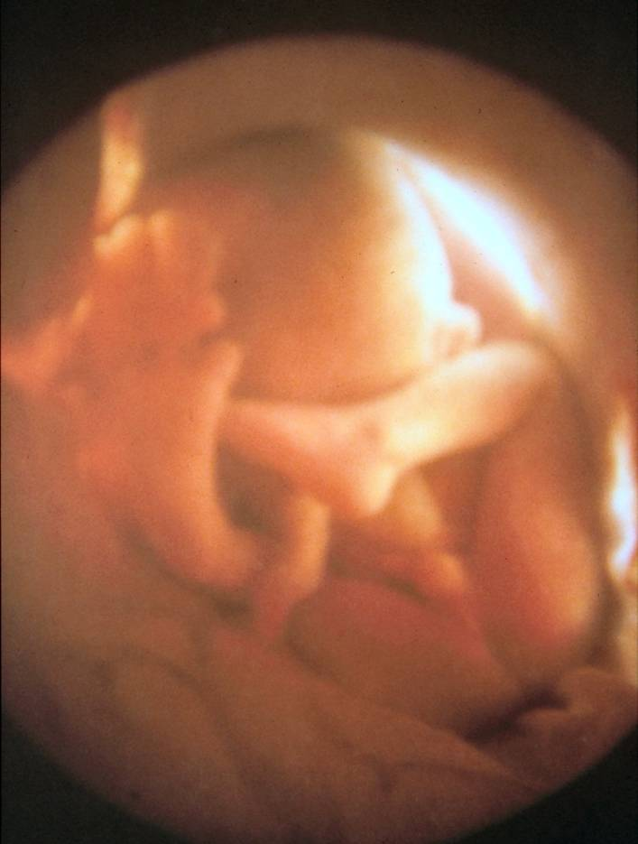

Slide 24
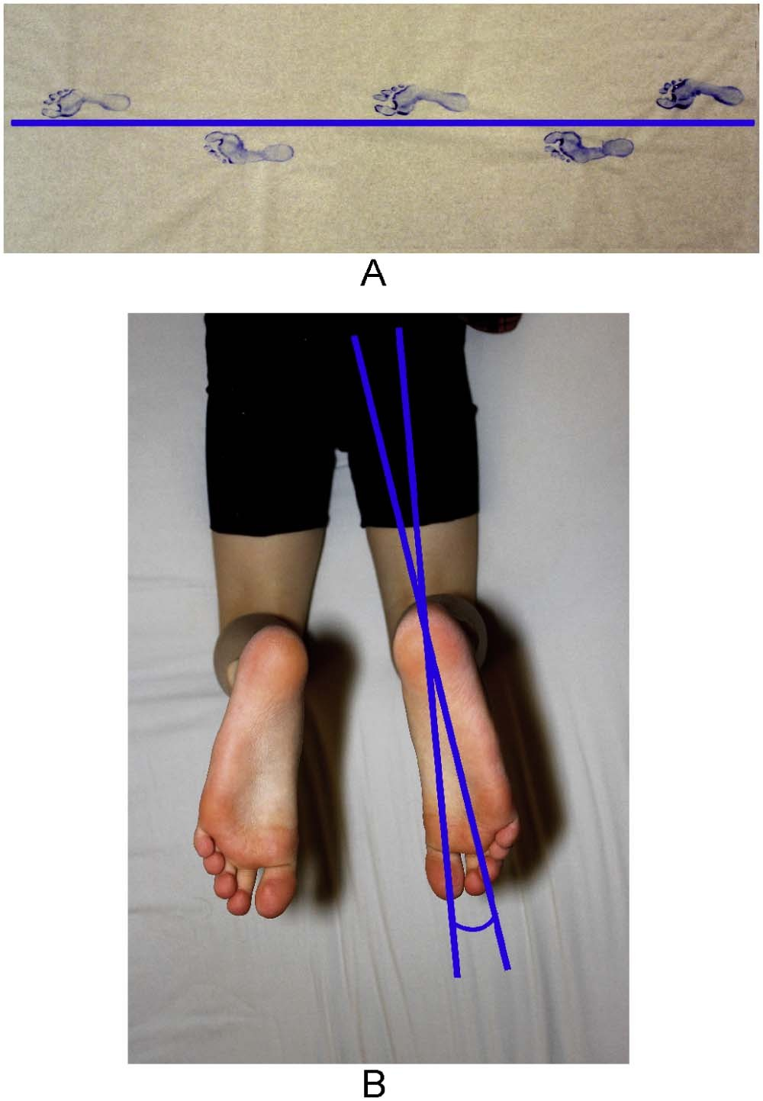
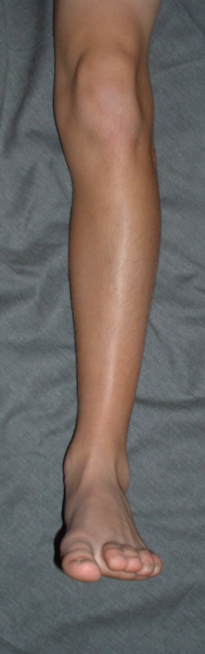
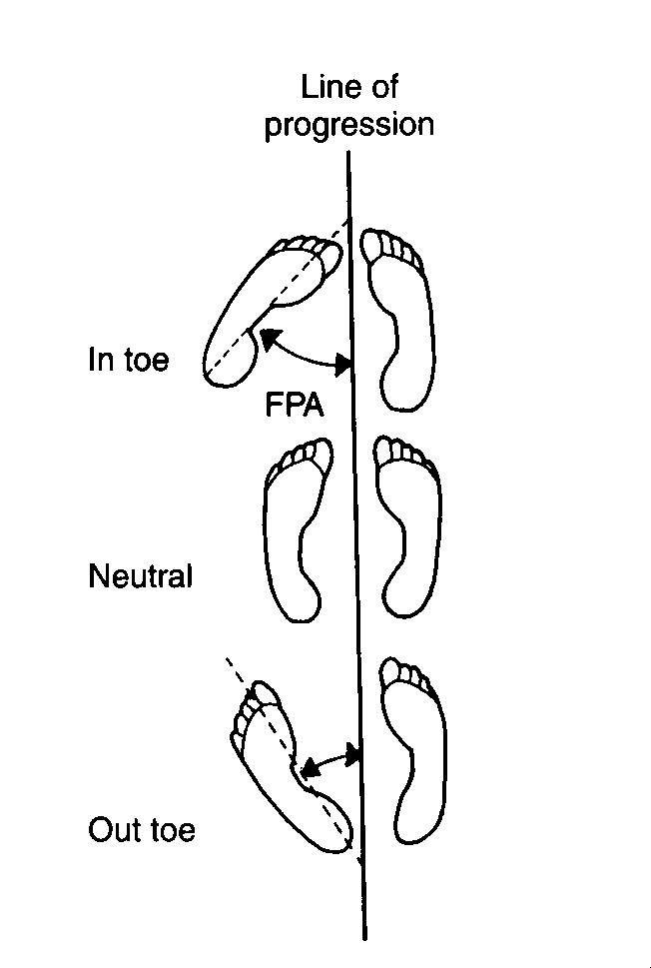
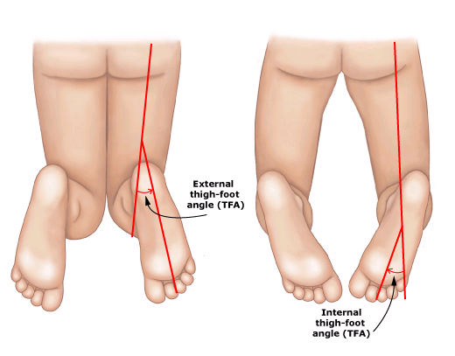

Slide 25
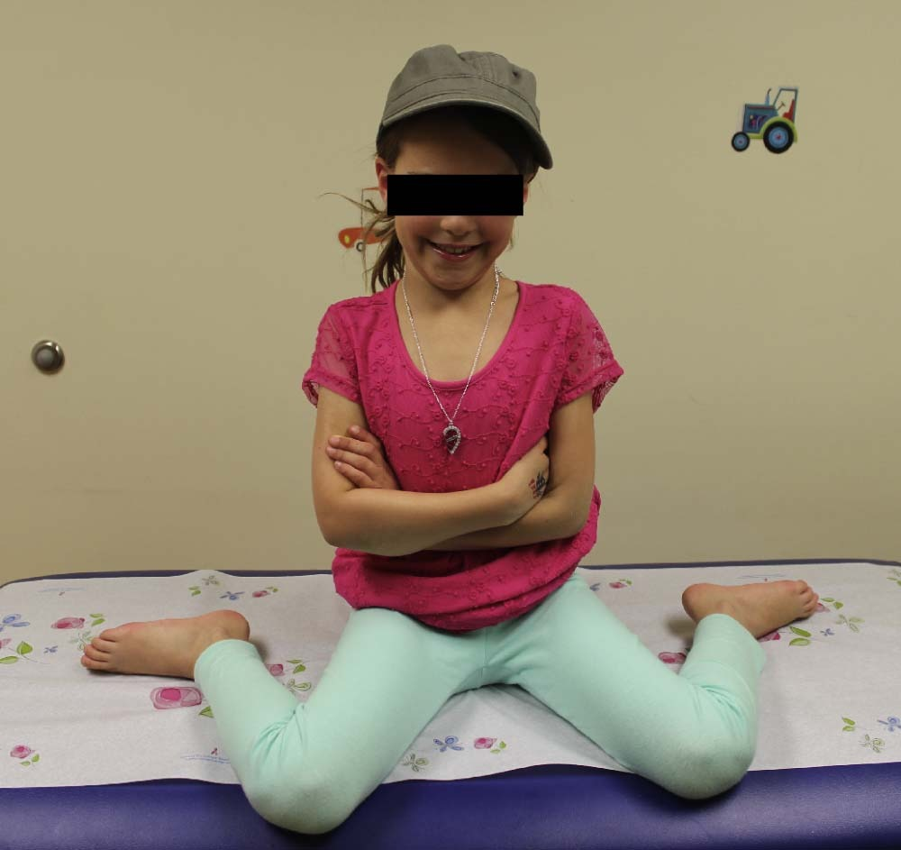
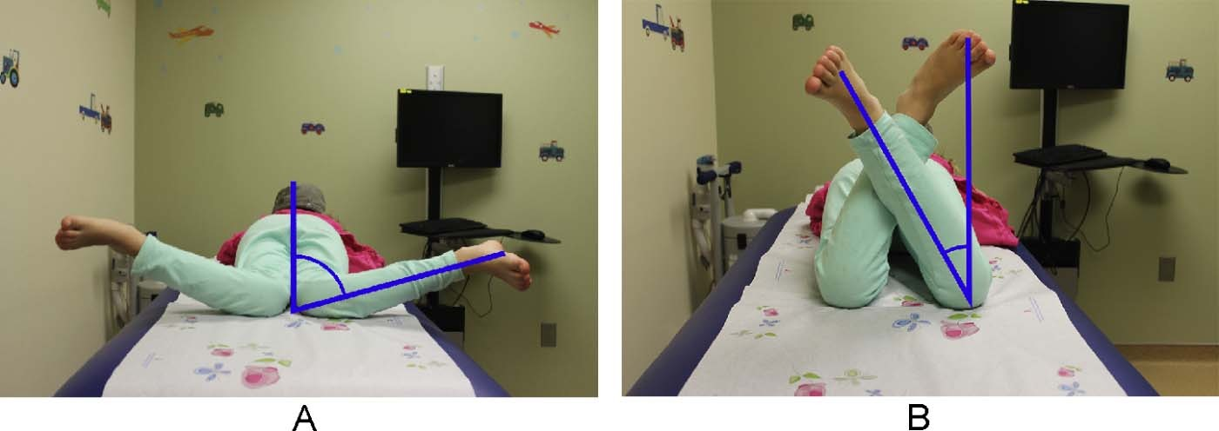
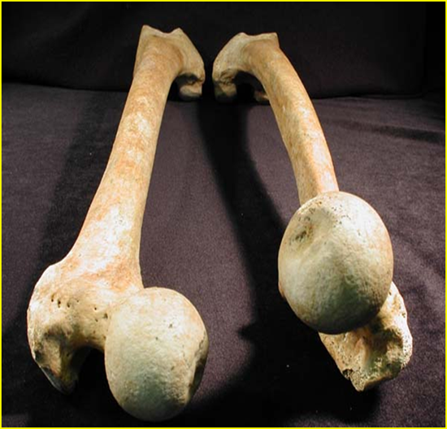
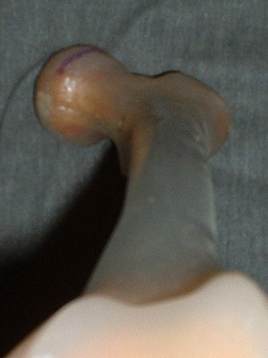
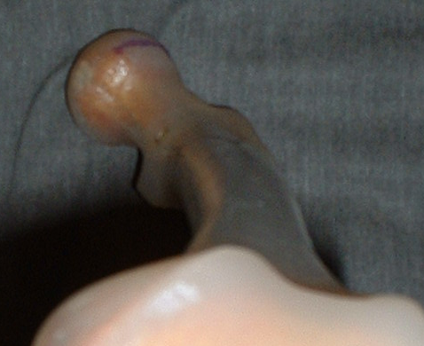

Slide 26
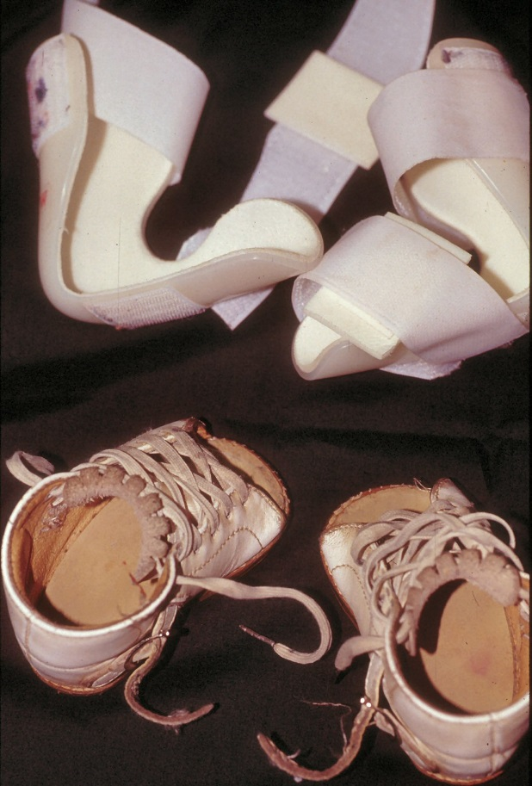
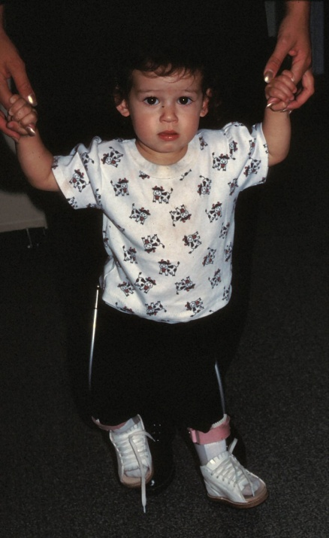
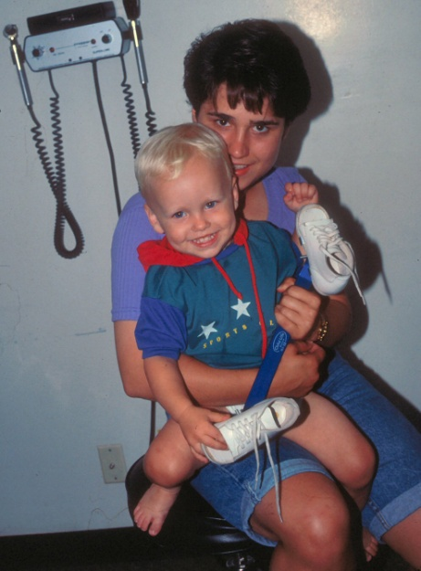
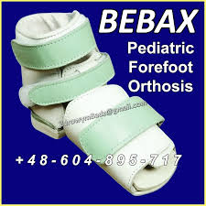

Slide 27
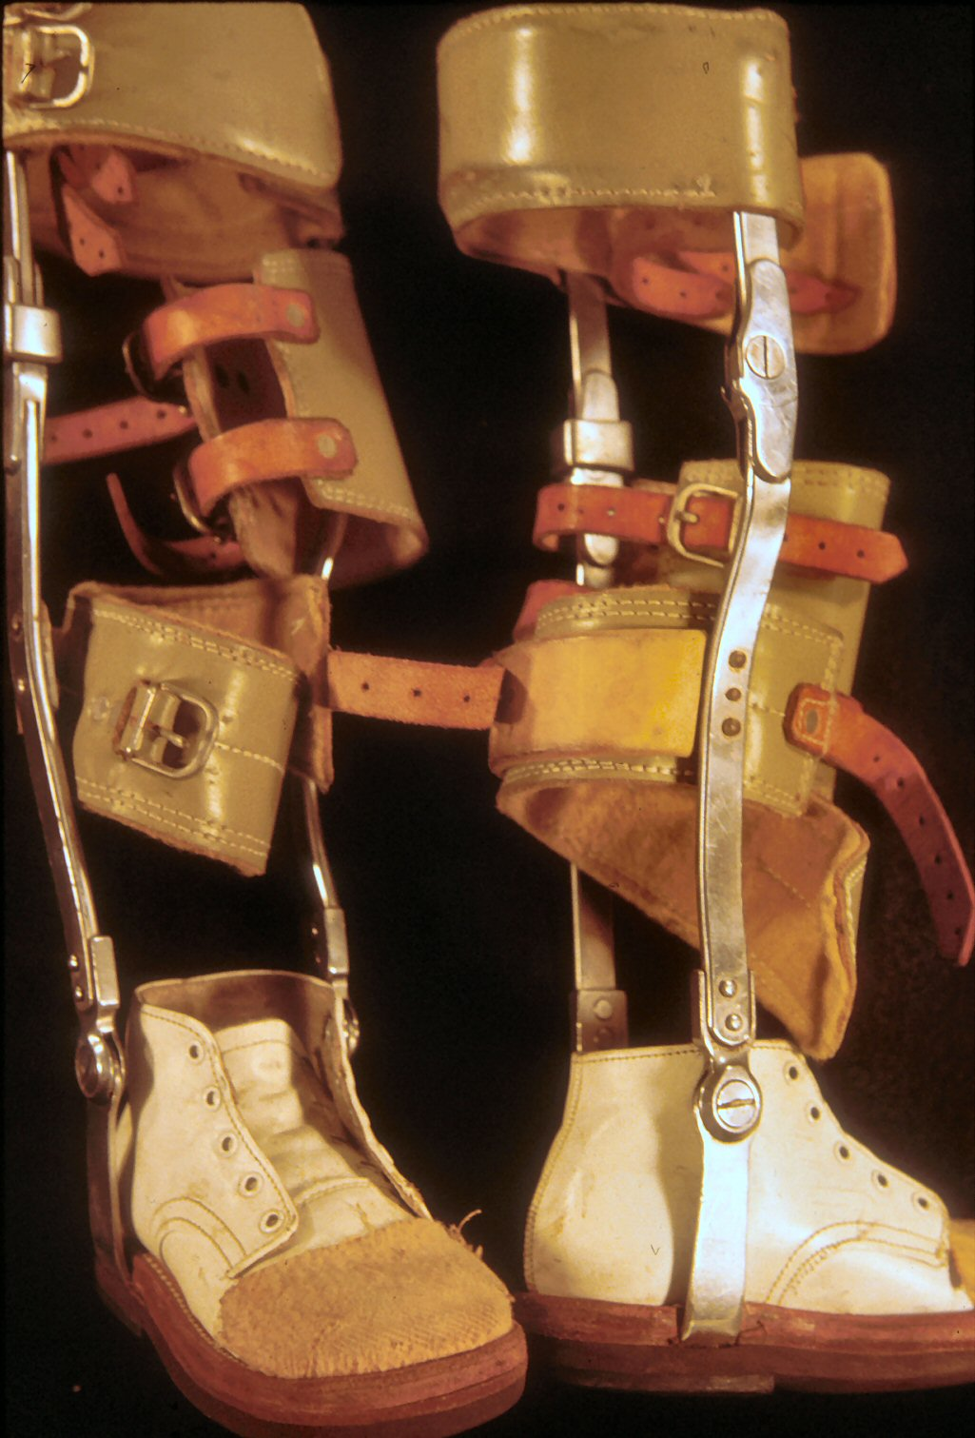
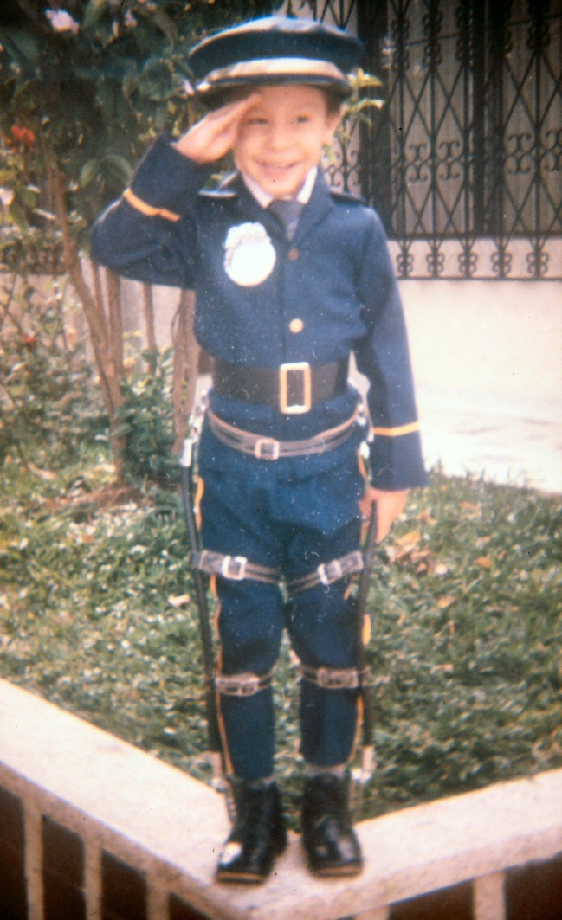
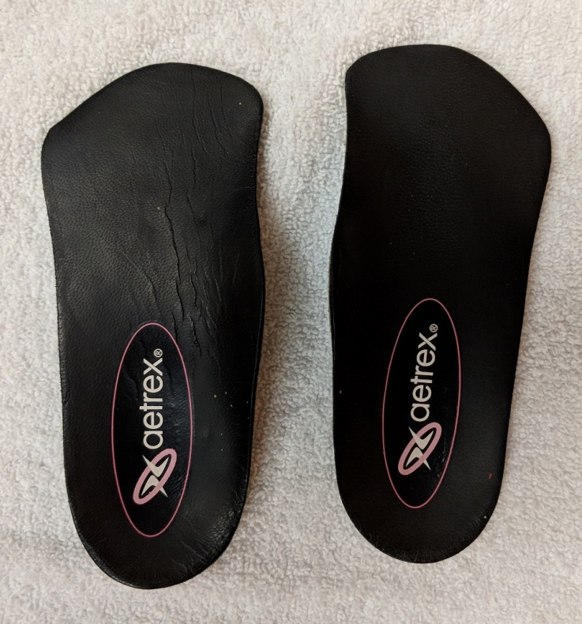

Slide 28
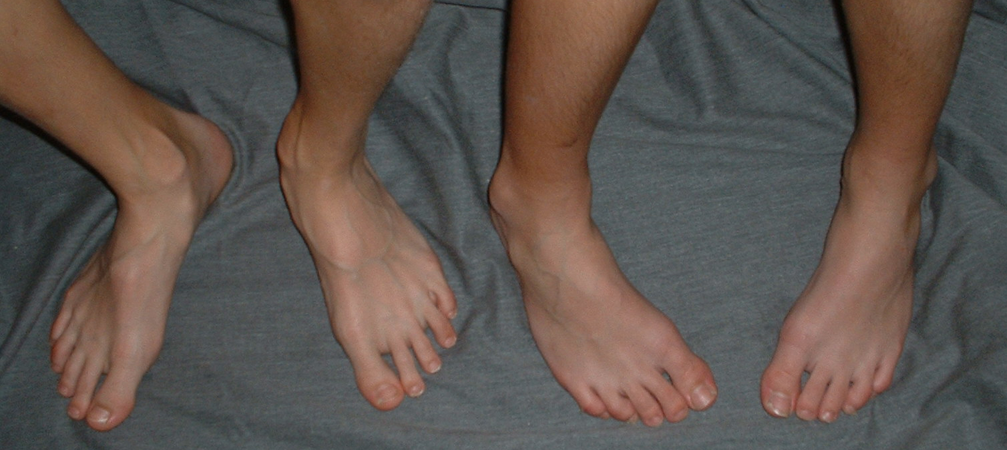
When to refer
Rigid MTA
Pain
Asymmetry
Age > 8 desire surgery

Slide 29
Pediatric Orthopaedics: Choosing Wisely 6 things that physicians and patients should question
# 4
An infant without risk factors for DDH and who has had a stable clinical hip exam does not need a screening hip ultrasound
Explanation: Routine use of ultrasound when there is no underlying risk factors for abnormalities from the physical exam is costly, time intensive, and the findings may be misleading to parents and physicians.

Slide 30
Goldberg M. Pediatrics 2000 Shaw B, Segal L. Pediatrics Dec 2016 Mulpur K, Otsuka N, Hennrikus W. et al. JBJS 2015
AAP screening recommendations
Screen all newborn hips by Physical Exam
Re-examine on a periodic schedule until walking age
Record physical exam findings
Be aware of the changing physical exam findings for DDH
If the PE raises suspicion refer to an orthopod or perform age appropriate imaging studies—US at 6 weeks or x-ray at 4 months
Understand risk factors for DDH
Ultrasound
Clarifies questionable physical exam findings
Assess high risk infant: *female breech*
This is the risk factor, even when the exam is normal, that the AAP recommends an US or X-ray
Monitoring DDH as it is treated in infants 4 mo or younger
Selective use of ultrasound recommended to guide treatment and prevent overtreatment

Slide 31
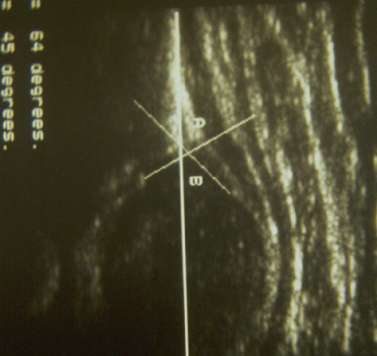
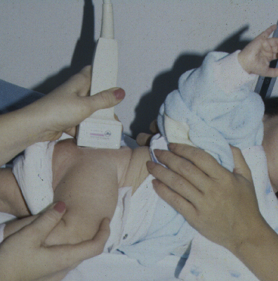
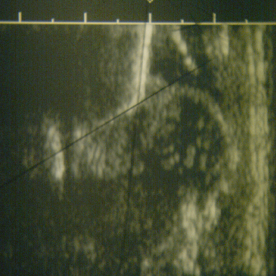
Why is hip ultrasound not recommended for all newborns?
Operator dependent
Availability questionable
Increases rate of treatment
Inter-observer variability
Increased costs

Slide 32
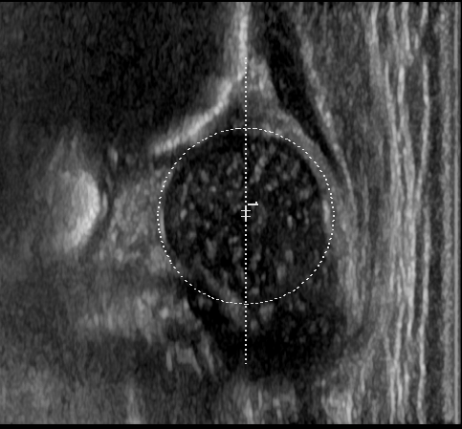
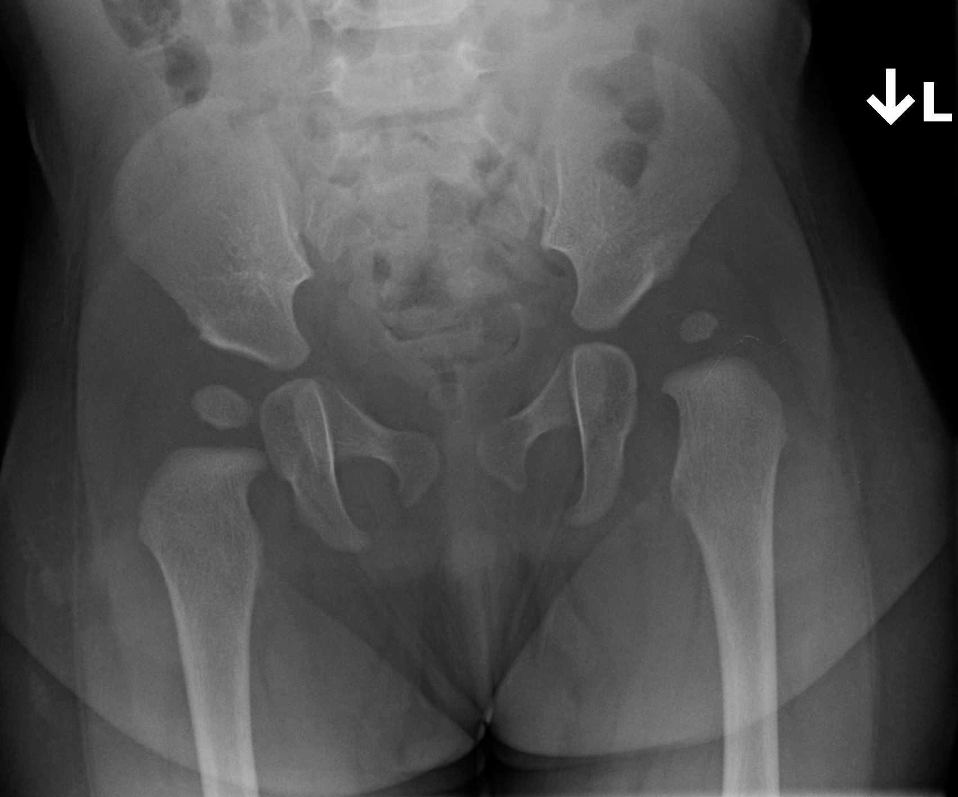
Can an infant with a normal US, later have DDH? Sankar W. JPO 2015 Pan T, Hennrikus W. JPO 2022 J Ped Child Health

Slide 33
Pediatric Orthopaedics: Choosing Wisely list of 6 things that physicians and patients should question
# 5
An MRI exam should not be performed unless a clinical exam and appropriate plain radiographs are done first
Explanation: History, physical exam, and appropriate radiographs remain the primary diagnostic modalities in pediatric orthopaedics. MRI is costly, frequently requires sedation in the young child, and may demonstrate clinically insignificant findings. MRI has greater value when used to answer a question that arises from a well done clinicial and radiographic evaluation.

Slide 34
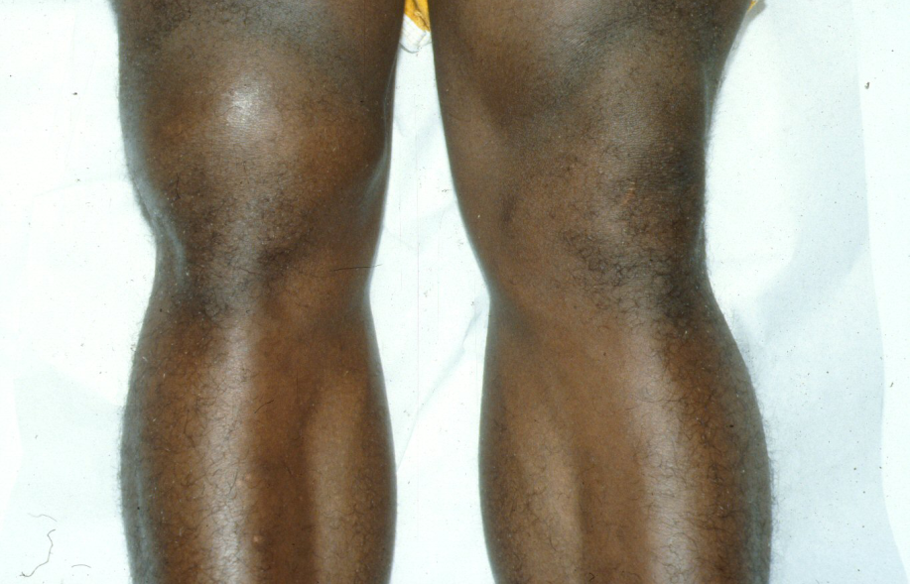
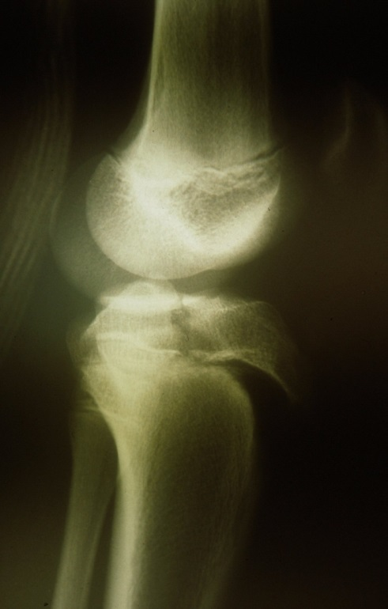
History, exam and plain X-rays make the diagnosis:

Slide 35
A knee MRI scan
screening test needed by all patients with knee trauma
B) cannot be performed on a knee injury until the knee effusion resolves
C) should be done prior to radiographs
D) used to confirm or clarify diagnosis or to plan surgery
Gill, Nemeth, Davis. MRI of the pediatric knee. Im Clin N Am 2014

Slide 36
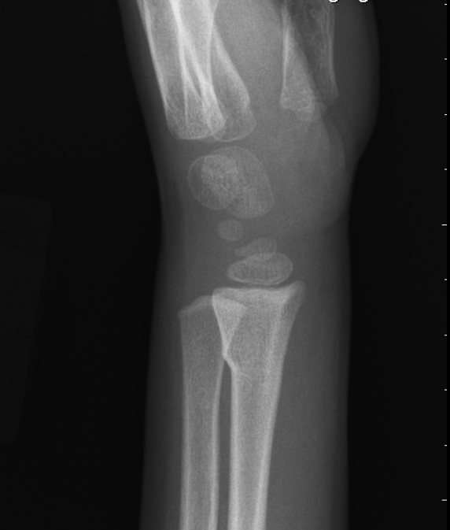

Pediatric Orthopaedics: Choosing Wisely 6 things that physicians and patients should question
# 6
Do not order follow up x-rays for buckle (torus) fractures
Explanation: Buckle fractures of the distal radius are common injuries in young children. The fracture is one of compression of metaphyseal bone. These fractures are stable and do not necessarily require a cast. A simple wrist brace or removable splint works well. The mild compression injury remodels over time and requires no monitoring. At 4 weeks post injury, no follow up radiograph is needed and full activity can be resumed.

Slide 37



Symons et al. Home management of buckle fractures of the distal radius. JBJS B 2001 Van Bosse H et al. Minimalistic approach to treating wrist buckle fractures. JPO 2005 Williams K et al. Randomized trial—cast vs splint for buckle fractures Ped Emerg Care 2013 Dua K, Ostuka N. et al. Variation treating distal rad fractures JPO 2019
Parents and patients prefer the convenience of splint treatment with no follow up radiograph. Outcomes the same without a cast or radiographic follow up.

Slide 38


Practice Change
Don’t miss the diagnosis of SCFE
Obtain radiograph-- Frog pelvis for any adolescent with hip, groin, thigh, knee pain, and/or limp.
Early diagnosis, quicker referral—better outcome
Luster T et al JPO 2023

Slide 39
Summary
Screening hip ultrasounds--overdone
Simple in-toeing gait-observation
Asymptomatic flat feet-observation
MRI --overdone
Routine follow up x-ray for buckle fractures—overdone
Don’t miss SCFE

Slide 40


Thank You

Slide 41


Questions?

