Slide 1

1
Notes:
1
1

Slide 2

Objectives
At the conclusion of this presentation you should be able to:
Recognize misconceptions that create barriers to breastfeeding
Create an office culture that supports breastfeeding
Provide anticipatory guidance to support mothers to successfully breastfeed
Assist families with breastfeeding problems
Learn which infections and medications are compatible with breastfeeding and where to locate this information
Understand the role of lactation consultants and when and how to utilize their services
Become familiar with community and online breastfeeding resources
2

Slide 3
AAP, AAFP, ACOG, ABM, WHO
Physicians and other health care professionals should routinely recommend:
Human milk for all infants, unless medically contraindicated
Breastfeeding initiation in the 1st hour of life
Exclusive breastfeeding for approximately 6 months
Continued breastfeeding as complementary foods are introduced
Continued breastfeeding as long as mutually desired by mother and child for 2 years and beyond
AAP Policy Statement: Breastfeeding and the Use of Human Milk
http://pediatrics.aappublications.org/content/early/2012/02/22/peds.2011-3552
3
Notes:
Access to objective, consistent, and complete information, free of commercial influences (WHO)

Slide 4
ACOG Committee Opinion Feb. 2016 (reaffirmed 2017)
Clinical Management of breastfeeding is a core component of reproductive healthcare
All obstetric care providers should:
Develop and maintain knowledge and skills in anticipatory guidance, physical assessment, and support of normal physiology and management of common BF problems
Provide complete and current information on risks of NOT breastfeeding
https://www.acog.org/Clinical-Guidance-and-Publications/Committee-Opinions/Committee-on-Obstetric-Practice/Optimizing-Support-for-Breastfeeding-as-Part-of-Obstetric-Practice

Slide 5
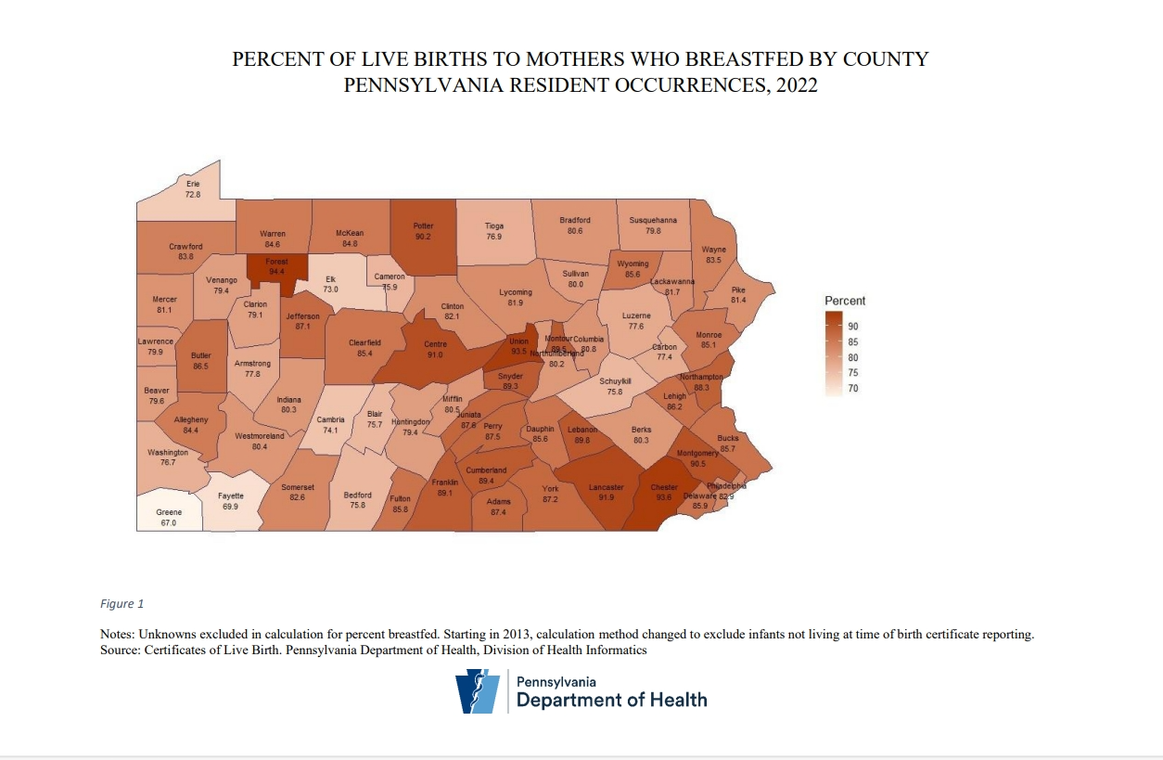

Slide 6
Healthy People 2030 Infant Health Goals
Increase the proportion of infants who are breastfed exclusively through age 6 months
Status: Improving
2007: 13.8% 2015: 24.9% 2021: 27.2% Target: 42.4%
Increase the proportion of infants who are breastfed at 1 year
Status: Improving
2007: 22.4% 2015: 35.9% 2021: 39.5% Target: 54.15%
nfants - Healthy People 2030 | odphp.health.gov
6

Slide 7


Breastfeeding
Benefits
Baby
Permission from Mymilkies.com
2018
Notes:
Educate families not only on the breastfeeding benefits, but also on the risks of not breastfeeding and the hazards of infant formula.

Slide 8
Advantages for Infants and Children Who are Breastfed
Decreased Risk of:
Respiratory Infections (especially lower)
Gastrointestinal Infections
Otitis Media
Asthma and Atopic Dermatitis
Diabetes Type I & Type II
Leukemia
Sudden Infant Death Syndrome (SIDS)
Necrotizing Enterocolitis and Sepsis (preterm)
Obesity
2025
Notes:
There are health advantages for women who breastfeed also.
Decreased postpartum bleeding and more rapid uterine involution
Less menstrual blood loss during early postpartum months
Earlier return to pre-pregnant weight
Delayed resumption of ovulation, leading to increased child spacing

Slide 9
Risks for Infants and Children Who are Formula Fed
Increased Risk of:
Respiratory Infections (especially lower)
Gastrointestinal Infections
Otitis Media
Asthma and Atopic Dermatitis
Diabetes Type I & Type II
Leukemia and Lymphoma
Sudden Infant Death Syndrome (SIDS)
Necrotizing Enterocolitis and Sepsis (preterm)
Obesity
Stuebe, A. (2009). The Risks of Not Breastfeeding for Mothers and Infants. Reviews in Obstetrics and Gynecology, 2(4), 222–231.
2025
Notes:
Formula feeding is associated with higher rates of illness, including both acute childhood diseases and long term chronic adult diseases.
Higher morbidity & mortality associated with formula feeding related to its non-species specific composition

Slide 10
Breastfeeding
Benefits
Mom
Permission from www.mymilkies.com
2018

Slide 11
Advantages for Women Who Breastfeed
Decreased postpartum blood loss
More rapid involution of the uterus
Increased natural child spacing
Decreased postpartum depression
Increased postpartum weight loss
Reduced risk of Type II Diabetes (if no h/o GDM)
Reduced risk of postmenopausal hip fracture
Reduced risk of ovarian cancer
Reduced risk of breast cancer (primarily premenopausal)
Reduced risk of hypertension and cardiovascular disease
Bartick, M. C., Stuebe, A. M., Schwarz, E. B., Luongo, C., Reinhold, A. G., & Foster, E. M. (2013). Cost analysis of maternal disease
associated with suboptimal breastfeeding. Obstetrics And Gynecology, 122(1), 111-119. doi:10.1097/AOG.0b013e318297a047d
2025
Notes:
There are health advantages for women who breastfeed also.
Decreased postpartum bleeding and more rapid uterine involution
Less menstrual blood loss during early postpartum months
Burns 600cal/day. Earlier return to pre-pregnant weight,
Delayed resumption of ovulation, leading to increased child spacing
Improved bone remineralization postpartum reducing hip fractures in the postmenopausal period

Slide 12
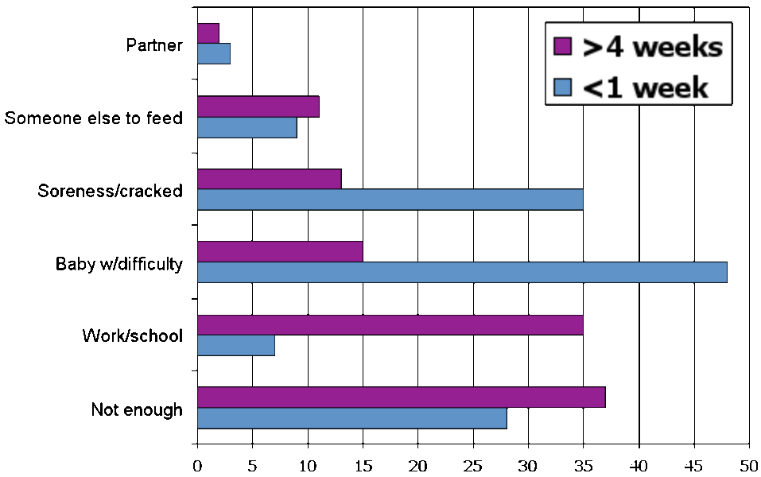
Reasons for Discontinuing Breastfeeding
Ahluwalia IB et al. Why Do Women Stop Breastfeeding? Findings from PRAMS. Pediatrics 2005.
12

Slide 13
Dispelling the misconceptions:
Yes - she can breastfeed!
Breastfeeding is recommended for these mothers:
Positive hepatitis B surface antigen (infant should receive HBIG)
Positive hepatitis C virus infection (unless nipples are cracked/bleeding)
Mastitis
Smoking tobacco
In treatment with methadone or buprenorphine (Subutex/Suboxone)
Pregnant
On most antidepressants
Receiving IV contrast for radiographic studies other than mangafodipir trisodium*
* do not breastfeed for 4 or more hours then pump and discard 1X
http://pediatrics.aappublications.org/content/129/3/e827.full#content-block
https://lactationmatters.org/wp-content/uploads/2013/09/radiology-brochure-1.pdf
13
Notes:
13

Slide 14
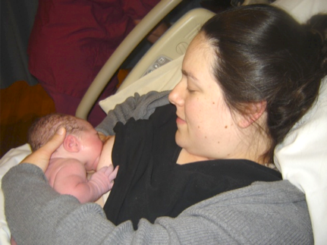
Contraindications to Breastfeeding in the US
Maternal:
Human T-cell lymphotropic virus I or II
Untreated brucellosis
Active (infectious) tuberculosis
Drugs of abuse and alcohol abuse
Contraindicated maternal medications (very few)
Infant:
Classic galactosemia
With milder forms and other metabolic diseases may alternate breastfeeding with protein free or modified formulas
Hatcher, S. W., & Buescher, E. (2008). Breastfeeding and diseases: A reference guide. Amarillo, Texas: Praeclarus Press
14

Slide 15
Infections with Special Situations
Separate mother and baby when mother has active
Tuberculosis
Express her milk and someone else feed milk to baby
Once no longer contagious (minimum of 14 days of treatment) she may breastfeed
Varicella-Zoster
Give infant VZIG (Varicella-zoster immunoglobulin)
Express her milk and someone else feed milk to baby
When no breast lesions and she is no longer contagious she may breastfeed the baby
Cover lesions and feed on unaffected side
Herpes lesions on nipple
Pump milk and discard from breast with lesion
Mother may breastfeed on the breast without lesions
3. Temporary interruption of breastfeeding
Brucellosis
Pump and discard milk from both breasts
Once appropriately treated for 72 to 96 hours, she may breastfeed
Lawrence RA, Lawrence RM. Breastfeeding: A Guide for the Medical Profession 8th edition, 2016
Lawrence RM. Breastfeeding Updates for the Pediatrician, p. 776
2018
15

Slide 16
HIV and Breastfeeding
Old Recommendation: Parents with HIV should avoid breastfeeding
New Recommendation: Patients should receive patient-centered counseling on infant feeding options and shared decision making with their providers.
The risk of HIV transmission while breastfeeding is less than 1% (but not zero) for parents with HIV on antiretroviral therapy (ART) with sustained undetectable viral load through pregnancy and postpartum.
Source: National Institutes of Health Office of AIDS Research (OAR)

Slide 17
HIV and Breastfeeding
When to discontinue breastfeeding:
Elevated maternal viral load
Maternal or infant gastroenteritis
Mastitis (discontinue from that side/breast)
Once formula supplementation/replacement is necessary*
*combo feeding breast milk and formula increases risk of HIV transmission due to changes in the infant's gut microbiome

Slide 18
Mastitis
.Anticipatory guidance and behavioral interventions:
Reassure mothers that many mastitis symptoms will resolve with conservative care and psychosocial support.
Educate patients on normal breast anatomy and postpartum physiology in lactation.
Feed the infant on demand, and do not aim to ‘‘empty’’ breasts.
Minimize breast pump usage.
Avoid the use of nipple shields.
Wear an appropriately fitting supportive bra.
Avoid deep massage of the lactating breast
Avoid saline soaks, castor oil, and other topical products.
Avoid routine sterilization of pumps and household items.

Slide 19
Mastitis
Medical Interventions
Decrease inflammation and pain.
Treat hyperlactation, or breast milk ‘‘oversupply.’’
Reserve antibiotics for bacterial mastitis.
Consider use of probiotics.
Evaluate for perinatal mood and anxiety disorders.

Slide 20
Smoking and Vaping
AAP policy, Breastfeeding and the Use of Human Milk (2022)
AAP policy: “Maternal smoking is not an absolute contraindication to breastfeeding but should be strongly discouraged, because it is associated with an increased incidence in infant respiratory allergy and SIDS."
Smoking should never occur while breastfeeding or in house or car with infant
Nicotine is a risk factor for low milk supply, poor weight gain, shorter lactation duration, and altered composition of milk
Despite the risks, breastfeeding while smoking is considered safer than formula feeding while smoking because of the proven health benefits of human milk, including a 50% reduction in the incidence of SIDS
BEST to quit! For Help: 1-800-Quit-Now
Consider prescribing nicotine replacement therapy
20

Slide 21
Breastfeeding and Alcohol
Breast milk alcohol concentrations closely parallel blood alcohol concentrations, with highest levels in milk occurring 30 to 60 minutes after consuming alcohol.
Moderate alcohol consumption by a breastfeeding mother (up to 1 standard drink per day) is not known to be harmful to the infant, especially if the mother waits at least 2 hours after a single drink before nursing or expressing milk to be fed to the infant.
Moderate alcohol intake does not appear to affect breastfeeding duration.
Consuming more than 2 standard alcoholic drinks daily is discouraged.
Pump or feed before drinking and wait 3-4 hours after each alcohol serving before providing milk to baby.
Alcohol does not increase milk production or let-down.

Slide 22
Breastfeeding and Marijuana
Infants absorb approximately 0.1% of parent's dose
Current data are insufficient to assess the effects of exposure of infants to maternal marijuana use during breastfeeding.
As a result, maternal marijuana use while breastfeeding is discouraged.
Experts agree that the proven benefits of human milk likely outweigh the risks of cannabis exposure
It is unacceptable to withhold lactation support

Slide 23
Breastfeeding and Opioids
Most opioids transfer into human milk at the rate of 1-3% of maternal dose, but bioavailability is poor due to infants' gastrointestinal tracts
Long- or short-term opiate use is not a contraindication to breastfeeding
Codeine is never recommended while breastfeeding (or for infants) due to differences in metabolism
Breastfeeding is known to reduce the severity of neonatal opioid withdrawal syndrome
Women who discontinue nonprescribed opioid use prior to or at delivery and/or who continue in treatment with methadone or buprenorphine can be supported in breastfeeding

Slide 24
Substance Use
All women who use nonprescribed substances in pregnancy and/or the postnatal period should engage in multidisciplinary substance use care:
Neonatal Abstinence Syndrome Family Guide / Toolkit (NAS)
Pennsylvania Plan of Safe Care

Slide 25
Medications and Breast Milk
Most medications are compatible with breastfeeding.
Drugs and Lactation Database (LactMed) from the National Library of Medicine (online and phone app)
A peer-reviewed and fully referenced database of drugs to which breastfeeding mothers may be exposed. Among the data included are maternal and infant levels of drugs, possible effects on breastfed infants and on lactation, and alternate drugs to consider.
25

Slide 26

Counseling Women About Breastfeeding
Explore her beliefs
Find out what she knows
Acknowledge her concerns
Answer her questions
Integrate breastfeeding into all prenatal contacts
Notes:
Discussions on breastfeeding should be initiated with all expectant women regardless of their feeding plans.
A three step counseling process (Best Start, 1995) can be helpful.
Ask open-ended questions to elicit client’s perceptions of breastfeeding.
Acknowledge a woman’s concerns and reassure her that these feelings are normal and surmountable.
Educate with carefully targeted messages that address her specific concerns (Taveras et al 2004).
For mothers, knowledge about breastfeeding advantages and management does not seem to be as effective as exploring beliefs. (Hill, 1987.)
Opportunities to explore experiences and beliefs about breastfeeding and receive targeted information about perceived barriers seems most effective. (Gabriel, et al., 1986)

Slide 27

Physician Encouragement Matters
Women who were encouraged to breastfeed more than 4 x as likely to initiate breastfeeding as women who did not receive encouragement
The influence of provider encouragement significant across the sample
The impact greatest among low-income, young, less-educated, black and single women
Lu, M. C., Lange, L., Slusser, W., Hamilton, J., & Halfon, N. (2001). Provider Encouragement of Breast-feeding.
Obstetrics & Gynecology, 97(2), 290-295. doi:10.1097/00006250-200102000-00023
27

Slide 28

Communication Is Key
Mothers need & want breastfeeding guidance from providers
Your neutrality can be perceived as lack of support for breastfeeding
Mothers get lots of conflicting advice
Accurate information is essential
What you say & how you say it matters
Provide positive breastfeeding images
You CAN make a difference!
Be Educated, Encouraging and Enthusiastic
28

Slide 29
Formula Companies: Marketing Through the Medical Community
Formula ads & free samples in doctors’offices send wrong message to families
Free formula samples at discharge or in the office give the impression that formula is endorsed by the medical community
Promotional items (pens, patient handouts) are marketing tools
2006 GAO – 06-282 Some Strategies Used to Market Infant Formula May Discourage Breastfeeding;
29

Slide 30

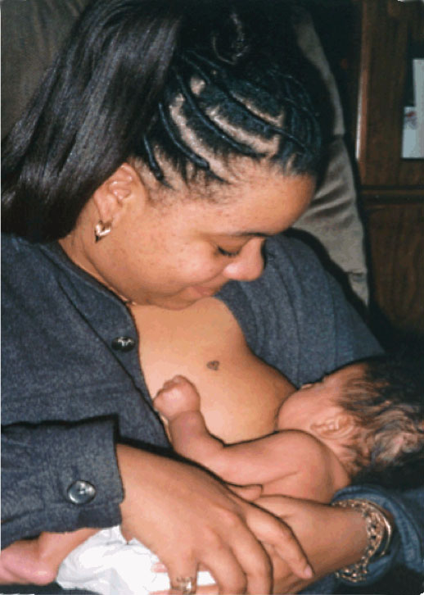
Breastfeeding Positions
Cross Cradle Hold
Cradle Hold
30

Slide 31
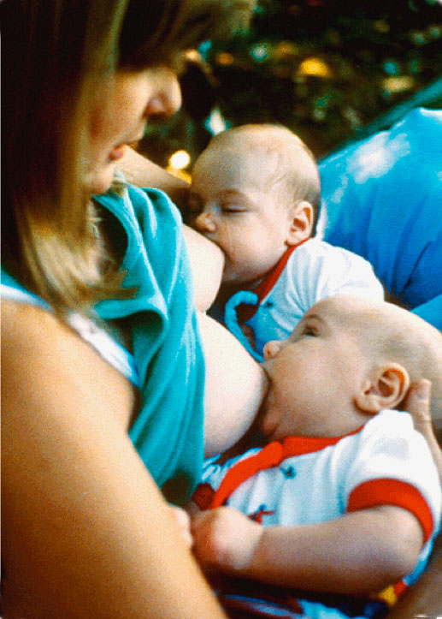
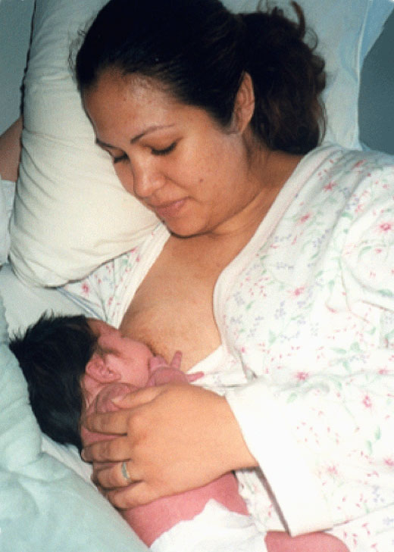
Breastfeeding Positions
Side-lying Position
Clutch or Football Hold
31
Copyright © 2003, Rev 2005 American Academy of Pediatrics. Adapted for this presentation.

Slide 32
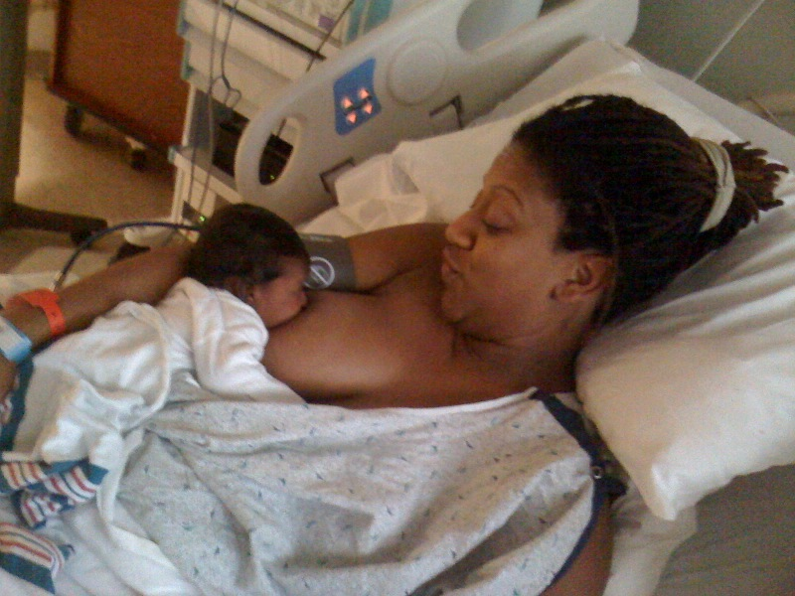
Laid-back Position
Mother leans back
Baby lies prone
Releases baby’s
feeding reflexes
to facilitate breastfeeding
Babies are abdominal feeders
Colson SD, Meek JH, Hawdon JM: Optimal positions for the release of primitive neonatal reflexes stimulating breastfeeding. Early Human Dev 84(7):441-449, 2008
32

Slide 33
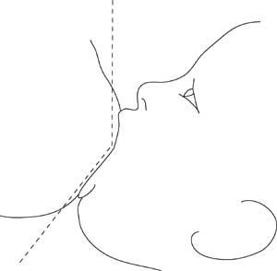
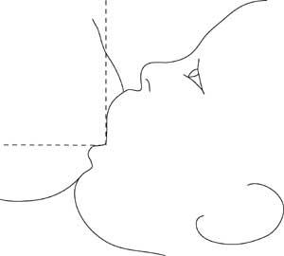
Latch
Shallow
Angle ~90 degrees
Wide
Angle ~130 degrees
©La Leche League International, www.llli.org, illustrations by Paul Torgus.
33

Slide 34

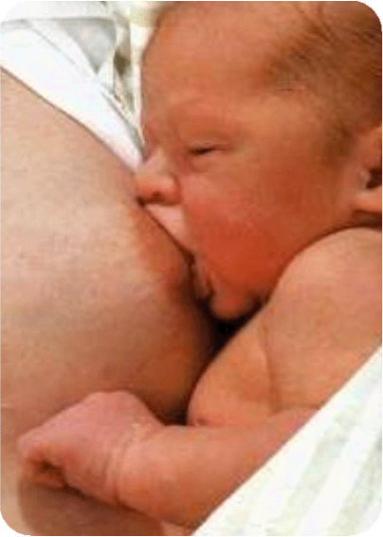
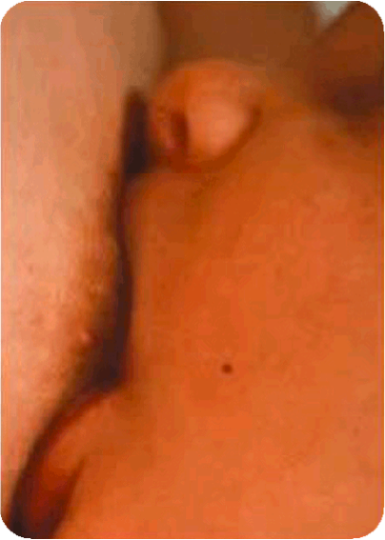
Effective Latch
Mouth filled with breast tissue
Flanged lips – “Fish lips”
Mother feels “tugging” but not pain
Deep jaw movements and full cheeks
Sustained rhythmic sucking with pauses
34

Slide 35
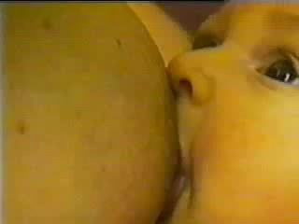
Breastfeeding Observation
click lower left corner to play
2018

Slide 36

Physician Office Support
1. Make a commitment to the importance of breastfeeding.
2. Train all staff in skills necessary to support breastfeeding.
3. Inform women and families about the benefits and management of breastfeeding.
4. Assess infants during early follow-up visits.
5. Encourage mothers to breastfeed on demand.
6. Show mothers how to breastfeed and how to maintain lactation when they will be away from their babies.
7. Use appropriate anticipatory guidance that supports exclusive breastfeeding until infants are about 6 months old.
8. Support breastfeeding by providing accurate information about maternal issues.
9. Communicate support for breastfeeding in the office environment.
10. Expand the network of support for breastfeeding.
Ten Steps to Support Parents’ Choice to Breastfeed Their baby American Academy of Pediatrics, 1999, Rev. 2005

Slide 37
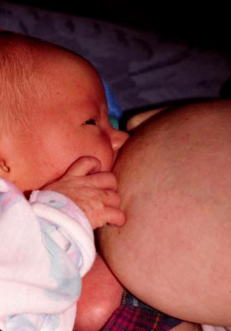
First Outpatient Visit Alerts (24 to 72 hour post discharge)
1. All breastfeeding newborn infants should be seen by a pediatrician
at 2 - 5 d/age (within 24 - 72 h after discharge)
2. Discuss maternal/infant issues
3. Observe and assess feeding
4. Evaluate stool output and color change
5. Evaluate baby’s weight
6. Intervention examples:
Active referral to IBCLC
Pumping after breastfeeding
Breast compressions while feeding
7. Return visit in 24 to 48 hours
AAP Policy Statement: Breastfeeding and the Use of Human Milk 2012

Slide 38

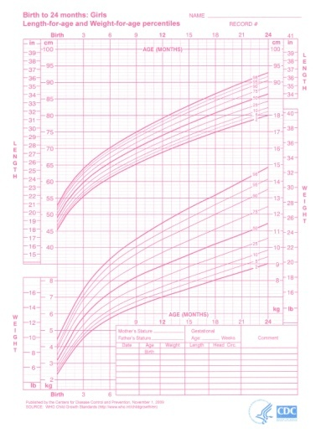
Infant Growth Charts
Normal for exclusively breastfed infant to be:
½ - ¾ lbs heavier than formula fed infant at age 3 months
¾ - 1½ lbs lighter than a formula fed infant by age one year.
2010 the AAP/CDC adopted the WHO growth charts for the first 2 years
www.cdc.gov/growthcharts/data/who/grchrt_boys_24lw_9210.pdf
www.cdc.gov/growthcharts/data/who/grchrt_girls_24lw_9210.pdf
38

Slide 39
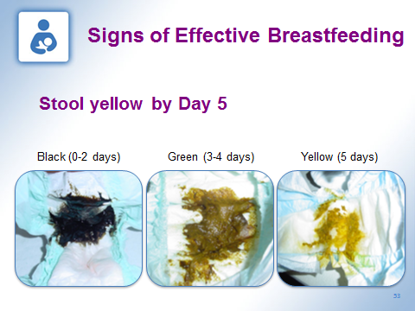
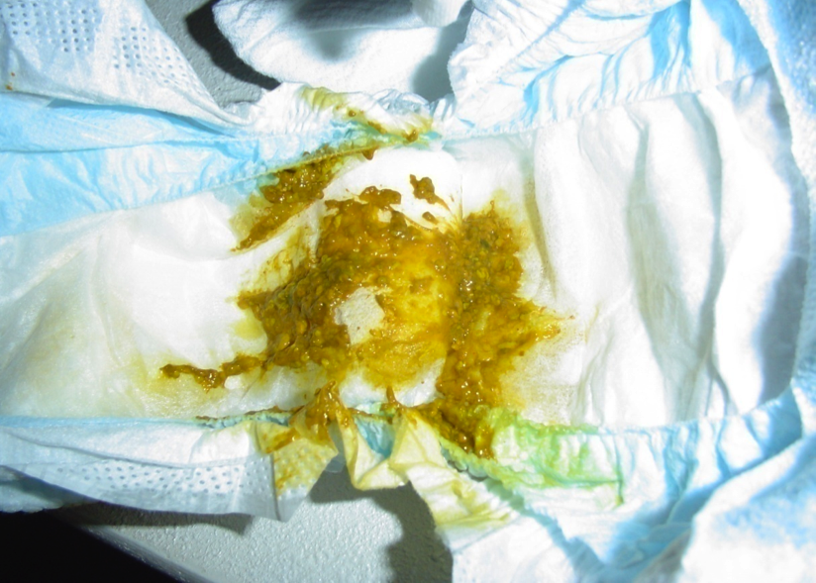
Signs of Effective Breastfeeding
Age-appropriate urine and stool output
1 void and stool per day of age from 1 to 4 days
Breastfed baby stool always liquid
Poop color change as milk volume increases in 1st week
Black (0-2 days) → Green (3-4 days) → Yellow (5 days)
39
39
Notes:
39
39

Slide 40
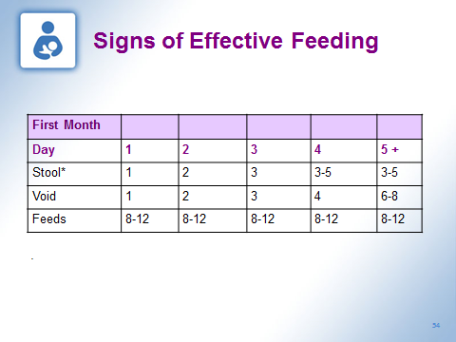
Lawrence Breastfeeding: A Guide for the Medical Profession 8th edition, 2016
P. 278
2018

Slide 41
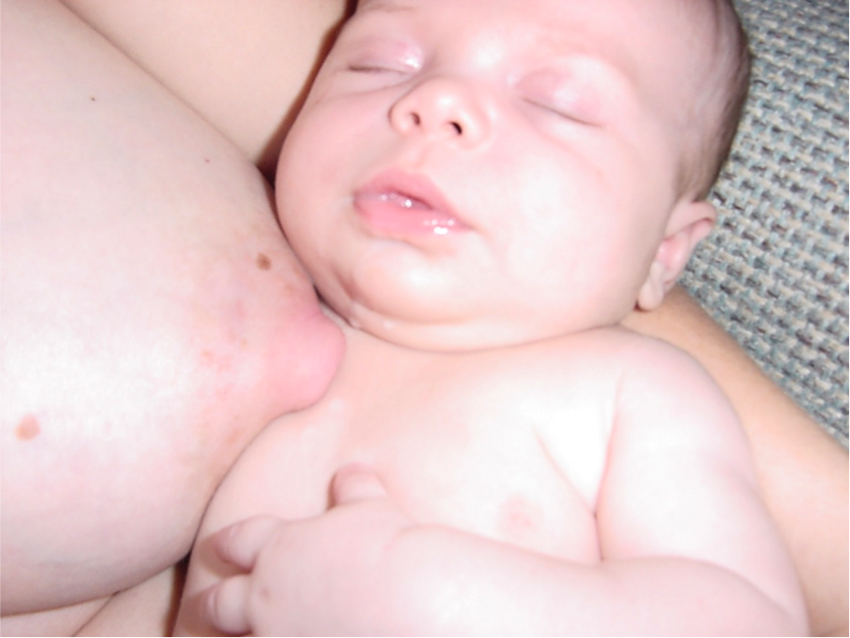
Signs of Effective Breastfeeding
Waking to feed 8-12x/day (average 10 times)
Full and “satisfied” after feedings
41
Notes:
41
41

Slide 42
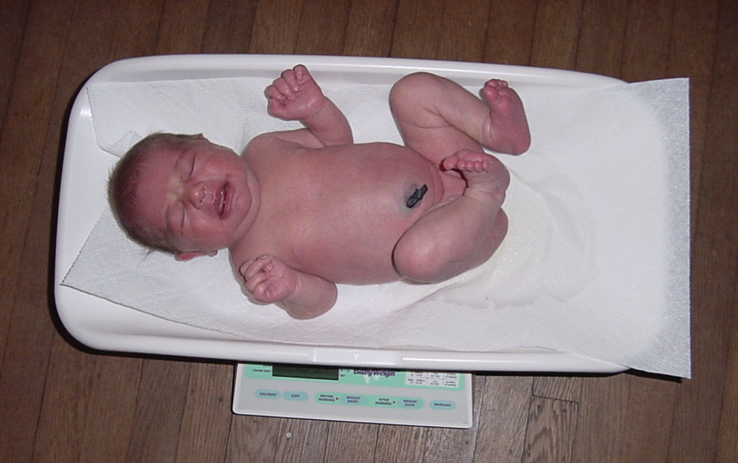
Signs of Effective Breastfeeding
Appropriate weight gain (0-3 months)
After “milk in” 20-30 grams/d (3/4 to 1 oz./d)
Back to birth weight by 10 - 14 days (follow closely and intervene if needed)
42
Notes:
42
42

Slide 43

Newt is the first tool that allows pediatric providers and parents to see how a newborn’s weight during the first days compares with a large sample of newborns, which can help with early identification of weight loss issues.
Developed by Dr. Ian Paul of Penn State Children’s Hospital
https://www.newbornweight.org/

Slide 44
If signs of effective feeding are not present, Immediate Action
Investigate
Wake baby to BF 8-12 times in 24 hours
Use breast compression to get more milk into the baby
Weigh after feeding (after day 3) to be sure baby is effectively feeding
Hand express or pump after BF and give that milk to baby
Supplement appropriate amount for day of life with donor milk or formula, if mother does not get any or enough breast milk
Try and avoid using a pacifier
Refer to expert or IBCLC in the community who can see the family today or tomorrow
Schedule a follow-up appointment in 24 to 48 hours
44

Slide 45
When is Supplementing Recommended?
Infant indications
Asymptomatic hypoglycemia that is unresponsive to appropriate frequent BF
Clinical evidence of significant dehydration
Weight loss of 8-10% accompanied by delayed lactogenesis
Delayed bowel movement or continued meconium on day 5
Insufficient intake despite adequate milk supply (poor transfer)
Breast pathology or prior breast surgery resulting in poor milk supply
Hyperbilirubinemia
Assoc. with starvation when breast milk intake is poor despite appropriate intervention
Bilirubin levels reach >20-25 mg/dL
When macronutrient supplement is indicated
ABM protocol #3: Hospital Guidelines for the Use of Supplemental Feedings in Healthy Neonate, rev 2017

Slide 46
Choice of Supplemental Feeding
Expressed milk is first choice
Pasteurized Human Donor milk
Formula
ABM Protocol #3: Hospital Guidelines for the Use of Supplemental Feedings in Healthy Neonate, rev 2017

Slide 47
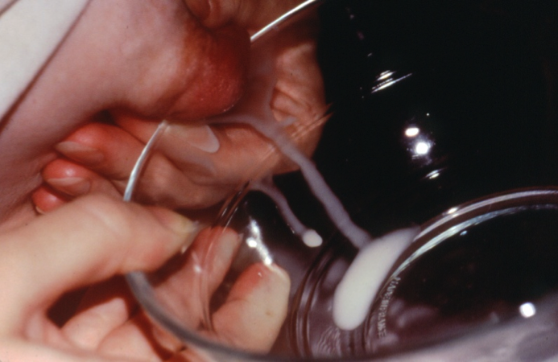
Engorgement
Breast fullness occurs when milk volume increases days 3 to 5
Management
Wake baby to feed if breasts feel overly full
Finish one breast before offering second
Apply cold to breasts for 20 min between feedings or cabbage leaves
Pump or hand express “to comfort” after feedings
Teach hand expression. Video available at
: https://med.stanford.edu/newborns/professional-education/breastfeeding/hand-expressing-milk.html
47
47

Slide 48
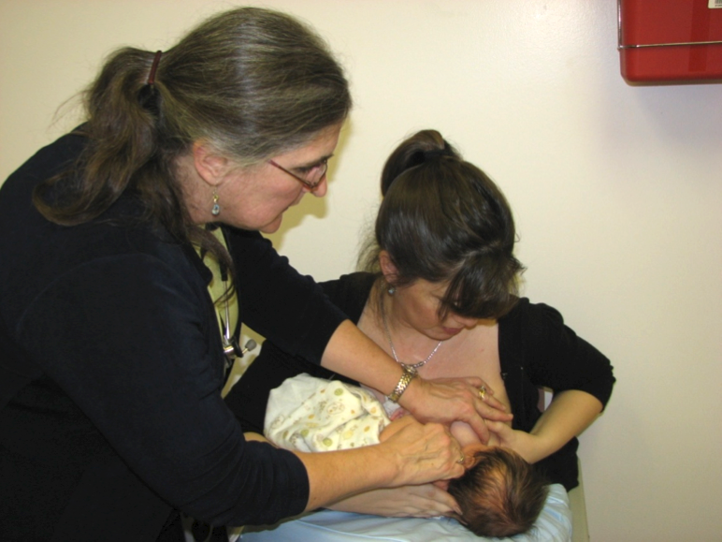
Guidance for Low Milk Supply
Increase frequency and number of breast feedings
Every 1.5 to 2 hours during day; 3 hours at night
Offer both breasts at each feeding
Keep baby on each breast for longer periods of time
Use breast compression to keep the baby actively swallowing
Hand expression
Assess for effective feeding
48

Slide 49
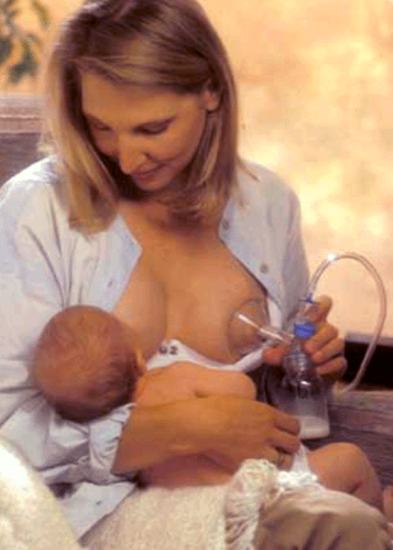
Pumping to Increase Supply
Double pump with multi-user hospital grade pump and feed expressed milk to the baby
Pump 15 minutes q 2 hours in daytime & q 3 hours at night
Once or twice a day pump for 10 min, take a break for 10 min, and continue the pattern for an hour--3x/1 hour
49

Slide 50
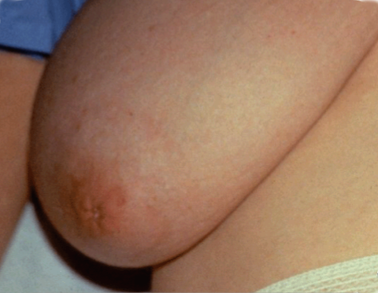
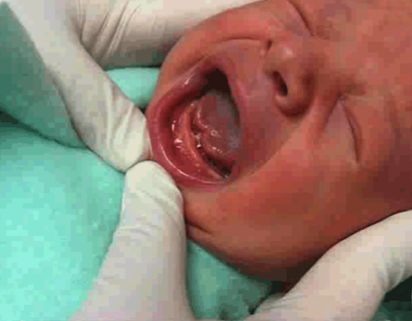
Sore Nipples: Common Causes
#1 reason - Poor latch which causes incorrect suck
Poor positioning at the breast
Flat or inverted nipples
Tongue-tie
Breast infection (bacterial or fungal)

Slide 51
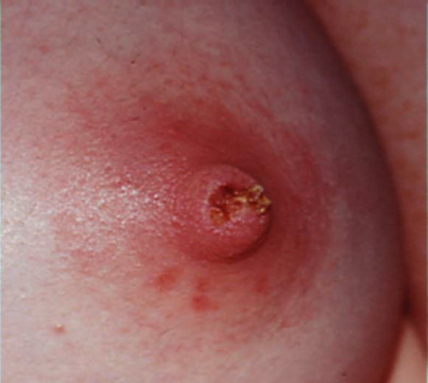
Sore Nipples: Treatment
Determine the cause of pain
Eliminate the problem
Heal the wound
Treat infections
If too painful to nurse
have mother express for few days to allow healing and feed baby expressed milk
or temporarily use a nipple shield to protect from pain
Consider referral for assessment and plan of care
University of North Carolina protocols
https://www.mombaby.org/wp-content/uploads/2016/04/PainProtocols.v3.pdf
51
51

Slide 52
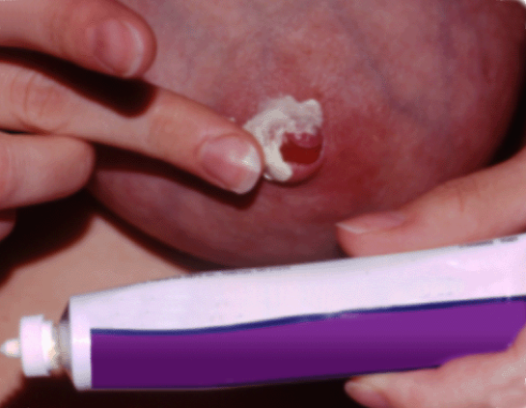
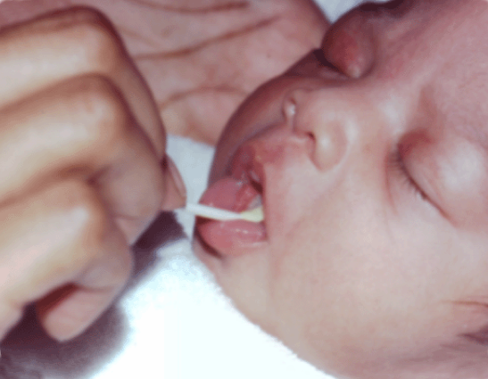
Sore Nipples: Treatment
Tongue-tie – consider frenotomy or refer to a pediatrician or surgeon who performs frenotomies
Bacterial or yeast infection – treat mother with antibiotic or topical antifungal agent & baby with an oral antifungal agent
52
52

Slide 53
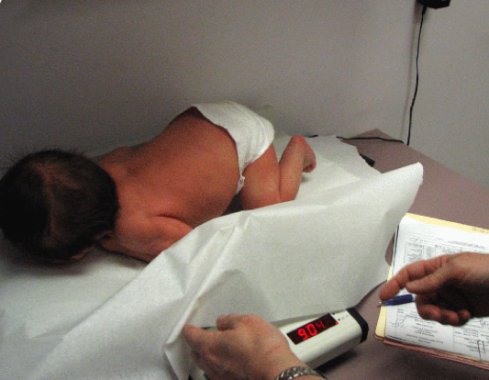
Anticipatory Guidance: 2-Week Visit
Reassess weight and concerns for low milk supply
Reassure her that she and the baby are doing well
Remind her that “cluster feedings” in the evening are normal
Inquire about mother’s medications
Discuss her birth control plans
Encourage non-hormonal methods
Give Encouragement, Support and Praise!

Slide 54
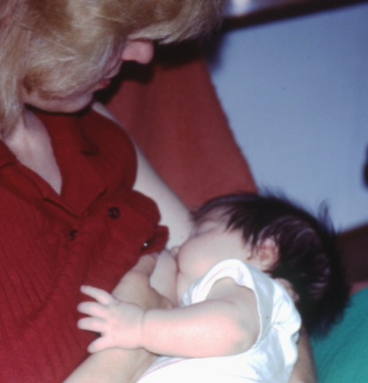
Anticipatory Guidance:
One-Month Visit
Discuss change in stooling
patterns
Less frequent stools
Decreases to every 3 to 7 days at 1 to 3 months for some but not all breastfed babies
Assess back-to-work or school issues
Give Encouragement, Support and Praise!
54

Slide 55
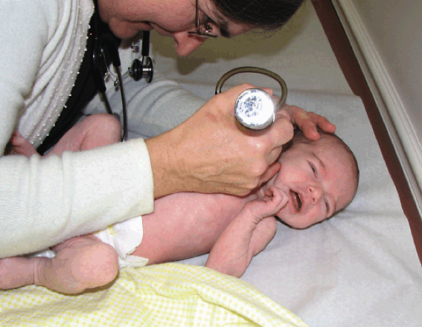
Take every Opportunity to Support BF at Sick Visits
Examples
Praise for feeding through gastroenteritis
– Breastmilk may be beneficial, so don't stop
Viral infections – breastmilk helps decrease severity and duration
Ear infection – fewer in breastfed infants
“Use every patient encounter to promote and support continued breastfeeding.”
55

Slide 56

Returning to Work or School
Address at every office visit
It is possible to continue breastfeeding
It takes preparation and planning
It is challenging
Refer to IBCLC or community group for support
56

Slide 57
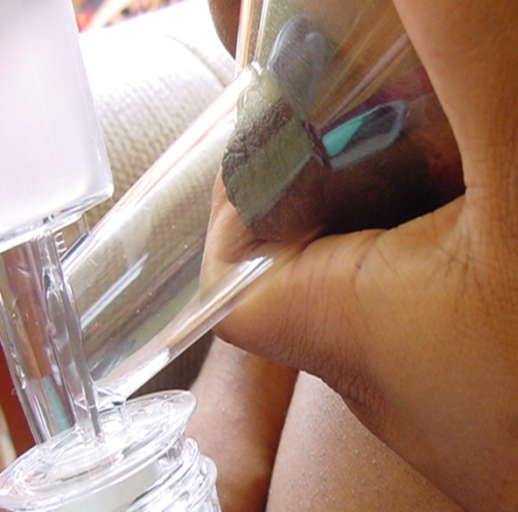
Returning to Work or School Exclusive Mother’s Milk Option
Hints for Success:
Before returning to work
Start storing milk 2 weeks before return date
Express and store at least 1x/day
Pump after early AM breastfeeding (to take advantage of larger volume of milk early in morning)
BF and pump as if at work few days before return date
57
57

Slide 58

Returning to Work or School
Option 1 Exclusive mother’s milk is preferred:
Optimal health benefits for mother and baby
Breastfeed while home, express milk at work
Option 2 Combination option is 2nd best:
Partial health benefits
Breastfeed while home, formula at work
Option 3 Weaning:
Should NOT be encouraged by providers
Providers Influence the Choice!
58

Slide 59
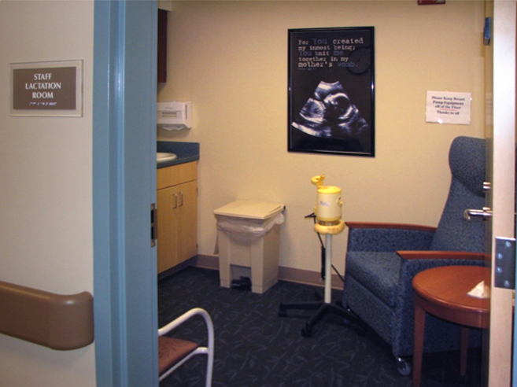
Affordable Care Act
and Breastfeeding
Provide reasonable break time for one year after birth
Provide a private place, other than a restroom
Insurance Providers to cover lactation counseling and breast pumps
https://www.healthcare.gov/what-are-my-breastfeeding-benefits/
59

Slide 60

International Board Certified Lactation Consultants (IBCLCs) in hospitals and physician offices
Provides “best practice” support for patients
Saves time and money
Improves patient satisfaction and family-friendly image of office
Increases exclusive breastfeeding and duration
Improves public health outcomes
60
60

Slide 61


Other Breastfeeding Support Providers
Work in health care and public health settings
Breastfeeding Educators
Nurses
Childbirth Educators
WIC staff
Doulas
Provide education and basic breastfeeding counseling and assistance
Volunteer groups like La Leche League

Slide 62
State Resources
PA Department of Health Breastfeeding Awareness and Support Program: www.health.state.pa.us/breastfeeding
PA Healthy Baby Line: 1-800-986-BABY
PA WIC: https://www.pawic.com/MothersMilkForTheFirstYear.aspx
Pennsylvania Breastfeeding Coalition: http://www.pabreastfeeding.org/
Pennsylvania Department of Health patient website for quitting smoking: PA Free Quitline
Free help to quit smoking: 1-800-QUIT-NOW
62
62

Slide 63
Academy of Breastfeeding Medicine
“Worldwide organization of physicians dedicated to the promotion, protection and support of breastfeeding and human lactation”
Protocols: http://www.bfmed.org/Resources/Protocols.aspx
Video: https://vimeo.com/141929848

Slide 64
National Resources
American Academy of Pediatrics :
https://www.aap.org/en-us/advocacy-and-policy/aap-health-initiatives/Breastfeeding/Pages/default.aspx
Academy of Breastfeeding Medicine: http://www.bfmed.org
American Academy of Family Physicians : http://www.aafp.org
American College of Nurse Midwives: http://midwife.org/
American Congress of Obstetricians and Gynecologists: http://www.acog.org/
Business Case for breastfeeding
https://www.womenshealth.gov/breastfeeding/breastfeeding-home-work-and-public/breastfeeding-and-going-back-work/business-case
64
64
64

Slide 65
National Resources continued
International Lactation Consultant Association (ILCA) www.ilca.org
La Leche League: www.lalecheleague.org/
Office on Women’s Health: www.womenshealth.gov/breastfeeding and help line 1-800-994-9662
Surgeon General’s Call to Action to Support Breastfeeding
http://www.surgeongeneral.gov/library/calls/breastfeeding/index.html
US Breastfeeding Committee: www.usbreastfeeding.org/
UNC Lactation Program: http://www.mombaby.org/index.php?c=2&s=30&p=623

Slide 66
Copyright
EPIC® Educating Practices in Their Communities
BEST: Breastfeeding Education, Support & Training
Copyright ©2018 by the Commonwealth of Pennsylvania, Pennsylvania Department of Health
Contact Dottie Schell at dschell@paaap.org for permission to utilize the EPIC®BEST Materials

