Slide 1


Staging and Prevention in Type 1 Diabetes
B. Katherine Vu-Boast, MD
UPMC Children’s Hospital of Pittsburgh
2024 Annual Pediatric Conference, PA Chapter, AAP

Slide 2
I have no disclosures.

Slide 3
Learning Objectives
Recognize stages in the development of type 1 diabetes
Review currently available therapies to delay onset of type 1 diabetes, as well as those under investigation
Discuss early screening resources available to patients and general practitioners

Slide 4
Outline
T1D: we’ve come a long way
Natural history & staging of T1D
Intervention trials
Successes & future directions

Slide 5
Outline
T1D: we’ve come a long way
Natural history & staging of T1D
Intervention trials
Successes & future directions

Slide 6
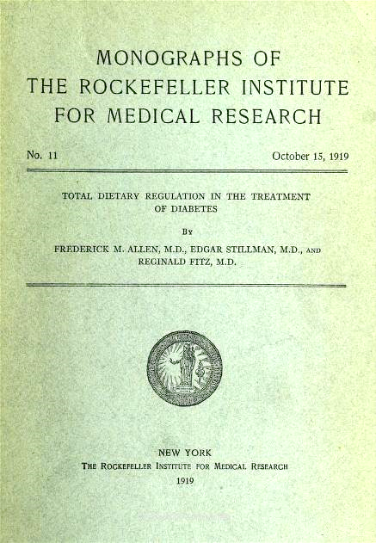

1910s: The Starvation Diet
Drastic reduction of caloric intake, esp. carbohydrates (sometimes as little as 8% of caloric intake)
Prolonged life by a few years, at best
Frederick Allen, MD
All images from University of Toronto Libraries. https://insulin.library.utoronto.ca/

Slide 7


Elizabeth Hughes
Elsie Needham
Diagnosed at age 12
Endured caloric intakes as low as 300 kcal/day
45 lb, ‘could barely walk on her own’
Presented to Toronto at age 14 and started on insulin Aug 1922
Lived to reach her 70s
At age 11, very ill, pronounced “hopeless”
Sent to Hospital for Sick Children in Toronto in Oct 1922, unconscious for several days
“The first child to recover from [diabetic] coma by the use of insulin”
Lived to at least age 35
All images from University of Toronto Libraries. https://insulin.library.utoronto.ca/

Slide 8

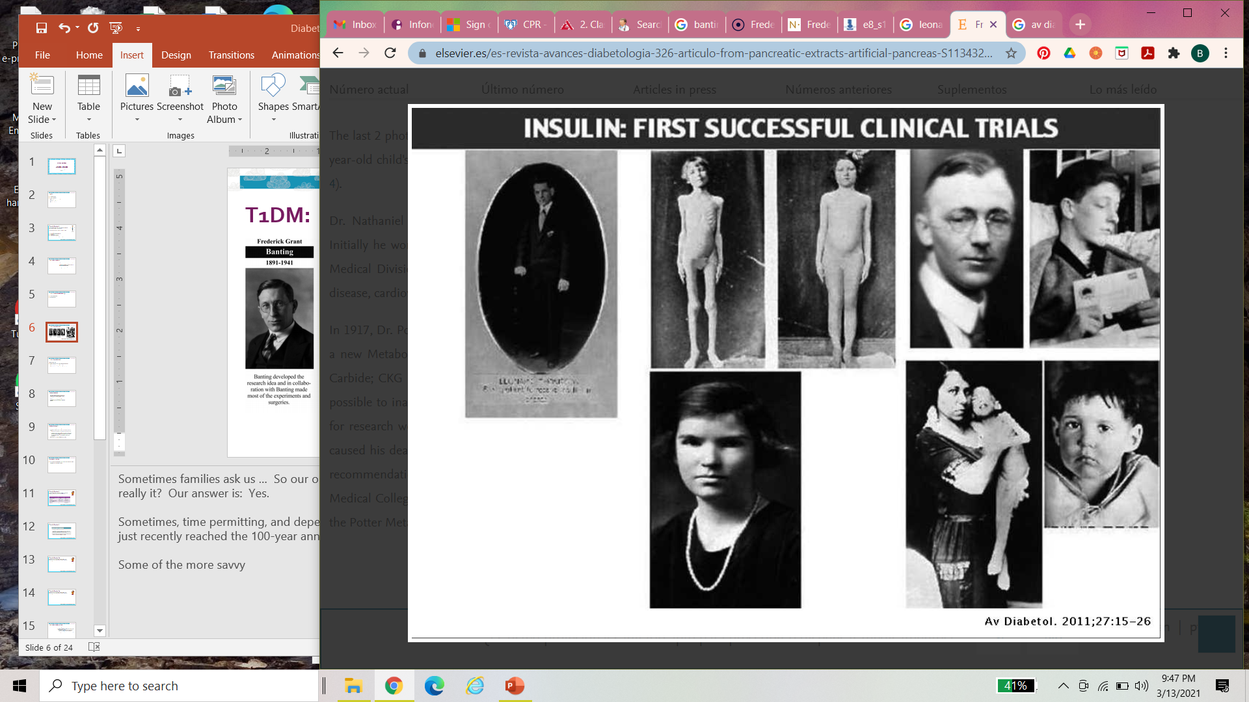
1920s: Insulin, the miracle drug
Image credits: (left & center) de Leiva-Hildalgo et al (2011) Av Diabetol 27(1):15-26.
(right) Sciencehistory.org

Slide 9
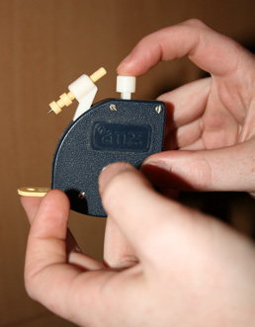
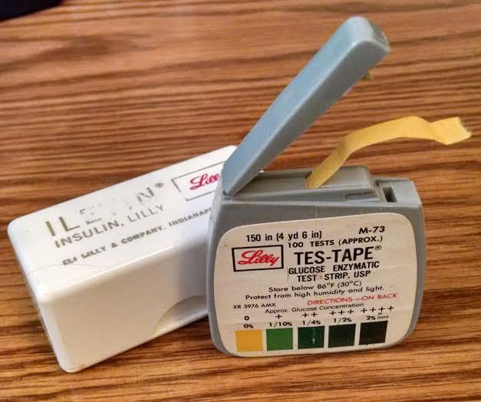
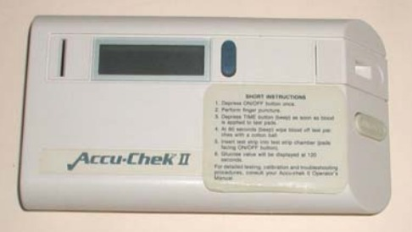
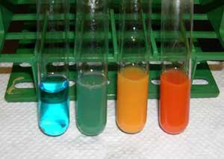

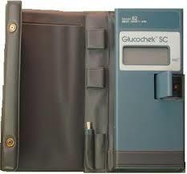

1940-80s: We’ve come a long way, baby!
9
Images posted in a thread about historic T1DM devices in a public forum:
https://forum.tudiabetes.org/t/some-old-ways-of-testing/47552

Slide 10
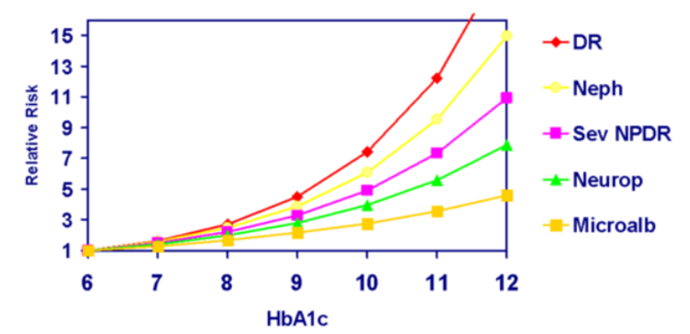
1990s: The DCCT – a prospective, randomized, multicenter clinical trial
Tight glycemic control reduces morbidity and mortality.
Intensive insulin therapy (vs conventional therapy)
  Results in lower HbA1c levels
  Reduces development of microvascular complications
DCCT, NEJM 1993, 329(14)

Slide 11
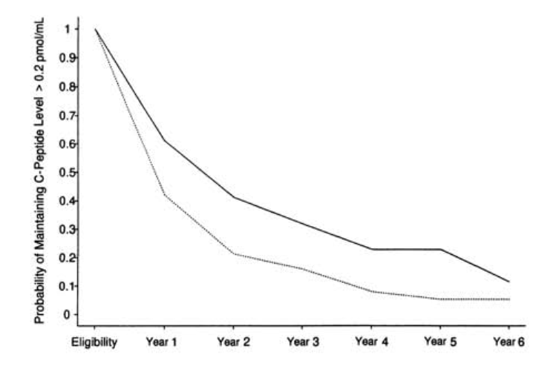
1990s: The DCCT – a prospective, randomized, multicenter clinical trial
Intensive insulin therapy
Conventional therapy
Intensive insulin therapy (vs conventional therapy)
  Increased likelihood of maintaining c-peptide secretion over 5-year follow-up
Persistence of C-peptide (beta cell function) meant better outcomes.
DCCT, NEJM 1993, 329(14)

Slide 12
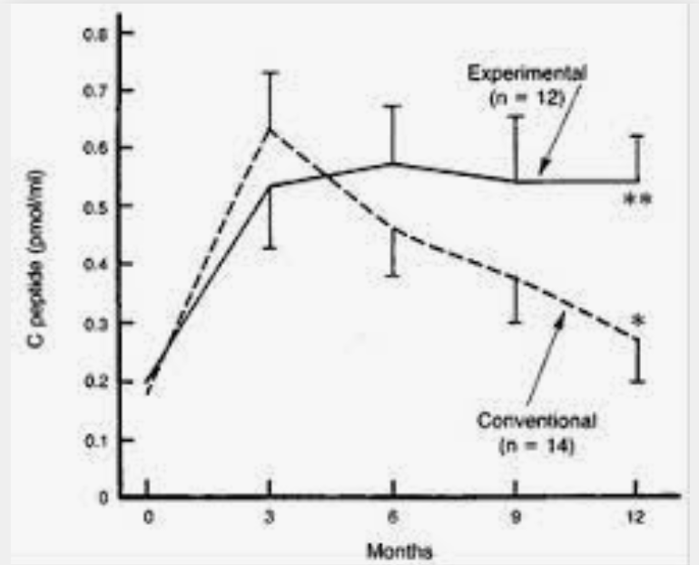
Another RCT of intensive insulin therapy in new-onset IDDM
Intensive insulin therapy (vs conventional therapy) for 2 wks after diagnosis:
  Suppressed endogenous insulin secretion initially
  Higher stimulated C-peptide levels at 1 year
  Lower HbA1c levels at 1 year
Since the 1990s, efforts have been aimed at finding ways to lower HbA1c and preserve c-peptide in order to reduce acute and chronic complications.
Shah S, Malone J, Simpson N, NEJM 1989

Slide 13
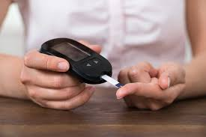
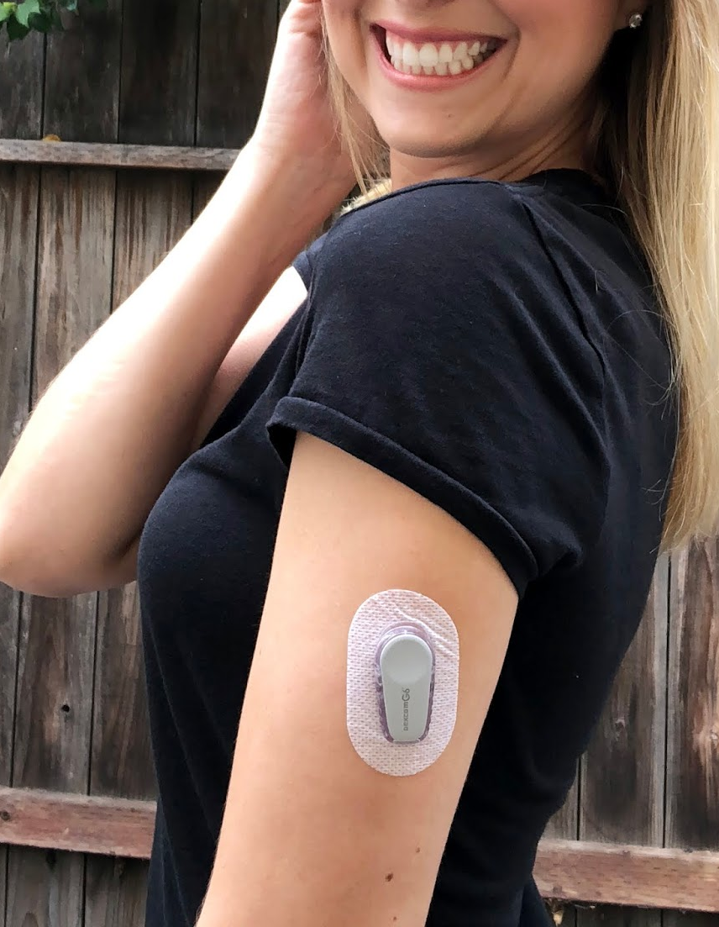
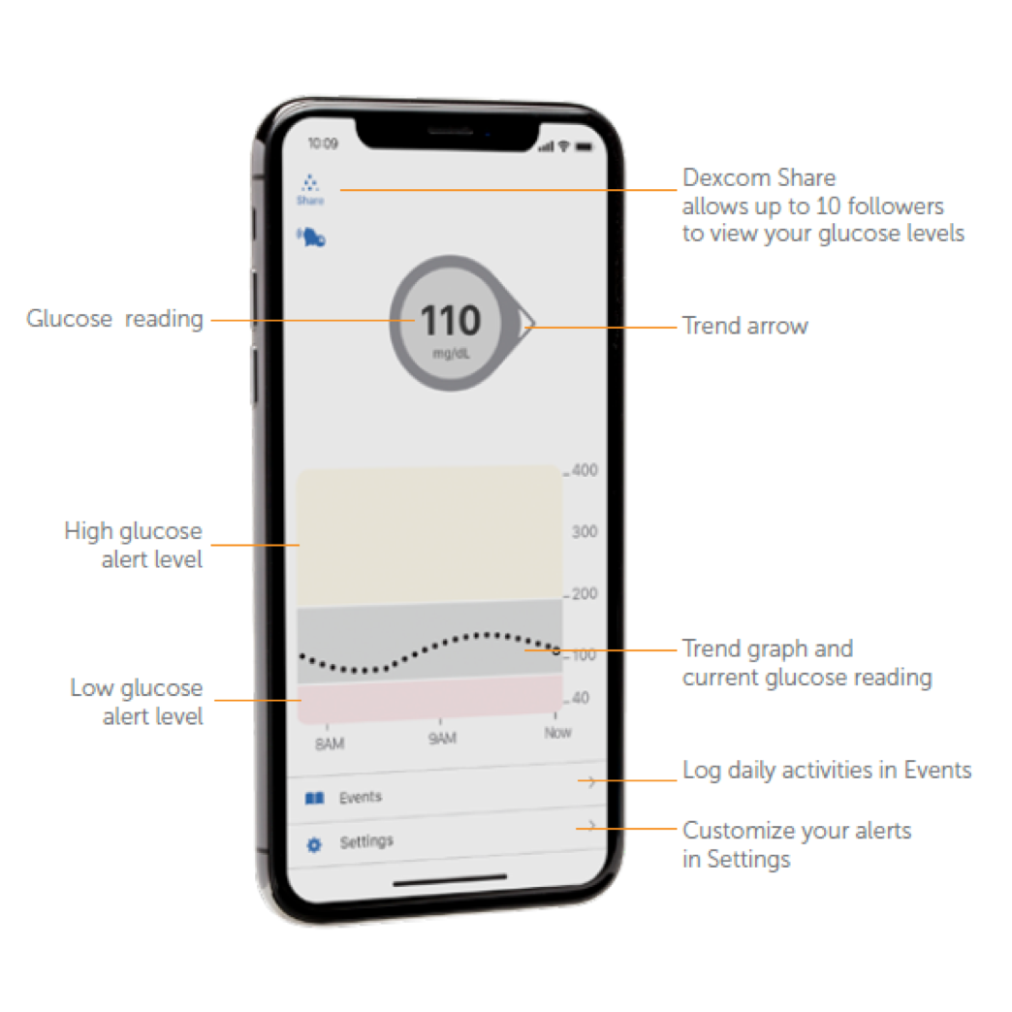
Glucose monitoring nowadays
Home glucometers
Handheld, portable, quick, digital
Continuous glucose monitors
Replaced every 10-14 days
Readings taken every 1-5 minutes
See trends
Set alerts
Share data with caregivers by transmitting to several devices
Share detailed reports with HCPs
Image credits: (top) diabetes.co.uk
(bottom left) typelovely.blogsport.com,
(bottom right) dexcom.com

Slide 14
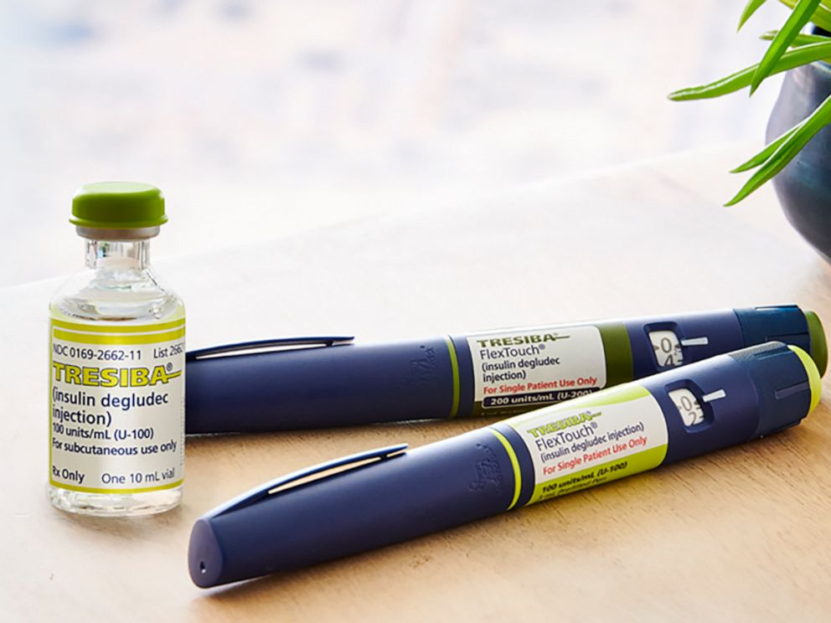

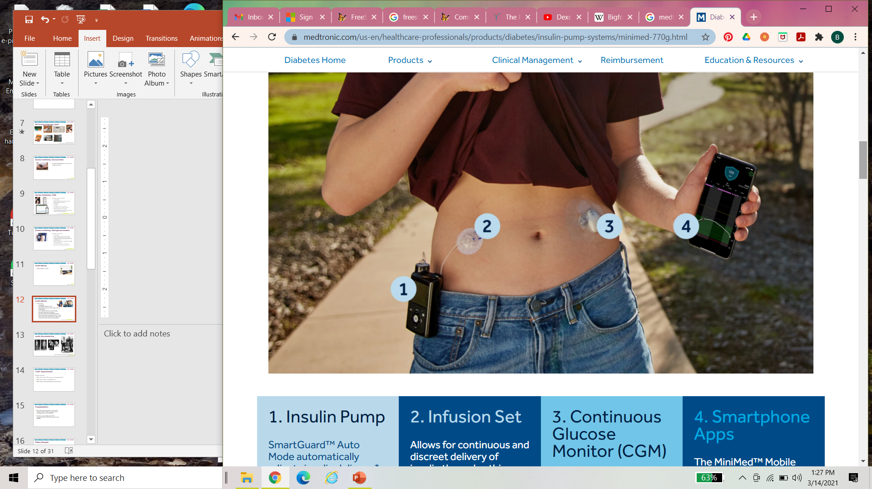
Insulin delivery nowadays
Disposable syringes
No more boiling your hypodermics!
Insulin pens
Easier administration, more precise doses
‘Smart’ pens: decision support, tracking
Insulin pumps
Replace infusion site every 2-3 days (no more multiple daily injections!)
Programmable, adjustable
Greater precision in insulin administration
Greater flexibility in schedule
Hybrid closed-loop systems now common
Image credits: (top) abcnews.com, (middle) thedaletribe.com, (bottom) medtronic.com

Slide 15
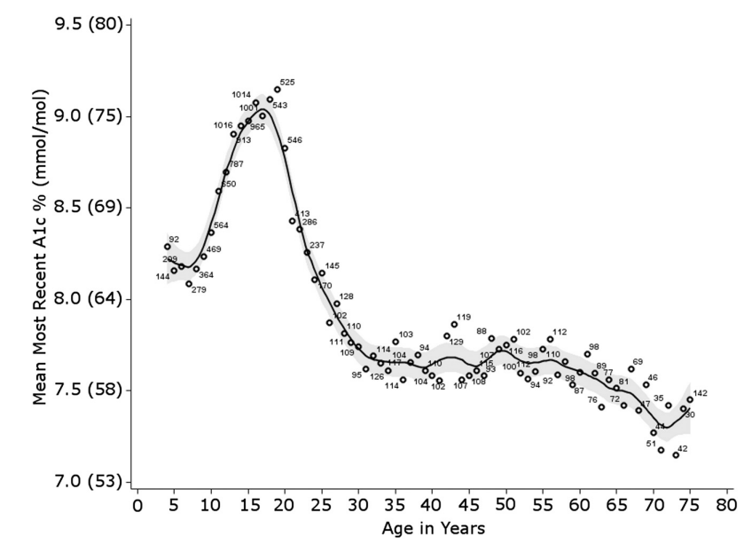
Rationale for pursuing other avenues
Maintaining near-normal glycemic control is critical to prevent complications. We have not been successful at doing this up until the late 2010’s.
2015 T1D Exchange data

Slide 16
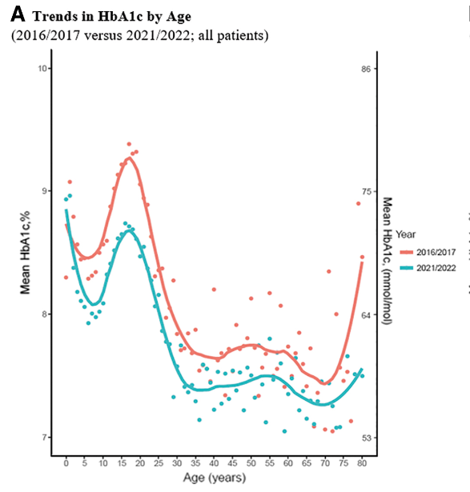
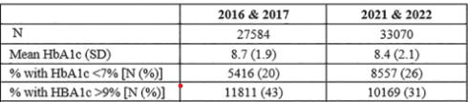
Rationale for pursuing other avenues
Maintaining near-normal glycemic control is critical to prevent complications. We have not been successful at doing this up until the late 2010’s early 2020’s.
T1D Exchange data
Ebkozien 2023 Diab Techn & Ther

Slide 17
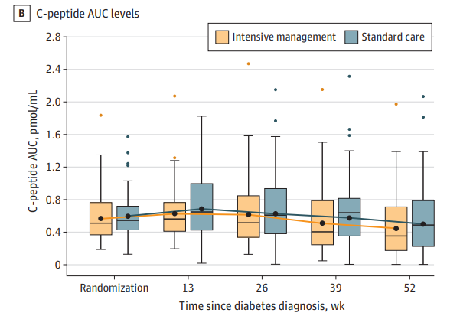
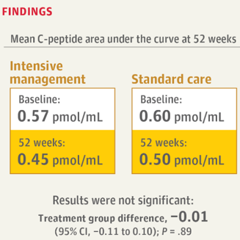
Rationale for pursuing other avenues
Even when we are able to achieve tight glycemic control via intensive management, we do not seem to be able to preserve c-peptide secretion using currently available technology.
Mcvean J et al.. JAMA 2023

Slide 18
But in this era of intensive management, we still haven’t solved …
Access
  Payor approval and reimbursement, out-of-pocket costs to families, provider bias
Uptake of available technologies
  Fear of technology
  Concerns about pain, inconvenience, visibility, and stigmatization
  Barriers for children living in institutions or foster care
Poor adherence to glucose monitoring, insulin administration, diet, and exercise
  Especially among adolescents
Mental health / Quality of life
  Stress/Distress (emotional, financial, school- or work-related)
  Family dysfunction, effect on relationships
  Depressive symptoms, depression, anxiety, eating disorders

Slide 19
Outline
T1D: we’ve come a long way … but not enough!
Natural history & staging of T1D
Intervention trials
Successes & future directions

Slide 20
The classic laboratory determination of diabetes ‘stages’
 | Normal | Prediabetes | Diabetes*
Fasting plasma glucose | <100 mg/dl | 100 to <125 mg/dl | 125 mg/dl and higher
Plasma glucose 2 hr after standard glucose load | <140 mg/dl | 140 to <200 mg/dl | 200 mg/dl and higher
Random plasma glucose |  |  | 200 mg/dl and higher
HbA1c | <5.7% | 5.7 to <6.5% | 6.5% and higher
*Diagnosis requires two positive tests, or one positive test in the presence of symptoms of hyperglycemia
ADA Standards of Care in Diabetes 2024

Slide 21
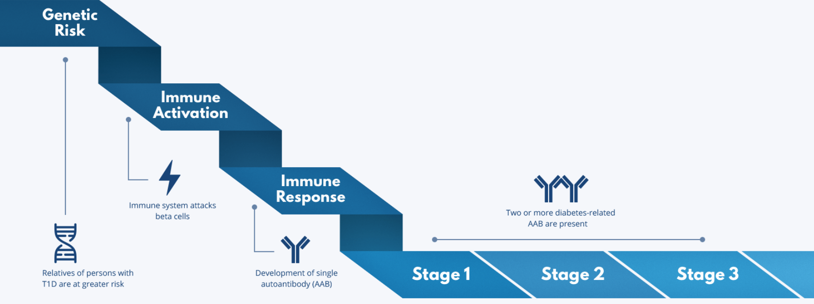
T1D Staging
Stage 1: Two or more diabetes-related AAB present
Stage 2: Dysglycemia
Stage 3: Onset of clinical diabetes
44% 75% N/A
Insel R et al. Diabetes Care 2015
Trialnet.org

Slide 22
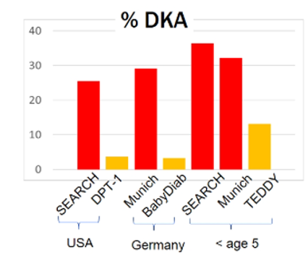
Why is this conceptual model of T1D development important?
Understanding mechanisms of disease
T1D can be identified at an earlier time point
  Less DKA at onset
  Reduced rates of hospitalization
Opens to door to treatment to delay or prevent progression to severe loss of insulin secretion
Framework for directing at-risk individuals toward clinical trials to prevent symptomatic T1D
Borrowed from talk by Libman I 2025

Slide 23
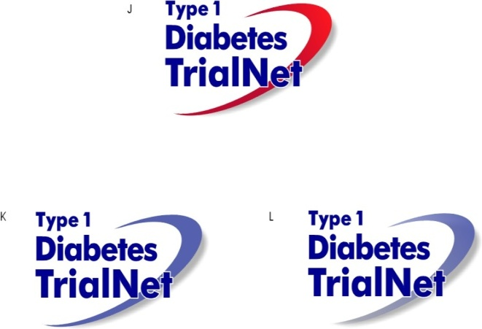
TRIALNET
International research consortium of
  17 Clinical Centers and >200 Affiliate Sites, a Data Coordinating Center, a Clinical Network Hub, Core Laboratories, and a Collaborative Mechanistic Studies Panel
Mission to prevent T1D and stop/delay disease progression by preserving insulin production before and after diagnosis.
  Pathway to Prevention (natural history study) – screening and monitoring
  Intervention trials prior to diagnosis
  Intervention trials in individuals with new-onset T1D
  Mechanistic studies

Slide 24
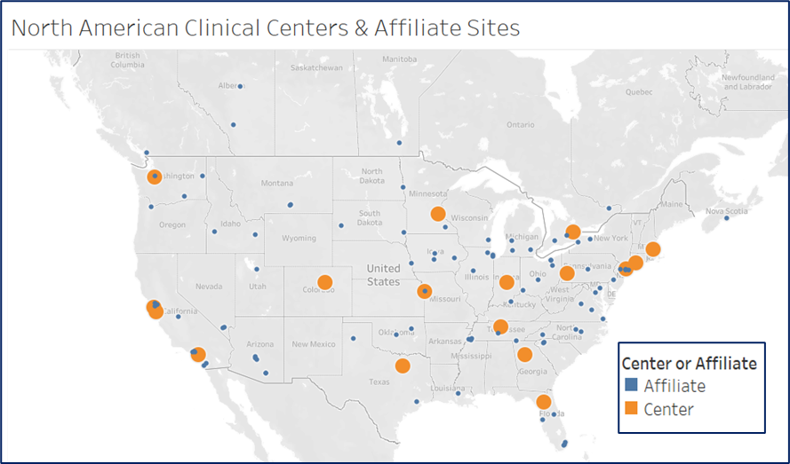

Slide 25
T1D Staging
44% 75% N/A
Insel R et al. Diabetes Care 2015
Trialnet.org

Slide 26
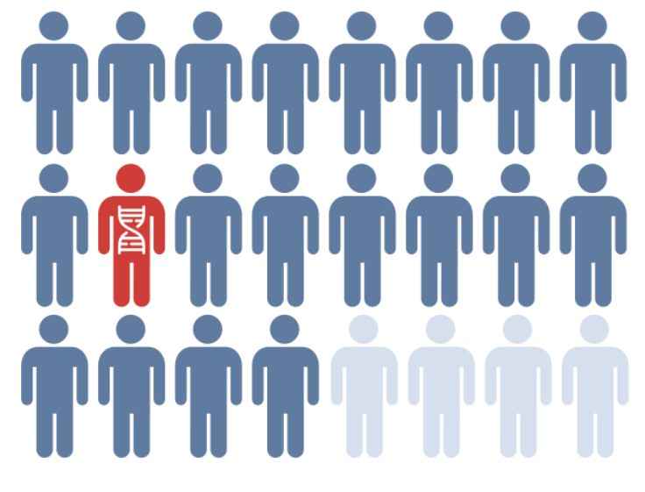
Risk for people in the general population: ~1 in 300
Risk for those with family member with T1D: 1 in 20 (15x greater)
 | Risk
If mom has T1D | 1:50
If dad has T1D | 1:15
If sibling has T1D | 1:20
If identical twin has T1D | 1:3
Insel R et al. Diabetes Care 2015
Trialnet.org

Slide 27
T1D Staging
44% 75% N/A
Insel R et al. Diabetes Care 2015
Trialnet.org

Slide 28



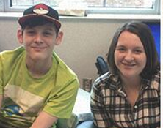
TrialNet: “Pathway to Prevention” Study
Screening to evaluate risk for T1D
  1st & 2nd degree relatives
  NEW: non-relatives who had a positive screening test outside of TrialNet
Measures autoantibodies
Based on results:
  Monitoring for progression
  Participate in clinical studies with aim to preserve beta cell function
Images credit: TrialNet, used with permission

Slide 29
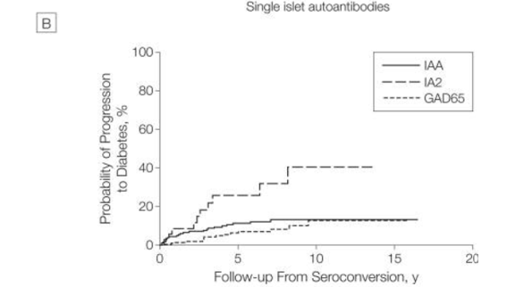
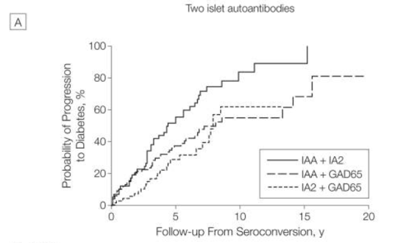
Progression to Stage 3 T1D in children from time of seroconversion according to antibody type
Ziegler et al. Jama 2013

Slide 30
T1D Staging
44% 75% N/A
Insel R et al. Diabetes Care 2015
Trialnet.org

Slide 31
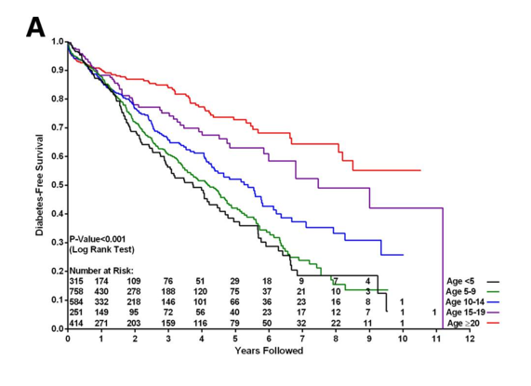
Progression to Stage 3 T1D from Stage 1: impact of age
Ziegler et al. Jama 2013

Slide 32
Outline
T1D: we’ve come a long way … but not enough!
Natural history & staging of T1D
Intervention trials
Successes & future directions

Slide 33
Pathway to Prevention
LIFT
Mechanistic Studies
JAK inhibition
Rituximab and Abatacept
Oral Insulin
Teplizumab
Plasmid Immunotherapy
ATG/GCSF
Immune Effects of Oral Insulin
ATG
Tocilizumab*
Abatacept
Alefacept*
Canakinumab
Hydroxychloroquine
Metabolic control**
GAD-alum
Abatacept
IL-2/Rapamycin*
Thymoglobulin*
Ritixumab
Teplizumab*
MMF/DZB
Insel R et al. Diabetes Care 2015
Trialnet.org

Slide 34

Hydroxychloroquine, well-known antimalarial
Has biologic activity
Long history of safe use in rheumatologic diseases
Aim to modify the disease state
Appears to act on the autoimmune response
Clark P et al, Annals of Medicine 1993
Solomon et al, JAMA 2011
Solomon et al, Arthritis Care Res 2014
Image credit: HealthCentral

Slide 35
TrialNet: A 45-center study randomized 273 subjects with Stage 1 T1D to receive either hydroxychloroquine or placebo.
Followed for a median of 23.3 months
Drug safety/tolerability was good, including in children
Terminated due to futility
Hydroxychloroquine in Stage 1 T1D did not delay disease progression.
Did reduce glucose MAUC at 6 months, but not c-peptide
Did alter autoantibody acquisition, reducing the # and titer of GADA and IAA
Libman et al. Diabetes Care 2023

Slide 36
Pathway to Prevention
LIFT
Mechanistic Studies
JAK inhibition
Rituximab and Abatacept
Oral Insulin
Teplizumab
Plasmid Immunotherapy
ATG/GCSF
Immune Effects of Oral Insulin
ATG
Tocilizumab*
Abatacept
Alefacept*
Canakinumab
Hydroxychloroquine
Metabolic control**
GAD-alum
Abatacept
IL-2/Rapamycin*
Thymoglobulin*
Ritixumab
Teplizumab*
MMF/DZB
Insel R et al. Diabetes Care 2015
Trialnet.org

Slide 37
Teplizumab, an anti-CD3 monoclonal antibody
Teplizumab
Delivers partial agonistic signal at the T cell receptor
T-cell receptor
Increase in regulatory T-cell function
Induction of exhausted CD8+ T cells
T-cell membrane
CD3
Inhibits the immune attack on β cells
Partial agonistic signal
inhibits immune attack

Slide 38
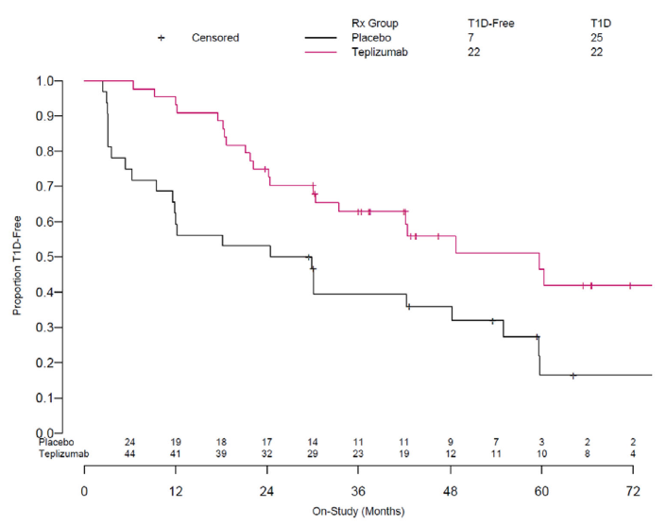
The pivotal TN-10 study: Among relatives with Stage 2 T1D, a single course of teplizumab (vs placebo) delayed time to diagnosis of T1D.
N=76, ages 8-49, 72% <18 years of age, 97% white
At 6-year follow-up, T1D had been diagnosed in
  Placebo arm: 25/32 (78%)
  Teplizumab arm: 22/44 (50%)
Median time to T1D diagnosis:
  Placebo arm: 27.1 months
  Teplizumab arm: 59.6 months
Hazard ratio (compares the rate of an event occurring in two groups over time):
  Overall: 0.457 (p=0.01)
  In the first year: 0.13 [95% CI, 0.05 to 0.34]
Median delay of 32 months !!!
Herold et al, 2019, NEJM 381(7)
Sims et al, 2021, Sci Transl Med 13(583)

Slide 39
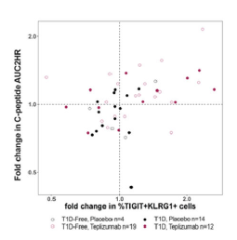
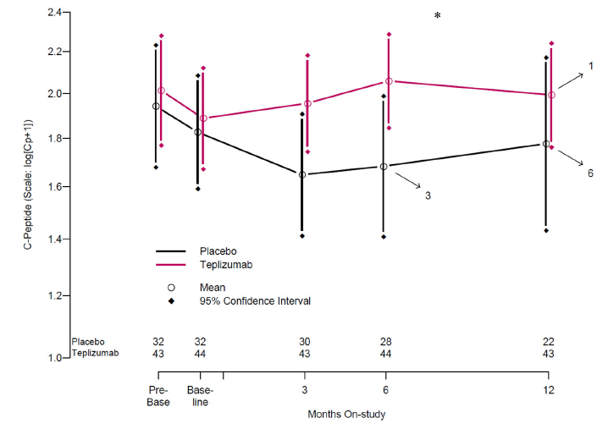
Mean C-peptide AUC was higher in the teplizumab group compared to their baseline AND compared to the placebo group
Functional changes in T cell subsets are associated with improvements in C-peptide AUC (beta cell function).
Sims et al, 2021, Sci Transl Med 13(583)

Slide 40
Teplizumab adverse reactions
Non-Serious | Serious
Rash (48%) | Lymphopenia (80%)
Leukopenia | Serum sickness (0.1%)
Headache | Cytokine release syndrome
Neutropenia (40%) | Hypersensitivity reactions including anaphylaxis (0.1%), edema (1.9%), urticaria (1.9%)
Increased ALT (25%) | Reactivation of EBV and CMV infections (5.1%, 0.5%)
Nausea
Diarrhea
Nasopharyngitis
Anemia (27%)
Thrombocytopenia (13%)
Hyperglycemia
Keam, 2023, Drugs 83:439-445
Herold, 2023, Diabetes Care 46(1):148-56

Slide 41
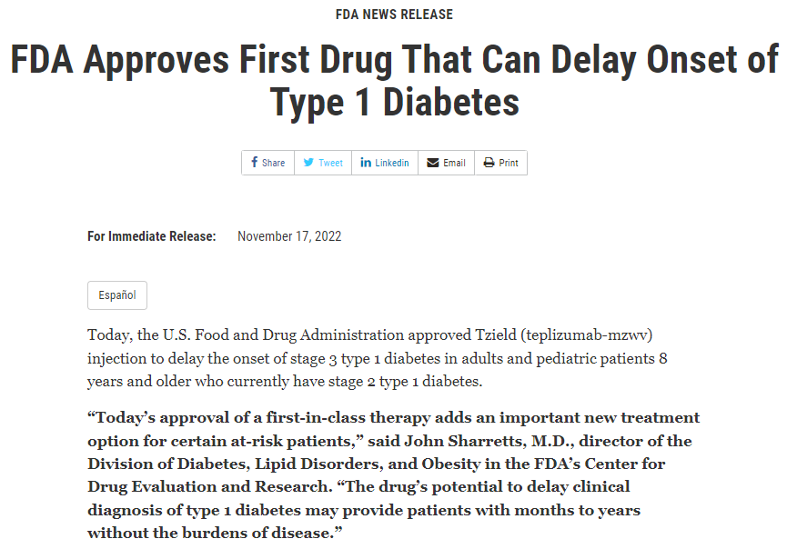
Teplizumab
Approved Nov 2022 by the US FDA to delay the onset of Stage 3 T1D in patients aged ≥8 years with Stage 2 (preclinical) disease¹

Slide 42
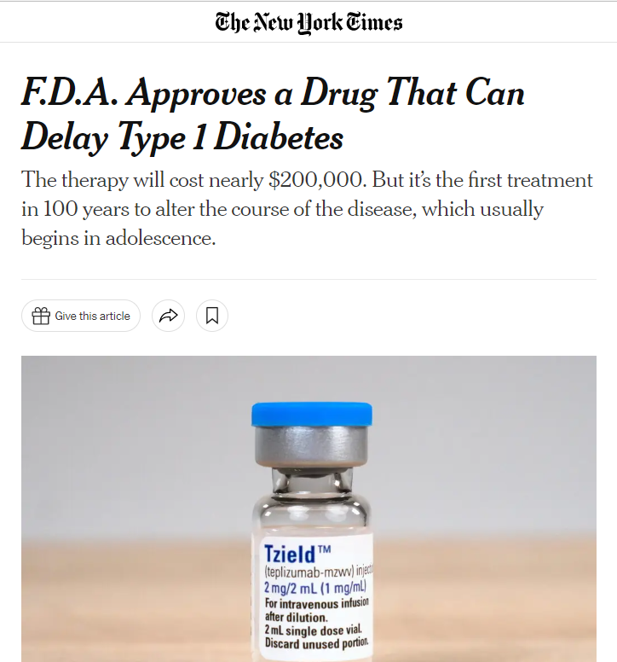
Teplizumab
Rationale for delaying onset of Stage 3:
Reducing morbidity & mortality associated with the clinical disease
Improving quality of life

Slide 43
It’s approved. Now what?
Approved for patients age 8+ with documented diagnosis of Stage 2 T1D
(2+ autoantibodies + dysglycemia using an OGTT or alternative method if appropriate and OGTT is not available)
  .
Keam, 2023, Drugs 83:439-445

Slide 44
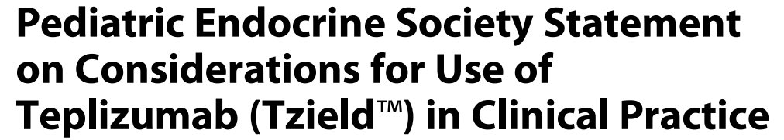
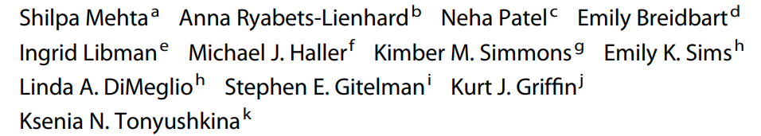
Horm Res Paediatr 2024

Slide 45
Teplizumab: the importance of a thoughtful approach
IV infusion, daily for 14 consecutive days
  BSA-based dose is ‘stepped up’ over the first 5 days
  Premedication for at least the first 5 days with NSAID or acetaminophen, an antihistamine and/or an antiemetic
Cautionary notes:
  Abnormal CBC, AST, ALT, bilirubin
  Acute EBV or CMV infection or other active serious or chronic active infections
  Pregnancy & lactation
Logistics:
  Avoid interruption midcourse
  PIV versus central line
  Inpatient vs an infusion center open daily including weekends, with appropriate nurse, pharmacy, laboratory, and on-call physician staffing
  Need for monitoring and treatment of serious adverse reactions: Cytokine release syndrome, serious infections, lymphopenia, acute hypersensitivity reactions
  Infection precautions due to expected lymphopenia
  Monitoring of labs (CBC, AST, ALT, bilirubin) throughout treatment
Keam, 2023, Drugs 83:439-445

Slide 46
Pathway to Prevention
LIFT
Mechanistic Studies
JAK inhibition
Rituximab and Abatacept
Oral Insulin
Teplizumab
Plasmid Immunotherapy
ATG/GCSF
Immune Effects of Oral Insulin
ATG
Tocilizumab*
Abatacept
Alefacept*
Canakinumab
Hydroxychloroquine
Metabolic control**
GAD-alum
Abatacept
IL-2/Rapamycin*
Thymoglobulin*
Ritixumab
Teplizumab*
MMF/DZB
Insel R et al. Diabetes Care 2015
Trialnet.org

Slide 47
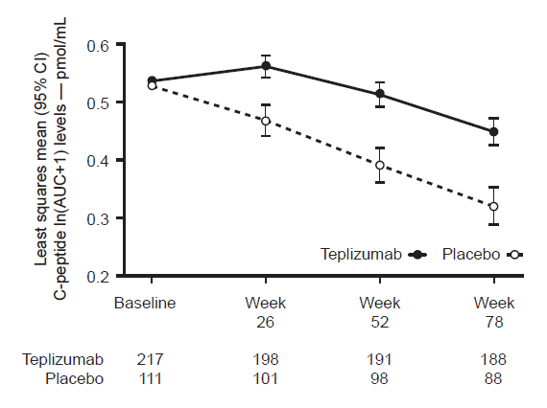
TrialNet’s PROTECT Study – Can teplizumab given in newly diagnosed Stage 3 T1D preserve beta-cell function?
Preserved stimulated c-peptide responses at Week 78 (vs placebo)
Clinically meaningful c-peptide levels ≥0.2 pmol/ml were maintained in 95% of treatment arm (vs 79% in placebo arm)
No differences in A1c (treat-to-target approach) but trend towards less insulin use in teplizumab group

Slide 48



JAK inhibitors – groundbreaking oral therapy
Janus kinase (JAK) inhibitors are used in eczema & several autoimmune conditions
BANDIT study: Daily oral baricitinib over 48 weeks preserved c-peptide responses (funded by JDRF, Weibel et al JCEM 2023)
Currently enrolling: ages 12-35 with Stage 3 T1D diagnosed within the last 3 months
Randomly assigned to abrocitinib, ritlecitinib, or placebo (daily pills for 1 yr)
2 year follow up with MMTT

Slide 49
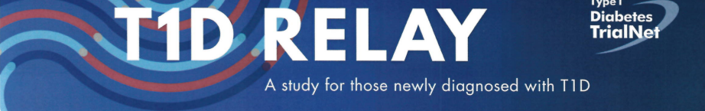
TrialNet: What about combo therapies?
Rituximab – mAb, reduces B cells
Abatacept – biologic that modifies T cell responses
Both are FDA approved treatments in autoimmune conditions like arthritis
Prior studies suggest that each alone may help preserve beta cell function.
Objective: Will their combined use have better results than Rituximab alone?
Currently enrolling: Ages 8-45, diagnosed with Stage 3 T1D within the last 3 months
4 weekly IV infusions of Rituximab, followed by 20 months of weekly SQ injections of either Abatacept or placebo
2 year follow-up, including MMTT and CGM monitoring

Slide 50
Outline
T1D: we’ve come a long way … but not enough!
Natural history & staging of T1D
Intervention trials
Successes & future directions

Slide 51
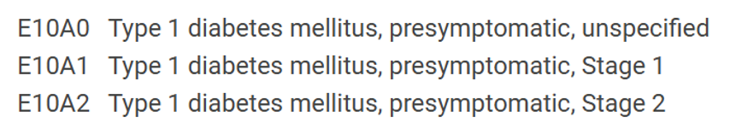
ICD-10 Codes approved in October 2024

Slide 52
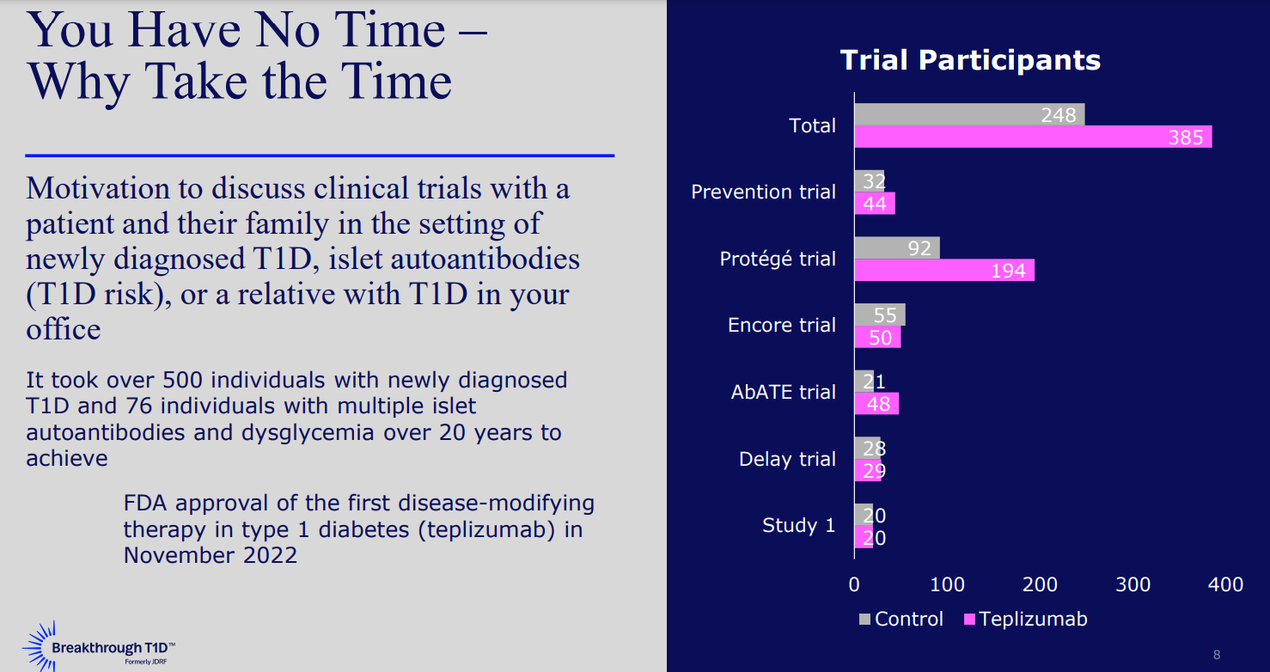

Slide 53

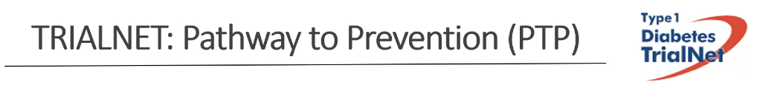
Please contact Kelli Delallo
412-692-5210 kelli.delallo@chp.edu
Confirmatory testing using standardized assays & protocols
Counseling
Education
Monitoring for disease progression
Clinical follow-up or appropriate referrals
Access to prevention and treatment studies

Slide 54


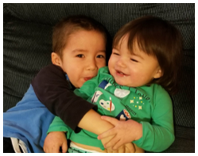



Thank you

