Slide 1
Vaccine Preventable Illnesses and
Vaccine Hesitancy
Glenn J. Rapsinski MD, PhD
Assistant Professor of Pediatric Infectious Disease
05/08/2025

Slide 2
COI Disclosure
I have no conflicts of interest that would influence the information that I am presenting today.

Slide 3
Learning Objectives
Recognize presentation of vaccine preventable illnesses.
  The two most contagious
Review treatments and how to prevent spread of these illnesses.
Discuss evidence based best practices for addressing vaccine hesitancy.

Slide 4
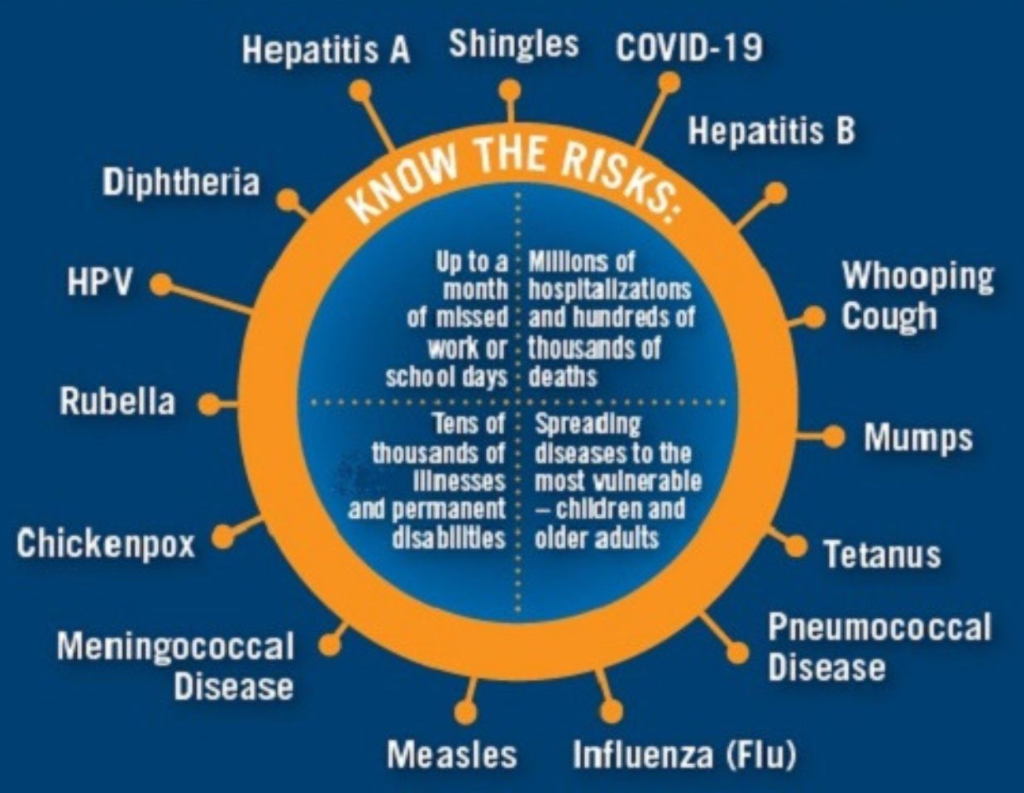
Why is this important?
Vaccine preventable illnesses are easy to forget because we don’t see them often.
Outbreaks have been happening
  2024: Pertussis Nationwide
  2025: Measles starting in Texas
    663 cases, 3 deaths
    Already more cases of measles in US 2025 compared to 2024.

Slide 5
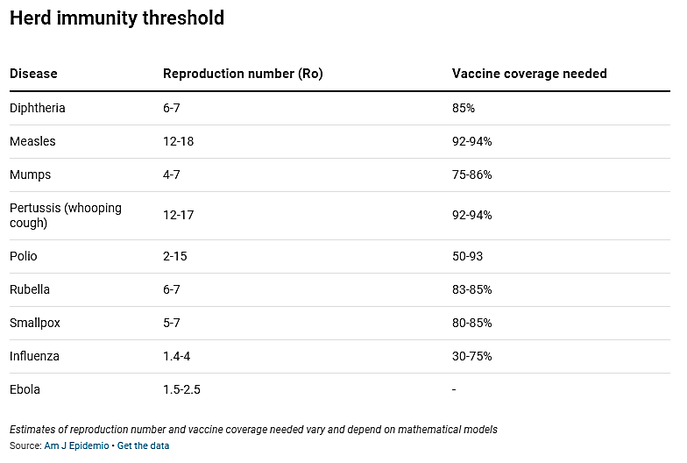
Presentation and Treatment
Let’s review the most contagious.
  Highest vaccine coverage needed.

Slide 6
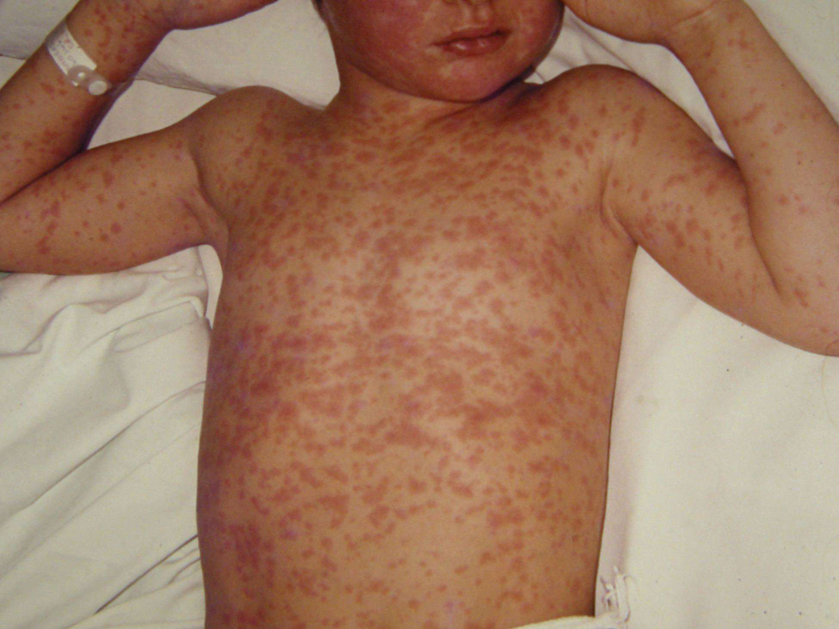
Measles
When to think of it:
  Susceptible host with epidemiologic link.
    Travel to area with endemic transmission or outbreak
    Known contact
  Fever and the three C’s
    Cough, coryza, and conjunctivitis
  Koplik spots
    Red spots on oral mucosal surfaces with blue-white centers
  Rash spreading from head down and centrally out

Slide 7
Complications of Measles
Complications:
  Ear infection, pneumonia, diarrhea
  Seizures 6-8/1000
  Encephalitis 1/1000
  Death 1-2/1000

Slide 8
Who are immune hosts?
Those without immunity:
  Vaccinated (for children this means 2 doses)
  Lab evidence of immunity (positive titers)
  Lab evidence of history of disease
  Born before 1957
Anyone else could be considered susceptible
https://www.cdc.gov/measles/hcp/vaccine-considerations/index.html

Slide 9
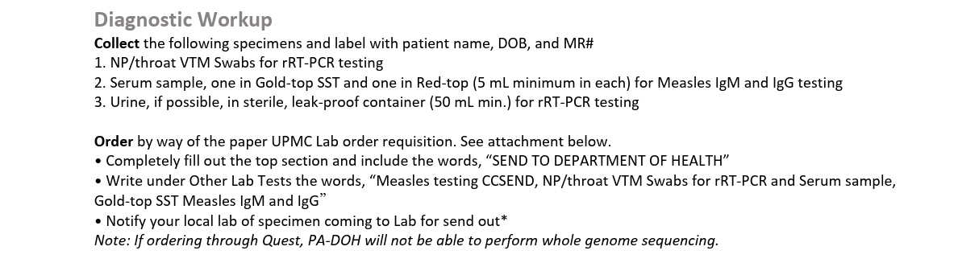
Work Up (on Infonet)

Slide 10

Treatment
Vitamin A is only recommended treatment
  On day of diagnosis and the next day
  Age based dosing
Should be given with doctor’s instructions.

Slide 11
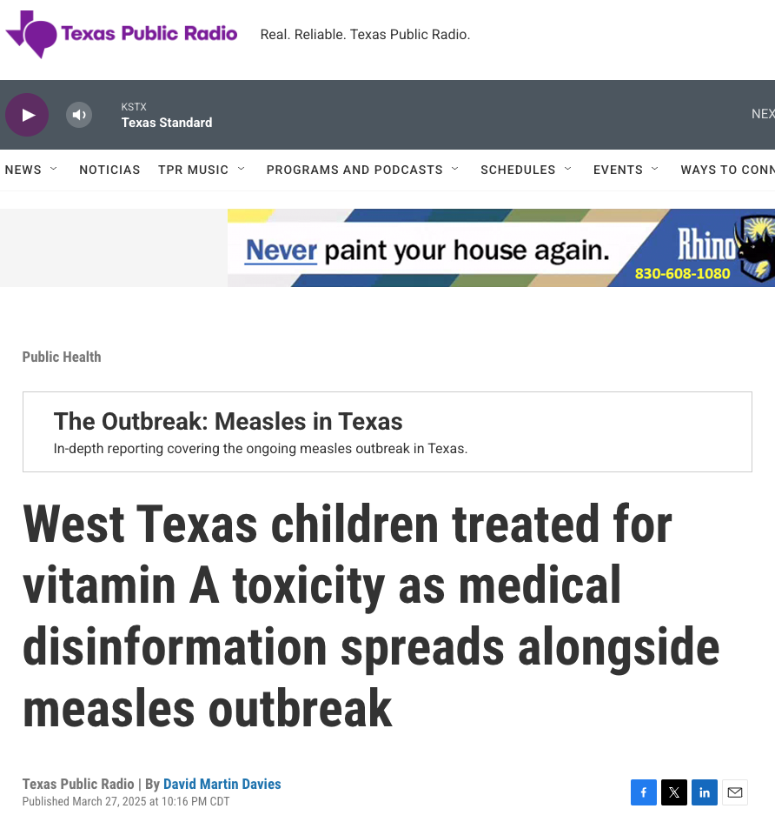
A word of caution…
Vitamin A is fat soluble vitamin.
  Can cause toxicity.
Families shouldn’t be giving their kids a bunch of vitamin A supplement.

Slide 12
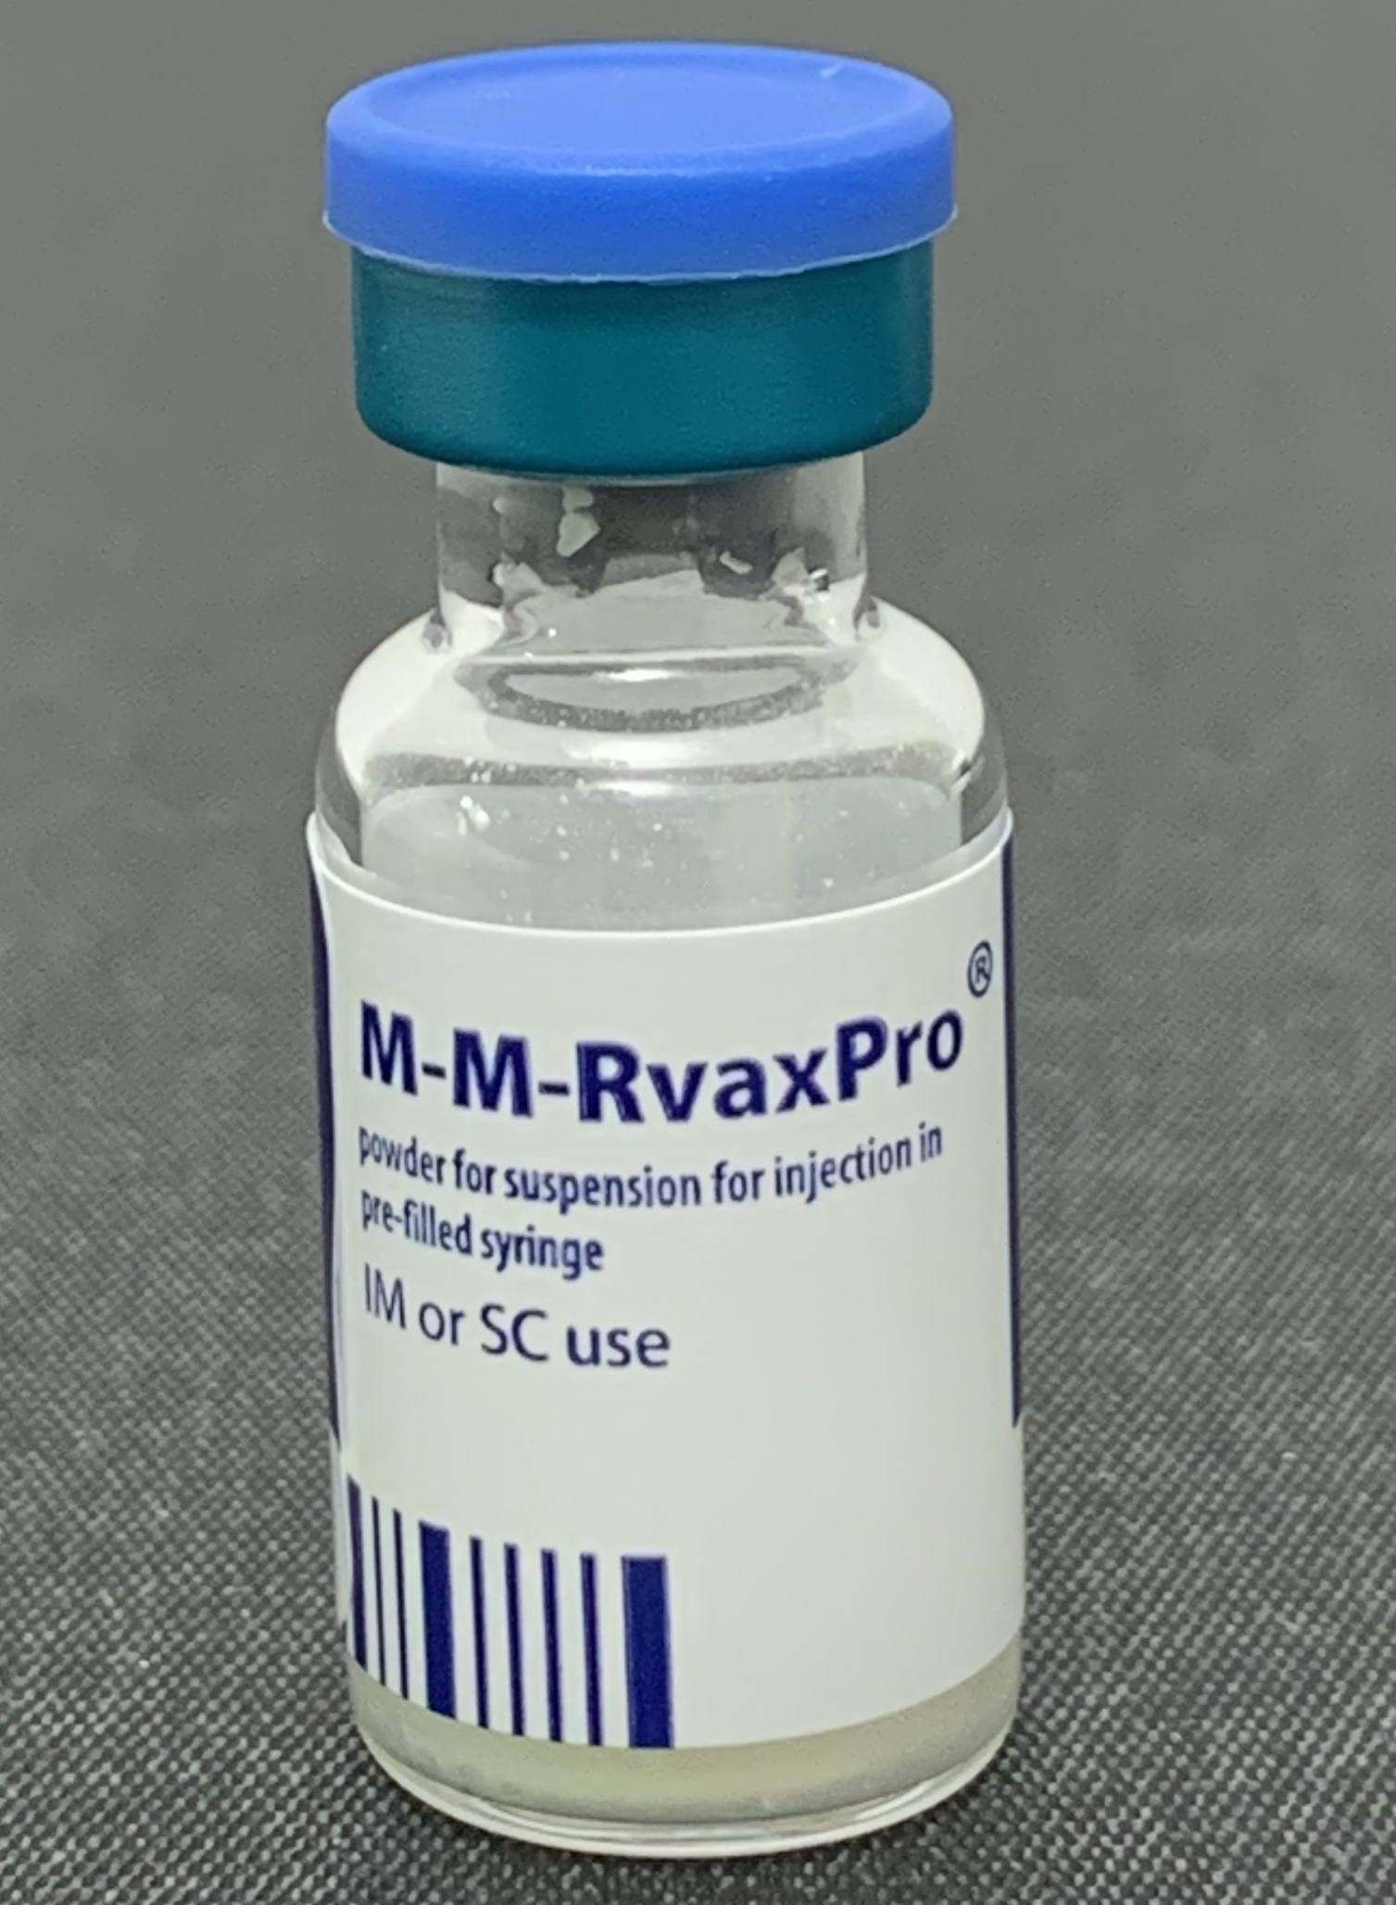
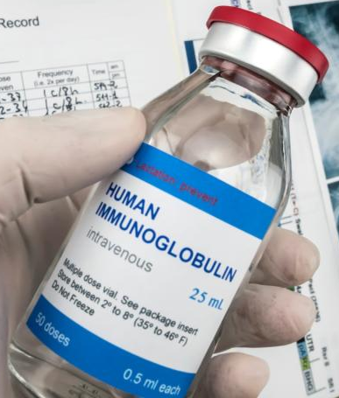
Prevention
Vaccination!!
  Two doses at least 28 days apart starting at 1 year of age.
  Can give a dose 6-11 months of age for travel to endemic areas, but doesn’t count for final immunity.
Post-exposure prophylaxis
  Vaccinate if within 72 hours of exposure
  IMIG if within 6 days of exposure.

Slide 13
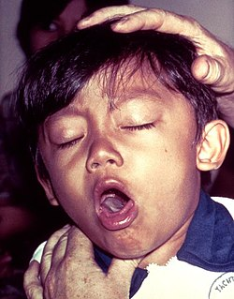
Pertussis (whooping cough)
Mild upper respiratory symptoms (catarrhal stage)
  Cough and congestion
Paroxysms of cough (paroxysmal stage)
  Inspiratory whoop (gasp)
  Post-tussive emesis
Symptoms wane over weeks to months (convalescent stage.

Slide 14
Pertussis
Incubation period is 7-10 days.
Nucleic acid amplification test (NAAT) of nasopharyngeal swab used to diagnose.
  May be negative if more than two weeks after cough starts.

Slide 15
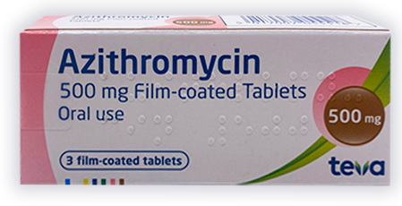
Treatment
Azithromycin is the treatment.
Once paroxysmal stage starts, no effect for that patient
  Should still treat
  Helps stop spread

Slide 16
Prevention
Vaccine!
Unvaccinated close contacts should get vaccinated as soon as possible.
Antibiotic prophylaxis
  Asymptomatic household contacts within 21 days of onset of cough.
  High risk people who have been exposed
    Infants < 12 mo
    Immunocompromised and severe asthma

Slide 17
Vaccine Principles

Slide 18
Understanding the basics
Vaccines are so accepted by providers that we don’t always realize what we don’t know about them.
Knowing the basics is important to be able to answer questions from parents.

Slide 19
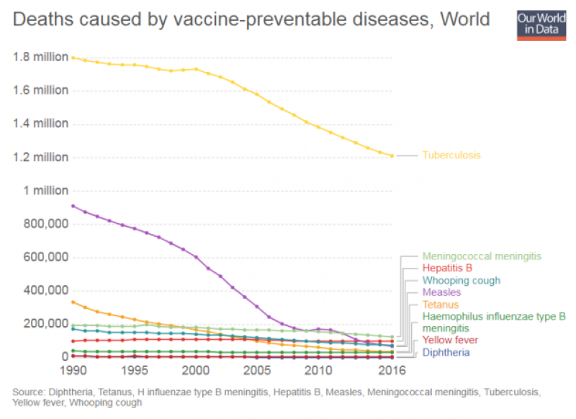
Why do we immunize?
Nothing has improved the health of children and adults as much as immunizations.
  Except sanitation 💩

Slide 20
Vaccines Work (US Data)
Inactivated vaccine
Live oral vaccine
Last indigenous case
Poliomyelitis: United States, 1950-2007

Slide 21
Measles: United States, 1950-2007
Vaccines Work!
Vaccine Licensed

Slide 22


Vaccines work!!!
Vaccines wooooork!
Rate per 100,000 children <5 years of age
Year
Invasive Hib: United States, 1990-2007

Slide 23
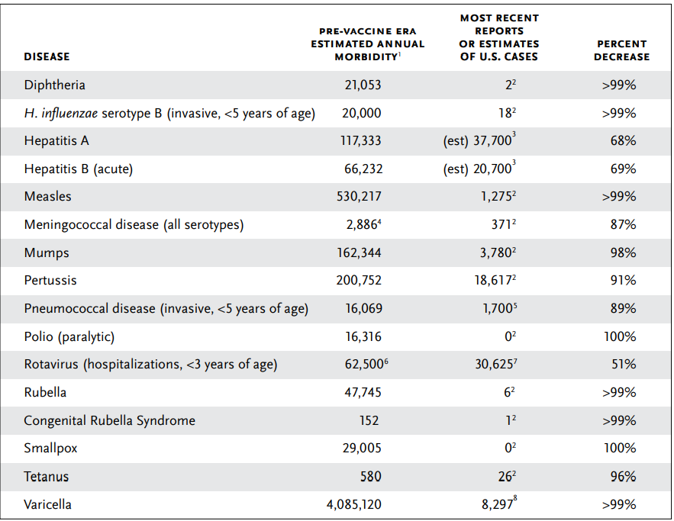
Change in Vaccine Preventable Illnesses
2022 Data
Immunization Action Coalition https://www.immunize.org/catg.d/p4037.pdf
Notes:
Some work really well like Diphtheria and H influenza type B ; Some like pertussis pneumococcal and varicella definitely work and decrease the amount compared to the past > 90% but still have substantial amount in the country and some lie rotavirus and HBV we have got to do better but the vaccine uptake has not been good enough Vaccines Work! (immunize.org) is the website for the table this was 2017 numbers from CDC

Slide 24
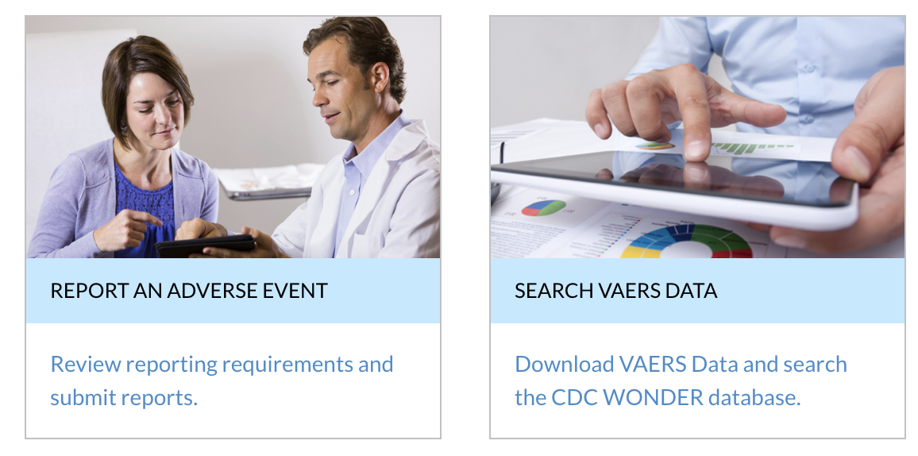
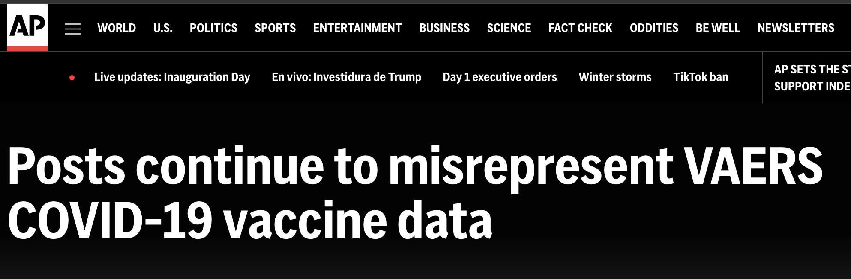
Vaccines are safe!
Fatal vaccine injuries are exceedingly rare.
Over 99% of reactions are
  Local
  Transient systemic symptoms – fevers, aches, etc.
VAERS
  Vaccine Adverse Event Reporting System
Multiple studies have investigated claims…
  Autism and MMR
  CFS and HPV
  GBS and influenza

Slide 25
How are vaccines studied?
Extensive laboratory studies
  Cell culture and animal studies
Clinical trials (Safety First)
  Phase I: Safety is small group
  Phase II: Safety in larger group and immune response
  Phase III: Safety and efficacy in even larger group
  Phase IV (after licensing): More safety monitroitng

Slide 26
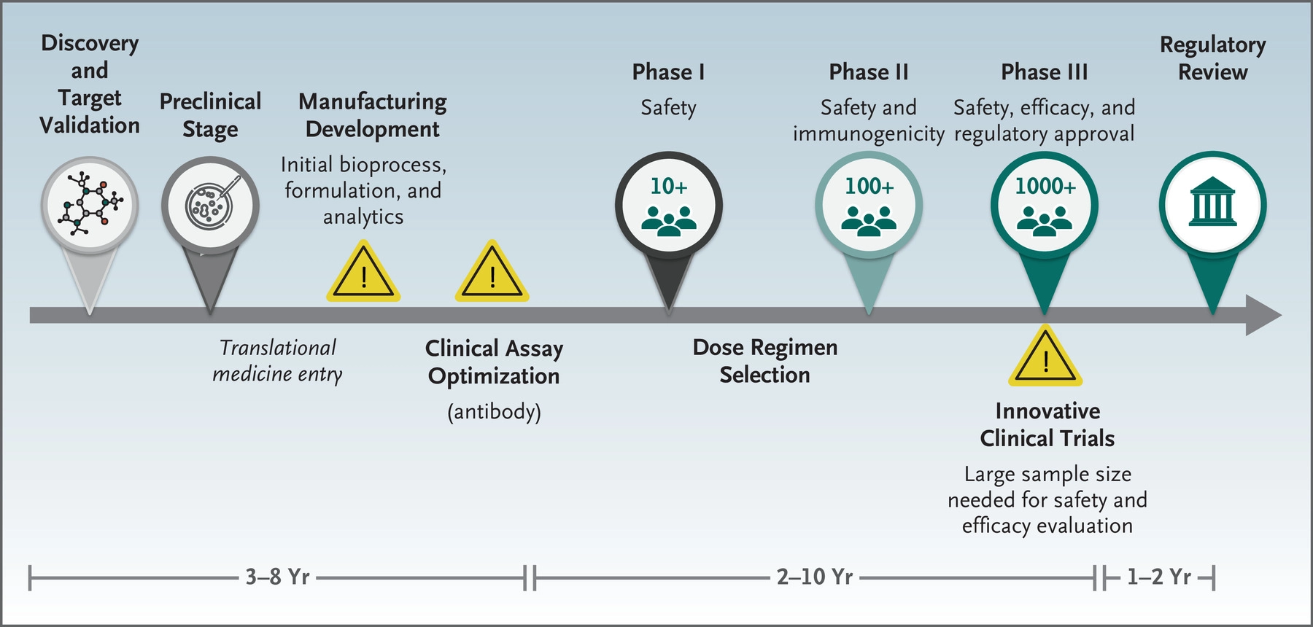
How are vaccines studied?
Traditional Vaccine Development Pathway
6-20 years

Slide 27

Claims against safety
Many claims originate from temporal associations.
  Survival is predicated on temporal associations.
Son actually has
Landau Kleffner Syndrome
(genetic)

Slide 28
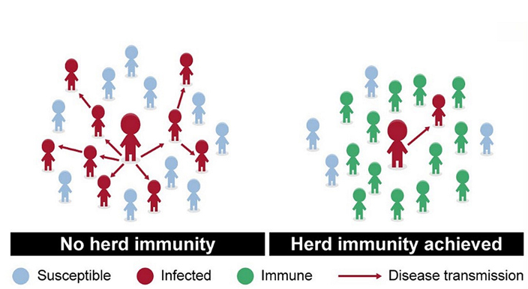
Vaccine Uptake
Community immunity requires a certain amount of vaccine uptake.
% immunity to prevent sustained transmission depends on several factors.
  Vaccine efficacy
  R₀
  Incubation
  Other factors

Slide 29
Herd Immunity Thresholds

Slide 30
Why are Under/Un-Immunized Important?
At risk of disease which can spread to…
  Those that can’t be immunized – from immune defects, chemo – are ALWAYS vulnerable
  Those who are immunized but don’t respond to vaccine (because no vaccine is 100% effective)
For example, Measles:
  Minimum vaccine coverage to prevent all transmission is 95% (5% susceptible despite vaccination)
  In the US, MMR coverage is 92%

Slide 31
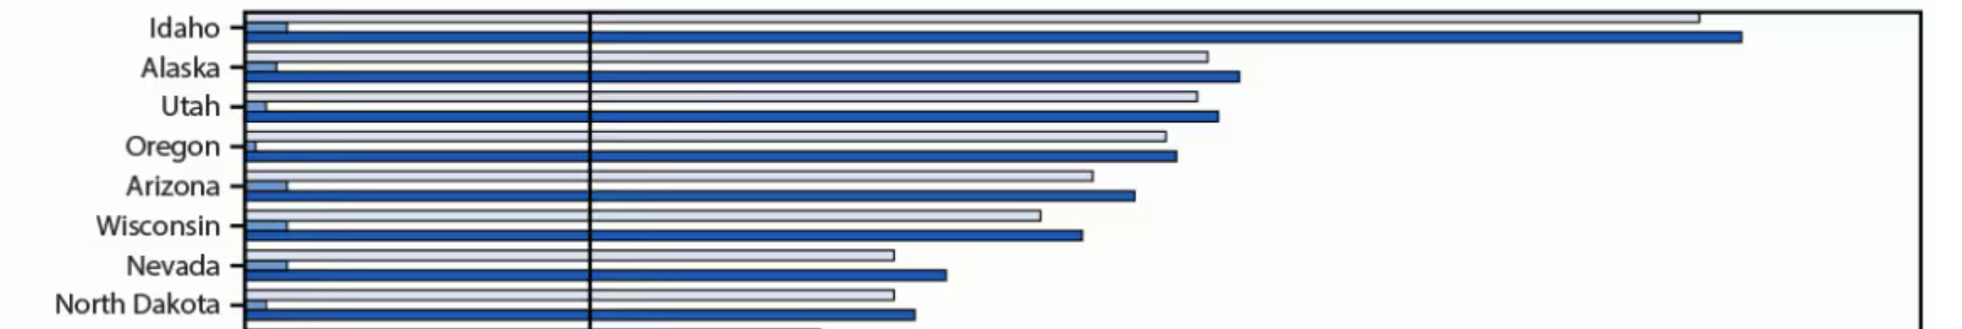
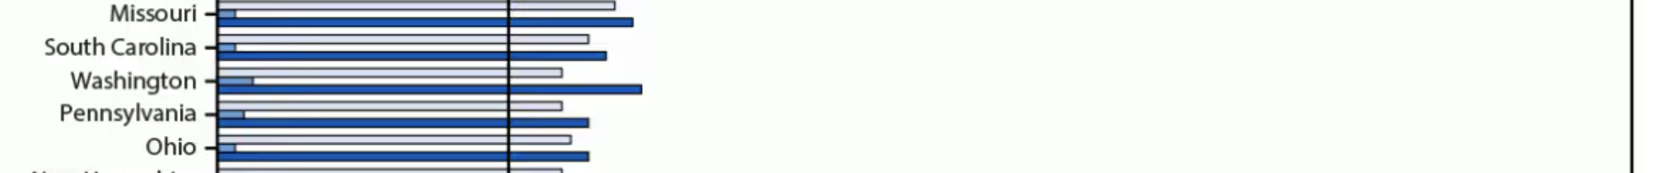
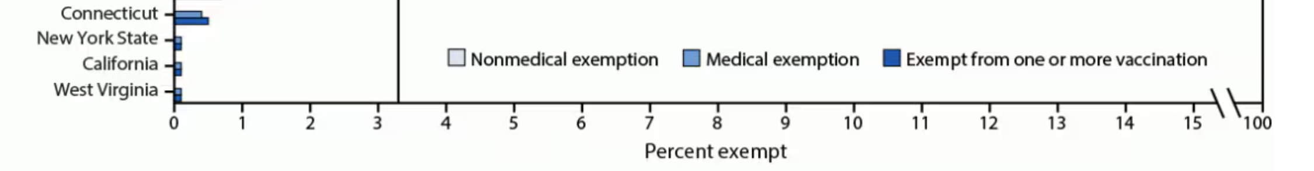
Exemption rates by state

Slide 32
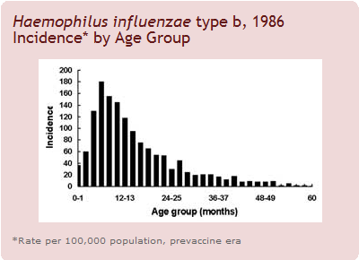
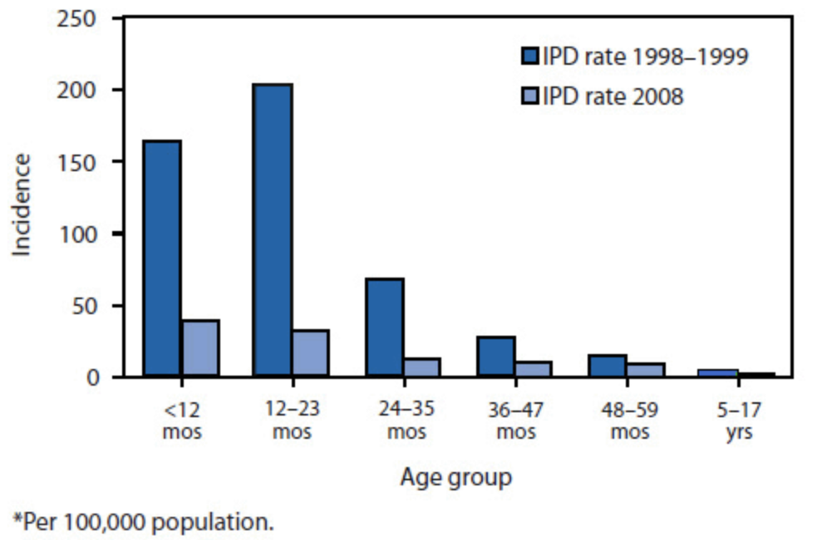
Vaccination Schedule
Give vaccines to at risk when they are at the greatest risk.
Ex:
  Strep pneumoniae
  HiB
Notes:
It wouldn’t make sense to give Pneumococcal vaccine after 24 months of age because the risk is down.

Slide 33
Responding with these principles
Vaccines don’t work!
  Fatal and disabling diseases are way down or gone.
Vaccines aren’t safe!
  Studies take years and thousands of participants to prove safety.
  >99% of vaccine adverse events are local and/or transient.
It’s my choice!
  We need herd immunity to protect those can’t get vaccines or won’t respond.
My child needs an alternative schedule!
  Vaccines are given to protect when your child is at the greatest risk.

Slide 34
Vaccine Hesitancy

Slide 35
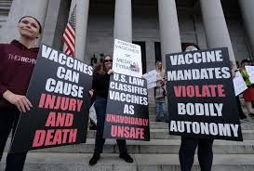
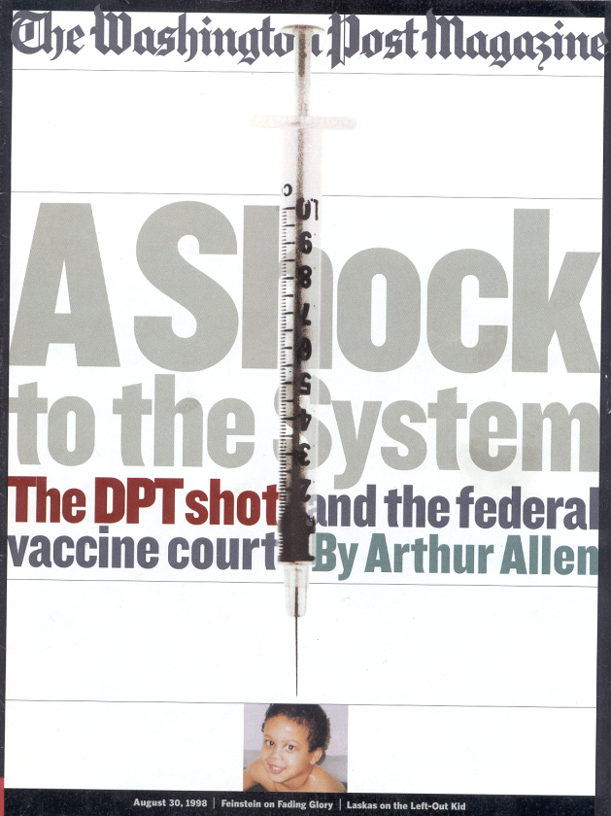
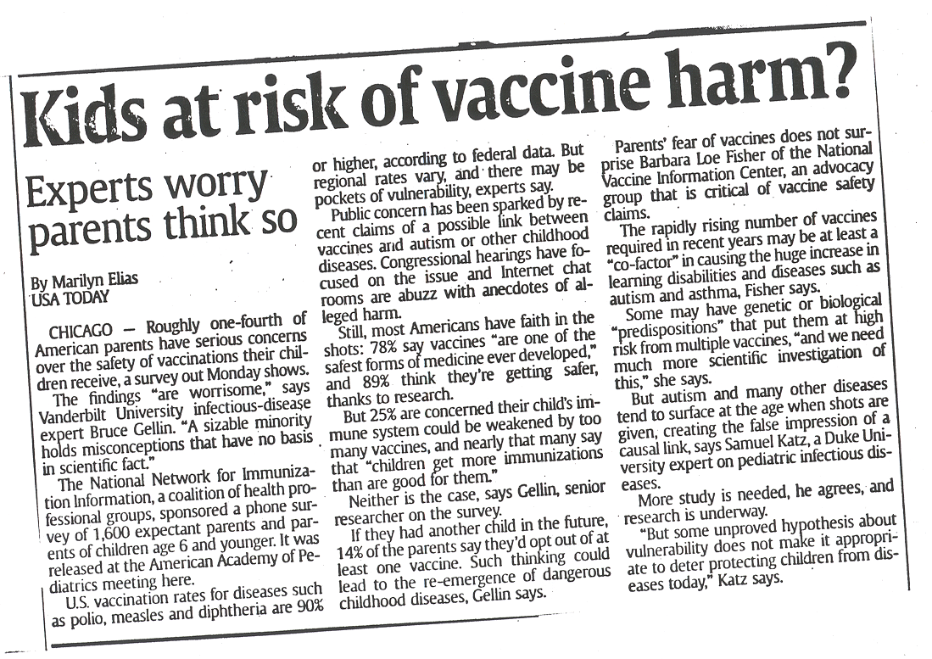
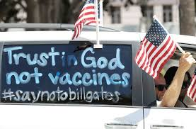
Notes:
35

Slide 36
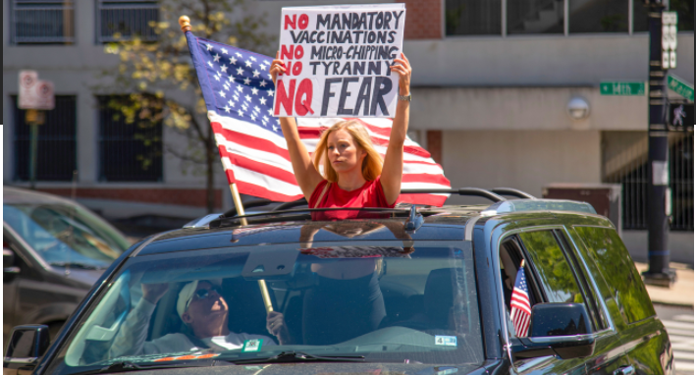
https://www.science.org/content/article/just-50-americans-plan-get-covid-19-vaccine-here-s-how-win-over-rest

Slide 37
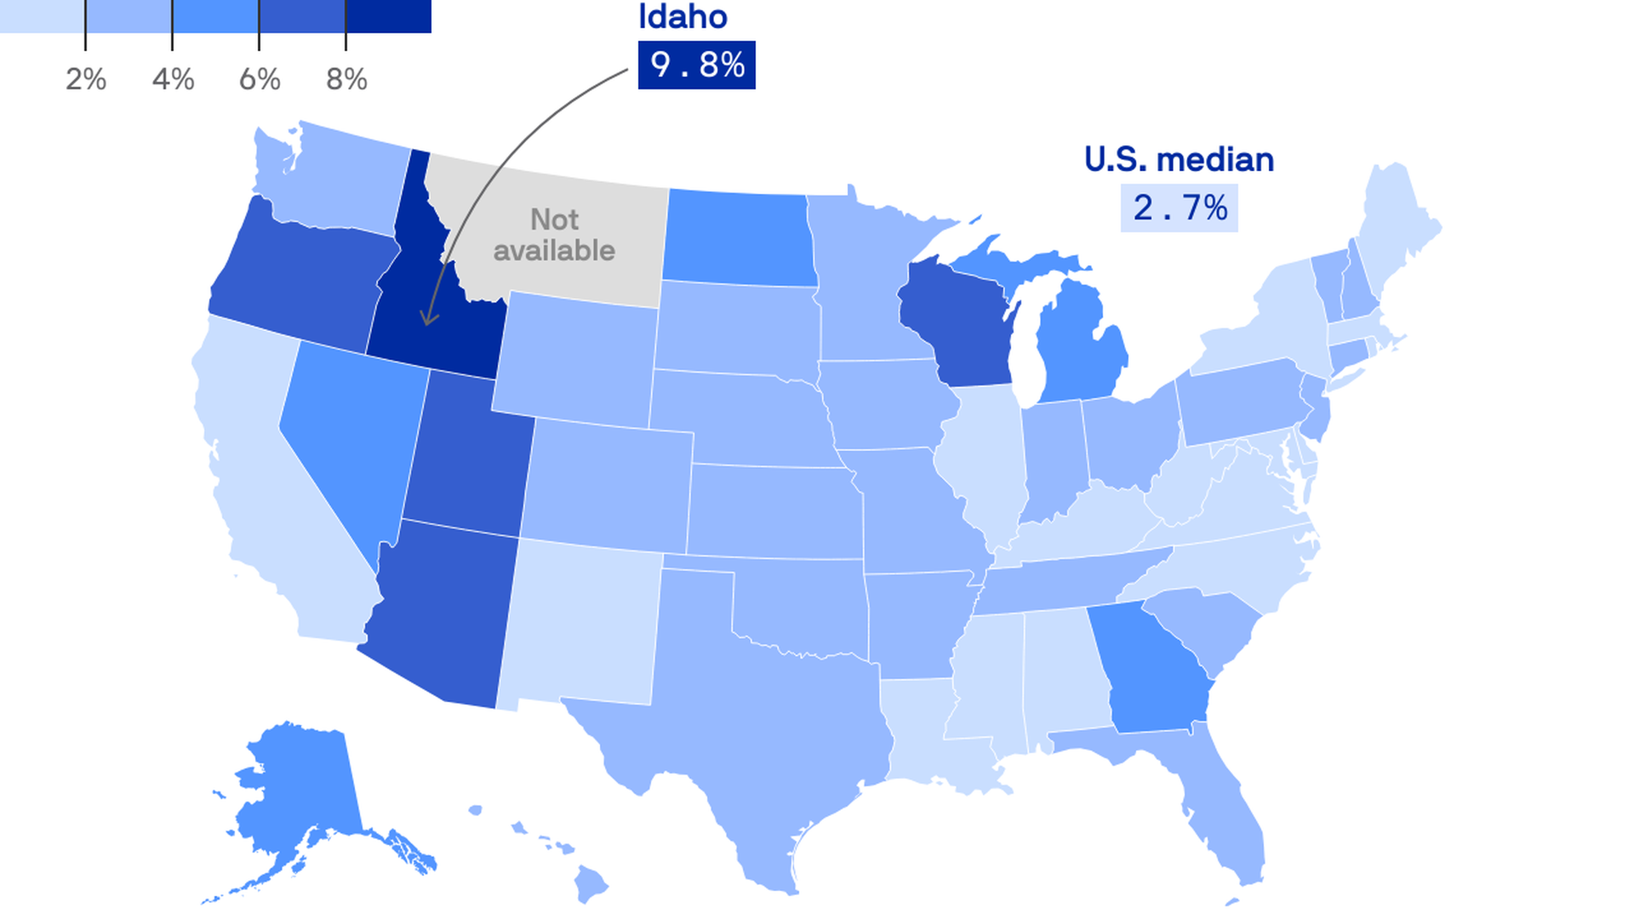
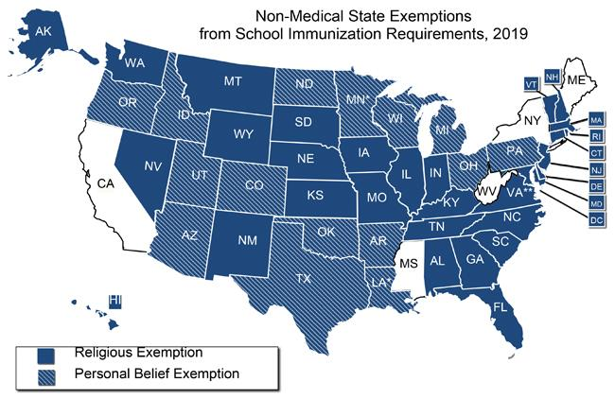
Vaccine Exemptions
Notes:
Vaccine exemptions vary by state. Some only have religious. Some have personal preference. Vaccine exemption rates are quite high in some states as we saw on the previous graph. But this map emphasizes that as well.

Slide 38
What do we know about vaccine hesitancy?

Slide 39
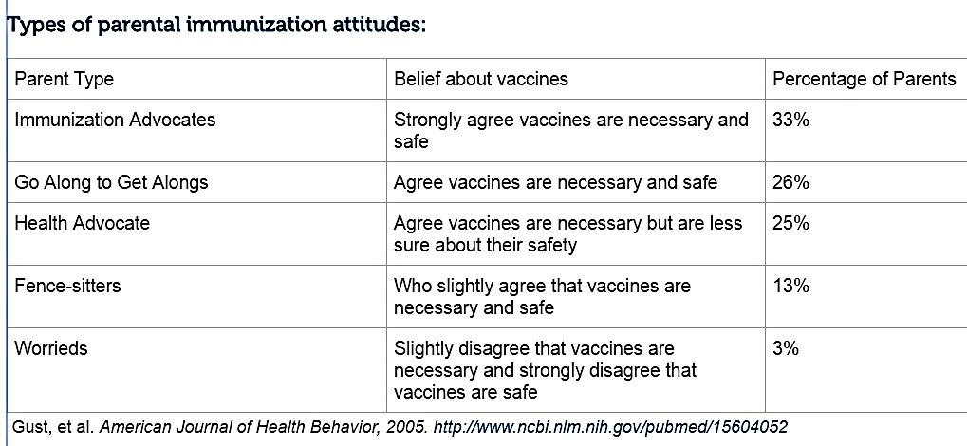
Few people objected in 2005

Slide 40
More Recently
A study of parents in 2021-2022 showed that vaccine hesitancy for routine childhood vaccinations increased briefly, but went back to baseline (22%).
  Higher than 16% in 2005 study.
  Though only 3% were flat out refusers in 2005
Most studies suggest hesitancy is in the 15-20% range.
Sociodemographic Trends and Correlation between Parental Hesitancy towards Pediatric COVID-19 Vaccines and Routine Childhood Immunizations in the United States: 2021–2022 National Immunization Survey—Child COVID Module, Vaccines 2024

Slide 41
Vaccine Hesitancy is not Monolithic
 | THE FACTS | THE CULTURE | THE MIND
PARENTS/PERSON | Misinformation -I read that vaccines cause autism | Anti-Science -Science isn’t always correct | Anecdotal thinking -temporal association; one case is sufficient
 | -Vaccines can have serious side effects | -They can’t prove vaccines are safe | -Serious side effects are common
Marshall GS. JPIDS 2018
Notes:
These two groups are easier to work with than the group that just says YOU are Wrong

Slide 42
Reasons for Refusal
Perceived dangers of vaccination
  Immune overload
  Too many, too fast
Lack of knowledge of the risks of diseases that the immunization is targeted for
  Natural disease is harmless
  Vaccines don’t eliminate the diseases
Erroneous beliefs about contraindications
  Vaccines cause ______________
My mom and I argue about this one.
Notes:
42

Slide 43
Vaccines most often refused
Varicella (not a serious infection!)
DTaP (used to cause brain damage!)
Hepatitis B (kids don’t get it!)
HPV (my kid will never have sex!)
MMR (autism!)
Influenza (it gives me the flu!)
SARS-CoV-2 (ugh…, Magnets? Microchips?)
Notes:
80 % effectiveness, 2nd shot meant to capture that group that didn’t build immunity with first dose
43

Slide 44
Vaccines most often refused
Varicella (50-100 deaths/year from VZV)
DTaP (no link to CNS damage, infant deaths)
Hepatitis B (90% of exposed babies convert)
HPV (40% of 15-19 year olds admit to sex)
MMR (no link to autism)
Influenza (no, it protects you 60-80% against)
Notes:
80 % effectiveness, 2nd shot meant to capture that group that didn’t build immunity with first dose
44

Slide 45

Countering Common Myths
“My Baby’s Immune System is Too Weak for Vaccines”
  T/B lymphocytes handle millions of antigens – there is no “immune overload”
  Premature babies respond to inactivated vaccines!
  We give vaccines TO infants because vaccine-preventable diseases KILL infants
“So Many So Soon, So Many at One Visit”
  To choose to delay is to choose risk
  We give vaccines TO infants WHEN we do because vaccine-preventable diseases KILL infants AT THAT AGE

Slide 46
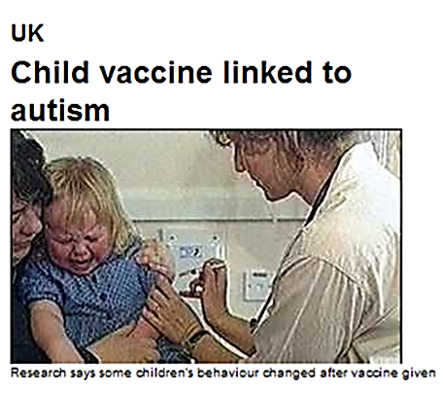
“Vaccines Cause Autism”
They don’t.
Wakefield
  Retracted paper, license revoked
Huge international studies show no connection
Translation: This is 🐂 💩
We do not yet know the cause of autism
  Find resources out there to discuss this.
Correlation is not causation

Slide 47
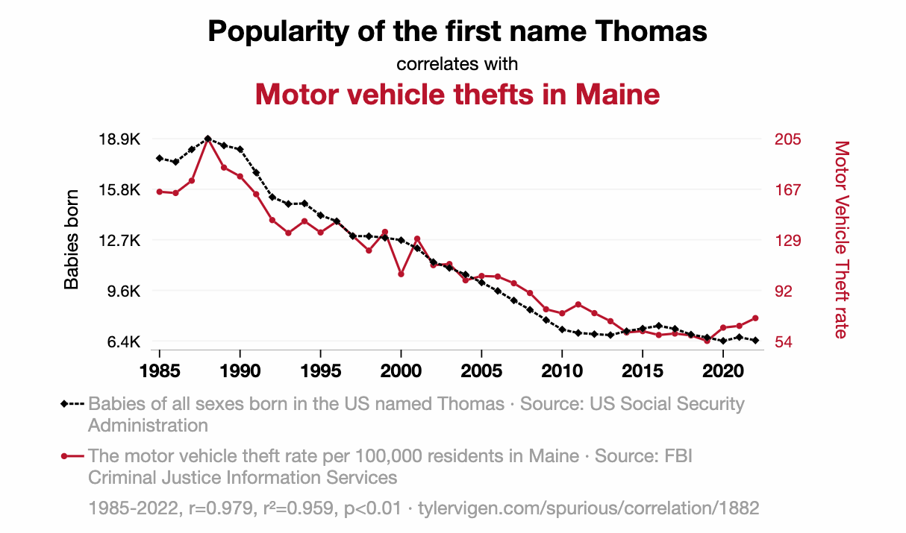
Example of correlation not causation

Slide 48
Providing counseling makes a difference
Health care providers are perceived by parents to be the most trusted source of immunization information.
Most parents choose to vaccinate when they get good information.

Slide 49
How to talk about it…
It’s not easy.
But there are resources and evidence-based practices you can implement.
  Presumptive over participatory language
  Redbook

Slide 50
Presumptive versus Participatory
Study by Washington State pediatric group
Pediatrician approaches
  Participatory: encouraging back and forth (typical pediatric model for care)
    “Do you want to talk about flu shots?”
  Presumptive: stating intention without debate
    “We are giving a flu shot today.”
Pediatrics 2013;132:1

Slide 52
ABP – Always Be Presumptive
Vaccines are being given.
This may lead to discussion
  Often doesn’t lead to a discussion.

Slide 53
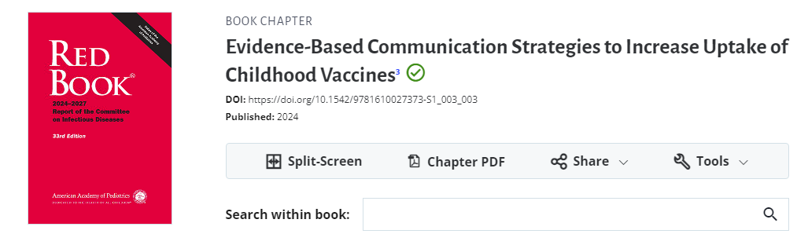
Red Book

Slide 54

Strong recommendation
”Timmy is due for a few shots today. I strongly recommend these vaccines to protect Timmy from bad diseases.”

Slide 55
If higher stakes/more refusal: Make your CASE
Corroborate: Acknowledge the parents’ concern and find some point on which you can agree
  ”I hear that you are concerned about the vaccines, but I think we both want to make sure Jenny is healthy and safe.”
About Me: Describe your expertise
Science: Describe what the science says
Explain/Advise: Give your advice to patient, based on the science
https://www.aap.org/en-us/advocacy-and-policy/aap-health-initiatives/immunization/Pages/vaccine-hesitant-parents.aspx

Slide 56
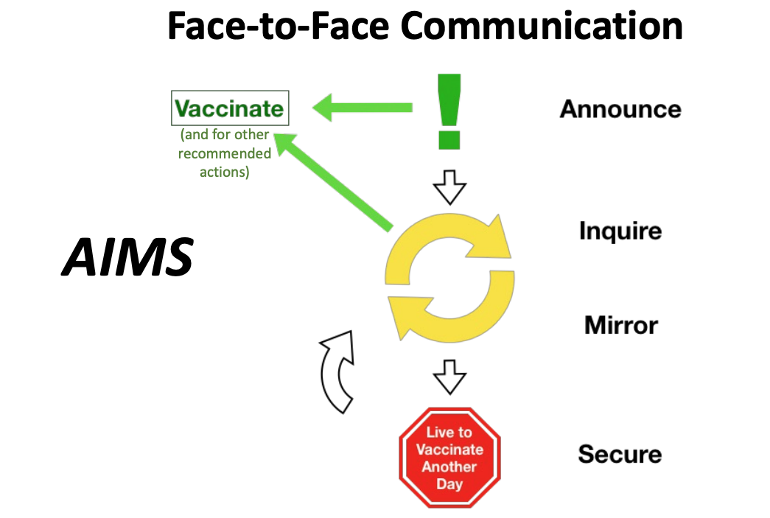
The AIMS Method
“We’ll be doing Jonny’s flu shot today.”
“What concerns you about giving Johnny the flu shot?”
“You are concerned that the flu shot will give Johnny the flu. (What else?)”
Provide information that addresses the concern.
-”The flu shot does not cause the flu.”

Slide 57
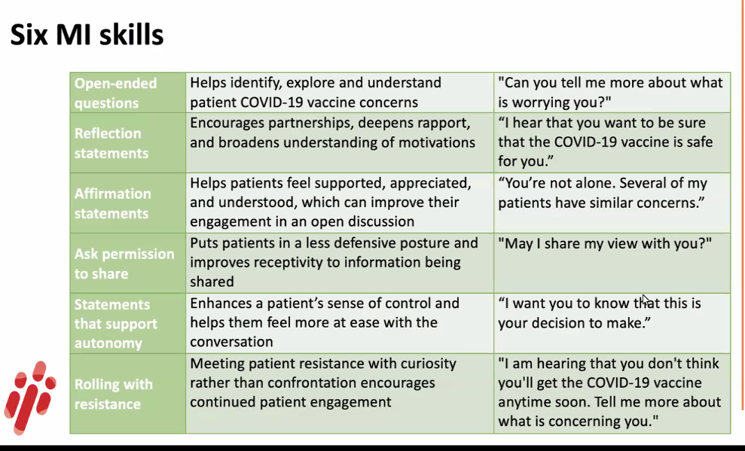
Motivational Interviewing
Doug Opel MD talk 2023

Slide 58
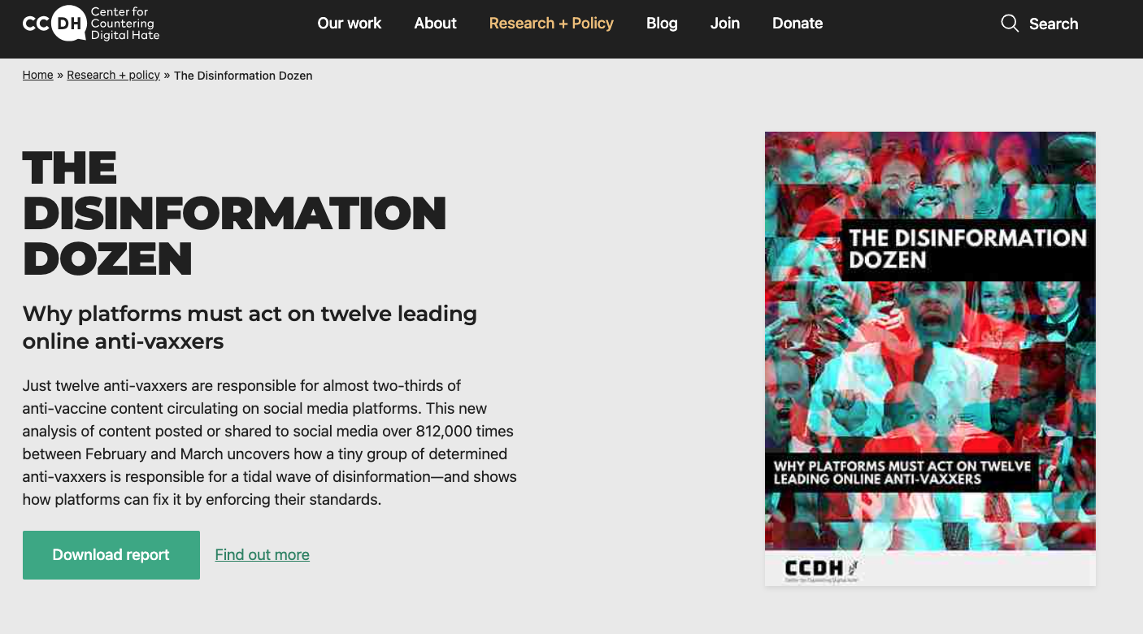
Antivaccine groups/influencers…
Notes:
Most misinformation about vaccines comes from these twelve people.

Slide 59
Themes from the Anti-vaccine Groups
Vaccines are ineffective and harm the immune system
Vaccine adverse effects are under reported
Vaccine preventable diseases are not that serious
Vaccine supporters are all profit driven (conspiracy!)
  I have yet to get my check from big pharma
Mandatory vaccination is a violation of civil rights
Notes:
? Placement
59

Slide 60
An anecdote…
5 yo unvaccinated girl comes in with complicated pneumonia and empyema.
PHM team talks about vaccines.
ID sees in follow up.
“I know we talked about vaccines while inpatient, but I wanted to talk about some of the things from my book…”
“What about strain replacement?”

Slide 61
Strain Replacement

Slide 62
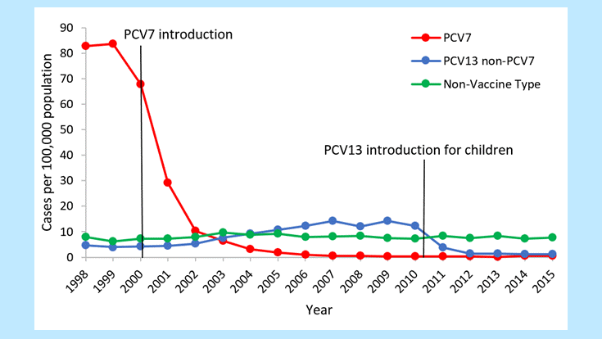

Slide 63
Always ask, never assume
Assuming what they are worried about can get you in trouble.
Always ask what they are worried about with the vaccines.
Debunking or providing better context can win you trust.

Slide 64
Online Vaccine Resources
Center for Disease Control and Prevention
  http://www.cdc.gov/vaccines/
Children’s Hosp of Philadelphia Vaccine Service
  http://www.chop.edu/service/vaccine-education-center/
Immunization action coalition
  http://www.immunize.org/aboutus/

Slide 65
Thank you!
What questions do you have?

