Slide 1

Cardiac Education Series: Transplant & Cardiac Medications

Slide 2

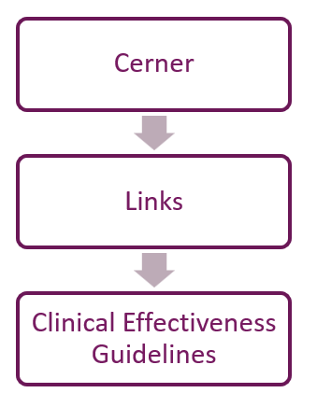
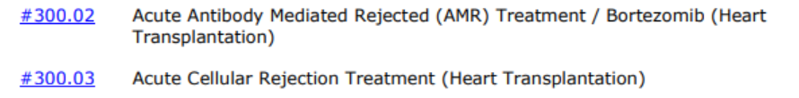
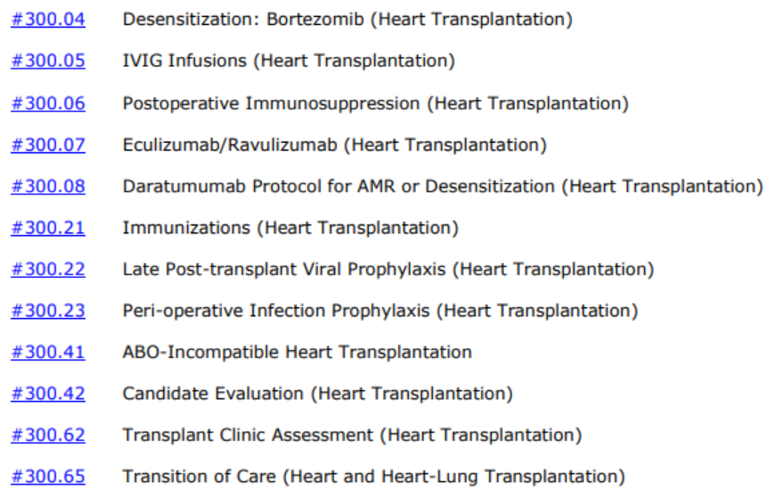
Heart Transplant Clinical Effectiveness Guidelines
Search for “Heart Transplant”

Slide 3
Hazardous Medication Guidelines
Risk levels for medications are defined as
Low Level: single gloves
Duration of excretion precaution
Long duration: 7 days of precautions after last dose
Short duration 72 hours of precautions after last dose
PPE and waste disposal (yellow bin)
Don PPE before disposing of any patient waste
IV bags, gowns, gloves, etc. are to be placed into the yellow bin marked Chemotherapy Waste Container
Diapers, urine collection devices, emesis basin, NG tubes, etc. obtained by patient are to be placed in yellow bin
Sharps and waste disposal
Including needles and syringes, are to be place in the sharp's container
High Level: Full PPE (2 pairs gloves, gown, face shield if splash risk)
High Level + RESP: Full PPE + N95/PAPR
Notes:
NIOSH recommends single gloving for administration of intact tablets or capsules. If manipulating tablets/capsules (eg, to prepare an oral suspension), NIOSH recommends double gloving, a protective gown, and preparation in a controlled device; if not prepared in a controlled device, respiratory and eye/face protection as well as ventilated engineering controls are recommended. NIOSH recommends double gloving, a protective gown, and (if there is a potential for vomit or spit up) eye/face protection for administration of an oral liquid/feeding tube administration.

Slide 4
Hazardous Medication Guidelines
Pharmacy Preparation
Labels indicating hazardous drug status will be on the drug product and outer bag
Pharmacy Dispensing/Delivery
IV infusion doses will be sent with tubing attached primed with diluent.
Hazardous medications must not be sent via pneumatic tube
Drug product will be dispensed in a “double bag,” to minimize chance of spills
If tubing is primed with medication, an auxiliary label stating “drug in tubing” will be placed near the product label and at the end of the tubing set
Nursing Principles
Pharmacy will determine which infusions will be primed with active hazardous medication or with a diluent/solution
Ongoing resources:
CHP Formulary
UPMC Health System Hazardous Drug Chart
Policy: Hazardous Drug Handling (HS-RPN0021) Policy: Chemotherapy for the Non-Oncology Patient (PTCMDIV820b)

Slide 5
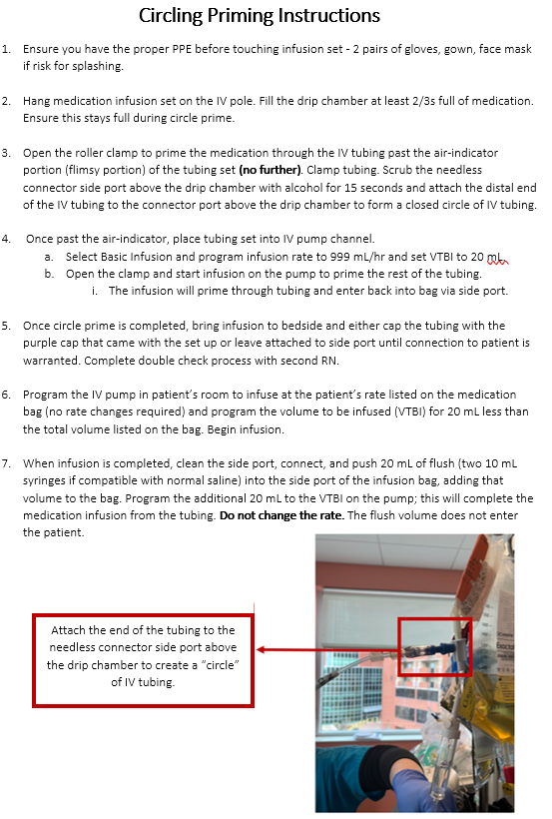
Circle Priming
Use: medications >50 mLs to be primed before administration to patients.
Label will be present indicating the need for circle priming
Closed system device transfer device is attached to the end of the tubing to prevent leaking medication when attaching to patient.
Priming tubing without using circle prime technique results in exposure to medication. Avoid “regular” priming into the air.
Complete a double check with another RN to ensure the rate and volume are programmed correctly into the pump
Medication infusion rate will be consistent through medication administration and flush administration.

Slide 6
Post-Operative Immunosuppression
Notes:
300.06.pdf (sharepoint.com)

Slide 7
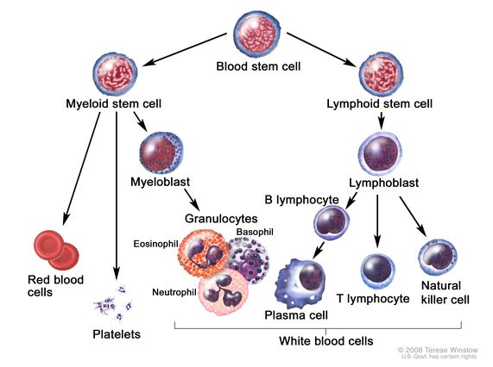
Immune Therapy
Antigens that activate the immune system against the allograft are in major histocompatibility antigens (MHC)
Encodes the human leukocyte antigens (HLA)
T-Cell targeted immunosuppression
MHC molecules present foreign antigens to T cells
CD4 and CD8 cells to recognize different peptides
Stimulation of T cells is an important drive of the immune response
B- Cell targeted immunosuppression
Presenting cells for HLA Class II molecules
Graft infiltrating B Cells are commonly observed after heart transplant where they presumably contribute to rejection (chronic form)
Mismatched donor HLA can be immunogenic to B cells (CD20)
Role in acute cellular rejection
Plasma Cell targeted immunosuppression
Antibodies originate from plasma cells and reactivate quickly due to previously generated memory B cells
Niche into inflamed tissues and can act as long term antibody factories, producing IgG.
Notes:
Controls the cellular alloimmune responses (antibody remediated rejection)
B cells are critical for optimal T-Cell activation and the development of T-cell memory in alloimmune responses. B-cell depletion (e.g. using rituximab) has been undertaken with the aim of reducing the potential deleterious contribution of B cells to an alloimmune response (left panel). These include antigen presentation to T cells, cytokine production facilitating T-cell polarization, antibody production, and tertiary lymphoid organ generation.
HLA antigens are responsible for eliciting the strongest response to allogenic tissues.
Targeting B Cells and Antibody in Transplantation – PMC
Mechanism of cellular rejection in transplantation – PMC

Slide 8
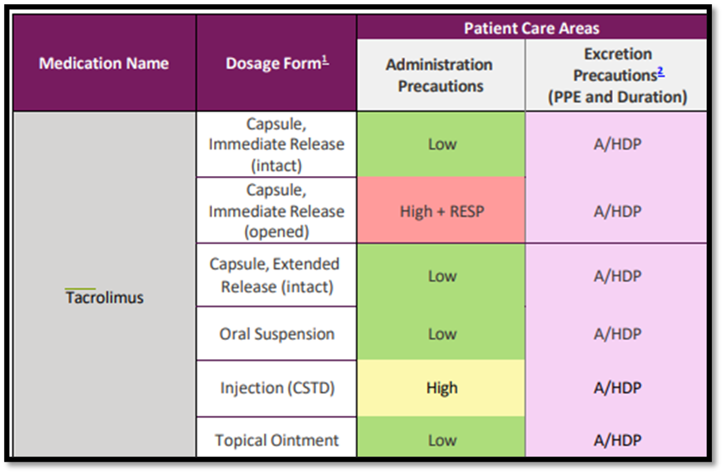
Tacrolimus (FK, Prograf)
Use: Prevention of organ rejection in solid organ transplantation patients
Dosing: 0.05-0.1 mg/kg/day in divided doses every 12 hours (oral)
Administration:
Heart Transplant requires enteral dosing only (suspension or capsule/pill)
Begins after intestinal function returns and renal function is deemed adequate
(usually POD 3 – 4)
Enteral tube
5 ml Ora-Plus
Medication
5 ml Ora-Plus
Notes:
Oral: usually 3-4 times the IV dose
FYI: there is an extended release version that is a 1:1 ratio (mg: mg) that is only administered once daily. Monitor 24 hour trough level
Liver/Small Bowel: capsule dosage, given sublingual
BMT: given through continuous infusion

Slide 9
Tacrolimus (FK, Prograf) Nursing Considerations
Closely monitor levels to assist in dose adjustment, compliance, prevention of rejection
Food decreases absorption significantly, be consistent with diet
When made NPO, watch for elevations in levels
System monitoring
ECG changes (prolong QT)
Mild-Severe hyperkalemia may occur
Hypomagnesemia may occur
Hyperglycemia may occur, some patients develop diabetes
Nephrotoxicity may occur when used in high doses or in patients with impaired renal function
Dyslipidemia, Hypertension
Drug Interactions that increase Tacrolimus levels
Fluconazole, Voriconazole
Amiodarone, Nicardipine, Amlodipine
Erythromycin, Azithromycin
Notes:
NSAID Avoidance recommended due to the potentiating nephrotoxic effects of FK
Long term side effects: HTN, dyslipidemia, diabetes mellitus
Patients should be brought up to date with all immunizations before initiating therapy. Inactivated vaccines may be administered, response could potentially be diminished)
Patients should not be immunized with live, attenuated vaccines during or shortly after treatment and should avoid contact with recently vaccinated individuals.

Slide 10
Tacrolimus (FK, Prograf)
Trough Level Range: 4-16 ng/mL
Collected at 6 am (10 hours after 8 pm dose)
Purple top tube to be send to the lab
Time after transplant | Heart | Lung
0-3 months | 10-12 ng/mL | 12-15 ng/mL
3-12 months | 7-10 ng/mL | 10-12 ng/mL
>12 months | 4-7 ng/mL | 8-10 ng/mL
Notes:
PRES: posterior reversible encephalopathy syndrome that can occur with high levels and sometimes normal levels
Discussion on AM rounds with team may determine dosing for next medication administration
Do not reschedule a dose of FK, the timing should stay at 8 am and 8 pm…if you are late giving your AM dose, you will still give the PM dose at 8 pm.

Slide 11
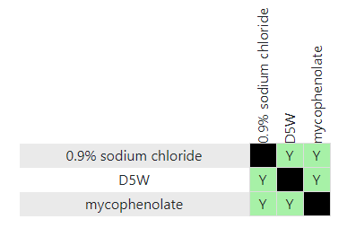
Mycophenolate (CellCept)
Use: Immunosuppressant agent used in conjunction with other therapies for the prophylaxis of organ rejection
Dosing:
Typical goal: 40 mg/kg/day (goal of 20 mg/kg/dose twice daily)
May start lower (10-20 mg/kg/day) to ensure no GI intolerance before advancing dose
Administration:
Oral:
empty stomach 1 hour before or 2 hours after food
Can be administered orally or via 8 Fr. NG tube or larger
Shake well before use
IV:
RN to use NON-DEHP tubing (comes from pharmacy)
Tubing must be flushed at completion to deliver full dose
D5W can be used to prime tubing and flush CellCept, new data suggests CellCept is also compatible with normal saline
Infuse over 2 hours
Notes:
Can also be used in nephrotic syndrome, moderate-severe psoriasis, chronic graft versus host disease, lupus, and other autoimmune diseases
Adults: IV may be used for up to 14 days, transition to oral therapy as soon as tolerated
NON-DEHP tubing: pre-primed with D5W when coming from pharmacy

Slide 12
Mycophenolate (CellCept) Monitoring Parameters
CBC, platelets (neutropenia may occur)
Therapeutic MPA trough levels for cardiac transplant recipients is 2-4 mcg/mL
Monitoring Parameters
Heart rate
Blood pressure
Confusion/lethargy
Kidney function (renal dosing may be needed)
Notes:
MPA: plasma concentrations of mycophenolic acid, the active metabolite
Conventionally, it is administered as a fixed dose without serial measurements

Slide 13
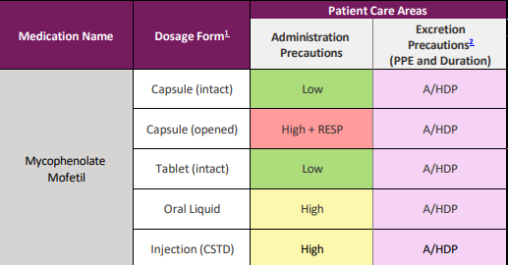
Mycophenolate (CellCept) Nursing Considerations
CellCept levels may be decreased by:
Antacids
Cyclosporine
Penicillin
Proton Pump Inhibitors
Oral CellCept should be taken on an empty stomach
1 hour before meals
2 hours after meals
Notes:
Medication is teratogenic to patient → considerations for female teenagers

Slide 14
Thymoglobulin
Use: Immunosuppressive agent used for prevention and/or treatment of acute rejection after transplantation
Dosing: 1.5 mg/kg/dose IV once daily for 5 days post-transplant (standard treatment)
Administration:
IV use only
Infuse over 6-12 hours
First dose preferred infusion time: 12 hours
Notes:
cause immunosuppression by acting on T-cell surface antigens and depleting CD4 lymphocytes
Dosing contingent upon CDC crossmatch and age
Low-dose immunosuppression, the thymo dose is given in 1 mg/kg/day x 2 days only

Slide 15
Thymoglobulin Nursing Considerations
Premedication: 1 hour before dose
Acetaminophen: 15 mg/kg (max. 650 mg) IV or PO
Benadryl: 1 mg/kg (max. 50 mg) IV or PO
Methylprednisolone: dose varies daily with prolonged administration times
Acetaminophen and Benadryl may be repeated with longer dose administration
Administration via a central line or high-flow vein
Administration via 0.22-micron filter
Patients should not be vaccinated with live, attenuated vaccines during or shortly after treatment
Notes:
Pretreated with antihistamine, antipyretic, and/or corticosteroid to help prevent infusion reaction
- Methylprednisolone dose is determined by protocol
Can stay in the body system for 3 months→ increases risk for infection

Slide 16
Thymoglobulin Monitoring Parameters
Most reactions occur with the first dose
Epinephrine and resuscitative equipment should be nearby
Physician should be immediately available in a timely manner to the nursing unit during administration
System reaction
Generalized rash
Tachycardia
Dyspnea
Hypotension
Anaphylaxis
Monitoring parameters (remember to document)
Heart rate and blood pressure Q 15min for first hour
Q 30 for second hour, usually Q1 hour after second hour
CBC with Diff. and platelet count daily
Notes:
Leukopenia or thrombocytopenia can happen, if seen dose adjustments are required

Slide 17
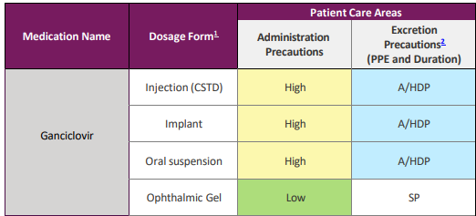
Ganciclovir
Use: Treatment of CMV or EBV infection in immunocompromised patients, as well as prophylaxis of CMV/EBV in solid organ transplant recipients
Dosing:
Prophylaxis post-transplant: 5 mg/kg/dose every 12 hours (IV dosing)
CMV infections including transplant
Initial: 10 mg/kg/day Q 12 hours Maintenance: 5 mg/kg/day as a single dose for 7 days/week
Dose must be adjusted for renal dysfunction, which is often seen post-transplant
Administration:
IV infusion over at least 1 hour
Infuse via large vein on syringe pump
Handle/dispose according to cytotoxic drug guidelines
Flush IV well with normal saline before and after administration
Notes:
Levels of ganciclovir may increase the levels of mycophenolate
Levels of ganciclovir may be increased by mycophenolate

Slide 18
AMR & CDC Crossmatch Positive Patient Therapies
Notes:
Patients who experience acute antibody mediated rejection post-transplant can see an aggressive treatment plan lasting as long as 19 days in response to an immune-mediated injury to the donor heart.
Sensitization to human leukocyte antigens (HLAs), pre-existing antibodies before transplant, positive donor-specific crossmatch, CMV recipient, or retransplant are risk factors for an acute rejection event.
Often these AMR treatment will include 6-7 rounds of plasmapheresis, high IV steroid use, along with IVIG, Bortezomib, and Rituximab

Slide 19
Rituximab
Use: used in conjunction with plasmapheresis post-transplant for cases with high risk of acute rejection and presence of donor specific antibodies
Helps deplete circulating B Cells
Administration:
Should not be administered IV push or bolus
Acute Antibody Mediated Rejected (AMR) Treatment (Heart Transplantation)
Premedication:
Tylenol & Benadryl before each infusion
Notes:
Seen with Acute Antibody Mediated Rejection
Dose #1 of Rituximab is administered on Day #3 AMR treatment protocol, although can be seen as early as day #1 while awaiting VASCath/pharesis

Slide 20
Rituximab
Monitoring Parameters:
Transient hypotension may occur during infusion, consider holding antihypertensive medications 12 hours prior to infusion
Document and monitor heart rate and blood pressure
Q 15 min = 1st hour
Q 30 min = 2nd hour
Then re-evaluate
Monitor CBC and platelet counts at regular intervals
Notes:
Seen with Acute Antibody Mediated Rejection
Dose #1 of Rituximab is administered on Day #3 AMR treatment protocol, although can be seen as early as day #1 while awaiting VASCath/pharesis

Slide 21
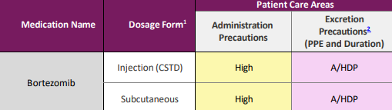
Bortezomib
Use: antineoplastic agent utilized in conjunction with plasmapheresis, IVIG, or Rituximab to treat antibody-mediated rejection.
deplete antibody-producing plasma cells
Administration:
Consecutive doses are separated by at least 72 hours
IV administration via rapid IV push (3-5 seconds)
Premedication: Benadryl, Tylenol, Zofran, IV steroid with each dose
Consent: requires chemotherapy consent when used to treat antibody mediated rejection
Notes:
Off label use– traditionally used for treatment of multiple myeloma cells.
Antibody mediated rejection remains one of the major barriers to successful long-term transplant outcomes. Bortezomib is able to reduce antibodies (HLA antibodies) by depleting antibody-producing plasma cells, per recent studies

Slide 22
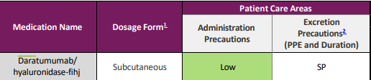
Daratumumab
Use: patients presenting with antibody-mediated rejection and HLA hypersensitization
Administration:
Typically given every 2 weeks for 2 doses, then every 4 weeks for 2 doses
Can be condensed to Q2 weekly or Q1 weekly dosing for severe AMR
Pre-medication:
Tylenol, Benadryl, Methylprednisolone, Montelukast, Famotidine, Zofran
Premedication & their timing (1-3 hours before dose) is specific to the Daratumumab infusion.
Considerations for adjunct therapy and timing of pre-medications
Post-medication:
Prednisone on Day 1 & Day 2 (Day 1 = 8 hours after start of infusion)
Montelukast PO once on Day 2
Notes:
Activity against plasma cells in HLA desensitization.
If rituximab or another infusion that requires some of these pre-medications is given before daratumumab and the infusion cannot be completed within the 1-3 hour timeframe then adequate time must be given to allow for re-dosing of the daratumumab pre-medications prior to starting the daratumumab infusion.
Montelukast (Singulair)

Slide 23
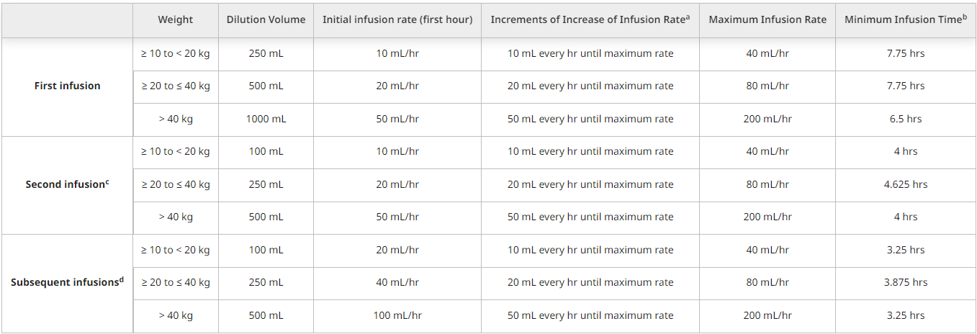
Daratumumab
Monitoring Parameters:
Vital signs: prior to infusion, Q15 min x1 hour, end of infusion
Nausea/ Vomiting, Diarrhea, Neutropenia/Anemia, Fever
Notes:
Things to remember: - Consider titration of the infusion rate only in the absence of infusion reactions
- Decreased dilution volume should only be used with no mild infusion reactions (infusion not needing to be interrupted) during first 3 hours of the first dose. May see the same initial dilution volume and instructions if necessary.

Slide 24
Cardiac Medications

Slide 25
Arrest Meds.
1
2
Epinephrine
Sodium Bicarb.
Dose: 0.01 mg/kg/dose
Improves cardiac contractility and stroke volume
Adult dosing: 1 mg/dose
Dose: 1-2 mEq/kg/dose
For patients <6mo, dilute 1:1 in sterile water
Acidotic state has adverse effects on contractility and myocardial function
Adult dosing: 50 mEq/dose

Slide 26
Arrest Meds.
3
Calcium Chloride
or
Calcium Gluconate
Dose: 10-20 mg /kg/dose
CENTRAL LINE
Promotes cardiac contractility
Adult dosing: 500-1000mg/dose
Dose: 100 mg /kg/dose
PERHIPERAL LINE
Promotes cardiac contractility
Adult dosing: 1500-3000 mg/dose

Slide 27
Arrest Meds.
Give every 3-5 minutes (RECORDER responsibility to keep track of time)
If you have drawn up your medications correctly, your volumes of epi and calcium chloride will be the same, and the volumes of calcium gluconate and bicarb (undiluted) will be the same
Tip: for epi and calcium chloride → take their dose weight and move the decimal point one place to the left and that is the volume
Tip: for calcium gluconate and bicarb → their dose weight is the same as the volume of these medications for them

Slide 28
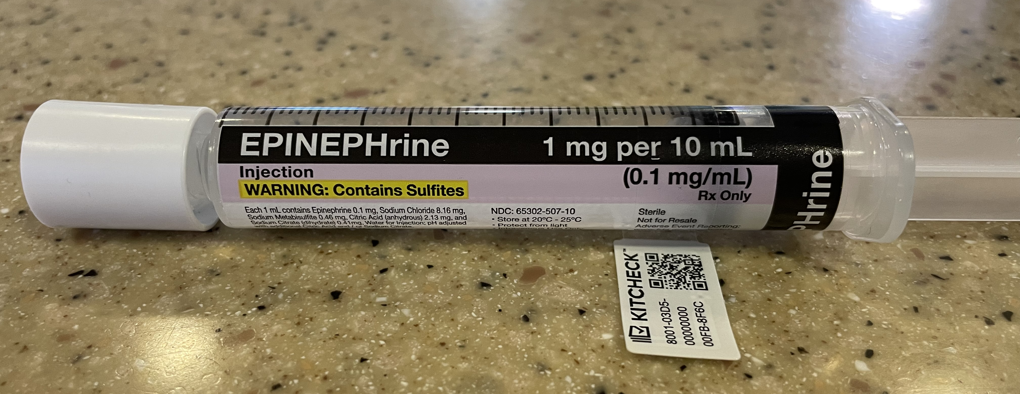
Epi Code Dose Syringes
100 mcg / mL concentration (0.1 mg / mL)
Higher concentration to be used in cardiac arrest (follow EDS)
Located in crash cart & AcuDose
Label code doses with the purple Epinephrine sticker on the crash cart.

Slide 29
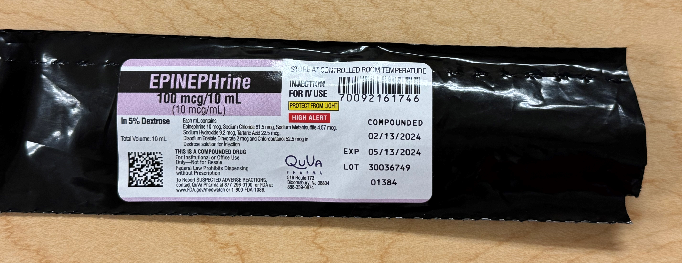
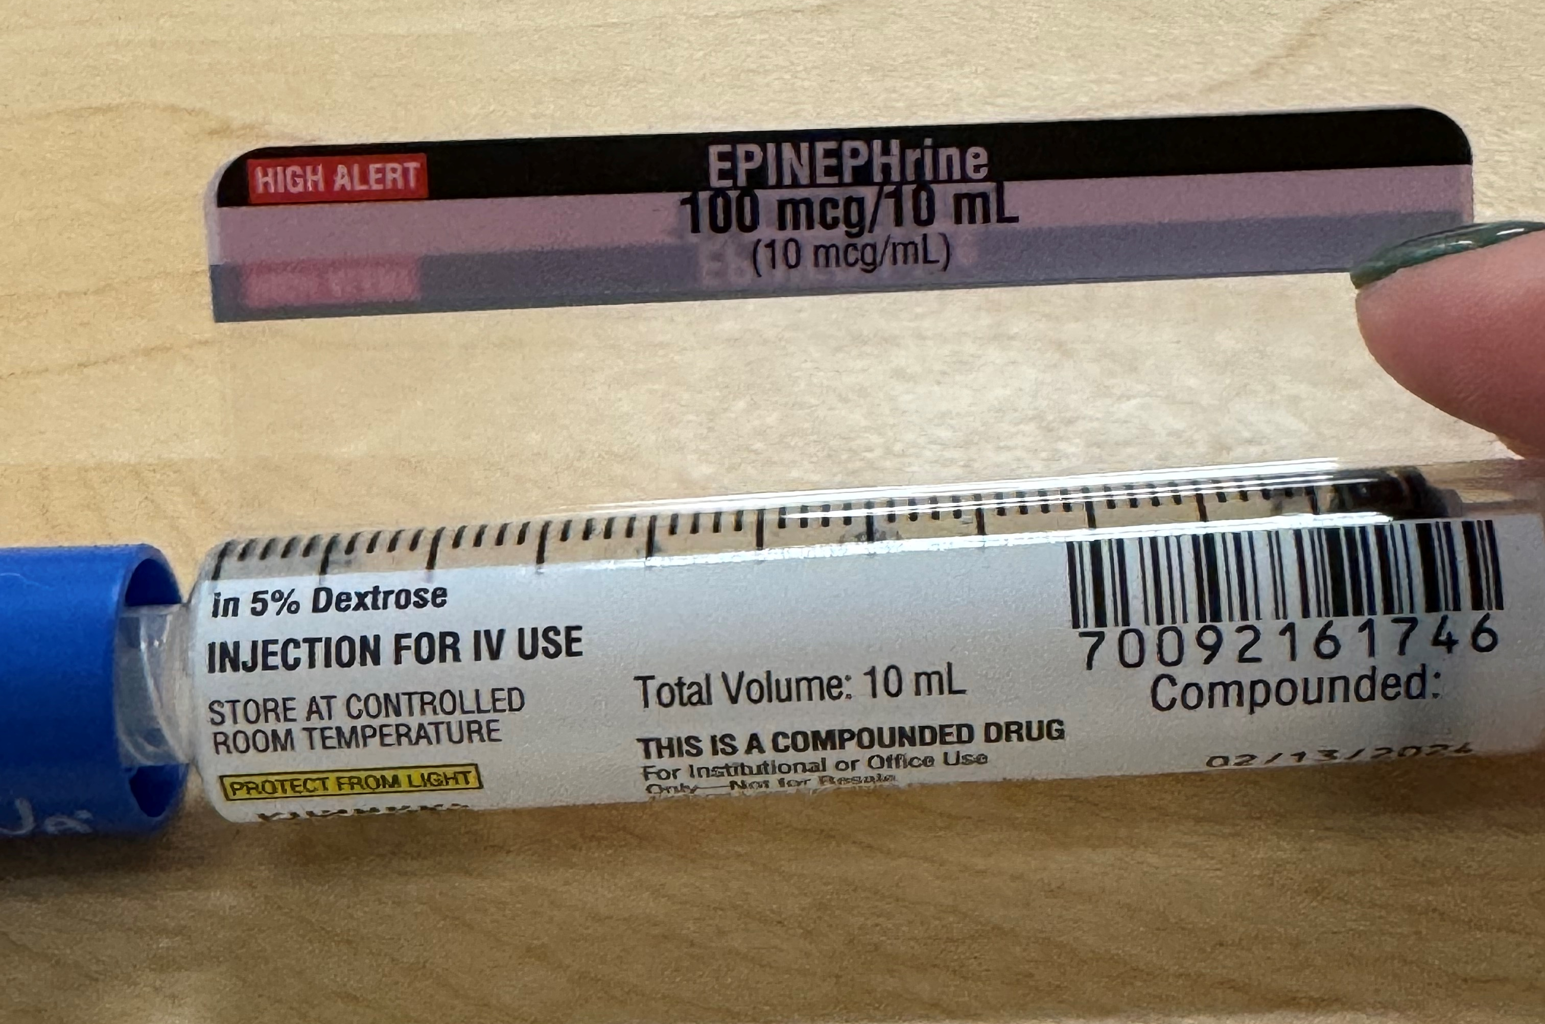
Epi Spritzer Syringes
10 mcg / mL concentration
Dose: 1 mcg/kg
1/10th of a code dose to be used for situational cardiac support.
Located in AcuDose only.
Spritzer volume (mL) = Code dose volume (mL)
Concentrations are different to result in same volume to be administered.
Spritzer volumes are no longer a standard 1 mL volume, volume will be dependent upon patient’s weight/dose.
Label spritzer doses with a green medication sticker.

Slide 30
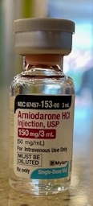
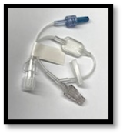
Amiodarone
Dose: 5 mg/kg bolus
Indications:
EAT, JET, V-fib or V-tach, SVT
Administration:
Dilute in D5W (not compatible with NS)
Central line: 6 mg amio:1 mL of D5W
Peripheral line: 1 mg amio:1 mL D5W
0.2-micron filter
30-60 minutes on a pump
Can cause hypotension due to calcium channel blocking activity (have calcium chloride or gluconate at bedside)
Draw up a separate 10 mL syringe of D5W to use as a flush for amio bolus
Adult dosing: 150 mg for perfusing arrhythmias
300 mg for pulseless v-fib or v-tach

Slide 31
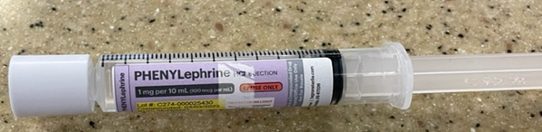
Phenylephrine
Dose: 5-20 mcg/kg
Administer over 20-30 seconds
Increases SVR
Indications: TET spells, suspected thrombosis in BTTS in Norwood patient, etc. (hypotension, low cardiac output)
Adult dosing: 100-500 mcg/dose every 10-15 minutes

Slide 32
Continuous Infusions: Epinephrine
Purpose: to treat hypotension, myocardial dysfunction, and low cardiac output
Dosing:
At low doses (<0.03 mcg/kg/min) – primary receptor: beta
Increase heart rate and contractility
At high doses (>0.06 mcg/kg/min) – primary receptor: alpha
Increases SVR and MAP via vasoconstriction
May increase oxygen consumption even though it increases oxygen delivery and may exacerbate arrhythmias at higher doses

Slide 33
Continuous Infusions: Norepinephrine
Purpose: management of septic or cardiogenic shock with severe hypotension after adequate volume resuscitation
Works well in the adult population to increase SVR when they are vasodilated
Alpha receptors only – increases SVR and MAP
Increasing SVR in a patient with myocardial dysfunction increases the workload of the heart
Less effect on HR and contractility compared to epi because it does not affect the beta receptors on the heart
Dosing:
Pediatrics: 0.05-0.1 mcg/kg/min
Adults: 0.01-0.15 mcg/kg/min

Slide 34
Continuous Infusions Vasopressin
Purpose: hypotension unresponsive to fluid resuscitation
Increases SVR and MAP (not PVR) to stabilize blood pressure or wean off/decrease requirement of other pressors
May have adverse effects on HR (bradycardia) and does not directly affect cardiac contractility
Dosing:
Pediatric Patients should be dosed in units/kg/min
0.0003-0.002 units/kg/min (***Important to take note of number of zeros in desired dose***)
Adult patients should be dosed in units/min
0.01-0.04 units/min

Slide 35
Continuous Infusions Dopamine
Purpose: Increases end-organ perfusion, MAP, and cardiac output primarily due to an increase in stroke volume
Natural precursor to epi and norepi
Dosing:
At low doses (1-5 mcg/kg/min) – increases renal perfusion (like epi) and potentially increases urine output
At moderate doses (5-15 mcg/kg/min) – increases HR and contractility
At high doses (>15 mcg/kg/min) – vasoconstricts
More commonly used in babies

Slide 36
Continuous Infusions Dobutamine
Purpose: increases contractility and HR (beta receptor agonist)
The increase in HR also increases myocardial oxygen demand
Promotes reduction of LV filling pressure
Dosing: 1-20 mcg/kg/min
Commonly used in CHF, pre-transplant, and low EF patients

Slide 37
Continuous Infusions Milrinone
Purpose: increases contractility and decreases SVR via vasodilation
Improves systolic and diastolic function
Has no significant increase in HR or myocardial oxygen consumption because there is no effect on beta receptors
Dosing:
Pediatrics: 0.2-1 mcg/kg/min
Adults: 0.2-0.75 mcg/kg/min

