Slide 1

Cardiac Education Series:
Pediatric Arrythmia & Electrophysiology

Slide 2

Myocardial Cell Properties
Mechanical cells (contractile units)
Electrical cells
Contractility | Extensibility | Automaticity | Excitability | Conductivity
Ability of the cell to shorten/lengthen its muscle fiber | Ability of the cell to stretch | Ability of the cell to spontaneously generate an electrical impulse | Ability of the cell to respond to an electrical impulse | Ability of the cell to transmit an electrical impulse from one cell to another
Arrythmias occur when there is a change in automaticity or conductivity of the cell.
Notes:
Electrical cells include SA/AV nodes, purkinje fibers, bundle branches
Mechanical cells include myofibrils

Slide 3
Myocardial Cell Properties
Automaticity | Excitability |  | Conductivity
INCREASED - hypoxia - hyperthermia - hypokalemia - sympathetic NS stimulation |  |  | INCREASED abnormal/extra conduction pathways WPW/Re-Entry Phenomenon
DECREASED - hypothermia - hyperkalemia - parasympathetic NS stimulation |  |  | DECREASED delayed/blocked conduction pathways AV Blocks / Escape
Notes:
Electrical cells include SA/AV nodes, purkinje fibers, bundle branches
Mechanical cells include myofibrils
Increase in Automaticity:
- atropine administration
- epinephrine administration
Decrease in Automaticity:
- propranolol administration
- precedex administration (rate control)

Slide 4
Supraventricular Arrythmias
Notes:
Term “tachycardia” Is reserved for persistent and significant increases in heart rate. Heart rate can transiently increase during fever or episodes of crying.
Common Causes
Reentrant conduction pathways
Hemorrhage/fluid shifts
Tamponade
Pneumothorax
Hypovolemia

Slide 5
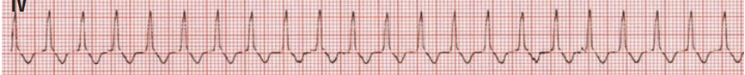
Atrial Ectopic Tachycardia
Type of AT in which a small cluster of cells with altered automaticity fire.
  Seen acutely with digoxin toxicity, electrolyte abnormalities, MI, etc.
May arise anywhere in the atrium
  Pulmonary veins, atrial appendage, crista terminalis, prior suture sites
  Multifocal: associated with organic heart disease (3 different P wave configurations)
Abnormal P-wave morphology
  Unless ectopic focus arises from the high right atrium near the sinus node
  Atrial rate = up to 250 bpm
Treatment
  Antiarrhythmic therapy
    IV amiodarone, procainamide
    IV esmolol, sotalol has shown efficacy in termination of multiple types of refractory tachyarrhythmias
    Precedex as adjunctive agent for rate control (sedative and hemodynamic benefits)
    AV nodal blocking agents: digoxin, beta blockers, etc.
  Adenosine transiently effective: only if pathway is reentry phenomenon
Notes:
Many patients present with s/s of congestive heart failure with decreased LV contractility, valve regurgitation and atrial dilation.
Ectopic Atrial Tachycardia - an overview | ScienceDirect Topics
The Johns Hopkins Manual of Cardiac Surgical Care | ScienceDirect

Slide 6
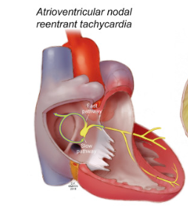
Supraventricular Tachycardia: Reentrant/Paroxysmal
Paroxysmal SVT
  Abrupt onset and offset
  Results from AVNRT or an accessory pathway
Reentrant AV Nodal Tachycardia
  Most common type of SVT
  Dual AV node accessory pathways
  Conduction from the atria to the AV node travels down both a fast and slow pathway
  Fast pathway conduction continues down to AV node and retrogrades back to the slow pathway and override
Reentrant AV Tachycardia
  Mediated through an accessory pathway
  Dependent on the presence of an electrical connection between the atrium and ventricle in addition to the normal conduction system
Notes:
In AVNRT, a small extra pathway (reentrant circuit) exists in or near the AV node. If an electrical impulse enters this pathway, it may start traveling in a circular pattern that causes the heart to abruptly start beating fast and regular (pre-excitation)
fast/abnormal pathway interferes with the electrical signals coming from the SA node
Most common type of SVT
Two conduction pathways within the AV node that conduct impulses at different rates
Fast pathway → conduction rapid with long refractory period (recovery)
Slow pathway → conduction slow with short refractory period
Pathways form an electrical loop
Allows the impulse to spin around in a circle indefinitely, reentering the normal pathways within each pass around the circuit
Cardiac impulse fails to stop and re-excites the tissues that have recovered from the refractory period

Slide 7
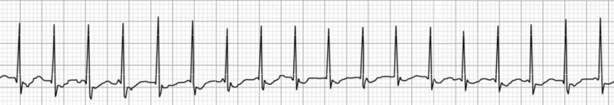
Supraventricular Tachycardia
Characteristics
  QRS complexes are narrow and regular
  Rate is very fast
  P waves absent or not obviously visible
  Abrupt onset & offset
  HR: 150-250 bpm in the atria
Symptoms
  Infants: poor feeding, irritability, pale lethargy
  Children: palpitations, dizziness, shortness of breath, syncope
Determining SVT
  AEG can determine if SVT is mediated by an accessory pathway or AV node reentry
    Retrograde P waves within ST segment →accessory
    P waves within QRS segment →AV node reentry
Notes:
Impulse typically spreads to the atria and ventricle at the same time = P waves are hidden in QRS complexes
Impulse reaches the ventricle first and then the atria, a negative (inverted) P wave will appear after the QRS in leads II and III. This will distort the end of the QRS complex.
ST segment depress may also be noticeable → thought to be the result of repolarization changes

Slide 8
Supraventricular Tachycardia: Treatment
Stable SVT
    Vagal maneuvers
    Medications: adenosine
    (0.1-0.2 mg/kg)
    Cardioversion: 0.5-1 J / KG
    Over drive pacing
  Unstable SVT
    Cardioversion: 0.5-1 J / KG
    Medications can be given but should not delay cardioversion
Notes:
Unstable: poor perfusion/ decreased cardiac output

Slide 9
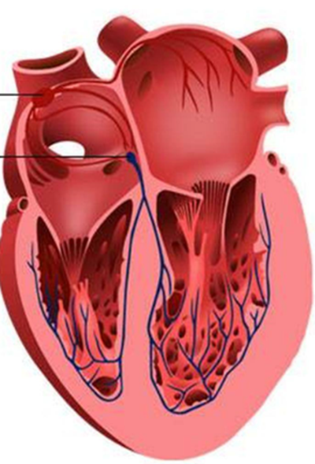
Atrioventricular Blocks
Notes:
AV Block occurs when conduction from the atria through the AV node to the ventricles is delayed, intermittent, or nonexistent
Without appropriate conduction through the AV node, the SA node cannot act to control the heart rate, and cardiac output can be diminished secondary to loss of coordination of the atria and the ventricles
Transient AV block following cardiac surgery, likely caused by edema localized around the nodal region
- Last longer than 7-10 days postoperatively, permanent pacing is recommended.

Slide 10
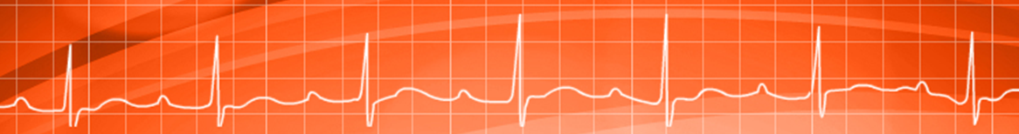

1st Degree Heart Block
Normal variation of the cardiac rhythm in those with no history of cardiac disease, especially athletes
Prolonged conduction through the AV node
  Prolonged PR interval
  Consistent P : QRS conduction
Causes
  Rheumatic heart disease
  Ischemia/Injury to the AV node or junction
  Metabolic (hyperkalemia)
  Medications: digoxin, beta blockers, calcium channel blockers, amiodarone
Notes:
Prolongation of PR interval (blocks) → myocarditis, ischemia / profound hypoxia, endocardial cushion defects (ASD), fever

Slide 11
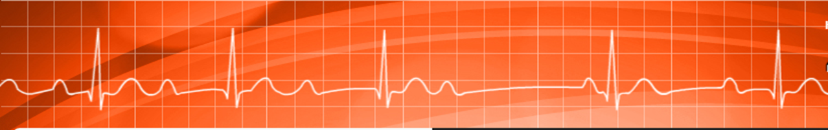
2nd Degree Heart Block (Type 1)
Mobitz I / Wenckebach
Gradually lengthening PR interval, eventually followed by a non-conducted QRS complex
P waves normal in appearance and occur on time (not a problem with SA node)
  “dropped beat” is indicative of a P wave appearing during the refractory period of the ventricles.
  P wave of the “dropped beat” looks like it’s early but is regular
    QRS complexes are appearing farther apart (ventricular irregularity)
Monitor for progression to a more advanced AV block post-surgery
Common Causes
  Post operative following surgery near AV junction or right coronary artery
  High vagal tone
Treatment
  Usually benign with no symptoms
  No treatment usually needed if ventricular rate is maintained
Notes:
2nd degree heart block: present when there is intermittent failure of conduction of impulses from the atria to the ventricles
Measure P- Waves versus QRS complexes on screen
Right coronary artery supplies blood to the AV node

Slide 12
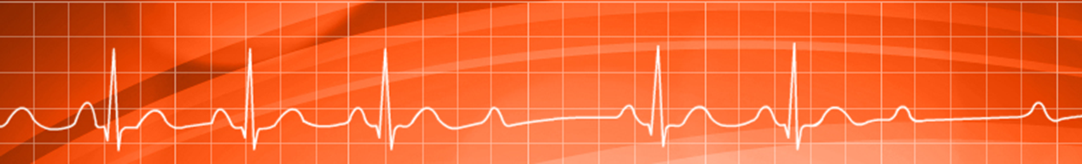
2nd Degree Heart Block (Type 2)
Mobitz II
Common Causes
  Trauma/irritation at or below Bundle of His or Bundle Branches following surgery
  Ischemic disease of conduction system
  Cardiomyopathy / acute myocarditis
Treatment
  May result in slow ventricular rate and require cardiac pacing to support cardiac output
  Monitoring: usually progresses to 3rd Degree HB
  Atropine may not be effective because it only improves conduction through the SA node, but not the Bundle of His or bundle branches
Intermitted failure of the QRS complex to be conducted
  PR intervals that are measurable are consistent with conducted beats
Most common location of failed conduction is in the bundle branches, resulting in wide QRS complexes (distal to AV node)
Notes:
May result in slow ventricular rate and require cardiac pacing to support cardiac output.
Mobitz II usually progresses to 3rd Degree

Slide 13


Second Degree: 2:1 Heart Block
Occurs when every other P wave is not conducted through the AV node
Every other P wave is not followed by a QRS complex
Classification
  Nodal: Normal QRS width and prolonged PR interval
    Association with AV nodal block location
    Site of type 1 block is usually in the AV node
  Infranodal: Widened QRS width and normal PR interval
    Association with His-Purkinje system block location
    Site of type 2 block is infranodal (60-70%)
  Advanced (3:1, 4:1) may involve either type I or type II mechanisms
Treatment is similar of type I or type II second degree blocks
Notes:
Classification is based on the width of the QRS complex, since there are no two PQRST complexes to compare
Contemporary definitions require at least 2 consecutively conducted P waves to adequately evaluate the P-R interval before establishing the type of Mobitz block, rendering 2:1 (and more advanced second-degree AVB) unclassifiable by definition.
The Mobitz type of second-degree AVB describes an ECG pattern, not block location; however, some generalizations can be made.
second-degree AV block 2:1 conduction probably type I
Second-degree AV block 2:1 conduction probably type II

Slide 14
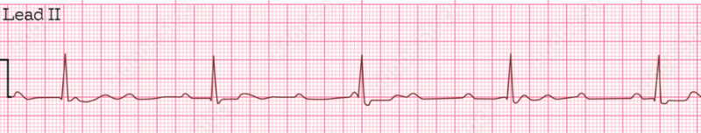
3rd Degree (Complete) Heart Block
Complete failure of the atrial impulses to be conducted to the ventricles (blocked impulse)
  Atrial rate is faster than ventricular rate
  Father down the block, slower the rhythm
Ventricles use “back up pacemaker” with a slower rate
Narrow QRS Complex
  Block occurs within the AV node or Bundle of His
Wide QRS Complex
  Below the bifurcation of the bundle of His
Common Causes
  Injury/Irritation to conduction system after surgery
  Congenitally corrected TGA, complex heterotaxia
Manifestations
  Dizziness, syncope, altered LOC
  Seizures
Treatment
  Medication for temporizing measures
    Atropine (?), epinephrine
    Ventricular slowing may cause hemodynamic compromise
    Temporary pacing via epicardial wires
    Permanent pacing is indicated of block persists more than 7 -10 days
Notes:
Atrial rhythm driven by the sinus node
Ventricular rhythm driven by a site distal to the block (QRS width dependent on location of the escape pacemaker and condition of intraventricular conduction system)
Slow ventricular rate may be inadequate to maintain cardiac output and systemic perfusion, especially if ventricular function is impaired (HLHS, cardiomyopathy, etc.)
Atropine acts at the AV node and, as such, is rarely effective in raising the heart rate in patients with complete heart block. Subsequently, medical options for the treatment of symptomatic bradycardia include dopamine and epinephrine
Treatment is based on presence of symptomatic bradycardia
Monitor for decreased LOC
Vital signs indicative of shock
Cyanosis and respiratory distress

Slide 15

Junctional Rhythms
Notes:
The AV node and the non branching section of the bundle of His is called the AV junction.
AV node itself doesn’t have pacemaker cells, nearest cells are in the bundle of His that are responsible for secondary pacing function.

Slide 16
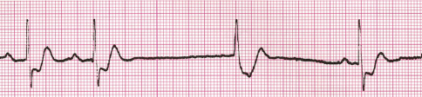
Junctional Escape Beats
Begin at the AV junction and appear late –after the next expected sinus beat
Frequently occur during episodes of sinus arrest or pauses in non-conducted PACs
  Serve as a protective measure to prevent cardiac standstill
Non-compensatory pause after the junctional beat during which SA node resets and follows with sinus beats.
Notes:
A junctional rhythm is several sequential junctional escape beats (40-60 bpm AV junction rate).

Slide 17
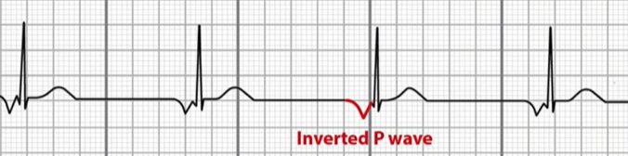
Junctional Escape Rhythm & Bradycardia
Junctional escape rhythm: 40-60 bpm
Junction bradycardia: rate < 40 bpm
Sinus node automaticity is blocked/ depressed
  Bundle of His / AV node (AV Junction) takes over as pacemaker
Treatment
  Correct cause of sinus slowing
  Medication therapy (atropine)
  Atrial pacing
Notes:
Junctional bradycardia refers to a rate slower than normal for the AV junction.
Junctional pacemaker is initiating the rhythm, the atria and ventricles are depolarized almost simultaneously. This can produce a P wave:
(1) in front of the QRS with a short PR interval
(2) during the QRS (ventricular depolarization overrides), or a block prevents the impulse from entering the atria, producing NO P wave.
(3) after the QRS (retrograde). From this low starting point, the impulse may travel backward, in a "retrograde" fashion, through the atria, producing a negatively-deflected P wave in Lead II (atria are activated in the opposite direction). Sometimes, in junctional rhythm,

Slide 18
Junctional Ectopic Tachycardia
Most common malignant post-operative arrhythmia seen post-operatively (60%)
  Usually begins with rewarming
Retrograde (VA) block or complete AV dissociation resulting in a ventricular rate that is more rapid than the atrial rate
  Ventricular filling and cardiac output are compromised
  Loss of “atrial kick” and cardiac output → LCOS
Characteristics
  Narrow-complex with AV dissociation
  Originates in autonomic tissue around AV junction
  HR: >95th % for age
  “Warming up” and “Cooling down” periods of onset/termination
Mechanism
  Thought to be combination of traction or trauma to AV area and His bundle, as well as ischemia from surgery
  Enhanced and abnormal automaticity
Notes:
JET can be congenital (high morbidity and mortality of up to 35% if not diagnosed and properly treated) or post-operative due to ischemia, stretching, and direct injury to the AV conduction tissue of the heart during repair.
The rapid heart rate and loss of AV synchrony lead to decreased cardiac output and increased central venous pressure, which result in multiorgan dysfunction. The reduced cardiac output stimulates the adrenergic system, which in turn further accelerates the heart rate. This rapidly evolves into a vicious hemodynamic spiral
A subset of these patients can become very sick—ventricular systolic dysfunction, hypotension, oliguria, capillary leak, and need for additional fluid resuscitation to maintain filling of a progressively stiffer RV.

Slide 19
Junctional Ectopic Tachycardia
Causes & Potential Triggers
  Age (especially infant and neonatal population) highest risk < 6 months
  Long cardiopulmonary bypass or aortic cross clamp time
  Rewarming / Hyperthermia
  Type of surgery
    Tetralogy of Fallot (35.7%)
    Arterial Switch
    Single Ventricle palliation
    AV septal defect repair
  Electrolyte & Acid/Base imbalance
    Hypokalemia: affects stability of cellular membranes, increases myocardial irritability
    Hypomagnesia: increases myocardial excitability by interfering with intracellular potassium
Notes:
Post-operative JET is known as secondary JET and occurs within 48 hours following surgical correction.
Most often seen in post-op patients with VSD repairs* that have associated stretching / trauma to the area around the AV nodal tissue
Diagnosis and management of junctional ectopic tachycardia in children - PMC (nih.gov)

Slide 20
Junctional Ectopic Tachycardia
Typically resolves on its own in 2-4 days post-operative, most prevalent in the first 24–72-hour time frame
Hyperthermia Prevention
  Mild hypothermia 36-36.5 °C → if needed, moderate hypothermia 35-36 °C
Medication
  Precedex: sedative & analgesic effects, prolongs AV node conduction time (heart rate control)
  Amiodarone: suppresses automaticity of cells
  Wean inotropic infusions: catecholamines further enhance the AV node’s automaticity
  Sedation/Pain/Paralytics: eliminate unwanted pain stimuli, agitation, etc.
Pacing
  Restoration of AV synchrony (AAI/AOO/DDD)
Notes:
Typically resolves on its own but needs to have intervention to stop
Adenosine does not terminate this arrhythmia given the absence of AV nodal reentry in JET. So, it will temporarily block the atrial conduction but will not block an accessory pathway to terminate rhythm because there isn’t one.
Automatic atrial tachycardias do not respond to cardioversion, JET behaves like these tachycardias

Slide 21
Ventricular Arrythmias

Slide 22
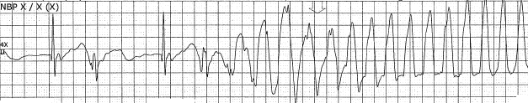
Ventricular Tachycardia
Causes: originates from an ectopic focus in either ventricle
  Underlying heart disease (post-surgery)
    LVOT surgery
  Long QT syndrome
  Myocarditis/cardiomyopathy
  Electrolyte disturbances*
Characteristics
  Wide QRS complexes
  P waves are not often identifiable
  Rate is 150-250 bpm and essentially regular
    Sometimes can be lower 110-150 bpm
Treatment
  With a pulse (stable)
    Medication therapy: amiodarone, lidocaine
    Elective cardioversion: 0.5-1 J / KG
  Without a pulse (unstable)
    High quality CPR
    Defibrillation: 2-4 J / KG
Notes:
4 or more PVCs in a row that spontaneously convert to sinus rhythm within 30 seconds = Ventricular Tachycardia
heart rhythm is driven by the lower chambers – the ventricles- instead from the upper chambers-the atria. During an episode of VT, the heart rate is fast, sometimes in excess of 200 beats per minute. The heart also pumps less effectively since the upper and lower chambers are no longer beating in synchrony with each other.
Lidocaine bolus 1 mg/kg, drip at 20-40 mcg/kg/min
Amiodarone bolus 5 mg/kg, drip at 5-10 mcg/kg/min

Slide 23
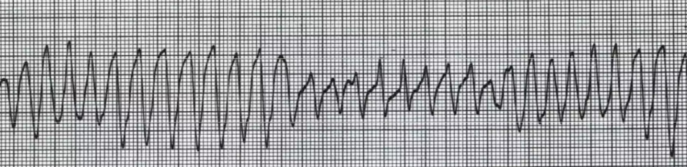
Torsades De Pointes
Causes
  Long QT syndrome (congenital or acquired)
    Defects in the sodium and potassium channels that affect repolarization
  Hypomagnesemia/Hypokalemia
  Antiarrhythmic drug toxicity
Display
  Polymorphic VT: QRS complexes vary in appearance, changing in polarity & amplitude
  Typically associated with a loss of pulses at onset
  Ventricular rate: 200-250 bpm
  Often transient but can progress to ventricular fibrillation
Notes:
French meaning: “turning on a point.”
QRS appear to rotate around the EKG isoelectric line

Slide 24
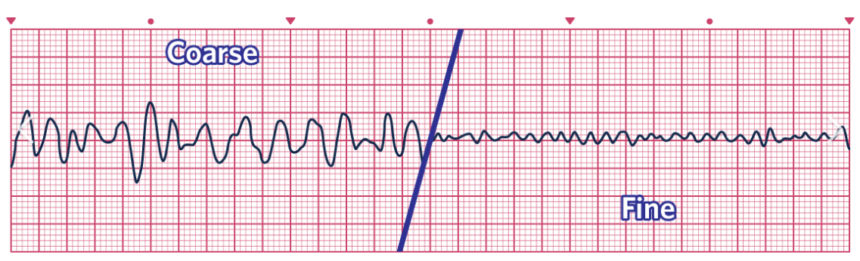
Ventricular Fibrillation
Causes
  End-result of sustained VT with degeneration to VF
  Undiagnosed cardiac abnormality (long QT)
  Sudden impact from collision resulting in commotio cordis
  Cardiomyopathy, damage/ischemia to heart muscle
Display
  No organized rhythm and no coordinated contractions
  Chaotic electrical activity
    No P waves, QRS complexes
  Heart quivers with no blood pumping/no cardiac output
Treatment
  Immediate recognition is essential
  High-quality CPR
  Rapid defibrillation
    2-4 J / KG
  Consider potential reversible causes
Notes:
VF may occur early during an arrest and quickly deteriorate to asystole.
During an episode of VF, the ventricles fire at a very high rate, from 450 to 600 beats per minute, and in a very disorganized way causing them to quiver "like a bowl of jelly". When this happens, the heart is not able to pump blood to the body, and death will occur unless electrical cardioversion is done or the rhythm converts back to normal on its own

Slide 25
Pulseless Electrical Activity (PEA)
Characterized: unresponsiveness and impalpable pulse in presence of sufficient electrical discharge.
  Electrical activity is not sufficient for contraction
  Depletion of myocardial energy reserves
Classified into primary (cardiac) or secondary (non cardiac) causes
Primary PEA:
  Cause by or related to cardiac arrest
  Depletion of myocardial energy reserves
  Responds poorly to therapy
Secondary PEA: “H’s & T’s”
Hypovolemia
Hypoxia
Hydrogen ions (acidosis)
Hypo/Hyperkalemia
Hypothermia
Tension Pneumothorax
Trauma
Tamponade
Thrombus, pulmonary
Thrombus coronary

Slide 26
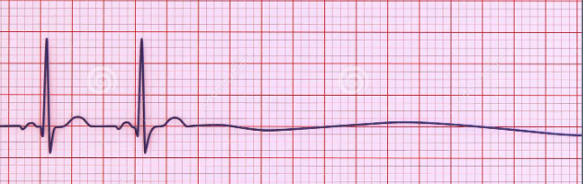
Asystole
Cessation of electrical and mechanical activity of the heart.
Lack of P-waves, QRS complexes, and T-waves
Causes:
  Deterioration of the initial non-perfusing ventricular rhythms
  Ventricular tachycardia, ventricular fibrillation,
  PEA cessation → asystole
  “H’s & T’s”
Treatment:
  High quality CPR
  Epinephrine administration every 3-5 minutes (IV/IO)
  Reversable causes

Slide 27
Defibrillation / Cardioversion
Review

Slide 28
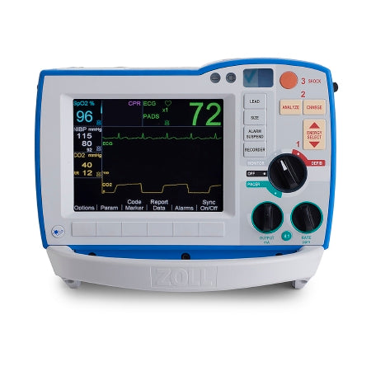
Defibrillator Indications
The defibrillator is used to provide an electrical current to restore a certain arrythmias to normal sinus.
4 indications for use:
  Monitor
  Defibrillation
  Cardioversion
  Transcutaneous Pace
ZOLL Medical Corporation, 2024
Notes:
The purpose of using a defibrillator is to restore an arrythmias back to normal sinus rhythm. To ensure the defibrillator is working correctly on your unit, there should be a green check mark in the corner, indicating the device has passed the internal quality test. When not in use, the defibrillator should be plugged into an emergency outlet to ensure the battery stays charged. This can be indicated by the two green circle lights on the screen of the defibrillator (and are outlined by the box on the screen).
Each defibrillator has the ability to complete 4 different actions.
The defibrillator has the ability to act as a monitor, including measuring the heart rate, pulse oximetry, respiratory rate, and blood pressure. Additionally, the defibrillator has advanced monitoring options, such as CO2 end tidal capnography and feedback for CPR.
The following defibrillation, cardioversion, and transcutaneous pacing will be discussed throughout this section.

Slide 29
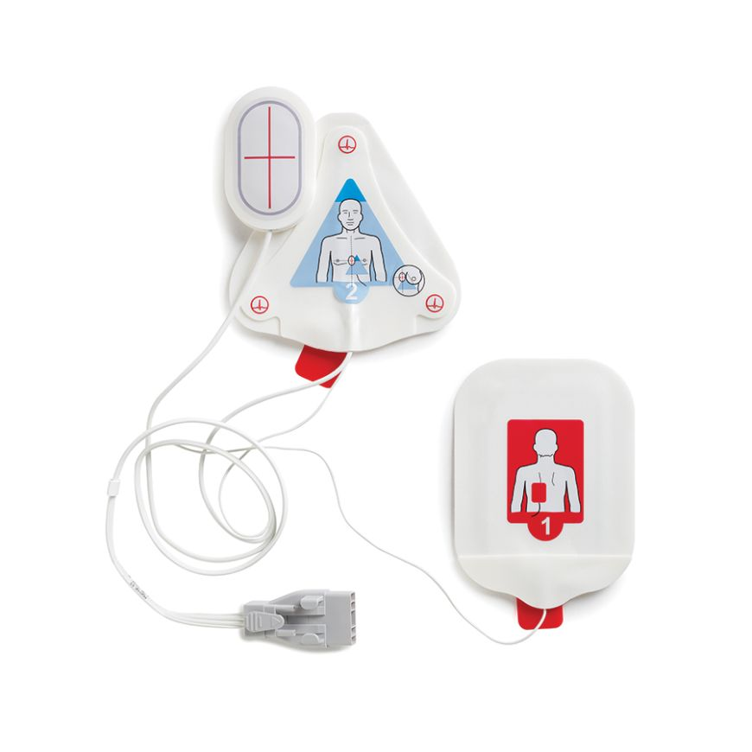
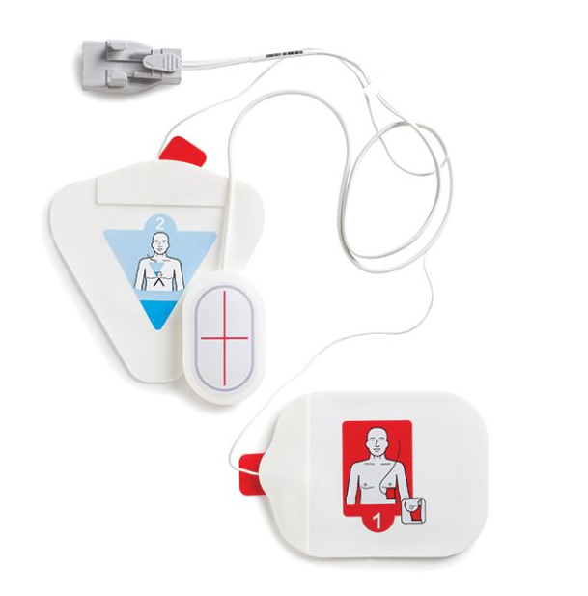
Pad Placement
Place electrode pads on clean, dry skin
  Remove excess hair
  Avoid any implanted devices
  Remove/clear skin of any medication patches
Place the posterior electrode pad first, to avoid damaging the front place pad
  Follow the picture on the pad for proper placement
  Left of the spine and under scapula
Place the anterior CPR compression sensor on the chest, mid sternum
Institutions with two anterior pads, apply electrode pad to align with the pectoral muscle on the left side
Anterior / Posterior Pad placement
Anterior / Anterior Pad placement

Slide 30
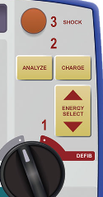
Indications: Defibrillation
Defibrillation: is non-synchronized administration of shock during a cardiac cycle of an unorganized rhythm with no pulse
The defibrillator mode can be used for the following arrythmias:
  Ventricular fibrillation
  V-Tach without a pulse
  Torsades de Pointes without a pulse
Energy selection will be based on patient:
  Adults: 120-200 J
  Pediatrics: 2-4 J/KG
Notes:
Defibrillation is the administration of a non-synchronized, electrical current (shock) during a cardiac cycle of an unorganized, chaotic rhythm with no pulse. The arrythmias that can be defibrillated are ventricular fibrillation, ventricular tachycardia, and Torsades de Pointes without a pulse. You cannot use the defibrillator to shock pulseless electrical activity or asystole, as there is no irregular rhythm or conduction to restore.
To utilizing the defibrillation mode, turn the black knob to the “Defib” section . Energy selection will occur based on the AHA guidelines for ACLS and/or PALS and is measured in Joules. The default energy of the defibrillator is set to 120 J, using the adult pads. To adjust energy manually, ALS providers will press the arrow up or down to select the identified amount of energy needed for defibrillation. Press charge to reach joule energy required for defibrillation and complete both a visual and verbal “CLEAR” check prior to administering shock. Once everyone is cleared from the patient, press the SHOCK button to delivery energy. Notice the “DEFIB” section outlines steps as 1, 2, and 3.
The ANALYZE soft-key button is a basic life support option to provide voice-prompted directions. This option provides similar instruction as an AED, until ALS provider arrive.

Slide 31
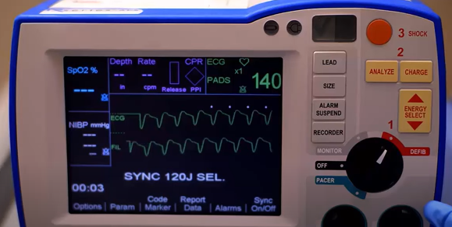
Indications: Cardioversion
Cardioversion: is a synchronized administration of shock during the R waves of a QRS complex in a cardiac cycle of an abnormal rhythm with a pulse.
The major difference between defibrillation and cardioversion is the timing of the energy delivery and amount of energy required.
To cardiovert a patient, ensure the soft-key SYNC button has been selected before setting and delivery energy shock.
  The SYNC soft-key will switch mode from DEFIB to SYNC
  Provides arrow markers above each R wave
Energy selection will be based on patient:
  Adults: 50-100 J
  Pediatrics: 0.5-1 J/KG
ZOLL Medical Corporation, 2024
Cardioversion can be used for arrythmias such as:
  Supraventricular tachycardias
  Ventricular tachycardia with a pulse
Notes:
To utilize the cardioversion mode, turn the black knob to the “Defib” section and press the soft-key SYNC button. Arrow markers will appear on the screen and show where the discharge of electricity can occur in each cardiac cycle. This SYNC mode needs to be activated to cardiovert. Patients who receive an electrical discharge without synchronizing can develop fatal arrythmias if shocked at the wrong point in a cardiac cycle.
Once the SYNC mode is activated, energy selection will occur based on the AHA guidelines for ACLS and/or PALS and is measured in Joules. To adjust energy manually, ALS providers will press the arrow up or down to select the identified amount of energy needed for cardioversion. Press charge to reach joule energy required for defibrillation and complete both a visual and verbal “CLEAR” check prior to administering shock. Once everyone is cleared from the patient, press and hold the SHOCK button until the light and sound disappear, to delivery energy.

