Slide 1
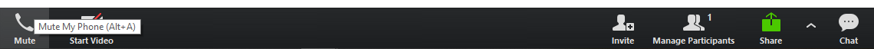
Housekeeping Reminders
Please submit questions via the Zoom chat during the presentation.
For attendance, please type in your name and organization in the chat.
Attendees are muted upon entry. Click “Unmute” when you would like to speak. Please mute yourself after speaking.
The presentations are posted on Tomorrow’s HealthCare www.tomorrowshealthcare.org

Slide 2
2025 PCMH Learning Network Well Child and Adolescent Well Care Visits Sprint Session #3
August 27, 2025
Pittsburgh Regional Health Initiative
Robert Ferguson, MPH, Chief Policy Officer, Pittsburgh Regional Health Initiative

Slide 3
Continuing Education Information
In support of improving patient care, this activity has been planned and implemented by the University of Pittsburgh and The Jewish Healthcare Foundation. The University of Pittsburgh is jointly accredited by the Accreditation Council for Continuing Medical Education (ACCME) and the American Nurses Credentialing Center (ANCC), to provide continuing education for the healthcare team. 1.5 hours are approved for this course.
As a Jointly Accredited Organization, University of Pittsburgh is approved to offer social work continuing education by the Association of Social Work Boards (ASWB) Approved Continuing Education (ACE) program. Organizations, not individual courses, are approved under this program. State and provincial regulatory boards have the final authority to determine whether an individual course may be accepted for continuing education credit. University of Pittsburgh maintains responsibility for this course. Social workers completing this course receive 1.5 continuing education credits.

Slide 4
Disclosures
No members of the planning committee, speakers, presenters, authors, content reviewers and/or anyone else in a position to control the content of this education activity have relevant financial relationships with any entity producing, marketing, re-selling, or distributing health care goods or services, used on, or consumed by, patients to disclose.
Notes:
No conflicts of interest

Slide 5
Disclaimer
The information presented at this Center for Continuing Education in Health Sciences program represents the views and opinions of the individual presenters, and does not constitute the opinion or endorsement of, or promotion by, the UPMC Center for Continuing Education in the Health Sciences, UPMC / University of Pittsburgh Medical Center or Affiliates and University of Pittsburgh School of Medicine. Reasonable efforts have been taken intending for educational subject matter to be presented in a balanced, unbiased fashion and in compliance with regulatory requirements. However, each program attendee must always use his/her own personal and professional judgment when considering further application of this information, particularly as it may relate to patient diagnostic or treatment decisions including, without limitation, FDA-approved uses and any off-label uses.

Slide 6
Learning Objectives
Discuss preliminary findings and progress from the mid-year sprint surveys
Describe how working with patient advisors can help PCMHs better understand why well-child and adolescent well-care visits are missed and develop effective outreach strategies

Slide 7
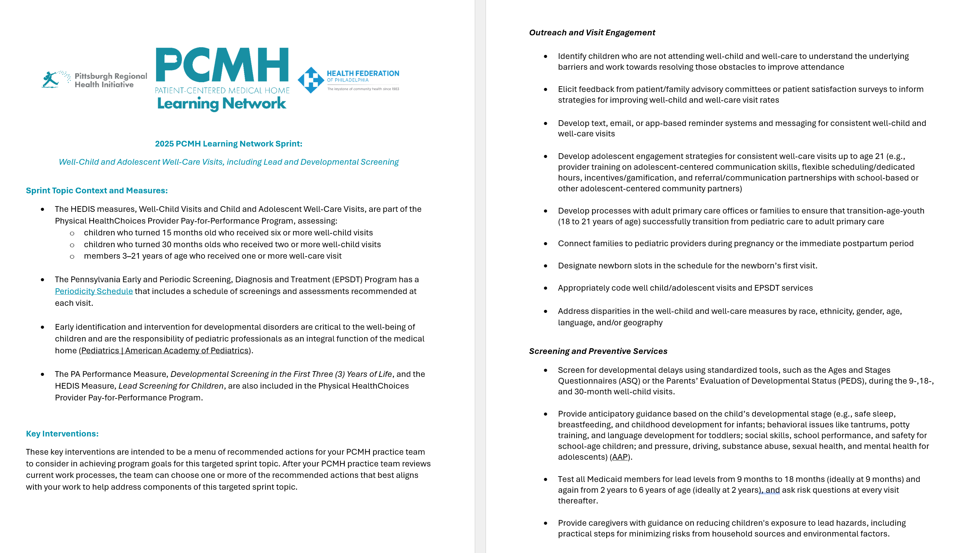
Well-Child and Well-Care Visits, Including Lead and Developmental Screening
Well-Care Visits:
60.21% (2023)
Well-Child:
68.77% (2023)
Lead Screening:
82.21% (2023)
Developmental Screening: 67% (2023)

Slide 8
2025 PCMH Learning Network
Jan. 22
Statewide Virtual Kickoff Session
(1.5 hr. session)
March 26 and May 29 Virtual Sessions for Each Sprint Cohort
(2 1.5 hr. sessions)
June 25
In-Person Statewide Event to Celebrate Sprint Progress and Launch Second Half of Sprint
(6 hr. session)
Aug. 27 and Oct. 29
Virtual Sessions for Each Sprint Cohort
(2 1.5 hr. sessions)
Nov. 13
Statewide Virtual Event to Celebrate Progress and Launch 2026 Sprints
(1.5 hr. session)
Session Dates for Well Child and Adolescent Well Care Visits Sprint
Baseline Sprint Survey
Sprint Survey (Time 2)
Sprint Survey (Time 3)
Optional Case-Based Learning Sessions on Clinical Topics Offered throughout the Year

Slide 9



PCMH Online Community https://www.tomorrowshealthcare.org/
Access the session materials in “Learning Sessions”
Look for guides and tools in “Resources”
To request a new login, please email J. Ashenayi, MPH, Program Associate (Ashenayi@JHF.org)

Slide 10
Sprint Surveys
Enables PCMHs to assess what’s in place and what to prioritize within sprints
Enables PCMH Learning Network to share back collective impact and customize learning content

Slide 11
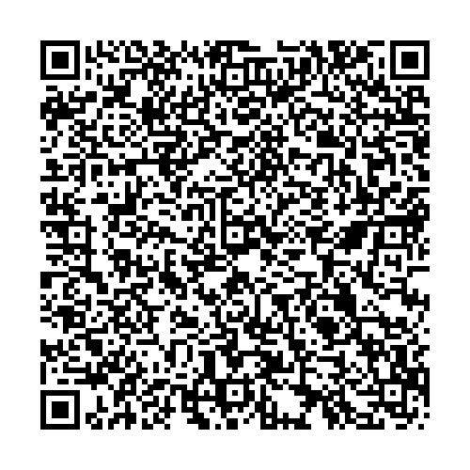
Review of Mid-Year Sprint Surveys
Reflects what PCMHs are working on and implementing within sprints
Included data from PCMHs that completed the baseline AND mid-year survey:
Well Child & Adolescent Well Visits – 5 PCMHs (83%)
*Full version of baseline vs. mid-year results are available in Tomorrow’s Health Care

Slide 12
Child and Adolescent
Well-Child and Well-Care Visits | Baseline | Midyear
Develop text, email, or app-based reminder systems and messaging for consistent well-child and well-care visits | Fully in Place: 60% In Progress: 20% Have not Started: 20% | Fully in Place: 40% In Progress: 60% Have not Started: 0%
Provide anticipatory guidance based on the child’s developmental stage | Fully in Place: 80% In Progress: 20% Have not Started: 0% | Fully in Place: 100% In Progress: 0% Have not Started: 0%
Provide caregivers with guidance on reducing children's exposure to lead hazards, including practical steps for minimizing risks from household sources and environmental factors. | Fully in Place: 20% In Progress: 80% Have not Started: 40% | Fully in Place 60% In Progress: 40% Have not Started: 0%

Slide 13
Sprint Session #4 - Topics
Please respond to the Zoom Poll and indicate your preferred topic for the upcoming Well Child and Adolescent Well Visits Sprint Session #4 on Wednesday, October 29th at 10 – 11:30 am via Zoom

Slide 14
Working with Patient Advisors to Address Missed Well-Child and Adolescent Well-Care Visits
Renee Turchi, MD, MPH, FAAP, Medical Director, Center for Children and Youth with Special Healthcare Needs, Tower Health

Slide 15
PCMH Peer-to-Peer Learning Discussion

Slide 16
Wrap Up & Session Evaluation

Slide 17
2025 PCMH Learning Network
Jan. 22
Statewide Virtual Kickoff Session
(1.5 hr. session)
March 26 and May 29 Virtual Sessions for Each Sprint Cohort
(2 1.5 hr. sessions)
June 25
In-Person Statewide Event to Celebrate Sprint Progress and Launch Second Half of Sprint
(6 hr. session)
Aug. 27 and Oct. 29
Virtual Sessions for Each Sprint Cohort
(2 1.5 hr. sessions)
Nov. 13
Statewide Virtual Event to Celebrate Progress and Launch 2026 Sprints
(1.5 hr. session)
Session Dates for Well Child and Adolescent Well Care Visits Sprint
Baseline Sprint Survey
Sprint Survey (Time 2)
Sprint Survey (Time 3)
Optional Case-Based Learning Sessions on Clinical Topics Offered throughout the Year

Slide 18
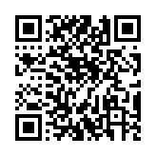
CEU Process
You will receive a follow up email with links to:
Complete the survey at: https://www.surveymonkey.com/r/KXNHGJN by Wednesday, September 3rd
Please be sure to designate which CEU credits you are requesting CME, CNE, Social Worker or Certificate of Attendance. If you already have an account with the UPMC Center for Continuing Education, please be sure the email you enter on the survey matches the UPMC CCE account email that you create.
The UPMC Center for Continuing Education will follow up with you via email after September 3rd with instructions on how to claim your credits.
To prepare, we recommend you create an account with UPMC CCE via this website https://cce.upmc.com.

Slide 19
Thank You!

