Slide 1
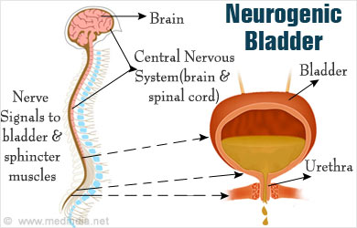
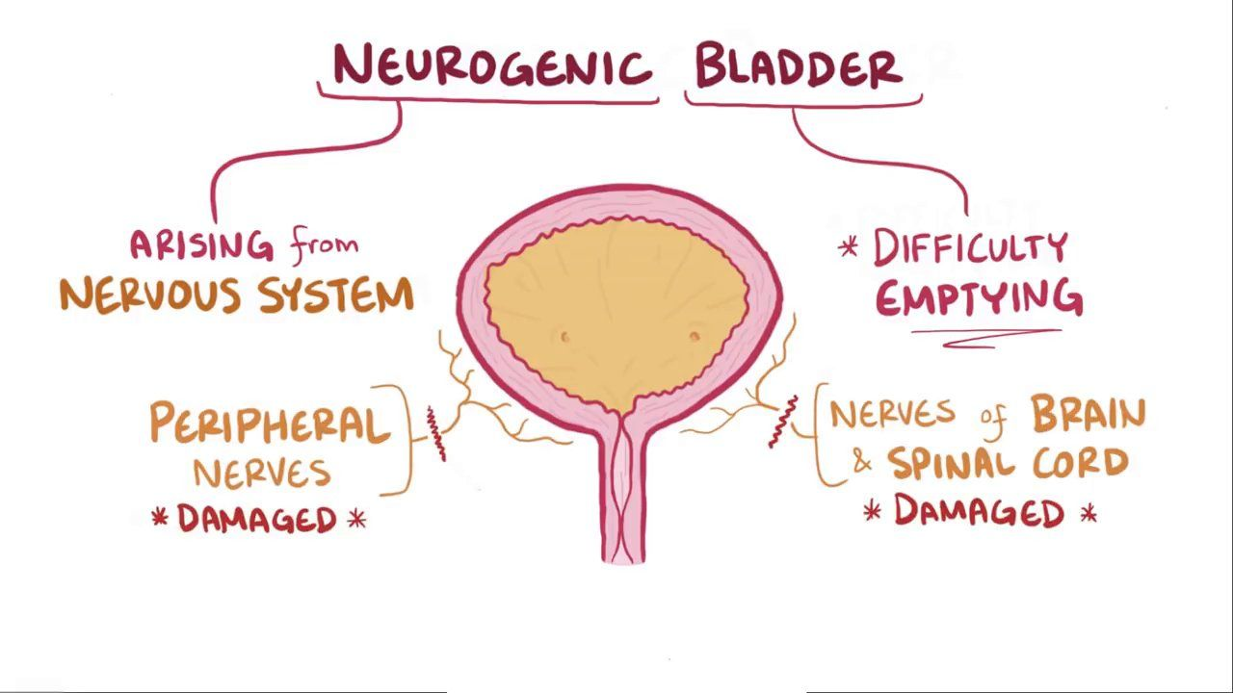

Neurogenic Bladder
Olivia Valenti RN, BSN
CHRU
Notes:
Hi my name is Olivia Valenti. I am a nurse on rehabilitation unit here at Children’s Hospital. I have been working on this unit for the last two years and have learned a lot about different traumas these young patients can face. This year for the trauma fair, the CHRU has chosen Neurogenic Bladder to be our topic. Due to the high volume of traumatic brain injuries and spinal cord injuries we see, neurogenic bladder is a common condition among our patients. This presentation will highlight what neurogenic bladder is, the causes, the signs and symptoms, as well as possible treatments and complications that may arise. At the end of this presentation, I have provided my contact information for any questions.

Slide 2
What is Neurogenic Bladder?
Neurogenic bladder is defined as a bladder dysfunction caused by damage to the body’s central nervous system.
  Patients diagnosed with neurogenic bladder lack bladder control due to a brain, spinal cord, or nerve condition/injury
  This condition can lead to difficulty voiding, such as voiding too often or not voiding enough to completely empty the bladder.
  There are 2 types of neurogenic bladder
    Flaccid Bladder
    Spastic Bladder
  Left untreated, a neurogenic bladder can cause damage to the kidneys.

Slide 3
Types of Neurogenic Bladder
Flaccid Bladder: a flaccid, or hypotonic, bladder does not contract fully, causing urine to exit the body in small amounts. This can lead to urinary retention and overflow incontinence (leakage of urine when bladder is full.) Because it is a type of neurogenic bladder, it is caused by nerve damage that disrupts communication between brain and bladder.
Spastic Bladder: also known as overactive bladder, is a condition where the bladder muscles contract involuntarily, causing a sudden, strong urge to urinate and potentially leading to leakage.

Slide 4
The Urinary System
The urinary system works as the body’s filtration system eliminating excess water and waste. This waste is called urine. In order to empty the bladder, the waste has to pass through a series of organs, ducts, and tubes.
The main organs in the urinary system are:
  2 kidneys (blood filtering organs)
  Two ureters (ducts that connect kidney to bladder)
  Bladder (organ that holds urine)
  Urethra (tube connected to bladder that allows urine to leave the body)
The purpose of the urinary system is mainly to eliminate the waste from the body as well as regulate blood volume and blood pressure, control electrolyte levels, and regulate the blood pH.

Slide 5
Signs and Symptoms
Common symptoms of neurogenic bladder include:
Urinating frequent small amounts without fully emptying the bladder
Loss of bladder control
Urinary retention
Frequent UTIs
Inability for the body to recognize when the bladder is full
Due to the wide variety of symptoms that can occur, neurogenic bladder can be difficult to diagnose and treat.

Slide 6
Causes of Neurogenic Bladder
Damage to the nervous system can cause difficulty emptying the bladder. Some common causes of neurogenic bladder include:
Diabetes: can damage nerves throughout the body, including those involved in bladder function
Encephalitis: inflammation of the brain can damage the nerves involved in bladder function
Brain/Spinal cord injuries: injuries at any level of the spinal cord can disrupt the nerve signals to and from the bladder
Stroke: can damage the brain areas that control bladder function
Spina Bifida: can compress or damage the spinal cord affecting bladder function
Cerebral Palsy: this condition affects the muscle movement and coordination that can affect bladder control.

Slide 7
Neurogenic Bladder in Spinal Cord Injuries
A spinal cord injury, or SCI, is damage to the spinal cord that can ultimately disrupt the communication between the body and the brain.
Though symptoms can vary depending on the severity of the injury, a common symptom seen is neurogenic bladder.
Due to high risk of frequent UTIs and kidney stones, bladder management is imperative in SCI patients.
On the rehabilitation unit, sterile intermittent catheterization is often used as a form of effective bladder management
The goals of bladder management in these patients include efficient bladder emptying, preventing infection, and ensuring social continence.

Slide 8
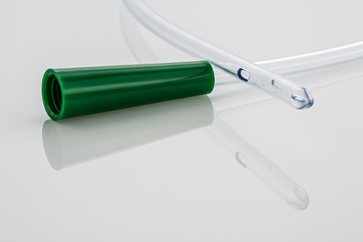
Intermittent Urinary Catheterization
Intermittent urinary catheterization is used to drain the bladder that is not emptying adequately. The catheter is inserted and removed several times a day to ensure that urine does not sit in the bladder for an excess period of time. It is common practice for managing urinary retention, leakage, or high bladder pressures.
Intermittent urinary catheterization is taught to patients by a registered nurse or other health care providers. Though there is typically difficulty not only learning, but adjusting to catherization, most families and patients can effectively perform this procedure with practice.
Before discharge, patients and families are taught how to sterilely insert the catheter at regular intervals throughout the day.
Though this is an effective way to empty the bladder throughout the day, complications can arise. Complications can include urethral injury, UTIs, and bleeding.
Thorough handwashing and proper disposal of the catheters are essential to minimize risk of infection.

Slide 9
Steps of Intermittent Urinary Catheterization
1. Gather supplies: gather all necessary supplies needed such as sterile gloves, catheter, lubricant, and antiseptic solution
2. Position Patient: ensure the patient is in a comfortable position
3. Perform Hand Hygiene
4. Apply sterile gloves: it is imperative to maintain a sterile field once gloves applied
5. Clean the area: use the antiseptic solution to clean the urethral area to prevent infection
6. Insert the Catheter: gently insert the lubricated catheter into the urethra, until urine begins to flow
7. Secure the catheter: secure the catheter to prevent movement and ensure proper drainage
8. Remove catheter/dispose of materials

Slide 10
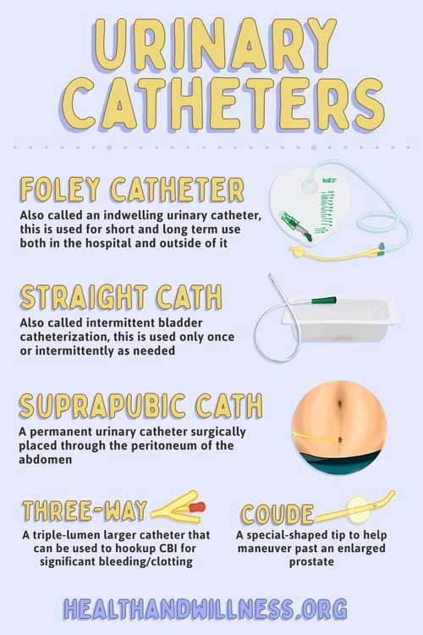
Notes:
These are the various types of catheters used for urinary elimination.
A foley catheter or also called an indwelling catheter is used for short and long term use both in the hospital and outside setting
A Straight cath, or intermittent bladder catheterization is used only once or intermittently as needed
A suprpubic catheter is a permanent urinary catheter surgically placed through the peritoneum of the abdomen
A three way catheter is a triple lumen larger catheter that can be used to hookup CBI for significant bleeding/clotting
A coude catheter is a special shaped tip catheter that is to help manuever past an enlarged prostate

Slide 11
How is Neurogenic Bladder Diagnosed
Neurogenic bladder is diagnosed by:
  Medical history: prior genitourinary conditions, surgeries, voiding history, urinary symptoms, current medications
  Physical Exam: focus on pelvic organs and neurological system
  Bladder Diary: patients track urinary occurrences and symptoms that can be used for diagnosis
  Urodynamic testing (key test): measures how well bladder stores and releases urine
    Sensors are placed near urethra or anus to test nerve functioning
  Imaging: CTs, MRI, cystoscopy,US,x-rays
  Neurological evaluations

Slide 12
Neurogenic Bladder Treatment
Bladder augmentation surgery to increase bladder size to be able to hold more urine
Botox to relax urinary sphincter helping with urinary symptoms and ability to hold urine
Continuous catheterization (chronic foley)
Medications such as oxybutynin
Self-catheterization
Urinary reconstruction such as creation of urostomy bag
Lifestyle changes (avoiding caffeine, large amounts of sugar, and preventing constipation

Slide 13
Physical Complications of Neurogenic Bladder
Physical complications include:
Urinary Tract Infections: incomplete bladder emptying allows bacteria to multiply, leading to infections
Kidney damage: high pressure in the bladder due to incomplete emptying or urinary retention can damage the kidneys and ureters
Kidney stones: changes in urine flow and composition can increase the risk of kidney stone formation
Autonomic Dysreflexia: a potentially dangerous condition of sudden and severe high blood pressures that can occur with neurogenic bladder
Renal disease: untreated neurogenic bladder can lead to chronic kidney disease and potential kidney failure.

Slide 14
Psychosocial Complications of Neurogenic Bladder
Psychosocial Complications include:
Anxiety and Depression: patients with neurogenic bladder often experience anxiety related to urinary leakage, need for catheterization, and potential UTIs. The impact on one’s daily life can also lead to depression.
Loss of control and Embarrassment: due to the unpredictable nature of bladder function, it can lead to feeling loss of control in one’s life. Whereas urinary incontinence can lead to embarrassment and shame especially if this occurs in public around peers.
Social Isolation: Fear of accidents and difficulty managing symptoms can lead to social isolation, especially in children.
Reduced Self-Esteem and Confidence: neurogenic bladder can negatively affect a patient’s self esteem and confidence, making them feel unlike everyone else.
Caregiver Burden: the caregivers of patients with neurogenic bladder may also experience emotional distress and anxiety due to helping with managing the condition.

Slide 15
References
Dr. Catherine Shaffer, Ph. D. (2022, December 29). Neurogenic bladder tests and diagnosis. News. https://www.news-medical.net/health/Neurogenic-Bladder-Tests-and-Diagnosis.aspx
What is neurogenic bladder?. Cleveland Clinic. (2025, June 2). https://my.clevelandclinic.org/health/diseases/15133-neurogenic-bladder
Neurogenic bladder. Johns Hopkins Medicine. (2024, April 26). https://www.hopkinsmedicine.org/health/conditions-and-diseases/neurogenic-bladder
Neurogenic bladder. Neurogenic Bladder | University of Michigan Health. (n.d.). https://www.uofmhealth.org/conditions-treatments/adult-urology/neurogenic-bladder

Slide 16

Questions?
Please email Olivia Valenti (valentiov@upmc.edu) for any questions!

