Slide 1
Information (and Misinformation) About Current Vaccine Recommendations
Kristine S. Schonder, PharmD
Associate Director of PharmD Program
Associate Professor, Department of Pharmacy & Therapeutics

Slide 2
I have no financial disclosure or conflicts of interest with the presented material in this presentation.

Slide 3
Learning Objectives
Summarize common myths and misinformation surrounding vaccines
Evaluate evidence for current vaccine recommendations
Develop responses to patient questions regarding vaccine safety

Slide 4
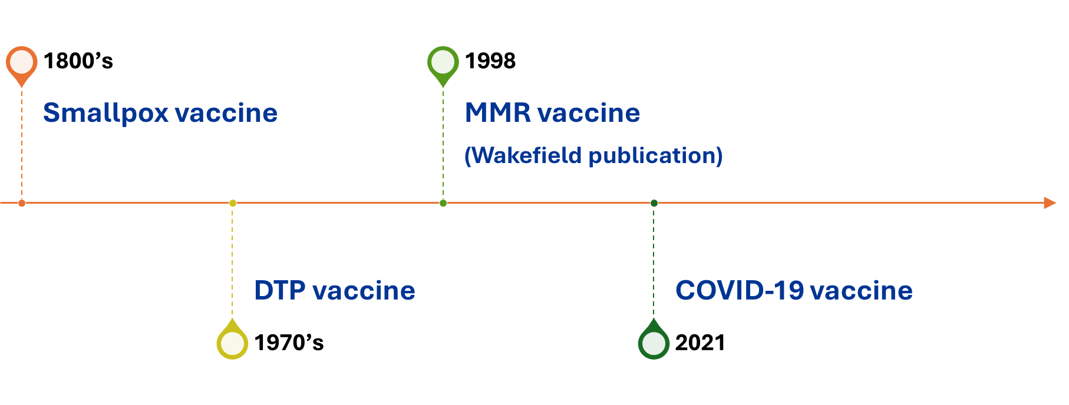
Tale as Old as Time

Slide 5
Vaccine Paradox
Vaccines are one of the greatest medical achievements in history
Over 154 million lives saved over past 50 years
- WHO
Myths and misinformation about vaccines creates unnecessary fears

Slide 6

Vaccine Adverse Event Reporting System
National early warning system
Co-managed by CDC and FDA
“Not designed to determine if a vaccine caused a health problem”
Passive reporting system
Anyone can submit report for any adverse experience
Data publicly available

Slide 7
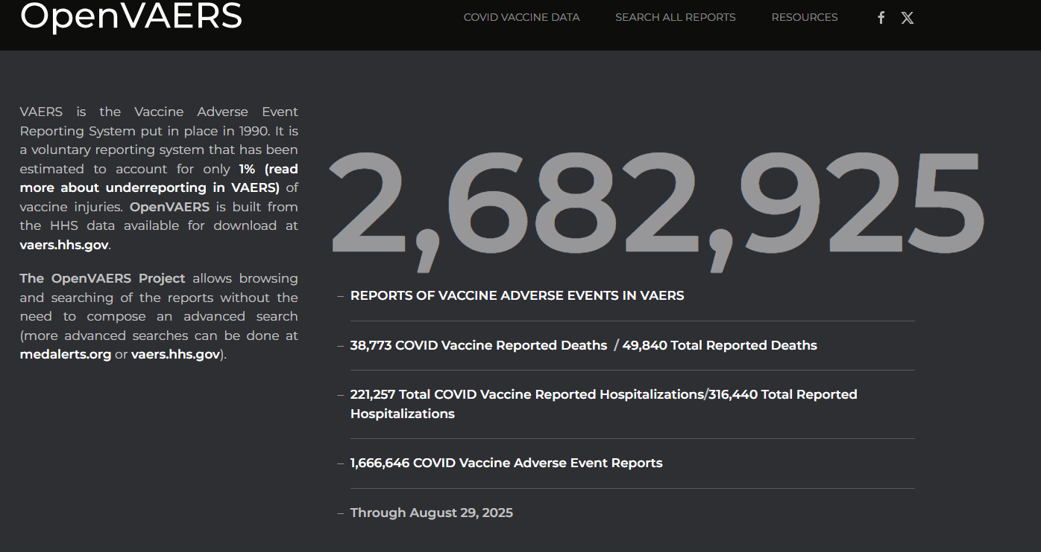
https://openvaers.com/

Slide 8

Reasons for Vaccine Hesitancy
Contextual Influences
Individual and Group Influences
Vaccine Influences
Communication and media
Influencers (leaders, gatekeepers, anti/pro-vaccine lobbies)
Historical influences
Religion/culture/ gender/socio-economic
Politics/policies
Geographic barriers
Pharmaceutical industry
Risk/benefit (scientific evidence)
Introduction of new vaccine / formulation
Mode of administration
Design of vaccination program / mode of delivery
Reliability/source of vaccine supply
Vaccination schedule
Costs
Role of healthcare professionals
Past vaccine experience
Beliefs, attitudes about health and prevention
Knowledge / awareness
Health system and provider-trust and personal experience
Perceived risk/benefit
Peer and social norms
Summary of WHO SAGE conclusions and recommendations on Vaccine Hesitancy, January 2015
https://www.who.int/docs/default-source/immunization/demand/summary-of-sage-vaccinehesitancy-en.pdf

Slide 9
Common Misinformation about Current Vaccines
Vaccines cause autism and sudden infant death syndrome (SIDS)
Vaccines are not safe and can cause harm
Vaccine contain harmful ingredients
Vaccines can cause the disease
Natural immunity is better than vaccine-induced immunity
Vaccines are only for children
Vaccines are not needed by everyone if enough people get vaccinated
Vaccines are not needed for uncommon diseases

Slide 10

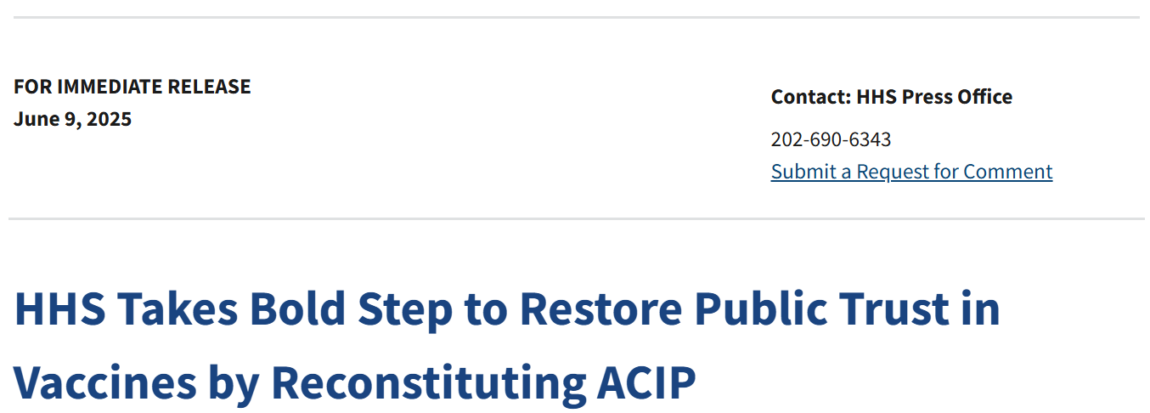
https://www.hhs.gov/press-room/hhs-restore-public-trust-vaccines-acip.html

Slide 11
Understanding the Science Behind
New Vaccine Recommendations

Slide 12
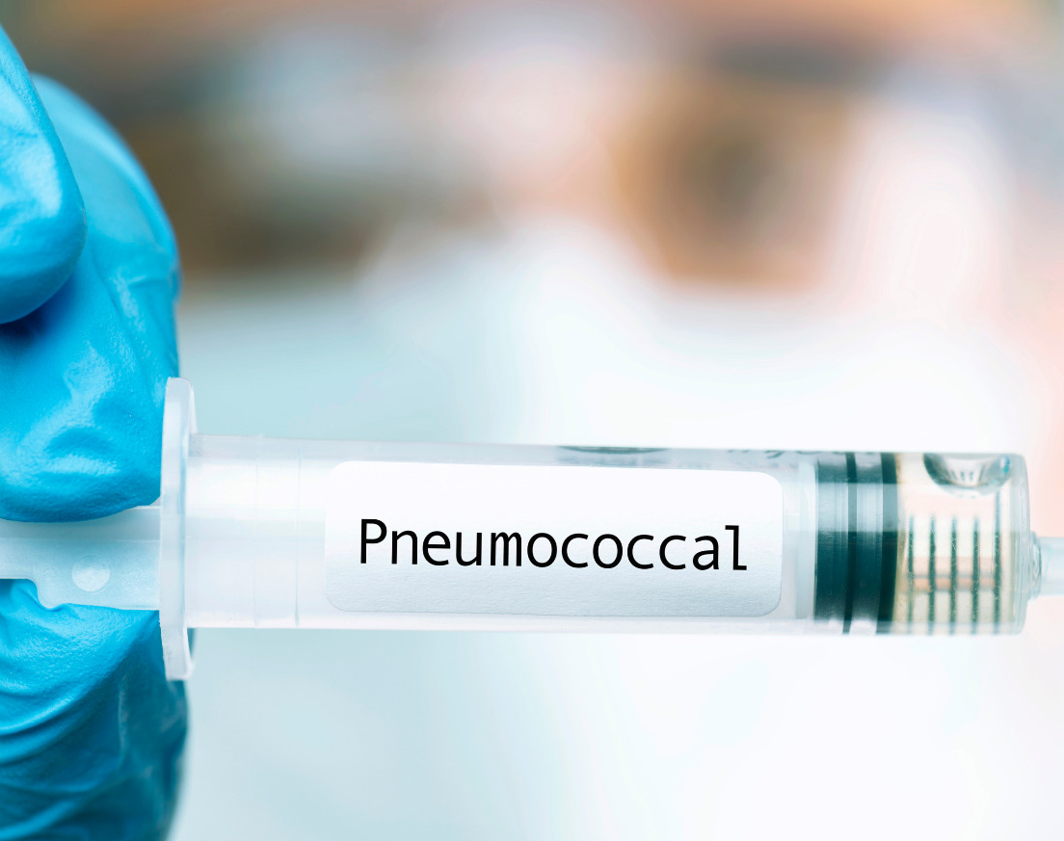
Pneumococcal Vaccine

Slide 13
Pneumococcal Vaccine
PCV recommended for all PCV-naïve adults aged > 50 years
PCV recommended for adults aged 19-49 years with underlying conditions or risk factors
Supplemental dose of PCV20 or PCV21 recommended for adults aged > 65 years who have completed recommended series with both PCV13 and PPSV23
Chronic heart disease
Chronic lung disease
Chronic liver disease
Chronic kidney disease
Diabetes
Smoking
Asplenia
Cochlear implant
Weakened immune system
Solid or blood cancer
HIV infection
Sickle cell disease
PCV = Pneumococcal Conjugate Vaccine

Slide 14
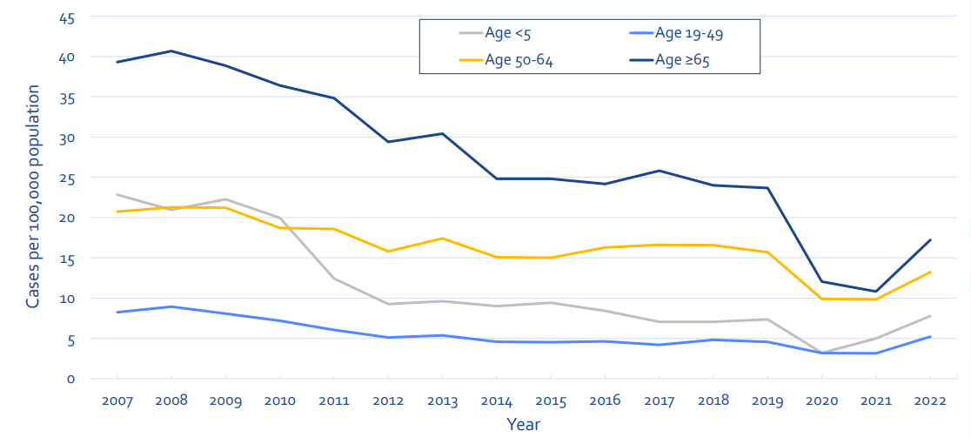
Incidence of Invasive Pneumococcal Disease, by age group US 2007-2022
PCV13: children
2023: PCV20: children
PCV13: adults
PCV15: children
PCV15 & PCV20:
adults
COVID-19
https://www.cdc.gov/abcs/methodology/surv-pop.html

Slide 15
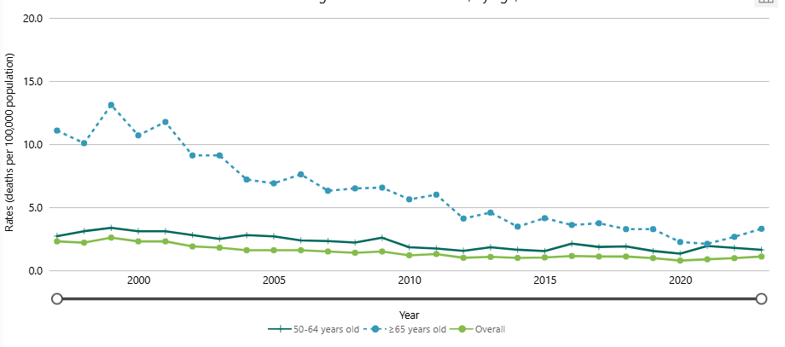
Invasive Pneumococcal Disease Mortality Rate, by age group
https://www.cdc.gov/abcs/bact-facts/data-dashboard.html

Slide 16
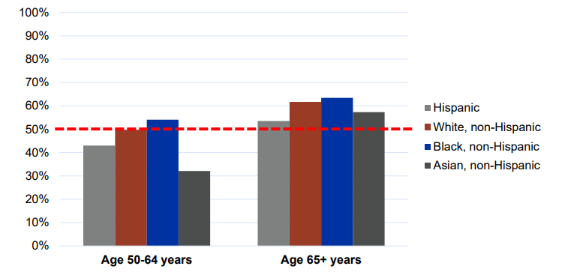
Risk for Pneumococcal Disease
Adults aged 50-64 years
88% with pneumococcal disease have > 1 condition with risk condition
32-54% have underlying conditions with risk-based indication
Chronic heart disease
Chronic lung disease
Chronic liver disease
Diabetes
Smoking
Alcoholism
Weakened immune system
Solid cancer
Blood cancer
Source: NHIS 2020 data

Slide 17
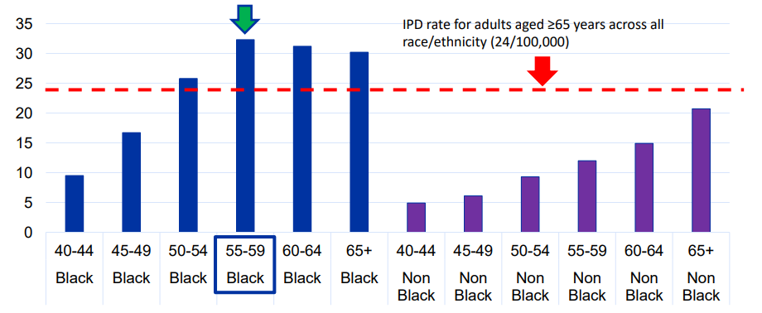
Pneumococcal Disease Rates
By Race, Age
https://www.cdc.gov/abcs/methodology/surv-pop.html
Presented: ACIP October 23, 2024

Slide 18
Pneumococcal Vaccine
PCV recommended for all PCV-naïve adults aged > 50 years
PCV recommended for adults aged 19-49 years with underlying conditions or risk factors
Supplemental dose of PCV20 or PCV21 recommended for adults aged > 65 years who have completed recommended series with both PCV13 and PPSV23
Chronic heart disease
Chronic lung disease
Chronic liver disease
Chronic kidney disease
Diabetes
Smoking
Asplenia
Cochlear implant
Weakened immune system
Solid or blood cancer
HIV infection
Sickle cell disease
PCV = Pneumococcal Conjugate Vaccine

Slide 19
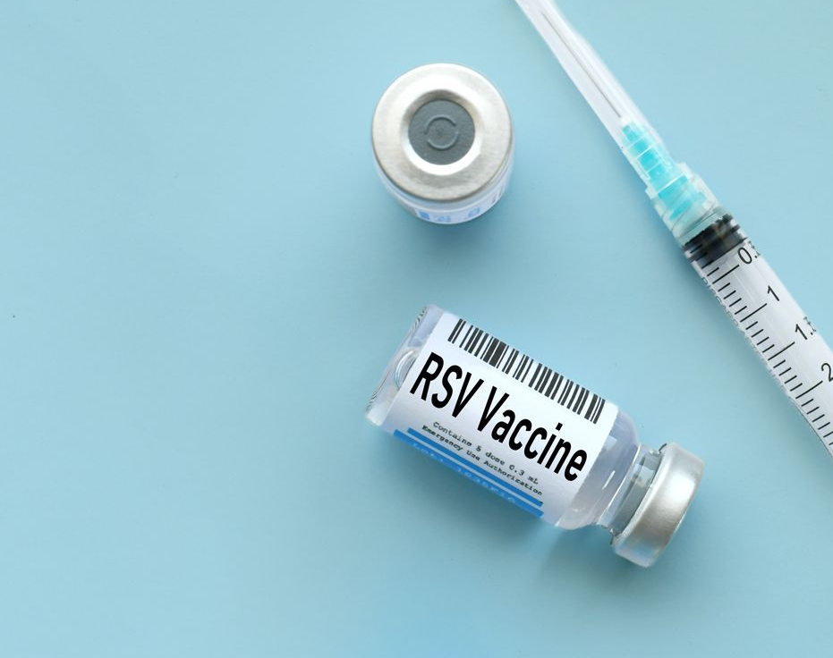
Respiratory Syncytial Virus (RSV) Vaccine

Slide 20
Respiratory Syncytial Virus (RSV) Vaccine
Single dose of RSV vaccine recommended for persons aged 50-59 years with increased risk for severe disease
CDC will publish Clinical Considerations that describe chronic medical conditions and risk factors
Single dose of RSV vaccine recommended for all persons aged > 75 years
Single dose of RSV vaccine recommended for persons aged 60-74 years at increased risk of severe RSV disease
Chronic heart disease
Chronic lung disease
End Stage Kidney Disease
Diabetes mellitus requiring treatment
Neurologic or neuromuscular conditions
Chronic liver disease
Chronic hematologic conditions
Severe obesity
Moderate-severe immunocompromise
Residence in nursing home
Shared clinical decision-making

Slide 21
Major Medical Condition Categories
Persons Hospitalized with RSV (weighted %)
Persons aged 50-59 years
Persons aged > 60 years
Cardiovascular disease 46.3
Diabetes mellitus 37.0
Asthma 29.7
COPD or chronic bronchitis 26.5
Immunocompromised condition 25.5
Severe obesity (BMI > 40 kg/m²) 21.3
Chronic kidney disease 19.8
Neurologic disorder 19.4
GI, liver, pancreatic disease 9.8
Blood disorder 4.5
Cardiovascular disease 66.7
Diabetes mellitus 36.9
COPD or chronic bronchitis 35.0
Chronic kidney disease 29.1
Neurologic disorder 26.5
Immunocompromised condition 18.5
Asthma 18.1
Severe obesity (BMI > 40 kg/m²) 10.7
GI, liver, pancreatic disease 6.5
Rheumatologic disease 4.2
Adapted from Britton, et al. ACIP Work Group, April 2025
Data from: RSV-NET

Slide 22
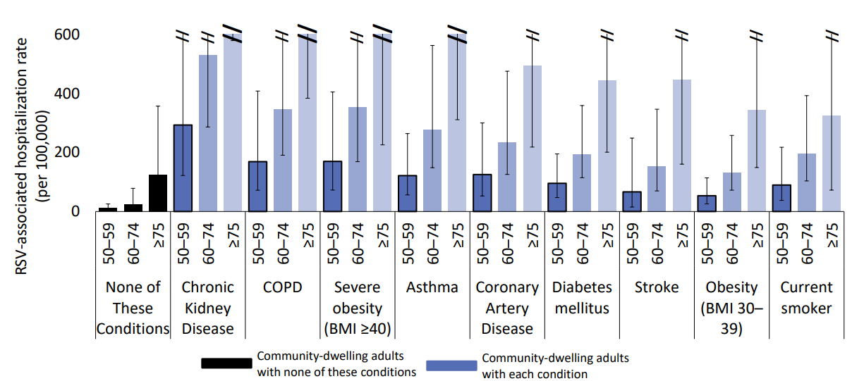
RSV-Associated Hospitalization Rates
Community-Dwelling Adults aged > 50 years, 2017-2018 season
Adapted from Britton, et al. ACIP Work Group, April 2025
Data from: RSV-NET

Slide 23
Respiratory Syncytial Virus (RSV) Vaccine
Single dose of RSV vaccine recommended for persons aged 50-59 years with increased risk for severe disease
CDC will publish Clinical Considerations that describe chronic medical conditions and risk factors
Single dose of RSV vaccine recommended for all persons aged > 75 years
Single dose of RSV vaccine recommended for persons aged 60-74 years at increased risk of severe RSV disease
Chronic heart disease
Chronic lung disease
End Stage Kidney Disease
Diabetes mellitus requiring treatment
Neurologic or neuromuscular conditions
Chronic liver disease
Chronic hematologic conditions
Severe obesity
Moderate-severe immunocompromise
Residence in nursing home
Shared clinical decision-making

Slide 24
Clesrovimab (Enflosnia®)
Long-acting RSV monoclonal antibody
Approved for infants born during or entering first RSV season
Single dose: 105 mg/0.7 mL
Same dose for all infants regardless of weight

Slide 25
Long-Acting RSV Monoclonal Antibodies
Nirsevimab (Beyfortis®)
Longer half-life
Approved for infants entering first or second RSV season
Weight-based dosing
< 5kg = 50 mg
> 5kg = 100 mg
Second RSV season = 200 mg
Clesrovimab (Enflonsia®)
Shorter half-ife
Approved for infants entering first RSV season only
Non-weight-based dosing
105 mg / 0.7mL syringe

Slide 26
Long-Acting RSV Monoclonal Antibody
1 dose long-acting RSV antibody recommended for infants aged < 8 months born during or entering first RSV season (No preference for nirsevimab or clesrovimab)
Mother did not receive RSV vaccine during pregnancy
Mother’s RSV vaccination status unknown
Infant born < 14 days after maternal RSV vaccination
Consider if mother vaccinated and:
Did not mount adequate immune response (e.g., immunocompromised)
Has condition associated with reduced transplacental antibody transfer (e.g., HIV infection)
Infant has procedure leading to loss of maternal antibodies
Infant with substantially increased risk for severe RSV disease
1 dose of nirsevimab recommended for children aged 8-19 months at increased risk for severe RSV disease entering 2nd RSV season

Slide 27
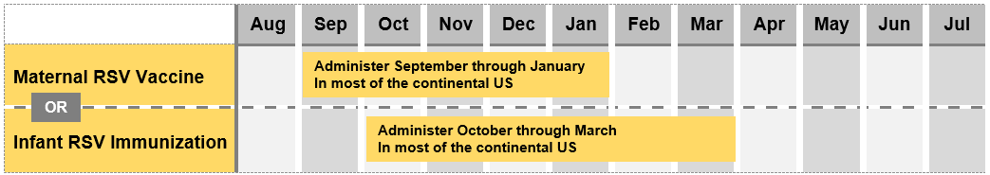
Preventing RSV Disease in Infants
Maternal RSV vaccination
Abrysvo® (Pfizer)
Infant RSV antibody
Nirsevimab
Clesrovimab
- or -
Adapted from CDC.gov

Slide 28

COVID-19 Vaccine

Slide 29
COVID-19 Vaccine
Vaccination based on shared clinical decision-making for all ages
Emphasized risk-benefit profile strongly favors vaccination of high-risk groups:
Aged > 65 years
Chronic medical conditions
Immunocompromised

Slide 30
Rates of COVID-19-Associated Hospitalizations
Data source: COVID-NET: https://www.cdc.gov/covid/php/covid-net/index.html

Slide 31
COVID-19 Vaccination Coverage
Data source: National Immunization Survey – Fall Respiratory Virus Model
Immunization Services Division, CDC, Spetember 2025

Slide 32
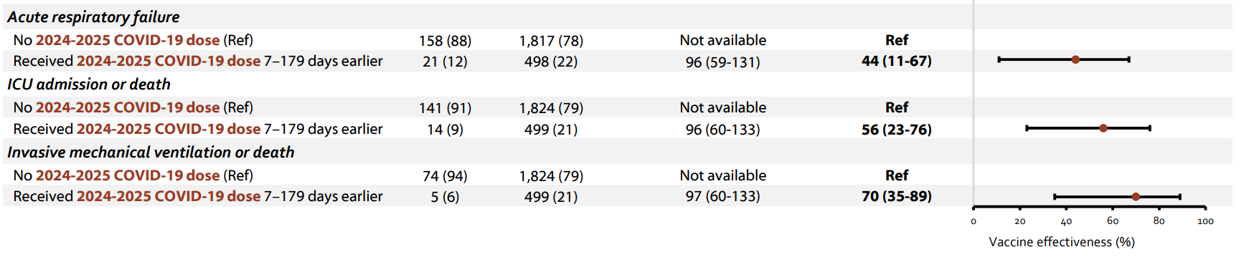
Effectiveness of 2024-2025 COVID-19
Against COVID-19-associated Critical Illness
Adults aged >65 years
From National Center for Immunization and Respiratory Diseases, CDC, September 2025
Data from: Link-Gelles, et al. MMWR: https://www.cdc.gov/mmwr/volumes/74/wr/mm7406a1.htm

Slide 33
Safety of mRNA COVID-19 Vaccination
Repeated COVID-19 vaccination in multiple doses can lead to immune responses
IgG4 antibodies
Persistent cytokine changes
Decreased circulating memory and effector CD4 T cells
Increased TNFα-expressing CD8 T cells
Risk of persistent or recurring infections

Slide 34
COVID-19 Vaccine: Shared Clinical Decision-Making
Healthcare providers should discuss risks and benefits of vaccination
Consider known risk factors for severe outcomes
Include discussion of potential benefits and risks of vaccine and unrelated uncertainties, especially those outlined in VIS as part of informed consent
VIS must be presented before every vaccine dose in all settings

Slide 35
Cumulative Estimated Number of COVID-19 Vaccines Administered
2024-2025 Season
90% of COVID-19 vaccines are administered in Pharmacies
https://www.cdc.gov/covidvaxview/weekly-dashboard/vaccinations-administered-pharmacies-medical.html

Slide 36
COVID-19 Vaccine
Strengthen informed consent language to include risks and uncertainties in VIS
Current assessments regarding protection provided by COVID-19 vaccines against severe outcomes are of low quality and is moderate and of short duration.
Evidence that repeated mRNA boosters cause acquired changes in the immune system and may be associated with increased vulnerability to future infections.
Documented deaths from symptomatic and subclinical myocarditis, pericarditis and potentially other CV conditions post COVID-19 vaccination, including of healthy children, with probable causal relationship to mRNA vaccine. Risk is likely relatively small but not well understood.
Reports demonstrate that COVID-19 vaccine can cause prolonged and debilitating post vaccine syndrome. Symptoms include insomnia, chronic pain, immune dysregulation, several neuropathy, CV injuries and severe clotting.
Resulting spike protein, mRNA and nano-lipids formulation components may persist in different body organs for months and possibly years.
Safety and efficacy of COVID-19 vaccination during pregnancy have never been tested in appropriately powered randomized clinical trials. One trial observed higher numerical imbalance of babies born with congenital malformation after maternal vaccination.

Slide 37
MMR and Varicella Vaccines

Slide 38
Measles, Mumps, Rubella and Varicella Vaccines (MMRV)
Combined MMRV vaccine is not recommended to be given before age 4 years
Children < 4 years should receive separate MMR vaccine and varicella vaccines
For the first dose at age > 48 months and for the second dose at any age (15 months – 12 years), MMRV is generally preferred

Slide 39
Timeline of Recommendations for MMRV Vaccine Use in US
2005
MMRV vaccine licensed
2006
Per ACIP, MMRV vaccine preferred over MMR + varicella vaccines
2008
Post-licensure monitoring showed increased risk for febrile seizures after first dose of MMRV vaccine
2009
ACIP updated recommendations:
Either MMR + varicella vaccine or MMRV can be used
Providers should discuss benefits and risk of both vaccination options

Slide 40
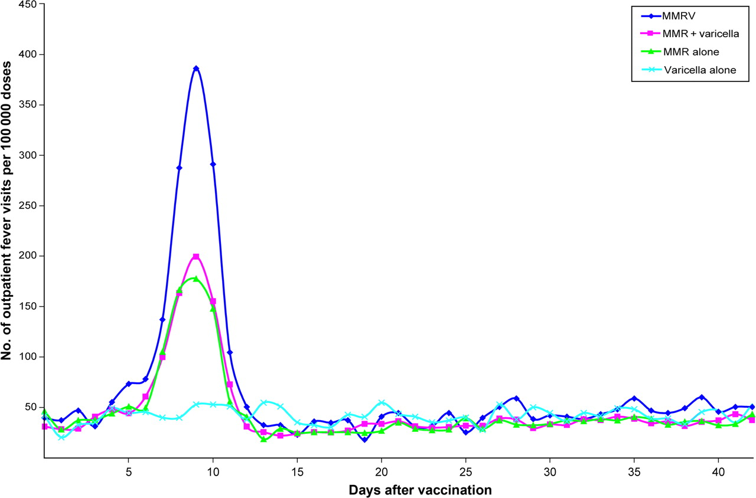

Postvaccination outpatient fever visits among 12- to 23-month-olds according to vaccine received: VSD study population, 2000–2008.
Pediatrics. 2010;126(1):e1-e8. doi:10.1542/peds.2010-0665
Date of Download: 11/3/2025
Copyright © 2025 American Academy of Pediatrics. All rights reserved.

Slide 41
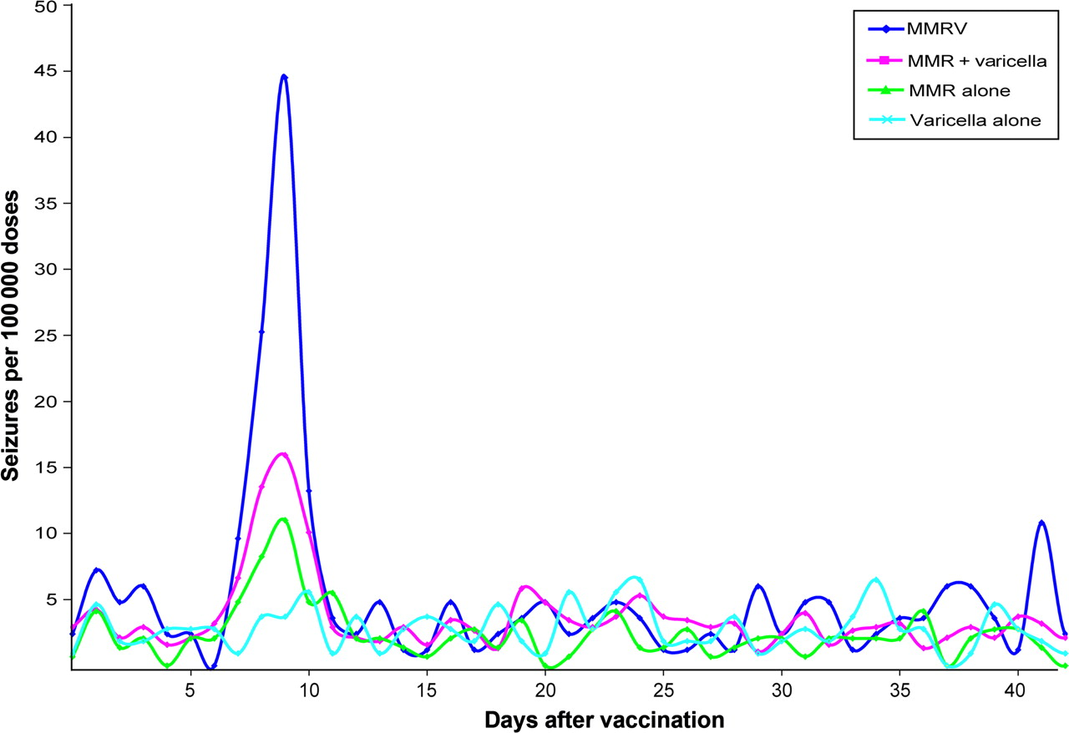
Postvaccination seizures among 12- to 23-month-olds according to vaccine received: VSD study population, 2000–2008.
Pediatrics. 2010;126(1):e1-e8. doi:10.1542/peds.2010-0665
Date of Download: 11/3/2025
Copyright © 2025 American Academy of Pediatrics. All rights reserved.

Slide 42
Cochrane Review: MMRV vs MMR + Varicella in Children
Febrile seizure review
Risk of febrile seizures after MMRV vaccination compared to MMR+V vaccination
Overall estimates
Within 42 days after vaccination: RR 1.31 (95% CI: 1.19 to 1.45)
Within 7 to 10 days after vaccination: RR 1.98 (95% CI: 1.69 to 2.33)
Cochrane Database Syst Rev. 2021;11(11):CD004407
Published 2021 Nov 22.doi:10.1002/14651858.CD004407.pub5

Slide 43
Impact: MMRV Vaccine Utilization
First dose: 15% of children aged 19-35 months (range by state: 5.1-31.8%)
Second dose: 75% of children aged 4-6 years (range by jurisdiction: 46-96%)
Data from National Immunization Survey-Child, 2023
Data from 39 jurisdictions’ Immunization Information System (IIS), children age 406 years by Dec 31, 2024 who received an MMR-containing vaccine

Slide 44
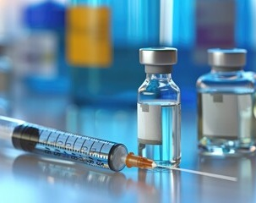
Thimerosal

Slide 45
Thimerosal
Children aged < 18 years recommended to receive seasonal influenza vaccines only in single dose formulations that are free of thimerosal as a preservative

Slide 46
Background: Thimerosal
Mercury-based preservative used in multi-dose vials
Vaccine concentrations: 0.001% to 0.01%
0.01% thimerosal per 0.5 mL = 25 mcg mercury per 0.5 mL
Metabolite: ethylmercury
More soluble than methylmercury: more rapid elimination
Shorter half-life: 3-7 days (vs. 50 days)
Different toxicity profile in vivo (compared to in vitro studies)

Slide 47
Thimerosal Concerns
1999 – Joint statement from US Public Health Service and American Academy of Pediatrics recommend removing thimerosal-containing vaccines
2001 – thimerosal removed from all childhood vaccines, except influenza
Concerns: Nervous system disorders, including autism, attention deficit hyperactivity disorder, speech or language delay (inconclusive evidence)
Robust evidence from scientific studies show no evidence of harm

Slide 48
Thimerosal Content in Current Vaccines
Multi-dose influenza vaccines only
Afluria (Seqirus Pty Ltd) – 0.01%
Flucelvax (Seqirus Inc) – 0.01%
Fluzone (Sanofi Pasteur Inc) – 0.01%
All have single-dose versions
All other influenza vaccines available as single-dose only

Slide 49
Responding to Patient Questions

Slide 50
Strategies to Address Vaccine Hesitancy
Take your own pulse
Understand what the patient is asking about vaccines
Take patient’s pulse
Motivational interviewing
Active listening
Give a strong recommendation
Use presumptive approach vs. participatory approach
Be persistent
Know when to fold
Loehr J, et al. Am Fam Phys 2016;94(2):94-6.

Slide 51
Words to Watch
Replace | Embrace
Making the choice to vaccinate; wrestling with the choice to vaccinate | “Managing immunizations”; “Keeping up with immunizations”
Safe and effective | Express care and concern for people and communities
Numerous studies show; Experts agree; Science is clear | Plain-language explanations; “medical researchers”; “physicians”
Anti-vaccine; anti-vax | “People who have absorbed misinformation about vaccines
Vaccine hesitancy | ‘Vaccine confidence”
Military language (vaccines are key weapon to fight diseases) | Preparation language (vaccines prepare our immune systems to recognize and resist diseases)
Words to Watch

Slide 52
Framing to Avoid
Ineffective openers – Don’t lead with:
Stark statistics
Disease prevalence
Potential negative health impacts
Expressing the controversy
Insider issues
“This is a public health problem”
“This is about the science”
Emphasizing “safety”
https://www.frameworksinstitute.org/resources/boosting-public-discourse-reframing-childhood-immunization/

Slide 53
Framing to Use
More effective openers:
Healthy kids are kids who can grow, play, and learn.
We come from a place of care and concern for people and communities.
Make the story about the immune system
Vaccines are “beginner books” for the immune system
Vaccine are ‘software updates” for the immune system
Shift topic to vaccine access whenever you can
https://www.frameworksinstitute.org/resources/boosting-public-discourse-reframing-childhood-immunization/

Slide 54
Helpful Resources
American Academy of Pediatrics (AAP)
Immunize.org
Vaccinate your Family
Local and state Health Departments
From: www.immunize.org

