Slide 1
The Evolving Landscape of Immunization Law
Kimberly Burns, RPh, JD
Nikol Muslimovic, PharmD Candidate 2026
University of Pittsburgh School of Pharmacy
November 2025

Slide 2
By the end of this session, participants will be able to…
01
02
03
Distinguish between federal and state authority to immunize within the practice of pharmacy
Discuss the PREP Act and its impact on the pharmacy profession involving immunizations
Identify recent amendments in Pennsylvania law surrounding immunizations by pharmacy professionals
04
Review legal cases involving vaccines and the pharmacy profession

Slide 3
01
Background: Legal Authority for Administering Immunizations

Slide 4
History of Pharmacists Vaccinating ^{1,2,3}
1990s-2016
Concerns over the need for increased public access to vaccines helped push the movement to grant pharmacists authority to administer vaccines
In 1994, Washington State Pharmacy Association offered the first formal vaccination training program for pharmacists
In 1996, APhA launched their own national vaccination training program which was endorsed by the CDC
2019 Pre-COVID
Pharmacists in 48 states, including Puerto Rico and the District of Columbia, were authorized to administer vaccines to adult patients

Slide 5
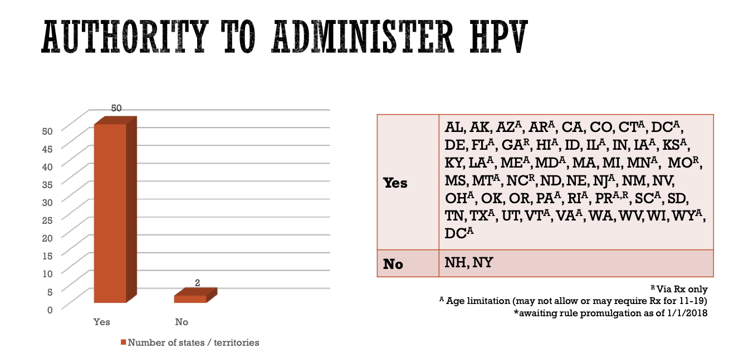
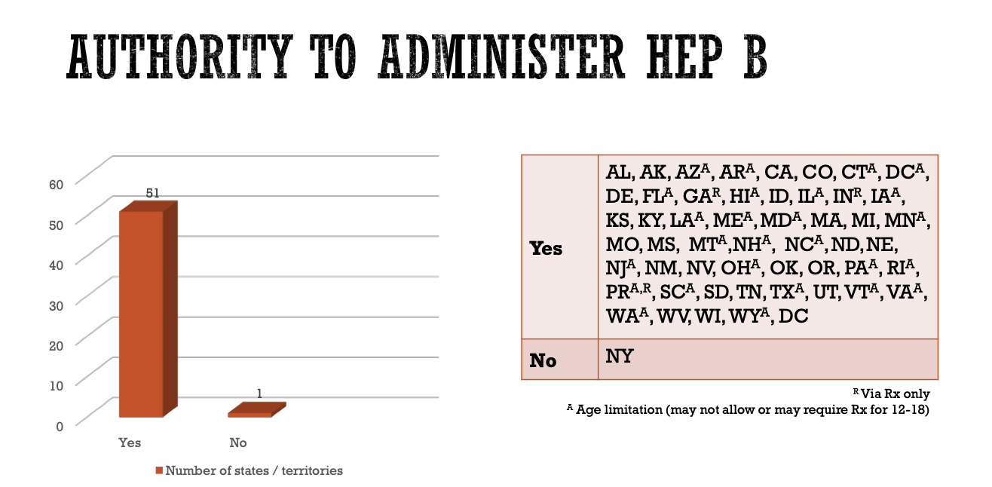
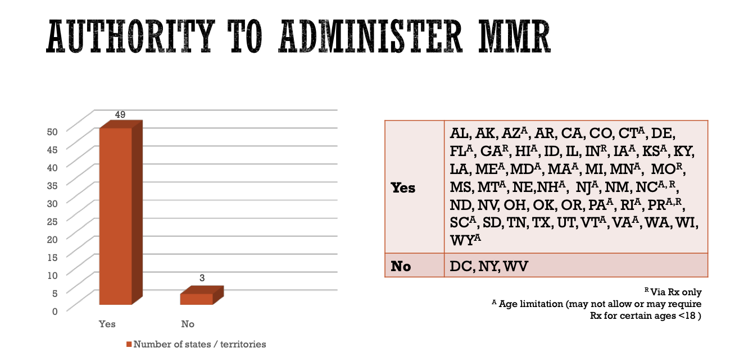
History of Pharmacists Vaccinating – 2019 ³
Comparison between states how vaccines could be administered by a pharmacist, including the HPV, MMR, and Hepatitis B vaccines
NASPA. Accessed September 7, 2025. https://naspa.us/wp-content/uploads/2019/04/IZ-Authority-012019.pdf.
NASPA. Accessed September 7, 2025. https://naspa.us/wp-content/uploads/2019/04/IZ-Authority-012019.pdf.
NASPA. Accessed September 7, 2025. https://naspa.us/wp-content/uploads/2019/04/IZ-Authority-012019.pdf.

Slide 6
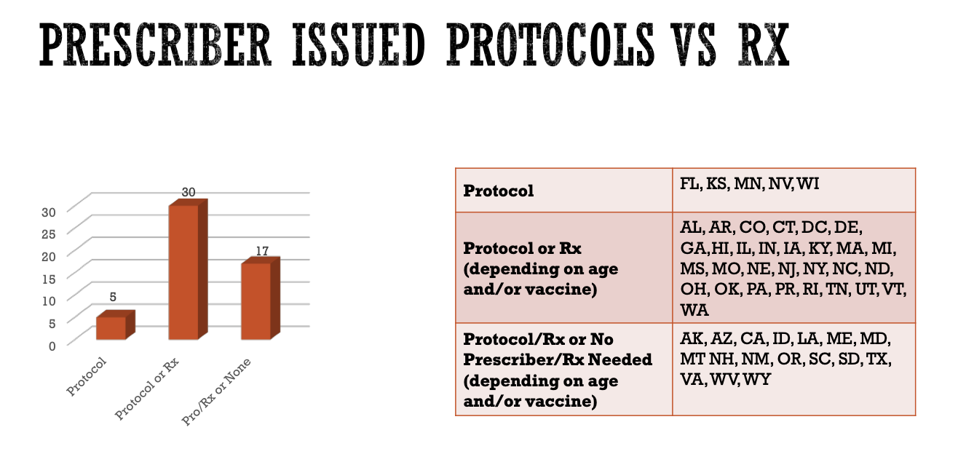
History of Pharmacists Vaccinating - 2019 ³
Comparison of states and requirements for pharmacists to immunize
NASPA. Accessed September 7, 2025. https://naspa.us/wp-content/uploads/2019/04/IZ-Authority-012019.pdf.

Slide 7
History of Pharmacists Vaccinating ^{4,5}
2024
According to the APhA and NASPA – only 19 states and DC allowed pharmacists to administer all ACIP-recommended vaccines to individuals 3 years and older (independently or by protocol)
State-by-state Variations
States vary in vaccination laws for pharmacists:
Age: adult-only to all ages
Types: COVID, influenza, ACIP- recommended vaccines
Variations in requirements providing authorization: standing order, pharmacist prescribing, prescription via prescriber

Slide 8
Knowledge Check
Which of the following represents how a pharmacist could obtain authoriztion to immunize patients? A. Standing Order B. Pharmacist Prescription C. Prescriber Prescription D. A and C only E. A, B, and C

Slide 9
02
COVID-19: PREP Act

Slide 10
History of PREP Act ⁶
Public Readiness and Emergency Preparedness Act -federal law passed in 2005
Authorizes the Secretary of Health and Human Services (HHS) to issue ”PREP Act declarations” during public health emergencies
Declarations can provide liability immunity for manufacturers , distributors, and healthcare providers administering countermeasures (vaccines or treatments) during emergencies
Also expands the scope of practice for certain healthcare professionals temporarily, superseding state laws if necessary
Notable prior uses (only used for liability immunity before COVID-19)
H1N2 2009 pandemic
Anthrax and other bioterrorism preparedness
Ebola outbreak 2014-2016

Slide 11
PREP Act During COVID-19 ⁶
Timeline of Important Events
March 17, 2020: First declaration of the PREP Act
August 4, 2020: Allowed pharmacists to administer FDA-licensed, ACIP-recommended pediatric vaccines (ages 3-18)
August 4, 2021: Allowed supervised technicians and interns to administer COVID-19 and ACIP-recommended pediatric vaccines
December 30, 2021: Allowed administration of seasonal influenza vaccines by interns and technicians
Late 2024: Pharmacy administration (COVID-19 testing, vaccines, therapeutics) federal expansion authority/liability immunity was set to expire end of 2024
December 10, 2024: HHS issued another declaration under PREP extending until December 31, 2029, for pharmacists to order/administer, and interns and techs to administer, certain vaccines, as well as certain point-of-care tests (e.g. COVID-19, seasonal influenza vaccines (3 and over); COVID-19 tests) (liability immunity was also extended)

Slide 12
PREP Act COVID-19 Expansion ⁷
Pharmacist Authorization
Nationwide authorization to order and administer COVID-19 and ACIP-recommended vaccines to individuals 3 years of age or older
Authorization to order and administer COVID-19 tests
Pharmacy Intern and Technician Authorization
Allowed authorized technicians and interns to administer COVID-19 and ACIP-recommended vaccines and tests, ages 3 or older, under a pharmacist’s supervision
Notes:
To highlight and summarize again, this is what expanded during the PREP act

Slide 13
T/F: Pharmacists, Interns, and Technicians can administer COVID-19 and ACIP-recommended vaccines under the PREP act.
Knowledge Check

Slide 14
03
Impact of Pharmacist Immunizations during COVID-19

Slide 15
Pharmacists Contribution to Vaccinations ⁸
Pharmacists’ Answer to the COVID-19 Pandemic: Contribution to the Federal Retail Pharmacy Program to COVID-19 vaccination across sociodemographic characteristics
The findings of this study found that FRPP pharmacies administered approximately 314.9 million COVID-19 vaccine doses, accounting for nearly 49% of all doses administered nationwide. These contributions were significant among adolescents and young adults, with FRPP pharmacies delivering over 56% of doses to individuals aged 12–17. The program also played a crucial role in reaching underserved populations, including Hispanic/Latino and Non-Hispanic Asian communities. FRPP made the highest contribution to administering COVID-19 doses to Non-Hispanic Asian (48.7%) and Hispanic/Latino (49.8%) persons.
Notes:
Check prior percentages before COVID

Slide 16
04
Where are we currently?

Slide 17
State Authorization Post-COVID ⁹
Pharmacists
All 50 states and the District of Columbia allow pharmacists to administer vaccines
Several states have restrictions on the extent of authority when it comes to type of vaccines and/or age groups
Interns and Technicians
All 50 states and the District of Columbia allow pharmacy interns to administer vaccines under the supervision of a pharmacist
All States except New York, Texas, Tennessee, and Missouri allow technicians to administer vaccines
Tennessee has laws in progress to allow technicians to administer vaccines

Slide 18
States - Expanded Authority ¹⁰
Connecticut: SB 133 (Enacted on May 28, 2024; effective October 1, 2024)
Authorizes pharmacists to order, prescribe, and administer vaccines to adults and children aged 12 and up with parental consent for all vaccines on the CDC schedule
Hawaii: HB 2553 (Enacted on June 27, 2024; effective January 1, 2025)
Authorizes pharmacists, pharmacy technicians, and pharmacy interns to vaccinate individuals aged 3 years and older with FDA-approved and ACIP-recommended vaccines under direct supervision of a licensed pharmacist.
Minnesota: HF 5247 (Signed into law on May 24, 2024; effective July 1, 2024)
Allows pharmacists to order and administer vaccines without a prescription; allows pharmacy personnel to vaccinate minors aged 6 and older, and COVID-19 and flu vaccines to minors aged 3 and older.
Ohio: SB 144 (Enacted on October 24, 2024)
Authorizes pharmacy interns and technicians to give vaccines; lowers age to 5 years for flu and COVID shots from pharmacists, interns, and technicians.

Slide 19
States - Expanded Authority ¹⁰
South Carolina: H.3988 (Signed into law on July 2, 2024; effective immediately)
Removes prohibition on pharmacy technicians administering vaccines; authorizes pharmacy technicians to vaccinate adults and children of all ages.
Tennessee: SB 869 (Signed into law on May 1, 2024; effective immediately)
Authorizes pharmacists to prescribe, order, and administer all vaccines to adults and COVID and flu vaccines to children aged 3 and up; requires registry reporting.
Illinois: SB 3268 (Enacted on June 7, 2024; effective immediately)
Expands vaccines authorized to be given by a pharmacy technician or student to include SARS-CoV-2 and RSV.
Maryland: HB 76/SB 18 (Approved on April 25, 2024; effective immediately)
Lowers the age of children to whom pharmacists can order and administer vaccines and expands which vaccines they are authorized to administer to children.
New Hampshire: SB 402 (Signed into law on August 2, 2024; effective October 1, 2024)
Allows a pharmacist, pharmacy intern, or pharmacy technician to administer vaccines licensed by the FDA and recommended by ACIP to individuals aged 18 years and older.

Slide 20
05
Immunizing in Pennsylvania

Slide 21
Authorization at State Level Expanded ¹¹
Pennsylvania: HB 2679 (Act 80 of 2022; approved and effective July 11, 2022)
Amended the Pennsylvania Pharmacy Act
Pharmacists
Authorized to administer COVID-19 and influenza vaccines to patients ages 5 or older
Interns
Authorized to administer COVID-19 and influenza vaccines to patients ages 5 or older
Additional
Allowed authorized pharmacists to delegate the authority to administer influenza and COVID-19 vaccines to other licensed individuals (e.g. certified registered nurse practitioners (CRNPs), physician assistants (Pas) and registered nurses (RNs)
Expanded eligible supervisors of pharmacy interns during administration of COVID-19 and influenza vaccines
Notes:
Multiple actions by states and government (shows progression)
Include: this amended the pharmacy act

Slide 22
Authorization at State Level Expanded ¹²
Pennsylvania: Act 77 of 2024 (Pharmacy Benefit Reform Act, Chapter 10 Pharmacy Services; July, 2024; effective November, 2024)
Pharmacists
Authorized to administer COVID-19 and influenza vaccines to patients ages 5 or older
Authorized to order and administer COVID-19, influenza, RSV, and streptococcal tests
Authorized to administer all ACIP Vaccines to patients ages 8 or older
Interns
Authorized to administer COVID-19 and influenza vaccines to patients ages 5 or older
Authorized to administer/perform COVID-19, influenza, RSV, and streptococcal tests
Authorized to administer all ACIP Vaccines to patients ages 8 or older
Technicians
Authorized to administer COVID-19 and Influenza vaccines to patients 13 or older (also can administer/perform COVID-19, influenza, RSV, and strep tests per national clinical guidelines)

Slide 23
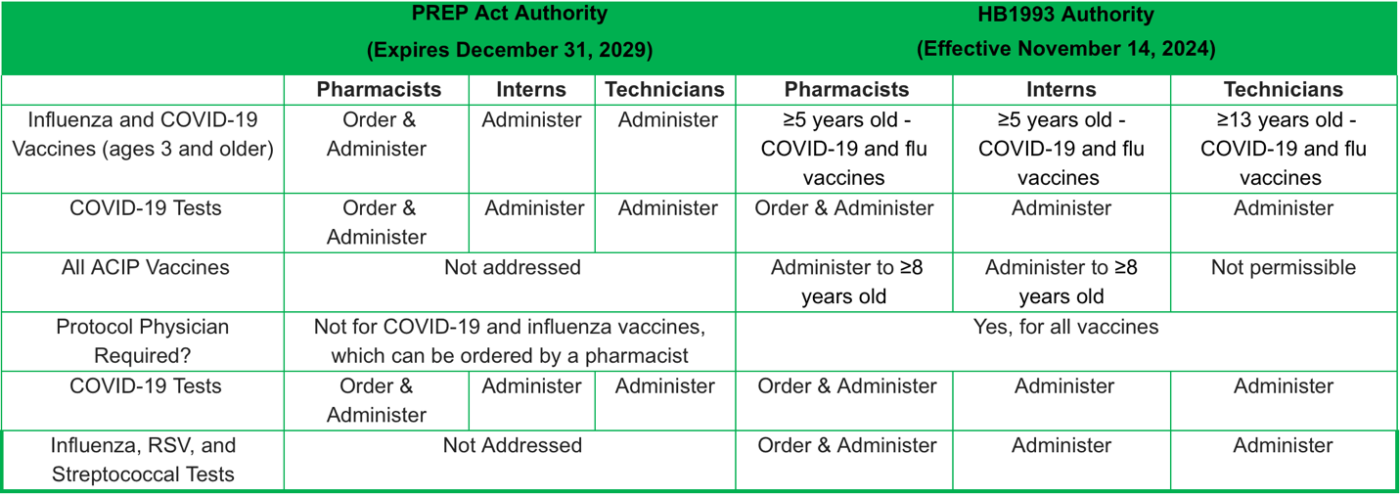
Authorization at State Level Expanded ¹³
Pennsylvania: Act 77 0f 2024
Pennsylvania Pharmacists Association. Accessed September 7, 2025. https://www.papharmacists.com/page/vaccinepage.
Pharmacists can administer vaccines recommended by the American College of Obstetricians and Gynecologists (ACOG), the American Academy of Pediatrics (AAP), the American Academy of Family Physicians (AAFP), and the U.S. Food & Drug Administration (FDA)

Slide 24
Under the current PA law, what is the age group that technicians can vaccinate? A. 3 years or older B. 13 years or older C. 18 years or older D. all ages
Knowledge Check

Slide 25
06
Vaccine Legal Cases
Notes:
Potential liability cases – people didn’t like the vaccine and intentionally left them out

Slide 26
Civil Case
Allegations included pharmacy/pharmacists (defendants) were negligent in their administration of the plaintiff’s COVID-19 vaccination, resulting in the plaintiff falling and injuring himself after he allegedly lost consciousness due to the administration of the vaccine
The PREP Act provides:
“[A] covered person shall be immune from suit and liability under Federal and State law with respect to all claims for loss caused by, arising out of, relating to, or resulting from the administration to or the use by an individual of a covered countermeasure.” 42 U.S.C. § 247d-6d(a)(1).
The PREP Act defines a “Covered Person” as a “Manufacturer,” a “Distributor,” a “Program Planner,” a “Qualified Person,” or an employee of one of these categories. 42 U.S.C. § 247d-6d(i)(2).
Defendants asked for case to be dismissed based on the idea that they were granted immunity
Supreme Court of Ohio, Case No. 2023-1159 (filed April 23, 2024), available at https://www.supremecourt.ohio.gov/pdf_viewer/pdf_viewer.aspx?pdf=949234.pdf&subdirectory=2023-1159%5CDocketItems&source=DL_Clerk
Notes:
Potential liability cases – people didn’t like the vaccine and intentionally left them out

Slide 27
Civil Case
Court reviewed past cases raising the issue of “Covered Person”/”Qualified Person” / Immunity
One case reviewed included Storment v. [Pharmacy], D. N.Mex. No. 1:21-CV-00898 MIS/CG, 2022 WL 2966607 (July 27, 2022)
Allegations included a patient receiving COVID vaccine, and due to lack of chairs at the pharmacy the pt was advised to walk around the store or go sit in car for 15 min; pt felt dizzy, couldn’t find a place to sit, went to car, but fell before she could sit in the car
Patient alleged pharmacy did not follow appropriate monitoring procedures
Court held that the PREP Act’s immunity from suit applied to the defendant pharmacy,
The case being decided was very similar to one just mentioned
Court determined the following:
“This chain of events is unfortunate and certainly deserving of a remedy, but it cannot be divorced from the administration of a covered countermeasure – the COVID-19 vaccine she received....”
“Plaintiff’s remedy for her injuries following her COVID-19 vaccination is through the Countermeasures Injury Compensation Program.”
Conclusion - Court dismissed the action against the defendants
Supreme Court of Ohio, Case No. 2023-1159 (filed April 23, 2024), available at https://www.supremecourt.ohio.gov/pdf_viewer/pdf_viewer.aspx?pdf=949234.pdf&subdirectory=2023-1159%5CDocketItems&source=DL_Clerk
Notes:
Potential liability cases – people didn’t like the vaccine and intentionally left them out

Slide 28
Administrative Case #1
Pharmacist disciplined by state’s Division of Occupational and Professional Licensing for fraudulently filling out COVID-19 vaccination cards without administering the vaccine to a patient
Reluctant patient seeking vaccine at request of employer was counseled on unconfirmed adverse reactions by technician, information not corrected by pharmacist
Pharmacist then spoke to patient and was seen on camera taking a vial of J&J vaccine and filling out vaccine card despite no syringe being prepared or vaccine administered to the patient
Pharmacist admitted providing filled vaccine cards to other apprehensive patients
[Pharmacist]. Utah pharmacist disciplined for fraudulently filling out COVID-19 vaccine cards. July, 2021. Available at: https://kutv.com/news/local/utah-pharmacist-disciplined-for-fraudulently-filling-out-covid-19-vaccine-cards.
Notes:
Potential liability cases – people didn’t like the vaccine and intentionally left them out

Slide 29
Administrative Case #1
Pharmacist’s actions were deemed harmful to the patient and others as he misrepresented the patient as vaccinated, putting others at risk for COVID
Vaccine card also has the CDC seal, actions were also unauthorized use of government agency’s seal, which violated state law and was punishable by 5 years in prison (that would be a separate legal action if pursued)
As part of disciplinary action, pharmacist surrendered license to practice pharmacy and agreed to pay a $2,000 fine
[Pharmacist]. Utah pharmacist disciplined for fraudulently filling out COVID-19 vaccine cards. July, 2021. Available at: https://kutv.com/news/local/utah-pharmacist-disciplined-for-fraudulently-filling-out-covid-19-vaccine-cards.
Notes:
Potential liability cases – people didn’t like the vaccine and intentionally left them out

Slide 30
Administrative Case #2 (Case Study)
A pharmacist at a national chain had been in practice for 2 years as a pharmacist
Patient (female/mid-30s) presented to the pharmacy and requested flu vaccine
Pharmacy technician processed the request and payment for the vaccination
Pharmacist prepared and administered the vaccine, failing to verify with the patient the vaccine to be administered, and then instructed the patient to return for a booster shot
When patient returned, pharmacist realized the error – the COVID-19 vaccine was administered in error
The pharmacist proceeded to administer the influenza vaccine as the patient had originally requested
HPSO - Pharmacist license protection case study: Making a false or misleading statement regarding a vaccination error
https://www.hpso.com/Resources/Legal-and-Ethical-Issues/Pharmacist-license-protection-case-study-Making-a-false-or-misleading-statement-regarding-a-vaccina
Notes:
Potential liability cases – people didn’t like the vaccine and intentionally left them out

Slide 31
Administrative Case #2 (Case Study)
3 weeks after incident was discovered the pharmacist provided employer a written statement (which did not include patient’s reaction or response to the error)
Incident report stated that the pharmacy technician had prepared the syringe containing the vaccine, and then the technician placed the syringe and patient consent form on the counter for the pharmacist to proceed with the procedure
Pharmacy PIC interviewed the technician, who denied drawing up the vaccination
PIC reviewed video footage of the incident and confirmed that the pharmacist had drawn up the COVID-19 vaccine before administering it to the patient
PIC filed a Board of Pharmacy complaint regarding the incident / conduct, including that the pharmacist failed to follow the pharmacy’s immunization protocol
HPSO - Pharmacist license protection case study: Making a false or misleading statement regarding a vaccination error
https://www.hpso.com/Resources/Legal-and-Ethical-Issues/Pharmacist-license-protection-case-study-Making-a-false-or-misleading-statement-regarding-a-vaccina
Notes:
Potential liability cases – people didn’t like the vaccine and intentionally left them out

Slide 32
Administrative Case #2 (Case Study)
Board inspectors/investigators reviewed the complaint, interviewed the pharmacist, pharmacy technician, PIC, pharmacist’s statement, and the video footage
Board investigators concluded that, in addition to failing to follow immunization protocols, the pharmacist made a false or misleading statement regarding the incident in question (written statement represented that the pharmacy technician prepared the vaccine)
Investigation further revealed that the pharmacist failed to adhere to state statutes for vaccine administration by failing to promptly report the vaccines administered to the patient’s primary care provider, or the state immunization registry, and by failing to complete an incident report as soon as possible following the vaccination error
HPSO - Pharmacist license protection case study: Making a false or misleading statement regarding a vaccination error
https://www.hpso.com/Resources/Legal-and-Ethical-Issues/Pharmacist-license-protection-case-study-Making-a-false-or-misleading-statement-regarding-a-vaccina
Notes:
Potential liability cases – people didn’t like the vaccine and intentionally left them out

Slide 33
Administrative Case #2 (Case Study)
The investigative report was submitted to the Board of Pharmacy, recommending that disciplinary charges be filed against the pharmacist
The Board reviewed the report and determined that the pharmacist’s conduct was contrary to acceptable standards of practice
The pharmacist agreed to a consent agreement, placing his license on probation for 2 yrs and imposed a $2,500 civil penalty, and the disciplinary action also was reported to the National Practitioner Data Bank (NPDB)
The matter took more than a year to resolve, and the expenses to defend the pharmacist in the Board investigation totaled thousands of dollars
HPSO - Pharmacist license protection case study: Making a false or misleading statement regarding a vaccination error
https://www.hpso.com/Resources/Legal-and-Ethical-Issues/Pharmacist-license-protection-case-study-Making-a-false-or-misleading-statement-regarding-a-vaccina
Notes:
Potential liability cases – people didn’t like the vaccine and intentionally left them out

Slide 34
Administrative Case #2 (Case Study)
HPSO provided risk control recommendations (proactive concepts and behaviors to mitigate the risk of complaints related to vaccine administration)
Develop, implement and adhere to standard operating procedures designed to prevent/identify errors prior to vaccine administration.
Store vaccine formulations apart from one another in separate bins that are accurately labeled with the corresponding age group or booster designation.
Utilize automated identification systems, such as barcode scanning, to reduce the risk of vaccine and administration errors.
Prior to preparation, check the patient’s vaccine card/medical record, and the immunization information system.
Clearly label all syringes. Dispense pharmacy prepared syringes where possible.
HPSO - Pharmacist license protection case study: Making a false or misleading statement regarding a vaccination error
https://www.hpso.com/Resources/Legal-and-Ethical-Issues/Pharmacist-license-protection-case-study-Making-a-false-or-misleading-statement-regarding-a-vaccina
Notes:
Potential liability cases – people didn’t like the vaccine and intentionally left them out

Slide 35
Administrative Case #2 (Case Study)
HPSO provided risk control recommendations (proactive concepts and behaviors to mitigate the risk of complaints related to vaccine administration)
Prior to administration, document vaccine information including the National Drug Code (NDC) number, lot number and expiration date of each vial or prefilled syringe. Document vaccine administration after doing so.
Only bring the intended and labeled vaccine syringe(s) for one patient into the vaccination area and vaccinate one patient at a time.
Use a checklist to perform a systematic final check, to confirm the correct vaccine/medication, dose, and patient. Involve the patient or caregiver in verifying the correct vaccine by reading the label to confirm the vaccine, formulation, and dose.
Review and implement additional recommendations appropriate for your practice according to state/jurisdictional regulations and guidance from appropriate organizations (resources and references provided within the case study online)
HPSO - Pharmacist license protection case study: Making a false or misleading statement regarding a vaccination error
https://www.hpso.com/Resources/Legal-and-Ethical-Issues/Pharmacist-license-protection-case-study-Making-a-false-or-misleading-statement-regarding-a-vaccina
Notes:
Potential liability cases – people didn’t like the vaccine and intentionally left them out

Slide 36
Administrative Case #2 (Case Study)
Additional Take Aways:
A regulatory Board complaint may be filed against a pharmacist by a patient, colleague, employer, and/or a regulatory agency, such as the State Department of Health
Complaints are subsequently investigated by the Board of Pharmacy in order to ensure that licensed pharmacists are practicing safely, professionally, and ethically.
Board of Pharmacy investigations may lead to outcomes ranging from no action against the pharmacist to revocation of the pharmacist’s license to practice.
HPSO - Pharmacist license protection case study: Making a false or misleading statement regarding a vaccination error
https://www.hpso.com/Resources/Legal-and-Ethical-Issues/Pharmacist-license-protection-case-study-Making-a-false-or-misleading-statement-regarding-a-vaccina
Notes:
Potential liability cases – people didn’t like the vaccine and intentionally left them out

Slide 37
Administrative Case #3
In November of 2021, a chain pharmacy notified the California Board of Pharmacy that it terminated a pharmacist for violation of company’s Standard Operating Procedures for Immunizations
Board inspector investigated the matter further; chain pharmacy provided that pharmacist processed a flu vaccine and removed it from the pharmacy to administer to her son at home; as well as during the investigation it was determined the pharmacist self-administered a COVID-19 vaccine in the pharmacy restroom
Both these actions were against company policy
Pharmacy records determined the pharmacist ordered/processed both immunizations; administered the flu vaccine to her son; but the COVID-19 vaccine was recorded as being administered to the pharmacist by a technician
Technician denied doing this
California Board of Pharmacy Case No. 7315 OAH No. 2022110800, available at: https://www.pharmacy.ca.gov/enforcement/fy2122/ac217315
Notes:
Potential liability cases – people didn’t like the vaccine and intentionally left them out

Slide 38
Administrative Case #3
Board alleged unprofessional conduct by pharmacist
Offered pharmacist opportunity to provide written statement
Pharmacist provided she wasn’t aware of the policies against home/self-administration (which she provided reasons to do both), and that she mistakenly/unknowingly added the techs name to documentation, but had no intent to forge any documents
Pharmacy supervisor provided that pharmacists are educated on company policies, and the pharmacist provided inaccurate information about the incident when confronted
Pharmacist had past history of discipline unrelated to issue being addressed (variation of prescription); but she also had a long employment history with the chain and received awards/recognitions during her employment
California Board of Pharmacy Case No. 7315 OAH No. 2022110800, available at: https://www.pharmacy.ca.gov/enforcement/fy2122/ac217315
Notes:
Potential liability cases – people didn’t like the vaccine and intentionally left them out

Slide 39
Administrative Case #3
Expert witness (practicing pharmacist/faculty member in CA) was asked to opine on whether the violation of company policy constituted unprofessional conduct
Expert determined the pharmacist's actions did not constitute unprofessional conduct (CA has no law/rule against home/self administration, and other pharmacists do it)
State has the burden to prove by “clear and convincing evidence” that pharmacist engaged in unprofessional conduct
After revieing all the evidence and holding a hearing, Board determined:
“When all the evidence is considered, [state] proved each allegation in the Accusation. However, as explained below, the Board believes that under the unique circumstances of this case, formal discipline of respondent’s license is not warranted.”
California Board of Pharmacy Case No. 7315 OAH No. 2022110800, available at: https://www.pharmacy.ca.gov/enforcement/fy2122/ac217315
Notes:
Potential liability cases – people didn’t like the vaccine and intentionally left them out

Slide 40
Administrative Case #3
Alleged violations would constitute a “Category II” under Board adopted disciplinary guidelines
“Category II” - recommended discipline range from a minimum of revocation, stayed, with probation of three years, to a maximum of revocation
Factors relevant to determine appropriate level of discipline include:
(1) actual/potential harm to the public; (2) actual/potential harm to any consumer; (3) prior discipline; (4) prior warnings/citations; (5) number and/or variety of current violations; (6) nature and severity of the acts or offenses under consideration; (7) evidence of aggravation, mitigation, or rehabilitation; (8) time passed since the acts or offenses; and (9) whether the conduct was intentional
Board determined:
Pharmacist did not cause any actual harm to the public or any consumer and the pharmacist has a career spanning > 25 years, with a disciplinary record limited to a 2016 citation for unrelated conduct
While the conduct at issue was in direct violation of [Company] policy, there is no law or regulation against self immunization or administering vaccines to family members at home.
The administration to her son at home was motivated by concern for his health/safety, and the administration to herself was motivated in part by her employer’s “zero waste” directive
Both administrations occurred during the height of the COVID-19 pandemic, a time of extreme uncertainty and unprecedented stress for front-line healthcare professionals, including pharmacists
California Board of Pharmacy Case No. 7315 OAH No. 2022110800, available at: https://www.pharmacy.ca.gov/enforcement/fy2122/ac217315
Notes:
Potential liability cases – people didn’t like the vaccine and intentionally left them out

Slide 41
Administrative Case #3
Board conclusion (as quoted in proceedings):
State proved each cause for discipline in the Accusation; however, when all the evidence is considered in light of the disciplinary criteria in the guidelines, the Board finds that formal discipline is not warranted, and would be unduly punitive under the unique circumstances of this case
Rather, the Board finds that administrative action, in the form of a citation and fine to be separately issued to respondent, is a more appropriate resolution
The public safety will not be compromised, and will be adequately protected, fulfilling the Board’s highest priority, by this more moderate measure in lieu of discipline
California Board of Pharmacy Case No. 7315 OAH No. 2022110800, available at: https://www.pharmacy.ca.gov/enforcement/fy2122/ac217315
Notes:
Potential liability cases – people didn’t like the vaccine and intentionally left them out

Slide 42
Criminal Case #1
Pharmacist intentionally removed hundreds of Moderna COVID-19 vaccine vials from hospital refrigeration unit during 2 overnight shifts in December 2020
Pharmacist left the vials out for several hours, then returned to the refrigeration unit to be used in the hospital’s vaccination clinic the following day; by the time his conduct was discovered, 57 people had received doses of the vaccine from these vials
Pharmacist tampered with the Moderna vaccine because he believed it was not safe; he was skeptical of vaccines in general, including Moderna, and he shared these concerns with other employees
US v Brandenburg, No. 2:21-cr-00025 (E.D. Wis); see also DOJ release at: https://www.justice.gov/archives/opa/pr/hospital-pharmacist-sentenced-attempt-spoil-hundreds-covid-vaccine-doses
Notes:
Potential liability cases – people didn’t like the vaccine and intentionally left them out

Slide 43
Criminal Case #1
Pharmacist pled guilty to 2 counts of attempting to tamper with consumer products with reckless disregard for the risk of another person / danger of death or bodily injury
Signed plea agreement for 3 years in prison, then 3 years of supervised release, and $83,800 in fees as restitution to the hospital
US v Brandenburg, No. 2:21-cr-00025 (E.D. Wis); see also DOJ release at: https://www.justice.gov/archives/opa/pr/hospital-pharmacist-sentenced-attempt-spoil-hundreds-covid-vaccine-doses
Notes:
Potential liability cases – people didn’t like the vaccine and intentionally left them out

Slide 44
Criminal Case #2
Defendant, the owner and president of a pharmacy in Puerto Rico, was charged and pleaded guilty to participating in a felony conspiracy to convert government property and to commit health care fraud in connection with the illegal vaccination of minors between the ages of 7 to 11 with a COVID-19 vaccine
From May – June, 2021, owner and employees of pharmacy conspired to knowingly filling and willfully administering the COVID-19 vaccine to children 11 years old or younger to submit Medicaid claims
24 children aged 7-11 were administered with the COVID-19 vaccine, at full dosage
CDC COVID-19 Vaccination Program required pharmacies to comply with FDA EUA requirements, which permitted administration of the COVID-19 vaccine billed to children aged 12 and older (the EUA for this vaccine was not approved for children 11 years old and younger)
DOJ Press Release from Sept. 27, 2021: Pharmacy Owner Pleads Guilty to Federal Charge Involving the Vaccination of Minors Under 12 with the Pfizer-BioNTech Covid-19 Vaccine available at: https://www.justice.gov/usao-pr/pr/pharmacy-owner-pleads-guilty-federal-charge-involving-thevaccination-minors-under-12
Notes:
Potential liability cases – people didn’t like the vaccine and intentionally left them out

Slide 45
Criminal Case #2
The administration represented an unauthorized and unlawful administration of the vaccine
The vaccine was property of the US govt. and were illegally converted without authority
The pharmacy also was not permitted to submit claims to Medicaid for the unlawful and unauthorized administration of the COVID-19 vaccine
The state DOH identified the activity and suspended the pharmacy from the vaccine program
No medical conditions identified from administration, and funds received for the vaccinations were voluntarily returned to Medicaid
Owner voluntarily agreed to be excluded as a provider for Medicare, Medicaid, and all other federal health care programs for 5 years, and faced up to 5 yrs in prison/3 yrs of supervised release & a $250,000 fine
DOJ: “Pharmacists rank among the most trusted professionals… [t]his individual used her special access to illegally vaccinate children under the age of 12 years old putting their health at risk…. the DOJ will continue to work with its law enforcement partners to ensure the public receives safe and effective vaccines.”
DOJ Press Release from Sept. 27, 2021: Pharmacy Owner Pleads Guilty to Federal Charge Involving the Vaccination of Minors Under 12 with the Pfizer-BioNTech Covid-19 Vaccine available at: https://www.justice.gov/usao-pr/pr/pharmacy-owner-pleads-guilty-federal-charge-involving-thevaccination-minors-under-12
Notes:
Potential liability cases – people didn’t like the vaccine and intentionally left them out

Slide 46
Which type of legal action could be brought against a pharmacist involving vaccine administration? I. Administrative II. Civil III. Criminal A. I only B. I and II only C. II and III only D. I, II, and III
Knowledge Check

Slide 47
Summary
Pharmacist authorization to vaccinate varies state-by-state, including ages, types of vaccines, and requirements in order to vaccinate
PREP act expanded the authorization and liability immunity of pharmacists, interns, and technicians to vaccinate, superseding any state laws, through 2029
Post-COVID, many states have started to expand their own state laws to allow pharmacists to vaccinate COVID-19, influenza, and ACIP-recommended vaccines as well as administer point-of-care tests
Administrative, civil, and criminal action pertaining vaccines can be brought against pharmacists

Slide 48
Thank you!
Any Questions?

Slide 49
References
Erintalati. Pharmacist vaccination laws, 1990-2016 - Petrie-Flom center. Petrie. January 10, 2017. Accessed September 7, 2025. http://petrieflom.law.harvard.edu/2017/01/10/pharmacist-vaccination-laws-1990-2016/.
Kathleen Kenny P. Pharmacist-administered immunization movement Propels Profession Forward. Pharmacy Times. September 14, 2021. Accessed September 7, 2025. https://www.pharmacytimes.com/view/pharmacist-administered-immunization-movement-propels-profession-forward.
NASPA. Accessed September 7, 2025. https://naspa.us/wp-content/uploads/2019/04/IZ-Authority-012019.pdf.
Pharmacist administered vaccines. Accessed September 7, 2025. https://naspa.us/wp-content/uploads/2022/06/Pharmacist-Immunization-Authority-June-2022.pdf.
Pharmacist and pharmacy technician vaccination authority. NASPA. August 29, 2025. Accessed September 7, 2025. https://naspa.us/resource/2024-pharmacist-immunization-authority/.
The PREP Act and Covid-19, part 2: The prep act declaration for covid-19 countermeasures. EveryCRSReport.com. January 3, 2025. Accessed September 7, 2025. https://www.everycrsreport.com/reports/LSB10730.html.
Keagy J. Apha Press Release. American Pharmacists Association. December 10, 2024. Accessed September 7, 2025. https://www.pharmacist.com/APhA-Press-Releases/hhs-extends-federal-authority-consistent-with-apha-request-for-pharmacy-personnel-to-independently-administer-vaccines-and-test-to-treat-services-through-2029.
El Kalach R, Jones-Jack NH, Grabenstein JD, et al. Pharmacists’ answer to the covid-19 pandemic: Contribution of the federal retail pharmacy program to covid-19 vaccination across sociodemographic characteristics—United States. Journal of the American Pharmacists Association. 2025;65(1):102305. doi:10.1016/j.japh.2024.102305
Pharmacist and pharmacy technician vaccination authority. NASPA. August 29, 2025. Accessed September 7, 2025. https://naspa.us/resource/2024-pharmacist-immunization-authority/.
The NVIC Advocacy Team. NVIC’s 2024 state vaccine legislation report | National Vaccine Information Center (NVIC). Accessed September 7, 2025. https://www.nvic.org/newsletter/nov-2024/nvics-2024-state-vaccine-legislation-report.
COVID Pharmacy Waivers PREP Act Extended. PA Pharmacists COVID Waivers. • https://www.papharmacists.com/page/covidwaivers .
Pennsylvania Act No. 77 of 2024 (Pharmacy Benefit Reform Act). Accessed September 19, 2025. https://www.legis.state.pa.us/cfdocs/legis/li/uconsCheck.cfm?yr=2024&sessInd=0&act=77.
Pennsylvania Pharmacists Association. Accessed September 7, 2025. https://www.papharmacists.com/page/vaccinepage.

