Slide 1
Cardiac Education Series
Quality Nurse Indicators

Slide 2
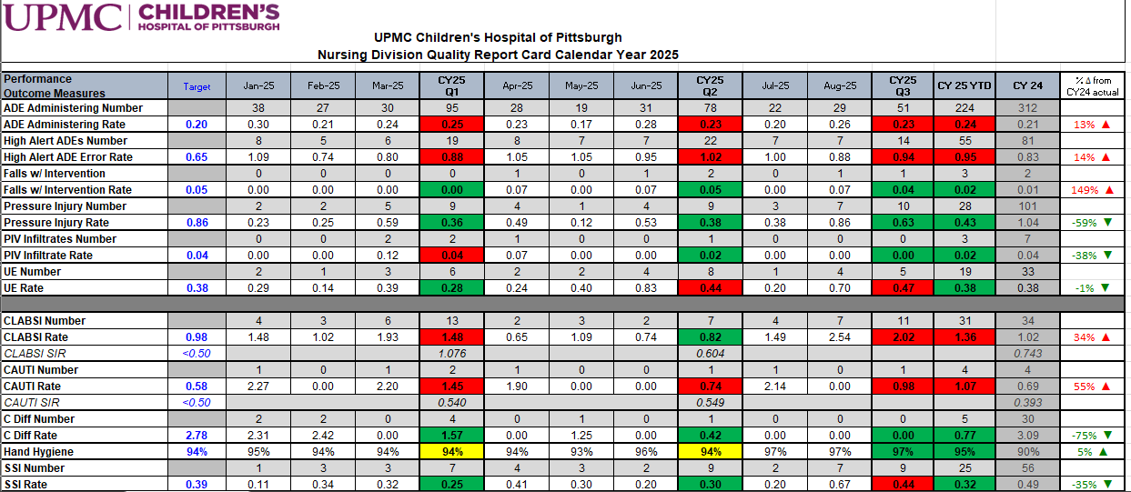
Nursing quality indicators
Nursing quality indicators are measurable outcomes that are directly influenced by nursing care.
Nursing quality indicators are reported to a variety of databases (NDNQI, NHSN, SPS) to help assess and evaluate practice.
At CHP, we also utilize a Nursing Quality Report Card to drive new practices and process changes.

Slide 3
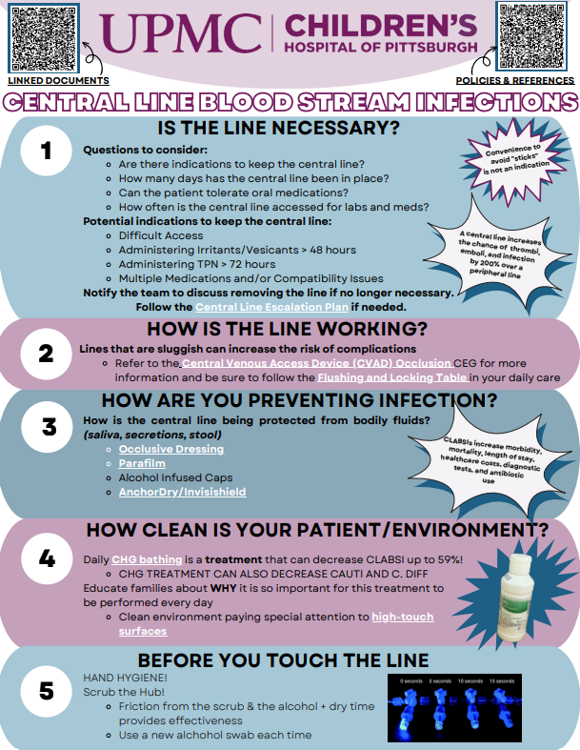
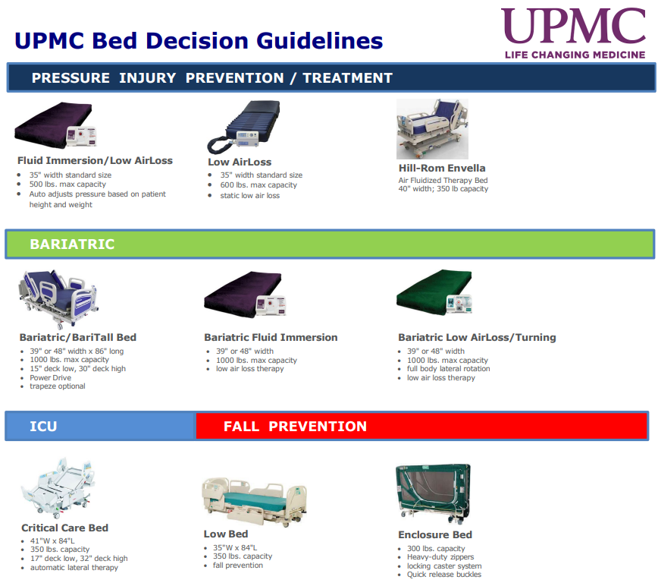
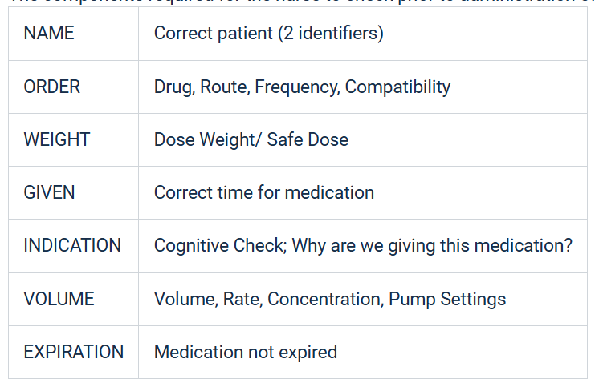
Nursing quality indicators
The direct influence of nursing actions are demonstrated through these patient outcomes, showing the value of nursing care and prioritize patient safety.
Below are a few (not all) of the quality indicators that are commonly evaluated in pediatric practice
ADVERSE DRUG EVENTS
PRESSURE INJURY
CENTRAL LINE INFECTION

Slide 4
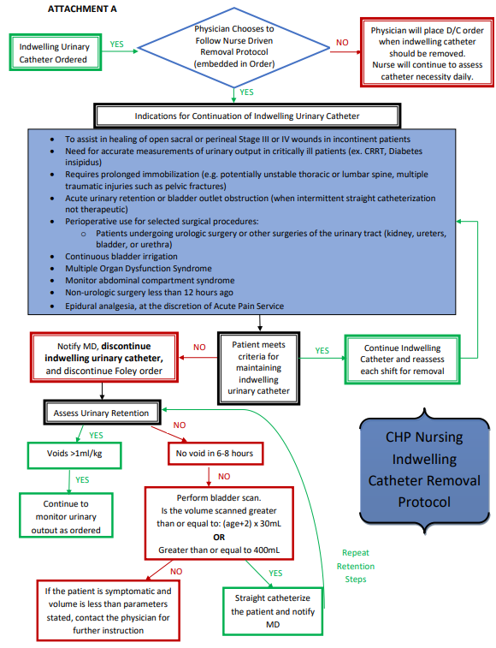

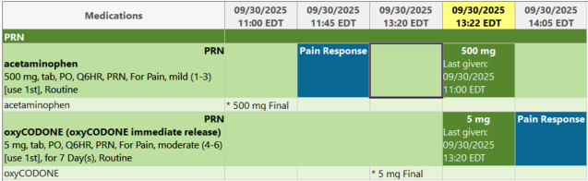
Nursing quality indicators
The direct influence of nursing actions are demonstrated through these patient outcomes, showing the value of nursing care and prioritize patient safety.
Below are a few (not all) of the quality indicators that are commonly evaluated in pediatric practice
CAUTI
SURGICAL SITE INFECTION
PAIN

Slide 5
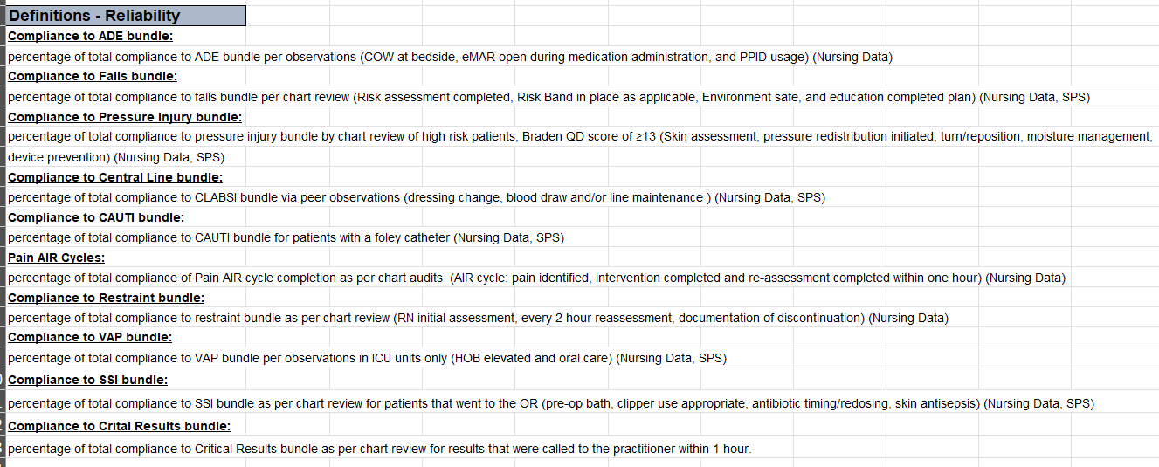
nursing Bundles
Specific, evidence-based set of nursing interventions designed to improve patient outcomes related to a nursing-sensitive quality indicator
Typically, these bundles are a cohesive unit of 3-5 practices that are all essential to the success of patient outcomes

Slide 6
Nursing quality indicators
A key aspect of our responsibilities at the bedside involves effectively utilizing available resources to access pertinent information and ensure adherence to best practices.
Please refer to the following resources, accessible via the UPMC Infonet, to complete the educational activity for this month.

Slide 7
UPMC Infonet Resources
Central Vascular Access Device: Dressing Change and Sutureless Securement Device Dressing Change (PTCMDIV818-A)
Central Venous Access Device Care: General Maintenance, Blood Draw, Blood Culture, and Laboratory Paper (PTCMDIV818)
Central Venous Catheter Clearance Using Alteplase or Hydrochloric Acid (PTCMDIV802)
2023 Line List Update (tPA)
Blood Culture Guideline in BMT Recipients (BMT234)
Blood Culture Checklist
Flushing & Locking Table
Vascular Access Reference Sheet
Medication Administration Checklist
StatSeal Powder
CVAD Skin Algorithm
7

Slide 8
UPMC Infonet Resources
Critical Results of Tests and Diagnostic Procedures (PTC-RN247)
Pain Management Policy (HS-NA0408)
Sepsis and Septic Shock CEG
Suctioning: Nasotracheal and Artificial Airways (PTC-RN485)
Tracheostomy Tube Care, Replacement, and Internal Transport (PTC-RN500)
Use of Patient Restraint Devices (PTC-RN455)
Suicide Risk Assessment and Suicide Precautions (PTC-RN490)
Support Surfaces and Specialty Beds (PTC-RN220)
Urethral Catheterization: Insertion, Care, and Removal (PTC-RN250)
8

