Slide 1

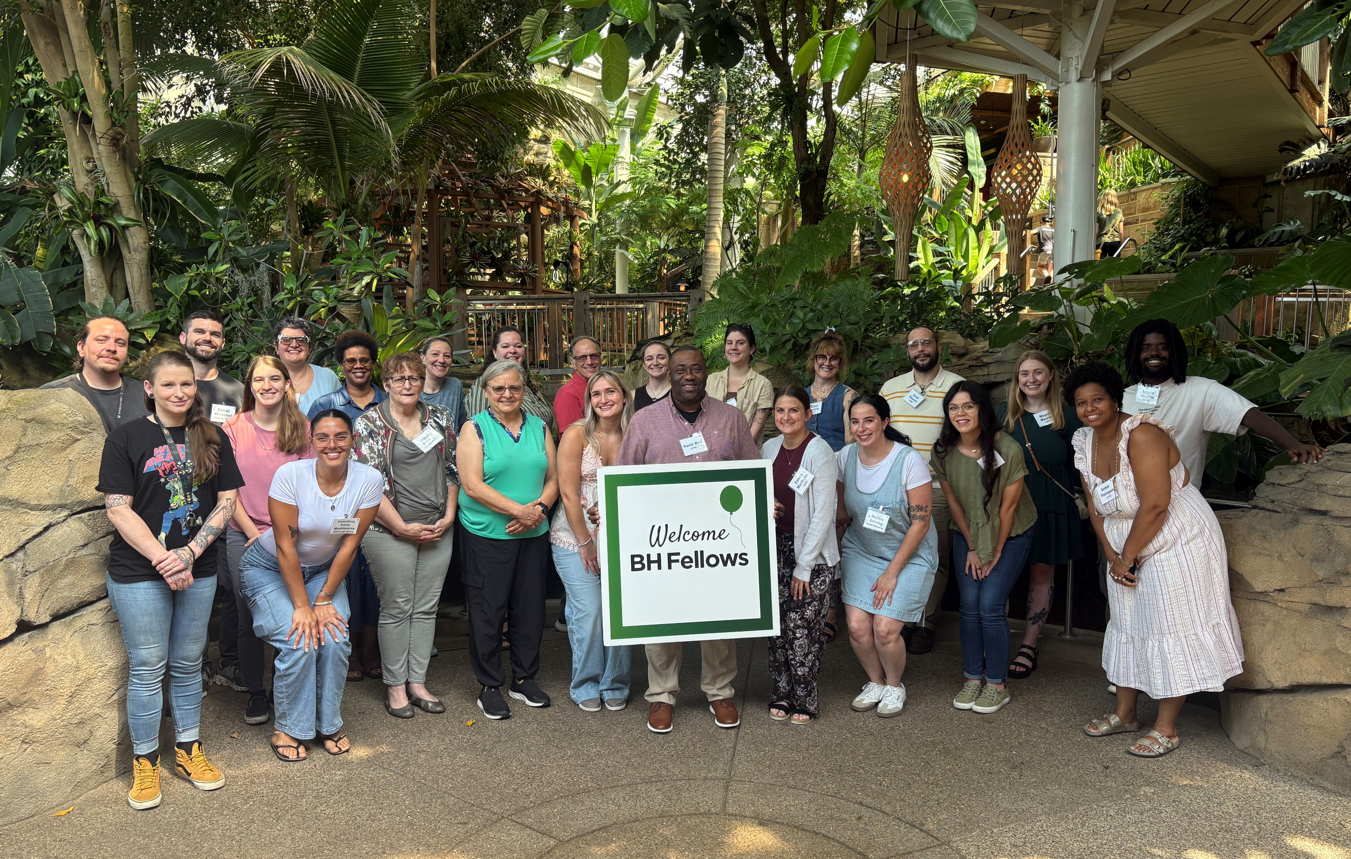

Good Morning
The Zesty Fellows
August 28, 2025

Slide 2

Agenda For the Day
Welcome with Sanctuary Model
Reflections
Situational Awareness and Safety in Behavioral Health
Break
Wellness Practices
Wrap-up
Lunch

Slide 3
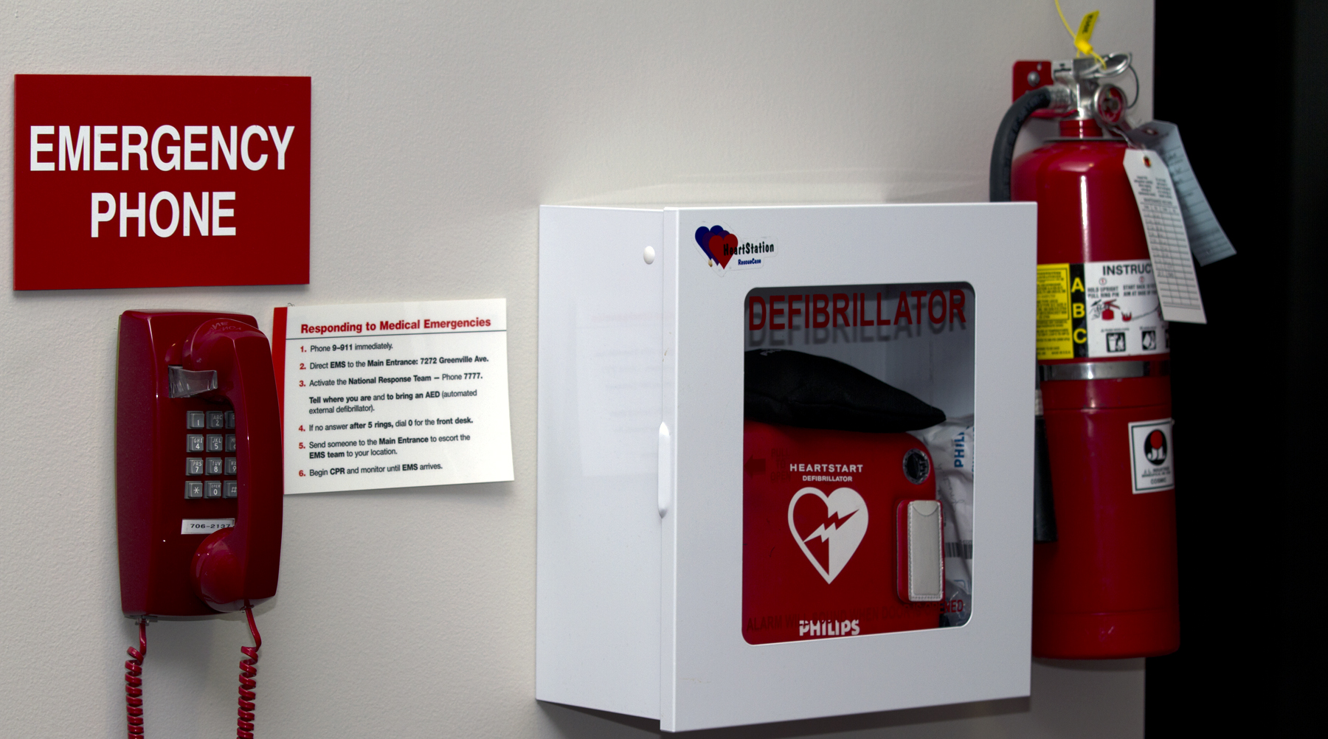


For Your Safety and Comfort
Notes:
Review safety logistics–we begin all of our meetings with a discussion of your safety. We do this because we believe in a customer focus and alerting you to these issues shows respect and value for you within this training.
Facilitator should know ahead of the presentation where the restrooms are located, what happens in case of a fire alarm, etc.
In the event of a fire, we will exit by staying together and exiting via…
Provide the location of the bathrooms—men’s and women’s (they may not be in the same place)
Let all participants know that it is acceptable to get up during the presentation to stretch or get something to eat and drink. This is a long day for people who are used to being on their feet and fighting fires all day.
STORY: We begin all our meetings with a safety message because:
When Paul O’Neill one of the co-founders of PRHI, worked at Alcoa he made it clear that safety was a top priority by doing just this: beginning each meeting with a safety message. The importance of safety came from his days of working at Alcoa where employees were regularly working with what could have been very unsafe materials: molten metal and sharp edges. He felt strongly that it was everyone’s responsibility to report hazards in the workplace. With the deployment of the TPS process Alcoa was able to become one of the safest workplaces in the world by attending to the importance of safety.
Putting safety first shows respect and value for every worker. Here we are touching on physical safety but a focus on safety includes emotional safety as well.
That means: this is a safe and respectful learning environment and we are all here to learn from each other. There are no dumb questions and everyone is valued.
A third type of safety is professional safety and we’ll discuss all three in more depth later today.
In relation to comfort, Please let the facilitator know if the room temperature is uncomfortable as he/she might be able to make adjustments.

Slide 4
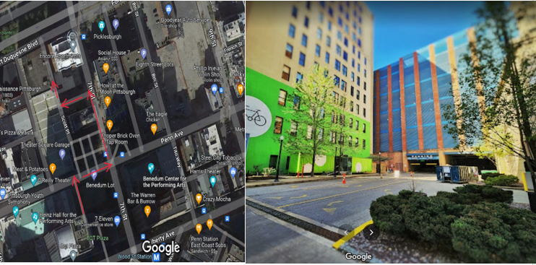
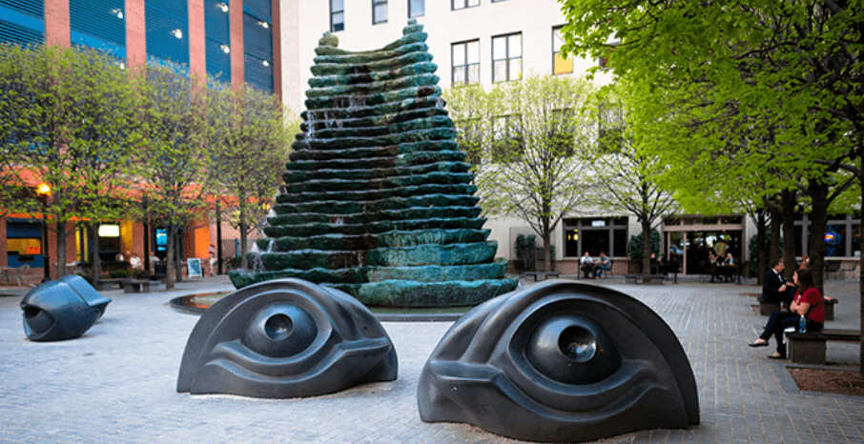
Designated meeting location for emergency evacuation:
Theater Square Garage Loading Dock in Scott Place Alley
(Penn Avenue side of Building behind “Eyeball Park”)

Slide 5

Please “Be Here Now”
Minimize distractions
Cellular phones
Work phones
Sidebar conversations
Other work
Attend all days, all sessions
‘Parking Lot’ for future further discussions
“All teach - all learn”
Notes:
You are giving up valuable time to be here. Please be present throughout the week. This means minimizing distractions and being physically and mentally present throughout the training.
Cell Phones and Pagers should be turned off or set to “silent”
We will be generating a lot of valuable discussion and it may lead to sidebar conversations. Please keep them to a minimum and feel free to share stories with the whole group, often it may be relevant to others as well!
Other work should be done at another time. We will move through material quickly and each lesson provides the foundation for the next lesson.
We do count on a certain number of people to be present for the exercises so if you know that you will be late or must leave early, please let your facilitator know so that adjustments can be made.

Slide 6
Continuing Education Information
In support of improving patient care, this activity has been planned and implemented by the University of Pittsburgh and The Jewish Healthcare Foundation.
As a Jointly Accredited Organization, University of Pittsburgh is approved to offer social work continuing education by the Association of Social Work Boards (ASWB) Approved Continuing Education (ACE) program. Organizations, not individual courses, are approved under this program. State and provincial regulatory boards have the final authority to determine whether an individual course may be accepted for continuing education credit. University of Pittsburgh maintains responsibility for this course. Social workers completing this course receive 2.0 continuing education credits.

Slide 7
Disclosures
No members of the planning committee, speakers, presenters, authors, content reviewers and/or anyone else in a position to control the content of this education activity have relevant financial relationships with any entity producing, marketing, re-selling, or distributing health care goods or services, used on, or consumed by, patients to disclose.
Notes:
No conflicts of interest

Slide 8
Disclaimer
The information presented at this Center for Continuing Education in Health Sciences program represents the views and opinions of the individual presenters, and does not constitute the opinion or endorsement of, or promotion by, the UPMC Center for Continuing Education in the Health Sciences, UPMC / University of Pittsburgh Medical Center or Affiliates and University of Pittsburgh School of Medicine. Reasonable efforts have been taken intending for educational subject matter to be presented in a balanced, unbiased fashion and in compliance with regulatory requirements. However, each program attendee must always use his/her own personal and professional judgment when considering further application of this information, particularly as it may relate to patient diagnostic or treatment decisions including, without limitation, FDA-approved uses and any off-label uses.

Slide 9

Learning Objectives
Understand the concept of situational awareness: Define situational awareness and explain its importance in maintaining a safe working environment.
Identify potential hazards and risk factors for violence in different work settings or scenarios.
Enhance observation skills: Improve the ability to actively observe and gather relevant information from the environment to anticipate potential dangers.
Demonstrate active listening and de-escalation skills via role play scenarios
Organizational considerations: Learn how to assess and advocate for an organizational culture where trauma-informed care is valued and practiced.

Slide 10
Welcome
Sanctuary Model
Please share your name, role, and organization
How are you feeling today?
What do you need from the group/anyone in the room?
What will you bring to the group?
Share a tip for maintaining safety in your work or a support/resource from your organization that has been helpful in terms of safety.

Slide 11

Reflections
What have been your experiences returning to your workplaces after your participation in the Burnout & Self-care session?
Have you been able to apply a self-care plan?

Slide 12
Safety in the Workplace: Applying Situational Awareness and Trauma-informed Care Culture
Michael Bowersox, LPC
Southwest PA AHEC (Area Health Education Center)
PA CHW Collaborative

Slide 13
Situational Awareness & Safety
Southwest PA Area Health Education Center
Mike Bowersox, LPC

Slide 14
Session Outline
Situational Awareness
Risk Factors for Violence
Nonverbal Communication
Organizational Considerations
Your Wellbeing

Slide 15
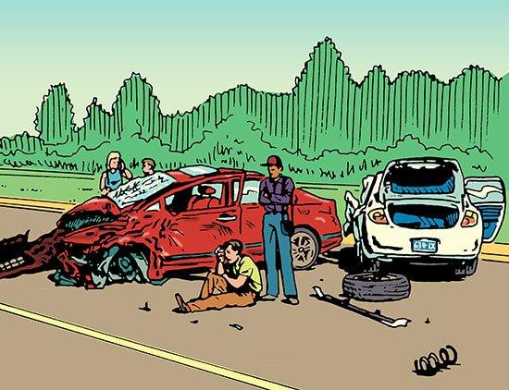

How many people total were involved in this accident?
What color were the two cars?
What objects were lying on the ground?
What injury did the person on the ground seem to be suffering from?
What was the license plate number of one of the cars?
How many people were wearing hats?
Notes:
After studying the picture for 60 seconds:
How many people total were involved in this accident?
How many males and how many females?
What color were the two cars?
What objects were lying on the ground?
What injury did the man on the ground seem to be suffering from?
What was the license plate number of one of the cars?

Slide 16
Group Scenario Creation
Create and describe a situation that includes at least these elements:
Describe the scene, ‘paint of picture’ of what is happening and where it is taking place
Eg, Private residence or public space? Potential threats? Exits? Number of people? etc.
Pick one: signs that the situation could potentially turn into a crisis – OR – an emergency/crisis already taking place. Describe this.
Who are the people involved? Add some relevant and not relevant details about those folks
Who will be the supervisor to ”huddle” the other table?

Slide 17
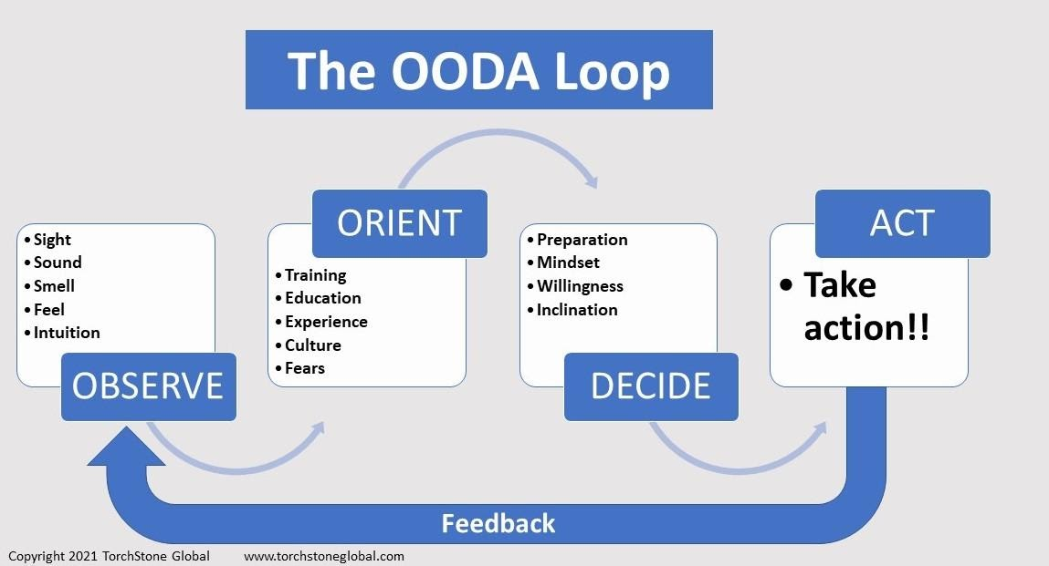

Slide 18
Observe
External Information
Internal Information
Situational details
Number of people
Potential threats
Time
Environmental details
Distractions
Temperature
Space
Pace of environment
Nonverbal cues
Identify exits
Be mindful
Tune into senses
Listen to your gut
Relaxed alertness
Don’t get complacent
System 1 & 2
Notes:
External info:
Uncomfortable behavior
Unusual actions
Hands
Aggressive/erratic behavior
Bulges in clothing

Slide 19
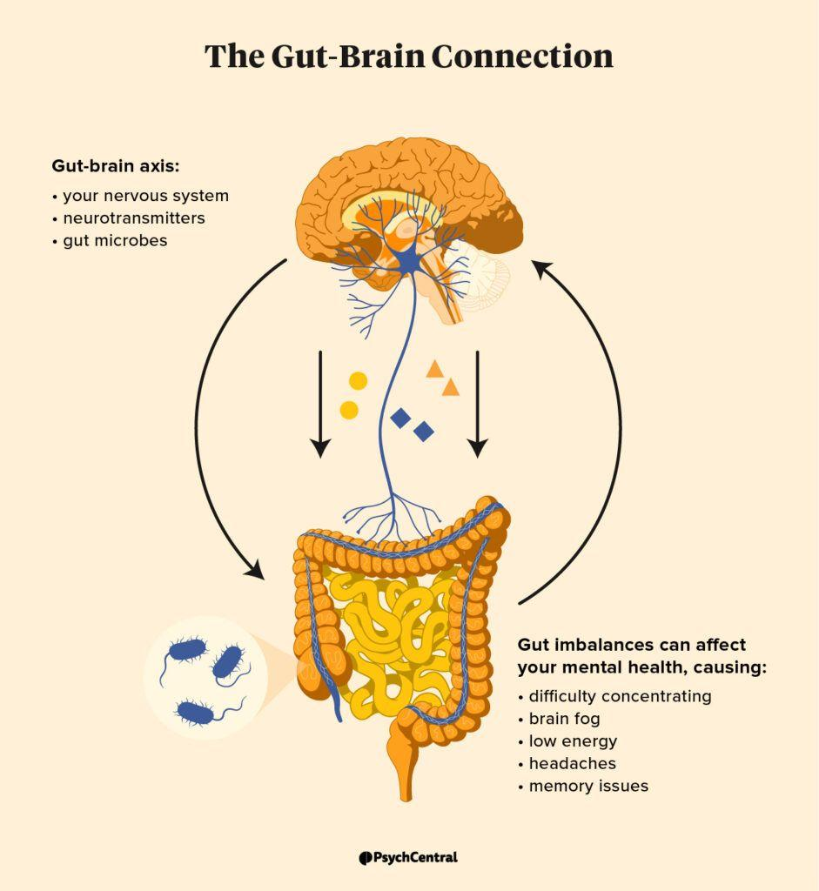
Perception & Neuroception
External Information
Internal Information
Situational details
Number of people
Potential threats
Time
Environmental details
Distractions
Temperature
Space
Pace of environment
Nonverbal cues
Identify exits
Be mindful
Tune into senses
Listening to your gut
Relaxed alertness
Don’t get complacent
System 1 & 2
Notes:
External info:
Uncomfortable behavior
Unusual actions
Hands
Aggressive/erratic behavior
Bulges in clothing
The gut, heart, and head all have complex networks and are functioning brains in their own right. Each different brain is a sophisticated system complete with billions of neurons that has the ability to grow, flex, and react. They are able to receive and process information, store it, and access it again when needed. They can: sense, learn, remember, communicate, and change
Neuroception refers to the neural circuits that allow our bodies to register whether an environment is safe or dangerous. Unlike perception, which delivers cognitive insights in the form of thoughts and sensory data, neuroception occurs outside of conscious thought.

Slide 20
high arousal
unpleasant
NEUTRAL
pleasant
low arousal
Notes:
Our emotions are also culturally informed. When a baby comes into the world it has this basic bearing… This is affect, the general sense of sensation/feeling that comes from your body.
Affect is not emotion – your body is producing affect all the time, whether you’re emotional or not and whether you notice it or not.
Affect is your brain’s summary of all the sense data coming from your body: your hormones, organs, immune system, heartbeat, respiration, muscle tension, body temperature – the storm of information coming from your experiencing of living in this moment is being summarized by your brains and you experience this as affect. This is an aspect of System 1

Slide 21
high arousal
Fight/flight
Distressed
Frustration
Elated, thrilled
Content
Gratified, pleased
unpleasant
NEUTRAL
pleasant
Lethargic
Depressed
Freeze/Collapse
Calm
Serene
low arousal
Notes:
The culturally layered and reinforced experiencing we label as…
Culturally overlap exists just as difference does.
Eg, in Western or individualistic culture, high arousal emotions are valued and promoted more than low arousal emotions. By contrast, in Eastern or collectivist culture, low arousal emotions are valued more than high arousal emotions. Moreover, people in the East actually experience and prefer to experience low arousal emotions more than high arousal emotions

Slide 22
Orient
Breathe
Where am I in relation to what’s important right now?
Notes:
A few things tend to hinder situational awareness: familiarity, complacency, apathy, over-confidence and denial.

Slide 23
Observe + Orient = Situational Awareness
Cultural traditions
Orienting (and re-orienting) takes what we need to be looking for when we’re observing, and then puts those observations into context so we know what to do with the information.
Interpreting a situation plays a significant role here, influenced by:
The ability to analyze and synthesize
Previous experience
New information coming in

Slide 24
System 1 & System 2

Slide 25
A baseball bat and ball cost a total of $1.10. The bat costs $1.00 more than the ball.
How much does the ball cost?
?
Ball | .05
Bat | 1.05
 | 1.10
Notes:
If the ball cost 10 cents and the bat costs $1.00 more than the ball, then the bat would cost $1.10 for a grand total of $1.20. The correct answer to this problem is that the ball costs 5 cents and the bat costs — at a dollar more — $1.05 for a grand total of $1.10.
So why do so many people answer incorrectly? The answer is that people often substitute difficult problems with simpler ones in order to quickly solve them. This is system one at work.

Slide 26
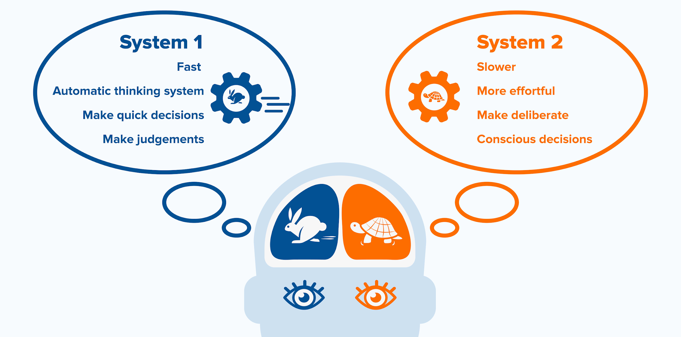
2 + 2 = ___
“Autopilot”
Detect sadness in a voice
Depth perception
17 x 24 = ___
Unfamiliar place/car radio
Monitor own behavior in social situation
Picking out friend in a crowd
Notes:
System 1 relies on our associative memory. It uses connections between earlier seen words, images, actions, and emotions to form a conclusion and make quick decisions. Even when there is not enough information available to make a rational decision. You could view System 1 as a stubborn hero, that does not think twice before acting.
System 2 is the mind’s slower, analytical mode, where reflection and reason dominate. To complement the stubborn hero, system 2 is the skeptical associate, not as fast or inexhaustible as our hero, but often second-guessing decisions and correcting them at critical moments.
System 1 discards important information in the name of efficiency. Situational awareness often means swimming against this current, becoming more intentional about enlisting the services of system 2. This is where OODA helps.
Daniel Kahneman, Thinking Fast and Slow

Slide 27


Slide 28
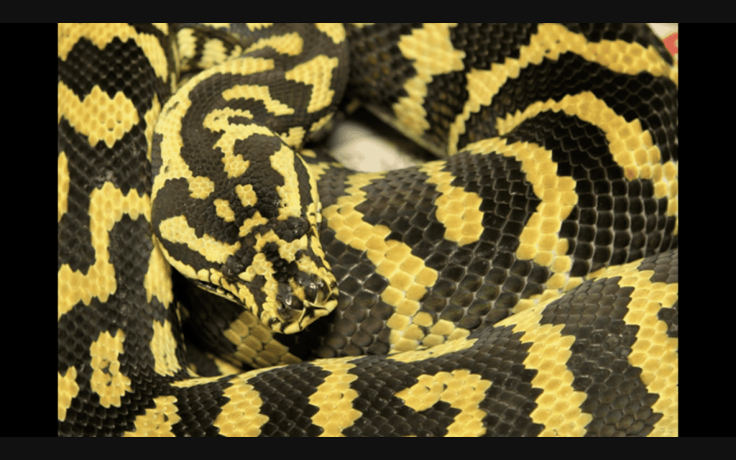

Slide 29
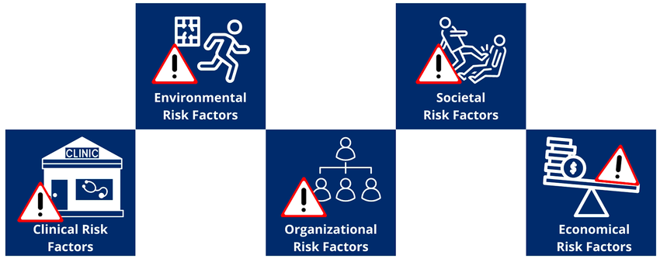
Risk Factors for Violence

Slide 30
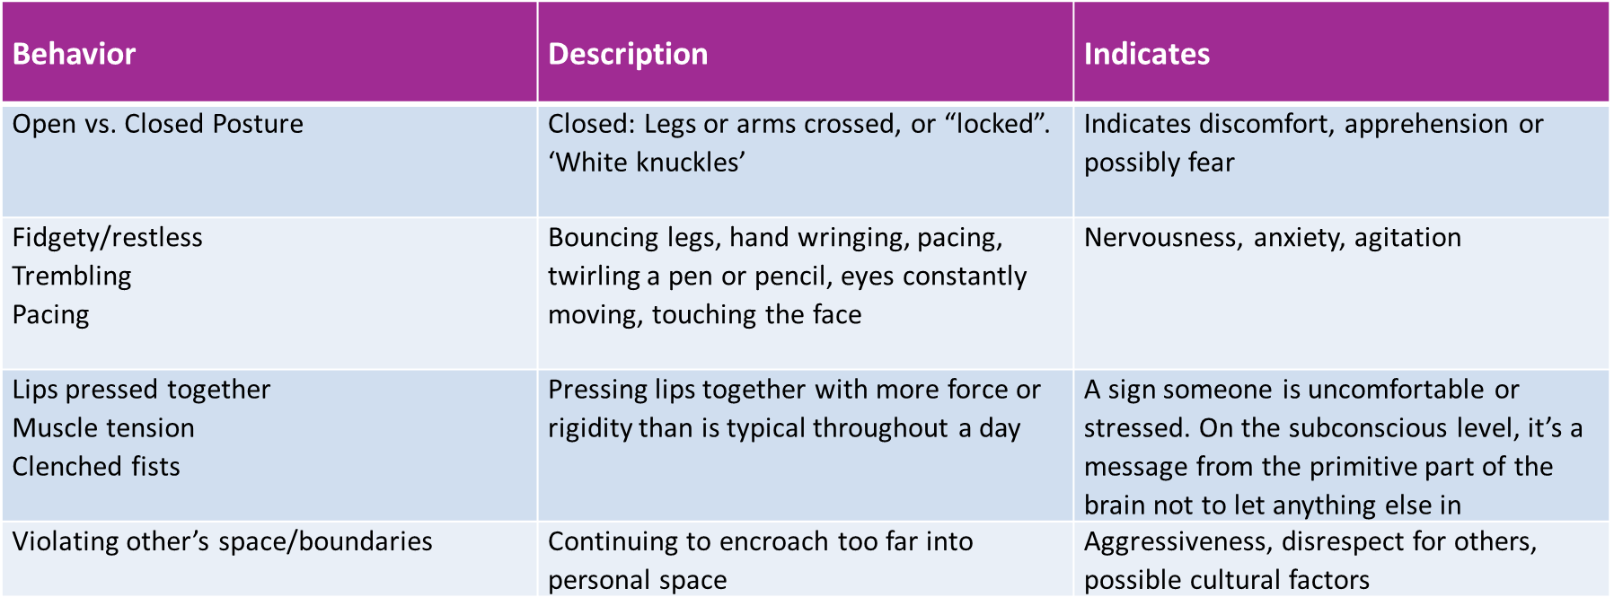
Nonverbal Warning Signals
Notes:
Others:
Silence
Subtle/Indirect (response in form of story)
Physical touch
Physical space
Eye contact
Dress/appearance
Specific threats to inflict harm, to self or others

Slide 31
Risk Factors for Violence
Health workers are at high risk of violence all over the world.
Many are threatened or exposed to verbal aggression. Most violence is perpetrated by patients and visitors
Between 8% and 38% of health workers suffer physical violence at some point in their careers.
- World Health Organization
Notes:
During the COVID-19 pandemic, 44% of nurses reported experiencing physical violence and 68% reported experiencing verbal abuse.
https://www.aha.org/fact-sheets/2022-06-07-fact-sheet-workplace-violence-and-intimidation-and-need-federal-legislative

Slide 32
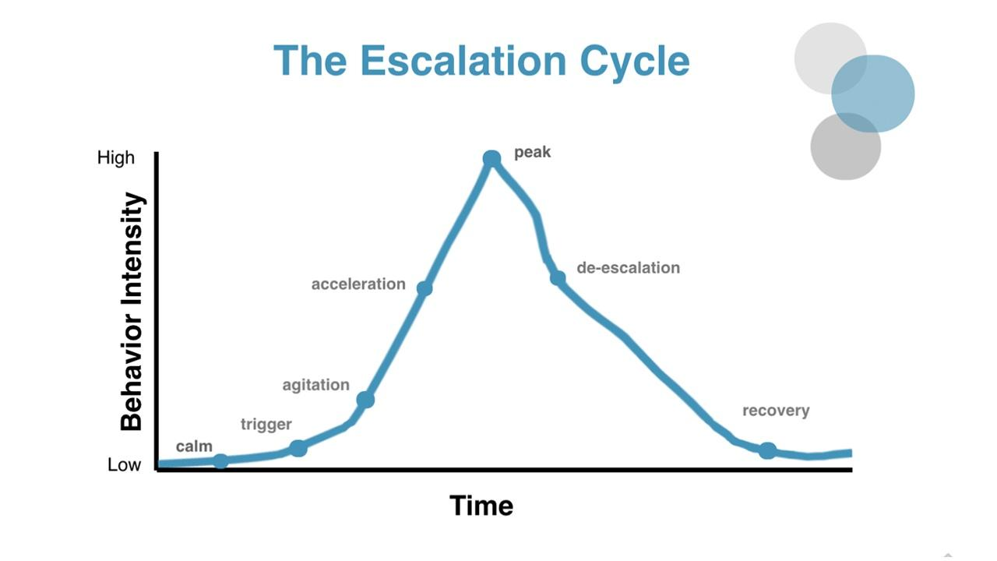
Decide & Act
Notes:
A few things tend to hinder situational awareness: familiarity, complacency, apathy, over-confidence and denial.

Slide 33
4 Tools for Challenging Situations
1
Empathetic Listening
Engage in attentive listening - "Listen with your ears, eyes, and heart. Listen for feelings and meaning."
Listen with intent to understand, rather than intent to reply
2
Verbal Communication Techniques
Calm, reassuring voice
Speak with respect
Ask open ended questions
Avoid using "You"
Paralanguage - non-verbal communication such as tone, pitch, manner of speaking
3
Non-Verbal Communication
90% of all communication is non-verbal
Avoid crossing your arms, pointing fingers, leaning in or getting too close
Maintain personal space
Relaxed body posture and open stance
Provide eye contact •Show concern and confidence
4
Asking for Help
Politely ask the guest to wait for a moment and scan for nearby colleagues
If you have a radio or phone, call a colleague you believe may be able to assist you
Notes:
Handout

Slide 34
10 Strategies for De-escalation (CPI)
Be Empathic and Nonjudgmental - Do not judge or be dismissive of the feelings of the person in distress. Remember that the person’s feelings are real, whether or not you think those feelings are justified. Respect those feelings, keeping in mind that whatever the person is going through could be the most important event in their life at the moment.
Respect Personal Space - Be aware of your position, posture, and proximity when interacting with a person in distress. Allowing personal space shows respect, keeps you safer, and tends to decrease a person’s anxiety. If you must enter someone’s personal space to provide care, explain what you’re doing so the person feels less confused and frightened.
Use Nonthreatening Nonverbals - The more a person is in distress, the less they hear your words—and the more they react to your nonverbal communication. Be mindful of your gestures, facial expressions, movements, and tone of voice. Keeping your tone and body language neutral will go a long way toward defusing a situation.
Be Mindful of your Emotional Brain - Remain calm, rational, and professional. While you can’t control the person’s behavior, how you respond to their behavior will have a direct effect on whether the situation escalates or defuses. Positive thoughts like “I can handle this” and “I know what to do” will help you maintain your own rationality and calm the person down.
Focus on Their Feelings - Facts are important, but how a person feels is the heart of the matter. Yet some people have trouble identifying how they feel about what’s happening to them. Watch and listen carefully for the person’s real message. Try saying something like “That must be scary.” Supportive words like these will let the person know that you understand what’s happening—and you may get a positive response.
Notes:
Handout

Slide 35
10 Strategies for De-escalation (CPI)
Ignore Challenging Questions - Engaging with people who ask challenging questions is rarely productive. When a person challenges your authority, redirect their attention to the issue at hand. Ignore the challenge, but not the person. Bring their focus back to how you can work together to solve the problem.
Set Limits - As a person progresses through a crisis, give them respectful, simple, and reasonable limits. Offer concise and respectful choices and consequences. A person who’s upset may not be able to focus on everything you say. Be clear, speak simply, and offer the positive choice first.
Choose Wisely What You Insist Upon - It’s important to be thoughtful in deciding which rules are negotiable and which are not. For example, if a person doesn’t want to shower in the morning, can you allow them to choose the time of day that feels best for them? If you can offer a person options and flexibility, you may be able to avoid unnecessary altercations.
Allow Silence for Reflection - We’ve all experienced awkward silences. While it may seem counterintuitive to let moments of silence occur, sometimes it’s the best choice. It can give a person a chance to reflect on what’s happening, and how they need to proceed. Silence can be a powerful communication tool.
Allow Time for Decisions - When a person is upset, they may not be able to think clearly. Give them a few moments to think through what you’ve said. A person’s stress rises when they feel rushed. Allowing time brings calm.
Notes:
Handout

Slide 36

Composed Confidence
Point your feet towards the person you are talking to
Sit/Stand up straight, shoulders back. You can also lean towards the person, but this is situationally and culturally dependent
Keep an open posture: arms, hands, and legs
Remember to breathe
The half-smile. Forcing a smile, even a half smile has been proven to lower heart rate and stress

Slide 37
Be curious not judgmental
Notes:
When someone says or does something you perceive as weird or irrational, try not to judge or discount their feelings. Whether or not you think those feelings are justified, they’re real to the other person. Pay attention to them.
Systems 1-2

Slide 38
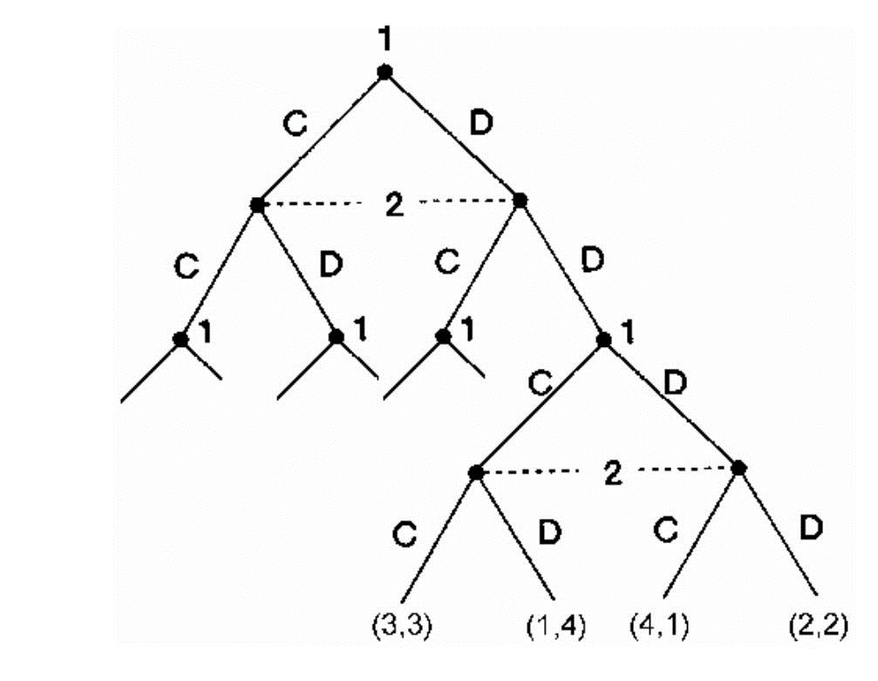
Group
Scenarios

Slide 39
Organizational Considerations
What training is provided on topics of:
Traumatic stress?
Crisis prevention?
De-escalation?
Cultural consideration?
Are topics related to trauma addressed in team meetings or supervision?
Are outreach workers and clients asked for their definition of physical safety?
How is supervision conducted?
Is part of supervision time used to help staff members understand their own stress reactions?

Slide 40
Nothing can survive without food. Everything we consume acts to either heal us or to poison us. We tend to think of nourishment only as what we take in through our mouths, but what we take in through our eyes, our ears, our noses, our tongues, and our bodies is also food. The conversations going on around us, and those we participate in, are also food. Are we consuming and creating the kind of food that is healthy for us and helps us grow?
- Thich Nhat Hahn

Slide 41


Wellness Practices

Slide 42

Wrap-up and Reminders
Take aways from today
Questions?
Reminders:
Next training: Cultural Humility, part 1
Thursday, February 26, 2026 at JHF Offices

Slide 43
Surveys
CEU Survey:
Session Survey:

Slide 44
