Slide 1




Housekeeping
This session is being recorded to Tomorrow’s Healthcare.
If you used a forwarded link, we need your email address.
Pose questions in the chat to
“Everyone”.
Please complete the post-session evaluation.
Notes:
Before we begin, we have some housekeeping items to review.
Please know that this learning network is being recorded and continued participation constitutes consent to be recorded. All recordings will be added to Tomorrow’s Healthcare for future viewing or to share with individuals in your organization who were unable to participate in this webinar.
If you used a link that was forwarded to you by a colleague and your name is not the name showing up as you on Zoom, it is likely that we will not have your email address to send the LN evaluation reminder and any follow up material. Please put your email address in the chat and we will be sure you receive follow up material.
You can type any questions you have in the chat box during the session, and we’ll answer them throughout the presentation. Please use the “everyone” option when sending your questions. You may also use the Q&A feature, if you prefer.
At the end of the session, we will share a link in the chat box which will direct you to the session evaluation. This is also how you will claim continuing education credits for this session. ​
Next slide, please.

Slide 2
Continuing Education Information
In support of improving patient care, this activity has been planned and implemented by the University of Pittsburgh and The Jewish Healthcare Foundation. The University of Pittsburgh is jointly accredited by the Accreditation Council for Continuing Medical Education (ACCME) and the American Nurses Credentialing Center (ANCC), to provide continuing education for the healthcare team. 1.25 hours is approved for this course.
As a Jointly Accredited Organization, University of Pittsburgh is approved to offer social work continuing education by the Association of Social Work Boards (ASWB) Approved Continuing Education (ACE) program. Organizations, not individual courses, are approved under this program. State and provincial regulatory boards have the final authority to determine whether an individual course may be accepted for continuing education credit. University of Pittsburgh maintains responsibility for this course. Social workers completing this course receive 1.25 continuing education credits.
Notes:
This session is approved for 1.25 hours of continuing education credit.

Slide 3
Disclosures
No members of the planning committee, speakers, presenters, authors, content reviewers, and/or anyone else in a position to control the content of this education activity have relevant financial relationships with any entity producing, marketing, re-selling, or distributing health care goods or services, used on, or consumed by, patients to disclose.
Notes:
No members of the planning committee nor presenters have conflicts to disclose

Slide 4
Disclaimer
The information presented at this Center for Continuing Education in Health Sciences program represents the views and opinions of the individual presenters, and does not constitute the opinion or endorsement of, or promotion by, the UPMC Center for Continuing Education in the Health Sciences, UPMC/University of Pittsburgh Medical Center or affiliates and University of Pittsburgh School of Medicine. Reasonable efforts have been taken intending for educational subject matter to be presented in a balanced, unbiased fashion and in compliance with regulatory requirements. However, each program attendee must always use their own personal and professional judgment when considering further application of this information, particularly as it may relate to patient diagnostic or treatment decisions including, without limitation, FDA-approved uses, and any off-label uses.
Notes:
The information being presented represent the views and opinions of the individual presenters, and does not constitute the opinion or endorsement of, or promotion by, the UPMC Center for Continuing Education in the Health Sciences

Slide 5
Mutual Agreement
Everyone on every Program Evaluation and Research Unit (PERU) webinar is valued. Everyone has an expectation of mutual, positive regard for everyone else that respects the diversity of everyone on the webinar.
We operate from a strength-based, empathetic, and supportive framework – with the people we serve, and with each other on PERU webinars.
We encourage the use of affirming language that is not discriminatory or stigmatizing.
We treat others as they would like to be treated and, therefore, avoid argumentative, disruptive, and/or aggressive language.
Notes:
There is a mutual agreement in place for all PERU webinars, including Learning Network sessions. These points are essential for a respectful learning environment. Let’s go through this agreement together.
<Read slide>
Next slide, please.

Slide 6
Mutual Agreement (continued)
We strive to listen to each person, avoid interrupting others, and seek to understand each other through the Learning Network as we work toward the highest quality services for Centers of Excellence (COE) clients.
Information presented in Learning Network sessions has been vetted. We recognize that people have different opinions, and those diverse perspectives are welcomed and valued. Questions and comments should be framed as constructive feedback.
The Learning Network format is not conducive to debate. If something happens that concerns you, please send a chat during the session to the panelists and we will attempt to make room to address it either during the session or by scheduling time outside of the session to process and understand it. Alternatively, you can reach out offline to your PERU point of contact.
Notes:
<Read slide>
Next slide, please.

Slide 7

Acknowledgements
The COE project is a partnership of the University of Pittsburgh’s Program Evaluation and Research Unit and the Pennsylvania Department of Human Services; and is funded by the Pennsylvania Department of Human Services, grant number 601747.
COE vision: The Centers of Excellence will ensure care coordination, increase access to medication-assisted treatment and integrate physical and behavioral health for individuals with opioid use disorder.
Notes:
This presentation was created in partnership with Pennsylvania Department of Human Services

Slide 8


Effective Communication About Medications for Opioid Use Disorder
COE Learning Network 1-26-2026
Raagini Jawa, MD, MPH, FASAM
Assistant Professor of Medicine, Center for Research on Healthcare, Division of General Internal Medicine
University of Pittsburgh
@Raaginizzle

Slide 9
Funding & Disclosures
Disclosures:
None
Acknowledgements:
Our patients & other individuals who have shared and taught us through their experiences
Harm reduction activists who have paved the way for our work today
Funding:
NIDA K23

Slide 10
Learning Objectives
By completion of this session, participants should be able to:
Recognize how language and attitudes influence perceptions of MOUD.
1
Use trauma-informed and culturally responsive communication to support client understanding and reduce stigma during MOUD education.
2
Accurately describe all MOUD options in plain language in a way that is non-stigmatizing.
3

Slide 11




The Overdose Crisis
4,719
drug overdose deaths in 2023
One Pennsylvanian died every
2 hours
Overdoses can be prevented by Medications for Opioid Use Disorder (MOUD)
Notes:
84% were opioid related

Slide 12
The Overdose Crisis
ODSMP 2023
Rate per 10,000 Population
Black
White
Notes:
Black PA have a higher rate of fatal overdoses than white PA

Slide 13



Barrier to MOUD = STIGMA
Public stigma
Negative attitudes and fears that isolate individuals with addiction
Structural stigma
Excluding individuals with addiction from opportunities and resources
Internalized stigma
Believing negative stereotypes about oneself
Notes:
Impact on PWUD: Poor health services access and uptake
Poor social or emotional wellbeing
Marginalization
Engagement in “riskier” situations and behaviors

Slide 14
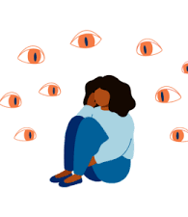
Attitudes That Influence Perceptions of MOUD
Belief that MOUD is “trading one drug for another”
Moral judgments about substance use
Personal discomfort discussing opioid use
Misunderstandings about effectiveness and safety
14
Notes:
Our tone and assumptions shape how clients feel about their choices.

Slide 15

Responding to Common Client Questions
“Isn’t this replacing one drug with another?”
→ “These are medications that help your brain heal and reduce overdose risk.”
“Will I get addicted to the medication?”
→ “MOUD is not the same as addiction. It helps stabilize your brain, not create harmful use.”
“How long do I have to be on it?”
→ “People stay on it for different lengths of time. You have control over that decision.”
15

Slide 16
Ways to Reduce Stigma in Care for PWUD
Personal Practice
Language Matters
Acknowledge your own feelings and biases
Avoid pre-judging clients
Listen closely and without interruption
Empathize with each person’s lived experience
Ensure there is always a path for re-engagement if someone leaves care
Words shape beliefs, emotions, and treatment engagement
Stigmatizing language can:
Reduce trust
Reinforce shame and internalized stigma
Discourage initiation or continuation of MOUD
Compassionate, person-first language promotes safety, dignity, and healing
16
Notes:
Emphasize that even well-intentioned staff may use stigmatizing phrases out of habit.

Slide 17


DO USE | DON’T USE
Person who uses substances Person with a substance use disorder | Addict Abuser Junkie Alcoholic User Drunk
Return to use | Failure Relapse
Utilizes services and supports | Frequent Flyer
Baby with dependency | Addicted Babies
Person in recovery | Clean
Medication for substance use | Medication assisted treatment
Addiction | Drug habit
No longer uses substances | Got clean
Positive, negative toxicology | Clean, Dirty
17
Notes:
Words Matter Pledge - Portrait

Slide 18

Trauma-Informed Communication Principles for MOUD
Safety: Create a nonjudgmental, calm environment.
Choice: Offer options whenever possible.
Collaboration: Engage clients as partners.
Empowerment: Affirm strengths and autonomy.
Transparency: Explain processes clearly.
18

Slide 19
Goals of MOUD Pharmacotherapy
Treatment of cravings & withdrawal symptoms
No illicit opioid use (or reduced use)
Reduced morbidity & mortality
Reset dopamine response
Ultimately, everyone’s goals are different
Courtesy of Dr Margaret Shang 2025
19
Notes:
Courtesy of Dr Margaret Shang 2025

Slide 20
MOUD
Buprenorphine
Methadone
Naltrexone
20

Slide 21

Types of Opioid Receptors
Courtesy of Dr Margaret Shang 2025
Delta (DOR)
Nociceptin (NOR)
Kappa (KOR)
Zeta (ZOR)
Mu (MOR)

Slide 22

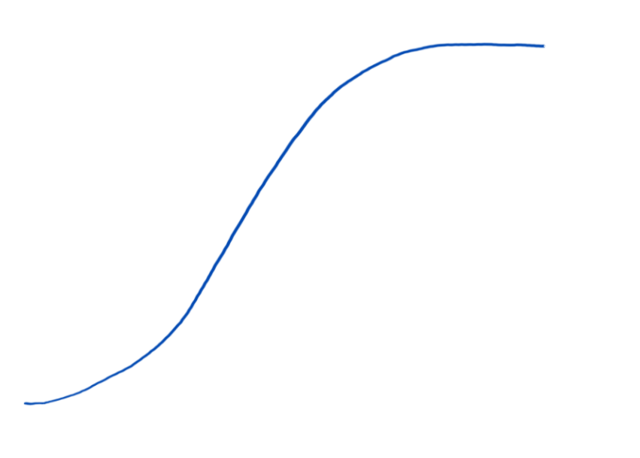


Mu-Opioid Receptor
Courtesy of Dr Margaret Shang 2025
Delta (DOR)
Full agonist (Methadone)
Nociceptin (NOR)
Kappa (KOR)
Receptor Response
Partial agonist (Buprenorphine)
Zeta (ZOR)
Mu (MOR)
Antagonist (Naltrexone)
Drug Concentration

Slide 23
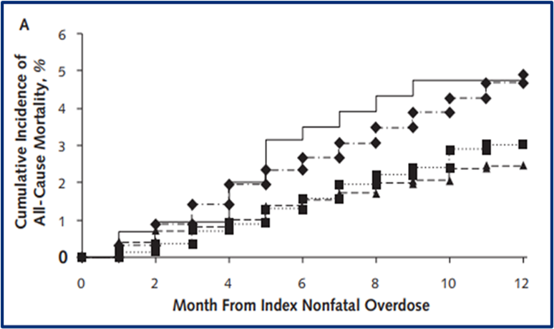
All MOUD Options Are NOT Equivalent!
Methadone and buprenorphine were associated with reduced all-cause and opioid-related mortality compared to no MOUD, with methadone showing stronger effects.
Naltrexone showed no significant impact on all-cause or opioid-related mortality in opioid overdose survivors.
LaRochelle 2018
23
Notes:
Source: https://www.ncbi.nlm.nih.gov/pmc/articles/PMC6387681/pdf/nihms-1002372.pdf (Larochelle, MR, et al, Annals of Internal Medicine, 2018)
14
Opioid Agonist Treatment is Associated with a Reduction in Mortality by ~50%
Results: Compared with no MOUD, MMT was associated with decreased all-cause mortality (adjusted hazard ratio [AHR], 0.47 [CI, 0.32 to 0.71]) and opioid-related mortality (AHR, 0.41 [CI, 0.24 to 0.70]). Buprenorphine was associated with decreased all-cause mortality (AHR, 0.63 [CI, 0.46 to 0.87]) and opioid-related mortality (AHR, 0.62 [CI, 0.41 to 0.92]). No associations between naltrexone and all-cause mortality (AHR, 1.44 [CI, 0.84 to 2.46]) or opioid-related mortality (AHR, 1.42 [CI, 0.73 to 2.79]) were identified.
Conclusion: A minority of opioid overdose survivors received MOUD. Buprenorphine and methadone were associated with reduced all-cause and opioid-related mortality. Naltrexone was not associated with decreased mortality.
Retrospective cohort
Opioid overdose survivors (n=17,568)
3 in 10 received MOUD over 12 months
All-cause & opioid-related mortality at 12 months
Methadone: decreased 53% and 59%
Buprenorphine: decreased 37% and 38%
No association with naltrexone (small sample)

Slide 24
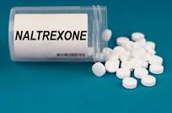
Naltrexone
Oral Naltrexone daily (Revia or Depade) vs Extentended-Release Naltrexone monthly (Vivatrol)
Also FDA-approved for Alcohol use disorder
Some data for stimulant use disorder (combined with bupropion), behavioral addictions (gambling)
Harder to initiate due to required period of abstinence (7-10 days)
Non-inferior to buprenorphine-naloxone over 12 weeks to abstain from opioids (Tanum 2017)
Decreased opioid tolerance leading to higher risk of overdose after discontinuation
24

Slide 25
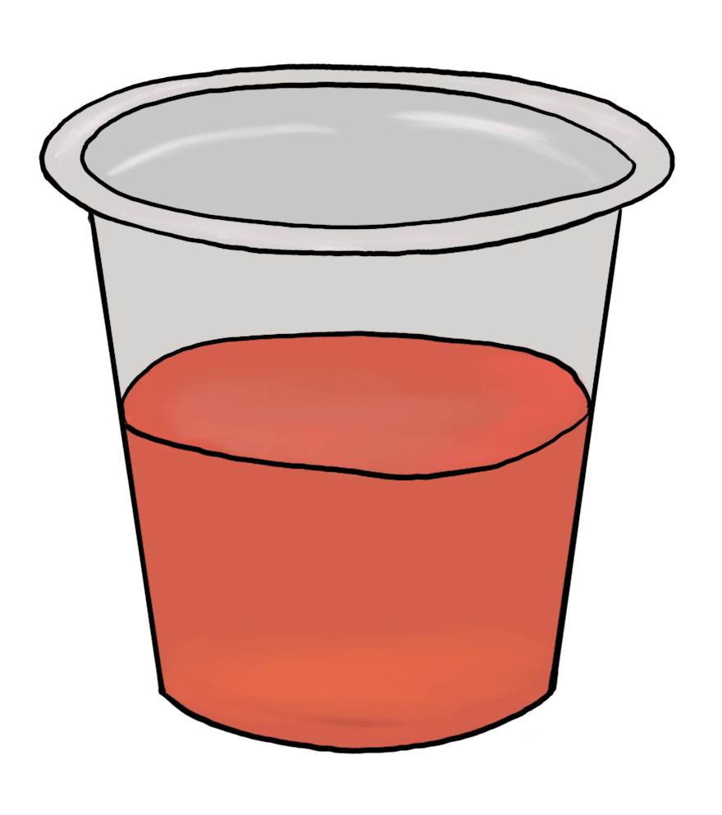
Methadone
Courtesy of Dr Margaret Shang 2025
Long-acting formulation
Slow uptitration (5-10 mg every 3-5 days) to therapeutic doses of 80-120 mg, with no dose cap.
Dispensed only at licensed treatment centers (OTP) under strict enrollment criteria (OUD only) and observed daily dosing (usually in the morning).
Liquid formulation with take-home privileges up to 28 days and potential for medical exemptions.
25
Notes:
Long-acting formulation, starting at 30 mg on day 1 (federal regulation), with an additional 10 mg after 2-4 hours if needed, for a total of 40 mg.
Slow uptitration (5-10 mg every 3-5 days) to therapeutic doses of 80-120 mg, with no dose cap.
Dispensed only at licensed treatment centers (OTP) under strict enrollment criteria (OUD only) and observed daily dosing (usually in the morning).
Liquid formulation with take-home privileges up to 28 days and potential for medical exemptions.

Slide 26
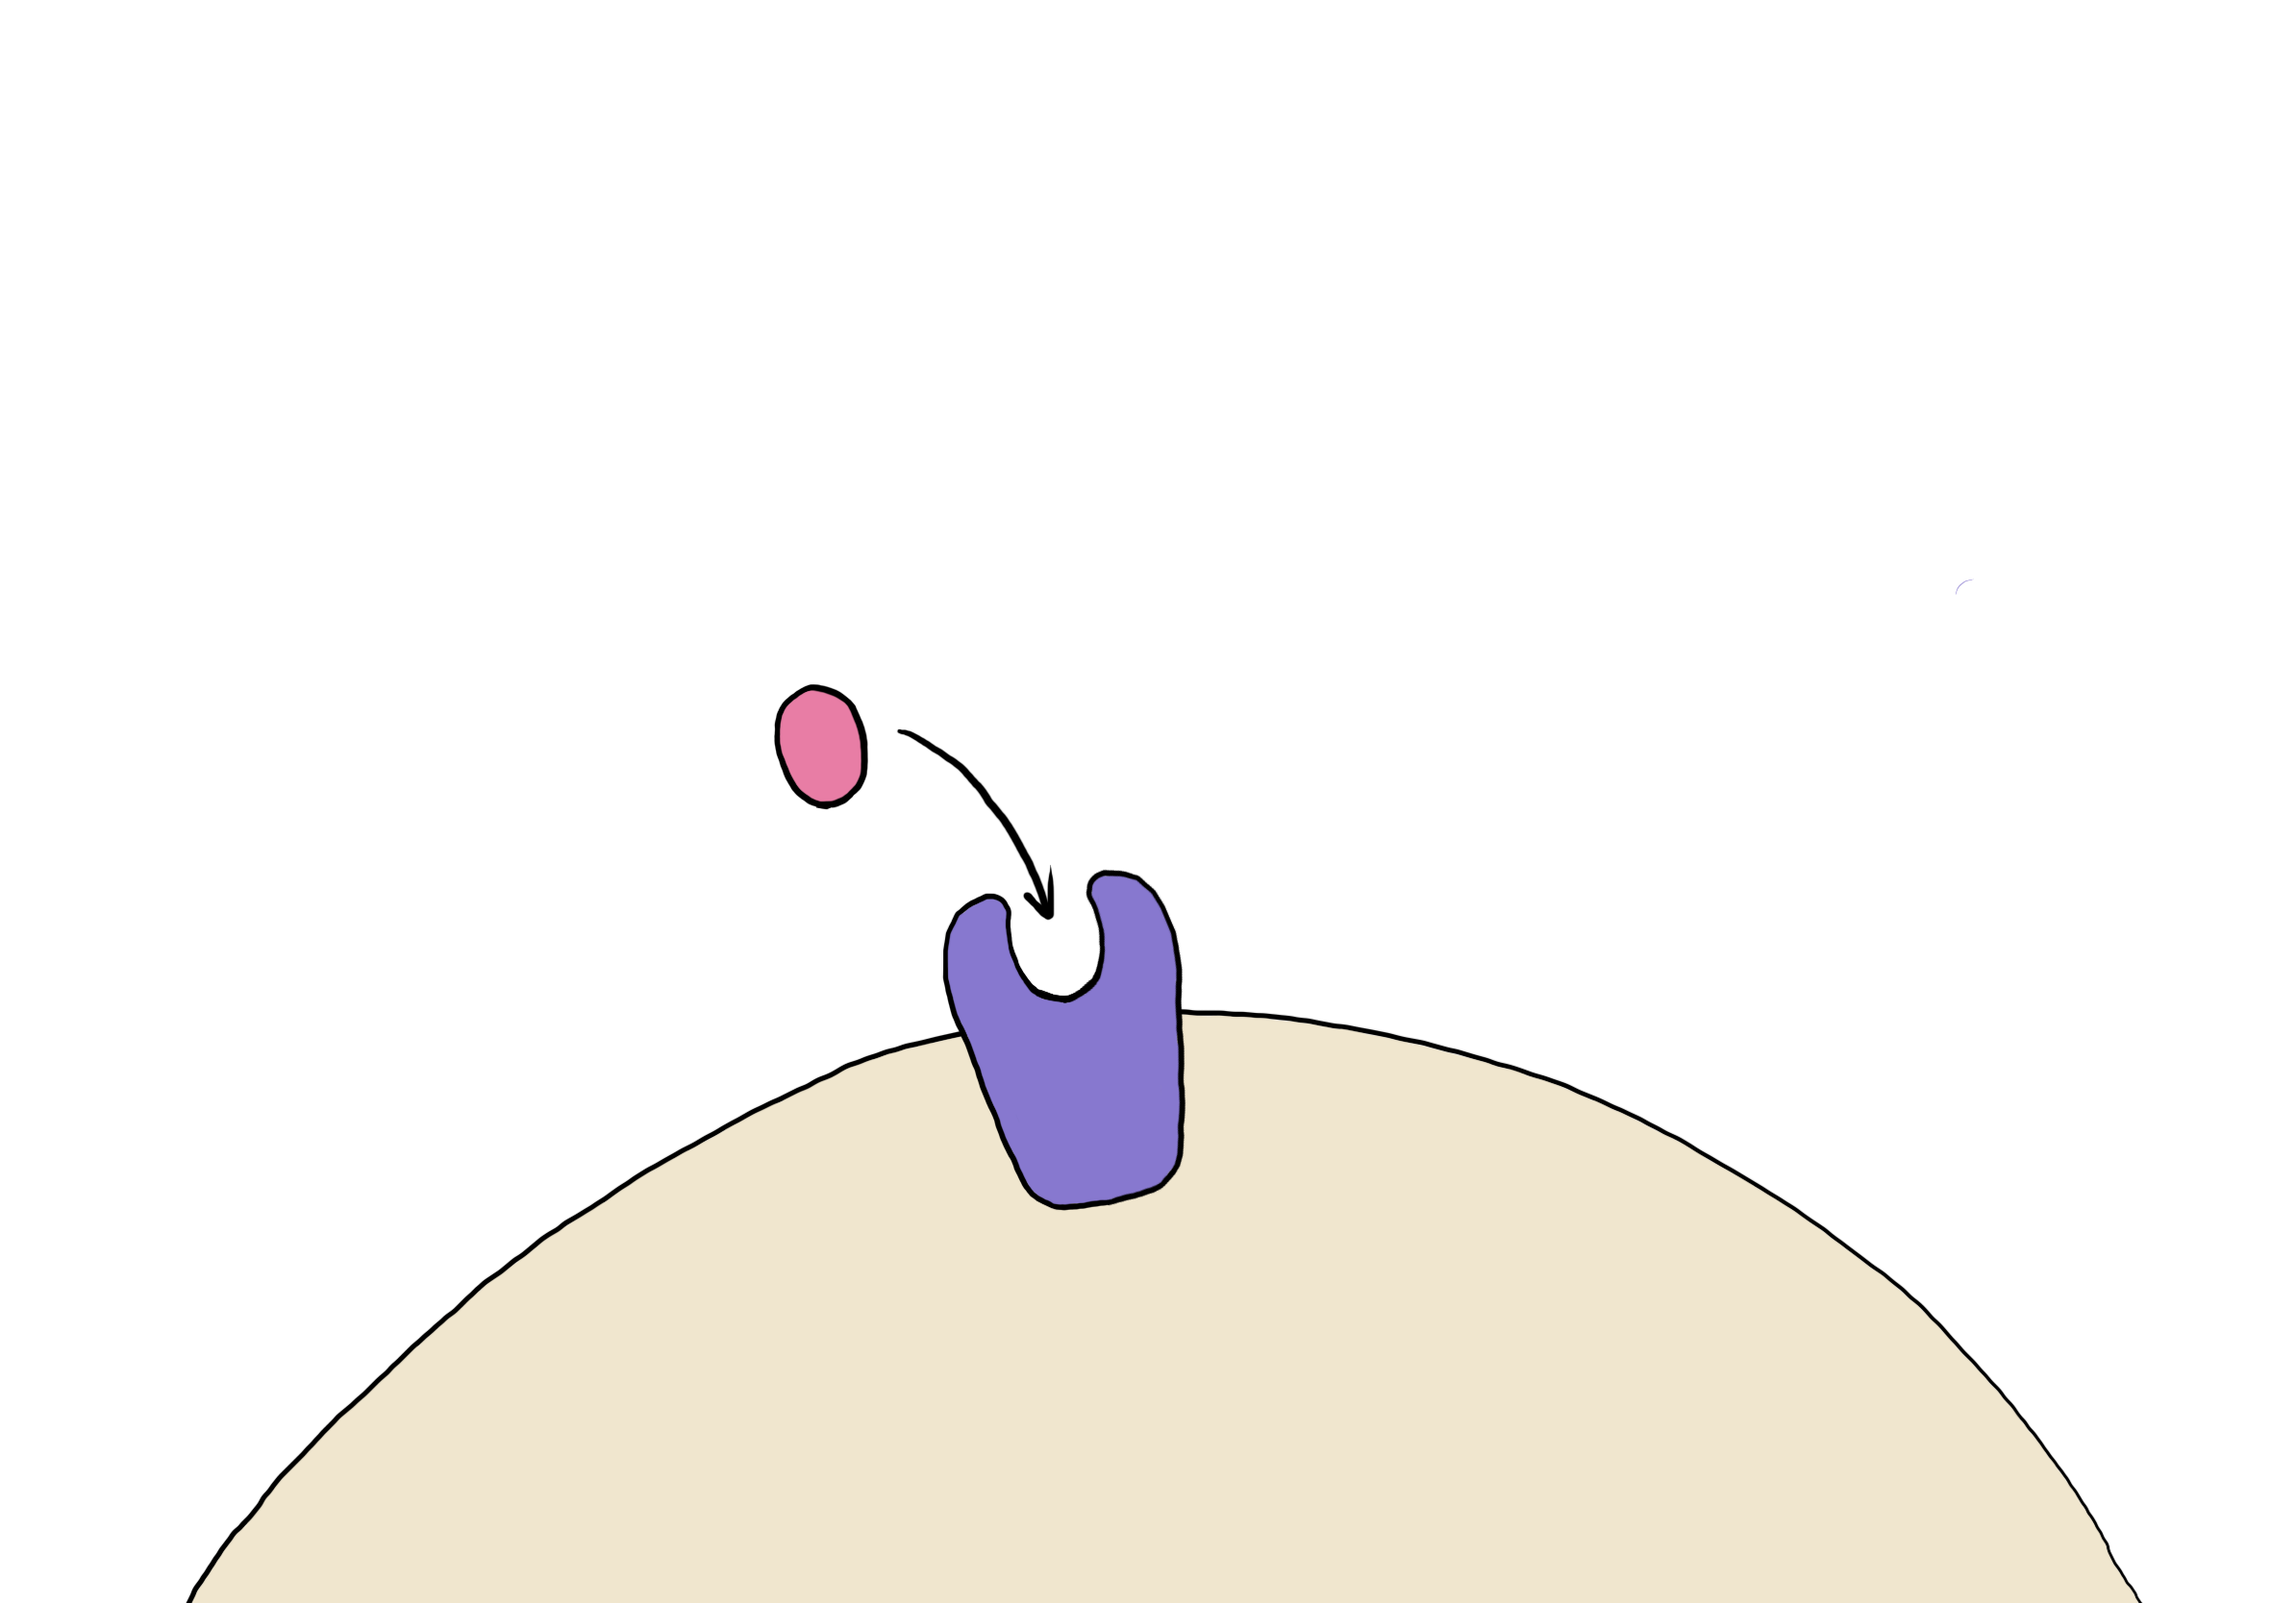
Courtesy of Dr Margaret Shang 2025
PARTIAL AGONIST
HIGH AFFINITY
buprenorphine
mu-opioid receptor

Slide 27
Courtesy of Dr Margaret Shang 2025
PARTIAL AGONIST
Receptor Response
Partial agonist (Buprenorphine)
Ceiling Effect
Respiratory depression
Euphoria
Drug Concentration

Slide 28
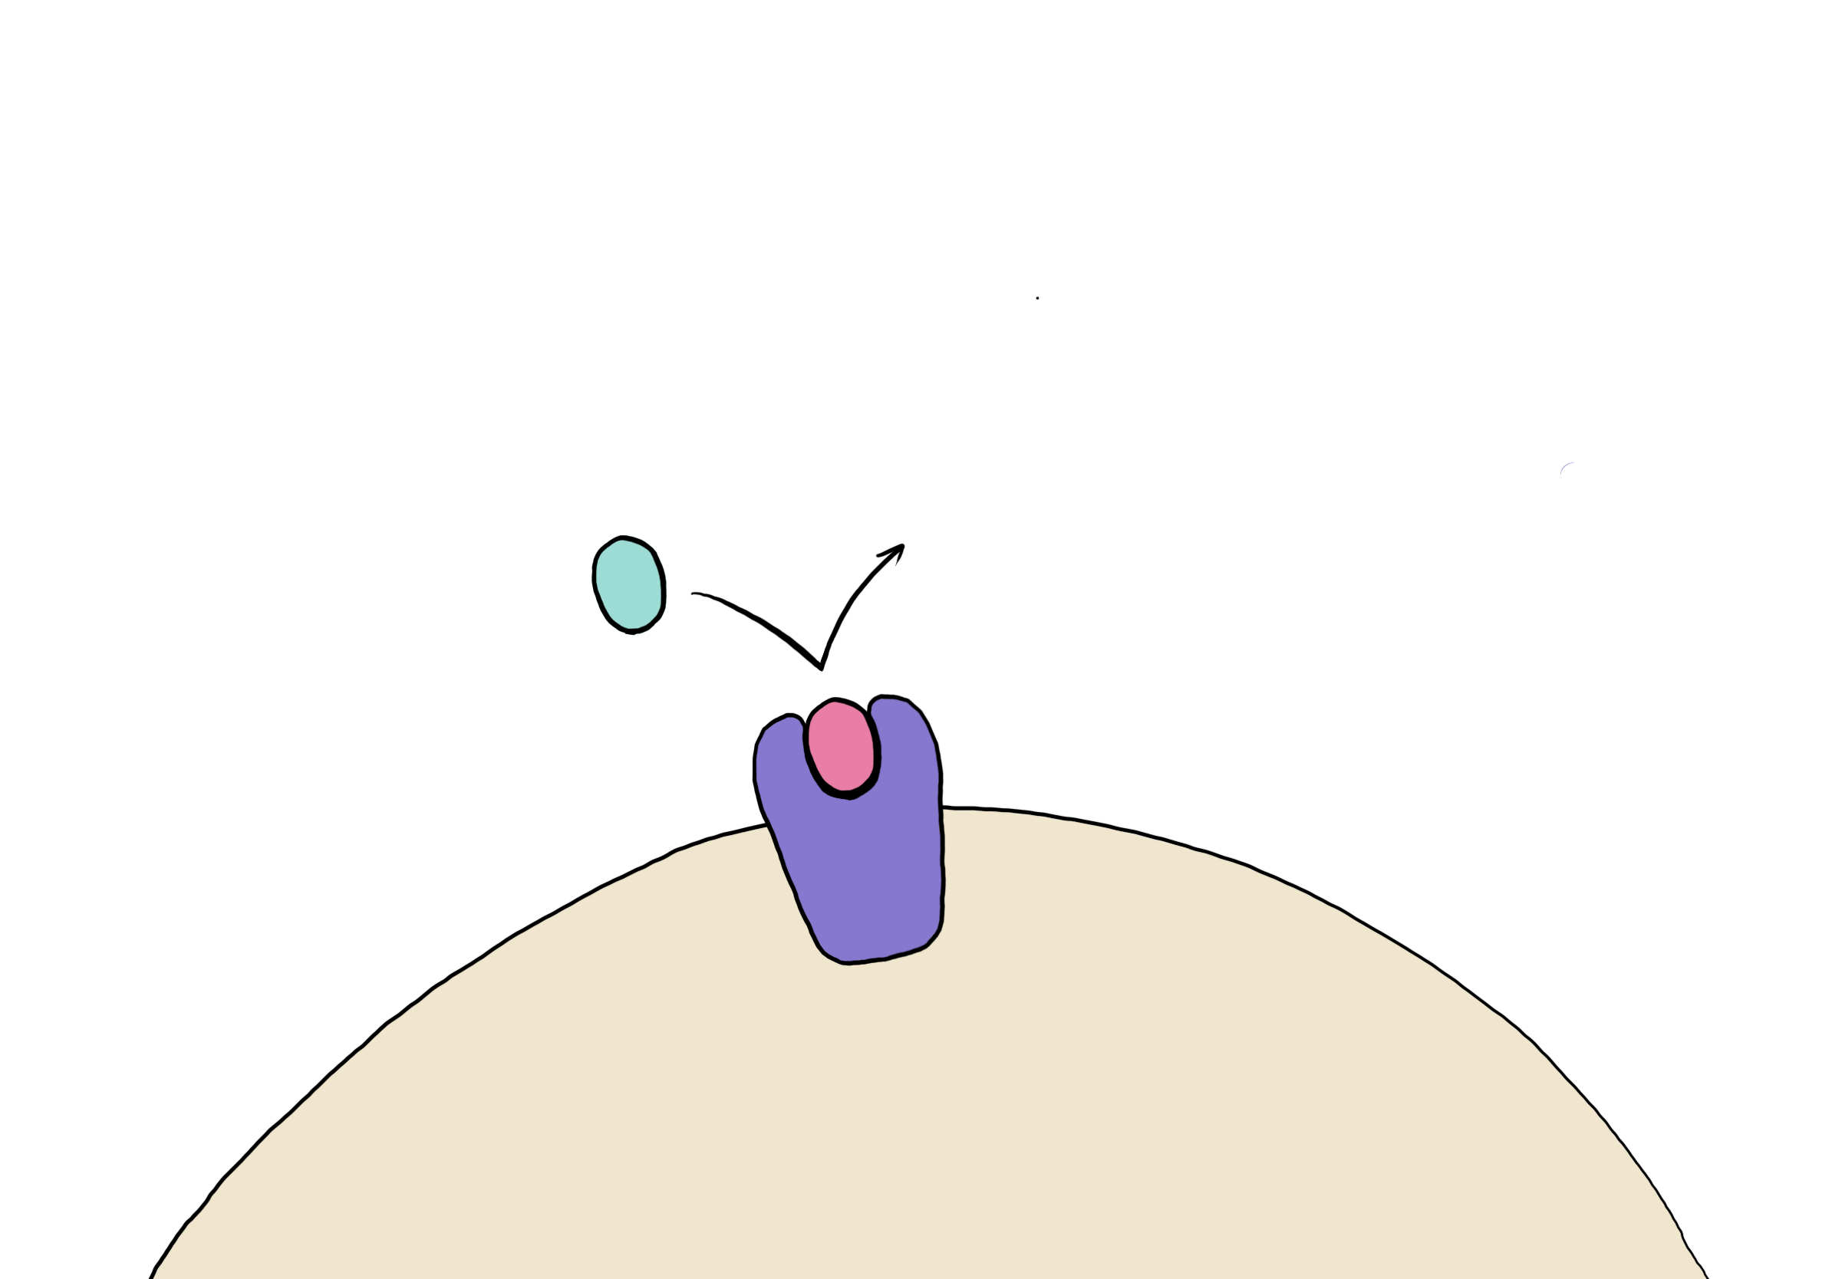
Courtesy of Dr Margaret Shang 2025
HIGH AFFINITY
+
PARTIAL AGONIST
=
fentanyl
mu-opioid receptor
PRECIPITATED WITHDRAWAL

Slide 29
Buprenorphine
 | Form | Brand Name
Buprenorphine | Film or tablet | Subutex
 | Patch | Butrans
 | Extended-Release injection | Sublocade Brixadi
Buprenorphine-naloxone | Film or tablet | Suboxone, Zubsolv, Bunavail

Slide 30


Buprenorphine
Naloxone in Suboxone will cause withdrawal in people who aren’t using opioids
Naloxone only has an effect if someone tries to misuse the medication by injecting it.
When taken as prescribed (sublingually), naloxone is poorly absorbed through the oral mucosa.
Notes:
Its presence in the combination is specifically to deter misuse.

Slide 31
Comparing MOUD Types
Courtesy of Dr Margaret Shang 2025
 | Methadone | Buprenorphine | Naltrexone
Action at mu-opioid receptor | Full agonist | Partial agonist | Antagonist
Route(s) of administration | Oral | Sublingual, subcutaneous extended-release injection | Oral, intramuscular extended-release injection
DEA schedule | Schedule II | Schedule III | None
Availability | Federally-certified Opioid Treatment Programs (OTP); acute inpatient hospital setting | Office-based; any provider with DEA license (X-wavier no longer needed; no patient limits) | Office-based; any provider with prescribing ability
Safety concerns | QTc prolongation, drug-drug interactions | Acute liver failure, precipitated withdrawal | Blocks other opioids; decreased opioid tolerance
Initiation | Anytime | Multiple protocols including low-dose and high-dose initiations | Abstinence from opioids 7-14 days
31
Notes:
Comparison of logistics
Usual doses
Complete 8 hours of training
Addiction medicine/psychiatry
Within 5 years of graduating from med school with 8 hour SUD/OUD curriculum
maintaining abstinence, achieving medication adherence, maintaining retention, protecting against reestablishment of opioid physical dependence, and may reduce craving for opioids for some individuals, while showing good safety and tolerability

Slide 32
Which MOUD to use?
Courtesy of Dr Margaret Shang 2025
Current regimen/use pattern
Last use
Withdrawal symptoms
Inpatient vs outpatient
Patient’s concerns & preference
32

Slide 33
Explaining MOUD in Plain, Non-Stigmatizing Language
Buprenorphine:
“Helps with cravings and withdrawal.”
“Allows your brain to stabilize so you can focus on healing.”
Methadone:
“A long-acting medication taken daily that prevents cravings and withdrawal.”
“Helps people stay safe and reduces overdose risk.”
Naltrexone (XR):
“A monthly injection that blocks the effects of opioids.”
“Works best for people who have already stopped using opioids.”
33

Slide 34

Strategies for Reducing Stigma When Talking About MOUD
Normalize MOUD as evidence-based medical treatment.
Emphasize that OUD is a treatable health condition.
Validate concerns without judgment.
Ask permission before sharing information.
Use simple, clear, consistent messaging.
34

Slide 35
References
https://www.addictiontraining.org/documents/resources/355_Words_Matter_Pledge.pdf
https://cce.upmc.com/content/diagnosing-substance-use-disorders-and-initiating-medications-opioid-use-disorder
Larochelle MR, Bernson D, Land T, Stopka TJ, Wang N, Xuan Z, Bagley SM, Liebschutz JM, Walley AY. Medication for Opioid Use Disorder After Nonfatal Opioid Overdose and Association With Mortality: A Cohort Study. Ann Intern Med. 2018 Aug 7;169(3):137-145. doi: 10.7326/M17-3107. Epub 2018 Jun 19. PMID: 29913516; PMCID: PMC6387681.
35

