Slide 1



Welcome to Dragon Medical One Training Monday, January 26, 2026 1 AM – 4 PM
Instructor: Carla Zimmerly, Epic Principal Trainer/Credentialed Trainer
Proctor: Ann Burns, Epic Credentialed Trainer
Learning Objectives:
Review the PowerMic
Log Into Dragon Medical One
Set Up Mobile Mic/Configure Buttons
Review the DragonBar Menu Options
Dictating Text – Selecting/Correcting Words
Manage Vocabulary – Add/Train Words
Create Auto-Text and Step-by-Step Commands
Review Training Materials
© 2025 UPMC*
*This material contains confidential and copyrighted information of
Epic Systems Corporation (© 2025 Epic Systems Corporation).
Notes:
Photo will change

Slide 2
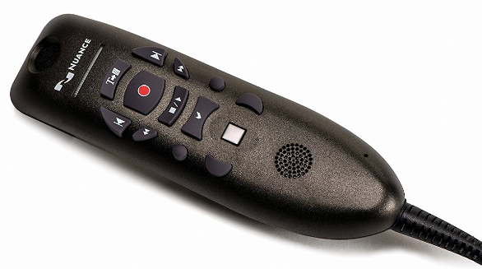

Dragon Medical One
Dragon Medical One Training_Dragon Medical One Training Presentation | Last Updated: 08/07/2025
© 2025 UPMC*
*This material contains confidential and copyrighted information of
Epic Systems Corporation (© 2025 Epic Systems Corporation).
Notes:
Dragon Medical One

Slide 3

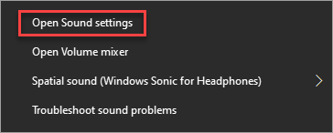
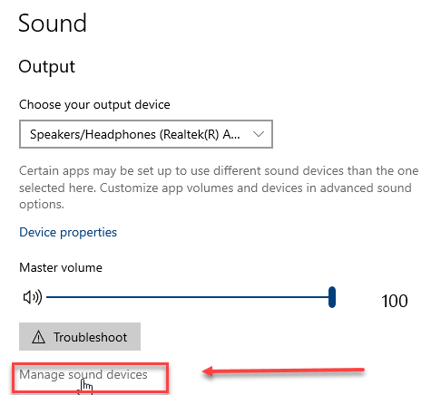
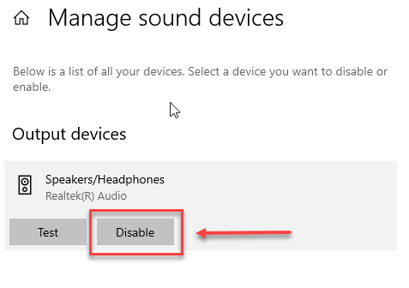
Audio Settings – Windows 10
If your audio for the presentation is going through your PowerMic and you would like to fix this:
For Windows 10: Right click on Speakers/Headphones icon in tray on your PC
Select Open Sound Settings:
Click on Open Sound settings:
Click on Manage Sound Devices in Output area, click on Speakers/Headphones to expand and click Disable:
Notes:
If your audio for the presentation is going through your PowerMic and you would like to fix this:
For Windows 10: Right click on Speakers/Headphones icon in tray on your PC
Select Open Sound Settings:
Click on Open Sound settings:
Click on Manage Sound Devices in Output area, click on Speakers/Headphones to expand and click Disable:

Slide 4

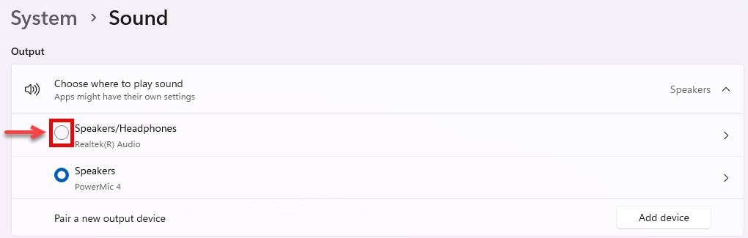
Audio Settings – Windows 11
If your audio for the presentation is going through your PowerMic and you would like to fix this:
For Windows 11: Right click on Speakers/Headphones icon in tray on your PC
Select Open Sound Settings:
Click on Sound settings:
Click on the radio button beside Speakers/Headphones (Realtek ® Audio) in the Output area, and close the Sound Settings window.
Notes:
If your audio for the presentation is going through your PowerMic and you would like to fix this:
For Windows 11: Right click on Speakers/Headphones icon in tray on your PC
Select Open Sound Settings:
Click on Open Sound settings:
Click on Manage Sound Devices in Output area, click on Speakers/Headphones to expand and click Disable:

Slide 5
What is Dragon Medical One?
Dragon Medical One is a revolutionary secure cloud-based speech recognition software.
You talk, it types…
It is most accurate when you speak clearly and distinctly.
It is not….
A transcriptionist.
You will be editing your own material.
Notes:
Dragon Medical One is a revolutionary secure cloud-based speech recognition software.
You talk, it types…
It is most accurate when you speak clearly and distinctly.
It is not….
A transcriptionist.
You will be editing your own material.

Slide 6
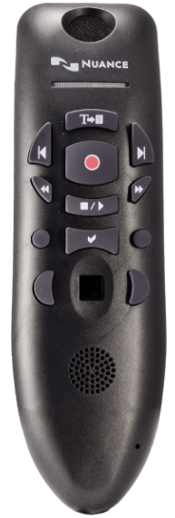
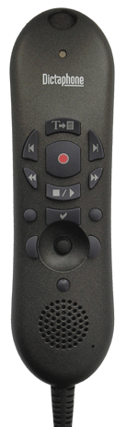
The Nuance PowerMic II/III- Epic
The Nuance PowerMicTM is specially designed for enhanced physician productivity.
Microphone
F2 Button
(Can be used to move from variable to variable in templated notes)
Record Button
Mouse
On back of mic there is a left click button for mouse.
Notes:
Microphone on at the top.
Red button is the record button.
F2 button can be used to move from variable to variable in templated notes.
Back of mic there is button that is LEFT click for mouse.
**Hold 1-3 in from the mouth. Elbow glued to your side so that your mic moves with you. Keep in front of you when you turn to talk.
Mention that to plug and play without rebooting, plug the microphone into the USB port closest to the green power light.

Slide 7
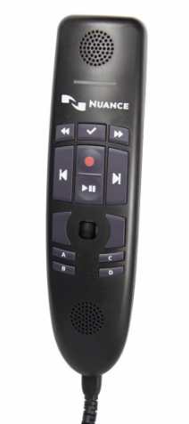
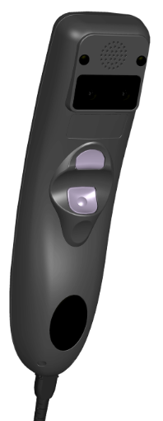
The Nuance PowerMic 4 - Epic
The Nuance PowerMicTM is specially designed for enhanced physician productivity.
Microphone
Accept Defaults Button
(Can be programmed as an F2 button to use to move from variable to variable in templated notes)
Record Button
Mouse
Transfer Text Button (Programmed as F2 for use with Epic by default mapping; was previously Transfer Text button; the “Transfer Text” verbal command can be used.)
Notes:
Microphone on at the top.
Red button is the record button.
F2 button can be used to move from variable to variable in templated notes.
Back of mic there is button that is LEFT click for mouse.
**Hold 1-3 in from the mouth. Elbow glued to your side so that your mic moves with you. Keep in front of you when you turn to talk.
Mention that to plug and play without rebooting, plug the microphone into the USB port closest to the green power light.

Slide 8
The Nuance PowerMic 4 - Cerner
The Nuance PowerMicTM from is specially designed for enhanced physician productivity.
Accept Defaults Button
Microphone
Record Button
Previous Field
Next Field
Mouse
Transfer Text Button
The “Transfer Text” verbal command can also be used.
Notes:
Microphone on at the top.
Red button is the record button.
F2 button can be used to move from variable to variable in templated notes.
Back of mic there is button that is LEFT click for mouse.
**Hold 1-3 in from the mouth. Elbow glued to your side so that your mic moves with you. Keep in front of you when you turn to talk.
Mention that to plug and play without rebooting, plug the microphone into the USB port closest to the green power light.

Slide 9
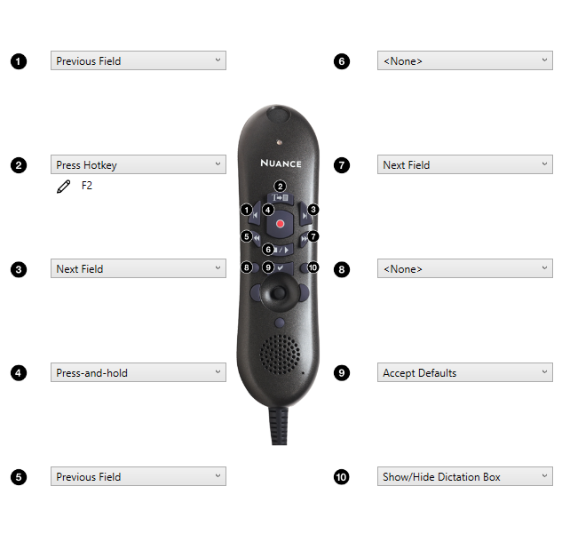
PowerMic Device
PowerMic:
Felt Circle – The felt circle located at the top of the PowerMic is where you speak into when dictating and should be in a good position (approximately 1 inch from your mouth at chin level).
Left Single Arrow - Previous Field (used when navigating through variables in an auto-text)
T Button - Transfers text from the Dictation Box to the application then closes the Dictation Box. You can also use the voice command: “Transfer Text” (when using the T Button in EpicCare, the T Button serves as a F2 button, when programmed as such, which allows you to toggle through Wildcards (***) which are placeholders in SmartPhrases that enable you to insert variable information that changes from patient to patient).
Right Single Arrow - Next Field (used when navigating through variables in an auto-text)
Red Button - Press and hold button when dictating – activates microphone (the red light will be on)
Left Double Arrow - Previous Field (used when navigating through variables in an auto-text)
This button can be programmed according to your preferences.
Right Double Arrow - Next Field (used when navigating through variables in an auto-text)
This button can be programmed according to your preferences.
Check Mark Button - Accepts Defaults
Right Circle Button - Opens or hides Dictation Box
Mouse - Moves Pointer
Left Mouse = Left Click
Right Mouse = Right Click
Rear Trigger Button - Left Click (we recommend that you not use this button)
Two-hand method is recommended using the PowerMic in your less dominant hand and your mouse with your dominant hand.
Of note, all of the buttons on the PowerMic an be programmed according to your preferences; however, the programming explained and as shown above is what is recommended for use with Cerner and Epic.
Notes:
Next, we will review the functionality of the buttons on the Nuance PowerMic device.
The felt circle located at the top of the PowerMic is where you speak into when dictating and should be in a good position. Approximately 1 inch from your mouth at chin level is recommended.
Number 1 on the diagram, the left single arrow, is the Previous Field button which is used when navigating through variables in an auto-text.
Number 2 on the diagram, the T Button, transfers text from the Dictation Box to the application then closes the Dictation Box. You can also use the voice command: “Transfer Text” (when using the T Button in EpicCare, the T Button serves as an F2 button, when programmed as such, which allows you to toggle through Wildcards (***) which are placeholders in SmartPhrases that enable you to insert variable information that changes from patient to patient).
Number 3 on the diagram, the right single arrow, is the Next Field button which is used when navigating through variables in an auto-text.
Number 4 on the diagram, a red button, is the Press and hold button for dictating. This button, when pressed in, activates the microphone, and the red light will be on.
Number 5 on the diagram, the left double arrow, is also a Previous Field button which can be used when navigating through variables in an auto-text.
Number 6 on the diagram, is a button that can be programmed according to your preferences.
Number 7 on the diagram, the right double arrow, is also a Next Field button which can be used when navigating through variables in an auto-text.
Number 8 on the diagram, is a button that can be programmed according to your preferences.
Number 9 on the diagram, the Check Mark button, accepts defaults.
Number 10 on the diagram, the Right Circle button, opens or hides the Dictation Box.
Here’s a helpful tip: The two-hand method is recommended using the PowerMic in your less dominant hand and your mouse with your dominant hand.
Of note, all of the buttons on the PowerMic can be programmed according to your preferences; however, the programming explained and as shown ris what is recommenced for use with Cerner and Epic.

Slide 10
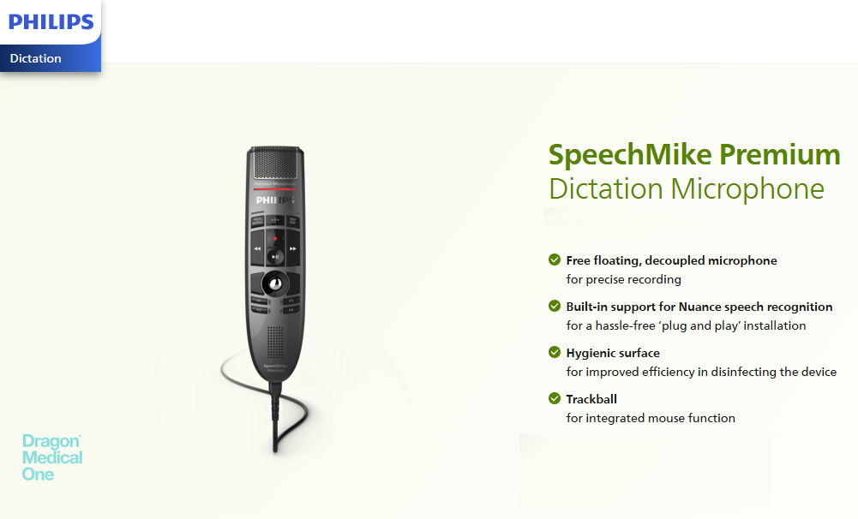
COMING SOON! The Philips SpeechMike Premium
Notes:
Microphone on at the top.
Red button is the record button.
F2 button can be used to move from variable to variable in templated notes.
Back of mic there is button that is LEFT click for mouse.
**Hold 1-3 in from the mouth. Elbow glued to your side so that your mic moves with you. Keep in front of you when you turn to talk.
Mention that to plug and play without rebooting, plug the microphone into the USB port closest to the green power light.

Slide 11
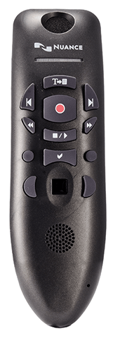
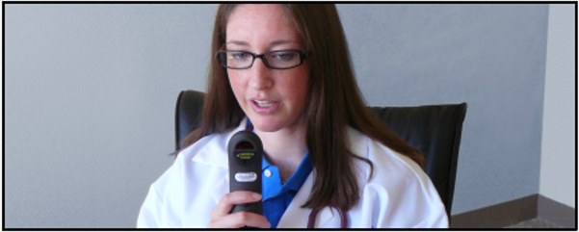
PowerMic Device
Correct positioning of your PowerMic microphone is one of the most important factors in receiving good dictation accuracy.
Speak into the circle located at the top of your PowerMic when dictating.
The microphone should be one to three inches away from your mouth at chin level.
Notes:
Correct positioning of your PowerMic microphone is one of the most important factors in receiving good dictation accuracy.
Speak into the circle located at the top of your PowerMic when dictating.
The microphone should be one to three inches away from your mouth at chin level.

Slide 12
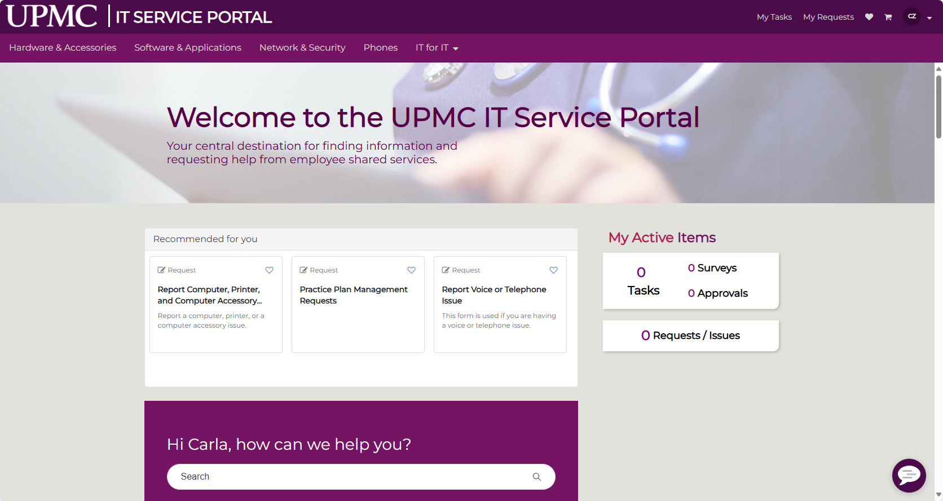

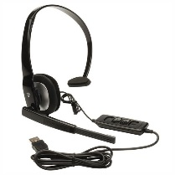
PowerMic Device
There are specific PCs with Dragon installed around the facility.
If you are using a UPMC computer and would like to order a PowerMic, have your administrator contact PC Support or use the link below to submit the request:
https://upmc.service-now.com/esc
If you do not have a PowerMic, you can use your iPhone or Android mobile device as a mic which we will set up later in class.
USB headsets also suffice as a mic and can be purchased on your own but would not have the feature of the programmable buttons.
Notes:
There are specific PCs with Dragon installed around the facility.
If you are using a UPMC computer and would like to order a PowerMic, have your administrator contact PC Support or use the link below to submit the request:
https://upmc.service-now.com/esc
If you do not have a PowerMic, you can use your iPhone or Android mobile device as a mic which will set up later in class.
USB headsets also suffice as a mic and can be purchased on your own but would not have the feature of the programmable buttons.

Slide 13
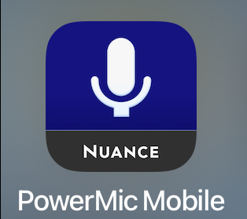
Important FYI
If your home PC is a Mac or a non-UPMC built device, the only way to dictate from home would be the use of the iPhone App PowerMic Mobile which we will setup together during training today.

Slide 14

Accessing Epic and DMO – IMPORTANT !!!
We will now review some different ways to access the Epic and DMO applications currently.
However, please do not work ahead, as despite multiple ways of opening Epic and DMO, today for training, we will all access the two applications using the same method which I will demonstrate shortly.
At the end of the training, for future reference, I will review how the Epic and DMO applications will be launched once you are using Epic Bridges which is coming soon!
Notes:
We will now review some different ways to access the Epic and DMO applications currently.
However, please do not work ahead, as despite multiple ways of opening Epic and DMO, today for training, we will all access the two applications using the same method which I will demonstrate shortly.
At the end of the training, for future reference, I will review how the Epic and DMO applications will be launched once you are using Epic Bridges which is coming soon!

Slide 15
Accessing Epic and DMO – What is UPMC Bridges???
UPMC Bridges is the name assigned to our journey to a single electronic health record (EHR) via the third-party software platform, Epic.
With this initiative, we aim to better connect patients and their health care providers and connect our regions more effectively with everyone using the same platform. We are currently operating on nine different EHRs which is inefficient, causing the need to string together data from multiple platforms which is also costly.
Besides enabling better patient care, consolidating to a single technology will facilitate easier and more efficient collaboration, connecting inpatient, outpatient, and ambulatory settings, giving patients access to more self-service tools as well as resulting in increased cybersecurity. One EHR will also greatly improve the clinical experience. Our teams will be able to deliver care faster and more efficiently.
Epic was selected, as it is the “gold standard” EHR and is the top EHR vendor by hospital market share in the United States with more than 300 million patients worldwide having a current record in Epic.
Additional information can be found on the UPMC Bridges Infonet Page: UPMC Bridges
Notes:
UPMC Bridges is the name assigned to our journey to a single electronic health record (EHR) via the third-party software platform, Epic.
With this initiative, we aim to better connect patients and their health care providers and connect our regions more effectively, as we are currently operating on nine different EHRs which is inefficient, causing the need to string together data from multiple platforms which is also costly.
Besides enabling better patient care, consolidating to a single technology will facilitate easier and more efficient collaboration, connecting inpatient, outpatient, and ambulatory settings, giving patients access to more self-service tools as well as resulting in increased cybersecurity. One EHR will also greatly improve the clinical experience. Our teams will be able to deliver care faster and more efficiently.
Epic was selected, as it is the “gold standard” EHR and is the top EHR vendor by hospital market share in the United States with more than 300 million patients worldwide having a current record in Epic.
Additional information can be found on the UPMC Bridges Infonet Page: UPMC Bridges

Slide 16
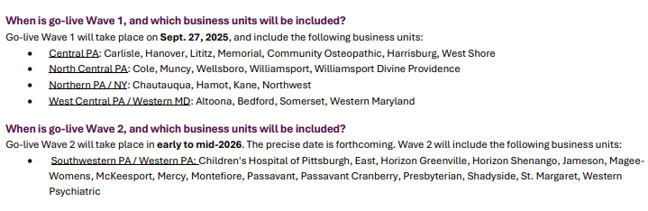
Accessing Epic and DMO – When is UPMC Bridges Go-Live?

Slide 17
Accessing DMO from a Clinical Workstation at a UPMC Facility using the CareFX-Launch Bar
Clinical workstations are workstations only found at UPMC facilities. To access DMO and the EHR application of your choice from a Clinical Workstation, click on the DMO icon from the CareFX-Launch Bar. This will launch your clinical application.
Notes:
Clinical workstations are workstations only found at UPMC facilities. To access DMO and the EHR application of your choice from a Clinical Workstation, click on the DMO icon from the CareFX-Launch Bar. This will launch your clinical application. The DMO Epic Hyperdrive icon on the CareFX-Launch bar is shown below:

Slide 18

Accessing Epic and DMO from a Clinical Workstation at a UPMC Facility Using the CareFX-Launch Bar
For future reference, clinical workstations are workstations only found at UPMC facilities. To access DMO and the EHR application from a Clinical Workstation, click on the DMO Epic icon from the CareFX-Launch Bar which is found at the top of the screen on these PCs. This will launch your applications. The DMO Epic icon on the CareFX-Launch bar is shown below:
Notes:
Clinical workstations are workstations only found at UPMC facilities. To access DMO and the EHR application of your choice from a Clinical Workstation, click on the DMO icon from the CareFX-Launch Bar. This will launch your clinical application. The DMO Epic Hyperdrive icon on the CareFX-Launch bar is shown below:

Slide 19


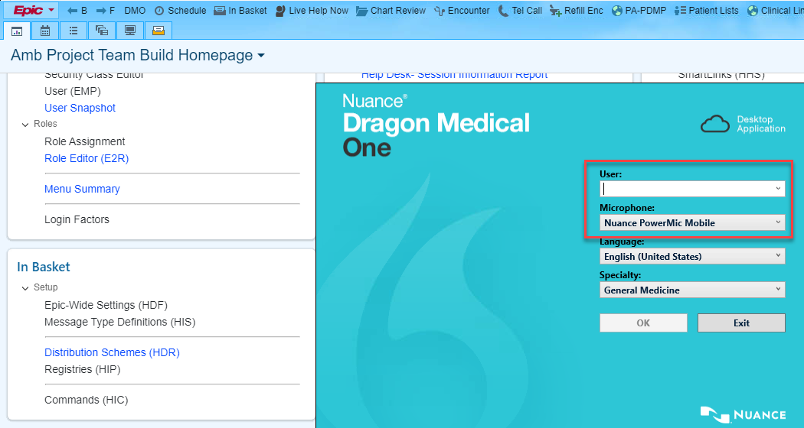
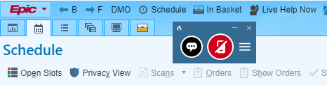

Accessing Epic and DMO via Epic Hyperdrive on Desktop (Must Be On UPMC Network)
If on the UPMC Network, first, access Epic by clicking the Epic Hyperdrive icon on your desktop. The desktop icon does not work when accessing the UPMC Network via any type of VPN, i.e., Global Protect, and users would need to access Epic and DMO via MyApps.
To launch DMO once in Epic Hyperspace, click the DMO button located on the Epic toolbar.
Once the Dragon Medical One log in window opens, users will enter their network username in the User field. To change the default microphone, users will click the arrow in the Microphone field to access the drop-down menu and then select the desired microphone and click OK.
Once logged in, the DragonBar will launch, and users will now be able to use DMO in Epic Hyperdrive.
Of Note: The desktop icon will no longer be available after Epic Bridges go-live.

Slide 20

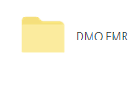
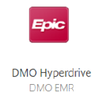
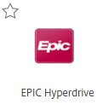
Accessing DMO and Epic From a Non-Clinical Workstation via MyApps (myapps.upmc.edu)
If you do not have access to the Epic Hyperdrive desktop icon or a clinical workstation due to not being onsite and want to access Epic and DMO remotely via MyApps, depending on your equipment, location, configuration, and/or access to VPN, i.e. Global Protect, you may need to utilize two-step authentication. For future reference, additional information regarding setting up two-step authentication can be found here:
https://upmchs.sharepoint.com/sites/infonet/BusinessTools/Technology/DevicesAccess/Documents/Work_From_Home_Technology_Frequently_Asked_Questions.pdf#search=office%20365
Notes:
If you are not using a clinical workstation at a UPMC facility, you will access the DMO Hyperdrive icon via MyApps. Depending on your location, you may need to utilize two-step authentication. For future reference, additional information regarding setting up two-step authentication can be found here:
https://upmchs.sharepoint.com/sites/infonet/BusinessTools/Technology/DevicesAccess/Documents/Work_From_Home_Technology_Frequently_Asked_Questions.pdf#search=office%20365

Slide 21

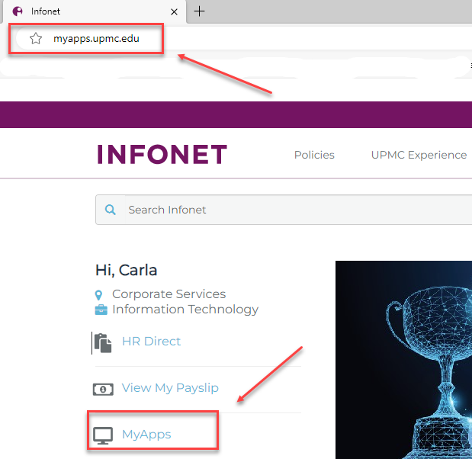
Accessing DMO From a Non-Clinical Workstation via MyApps (myapps.upmc.edu)
For training today, you will access the MyApps login page by typing myapps.upmc.edu in your browser.
If you are using a UPMC device, you can click on the Edge icon.
If this takes you to the main page of the Infonet, you can use the link to MyApps or type the address in the Edge browser window.
TIP: If Mac users run into issues with logging into MyApps, we recommend using the url: myapps.upmc.edu.
Notes:
You can access the MyApps log on page by typing myapps.upmc.edu in your browser.
If you are using a UPMC device, you can click on the Edge icon.
If this takes you to the main page of the Infonet, you can use the link to MyApps or type the address in the Edge browser window.

Slide 22
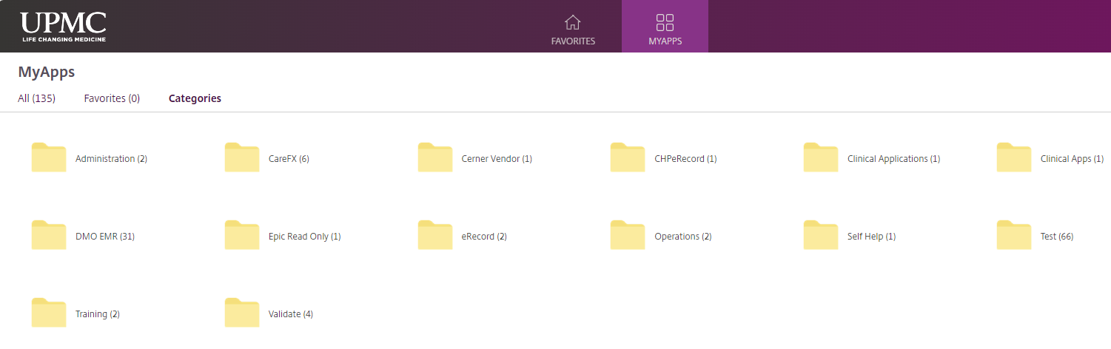
Accessing DMO From a Non-Clinical Workstation via MyApps - Cerner
When using a non-clinical workstation, you will need to access DMO via MyApps by clicking on the DMO EMR folder and then clicking on the DMO Core PowerChart icon. This will launch both the DMO and Cerner application login windows.
Notes:
When using a non-clinical workstation, you will need to access DMO via MyApps by clicking on the DMO EMR folder, and then clicking on the EMR application of your choice. This will launch both DMO and EMR application login windows. For Epic users, please use the DMO Hyperdrive icon.

Slide 23
Accessing DMO and Epic From a Non-Clinical Workstation via MyApps – Paired Launch
Again, when using a non-clinical workstation, you will need to access DMO via MyApps.
The method we will use today during training is a paired launch option in MyApps which will launch the Epic login window and will automatically sign into DMO.
Click on the DMO EMR folder to open it and then click on the DMO Hyperdrive icon.
Notes:
Again, when using a non-clinical workstation, you will need to access DMO via MyApps.
The method we will use today during training is a paired launch option in MyApps which will launch the Epic login window and will automatically sign into DMO.
Click on the DMO EMR folder to open it and then click on the DMO Hyperdrive icon.

Slide 24
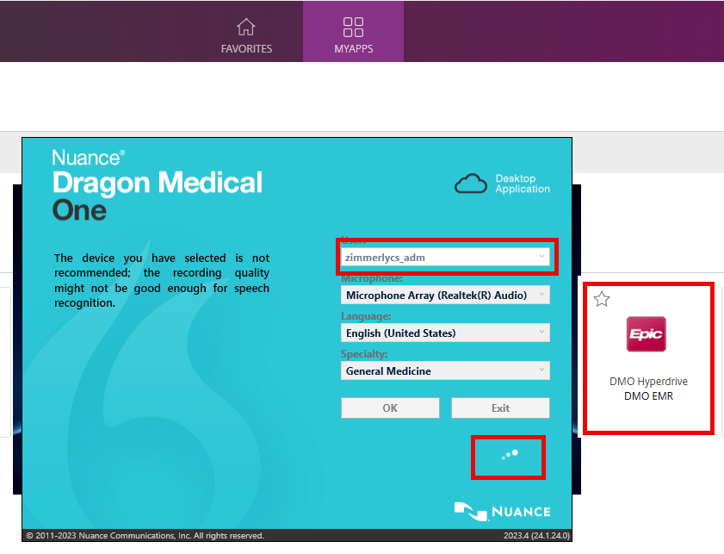
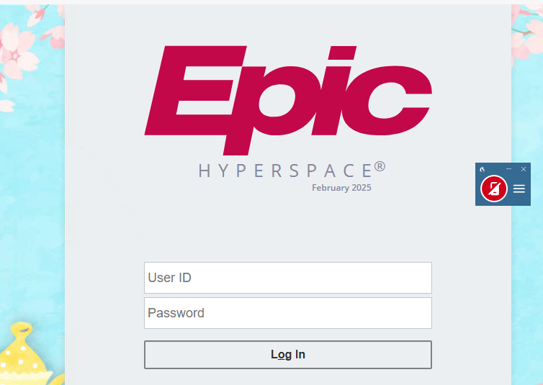
Accessing DMO and Epic From a Non-Clinical Workstation via MyApps – Paired Launch
The DMO window will launch, type the username in automatically, and the Dragon Bar will appear. The Epic login window will also simultaneously launch.
Of Note: The paired launch method of logging in was designed for therapy-type providers (BH/ST/OT/PT) who would not have the DMO button on the Epic toolbar, as this is only available to MD/NP/PA type providers, BUT ANYONE CAN USE PAIRED LAUNCH.
Notes:
When using a non-clinical workstation, you will need to access DMO via MyApps by clicking on the DMO EMR folder, and then clicking on the EMR application of your choice. This will launch both DMO and EMR application login windows. For Epic users, please use the DMO Hyperdrive icon.

Slide 25

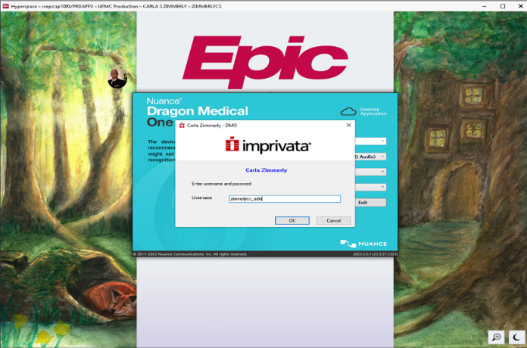
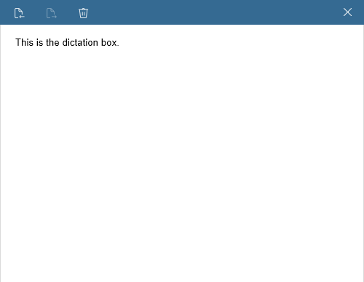
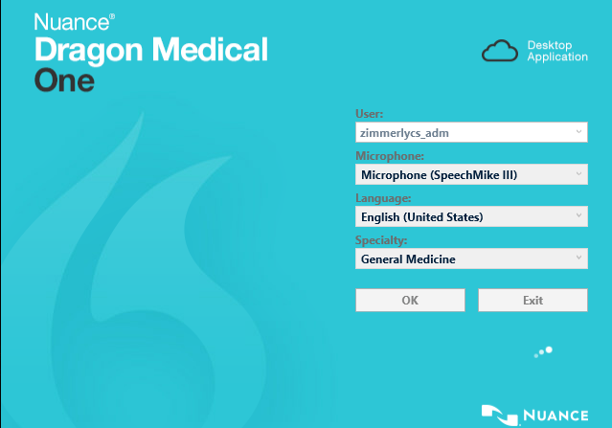
Accessing DMO and Epic From a Non-Clinical Workstation via MyApps
Some attendees today may not yet have access to the Epic application until their Epic Bridges go-live date.
In this scenario, if your Epic login attempts fail, meaning you do not have access, DMO will auto login, you will see the Dragon Bar, and you can simply minimize the Epic window.
All attendees will be using the dictation box which opens from the Dragon Bar for hands-on exercises.
Any attendee not having Epic access today will only be limited to view only when we test the Step-by-Step commands we have created in a workspace in the actual Epic application.
Notes:
Once the DMO Hyperdrive icon is clicked, some users may see an imprivata login screen the first time they log in. This step enrolls the user into OneSign which enables auto-login to DMO and other applications.
In this case, the network username should be entered and then click OK.

Slide 26
Accessing DMO and Epic From a Non-Clinical Workstation via MyApps - imprivata
Once the DMO Hyperdrive icon is clicked, some users may see an imprivata login screen the first time they log in. This step enrolls the user into OneSign which enables auto-login to DMO and other applications.
In this case, the network username should be entered and then click OK.
Notes:
Once the DMO Hyperdrive icon is clicked, some users may see an imprivata login screen the first time they log in. This step enrolls the user into OneSign which enables auto-login to DMO and other applications.
In this case, the network username should be entered and then click OK.

Slide 27
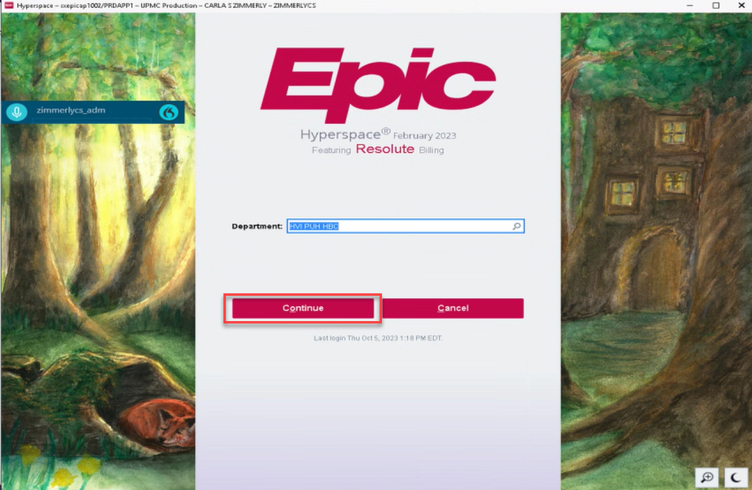




Accessing DMO and Epic From a Non-Clinical Workstation via MyApps - imprivata
Once the imprivata step has been completed, if necessary, some users may need to click Continue at the Epic Hyperdrive login screen, and other users may be auto-logged in at that time.
Microphone Array Realtec ® Audio Selected
PowerMic Selected
PowerMic Mobile Selected
Notes:
Once the Imprivata step has been completed if necessary, some users may need to click Continue at the Epic Hyperdrive login screen, and other users may be auto-logged in at that time.

Slide 28


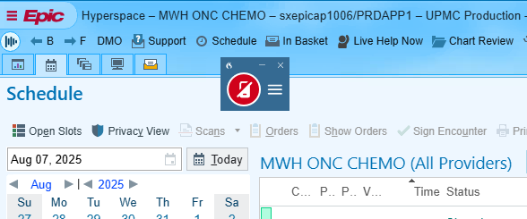
Accessing DMO and Epic From a Non-Clinical Workstation via MyApps
Users will now be able to use DMO in Epic Hyperdrive.
REMINDERS:
If you choose to use the Epic Hyperdrive icon on the desktop to log into Epic instead of the DMO Hyperdrive icon in the DMO EMR folder in MyApps, DMO will not automatically login, and you will need to click the DMO icon on the Epic toolbar to launch DMO.
Again, the DMO button on the Epic toolbar is not available for behavioral health, speech, occupational, and physical therapists, necessitating the need for use of paired launch method in MyApps for these roles.
Of note, if while using Epic, you accidentally log out of DMO, you can use the DMO icon on the Epic toolbar to log back in to DMO.

Slide 29
Accessing DMO and Epic From a Non-Clinical Workstation via MyApps
If you are an MD, NP, or PA and do not see the DMO icon on your Epic toolbar, please let me know so that I can open a ticket with the Dragon team on your behalf to fix this issue.

Slide 30
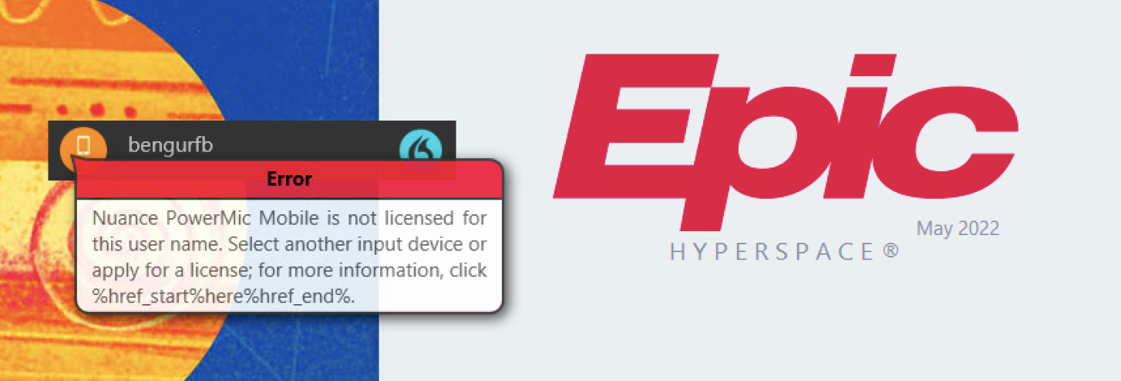
Error Message Troubleshooting
If you should get this message when logging into DMO and Epic, please disregard. It should disappear, and if it does not, close out of DMO, Epic, and MyApps, and log back in again. If it recurs again, again, please disregard. We are currently investigating the reason for this message; however, it should not affect your training or the functionality of Epic or DMO.

Slide 31

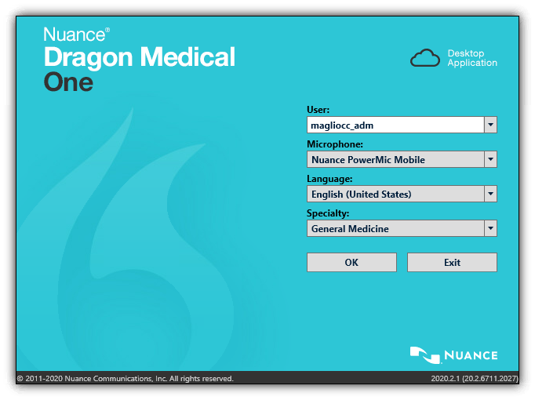

Just a tip if you are using PowerMic Mobile…
Once you have installed and set up the Nuance PowerMic Mobile app, which we will do together shortly, DMO must always be launched and Nuance PowerMic Mobile selected from the dropdown menu on the DMO login window before launching the Nuance PowerMic Mobile app on your smartphone. This will enable pairing to occur between the app and your workstation. Otherwise, you will see a message on the app stating “Searching for computers…” and then eventually “No targets found” until you log into the DMO application.
When logging in to DMO, once PowerMic Mobile has been selected as the microphone, you will see the gray smartphone icon on the DragonBar until pairing occurs.
Once PowerMic Mobile and DMO have paired, you will see the red smartphone icon on the DragonBar.
Last microphone source is saved automatically.

Slide 32

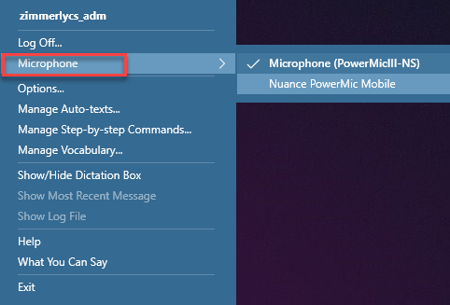

Switching the Type of Microphone
If you need to switch the type of microphone you are using during your DMO session, you do not need to exit the application.
Simply click the DragonBar menu and hover over Microphone in the dropdown menu.
Click on the microphone you would like to switch to from the fly-out menu.
Click OK.
If you are switching to the PowerMic Mobile, open the Nuance PowerMic Mobile app on your mobile device.
DMO will automatically pair with your mobile device.
If you logged into DMO and Epic via DMO Hyperdrive, DMO auto logged in and may not have defaulted to the microphone you are wanting to use today, and you will want to utilize this step if your microphone is not defaulted to Nuance PowerMic Mobile which we will be setting up next.

Slide 33





PowerMic Mobile Features and Benefits
More freedom, the same PowerMic experience…

Slide 34
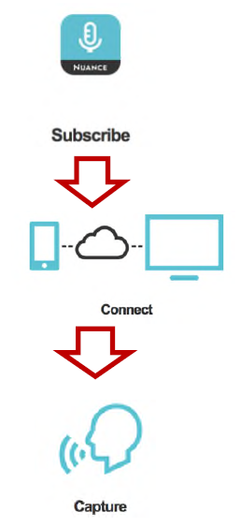
Introduction to PowerMic Mobile
PowerMic Mobile turns iOS and Android-based devices
into secure wireless microphones for use with Dragon
Medical One and any workstation. It gives physicians the
freedom to roam from workstation-to-workstation, room-to-
room, and location-to-location to complete their clinical
documentation using their smartphone as a wireless
microphone at the desktop.
To use PowerMic Mobile, the free PowerMic Mobile app
must be downloaded from the App Store or Google Play.
You will be provided with a Welcome Letter that includes
configuration instructions.

Slide 35
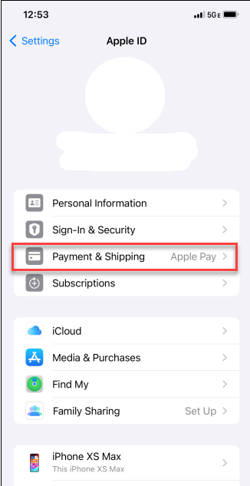
Introduction to PowerMic Mobile
The Nuance PowerMic Mobile application is FREE. If you are seeing notifications regarding payment, be sure that you have a payment option selected in your phone settings. Once this setting is satisfied, you will no longer see prompts regarding payment.

Slide 36
Setting up your PowerMic Mobile Device (PMM)
Today, we will download the free of charge PowerMic Mobile application via the Apple app store or Google Play store.
When searching for PowerMic Mobile, the icon will look like this:
Mobile phone operating system requirements:
iPhone Users (requires iOS 15.0 or greater)
Android Users (requires Android 11.0 or greater)
Once the Nuance PowerMic Mobile app has been downloaded, we will configure the app together.

Slide 37
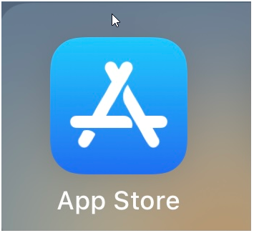
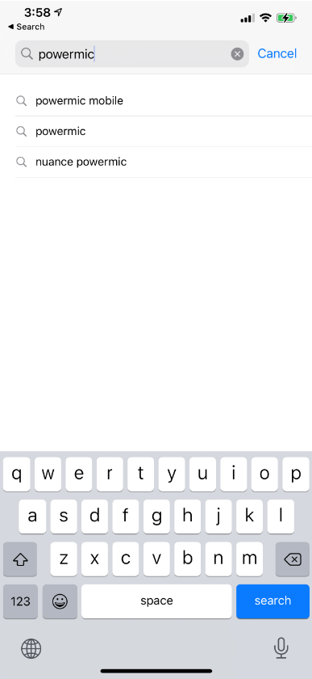
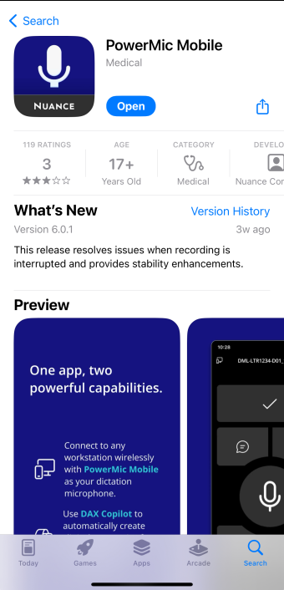
Setting up your PowerMic Mobile Device (PMM) - iPhone
Find the App Store on your iPhone mobile device.
Search for “powermic mobile” and select powermic mobile from the search results.
Download the app.
Do not open the app.

Slide 38
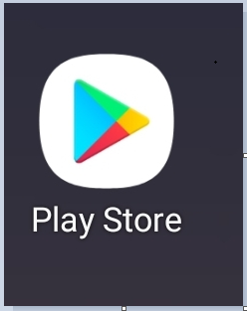
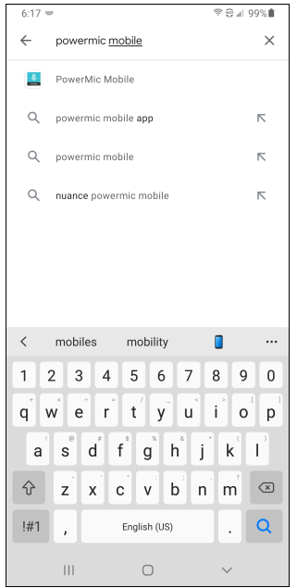
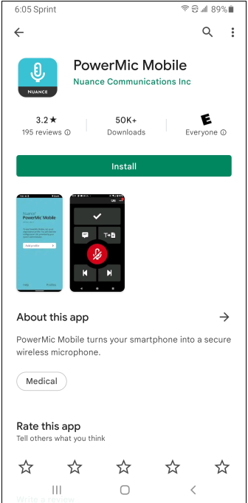
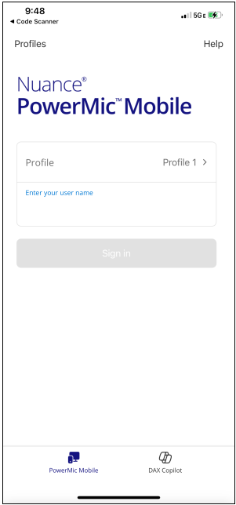
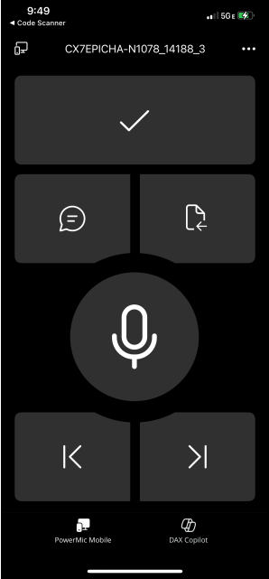
Setting up your PowerMic Mobile Device (PMM) - Android
Find the Google Play Store on your Android Mobile device.
Search for “powermic mobile” and select powermic mobile from the search results.
Download the app.
Do not open the app.

Slide 39
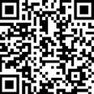
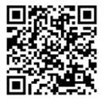
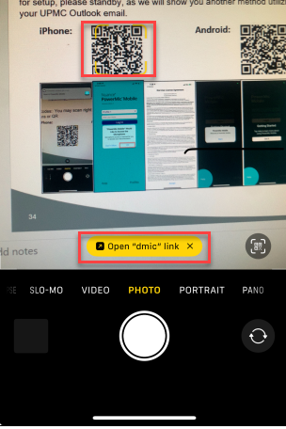
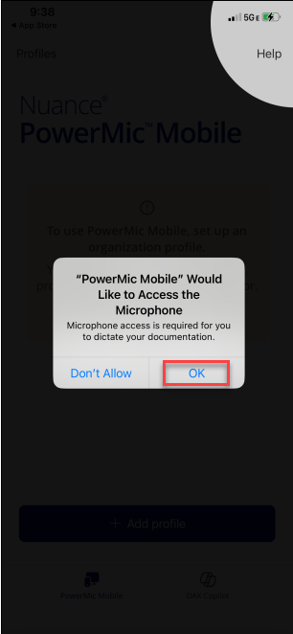
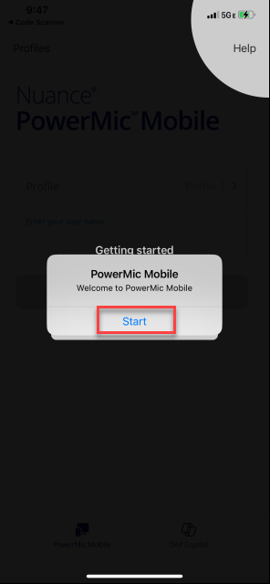
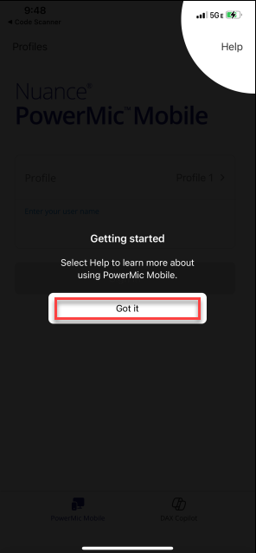

How to Configure Nuance PowerMic Mobile App with a QR Code
To configure your Nuance PowerMic Mobile app with a QR code, simply scan the QR code using the camera on your smartphone or a QR code reader app. You may now scan the appropriate QR code right from your computer screen. If you are unable to use the QR codes for setup, please standby, as we will show you another method utilizing links we emailed to your UPMC Outlook email.
iPhone:
Android:
Enter Network Username

Slide 40


How to Configure Nuance PowerMic Mobile App with Links
If you were unable to configure the Nuance PowerMic Mobile app using the QR code, answer the prompts on the setup screens as follows:
Once you have downloaded the app, click Open
Click OK to allow PowerMic Mobile to access the microphone on your device
Click Accept to accept the End User License Agreement
Click Got it on the Getting Started screen
Click on Add Profile

Slide 41

QR Codes/Links to Set Up PowerMic Mobile for DMO
If you were unable to use the QR codes below, you will need to access the email sent to your UPMC Outlook email account by opening UPMC Outlook on your mobile device so that you can copy the links in the email (do not click on the links). After launching the Nuance Powermic Mobile app and answering the prompts on the setup screens, you will then be pasting the appropriate copied link into the PROFILE URL field on the setup screen. We will next go over in detail how to properly copy the link from your email and paste it into the Nuance PowerMic application.

Slide 42


Links to Set Up PowerMic Mobile for DMO
After accessing the email in UPMC Outlook on your mobile device, hold your finger down on the appropriate link (iPhone or Android).
If the entire link is not highlighted, drag each end of the highlighted area to each end of the hyperlink.
Be sure not to include text within the email.
Click Copy.

Slide 43


How to Configure Nuance PowerMic Mobile App with Links
To complete configuration of the app, you will need to paste the link into the PROFILE URL to configure the application to work within the UPMC environment.
Navigate back to the New Profile screen in the Nuance Powermic Mobile app. To paste the link into the PROFILE URL field, hold your finger down in the area that states “Paste your organization URL here….”, and click Paste.
Once you have successfully pasted the link, you will see the Valid Profile notification.
Again, you will only need to do this if you download through the iPhone App Store or the Android Google Play Store. Intune downloads will auto-configure.

Slide 44



How to Configure Nuance PowerMic Mobile App with Links
Now tap the PROFILE NAME space and type your network username and click Save.
Click Start on the Welcome to PowerMic Mobile screen.
Then enter your network username in the Enter the User Name field and click Log in.

Slide 45


How to Configure Nuance PowerMic Mobile App with Links
You may see the “Searching for computers…” prompt on your mobile phone screen, as the PowerMic Mobile app is attempting to pair with the open DMO session on your workstation.
Once paired, you will see the PowerMic Mobile buttons on your mobile phone screen.
Pairing must occur before you can dictate.
Once PowerMic Mobile and DMO have paired, the previously gray smartphone icon on the DragonBar will turn red.
If the PowerMic mobile app fails to pair with your workstation, this can be due to not having the correct microphone selected in the microphone settings found within the DragonBar menu.
We will next review how to change the microphone selection using the DragonBar located on your workstation screen.

Slide 46
Switching the Type of Microphone
If you need to switch the type of microphone you are using during your DMO session, you do not need to exit the application.
Simply click the DragonBar menu and hover over Microphone in the dropdown menu.
Click on the microphone you would like to switch to from the fly-out menu.
Click OK.
If you are switching to the PowerMic Mobile, open the Nuance PowerMic Mobile app on your mobile device.
DMO will automatically pair with your mobile device.
If you logged into DMO and Epic via DMO Hyperdrive, DMO auto logged in and may not have defaulted to the microphone you are wanting to use today, and you will want to utilize this step if your microphone is not defaulted to Nuance PowerMic Mobile which we will be setting up next.

Slide 47

Manual Pairing ID
In the event that you need the Manual Pairing ID when setting up PowerMic Mobile, once you are logged into DMO, having selected PowerMic Mobile as the microphone, click on the gray circle in the Dragon Bar to view the Pairing ID:

Slide 48



Jumping Cursor Fix
Click on the DragonBar Menu and select Options from the drop-down menu:
On the General tab, make sure the Speech focus setting for Anchor the speech focus when recording is started is unchecked.

Slide 49

PowerMic Mobile Configuration
PowerMic Mobile button configuration:
Tap the Microphone button in the center of
your screen to turn the microphone on and off.
These buttons have the same characteristics
as PowerMics.
Limited noise cancellation.
Pairing:
If the smartphone locks or receives a call, the pairing will be disconnected.
Extending screen lock timeout will minimize
pairing disconnection occurrences.
Set the device to “Do Not Disturb” when
dictating for significant lengths of time.

Slide 50

How to change MAC settings to function like a PC

Slide 51

PowerMic Mobile Device
PowerMic Mobile Devices (iPhone or Android):
T (Transfer text) -Transfers text to your EMR (ex: DMO Core PowerChart) and, as stated previously, can be programmed to be used as an F2 button to toggle through Wildcards in EpicCare
Check Mark Button - Accepts Defaults
Show/Hide Dictation Box Icon
Left Single Arrow - Previous Field (used when moving within different variables in an auto-text)
Right Single Arrow - Next Field (used when moving within different variables in an auto-text)
Microphone icon - Tap on the microphone icon to turn on, and tap on the microphone icon again to turn off

Slide 52






PowerMic Mobile - Programming the “T” Button to Use as F2 with EPIC
If using the EPIC application, click the DragonBar menu and select Options from the drop-down menu.
Select Microphone Buttons from the menu and change the “T” button by clicking the arrow to access the drop-down menu.
Select Press Hotkey.
Click the pencil icon and then click the F2 key on your keyboard.
Click Apply All.
Click Close.
Notes:
Next, we will learn how to program the F2 button on the PowerMic Mobile app for use with Epic.
Just a reminder that the F2 key for Mac users is Function key plus F2 key.

Slide 53


PowerMic II/III - Programming the “T” Button to Use as F2 with EPIC
The PowerMics at your workstation may already be programmed appropriately; however, to program the T button to function as F2:
Click the DragonBar menu and select Options.
Select Microphone Buttons from the menu and change the “T” button by clicking the arrow to access the drop menu.
Select Press Hotkey.
Click the pencil icon and then click the F2 key on your keyboard.
Click Apply All.
Click Close.

Slide 54



PowerMic 4 - Programming the “Accept Defaults” Button to Use as F2 with EPIC
The PowerMics at your workstation may already be programmed appropriately; however, to program the Accept Defaults button to function as F2:
Click the DragonBar menu and select Options.
Select Microphone Buttons from the menu and change the “Accept Defaults” button by clicking the arrow to access the drop menu.
Select Press Hotkey.
Click the pencil icon and then click the F2 key on your keyboard.
Click Apply All.
Click Close.

Slide 55
Switching the Type of Microphone
If you need to switch the type of microphone you are using during your DMO session, you do not need to exit the application.
Simply click the DragonBar menu and hover over Microphone in the dropdown menu.
Click on the microphone you would like to switch to from the fly-out menu.
Click OK.
If you are switching to the PowerMic Mobile, open the Nuance PowerMic Mobile app on your mobile device.
DMO will automatically pair with your mobile device.
If you logged into DMO and Epic via DMO Hyperdrive, DMO auto logged in and may not have defaulted to the microphone you are wanting to use today, and you will want to utilize this step if your microphone is not defaulted to Nuance PowerMic Mobile which we will be setting up next.

Slide 56



PowerMic – Programming the Microphone Buttons
Of note, the PowerMic has default settings for each button; however, you can program the buttons based on your preferences.
Click the DragonBar menu and select Options from the drop-down menu.
Select Microphone Buttons from the Options window menu.
Click the drop-down arrow for the button you want to program to view options and select an option to program the button.
Click Apply All.
Click Close.
Notes:
Next, we will learn how to program the F2 button on the PowerMic Mobile app for use with Epic.
Just a reminder that the F2 key for Mac users is Function key plus F2 key.

Slide 57


PowerMic Mobile - Programming to Optimize for Rapid Navigation
If you tend to navigate rapidly and it feels like DMO is having an issue keeping up with your clicks:
Click the DragonBar menu and select Options from the drop-down menu.
Select General from the Options window menu and check the box for Optimize for rapid navigation.
Click Apply All.
Click Close.
Notes:
Next, we will learn how to program the F2 button on the PowerMic Mobile app for use with Epic.
Just a reminder that the F2 key for Mac users is Function key plus F2 key.

Slide 58




DragonBar
TIP: Click on the DragonBar and drag it to your desired location.
Hide the DragonBar
Stop/Start Recording
To Open DragonBar Menu (Nickname: “hamburger”)
or
DragonBar Menu
Run Dragon Medical Advisor
(Suggests corrections in your dictation to enhance ICD compliance – may be activated for specific physicians and be a future enhancement for others.)

Slide 59

DragonBar (blue flame icon) Dropdown Menu: Logoff, Microphone and Options
Click the DragonBar Menu to see a drop-down menu of all the features in Dragon Medical One:
Log Off: This icon allows you to log out of the application and change users without having to relaunch Dragon Medical One. The logon screen will appear, and then you may change users.
Microphone: This allows you to change your microphone selection without logging off.
Options: Allows users to set their own preferences; for example, PowerMic button customization, hot keys, etc.

Slide 60




DragonBar EPIC (blue flame icon) Dropdown Menu (cont.): Manage Auto-text and Manage Step-by-step Commands
Manage Auto-text: Auto-text are custom commands used to insert specific user-defined content in a report. Use Auto-text commands to create phrases, paragraphs, or complete note templates that you dictate frequently outside of Epic.
Manage Step-by-step Commands: This is where you will see your Step-by-step Commands arranged by name. A Step-by-step Command is used to execute a series of predefined actions by saying a key phrase. The concept is similar to that of an Auto-text, but instead of simply entering a block of text, Step-by-step Commands can simulate keystrokes. The steps can be customized to execute a wide variety of functions on your workstation to help save time when accomplishing repetitive tasks such as bringing a SmartPhrase built in EpicCare into your progress note with a voice command (Ex: “Insert My New Patient”).
This is where you will see your Auto-text or Step-by-step Commands arranged by name to edit, copy, or delete.
You can search for an existing Auto-text or Step-by-step Command. Select one from the list or click on the “+” to create a new one.
When using the Auto-texts you must say “insert” then the name of the Auto-text you would like to pull into your note.
Auto-text
Auto-text with Cerner
Step-by-Step

Slide 61


DragonBar (blue flame icon) Dropdown Menu (cont.): Manage Vocabulary
Click the DragonBar Menu to see a drop-down menu of all the features in Dragon Medical One:
Manage Vocabulary: This is where the Dragon vocabulary lives and allows users to add and edit custom words or phrases for better accuracy.
It is recommended that you add new words or phrases and train them here.
(Dragon does not recognize proper nouns very well).
You can add a word by clicking the “+”. You can use the default pronunciation or enter the word as you would pronounce it.
You can add written and spoken versions of names and facilities.

Slide 62




DragonBar (blue flame icon) Dropdown Menu (cont.): Dictation Box/Transfer Text
Click the DragonBar Menu to see a drop-down menu of all the features in Dragon Medical One:
Show/Hide Dictation Box: A free-text box that allows you to collect dictated text independent of your EMR and then “Transfer Text” into your target application.
The Dictation Box automatically opens when DMO doesn’t recognize where to place text, thus, allowing users to navigate freely while reviewing data.
You can open the Dictation Box by pressing the right circle button on your mic.
You can use the voice command, “open dictation box.”
It is recommended that you use the Dictation Box, as it is easier to use when moving through and working with variables/auto texts.
You may also dictate directly into the application. (PowerNote, Dynamic Documentation, Ambulatory Workflow, FirstNet, Aria or EpicCare).
When the Dictation Box is open, you will see three icons: Transfer text, recall text and trash.
You can also use the command “transfer text”, and the command “discard text” will also delete the text in the dictation box.
You have the ability to recover text if you accidently transfer text to a non-text location using the recall text button in the dictation box or using the command “recall text.”

Slide 63


DragonBar (blue flame icon) Dropdown Menu (cont.): Show Most Recent Message, Show Log File, and Help
Click the DragonBar Menu to see a drop-down menu of all the features in Dragon Medical One:
Show Most Recent Message: Displays the most recent message (currently not available).
Show Log File (Displays in Notepad): Used for Nuance to assist with issues.
Dragon Help and Speech Recognition Help:
Say “open help” to launch Help.

Slide 64


DragonBar (blue flame icon) Dropdown Menu (cont.): What You Can Say and Exit
What You Can Say: Displays a menu of voice command categories for commands that you can say. You may also use the verbal command “What can I say?” to see a menu of features offered such as:
Auto-texts (Standard)
User Settings
Dragon
Anchoring
Formatting
Manage Auto-texts
Manage Commands
Dragon Medical Advisor
(not used yet at UPMC)
Customer Feedback
Tutorial
Custom Commands
Correction
Navigation
Recording
Personalization and Help
Exit: Select Exit to exit Dragon Medical One.

Slide 65

What You Can Say Topics, Description, & Commands

Slide 66

What You Can Say Topics, Description, & Commands

Slide 67

What You Can Say Topics, Description, & Commands

Slide 68
Tips For Dictating
Speak clearly and pronounce each word.
Speak in phrases or complete sentences not … like … this … speak to your Dragon like I am speaking to you.
Say each punctuation mark, for example, “period,” “comma,” and “question mark.”
Dragon understands you better when you speak in long phrases, using your “natural” voice.
Disclaimers provide no protection to your documentation and, if used, can, in fact, invalidate your entire dictation. You are responsible for the final content of your notes.

Slide 69
Basic Dictation Commands Review: Lines and Spaces
Lines and Spaces
“new line” – Equivalent to hitting “enter” on the keyboard
“new paragraph” – Equivalent to hitting enter twice on the keyboard
“scratch that” – Erases last utterance of what you said. Depending on how you pause when you speak, it could be a word, phrase, sentence, paragraph or more.
Punctuation - You must dictate your punctuation. (Example: Period, comma, etc.)
You must correct all documents.
Cerner Only: Use the Contributor view button to check the PowerNote before clicking the sign button.

Slide 70
Basic Dictation Commands Review: Selecting and Correcting Words
Selecting Words
Verbal commands “select” and “unselect that”
You can select incorrect text by using the “select” command and then speak over it to replace the text.
Correcting Words
You will have to edit and correct notes.
Using correction menu – select text that needs to be corrected. When the correction menu is displayed, say for example, choose 1 or choose 2, whichever option is correct.
Note: If you use the verbal commands or correction menu, Dragon will learn it. If you use the mouse and keyboard to correct your errors, Dragon will not learn it.

Slide 71
Basic Dictation Commands Review: Deleting and Formatting Words
Deleting Words
“scratch that” – Deletes selection if specified or deletes the last utterance of what you said
“delete that” – Same as “scratch that”
“undo that” – Brings back last deletion (can be used multiple times)
“insert before” and “insert after” – Insert word commands
Remember to pause after “insert before” or “insert after” commands. Once the cursor is in the correct position, you can give it the next command.
Formatting Words
“cap that” – Capitalizes the first letter of each word
“all caps that” – All letters of all the words specified

Slide 72
Starting New Lines and Paragraphs
In the next exercise, you will have the opportunity to practice the commands “…new line” and “…new paragraph” as well as practicing dictating punctuation.
You will say:
“…new line” …which starts a new line.
“…new paragraph” …which starts a new paragraph.
Be sure to:
Pause briefly …before saying a command.
Say the command evenly without pausing.
Pause briefly after the command.

Slide 73
Practice: Let’s Try Dictating
In our first practice exercise, dictate the text below. Reminder: You can use the command “scratch that” to remove the last utterance.
Say:
“Subjective (colon) (new line) The patient is a 17-year-old male who presents today complaining of a sore throat (period) His symptoms started 2 days ago (comma) but have become more severe over the past 4 hours (period) (new paragraph)
Notes:
Discuss changing the results box view.

Slide 74
Commands “Select All” and “Delete That”
Now PAUSE… to take a look at the text that has been generated by Dragon, and then say:
(…select all)
(…delete that)

Slide 75
Dictating Punctuation and Navigation Exercise…Try It!
To Enter:
.
,
?
!
“”
()
/ or –
Say:
“period” or “dot” (…new line)
“comma” (…new line)
“question mark” (…new line)
“exclamation mark” (…new line)
“open quotes …close quotes ” (…new line)
“open parenthesis …close parenthesis” (…new line)
“slash” or “dash” (…new line)

Slide 76
Commands “Select All” and “Delete That”
Now PAUSE… to take a look at the text that has been generated by Dragon, and then say:
(…select all)
(…delete that)

Slide 77
Dictating Numbers and Dates…Try it!
To Enter:
1.
1
2-3/4
16.23
120/64
122
April 1, 2009
4/1/2009
Say:
“Number one” (…new line)
“One” (…new line)
“Two and three fourths” (…new line)
“Sixteen point twenty three” (…new line)
“One twenty over sixty four” (…new line)
“One hundred twenty two” (…new line)
“April one, two thousand and nine” (…new line)
“Four slash one slash two thousand nine” (…new line)

Slide 78
Clear Your Dictation Box For The Next Exercise
(…select all)
(…delete that)

Slide 79
Practice Exercises
Chief complaint (colon) Referral for a second opinion (period) (…new line)
History of present illness (colon) Ms. Johnson is a 50-year-old female who presents today for a new patient evaluation (period) On November 5, 2011 she suffered a 15 minute episode of sharp chest pain and shortness of breath (period) She was evaluated at Mercy Hospital and underwent an adenosine thallium stress test (period) The scan revealed a question of septal ischemia (period) On 12 (slash) 17 (slash) 2012, she reported a similar episode which she describes as (open quote) way more intense (exclamation point) (close quote) She denies hyperlipidemia (comma) smoking (comma) or diabetes (period) (…new paragraph)
(…select complaint) (…cap that)
(…select present illness) (…cap that)

Slide 80
Clear Your Dictation Box For The Next Exercise
(…select all)
(…delete that)

Slide 81
Practice Exercises (Numbers)
Past Medical History (colon) Asthma and hypertension (period) (…new line)
Medications (colon) Zyrtec 10 milligrams tablet once daily (period) Albuterol Inhaler 2 puffs every 4 to 6 hours as needed (period) Altace 2.5 milligrams once daily (period) (…new paragraph)
Physical Exam (colon) (…new line)
VS (colon) BP 140/90 (comma) pulse 70 (comma) respirations 20
(…new line)

Slide 82
Clear Your Dictation Box For The Next Exercise
(…select all)
(…delete that)

Slide 83
Next…
We are now going to learn about selecting and deleting text. In the next practice exercise, you will get a chance to try these commands.

Slide 84
Selecting and Deleting
To select text, you can say:
“Select (word)”
“Select all”
“Select (word) through (word)”
“Unselect that”
“Select this sentence” (selects sentence in which cursor currently located)
To erase the last phrase you said, you can say:
“Delete that”
“Scratch that”
To erase additional text, you can say:
“Select (word) “Delete that”
Notes:
Phrase is the last thing you said before a pause. Note, some people may naturally say longer sentences without a pause than others. In this case, if you delete the last phrase, you may be deleting 2 or 3 sentences.
These all get rid of the last utterance – which is the space between two pauses.
Delete will work for utterances, words, lines, and paragraphs. Scratch that and Strike that will only work for the last utterance.

Slide 85
Practice Exercise - Selecting and Deleting Text
On examination, she appeared in good health and spirits. Vital signs as documented. Skin warm and dry and without overt rashes. Neck without JVD. Lungs clear. Heart exam notable for regular rhythm, normal sounds and absence of murmurs, rubs or gallops. Abdomen unremarkable and without evidence of organomegaly, masses, or abdominal aortic enlargement. Extremities nonedematous.
(…select and spirits…delete that)
(…select Neck through JVD period…delete that)
(…select Extremities)
(…select this sentence)
(…delete that)

Slide 86
Clear Your Dictation Box For The Next Exercise
(…select all)
(…delete that)

Slide 87
Navigating Your Document
In the next practice exercises, we will practice the commands:
“insert before (word)”
“insert after (word)”
“all caps that”
“go to end of paragraph”
“go to end of sentence”
“new paragraph”
“new line”
Notes:
This is dictating where to place your cursor.

Slide 88
Practice Exercises…try these commands…
Physical examination: On examination, she appeared in good health. Vital signs as documented. Skin warm and dry and without overt rashes. Lungs clear. Heart exam notable for regular rhythm, normal sounds and absence of murmurs, rubs or gallops. Abdomen unremarkable and without evidence of organomegaly, masses, or abdominal aortic enlargement. Extremities nonedematous.
(…insert after clear) to auscultation
(…insert before extremities) lower
(…select Physical examination) (…all caps that)
(…go to end of paragraph)
(…new paragraph)

Slide 89
Practice Exercises (Enumeration)
Assessment and Plan (colon) (…select Assessment and Plan colon) (…all caps that)
(…new line)
One (period) Low risk of cardiac disease estimated (period)
(…new line)
Two (period) EKG and follow up scheduled for 6 months (period)

Slide 90
Clear Your Dictation Box For The Next Exercise
(…select all)
(…delete that)

Slide 91

Questions
Questions

Slide 92
Correcting
Errors

Slide 93
3 Types of Correction
Select & Replace – Select text and dictate over it.
Select & Choose – Select text and use ‘choose’ option from the correction menu.
Manage Vocabulary – This is where the Dragon vocabulary lives and allows users to add and edit custom words or phrases for better accuracy.
Note: If you use the mouse and keyboard to correct your errors, Dragon will not learn it.
Notes:
Should you correct all mistakes? Not if you were mumbling or saying something that was incorrect. You do not want Dragon to learn, you just speak over what you said. If you do not correct, it will slowly get worse over time because the algorithm assumes that the word it used was correct for what you said.

Slide 94
1. Select and Replace
Select text and dictate over selected text.
Select the incorrect word.
Speak over it with the intended text.
The patient reports his father has a history of cancer [period] […select father] …mother
Useful if you made a mistake in your dictating. Your profile is not learning your language preferences
Now say:
[…go to end of sentence] […new line]
Notes:
Use this option when you made a mistake in what you said. If you did not want to select a word, you can say “Unselect that”

Slide 95

2. Select & Choose
“Select” text and use “Choose” option from correction menu.
Select the incorrect word.
If the correct word appears as an option, select it by saying “Choose” followed by the numbered option.
The patient was given 4 aspirin [period]
[…select 4] or what generated for you (4, four, #4, etc.)
[…choose 6] (…or whichever option you prefer to choose to change to version of number four that you prefer.)
Use if the corrected text is available.
Your profile is learning your preferences.

Slide 96


Manage Vocabulary
Manage Vocabulary is where the Dragon vocabulary lives and allows users to add and edit custom words or phrases that Dragon does not know to create a personal vocabulary.
As a user, you begin with a base vocabulary that best fits your medical specialty. If a word or phrase is not included in that vocabulary base, Dragon will not be able to transcribe it correctly. Adding a new word or phrase that you frequently use will improve Dragon’s accuracy.
To access Manage Vocabulary and add a new word or phrase, click the DragonBar Menu and select Manage Vocabulary from the dropdown menu.
It is recommended that you add new words or phrases and train them here.
Reminder: Dragon does not recognize proper nouns very well.
You can add a word by clicking the “+”. You can use the default pronunciation or enter the word as you would pronounce it.
You can add written and spoken versions of names and facilities such as for example using nicknames or acronyms. Let’s try it!
To access, you can also say one of the following commands:
“Manage Vocabulary”
“Edit Vocabulary”
“Manage Words”

Slide 97
Manage Vocabulary
Open Manage Vocabulary by either using the menu option Manage Vocabulary or by using one of the three commands:
To access, you can also say one of the following commands:
“Manage Vocabulary”
“Edit Vocabulary”
“Manage Words”

Slide 98








Adding Words To Manage Vocabulary Possible Outcomes
When adding and training a word, Dragon may successfully add it on the first attempt at training and state The Vocabulary has been successfully trained.
You may see a message stating: “Training the Vocabulary has failed. Please try again.”
You may see a message stating: “The audio quality is not good enough; click Retry and say the word again.”
You may see a message stating: “The word as you said it differs too much from how it is written. Enter the word as you would pronounce it…”
Let’s try adding some words!!!!

Slide 99

Adding Words To Manage Vocabulary
Click the + sign to add a word:
We will add the name Hilko in the Enter the word you want to add: text field.
Tip: To bypass the Manage Vocabulary main window and directly open the Add Word window, use the command “add word”.

Slide 100





Adding Words To Manage Vocabulary
…and then train the word by clicking the microphone icon and saying name that you added.
Dictation Tips:
Don’t push the Record button on the mic when training a word when using PowerMic.
You will need to press the red microphone icon AND the record button on your phone when using the PowerMic Mobile.
You have trained the word successfully when you see Click Confirm to save the word in the vocabulary.

Slide 101


Adding Words To Manage Vocabulary
If you get a message that training the vocabulary has failed, or the audio quality is not good…try again!
You may see a message stating: The word as you said it differs too much from how it is written. Enter the word as you would pronounce it.
In this case, you will need to enter a phonetic pronunciation (ex: hill ko for Hilko) and click Confirm.
You have successfully trained the word phonetically, when you get the message: The Vocabulary has been successfully trained.
Click the X on the Manage Vocabulary toolbar to close.

Slide 102

Let’s try it!
Let’s test custom word we just added to our vocabulary:
Say: ”Hilko”
Dragon should have generated the text Hilko in your dictation box.

Slide 103


Adding Words To Manage Vocabulary – Practice Exercise: Entering the word as you would pronounce it…
Let’s try adding a word where Dragon will mostly likely prompt you to enter the pronunciation when you pronounce the word differently from the spelling.
Say “Manage Vocabulary”
Click the + sign to add a word:
We will now add the name Zimmerly:
…and then train the word by clicking the microphone icon and saying “Zimmerly”
Tip: To bypass the Manage Vocabulary main window and directly open the Add Word window, use the command “add word”.
Reminder: Don’t push Record button on the PowerMic when training a word. You will need to press the red record icon and the record button on your phone when using PowerMic Mobile.

Slide 104


Adding Words to Manage Vocabulary: Entering the word as you would pronounce it...
Again, Dragon may detect that the word as you said it differs too much from how it is written.
In that case, we would add the phonetic pronunciation: zim er lee and click Confirm:
Dragon will prompt you when the vocabulary has been successfully trained.
Click the X to exit Manage Vocabulary.
Of Note: If you add the word and click the Default Pronunciation button, Dragon will provide the default pronunciation based on the spelling. It is recommended that you train any words or phrases you add to the Vocabulary Manager.

Slide 105







Adding Words To Manage Vocabulary: Entering the word as you would pronounce it...
Let’s test the custom word we just added to our vocabulary:
Say: “zim er lee”
Dragon should have generated the text Zimmerly in your dictation box.
If Dragon did not generate the text correctly, you can open Manage Vocabulary or say, “Manage Vocabulary” and click on the word and edit the spelling of the word, update the trained recording of a custom word, or disable the word.

Slide 106

Adding Words To Manage Vocabulary: Entering the word as you would pronounce it…
Let’s do another practice exercise where we will enter a phonetic pronunciation of the word that we assume Dragon will not understand.
Say “Manage Vocabulary”
Click the + sign to add a word:
We will now add the name Dr. Cetindag
…and then click Enter the word as you would pronounce it. Y
it
Tip: To bypass the Manage Vocabulary main window and directly open the Add Word window, use the command “add word”.
Notes:
Dr. Cetindag pronounced doctor chet in dah.

Slide 107

Adding Words To Manage Vocabulary: Entering the word as you would pronounce it…
Enter phonetic spelling of name in Pronunciation typing field: doctor chet in dah
Then click √Save.
Dragon will prompt you when the word has been successfully added to the vocabulary.
Click the X on the Manage Vocabulary toolbar to close.
Notes:
Dr. Cetindag pronounced doctor chet in dah.

Slide 108





Let’s try it!
Let’s test the custom word we just added to our vocabulary:
Say: “doctor chet in dah”
Dragon should have generated the text Dr. Cetindag in your dictation box.
Reminder: If Dragon does not recognize the word, you can say “Manage Vocabulary” and go back and edit the enter the word as you would pronounce it or retrain the word by clicking on the word in Manage Vocabulary and clicking the Train icon:
Reminder: Don’t click red Record button on the mic when training a word.

Slide 109


Adding Words To Manage Vocabulary: Using a Nickname or Acronym Pronunciation
The Enter the word as you would pronounce it feature can also be used to associate a nickname or acronym.
Example:
If you would want to say “MWCC” to generate the text Magee Women’s Cancer Center:
Written Form: Magee Women’s Cancer Center
Spoken Form: MWCC
Let’s try it!

Slide 110
Adding Words To Manage Vocabulary: Using “Enter the word as you would pronounce it”
Say “Manage Vocabulary”
Click the + sign to add a word:
Now add Magee Women’s Cancer Center in the “Enter the word you want to add” field:
…and then click Enter the word as you would pronounce it. o
u would pronounce it
Tip: To bypass the Manage Vocabulary main window and directly open the Add Word window, use the command “add word”.

Slide 111



Adding Words To Manage Vocabulary: Using “Enter the word as you would pronounce it”
u would pronounce it
Enter the nickname/acronym MWCC and click √Save.
Dragon will prompt you when the word has been successfully added to the vocabulary.
Click the X on the Manage Vocabulary toolbar to close.

Slide 112

Let’s try it!
Let’s test the custom word we just added to our vocabulary:
Say: “MWCC”
Dragon should have generated the text Magee Women’s Cancer Center in your dictation box.

Slide 113
Questions
Questions

Slide 114
Creating Templates
and Commands

Slide 115


Creating an Auto-text

Slide 116


Creating an Auto-text
Manage Auto-text: An Auto-text is text that Dragon stores so you can insert it easily with a voice command. If you have text, you frequently use when not in Epic, you can create an Auto-text to save time. Auto-text would not be used in Epic, as we create our templates to be used with Epic within the Epic application. They are called SmartPhrases.
To access Manage Auto-texts, click the DragonBar menu and select Manage Auto-texts from the drop-down menu.

Slide 117


Creating an Auto-text
We will now create a sample Auto-text to insert a signature.
Click the + sign to add a word:
Enter what you want to say to bring in the auto-text into the Name text field: My Signature
Dragon will copy the name of the Spoken form field for you.
Then enter the text you want to bring in with this Auto-text command.Yo
Note: When you later dictate the name of this command to bring in your Auto-text, you will need to say “insert” before the name of the command.
u would pronounce it
Click Apply All.
Click Close.
Notes:
Dr. Cetindag pronounced doctor chet in dah.

Slide 118

Let’s try it!
Let’s test the Auto-text we just created:
Say: “Insert My Signature”
Dragon should have generated the Auto-text in your dictation box.

Slide 119

Troubleshooting Tip!!!
If you are unable to click on the Apply All button to save your changes and click Close to save the command, it may be that you have accidentally started creating more than one command, and you will need to click on it and click the X to delete it.

Slide 120

Editing an Auto-text
We will now edit the sample Auto-text we created.
Say “Manage Auto-text”:
Click on the Auto-text you would like to edit from the Manage Auto-text window. (My Signature)
Click into the Name or Content text areas and edit the name or text.
ouldpronounce it
Click Apply All.
Click Close.
Notes:
Dr. Cetindag pronounced doctor chet in dah.

Slide 121
Creating an Auto-text with Variables
Say:
This patient is a (open bracket) 65-year-old (close bracket) (open bracket) male (close bracket) who was admitted to (open bracket) UPMC Shadyside (close bracket) with (open bracket) left-sided (close bracket) chest pain at approximately (open bracket) 3 PM (close bracket) this afternoon. He was given an (open bracket) EKG (close bracket) at the bedside which showed (open bracket) abnormal (close bracket) results. Next, he will be taken down to radiology for a chest x-ray.
(…select all)
(…make that an Auto-text)
We will now name the Auto-text by typing out the name in the Name box. This will be what is spoken to activate the command. Commands should be named something not normally spoken in dictation. Start the name of your command with “My” (ex: My Chest Pain Template).
The name you have typed will also populate in the Spoken Form field.
Click Apply All.
Notes:
Remember not to pause when saying a command or it will search the entire web.

Slide 122

Creating an Auto-text with Variables (cont.)
Go back to the Dictation Box.
Say (…select all)
Say (…delete that)
Say the name of the Auto-text to bring it back in to the Dictation Box. Ex: “Insert My Chest Pain Template”.
Now try navigating through the text with brackets by using the single arrow buttons on the microphone or by using the verbal commands: “Next Field” and “Previous Field”.
Accept the text by clicking the accept defaults button (check mark button) on the microphone.
You can also create open variables [ ] by saying (open bracket) (space) (closed bracket).

Slide 123

Selecting your Patient in CORE PowerChart
Select patient from your toolbar. In the search box type in the Name and Date of Birth, MRN or FIN to search for the patient. Make sure you select the correct 13 digit FIN on the bottom of the screen. Then click OK.

Slide 124


Creating a PowerNote in CORE Powerchart
Select PowerNote 2G + Add from the Menu. Type “General Progress” in the search box from the Encounter Pathway Tab and click on the binoculars. Once you see the note name displayed and highlighted, you can double click on it or click the OK button to open the note.

Slide 125

Using DMO in PowerNote in CORE Powerchart
The three main areas that you can use Dragon to dictate are: Use Free Text at the paragraph level, OTHER at the sentence level or right click on a term and enter a comment. Anywhere you can type, you can dictate using Dragon Medical One.
Once you have completed your PowerNote click on the contributor view button located on the scroll bar on the right to see the rendered view of your note before clicking the Sign/Submit button. If you need to go back to the template view, click on the icon again. It looks like two pieces of paper. Once your note is signed, you will not be able to edit your note and can only add an addendum.

Slide 126



Dragon Training Materials (cont.)
To access reference documents in Core PowerChart, select the eRecord A to Z Help from the toolbar.

Slide 127
EPIC PART OF COMBINED CLASS STARTS HERE
DMO Epic class resumes on slide 141.

Slide 128
Exiting DMO/Cerner and Launching DMO/Epic
We will now our exit the current DMO session so that we can launch DMO/Epic to proceed to learn how to create Step-by-step Commands to pull Epic SmartPhrases into the progress note using a Dragon Step-by-step Command.
Click on the DragonBar menu and select Exit from the dropdown menu.
Log off of the Cerner application.

Slide 129
Accessing Epic and DMO from a Clinical Workstation at a UPMC Facility Using the CareFX-Launch Bar
For future reference, clinical workstations are workstations only found at UPMC facilities. To access DMO and the EHR application from a Clinical Workstation, click on the DMO Epic icon from the CareFX-Launch Bar which is found at the top of the screen on these PCs. This will launch your applications. The DMO Epic icon on the CareFX-Launch bar is shown below:
Notes:
Clinical workstations are workstations only found at UPMC facilities. To access DMO and the EHR application of your choice from a Clinical Workstation, click on the DMO icon from the CareFX-Launch Bar. This will launch your clinical application. The DMO Epic Hyperdrive icon on the CareFX-Launch bar is shown below:

Slide 130
Accessing Epic and DMO via Epic Hyperdrive on Desktop (Must Be On UPMC Network)
If on the UPMC Network, first, access Epic by clicking the Epic Hyperdrive icon on your desktop. The desktop icon does not work when accessing the UPMC Network via any type of VPN, i.e., Global Protect, and users would need to access Epic and DMO via MyApps.
To launch DMO once in Epic Hyperspace, click the DMO button located on the Epic toolbar.
Once the Dragon Medical One log in window opens, users will enter their network username in the User field. To change the default microphone, users will click the arrow in the Microphone field to access the drop-down menu and then select the desired microphone and click OK.
Once logged in, the DragonBar will launch, and users will now be able to use DMO in Epic Hyperdrive.
Of Note: The desktop icon will no longer be available after Epic Bridges go-live.

Slide 131
Accessing DMO and Epic From a Non-Clinical Workstation via MyApps (myapps.upmc.edu)
If you do not have access to the Epic Hyperdrive desktop icon or a clinical workstation due to not being onsite and want to access Epic and DMO remotely via MyApps, depending on your equipment, location, configuration, and/or access to VPN, i.e. Global Protect, you may need to utilize two-step authentication. For future reference, additional information regarding setting up two-step authentication can be found here:
https://upmchs.sharepoint.com/sites/infonet/BusinessTools/Technology/DevicesAccess/Documents/Work_From_Home_Technology_Frequently_Asked_Questions.pdf#search=office%20365
Notes:
If you are not using a clinical workstation at a UPMC facility, you will access the DMO Hyperdrive icon via MyApps. Depending on your location, you may need to utilize two-step authentication. For future reference, additional information regarding setting up two-step authentication can be found here:
https://upmchs.sharepoint.com/sites/infonet/BusinessTools/Technology/DevicesAccess/Documents/Work_From_Home_Technology_Frequently_Asked_Questions.pdf#search=office%20365

Slide 132
Accessing DMO and Epic From a Non-Clinical Workstation via MyApps (myapps.upmc.edu)
For training today, you will access the MyApps login page by typing myapps.upmc.edu in your browser.
If you are using a UPMC device, you can click on the Edge icon.
If this takes you to the main page of the Infonet, you can use the link to MyApps or type the address in the Edge browser window.
TIP: If Mac users run into issues with logging into MyApps, we recommend using the url: myapps.upmc.edu.
Notes:
You can access the MyApps log on page by typing myapps.upmc.edu in your browser.
If you are using a UPMC device, you can click on the Edge icon.
If this takes you to the main page of the Infonet, you can use the link to MyApps or type the address in the Edge browser window.

Slide 133
Accessing DMO and Epic From a Non-Clinical Workstation via MyApps – Paired Launch
Again, when using a non-clinical workstation, you will need to access DMO via MyApps.
The method we will use today during training is a paired launch option in MyApps which will launch the Epic login window and will automatically sign into DMO.
Click on the DMO EMR folder to open it and then click on the DMO Hyperdrive icon.
Notes:
When using a non-clinical workstation, you will need to access DMO via MyApps by clicking on the DMO EMR folder, and then clicking on the EMR application of your choice. This will launch both DMO and EMR application login windows. For Epic users, please use the DMO Hyperdrive icon.

Slide 134
Accessing DMO and Epic From a Non-Clinical Workstation via MyApps – Paired Launch
The DMO window will launch, type the username in automatically, and the Dragon Bar will appear. The Epic login window will also simultaneously launch.
Of Note: The Paired Launch method of logging in was designed for therapy-type providers (BH/ST/OT/PT) who would not have the DMO button on the Epic toolbar, as this is only available to MD/NP/PA type providers, BUT ANYONE CAN USE PAIRED LAUNCH.
Notes:
When using a non-clinical workstation, you will need to access DMO via MyApps by clicking on the DMO EMR folder, and then clicking on the EMR application of your choice. This will launch both DMO and EMR application login windows. For Epic users, please use the DMO Hyperdrive icon.

Slide 135
Accessing DMO and Epic From a Non-Clinical Workstation via MyApps
Some attendees today may not yet have access to the Epic application until their Epic Bridges go-live date.
In this scenario, if your Epic login attempts fail, meaning you do not have access, DMO will auto login, you will see the Dragon Bar, and you can simply minimize the Epic window.
All attendees will be using the dictation box which opens from the Dragon Bar for hands-on exercises.
Any attendee not having Epic access today will only be limited to view only when we test the Step-by-Step commands we have created in a workspace in the actual Epic application.
Notes:
Once the DMO Hyperdrive icon is clicked, some users may see an imprivata login screen the first time they log in. This step enrolls the user into OneSign which enables auto-login to DMO and other applications.
In this case, the network username should be entered and then click OK.

Slide 136
Accessing DMO and Epic From a Non-Clinical Workstation via MyApps - imprivata
Once the DMO Hyperdrive icon is clicked, some users may see an imprivata login screen the first time they log in. This step enrolls the user into OneSign which enables auto-login to DMO and other applications.
In this case, the network username should be entered and then click OK.
Notes:
Once the DMO Hyperdrive icon is clicked, some users may see an imprivata login screen the first time they log in. This step enrolls the user into OneSign which enables auto-login to DMO and other applications.
In this case, the network username should be entered and then click OK.

Slide 137
Accessing DMO and Epic From a Non-Clinical Workstation via MyApps - imprivata
Once the imprivata step has been completed, if necessary, some users may need to click Continue at the Epic Hyperdrive login screen, and other users may be auto-logged in at that time.
Microphone Array Realtec ® Audio Selected
PowerMic Selected
PowerMic Mobile Selected
Notes:
Once the Imprivata step has been completed if necessary, some users may need to click Continue at the Epic Hyperdrive login screen, and other users may be auto-logged in at that time.

Slide 138
Accessing DMO and Epic From a Non-Clinical Workstation via MyApps
Users will now be able to use DMO in Epic Hyperdrive.
REMINDERS:
If you choose to use the Epic Hyperdrive icon on the desktop to log into Epic instead of the DMO Hyperdrive icon in the DMO EMR folder in MyApps, DMO will not autologin, and you will need to click the DMO icon on the Epic toolbar to launch DMO.
Again, the DMO button on the Epic toolbar is not available for behavioral health, speech, occupational, and physical therapists, necessitating the need for use of paired launch method in MyApps for these roles.
Of note, if while using Epic, you accidentally log out of DMO, you can use the DMO icon on the Epic toolbar to log back in to DMO.

Slide 139
Accessing DMO and Epic From a Non-Clinical Workstation via MyApps
If you are an MD, NP, or PA and do not see the DMO icon on your Epic toolbar, please let me know so that I can open a ticket with the Dragon team on your behalf to fix this issue.

Slide 140
Switching the Type of Microphone
If you need to switch the type of microphone you are using during your DMO session, you do not need to exit the application.
Simply click the DragonBar menu and hover over Microphone in the dropdown menu.
Click on the microphone you would like to switch to from the fly-out menu.
Click OK.
If you are switching to the PowerMic Mobile, open the Nuance PowerMic Mobile app on your mobile device.
DMO will automatically pair with your mobile device.
If you logged into DMO and Epic via DMO Hyperdrive, DMO auto logged in and may not have defaulted to the microphone you are wanting to use today, and you will want to utilize this step if your microphone is not defaulted to Nuance PowerMic Mobile which we will be setting up next.

Slide 141
How Do You Plan To Use Dragon?
How do you plan to use Dragon?
Do you plan on using Epic SmartPhrases that you have created yourself or copied from another user?
Do you wish to create Step-By-step Commands in Dragon to pull your SmartPhrases into your Epic Progress Notes?
Notes:
At this point, ask who in the class has SmartPhrases already and who would like to stay for this part of the class where we will learn how to create commands to enter our SmartPhrases using Dragon while in EpicCare.

Slide 142
Creating a Step-by-step Command for Use in EPIC
We will now learn about creating Step-by-step Commands.
Step-by-step Commands are used in Epic to pull in a template, created within Epic, into the progress note or any typing area using a verbal command. These templates created within Epic are called SmartPhrases.
Variable fields can be created, called Wildcards (***), which can be toggled through using the button on your PowerMic that you have programmed to be used as an F2 key. We will review programming a PowerMic button to function as an F2 button later in the training.
A Step-by-step Command executes predefined actions by simulating the same keystrokes required to execute the action with your keyboard.
We will first access the Epic Hyperspace so that we can access our SmartPhrases. SmartPhrases are stored in the SmartPhrase workbench in Epic.
We will determine which SmartPhrases we would like to make Step-by-step Commands for in DMO.

Slide 143
PowerMic Mobile - Programming the “T” Button to Use as F2 with EPIC
If using the EPIC application, click the DragonBar menu and select Options from the drop-down menu.
Select Microphone Buttons from the menu and change the “T” button by clicking the arrow to access the drop-down menu.
Select Press Hotkey.
Click the pencil icon and then click the F2 key on your keyboard.
Click Apply All.
Click Close.
Notes:
Next, we will learn how to program the F2 button on the PowerMic Mobile app for use with Epic.
Just a reminder that the F2 key for Mac users is Function key plus F2 key.

Slide 144
PowerMic II/III - Programming the “T” Button to Use as F2 with EPIC
The PowerMics at your workstation may already be programmed appropriately; however, to program the T button to function as F2:
Click the DragonBar menu and select Options.
Select Microphone Buttons from the menu and change the “T” button by clicking the arrow to access the drop menu.
Select Press Hotkey.
Click the pencil icon and then click the F2 key on your keyboard.
Click Apply All.
Click Close.

Slide 145
PowerMic 4 - Programming the “Accept Defaults” Button to Use as F2 with EPIC
The PowerMics at your workstation may already be programmed appropriately; however, to program the Accept Defaults button to function as F2:
Click the DragonBar menu and select Options.
Select Microphone Buttons from the menu and change the “Accept Defaults” button by clicking the arrow to access the drop menu.
Select Press Hotkey.
Click the pencil icon and then click the F2 key on your keyboard.
Click Apply All.
Click Close.

Slide 146



Select an Existing SmartPhrase to Create a Command
Click on the Epic button.
Then click:
Tools
SmartTool Editors
My SmartPhrases
(templates you create)
Click the Epic button again, hover over My SmartPhrases, and click the pushpin that appears on the right to ensure it remains a favorite.
Another way to access your SmartPhrases is by typing the word smart in the Epic search field (do not hit Enter) and then choosing My SmartPhrases from the results in the dropdown menu.

Slide 147


Select an Existing SmartPhrase to Create a Command
Make note of the name of the SmartPhrases in which you want to create Step-by-step Commands in DMO.
You will use these names to create and copy commands in DMO. When you dictate those commands while in Epic, your SmartPhrases will populate.

Slide 148

Creating a Step-by-step Command in Dragon
Click the DragonBar menu and choose Manage Step-by-step Commands or you can say “manage commands”.

Slide 149


Creating a Step-by-step Command in Dragon
Click +
Enter in the Name field what you want to say to bring in your SmartPhrase. Start the name of command with the word Insert or Insert My. The Description field is optional. Just like with Auto-texts, Dragon will copy the name of the Spoken form field for you (Tip: The name will turn bold in both field when the name entered is acceptable.)

Slide 150


Creating a Step-by-step Command in Dragon
In the Steps section, click the New Step button to see a drop-down list of the types of steps available.
Select Enter Text.

Slide 151



Creating a Step-by-step Command in Dragon
We will now click into the Text field and type in the exact name of the SmartPhrase as it is shown in SmartPhrase Manager in Epic including the dot (.).
This step will select the SmartPhrase that will pull into your text area when you dictate the name of the verbal command.

Slide 152
Creating a Step-by-step Command in Dragon
The next three steps will be Press Hotkey steps in order that the Step-by-step Command can execute predefined actions by simulating the same keystrokes required to execute the action with your keyboard:
We will create the Press Hotkey step Enter to bring the SmartPhrase into the text area.
We will then create the Press Hotkey step Ctrl and Home to bring the cursor to the top of the SmartPhrase.
The last Press Hotkey step we will add is F2 which will find the first Wildcard (***) where we would want to start dictating. Again, a Wildcard is a variable field in an Epic SmartPhrase that is a placeholder for information that changes from patient to patient.
We can then use the button on the PowerMic that has been programmed for use as an F2 button for Epic users to toggle through the Wildcards in SmartPhrases.
Let’s proceed!

Slide 153


Creating a Step-by-step Command in Dragon
In the Steps section, click the New Step button to see a drop-down list of the types of steps available.
Select Press Hotkey.

Slide 154



Creating a Step-by-step Command in Dragon
To configure, click on the pencil icon.
Press Enter using your keyboard to create the first Press Hotkey step (this step will cause your SmartPhrase to populate in the text area when you dictate your verbal command).
Click the New Step button to create the next Press Hotkey step.
Enter key

Slide 155




Creating a Step-by-step Command in Dragon
Select Press Hotkey.
To configure, click on the pencil icon.
Hold down the Ctrl key on the keyboard and press the Home key (this step will cause your cursor to go to the top of the SmartPhrase after bringing it into the text area in Epic).
Click the New Step button to create the next Press Hotkey step.
Home key for Mac user: Fn + Left Arrow

Slide 156



Creating a Step-by-step Command in Dragon
Select Press Hotkey.
To configure, click on the pencil icon.
Press F2 on the keyboard (this step will cause your cursor to find the first Wildcard (***) in the SmartPhrase to begin dictating).
F2 key for Mac user: Fn + F2

Slide 157


Creating a Step-by-step Command in Dragon
Click Apply All.
Click Close.
Your new Step-by-step Command has been saved.
Now let’s test it in EpicCare.

Slide 158

Using Your Dragon Commands in EpicCare
You would normally use your Step-by-step Commands in Progress Notes. However, for testing purposes, to avoid editing a real patient’s note, we will test in the In Basket by creating a Staff Message which does not attach to a patient’s chart. Click In Basket on the Epic Toolbar, and then click New Message on the In Basket Toolbar.

Slide 159



Let’s Try It!
Using Your Dragon Commands in EpicCare
In the Notes: section of the Staff Message, click into the Notes: field and dictate whatever you named your Dragon command to insert your SmartPhrase:

Slide 160

Just a reminder…
If you find that DMO is not working in the text areas of the EMR you are using, please be sure that you are using the EMR that you launched via the DMO EMR folder and have no other instances of the application open.
If you would happen to accidentally close the EMR you are using with DMO, and then relaunch the EMR a different way, i.e., a desktop icon for example, DMO will not interface with the EMR.
DMO only works with an EMR when both are launched using the icons in the DMO EMR folder.
When attempting to work in multiple EMRs at the same time, it is always best to limit the number of DMO instances you have open.
If DMO is not working in the text area you have clicked into, try exiting out of all applications and relaunching DMO and the EMR using the DMO EMR folder and appropriate icon.

Slide 161
Copying a Step-by-step Command in Dragon
To copy a Step-by-step Command in Dragon, you will be able to skip the steps when creating a new command by creating a duplicate of an entry that has already been created which will allow you to easily edit rather than recreate.
Click the DragonBar menu and choose Manage Step-by-step Commands or you can say “manage commands”.

Slide 162




Copying a Step-by-step Command in Dragon
From the Manage Step-by-step Commands window, identify the command you would like to copy, right click on the entry, and select Copy. You can also click the Copy icon located to the right of the entry to copy the entry.
This will create a copy of the Step-by-step Command that is ready for customization.
The “Revert Changes” feature reverts ALL recent modifications and changes back to its original state.

Slide 163


Copying a Step-by-step Command in Dragon
Enter the name of the new Step-by-step Command you are creating in the Name field.
Click on the arrow by the Enter Text step to open the text area, and enter the name of the new SmartPhrase in the typing field.
Click Apply All.
Click Close.

Slide 164


Let’s Try It!
Let’s Try It!
In the Notes section of the Staff Message, click into the Notes: field and dictate whatever you named your Dragon command to insert your SmartPhrase:
Use the:
“select all”
”delete that”
commands
to clear the
Notes field.

Slide 165
Questions
Questions

Slide 166


Using Dragon in EpicCare - Review
Open a Progress Note in EpicCare.
Use one of the Step-by-step SmartPhrase commands.
Press the T button on the PowerMic to move through the wildcards (***) SmartPhrase.
Open Communications
Select an EpicCare letter template.

Slide 167

EpicCare Workflow
If you work under a supervising physician, please consult your supervising physician or practice manager regarding cc’ing notes and sending letters.

Slide 168
Responsibilities
Remember, in almost all cases, your completed dictation in Dragon is the final product. There is no transcriptionist to review or interpret what you say.

Slide 169





Anchor Speech Focus - Option
Anchoring Speech Focus allows you to dictate directly into a note while interacting with other applications, to save time and clicks within your daily routines or workflows.
Say “anchor speech focus” to anchor the cursor where you want the dictation to populate in the EMR. You will see the Dragon microphone icon change to a padlock when it’s toggled on.
Say “release speech focus” to toggle it off. The icon will change back to a microphone.

Slide 170

Anchor Speech Focus - Option
Anchoring Speech Focus allows you to dictate directly into a note while interacting with other applications, to save time and clicks within your daily routines or workflows.
Say “anchor speech focus” to anchor the cursor where you want the dictation to populate in the EMR. You will see the Dragon microphone icon change to a padlock when it’s toggled on.
Say “release speech focus” to toggle it off. The icon will change back to a microphone.

Slide 171


Using DMO with multiple EMR’s
DMO uses skin colors to differentiate instances of Dragon.
You can click on the correct DragonBar before dictating.
or
Core PowerChart/CHP PowerChart
or
Epic DMO Hyperdrive
Click the Blue skin for MedOnc Manager (Medical Oncology) or RO (Radiology Oncology)
or
FYI: Aria Medical Oncology (MedOnc) will be going away after Epic Bridges go-live. Aria Radiology Oncology (RO) will remain.

Slide 172
Web Searches Using Dragon
Search WebMD for chest pain.
Search Up-To-Date for diabetes.
Search PubMed for sore throat.
Search ICD-10 for abdominal pain.
Search Google for back pain.
*(Must say in one fluent sentence).
Note: You will get a popup with keyword. Click do not show this again and Search. You do not have to be in a dictation area to use this function.
Notes:
Remember not to pause when saying a command or it will search the entire web.

Slide 173
Web Searches Using Dragon
Search WebMD.
Search Up-To-Date.
Search PubMed.
Search ICD-10.
Search Google.
Note: This functionality will only navigate you to the website at which point you can proceed to searching for specific topics within the search fields of the website.
Notes:
Remember not to pause when saying a command or it will search the entire web.

Slide 174

Self-Paced Training Videos
Say “Open Training” to launch training videos.

Slide 175



Support Ticket – EpicCare/DMO
If Dragon is open, say “Open Support Ticket”.
If not able to access via Dragon, then…
Click the Support button on the EpicCare toolbar.
Choose EpicCare Ambulatory by clicking the Issue button.
Complete the form and be sure to select “Voice Recognition” under Category.
Choose a related issue from the dropdown list.
Click Submit.

Slide 176

Support Ticket – EpicCare/DMO

Slide 177



Support Ticket – EpicCare/DMO
Select Voice Recognition for any Dragon Issues.

Slide 178


EpicCare Training Materials: Access Web Based Training, Training Classes & Resources & Support
You are able to access the EpicCare Training home page using direct search options. The EpicCare Training page offers users additional information and resource links to: EpicCare New Hire Training Schedules, EpicCare Reference Documents, EpicCare Play Environment, EpicCare SuperUser Program, etc.
Using your internet browser, open the UPMC Infonet home page.
To locate the EpicCare Training home page from the Infonet, type EpicCare in the Search Infonet window.
From the search results, select EpicCare.
You can also access the EpicCare Training home page in Epic by typing Train in the EpicCare search field and clicking on Training Home Page from the search results.

Slide 179



DMO InfoNet Page
Dragon Medical One (DMO) Dictation (sharepoint.com)
Notes:
On the DMO Infonet Page, you will be able to access DMO self-paced learning including training documents as well as links to register for virtual and in classroom DMO training.

Slide 180

COMING SOON!!! Accessing DMO and Epic Bridges From a Non-Clinical Workstation via MyApps (myapps.upmc.edu)
If you are not using a clinical workstation at a UPMC facility or are remote and want to access the DMO PRD Hyperspace Epic Bridges icon via MyApps to experience paired launch of DMO, depending on your equipment, location, configuration, and/or access to VPN, i.e. Global Protect, you may need to utilize two-step authentication. For future reference, additional information regarding setting up two-step authentication can be found here:
https://upmchs.sharepoint.com/sites/infonet/BusinessTools/Technology/DevicesAccess/Documents/Work_From_Home_Technology_Frequently_Asked_Questions.pdf#search=office%20365
TIP: If Mac users run into issues with logging into MyApps, we recommend using the url: myapps.upmc.edu.
Notes:
If you are not using a clinical workstation at a UPMC facility, you will access the DMO Hyperdrive icon via MyApps. Depending on your location, you may need to utilize two-step authentication. For future reference, additional information regarding setting up two-step authentication can be found here:
https://upmchs.sharepoint.com/sites/infonet/BusinessTools/Technology/DevicesAccess/Documents/Work_From_Home_Technology_Frequently_Asked_Questions.pdf#search=office%20365

Slide 181
COMING SOON!!! Accessing DMO PRD Hyperspace Epic Bridges From a Non-Clinical Workstation via MyApps
When using a non-clinical workstation, for paired launch, you will need to access DMO via MyApps by clicking on the DMO EMR folder and then clicking on the DMO PRD Hyperspace EPIC Bridges icon. This will launch Epic and the DMO log in window.
Of note, Epic Bridges users will need to enter their network username in the DMO log in window when launching DMO PRD Hyperspace EPIC Bridges unlike prior to Bridges when the username automatically populated. This change is due to the sunsetting of the third-party application Imprivata that once facilitated automatic population of the username.
Reminder: The paired launch method of logging in was designed for therapy-type providers (BH/ST/OT/PT) who would not have the DMO button on the Epic toolbar, as this is only available to MD/NP/PA type providers, BUT ANYONE CAN USE PAIRED LAUNCH.
Notes:
When using a non-clinical workstation, you will need to access DMO via MyApps by clicking on the DMO EMR folder, and then clicking on the EMR application of your choice. This will launch both DMO and EMR application login windows. For Epic users, please use the DMO Hyperdrive icon.

Slide 182




COMING SOON!!! Accessing Epic Bridges and DMO via Epic PRD Hyperspace Bridges Icon in MyApps
Log into MyApps.
Click on the Epic PRD Hyperspace Bridges icon and log into the application. To launch DMO, click the DMO button located on the Epic toolbar.
Once the Dragon Medical One log in window opens, users will enter their network username in the User field. To change the default microphone, users will click the arrow in the Microphone field to access the drop-down menu and then select the desired microphone and click OK.
Once logged in, the DragonBar will launch, and users will now be able to use DMO in Epic Hyperspace.
Notes:
Log into MyApps.
Click on the Epic PRD Hyperspace Bridges icon and log into the application. To launch DMO, click the DMO button located on the Epic toolbar.
Once the Dragon Medical One log in window opens, users will enter their network username in the User field. To change the default microphone, users will click the arrow in the Microphone field to access the drop-down menu and then select the desired microphone and click OK.
Once logged in, the DragonBar will launch, and users will now be able to use DMO in Epic Hyperspace.

Slide 183





Epic Bridges - Enabling DMO AutoLaunch
When accessing Epic Bridges via the PRD Hyperspace EPIC Bridges icon in MyApps, DMO AutoLaunch can be enabled so that DMO will log in automatically when you log into the Epic Bridges application.
To enable, once logged into Epic, click the down arrow beside the DMO icon on the Epic toolbar, and click on the white DMO AUTOLAUNCH PREFERENCE button that appears.
Enter your Epic User ID in the User ID field. No Password is required.
Click Save.
Log out of Epic and subsequently log back in, and your AutoLaunch preference will then be acknowledged, and DMO will now AutoLaunch when you log into Epic Bridges.
AutoLaunch can be disabled utilizing the same method. Click the down arrow beside the DMO icon on the Epic toolbar, click on the white DMO AUTOLAUNCH PREFERENCE button that appears, clear the User ID field, and then click Save.

Slide 184

Exiting DMO and the EMR and Logging Off the PC
Be sure to exit the DMO application.
Click DragonBar menu and select Exit from the dropdown menu.
Log off the EHR application.
Log off the PC.
Notes:
Be sure to exit the DMO application.
Click DragonBar menu and select Exit from the dropdown menu.
Log off the EHR application.
Log off the PC.

Slide 185
Questions
Questions
Notes:
Questions?

Slide 186

Open DMO – MedOnc Manager PROD
To access DMO and the EHR application of your choice, you need to access the EHR through the “DMO EMR” folder in MyApps (it will open both applications).

Slide 187

Using DMO in MedOnc
Patient Agenda – Visit Reason: Select from the dropdown.
Select Chief Complaint/HPI.

Slide 188

Using DMO in MedOnc (cont.)
Select your physician from the dropdown and Click to dictate into the Chief Complaint and/or HPI Free text areas then click Approve when finished.

Slide 189

Using DMO in MedOnc (cont.)
Select Plan/Impression.

Slide 190

Using DMO in MedOnc (cont.)
Select your physicians from the Dropdown. Dictate your Impression and Plan in the Free text area then Click Approve when finished.

Slide 191

Using DMO in MedOnc (cont.)
Select New.

Slide 192

Using DMO in MedOnc (cont.)
Select Template.

Slide 193

Using DMO in MedOnc (cont.)
Select your Template and Click OK.

Slide 194

Using DMO in MedOnc (cont.)
Click on the Free text area where you would like to dictate.
Ex: Family History, Social History, Physical Examination etc.
When you are finished dictating Click Approve.

Slide 195
Open DMO – RO User Home PROD
To access DMO and the EHR application of your choice, you need to access the EHR through the “DMO EMR” folder in MyApps (it will open both applications).

Slide 196

Using DMO in RadOnc
Select an item from your Favorites Tab. Ex: Documents, Encounters, etc.

Slide 197

Using DMO with RadOnc (cont.)
Choose an Encounter Workspace. Ex: Chief Complaint or History of Present Illness then dictate. Click Approve or OK.

Slide 198

Using DMO with RadOnc (cont.)
Select a Document Template – (Ex: Progress Note) then Click OK.

Slide 199

Using DMO with RadOnc (cont.)
Click in the field where you wish to dictate and begin dictating.

Slide 200

Entering an ARIA Support Ticket Request - CCWEB

Slide 201

Accessing DMO and CHP Cerner
Select the DMO EMR folder from MyApps then select the appropriate DMO CHP Cerner application.

Slide 202

Logging into DMO and CHP Cerner
Clicking the DMO EMR Icon will open both Dragon and CHP Cerner.

Slide 203
Where can DMO be used in CHP Cerner?
DMO can be used in:
In-Box Communication Messages
Clinical Note Templates
PowerNotes
Ambulatory Workflow
Dynamic Documentation
Depart Patient Education
AdHoc Charting Forms

Slide 204


Selecting your patients
Inpatients should be selected from the patient list.
Ambulatory patients should be selected from the ambulatory organizer.

Slide 205

Using DMO in CHP PowerNotes
You can utilize DMO in any box in PowerNotes that you would have typed in.
All free text boxes are identified by “===“ in the PowerNote templates.

Slide 206

Formatting will only work in boxes that display the formatting actions in the tool bar

Slide 207

Using DMO in the Ambulatory Workflow
You can use DMO to dictate directly into the workflow or to insert a Cerner Auto-text in the appropriate section.

Slide 208

Using DMO in Dynamic Documentation
DMO can also be utilized to dictate directly into Dynamic Documentation (Dyn Doc) or to insert Cerner Auto-text into the appropriate section of the note.

Slide 209

Creating a Step-by-step Command to insert Cerner Auto-text
Say “Manage Step-by-step Commands”.
Name your command.
Complete the Steps.
Enter the text used to insert the Cerner Auto-text.
Add a wait time of 700
Press Hot Key “Enter”
To insert your Auto-text say” Insert xxx”

Slide 210

DMNE to DMO Command Comparison

Slide 211


Support: UPMC in Central PA

Slide 212
Support: UPMC in Western PA
Help Desk Number – 24/7: 412-647-HELP (4357)

