Slide 1

Activity Title: Introduction to Radiation Oncology
Target audience: Nurse, medical assistant new to radiation oncology
Objectives:
After viewing this presentation and taking the test the learner will be able to:
Describe radiation therapy treatment principles and modalities.
Explain treatment process/workflow.
​Explain methods of reducing treatment related toxicity.
​Define treatment toxicities.
Faculty:
Planning Committee & Course Director:
Apryl M. Spencer, MSB, RN, OCN
Course Presenter: Apryl M Spencer MSN, RN, OCN
Conflict of Interest Disclosure:
No planners, members of the planning committee, speakers, presenters, authors, content reviewers and/or anyone else in a position to control the content of this education activity have relevant financial relationships to disclose.
Accreditation Statement:
In support of improving patient care, the University of Pittsburgh is jointly accredited by the Accreditation Council for Continuing Medical Education (ACCME), the Accreditation Council for Pharmacy Education (ACPE), and the American Nurses Credentialing Center (ANCC), to provide continuing education for the healthcare team.

Slide 2
Accreditation Statement:
In support of improving patient care, the University of Pittsburgh is jointly accredited by the Accreditation Council for Continuing Medical Education (ACCME), the Accreditation Council for Pharmacy Education (ACPE), and the American Nurses Credentialing Center (ANCC), to provide continuing education for the healthcare team.
Nursing (CNE)
The maximum number of hours awarded for this Continuing Nursing Education activity is 1.25 contact hour.
Other health care professionals will receive a certificate of attendance confirming the number of contact hours commensurate with the extent of participation in this activity.
Disclaimer Statement
The information presented at this CME program represents the views and opinions of the individual presenters, and does not constitute the opinion or endorsement of, or promotion by, the UPMC Center for Continuing Education in the Health Sciences, UPMC / University of Pittsburgh Medical Center or Affiliates and University of Pittsburgh School of Medicine. Reasonable efforts have been taken intending for educational subject matter to be presented in a balanced, unbiased fashion and in compliance with regulatory requirements. However, each program attendee must always use his/her own personal and professional judgment when considering further application of this information, particularly as it may relate to patient diagnostic or treatment decisions including, without limitation, FDA-approved uses and any off-label uses.
Released 1/12/2026, Expires 1/12/2029

Slide 3

Introduction to Radiation Oncology
Apryl Spencer BSN, RN, OCN
May 29, 2024, Reviewed 2/9/2026
Notes:
Thank you for taking the introduction to radiation oncology course. We are so excited to have you as part of our team!
This course was designed for nurses who are new to radiation oncology to have a better understanding of what radiation therapy is, potential side effects and how to manage side effects when entering into the clinic.
It will provide a general overview on how to care for our patients. However, it is not all inclusive. Your clinic may care for patients with diagnoses and treatments that are not covered in this course.

Slide 4

Course Objectives
Develop a basic understanding of radiation oncology and the radiation oncology team.
Identify types of radiation treatment
Demonstrate understanding of the role of the Radiation Oncology Nurse
Identify ways to protect healthy tissues during radiation treatment and why it is important
Identify site specific side effects
Demonstrate patient education surrounding side effect management and prevention
Notes:
The objectives for this course are:
Develop a basic understanding of radiation oncology and the radiation oncology team.
Identify types of radiation treatment
Demonstrate understanding of the role of the Radiation Oncology Nurse
Identify ways to protect healthy tissues during radiation treatment and why it is important
Identify site specific side effects
Demonstrate patient education surrounding side effect management and prevention
Demonstrate understanding of how to use CTCAE Criteria to assess patients

Slide 5
The Radiation Oncology Team
The radiation oncology team is composed of multidisciplinary experts, each utilizing their specialized skills to deliver exceptional care to patients.
Radiation Oncologist-This is a physician who specializes in using radiation to treat cancer.
Medical Physicist-Works closely with the radiation oncologist and radiation therapists to ensure that complex treatments are customized precisely for each patient.
Medical Dosimetrist-Develop, monitor and optimize patient treatment plans that are tailored to the patients needs.
Radiation Therapist-Administers the radiation treatment as prescribed.
The Radiation Oncology Nurse- provides nursing care before, during, and after radiation treatment. They perform assessments, patient education, and care coordination for all patients.
PSR’s or Administrative Assistants-Schedule patient’s appointments, within the clinic as well as outside procedures and tests.
Billers/Coders-Ensure that insurance authorizations are obtained timely.
Notes:
Before we jump into the details about Radiation Oncology. Let's talk about the many roles that make up the radiation oncology team! This is a general overview of each position and certainly not all inclusive of everything each team member does.
The radiation oncology team is composed of multidisciplinary experts, each utilizing their specialized skills to deliver exceptional care to patients.
Radiation Oncologist-This is a physician who specializes in using radiation to treat cancer. They create a plan prescribing how much radiation is to be given and how it is given.
Medical Physicist-Works closely with the radiation oncologist and radiation therapists to ensure that complex treatments are customized precisely for each patient. They develop protocols to maintain safety, effectiveness and pinpoint accuracy.
Medical Dosimetrist-Works closely with the medical physicist, the radiation oncologist and the radiation therapists to develop, monitor and optimize patient treatment plans. Each treatment plan is tailored to the patients needs, with much focus placed on maximizing the radiation dose to the cancer cells and minimizing radiation to the healthy tissues.
Radiation Therapist-works closely with radiation oncologists to administer the radiation treatments as prescribed. They ensure patients are positioned precisely on the treatment table and monitor patients closely during their treatment.
The Radiation Oncology Nurse-The radiation oncology nurse provides nursing care before, during, and after radiation treatment. They perform assessments, patient education, and care coordination for all patients.

Slide 6
Radiation Nurse Responsibilities
Care coordination
Assessment
Education
Assist with procedures
Phone triage
Emotional Support
Notes:
The Radiation Oncology Nurse follows the patient before, during and after their radiation treatment. They provide care coordination, perform patient assessments, provide patient education, assist with procedures as needed and perform telephone triage and also provide emotional support the patients and their families.
It is important that you have an understanding of what radiation is, how it is delivered, the radiation workflow, as well as potential side effects and the necessary education to provide patients.

Slide 7
What is Radiation Oncology
High energy radiation is used to cause cell death by damaging target cell DNA.
Radiation therapy treatment delivery typically occurs via three modalities.
External beam radiation
Internal radiation (Brachytherapy)
Systemic radiation (Radiopharmaceuticals)
The treatment modality and intent will determine the method of radiation delivery, number, and frequency of visits
In fractionated therapy a patient is prescribed a large dose of radiation that is then split into fractions (% of dose divided into daily treatments) and delivered over multiple appointments.
Notes:
Radiation therapy is the use of high-energy x-rays or other radiation particles to treat malignant and some benign disease (ONS, 2015).
Radiation is typically delivered through 1 of 3 modalities, External beam radiation, internal radiation (brachytherapy), Systemic Radiation (radiopharmaceuticals).
The treatment modality and the intent of treatment, ( is treatment curative or palliative) will determine the method of radiation delivery, number of treatments and the frequency of visits.
Many patients receive fractionated therapy. They are prescribed a large dose of radiation that is split into fractions, the total dose is divided into smaller daily treatments.

Slide 8
External Beam Radiation Therapy
The bulk of patients referred to Radiation Oncology will receive external beam radiation. External beam radiation treatments are delivered using a machine called a linear particle accelerator which is often abbreviated as LINAC.
The radiation energy that is delivered to the patient is created by directing a particle beam into a block of tungsten which creates radioactive particles.
These particles are then accurately and precisely directed into the target area inside of the patient where they will interact with the DNA of cells located within the treated tissue.
Notes:
Most patient receiving radiation therapy receive external beam radiation or you will often hear this referred to as EBRT. EBRT is delivered by a machine called a linear particle accelerator or LINAC.
The radiation energy that is delivered to the patient is created by directing a particle beam into a block of tungsten with creates radioactive particles which are precisely directed into the target where they damage the DNA of the tissue we are treating.

Slide 9
Types of External Beam Therapy
Intensity modulated radiation therapy (IMRT) is a 3D treatment that uses relies on the use of computer-generated images of the tumor to deliver thin beams of radiation to the target from different angles. Helps reduce damage to healthy tissue.
Image guided radiation therapy (IGRT) is a form of treatment that relies on imaging data (PET, MRI or CT) to accurately send the radiation beam to the target.
Stereotactic body radiation therapy (SBRT) is used to treat small, early-stage cancers; often in the lung or pancreas, but also to treat cancer that has spread to the lung, liver, adrenal glands or the spine. SBRT delivers high doses of radiation that is extremely precise to the cancer minimizing damage to the healthy tissues. It is usually given over 1 to 5 treatments.
Stereotactic radiosurgery (SRS) is a way to deliver radiation to brain tumors, It can be done in place of surgery. It is used to treat cancers that have originated in the brain as well as cancers that have spread to the brain. It delivers a highly targeted and intense dose of photon radiation, conforming to the three –dimensional shape and size of the tumor, again, resulting in minimal exposure to healthy tissues in the brain.
www.mskcc.org
Notes:
Types of EBRT include,
Intensity modulated radiation therapy (IMRT) which is a 3 D treatment that relies on the use of computer generated images of the tumor to deliver beams of varying intensity to the target. This healps to reduce damage to the surrounding healthy tissues.
Image guided Radiation Therapy or IGRT relies on imaging data from a PET scan, MRP or CT to accurately send the radiation beam to it's target.
Stereotactic body radiation therapy (SBRT) is used to treat small, early-stage cancers; often in the lung or pancreas, but also to treat cancer that has spread to the lung, liver, adrenal glands or the spine. SBRT delivers high doses of radiation that is extremely precise to the cancer minimizing damage to the healthy tissues. It is usually given over 1 to 5 treatments.
Stereotactic radiosurgery (SRS) is a way to deliver radiation to brain tumors, It can be done in place of surgery. It is used to treat cancers that have originated in the brain as well as cancers that have spread to the brain. It delivers a highly targeted and intense dose of photon radiation, conforming to the three –dimensional shape and size of the tumor, again, resulting in minimal exposure to healthy tissues in the brain.

Slide 10
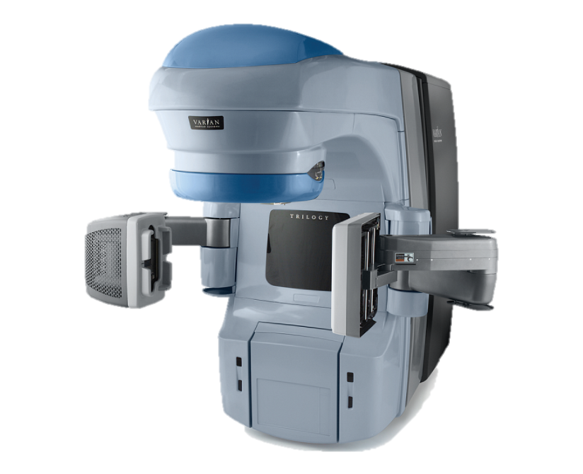
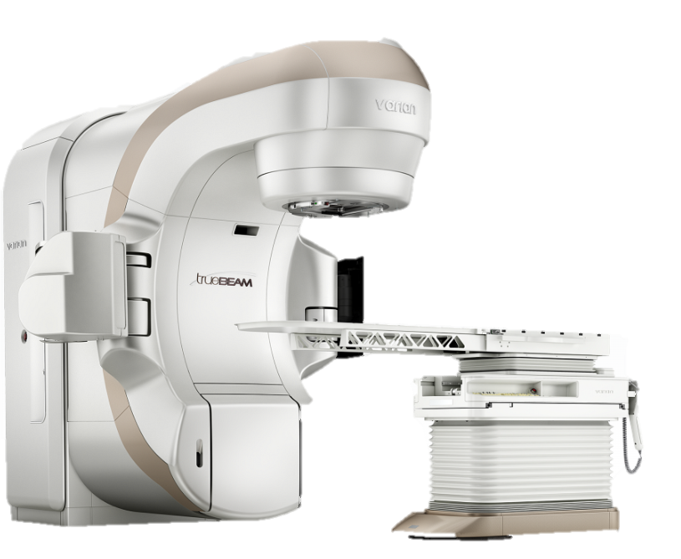
Linear Particle Accelerator
Figure 1
Figure 2

Slide 11
Internal Radiation Therapy-(Brachytherapy)
Brachytherapy
Radioactive source delivered through implants placed into the patient.
Low Dose (LDR)
High Dose (HDR)
High Dose Radiation (HDR)
Delivered using a reusable radioactive source
Commonly treated site:
Cervix/endometrial
Prostate
Breast
Low dose radiation
(LDR)
Placement of small radioactive pellets called seeds into the target tissue.
Remain in the patient.
Notes:
Internal radiation therapy or brachytherapy is delivered by placing a radioactive source into a target area inside of the patient. Internal radiation can be administered via a low continuous dose (LDR) or fractionated high dose therapy (HDR).
Low dose radiation therapy is provided through the placement of small radioactive pellets called seeds into the target tissue. The seeds remain in the target tissue for the life of the patient and will gradually cease to emit radiation over time.
Fractionated HDR is delivered using a variety of applicators and a reusable radioactive source stored in a machine called an afterloader.
Common HDR treatment sites are female pelvis (endometrial/cervical), male pelvis (prostate), and breast.

Slide 12
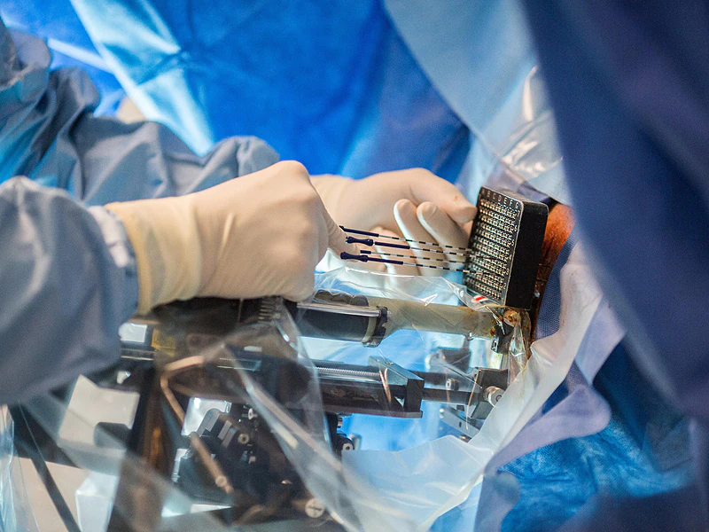
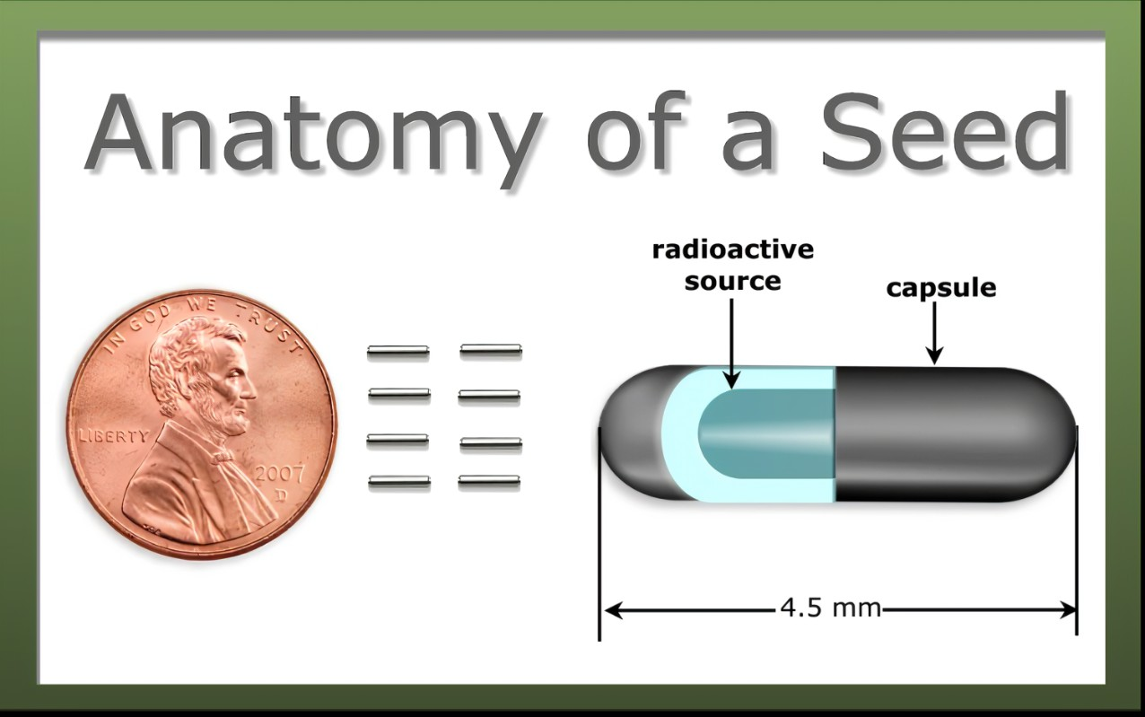
Low Dose Seeds
Figure 3
Figure 4
Notes:
Figure 3 is an example of a patient receiving low dose seed placement for Low Dose radiation for the treatment of prostate cancer. In figure 4 you can see just how tiny the seeds are. 8 of them are not even quite as big as a penny.

Slide 13
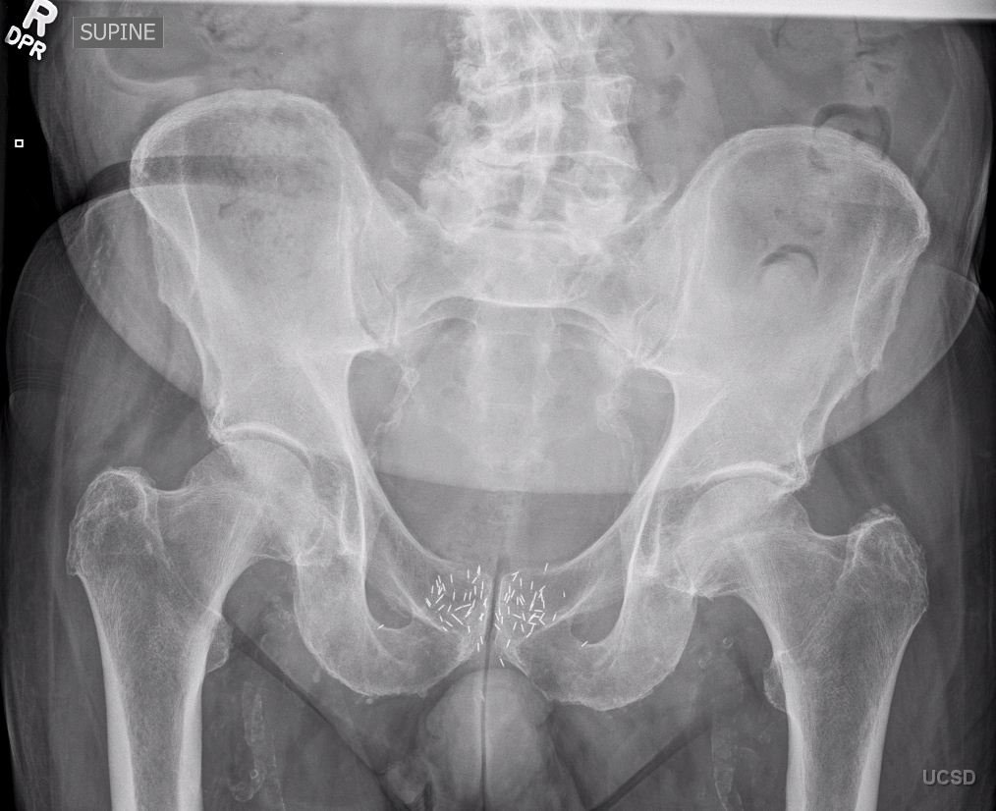
Low Dose Seeds
Figure 5
Notes:
Here you can see all of the seeds that have been implanted into the prostate.

Slide 14
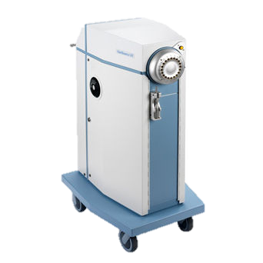
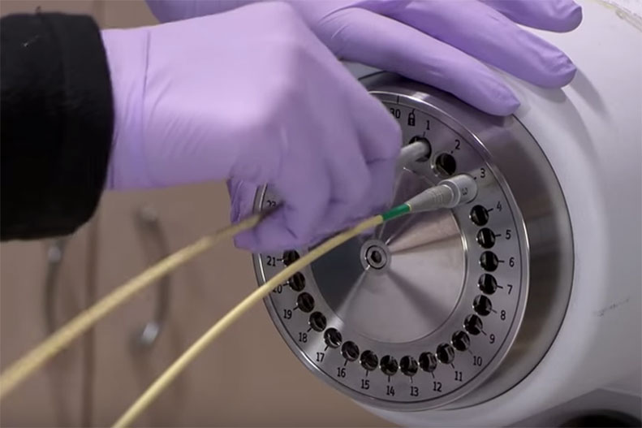
High Dose Radiation
Figure 6
Figure 7
Notes:
70440-126797.jpg (342×342) (medicalexpo.com)
cbrachytherapy.jpg (791×527) (azureedge.net)
Figure 6 is a picture of the afterloader used for high dose rate radiation therapy. This is where the radiation is housed. In Figure 7 you can see that the radiation therapist is attaching small thin tubes to the afterloader. The other end is attached to the applicator which is attached to the patient. The radiation seeds travel through the tubes and are allowed to dwell in the applicators for a predetermined amount of time emitting radiation to the target area. Once the radiation dose has been delivered, the seeds are retracted back into the afterloader. The patient is then scanned by the physicist to ensure that no seeds were left behind before removing the device.

Slide 15
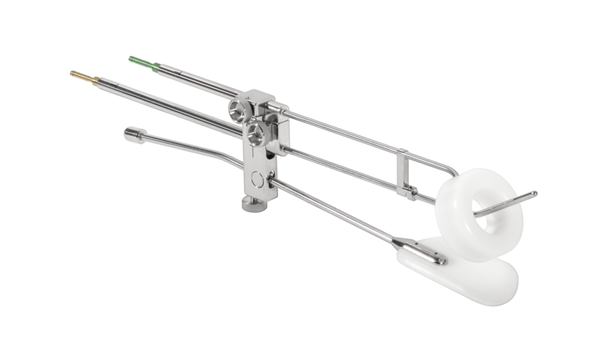
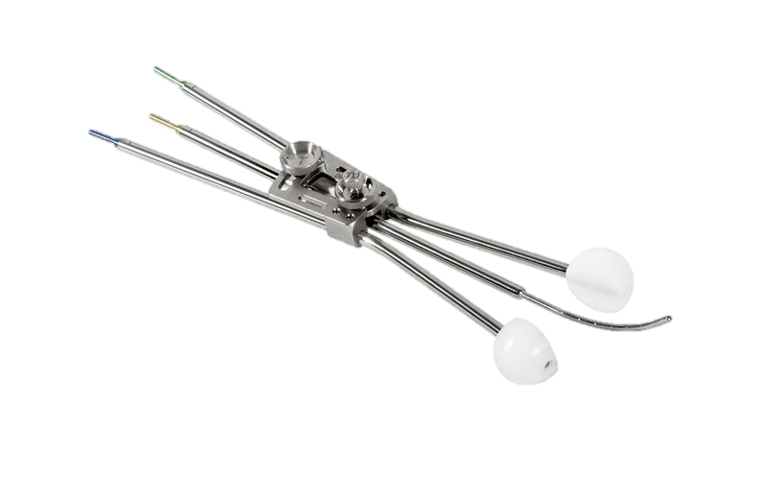
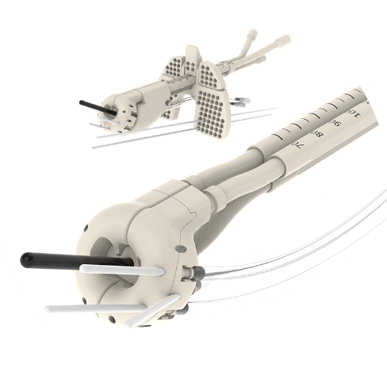
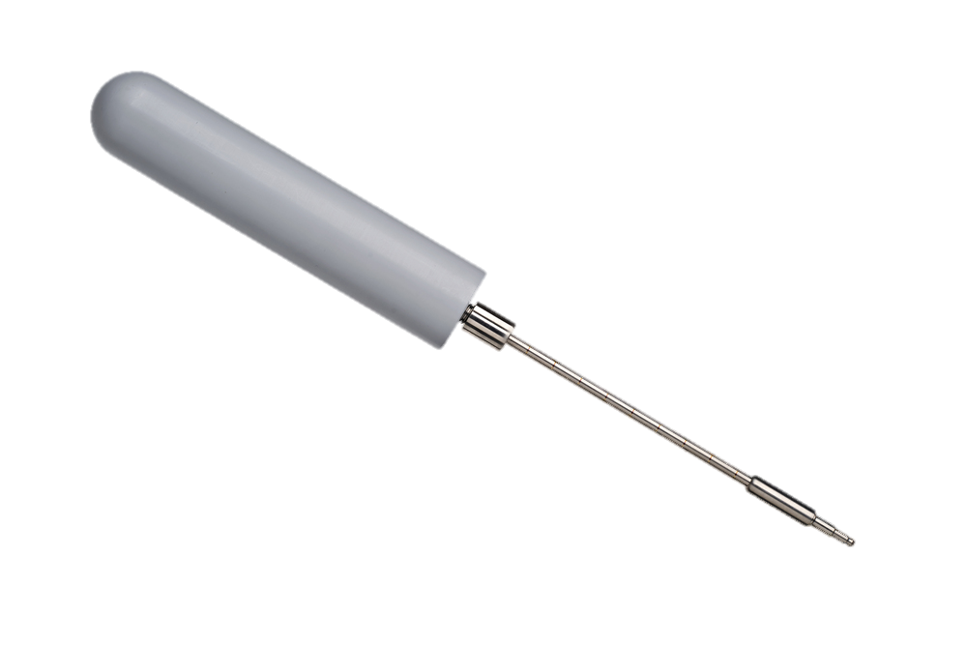
High Dose Radiation Applicators
Figure 8
Figure 9
Figure 10
Figure 11
Notes:
csm_0922_ringtandem_withrectal_BEBIG_7a0899b451.png (800×473) (micknuclear.com)
csm_1408_henschke_BEBIG__1280x795__5cf2cefa8b.jpg (800×497) (micknuclear.com)
16024+Kobold0261.jpg (1000×667) (koboldmedical.com)
Here you can see just some of the applicators we use for gyn brachytherapy. Figure 8 is a tandem and ring with a rectal blade, Figure 9 is a tandem and ovoid, figure 10 is a vaginal cylinder and figure 11 is used for interstitial vaginal brachytherapy. The type of applicator used is based on the location and the size/shape the area we are treating.

Slide 16
Systemic Radiation Therapy (Radiopharmaceuticals)
Systemic radiation is administered via an infusion that contains actively emitting radioisotopes. Radiopharmaceuticals deliver radiation directly and specifically to the cancer cells (cancer.gov, 2020).
Common Radiopharmaceuticals:
Lutathera (lutetium Lu 177 dotatate)
Treats gastroenteropancreatic neuroendocrine tumors (GEP-NET)
Pluvicto (lutetium Lu 177 vipivotide tetraxetan
Treats metastatic castrate-resistant prostate cancer (mCRPC) with prostate specific antigen positivity (PSMA +)
Xofigo (Radium 223 dichloride)-
Treats mCRPC with bone only metastatic disease.
Figur 11
Notes:
1 (500×333) (akamaihd.net)
Systemic radiation is administered via an infusion that contains actively emitting radioisotopes. Radiopharmaceuticals deliver radiation directly and specifically to the cancer cells (cancer.gov, 2020).
Common Radiopharmaceuticals:
Lutathera (lutetium Lu 177 dotatate)
Treats gastroenteropancreatic neuroendocrine tumors (GEP-NET)
Pluvicto (lutetium Lu 177 vipivotide tetraxetan
Treats metastatic castrate-resistant prostate cancer (mCRPC) with prostate specific antigen positivity (PSMA +)
Xofigo (Radium 223 dichloride)-
Treats mCRPC with bone only metastatic disease.

Slide 17
Radiation Workflow
Consult
CT Simulation
Treatment planning
Treatment
Follow-Up
Notes:
The radiation oncology workflow requires several steps before the patient can start radiation therapy. They start with initial consult with the radiation oncologist, they will be scheduled for a CT Simulation, treatment planning occurs, and about 7-10 days later, treatment begins, the patient completes treatment and then return to the clinic for routine follow-up care.
Patients, once diagnosed will be referred to Radiation Oncology to discuss the role of radiation in their treatment plan.
The first visit for a patient in Radiation Oncology is a consultation. During this visit the Radiation Oncologist will educate the patient on their diagnosis, prognosis, and whether radiation will be beneficial.
If radiation is appropriate consent will be signed and care will be coordinated with the intent of moving the patient towards scheduling a CT simulation.

Slide 18
CT Simulation
The CT simulation is a CT scan done in the radiation oncology department to obtain anatomical data specific to the area that will receive treatment. The CT scan that is performed is not done to a diagnostic protocol and it is not read by radiology.
The imaging data instead will be used by the provider and dosimetry team to create a safe and effective treatment plan. Treatment planning can take up to 10 business days based off the complexity of the plan and patient anatomy.
Tattoos will be placed on the patient to use as a point of reference to align them on the treatment machine. If the patient requires assistance holding a position a mask or Vac-Lock will be fitted to them.
Patients will receive education on potential side effects and self-care. They also have the opportunity to ask any additional questions they may have.
Notes:
The CT simulation is a CT scan done in the radiation oncology department to obtain anatomical data specific to the area that will receive treatment. The CT scan that is performed is not done to a diagnostic protocol and it is not read by radiology.
The imaging data instead will be used by the provider and dosimetry team to create a safe and effective treatment plan. Treatment planning can take up to 10 business days based off the complexity of the plan and patient anatomy.
Tattoos will be placed on the patient to use as a point of reference to align them on the treatment machine. If the patient requires assistance holding a position a mask or Vac-Lock will be fitted to them.
Patients will receive education on potential side effects and self care. They also have the opportunity to ask any additional questions they may have.

Slide 19
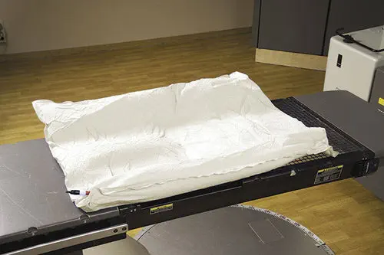
Vac-Lock
Figure 12
Notes:
This is a picture of a vac-lok. Before it is molded it is similar to a bean bag. It is used to stabilize the patient or a body part that we are treating. It will be molded to fit the patient and the air is removed allowing it to maintain it's shape so the patient is in the same position for each treatment.

Slide 20
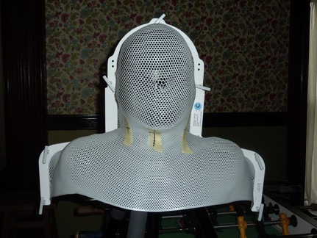
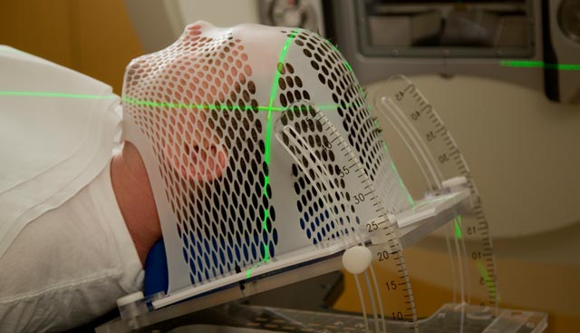
Masks
Figure 13
Figure 14
Notes:
This is a mask used to stabilize patients if they are being treated for cancer to the head or the neck. It starts out as a flat piece of plastic mesh and is warmed in an oven or a water bath to soften and become pliable. It is then molded to fit the patients head or head, neck and shoulders. Once it cools, it hardens again. It is placed on the patient, and they are secured to the table with each treatment. IT is important to know if your patient is claustrophobic. Sometimes patients may require medications to help them relax during treatment.

Slide 21
Entering Treatment
The first visit after simulation for external beam patients is a virtual simulation (V-Sim). During this visit, the patient will be set up for treatment on the LINAC and imaging will be done to confirm the treatment machine set up matches the simulation set up.
External beam treatments take on average 15-30 minutes per treatment. HDR treatments take between ½ to 5 hours depending modality and anatomy/planning.
Once every 5 treatments the patient will see the provider for an on-treatment visit (OTV). During this visit, the patient will be assessed for toxicities and if present they will be educated on how to manage them.
Notes:
The first visit after simulation for external beam patients is a Verification simulation (V-Sim). During this visit, the patient will be set up for treatment on the LINAC and imaging will be done to confirm the treatment machine set up matches the simulation set up.
External beam treatments take on average 15-30 minutes per treatment. HDR treatments take between ½ to 5 hours depending modality and anatomy/planning.
Once every 5 treatments the patient will see the provider for an on-treatment visit (OTV). During this visit, the patient will be assessed for toxicities and if present they will be educated on how to manage them.

Slide 22
Protecting Healthy Tissue
It is important to minimize healthy tissue exposure while the patient is under treatment in order to reduce toxicities.
To protect healthy tissue a variety of methods are utilized. These protections can be built into the planning process or physical interventions such as positioning or space creating devices.
Notes:
It is important to minimize healthy tissue exposure while the patient is under treatment in order to reduce toxicities.
To protect healthy tissue a variety of methods are utilized. These protections can be built into the planning process or physical interventions such as positioning or space creating devices.

Slide 23
Techniques that Help Protect Tissue
Deep inspiration breath hold (DIBH) is a method used to protect heart tissue. The machine will only beam on when it detects the patient is holding their breath.
Wing and breast boards are positioning devices patients will lay on that will help them favorably position their anatomy for treatment.
Patients may also lay prone or supine in whichever positions reduces healthy tissue exposure to the treatment beam.
Pelvic patients may do a bladder and bowel prep to help displace healthy tissue from the treatment field.
Rectal spacers for prostate patients.
Notes:
Deep inspiration breath hold (DIBH) is a method used to protect heart tissue. The machine will only beam on when it detects the patient is holding their breath.
Wing and breast boards are positioning devices patients will lay on that will help them favorably position their anatomy for treatment.
Patients may also lay prone or supine in whichever positions reduces healthy tissue exposure to the treatment beam.
Pelvic patients may do a bladder and bowel prep to help displace healthy tissue from the treatment field.
Rectal Spacers for prostate patients.

Slide 24
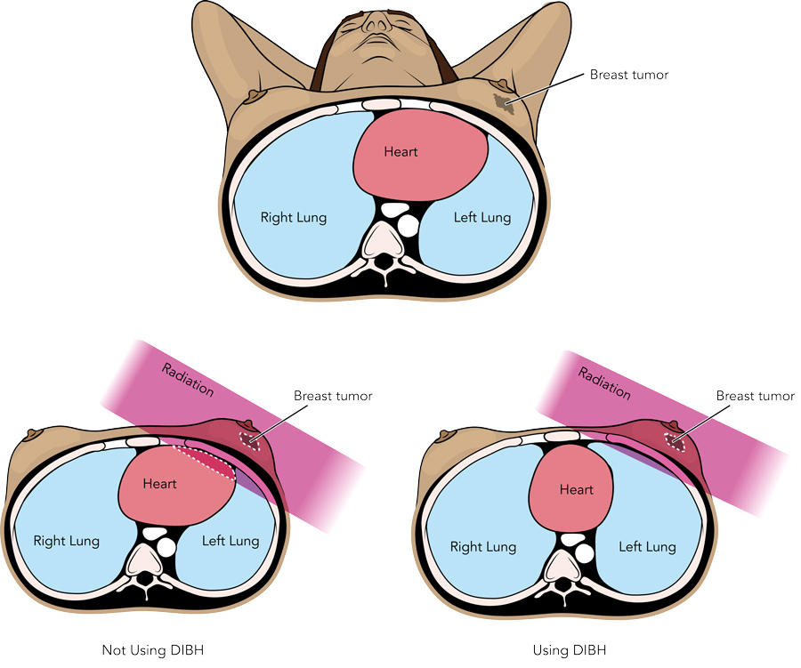
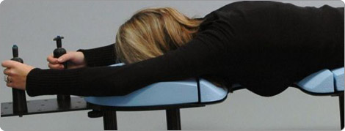
Techniques that Help Protect Tissue
Put pictures here
Figure 17
Figure 16
Notes:
Figure 16 on the left is showing you what happens during Deep Inspiration Breath Hold (DIBH), you can see the we are treating a patient with left breast cancer. If the patient breathes normally, during treatment, the picture in the lower left shows you how a small area of the heart is receiving radiation. Down the road, this could cause some long term side effects. However, the image on the lower right shows the patient taking a deep breath in, as the lung inflates, it pushes the heart out of the radiation field, reducing the dose received by the heart.
Figure 17 is a patient being treated in the prone position for breast cancer. This position allows the breast to fall away from the body minimizing the radiation to the heart.

Slide 25
Rectal Spacing
Rectal spacers can be placed between the prostate and rectum to reduce rectal exposure to radiation.
There are a variety of rectal spacers on the market.
The come in the form of gels or balloons.
Notes:
Rectal spacers can be placed between the prostate and rectum to reduce rectal exposure to radiation.
There are a variety of rectal spacers on the market.
The come in the form of gels or balloons and are inserted transperineally

Slide 26
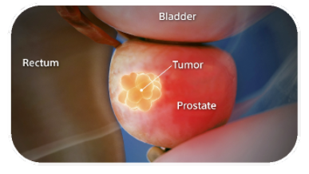
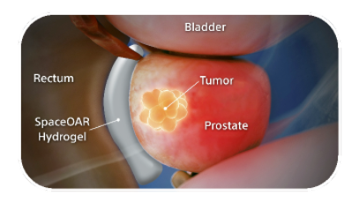
Rectal Spacers
Figure 20
Notes:
In this image you can see how the prostate abuts the rectum which will cause the rectum to receive radiation, but over here you can see how the spacer makes room between the prostate and the rectum, reducing the amount of radiation received by the rectum.

Slide 27
Radiation Side Effects
Side effects associated with radiation therapy are dose and site specific. The side effects are LOCAL AND DO NOT TRAVEL outside of the treated area.
01
Two “universal” side effects of radiation are possible skin reactions and fatigue. Side effects typically present at week 2-3 of treatment.
02
When given alone, side effects from radiation are typically mild.
03
Patients who are receiving chemotherapy concurrently with radiation tend to experience worse side effects than those who receive radiation alone.
04
Chemotherapy is given to patients at the same time as radiation to sensitize the tumor, making it more sensitive to the radiation.
Notes:
Side effects associated with radiation therapy are dose and site specific. The side effects are LOCAL AND DO NOT TRAVEL outside of the treated area.
2 “universal” side effects of radiation are possible skin reactions and fatigue. Side effects typically present at week 2-3 of treatment.
When given alone, side effects from radiation are typically mild.
Patients who are receiving chemotherapy concurrently with radiation tend to experience worse side effects than those who receive radiation alone.
Chemotherapy is given to patients at the same time as radiation to sensitize the tumor, making it more sensitive to the radiation.
It is important when patients are receiving concurrent chemotherapy and radiation that you are keeping a close eye on their labs and notifying the physician of any abnormal results.

Slide 28
Radiation Side effects
The next several slides will touch upon expected site-specific side effects and ways to manage side effects.
Side effects are graded using the National Cancer Institute's Common Terminology Criteria for Adverse Events (CTCAE).
Most side effects are graded on a toxicity scale of 0-5.
0=No/No side effect
1-2 = Mild/Moderate
3-4 =Severe
5=Death
Notes:
The next several slides will touch upon expected site-specific side effects and ways to manage them.
Side effects are graded using the National Cancer Institutes Common Terminology Criteria for Adverse Events (CTCAE).
Most side effectsare graded on a toxicity scale of 0-5.
0=No/No side effect
1-2 = Mild/Moderate
3-4 =Severe
5=Death

Slide 29
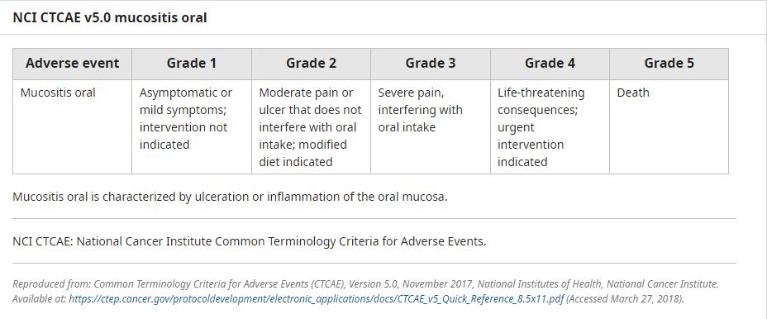
Example of Oral Mucositis-CTCAE Grading
Uptodate.com, 2024
Notes:
This is an example of the CTCAE Grading scale for oral mucositis. It is important to have the criteria for the side effects you are assessing in front of you to help guide your assessment.
To perform a thorough oral assessment, you would first assess pain. If they are having pain in their mouth, ask them to rate it on a scale of 0-10. 0 being no pain, 10 being the worst.
Ask them what their diet is like, are they eating regular foods, without modification or are they eating a soft diet such as masked potatoes, soups, puddings, etc, because their mouth hurts?
Inspect their mouth using a flashlight. Are there sores on their tongue or cheeks? Do they have thrush? Asking the right questions and inspecting the area can help you determine how to grade their side effects.
So, if you assess your patient and they indicate that the pain in their mouth is 8/10, they are unable to eat even a soft or modified diet due to their mouth pain and you observe sores throughout their oral mucosa, (they may even exhibit weight loss) this would be graded as a Grade 3 oral mucositis. Often the first line of treatment for patients with oral mucositis is magic mouth wash or magic swizzle. This is a combination of Viscous Lidocaine, Benadryl and Maalox. However, patients experiencing grade 3 oral mucositis may require a stronger analgesic. This patient would need to be added to your facility’s Morbidity and Mortality report. You should speak with your manager to learn how your site tracks morbidity and mortality.

Slide 30
CTCAE Resources
CTCAE Plus- Phone App
Common Terminology Criteria for Adverse Events (CTCAE) (cancer.gov)
Notes:
CTCAE Criteria is organized alphabetically based on the system affected. You can use the link at Cancer.gov to find the criteria or there is an app you can put on your phone called CTCAE Plus. Some sites may have a book. If you do not have a book and would like one, please let me know and I can try to get one for you.

Slide 31
Site-Specific Side Effects
Side effects from Radiation are local and do not travel.
The are specific to the body part/location that is being treated.
Notes:
As I mentioned earlier, side effects from radiation are local and do not travel to other parts of the body.
The next several slides will explain anticipated site-specific side effects.
Then I will discuss about how to manage side effects.

Slide 32
Site Specific Side Effects
Abdomen
Anal/Rectal
Loss of appetite
Nausea/vomiting
Acid Reflux
Diarrhea
Fatigue
Skin irritation
Fatigue
Diarrhea
Skin irritation (radiation dermatitis)
Burning, frequency, or painful urination
Notes:
When treating the abdomen, you would expect a variety of GI related side effects (depending on how high or low on the abdomen we are treating) such as Loss of appetite, Nausea/vomiting, acid reflux, diarrhea, and then fatigue and possibly some skin irritation
When treating the an ano-rectal cancer, you would expect to see side effects specific to the low pelvis such as , diarrhea and urinary symptoms. These patients also tend to experience fatigue and often radiation dermatitis.

Slide 33
Site Specific Side Effects (Con’t)
Bone
Breast/Chest Wall
Fatigue
Radiation Dermatitis
Fatigue
Radiation Dermatitis
Fullness/tenderness of the treated breast
Feeling of lump in the throat/chest
Notes:
If we are treating a bone patients may experience fatigue and radiation dermatitis and patients receiving radiation to the breast or chest wall may experience fatigue, Radiation Dermatitis, a feeling of fullness or tenderness of the treated breast and depending where on the breast or CW we are treating, some patients may report they feel a lump in their throat, so perhaps they are experiencing some esophagitis.

Slide 34
Site Specific Side Effects (Con’t)
Brain
Chest/Thorax/Lung
Hair loss in the treatment field
Skin changes, scalp, and ear irritation
“Plugged up” ears with decreased hearing (if ears are in the field)
Drowsiness or fatigue
Headaches
Nausea
Vomiting
Trouble with memory and speech
Discomfort when swallowing
Difficulty swallowing or a “lump in throat” sensation
Cough
Radiation Dermatitis
Loss of appetite
Fatigue
Notes:
Patients receiving treatment to the brain may experience:
Hair loss in the treatment field
Skin changes, scalp, and ear irritation
“Plugged up” ears with decreased hearing (if ears are in the field)
Drowsiness or fatigue
Headaches
Nausea
Vomiting
Trouble with memory and speech
If we are treating the Chest/Lung or Thorax, people may report:
Discomfort when swallowing
Difficulty swallowing or a “lump in throat” sensation
Cough
Radiation Dermatitis
Loss of appetite
Fatigue

Slide 35
Site Specific Side Effects (Con’t)
Female Pelvis
Male Pelvis
Fatigue
Diarrhea
Radiation Dermatitis
Urinary symptoms
Urinary Symptoms,
Frequency, urgency, incontinence
Blood in urine
GI symptoms
Proctitis
Sexual Dysfunction
Fatigue
Notes:
Female patients receiving pelvic radiation should be taught to expect side effects including fatigue, diarrhea, RD, and urinary symptoms.
Male patients receiving RT to the pelvis (specifically patients receiving RT to the prostate) may experience Urinary symptoms such as frequency, urgency, or incontinence.
The may report some GI symptoms, such as abd cramping or diarrhea. They may develop a proctitis, which is why rectal spacing and measures to separate the rectum from the prostate are so important. Sexual Function and fatigue.

Slide 36
Site Specific Side Effects (Con’t)
Head and Neck
Fatigue
Soreness or discomfort around the front of the ears and the jaw
Dry mouth
Changes in how food tastes
Decreased appetite
Weight loss
Decrease in saliva or thick saliva.
Soreness of tongue, mouth.
Pain when swallowing
Radiation Dermatitis
Voice change or cough
Notes:
Patients receiving treatment for head and neck cancers should be taught to expect:
Fatigue
Soreness or discomfort around the front of the ears and the jaw
Dry mouth
Changes in how food tastes
Decreased appetite
Weight loss
Decrease in saliva or thick saliva.
Soreness of tongue, mouth.
Pain when swallowing
Radiation Dermatitis
Voice change or cough

Slide 37
Site Specific Side Effects (Con’t)
Skin
Spine
Redness of the skin
Dry and Peeling Skin
Itching of the Skin
Swelling of the Treatment Area
Hair Loss of the Treatment Area
Skin irritation
Fatigue
Sore throat/dysphagia (C spine)
Sore throat/dysphagia/nausea (T spine)
Nausea or diarrhea (L spine)
Notes:
Patients receiving radiation to the skin should be taught about skin side effects including redness, dry, peeling or itchy skin, hair loss in the treatment area.
Patients receiving radiation to the spine would expect to experience symptoms related to the area of the spine we are treating.
Skin irritation
Fatigue, these are pretty universal.
Sore throat/dysphagia (C spine)
Sore throat/dysphagia/nausea (T spine)
Nausea or diarrhea (L spine)

Slide 38
How Do We Manage Side effects?
Anticipate
Educate
Evaluate/Assess
Notes:
So, how do we manage all of the side effects?
Prior to patients starting treatment we want to educate them on what side effects they may experience.
Knowing what side effects to anticipate, allows you to better educate your patients to care for themselves.
During their weekly OTV's you will assess patients for any side effects they are experiencing, and you may need to reinforce the education you have already provided.

Slide 39
Preventive Care and Side Effect Management
Radiation Dermatitis
Radiation Induced Diarrhea
Nausea/Vomiting
Most frequent side effect
Mild erythema to moist desquamation or necrosis
Gentle cleansers
Avoid scratching the skin
Avoid sun exposure
Preventative skin care at 1st treatment
Radiation induced
Result of chemotherapy
Educate
Stop any laxatives
Fluid intake
Nutrition
Avoid foods that cause diarrhea
Increase foods that help to bulk up stools
BRAT Diet
Antidiarrheals
Patients receiving tx around the abdomen
NPO 3 hours
Antiemetics as prescribed
Encourage fluids
Ginger
Small, frequent, light meals
(Hickey & Newton (2019))
Notes:
Radiation Dermatitis is the most reported side effect of radiation treatment, occurring in as many as 95% of patients receiving radiation therapy. Radiation Dermatitis can range from mild erythema of the skin to moist desquamation and necrosis. We teach all patients to be gentle with their skin. Perform good skin hygiene, to use gentle, unscented soaps or cleansers to bath, avoid using rough wash cloths. Avoid itching or scratching of the skin, and it they are at a high risk of developing RD they should begin applying approved moisturizing ointments or creams on the first day of treatment. Make sure you speak with your nursing team to see what your providers like to recommend. For patients receiving pelvic radiation, sitz baths can be helpful
Radiation induced diarrhea-is defined by the NIH CTCAE criteria as an increase in frequency, and/or loose or watery bowel movements. The prevalence of treatment related diarrhea is 80%. Patients who may experience Radiation “Induced Diarrhea are patients receiving radiation to the pelvis, abdomen, or lower thoracic or lumbar spine. Patients who are receiving concurrent chemotherapy may also experience diarrhea as a result of their chemotherapy. It is important to educate patients experiencing diarrhea to ensure they are having adequate fluid intake.
If your patient is using laxatives, ensure they have stopped them. Encourage them to increase their fluid intake. Ensure they are eating the right foods, avoid greasy fatty foods, avoid raw fruits and vegetables, milk and dairy, heavily seasoned or spicey foods.
Encourage them to eat foods such as peeled apples, white rice, bananas, baked potatoes, without skin, white bread, plain pasta, etc. If diarrhea does not improve with diet modifications, they may need to follow a BRAT diet and use antidiarrheal agents such as Imodium or Lomotil.
Nausea is defined as the subjective phenomenon of an unpleasant wavelike sensation experienced in the back of the throat and epigastrum that may culminate in emesis or vomiting. Patients receiving radiation to the abdominal area may experience nausea. Teach patients to be NPO 3 hours prior to treatment. Encourage them to take antiemetics as ordered. Encourage fluid intake, but in small amounts at a time. They can try things like ginger tea or ginger ale, or foods that contain ginger. They should eat small frequent meals, foods should be light such as turkey sandwiches, chicken soup, applesauce, jello, etc.

Slide 40
Preventive Care and Side Effect Management (Con’t)
Dysphagia
Oral Mucositis
Anorexia
Difficult or painful swallowing
May need to see a speech-language pathologist
Analgesics as prescribed
Nutrition referral
Sit upright when eating/drinking
Drink using a straw/tilting chin forward
Avoid smoking/Alcohol
Avoid foods that are too hot or too cold
Ulcerations of the oral mucosa
7-10 days after starting TX.
Good oral hygiene
Baking soda/saltwater rinses
Avoid rough sharp foods
Soft diet
Magic Swizzle/mouthwash
Narcotic analgesics
Weight loss
Need to replan treatment
Treatment delays
Avoid foods that are heavily seasoned
Eat small frequent bland meals
Add protein supplements, powdered milk to foods and smoothies
Eat foods that are high in protein and calories
Nutrition referral
Notes:
Oral mucositis is the inflammation or ulcerations of the oral and/or oropharyngeal mucosa. Effects almost all patients receiving radiation to the head and neck. Ulcerations can often be noted within 7-10 days of a patient starting radiation therapy. Encourage patients to perform good oral hygiene, using soft bristled toothbrushes, avoid mouthwashes that contain alcohol, They should be taught to do baking soda and saltwater rinses 4-6 times per day. Eat a soft diet and avoid foods that are sharp or rough. Talk to your provider about ordering magic swizzle mouthwash, or they may even require something stronger like a narcotic analgesic.
Dysphagia is difficulty or painful swallowing that preventing the normal passage of food and liquid. Dysphagia can increase the risk of aspirating. You probably want to set these patients up with a nutritionist to help them find foods that are easy to eat and high in calories and protein. They may also need to see a speech-language pathologist who can teach them tips for safe swallowing including drinking from a straw and tilting their chin forward to swallow liquids, they may even need to use thickened liquids. Teach your patients to sit upright when earing or drinking and to avoid food and beverages that are too hot or too cold.
Anorexia is the abnormal loss of appetite for food associated with medical treatment and is a direct cause of weight loss in our patients. Patients need to be taught to maintain their weight during treatment. If they lose too much weight throughout their treatment course, it could result in the need to replan their treatment, causing treatment delays. Again, teach patients to avoid heavily seasoned foods, eat small frequent bland meals, Often patients say they just can’t eat or food doesn’t taste good and they just aren’t hungry, but they still have to eat. I encourage them to treat food like medicine.. They should choose foods that are high in calories and high in protein, as the body needs more calories and protein to heal during radiation treatment. Set a timer and eat something small every hour whether it be a quarter of a turkey sandwich, a small cup of soup or apple sauce. It is so important that they are getting adequate calories, protein, etc. They can add ice cream and peanut butter to their Ensure and make a milkshake. And of course, make sure that these patients have a referral to nutrition.

Slide 41
Urinary Symptoms
Radiation to the pelvis
Dysuria/painful urination
Burning
Frequency
Urgency
Hematuria
Incontinence
Nocturia
Encourage fluid intake
Cranberry juice or AZO
Avoid caffeinatedx beverages
Limit fluid intake after 7 PM
Pelvic floor strengthening
Cancer rehab if necessary
Notes:
Patients undergoing radiation to the pelvis may experience a variety of urinary symptoms including dysuria,
Frequency, hematuria, hesitancy, urgency
Encourage adequate fluid intake 8-10 8-ounce glasses of fluids per day.
Encourage cranberry juice if they are reporting burning or AZO.
Avoid caffeinated beverages,
Discourage fluid intake in the few hours leading up to their bedtime
Teach kegel’s/pelvic floor exercises, refer to cancer rehab if necessary.

Slide 42
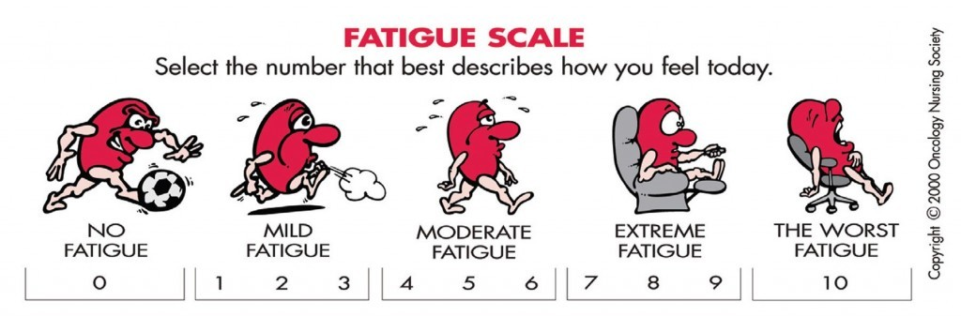
Cancer Related Fatigue
What is Fatigue?
Persistent
Distressing
Physical and emotional exhaustion
How do we manage fatigue?
Exercise
-Short walks
Gentle stretching
Yoga
Energy Conservation
Rest
Good nutrition
Notes:
Fatigue- Cancer related fatigue is defined as a distressing, persistent , subjective sense of physical, emotional , and or cognitive tiredness or exhaustion related to cancer or cancer treatment that is not proportional to recent activity and interferes with usual functioning. Maintain healthy nutrition status, exercise, resting/napping, and planning daily tasks. The more heavily treated a patient is, the more fatigue they may feel. So, if they are having concurrent chemo they may note more fatigue or a patient who have just completed 12 cycles of chemo for breast cancer, may enter radiation already feeling fatigue.
So how do we teach patients to manage fatigue? Exercise! Exercise is the best way to manage fatigue. Patients don’t have to hit the gym each day, or do a strenuous workout, encourage light exercise, short walks, stretching, yoga, etc. Evidence shows that patients who continue to be active during their cancer treatment have fewer side effects, feel better during treatment and stay on track with treatment. Conserve energy, Prioritize tasks. I always tell patients, do what has to be done when you feel your best (that might not always be first thing in the morning), everything else can wait and certainly don’t be afraid to ask for help.
Rest, limit naps to no more than 30 minutes, don’t nap to close to bedtime
Make sure you are eating a well-balanced diet, adequate fluid intake (64 ounces of water each day), eating adequate calories, protein, carbs, etc. each day.
While this was not a comprehensive list of all treatment related side effects, this covered the most frequently noted side effects and management guidelines. Be sure you speak with your manager and physicians on specific ways they like to manage side effects.

Slide 43
Post Treatment Care/Follow up
Depending on the diagnosis patients may or may not follow with radiation oncology for the long term.
If a survivorship program exists, patients should be referred
Follow up visits are scheduled based on severity of treatment toxicities and diagnosis based follow up guidelines.
Notes:
Once the patient completes treatment, their physician will guide them on with what their follow up plan looks like.
Depending on the diagnosis patients may or may not follow with radiation oncology for the long term.
If a survivorship program exists, patients should be referred
Follow up visits are scheduled based on severity of treatment toxicities and diagnosis based follow up guidelines.

Slide 44
Thank you for attending!!!
Please email me with any questions
spenceram@upmc.edu
Notes:
This concludes the Introduction to Radiation Oncology. If you have any questions, please feel free to email me at spenceram@upmc.edu.
Once again, Welcome to our team!

Slide 45
Sources
NCI Dictionary of Cancer terms. National Cancer Institute. (n.d.). Retrieved March 30, 2022, from https://www.cancer.gov/publications/dictionaries/cancer-terms/def/imrt
NCI Dictionary of Cancer terms. National Cancer Institute. (n.d.). Retrieved March 30, 2022, from https://www.cancer.gov/publications/dictionaries/cancer-terms/def/igrt
NCI Dictionary of Cancer terms. National Cancer Institute. (n.d.). Retrieved March 30, 2022, from https://www.cancer.gov/publications/dictionaries/cancer-terms/def/stereotactic-radiation- therapy
NCI Dictionary of Cancer terms. National Cancer Institute. (n.d.). Retrieved March 30, 2022, from https://www.cancer.gov/publications/dictionaries/cancer-terms/def/sbrt
Types of cancer treatments. Memorial Sloan Kettering Cancer Center. (n.d.-a). https://www.mskcc.org/cancer-care/diagnosis-treatment/cancer-treatments

Slide 46
Sources
Varian. (2022). [Trilogy image]. Varian. https://www.varian.com/en-au/products/radiotherapy/treatment-delivery/trilogy
Varian. (2022). [Truebeam image]. Varian. https://www.varian.com/en-au/products/radiotherapy/treatment-delivery/truebeam
[Image of Brachytherapy]. (n.d.). Retrieved March 31, 2022, https://img.medscape.com/thumbnail_library/ps_160929_brachytherapy_prostate_800x600.jpg
Mount Sinai Hospital. (2022). [Anatomy of a seed image]. Dr. Richard Stock. http://www.drrichardstock.com/seedimplants.html
UCSD. (n.d.). [Prostate seed image]. Dr. Andrew Yen. http://radres.ucsd.edu/CC/album/E/index.html#Embolization%207g%20Prostate%20Seed%20Implants.jpeg

Slide 47
Sources
[HDR afterloader image]. (n.d.). https://img.medicalexpo.com/images_me/photo-g/70440-126797.jpg
[HDR afterloader close up image]. (n.d.). https://share-cdn-prod.azureedge.net/wp-content/uploads/2015/08/brachytherapy.jpg
Mick Radio-Nuclear Instruments. (n.d.). [Ring and tandem applicator image]. Mick Nuclear. https://www.micknuclear.com/home/products/hdr_brachytherapy/intracavitary_applications/
Mick Radio-Nuclear Instruments. (n.d.). [Henschke applicator set image]. Mick Nuclear. https://www.micknuclear.com/home/products/hdr_brachytherapy/intracavitary_applications/
Kobold Medical. (2022). [Kobold vaginal cylinder image] Kobold Medical. http://www.koboldmedical.com/brachytherapy.html
[Xofigo container image]. (n.d.) https://prnewswire2-a.akamaihd.net/p/1893751/sp/189375100/thumbnail/entry_id/0_jl27puh3/def_height/500/def_width/500/version/100012/type/1

Slide 48
Sources
Medical Expo. (2022). [Image of Vac-Lok]. Medical Expo. https://www.medicalexpo.com/prod/civco/product-75914-665152.html
Head and Neck Cancer Patient. (n.d.). [Image of head and neck mask]. Head and Neck Cancer Patient. https://www.headandneckcancerpatient.com/radiation-treatment.html
Moffitt Cancer Center. (2018). [Image of treatment mask]. Moffitt Cancer Center. https://moffitt.org/taking-care-of-your-health/taking-care-of-your-health-story-archive/what-you-need-to-know-about-radiation-masks/
Dr. Dumane, V.A. (2020). [ Image of breath hold]. Research Outreach. https://researchoutreach.org/articles/breath-hold-techniques-during-volumetric-modulated-arc-therapy-breast-cancer-patients/

Slide 49
Sources
Orbital Therapy. (2022). [Image of prone breast board]. Orbital Therapy. http://www.orbitaltherapy.com/products/clearvue/
Qfix Positioning. (n.d.). [Image of supine breast board]. Q Fix. https://qfix.com/catalog/radiotherapy-breast-torso-solutions/supine-positioning
Qfix Positioning. (n.d.). [Image of breast/lung board]. Q Fix. https://qfix.com/catalog/mr-solutions/access-supine-mr-breast-lung-treatment-device
Boston Scientific. (2022). [Image of Space OAR pre/post placement]. Boston Scientific. https://www.bostonscientific.com/en-US/medical-specialties/urology/prostate-health/prostate-cancer/spaceoar-hydrogel/product-and-procedure.html

