Slide 1
Cardiac Education Series
Quality Nurse Indicators

Slide 2
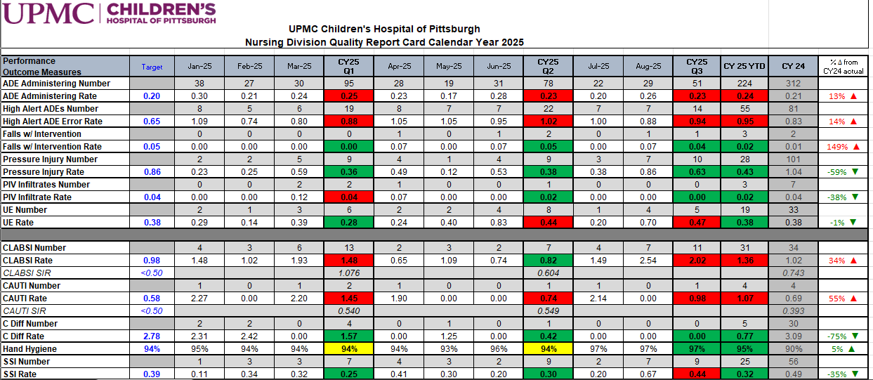
Nursing quality indicators
Nursing quality indicators are measurable outcomes that are directly influenced by nursing care.
Nursing quality indicators are reported to a variety of databases (NDNQI, NHSN, SPS) to help assess and evaluate practice.
At CHP, we also utilize a Nursing Quality Report Card to drive new practices and process changes.

Slide 3
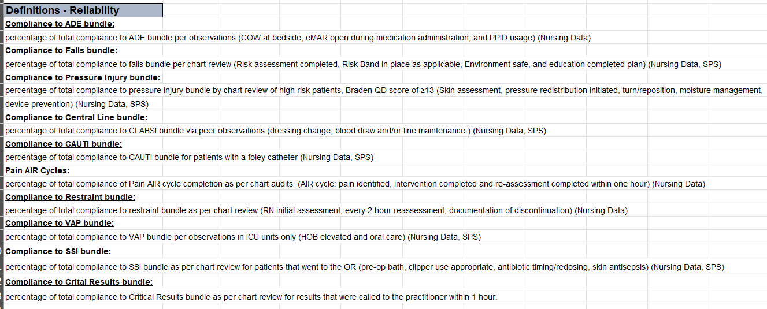
nursing Bundles
Specific, evidence-based set of nursing interventions designed to improve patient outcomes related to a nursing-sensitive quality indicator
Typically, these bundles are a cohesive unit of 3-5 practices that are all essential to the success of patient outcomes

Slide 4
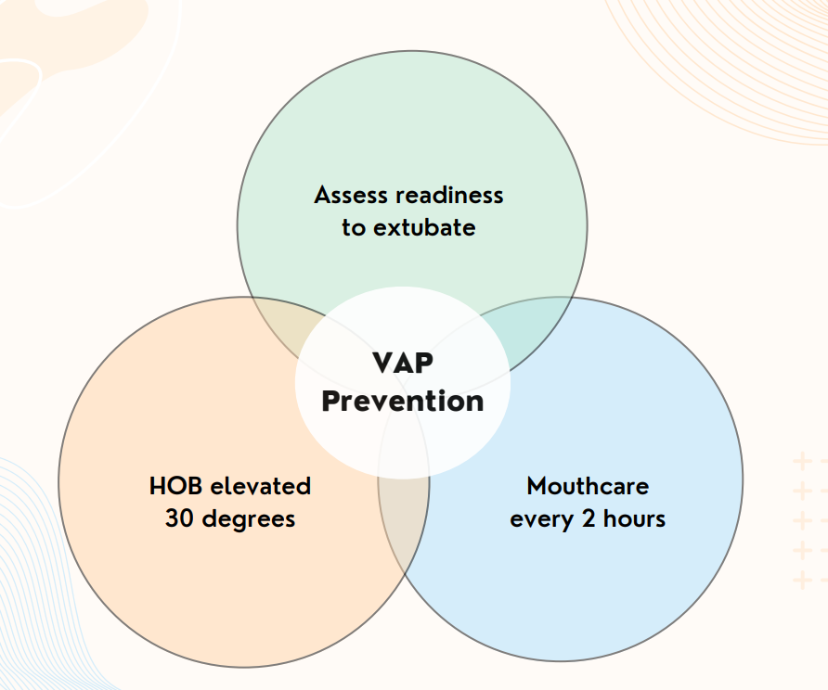
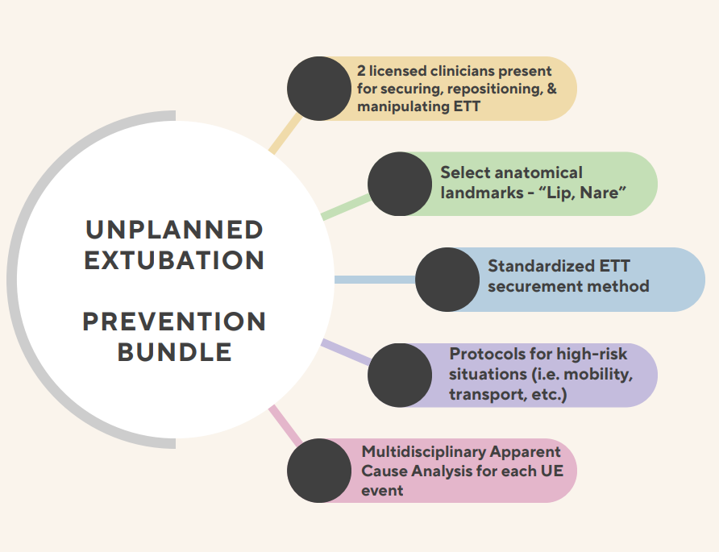
Nursing quality indicators: Bundles
Ventilator Associated Events

Slide 5
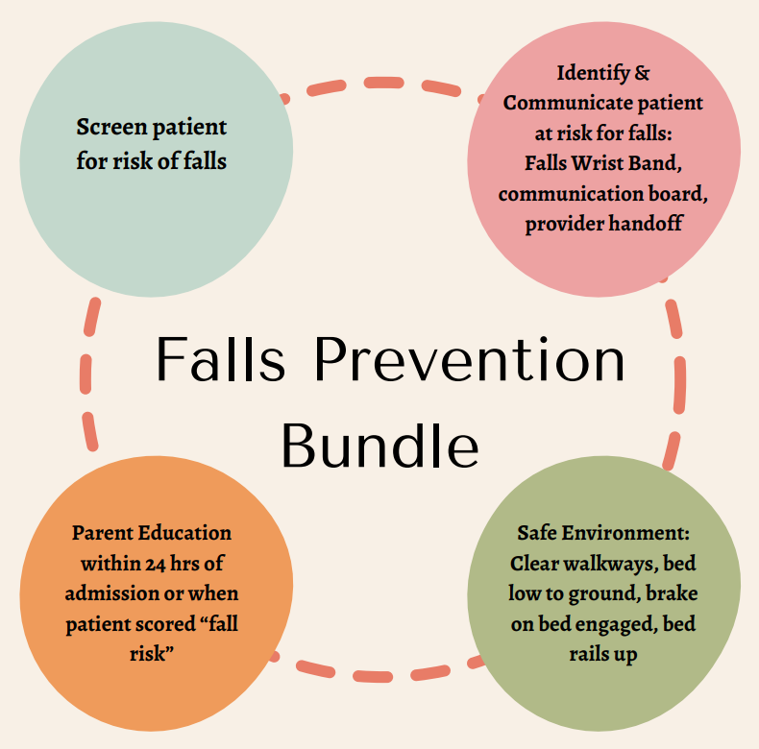
Nursing quality indicators: Bundles
Fall Prevention

Slide 6
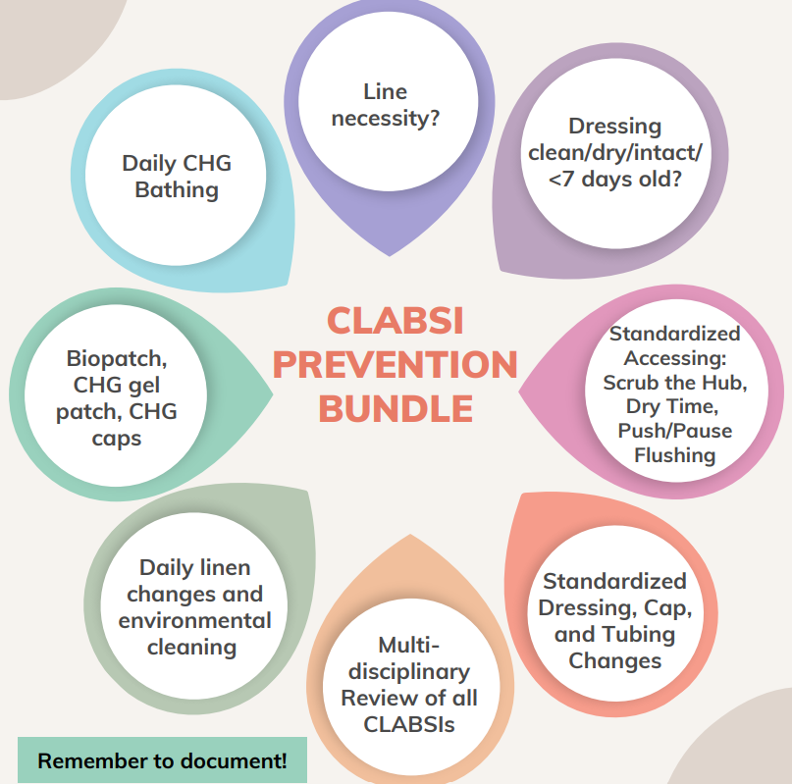
Nursing quality indicators: Bundles
CLABSI Prevention

Slide 7
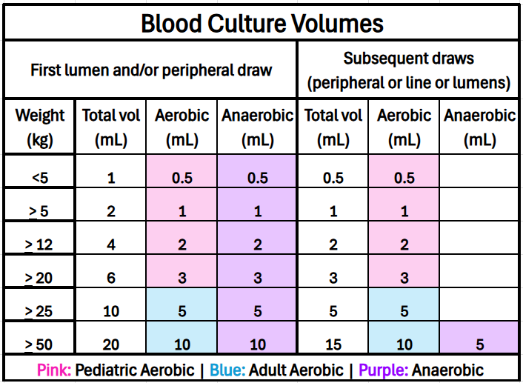
Nursing quality indicators: Bundles
CLABSI Prevention: Blood Culture Collection

Slide 8
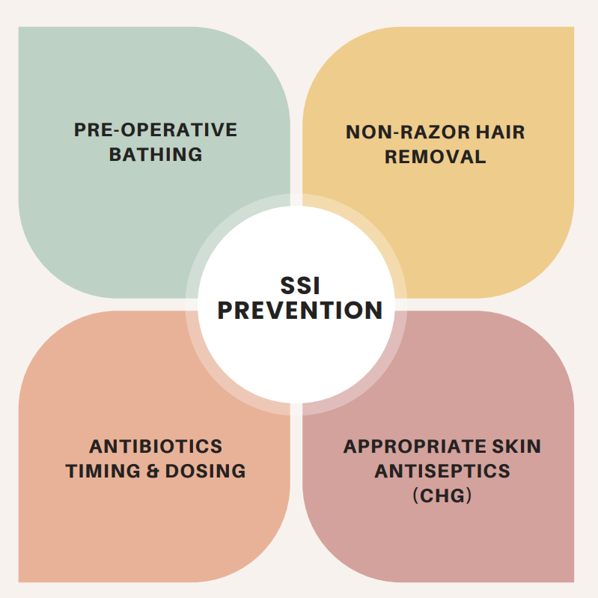
Nursing quality indicators: Bundles
Surgical Site Infection (SSI)

Slide 9
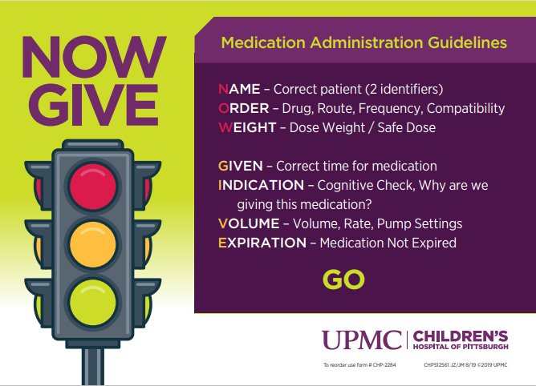
Nursing quality indicators: Bundles
Adverse Drug/Medication Events

Slide 10
Nursing quality indicators: Bundles
Separate Double Check Process
These medications have high risk of causing significant harm to patients warrant additional safety
When to do a separate double check
Change of shift
Changing syringe
Change in order
Order new/stop/suspend
Clinical judgement/status change
This process should not be completed together, rather completely independent of each other
Unit Standard: complete this process with all continuous medications and certain intermittent medications (electrolytes, antiarrhythmics, oral immunosuppression, etc.)
TPN/Lipids
Insulin (continuous)
Narcotics
Heparin/Anticoagulation Infusions
Chemotherapy

Slide 11
Nursing quality indicators
A key aspect of our responsibilities at the bedside involves effectively utilizing available resources to access pertinent information and ensure adherence to best practices.
Please refer to the following resources, accessible via the UPMC Infonet, to complete the educational activity for this month.

Slide 12
UPMC Infonet Policy resources
Central Venous Access Device Care: General Maintenance, Blood Draw, Blood Culture, and Laboratory Paper (PTCMDIV818)
Urethral Catheterization: Insertion, Care, and Removal (PTC-RN250)
Patient Falls-Assessment Re-Assessment and Documentation (HS-NA0410)
Mechanical Ventilation: Invasive and Noninvasive, Locations for Use (PTC-RN384)
Oral Care with Colostrum and/or Breastmilk for Infants in Intensive Care Units/Special Care Nursery (HS-WH0012 *)
Administration of Medications to Children (PTCMDIV800)
Parenteral Nutrition and Fat Emulsion (PTCMDIV840)
12

