Slide 1
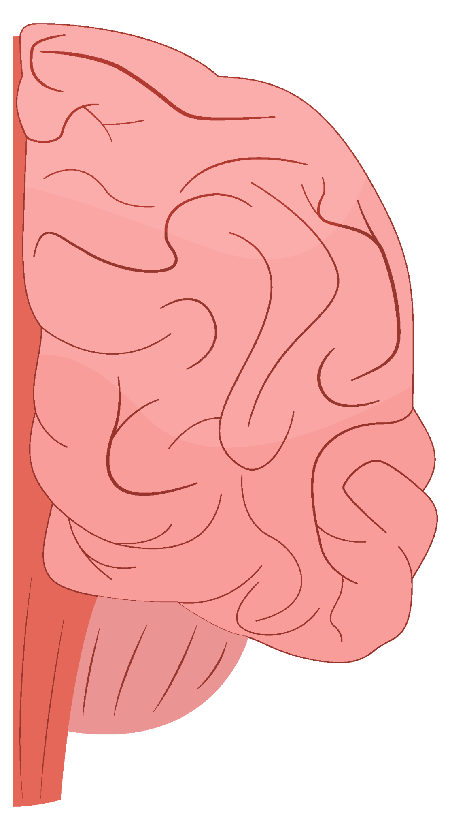
Stroke of Genius:
Key Updates in the 2026 Acute Ischemic Stroke Guidelines
Rylan Sergi, PharmD
PGY-1 Pharmacy Resident
UPMC Mercy

Slide 2
Continuing Education Information
In support of improving patient care, the University of Pittsburgh is jointly accredited by the Accreditation Council for Continuing Medical Education (ACCME), the Accreditation Council for Pharmacy Education (ACPE), and the American Nurses Credentialing Center (ANCC), to provide continuing education for the healthcare team.
Pharmacy (CPE)
This knowledge-based activity provides 0.5 contact hours of continuing pharmacy education credit.

Slide 3
Disclosures
No members of the planning committee, speakers, presenters, authors, content reviewers and/or anyone else in a position to control the content of this education activity have relevant financial relationships with any entity producing, marketing, re-selling, or distributing health care goods or services, used on, or consumed by, patients to disclose.

Slide 4
Disclaimer
The information presented at this Center for Continuing Education in Health Sciences program represents the views and opinions of the individual presenters, and does not constitute the opinion or endorsement of, or promotion by, the UPMC Center for Continuing Education in the Health Sciences, UPMC/University of Pittsburgh Medical Center or Affiliates and University of Pittsburgh School of Medicine. Reasonable efforts have been taken intending for education subject matter to be presented in a balanced, unbiased fashion and in compliance with regulatory requirements. However, each program attendee must always use his/her own personal and professional judgement when considering further application of this information, particularly as it may relate to patient diagnostic or treatment decisions including, without limitation, FDA-approved uses and any off-label uses.

