Slide 1
_____________________ decisionscience
Deb Lessard, JD, MA, BSN, CPHRM, FASHRM
Healthcare Consultant
Adjunct Faculty, Carlow University
Adjunct Faculty, Georgetown University

Slide 2

introduction to systems leadership I & II
The four circles in this graphic rest on a platform that identifies different areas of competencies.
The platform is built using communication science, decision science, financial management, health information technology, advocacy and collaboration, complexity science, leadership theories and models, and application (which includes evidence based research and best practices).
This is the “big picture” for Systems Leadership.
Systems Leadership I addresses interpersonal and group communication, neuroeconomics, quality, innovation, technology and financial management.
Systems Leadership II frames the Leadership I topics by intersecting organizational communication (informational and constitutive) with policy (including the ACA) and advocacy, ethics and informatics/technology.
See full size
Illustration 1
The sweet spot of all four circles is where the value “lives”. Value means increasing revenue, decreasing costs and improving outcomes.
You will be navigating these circles throughout Systems Leadership I and II.
2

Slide 3
introduction to decision science module
Throughout Systems Leadership I, we will be examining how to build and deliver proposals relating to quality improvement, performance improvement, patient safety and value-driven enterprise risk management.
The decision science module will provide you with one of the building blocks necessary for leading or facilitating a decision making team. This module will provide the theory, strategies and tools for quality decisions.
The sweet spot of all four circles is where the value “lives”. Value means increasing revenue, decreasing costs and improving outcomes.
You will be navigating these circles throughout Systems Leadership I and II.
3

Slide 4


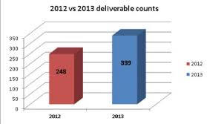
introduction to decision science and value-driven enterprise risk management modules
Package your expertise
Communication science
Neuroeconomics
Acquire commitment
Behavioral change theories
Decision science
Value-driven enterprise risk management approach
Evaluate outcomes
Financial management
Value-driven enterprise risk management metrics
4

Slide 5
introduction to concept maps
Concept maps are tools for organizing and representing knowledge. Joseph Novak developed this technique and tool in the 1970’s. Concept maps include concepts, relationships between concepts or propositions.
Novak defines “concept” as a perceived regularity in events or objects, or records of events or objects, designated by a label. Concepts are connected by relationships or propositions.
Propositions are statements about some object or event in the universe. Propositions contain two or more concepts that are connected with other words to result in a meaningful statement.
Concept maps are hierarchical where high level concepts are refined by following the map in a down-ward direction. Relationships are also directed downward and are represented with connecting lines, unless an arrowhead is present to show differently.
Some of the section material presented in this module will be followed by a concept map to visually summarize the central ideas (concepts) and their relationships.
Links for concept maps:
https://www.youtube.com/watch?v=A625Yh6v6uQ
http://uwf.edu/jgould/ConceptMappingIntro.pdf
http://cmap.ihmc.us/publications/researchpapers/theorycmaps/theoryunderlyingconceptmaps.htm

Slide 6
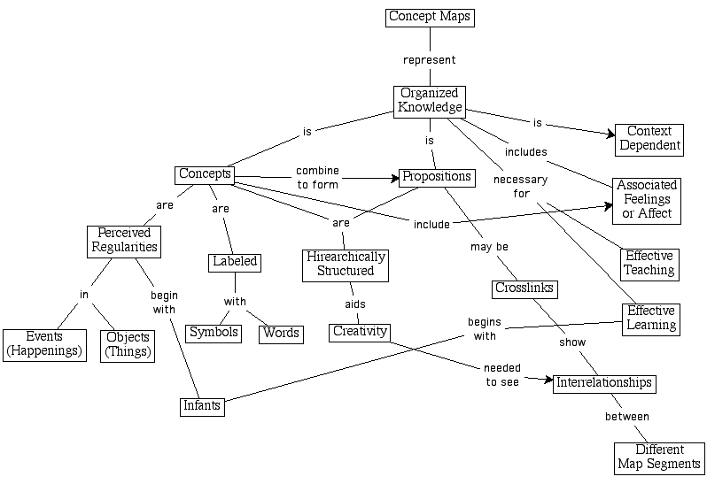
introduction to concept maps
From: https://www.msu.edu/~luckie/ctools/

Slide 7
introduction to communication and neuroeconomics modules
Illustrations are shown in full page format in the appendix following section 5 on page 174 .

Slide 8
TABLE OF CONTENTS
01
02
03
04
05
Why?
Introduction & Basics
Decision
Quality
Tools
Introduction to Risk Management
Pages 9–33
Pages 34–66
Pages 67–109
Pages 110-115
Pages 166–173
Why this is important
Biases, uncertainty and probability
What is decision science
Successes in other fields
History
Decisions vs outcomes
Strategic vs operations
When
Traditional method
Process
Steps
+ Introduction
+ DH
Strategy table
Influence diagram/Value map
Heat map
Decision trees
Calibrating the SME
Definition
VDERM
5

Slide 9
Why?
Why this is important
Biases, uncertainty and probability
What is decision science?
Successes in other fields
01

Slide 10
Why this is important
01

Slide 11

Your obligation to propose solutions is tied to your ability to acquire commitment
Why this is important
Sound familiar?
Those closest to the problem have the best solutions. These people (YOU!) are the subject matter experts (“SME”)
As the SME and/or the leader, you will need to acquire buy in and ultimately commitment
Adhering to a structured decision process based on decision science will involve the right people at the right time to result in a quality decision
Engaging others in the process will facilitate buy-in and decision quality
Decision science knowledge is related to your obligation to propose solutions (Communication science and neuroeconomics module/section 1)
As the SME and leader, you have an obligation to propose solutions and lead your organization into the future.
section 01

Slide 12
Your ability to acquire commitment is tied to your biases and your receiver/audience biases
Why this is important
Sound familiar?
Risk perception and reality are often far apart.
We are susceptible to many psychological and social distortions. Manipulations of our perceptions is a learned skill. It is applied by marketing, politicians, lawyers and leadership.
We judge on a relative basis and find safety with the “herd” (group think).
Bias is classified differently by different experts. Some common categories are comfort zone bias, cognitive bias, motivational bias, fallacies in reasoning and group think. It is human nature to prefer doing what we already know how to do, whether or not it leads to a good decision
Communication science, neuroeconomics and behavioral economics provide principles, theories and tools to exploit/leverage, minimize or neutralize biases which will then pave the way to commitment
section 01

Slide 13
Decisions involve dealing with uncertainty. Biases influence how we feel about and deal with uncertainty
Why this is important
Uncertainty is a fact of life. Thinking clearly about uncertainties is the focus of this module. We need to think clearly about uncertainties so we can plan better, communicate better and make better decisions.
Thinking clearly about decisions requires us to use the language of probabilities to describe uncertainty.
Biases influence and impede our ability to think clearly and therefore interfere with defining probabilities and result in low quality decisions.
Decisions are an irrevocable commitment to resources. If the commitment is revocable, your work has resulted in producing an option.
section 01

Slide 14
Thinking clearly results in clear actions
Why this is important
Actions
Thoughts
Actionable thought:
Achieve clarity of thought
Achieve clarity of action in making decisions
section 01

Slide 15
Getting it wrong destroys immense value
Why this is important
There are five ways to “get it wrong”:
Missing the market
Poor execution
Bad strategy
Bad luck
Fraud
section 01

Slide 16
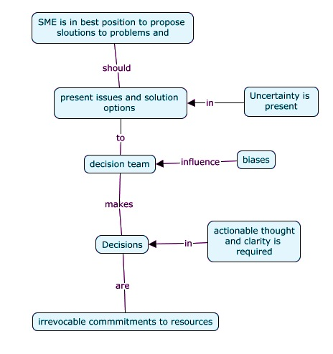
Concept Map
Why this is important
Relationships are directed downward and are represented with connecting lines, unless an arrowhead is present to show differently.
section 01

Slide 17
Biases, uncertainty and probability
01

Slide 18
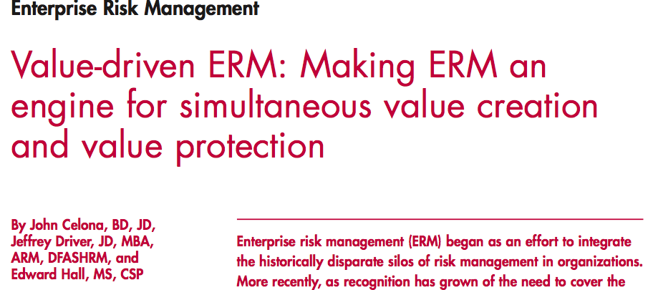
Biases influence how we manage uncertainty
Biases, uncertainty and probability
See
for an excellent, in-depth explanation
You are in a unique role where you are either one or both: the SME and/or the facilitator leading a group to make a decision.
In either role, you will have to demonstrate to your audience that you have a method that neutralizes or minimizes bias when you are discussing uncertainty (1) as it relates to your fact gathering to analyze the issue or problem and (2) as it relates to your solution proposal.
One way to do this is to use probabilities to describe uncertainty. Probability language defines intuitive concepts of uncertainty.
You will have to describe and communicate about uncertainty and understand how to facilitate decision-making under uncertainty.
This brings us full circle back to why we need to understand and manage bias.
You (as the SME or facilitator) need to manage bias when discussing uncertainty
Probability language can be used to describe uncertainty
SME are asked to define probabilities
SME are influenced by uncertainty
section 01
Notes:
David, please link the article to the reference section in the appendix for an accurate citation.

Slide 19
Eliminating ambiguity in uncertainty
Biases, uncertainty and probability
You (as the SME or facilitator) need to manage bias when discussing uncertainty
Probability language can be used to describe uncertainty
SME are asked to define probabilities
SME are influenced by uncertainty
Uncertainty is often managed using likert scale labels to describe “likelihood”. Examples of these labels could include “certain”, “almost certain”, “likely”, “probable”, “unlikely” and “almost never”.
What is the difference between “likely” and “probable”?
Likert scale labels are also used to describe “impact”. Examples of impact labels are “minimal”, “moderate”, “major” and “severe”.
These labels are subjective and are compounded by individual bias when assessing both likelihood and impact.
For example, SME “A” may describe the likelihood of an event as “likely” and believe there is 80% chance of occurrence and SME “B” may may describe it as “probable” and believe there is a 90% chance of occurrence.
The solution to this word ambiguity is to use unambiguous numbers. SMEs can describe probabilities in terms of percentages. This is known as a subjective probability.
Uncertainty is often defined by using words to define levels of likelihood and impact. For example, a SME may say it is likely that an event may occur and if this event occurs, the impact will be major.
section 01

Slide 20
Eliminating ambiguity in uncertainty by using subjective probabilities
Biases, uncertainty and probability
In academia, research and best practices, we are used to dealing with statistical probabilities. So when an SME provides an opinion reflected as an unambiguous number, we want to verify the number. We ask questions like, “how do you know this number is correct?”
The answer is that a subjective probability is correct when it correctly reflects the deliberate, thoughtful and considered opinion of the person it comes from.
“Probability” can refer to two different “types” of numbers:
Statistical probabilities: calculated using statistical analysis of data
Subjective probabilities (Bayesian): calculated using opinions of an SME(s) related to the likelihood of an event.
SMEs may use statistical probabilities to inform their subjective probabilities when it makes sense to use statistical probabilities. So the question arises, why not just use statistical data analysis? The answer is that statistical data analysis is only appropriate when you are dealing with a stable system and have a statistically significant and representative data set.
Most risks that you will be encountering in your quality proposal will not occur in a stable system and may be intangible. Other risks will be tangible, but uncertain. For example, you will be defining and describing economic situations, triangulating market forces, defining project budgets and schedules, competitor behavior, patient/customer/client behavior etc. There may not be historical data to analyze for these types of uncertainties. And if there is historical data it may not be enough to result in a statistically relevant data set.
section 01

Slide 21
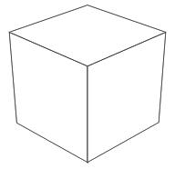
Eliminating ambiguity in uncertainty
Biases, uncertainty and probability
You (as the SME or facilitator) need to manage bias when discussing uncertainty
Probability language can be used to describe uncertainty
SME are asked to define probabilities
SME are influenced by uncertainty
Most people trained in statistical methods have a difficult time accepting subjective probabilities. In large part this is because there is no validity test.
But the decisions we are making when we are managing risk to mitigate exposures or leveraging risk to create value are not disposed to statistical analysis. You either do something and get N = 1 or do not do anything and get N = 0.
Decision consulting groups have learned that well done subjective probabilities result in solid analysis and logical, sound and supported options for complex and uncertain issues. Later in this module we will be examining complexity and you will see how decision analysis is linked to three types of complexity: organizational, content and analytical complexity.
Decision analysis using subjective probabilities has been used in the medical/finance/quality outcomes area, as well as in pharmaceuticals, energy, aeronautics industries.
Thre
3 meta-dimensions of complexity
Organizational
Content
Analytical
section 01

Slide 22
Eliminating ambiguity in uncertainty by using subjective probabilities
Biases, uncertainty and probability
.
You (as the SME or facilitator) need to manage bias when discussing uncertainty
Probability language can be used to describe uncertainty
SME are asked to define probabilities
SME are influenced by uncertainty
People do not have natural or intuitive methods of dealing with uncertainty. The areas of cognitive psychology, behavioral psychology, neuroeconomics and behavioral economics have all examined the process of of how people think about uncertainty. Their research demonstrates that we are not able to naturally or intuitively think clearly about uncertainty. Therefore, as a SME you are susceptible to not being able to think clearly about uncertainties. Likewise, as a facilitator, you will have to build in a process to deal with this unclear thinking. This is called “encoding probability”
There have been over 200 biases identified. The communication science and neuroeconomics module examined bias using the two categories of cognitive and motivational biases.
Motivational biases arise when the encoded probabilities do not reflect the expert’s conscious believes. The bias arises because of a perception of a reward or negative consequence.
Cognitive biases arise when you engage a heuristic to simplify an issue. It is an unconscious error in thinking.
Daniel Kahneman won a Nobel prize in 2002 for his work on the psychology of judgment and decision making. His work defined a cognitive basis for common errors that result from biases and heuristics
section 01

Slide 23
Eliminating ambiguity in uncertainty by using subjective probabilities
Biases, uncertainty and probability
.
Other categories are perceptions, reasoning (related to cognitive), habits and personalities and group dynamics.
Some common biases are:
Availability bias: recalling occurrences or events or similar events will result in a judgment that there is a higher probability that the event will occur.
Counteract this bias by understanding if there are reasons that the recalled information is more readily available.
Adjustment and anchoring bias: the SME provides an initial estimate and then adjusts the estimate according to variables. This adjusted estimate is usually anchored around the initial estimate and reflects the SME’s perception of their estimate’s certainty.
Counteract this bias by discussing extreme outcomes and ask the expert for explanatory scenarios. You will be looking for ways that does not commit the expert
Representative bias: when looking at evidence and assigning a high probability to an event (like a diagnosis) that supports the evidence. Stereotyping is an example of representative bias.
Counteract this bias by separating prior or general information from new evidence
You (as the SME or facilitator) need to manage bias when discussing uncertainty
Probability language can be used to describe uncertainty
SME are asked to define probabilities
SME are influenced by uncertainty
Another way to neutralize or minimize bias is to ask the expert to think about an extreme outcome and then provide scenarios that would lead to this outcome. This technique forces the expert to deliberately and thoughtfully think about “not readily available” information
section 01

Slide 24
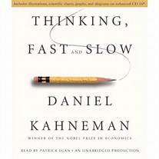
Eliminating ambiguity in uncertainty by using subjective probabilities
Biases, uncertainty and probability
.
You (as the SME or facilitator) need to manage bias when discussing uncertainty
Probability language can be used to describe uncertainty
SME are asked to define probabilities
SME are influenced by uncertainty
In 1974 Daniel Kahneman and Amos Tversky wrote a seminal paper on biases and heuristics and uncertainty, “Judgment under uncertainty: Heuristics and biases”. Since that time, much work has been done in this area and in 2011, Kahneman wrote a book that became very popular, “Thinking fast and slow” . This book centers around why we cannot trust our intuition when we make decisions involving uncertainties.
His book won the National Academy of Sciences Best Book Award and the Los Angeles Times Book Prize and was selected by The New York Times Book Review as one of the ten best books of 2011.
Kahneman’s introduction in his book discusses his relationship with Amos Tversky and how they became interested in this area of study. Together they learned that reliance on a heuristic produces predictable bias in judgments.
section 01

Slide 25


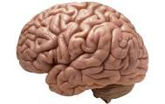
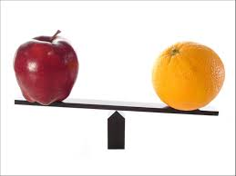

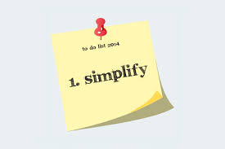
Biases, uncertainty and probability (from communication science and neuroeconomics eBook)
Association
Protection of mindset
“Marian” (Representativeness)
“Blizzard” (Mental accounting)
“Kite” (Theory of mind)
Relative comparison
Social influence
“MPG” (Framing)
“Redwood tree” (Anchoring)
Simplification
Habits and personalities
Knowledge
Desire
Skills
“Bat and ball” (Over-simplifying)
Habits
section 01

Slide 26

Eliminating ambiguity in uncertainty by using subjective probabilities
Biases, uncertainty and probability
.
You (as the SME or facilitator) need to manage bias when discussing uncertainty
Probability language can be used to describe uncertainty
SME are asked to define probabilities
SME are influenced by uncertainty
So now we have made a full circle and are back to “You as the SME or as the facilitator need to manage bias”. The process of managing bias with an expert is called “encoding probability”.
There are two initial issues in encoding:
Choosing the SME who will provide the probability distribution. The questions related to this issue include:
Does the SME have adequate state of relevant knowledge
Are sufficient and correct experience/data available
Can the SME assimilate this experience/data
Basically, these are the types of questions that we all have when we consider opinions or judgments of “experts” We ask ourselves and others: , “who do I/you believe” or “who do I/you rely on”
Does the encoded probability distribution represent the state of knowledge of the SME?
Biases influence this question
If the probability distribution is carelessly encoded then the result will be an inadequate representation of the SME’s state of knowledge
.
Recommended if you are serious about learning DA: http://smartorg.com/wp-content/uploads/2011/08/Decision-Analysis-for-the-Professional.pdf
section 01

Slide 27
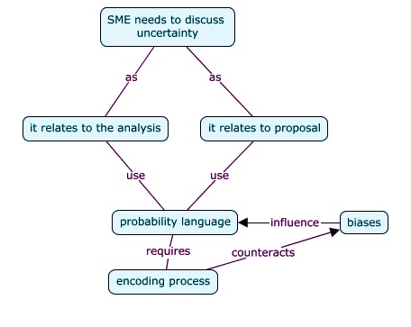
Concept map
Biases, uncertainty and probability
Relationships are directed downward and are represented with connecting lines, unless an arrowhead is present to show differently.
section 01

Slide 28
What is decision science?
01

Slide 29

What is decision science?
For more in-depth information, sign up for:
DQ 101: Introduction to Decision Quality
Oct. 9 - Nov. 15, 2014 Free five-week online course featuring Dr. Carl Spetzler's lectures and cases.
Read More / Register » http://www.sdg.com
Decision science comprises a large body of theoretical and applied work that deals with making decisions under a state of uncertainty.
It addresses decisions where tradeoffs have to be made between uncertain costs, uncertain benefits and other risks.
The methodology of decision analysis provides the means to capture systemic, correlated and value creation risk and value protection risks.
My first exposure to decision science was in a a two year strategic decision making and risk management program at Stanford University. This program is jointly administered by the Stanford University Engineering and Leadership program and by the Stanford Strategic Decision Group.
I have since been applying decision science concepts and using DA tools in my consulting projects.
section 01

Slide 30

What is decision science?
Decision science provides structure and guidance for systematic thinking about questions and issues involving uncertainty, risk, different perspectives, and competing objectives. Managing all of these variables is beyond our human capacity which makes analyzing these variables impossible. Decision science is based on logical principles and is informed by the research on biases and heuristics relating to the limitations of human judgment in decision making.
The Department of Health Policy and Management at Harvard School of Public Health explains: “We make decisions everyday, usually without much thought about how we make them. An intuitive, personal approach works fairly well when we’re deciding whether we’re going to have eggs or cereal for breakfast, but we may very well overlook important considerations and possibilities when it comes to more complex decisions.
This is particularly true of the complex decisions often required of policy makers, questions such as how to determine the best prevention and treatment policy for HIV-infected individuals in the United States or sub-Saharan Africa, or the best use of drugs or technologies to prevent or treat heart disease in the United States or India. How can a health-care payer decide which of the expensive but effective cancer therapies available should be offered to patients if funds are finite?”
section 01

Slide 31
What is decision science?
“ What is the best global policy to control tuberculosis, taking into account the interests of individual patients and the larger community, and considering costs of treatment, risks of multi-drug resistance, and short-term and long-term outcomes? Should drugs be stockpiled in preparation for a possible influenza pandemic, and what early warning signs should trigger precautionary measures, such as school closings or quarantines? What is the best policy of water disinfection, recognizing the benefits of reducing the incidence of waterborne diseases, the risks of exposure to heavy metals, and economic costs of chlorination and demineralization?
For these kinds of questions—high-impact questions that involve uncertainty, risk, several possible perspectives, and multiple competing objectives—we may try using rules of thumb or panels of experts, but even these approaches can easily bypass optimal choices. Merely keeping all the variables in mind is beyond human capacity; analyzing them effectively is even more unmanageable.”
section 01

Slide 32
Successes in other fields
01

Slide 33

Decision science is routinely used in the oil and gas industry aerospace industry, and the banking and finance industry
Successes in other fields
Sound familiar?
Example: Chevron
Chevron characterizes their use of decision quality by saying “Chevron has DQ in their DNA”
Chevron employs 400 decision professional
They apply DQ to all decisions exceeding $100M in capital expenditures
Chevron invest over $20B/year
Chevron has been applying DQ “fully” for 14 years.
They started with DQ in 1990 and “flipped the switch” in 2000 to apply DQ to all areas of the business
section 01

Slide 34
Introduction & Basics
History
Decisions vs outcomes
Strategic vs operations
When
Decision making methods
02

Slide 35
History
02

Slide 36
Origins of decision science
History
For more information on the origins of decision science and decision analysis See:
http://psychweb.psy.umt.edu/denis/datadecision/front/smith.pdf
Decision science evolved as a discipline, method and approach to manage decision making in complex situations that involve uncertainty, risk and conflicting values. Its roots can be traced to the early 1700’s as Bernoulli and Bayes (1763) developed their Expected Utility hypothesis.
Bernoulli was interested in examining why people do not follow the expected value model when gambling, like when they purchase insurance. Bayes was interested in probabilities.
Behavioral economics, game theory and decision science all use the Expected Utility hypothesis.
Decision science remained an academic pursuit until a WWII when systems analysis and operational research began to develop. Decision analysis grew out of this.
Bernoulli’s hypothesis states that if certain axioms are satisfied, the subjective value associated with a gamble by a person is the statistical expectation of that person’s valuations of the outcomes of that gamble
section 02

Slide 37
Origins of decision science
History
Decision science grew out of a combination of descriptive and normative disciplines. This combination results in a an “understanding”. For example:
Economics
Decision analysis (DA) is the application of decision science to real-world problems through the use of systems analysis and operations research.
DA is referred to as a normative discipline, meaning that it describes how people should logically make decisions. This is different from the prescriptive perspective which describes how people should make decisions to get more of what they want
Descriptive: social science
Normative: math
DA functions at four levels:
As a philosophy
As a decision framework
As a decision making process
As a decision making methodology
section 02

Slide 38
Origins of decision science
History
Decision science is comprised of four fields of study which use prescriptive and descriptive norms. Decision science is used by both the singular and the multiparty decision makers:
Systems engineering
Game theory
Organizational behavior
Cognitive science
Prescriptive
(describes how you
should make a decision)
Singular
Decision
maker
Normative
Multiparty
decision
maker
Descriptive
(describes how
people make decisions)
section 02

Slide 39
Origins of decision science
History
Decision science is comprised of four fields of study which use prescriptive and descriptive norms:
What do the four circles bring to the decision table?
Systems engineering : How to get the right answer
Game theory: Negotiating and multiparty decision making
Organizational behavior: What will people do in groups?
Cognitive science: How we get “stuck”, includes bias, distortion of judgments, heuristics
section 02

Slide 40
Relationships in decision science
History
DA- Art & Science & Business:
Science, Best Practices, Business /Budget Tools
Prescriptive Decision Science
How people should make decisions to get more of what they want
Behavioral Decision Science
How people naturally make decisions
Neuroscience
How the mind works
Communication Models
adversary, collaborative
Influence
Biases
section 02

Slide 41
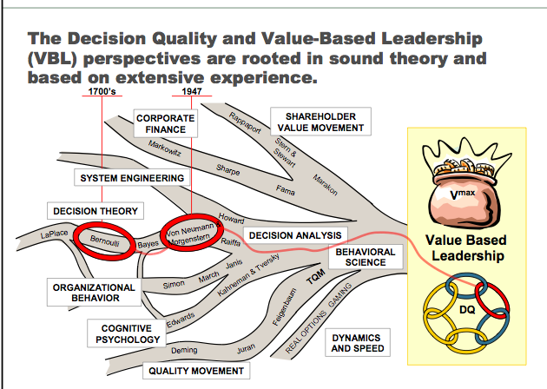
Integration of disciplines in decision analysis
History
6-step DQ process
1. Appropriate Frame
2. Creative, Doable Alternatives
3. Meaningful, Reliable Information
4. Clear Values and Trade Offs
5. Logically Correct Reasoning
6. Commitment to Action
Adapted from Celona, Driver, Hall article referred to herein
section 02

Slide 42
Decisions vs outcomes
02

Slide 43


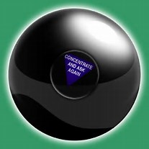
What does this mean?
Decision vs outcomes
It is critical to judge the decision separate from the outcome.
The quality of the decision does not have anything to do with the outcome.
But … people do not normally think this way. They evaluate their decisions based on the outcome. Biases are in play here – people rationalize and use hindsight to explain the outcome.
Quality of Decision
Bad Good
section 02
Notes:
From bing.com images

Slide 44
Decisions are different from outcomes
Decision vs outcomes
We desire good outcomes and good decisions are what we can do to maximize the likelihood of good outcomes.
This is easy when there is an individual decision maker and a non-complex problem. But in a multi-decision-maker environment, it is difficult to determine when the organization is “decision-ready”.
Being decision-ready requires agreement on quality of alternatives, information and values. You must be able to answer:
”Are we all addressing the same problem?” and
“Can we engage the organization to act?”
It is human nature to prefer doing what already know how to do, whether or not it leads to a good decision.
In contrast, good decision-making processes help us to first identify what is most important about the decision and its outcome, and then to address those particular issues- even if doing so forces us out our comfort zone.
Quality of Decision
Bad Good
section 02
Notes:
From bing.com images

Slide 45
4 variations
Decision vs outcomes
The decision has quality at the time it is made. There are four variations of decisions and outcomes:
Good decision and good outcome
Good decision and bad outcome
Bad decision and good outcome
Bad decision and bad outcome
 | Quality of outcome Bad Good
 | Good decision Bad outcome | Good decision Good outcome
 | Bad decision Bad outcome | Bad decision Good outcome
Quality of Decision
Bad Good
section 02

Slide 46
Decisions are not equal to outcomes
Decision vs outcomes
 | Quality of outcome Bad Good
 | Driving sober and getting into an accidtropt | Driving sober and arriving safely
 | Driving drunk and getting into an accident | Driving drunk and arriving safely
Quality of Decision
Good
Bad
Is this “dumb luck?”
section 02

Slide 47
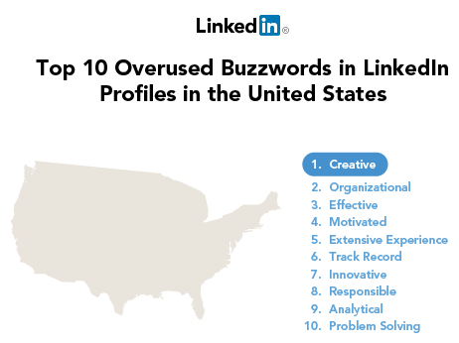
Is this counterintuitive?
Decision vs outcomes
This may seem counterintuitive and may not “sit” well with you. We live in a results- based world. We are action-oriented. We measure outcomes. We even have a “saying” that demonstrates our negative feelings towards analysis, “analysis leads to paralysis”.
LinkedIn performs an annual analysis of overused buzzwords and in 2012, “Track record” came in at #6. Track records are results.
All businesses require decision making under uncertainty. Everyday, management and non-management make “investment decisions” related to resources, people and time.
Quality of Decision
Bad Good
section 02

Slide 48
Is this counterintuitive?
Decision vs outcomes
Examples of these types of “investment decisions” include questions like:
What segment of the market should be targeted first?
What benefits do clients/customers/patients value more? (And therefore what products or services do we provide?)
A decision making process can be used to estimate market sizes and select segments that offer the highest probability of success. Statistical models can be built to determine customer value distribution.
And … there will be much uncertainty in results.
External elements may negatively influence market size. Examples of this are mergers & acquisitions, people and businesses relocating because of tax rates, etc.
Customers may reject the main value proposition
Sound familiar?
Remember the external forces from the “Creating urgency” section of the Communication Science and Neuroeconomics eBook? Refer back to pages 65-69 to review these three forces
Quality of Decision
Bad Good
section 02

Slide 49
Is this counterintuitive?
Decision vs outcomes
Using the words “Hail Mary” to describe a football play started with Notre Dame in the early 1920’s when they played Georgia Tech and allegedly prayed a “Hail Mary” before scoring each touchdown.
This morphed into the present day usage of the phrase “Hail Mary” which now means to throw a last second desperation pass. This description became popular in 1975 when Roger Staubach (a Roman Catholic) said that he closed his eyes and said a Hail Mary before throwing his game-winning touchdown pass to his wide receiver, Drew Pearson.
When you judge a person or a decision only on the basis of the results, you fail to understand if the person was capable of delivering similar results in the future, especially if conditions changed.
A person’s results do not tell the full story and they do not necessarily tell the wrong story. Their decision making process tells the real story.
It is the quality and repeatability of the decision making process that matters more than the results.
Think about this way … a quarterback is having a bad season because of poor decisions. In a crucial game, he makes a “Hail Mary pass” and a touchdown is scored. Should he be judged by the quality of poor decisions throughout the season or should he be judged by the successful Hail Mary?
In the end, it is the quality and repeatability of the decision making process that matters more than the results.
Quality of Decision
Bad Good
section 02

Slide 50

Is this counterintuitive?/ One more analogy
Decision vs outcomes
Poker theorist David Sklansky wrote:
”You should consider yourself a winner as long as you had the higher probability of winning the hand when all the money went into the pot.
This attitude is consistent with the underlying mathematical reality of poker, and it can smooth out your emotional reactions to losses and wins.
What matters is the quality of your decisions, not the results that come from them.”
See the WSJ article: “The science of winning poker”, 7/26/2013:
http://online.wsj.com/news/articles/SB10001424127887323610704578625812355516182
Quality of Decision
Bad Good
section 02

Slide 51
So what does this mean?
Decision vs outcomes
Decisions are different from outcomes.
A structured decision process is different from natural decision behaviors.
Natural decision behaviors may undermine your preparation efforts and result in a “trap”
This trap is where biases are “in-play”. You will have to expect biases and prepare for biases. What you have learned in communication science and neuroeconomics will assist you when you prepare for a presentation. You will also need to learn how to counteract biases.
Remember some of the broad groups of biases: cognitive, motivational, protection of mindset, comfort zone, habits and personalities, fallacies in reasoning and groupthink
Group dynamics that are often present in groupthink include:
Premature harmony
Conformity
Anonymity
Attention to shared evidence
Psychological safety
Obedience
These dynamics will be addressed in depth when we discuss communication and decision making with generational cohorts in Nu 832
Quality of Decision
Bad Good
section 02

Slide 52

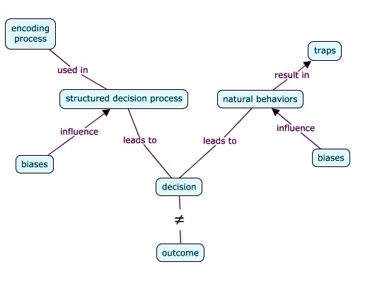
Concept map
Decision vs outcomes
Relationships are directed downward and are represented with connecting lines, unless an arrowhead is present to show differently.
section 02

Slide 53
Strategic vs operations
02

Slide 54


Strategic and operational functions & decisions require fundamentally different tasks
Strategic vs operations
Managing strategic decisions Managing operations
Choosing the right road Running well on the chosen road
“Doing stuff right” “Doing the right stuff”
Quality of Decision
Bad Good
Is your proposal strategic or operational?
section 02

Slide 55
Strategic and operational functions & decisions require fundamentally different tasks
Strategic vs operations
Managing strategic decisions “Decision focused” | Managing operational functions and decisions “Results focused”
Focused on critical issues | Attends to detail and follow-through
Considers long term horizons | Concentrates on short term performance
Accounts for uncertainty | Ignores uncertainties (“Let’s adjust as we go”)
Choose among significantly different alternatives | Avoids new alternatives (“Lets get going” “lets keep going”)
Quality of Decision
Bad Good
section 02

Slide 56
The quality of strategic and operational decisions can determine the organization’s success or failure
Strategic vs operations
 |  | Quality of operational decisions
 |  | Good | Bad
Quality of strategic decisions | Good | Likely success | Likely failure
 | Bad | Hit or miss (you and the organization do not grow and do not learn)
Is your proposal strategic or operational?
Quality of Decision
Bad Good
section 02

Slide 57
When
02

Slide 58
Decision professionals assess the level of complexity to determine the appropriate decision making method and tools
When?
Three meta-dimensions are assessed:
Organizational complexity
Analytical complexity
Content difficulty or complexity
Complexity assessment enables decision competency which paves the way for decision participants to address the true nature of the problem or issue with the appropriate skills, processes and tools.
Decision competency involves the right people contributing in ways that will most help the organization achieve clarity, alignment and commitment to action.
section 02

Slide 59
Decision professionals assess the level of complexity to determine the appropriate decision making method and tools
When?
Organizational complexity
This includes:
All psycho-social aspects of a decision situation that might arise if various parties are in conflict due to individual and organizational differences. This Includes differences in:
values, desires, and motivation
initial convictions and fundamentally different frames
personalities and competencies
degrees of power and resource availability.
cognitive and motivational biases
group dynamics.
Decisions with a high degree of organizational complexity require extra attention to reducing biases and the use of facilitative approaches for achieving organizational alignment and commitment.
section 02

Slide 60
Decision professionals assess the level of complexity to determine the appropriate decision making method and tools
When?
Analytical complexity
This dimension includes all aspects that make the decision technically difficult to specify and solve.
This includes:
High uncertainty
Decision dynamics (downstream decisions, learning opportunities and competitor reactions)
Many variables that may be closely interrelated and interdependent
Multitude of decision alternatives and multiple decision criteria
section 02

Slide 61
Decision professionals tailor the decision process to the problem’s characteristics to determine the appropriate decision making, method and tools
When?
High
Strategic
DDP (discussed in DQ, section 03)
DA tools (discussed in Tools section 04)
Significant
Facilitation
Checklists &
stratification/
weighted scores
Quick
Common-
sense
None
Low High
Organizational Complexity
Many parties in conflict
Biases
Individual and organizational
differences with:
Values, desires, motives
Initial convictions
Fundamental different frames
Personalities & competencies
Degrees of power
Key:
Blue = type of decision
Red = decision process
Green = decision tool
Analytical Complexity
Uncertainty
Many interrelated, interdependent variables
Many alternatives
Many interrelated decision criteria
Multiple players in competitions
section 02

Slide 62
Decision making methods
02

Slide 63
Decision methods
Decision making methods
Method | Tool
Expert intuition | Gut feeling
Expert audit | Comprehensive check list
Simple stratification | Low, medium, high rating
Weighted scores | Risk indicators x weight=risk score
Traditional analysis | Best, expected and worst case scenarios for cost and benefits of various decisions
DQ Process | DA tools
section 02

Slide 64
Traditional method
02

Slide 65
Advocacy and approval method
Traditional method
This is the typical consultant experience. Consultants are asked to analyze an issue and propose/implement a solution.
The problem with this approach is that the consultant does not have any knowledge of the organizational culture and therefore the solution that is most often recommended is a “one size fits all” solution.
This is a main reason why many consultants’ solutions fail and why many employees have consultant or change fatigue
In this traditional approach, executives and managers with strategic decision-making responsibility refer problems to a specific department, another group, a decision support team, a task force or a consultant.
These teams are charged with researching and analyzing the problem and recommending a solution to the decision makers.
If the decision makers question any part of the solution or support/rationale being presented, then the team will address those questions.
This decision process effectively omits communication between decision makers and the decision support team during the critical phase of identifying, researching and evaluating potential solutions. This means that the decision makers were excluded from the process.
section 02

Slide 66

Result of excluding decision makers
Traditional method
Prior to making recommendations, decision makers are usually unaware of the alternatives and variations developed and evaluated by the support teams. This results in losing whatever potential value such concepts held.
There is little opportunity for decision-makers to provide guidance to the support team’s efforts or to otherwise contribute once they referred a problem to a team.
Support teams risk proposing flawed solutions or solutions that were unacceptable for some other reason that the decision-maker could have identified for them early in the process.
Moreover, support teams are destined to repeat the cycle when decision-makers rejected a proposed solution.
section 02

Slide 67
Decision quality
Process
Steps
03

Slide 68
Process
03

Slide 69
Process
A structured decision process allows for
including the right people at the right time for decision quality
Advocacy vs collaboration will be a theme you will observe throughout all of the modules. You are already familiar with collaboration concepts/application:
Edward de Bono Six Thinking Hats
Collaborative negotiation: Separating interests from positions
A structured process for making decisions is required to achieve success where there is high organizational and high analytical complexity. The structured process elements include:
A group process where decision makers have roles
All people having a stake in the decisions should be represented
The group should include a skilled person in analysis
Formal communication structures should be developed to communicate within the group and throughout the organization
Project management methods should be used which include defining deliverables and milestones
The purposed of this structure is to encourage collaboration rather than advocacy.
section 03

Slide 70
Process
A structured decision process: How is this different?
Management commissions a team to work on a problem
The team analyzes the situation, creates a solution and presents to management
Management accepts or rejects
Many organizational decisions are made using a team structure. Silo teams (intradepartmental) teams usually tackle issues that are not high in organizational or analytical complexity.
When issues are high in organizational or analytical complexity teams are often cross-functional or cross-organizational in a deliberate effort to combine varied expertise. This is referred to as an interdepartmental team.
This team develops a solution that solves the problem. The solution is then presented to a management team for approval.
A significant flaw with this team based approach is that there is not enough formal communication and the process and type of communication is structured from a traditional advocacy and approval paradigm.
Traditional method: Advocacy and approval
section 03

Slide 71

Process
A structured decision process: How is this different?
Traditional method: Advocacy and Approval
What is really happening in this “paradigm”?
The team wants to get the answer right the first time. There are many biases “in-play” here, including motivational bias, mental accounting and social influence.
Other flaws in this method are:
The team may be working on the wrong problem because they did not understand the problem frame
Alternatives may not have been examined because they may have been controversial or because of individual biases or or group think or other group dynamics
This process encourages advocacy rather than collaboration. The team does not want management to disapprove of them, their effort or their deliverable. The team does not want management to discuss the cost of their effort if their effort will be rejected and send them back to the drawing table. This is known as “sunk costs” and will be discussed in the financial management module
This process encourages developing conventional and noncontroversial solutions and hides any problems with the solution.
The decision makers do not have an opportunity to use their collective wisdom and experience to collaborate in creating a solution
“SUNK COSTS”
section 03

Slide 72
Process
A structured decision process: How is this different?
Refer back to our first class where we discussed DNP Essential VI: Interprofessional collaboration for improving patient and population health outcomes:
The DNP Program prepares the graduate to
Employ effective communication and collaborative skills in the development and implementation of practice models, peer review, practice guidelines, health policy, standards of care, and/or other scholarly products.
Lead interprofessional teams in the analysis of complex practice and organizational issues.
Employ consultative and leadership skills with intraprofessional and interprofessional teams to create change in health care and complex healthcare delivery systems.
A more descriptive way to define the structure presented here is to refer to it as an “interprofessional” team.
An interprofessional team is broader than an interdisciplinary team. It refers to a collaboration with individual professionals representing a particular discipline and who bring their unique educational backgrounds, experiences, values and roles. This results in an increasing theory of mind which is discussed in the Communication Science and Neuroeconomics eBook.
One process that has been developed to bring the power of decision analysis to team-based decision making is called “Dialogue Decision Process” (“DDP”).
section 03

Slide 73
Process
A structured decision process: DDP
The name DDP refers to the emphasis on systematic dialogue between two groups:
The team that makes the decision (“Decision Makers (“DM”)). The DM team can be a singular team (one person or one entity, like a board or a senior management team), or it can be a multi-party entity (like a task force from different departments or organizations).
The team that develops the basis for the decision (Project Team (“PT”))
This process evolved from the integration of strategic planning and decision analysis and was first used at Stanford Research International (SRI) and adopted and refined as Stanford Decision Group (SDG) in the late 1970’s. The process was named “DDP” at GM in the late 1980’s and was adopted as GMs decision making process. Since that time, many industries have adopted this process and use it when there are issues that have both high organizational and high analytical complexity.
The DDP has four dialogues in response to four questions:
Framing: do we all see the same problem and see it I the same way?
Alternatives: have we identified a good and varied set of alternatives to choose from
Analysis: What have learned about the alternatives
Decision: what do we choose to do?
section 03

Slide 74
Process
A structured decision process: DDP
)
section 03

Slide 75
Process
A structured decision process: DDP
-Purpose
-Perspective
-Scope
-Alternatives
-Information
-Values
-Risks
-Returns
-Insight
-Transition agenda
section 03

Slide 76


Process
A structured decision process: DDP
The decision team is comprised of the people who allocate the resources and who represent those who have a stake in the decision. They have broad experiences and little time.
The project team is comprised of SME and who have or represent those who have stakes in implementing the decisions.
Framing refers to a deliberate effort to make sure that the right people are treating the right problem from the right perspective. There are three elements to framing a problem:
Purpose: a clear purpose has to be established before the team begins work
Scope: establish boundaries of the problem, dimensions of the solution, sources of information and criterion to be used in selection/acceptance
Perspective: this element refers to how individuals manage large quantities of information. It can be understood using two analogies. We can think of a filter to discard irrelevant information and contain relevant information or we can think of a picture frame which is placed around a problem and represents a boundary between irrelevant and relevant information
section 03

Slide 77
Process
A structured decision process: DDP
More on framing
Framing takes a great deal of time. Imagine the differences in framing between a nurse or physician who wants to provide the best care for a patient and the person from the central billing office who wants to reduce non-reimbursable expenses.
What about when you introduce a person from marketing who wants the healthcare providers to use prepared customer service scripts so that patients receive a luxury hotel experience.
Add the person from the financial office who is focused on the interplay of variable cost and patient volume with the goal of reducing expenses, eliminating waste and increasing revenue.
Now introduce the risk manager who is looking for ways to reduce exposures and protect the organization.
section 03

Slide 78
Process
A structured decision process: DDP
More on framing
When a cross-functional, multidisciplinary problem arises, the frame must be enlarged and shared amongst the team members. It is impossible to think strategically or to commit to implementation unless everyone in the group shares the same frame.
Framing success is critical for decision quality. To achieve successful framing, the team will have to:
Develop a shared understanding of the problem, opportunity and challenges
Develop a platform that results in awareness of the different perspectives of each member
Surface unstated assumptions that could affect the project
Explicitly formulate and communicate the problem to be solved
section 03

Slide 79
Process
A structured decision process:
Other methods
Your organization may already have an approved method for teamwork and may not want to expend any time or energy in developing a DDP format and approach.
This does not need to stop you from following the approach. You can integrate the DDP process with your method. Here is an example:
I consulted in an organization that utilized a format called “ARCIE”
Approval: Person with ultimate responsibility for approving a decision
Recommenders: Persons who ultimately makes the recommendation to the approver
Consultants: Persons with detailed knowledge important in making an informed and fact based decision. Not responsible for making a direct recommendation
Informed: key stakeholders who must know about the decision. Does not need to be involved in decision making process, only need to be informed afterward
Execute: Single person accountable for implementing the decision. Ideally should be a person who recommends or a member of the recommending committee.
This ARCIE method excluded many significant elements from the DDP process and had one critical flaw. I discussed this with their senior management and they requested that I use their ARCIE. I did, but I “ran DDP in the background”. It is possible to do both.
Question:
What do you think about the “Informed” category in ARCIE?
What may be missing?
section 03

Slide 80
Process
A structured decision process:
Creating organizational congruence
A significant “by-product” of using a structured decision process is organizational congruence.
Organizational congruence is the state where decision competency is self-reinforcing.
In congruent organizations, leaders raise and address conflicts and issues having organizational and analytical complexity. They do this with the intent to solve the issue and create the most value.
In any system, congruence requires alignment of many moving parts.
To achieve a high-performance state of organizational decision competency requires bringing all of the elements into position and then continuing to learn while simultaneously strengthening the weakest link in the system.
.
Congruence ≠ Harmony
section 03

Slide 81
Steps
03

Slide 82
Steps
Six steps in the decision quality (DQ) process
Appropriate frame (What am I deciding?)
Creative doable alternatives (What are my choices?)
Meaningful, reliable information (What do I know?)
Clear values and trade offs (What consequences do I care about?)
Logically correct reasoning (Am I thinking straight about this?)
Commitment to action (Action = follow through)
The objective is to achieve quality in each step to produce quality in the decision. You can think of these steps as 6 links in a chain. Stanford University and the SDG developed this analogy: If the chain has a weak link (meaning that it does not have quality in the step), the weakness will be transferred to the integrity of the chain and the decision will suffer that weakness.
1. Appropriate Frame
2. Creative, Doable Alternatives
3. Meaningful, Reliable Information
4. Clear Values and Trade Offs
5. Logically Correct Reasoning
6. Commitment to Action
This is an interesting blog that rethinks the weakest link analogy: http://ehstoday.com/mag/ehs_imp_36709
section 03

Slide 83
Steps
Six steps in the decision quality (DQ) process
This is the way that I visualize this process. This graphic conveys the importance of the first step.
The first step, “Appropriate frame” is illustrated as the largest gear with the most teeth. When gears mesh they transmit rotational motion which results in transmitting torque. When two gears mesh and one gear is bigger than the other, a mechanical advantage is produced.
If you achieve quality in this first step you will have obtained an advantage and quality work can be accomplished resulting in a quality decision.
4. Clear values & trade-offs
4. Clear values & trade-offs
1. Appropriate fame
3. Meaningful reliable information
2. Creative, doable alternatives
5. Logically correct reasoning
6.
Commitment to action
section 03

Slide 84

Six steps in the decision quality (DQ) process
This graphic conveys the importance of the first step.
The first step, “Appropriate frame” is illustrated as the largest gear with the most teeth. When gears mesh they transmit rotational motion which results in transmitting torque. When two gears mesh and one gear is bigger than the other, a mechanical advantage is produced.
If you achieve quality in this first step you will have obtained an advantage and quality work can be accomplished resulting in a quality decision.
4. Clear values & trade-offs
4. Clear values & trade-offs
1. Appropriate fame
3. Meaningful reliable information
2. Creative, doable alternatives
5. Logically correct reasoning
6.
Commitment to action

Slide 85
Steps
Six steps in the decision quality (DQ) process:
Assessing the quality of each step
You will need to assess the quality of each step. The quality of the decision is not the average or the sum. It is the minimum because all six steps are necessary.
If steps 2-6 are assessed at 90-100% quality and the first step is at 50%, you may be solving the wrong problem.
You may have committed to a great solution for the wrong problem!
Assessing quality
Frame
0% 50% 100%
Alternatives
0% 50% 100%
Information
0% 50% 100%
Values
0% 50% 100%
Reasoning
0% 50% 100%
Commitment
0% 50% 100%
section 03

Slide 86
Steps
Six steps in the decision quality (DQ) process:
Each step needs to be considered from multiple parties’ perspectives.
Thinking about what the other parties are likely to do will inform what you will do
An understanding of communication science and neuroeconomics will enhance your ability to work with multiple parties’ perspectives
You will need to understand three dynamics
Collaboration
Incentive to cooperate for mutual gain, but also to gain an advantage
Non-zero sum
Coordination
Mutual incentive for win/win
Non-zero sum
Competition
Incentive to win at the expense of others
zero sum
Decisions involving singular decision makers (individuals and decision bodies) are very different than multiparty decision makers.
Game theory and negotiation strategies are tools that are often used in multiparty decisions.
Since 1994, four Nobel prizes have been awarded to game theorists.
Although we will not be discussing game theory in any depth in this eBook, you should be aware of what it is: Game theory is the science of strategic thinking. Although it is called “game theory”, it is as much a tool as it is a theory.
We will be discussing negotiation in depth in Nu 832
section 03

Slide 87
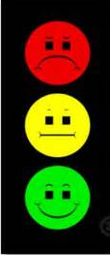
Steps
Six steps in the decision quality (DQ) process
Step 1: Framing
Elements | purpose, perspective, scope
Tools | Vision statement, statement of issues and challenges, session to surface assumptions, decision hierarchy
Judging success | Clear purpose, conscious perspective, defined scope
Failure modes | Wrong people, wrong perspective or responding to wrong question, plunging in, lack of focus, scope is too broad or narrow
Assessing quality | 0%: “Plunging in” (also called “frame blindness”) No conscious perspective Scope unstated Assumptions unstated 50%: Lists are made, but not fully structured regarding: Issues, perspectives and concerns Decision makers and project team 100%: conscious, shared perspective Clear statements of: purpose, scope and perspective Decisions to be addressed
We began the “Appropriate Frame” discussion under the “Process” section where the three main elements were identified: Purpose, scope
and perspective.
1. Appropriate fame
section 03
Notes:
link

Slide 88
Steps
Six steps in the decision quality (DQ) process
Step 1: Framing
Tools for framing to achieve shared purpose and scope
Vision statement
What are we going to do?
Why are we doing this?
How will we recognize success?
Process
DDP
ARCIE
Decision Hierarchy
1. Appropriate fame
Givens
Focus On
Decide Later
section 03
Notes:
link

Slide 89
Steps
Considering framing from a multiple party perspective
Frames are mental structures which shape the way we view ourselves and the world.
There are many type of frames. We will discuss five frames:
Power frame
Time frame
Analyst frame
Prize frame
Intrigue frame
Frames are competitive
Frames are rooted in survival instincts
Two opposing frames cannot coexist at the same time. They collide and the stronger frame will absorb the weaker frame.
Frame collisions are primal.
These dynamics will be in play during the first step of DQ when you frame the problem.
We are actually discussing two definitions of framing and these two overlap.
Sound familiar?
You will need to be aware of frame collisions
You will need to assess whether the dynamic is one of collaboration, coordination or competition
(Remember the arm wrestle exercise?)
section 03
Notes:
link

Slide 90
Steps
More on framing
Framing filters out what is irrelevant or immaterial.
Framing answers these three questions:
What is the decision
When does the decision need to be made?
Who should be involved?
1. Appropriate fame
section 03
Notes:
link

Slide 91
Steps
More on framing
Source: “The faming of decision and the psychology of choice”: http://www.uta.edu/faculty/richarme/MARK%205342/Articles/Tversky%2081.pdf
Framing the problem in two different ways influences choices and decisions.
Framing is referred to the decision-maker’s conception of acts, outcomes and contingencies associated with a particular choice.
The frame that a decision maker adopts is partially controlled by the formulation of the problem and by the decision-maker’s norms, habits and characteristics. This is the overlap of the two definitions of framing
The following demonstrates the effect of framing where inconsequential changes in the formation of choice problems caused significant shifts of preference.
1. Appropriate fame
section 03
Notes:
link

Slide 92
Steps
More on framing
Source: “The faming if decision and the psychology of choice”: http://www.uta.edu/faculty/richarme/MARK%205342/Articles/Tversky%2081.pdf
Consider Tversky’s findings in these two problems:
Problem 1: [N=152]: Imagine that the US is preparing for the outbreak of an unusual disease which is expected to kill 600 people. Two alternative programs to combat the disease have been proposed:
If Program A is adopted, 200 people will be saved [72%]
If Program B is adopted there is 1/3 probability that 600 people will be saved and 2/3 probability that no people will be saved. [28%]
The majority choice in this problem is risk averse: the prospect of certainly saving 200 lives is more attractive than a risky prospect of equal expected value, which is a one-in three chance of saving 600 lives.
1. Appropriate fame
section 03
Notes:
link

Slide 93
Steps
More on framing
Source: “The faming if decision and the psychology of choice”: http://www.uta.edu/faculty/richarme/MARK%205342/Articles/Tversky%2081.pdf
Problem 2: [N=155]: Imagine that the US is preparing for the outbreak of an unusual disease which is expected to kill 600 people. Two alternative programs to combat the disease have been proposed:
If Program C is adopted, 400 people will die [22%]
If Program D is adopted there is 1/3 probability that nobody will die and 2/3 probability that 600 people will die. [78%]
The majority choice in this problem is risk taking: the certain death of 400 people is less acceptable than the two in three chance that 600 will die.
1. Appropriate fame
section 03
Notes:
link

Slide 94
Steps
More on framing
Source: “The faming if decision and the psychology of choice”: http://www.uta.edu/faculty/richarme/MARK%205342/Articles/Tversky%2081.pdf
The preferences in both problems illustrate a common pattern: choices involving gains are often risk averse and choices involving losses are often risk taking.
These problems are effectively identical. The difference between them is that the outcomes are described in problem 1 by the number of lives saved and the outcome in problem 2 is described by the number of lives lost.
The change is accompanied by a pronounced shift from risk aversion to risk taking. The preceding groups were students at Stanford University and the University of British Columbia.
The same reversal was observed in different groups of respondents. This reversal was also observed in groups of university faculty and physicians.
1. Appropriate fame
section 03
Notes:
link

Slide 95

Steps
More on framing
Source: James Reason, 2000
 | Error | Violation
Where | Cognitive | Organization context
Why | Informational problem | Motivational problem
Prevention | Improve knowledge and information | Address motivational and organizational issues
1. Appropriate fame
section 03
Notes:
link

Slide 96
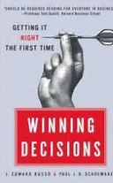
Steps
More on framing
Source:
Frames can be expanded or contracted. Frames can change viewpoints
Issue | Frame 1 | Frame 2
Buyer-seller exchange | A transaction | Part of a relationship
Client/customer/patient with a complaint | Potential litigant | Free informant
Negotiation | Competition, W/L | Joint problem solving, W/W
Competitors | A person or organization trying to take our clients | A person or organization trying to take our profits
Time | A limited finite resource; an input to productivity | Unlimited, goes on forever; a background to work and relationships
Training | Cost | Investment
Work group | Sports team | Part of a smooth running machine
Organization | Collection of contracts | Community of people
1. Appropriate fame
section 03
Notes:
link

Slide 97
Steps
Six steps in the decision quality (DQ) process
Step 2: Creative, doable alternatives
* “Only one alternative”:
This refers back to the concept of the team not wanting management to “disapprove” of them, so the project team develops one “bullet proof” solution rather than multiple alternatives that have value and can be analyzed
Elements | Creative, doable, significantly different, comprehensive, compelling
Tools | Creativity methods (brainstorming, brain swarming, 6-thinking hats), strategy table
Judging success | Creative stretch, truly doable, significantly different, comprehensive, compelling
Failure modes | Only one alternative*, delusion on what is feasible, considering “not doable” options, staying in the comfort zone
Assessing quality | 0%: “Business as usual” Only one alternative Considering non-feasible alternatives 50%: Lists are made, but not fully structured regarding: Alternatives that “span the space” No clear winner, need evaluation 100%: Hybrid alternatives New alternatives combining best features Understanding how to implement each alternative
2. Creative, doable alternatives
section 03
Notes:
link

Slide 98
Steps
Considering creative, doable alternatives from a multiple party perspective
Separate alternative generation is different from the act of bargaining or negotiating.
Leverage differences from perceptions and interests.
When we discuss negotiation strategy in Nu 832, we will discuss BATNA which is the best alternative to a negotiated agreement. BATNA is used in multiparty decision making,
2. Creative, doable alternatives
section 03
Notes:
link

Slide 99
Steps
Six steps in the decision quality (DQ) process
Step 2: Creative, doable alternatives
Tools for creating high value alternatives:
This step requires both left and right brain work (art and science)
Strategy table: (This is left brain work) A systematic method to define and create strategy
Brainstorming (right brain)
Role playing (right brain)
2. Creative, doable alternatives
section 03
Notes:
link

Slide 100
Steps
More on creative, doable alternatives
It is hard to generate alternatives in organizations that are structured for value delivery rather than value creation.
Organizations are set up for execution
Incentives favor execution
Warren Buffett views his worst investment failures as errors of “omission” rather than “commission”
2. Creative, doable alternatives
section 03
Notes:
link

Slide 101
Steps
Six steps in the decision quality (DQ) process
Step 3: Meaningful reliable information
Elements | Knowing what is important, having it correct and explicit, basing alternative solutions on appropriate facts and data, including uncertainty, know what you know and don’t know
Tools | Information research, encoding judgment, de-biasing techniques to subjective probabilities, influence diagrams, sensitivity analyses
Judging success | Assessing whether the information and data material to the decision and reflective of uncertainty
Failure modes | Focusing on what we know, ignoring uncertainty, ignoring tangibles, allowing biases to influence process, missing interdependencies
Assessing quality | 0%: “Blissful ignorance” Ignoring uncertainty Ignoring intangibles 50%: Lists are made, but not fully structured regarding: Know information gaps Know what is important Quantified uncertainty Interdependence and not explored 100%: Hybrid alternatives Important gaps filled Information explicit and correct Limits of knowledge stated Sources and rationales well documented
* Including uncertainty Refer back to section 01 “Biases, uncertainty and probability”
3. Meaningful reliable information
section 03
Notes:
link

Slide 102
Steps
Consider meaningful reliable information from a
multiple party perspective
Use fair standards as anchors.
Consider that differences are opportunities.
Trust but verify.
Understand the differences between fully open and truthful, partially open and truthful and deception. When you or someone else is being partially open and truthful, an important piece of if information is being held back. Game theory provides useful strategies to bring this information forth or to deal with the partial information.
3. Meaningful reliable information
section 03
Notes:
link

Slide 103
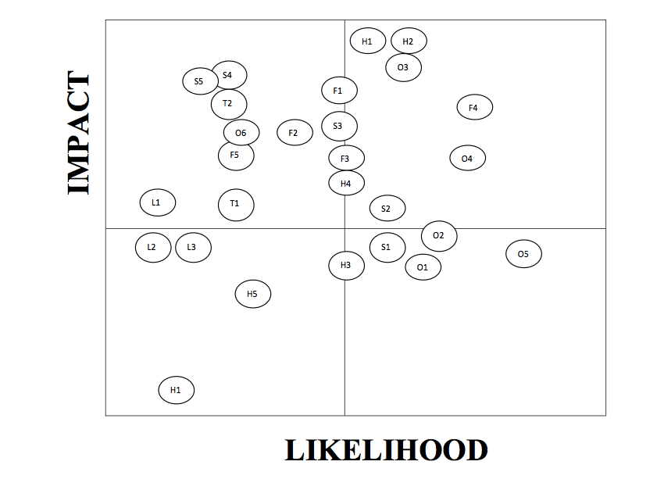
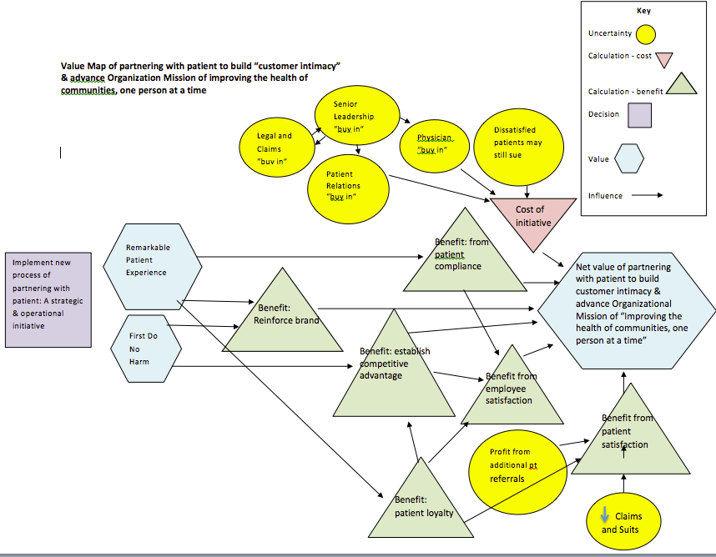
Steps
Six steps in the decision quality (DQ) process
Step 3: Meaningful reliable information
Tools for working with meaningful reliable information
Influence diagrams (sometimes referred to as value maps or relevance diagrams
Heat maps
Sensitivity tools
Tornado diagrams
Waterfall diagrams
Monte Carlo simulations
Probability distribution
De-biasing method
3. Meaningful reliable information
section 03
Notes:
link

Slide 104
Steps
Six steps in the decision quality (DQ) process
Step 4: Clear values & trade-offs
Elements | An explicit statement of “wants” in terms of decision criteria, statement of trade-offs and values among the decision criteria
Tools | Statement of: stakeholder expectations; values attributes; explicit trade-offs re long term v short term, customer v shareholders, cost v environment; distinction between direct and indirect values
Judging success | Explicit statement of decision criteria (are you trying to maximize profitability or market share?), focus on value creation
Failure modes | Neglecting a key constituency, insufficient clarity on trade-offs, ignoring intangibles, double-counting risk, lack of clarity and communication
Assessing quality | 0%: It is not clear what we want Not explicit about preference Stakeholders not identified Ignoring intangibles 50%: Clear value measures: Identified stakeholders & criteria Distinguished direct and indirect values 100%: Clear trade-offs Explicit trade-offs among criteria Cost v jobs v environment Customers v shareholders Short v long term Certain v uncertain
4. Clear values & trade-offs
4. Clear values & trade-offs
section 03
Notes:
link

Slide 105
Steps
Consider clear values and trade-offs from a
multiple party perspective
Growing the pie is different from dividing a finite pie.
Consider fairness as a value.
Separate interests from position.
Understand ends vs means ethics as values.
4. Clear values & trade-offs
4. Clear values & trade-offs
section 03
Notes:
link

Slide 106



Steps
Six steps in the decision quality (DQ) process
Step 3: Meaningful reliable information
Tools for working with meaningful reliable information
Organization mission, vision and values
Strategic and operating goals
Strategic and operating budgets
4. Clear values & trade-offs
4. Clear values & trade-offs
section 03
Notes:
link

Slide 107
Steps
Six steps in the decision quality (DQ) process
Step 5: Logically correct reasoning
Using decision analysis to evaluate what we can do in light of what we know and what we want
Elements | The logic that distills frame/alternatives/information/values into a clear choice
Tools | Modeling tools that model npv, ev and consequences of alternatives
Judging success | Sound analysis and logically correct reasoning, appropriately dealing with uncertainty, focusing on insight at the appropriate level of complexity
Failure modes | Wrong logic for the decision, models that are too cumbersome to enable sensitivity and probability analysis, ignoring dependencies, relying on instinct and intuition
Assessing quality | 0%: Extinction by instinct Intuitive evaluation by each decision maker 50%: Pilot level insights Key sources of value identified Knowing which uncertainties are most important 100%: The best choice is clear Reliable analysis of each alternative Uncertainty, dependencies and complexities accounted for Analysis is as simple as possible to be effective
5. Logically correct reasoning
section 03
Notes:
link

Slide 108
Steps
Consider logically correct reasoning from a
multiple party perspective
Game theory is very useful in this step
Skill in negotiation is as important as skill in analysis of the multi-party decision problem
5. Logically correct reasoning
section 03
Notes:
link

Slide 109
Steps
Six steps in the decision quality (DQ) process
Step 6: Commitment to action
Elements | Gaining motivation and commitment to action from necessary individuals
Tools | Involvement of key individuals during process, building organization readiness from the start, credibility of input sources
Judging success | Explicit statement of decision criteria (are you trying to maximize profitability or market share?), focus on value creation
Failure modes | Poor quality in other steps, continually reworking a decision, insufficient support, organizational infrastructure “kills it”, lack of motivation, change fatigue, management fatigue, consultant fatigue
Assessing quality | 0%: Unmotivated Lack of interest by key decision-makers Insurmountable organizational hurdles Insufficient support 50%: Active decision board Active participation by the right people Commitment to achieve decision quality Commitment to “do it right the first time” 100%: Take action Buy in from project team, decsion board and those affected by the decision
Commitment to action = Decision
Decision = irrevocable commitment of resources
6.
Commitment to action
section 03
Notes:
link

Slide 110
Steps
Contrast these six steps in the DQ process with what occurs when we use other decision methods or when we act naturally
When we act “naturally”, we | Our minds operate with
Move to action before we even consider what the problem is - This is seen in cause and effect thinking, in simple organizational context and is reactive | Habits and framing effects
Confuse decisions and outcomes and don’t learn | Inappropriate causal structures, hindsight bias and rationalization
Tackle a problem using the tools we have rather than the tools we need | Comfort zone biases based on our personality traits
Use advocacy/approval processes that are driven by the power of personalities rather than deliberation - this is seen in traditional consulting | An acceptance of storytelling and the use of agreement as a signal of quality - trials - think of advantage of constructive, conflict management and collaboration -”Groupthink” - if agreement, than a “good decision”
Settle for “good enough” decision-making without even realizing that we are giving up significant value | Satisficing (a decision making strategy that attempts to meet an acceptability threshold) Contrast this with optimal decision making seen in the DQ process
section 03
Notes:
link

Slide 111
Tools
+ Introduction
+ DH
+ Strategy table
Influence diagram/Value map
Heat map
Decision trees
Calibrating the SME
04

Slide 112
Introduction
04

Slide 113
introduction
There are three categories of tools:
What the tool is used for | Tools
Applying the framework | DQ, DDP
Defining the problem and gathering information | DH, strategy table, influence/value diagram
Understanding the value of different alternatives | Waterfall diagram, tornado diagram, Monte Carlo simulation, decision tree, probability distribution
We will not be discussing any tools in the “Understanding the value of different alternatives” category
section 04

Slide 114
DH
04

Slide 115
DH
The decision hierarchy defines the scope of the decision to be analyzed
The decision hierarchy defines the boundaries to the problem so that you do not develop a solution to the wrong problem. It also reveals potential obstacles to a quality decision. For example, you may find that there are policy decisions that have been in place and are regarded as a “given” may conflict with the strategy decisions. Your question now becomes, is this policy a decision a “given”, or can it be discussed.
Givens
Focus On
Decide Later
Policy decisions Take as “given”
Strategic decisions Focus on in this analysis
Tactical decisions Decide at a later time
section 04

Slide 116
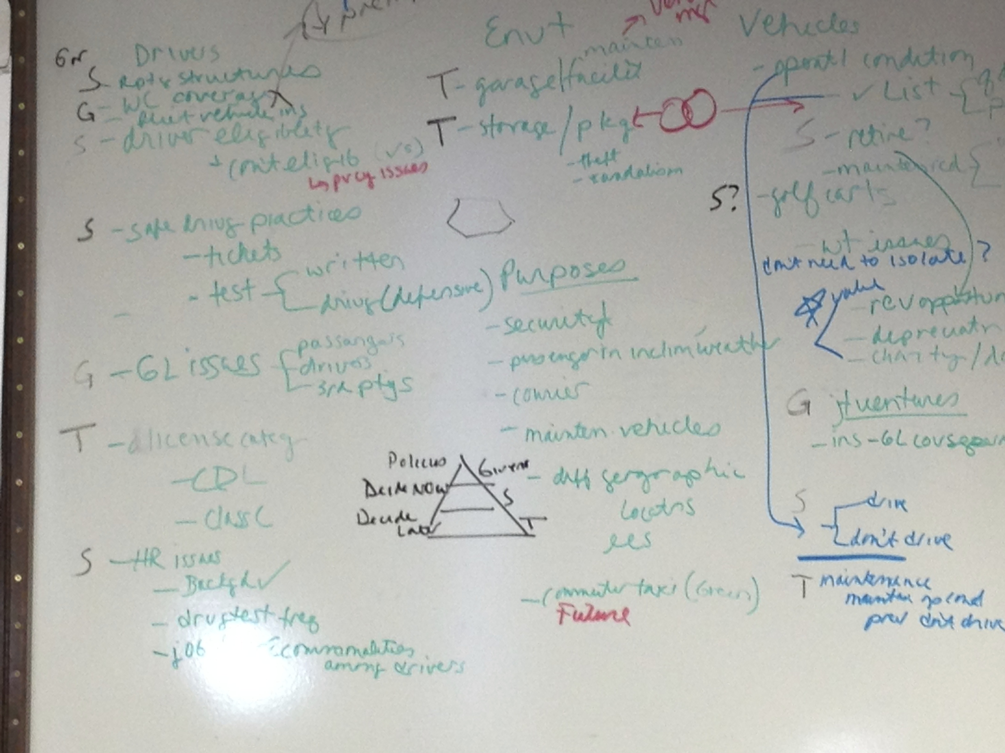
DH
The decision hierarchy defines the scope of the decision to be analyzed
Begin the process by defining each issue/decision and separate into the three categories of : givens, strategic decisions and decide later
This is an example of a session with a client where we began the decision hierarchy process.
section 04

Slide 117
DH
The decision hierarchy defines the scope of the decision to be analyzed
We began the process by identifying the elements of the problem in a traditional brainstorming session. This un-surfaced many frames in terms of different perspectives.
This lead us to the conclusion that the problem was not yet framed. In terms of assessing the quality of this first step, we were at 0%. We were plunging in and assumptions were surfacing from different perspectives.
We knew there was more preliminary work to do. We went back to the original issue to refine it. The issue that the client wanted to tackle was to develop an enterprise approach to managing the risk in their maintenance and fleet vehicles. The client was a large single-state, multiple location integrated health care system. The white board illustrates that we broke the issue down by using the following categories:
Defining the purpose, describing the type of drivers (big equipment, golf cart, taxi buses), addressing general liability issues and loss history, addressing workers comp insurance issues and loss history, defining the HR issues, environmental issues, identifying vehicle type, determining whether there were joint ventures.
Each of these categories were broken down into elements and sub-elements and then assigned “G”, “S”, or “T”
section 04

Slide 118
DH
The decision hierarchy defines the scope of the decision to be analyzed
The following pages will present several examples of using the various tools beginning with the DH.
The first example will involve decisions related to a hospital pharmacy. The sources for this example was an SDG webinar and a modeling course in the Strategic Decision Making and Risk Management curriculum.
The second example will involve decisions related to managing patient grievances to prevent them from becoming formal claims. The source for this example came from one of my consulting experiences.
The third example is whether to invest in a safe patient handling program. The source for this example is the article: “Value-driven ERM: Making ERM and engine for simultaneous value creation and value protection” by Celona, Driver, Hall
section 04

Slide 119
DH
The decision hierarchy defines the scope of the decision to be analyzed
Example 1 Drug supply chain issues in hospital pharmacy
Policy Decisions (Take as given)
- The hospital pharmacy will have on hand sufficient types and quantities of medications so that drug availability does not negatively impact patient care
- The hospital will seek to be efficient in expenditures for the formulary as with all sources of cost to patients.
Focus On
Decide Later
section 04

Slide 120
DH
Decision hierarchy example
Example 1: Possible decisions for drug supply chain issues
Givens
Decide Later
Strategic decisions: To be made now
Requisite frequency of need for a medication to be stocked
Days of supply kept on hand for each medication
Level of ongoing monitoring for potential medication shortfalls
Contingency plans for dealing with medication shortfalls (e.g., grey market sourcing, on-site compounding, etc)
section 04

Slide 121
DH
Decision hierarchy example
Example 1: Possible decisions for drug supply chain issues
Givens
Focus on
Tactical decisions (Important but can be decided later) - - Drug storage facilities
- Contact personal for various types of drug shortages
- Reimbursement procedures for non-standard drug procurement
section 04

Slide 122
DH
The decision hierarchy defines the scope of the decision to be analyzed
Example 2: Consulting experience: Patient grievance issue
The problem was that patient grievances that should have been a non-claim event were being routed to the claims department which artificially increased the claim volume.
This resulted in:
Increased excess and reinsurance premiums
Internal and external audit issues
Increased expense reserves
Increased claim workload
Resulting in
resource issues
regulatory compliance issues
including CMS condition of participation leading to immediate jeopardy
legal issues
section 04

Slide 123
DH
Decision hierarchy example
Example 2: Patient grievance issue
Decide later
Focus on
Givens (partial list)
The Patient Relations Department operates from a patient advocacy model
The Patient Relations Department manages property and clinical grievances that are not formal claims
The Claims Department manages claims
section 04

Slide 124

DH
The decision hierarchy defines the scope of the decision to be analyzed
Example 2: Consulting experience: Patient grievance issue
A challenge/opportunity was uncovered in the Policy/Take as given category when I identified that the Patient Relations Department was using a patient advocacy model. I discussed this model in terms of :
Defining advocacy
Analyzing the health system’s language used in their mission, vision and value statements
Defining the health system’s core product
This resulted in a transitioning from an advocacy model to a partnership model, which laid the foundation for the strategic decisions
section 04

Slide 125
DH
Decision hierarchy example
Example 2: Patient grievance issue
Givens
Decide Later
Strategic decisions: To be made now (partial list)
Patient relations staffing
Who initially communicates with the patient
Who communicates with patient when patient is dissatisfied with conclusions
In cases where there has been a deviation of standard of care (SOC): What is offered to patients and from where
section 04

Slide 126
DH
Decision hierarchy example
Example 2: Patient grievance issue
Givens
Decide Later
Strategic decisions: To be made now (partial list)
Should the Patient Relations Department be staffed with more clinical professionals (including advanced care nurses)
Should a new department be created and if so, how should it be staffed?
Should the function of the new role or new department expand to include an “Apology Program”
Should the function of the new role or new department be enlarged to provide internal consulting in addition to managing patient grievances
section 04

Slide 127
DH
Decision hierarchy example
Example 2: Patient grievance issue
Givens
Tactical decisions (important but can be decided later) (partial list)
- If new department is created, where will it reside and what is the reporting structure
Focus on
section 04

Slide 128
Strategy table
04

Slide 129
Strategy table
The strategy table develops specific alternatives for each strategic decision
Strategy tables are tools for sorting through complex sets of decisions
Strategy tables identify mutually exclusive choices for each strategic direction
A strategy comprises a consistent set of choices (one choice for each decision)
A hybrid alternative combines the best features of initial strategies evaluated
Strategic Decisions: One column for each
SD-1 | SD-2 | SD-3
Choice 1
Choice 2
Choice 3
Givens
Focus On
Decide Later
section 04

Slide 130
Strategy table
The strategy table develops specific alternatives for each strategic decision
Example 1 Drug supply chain issues in hospital pharmacy
 | Drug Stocking | Days of Supply | Potential Shortfall Monitoring | Shortfall Contingency Plans
section 04

Slide 131
Strategy table
Start with identifying the status quo or “no changes” alternatives decision
Example 1: Drug supply chain issues in hospital pharmacy
 | Drug Stocking | Days of Supply | Potential Shortfall Monitoring | Shortfall Contingency Plans
Status quo (no changes) | Ad hoc, depending on historical order patterns | Ad hoc, depending historical order patterns | No formal monitoring | No formal plans
section 04

Slide 132
Strategy table
Begin developing alternatives for each strategic decision
Example 1: Drug supply chain issues in hospital pharmacy
 | Drug Stocking | Days of Supply | Potential Shortfall Monitoring | Shortfall Contingency Plans
Status quo (no changes) | Ad hoc, depending on historical order patterns Stock all drugs needed in an avg week Stock all drugs needed in an avg month Stock only drugs ordered in the prior x weeks | Ad hoc, depending historical order patterns | No formal monitoring | No formal plans
section 04

Slide 133
Strategy table
When all alternatives are identified, we are ready
to start crafting alternative strategies
Example 1: Drug supply chain issues in hospital pharmacy
 | Drug Stocking | Days of Supply | Potential Shortfall Monitoring | Shortfall Contingency Plans
Status quo (no changes) Optimizing drug supply | Ad hoc, depending on historical order patterns Stock all drugs needed in an avg week Stock all drugs needed in an avg month Stock only drugs ordered in the prior x weeks | Ad hoc, depending historical order patterns Stock X days of supply for critical shortfall drugs Stock X days of supply for drugs most at risk of shortfall Stock X days of supply for all drugs | No formal monitoring Order as potential shortfalls are identified by whatever means Periodic scan for supply issues Formal projection of future drug needs couple with preemptive acquisition | No formal plans Identify contingent suppliers (normal channels only) Contingent suppliers plus onsite compounding capabilities Above plus qualify grey market resources
section 04

Slide 134
Strategy table
An alternative strategy might be to optimize drug supply,
considering all costs, benefits, risks and uncertainties
(Identify the alternatives that create the best value)
Example 1: Drug supply chain issues in hospital pharmacy
section 04

Slide 135
Strategy table
The strategy table develops specific alternatives for each strategic decision
Example 2: Consulting experience: Patient grievance issue
 | Patient Relations Staffing | Who initially communicates with patient | Who communicates w patent when patient is dissatisfied w conclusions | What and from where is offered to patients in case where SOC has deviated
Status quo (no changes) | No staffing changes Add clinical nurses (downsize and then add or add to existing staff) Add advance care nurses (downsize and then add or add to existing) | Patient Relations Admin Staff Claims Interdepart-mental group, ad hoc New department | Claims Admin Staff Interdepartmental group, ad hoc (like an appeals process) New department | Service recovery budget (Patient relations – no committee or formal process or reporting required) Claims indemnity (formal process required, reporting to outside entities required, Becomes part of internal and external audit) RM apology program: Trust (formal process required but no reporting to outside entities, becomes part of internal and external audit) Individual unit or outpatient dept/clinic (no committee or formal process or reporting required) Admin budget
section 04

Slide 136
Influence diagram/Value map
04

Slide 137
Influence diagram/Value map
The ID/VM can be two separate tools, but
we will combine them for our purposes
Influence diagrams show interrelationships, decisions and uncertainties. Value diagrams show interrelationships, decisions, uncertainties different types of costs and benefits. This enables decision-makers to define costs as investments or expenses.
Remember that uncertainty is the element that makes decision making difficult. The quality of the decision making depends in large part on the treatment of uncertainty
Strategic Decisions: One column for each
SD-1 | SD-2 | SD-3
Choice 1
Choice 2
Choice 3
section 04

Slide 138
Influence diagram/Value map
The ID/VM can be two separate tools, but
we will combine them for our purposes
These diagrams provide a clear, graphical picture of the problem which facilitates dialogue among team members with different backgrounds and interests.
These are NOT flow charts
Rule: You cannot have circular references of feedback loops
section 04

Slide 139
Influence diagram/Value map
Example 1: Drug supply chain issues in hospital pharmacy
Start with the value
Total value impact of drug supply chain issues
Add the decision(s)
Drug supply chain strategy
section 04

Slide 140
Influence diagram/Value map
Example 1: Drug supply chain issues in hospital pharmacy
section 04

Slide 141
Influence diagram/Value map
Example 1: Drug supply chain issues in hospital pharmacy
section 04

Slide 142
Influence diagram/Value map
The patient grievance issue: Background
A gap was identified when the patient relations department could not satisfy a patient with a grievance. This gap has resulted in immediate jeopardy and lawsuits. In an attempt to manage this gap, many of grievances were routed to the claims department. An analysis of this gap provided that there were many options in communicating with a patient having a grievance and these options contained value opportunities.
The analysis began by deconstructing the initial communication between the patient relations department and the patient with a grievance. A pattern of imbalance was found with:
Language associated with regulatory compliance
Language associated with risk management in an effort to minimize exposure and mitigate damages
Language associated with the organization’s mission vision and value statements
Language explaining the the standard of care (SOC) has been met as the reason to deny the relief sought in the grievance
section 04

Slide 143
Influence diagram/Value map
The patient grievance issue: Background
These four categories have competing interests and are in conflict with each other. The letters to the patients have to meet CMS requirements. The language in the letters have to reflect the organizational values of providing “remarkable patient experience” and “first do no harm”. Yet the letters also have to contain solid rationale as to why the organization is denying the relief the patients has sought in their grievance and simultaneously provide a foundation for the organization to mitigate damages should their grievance advance to claims status.
The analysis revealed that the letters meet the regulatory requirements but provide minimal explanation as to the rationale underlying the decision to not honor the request for relief that the patient was seeking in their grievance. Further, the regulatory language in many instances unnecessarily exposed the organization. There was no specific, deliberate or focused risk management language.
section 04

Slide 144
Influence diagram/Value map
The patient grievance issue: Background
This imbalance is depicted in this diagram which creates a mixed message for patients and provides a weak foundation to protect the organization’s interests
Regulatory requirements
Organizational values regarding the “remarkable patient experience” and first do no harm
Language explaining that the SOC was met as the reason to deny the relief sought in the grievance
Risk language to minimize exposure to organization and to mitigate damages
section 04

Slide 145
Influence diagram/Value map
The patient grievance issue: Background
This graphic establishes a more proportional balance and creates a partnership opportunity with the patient. A partnership model is significantly different from the current advocacy model. The construction of this new opportunity reinforces the concept that “patient partnerships” are the organization's core product as was evidenced by their language “the remarkable patient experience”.
CMS requirements
Respond to relief sought in grievance
Risk management language
Create Partnership opportunity
Organization’s mission, vision and value language
section 04

Slide 146
Influence diagram/Value map
The patient grievance issue: Background
This analysis provided the background for the value map. The value map on the following page identifies the value of partnering with patients to build customer intimacy and advance the organizational mission of “improving the health of communities, one person at a time”.
This map offers value for creating a new department, changing the communication model from patient advocacy to patient partnership and establishes a foundation for increased patient satisfaction.
section 04

Slide 147
Influence diagram/Value map
Example 2: Patient grievance issue
section 04

Slide 148
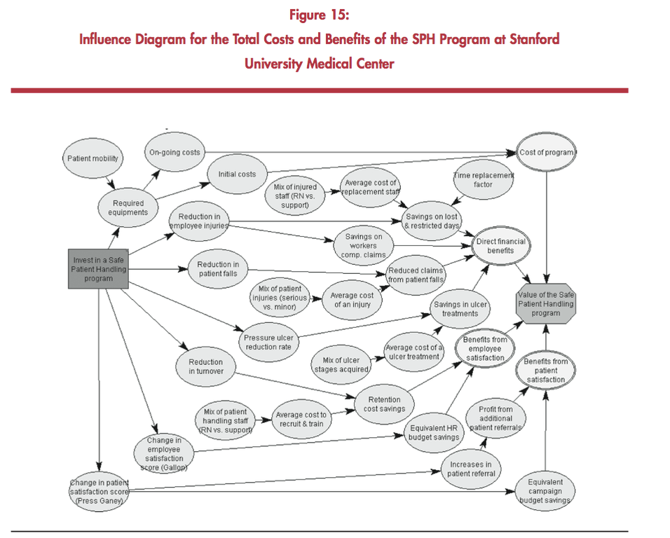
Influence diagram/Value map
Example 3: Investment in Safe Patient Handling: (Source p.26)
section 04

Slide 149
Heat map
04

Slide 150
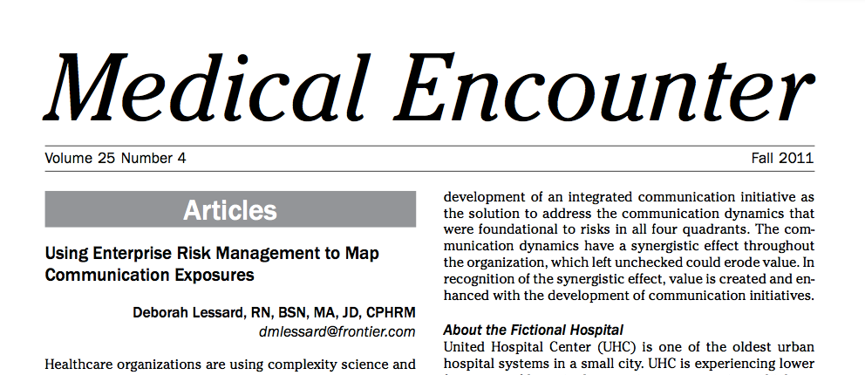
Heat map
Introduction
A user friendly tool used in ERM and VDERM is a heat map (also known as a “risk map”). This is a visual depiction of the relationship between risk frequency and risk severity and tells the story of the organization's threats and opportunities. Risk maps position the organization to develop prioritized, organizational-wide solutions and strategies.
Heat (risk) maps are presented by using a two dimensional grid with one axis representing likelihood of occurrence (known as frequency) and the other axis representing degree of financial impact or harm (known as severity). The upper right quadrant represents critical risk, the upper and lower right quadrants represent moderate risk and the lower right quadrant represents low risk. Typically, risks are organized into six categories: financial risk, operational risk, strategic risk, legal and regulatory risk, technology risk and human capital risk.
P
Please refer to this article in your reading materials
section 04

Slide 151

Heat map
Introduction
The AHSRM ERM White paper provides definitions of the risk domains that are used on risk maps. They identify 8 domains:
Please refer to this article in your reading materials for a more in-depth explanation
Domain | Description/Example
Operational | Related to risks resulting from inadequate or failed internal processes, people or systems that affect business operations
Clinical/Patient Safety | Related to risks associated with the delivery of care
Strategic | Related to risks associated with the focus and direction of the organization
Financial | Related to risks resulting from anything that affects the sustainability of the organization, access to capital or external financial ratings
Human Capital | Related to risks resulting from employee selection, retention, turnover, staffing, work-related injuries, schedules fatigue, productivity and compensation
Legal/ Regulatory | Related to risks resulting from failure to identify, manage, monitor legal, regulatory and statutory mandates on a local, state or federal level
Technology | Related to risks resulting from equipment, devices, tools, systems and methods of operation
Hazard | Related to risks resulting from natural exposure and business operation
section 04

Slide 152
Heat map
Introduction
The AHSRM ERM White paper provides definitions of the risk domains that are used on risk maps. They identify 8 domains
Please refer to this article in your reading materials for a more in-depth explanation
Domain | Description/Example
Operational
Clinical/Patient Safety
Strategic
Financial | Related to risks resulting from anything that affects the sustainability of the organization, access to capital or external financial ratings
Human Capital
Legal/ Regulatory
Technology
Hazard
Recall that we
addressed
the significance of
external financial
ratings when we
discussed
triangulating the
three market
forces (in the
Neuroeconoimc
Sections of the
Comm Science
eBook
section 04

Slide 153
Decision trees
04

Slide 154
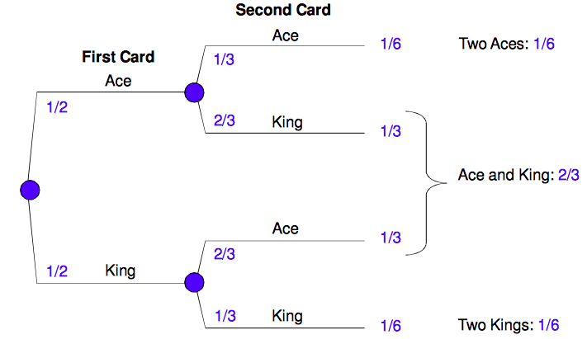
Decision trees
Introduction
A decision tree is another way to express and communicate about complex uncertainties. Decision trees are also known as probability trees and they provide the framework that facilities calculations with probabilities and the development of insight into the solution.
In most cases, you will need specialized decision software to build a decision tree because there are so many branches. These trees are built in excel with specific formulas and then are conveyed in a visual tree format.
You may be able to use a decision tree without software if there are two or three discrete variables.
The following pages are examples of decision (probability trees).
section 04

Slide 155
Decision trees
Card example
(Source: SDG course)
In order to decide, you need to be able to think clearly about uncertainties. Thinking clearly about uncertainties:
Helps you plan better
Make better decisions
Communicate better about plans and decisions
The key to thinking and communicating clearly about uncertainties is to use probabilities to describe uncertainty
You have an opportunity to invest $20 with an uncertain return
Your investment will not be returned
Simulate uncertainty with deck of 4 cards
If you draw 2 aces = $60
If you draw 1 ace + 1 king = $30
If you draw 2 kings, you will pay an additional $18 and receive nothing
What is the worst outcome?
$20 +$18 = loss of $38
How do you decide?
section 04

Slide 156
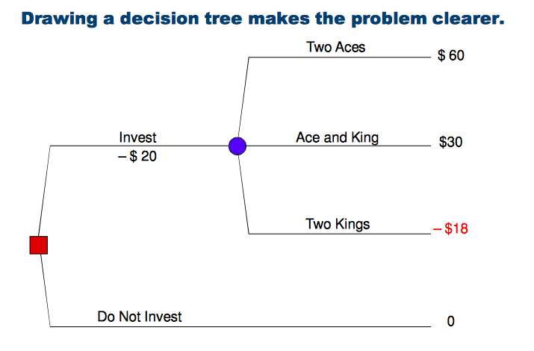
Decision trees
Card example
Draw a decision tree to visualize the chances of winning
section 04

Slide 157
Decision trees
Card example
Draw a probability tree to visualize the chances of winning
section 04

Slide 158
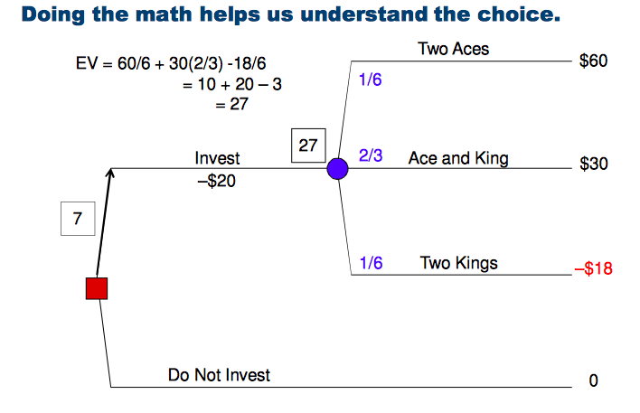
Decision trees
Card example
Do the math to provide an objective method for decision
section 04

Slide 159
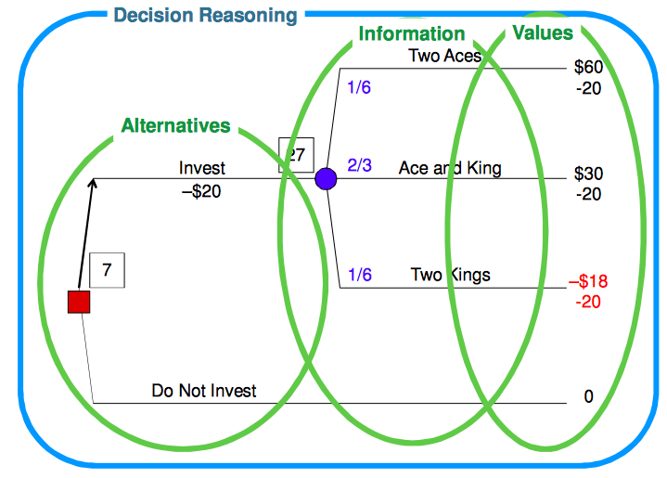
Decision trees
Card example
Decision reasoning: These are 3 steps in the DQ process:
Step 2: alternatives; Step 3: Information; Step 4: Values
section 04

Slide 160
Expected Value
The expected value for an uncertain alternative is calculated by multiplying each possible outcome of the uncertain alternative by its probability, and summing the results. The expected value decision criterion selects the alternative that has the best expected value. In situations involving profits “where more is better," the alternative with the highest expected value is best, and in situations involving costs, where “less is better," the alternative with the lowest expected value is best.

Slide 161
Decision trees
Car accident: Decision to settle or sue
Imagine you are injured in motor vehicle accident (MVA). You have retained an attorney and are deciding whether to settle or sue.
You have knowns and unknowns (uncertainty). Therefore you need more information. There are two knowns: You are guaranteed $9,000 if you settle. Attorney fees and court costs =$15,000
You need to determine the probabilities of winning and loosing and the probability of different judgments.
Your attorney tells you that you have a 20% chance of loosing and that attorney fees and court costs will = $15,000
You are also told you have:
20% chance of winning $10,000
20% chance of winning $25,000
20% chance of winning $60,000
20% chance of winning $140,000
Your attorney then tells you that the defendant has increased the settlement offer to $29,000
section 04

Slide 162
Decision trees
Car accident: Decision to settle or sue
section 04

Slide 163
Decision trees
Patient product company and bidding a product (Source: SDG webinar)
This tree would require specific software because of the multiple branches
Think about this scenario:
You are a patient product company and you are bidding your product.
There is only one competitor
Your cost to develop a bid is $1M, which includes the cost of manufacturing samples for client.
Your current manufacturing cost per unit is $8,000
You have developed a new manufacturing process
The contract will be for manufacturing of 10,000 units
The next step is to identify the unknowns
The competitor could offer one of three price points: $10k, $9k or $8k
You could offer one of three price points: $9.5k, $8.5k or $7.5k
Current manufacturing cost is $8k. With the new manufacturing process, there is a:
25% probability that you could reduce cost to $5k
50% probability that you could reduce cost to $7.5k
25% probability that the cost would increase to $8.5k
section 04

Slide 164
Decision trees
Patient product company and bidding a product:
This tree would require specific software because of the multiple branches
This scenario would require two decision nodes (squares) and many chance nodes (circles)
The two decisions are:
Bid/don’t bid
Use current process/use new process
section 04

Slide 165
Calibrating the SME
04

Slide 166
Calibrating the SME
Five step procedure for minimizing forecast bias
Motivate
a. Explain importance
b. Emphasize communication
c. Explore stake in decision
Structure
a. Define variable
b. Choose known scale
c. Draw out assumptions
Condition: This step prepares the expert to assess probabilities in a manner that compensates for biases
Compensate for availability
Assess extremes (reasons for extremely low and extremely high)
Keep in front of expert to help overcome anchoring
Encode the expert’s judgment
Assess probabilities
Assess 3 points to identify range of uncertainties:
10%chance that estimate will be lower, 10% chance that estimate will be higher and 50/50 chance
Avoid anchors
Verify
Ask “check” questions
Show results
Ask if “willing to bet (if expert is not indifferent to each bet, revise assessment
Resources:
http://oai.dtic.mil/oai/oai?verb=getRecord&metadataPrefix=html&identifier=ADA047747
http://oai.dtic.mil/oai/oai?verb=getRecord&metadataPrefix=html&identifier=ADA099435
section 04

Slide 167
Calibrating the SME
Five step procedure for minimizing forecast bias
More on Step 4: Encode
Low, base and high estimates are good representatives of the bottom and top “quartiles”
10,50, 90 numbers translate to probabilities of 25%, 50% and 25%
Document each assessment for easy reference during model and data refinements
This concept and method will be valuable for you to be familiar with. It is unlikely that you will be required to have a working knowledge of this process.
Familiarity with this material will enable you to discuss the issues that influence and impair expert’s opinions on issues
section 04

Slide 168
Introduction to Risk Management
What is risk management?
VDERM
05

Slide 169
What is risk management?
03

Slide 170

Vocabulary
What is risk management?
The Failure of Risk Management by Douglas Hubbard is a recognized leading risk management text
Hubbard begins his discussion of risk management by defining words.
Word | Trade definition | Shorter definition
Risk | A state of uncertainty where the probability and magnitude of a loss, disaster or other undesirable event are possibilities | Something bad can happen
Manage | Planning, organization, coordination and direction of resources toward defined objectives | Using what you have to get what you need
Risk management | Identification, assessment and prioritization of risks followed by coordination and economical application of resources to minimize and control the probability and/or impact of unfortunate events | Being smart about taking chances
Measuring risk | Set of possibilities each with quantified probabilities and quantified losses
Uncertainty | Lack of complete certainty. The existence of more than one probability
Measuring uncertainty | Assigning a set of probabilities to a set of possibilities
section 05

Slide 171
VDERM
03

Slide 172

Silo risk management to ERM
VDERM
Risk management in the healthcare industry has traditionally existed in silos. We typically think of health care risk management in terms of only one silo - clinical risk management, but there are many other types of silo risk management.
Examples of silo-ed risk management:
Healthcare risk managers have processes to prevent or minimize adverse events such as medication errors, wrong-site surgery, etc.
The regulatory and compliance staff assured that there was compliance with all regulations and laws.
HR managed workers compensation issues and OSHA issues
There was not an awareness that risks in individual silos were interdependent and created synergistic risks.
Sometime in the 90’s, this awareness surfaced and the people in the individual silos began talking to each other and connecting the dots where there were interdependencies and the benefits of ERM that were seen in other industries was introduced into healthcare
section 05

Slide 173
VDERM evolved from ERM
VDERM
ERM is a holistic approach to risk management which provide a framework for looking beyond the four walls of the hospital
It involves:
Organization wide risk identification
Prioritization of key exposures
Development of strategic and operational positions as a proactive process to existing and emerging exposures
Development of operational responses to adverse events
ERM is based on a foundation of collaboration, accountability and transparency.
VDERM leverages the upside of uncertainty to create value opportunities in addition to the traditional role of ERM which is to protect value.
The following two graphics present the creation of value and protection of value concepts from a strategic and operational perspective
section 05

Slide 174
VDERM recognizes value potential and value realized
VDERM
section 05

Slide 175
Recognizing value potential and value realized
VDERM
Strategic decision
Decision implementation
Operations (Management)
Value Potential
Platform for Value Delivery
Value Realized
section 05

Slide 176
Appendix
06
Notes:
Can we eliminate the copyright at the bottom right?

