Slide 1

Safe Use of Medications in Pregnancy and Lactation
Jenna McCullough, PharmD, BCPS
Clinical Pharmacist
UPMC Magee-Womens Hospital

Slide 2
Objectives
Describe the pharmacokinetic properties that impact drug transfer
Determine if a medication is safe for use in specific scenarios
Identify 3 appropriate resources for assessing medication safety in pregnancy and lactation

Slide 3
Outline
01
02
03
04
05
06
Stages of Fetal Development & Teratogenicity
History of FDA Labeling
Pharmacokinetic Principles
Specific Lactation Considerations
Resources for Medication Safety
Pharmacist Role in Patient Care

Slide 4
01
Stages of Fetal Development & Teratogenicity

Slide 5
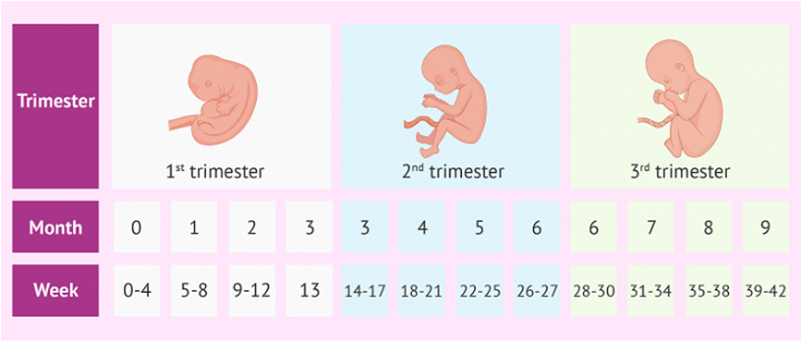
Fetal Development¹
First Trimester (1w-13w/6d)
Brain and spinal cord development
Major organs begin to develop
Fetal heartbeat can be detected
Kidneys begin to make urine
Second Trimester (14w-27w/6d)
Continued organ development
Sex of fetus can be determined
Lungs develop surfactant
Third Trimester (28w-40w/6d)
Lung surfactant increases
Organ function progresses
Bones begin to harden
https://www.alhilalhealthcare.com/blog/pregnancy-trimesters/

Slide 6
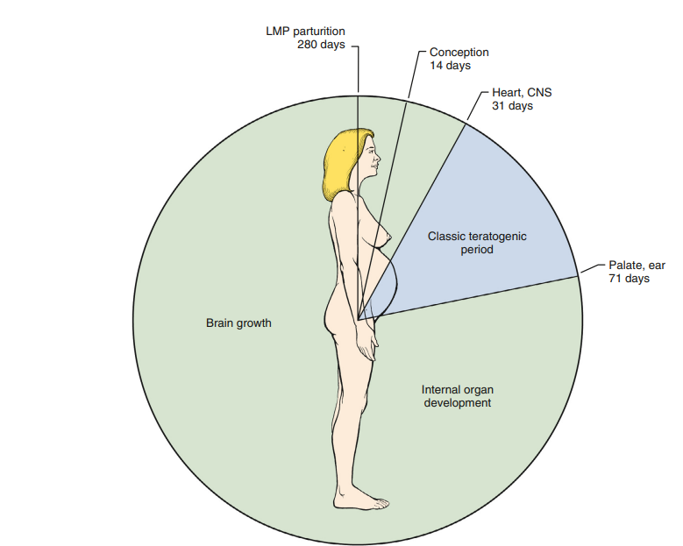
Teratogenicity²⁻³
What is a Teratogen?
An agent that interferes with normal fetal development
Potentially causes congenital disabilities, miscarriages, preterm labor or stillbirth
Teratogenic period:
Day 31 to Day 71: classic teratogenicity period
Before Day 31: exposure is “all-or-none” effect

Slide 7
Wilson’s Six Principles of Teratogenesis²⁻³
Genetics and Resulting Interaction
Some embryos are genetically predisposed and at an increased risk
Timing of Exposure
Susceptibility to teratogenicity varies depending on exposure and gestational age
Mechanism of Teratogenesis
Agents have specific mechanisms of teratogenic action
Manifestation
The final effect of exposure to the agent
Environmental Influences
Pharmacologic factors, and maternal physiology impact on transfer
Dose Effect
Teratogenicity varies depending on dose, duration, or amount of exposure

Slide 8
02
History of FDA Labeling

Slide 9
History of Labeling⁴
1960(ish) Thalidomide teratogenicity recognized
Used to treat morning sickness, caused limb deformities
1962 Kefauver-Harris Amendments
Required manufacturers to prove drug safety and efficacy
1979 FDA Pregnancy labeling introduced
Traditional lettering (A, B, C, D, or X)
2015 Pregnancy and Lactation Labeling Rule (PLLR) replaces traditional labeling

Slide 10
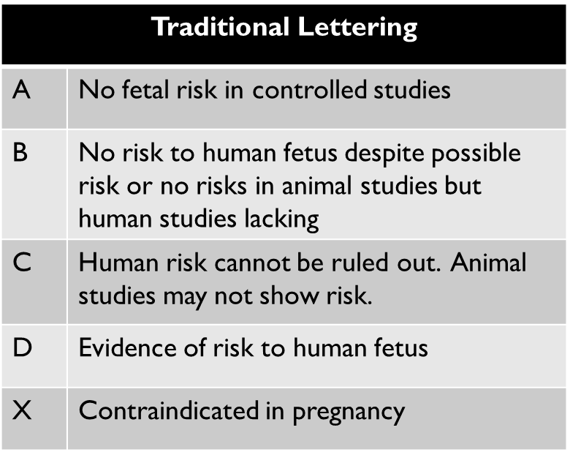
Historical FDA Labeling⁴
Limitations:
Overly simplistic
Most medications are Category C
Drugs in the same category do not always have the same risk
Categorization of specific medications are not always updated
Did not account for lactation and male reproductive factors

Slide 11
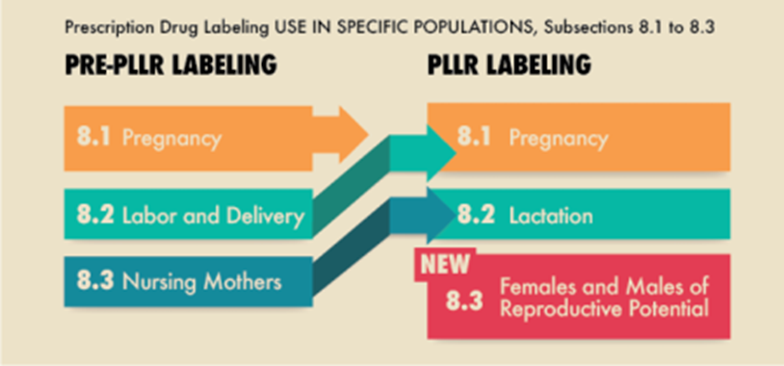
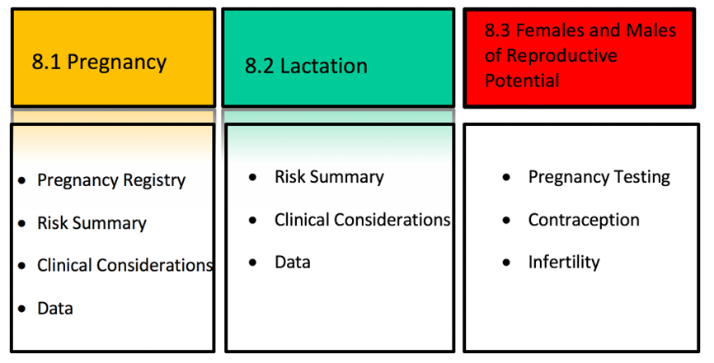
Updated FDA Pregnancy & Lactation Labeling⁴
https://www.fda.gov/drugs/labeling-information-drug-products/pregnancy-and-lactation-labeling-resources

Slide 12
Medication Considerations
All medications have a degree of possible drug transfer
Drug transfer does not equal harm
The dose, frequency, and duration of use must be considered
The gestational age and/or the postnatal age impacts medication safety

Slide 13
03
Pharmacokinetic Principles

Slide 14
Mechanism of Transport³
Most drugs transfer via passive diffusion
Passive diffusion occurs when molecules move from areas of high concentration to low concentration without energy expenditure
Certain drug properties facilitate passive diffusion

Slide 15
Placental and Milk Transfer³
Molecular Weight
Smaller molecules are more likely to transfer into milk
Ex: Lithium-small
Ex: Enoxaparin- large
Protein Binding
Free drug transfers
Lipid Solubility
Lipophilicity increases drug transfer potential
Drugs that cross the blood brain barrier also transfer
Protein-drug complexes are usually too large

Slide 16
Placental and Milk Transfer³
Bioavailability
Increased oral bioavailability increases transfer potential
Ex: Oral vancomycin
Half-Life
Longer half-lives are more likely to transfer
Volume of Distribution (Vd)
Increase in Vd will increase the likelihood of transfer
Ex: Digoxin

Slide 17
Question #1
A 38-year-old female, who delivered a baby 4 months ago, is admitted to your unit. She is receiving vancomycin 1000mg IV Q8H for MRSA cellulitis. The patient is breastfeeding and is concerned about the vancomycin exposure to her baby.
Which of the following is false regarding vancomycin and lactation?
IV vancomycin is 100% systemically absorbed, so there is a strong probability of high concentration in the breastmilk.
Vancomycin has poor oral bioavailability, so it is unlikely to affect the infant.
Vancomycin is a large molecule. Therefore, it will have minimal transfer into breastmilk.
Vancomycin is a hydrophilic molecule, so it is less likely to cross into breastmilk.

Slide 18
04
Specific Lactation Considerations

Slide 19
Evaluating Drug Concentrations in Breast Milk^{5,9}
Relative Infant Dose (RID)
RID (%) = absolute infant dose / Maternal dose (mg/kg/day) *100
Milk Plasma Ratio (M/P)
Concentration of drug in milk in relation to concentration of drug in maternal plasma
M/P >1: drug concentrates in milk -> does not depict drug safety
Standardized percent maternal dose to a referenced weight-based infant dose
RID <10%: regarded as safe; RID<5% has been suggested for psychotropic drugs
Milk plasma ratios are clinically irrelevant
Absolute Infant Dose
Estimates the dose of drug that baby is exposed to per day
Uses an estimate of milk ingestion = 150mL/kg/day
AID= (C_{max} or C_{ave}) x (volume of milk ingested per day)
Notes:
RID is a practical tool for assessing drug safety in breastfeeding
RID (%) = absolute infant dose (milk; (mg/kg/day) / Maternal dose (mg/kg/day) *100
RID is a practical tool for assessing drug safety in breastfeeding. It is more than simply the percentage of a maternal dose that is excreted in milk. RID standardizes the maternal dose to a referential weight-adjusted infant-sized dose. For example, if a 70-kg patient takes a 1,000-mg dose of medication and their infant consumes a milk volume containing 5.7 mg of the drug, the infant consumes 0.57% of the maternal dose. Using this example, the RID is 8%
AID (absolute infant dose)
The absolute (theoretical) infant dose estimates the dose of drug an infant is exposed to per day.
AID = (Cmax or Cave) * (volume of milk ingested in a day).
<10% clinically insignificant

Slide 20
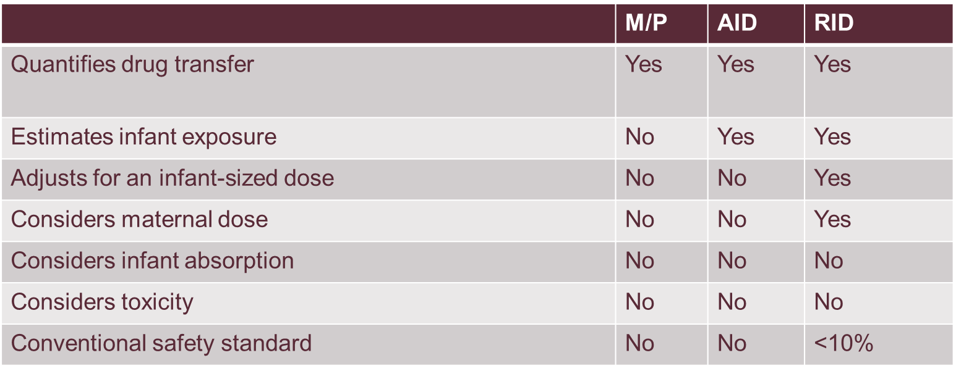

Comparison of Quantifying Methods^{5,9}

Slide 21
Milk Consumption^{5,6}
The standard reference for an exclusively breastfed infant is ~150mL/Kg/day
Actual milk consumption is highly variable
Infants may ingest donor milk or supplemented with formula
Volume of milk ingested is higher over first few months of life and decreases over time
The peak in ingested milk volume often aligns with reports of adverse medication events

Slide 22
Infant Considerations for Lactation^{1,3,9}
Toxicity
Drugs with known toxicity are more likely to cause harm to infant
Risk-benefit analysis/discussions are needed
Variable pharmacokinetic properties
Absorption, distribution, metabolism, excretion processes depend on specific factors
Postnatal (Chronological) Age
Organ function can continue to develop after birth
Milk consumption varies
Gestational age, postmenstrual age, and postnatal age can affect ADME processes

Slide 23
05
Resources for Medication Safety

Slide 24
Potential Resources for Medication Safety
Briggs
Hale’s
LactMed
Micromedex

Slide 25
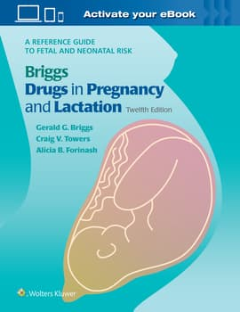
Briggs Drugs in Pregnancy and Lactation: Reference Guide to Fetal and Neonatal Risk⁸
Reference with information on possible effects on the mother, embryo, fetus, and nursing infant
Monographs include:
Generic drug name
Risk factors
Pharmacologic class
Pregnancy and breastfeeding recommendations
Pregnancy, fetal risk, and breastfeeding summaries
Access through: Lexicomp, print, and university databases
Reviewed and updated approximately every 5 years

Slide 26
Briggs Rating Scale⁸
Compatible
Low or nonexistent risk
Human Data
Suggest level of risk/potential toxicity
No (Limited) Human Data
Limited or nonexistent human data to evaluate risk
Contraindicated
Known association with toxicity
Maternal Benefit >> Embryo-fetal risk: Benefit of use outweighs risk
Risk during specific trimesters
Animal data used to evaluate risk
Data suggests risk

Slide 27
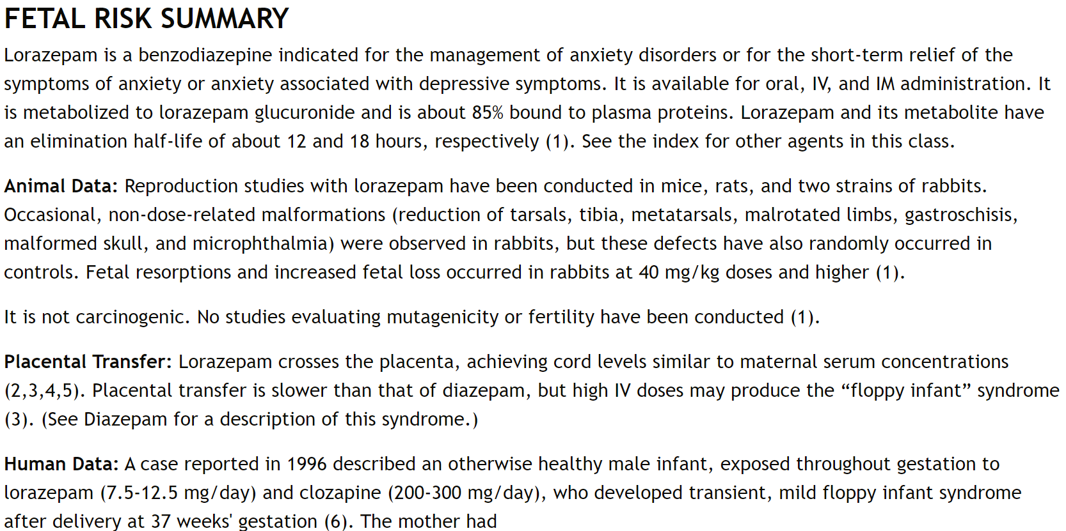
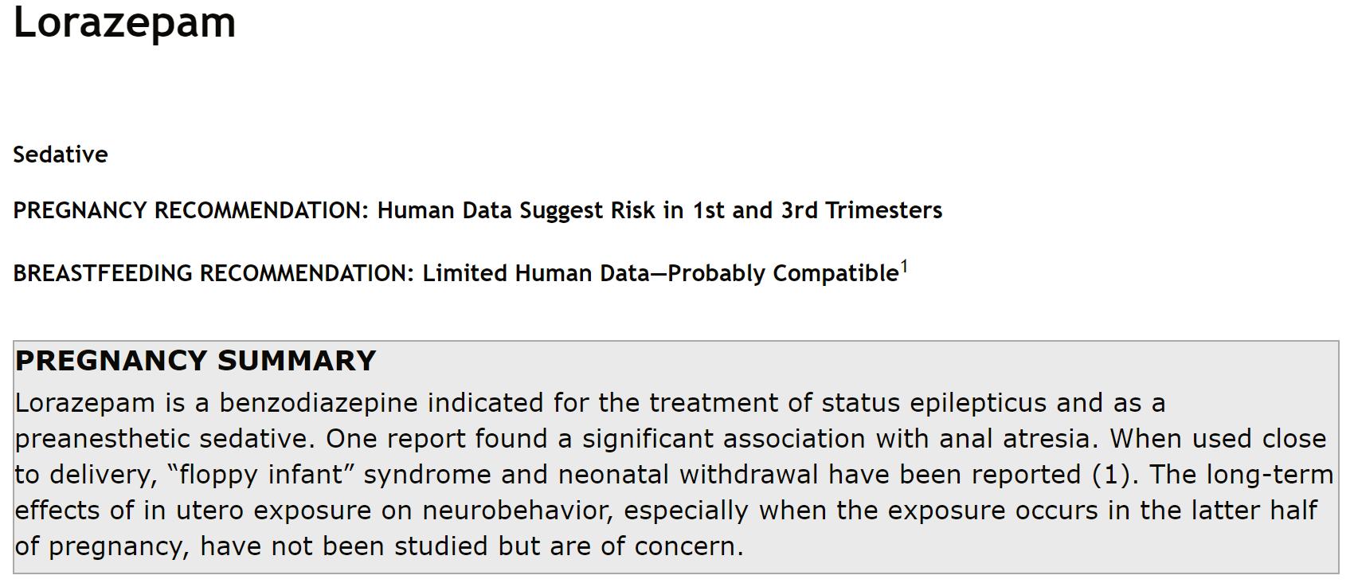
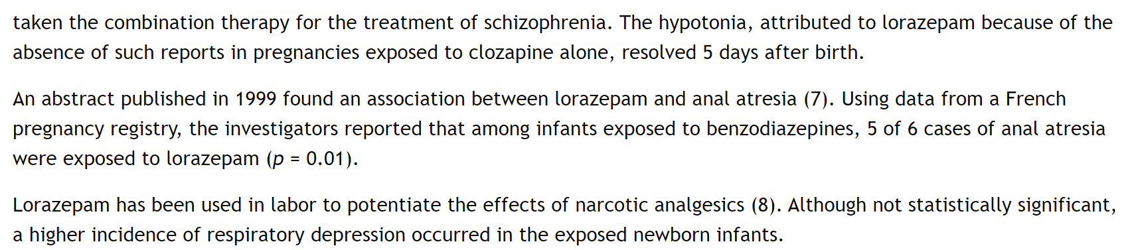
Briggs Example⁸
Briggs Drugs in Pregnancy and Lactation: A Reference Guide to Fetal and Neonatal Risk. Philadelphia: Wolters Kluwer; 2022.

Slide 28
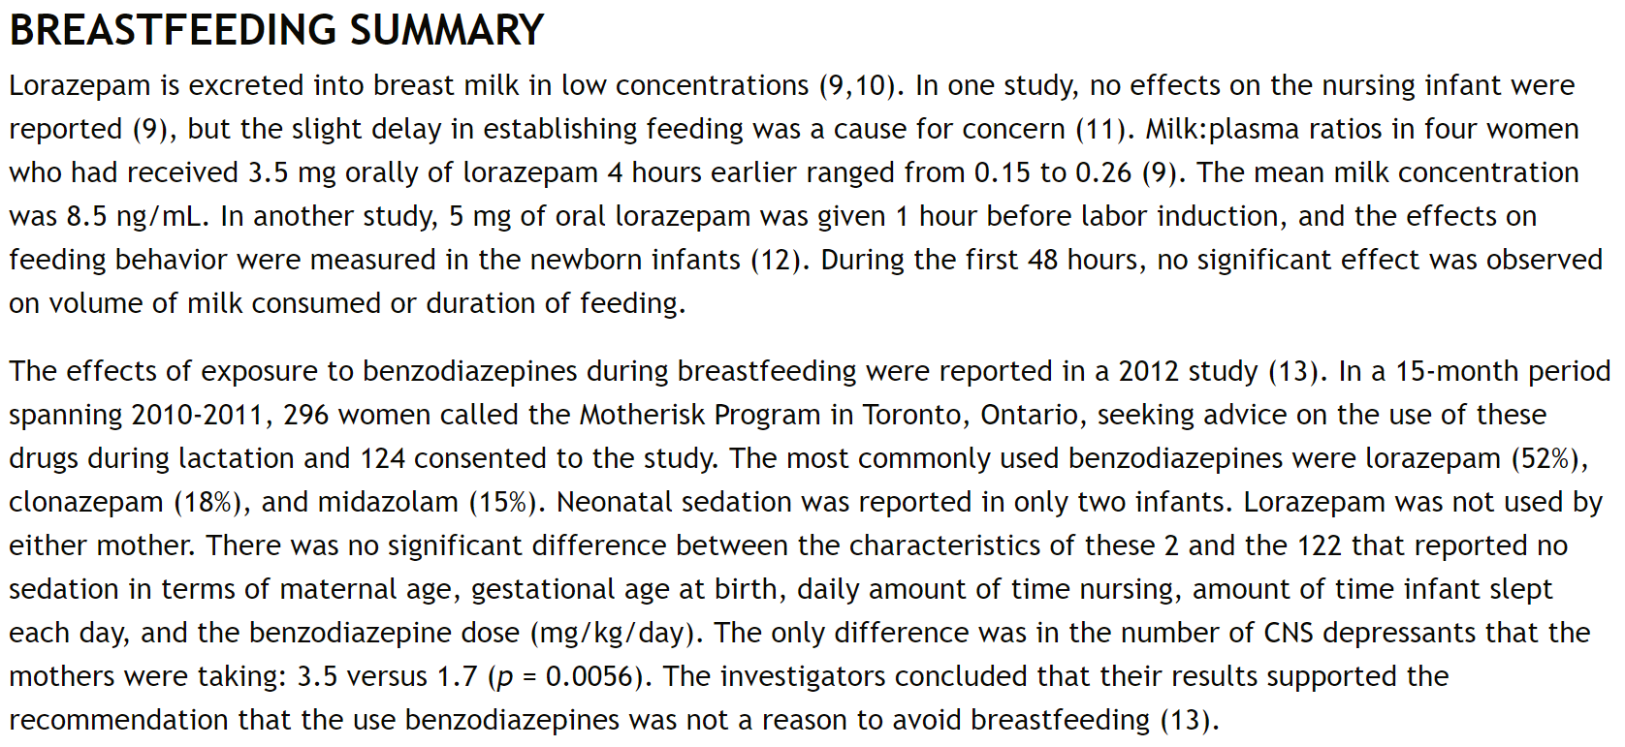
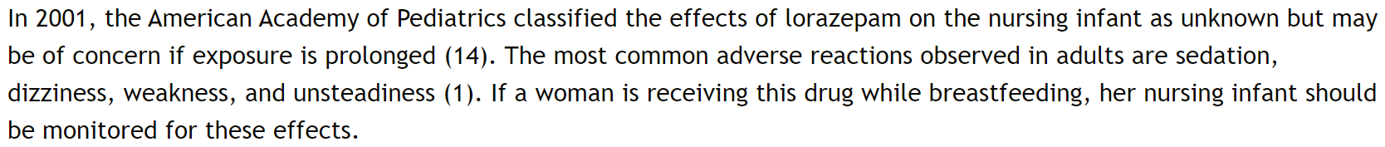
Briggs Example⁸
Briggs Drugs in Pregnancy and Lactation: A Reference Guide to Fetal and Neonatal Risk. Philadelphia: Wolters Kluwer; 2022.

Slide 29
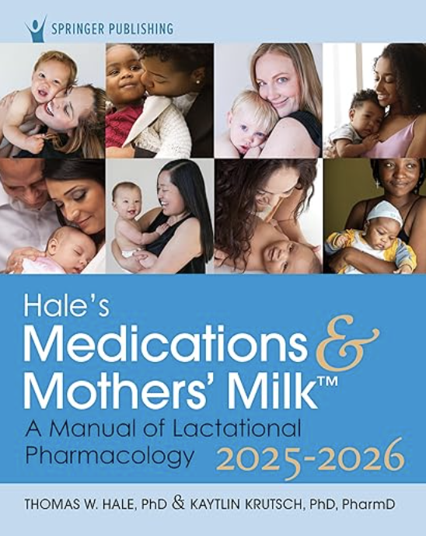
Hale’s Medications & Mothers’ Milk: A Manual of Lactational Pharmacology⁹
Contains information available on the transmission of maternal drugs into human milk
Monographs include:
Generic drug and trade name(s)
Pharmacologic category
Lactation Risk Categories
Pregnancy and breastfeeding recommendations
Infant monitoring and alternatives
Access through: University databases, print, FREE InfantRisk Hotline, mobile Apps($)
Reviewed and new edition released every 2 years
Apps are updated monthly

Slide 30

Texas Tech University Health Sciences Center, in Amarillo Texas
Resource for Medication Safety
InfantRisk.com
Articles on various topics for breastfeeding and pregnancy
FREE InfantRisk Hotline
Available to answer medication questions for specific scenarios forparents or clinicians
Available during regular business hours (Central Standard Time) at +1 (806) 352-2519.
Published over 25 drug studies in pregnancy/lactation
A World-Wide Call Center¹⁰

Slide 31
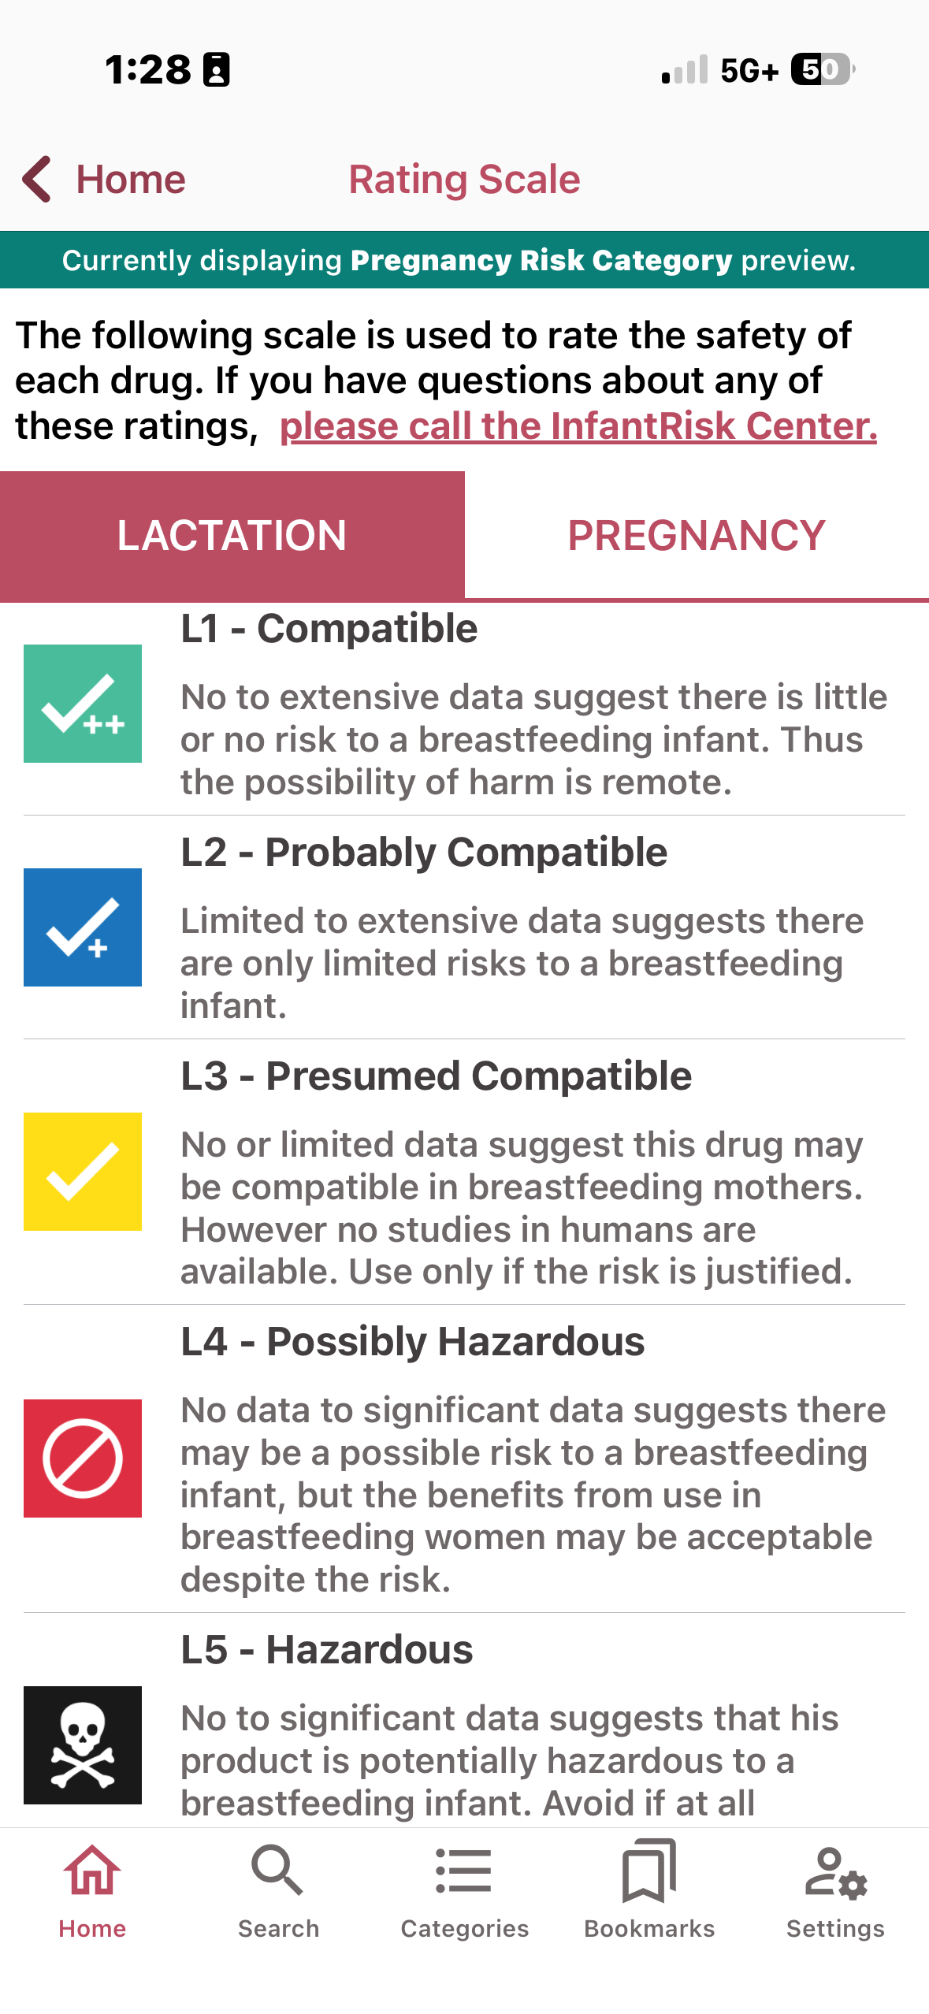
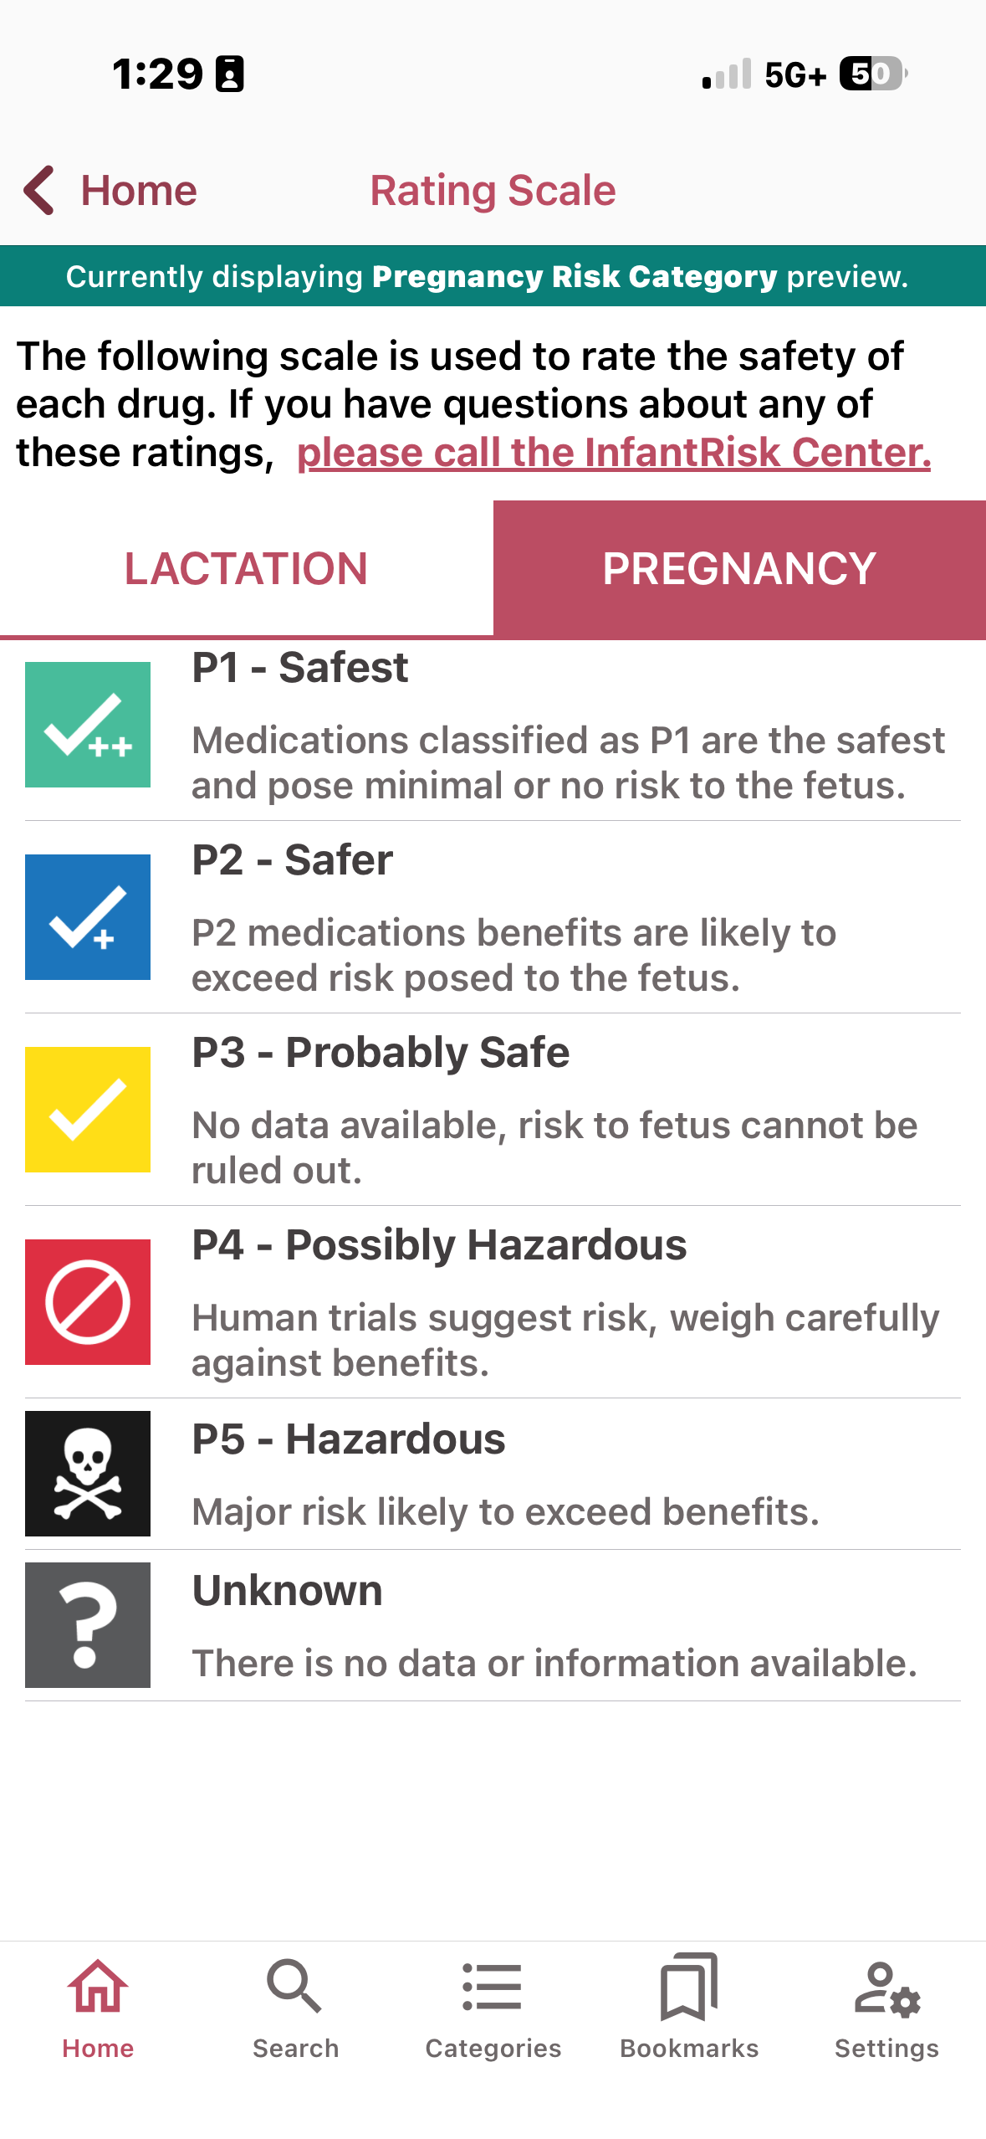
InfantRisk HCP Rating Scale^{9,10}

Slide 32
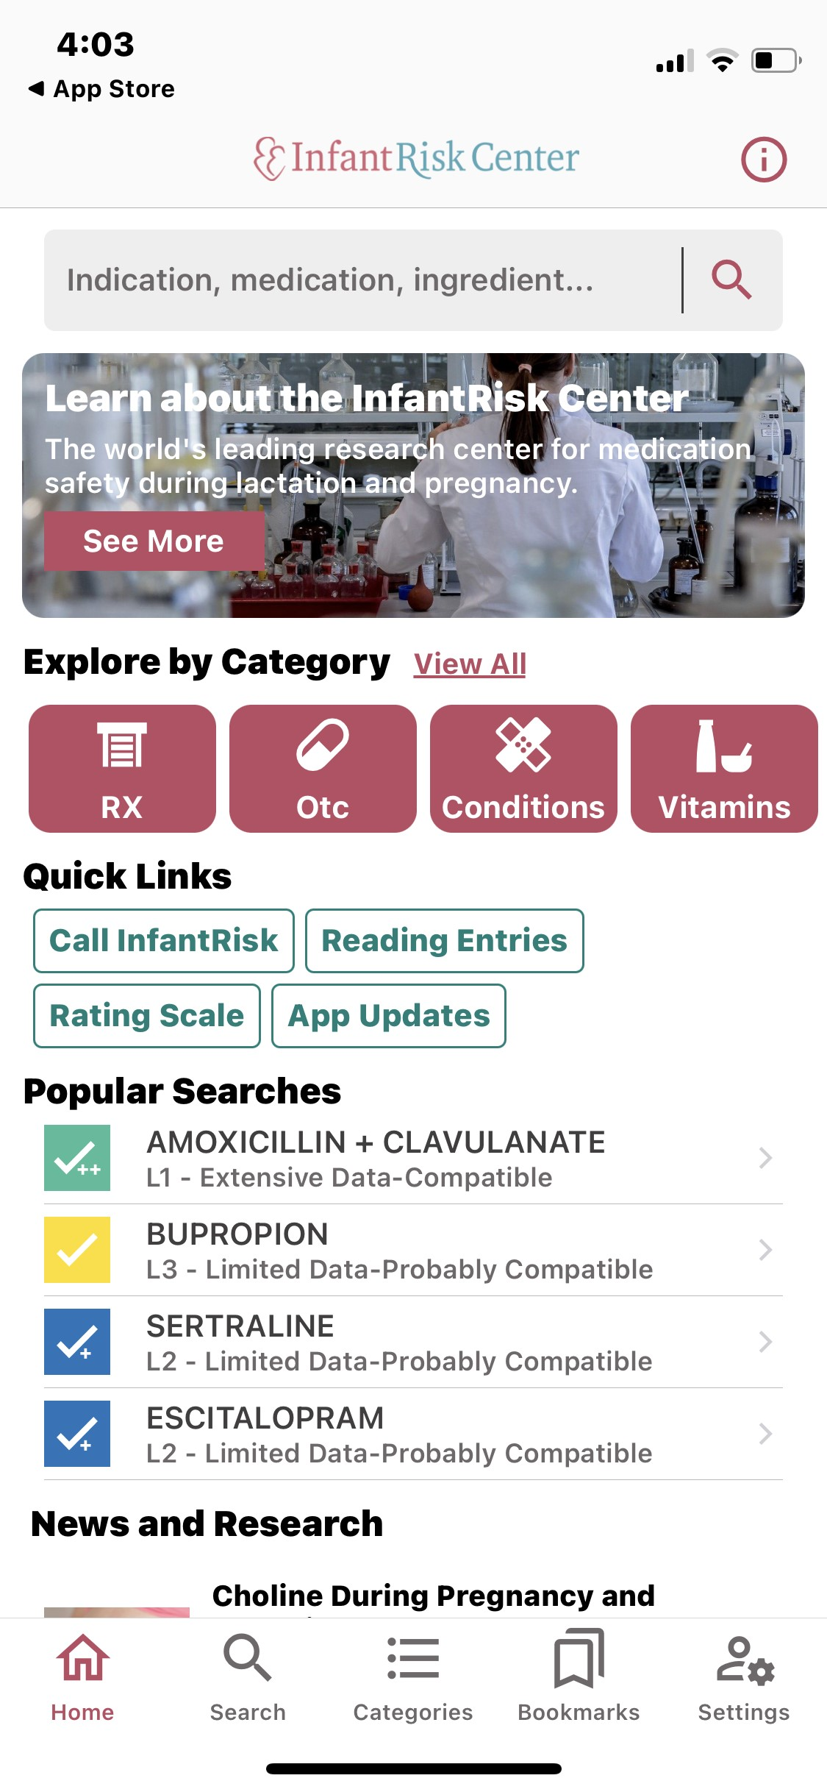
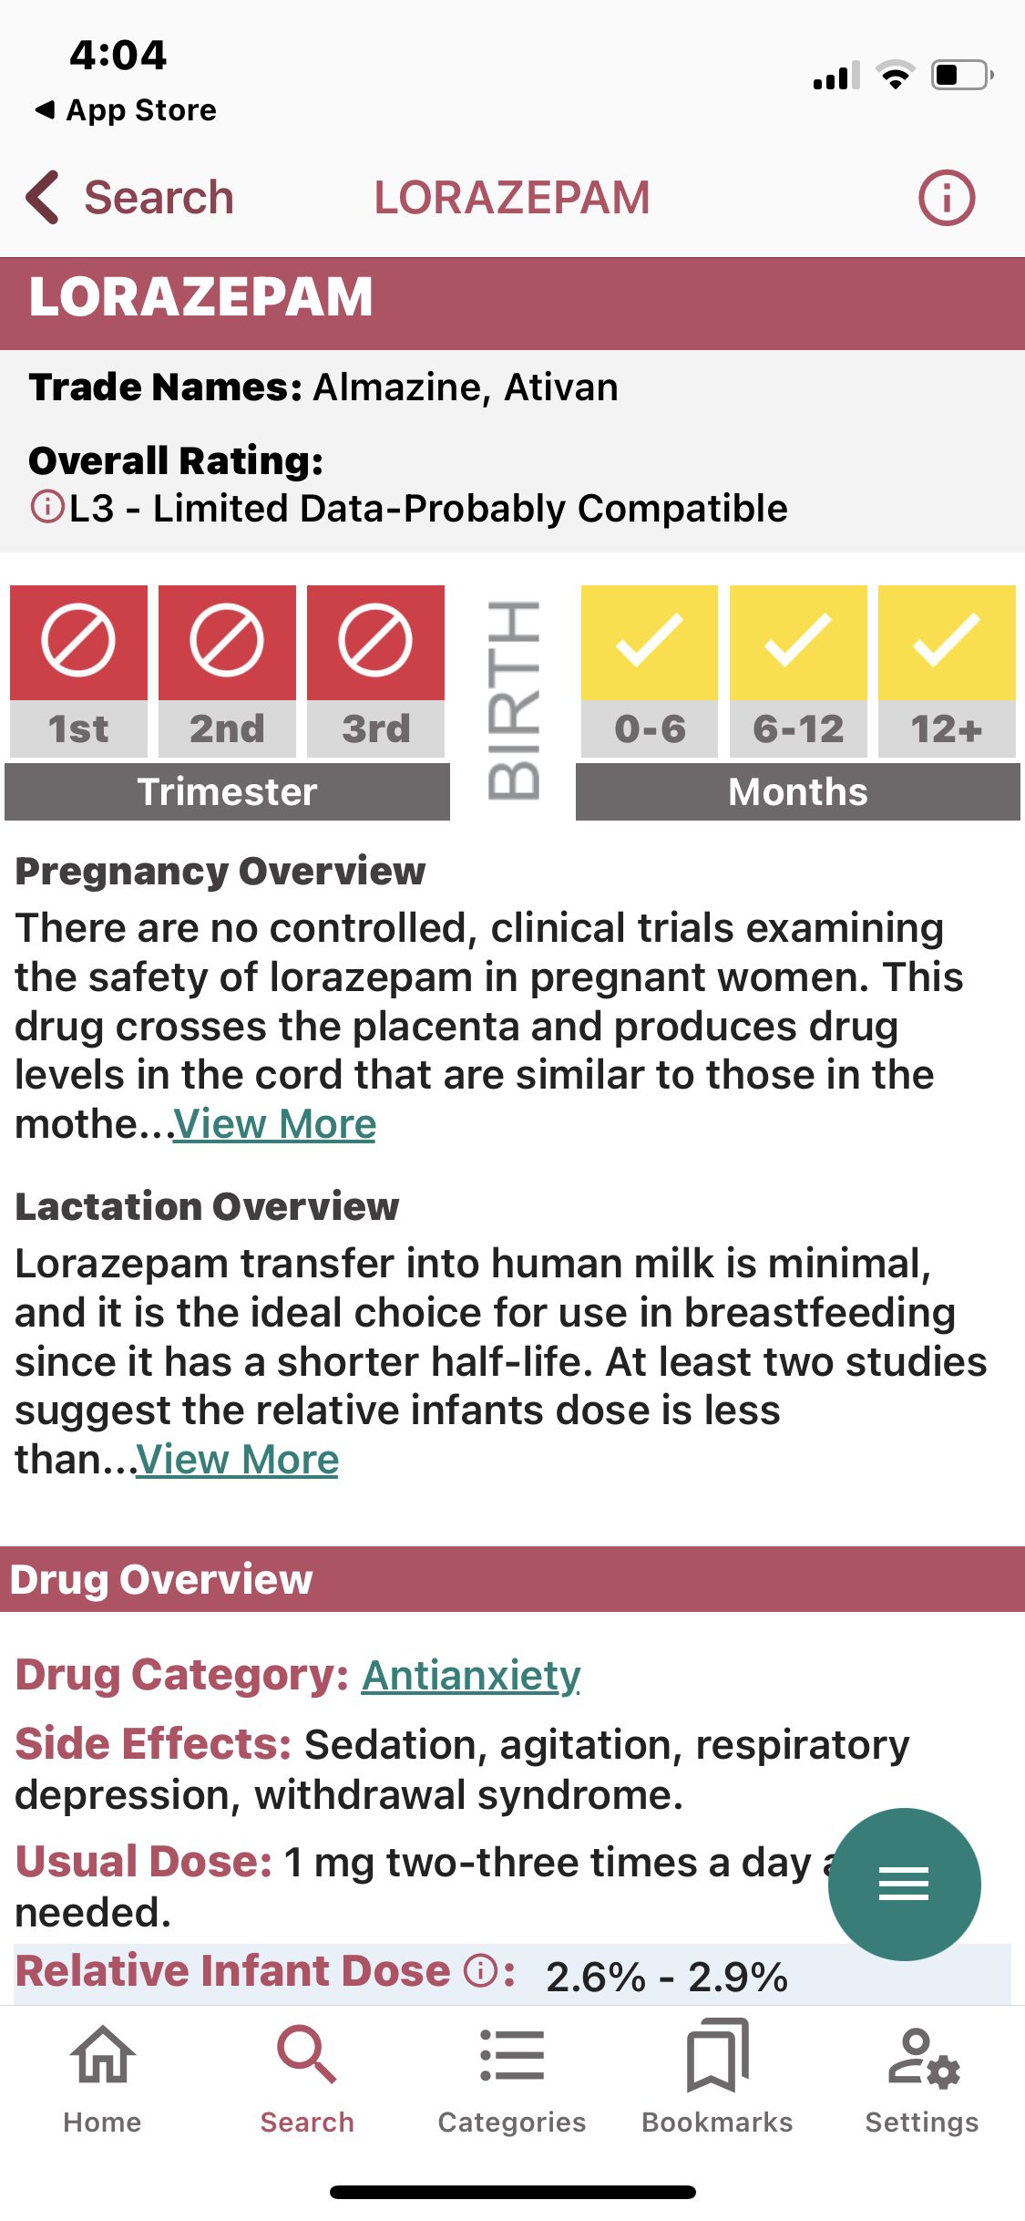
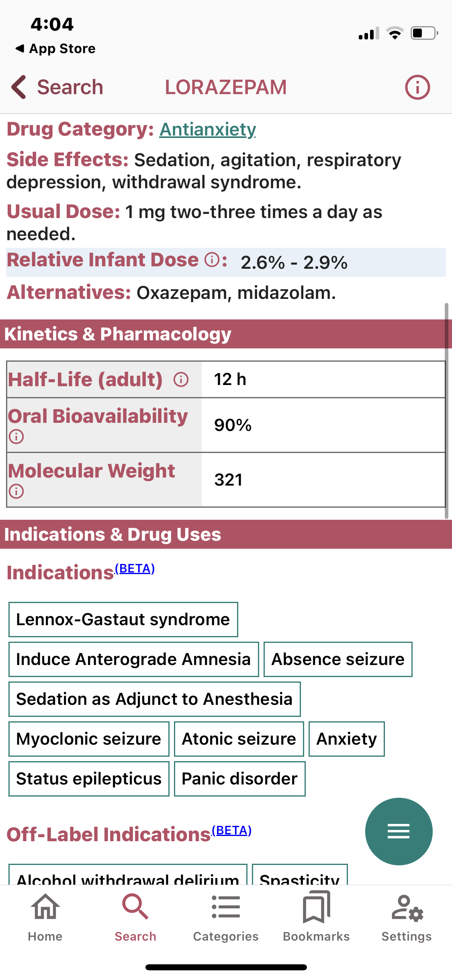
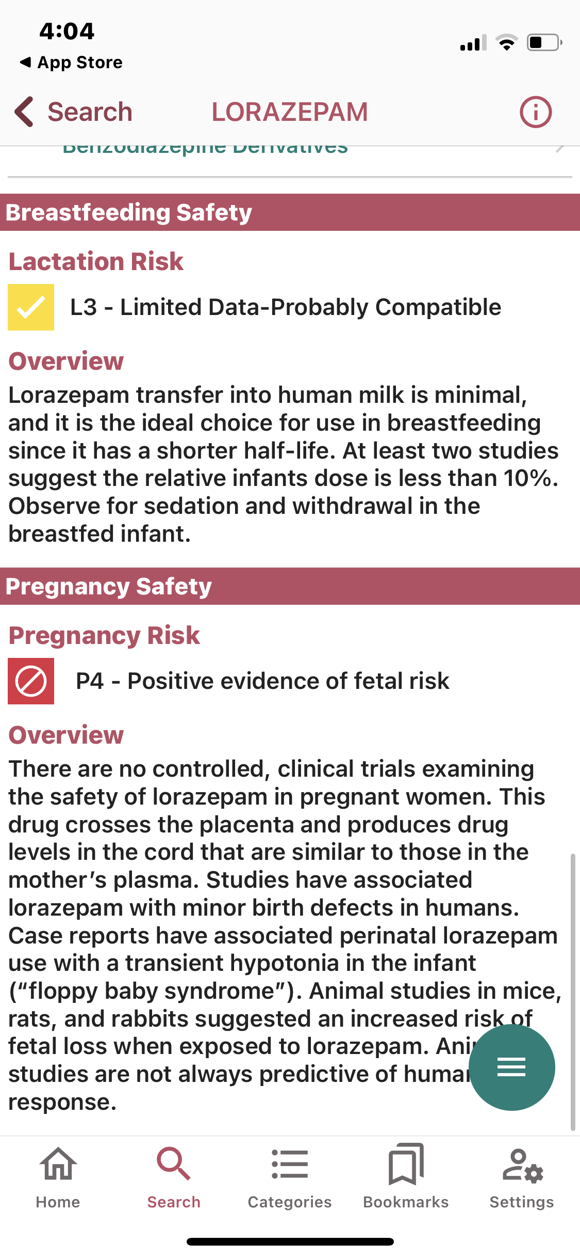
InfantRisk HCP Example^{9,10}

Slide 33
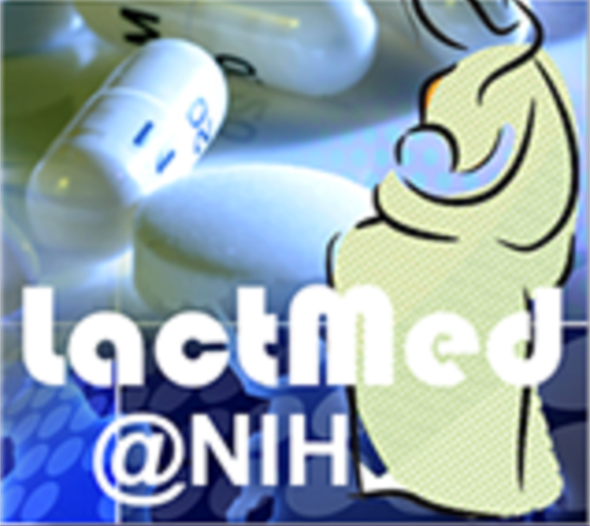
Drugs and Lactation Database (LACTMED)¹¹
Information on drugs and other chemicals which may affect breastfeeding mothers and infants​
Produced by the National Library of Medicine (NIH)​
Includes information on:​
Levels of drugs/substances in breast milk and infant blood​
Possible adverse effects in the nursing infant​
Potential therapeutic alternatives ​
Access through: National Library of Medicine website and University databases
Reviewed and updated monthly

Slide 34
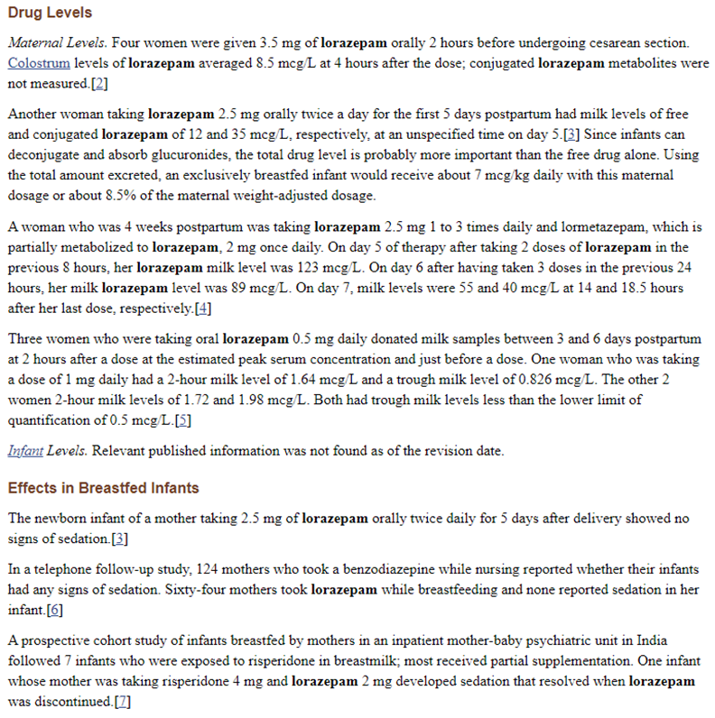
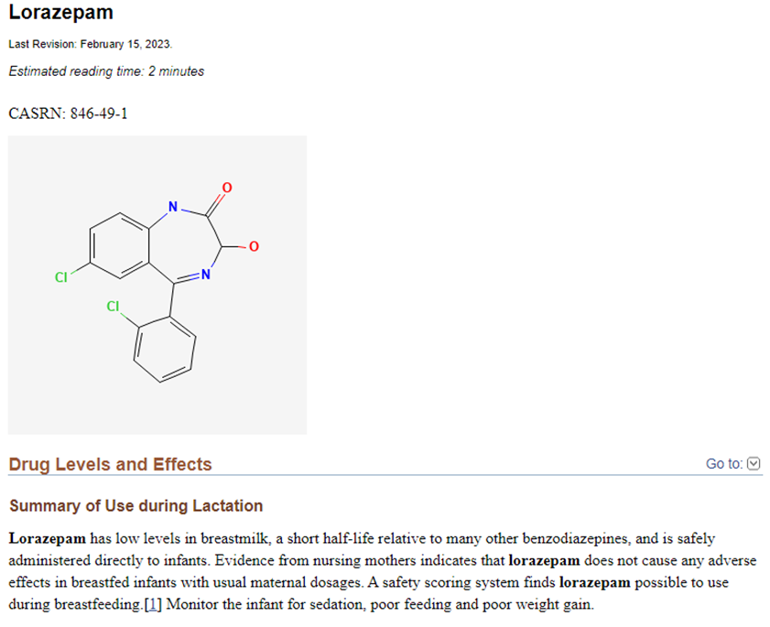
Lactmed Example¹¹

Slide 35
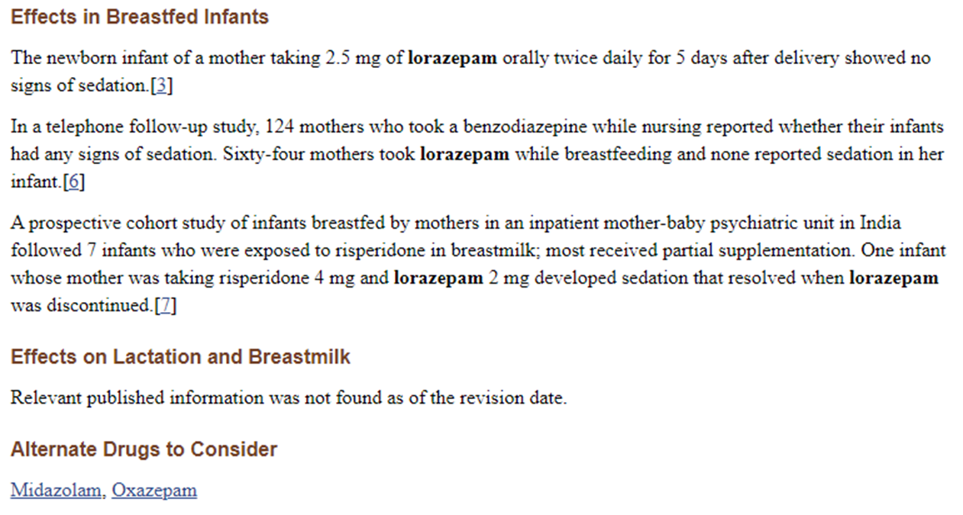
Lactmed Example¹¹

Slide 36
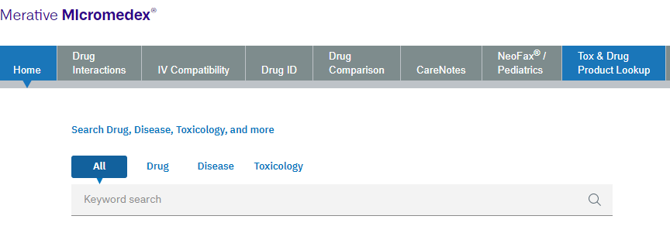
Micromedex¹²
Offers comprehensive drug, disease and toxicology-oriented information for healthcare professionals
Includes information on:​
Section for Pregnancy and Lactation
Pregnancy Category
Breastfeeding Category
Accessible through the university databases and subscriptions
In-Depth Answers provides summaries of:
General recommendations for clinical management
Patient case reports

Slide 37
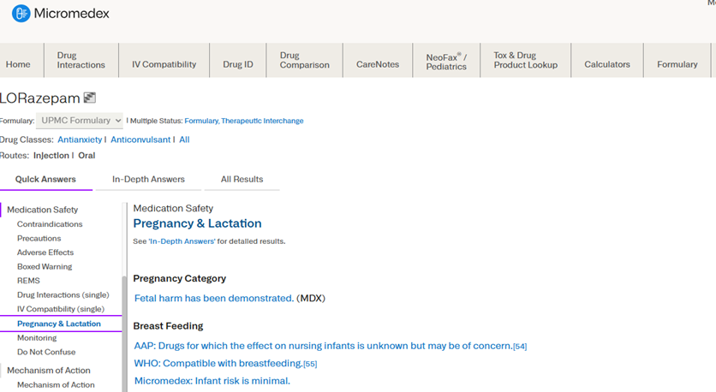
Micromedex Example¹²

Slide 38
Comparison of Sources
Briggs
High-quality evidence and recommendations
Hale’s/InfantRisk
Contains pharmacokinetic data in a user-friendly format
Updated every 2 years
LactMed
Includes medication safety information for lactation only
Does not provide information on every medication
Includes detailed summaries of case reports and studies published
Micromedex
Not updated frequently
Provides general summaries
Updated every 5 years

Slide 39
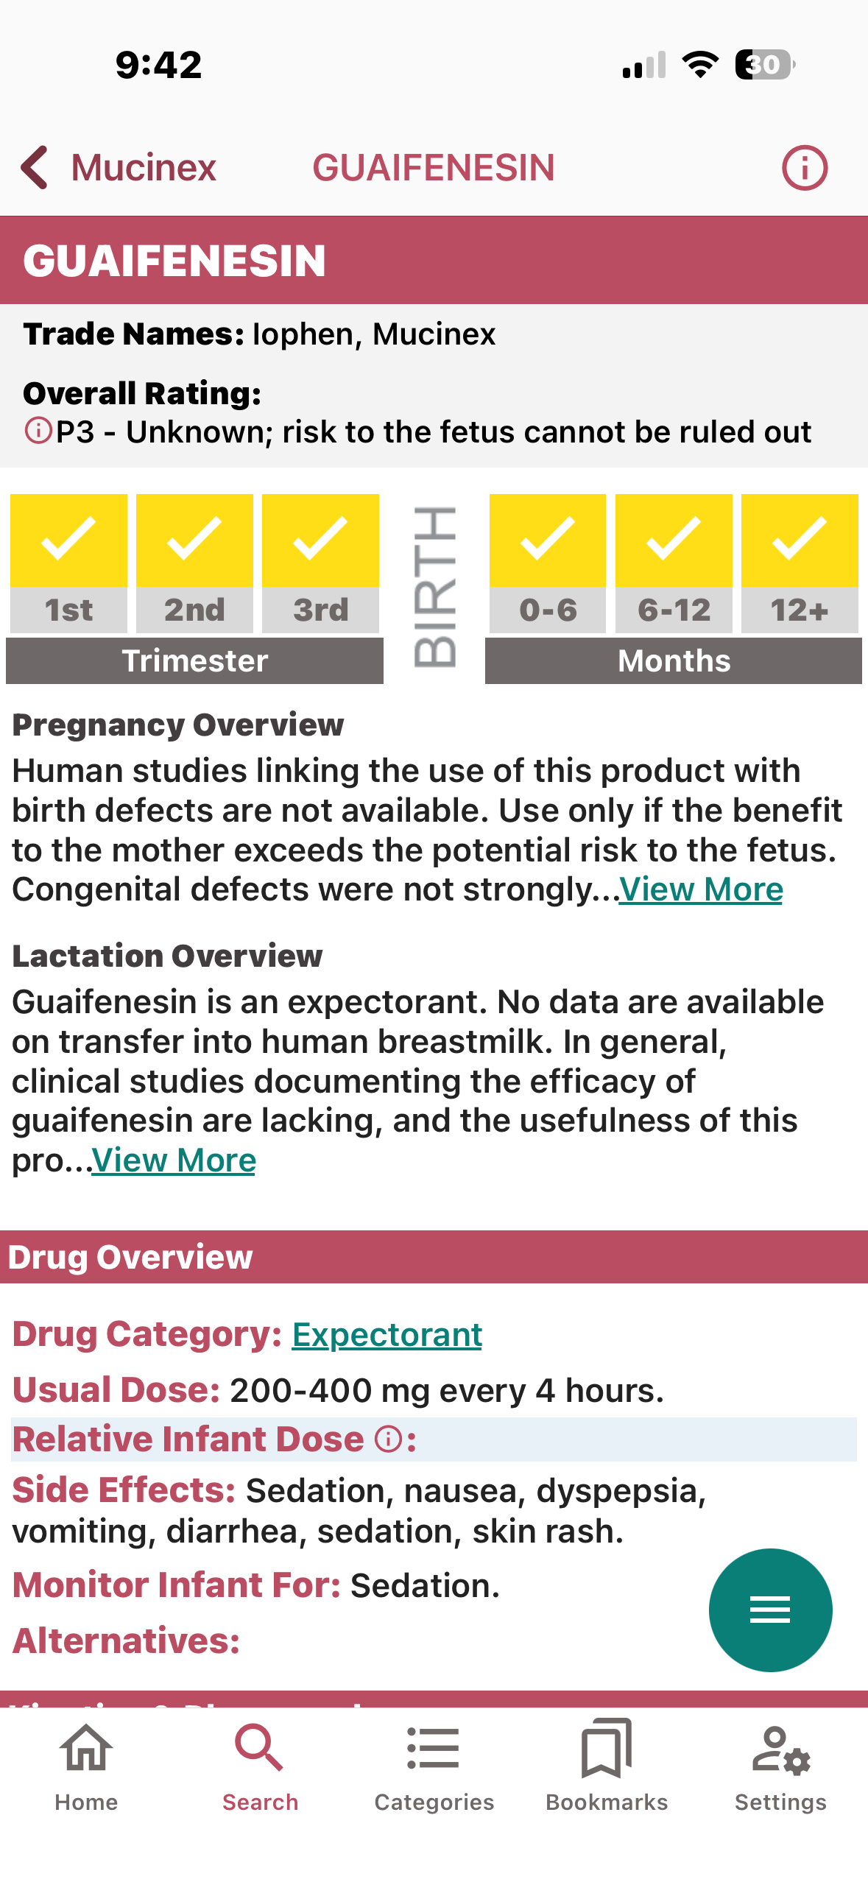
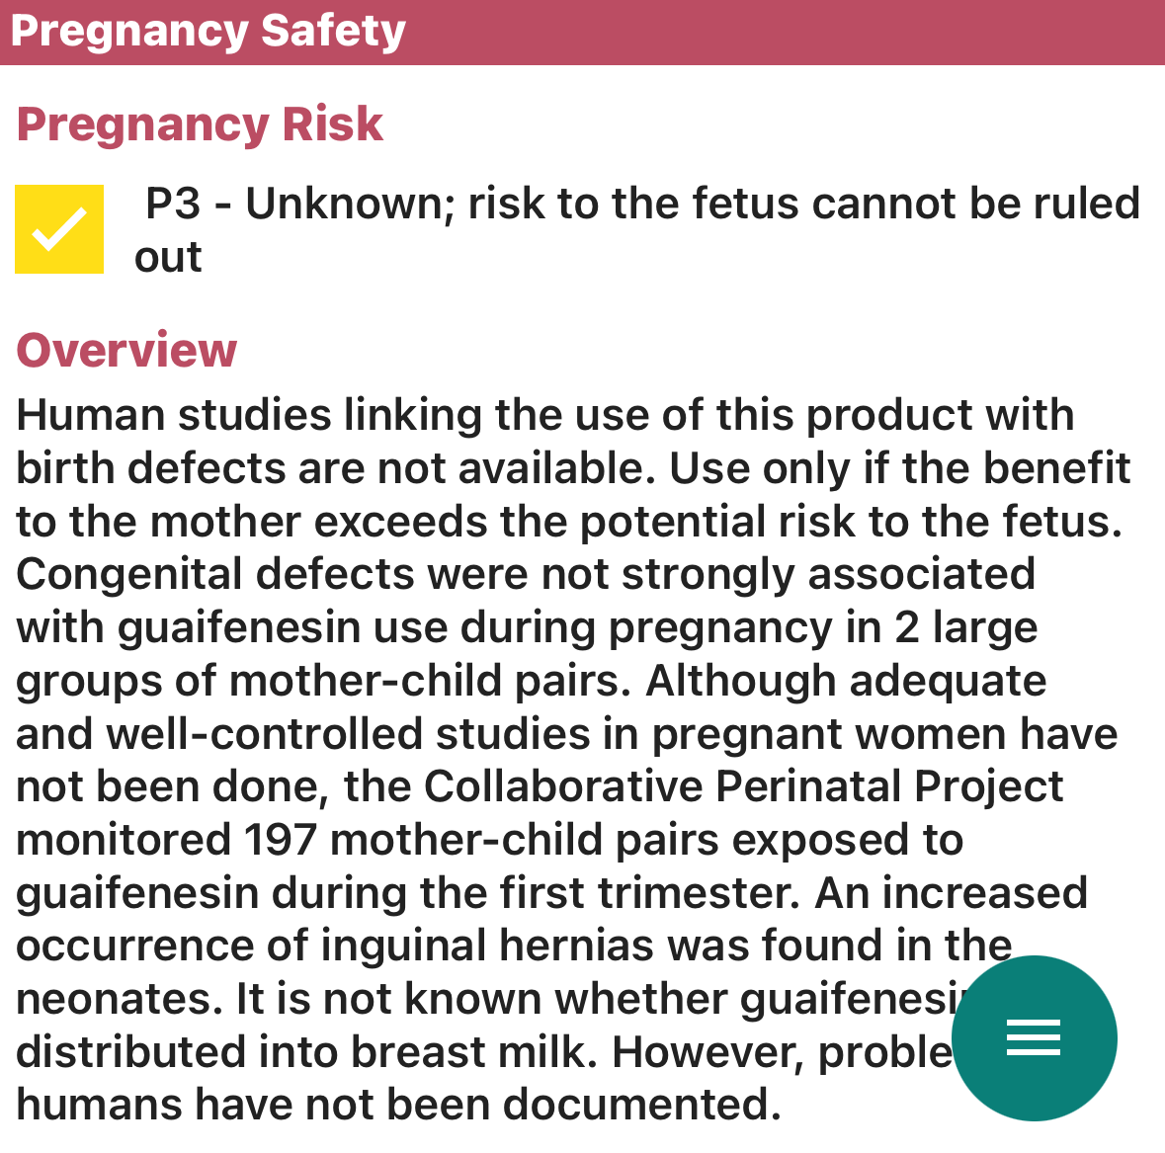
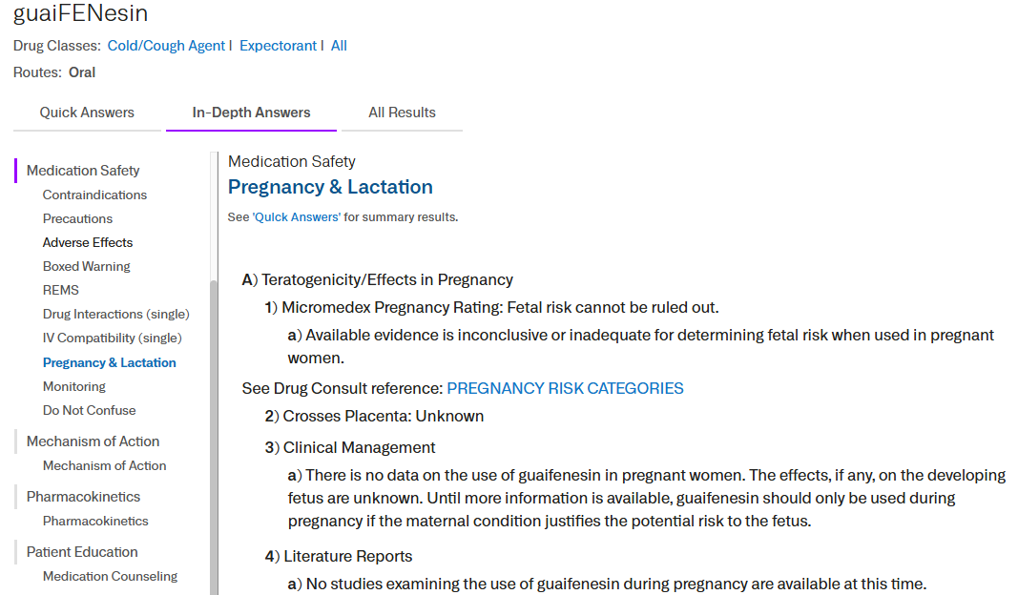
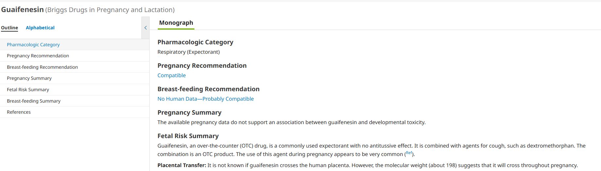
Question #2
A 27-year-old female, who is 25 weeks pregnant, comes into your pharmacy and has complaints of a common cold. She wants to buy Mucinex as it has helped her cough symptoms in the past, but she does not know if it is safe during pregnancy. She asks you for help.
Based on your assessment of your available resources, is Mucinex safe to use during pregnancy?
Yes, based off the resource evaluation, it is safe to use during pregnancy.
No, based off the resource evaluation, it is not safe to use during pregnancy.

Slide 40
06
Pharmacist Role in Patient Care

Slide 41
Medication Use Barrier¹³
CDC estimates 90% of women use one or more medications while pregnant or breastfeeding
The question often arises, “Can I take this while pregnant or breastfeeding?”
Concrete data is often lacking regarding medication safety
Providers usually practice a more cautionary approach

Slide 42
Pharmacist Role in Medication Safety
Evaluate at least 2 established resources
Avoid package inserts and Micromedex
Evaluate pharmacokinetic principles
Assess trimester, gestational age, and postnatal age
Evaluate risk vs. benefit of medication use during pregnancy and lactation
Avoid known teratogens or newly marketed drugs

Slide 43
Pharmacist Role in Medication Safety
Promote non-pharmacologic therapies when able
Recommend consulting healthcare providers prior to using new OTCs or herbal supplements
Provide support and follow up if inadvertent exposure
Promote shared decision-making and patient-centered care
Educate on potential adverse events to monitor for in breastfed infants

Slide 44
Question #3
A 25-year-old female presents to your emergency department after cutting her finger while cooking. She endorses 10/10 pain. The team would like to give her 5mg of oxycodone to alleviate the pain. The patient is concerned because she is breastfeeding and is due to pump soon. What questions could you ask the patient to assess the risk vs. benefit of the oxycodone?
How old is your baby?
Does your baby have any health concerns?
Would you consider holding off on breastfeeding?
Would you consider starting with a nonopioid pain medication?
All of the above
Potential Recommendations:
Consider asking the patient to pump now, then give the 5mg oxycodone
Consider a one-time oxycodone dose, then assess pain
Consider an alternative, nonopioid pain medication

Slide 45
References
Landon, M. B., Galan, H. L., Jauniaux, E., Driscoll, D. A., Berghella, V., Grobman, W. A., Kilpatrick, S. J., & Cahill, A. G. (2025). Gabbe’s obstetrics normal and problem pregnancies 9th edition. Elsevier Ltd.
Wilson JG. Current status of teratology—general principles and mechanisms derived from animal studies. In: Wilson JG, Fraser FC, eds. Handbook of Teratology. New York: Plenum; 1977:47.
Weber RJ, Jauniaux ERM. Drugs and environmental agents in pregnancy and lactation: teratology, epidemiology & patient management. Chapter 7. In: Landon MB, Gabbe SC, eds. Obstetrics: Normal and Problem Pregnancies, 8e. 2021. Elsevier, Philadelphia, PA. Accessed at: https://www.clinicalkeu.com/#!/content/book/3-s2.0B9780323608701000071.
Food and Drug Administration. Content and Format of Labeling for Human Prescription Drug and Biological Products; Requirements for Pregnancy and Lactation Labeling (Final Rule). Federal Register 79:233 (December 4, 2014):72064-72103.
Gasparyan, J., Anderson, P.O., Lewis, T. and Yeung, C.H.T. (2026), Rules of Thumb for Estimating Drug Levels in Breast Milk: How Well Do They Work?. Clin Pharmacol Ther, 119: 101-108. https://doi.org/10.1002/cpt.70021
Centers for Disease Control and Prevention. How much and how often to breastfeed. CDC website. https://www.cdc.gov/infant-toddler-nutrition/breastfeeding/how-much-and-how-often.html. Accessed April 30, 2026.
Anderson PO, Manoguerra AS, Valdés V. A Review of Adverse Reactions in Infants From Medications in Breastmilk. Clinical Pediatrics. 2016;55(3):236-244. doi:10.1177/0009922815594586
Briggs GG, Towers CV, Forinash AB. Briggs Drugs in Pregnancy and Lactation: A Reference Guide to Fetal and Neonatal Risk. Philadelphia: Wolters Kluwer; 2022.
Hale TW, Krutsch K. Hale's Medications & Mothers' Milk 2025: A Manual of Lactational Pharmacology. New York: Springer Publishing Company; 2025.
About the Infantrisk Center. InfantRisk Center. https://www.infantrisk.com/about-infantrisk-center. Accessed April 26, 2025.
Drugs and lactation database (LactMed®) - NCBI bookshelf. https://www.ncbi.nlm.nih.gov/books/NBK501922/. Accessed April 26, 2025.
Home. MICROMEDEX. https://www-micromedexsolutions-com.pitt.idm.oclc.org/micromedex2/librarian/CS /BE6DCE/ND_PR/evidencexpert/ND_P/evidencexpert/DUPLICATIONSHIELDSYNC/D864C9/ND_PG/evidencexpert/ND_B/evidencexpert/ND_AppProduct/evidencexpert/ND_T/evidencexpert/PFActionId/pf.HomePage?navitem=topHome&isToolPage=true. Accessed April 26, 2025.
Centers for Disease Control and Prevention. About medicine and pregnancy. Centers for Disease Control and Prevention. Accessed April 30, 2026. https://www.cdc.gov/medicine-and-pregnancy/about/index.html

Slide 46
Thank you!
Questions?

