Slide 1
SDS/PACU Clinical Education Series:
Neurological Considerations

Slide 2
Baseline Neurologic Assessment
LOC
Alert → lethargic; responds to voice/touch/pain (infants: consolability)
Pupils
PERRLA (size, equality, reactivity)
Eyes (CN III, IV, VI):
Tracks objects; no nystagmus/strabismus
Motor
Moves all extremities; symmetric strength; no posturing
Sensory
Responds to touch/pain; withdrawal/localization
Reflexes
Infants: Moro, grasp, rooting
Older child: DTRs, Babinski (<1 yr normal)
Speech/Behavior
Age-appropriate speech/cry; interaction
Coordination/Gait
Balance, walking, ataxia (if appropriate)
Immediately report change in consciousness, significant change in pupils, seizure activity, severe headaches with and without emesis, high-pitched cries, and bulging fontanels

Slide 3
Glasgow Coma Scale
Rationale
Pediatric Considerations
Responses must be age-appropriate
No verbal responses in 0-23 months
Limited motor scale use in infants (especially <6–12 months)
Any sound (including crying) = speech response
Orientation shown by:
Recognizing parents
Stating own name
Clinical Tips:
Have a parent present to help elicit responses
Young children may not respond to unfamiliar environments and voices
Used to detect changes in mental status and life-threatening complications

Slide 4
Glasgow Coma Scale
Score | Child | Infant | Child | Infant | Child | Infant
 | Eye Opening | Eye Opening | Best Motor Response | Best Motor Response | Best Verbal Response | Best Verbal Response
6 |  |  | Obeys commands | Spontaneous movements
5 |  |  | Localizes pain | Withdraws to touch | Oriented & converses | Smiles, coos, and babbles
4 | Spontaneously | Spontaneously | Flexion-appropriate withdraw to pain | Flexion-appropriate withdraw to pain | Disoriented, confused | Cries but is consolable
3 | To verbal command | To shout, speech | Flexion-abnormal (decorticate rigidity) | Flexion-abnormal (decorticate rigidity) | Inappropriate words | Persistent, inappropriate crying and/or screaming
2 | To pain | To pain | Extension (decerebrate rigidity) | Extension (decerebrate rigidity) | Incomprehensible sounds | Moans, grunts to pain
1 | No response | No response | No response | No response | No response | No response
Total= 3 to 15

Slide 5
Seizures
What is a seizure?
  A sudden, abnormal burst of electrical activity in the brain
  May affect movement, awareness, behavior, or autonomic function
  See Lippincott reference for more details on the variety of seizures:
  Lippincott® Solutions

Slide 6
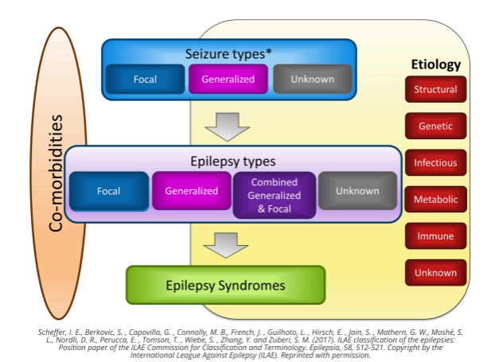
Notes:
Sims, G. L., & LeClaire, A (2023, June 23). Neurological complications: Seizure.

Slide 7
Seizures- Nursing Interventions
Stay with the patient & call for help
Note the time of onset/completion & characteristics
Maintain airway & oxygenation
Protect from further injury

Slide 8
Strokes - Key Points
Loss of balance or trouble walking
Pediatric stroke may increase risk of developing epilepsy
Potential causes
Congenital or acquired heart disease
Birth defects
Infections such as meningitis or encephalitis
Trauma
Blood disorders such as Sickle Cell Disease
Arteriovenous malformations
Potential symptoms
Headache
Seizures (especially in newborns)
Speech difficulties
Problems with eye movement
Numbness and weakness on one side of the body
Medications
Hormones
Notes:
Camicia, M., & Lutz, B. J. (2023, June 30). Children and stroke.Medbridge.

Slide 9
Strokes - Key Points
Related Disabilities
Speech and communication disorders
Paralysis or weakness
Cerebral Palsy
Intellectual Disability
Epilepsy
More likely to have meaningful recovery due to plasticity of brain
Notes:
Camicia, M., & Lutz, B. J. (2023, June 30). Children and stroke.Medbridge.

Slide 10
Classifications of Stroke
Ischemic Stroke
Caused by thrombosis or embolism
More common than hemorrhagic
Timing of restoration of blood flow is critical
Hemorrhagic Stroke
Result of spontaneous rupture of cerebral vessel
Most common causes are hypertension, ruptured aneurysms, vascular malformations, vasculitis, tumors, head trauma
Watershed Stroke
Result of systemic hypoperfusion
Typically caused by myocardial infarction, stroke, cardiac arrest, sepsis or gastrointestinal bleed
Time=Tissue
Transient Ischemic Attack
Temporary blockage of flow to brain
Causes include blood clots, fat embolism, plaque
Lasts minutes to hours then resolves
Considered a "warning sign" as many individuals with TIAs will have more severe stroke within one year
Often underreported due to subtle symptoms
Notes:
Camicia, M., & Lutz, B. J. (2023, June 11). Classifications of stroke.

Slide 11
Stroke - Nursing Interventions
Stay with the patient & call for help
Note the symptoms and type of onset
Note side of symptoms/deficits
Maintain airway & oxygenation
Prepare for CTH immediately

Slide 12
Other neurological considerations
Increased intracranial pressure: Early recognition is key
  Signs/symptoms- headache, vomiting, altered LOC, seizures, abnormal eye movements, pupillary changes, Cushing’s triad
  Delayed Emergence/altered level of consciousness
  Do not assume that prolonged sedation is normal
  Escalate concern if patient does not progress or has a sudden change in LOC

Slide 13
Other neurological considerations
Hypoglycemia
  Can present as altered LOC, lethargy, irritability, or seizures
  Early glucose check for any change in LOC
  Pain & pain management
  Pain can mask neurologic changes
  Pain management and/or sedatives can also cloud assessment

Slide 14
UPMC Resources
Seizure Precautions (PTC-RN469 )
PLS Pediatric Stroke
PLS Status Epilepticus

Slide 15
References
American Heart Association (2025). Pediatric advanced life support (PALS) provider manual. American Heart Association. ISBN 978-1-68472-339-3.
Camicia, M., & Lutz, B. J. (2023, June 30). Children and stroke. Medbridge.
Camicia, M., & Lutz, B. J. (2023, June 11). Classifications of stroke. Medbridge.
Hockenberry, M. J., & Wilson, D. (2023). Wong’s nursing care of infants and children (12th ed.). Elsevier.
Shaw E, Patel S, Davies P, Stewart C. Managing raised intracranial pressure in paediatric brain injury. Paediatrics and Child Health. 2023;33(11):350–356.
Sims, G. L., & LeClaire, A (2023, June 23). Neurological complications: Seizure. Medbridge.
UPMC Children’s Hospital of Pittsburgh (2025). Seizure Precautions (PTC-RN469 ). Retrieved March, 30, 2026, from PolicyStat ID 18513800.
Wolters Kluwer. (2025). Seizure management, pediatric. Lippincott® Procedures. Retrieved March 30, 2026 from Lippincott® Solutions

