Slide 1
Housekeeping Reminders
Please submit questions via the Zoom chat during the presentation.
For attendance, please type in your name and organization in the chat.
Attendees are muted upon entry. Click “Unmute” when you would like to speak. Please mute yourself after speaking.
The presentations are posted on Tomorrow’s HealthCare www.tomorrowshealthcare.org

Slide 2
2026 PCMH Perinatal Care in Family and Pediatric Offices
Sprint Session #3
June 23, 2026
Pittsburgh Regional Health Initiative

Slide 3
Continuing Education Information
In support of improving patient care, this activity has been planned and implemented by the University of Pittsburgh and The Jewish Healthcare Foundation. The University of Pittsburgh is jointly accredited by the Accreditation Council for Continuing Medical Education (ACCME) and the American Nurses Credentialing Center (ANCC), to provide continuing education for the healthcare team. 1.5 hours are approved for this course.
As a Jointly Accredited Organization, University of Pittsburgh is approved to offer social work continuing education by the Association of Social Work Boards (ASWB) Approved Continuing Education (ACE) program. Organizations, not individual courses, are approved under this program. State and provincial regulatory boards have the final authority to determine whether an individual course may be accepted for continuing education credit. University of Pittsburgh maintains responsibility for this course. Social workers completing this course receive 1.5 continuing education credits.

Slide 4
Disclosures
No members of the planning committee, speakers, presenters, authors, content reviewers and/or anyone else in a position to control the content of this education activity have relevant financial relationships with any entity producing, marketing, re-selling, or distributing health care goods or services, used on, or consumed by, patients
to disclose.
Notes:
No conflicts of interest

Slide 5
Disclaimer
The information presented at this Center for Continuing Education in Health Sciences program represents the views and opinions of the individual presenters, and does not constitute the opinion or endorsement of, or promotion by, the UPMC Center for Continuing Education in the Health Sciences, UPMC / University of Pittsburgh Medical Center or Affiliates and University of Pittsburgh School of Medicine. Reasonable efforts have been taken intending for educational subject matter to be presented in a balanced, unbiased fashion and in compliance with regulatory requirements. However, each program attendee must always use his/her own personal and professional judgment when considering further application of this information, particularly as it may relate to patient diagnostic or treatment decisions including, without limitation, FDA-approved uses and any off-label uses.

Slide 6
Learning Objectives
Describe strategies for maternal mental health screening and referrals in pediatric and family practice settings
Discuss progress in PCMH quality improvement projects for improving perinatal care in family and pediatric offices
Describe strategies to implement the second PDSA sprint cycle

Slide 7
Welcome
Robert Ferguson, MPH
Chief Policy Officer
Pittsburgh Regional Health Initiative

Slide 8
Maternal Mental Health Screening and Referral Strategies for Pediatric and Family Practice Settings
Brianna K. Moyer, MD, LG Health Physicians Family and Maternity Medicine
Sarah H. Jones, MD, University of Mississippi Medical Center

Slide 9

IMPLICIT ICC Maternal Depression Screening
June 23, 2026
Notes:
9

Slide 10

IMPLICIT Network Overview
Notes:
10

Slide 11

What does the IMPLICIT Network do?
Innovations for Maternal and PerinataL Care ImprovemenT
Established in 2003
Develops, implements, evaluates, and optimizes new and existing models of care focused on improving birth outcomes and the health of women/birthing people, infants and families
Supports implementation of ICC and 4TM models at clinical sites
Provides evidence, materials, resources, trainings and support for providers and residency faculty
Creates a professional forum for primary care providers that grounds conversations about maternal and infant health outcomes in evidence, equity and justice.

Slide 12
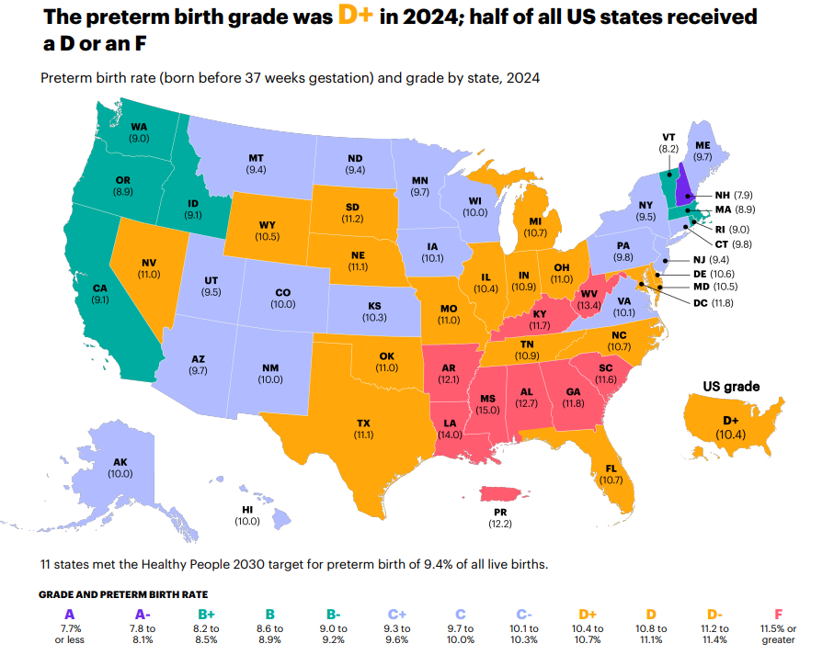
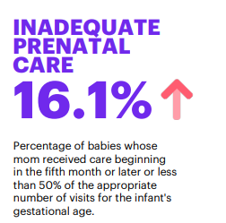
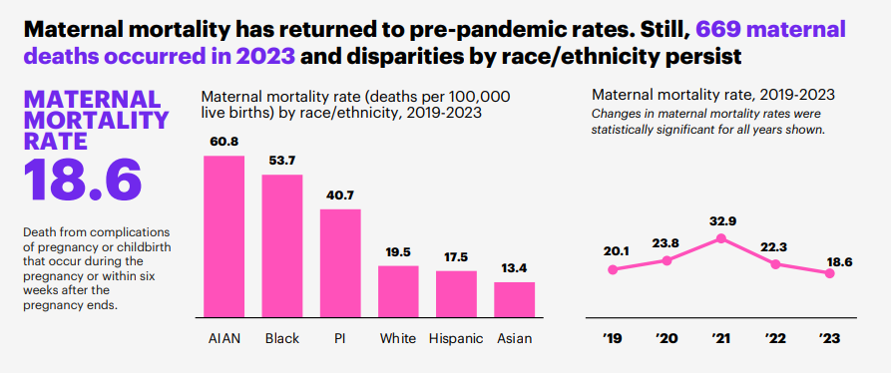

Why?
MoD 2024 Report Card
Notes:
Grades determined by March of Dimes based on preterm birth rates from National Center for Health;
https://www.marchofdimes.org/mission/prematurity-reportcard.aspx

Slide 13
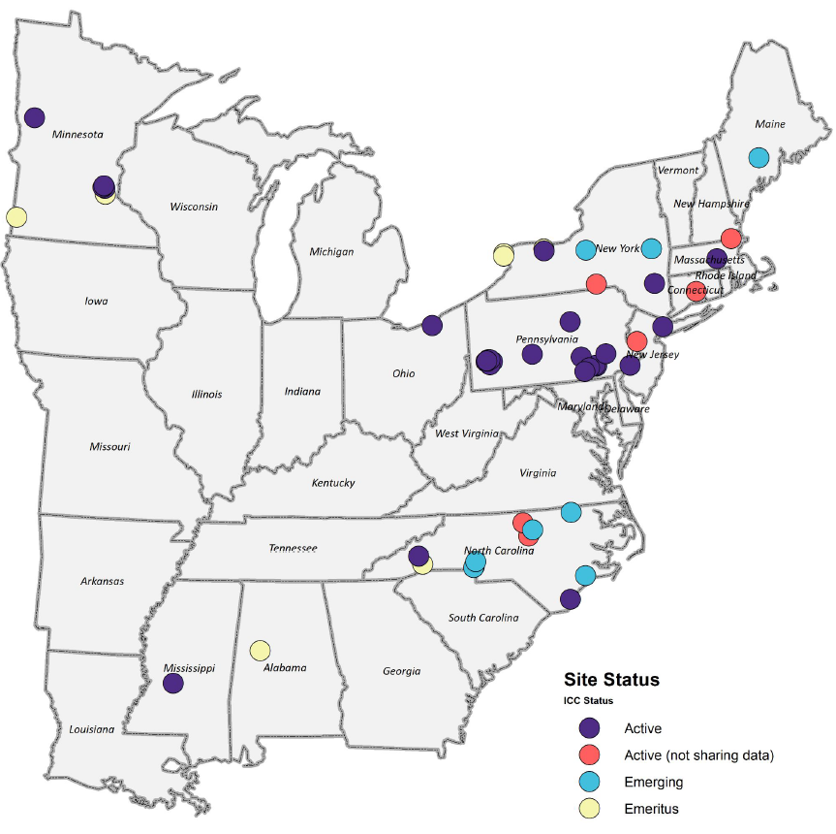
IMPLICIT Network Sites
51 sites have utilized the Network to implement ICC
44 sites are active with ICC in the Network
29 sites share ICC data with the Network via REDCap
12 sites are active with 4TM in the Network

Slide 14

Interconception Care (ICC)

Slide 15
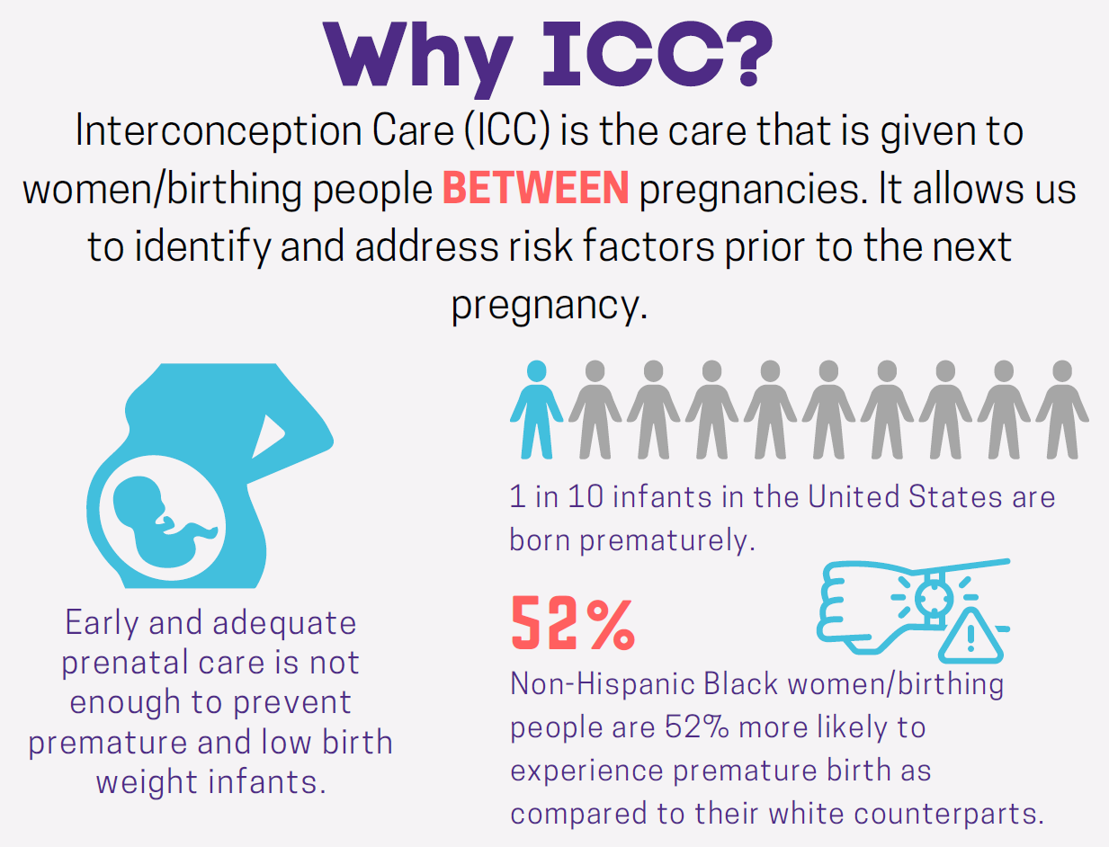

Slide 16
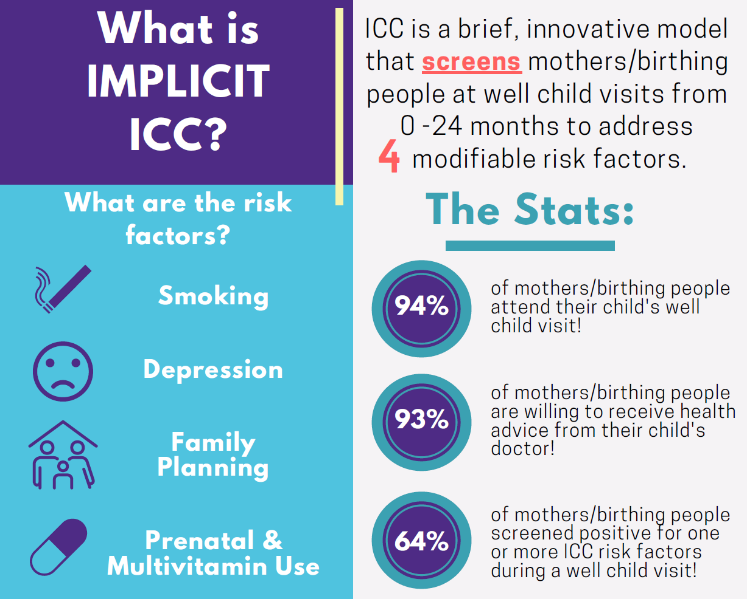

Slide 17

IMPLICIT ICC Workflow
Screen & Support Birthing Persons
At child's
0-24
month
Well Child
Visits
Behavioral Risk Factors
Smoking
Depression
To ensure a healthy mom and thus a healthy family
Family Planning
Multivitamin Use

Slide 18
The Model
Focus on four evidence-based risk factors affecting future birth outcomes.
Smoking
Depression
Family Planning
MVI w/ folic acid
Complete screen during well child visits from 0 -24 months.
Repeated screening can help identify and address risk factors.

Slide 19

Prevalence of Maternal Depression
1 in 8 mothers/birthing people experience postpartum depression
Depression has a peripartum recurrence of 40%
Postpartum depression is one of the most underdiagnosed obstetric complications in America

Slide 20
Evidence for Maternal
Depression Screening
Maternal depression can create an environment that places the child at higher risk of language, cognitive, social, and emotional delays
AAP states that pediatric medical homes should establish a system to screen for depression at the 1-, 2-, 4-, and 6-month well-child visits and provide referrals when necessary
Effective treatment of depression in MBPs reduces the risk of problem behavior and psychopathology in children

Slide 21
Best Practices for Maternal
Depression Screening
The AAP, ACOG, and USPSTF all endorse the Edinburgh Postnatal Depression Scale and the two-question Patient Health Questionnaire (PHQ- 2) screen for depression
After initial screening at 1-month, repeated screening at 6 and 12 months postpartum identifies an additional 13 percent of women at high risk of depression
Screening should be non-stigmatizing, assuage an MBP’s fear of being reported to authorities, and use language that frames questions about the MBP’s well-being in terms of their child’s health

Slide 22
Evidence for Maternal Depression Screening
Scope of the problem
1 in 8 women is affected by perinatal depression (depression during pregnancy or in first 12 months after delivery) (Bauman et al., 2020).
Mental health conditions were the underlying cause of 22% of pregnancy-related deaths (Trost et al., 2022).
USPSTF (2023) guidelines recommend screening for depression in adults, including during pregnancy and the postpartum period.
In the United States, 400,000 infants are born each year to depressed MBPs (Earls & AAP Committee on Psychosocial Aspects of Child and Family Health, 2010).
Major depression peaks 6 weeks after birth and minor depression 2 to 3 months after birth; another peak in depression occurs 6 months after birth (Earls et al., 2018).
MBPs often change their primary healthcare providers when they begin prenatal care, and the relationship with their pre-pregnancy providers may not resume after giving birth. This period of transition can stretch from pregnancy through the first year postpartum, potentially creating an 18- to 24-month disruption in usual care providers (Dietrich et al., 2003; Hill, Greenberg, Holzman & Schulkin, 2001; LaRocco-Cockburn, Melville, Bell & Katon, 2003; Katon, et al, 2017).
Competing demands make it more difficult for MBPs to maintain ongoing relationships with specialty mental health providers.

Slide 23
Evidence for Maternal Depression Screening
Evidence for association of maternal depression and child outcomes
Maternal depression can create an environment that places the child at higher risk of language, cognitive, social, and emotional delays (Sutherland et al., 2022; Earls et al., 2018, Netsi et al., 2018).
Effective treatment of depression in MBPs reduces the risk of problem behavior and psychopathology in children (Earls et al., 2018; Weissman et al., 2006).
Evidence in pediatric/postpartum care
The USPSTF (2019) recommends referring postpartum people who are at increased risk of perinatal depression to counseling.
AAP states that pediatric medical homes should establish a system to screen for depression at the 1-, 2-, 4-, and 6-month well-child visits and provide referrals when necessary (Earls et al., 2018).
Many pediatricians can screen for and address maternal depression (Earls et al., 2018; USPSTF, 2016).
The benefits of screening MBPs outweigh the risks legally, ethically, and practically (Earls et al., 2018).
Randomized trials show benefit of implementing team-based care for perinatal depression in sites providing non-specialty mental health services (Grote et al., 2015; Melville et al., 2014; Reist et al., 2022).

Slide 24
Evidence for Maternal Depression Screening
Evidence for best screening method
The AAP, ACOG, and USPSTF all endorse the Edinburgh Postnatal Depression Scale and the two-question Patient Health Questionnaire (PHQ- 2) screen for depression. (AAP, 2022; ACOG, 2015; USPSTF, 2023).
Bennett and colleagues (2008) compared the Edinburgh Postnatal Depression Scale with a 2- item screen (Spitzer et al., 1994) modified from the PHQ-2. The authors found that the simpler 2- item screen is efficient in ruling out depression and can be used as a pre-screen for a longer tool, such as the PHQ-9 (9-question depression screen; Table 4). See Table 5 for a comparison of the two-question screens.
After initial screening at 1 month, repeated screening at 6 and 12 months postpartum identifies an additional 13 percent of women at high risk of depression (Yawn, Bertram, Kurland & Wollan, 2015).
Screening should be nonstigmatizing, assuage an MBP’s fear of being reported to authorities, and use language that frames questions about the MBP’s well-being in terms of their child’s health (Byatt, Biebel, Friedman, Debordes-Jackson & Ziedonis, 2013).
Evidence for best intervention
The Motivating Our Mothers (MOM) trial screened MBPs at well-child visits, followed by an educational intervention with motivational and destigmatizing language, followed by a telephone booster. The outcome of the randomized controlled study was an increase in MBPs who reported attempting to contact identified resources: 73 percent intervention vs. 53 percent control (Fernandez y Garcia et al., 2015).
Engaging with community partners can reveal public and private resources for follow-up and treatment (Earls & AAP Committee on Psychosocial Aspects of Child and Family Health, 2010).

Slide 25
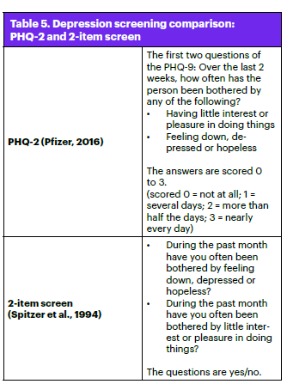
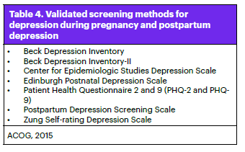
Evidence for Maternal Depression Screening

Slide 26
Completing ICC at the WCV
How do I integrate the screening questions into the well child visit?

Slide 27
Family medicine physicians are uniquely suited to addressing issues during the interconception period

Slide 28
Addressing Positive
Screens
  Need to develop workflows for addressing positive screens, especially if mother/birthing person is not a patient
  Additional appointments or referrals often needed to improve maternal health
  Some sites are testing case management strategies
  Most sites have patient education materials that focus on the four risk factors
  Build a care team system for referrals
Workflows for addressing positive depression screens
are crucial for acute suicidality/homicidality since screening occurs during WCV

Slide 29
ICC at the WCV
How to include ICC in the WCV
Ask mother/birthing person how they are doing while you are examining baby!
Ask mother/birthing person how they are doing after you are done examining baby!
It's totally up to you!
Example:
"Asking these questions help us to provide the best possible care for your family. We want to make sure we support your family as best we can!"
Something to consider. . .
We should explain to mother/birthing person why we are asking these questions at the well child visits . . .
Video examples of ICC conducted at WCVs

Slide 30
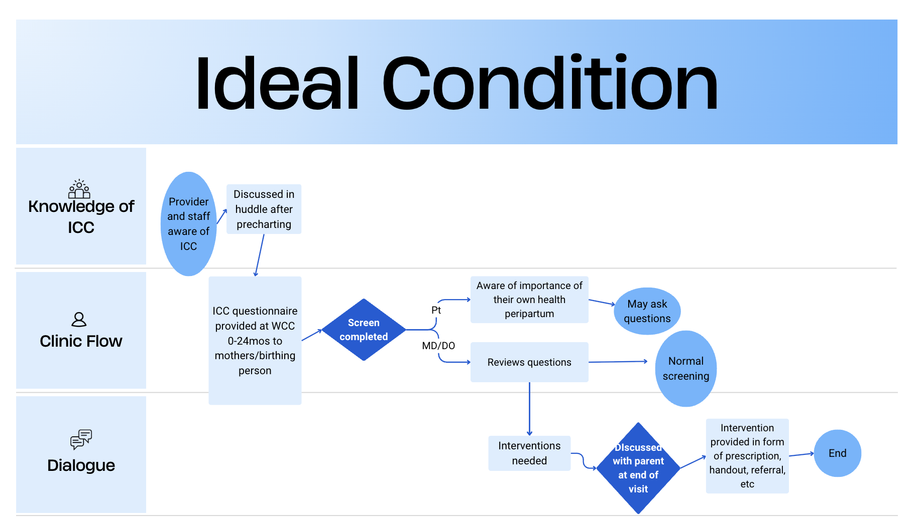
Sample Family Medicine Workflow

Slide 31
Sample Family Medicine Workflow
ICC questions are on a laminated sheet that is given to the mother/birthing person (MBP) at the time of rooming
MBP completes the screening questions, including the PHQ-9, prior to the provider entering the room
Provider reviews the ICC questions during the visit and addresses any positive risks

Slide 32
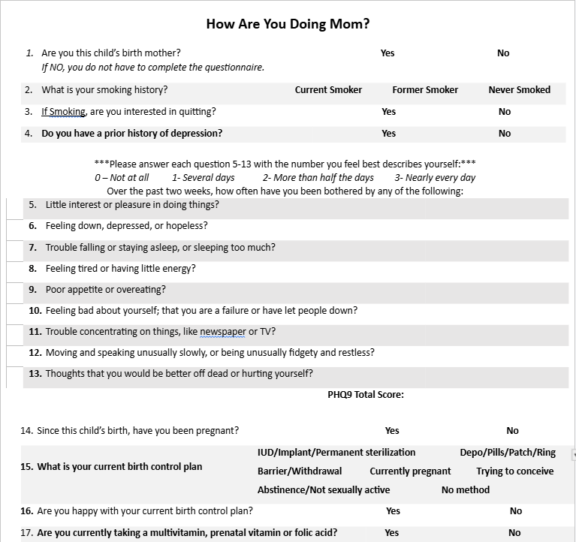
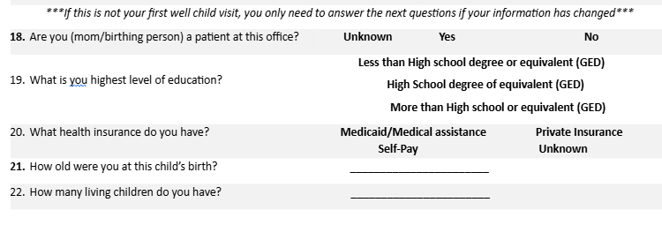
ICC Screening Form

Slide 33
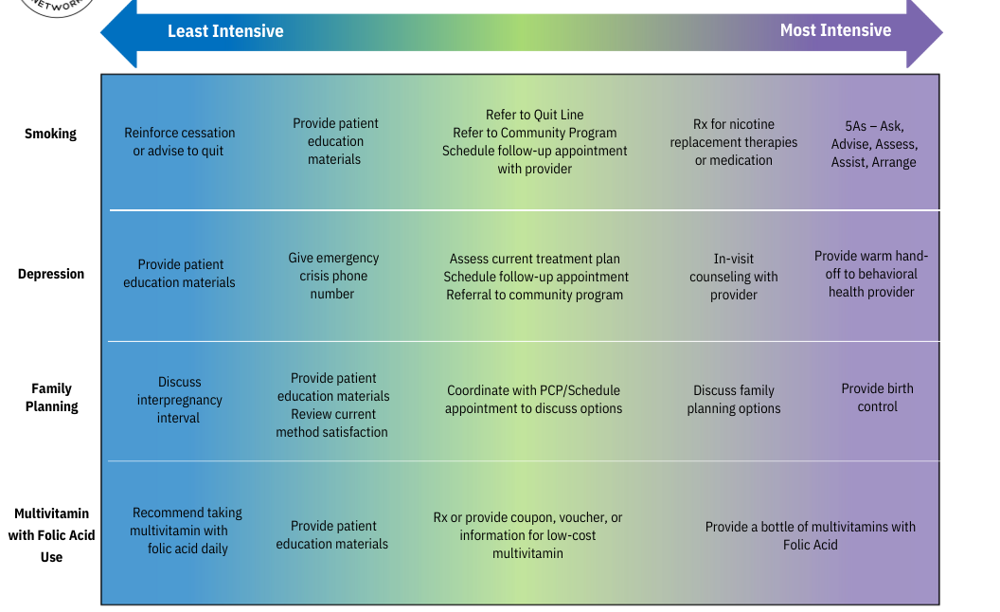

Intervention Spectrum

Slide 34
Interventions if the Clinic is PCP
Informational handout with relevant phone numbers and resources
Referral to integrated counselor or community counseling services
Separate appointment scheduled to further discuss symptoms and treatment options
Prescription for new medication or adjustment of current medications

Slide 35
Interventions if the Clinic is Not PCP
Informational handout with relevant phone numbers and resources
Referral back to or direct communication with PCP
If no PCP, offer to have the MBP establish at the clinic

Slide 36
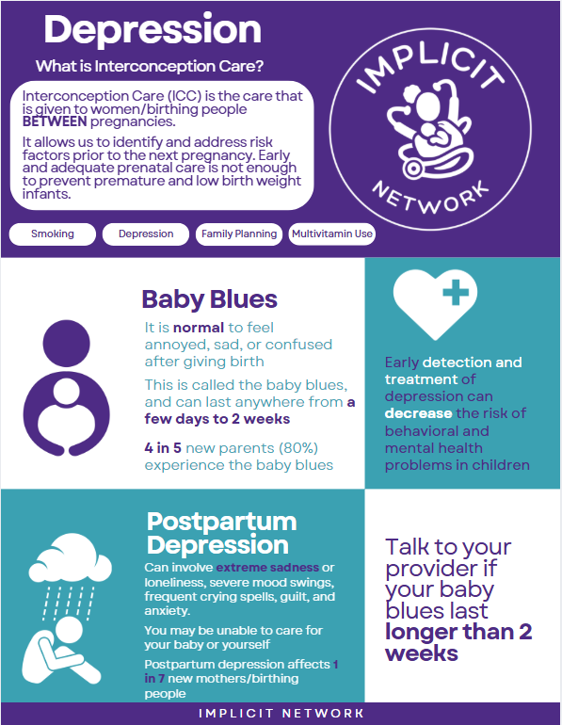

ICC Patient Education

Slide 37
Documenting Interventions
Interventions are documented in the child’s chart under the ICC workflow
If the MBP is a patient, can consider an add-on visit that day or document in a telephone encounter
If the MBP is a patient and is agreeable to the add-on visit, then the discussion and intervention can be billed as a regular office visit

Slide 38
White lettering on a color block is especially effective for catching attention
and for retention.
ICC in Pediatric Setting
Notes:
38

Slide 39
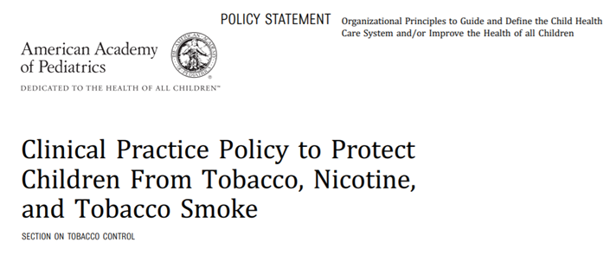
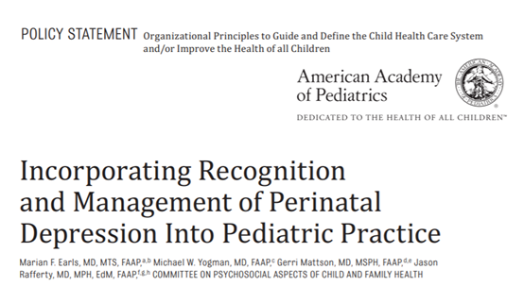
ICC in Pediatric Setting
In a 2013 study by Walker, et al in the Journal of Pediatric Health Care, more than 85% of mothers found it acceptable to discuss their health, including depression, smoking, and alcohol use, at their child’s pediatric visits
In addition, maternal screening for smoking and depression is recommended by the American Academy of Pediatrics during well child exams
Pediatrics and Family Medicine physicians are a team

Slide 40
ICC at UMMC
2 pediatric clinic sites at University of Mississippi Medical Center
  Jackson Medical Mall (JMM) and North Clinic (NC)
      JMM Complex Care and General Pediatrics
      NC General Pediatrics
10 attending and 47 resident physicians per year were trained or re-trained.
The first screen was 3/22/2017 (IMPLICIT phase 2) in EPIC.
Phase 3 started on 6/30/2019 and was transitioned to Redcap on 12/3/2019

Slide 41
UMMC: Provider Education and Retention
Pediatric primary care providers (PCP), both resident and attending physicians, at 2 sites were initially educated on the IMPLICIT project, screening tools, action plans, and standardized resources
  The education was performed over several weeks in a series of informational emails, small group meetings, and one lecture session prior to project initiation
With implementation, clinic and provider data was reviewed monthly and follow up reminders sent to attending PCPs to encourage participation and clarify usage

Slide 42
UMMC: Provider Education and Retention
The attending physicians during resident continuity clinic ask the resident with each well child encounter the details of the screen and concerns addressed to re-enforce the use of the screening tool and appropriate education
Annual presentations of de-identified data (e.g., screenings completed; positive findings on screening items) were presented to provider groups
PCPs were offered Maintenance of Certification (MOC) credit for participation 6/1/2018-12/1/2018 to encourage participation

Slide 43
Mother screened by provider at WCV
Positive Family Planning Risk
Does mother have GYN/PCP?
Yes
Positive Tobacco Use Risk
Educate and Direct to MVI/Folic Acid options
Positive Folic Acid/MVI Risk
No
Educate and direct to GYN/PCP
Mother >21y
Mother ≤21y
Is Adolescent Medicine Available?
Yes
No
Educate and refer to Adolescent Medicine
Educate and refer to Family Medicine or FQHC
Educate and refer to Family Medicine or FQHC
Educate and Refer to UMMC ACT Center
ICC Workflow
Maternal Smoking Cessation
Family Planning and Preconception
Folic acid/Multivitamin Supplementation
Action Plan

Slide 44
ICC Workflow
Positive Depression Screen (PHQ-2)
PHQ-9 <10
Does Mother have a PCP/Mental Health Provider?
Yes
PHQ-9 ≥10
SI
No
Mother >21y
Mother ≤21y
Is Adolescent Medicine available
SI
Yes- See SI under PHQ-9 ≥10
No
Yes
No
Educate and Refer to Adolescent Medicine
Educate and offer resources
Refer to Family Med/ FQHC/ Mental Health Provider
Yes
No
Immediate Referral and Transport to ER via EMS; Child transferred to responsible adult care
Does Mother have a PCP/Mental health Provider?
Yes
No
Mother to call and make contact while in WCV with her provider
Mother >21y
Mother ≤21y
Is Adolescent Medicine available
Yes
Educate and Refer to Adolescent Medicine AND contact provider
No
Educate and Refer to Family Med/ FQHC/ Mental Health Provider AND contact provider
Educate and Refer to Family Med/ FQHC/ Mental Health Provider AND contact provider
Educate and offer resources
Refer to Family Med/ FQHC/ Mental Health Provider
Maternal Depression Screen Action Plan

Slide 45
Positive Depression Screen (PHQ-2)
PHQ-9 <10
SI
Yes- See SI under PHQ-9 ≥10
No
Does Mother have a PCP/Mental Health Provider?
Yes
No
Mother >21y
Mother ≤21y
Is Adolescent Medicine available
Yes
Educate and Refer to Adolescent Medicine
No
Educate and offer resources
Refer to Family Med/ FQHC/ Mental Health Provider
Educate and offer resources
Refer to Family Med/ FQHC/ Mental Health Provider
Maternal Depression Screen Action Plan

Slide 46
PHQ-9 ≥10
Positive Depression Screen (PHQ-2)
SI
Yes
Immediate Referral and Transport to ER via EMS; Child transferred to responsible adult care
No
Does Mother have a PCP/Mental health Provider?
Yes
Mother to call and make contact while in WCV with her provider
No
Mother >21y
Educate and Refer to Family Med/ FQHC/ Mental Health Provider AND contact provider
Mother ≤21y
Is Adolescent Medicine available
Yes
Educate and Refer to Adolescent Medicine AND contact provider
No
Educate and Refer to Family Med/ FQHC/ Mental Health Provider AND contact provider
Maternal Depression Screen Action Plan

Slide 47
White lettering on a color block is especially effective for catching attention
and for retention.
IMPLICIT ICC Continuous Quality Improvement
Notes:
47

Slide 48
Continuous Quality Improvement
To improve ICC processes and maternal behavior, sites should use their data for continuous quality improvement (CQI)
Examples of QI Activities Include:
Meetings
Data Analysis
Optimize Risk Factors
Regular meetings with ICC Team at site
Analyze/use data
e.g. develop provider report cards
Make risk factor interventions more meaningful
Screening
Data Analysis
Identify and troubleshoot barriers to screening
Check data quality with Network Coordinator

Slide 49
ICC Model:
Depression Data
Out of 140,160 WCVs there were 90,485 depression screens
93.2% received an intervention when documented
6.3% positive depression risk screening

Slide 50
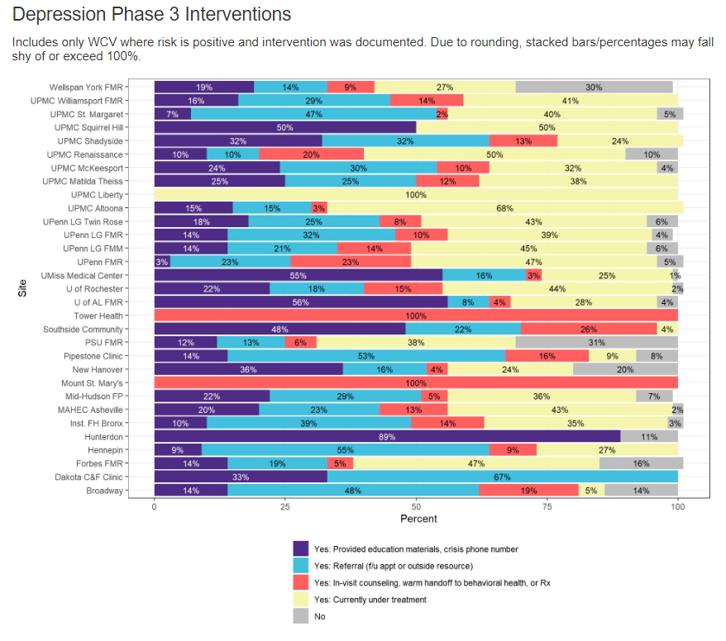
Notes:
Varies a lot between allows, requires, medicaid vs all payer coverage

Slide 51
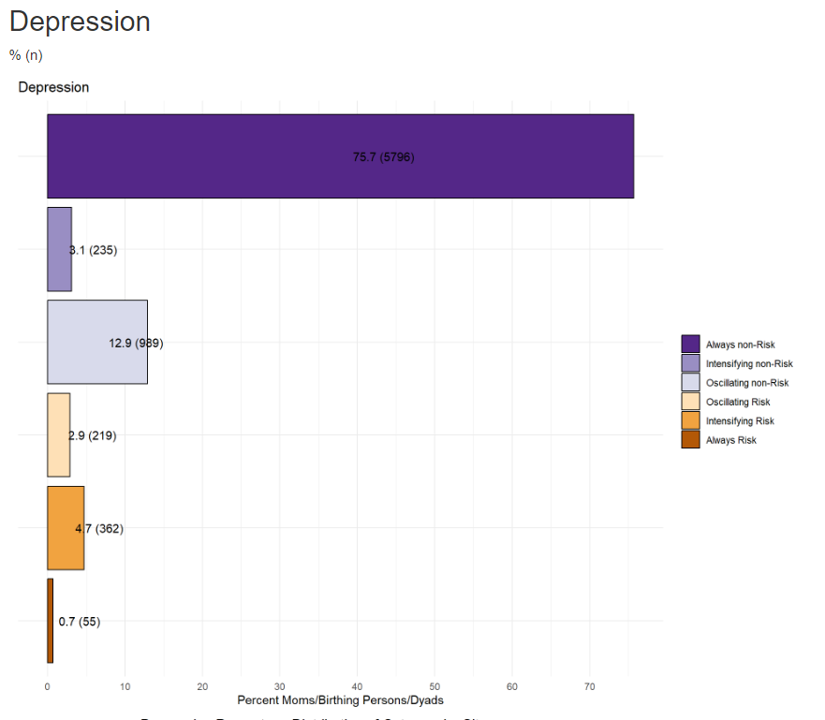
Depression Behavior Change

Slide 52
White lettering on a color block is especially effective for catching attention
and for retention.
Postpartum Depression Screening Reimbursement
Notes:
52

Slide 53
White lettering on a color block is especially effective for catching attention
and for retention.
Postpartum Depression Screening Reimbursement
Notes:
53

Slide 54
States that have requirements or mandates for screening for maternal mental health conditions
New Jersey
West Virginia
Massachusetts
Pennsylvania
Washington
Nevada
New Mexico
Mississippi
Michigan
Maryland
Georgia
https://policycentermmh.org/2024-state-maternal-mental-health-legislation-report/
https://nashp.org/state-tracker/maternal-depression-screening/
Notes:
Varies a lot between allows, requires, medicaid vs all payer coverage

Slide 55

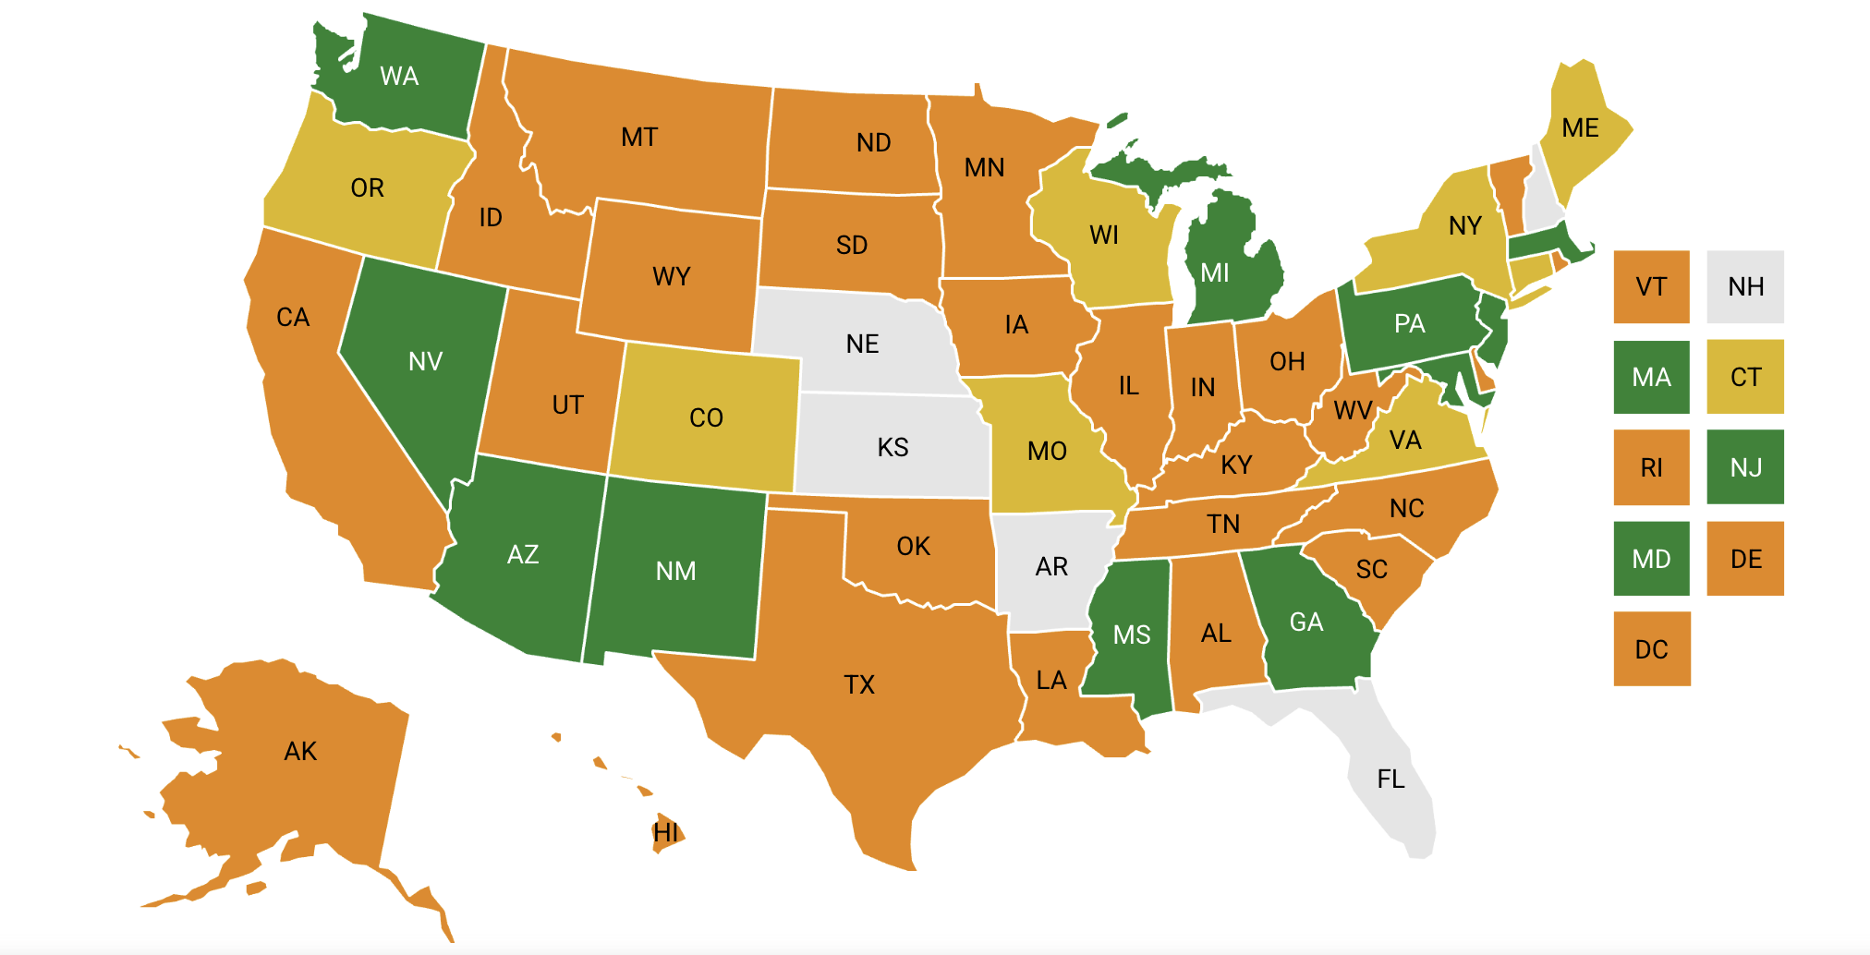
Medicaid Policies for Caregiver and Maternal Depression Screening during Well-Child Visits, by State
https://nashp.org/state-tracker/maternal-depression-screening/
Interactive tool for Medicaid coverage for maternal depression screening at WCC
Notes:
https://nashp.org/state-tracker/maternal-depression-screening/
Interactive tool for Medicaid coverage for maternal depression screening at WCC

Slide 56
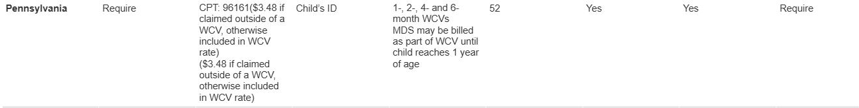
MDS Reimbursement for PA
Depression Reimbursement Table Link
Pennsylvania reimburses as part of the WCV bundle, if it is claimed outside of a WCV it is $3.48
(Billing code 96161)
Can only be billed as part of WCV for up to the first year
Staff, N. (2020, February 25). Medicaid Policies for Caregiver and Maternal Depression Screening during Well-Child Visits, by State - NASHP. NASHP. https://nashp.org/state-tracker/maternal-depression-screening/
Notes:
Medicaid MDS reimbursement: table goes into even more detail with modifiers, required tools etc and will be sent out to the Network. This SS shows a snapshot of the info we have for states. Most reimburse up to 1 year, though many recommend screening through 6m as per AAP guidelines. The majority also bill for MDS under the child’s ID at the visit.
Table contains the following information:
Allow, recommend or require MDS at WCV
Code(s) and FFS Rate(s)
Bill using child or mothers ID or either?
Minimum Allowed and Other Usage
Modifier(s)
Distinguish positive and negative screens?
Can other caregivers be screened?
Require or recommend tools?
Specified Tool(s)
Maternal Mental Health Tracking/Referral, Follow Up Guidance
Related State Initiative

Slide 57

Case Study:
What happened in Massachusetts
2011 Postpartum Depression Legislative Commission created
2016 MassHealth (Medicaid) started to cover screenings
2024 All insurers required to cover screening
Currently reimbursed at ~$9

Slide 58
Massachusetts Maternal Depression Screening
Perinatal Care Providers
Providers may submit claims for one prenatal and one postpartum depression screen for a pregnant or postpartum MassHealth member in a 12-month period, using the woman’s MassHealth ID number.
Pediatric Providers
Pediatric providers may claim for the administration of one postpartum depression screen in conjunction with a well-child or episodic visit for a MassHealth member aged 0-6 months, using the infant’s MassHealth ID number.
Perinatal Depression Screening in Conjunction with Pediatric Visits Does Not Affect CBHI Screening
Providers must continue to administer and claim for behavioral-health screening for the infant during well-child visits using the appropriate Current Procedural Terminology (CPT) code and modifier.
For a single date of service, pediatric providers may file a claim for a child’s Children’s Behavioral Health Initiative (CBHI) screen and separately claim for a MassHealth-approved perinatal depression-screening tool using the infant’s MassHealth ID number.

Slide 59
Results of Payment for Screening
“After regression adjustment, implementation of the Massachusetts Medicaid reimbursement policy was positively associated with perinatal depression screening rates with a differential increase of 10.0 percentage points (p < 0.001) for postpartum screening and 3.5 percentage points (p < 0.001) for prenatal screening”
Jeung C, Attanasio LB, Geissler KH. Improving perinatal depression screening uptake: The impact of Medicaid reimbursement policy in Massachusetts. Health Serv Res. 2024 Dec 16:e14420. doi: 10.1111/1475-6773.14420. Epub ahead of print. PMID: 39681957.

Slide 60
White lettering on a color block is especially effective for catching attention
and for retention.
Case Studies
Notes:
60

Slide 61
Family Medicine Case Study
Part 1
Emma is a 25-year-old female presenting with her daughter for her daughter’s 4-month WCC. Emma also has a 2-year-old son at home. Emma is a patient at the practice, and she sees the same physician who will be seeing her daughter today. As the nurse is rooming her for the visit, she provides her with a laminated paper with questions about her own health, including questions about her mood. Emma has a history of depression and takes sertraline 50 mg daily. Prior to her recent pregnancy, she was seeing a counselor, but she hasn’t had time to make an appointment since the baby was born.
When the physician enters the room, she talks with Emma about her daughter and answers her questions about when she can start introducing solid foods. The physician examines Emma’s daughter and reviews the growth charts with Emma.
After she finishes the exam, the physician picks up the laminated sheet with Emma’s questions and reviews the answers. She explains to Emma how integrated her health is with the health of her children, and she asks if Emma has any concerns about herself. Emma says she has no particular concerns.

Slide 62
Family Medicine Case Study
Part 2
The physician explains to Emma that she reviewed the answers and Emma has some symptoms suggestive of worsening depression. The physician asks Emma if she would be willing to share more about what she has been feeling. Emma shares that she has been feeling exhausted, has not wanted to do things she normally enjoys, and constantly feels guilty that she is not doing enough. Emma explains that she was not sure if this was normal or a sign that her depression was worsening.
The physician thanks Emma for sharing with her, and they discuss options, including re-establishing with counseling and increasing the sertraline dose. Emma learns that she can do telemedicine counseling appointments, and she is open to scheduling one of these appointments. She is also open to increasing the dose of her sertraline. On her way out of the clinic, she schedules a follow-up appointment for herself in 4 weeks and also schedules her daughter’s 6 month well child check.

Slide 63
Pediatric Case Study
Part 1
Zoe has brought her 4-month-old daughter, Hannah, for a well-child visit and to establish care at your office. They recently moved to the area for her work and this is the first time anyone in the family has seen a local physician. As interconception care is the standard for all well-child visits from birth to 2 years of age at your office, Zoe was screened for depression, whether she was smoking, taking prenatal vitamins, and asked about her plans for more children. She had no history of smoking or depression, and had no current depression symptoms, but has been a little stressed with the move. She had not been taking her prenatal vitamins since she ran out a few weeks ago, and wants to wait at least 2 years before they try to have a second child. She did not have a postpartum visit before the move, and has been using condoms recently.

Slide 64
Pediatric Case Study
Part 2
As Zoe is not a patient at our practice, she is given a handout on interconception care that includes information on the importance of taking a multivitamin with folic acid and birth control options. She’s interested in starting an oral contraceptive. You give her a list of local family medicine offices and have your office staff assist her with scheduling an intake visit later in the week. You give her a coupon for free prenatal vitamins at the local pharmacy.

Slide 65
Case Study Questions
Case study: Emma
Questions:
For a mother/birthing person who is a patient at the practice, how could your practice develop workflows to reconnect this patient back to care? What strategies could be used to provide easily accessible and prompt care to this patient?
How might this visit look different if the mother/birthing person is not a patient at the practice? What strategies could be used to connect the mother/birthing person to appropriate care?
Case study: Zoe
Questions:
What resources does your site have available for parents who are not patients of your practice, whether you are able to offer the services or not?
Does just giving information about the four areas of interconception care count as an intervention?

Slide 66

Questions?
Notes:
66

Slide 67


Want to Learn More?
Download Our ICC Toolkit
Contact us:
anna.fetterolf@pennmedicine.upenn.edu implicitinfo@fmec.net
Follow us on Instagram:
Check out our Website:
Notes:
We can share a link to the toolkit in the chat
ICC toolkit: https://www.marchofdimes.org/implicittoolkit
https://implicitnetwork.org/projects/interconception-care-icc/
Website: https://implicitnetwork.org

Slide 68
PCMHs’ Sharing of PDSA Plans and Peer-to-Peer Learning

Slide 69
Discussion Questions
Briefly describe your PCMH's goal, intervention(s), and findings for the first PDSA cycle.
How have your early findings influenced the focus of your second PDSA cycle?
As you move into the second PDSA sprint, what implementation challenges are you anticipating, and what strategies are you considering to address them?
Thinking about the screening and referral strategies discussed by today's speakers, what ideas or approaches are most relevant to your practice's next phase of improvement work?

Slide 70
Next Steps, Wrap Up &
Session Evaluation
Lisa Boyd
Pittsburgh Regional Health Initiative

Slide 71
Next Steps from Today’s Session
Update and submit Plans for PDSAs by August 14th and begin work on Plan and Do for second PDSA cycle
Reach out with any questions or to request 1:1 support or TA
Make sure you and your team are registered for the next session – Tuesday, September 15th at 9 – 10:30 a.m. via Zoom
Register for the In-Person Statewide Midyear session – Tuesday, November 10th at 8:30 a.m. to 3:00 p.m. at the Harrisburg Hilton

Slide 72
2026 PCMH Learning Network
Final In-Person Session November 10th at 8:30 a.m. to 3:00 p.m.
Final In-Person Session
PCMHs share their completed PDSA cycles
LN recognizes PCMHs with greatest improvements
LN announces 2027 Sprints
PCMH Milestone: Complete at least 2 PDSA cycles and share at the in-person event*

Slide 73
Statewide Supplemental Sessions
HIV in Primary Care – Thursday, July 29th at 9 – 10:00 a.m. via Zoom https://us06web.zoom.us/meeting/register/QY4Q84qBQzasiZlsORIERg#/registration
Stay tuned for additional information on these sessions and dates for fall supplemental sessions.

Slide 74



PCMH Online Community https://www.tomorrowshealthcare.org/
Access the session materials in “Learning Sessions”
Look for guides and tools in “Resources”
Find session dates and registration links under “Events”
Members of your PCMH’s multi-disciplinary learning team will receive log-ins

Slide 75

CEU Process
You will receive a follow up email with links to:
Complete the survey at: https://www.surveymonkey.com/r/PD39XS2 by Tuesday, June 30th
Please be sure to designate which CEU credits you are requesting CME, CNE, Social Worker or Certificate of Attendance. If you already have an account with the UPMC Center for Continuing Education, please be sure the email you enter on the survey matches the UPMC CCE account email that you create.
The UPMC Center for Continuing Education will follow up with you via email after June 30th with instructions on how to claim your credits.
  To prepare, we recommend you create an account with UPMC CCE via this website https://cce.upmc.com.

Slide 76
Thank You!

