Slide 1
Comprehensive Diabetes Care & Health Equity
Sprint Learning Session #3
June 16, 2026
HealthChoices PCMH Learning Network
Suzanne Cohen, Senior Director of Population Health, Health Federation of Philadelphia

Slide 2
Agenda
1:00 – 1:15 p.m. | Welcome & Presentation of the transition to the second PDSA cycle | Suzanne Cohen, Health Federation of Philadelphia
1:15 – 1:45 p.m. | PCMH Sharing of Challenges and Potential Support | Laura Line, Health Federation of Philadelphia
1:45 – 2:15 p.m. | PCMH Panel Discussion: Moving from PDSA Cycle 1 to 2 | Whitney Gregori, Guthrie Medical Group Jaime Bailey, UPMC CMI
2:15 – 2:30 p.m. | Sprint Timeline, Next Steps & Evaluation | Suzanne Cohen, Health Federation of Philadelphia
Notes:
Thank everyone for getting your PDSA worksheets submitted and for putting up with us as we figure out this process. Please feel free to let us know if anything is not working or is super cumbersome.

Slide 3
Continuing Education Information
In support of improving patient care, this activity has been planned and implemented by the University of Pittsburgh and The Jewish Healthcare Foundation. The University of Pittsburgh is jointly accredited by the Accreditation Council for Continuing Medical Education (ACCME) and the American Nurses Credentialing Center (ANCC), to provide continuing education for the healthcare team. 1.5 hours are approved for this course.
As a Jointly Accredited Organization, University of Pittsburgh is approved to offer social work continuing education by the Association of Social Work Boards (ASWB) Approved Continuing Education (ACE) program. Organizations, not individual courses, are approved under this program. State and provincial regulatory boards have the final authority to determine whether an individual course may be accepted for continuing education credit. University of Pittsburgh maintains responsibility for this course. Social workers completing this course receive 1.5 continuing education credits.

Slide 4
Disclosures
No members of the planning committee, speakers, presenters, authors, content reviewers and/or anyone else in a position to control the content of this education activity have relevant financial relationships with any entity producing, marketing, re-selling, or distributing health care goods or services, used on, or consumed by, patients
to disclose.
Notes:
No conflicts of interest

Slide 5
Disclaimer
The information presented at this Center for Continuing Education in Health Sciences program represents the views and opinions of the individual presenters, and does not constitute the opinion or endorsement of, or promotion by, the UPMC Center for Continuing Education in the Health Sciences, UPMC / University of Pittsburgh Medical Center or Affiliates and University of Pittsburgh School of Medicine. Reasonable efforts have been taken intending for educational subject matter to be presented in a balanced, unbiased fashion and in compliance with regulatory requirements. However, each program attendee must always use his/her own personal and professional judgment when considering further application of this information, particularly as it may relate to patient diagnostic or treatment decisions including, without limitation, FDA-approved uses and any off-label uses.

Slide 6
The PCMH Learning Network
Designed to support the PCMHs and MCOs in:
  Achieving the shared aims of the HealthChoices PCMH Program
  Identifying and acting on strategies in response to opportunities for improvement
  Developing an internal capacity to continuously learn, adapt, and improve
Notes:
As always, our goal is to help the MCOs and PCMHs achieve the common expectations of the PCMH value-based payment program.

Slide 7
Access today’s slides online
GO TO: www.tomorrowshealthcare.org
Your Login: The email address you RSVP’d with
Your Password: Welcome
To get assistance or access for your colleagues:
email J. at ashenayi@jhf.org

Slide 8
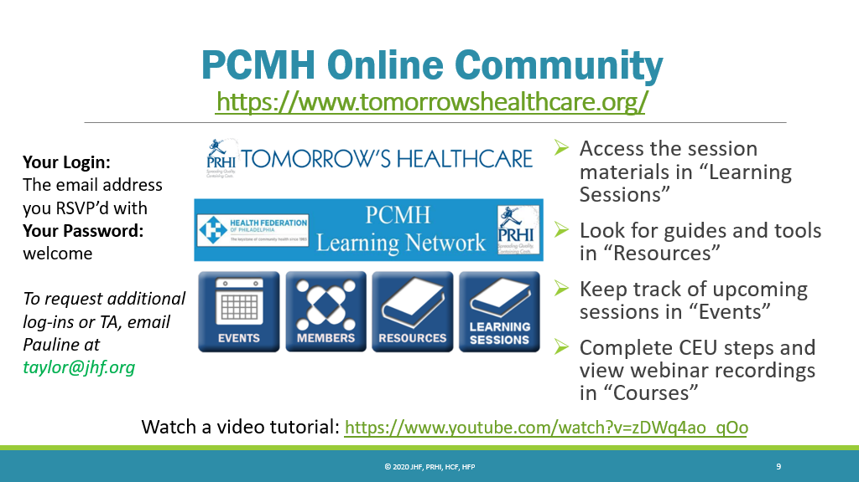
PCMH Online Community
Keep track of upcoming
sessions in “Events”
Access session materials in “Learning Sessions”
Including slides and webinar recording
Look for guides and tools in “Resources”

Slide 9
Learning Objectives for Today
Describe strategies that are effective in providing comprehensive diabetes care within primary care.
Describe progress in planning quality improvement activities across participating PCMH practices.
Identify potential approaches to implement quality improvement interventions.

Slide 10
Transition to 2nd PDSA Cycle
Suzanne Cohen, Senior Director of Population Health
Health Federation of Philadelphia

Slide 11
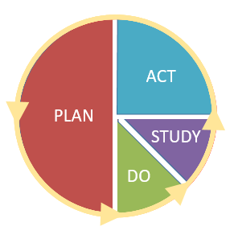
Plan Do Study Act

Slide 12
PDSA Plan Submission Due Dates
2/12
3/25
4/28
6/9
8/27
10/6
10/30
PCMH Milestone Prior to Kickoff: Enroll in Sprints and submit preliminary QI plans (completed)
PCMH Milestone: Complete first PDSA cycle*
PCMH Milestone: Complete at least 2 PDSA cycles and share at the 11/10 in-person event*
*If your PCMH does not reach the milestone or is at risk of not meeting the milestone,
request TA from the PCMH Learning Network.
Due dates are also designed to prepare PCMHs for each session.

Slide 13
Match implementation Strategies
Rule of Thumb
Barrier Type | Recommended Strategies
Knowledge Gaps | 📚 Education, 📊 Feedback
Access Gaps | 🏥 Service Redesign, 🛠️ Equipment, 🤝 Partnerships
Workflow Gaps | 💻 EHR Tools, ✅ Standing Orders

Slide 14
Pre-implementation measures
Acceptability
Appropriateness
Feasibility
Cost
Reach
Things to Consider
Start with fit, not ambition.
Proctor E, Silmere H, Raghavan R, et al. Outcomes for implementation research: conceptual distinctions, measurement challenges, and research agenda. Adm Policy Ment Health. 2011;38(2):65-76. doi:10.1007/s10488-010-0319-7

Slide 15
Higher impact/
effectiveness
Maybe
Best
Lower equitability
Higher equitability
Avoid
Caution
Lower impact/
effectiveness

Slide 16
Narrow to Broad Approach
PDSA 1: Initial Improvement Plan
Focused on:
  One care team
  One pod
  One location
Goal:
  Test and refine the improvement project on a small scale
Results:
  Demonstrated successful improvement and positive results
PDSA 2: Initial Improvement Plan
Expand implementation to:
  Additional care teams
  Additional pods
  Additional locations
Goal:
  Scale successful practices across broader settings
  Ensure consistency and sustainability of improvement efforts

Slide 17
Broad to Narrow Approach
PDSA 1
Broad implementation goals
Goal:
  Multiple!
  Ex: improve practice performance on patients completing the full diabetic bundle – A1c, Retina screening, Kidney screening, Statin Rx
Results:
  unclear or uneven
PDSA 2
Narrow and dig into a single metric
Focus on improvement in that one area
Ex: Improve practice performance on retinal screening

Slide 18
Reassess Root Causes &
Match Implementation Strategies
PDSA 2: Workflow & System Redesign
Key Learning from PDSA 1:
  Workflow and lack of system supports made warm hand-offs difficult to complete consistently, independent of training/knowledge levels
New Strategy: Focus on systems and workflow
Ex: Create standing orders with system prompts or flags for eligible patients
  Medical Assistants should refer any patient with a PHQ9> X to integrated behavioral health
PDSA 1: Improve Warm Hand-offs to Integrated Behavioral Health
Assumption:
Low hand-off rates were caused by lack of knowledge or awareness
Intervention:
Train PCPs and behavioral health providers on warm hand-offs
Results:
Warm hand-off rates did not improve significantly
Notes:
Match Implementation strategies to the true root cause of the problem

Slide 19
Use Variation in Results to Inform PDSA 2
PDSA 1: Depression Screening & Referral Improvement
Goal: Increase depression screening and referral to follow-up care
Interventions:
  Train MAs on PHQ-9
  Create standing orders
  Adjust workflows/systems
  Apply across 4 care teams
Results: 2 teams showed improvement, 2 showed little to no improvement
PDSA 2: Investigate & Tailor the Response
Examine implementation differences across the teams
  Were workflows followed consistently?
  Were there staffing barriers?
  Did implementation go as intended?
Possible next steps:
  Re-implement PDSA 1 with better support to care teams with little improvement
  Develop a new intervention tailored to the specific barrier’s for each team
Notes:
Variation in outcomes provides insight into implementation challenges and helps guide more targeted improvement strategies

Slide 20
Overall Considerations
It probably won’t be this neat - real life rarely is!
PDSA 1 may not be finished. PDSA 2 can be a refinement, or mid-cycle adjustment. It does not need to be a whole new thing.
Go back to your implementation science principles. Match the intervention to the outcome and make it realistic!
Have a single clearly defined primary outcome and clear methods to collect data to measure process (whether you are implementing your intervention as planned) and whether you are achieving your outcome.

Slide 21
PCMH Sharing of Challenges and Potential Support
Laura Line, Consultant, Health Federation of Philadelphia

Slide 22
Survey from the Comprehensive Diabetes Care Sprint Session #3
Tuesday, June 09, 2026

Slide 23
What have been your team's biggest challenges in implementing this first PDSA cycle? Name up to two.
Answered: 10

Slide 24
Other responses
  Resource constraints
  Intervention will not work with partners
  Getting all departments to focus on the same measure because they are each focused on different initiatives (Different taxpayer id #s for staff and several departments under each TIN)

Slide 25
How can the Learning Network help you address these through the sprints?
Answered: 10
Strategies on provider engagement and buy in (1)
Notes:
Speaker: presentations focused on resources and support services available for patients with diabetes, including diabetes education programs, nutritional counseling, healthy eating strategies, and disease management. I would also like information on community-based programs that accept patients regardless of insurance status, as finding accessible referral resources can be challenging. Additionally, it would be helpful to learn which organizations offer transportation assistance or other support services for patients who face barriers to accessing care.

Slide 26
In reflecting on the PDSA sprint approach, what has been your biggest takeaway?
Answered: 6
Very focused
This has helped us to choose a topic and really focus on improvements, monitor, and consistently provide feedback to staff
One of the most valuable aspects...has been the opportunity to learn from other practices. Hearing how different organizations are approaching their goals, implementing changes, and overcoming challenges has provided practical ideas that can be adapted within our own practice. ... also what strategies have been successful; what obstacles others have encountered, allowing us to benefit from their experiences. Overall, the collaborative nature of the sprint process has encouraged the sharing of best practices and has provided valuable insight into improving patient care and practice operations.

Slide 27
In reflecting on the PDSA sprint approach, what has been your biggest takeaway?
Answered: 6
Different workflows to implement and feedback from other providers is helpful. How to engage providers/staff or to have better buy in
Executive sponsorship to implement a project improvement plan was key. Holding team members accountable for their role in the success of the project.
Hearing from other organizations has been helpful.

Slide 28
White Board Activity:
Offering Solutions to Common Challenges

Slide 29
PCMH Panel Discussion: Moving from PDSA Cycle 1 to 2
Whitney Gregori, BSN-RN, Manager, Value-Based Reimbursement, Guthrie Medical Group
Jaime Bailey, RN. MSN, CCM, Supervisor CMI PCMH, UPMC Health Plan

Slide 30
Comprehensive Diabetes Care and Health Equity Sprint Session #3
Katie Elliott- Sluyter BSN, RN and Whitney Gregori BSN, RN
Guthrie Medical Group
June 16, 2026

Slide 31
Goal for first PDSA cycle
Improving Medicaid compliance for the Diabetic Bundle (A1C <8.0, statin use, and diabetic eye exam)
Total System Baseline 27% July 2025, goal of 34.3% by July of 2026

Slide 32
Interventions
Reviewing diabetic bundle quality metrics at monthly site PCMH meetings, monthly lead provider meetings, and quarterly leadership forums
Utilize centralized outreach coordination team to facilitate diabetic care gap closure
Utilize clinical staff in individual primary care sites to complete diabetic outreach calls
Use of Aeye to improve diabetic eye compliance

Slide 33
Fiscal Year to Date Performance

Slide 34
Quantitative Findings
Initial outreach strategy focused on patients meeting 2 of 3 bundle measures
A1c variability created challenges, as values could change multiple times during the measurement year
Limited optometry capacity impacted ability to complete eye exams
Gaps in external data sharing from outside optometry providers delayed result capture
AEYE device technical issues affected screening reliability and workflow

Slide 35
Lessons Learned
Identified the need for better engagement in coding exclusion criteria for statins and discussing alternative therapies
Major access issues within our internal optometry departments, booking out to end of 2026
Difficulties obtaining out of system eye exam reports
Family practice clinicians seem to follow their own preference for repeating A1C’s

Slide 36
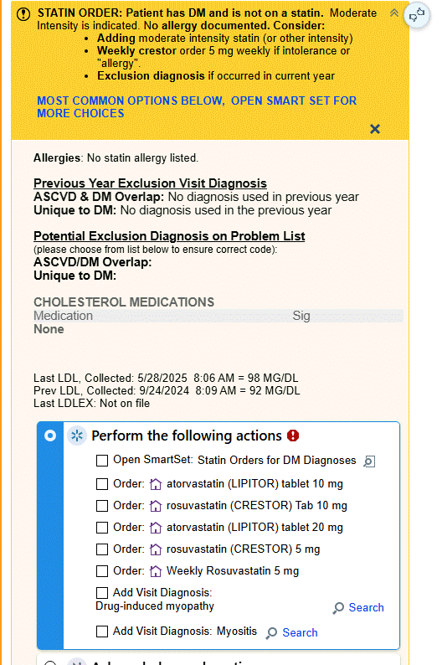
Changes for Next PDSA Cycle
Revised statin use and diabetes OPA in Epic for primary care
Purchased and dispersed 7 Aeye cameras throughout primary care
Worked with compliance to educate external optometry offices on information blocking
Began discussions on system policy for A1C

Slide 37
New/Revised Goal
Guthrie’s system goals run on a fiscal year
Goal remains the same as we approach the end of the fiscal year on June 30th
Cumulative Goal of 34.3% for the Medicaid diabetic bundle

Slide 38

Questions

Slide 39
PCMH Learning Network Project
Diabetes Outreach Initiative
CMI South/West Regional Care Team | Medicaid Population
Report Date: May 20, 2026

Slide 40
Program Overview
Targeted outreach to Medicaid members attributed to the CMI South/West Regional Care team (RCT) that have a diagnosis of Diabetes and fall into the denominator for the GSD (Glucose Screening for Diabetes) HEDIS quality measure.
The initiative focuses on HbA1c compliance across three gap categories: No Test, No Value, and Value ≥8%.
Measurement period: March–May 2026 for South/West RCT (12 Site Locations across 5 practices) with expansion to CMI Residency Practices and then across all CMI RCT practices June-August.
Goal
Improve A1C compliance and outcomes for Medicaid Members with Diabetes through education, support, and connection to resources.
Improve Gaps in Care Closure Rates.
Reduce unplanned care through connection with PCP office.
Gap Category Outreach by Month
March 2026: No Test (missing HbA1c) – 34 members in gap
April 2026: Value ≥8% (uncontrolled) – 55 members in gap
May 2026: No Value (pending/missing result) – 9 members in gap
Total: 98 unique members with open HEDIS gaps

Slide 41
Outreach Disposition & Gap Status
March 2026 – No Test Gap Population (34 Members)
  Left Voicemail (LVMM): 11
  Unable to Reach (UTR): 12
  Excluded (Commercial/Deceased/Termed): 11
April 2026 – Uncontrolled A1c Gap Population (55 Members)
  Successful Contact: 11
  Unable to Reach: 2
  Excluded (Non-CMI/Commercial): 2
  Pending Follow-up: 25
May 2026 – No Value Population
  No Value Gap: 9

Slide 42
2026 Performance Targets & Key Findings
2026 Medicaid GSD Measure Targets Comparative to CY2025 Year End SW Results of 64.7%
  3 Star Cut Point 65% | Gap: -0.30%
  4 Star Cut Point 70%:| Gap: -5.30%
  5 Star Cut Point 73% | Gap: -8.30%
Gap Closure Barriers & Documentation Issues
  POC A1C results not auto-closing gaps in Novillus – escalated to HEDIS Measure Inquiries for Quality Team Follow-Up
  External lab results (Jefferson Regional, AHN, Quest) require manual upload for gap closure
  LTC/SNF members require facility-based outreach protocol
  Care Everywhere results not auto-populating in reporting system – manual reconciliation needed
  PBCM case management coordination and collaboration needed for complex/high-risk diabetic members
  Endocrinology/UPMC Center for Diabetes follow-ups documented for compliant members

Slide 43

GSD Measure: 2025 Rate vs. 2026 Tier Targets
Gap Analysis
Current Rate: 64.70%
(Dec 2025 baseline)
Tier 1 (3 Star): 65% (Gap: -0.30%)
Near target – likely achievable with current outreach
Tier 2 (4 Star): 70% (Gap: -5.30%)
Requires intensified gap closure efforts
Tier 3 (5 Star): 73% (Gap: -8.30%)
Stretch goal – requires systemic improvements

Slide 44
Recommendations & Next Steps
Priority Actions
Hire and Onboard second RN to support Medicaid directed efforts (Hired with Start Date in July)
Prioritize Medicaid Value ≥8% gap closure before measurement year end to impact GSD rates with focus on residency practices June-August and expansion to all CMI RCTs for September
Coordinated Outreach to members utilizing the Diabetes EPIC SmartPhrase to guide documentation and outreach focusing on education and connection to resources
Address all open Diabetes Gaps in Care with Members and assist to facilitate testing (DRE, KED, BP, Statins, BP)
Ensure all compliant A1C results are uploaded and reflected in Novillus for HEDIS reporting after June data refresh
Coordinate with Practice-Based Care Managers (PBCMs) and Providers for intensive case management coordination of needs (Individual PBCM ICT Meetings scheduled to review cases/actions/next steps)
Recommendations
Outreach Intensification: Maintain systematic re-contact cadence for LVMM/UTR members until gap closure or exclusion
POC A1C Reconciliation: Resolve Novillus gap closure logic for POC A1C results with HEDIS team
Outside Records: Establish workflow for uploading external lab results to close open gaps
Care Coordination: Coordinate with specialty providers to capture compliant results for gap closure
LTC/SNF Coordination: Develop LTC/SNF outreach protocol for facility-based member compliance tracking
Provider Education: Educate PBCM team on smart phrase utilization and timely documentation for gap closure
Monthly Monitoring: Monitor monthly GSD rate progression against 2026 Tier 1-3 targets (65%–73%) along with DRE, KED, BP, and Statins

Slide 45
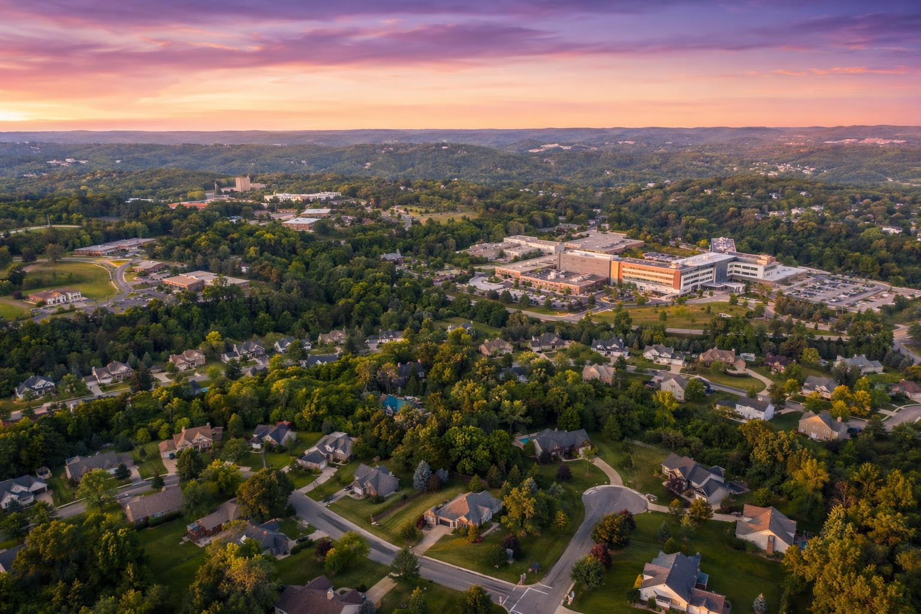
CMI South/West RCT Sites in Outreach
Practice Site | Service Area (ZIP Codes)
Complete Primary Care Associates UPMC | Bethel Park, Pittsburgh (15102, 15203, 15219, 15227, 15275)
Pittsburgh Primary Care UPMC | Pittsburgh, Pleasant Hills (15220, 15227, 15236)
Pittsburgh Internal Medicine Associates UPMC | Castle Shannon (15234)
Gateway Medical Group UPMC | Carnegie, McKees Rocks (15106, 15136)
Internal Medicine UPMC | Bethel Park (15102)
Data Sources: March Outreach No Test, April Outreach A1c>8, May Outreach No Value | Member identifiers excluded per HIPAA compliance

Slide 46
Expansion of Project into CMI Residency Practices with PBCM Support
June-August (No Test, A1C >8, No Result)
June 187 members identified with No Test
Office ID | Office Name | Address | PBCM
469C | UPMC Mercy Health Center | 1st Floor, 1515 Locust Street Pittsburgh, PA 15219 | Christine Wheary
2437 | McKeesport Internal Medicine Center UPMC | Suite 1 1321 Fifth Avenue McKeesport, PA 15132 | Kerri Baer
3268 | UPMC McKeesport Latterman Family Health Center | 2347 Fifth Avenue McKeesport, PA 15132 | Kerri Baer
0876 | UPMC St Margaret FHC Bloomfield Garfield | 5475 Penn Avenue Pittsburgh, PA 15206 | Susan Gubash/Bridget Virbitsky
0877 | UPMC St Margaret FHC Lawrenceville | 3937 Butler Street Pittsburgh, PA 15201 | Susan Gubash/Bridget Virbitsky
C692 | UPMC St Margaret FHC New Kensington | 1072 Fifth Avenue New Kensington, PA 15068 | Susan Gubash/Bridget Virbitsky
0L67 | Shenango Valley Family Medicine Center UPMC | 2008 West State Street New Castle, PA 16101 | Traci Carlson
2905 | Shenango Valley Family Medicine Center UPMC | 2000 Memorial Drive Farrell, PA 16121 | Traci Carlson
0822 | UPMC Shadyside Family Health Center | 2nd Floor 5215 Centre Avenue Pittsburgh, PA 15232 | Pam Hess

Slide 47
Questions?

Slide 48
Sprint Timeline, Next Steps & Evaluation

Slide 49
2026 PCMH Learning Network
3rd and 4th Sprint Session
Sprint Session 3
Today!
LN provides Tactical how-to information related to PCMHs’ QI plans
PCMHs share PDSA 2nd Cyle “Plan” through facilitated peer-to-peer learning
LN provides guidance for completing 2nd cycle of Study and Act
Sprint Session 4
September 10, 2026
PDSA by August 27th
LN provides Tactical how-to information related to PCMHs’ QI plans
PCMHs share 2nd Cycle of “Study” and “Act” through facilitated peer-to-peer learning
LN provides guidance on completing PDSA cycles (e.g., standardizing and scaling improvements) and preparing for the final session

Slide 50
2026 PCMH Learning Network
Final In-Person Session November 10th 8:30 a.m. to 3:00 p.m.
Final In-Person Session
PCMHs share their completed PDSA cycles
LN recognizes PCMHs with greatest improvements
LN announces 2027 Sprints
PCMH Milestone: Complete at least 2 PDSA cycles and share at the in-person event*

Slide 51



PCMH Online Community https://www.tomorrowshealthcare.org/
Access the session materials in “Learning Sessions”
Look for guides and tools in “Resources”
Members of your PCMH’s multi-disciplinary learning team will receive log-ins

Slide 52

CEU Process
You will receive a follow up email with links to:
Complete the survey at: by 6/23/2026
Please be sure to designate which CEU credits you are requesting CME, CNE, Social Worker or Certificate of Attendance. If you already have an account with the UPMC Center for Continuing Education, please be sure the email you enter on the survey matches the UPMC CCE account email that you create.
The UPMC Center for Continuing Education will follow up with you via email after 6/23/2026 with instructions on how to claim your credits.
  To prepare, we recommend you create an account with UPMC CCE via this website https://cce.upmc.com.
https://www.surveymonkey.com/r/GBWTW5T

Slide 53
Upcoming Sessions
Virtual Sprint Session #4
September 10, 2026
9:00 am – 10:30 am
HIV Screening, Prevention, and Treatment
July 9, 2026
5:00 pm – 6:00 pm
Statewide End of Year In-Person Session:
November 10, 2026
8:30 am – 3:00 pm
Hilton Harrisburg, One North Second Street, Harrisburg, PA 17101

Slide 54
Thank You!

