Slide 1
summary
This presentation provides education regarding how to navigate the complexities of suicidality and associated grief responses for people working in healthcare. Various types of grief are defined and explained to provide foundational understanding of a typical grief experience. Understanding the different types of grief, such as anticipatory grief, complicated grief, or disenfranchised grief, helps identify the unique experiences of those affected by suicidality. Further education is provided to introduce careful assessment of risk factors and appropriate intervention, as well as special considerations for grief associated with suicide. This education concludes with identifying strategies, techniques and resources for supporting bereaved clients, colleagues and other involved healthcare workers.

Slide 2

This existence of ours is as transient as autumn clouds. To watch the birth and death of beings is like looking at the movements of a dance. A lifetime is like a flash of lightning in the sky; rushing by, like a torrent down a steep mountain.
— Gautama Buddha

Slide 3
Navigating Grief and Suicide as a Behavioral Health Provider
Elizabeth Schandelmeier, LCSW, APHSW-C, FT

Slide 4
Objectives
Define grief and identify types and variations and related symptoms
Discuss suicide, including assessment, treatment and management, as well as special considerations for the grieving experience
Identify strategies, techniques and resources for supporting bereaved clients, colleagues and yourself

Slide 5
Let's talk about grief...

Slide 6
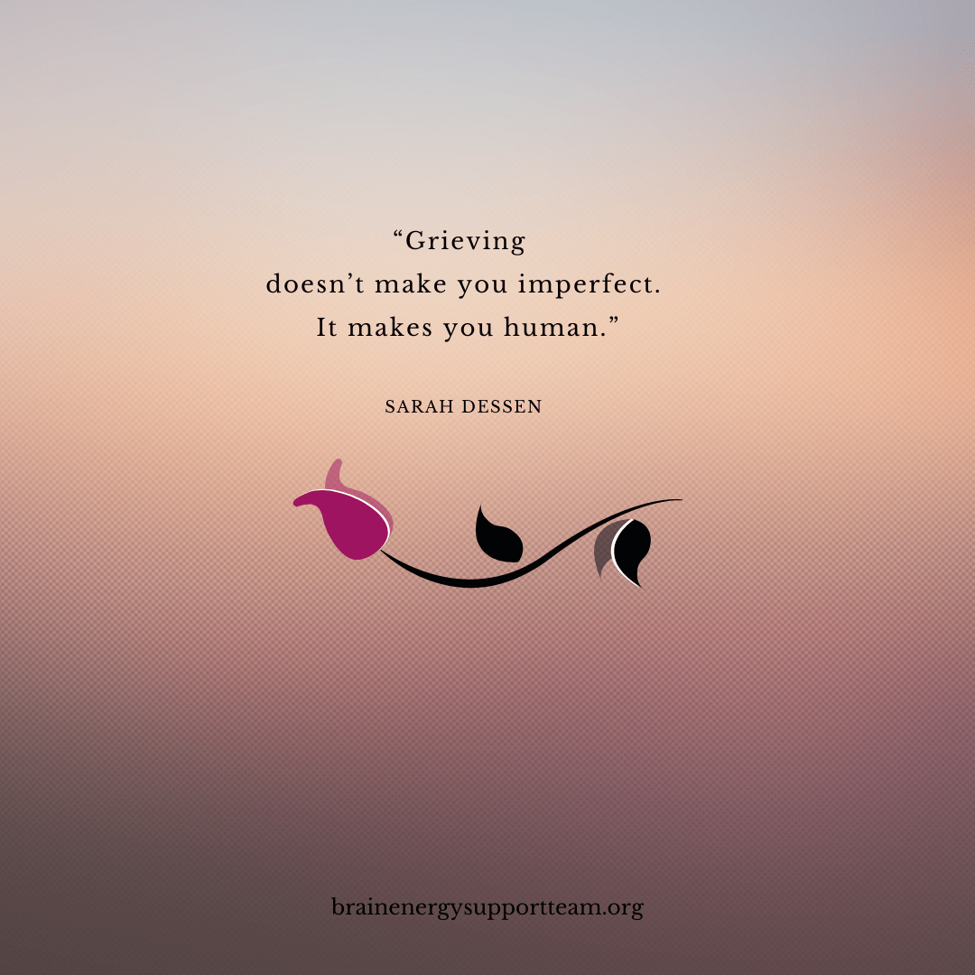
What is grief?
Grief is a normal and natural response to loss.

Slide 7
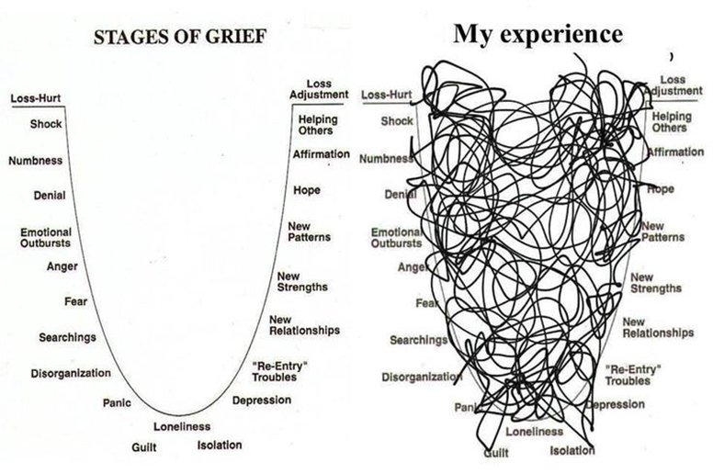
Image: http://wecandiebetter.com/stages-of-grief/

Slide 8
Grief Reactions: Physical Symptoms
Exhaustion and fatigue
Change in sleep patterns (falling asleep and staying asleep)
Difficulty focusing, fogginess, forgetfulness, “clumsiness”
Changes in appetite (increase or decrease), digestive issues
Headaches, muscle aches
Sensitivity to light and/or sound
Suppressed immune system
Tightness in chest, shortness of breath, heart palpitations
Notes:
Bereaved are always encouraged to visit their PCP for a health checkup, often bereaved have neglected their own care and follow up through the course of another person's illness, important to rule out any underlying causes for physical symptoms but also important to encouraged bereaved to shift their behavior away from caring for others and toward caring for themselves.

Slide 9
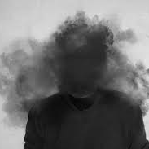
Grief Reactions: Cognitive Changes
“Disbelief,” the death or resulting changes don't seem real
Heightened emotional sensitivity
Confusion, forgetfulness, brain fog
Not able to concentrate, may affect your daily life
Challenge to sense of order, safety, and security in the world
Notes:
Important for medical professionals to be aware of this and to check in about this because the bereaved are often worried that their fogginess or memory loss are potentially due to medical or mental health issues. Sometimes the bereaved are hesitant to mention because they are embarrassed or uneasy about the thought. These symptoms are often overlooked in discussion as compared with emotional or physical symptoms.

Slide 10

Grief Reactions: Behavioral Reactions
Social withdrawal
Hyper/hypoactivity
Irritability/restlessness
Avoidance of reminders
Shifting priorities

Slide 11
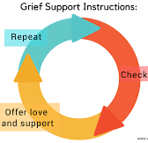
Supporting Someone Who is Grieving
Use appropriate and concise language (actualizing the death)
Allow time, do not set limits on the grief experience
Explore transformation and growth over time
Encourage the identification, expression, and experience of all feelings
Encourage adaptation to living without the deceased and finding meaning in the death, one’s own life and the future

Slide 12
Cultural Considerations
Grief is a common denominator...the expression of grief is not.
Collective, community, family, or individual experience
Language to describe loss
Support providers (family, friends, faith and religious community/leaders, therapist)
Sense of familial duty or sacrifice
Faith, spirituality, philosophy, or atheism/agnosticism
Access to resources
Views on loss/dying/death and what comes next
Norms about how to express grief (stoic, emotional)
Outward expression may differ from internal experience

Slide 13
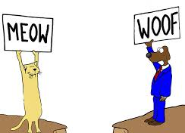
Recognize Potential Support Barriers
Cultural misunderstandings, including language, family system/structure, decision-making process, accepted medical strategies/expectations, bias (perceived or otherwise)
Denial or disagreement
Emotion, including fear, guilt, and injustice
Education level, health literacy, previous experience with medical system
Language, including use of medical jargon or technical terms
Access to resources, especially those that may result in barriers to treatment or support
Other underlying issues
Notes:
These are places where we can all do better, things to keep in mind during discussion.

Slide 14

Potential Red Flag Circumstances
Guilt or shame
Cumulative losses
Psychiatric history
Conflicted or ambivalent relationship with deceased
Isolated or alienated family/support network
Type of death (sudden, violent death; suicide; highly medicalized death: ICU stay, technology [e.g., dialysis, feeding tubes, intubation]; quality of medical intervention [e.g., communication, level of care, support received])
Notes:
Talk through this slide, point out that age of patient or whether there are children involved are not necessarily red flag issues

Slide 15
What can I say?
Ask about their person and their story
“I don’t know”
“I am here to do X,Y,Z”, be concrete
Use empathetic and supportive statements
Validate their feelings
Nothing – just listen
Notes:
Telling the truth can be harder than it sounds, I don’t know should be followed by “but I can find out”, be concrete, empathize but do not own, “I wish we could do more”, “I hear that you feel frustrated”, “of course you are crying, this is a very sad day filled with terrible news, sometimes silence is more valuable than words, its ok to tell funny or sad stories

Slide 16

What shouldn’t I say?
“I know how you feel” (hint: you don’t)
Platitudes (they don’t help)
Faith-based or spiritual comments
Anything that implies taking sides
Anything that implies fault

Slide 17
Let's talk about suicide...

Slide 18
Suicide Basics (in the US)
According to the CDC (2024 data):
Adults 35 – 64 account for ~50% of all suicides, suicide is the 6th leading cause of death for this age group.
Adults 80 - 84 years have the highest suicide rates.
Youth 10 - 24 years account for 13% of all suicides, suicide is the second leading cause of death for this age group.
20% high school students seriously considered attempting, 9% attempted suicide during the past year. Female students were more likely than male students to seriously consider suicide and attempt suicide.
20% high school students identifying as lesbian, gay, or bisexual report attempting suicide in the past year (3x > heterosexual).
Suicide was the 12th leading cause of death among veterans overall, 2nd leading cause of death among veterans under 45.
The racial/ethnic groups with the highest suicide rates: non-Hispanic American Indian, Alaska Native (AI/AN) people and non-Hispanic White people.
The top five occupation groups that had the highest suicide rates were: Construction and Extraction; Farming, Fishing, and Forestry; Personal Care and Service; Installation, Maintenance, and Repair; Arts, Design, Entertainment, Sports, and Media
The suicide rate among males in 2024 was nearly four times higher than the rate among females.
Source: https://www.cdc.gov/suicide/site.html#gen

Slide 19
Suicide Basics (Pennsylvania)
According to the CDC (2024 data):
White, non Hispanic males accounted for 68% of all suicide victims in Pennsylvania in 2022.
The 30-39 and 50-59 age groups had the highest percentage of all persons who died by suicide in Pennsylvania in 2022. Under 30, 19%.
Firearms were involved in 54% of suicides in 2022.
Nearly half of people who died by suicide had a diagnosed mental health problem.
At least 20% of people were known to authorities such as police, emergency medical services, the courts, social services, etc.
In the month before their death, 14% of people told another person they were considering suicide. Most people told an intimate partner or family member.
The University of Pittsburgh School of Public Health is launching a new study to investigate mental health challenges facing Pennsylvania’s poultry and swine farmers, including challenges exacerbated by infectious disease outbreaks and related disruptions. The exploratory project will examine the factors contributing to depression, anxiety and suicidal ideation within this essential workforce.
Source: https://www.pa.gov/content/dam/copapwp-pagov/en/health/documents/topics/documents/programs/violence-and-injury-prevention/2022%20Pennsylvania%20Suicide%20Fact%20Sheet.pdf

Slide 20
Suicide Risk Factors
Individual | Relationship | Community | Societal
Previous suicide attempt History of depression and other mental illnesses Serious illness such as chronic pain Criminal/legal problems Job/financial problems or loss Impulsive or aggressive tendencies Substance use Current or prior history of adverse childhood experiences Sense of hopelessness Violence victimization and/or perpetration | Bullying Family/loved one’s history of suicide Loss of relationships High conflict or violent relationships Social isolation | Lack of access to healthcare Suicide cluster in the community Stress of acculturation Community violence Historical trauma Discrimination | Stigma associated with help-seeking and mental illness Easy access to lethal means of suicide among people at risk Unsafe media portrayals of suicide

Slide 21
Suicide Protective Factors
Individual | Relationship | Community | Societal
Effective coping and problem-solving skills Reasons for living (for example, family, friends, pets, etc.) Strong sense of cultural identity | Support from partners, friends, and family Feeling connected to others | Feeling connected to school, community, and other social institutions Availability of consistent and high quality physical and behavioral healthcare | Reduced access to lethal means of suicide among people at risk Cultural, religious, or moral objections to suicide

Slide 22
Suicidality Red Flags
Talking about being a burden
Being isolated
Increased anxiety
Talking about feeling trapped or in unbearable pain
Increased substance use
Looking for a way to access lethal means
Increased anger or rage
Extreme mood swings
Expressing hopelessness
Sleeping too little or too much
Talking or posting about wanting to die
Making plans for suicide

Slide 23
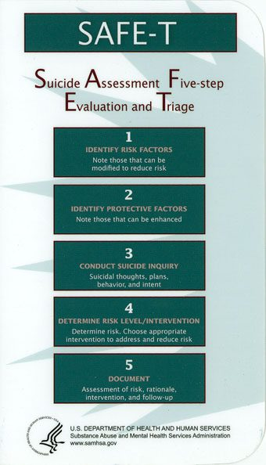
SAFE-T Assessment

Slide 24
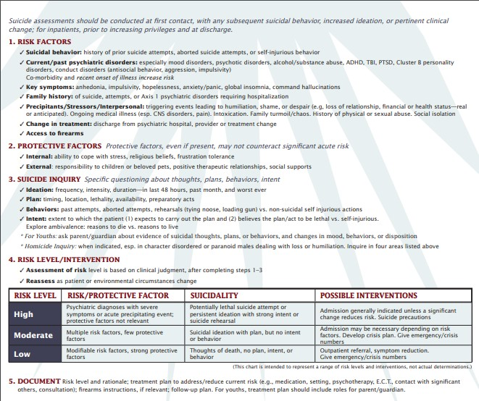
SAFE-T Assessment & Evaluation

Slide 25
Local Hotlines
re:solve Crisis Network 1-888-7-YOU-CAN (1-888-796-8226) | Women's Center and Shelter of Greater Pittsburgh (412) 687-8005
Pittsburgh Action Against Rape (PAAR) Crisis Hotline 1-866-363-7273 General Phone (412) 431-5665 | Center for Victims of Violent Crime Crisis Hotline (412) 392-8582 General Phone (412) 482-3240
Womansplace, Inc. (Shelter for Female Victims of Domestic Violence) 1-866-202-5573 | Womanspace East, Inc. (Shelter for Female Victims of Domestic Violence) (412) 765-2661
United Way HelpLine (412) 255-1155 | Family Resources WARMLINE (Parenting Information) 1-877-927-6596
Allegheny County Health Department - Public Health Emergency Services (412) 687-2243

Slide 26
Hotlines
Pennsylvania State | National
Office of Mental Health & Substance Abuse Services (OMHSAS) 1-877-356-5355 Childline (PA Child Abuse Hotline) 1-800-932-0313 | National Hopeline Network (Crisis or Suicidal Thoughts) 1-800-784-2433 Al-Anon/Alateen (Monday - Friday, 8 AM - 6 PM EST) 1-888-425-2666 The Alcohol Hotline 1-800-622-2255 National Child Abuse Hotline 1-800-422-4453 National Domestic Violence Hotline 1-800-799-SAFE (7233) National Victim Center (Victims of Violent Crimes) 1-800-394-2255 Gay & Lesbian National Hotline (Monday - Friday, 4 PM - 12 AM EST; Saturday, 12 PM - 5 PM EST) 1-888-843-4564 National Health Information Center 1-800-336-4797 National Poison Control 1-800-222-1222 National Suicide Prevention Lifeline 1-800-273-TALK (8255) RAINN (Rape Abuse & Incest National Network) 1-800-656-HOPE (4673)

Slide 27

Let's talk about grief and suicide...

Slide 28
Special Considerations
Traumatic Grief
Underlying conditions (mental health/medical)
Immediate action may be appropriate
Language (died from or by suicide)/MAID

Slide 29
Grief and Suicide: Special Considerations
Traumatic aftermath
sudden, sometimes violent, unexpected
survivors may need to deal with the police or handle press inquiries
recurring thoughts of the death/circumstances
may develop post-traumatic stress disorder (PTSD)
Stigma, shame, and isolation
stigma attached to mental illness
many religions specifically condemn the act as a sin
survivors may be reluctant to acknowledge or disclose the circumstances of such a death
family differences over how to privately or publicly discuss the death undermine a family's ability to provide mutual support.
Mixed emotions
victim and "perpetrator" are one
feelings anger, rejection, and abandonment may be particularly acute
Need for reason, the "why", the "what ifs"
Increased risk for survivors

Slide 30
What to do: Special Considerations
Reminder: It is not your fault
Developing neural pathways
Repetition helps to strengthen pathways
Creating a bearable narrative from the start
Language regarding baseline condition
Immediate therapeutic support may be appropriate

Slide 31

Interventions and Strategies
Normalize the grief experience
Listen, sometimes it is helpful to be quiet
Be compassionate and empathetic, remember that this is the person’s experience to live with
Use an informed biopsychosocial, strengths-based approach to empower the person to ask for help
Customize interventions to the person’s background, gender, resources, and needs (as defined by the person)
Consider coping style, personality, previous losses, access to and availability of support resources, as well as medical, psychiatric, and trauma history

Slide 32
Grief and Suicide: Supporting Clients
Ask clients what they know and how they feel
Give accurate information about suicide
Do not talk about the method
Avoid blaming and scapegoating
Address anger: one can be angry at someone’s behavior and still care deeply
Address feelings of responsibility
Encourage help-seeking behavior and self-care

Slide 33
Grief and Suicide: Family Contact
Contacting family directly to extend condolences
  Is necessary to notify the family of the death, will your outreach be welcome?
  Families may be angry, unreceptive or express blame (regarding clinician OR decedent)
  Contact with family can help clinicians’ own sense of closure
  Consider legal repercussions
Attending funeral or memorial services
  Be aware and respectful of the family’s wishes, ask for permission from the family of the deceased prior to attending
  Do not disclose involvement in the deceased’s treatment
  Discuss in clinical supervision, get approval from supervisor and/or manager, know the policy, including paid time off
Maintaining confidentiality
  Is the family aware that the decedent was in treatment?
  Is there a signed consent on file?
  Has the provider had previous contact with the family?
  Would attending the funeral or sending a card violate confidentiality?
  Families may not always understand the complexities of confidentiality - what do you think the family expects you to do?

Slide 34
Grief and Suicide: Group Settings
Discourage speculation/rumors/gossip
Do not provide details
Protect the client’s privacy – confidentiality regulations continue to apply even after the death of a patient
Focus on remembering the client, discussing feelings and reactions, and promoting help seeking behavior
Validate the feelings of the group – mixed reactions, fears of “being next,” signs of traumatic stress
Gently redirect conversations with irrelevant or potentially hurtful statements
Emphasize that there is always help available when someone needs it.
Provide immediate individual response immediately to any client who appears to be especially impacted by the news
Pay attention to clients who might be at increased suicide risk

Slide 35
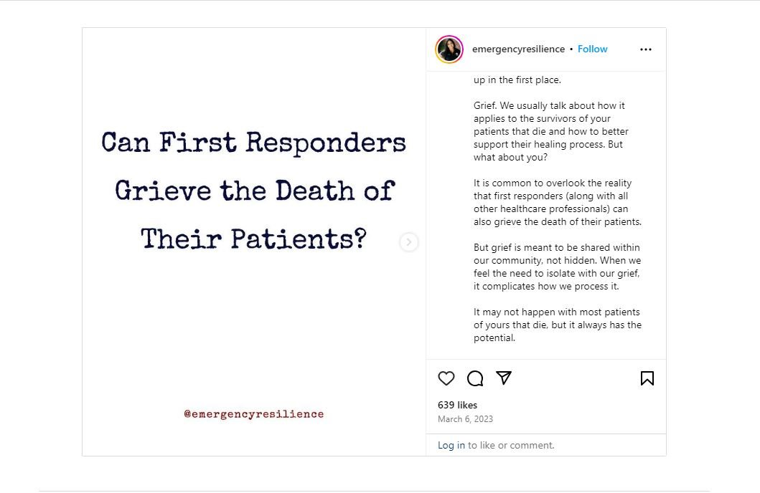
Disenfranchised Grief

Slide 36
Grief and Suicide: Supporting Colleagues
Institutional debriefing
Keep the conversation factual and the tone non-accusatory
Open-ended questions encourages staff to contribute
Keep things simple: debriefings answer the “who, what, when, where” of a patient death
Avoid going into details of the death, and avoid sharing suspicions or spreading rumors
Keep the meeting short: a debriefing should take between 30 minutes to an hour
As you prepare for debriefing, identify your own feelings and reactions and understand that the person communicating the news sets the tone for subsequent communications
Be prepared for a wide range of reactions, including no reaction at all.

Slide 37

Team Care at Work
Regularly scheduled moments of remembrance: Daily/weekly/monthly/annual, candle lighting, moment of silence each morning or change of shift, reading names of deceased, sharing of stories, celebration of life with tea and cookies, the main goal is to bring staff together to connect them in their shared grief space as an established routine that staff can expect, look forward to, and count on
Memorial "garden": outdoor space for reflection or an indoor planter with succulents, ask staff to paint/use marker to write the initials of the patient on a small stone for collection and placement in a container garden with sand or small plants or even in a jar as a centerpiece for a daily/weekly/monthly moment of remembrance
Grief jar: invite staff to write a thought when motivated or pick a thought when in need from a jar or a box, notes to each other for encouragement, support, understanding, shared grieving, "we are all here together, you are not alone" type of messages to each other to form shared connection over loss
Legacy/Grief book: write notes about deceased patients, favorite memories, stories in a single volume to be shared with the patient's family or could be collected and kept at the clinic where staff continue to add
Collage: establish a wall/bulletin board dedicated to an established memorial symbol (a certain flower, heart, bird shape, etc.), staff could write a small message on the back and hang them as a remembrance
If a series of support sessions would be helpful, EAP
Regular ritual to acknowledge cumulative losses as appropriate in addition to more specific events to recognize the death of individual patients and the impact on staff

Slide 38
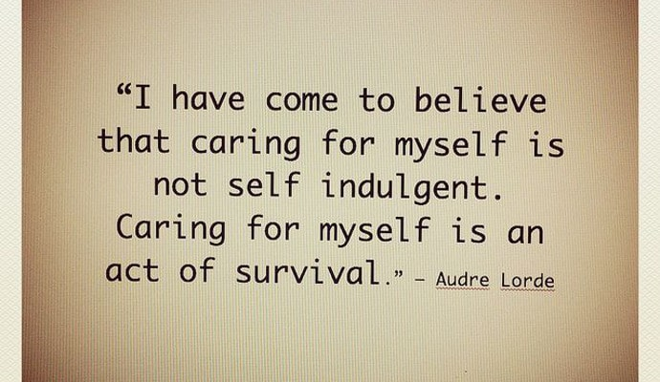

Slide 39
Grief and Suicide: Supporting Yourself
Compounded impact: personal grief reaction, professional identity and relationships with colleagues and their clinical work
Insecurities about their own competence
Feelings that the work is too sad and too emotionally draining to continue
May develop hypervigilance to perceived suicide risk
Issues recognizing value and self worth in role
A 2017 study found that 10% of surveyed psychiatrists stopped accepting potentially suicidal clients

Slide 40
What can we do?
Acknowledge the death AND your grief (both are real)
Give yourself time to grieve
Identify, express and experience your feelings
Adapt your routine to accept changes in your schedule
Find meaning in the death

Slide 41

Ideas for Work
Feeling overwhelmed or sad? Know who to call (your manager or a particularly comforting colleague)
Find ways to refuel
  Breathe deeply
  Climb a flight of stairs (or several)
  Find a scenic route
  Look out of a window
  Smile
  Find a quiet space and visualize a comforting place
  Look at a cat meme, find a way to laugh
Be acutely aware of your professional boundaries
Do your best work
Notes:
Breathe and laugh, life is short

Slide 42
If self-care seems impossible
Remember, you can't care for others if you don't take care of yourself
Divide duties with co-workers, family, friends, community groups, faith organizations
Eat, hydrate, sleep, exercise...repeat
Take breaks, have some fun
Connect with others, reach out for support
Ask for (and accept!) help

Slide 43
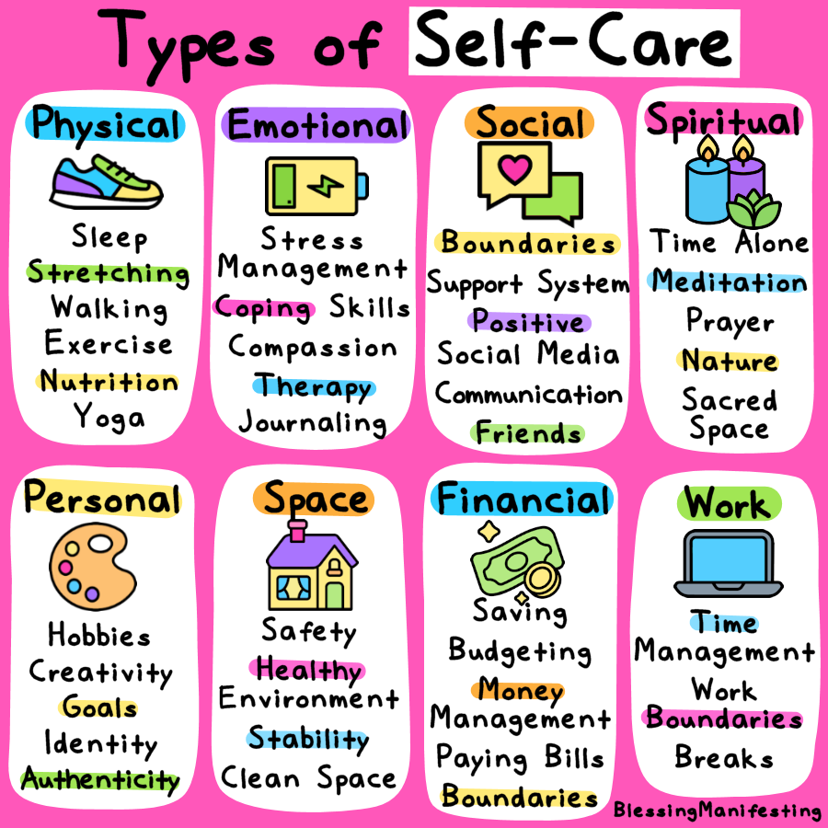
Self Care
(home and work)

Slide 44
5-minute self-care ideas (that are not about self-improvement)
Clean/organize one thing
Have a good cry
Read some good news
Put on lotion
Cut or paint your fingernails
Light candles
Play your favorite song
Laugh (at anything!)
Go off the grid
Breathe​
Step outside​
Journal​
Sing and dance​
Stretch​
Shower​
Close your eyes​
Text a friend​
Say thank you​
Color or draw

Slide 45
What else can I do?
Is there a physical cause of your anxiety/depression/emotions? Impact of medications or medical procedures?
Talk to the people around you.
Remember gut/brain connection, be mindful of your digestive system
Breathe
Seek help (EAP, counselor, therapist, social worker, palliative team)

Slide 46


Slide 47


