Slide 1
Housekeeping Reminders
Please submit questions via the Zoom chat during the presentation.
For attendance, please type in your name and organization in the chat.
Attendees are muted upon entry. Click “Unmute” when you would like to speak. Please mute yourself after speaking.
The presentations are posted on Tomorrow’s HealthCare www.tomorrowshealthcare.org

Slide 2
2026 PCMH Pediatric Nursing Care Sprint Session #3
July 14, 2026
Pittsburgh Regional Health Initiative

Slide 3
Continuing Education Information
In support of improving patient care, this activity has been planned and implemented by the University of Pittsburgh and The Jewish Healthcare Foundation. The University of Pittsburgh is jointly accredited by the Accreditation Council for Continuing Medical Education (ACCME) and the American Nurses Credentialing Center (ANCC), to provide continuing education for the healthcare team. 1.5 hours are approved for this course.
As a Jointly Accredited Organization, University of Pittsburgh is approved to offer social work continuing education by the Association of Social Work Boards (ASWB) Approved Continuing Education (ACE) program. Organizations, not individual courses, are approved under this program. State and provincial regulatory boards have the final authority to determine whether an individual course may be accepted for continuing education credit. University of Pittsburgh maintains responsibility for this course. Social workers completing this course receive 1.5 continuing education credits.

Slide 4
Disclosures
No members of the planning committee, speakers, presenters, authors, content reviewers and/or anyone else in a position to control the content of this education activity have relevant financial relationships with any entity producing, marketing, re-selling, or distributing health care goods or services, used on, or consumed by, patients
to disclose.
Notes:
No conflicts of interest

Slide 5
Disclaimer
The information presented at this Center for Continuing Education in Health Sciences program represents the views and opinions of the individual presenters, and does not constitute the opinion or endorsement of, or promotion by, the UPMC Center for Continuing Education in the Health Sciences, UPMC / University of Pittsburgh Medical Center or Affiliates and University of Pittsburgh School of Medicine. Reasonable efforts have been taken intending for educational subject matter to be presented in a balanced, unbiased fashion and in compliance with regulatory requirements. However, each program attendee must always use his/her own personal and professional judgment when considering further application of this information, particularly as it may relate to patient diagnostic or treatment decisions including, without limitation, FDA-approved uses and any off-label uses.

Slide 6
Learning Objectives
Describe an example of how PCMH-PNCs can improve the patient and family transition from pediatric to adult care
Discuss how PCMH-PNC teams can use tools like Gemba Walks and the RACI matrix to define roles and standard work for PCMH-PNC Case Managers
Discuss progress in PCMH-PNC quality improvement projects
Describe strategies to implement the second PDSA sprint cycle

Slide 7
PCMH Spotlight:
WellSpan Community
Health Center

Slide 8


Slide 9
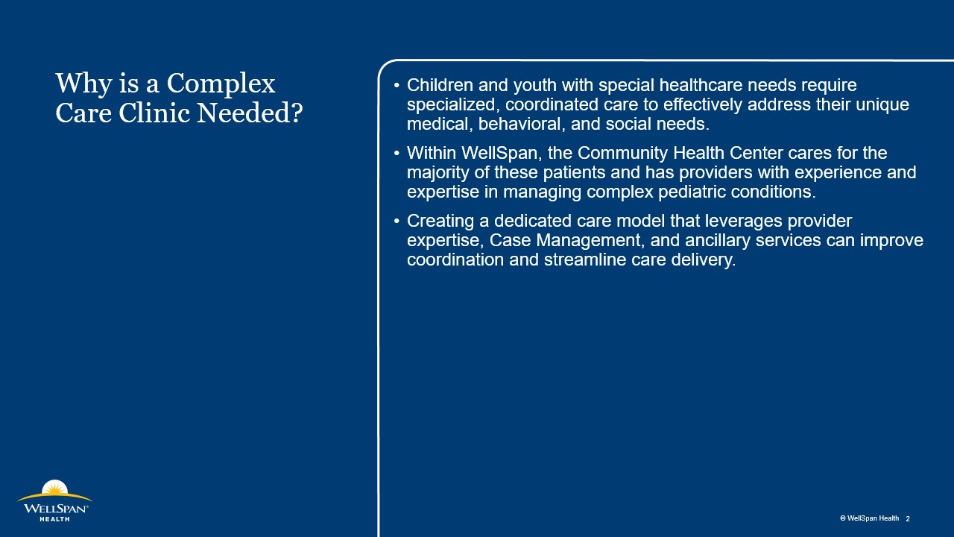

Slide 10
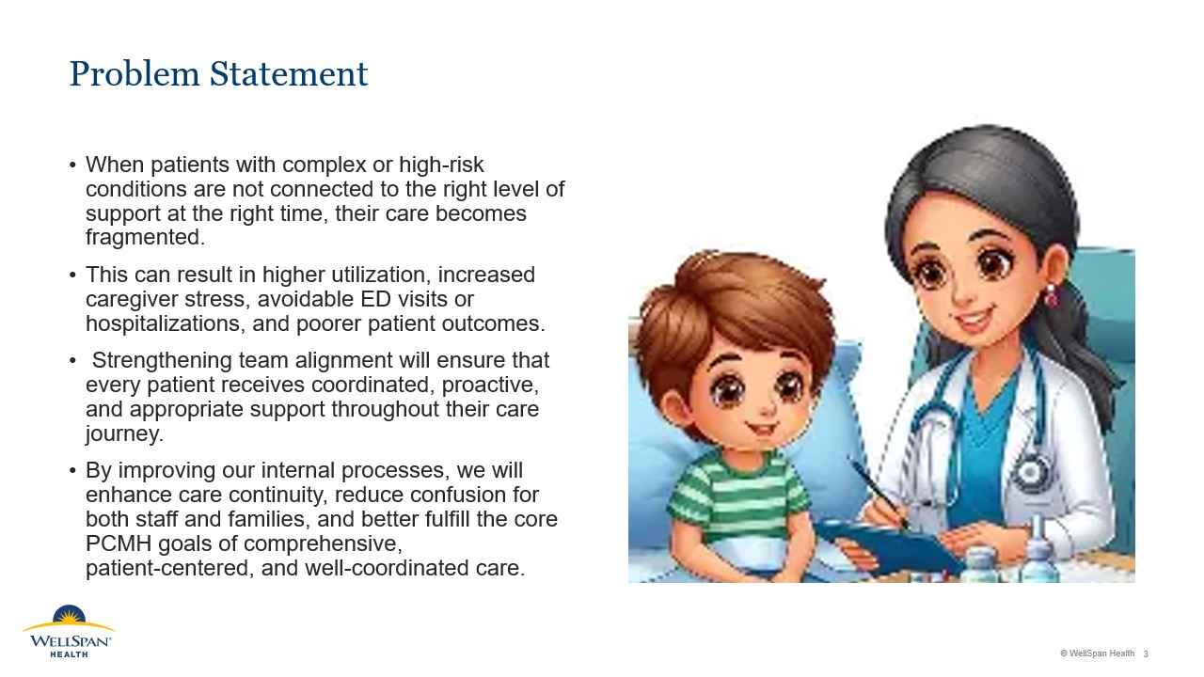

Slide 11
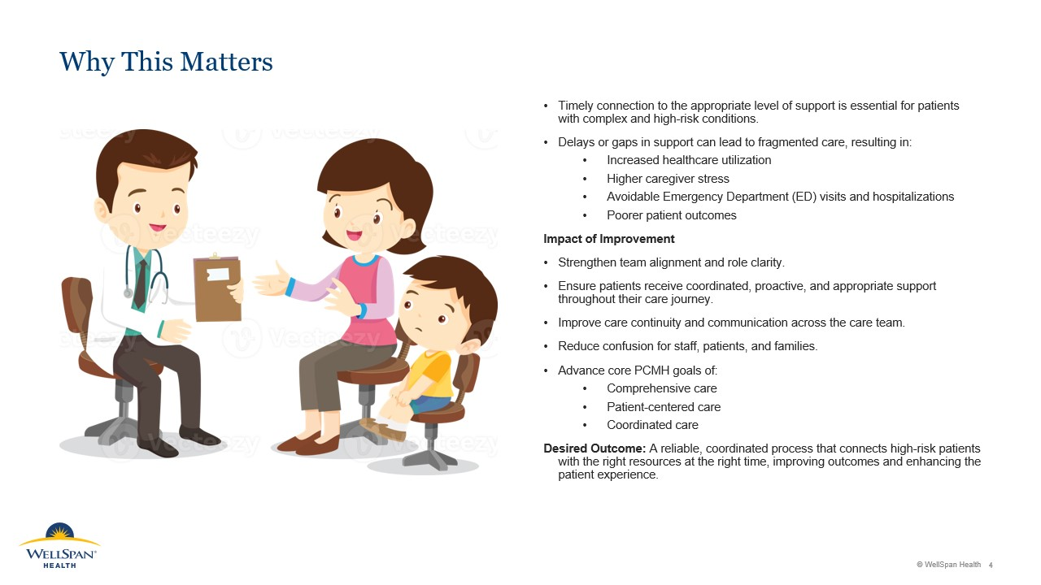

Slide 12
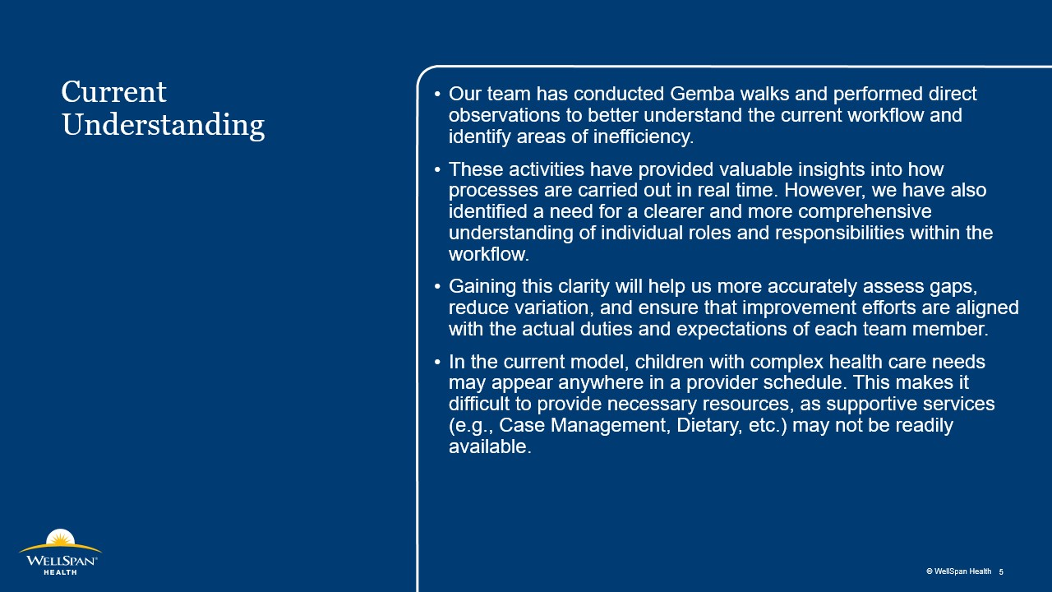

Slide 13
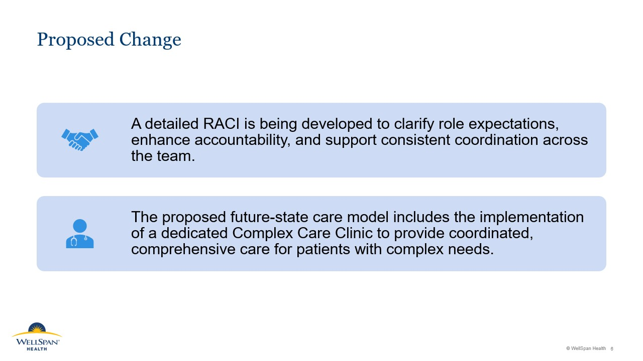

Slide 14
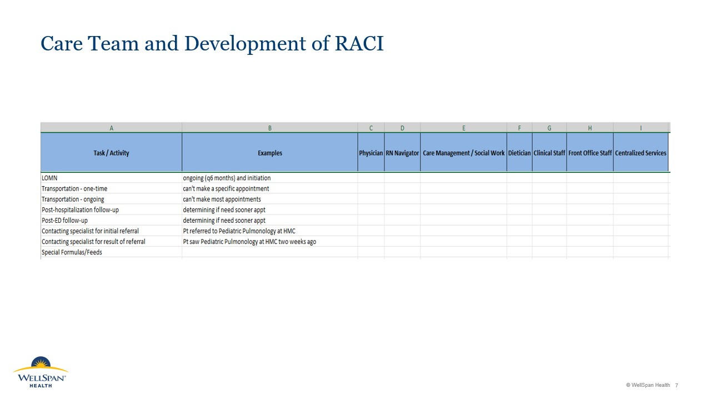

Slide 15
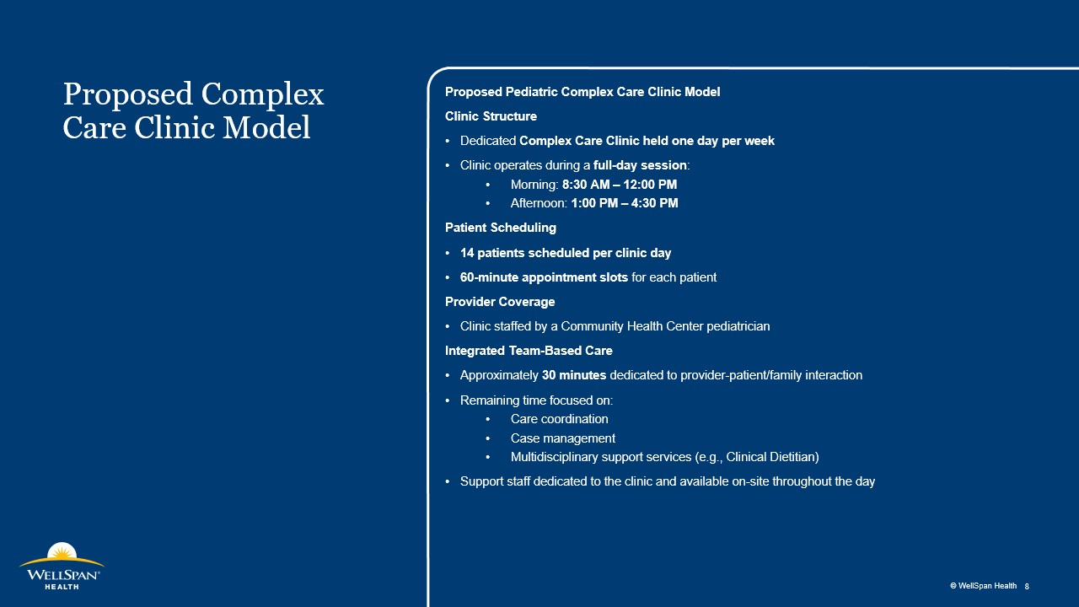

Slide 16
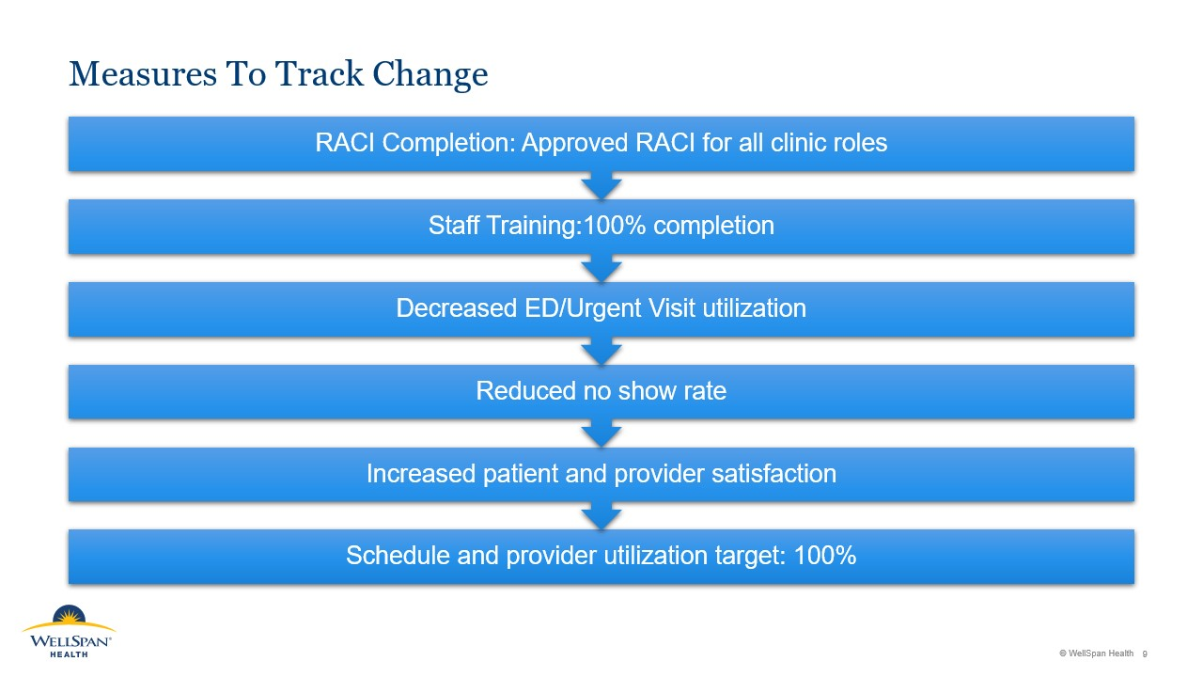

Slide 17
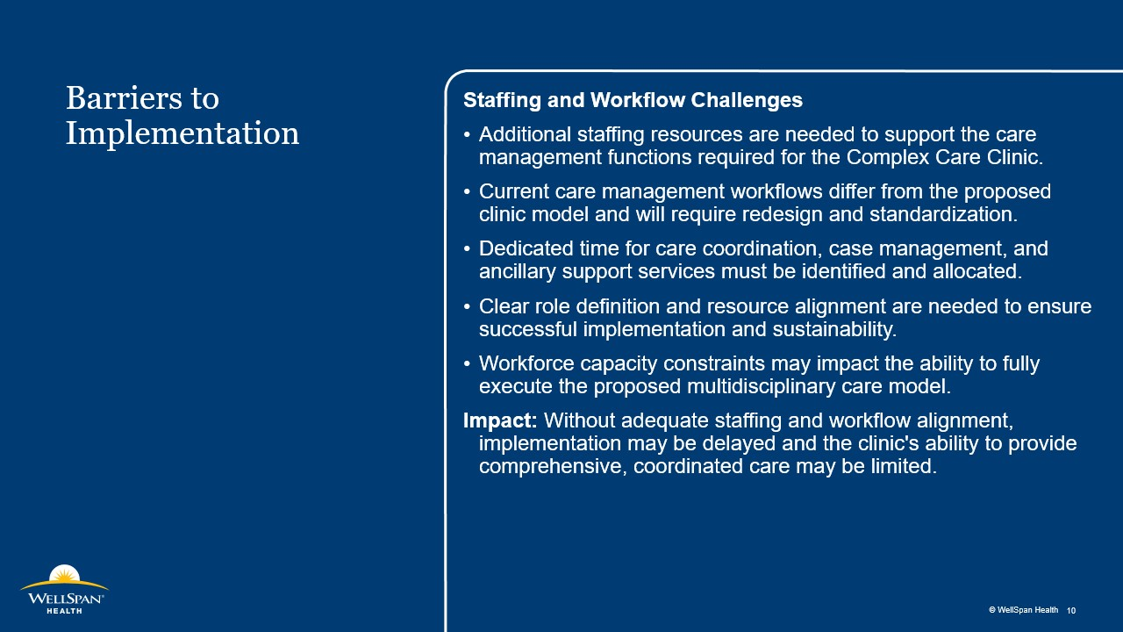

Slide 18


Slide 19
PCMH Spotlight:
LG Health Physicians
Roseville Pediatrics

Slide 20
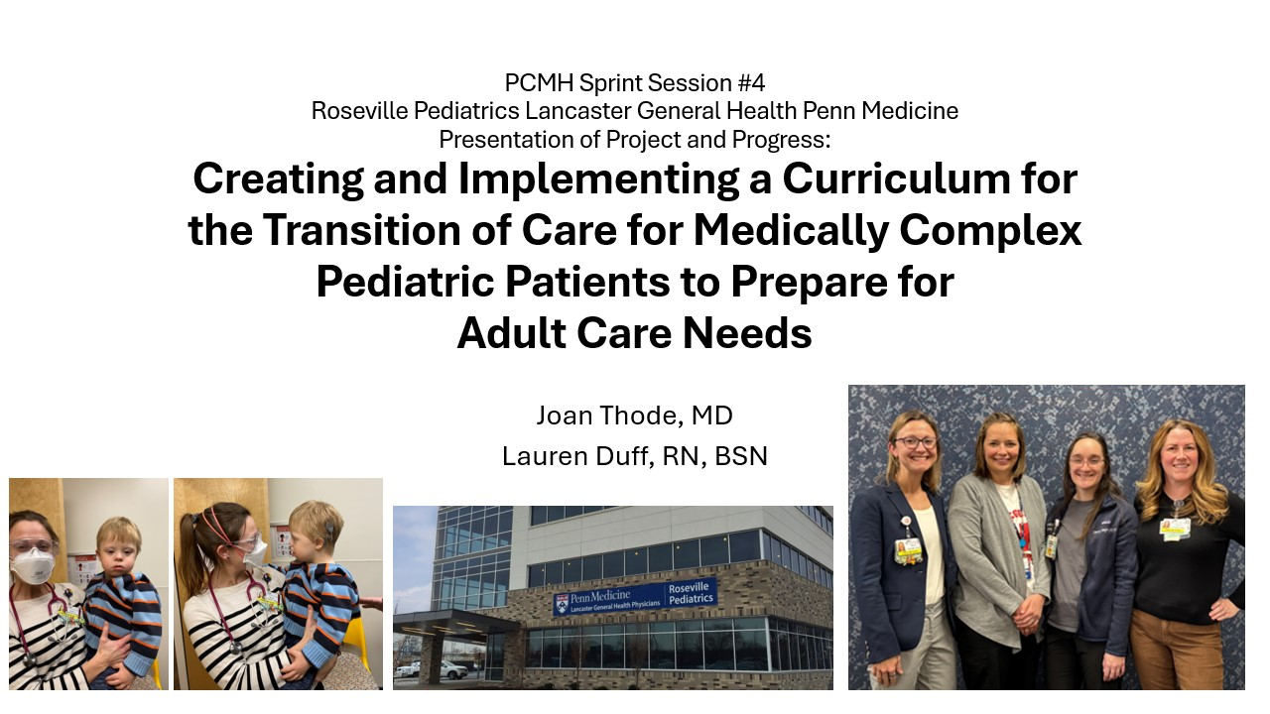

Slide 21
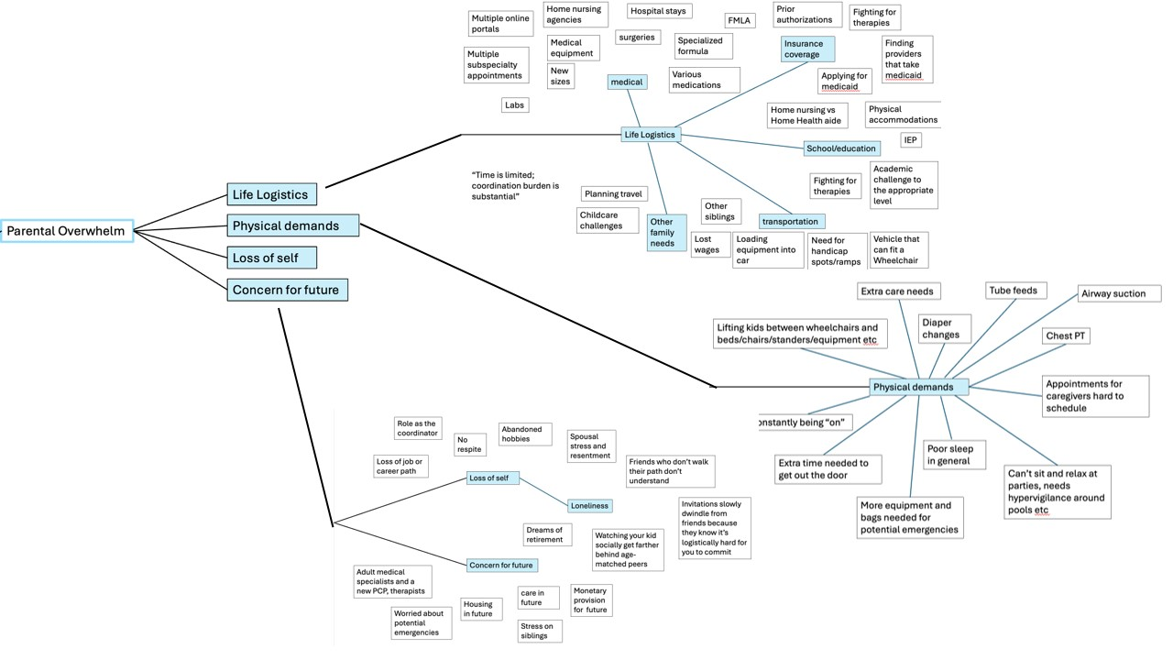

Slide 22
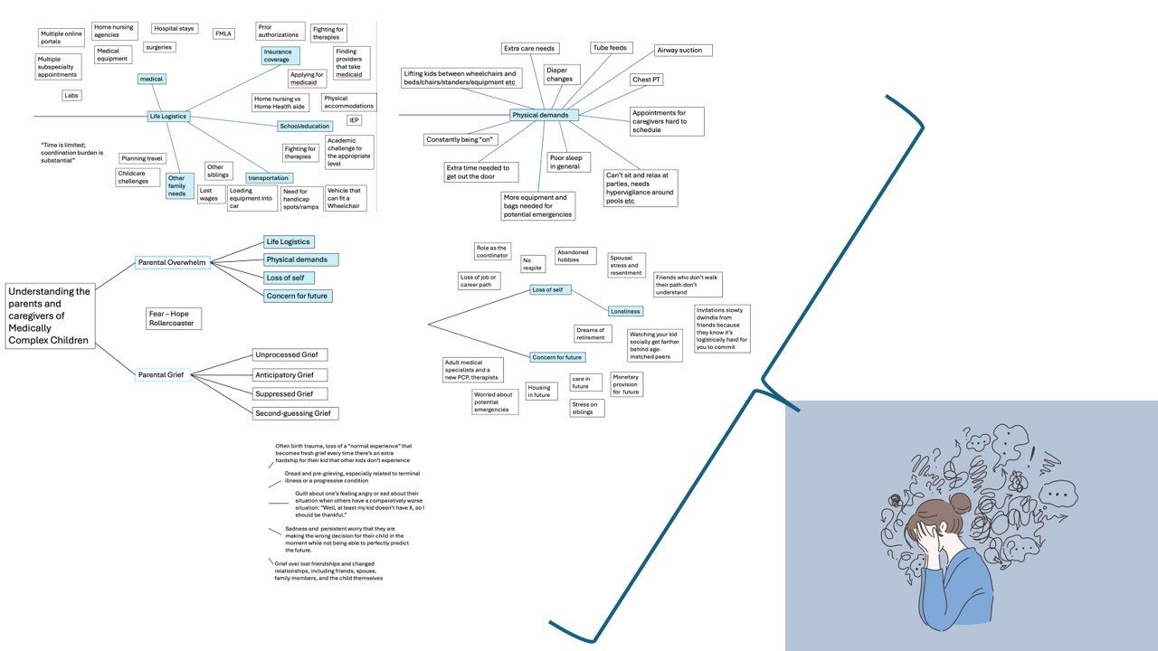

Slide 23
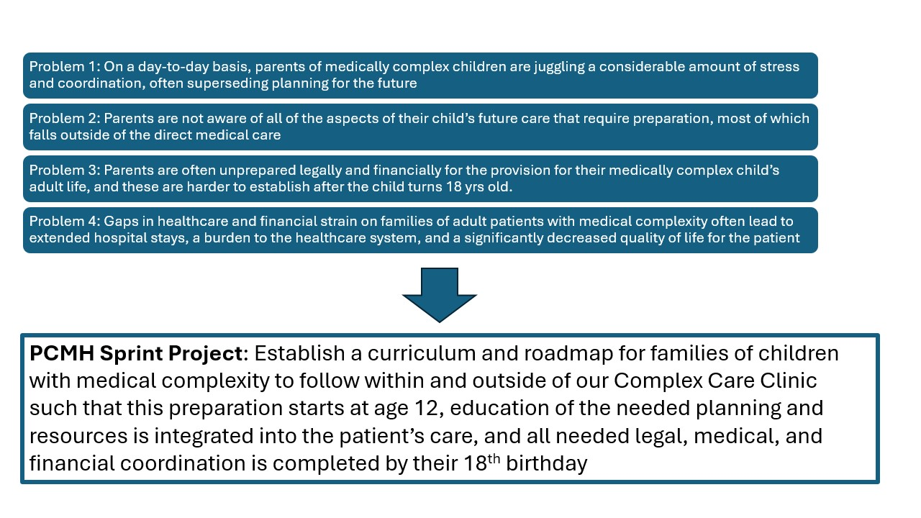

Slide 24
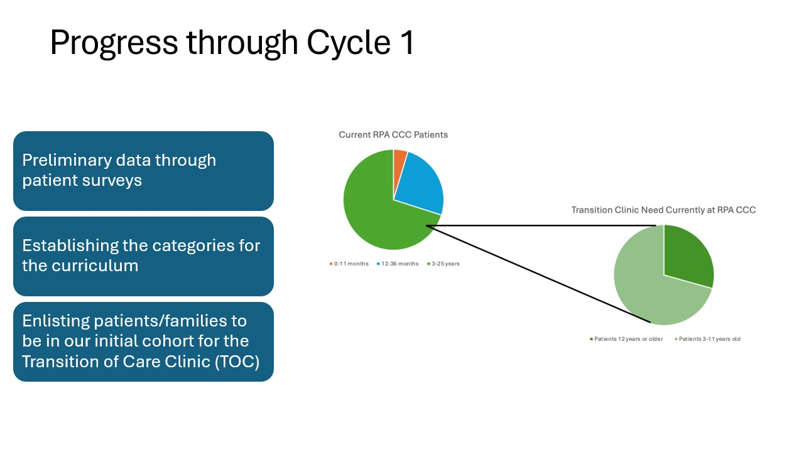

Slide 25
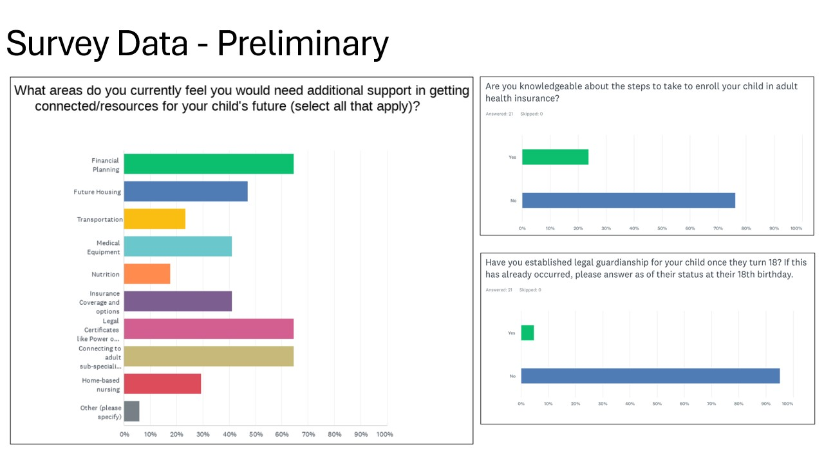

Slide 26
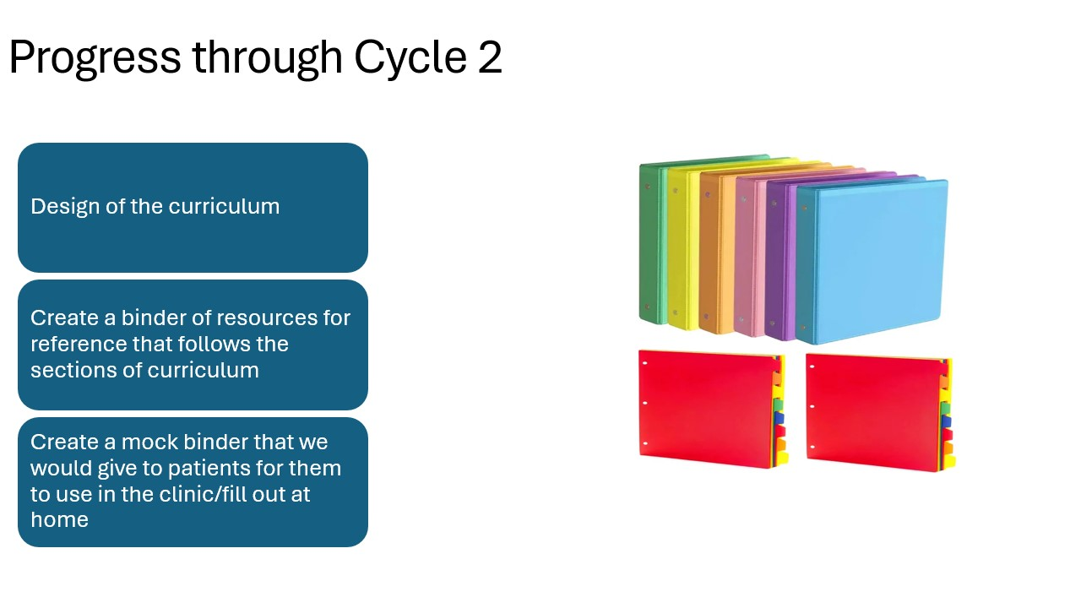

Slide 27
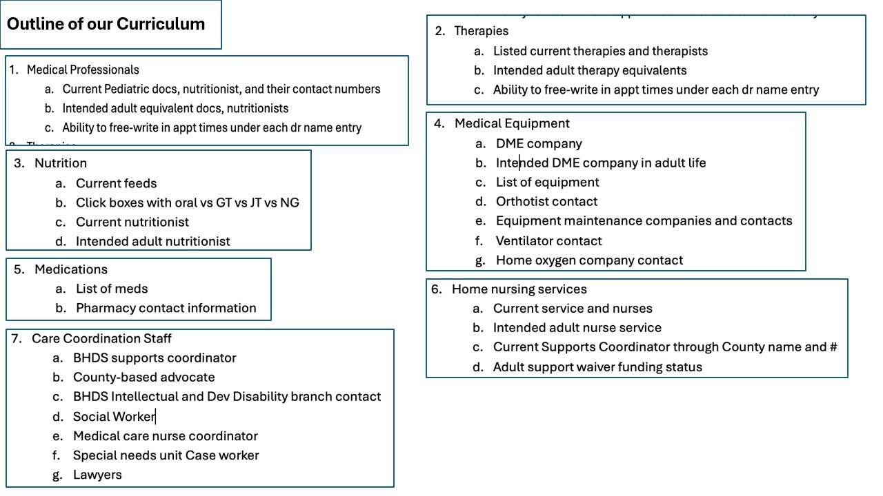

Slide 28
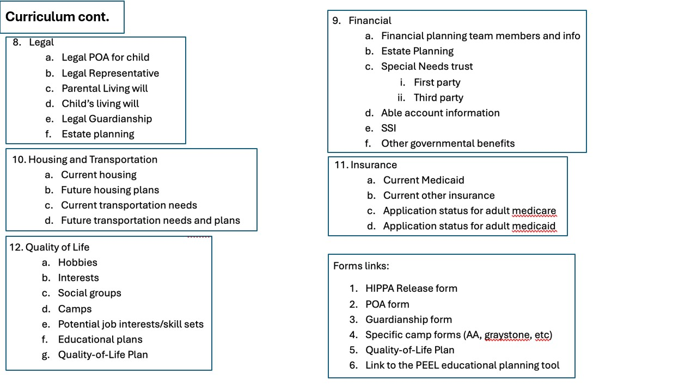

Slide 29
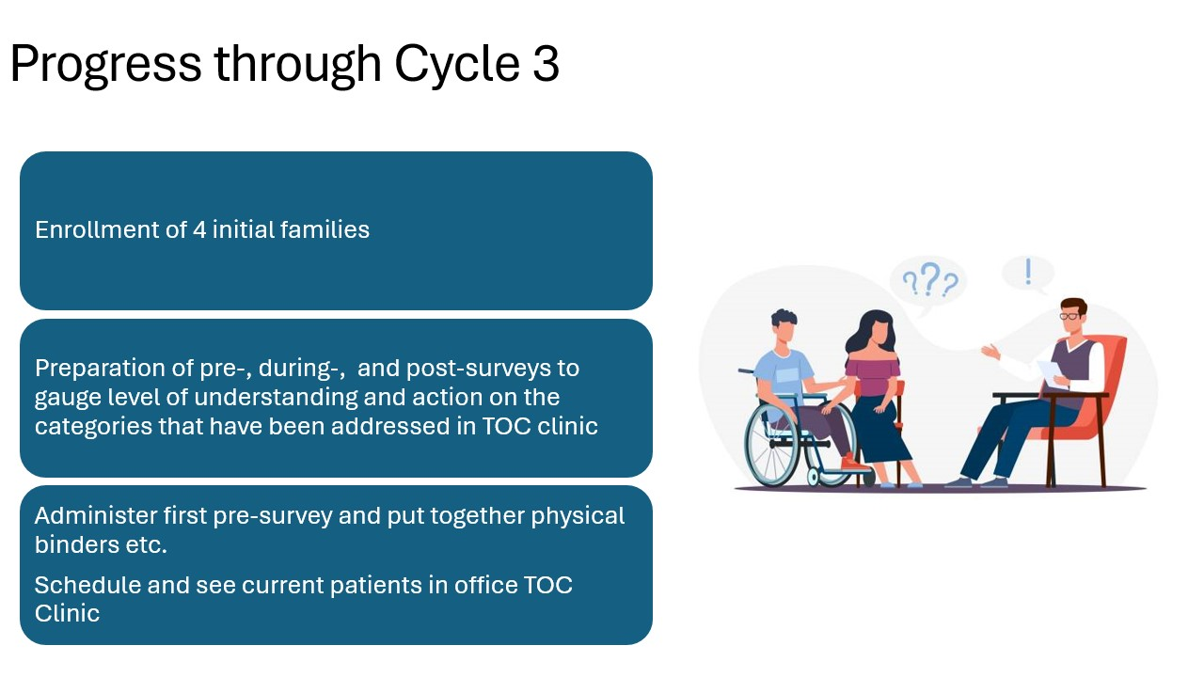

Slide 30
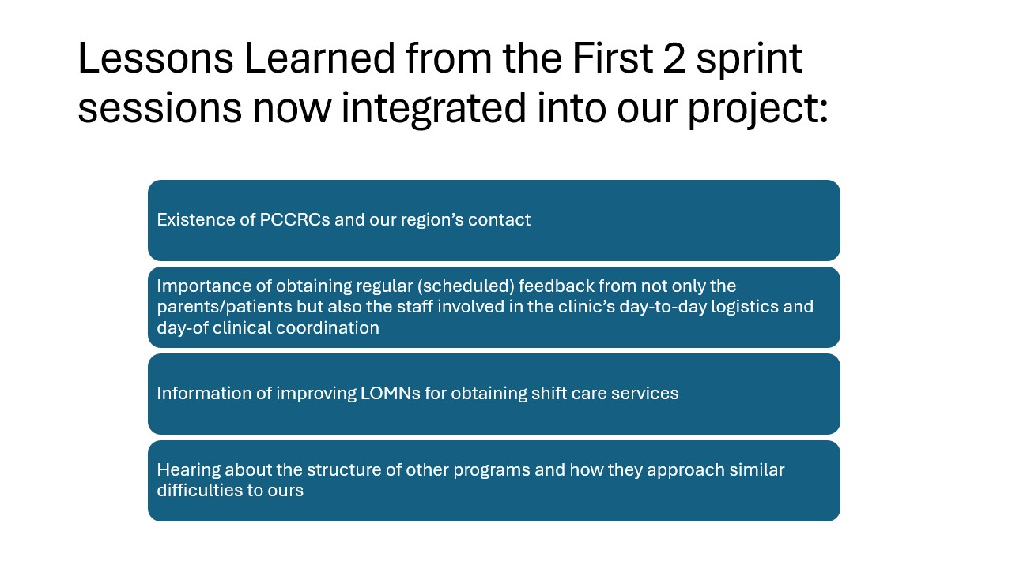

Slide 31
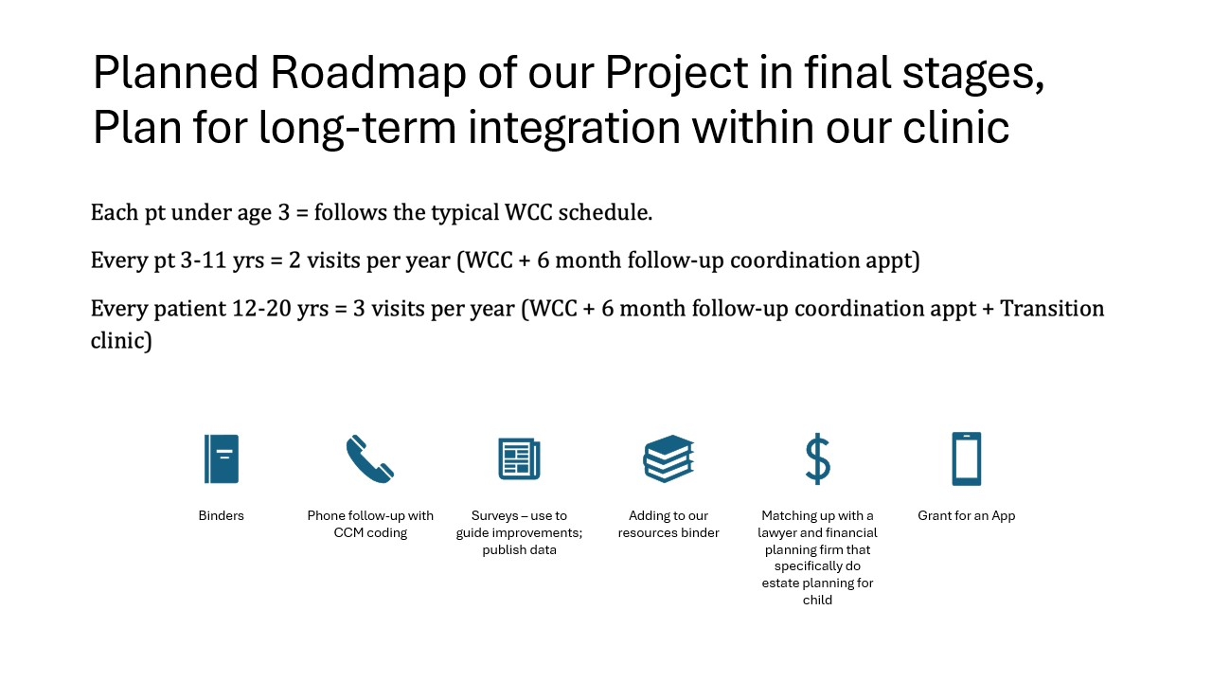

Slide 32
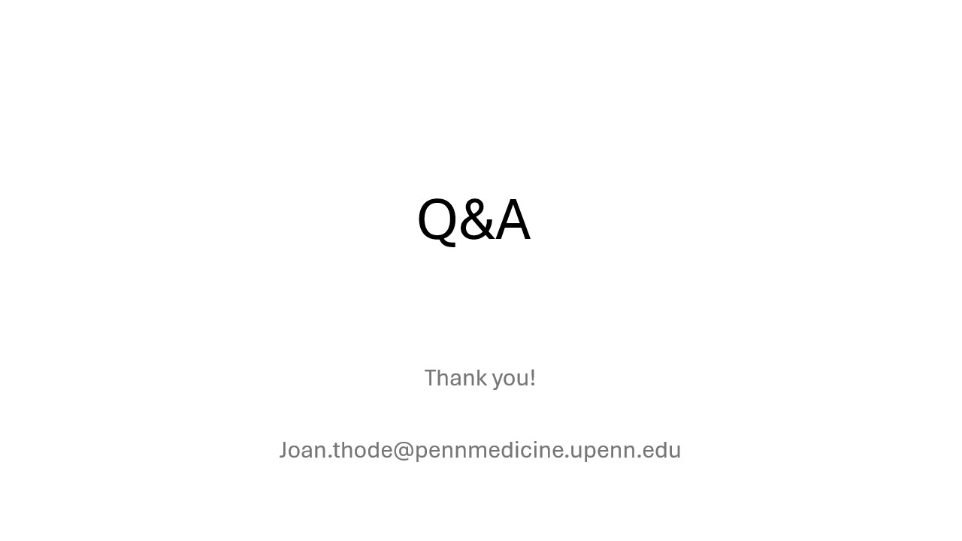

Slide 33
PCMHs’ Sharing of PDSA Plans and Peer-to-Peer Learning

Slide 34
Discussion Questions
Briefly describe your PCMH's goal, intervention(s), and findings for the first PDSA cycle.
How have your early findings influenced the focus of your second PDSA cycle?
As you move into the second PDSA sprint, what implementation challenges are you anticipating, and what strategies are you considering to address them?
Thinking about the strategies discussed by today's speakers, what ideas or approaches are most relevant to your practice's next phase of improvement work?

Slide 35
Next Steps, Wrap Up &
Session Evaluation
J. Ashenayi, Program Associate
Pittsburgh Regional Health Initiative

Slide 36
Next Steps from Today’s Session
Update your PDSA plan
Reach out with any questions or to request 1:1 support or TA
Register for the final sprint session, the final in-person wrap-up session, and supplemental sessions

Slide 37
2026 PCMH Learning Network
4th Sprint Session & November 10th In-Person Session
PCMH Milestone: Complete at least 2 PDSA cycles and share at the in-person event*
Sprint Session 4
Thursday, October 1st at 9-10:30 am
LN provides Tactical how-to information related to PCMHs’ QI plans
PCMHs share 2nd Cycle of “Study” and “Act” through facilitated peer-to-peer learning
LN provides guidance on completing PDSA cycles (e.g., standardizing and scaling improvements) and preparing for the final session
Final In-Person Session
PCMHs share their completed PDSA cycles
LN recognizes PCMHs with greatest improvements
LN announces 2027 Sprints

Slide 38
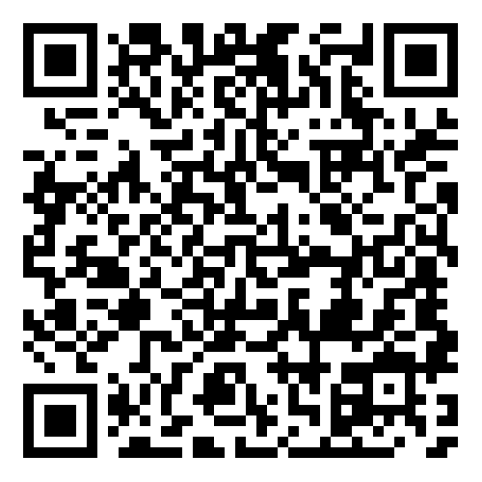
Supplemental Sessions
HIV Screening, Prevention, and Treatment
July 29, 2026 (New)
9:00 am – 10:00 am
Oral Cancer Prevention and Early Detection
September 24, 2026
9:00 am – 10:00 am
Contraceptive Care: IUD Pain Management
October 29, 2026
9:00 am – 10:00 am

Slide 39



PCMH Online Community https://www.tomorrowshealthcare.org/
Access the session materials in “Learning Sessions”
Look for guides and tools in “Resources”
Find session dates and registration links under “Events”
Members of your PCMH’s multi-disciplinary learning team will receive log-ins

Slide 40
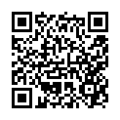
CEU Process
You will receive a follow up email with links to
Complete the survey at: https://www.surveymonkey.com/r/7VB8YDD by Tuesday, July 21st
Please be sure to designate which CEU credits you are requesting CME, CNE, Social Worker or Certificate of Attendance. If you already have an account with the UPMC Center for Continuing Education, please be sure the email you enter on the survey matches the UPMC CCE account email that you create.
The UPMC Center for Continuing Education will follow up with you via email after July 21st with instructions on how to claim your credits.
  To prepare, we recommend you create an account with UPMC CCE via this website https://cce.upmc.com.

Slide 41
Thank You!

