Slide 1
Behavioral Health Integration
Sprint Learning Session #3
July 9, 2026
HealthChoices PCMH Learning Network
Suzanne Cohen, Senior Director of Population Health, Health Federation of Philadelphia

Slide 2
Agenda
9:00 – 9:15 a.m. | Welcome & Presentation of the transition to the second PDSA cycle | Suzanne Cohen, Health Federation of Philadelphia
9:15 – 9:45 a.m. | PCMH Sharing of Challenges and Solutions | Laura Line, Health Federation of Philadelphia
9:45 – 10:15 a.m. | PCMH Panel Discussion: Moving from PDSA Cycle 1 to 2 | Rafaela Velez & Niya Grenevich, Berks Community Health Center
10:15 – 10:30 p.m. | Sprint Timeline, Next Steps & Evaluation | Suzanne Cohen, Health Federation of Philadelphia
Notes:
Thank everyone for getting your PDSA worksheets submitted and for putting up with us as we figure out this process. Please feel free to let us know if anything is not working or is super cumbersome.

Slide 3
Continuing Education Information
In support of improving patient care, this activity has been planned and implemented by the University of Pittsburgh and The Jewish Healthcare Foundation. The University of Pittsburgh is jointly accredited by the Accreditation Council for Continuing Medical Education (ACCME) and the American Nurses Credentialing Center (ANCC), to provide continuing education for the healthcare team. 1.5 hours are approved for this course.
As a Jointly Accredited Organization, University of Pittsburgh is approved to offer social work continuing education by the Association of Social Work Boards (ASWB) Approved Continuing Education (ACE) program. Organizations, not individual courses, are approved under this program. State and provincial regulatory boards have the final authority to determine whether an individual course may be accepted for continuing education credit. University of Pittsburgh maintains responsibility for this course. Social workers completing this course receive 1.5 continuing education credits.

Slide 4
Disclosures
No members of the planning committee, speakers, presenters, authors, content reviewers and/or anyone else in a position to control the content of this education activity have relevant financial relationships with any entity producing, marketing, re-selling, or distributing health care goods or services, used on, or consumed by, patients
to disclose.
Notes:
No conflicts of interest

Slide 5
Disclaimer
The information presented at this Center for Continuing Education in Health Sciences program represents the views and opinions of the individual presenters, and does not constitute the opinion or endorsement of, or promotion by, the UPMC Center for Continuing Education in the Health Sciences, UPMC / University of Pittsburgh Medical Center or Affiliates and University of Pittsburgh School of Medicine. Reasonable efforts have been taken intending for educational subject matter to be presented in a balanced, unbiased fashion and in compliance with regulatory requirements. However, each program attendee must always use his/her own personal and professional judgment when considering further application of this information, particularly as it may relate to patient diagnostic or treatment decisions including, without limitation, FDA-approved uses and any off-label uses.

Slide 6
The PCMH Learning Network
Designed to support the PCMHs and MCOs in:
  Achieving the shared aims of the HealthChoices PCMH Program
  Identifying and acting on strategies in response to opportunities for improvement
  Developing an internal capacity to continuously learn, adapt, and improve
Notes:
As always, our goal is to help the MCOs and PCMHs achieve the common expectations of the PCMH value-based payment program.

Slide 7
Access today’s slides online
GO TO: www.tomorrowshealthcare.org
Your Login: The email address you RSVP’d with
Your Password: Welcome
To get assistance or access for your colleagues:
email J. at ashenayi@jhf.org

Slide 8
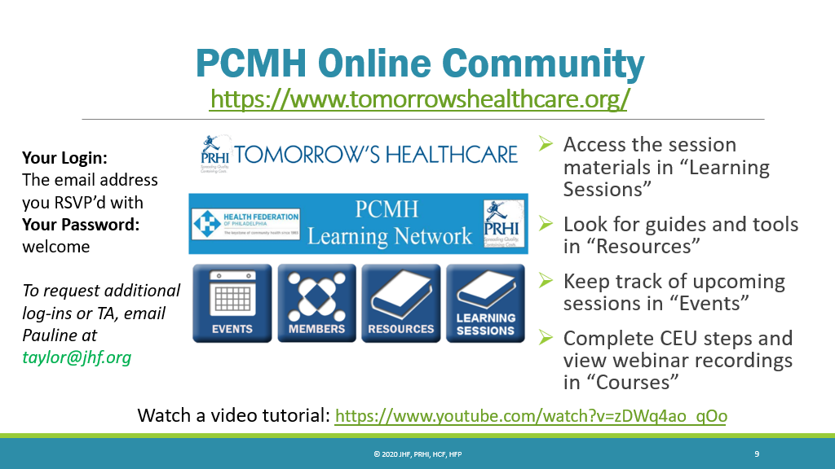
PCMH Online Community
Keep track of upcoming
sessions in “Events”
Access session materials in “Learning Sessions”
Including slides and webinar recording
Look for guides and tools in “Resources”

Slide 9
Learning Objectives for Today
Describe strategies that are effective in providing integrated behavioral health within primary care.
Describe progress in planning quality improvement activities across participating PCMH practices.
Identify potential approaches to implement quality improvement interventions.

Slide 10
Transition to 2nd PDSA Cycle
Suzanne Cohen, Senior Director of Population Health
Health Federation of Philadelphia

Slide 11
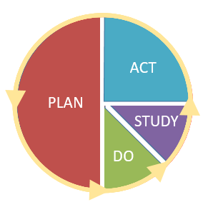
Plan Do Study Act

Slide 12
PDSA Plan Submission Due Dates
2/12
3/25
4/28
6/9
9/22
10/30
6/29
Session 1
3/11
Session 2
4/21
PCMH Statewide Midyear
6/02
Session 3
Today!
Session 4
10/06
PCMH Statewide In-Person
11/11
PCMH Statewide Kickoff
1/27
Goal: Complete PDSA 1
Goal:
Complete PDSA 2

Slide 13
Match implementation Strategies
Rule of Thumb
Barrier Type | Recommended Strategies
Knowledge Gaps | 📚 Education, 📊 Feedback
Access Gaps | 🏥 Service Redesign, 🛠️ Equipment, 🤝 Partnerships
Workflow Gaps | 💻 EHR Tools, ✅ Standing Orders

Slide 14
Pre-implementation measures
Acceptability
Appropriateness
Feasibility
Cost
Reach
Things to Consider
Start with fit, not ambition.
Proctor E, Silmere H, Raghavan R, et al. Outcomes for implementation research: conceptual distinctions, measurement challenges, and research agenda. Adm Policy Ment Health. 2011;38(2):65-76. doi:10.1007/s10488-010-0319-7

Slide 15
Higher impact/
effectiveness
Maybe
Best
More things to Consider
Lower equitability
Higher equitability
Avoid
Caution
Lower impact/
effectiveness

Slide 16
Narrow to Broad Approach
PDSA 1: Initial Improvement Plan
Focused on:
  One care team
  One pod
  One location
Goal:
  Test and refine the improvement project on a small scale
Results:
  Demonstrated successful improvement and positive results
PDSA 2: Initial Improvement Plan
Expand implementation to:
  Additional care teams
  Additional pods
  Additional locations
Goal:
  Scale successful practices across broader settings
  Ensure consistency and sustainability of improvement efforts

Slide 17
Broad to Narrow Approach
PDSA 1
Broad implementation goals
Goal:
  Multiple!
  Ex: improve practice performance on depression screening and follow-up to positive screens
  Results: unclear or uneven
PDSA 2
Narrow and dig into a single metric
Focus on improvement in that one area
Ex: Improve practice performance on depression screening

Slide 18
Reassess Root Causes &
Match Implementation Strategies
PDSA 2: Workflow & System Redesign
Key Learning from PDSA 1:
  Workflow and lack of system supports made warm hand-offs difficult to complete consistently, independent of training/knowledge levels
New Strategy: Focus on systems and workflow
Ex: Create standing orders with system prompts or flags for eligible patients
  Medical Assistants should refer any patient with a PHQ9> X to integrated behavioral health
PDSA 1: Improve Warm Hand-offs to Integrated Behavioral Health
Assumption:
Low hand-off rates were caused by lack of knowledge or awareness
Intervention:
Train PCPs and behavioral health providers on warm hand-offs
Results:
Warm hand-off rates did not improve significantly
Notes:
Match Implementation strategies to the true root cause of the problem

Slide 19
Use Variation in Results to Inform PDSA 2
PDSA 1: Depression Screening & Referral Improvement
Goal: Increase depression screening and referral to follow-up care
Interventions:
  Train MAs on PHQ-9
  Create standing orders
  Adjust workflows/systems
  Apply across 4 care teams
Results: 2 teams showed improvement, 2 showed little to no improvement
PDSA 2: Investigate & Tailor the Response
Examine implementation differences across the teams
  Were workflows followed consistently?
  Were there staffing barriers?
  Did implementation go as intended?
Possible next steps:
  Re-implement PDSA 1 with better support to care teams with little improvement
  Develop a new intervention tailored to the specific barrier’s for each team
Notes:
Variation in outcomes provides insight into implementation challenges and helps guide more targeted improvement strategies

Slide 20
Overall Considerations
It probably won’t be this neat - real life rarely is!
PDSA 1 may not be finished. PDSA 2 can be a refinement, or mid-cycle adjustment. It does not need to be a whole new thing.
Go back to your implementation science principles. Match the intervention to the outcome and make it realistic!
Have a single clearly defined primary outcome and clear methods to collect data to measure process (whether you are implementing your intervention as planned) and whether you are achieving your outcome.

Slide 21

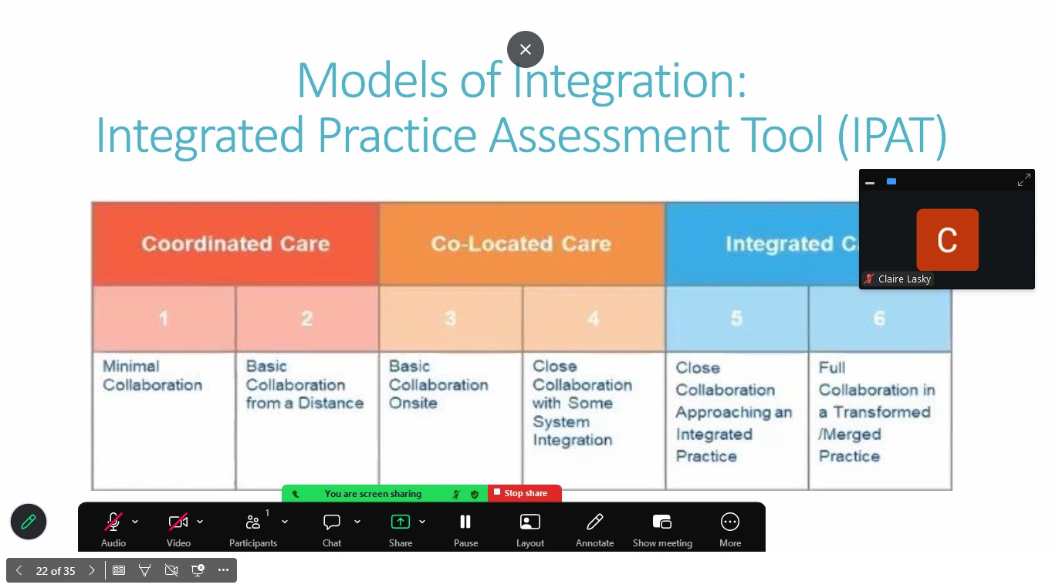

Practice Placement Directions

Slide 22
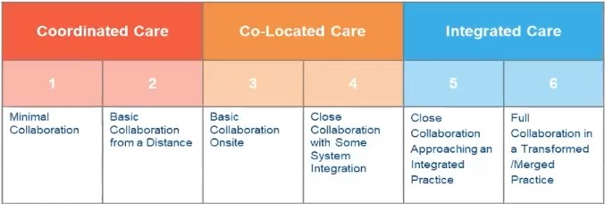
Models of Integration:
Integrated Practice Assessment Tool (IPAT)

Slide 23
PCMH Sharing of Challenges and Potential Support
Laura Line, Consultant
Health Federation of Philadelphia

Slide 24
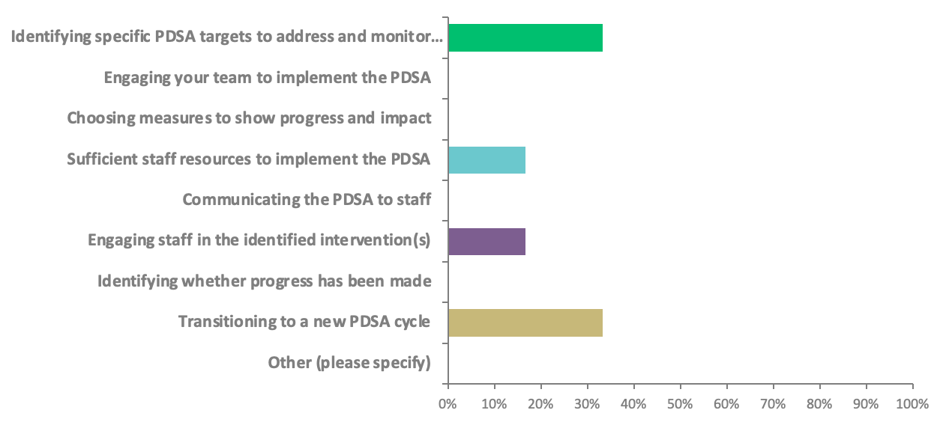
What have been your team's biggest challenges in implementing this first PDSA cycle?

Slide 25
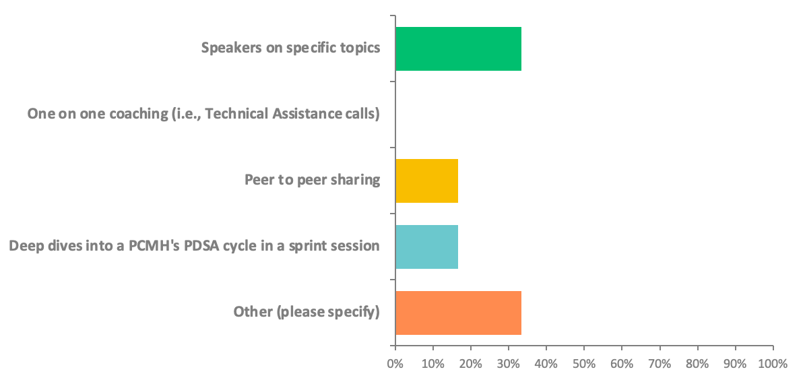
How can the Learning Network help you address these through the sprints?
Notes:
1 Other response: How to improve scaling efforts on this topic.

Slide 26
White Board Activity:
Identifying Common Challenges

Slide 27
PCMH Panel Discussion: Moving from PDSA Cycle 1 to 2
Niya Grenevich, LPC, Director of Integrated Behavioral Health, Berks Community Health Center
Rafaela Velez, RN, Director of Quality and Risk Management, Berks Community Health Center

Slide 28
Behavioral Health Referral Workflow Improvement PDSA
July 9th, 2026
Rafaela Velez, RN- Director of Quality and Risk Management
Niya Grenevich, LPC: Director of Integrated Behavioral Health

Slide 29
IBH
DO THE THING:
• Transition IBH referral work queue to IBH consultants
• Restrict inappropriate external IBH/Psych referrals
IMPLEMENTATION OUTCOMES:
• Referral/report alignment ≥95%
• 100% internal referral scheduling compliance

Slide 30
Implementation Strategies
Barrier | Strategy
Knowledge gaps | Provided providers education on PHQ9 scores, Completion of the SAFE-T Protocol Assessment and use of the Columbia Suicide Severity Rating Scale (C-SSRS).
Workflow gaps | Redesign the EPIC referral report and establish clear work queue ownership and accountability
Access gaps | Implement a standardized internal referral routing process to improve access and continuity of care

Slide 31
Implementation Steps
Identify inconsistent referral pathways
  Create report in EPIC to run list of patients with a positive PHQ9 that were seen during a specific time period.
  Review charts for patients with a positive phq9 score of 10 or greater to review additional steps taken by the provider to address the positive PHQ9.
Assess referral/order mismatch
  Create reports in EPIC for Behavioral Health referrals
Implement EPIC workflow changes
  We are in the process of identifying what those workflow changes are
Monitor referral completion and follow-up

Slide 32
Acceptability Factors
Reduced manual reconciliation
IBH consultants manage queue directly and schedule patients to be seen.
More consistent application of behavioral Health workflows across sites.
Enhance continuity and coordination of care
Decrease delays in connecting patients to behavioral health services.

Slide 33
Appropriateness
Address workflow inconsistency across departments and sites
Support depression remission and follow up screening performance measure
Prevent unnecessary external referrals
Standardize referral and screening processes

Slide 34
Feasibility Considerations
Can be implemented using current staffing resources
Existing IBH team structure supports ongoing management
Standard work can be incorporated into current operations
Audit process allowed rapid identification of workflow gaps.

Slide 35
Next Steps
Transition the internal referral to the Behavioral health consultants.
Providers to receive presentation for peer on steps to completed the additional screening forms.
Review referral orders.
Continue monthly monitoring.

Slide 36
Thank you

Slide 37
Questions?

Slide 38
Sprint Timeline, Next Steps & Evaluation

Slide 39
2026 PCMH Learning Network
3rd and 4th Sprint Session
Sprint Session 3
Today!
LN provides Tactical how-to information related to PCMHs’ QI plans
PCMHs share PDSA 2nd Cyle “Plan” through facilitated peer-to-peer learning
LN provides guidance for completing 2nd cycle of Study and Act
Sprint Session 4
October 10, 2026
PDSA by September 22nd
LN provides Tactical how-to information related to PCMHs’ QI plans
PCMHs share 2nd Cycle of “Study” and “Act” through facilitated peer-to-peer learning
LN provides guidance on completing PDSA cycles (e.g., standardizing and scaling improvements) and preparing for the final session

Slide 40
2026 PCMH Learning Network
Final In-Person Session November 10th 8:30 a.m. to 3:00 p.m.
Location: Hilton Harrisburg, One North Second Street, Harrisburg, PA 17101
Final In-Person Session
PCMHs share their completed PDSA cycles
LN recognizes PCMHs with greatest improvements
LN announces 2027 Sprints
PCMH Milestone: Complete at least 2 PDSA cycles and share at the in-person event*

Slide 41



PCMH Online Community https://www.tomorrowshealthcare.org/
Access the session materials in “Learning Sessions”
Look for guides and tools in “Resources”
Members of your PCMH’s multi-disciplinary learning team will receive log-ins

Slide 42

CEU Process
You will receive a follow up email with links to:
Complete the survey at: https://www.surveymonkey.com/r/2W7KBDF by 7/16/2026
Please be sure to designate which CEU credits you are requesting CME, CNE, Social Worker or Certificate of Attendance. If you already have an account with the UPMC Center for Continuing Education, please be sure the email you enter on the survey matches the UPMC CCE account email that you create.
The UPMC Center for Continuing Education will follow up with you via email after 7/16/2026 with instructions on how to claim your credits.
  To prepare, we recommend you create an account with UPMC CCE via this website https://cce.upmc.com.

Slide 43
Upcoming Sessions
HIV Screening, Prevention, and Treatment
July 29, 2026 I 9:00 am – 10:00 am
Oral Cancer Prevention and Early Detection
September 24, 2026 I 5:00 pm – 6:00 pm
Virtual Sprint Session #4
October 6, 2026 I 1:00 pm – 2:30 pm
Contraceptive Care: IUD Pain Management
October 29th at 9 – 10:00 am
Statewide End of Year In-Person Session:
November 10, 2026 I 8:30 am – 3:00 pm
Hilton Harrisburg, One North Second Street, Harrisburg, PA 17101

Slide 44
Thank You!

