Slide 1
Grief:
Coping, Surviving, Growing
Kenneth J. Doka, PhD
Professor Emeritus, The College of New Rochelle
Senior Vice-President, The Hospice Foundation of America

Slide 2
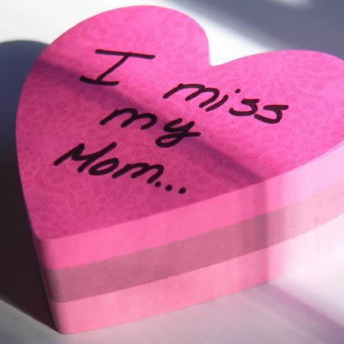
Why Are You Here?
Possibly:
In the midst of grief
Here to support someone
Perhaps a caregiver

Slide 3

What Can You Expect?
No magic wand
Three stories
  Quinn
  Mary Ellen
  Stanley

Slide 4
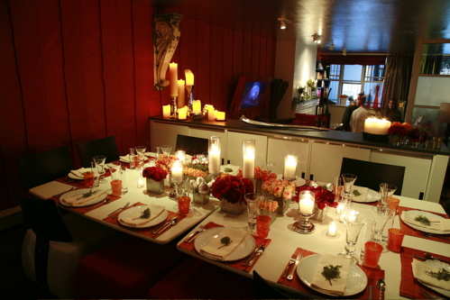
What Can You Expect?
Perhaps Three Things
Validation
Possibilities for Coping
Hope of Shared Stories

Slide 5

How to Avoid Grief
Avoid any attachments!
Grief is the price we pay for love

Slide 6
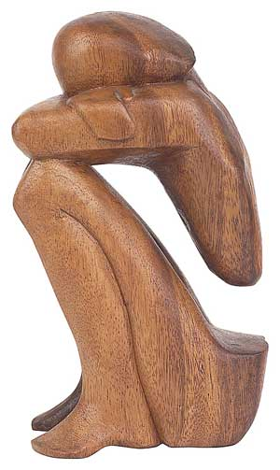
What is Grief?
A reaction to loss
Very individual – we each grief in our own way
  Relationship
  Circumstances of death – and life
  Support (internal and external)
  Health
  Culture and spirituality

Slide 7
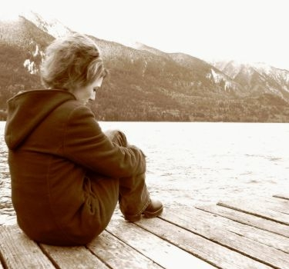
Grief
Affects us in many ways
  Physically
  Emotionally
  How we think
  Behave
  Even spiritually

Slide 8
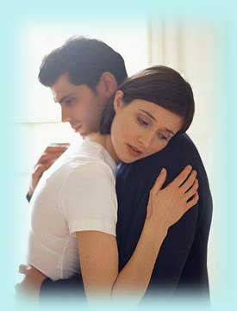
Styles of Grief
Instrumental vs. Intuitive Styles
Blended and Dissonant
Note a continuum
Coping with grief and grieving styles as a family
  Complementary or symmetrical?
  Isolating or interacting?
  Conflicting or respectful?
  Culture
How we grieve is not a measure of love

Slide 9
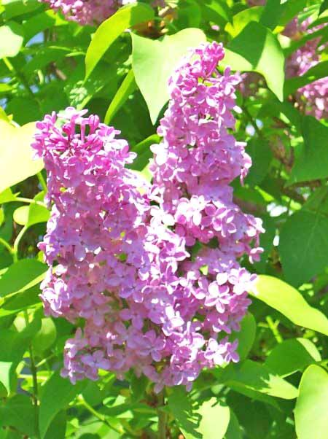
Grief as a Roller Coaster
Dual Process
Ups and downs, good days and bad days
Some predictable, some not
No universal stages – rather personal pathways (including resilience)

Slide 10

Resilience as a Pattern
You may be wondering if you are doing too well
Some people have a comparatively limited reaction to loss
Part is situation – fewer losses or other stress, death not sudden so chance to say goodbye, intrinsic spirituality, and good psychological health
But could teach us something

Slide 11
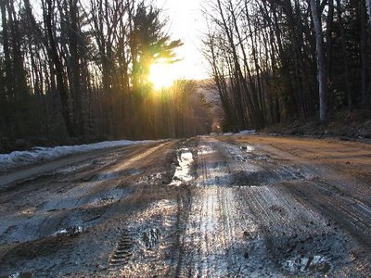
Grief
No timetable to grief
Over time the pain lessens
We return to similar – sometimes better – levels of functioning
Yet we continue a bond

Slide 12
Amelioration of Grief
Over time pain lessens
Persons function at similar (or sometimes better levels) than prior to the loss
Yet, grief still has a developmental aspect

Slide 13

Continuing Bonds
Memories
Biography
Legacies
Extraordinary Experiences
Spiritual Connections

Slide 14

Continuing Bonds
The lessening of grief is not the end of memory or attachment
In fact as the pain ebbs, we can now enjoy memories
Yet still may experience surges of grief

Slide 15

Placing Holidays in the Context of Grief

Slide 16

Holidays Are a Traditionally Difficult Time
Awash in Memories
Constant Reminders
“Hallmark” Expectations – TV Shows and the Idealized Family Holiday
“Out of Season”
Anxiety
Stress
Cold, Darkness – Isolation and SAD

Slide 17
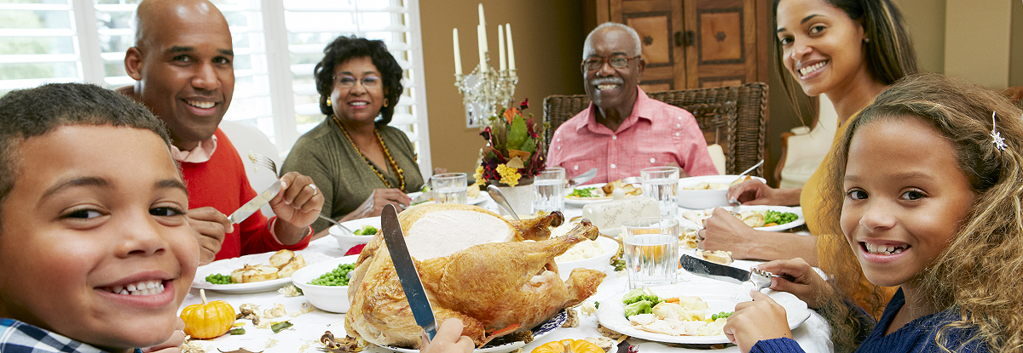
Yet Not for Everyone
Individuality of grief
For some bereaved persons, the holidays offer a time to reunite with family
Holiday activities offers diversion and respite from grief

Slide 18
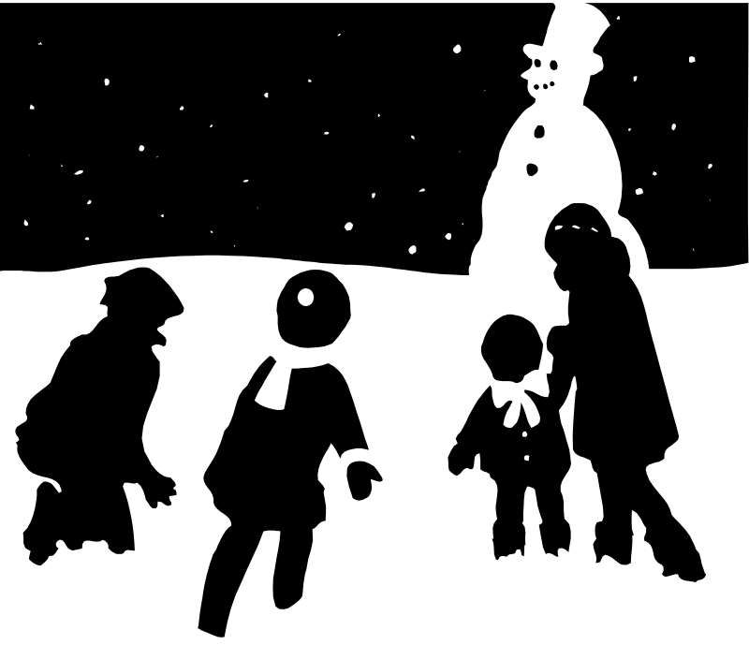
There are two strategies to avoid
Keep everything the same
Escape
  Physically
  Substance abuse

Slide 19

Substance Abuse
Readily supported in holiday times
At best, one problem remains

Slide 20

Beyond that, there are few rights and wrongs in grief

Slide 21

Assess Strengths
What Helped Before?
External Sources of Help
  L, D, R
Spiritual Strengths
Family Strengths – review family history

Slide 22
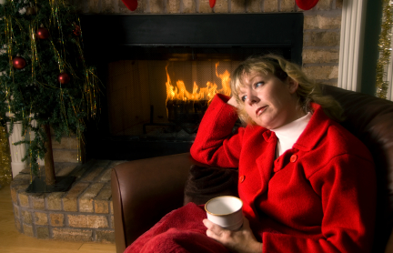
Coping with Grief during the Holidays
Acknowledge and validate grief
Challenge negative beliefs – “The Holidays will never be happy”
The danger of drift

Slide 23

The Three “C’s”
Choose
  A bit differently
  New meanings
  What needs to be done, how
  Who to be with and when to leave
  The choice to decide when to choose
Communicate
Compromise

Slide 24
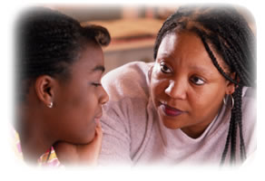
Children, Grief, and the Holidays
Children’s grief – including the normal “self-centeredness” of younger children
The importance of the holidays
Respecting children’s choices
Remember adolescents and children may displace anger
Creating rituals and memorials
Plan special activities

Slide 25
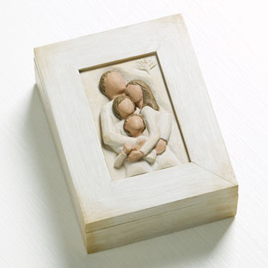
Possible Activities
Memory boxes
Charitable or memorial activities – plant a tree, donate etc.
Gift for the deceased
Personal actions – baking cookies for nurses who cared for Grandma etc

Slide 26
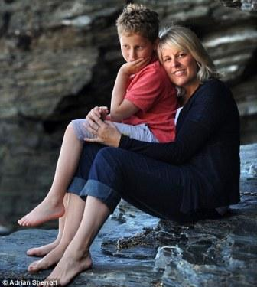
Children, Grief, and the Holidays
Remember how well parent’s function is a major predictor of how well children will do
Model your grief and coping
Take care of your child – do not expect them to take care of you
Draw on extended family and intimate network

Slide 27

The Horse on the Dining Room Table

Slide 28
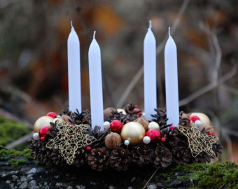
A Holiday Ritual
Candles may represent many things such as grief over loss, courage in grief, memories, and love

Slide 29

Remind Families of the Need to Be Gentle with Themselves
Cope with Stress
Good Self-Care
Acceptance of Tough Time

Slide 30

Gentle with Others
Coping with Insensitive Comments
Linn’s Questions
  Why did it hurt?
  What did it mean?
  How could I respond?

Slide 31
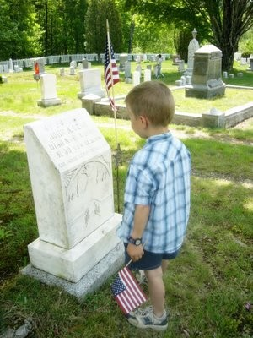
The Hidden Holidays
These same principles can be used for other holidays – Mothers and Fathers Day, Easter, Passover
Or personal days – Birthdays, Anniversaries etc.

Slide 32
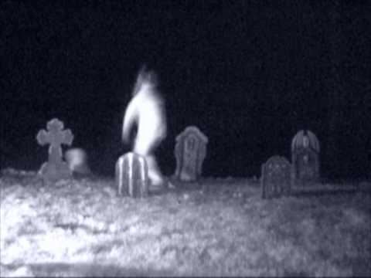
Late October/Early November Holidays
Historically a time of “thin places” – where the boundary between the dead and alive is more permeable
Recognized today in observances such as:
  Halloween
  All Souls and Saints Days
  Day of the Dead (Mexican)
  Samhain (Wiccan, Celtic roots) – final harvest, end of summer – spirits journey

Slide 33

Grief Surges
Remember other dates or seasons may have significance as well—i.e. one father who lost an adult son, experienced grief surges at the start of the baseball season and the World Series as he and his son often watched gamers together.

Slide 34
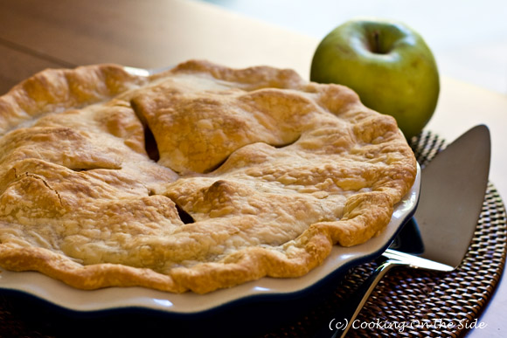
Grief Surges
Other times, grief surges can be aroused by smells, tastes, sounds, touch, or sights—any of the senses

Slide 35
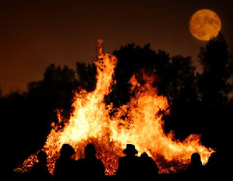
Remember Spiritual Diversity
Remember there is increased spiritual diversity in the US beyond Judeo-Christian Faiths – even including Native Americans, Humanists, and Wiccans
http://www.interfaithcalendar.org/ for an Interfaith Calendar

Slide 36
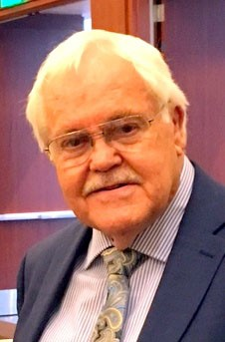
The Tasks of Grief
Value of Task Model
Worden’s Four Tasks
  Accept the reality
  Experience the pain
  Adjust to a changed life
  Maintaining the bond
  Re-evaluating faith and meaning

Slide 37
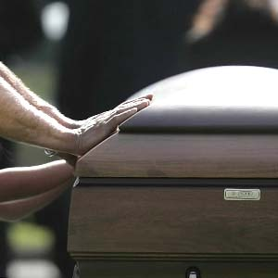
Accepting Reality
The role of funeral and other rituals
Talking about the loss freely

Slide 38
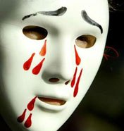
Experiencing Emotions
No need to bottle feelings
Understanding ambivalence and finishing business
Planning for difficult times

Slide 39
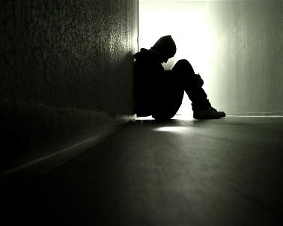
Adjusting to Life without the Person
Assessing change
Coping (and assessing) with loneliness
Drawing from strengths – and avoiding past weaknesses
Secondary losses
Getting Support (D, L, R)

Slide 40

Continuing the Bond
Building in moments to remember or reaffirm
Sanders’ Questions
What do I wish to take from my old life into my new life?
What do I wish to leave behind?
What do I need to add?

Slide 41

Reviewing Faith and Meaning
The challenge to our spirituality and assumptions
How does your faith or philosophy speak to you?
What resources does it offer (beliefs, practices, rituals, community)?

Slide 42

Growing in Grief
We can do more than cope and survive grief
However painful, we can grow through grief!

Slide 43
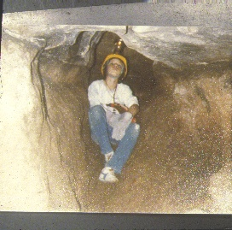

Slide 44
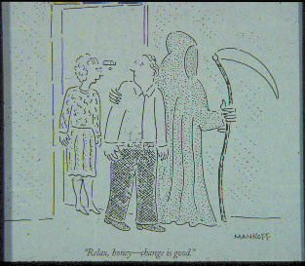

Slide 45
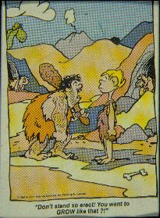

Slide 46
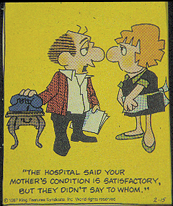

Slide 47
Can grief be an impetus to new growth?

Slide 48

Transformative Grief
In Celtic Mythology, thin places are places where the boundaries between this world and the other world are permeable
In a sense, grief exists within this thin place

Slide 49
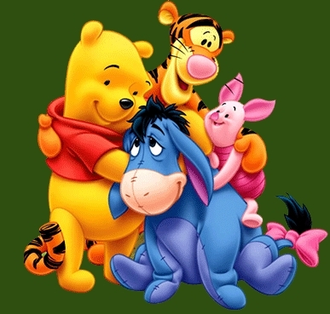
A Lesson From Winnie the Pooh
"If ever there is tomorrow when we're not together.. there is something you must always remember. You are braver than you believe, stronger than you seem, and smarter than you think. but the most important thing is, even if we're apart.. I'll always be with you."
Winnie the Pooh (A.A. Milne)

Slide 50
The Mysterious Math of Grief
3-1=2
3-1=0
3-1=5

Slide 51
Parental Loss and Achievement
Motivation a “will to power and control”
Eisenstadt

Slide 52
Blooming Widows
Widows who are socially constrained may be pushed into greater self-reliance with rise in sense of self-esteem
Calhoun & Tedeschi

Slide 53
Possible Changes
Greater Appreciation of Life, Relationships, and Priorities
Growth in Character – Perceptions of Strength
Existential Awareness
Growth in Skills
Changes in Lifestyle
Renewed Spirituality
Calhoun & Tedeschi

Slide 54
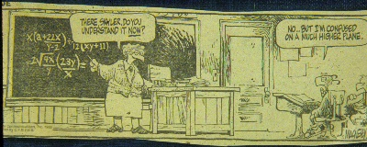

Slide 55
How Can We Enhance Transformation?
Language of Survivorship
Empowering Language – Challenge, Courage, Confidence (Chappelear)
Small choices empower bigger ones
Assist clients in developing a mission
Examination of positive and negative adaptations
Reflection “How has this loss changed you?”
“Can you imagine what your life would be like (what you would have become) if this had not happened?”
The value of “benefit finding” in the experience of grief

Slide 56

Transformative Group Technique:
Grief Narrative
Begin each session with a group round
How has my story changed since the last session?
Focused on what was learned, new insights, skills growth

Slide 57
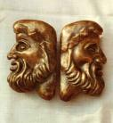
Looking Backward
What is lost?
What is left?
Reviewing strengths
  Internal
  External

Slide 58
Looking Forward
What do I need to bring from my old life into my new life?
What do I need to leave behind?
What do I need to add?

Slide 59
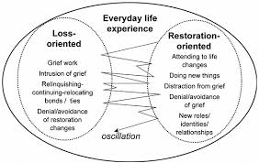
Locking Forward, Backward
Consistent with the Dual Process Model of Stroebe and Schut (1999)
Allows acknowledge of loss while adjusting to a new life created by loss

Slide 60

How Organizations Can Help
Counseling and Support
Educational Programs – How to Handle the Holidays etc.
Memorial Events – Tree Lightings etc.
Using Emails/Social Media/Mailings

Slide 61
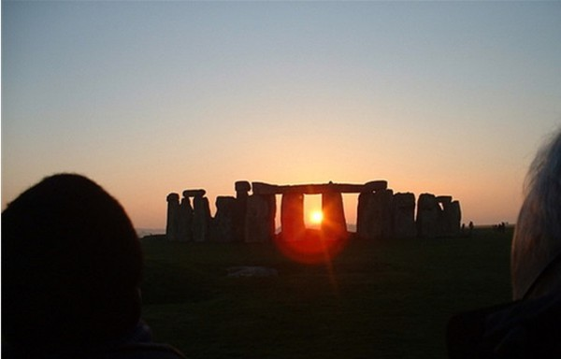
How Organizations Can Help
Partnering and Educating Local Resources
Example – Darkest/Longest Night/Blue Christmas Services

Slide 62

Resources for Your Struggle
Books
Self-Help Groups
Counseling

Slide 63

Grief Counseling
Studies show that clients will do better in groups when leaders have transformation rather than coping as a goal of therapy or support

Slide 64
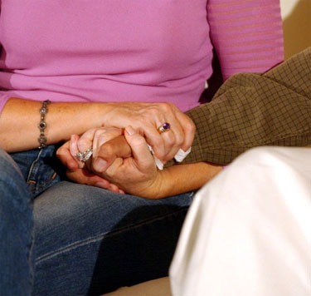
Support Groups
Lund found that one of the other benefits of support groups was a sense of using your own negative experience to assist others

Slide 65
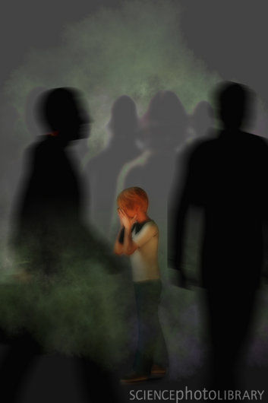
The Journey of Grief
Lost, confused, frightened, and disoriented in the journey of grief, we need more than companions – We need guides

Slide 66

A Year From Now
My exercise with my grief group
My hope

Slide 67
