Slide 1
Puberty
Jennifer Badik, MD
Pediatric Endocrinology
UPMC Children’s Services, Lemoyne
(717) 988-0090

Slide 2
I have no disclosures

Slide 3

What is Puberty?
Series of biochemical/hormonal changes
Transition from juvenile to adolescent/adult body

Slide 4
Factors Initiating Pubertal Development
Activation Adrenal Androgens
Increased neuro-transmitters
Activation of hypothalamus
Adrenarche

Slide 5
Factors Initiating Pubertal Development
Activation Gonadal Hormones
Increased gonado-tropins
Activation of Pituitary
Gonadarche

Slide 6
Factors Initiating Pubertal Development
Nutrition
Environment
Genetics

Slide 7

Female Puberty

Slide 8
Development of the breasts (thelarche)
Appearance of pubic hair (pubarche/ adrenarche)
Appearance of axillary hair
Female Secondary sex characteristics
Development of the breasts (thelarche)
Appearance of pubic hair (pubarche/ adrenarche)
Appearance of axillary hair

Slide 9

Normal Female puberty
Normal female puberty timing includes development of secondary
sexual characteristics by age 13 AND menses by age 16
Anticipate MENARCHE (onset of periods) 2-3 years from onset of THELARCHE.
PUBARCHE/Adrenarche DOES NOT predict onset of menses.

Slide 10
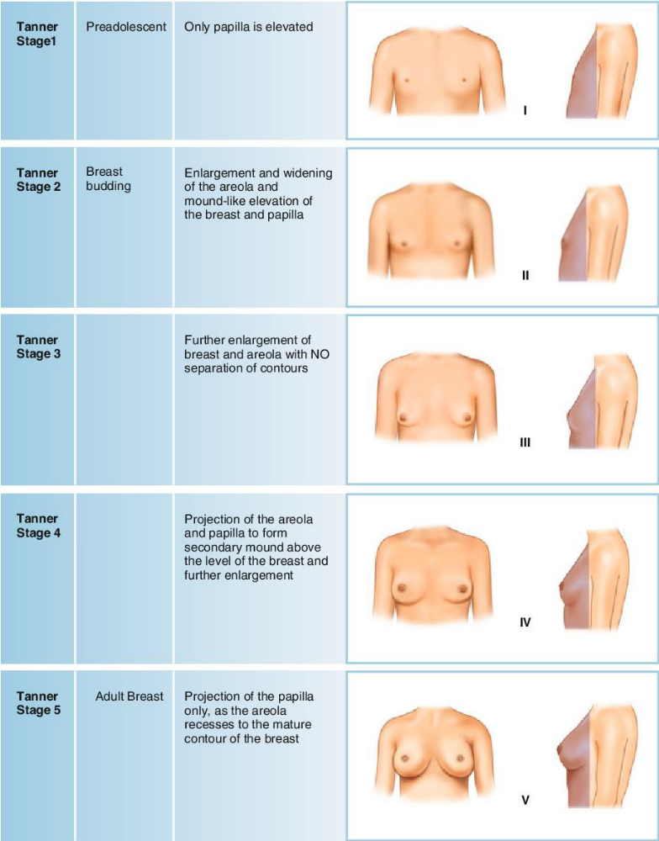
Female Tanner Staging BREASTS

Slide 11
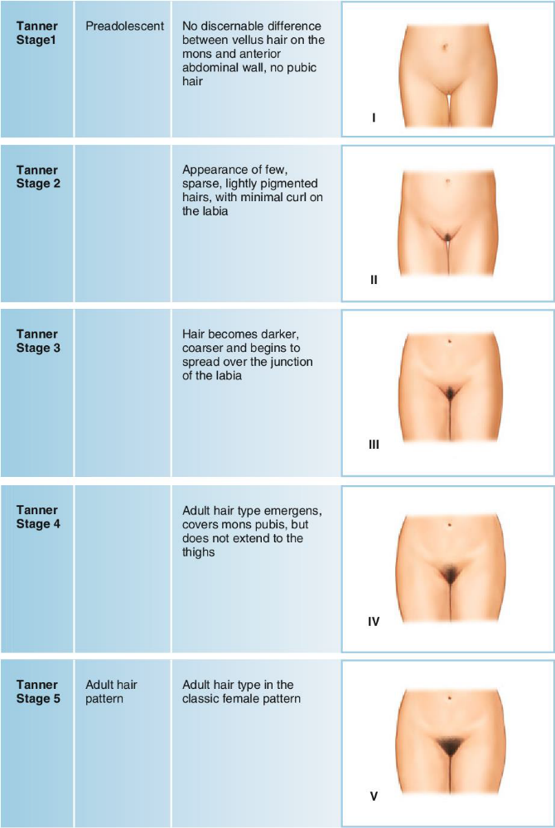
Female Tanner Staging Pubic Hair

Slide 12
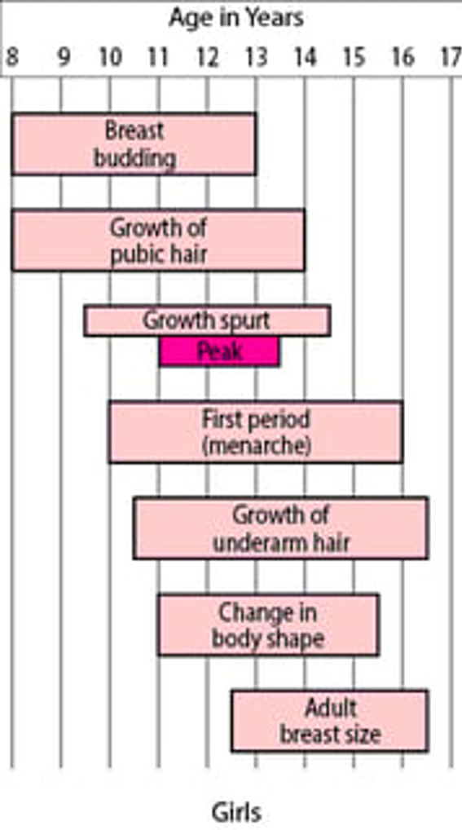
Developmental Milestones Female Puberty
Merck Manual: Milestones in Sexual Development for Girls and Boys

Slide 13

Male Puberty

Slide 14
Male Secondary Sex Characteristics
Testicular enlargement, starting as early as 9.5 yr
Development of pubic hair
Penile growth
Normal male puberty timing includes development of secondary sexual
characteristics by age 14-15
Male Gynecomastia (breast growth) is NORMAL from ~age 13-16 due to
increased estrogen levels. It usually resolves spontaneously by age 18.
Persistence past age 18 or PENDULOUS breasts that continue to grow past
age 16 should be referred

Slide 15
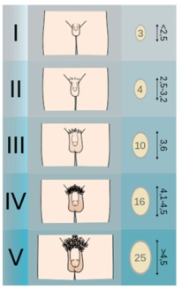
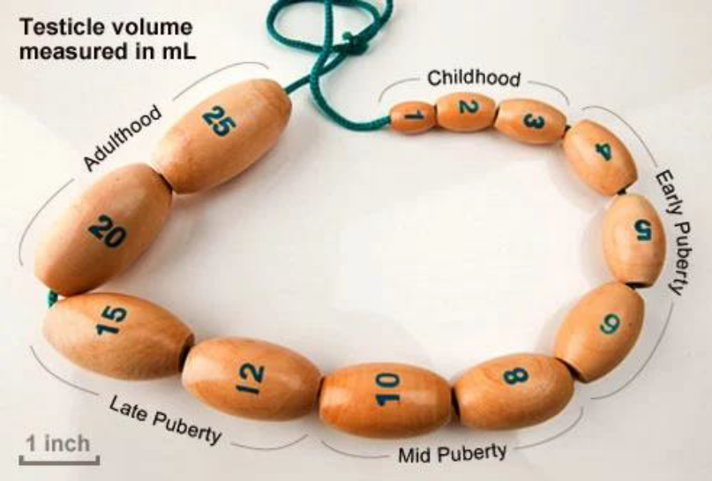
Male Tanner Staging

Slide 16
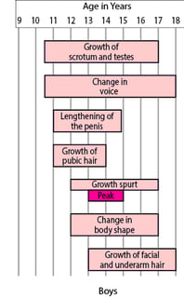
Developmental Milestones Male Puberty
Merck Manual: Milestones in Sexual Development for Girls and Boys

Slide 17
Puberty Concerns

Slide 18

Environmental Exposures
Lavender or tea tree oil
Flame retardants
Plastics
Estrogens/progestins/testosterone (creams/gels/ointments)
Hair masks made with sheep placenta

Slide 19
Toddler Thelarche

Slide 20
Toddler Thelarche
Girls develop a small amount of breast tissue (typically 1” or less across), typically before the age of 3 years.
The breasts do not get larger, and the girl does not have a growth spurt.
Can go a year or more with little or no change in the size of the breasts (sometimes, they will get smaller).
Usually, both breasts are enlarged, but, sometimes, premature thelarche only affects one side.

Slide 21
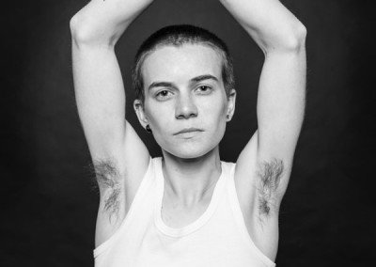

Premature Adrenarche
This Photo by Unknown Author is licensed under CC BY-SA-NC

Slide 22
Premature Adrenarche
Appearance of pubic and/or underarm hair in girls younger than 8 years or boys younger than 9 years
Adult-type underarm odor, often requiring use of deodorants
Absence of breast development in girls or of genital enlargement in boys (which, if present, often points to the diagnosis of true precocious puberty)

Slide 23
Premature Adrenarche Labs
Labs may show higher than normal for age levels of DHEA-S or Androstenedione
17OHP and Testosterone levels should not be elevated

Slide 24
Precocious Puberty

Slide 25
Precocious Puberty
Onset of puberty:
before age 8 in girls (breasts AND pubic hair)
before age 9 in boys (pubic hair AND testicular enlargement)
On average, African American and Hispanic girls may start puberty somewhat earlier than Caucasian girls

Slide 26
Precocious Puberty: Reasons to treat
Data suggesting earlier age of menarche linked to earlier age of first sexual experience
Earlier age of menarche linked to earlier age of menopause/shorter fertility window as adult
Possible impact on final adult height (tall for age when young but early completion of linear growth)

Slide 27




Treatment of Central Precocious Puberty
GnRH
X
LH/FSH
Puberty Blocker/GnRH Agonist Therapy
Leuprolide injection
Histrelin implant
X

Slide 28
Precocious Puberty Labs
Gonadotropins (LH/FSH) will be elevated (EARLY MORNING LABS)
Sex steroids (Estradiol, Testosterone) will be elevated

Slide 29

Evaluation of abnormal puberty
BONE AGE (after age 5)
EARLY MORNING labs for:
  PEDIATRIC (Ultrasensitive) LH/FSH/Estradiol
  Testosterone
If concerns for early pubic hair/axillary hair OR clitoromegaly
  17 hydroxyprogesterone
  Androstenedione
  DHEA-S
  Cortisol

Slide 30
Rare Puberty Issues
Testotoxicosis
VanWyk Grumbach Syndrome
Premature Ovarian Insufficiency
Kallmann Syndrome
McCune Albright Syndrome

Slide 31

WHEN TO REFER TO PEDS ENDO
Penile growth and/or testicular enlargement before age 9
Menarche before age 8
Progressive breast enlargement before age 8, over a period of 4-6 months
Clitoromegaly or abnormal appearance of genitalia
Café au lait macules (McCune Albright?)
Presence of pubic hair in infancy/toddlers, with or without breast development
Steep upward growth trend (increasing across one or more centile spaces—eg, below 50th to above 75th centile), in 3-6 months
New onset polydipsia / polyuria, headaches or visual disturbances
History of CNS disorders or injury

Slide 32
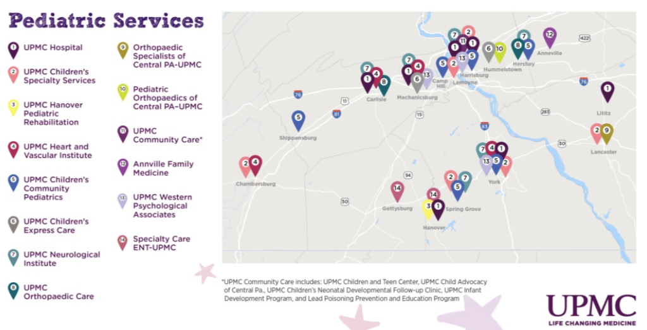

Slide 33
Pediatric Cardiology in Newport
September 2026

Slide 34
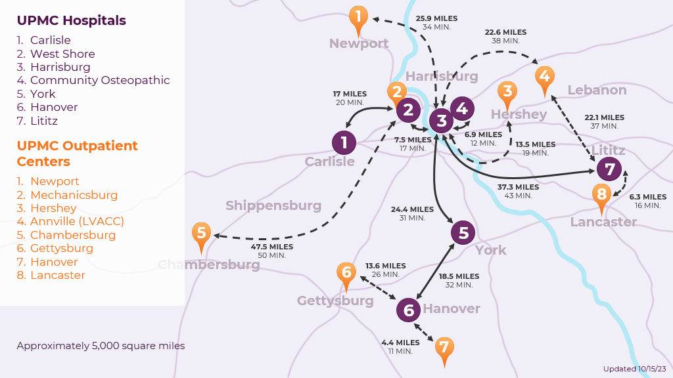
Pediatric Cardiology at Newport
Services We Offer:
Advanced diagnostic testing, including:
  Electrocardiograms
  Echocardiograms
  Stress echocardiograms
  Fetal echocardiograms
  Holter monitors
  Treadmill tests
  Cardiac MRI
  Coronary CT angiography
Care coordination and treatment plans – We facilitate care with maternal fetal medicine and other pediatric specialists required.
Follow-up care – Patients born with a heart problem may need follow-up care through adulthood. Consultation and follow-up care for adults with congenital heart disease is also available.
UPMC Heart and Vascular Institute in Central Pa.
To refer a patient, please visit UPMC.com/CentralPaHeart or call 717-761-0200.
UPMC Heart and Vascular Institute in Central Pa.

Slide 35

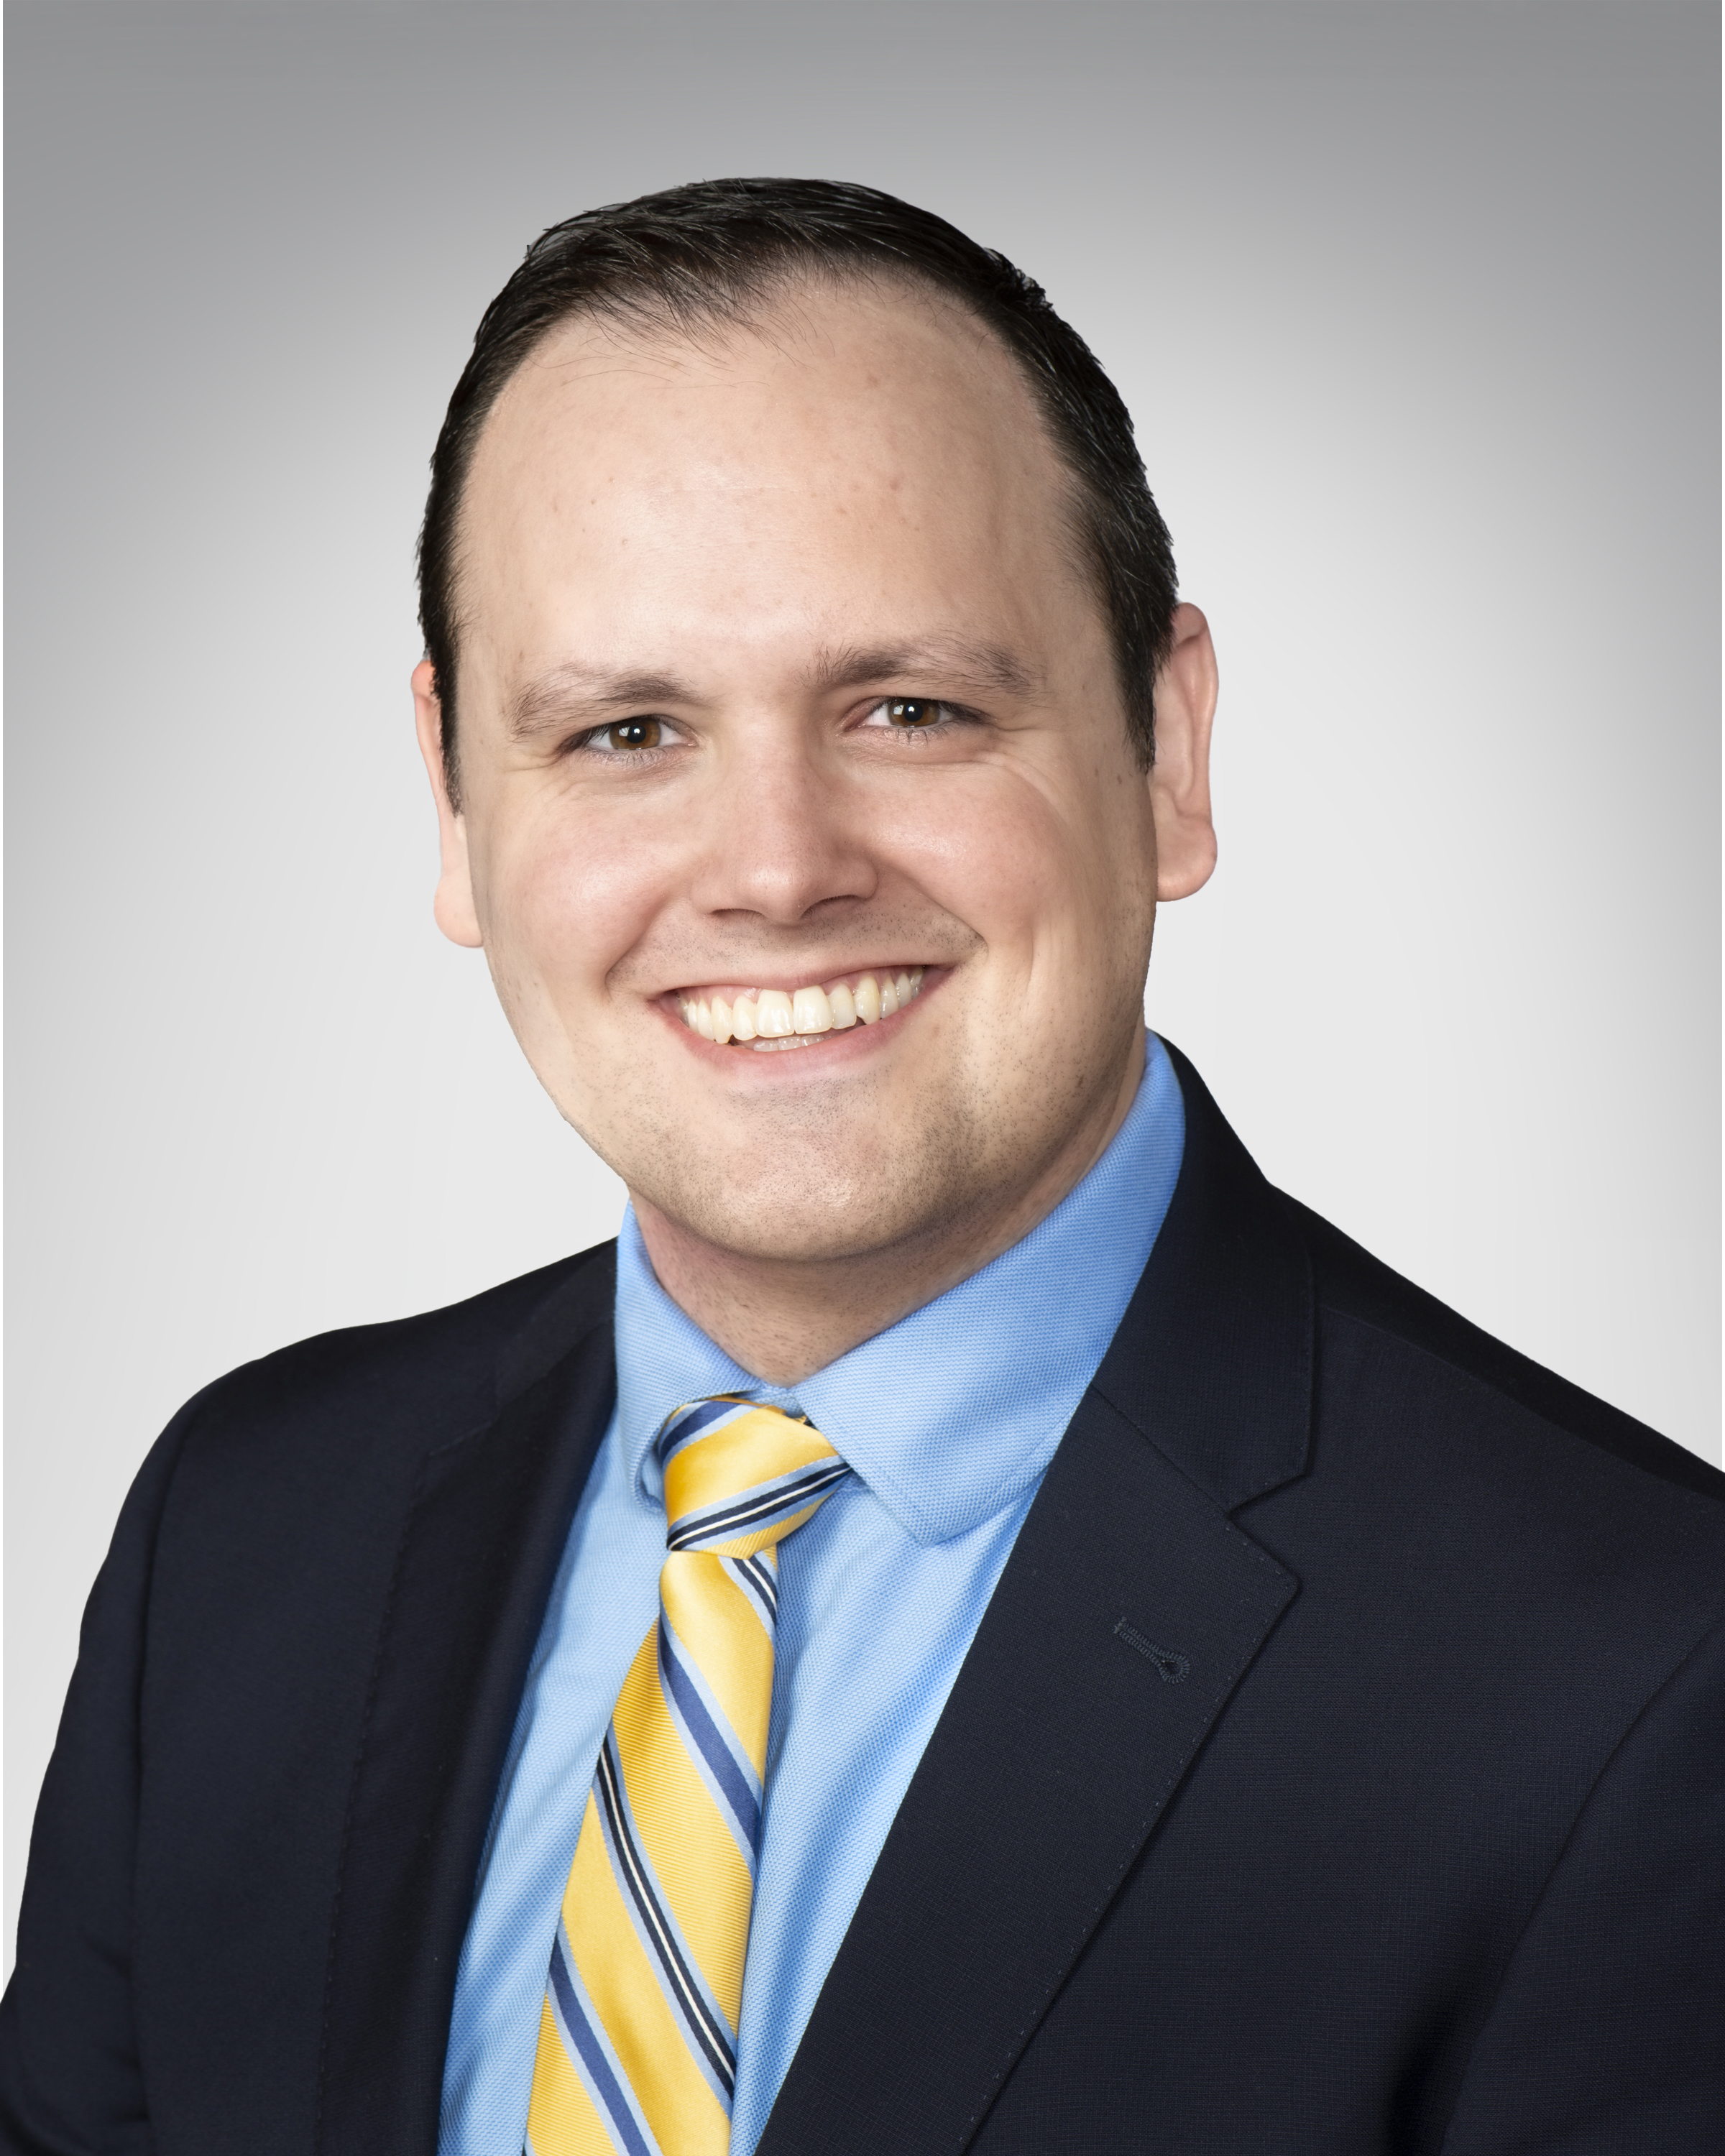


Meet the Team
Shaji Menon, MD*
Adam Seitz, MD*
Sunil Patel, MD
David J. Freeman, MD
*Available to see patients in Newport
UPMC Heart and Vascular Institute in Central Pa.

Slide 36

QUESTIONS?

