Slide 1




Bleeding Disorders in
Children & Adolescents
Deirdre Nolfi Donegan, MD
Pediatric Update for Primary Care Practitioners
UPMC Cole | September 18, 2026
Notes:
Welcome, and thanks for having me.
For everyone's’ sake, this talk is by no means comprehensive, but I’m going to focus on presentation of bleeding disorders you may encounter, and some of the questions you actually face in clinic and before a procedure: who needs a workup, who can be reassured, and who needs hematology
CLICK

Slide 2



Objectives
Recognize the presentations
Let the child's developmental stage and personal history guide the workup.
Order and interpret first-line coagulation labs
PT, aPTT, CBC, VWF labs, etc — and know what they do not rule out.
Know when and how to refer to pediatric hematology
Abnormal labs, a high bleeding score, or a convincing history despite normal labs.
Notes:
Three things I want you to walk out with.
The first is pattern recognition of bleeding disorders - The history, the physical, the family tree, and what tools are available to help quantify bleeding.
The second is knowing what our first-line panel can and cannot exclude.
And the third is the referral threshold, including the cases where the labs are clean but you still believe there’s something going on
CLICK

Slide 3
Case Presentation
15 year-old girl presents to outpatient clinic with concerns about menstrual bleeding
Reached menarche at 12y
Bleeding has always seemed heavy to her
Bleeding lasts for 7 days with changing pads every 90 minutes (fully saturated) for first several days
Occasional nocturnal flooding and clots. No daytime accidents or missed school days
A visiting aunt thinks she looks pale. Her mother has not noticed any difference
Notes:
So lets just jump in. Here is our first patient. 15 year old girl, in clinic for heavy periods.
Periods have been heavy since menarche. Heavy from day one is a different story than heavy starting last year.
She bleeds for 7 days and saturates a pad every ninety minutes which seems like a bit much.
When asked about pallor, her mother reports she hasnt noticed any changes but an aunt who traveled in from out of town and who doesn’t see her often, did remark she looked paler than usual.
We are going to use her presentation to talk about bleeding, and what is/is not “normal”
Keep this girl in mind. We are going to come back to her in a little bit.
CLICK

Slide 4
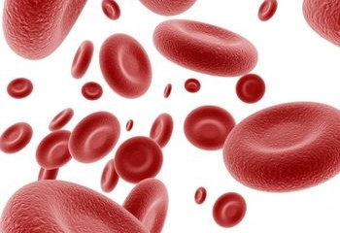
When is bleeding abnormal?
Heavy menses since menarche
Profuse bleeding with minor cuts
Surgical bleeding
    Post tonsillectomy
    Dental
    Circumcision
Epistaxis
  Bruising and gum bleeding less helpful
Back to our 15-year-old
Do the menstrual symptoms worry you?
How many symptoms are too many?
Should she be tested? Should everyone?
Notes:
Normal vs abnormal is sometimes subjective.
Quantifying bleeding on a more objective level starts with a good history
So you may want to ask the the patient about other hemostatic challenges, where the the patient’s ability to clot has been stress-tested.
So that means, asking about excess bleeding in surgeries: tonsillectomy, circumcision, dental work.
Heavy menses since menarche or recurrent nosebleeds belongs on that same list. They are also hemostatic challenges.
Bruising and gum bleeding are important but a little less specific. Everyone bruises, and lots of healthy people bleed when they floss.
So with this starting list in hand, let come back to our 15-year-old. Does she worry you? How many symptoms is too many, and is there a way to ask her these questions in a standardized way? Should everyone be screened before a surgery or for one symptom? No.
To put bleeding in perspective, we should be aware of the statistical likelihood of whether someone has a true bleeding disorder.
CLICK

Slide 5
How common are inherited bleeding disorders?
1 in 100
von Willebrand disease
1 in 1,000
VWD that actually bleeds
1 in 5,000
Hemophilia A, male births
Hemophilia B: 1 in 25,000
Unknown
Platelet function disorders
mild ones invisible to screening
Rare factor deficiencies (I, II, V, VII, X, XI, XIII) — each 1 in 500,000 to 1 in 2 million; all of them together below 1 in 30,000
1 in 5 adolescents with heavy menstrual bleeding has a bleeding disorder
VWD in 5–20% referred for menorrhagia — up to 50% when heavy since the first period
Notes:
And maybe surprisingly, bleeding disorders are kind of common.
Von Willebrand disease is the most common one. Screen a population and about one in a hundred has it. In Pittsburgh alone, that is enough people to fill a concert hall — roughly three thousand people — and most of them have no idea. The ones who actually bleed enough to matter are closer to one in a thousand, and the ones we have actually diagnosed and are following in registries are a tiny fraction of that.
Hemophilia A, one in five thousand boys. Hemophilia B, one in twenty to thirty thousand — although I will say that here in Pennsylvania we see far more hemophilia B than that number suggests, because of our local Amish population. The other hemophilias/factor deficiencies are super super rare
For the platelet function disorders we genuinely do not know the prevalence, especially the mild ones, because our screening tests are not great at picking them up. They may actually be more common than von Willebrand Disease.
Now interestingly, when you isolate the population of people who actually present to medical attention with complaint of bleeding symptoms, like a teenager reporting heavy periods, the pre-test probably of finding a bleeding disorder in that person jumps to one in five.
So, if its significant enough to be noticeable to the patient, the likelihood of finding an actual clotting defect increases.
CLICK

Slide 6
Prevalence of bleeding symptoms in the general healthy population
Symptom | Healthy Controls (%)
Bleeding from minor wounds | .2-2
Dental extraction bleeding | 1-13
Post-tonsillectomy bleeding | 2-11
Epistaxis | 5-39
Post-partum bleeding | 6-23
Gum bleeding | 7-51
Bruising | 12-24
Heavy menstrual bleeding | 23-44
Notes:
But even in the general population, everybody at some time or another, bleeds.
A good proportion of the general healthy population, still report bruising, still report nosebleeds, still report bleeding after a dental extraction.
And if you look at the bottom row. Somewhere between a quarter and half of women call their periods heavy. This is a huge number.
And this comes from healthy controls who have been confirmed to have no bleeding disorder.
So a positive answer to any single question on a patient’s bleeding history is not very meaningful. What carries diagnostic weight is the combination, and the severity, and whether anything had to be done about it.
So how to we take that subjective history and quantify it a little more objectively? Well we have some some tools for that.

Slide 7
When is menstrual bleeding abnormal?
Normal adult cycle
Cycle 21–35 days (average 28)
Duration 2–7 days
Flow 25–50 mL — about 10–15 soaked pads or tampons per cycle
Heavy menstrual bleeding
Cycles more often than every 21 days
Bleeding longer than 7 days
Flooding, clots, leakage
Greater than 80 mL per cycle
Normal in the young teen
Longer and irregular — average 35 days, range 20–65
Regularity builds over 5–6 years post-menarche
Duration and flow match adults from the start
Heavy does not mean hematologic. Rule out pregnancy, anovulation, PCOS or thyroid disease, trauma, medications, and chronic illness. Recent skipped menses, young gynecologic age, and prior normal flow all point away from a bleeding disorder — heavy since menarche, with bleeding at other sites, points toward one.
Notes:
Lets start with menstrual bleeding, its by far the most common bleeding complaint that I think any of us see.
Left card is the adult reference of “normal”: cycle counted day one to day one, two to seven days of flow, and roughly 10 to 15 soaked products per cycle. This is considered normal.
Middle card crosses into what is clinically considered heavy menstrual bleeding that would trigger a bleeding disorder eval— cycles shorter than 21 days, flow past seven days, over 80 mL lost in a cycle. Nobody measures milliliters, so in practice it is products per day plus flooding, clots, and nocturnal changes.
Right card for adolescents in particular: Early post-menarchal cycles are long and irregular — that typically means anovulation, not a bleeding disorder. Meaning, irregular periods are somewhat expected. But duration and volume of bleeding is still notable in a teenager if it meets that midthose numbers in the middle box.
I should mention that an evaluation for abnormal menstrual bleeding should not be limited to looking just for a bleeding disorder. Far more common reasons like anovulation, PCOS and thyroid disease, medications, and chronic illness should also be considered for irregularity or heavy flow.
But getting a teenager to tell you how heavy the flow is or quantify period loss is sometimes difficult— but wait! There’s a tool for that.
CLICK

Slide 8
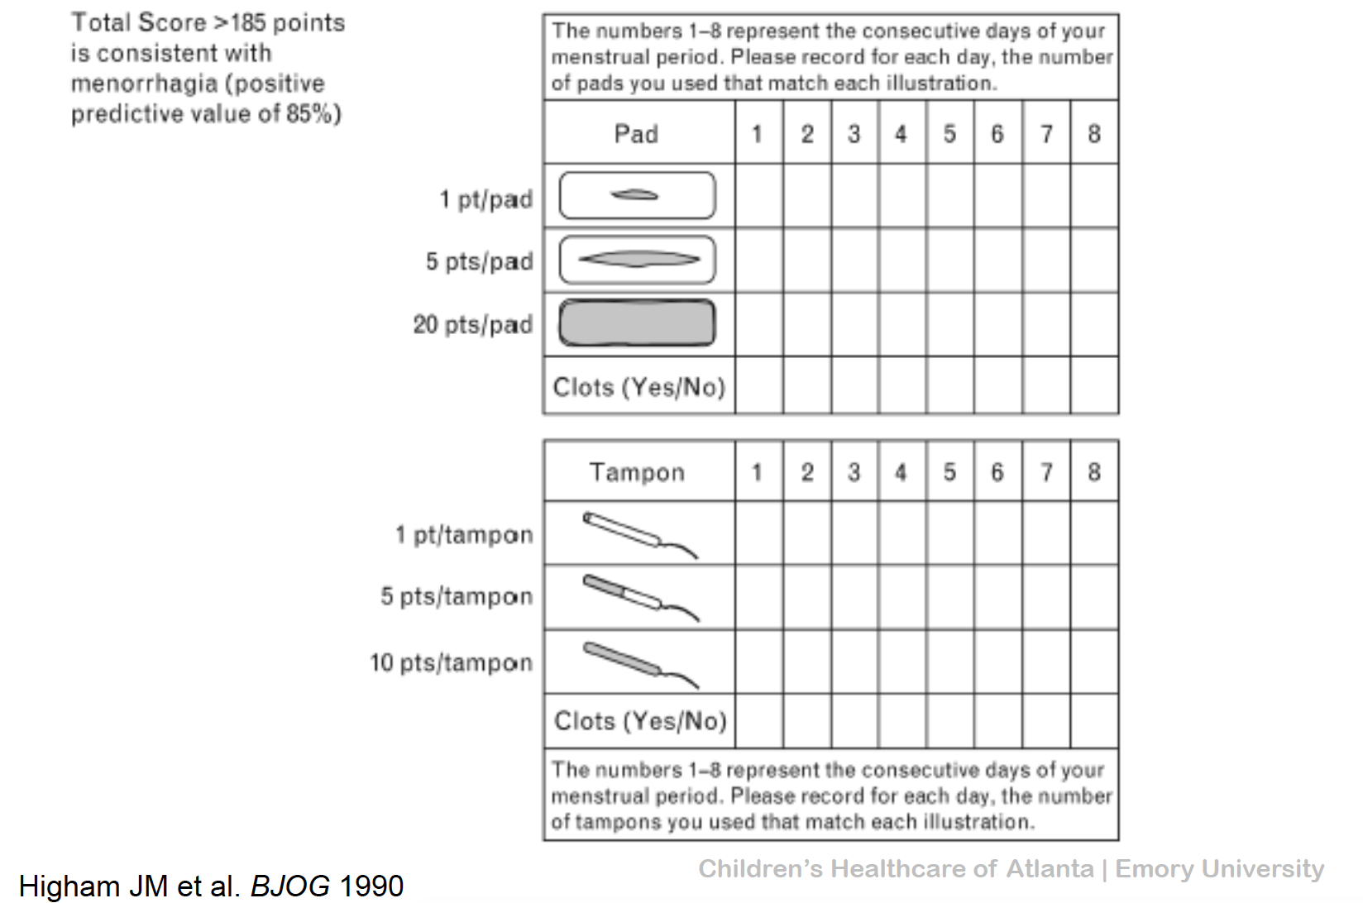
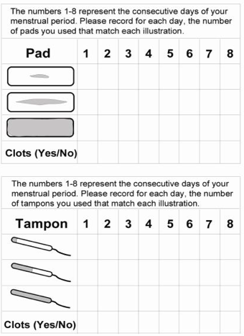
Pictorial Bleeding Assessment Chart (PBAC)
Slide courtesy of FWGBD
Notes:
For menstrual bleeding specifically, the pictorial bleeding assessment chart solves part of the verbal history-taking problem by scoring saturation and product count rather than asking for recall from the patient.
It is something she can fill out over one cycle and bring back.
Notice what the this chart actually does — it calulates a number tied to how many times she changed the pad/tampon and how saturated the pad or tampon was, and how many days it went on for.
A score of >185 points for the whole cycle diagnoses menorrhagia
To put that in context, its like soaking through at least 9-10 pads in a whole cycle, or half-soaking 20 pads in a whole cycle. For some people, that might not actually seem like a whole lot.
But what about other bleeding history? How do we measure that?
CLICK

Slide 9
The ISTH-BAT (Bleeding Assessment Tool)/ Pediatric Bleeding Questionnaire (PBQ): Scoring Key
Symptom | -1 | 0 | 1 | 2 | 3 | 4
Epistaxis | – | No or trivial (<5/yr) | >5/yr OR >10 min duration | Consultation only | Packing, cauterization or antifibrinolytics | Transfusion, factor replacement or desmopressin
Cutaneous | – | No or trivial (<1 cm) | >1 cm AND no trauma | Consultation only | – | –
Minor wounds | – | No or trivial (<5/yr) | >5/yr OR >5 min duration | Consultation only or Steri-Strips | Surgical hemostasis or antifibrinolytics | Transfusion, factor replacement or desmopressin
Oral cavity | – | No | Reported at least once | Consultation only | Surgical hemostasis or antifibrinolytics | Transfusion, factor replacement or desmopressin
GI tract | – | No | Identified cause | Consultation or spontaneous | Surgical hemostasis, antifibrinolytics, transfusion, factor replacement or desmopressin | –
Tooth extraction | No bleeding in ≥2 extractions | None done, or no bleeding in 1 | Reported, no consultation | Consultation only | Resuturing, repacking or antifibrinolytics | Transfusion, factor replacement or desmopressin
Surgery | No bleeding in ≥2 surgeries | None done, or no bleeding in 1 | Reported, no consultation | Consultation only | Surgical hemostasis or antifibrinolytics | Transfusion, factor replacement or desmopressin
Menorrhagia | – | No | Reported or consultation only | Antifibrinolytics or contraceptive pill | D&C or iron therapy | Transfusion, factor replacement, desmopressin or hysterectomy
Post-partum | No bleeding in ≥2 deliveries | No deliveries, or no bleeding in 1 | Reported or consultation only | D&C, iron therapy or antifibrinolytics | Transfusion, factor replacement or desmopressin | –
Muscle hematoma | – | Never | Post-trauma, no therapy | Spontaneous, no therapy | Spontaneous or traumatic, needs factor replacement or desmopressin | Spontaneous or traumatic, needs surgery or transfusion
Hemarthrosis | – | Never | Post-trauma, no therapy | Spontaneous, no therapy | Spontaneous or traumatic, needs factor replacement or desmopressin | Spontaneous or traumatic, needs surgery or transfusion
CNS bleeding | – | Never | – | – | Subdural, any intervention | Intracerebral, any intervention
Other* | – | No | Reported | Consultation only | Surgical hemostasis, antifibrinolytics or iron therapy | Transfusion, factor replacement or desmopressin
*Other: post-circumcision, umbilical stump, cephalohematoma, macroscopic hematuria, post-venipuncture, conjunctival hemorrhage.
Notes:
We actually have a validated Bleeding Assessment Tool that forces consistency in the rest of the history taking.
The ISTH BAT, and its pediatric version, the pediatric bleeding questionnaire or PBQ, take the bleeding history and puts it on a scale that has been tested against real diagnoses.
Now I know this looks like a very busy slide, so I’ll just do a brief overview.
There are 14 body system domains its asks about. Things like nosebleeds, bruising, wound healing, GI bleeding, dental bleeding, sureery bleeding, etc. Every domain is graded the same way: what was the severity of the symptom, and was there an intervention required? Zero points there was no or trivial bleeding reported for that domain. One is rthe symptoms is reported by the patient, but did not seek medical attention. Two points is there was a consultation/presented to medical care, and in some categories, an intervention like hormonal therapy to help with peiod bleeding. Three’s and Four’s are all about the interventions — the bleeding required packing, cautery, antifibrinolytics, iron, surgical hemostasis, transfusion.
The minus-one or negaitve column is very helpful. Two dental extractions or two surgeries with no bleeding is a genuine negative stress test, and it pulls the total down. No surgical history at all is a blank, not a negative — which is why the dental and surgical rows carry so much of the weight.
So what constitutes a significant score?
CLICK

Slide 10
The ISTH-BAT (Bleeding Assessment Tool)
Standardizes the bleeding history
Validated in children and adults across VWD, platelet function disorders, and rare factor deficiencies.
Validated score cutoffs — upper limit of normal
≤ 3
Children
≤ 5
Adult men
≤ 6
Adult women
Patients can fill it out themselves
Self-administered scores perform comparably to clinician-administered — practical for clinic intake.
Anything above these thresholds counts as abnormal.
Above threshold → significantly higher odds of a clinically relevant hemostatic defect, even when screening labs are normal
Fasulo, J Thromb Haemost, 2018
Notes:
When you tally up the scores from every category, the cutoff for a positive score is: three or more in a child, five in adult men, six in adult women.
A young child simply has not lived long enough to accumulate hemostatic challenges, which is why the pediatric cutoff is lower.
A high score, with or without abnormal screening labs if they’ve been sent, should always be a referral to Hematology for further evaluation.
The other thing that often triggers an automatic referral to Hematology is family history.
CLICK

Slide 11
Family History
Known bleeding disorder
1st degree relatives with unexplained bleeding, especially with
  Hysterectomy for heavy menses
  Transfusions
  Anemia
Notes:
Family history, though its not part of any formal diagnostic criteria, is always worth the extra minute, and should be asked precisely.
The high-yield questions here are about (1) known bleeding diagnoses in relatives, and (2) interventions for their bleeding.
Did an aunt end up with a hysterectomy for bleeding after childbirth? Did anyone need a transfusion after an operation? Was someone in the family iron deficient for years with no explanation?
Also remember many bleeding disorders are autosomal and affect women and men equally. So we try not to anchor on the maternal side or on males only.
CLICK

Slide 12
The Physical Exam
General: anatomic abnormalities
Mucosa: wet purpura, petechiae, frank blood
Liver/Spleen: hepatosplenomegaly
Nodes: lymphadenopathy
Skin: petechiae, poorly-healed scars, hematomas, bruises (sites important)
Joints: range of motion, tenderness
Notes:
The physical exam here is less about making a diagnosis of a bleeding disorder and more about redirecting the workup if it needs to be directed elsewhere. Most of these kids with bleeding disorders look completely well.
Distribution of bruising matters more than the number. Bruises over shins and elbows in an ambulatory well child are expected. Bruising on the trunk, back, or face in a non-mobile infant is a different conversation entirely, and that includes non-accidental trauma.
Wet purpura on the buccal mucosa is the finding I care about most in a thrombocytopenic child. It correlates with mucosal bleeding risk and it changes urgency.
Organomegaly or adenopathy takes you out of the bleeding disorder lane and into oncology.
And look at old scars. Poor wound healing and atrophic scarring points you toward a connective tissue disorder rather than a clotting problem.
That last finding — the hypermobile joints — is common enough in certain populations that it is worth knowing how to measure properly. We’ll come back to that at the very end
First we need to dive into the laboratory workup you’ll want to send.
CLICK

Slide 13
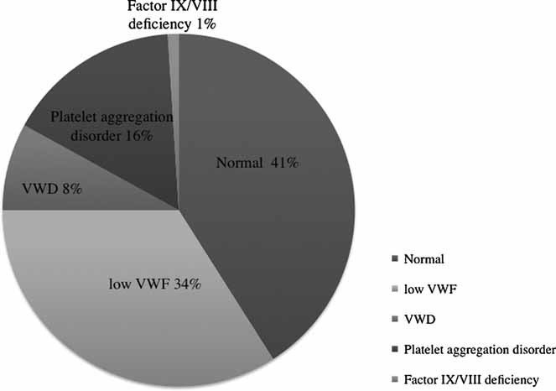
Initial Laboratory Work-Up
What to send
CBC
PT / PTT
Fibrinogen level
Von Willebrand testing*
Platelet function testing*
* Draw when the child is well and off NSAIDs; repeat before calling it normal
Sidonio, R.F., Jr., Gunawardena, S., Shaw, P.H. and Ragni, M. (2012), Predictors of von Willebrand disease in children†. Pediatr. Blood Cancer, 58: 736-740. https://doi.org/10.1002/pbc.23411
Notes:
After we have taken the history and the bleeding score is high, and we have decided the story is convincing enough to test – what are we gonna be looking for?
The initial screen is relatively short:
1. The platelet count should be measured with a CBC.
2. All patients should have a prothrombin time, activated partial thromboplastin time, fibrinogen level sent
3. All patients with symptoms suggestive of muocutaneous bleeding (GU, oral, epistaxis) should be investigated for VWD. But this has to be timed carefully and sent to the right laboratory
We are looking into three main things: Platelets defects (looking for low number or eventually, poor function), inadequate factor levels aka hemophilias, or von Willebrand disease. This isn’t comprehensive, but it’s a good place to start.
The pie chart is showing the diagnoses typically found in children referred for a bleeding evaluation: 41% have normal results, 34% low VWF which may or may not be actual disease, 16% a platelet function defects (nonspecific), 8% von Willebrand disease, and 1% factor VIII/IX deficiency (the two most major hemophilias)
I’m gonna walk through where this label panel get us diagnostically.
CLICK

Slide 14
Normal Blood Flow
Notes:
Before we can make sense of any lab tests, we need a shared picture of what normal hemostasis looks like. FIVE CLICKS
We’re looking at a vessel wall and starting with normal blood flow.
The endothelium lines blood vessels and is an active surface. When intact, endothelium is antithrombotic. It actively keeps platelets from sticking to it and clotting as blood flows by.
CLICK

Slide 15
Hemostasis In Action
DAMAGE TO ENDOTHELIUM
ACTIVATION OF ENDOTHELIAL PROTEINS
FORMATION OF FIBRIN CLOT
PLATELET PLUG FORMATION
BLOOD EXTRAVASATION
Notes:
Then uh oh, the vessel wall is injured, and the endothelial lining breaks. 2 CLICKS
Blood leaks out through that break — extravasation. The vessel also constricts to slow the flow. 3 CLICKS
The injury exposes proteins underneath the endothelium, mainly collagen and von Willebrand factor. 1 CLICK
Platelets stick to those exposed proteins, get activated, and clump together into a platelet plug. That is primary hemostasis. 1 CLICK
Then, the coagulation cascade runs on the surface of those same platelets and lays down fibrin, which knits the loose plug into a stable clot.
That is secondary hemostasis. 1 CLICK
The fibrin sort of holds things together and is what prevents the delayed rebleed.
CLICK

Slide 16


Three Hemostasis Buckets
Primary Hemostasis
Secondary Hemostasis
Clot Stabilization
Platelets, von Willebrand factor
Coagulation factors
Normal standard screening
Up-front bleeding
Mucocutaneous bleeding pattern
Epistaxis, gum bleeding
Bruising
Menorrhagia
Delayed bleeding
Deep bleeding pattern
Hemarthrosis (joint bleeds)
Muscle hematomas
Delayed or up-front bleeding
Fibrinolysis, vascular disorders
Mucosal surfaces, skin
Neutze & Roque, Am Fam Physician, 2016
Notes:
We just walked the mechanism. Now flip it: where and when a child bleeds tells you which part of the mechanism may be broken
Primary hemostasis — if there is a problem with platelets or VWF, it typically presents as immediate or superficial bleeding: nosebleeds, gums, bruising, heavy periods, bleeding during the surgery.
Secondary hemostasis are the the factors and fibrin. The platelet plug has no problem forming but then gives way: this results in delayed, deep bleeding into joints and muscles. Fine at the time of the injury or the surgery, but then bleeding occurs a few hours later or even the next day.
Clot stabilization — which addresses Fibrinolytic and vascular/connective tissue defects. The bleeding pattern can be variable: mucosal, cutaneous, or deep; immediate or delayed.
These are tendencies, not rules — severe VWD can mimic hemophilia, and mixed pictures are common. The buckets organize thinking but they don't make the diagnosis.
So let's start where every workup starts — the CBC — and with the simplest question in the first bucket: are there enough platelets?
CLICK

Slide 17
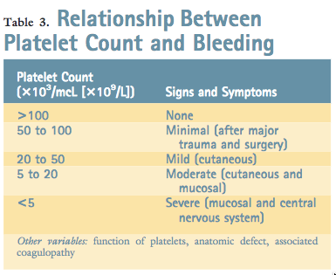
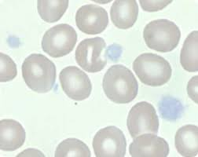
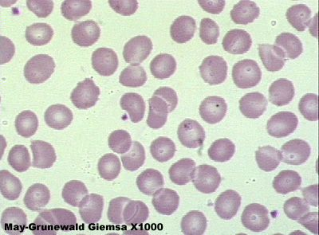
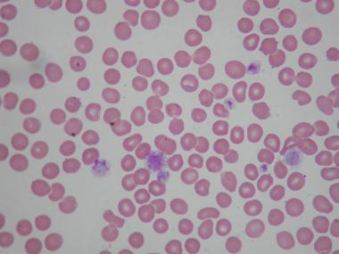
CBC: Platelet Numbers
Normal: 150,000 – 450,000
platelets per microliter
How low is safe?
>75–100k
Neurosurgery
>50k
General surgery
>30k
Minor procedures, injections
>10k
General safety at home
Notes:
The CBC measures the platelet count, also the hemoglobin, which tells you whether the bleeding has been significant enough to cause anemia.
It also checks the white count and differential, which is your check for leukemia before you go further.
Normal platelet count is 150 to 450 thousand, and that range is as true in a newborn as it is in a teenager or adult. In kids, a high count is much less alarming than a low one.
The body has “reserve capacity” with regard to platelets. Although the normal platelet count is 150 to 450, primary hemostasis is not impaired until the platelet count is below 75. Spontaneous bleeding does not occur unless the platelet count is less than 50, and noticeable or clinically significant hemorrhage rarely occurs unless the platelet count declines to less than 20. Most patients who have life-threatening hemorrhage due to thrombocytopenia have platelet counts less than 10.
30k is safe for most minor procedures to proceed, fifty for general surgery, and seventy-five to a hundred for neurosurgery.
So when you get a CBC that comes back with a low platelet count, the next question is what to do about it
CLICK

Slide 18
Triaging a Low Platelet Count
Step 1: repeat the CBC in a citrate (blue-top) tube — clumping artifact is common
Normal on repeat
Pseudothrombocytopenia. No further workup needed.
Still low, child well
Isolated low count with a normal exam — post-viral suppression or ITP.
Still low, child unwell
Fever, pallor, bone pain, organomegaly, bleeding, or other cytopenias — urgent Hematology/Oncology.
Step 2: let the count set the plan — treat the patient, not the number
Under 50k
Call Hematology
50–150k
Recheck in 1–2 weeks
Call Hematology before sending to the ED — most well children can be seen in clinic. Newborns follow a different pathway.
Notes:
This is the office roadmap - the details on each branch come in the slides that follow.
First, Always repeat the count in a citrate tube. Platelet clumping in EDTA is the a very common reason for a falsely low result, and it saves an unnecessary workup.
Then split your next steps on how the child looks: are they well with an isolated low count? Its probably transient post-infectios suppression or maybe ITP
Is the child unwell, or are other cell lines affected – if so, this is a call to Heme/Onc to discuss
Let the count set the tempo in a well child - under 50,000 call Heme the same day, above 50k recheck in a week or two.
And call before sending anyone to the ED - most well children are better served in clinic.However, Newborns follow a different pathway, which is next.
CLICK

Slide 19
Case History
A full term newborn male with no significant prenatal history was born to a 27 yo healthy mother via NSVD. His mother had a documented normal platelet count. Her only medications were prenatal vitamins.
While in the newborn nursery at 12 hours of life he was noted to have extensive petechiae over his face, back, and chest. Coags and a CBC were normal except for a platelet count of 12k. A HUS showed a small left-sided ventricular hemorrhage, without any corresponding clinical neurologic deficit.
The rest of his exam was unremarkable for any skin lesions, dismorphic features, or skeletal abnormalities.
Notes:
A well full-term boy is in the newborn nursery, he is the product of an uncomplicated pregnancy and delivery, and a mother with a documented normal platelet count.
At 12 hours of life he has extensive petechiae, a platelet count of 12,000, and normal coags — isolated severe thrombocytopenia. Where is this coming from?
The head ultrasound shows a small intraventricular hemorrhage even though he looks neurologically normal
But otherwise he is a well baby with no distinguishing physical abnormalities or other organ system issues
CLICK

Slide 20
Non-immune destruction
Decreased production
Rare neonatal leukemia or aplastic anemia, drug-induced, infection, other infiltrative process
Maternal SLE, Maternal ITP, NAIT
Vasculitis, endotoxin, immune complexes, DIC
Infection
Other Causes: NEC, RDS, sepsis, placental disorders
Sequestration/
Consumption
Immune Destruction
Notes:
Three buckets for a low platelet count in a newborn: non-immune destruction, immune destruction, or decreased production.
Non-immune destruction is the sick baby — sepsis or intrauterine infection, DIC, NEC, respiratory distress. Growth restriction and microcephaly point to a congenital viral infection. Maternal factors like pre-eclampsia an cause a transient dip in platelets in the baby.
Immune destruction is the well baby: this refers to maternal antibody crossing the placenta — her autoantibody in maternal ITP, or an alloantibody against the baby's platelets in neonatal alloimmune thrombocytopenia.
True decreased production is rare — congenital thrombocytopenias, neonatal leukemia, aplastic anemia.
The shortcut: a sick baby usually has a consumptive cause; a well baby with severe isolated thrombocytopenia is immune until proven otherwise, and that is where we are headed.

Slide 21
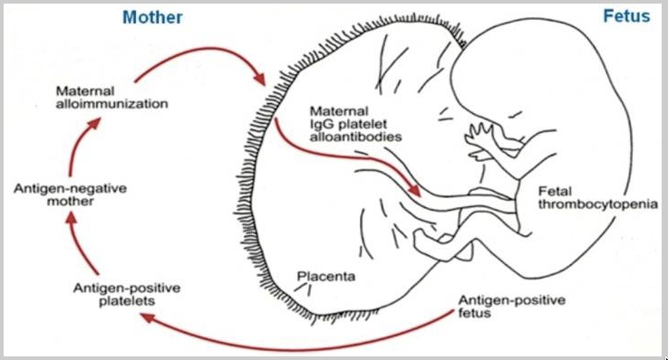
Mechanism of NAIT
Notes:
This baby in the case has NAIT, neonatal alloimmune thrombocytopenia.
The mechanism is the platelet equivalent of Rh disease of the newborn.
NAIT results from maternal alloimmunization during pregnancy against specific fetal platelet antigens HPA inherited from the father and absent in the mother.
These maternal IgG alloantibodies that she has made against babies platelets, cross the placenta and bind to the fetal platelets and cause them to be marked for destruction leading to thrombocytopenia in the baby. The mother is fine/unaffected.

Slide 22
NAIT vs Maternal ITP
NAIT (alloimmune)
Maternal ITP (autoimmune)
• Maternal ALLOantibody against a platelet antigen she lacks and the baby inherited from dad (usually HPA-1a)
• Mother’s platelet count is NORMAL
• About 1 in 2,000 births
• Can occur in a first pregnancy; later ones are worse
• Highest risk of intracranial hemorrhage — can occur in utero – image the head with US
Treatment
• Treat promptly: goal > 30k, or > 50k if bleeding or premature
• Maternal (antigen-negative) platelets if available; random-donor platelets if unavailable
• IVIG
• Recovers over several weeks
• Maternal AUTOantibody against antigens common to all platelets; IgG crosses the placenta
• Mother’s platelet count is LOW
• About 1 in 50,000 births
• Severe thrombocytopenia is uncommon
• Intrauterine hemorrhage rare
Treatment
• Most newborns need no treatment
• IVIG if the count is below about 10–20k or there is bleeding
• Transfusion rarely required; nadir is in the first few days
• Resolves over 2 to 3 months
The mother’s platelet count is the quickest clue: normal points to NAIT, low points to maternal ITP
Notes:
The differential for neonatal severe thrombocytopenia typically boils down to alloimmune NAIT vs autoimmue ITP
NAIT is alloimmune: the mother makes antibody against a paternal antigen the baby inherited (usually HPA-1a) - her own platelets are normal. Maternal ITP is autoimmune: she makes antibody against her own platelets, and some of it crosses the placenta. So the mother is thrombocytopenic in ITP; but does not have to be the time of the birth to make the diagnosis, it could have just been sometime in her history with the ab still circulating now.
Severity and risk diverge sharply. NAIT drops lower, drops faster, and carries a real risk of intracranial hemorrhage - a meaningful fraction occur in utero. Maternal ITP is usually milder for the baby, and intrauterine hemorrhage is essentially not seen. That difference is why NAIT gets a higher transfusion threshold, and ITP is more liberal.
Treatment follows the mechanism. In NAIT the baby needs to be given platelets the antibody cannot attack: maternal antigen-negative platelets are ideal, otherwise transfuse random-donor platelets and give IVIG to soak up the circulating antibody- do not withhold platelets waiting for maternal units which is often not logically feasible to collect post-partum.
In ITP, transfused platelets are destroyed too, so IVIG is the mainstay if you have to treat for a low number, and transfusion is reserved only for bleeding.
Recurrence differs too, and parents ask: NAIT recurs and typically worsens in subsequent pregnancies, so future pregnancies need maternal IVIG and MFM co-management. ITP severity in the newborn does not track with the mother's count and does not reliably worsen with the number of pregnancies.
Timeline to recovery for the baby: both improve in the baby as maternal antibody clears - NAIT over a few weeks, ITP often resolved by 2 to 3 months. Either way, a discharge CBC is not the last one and the baby needs outpatient follow up.
Now lets contrast this case with a similar one, but in a different age group- same isolated thrombocytopenia, entirely different setting and course.
CLICK

Slide 23
Case History
A 4-year-old boy who is recovering from a minor respiratory infection suddenly develops petechiae and bruises on his trunk and extremities.
Two days later, after a transient nosebleed, he is brought to his physician’s office. His past medical history and family history are unremarkable. Findings on his physical examination are normal (no LAD, no HSM) except for scattered crops of petechiae and multiple bruises. There is no active bleeding from the nose or other sites. There are no oral purpura.
A CBC shows a Hg of 12.7, a WBC of 8, a normal differential count, and platelet count of 6k. Urinalysis shows 2 RBCs.
Hematology looks at a smear through Cellavision. It shows a paucity of platelets, but is otherwise unremarkable.
The diagnosis of idiopathic thrombocytopenic purpura (ITP) is suspected.
Notes:
A 4-year-old recovering from a minor respiratory infection and abruptly develops petechiae and bruises on the trunk and extremities
He presents two days later after a transient nosebleed. Past medical and family history are unremarkable, which argues against an inherited
disorder
The exam is normal apart from scattered crops of petechiae and multiple bruises - specifically no lymphadenopathy and no hepatosplenomegaly. There is no active bleeding during the exam and no oral purpura.
The CBC is normal other than an isolated low platelet count of 6,000. One cell line down, two normal – that argues against leukemia or bone marrow failure.
Urinalysis shows only 2 RBCs, so no significant occult bleeding despite the very low count.
Hematology reviews the smear through Cellavision: few platelets, otherwise unremarkable - no blasts, no schistocytes, no clumping to suggest pseudothrombocytopenia.
Put together, autoimmune thrombocytopenia is suspected

Slide 24
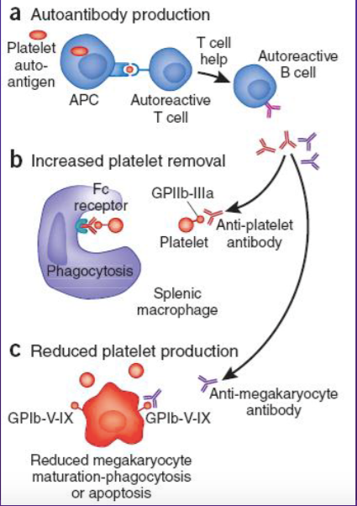
Acute Immune Thrombocytopenia (ITP)
Most common cause of isolated thrombocytopenia in otherwise well children.
Annual frequency ~ 5 in 100,000 children.
Sudden onset of petechiae and bruising (some mucosal hemorrhage in about 30% of patients).
50% of cases follow a viral infection.
Some cases occur a few weeks after a live virus vaccination (~1 in 25,000 children receiving measles-mumps-rubella vaccine).
  >MMR does not cause recurrence of ITP in patients already diagnosed
Notes:
ITP is the most common cause of isolated severe thrombocytopenia in otherwise well school-aged children.
This condition occurs at a slightly greater frequency than acute leukemia (approximately 5 in 100,000 children annually) and manifests as a sudden onset of petechiae and bruising (as well as some mucosal hemorrhage in about 30% of patients).
At least 50% of cases follow a nonspecific viral infection in otherwise well children.
Mechanistically, ITP is caused by an antiplatelet antibody that binds to the platelet surface and enhances its destruction by Fc receptor-mediated phagocytosis in the spleen and liver. So they are making platelets, but destroying them quickly.
Some cases occur a few weeks after a live virus vaccination. It has been estimated that 1 in 25,000 children receiving measles-mumps-rubella vaccine develops ITP. However that is NOT an absolute contraindication for future MMR doses. And actually the risk of ITP from actual infection with MMR is much higher than with the vaccine (8 in 25,000)
A question parents will sometimes ask: Giving the MMR vaccine to children who already had ITP — whether it was their first MMR shot or a repeat dose after a prior episode of ITP — does not cause their low platelet count to come back.

Slide 25
Diagnosis of Acute ITP
Isolated thrombocytopenia
  Usually < 20k, but by definition must be <100k
  “Acute” = duration < 12 months
  “Persistent” = 3 – 12 months
  “Chronic” = > 12 months
Unremarkable blood smear except for a paucity of platelets.
  Platelets are large
Bone marrow examination is often unnecessary, even before initiating treatment with corticosteroids
Seldom an emergency – call Hematology prior to referring to the ED – they can usually get an outpatient Heme appointment quickly
Notes:
So how to make this diagnosis.
The laboratory findings in ITP are those of isolated thrombocytopenia. The platelet count usually is less than 20 and sometimes is below 5.
The hemoglobin should be normal. The total and differential WBC counts should also be normal. Borderline or atypical cases should prompt consideration of marrow failure and referral to a hematologist for performance of a bone marrow aspirate.
The peripheral blood smear in children who have ITP is unremarkable except for a paucity of platelets. Platelets that are present are large (MPV of 10 to 15 fL or at least half the diameter of an red cell on the blood film).
Additional laboratory tests usually are not warranted. Results of the PT, PTT, and other blood coagulation tests invariably are normal. Antiplatelet antibody testing in the laboratory is unnecessary because the test results lack appropriate diagnostic validity. ITP basically is a diagnosis of exclusion.
A practical point for the office: when you find a platelet count this low, call Hematology before you send the child anywhere. We will help decide where the child actually needs to be seen.
Most well-appearing children with isolated thrombocytopenia and no active bleeding do not need an emergency department at all - they can often be seen the same day or next morning in clinic, which avoids hours of waiting, a repeat workup, and an unnecessary transfer.
The ED is the right destination for the child with active mucosal bleeding, head injury or neurologic symptoms, or one who looks unwell - and still a call ahead lets us make sure the right team and labs are ready when they arrive.

Slide 26
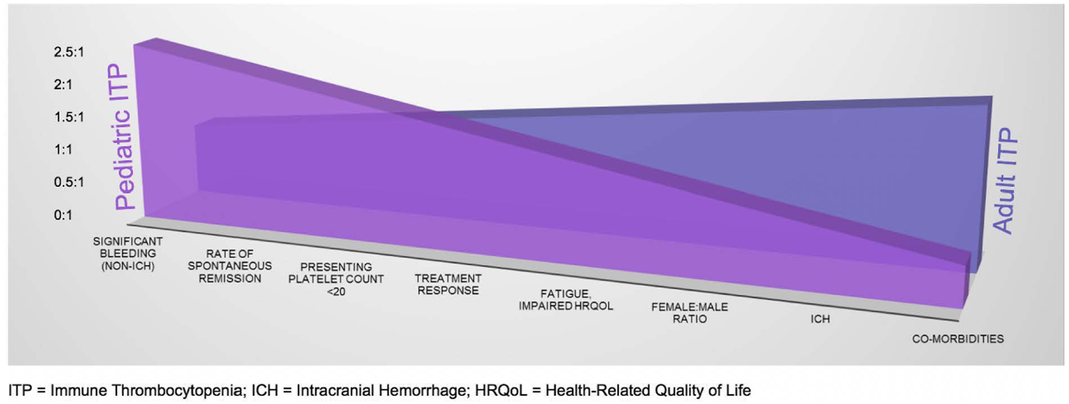
Natural History & Management of Acute ITP
75% of children resolve spontaneously within 6 months, often sooner
Management: avoid NSAIDs and contact sports; reassure the family
ASH 2019: no or mild bleeding (skin findings only) is managed with observation alone, regardless of platelet count
Notes:
Some 75% of children who have ITP have the so- called “acute” form of the disease, which, by definition, resolves spontaneously within 6-12 months following presentation (and often much sooner). The bleeding symptoms apparent at diagnosis usually lessens within 1 to 2 weeks, followed simultaneously or shortly thereafter by a rising platelet count.
Of note there are large differences between pediatric and adult ITP, including the type of bleeding events (less intracranial bleeding risk in kids) and higher likelihood of spontaneous remission in children. Despite the fact that children also tend to present with lower platelet counts.
- The platelets in ITP, are large, metabolically active, newly produced and “sticky.” Therefore, they function well, even when their numbers are markedly reduced.
Therefore, what you’ll notice is that first-line treatment is NO treatment – only treat if they are bleeding or if there are oral purpura. You do not need to treat for skin findings.
Management includes avoidance of NSAIDS; avoidance of contact sports; limitation of the child’s activities (if possible); and most especially, reassurance of the parents regarding the child’s recovery and the rarity of serious or life-threatening hemorrhage.
What about when you DO need to treat?

Slide 27
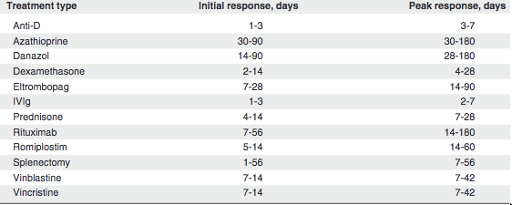
Treatment of ITP
Indications to treat
Mucosal or other clinically significant bleeding (epistaxis, hematuria, visible oral blood blisters), acute injury
First line: IVIG or a short course of corticosteroids
Second line and chronic ITP: rituximab, TPO-receptor agonists (eltrombopag, romiplostim); splenectomy for refractory disease
Emergent bleeding: platelet transfusion + IV corticosteroid + IVIG; consider emergent splenectomy
Notes:
If you must treat, then remember that no treatment alters the natural history of acute ITP - it does not prevent progression to chronic disease nor does it speed up clearance of the antiplatelet antibody. Treatment only raises the count temporarily by blocking destruction of antibody-coated platelets.
So treat the bleeding, not the number. Indications are clinically significant mucosal bleeding, an upcoming procedure or surgery, or trauma - especially head injury.
First line is a single dose of IVIG or a short course of corticosteroids
Of those two, IVIG works faster (response in 1 to 3 days), whereas a 4 day course of prednisone take up to 2 weeks for a response, and other agents like the newer TPO agonists take weeks - that matters when you need a count before a procedure.
Second line agents are typically introduced after IVIG or steroids fail and the ITP becomes chronic, and Splenectomy is reserved for truly refractory cases
For emergent life threatening bleeding, stack therapies: platelet transfusion plus IV corticosteroid plus IVIG, with emergent splenectomy if bleeding continues. It hardly ever comes to that in kids, though.
Now lets skip over to some other platelet problems you could encounter –
CLICK

Slide 28
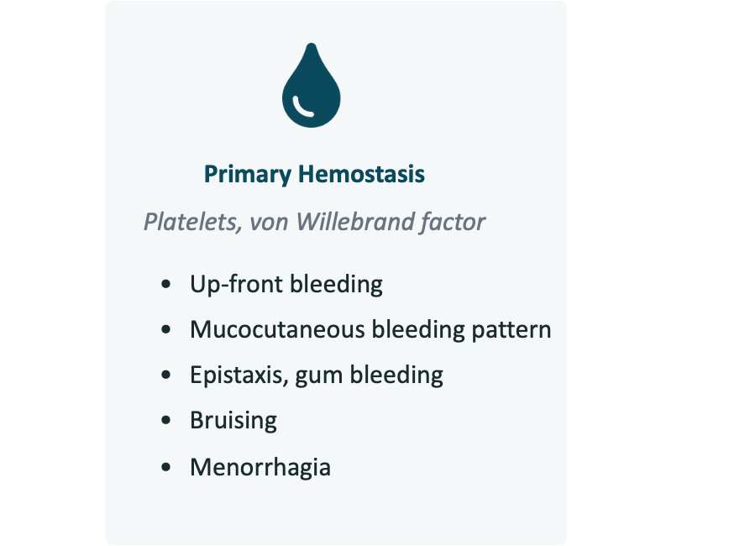
What about true congenital platelet disorders?
Factor VII deficiency
0.002/1000
Hemophilia B
0.04/1000 males
Hemophilia A
0.2/1000 males
Congenital platelet defects
3/1000
Von Willebrand
10/1000
https://www.ncbi.nlm.nih.gov/books/NBK459222/
https://www.cdc.gov/ncbddd/hemophilia/features/keyfinding-hemophilia-occurrence-US.html
https://www.sciencedirect.com/science/article/pii/S1538783622004263?via%3Dihub
Notes:
-Maybe there’s a family history of platelet function disorder or maybe the patient’s bleeding symptoms have been present for a very long time, or their platelet count is not getting better on repeat checks. These are additional reasons to refer to hematology.
-One reason to refer in those scenarios is because evaluating for inherited platelet disorders can get tricky
-In the grand scheme of bleeding disorders, platelet defects are maybe up there with von Willebrand disease as some of the most common
-Inherited Platelet defects affect 3/1000 people in the US, and are much more common than congenital factor deficiencies aka the hemophilias, but we just hear about them much less
-And that’s probably because the severity of platelet disorders are mostly mild chronic thrombocytopenias or functional defects, although some forms can be severe with hemophilia-like bleeding.
-But if most of them are mild-to-moderate and the bleeding risk if low, you may ask: why is it important that we identify them?
CLICK

Slide 29
Why is it important to identify congenital platelet defects?
Bleeding risk
Syndromes
Notes:
-Well ignoring the bleeding risk for a second, due to the nature of the mutations that cause platelet disorders, they typically run as part and parcel of other syndromes that involve major organ systems, or are associated with cancer predispositions, or bone marrow failure syndromes.
CLICK

Slide 30
Inherited Platelet Disorders
Quantitative
Qualitative
Large size
Normal size
Small size
Large size
Normal size
MYH-9 defects
Mediterranean thrombocytopenia
Bernard-Soulier
Velocardiofacial/
DiGeorge syndrome
GATA1 mutation
Gray platelet
Paris-Trousseau /Jacobsen
TAR
THPO
MECOM
CAMT
Familial platelet disorder/AML
ETV6-related thrombocytopenia
ANKRD26-related thrombocytopenia
Essential thrombocythemia
Wiscott Aldrich
X-linked thrombocytopenia
Platelet-type VWD
ITGA2B/ITGB3
Glanzmann
Receptor defects
Signal transduction defects
Quebec platelet syndrome
Granule disorders EXCEPT gray platelet (CHS, HPS)
TUBB1
Scott syndrome
Stormorken syndrome
Notes:
-We are not gonna talk about every single one today, but I do want to highlight something important:
-The firs tthing, is that what you are seeing on this slide is a list of platelet disorder in red that are a part of larger syndromes that require management on a more systemic level. In folks with these diseases, the platelet issue is typically not the thing they present to medical attention for; these are cancer dispositions or syndrome associated with immune disorders or anatomic defects
You’ll also notice that platelet disorders are often classified as either Qualitative and Quantitative, and also classified by the size of the platelet (small, normal, or big platelets). But there is a TON of disorders where the defect is in both function and number
CLICK

Slide 31
How to measure Platelet Function?
Bleeding time | Screening test (obsolete) | In vivo measurement of bleeding block
Platelet function analyzer-100 | Assessment of bleeding risk and drug effects; Searching severe platelet dysfunctions; revealing of VWD | Time evaluation of high shear WB flow blocked by platelet plug into a hole in activated surface
Aggregometry | Screening test for bleeding tendency; Diagnostic for platelet defects | Measurement of agonist-induced platelet aggregation
Lumiaggregometry | Detection of storage/release disorders | aggregometry combined with luminescence
Thromboelastography | Assessment of global hemostasis plus monitoring antiplatelet treatments effect | Evaluation of rate of clot formation based on low shear-induced and agonist addition
Flow cytometry | Cell counting, detection platelet activation by extent of expression of surface and/or cytoplasmic biomarkers | laser-based detection of suspending fluorescent label platelets in a flowing solution
Radio- or enzyme-linked immune assays | Measurement of TxA2 metabolites | Ligand-binding assays
Notes:
Now, I don’t expect anyone outside of a hemophilia center or a hematology department to try to diagnose one of these things. But I did just want to run down some of the screening tools available to measure platelet function, because they may pop up in your patients charts or labwork.
Most of these tools are indirect and some are more precise.
The two worth knowing are the PFA-100 and platelet aggregometry. Those are the next slides.
Everything else here —thromboelastography, flow cytometry, immunoassays — are specialized send-out testing a hematologist orders. You do not need to choose among them in clinic.

Slide 32
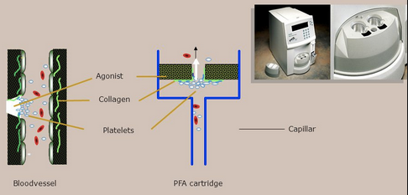
Platelet Function Analyzer-100
Notes:
The PFA-100 is how we get a closure time. It’s a really rough way of measuring platelet function.
Citrated whole blood is pulled through a small hole in a membrane coated with collagen plus either epinephrine or ADP to stimulate platelet activity.
Platelets stick, plug the hole, and the time that takes for the hole to close is the closure time.
It runs at high shear, so it roughly mimics what happens in a small vessel.
A long closure time means the platelet plug is slow to form — either a platelet problem or missing von Willebrand factor.
A short closure time means pretty much nothing.
It is fast and easy, which is what makes it attractive as a screen. If its really really abnormal then there’s probably something going on with the patient. If its only slightly abnormal, then its very hard to interpret.
There are also some major caveats when sending this testing
CLICK

Slide 33
Factors That Influence PFA-100 Results
  VWF levels
  Hematocrit
  Platelet number
  Platelet function
  NSAIDs/other meds
Abnormal results are not specific for any disorder
  Results are abnormal in Glanzmann thrombasthenia and Bernard–Soulier syndrome with closure times typically >300 s on both ADP/collagen and adrenaline/collagen cartridges
  False negatives are more common for storage pool defects like Hermansky–Pudlak syndrome (HPS) and Quebec syndrome
Use in conjunction with other screening tests
Platelet function testing cannot be performed in babies under 6 months of age
Family history of a platelet function disorder (not thrombocytopenia)?
Refer to Hematology and send a CBC only — no other platelet testing.
Notes:
For one thing, the closure time is not a pure platelet test. Von Willebrand factor level, platelet count, hematocrit, and NSAIDs, antihistamines, andothers will affect the results.
So send a CBC with every PFA. Anemia or thrombocytopenia will prolong it on their own.
An abnormal result is not diagnostic of anything. It tells you to advance to the next tier of testing.
But a normal result does not clear anyone. Mild von Willebrand disease and mild platelet function disorders slip through
Bottom line: use it alongside other tests, and let the bleeding history drive the workup.

Slide 34
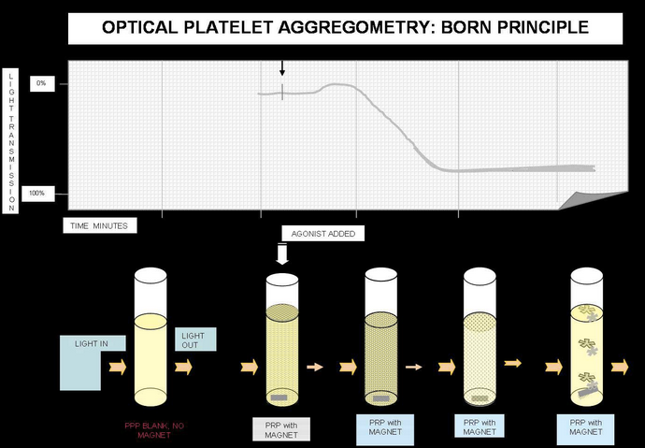
Platelet Aggregation
Notes:
Aggregometry is the next tier of platelet function testing after the PFA. Ours are sent out to Vitalant labs.
Platelet-rich plasma is mixed with a panel of agonists, to stimulate platelet activation and forming a plug — and the response is recorded.
As platelets clump, a bean of light is shot through the solution. Non-activated platelet form a cloudy solution. As they aggregatate, they clump together and more light passes through.
Different platelet disorders give different patterns of aggregation— though some abnormal patterns are simply non-specific.
CLICK

Slide 35

Sending Platelet Aggregation Testing
Pre-analytic factors matter more here than anywhere
  Fresh draw in the AM
  Aspirin, NSAIDs, antihistamines, and herbal supplements must be held about 5 days
  Thrombocytopenia and uremia will skew the results
If you are sending the test
  Schedule it when the child is off medications
  Send them to a lab that runs the assay regularly: Vitalant is the only show in town for this
    >Draw at a Main UPMC facility, weekday mornings only
Remember:
No platelet function testing under 6 months of age
Family history of a platelet function disorder (not thrombocytopenia)?
>Refer to Hematology and send a CBC only — no other platelet testing.
Notes:
Pre-analytic factors matter more here than anywhere: need to be fresh whole blood, drawn on a weekday morning, from a drug-free patient.
Aspirin, NSAIDs, antihistamines, and herbal supplements all need to be held about 5 days. Thrombocytopenia and uremia will also skew results.
If you are sending this test, schedule it when the child is off medications and send them to a lab that runs it regularly. In our region, vitalant is the only lab that will run this test accurately.
And finally, some practical points for very young patients:
First, platelet function testing cannot be performed in babies under 6 months of age — neither the PFA nor aggregometry is valid in that age group, so we wait to order those tests til they are older. Also, aggregation requires a lot of blood to be drawn, another reason to wait til the baby is older and can give the proper volume required for the test.
CLICK

Slide 36
The value of PT, aPTT, fibrinogen –
Case Example
Case History:
Healthy newborn boy after an uneventful pregnancy and delivery
Circumcised on day of life 2 and discharged
On day 3 his mother finds blood on the gauze and calls the office
Bleeding continues on and off for several days, always stopping with pressure
Mother reassured — no workup pursued
Six years later
He falls and develops a swollen knee
An orthopedist finds blood in the joint
Workup shows a prolonged aPTT
Notes:
Lets move onto another case and out of the platelet sphere – what about the other coag labs? Lets get into the coagulation cascade now
Healthy term boy is born. Uneventful pregnancy, uneventful delivery. Circumcised on day two, goes home. Nothing about him looks unusual.
Day three, mom finds blood on the gauze in his diaper and calls in. The bleeding comes and goes over several days, and every time it stops with pressure.
No workup is performed because the bleeding ultimately stops.
Six years later he falls, the knee swells, and an orthopedist taps blood out of the joint.
Now some labs are sent off, and the activated partial thromboplastin time is long ---- well what does that mean, a prolonged PTT?

Slide 37
What the PT and aPTT Measure
aPTT measures the intrinsic arm
Factors XII, XI, IX, VIII
HMWK
XII
XIa
TISSUE
FACTOR
PT measures the extrinsic arm
Tissue factor + factor VII
IXa
X
VIIa
VIIIa
Xa
Both PT and aPTT feed into the common pathway:
X, V, II, fibrinogen
Between them the two tests cover all three arms
+
PROTHROMBIN
Va
THROMBIN
FIBRINOGEN
FIBRIN
Notes:
Here comes the coagulation cascade. I’ll try to make this painless.
The PT and the aPTT are simply stopwatches for how long it takes a clot to form in a test tube.
We take the patients plasma and add a trigger to it and time how many seconds it takes to clot.
Every laboratory has their own reference range, so the absolute number means nothing, what matters is whether or not it falls in the reference range.
A “long” PT or PTT just means the clot took longer to form than it should have, and that means one of the clotting factors in the arm that test is probing is either low or being blocked or inhibited. It does not tell you which factor, and by itself it does not tell you if the patient bleeds.
The difference between the two pathways is simply which factors are being screened. The PT probes the extrinsic arm — tissue factor and factor seven.
The aPTT probes the intrinsic arm — factors twelve, eleven, nine, and eight.
And then both of them run through the same common pathway: ten, five, prothrombin (II), and fibrinogen.
CLICK

Slide 38
Both PT and aPTT Prolonged
COMMON PATHWAY = FIBRIN FORMATION
Both Prolonged: PT & PTT
Consider
X
Liver dysfunction, severe vitamin K deficiency, warfarin overdose, low fibrinogen
Xa
+
PROTHROMBIN
Next Step
Va
Evaluate liver function, fibrinogen level
THROMBIN
Thrombin time — the last step only
Prolonged TT means low or dysfunctional fibrinogen, or a thrombin inhibitor — most often heparin from a line draw. Redraw peripherally first.
FIBRINOGEN
FIBRIN
Notes:
Both prolonged means your problem is at or below factor ten into the common pathway, or you have something global that’s preventing your body from making a variety of factors in both arms, not just one.
In children the usual answers behind this are liver dysfunction where the liver-derived factors aren’t being made, advanced vitamin K deficiency where the vitamin k dependent factors in both arms cannot function, and this includes warfarin overdose, or low fibrinogen which is where all the pathways converge.
If you see both prolonged, go get the liver panel and a fibrinogen. If its in an infant, check if they got their Vit K shot at birth. Those two results speak for themselves and can usually give you an answer.
Side note: There is a way to measure fibrinogen function by itelf, its called a thrombin time. Fibrinogen is the protein that becomes the clot and eventually gets cut into fibrin to hold the lot together. The thrombin time tests only that last step of fibrinogen to fibrin conversion.
So a prolonged TT means low or dysfunctional fibrinogen, or something inhibiting its conversion.
CLICK

Slide 39
Isolated Prolonged PT
LONG PT + NORMAL PTT = EXTRINSIC ARM
HMWK
XII
Vitamin K Deficiency — far more common
Consider
Malabsorption, prolonged antibiotics, early liver disease, or warfarin exposure
XIa
TISSUE
FACTOR
Next Step
IXa
X
VIIa
Give vitamin K and repeat the PT — correction confirms it
VIIIa
Factor VII Deficiency
Xa
Consider
+
PROTHROMBIN
Consumption from bleeding, Vit K deficiency, true FVII deficiency
Va
Next Step
THROMBIN
If the PT does not correct, end a factor VII level and check liver function; if level is mildly low, repeat when well
FIBRINOGEN
FIBRIN
Notes:
Long PT with a normal PTT points to the extrinsic arm — which really means factor VII.
Factor VII has the shortest half-life of any clotting factor, so it drops first if there is a production issue with factors or if factors are being consumed as in active bleeding. That is why the PT is the first test to go up when vitamin K runs low or the liver is struggling.
By far the most common cause is vitamin K deficiency: a child who does not absorb fat well, a child on long antibiotics with poor intake, or a warfarin exposure.
The treatment is the test — give vitamin K and repeat the PT. Correction gives you the answer.
True factor VII deficiency is rarer. That said, Bleeding does not track with the level, so a mild number does not mean a mild bleeder.

Slide 40
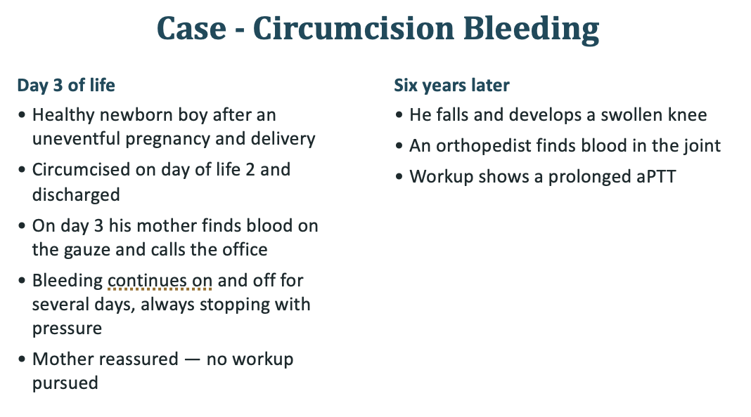
Isolated Prolonged aPTT:
Four Questions
HMWK
XII
XIa
TISSUE
FACTOR
IXa
X
VIIa
VIIIa
Xa
Wrong reference range for age?
Heparin contamination?
An inhibitor (lupus anticoagulant)?
A truly low factor: VIII, IX, XI, XII?
+
PROTHROMBIN
Va
THROMBIN
FIBRINOGEN
FIBRIN
Notes:
But what about our little boy with the prolonged PTT who bled during his circumcision-
Four questions, in this order, when you see his isolated long PTT.
First, is the range right for the age. Neonates and young infants have physiologically lower contact and vitamin K dependent factors, so an adult range manufactures abnormal results. This is accounted for in most childrens hospitals and clinics.
Second, is it heparin contamination. If the sample came out of a line that is heparinized, or was drawn through a flushed catheter, even a tiny amount of carryover prolongs the PTT — the heparin blocks thrombin and factor ten in the tube.. Redraw peripherally before you send any factor levels. If you want confirmation, the thrombin time will be prolonged too, and the lab can run a heparin neutralization.
Third, is there an inhibitor. An inhibitor is something in the plasma that gets in the way of the clotting reaction. The factors are all there, but something — almost always an antibody the patient has made — is sticking to one of them or to the test surface and blocking it from working. In a well child, a transient lupus anticoagulant after a viral illness is common. The key there is the patient DOES NOT BLEED despite a long PTT, because the long PTT is a test-tube phenomenon.
Fourth, could a factor be genuinely low. That is your hemophilias or your von Willebrand with low factor eight
CLICK

Slide 41
Factors Deficient or Inhibited?
Mixing studies can help determine the cause
Equal volumes of patient and normal plasma are mixed and PTT is repeated with and without incubation for 60 minutes at 37°C
Test that remains abnormal suggests inhibitor
Test that corrects to normal indicates a factor deficiency
Notes:
Quick side bar about mixing studies, which are very helpful when a PTT or PT is prolonged in a child with zero bleeding symptoms.
The mixing study is how you determine if a factor is missing vs inhibited.
Mix the patient plasma Fifty-fifty with normal plasma which should be enough to supply back if a factor is missing, and normalize the PTT, so a deficiency corrects. An inhibitor consumes the added factor and the test stays long aka does not correct on mixing study
CLICK

Slide 42
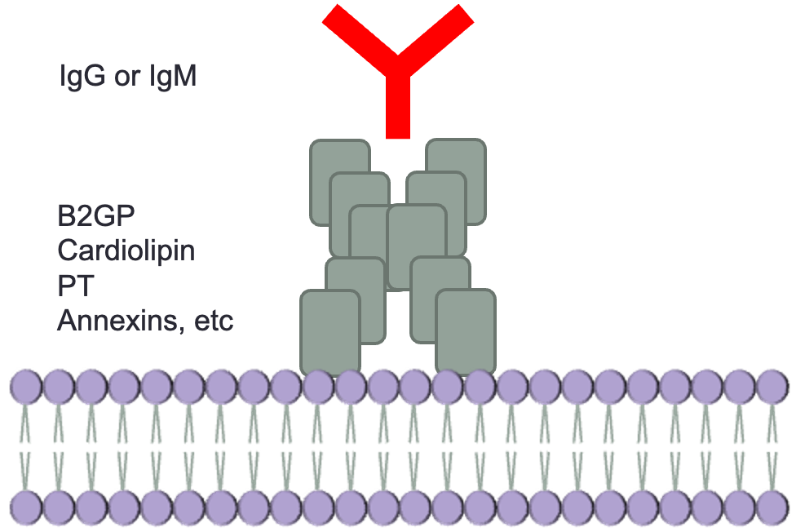
Case — aPTT that does not correct
6-year-old with recurrent otitis media · pre-op PTT 54 sec (ref 28–42) · no bruising, no bleeding, no family history
Isolated prolonged PTT
LAC antibodies
MIXING STUDY CORRECTS
= Factor deficiency — VIII, IX or XI
DOES NOT CORRECT — OUR PATIENT
= An inhibitor is present
Lupus anticoagulant — dRVVT positive
Transient and post-infectious: prolongs the PTT in vitro, causes no bleeding in vivo
OUTCOME
Surgery proceeded with no factor coverage and no bleeding; repeat testing normal at 12 weeks
Notes:
Case in point, Six-year-old comes in for tubes. No history of bleeding, no family history of bleeding. Screening labs are sent Pre-op and shows a prolonged PTT 54 seconds, PT and platelets are normal.
Mixing study is the deciding test: if it corrects it means the ptt is long because of a factor deficiency, if it doesn't correct it means there’s inhibitor.
Our patients PTT does NOT correct on mix, and someone sends a lupus anticoagulant panel to try and identify the antibody inhibitor – the it comes back positive — so he has a “LAC” a lupus anticoagulant.
That does not mean he has lupus or antiphospholipid antibody syndrome.
A healthy child can develop an antibody (a lupus anticoagulant, often after a viral illness) that sticks to the phospholipid needed for the PTT test, making the test-tube clotting time look prolonged even though the child clots and bleeds normally. A LAC panel — including a mixing study that fails to correct — confirms this harmless, often temporary lab artifact rather than a true bleeding disorder.
Transient LACs typically clear within twelve weeks. No bleeding risk, surgery proceeds without issue.
But what would happen if the PTT was prolonged and DID correct on mix?

Slide 43
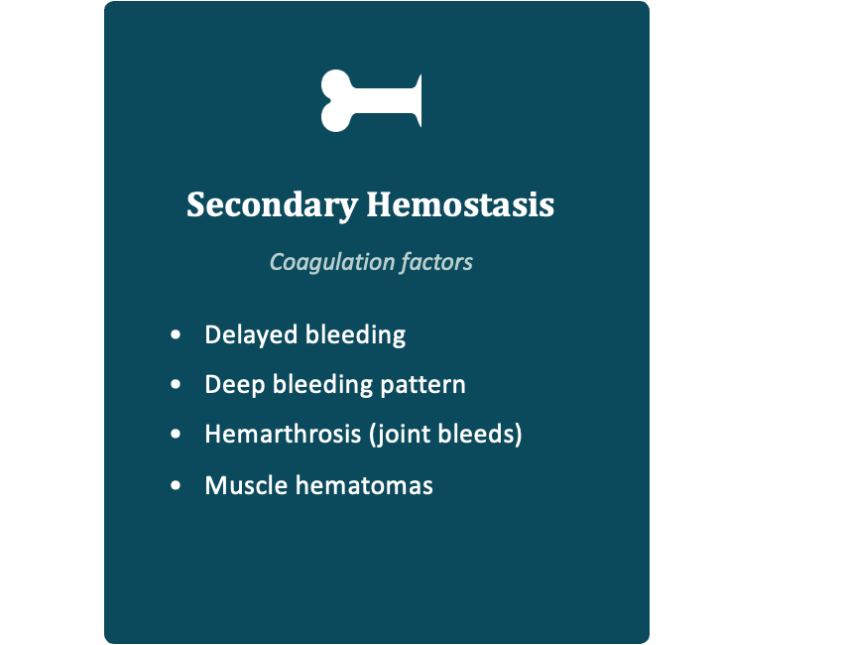
Hemophilia: missing or low factor
Factor VIII level 3%
Hemophilia leads to delayed formation of an abnormal clot
Hemorrhages can occur after minimal or even unknown trauma
Screening tests: PT and aPTT
Notes:
That leads us back to our other little boy who had circumcision bleeding a prolonged PTT now in the setting of hemarthrosis at the age of 6 years. His mix DOES correct. A factor is missing.
He gets referred to hematology, and a factor VIII level is found to be 3% of what it should be. This child has hemophilia A, which is a problem of secondary hemostasis. There are many types of hemophilia depending on what factor is missing, but for the purpose of this talk im going to focus on hemophilia A and B, the two most common types of factor deficiencies.
Patients with hemophilia can make a platelet plug if injured, and their platelet number and function are normal. They are missing a clotting factor which will be picked up on the PT or the PTT, not the CBC.
The obvious next question is how often you are actually going to meet this kind of patient — and who else in the family might be at risk. Let us look at the numbers.
CLICK

Slide 44
Hemophilia Demographics
Hemophilia A or B
1 in 4,000
male births
80–85% A
15–20% B
A and B: X-linked recessive
~30% are new mutations — no family history.
Carrier girls can bleed.
~33,000
males in the US
(~1.1 million worldwide)
The other factor deficiencies (comprise 3–5% of all factor deficiencies)
XI (‘hemophilia C’), VII, X, V, XIII, II, fibrinogen — each ~1 in 500,000 to 1 in 2 million.
All autosomal, girls are affected too.
Notes:
Like I mentioned, there are many types of hemophilia depending on which factor in the coagulation cascade is missing or low. The most common are deficiencies in either factor VIII (hemophilia A) or factor IX (hemophilia B). Minority are other factors, like factor VII or XI
For the sake of this talk, when we talk about hemophilia we’ll be talking about A or B, and the other hemophilias are now morre commonly referred to as rare bleeding disorders
About one in four thousand male births is affected by hemophilia A or B. Most are hemophilia A – unless you live in Western PA where hemophilia B is much more common due to the founder effect of the Amish population.
But as a general rule, there are no racial or ethnic differences.
Prevalance is about thirty thousand males in the US, and roughly one point one million people worldwide.
Most are cared for through dedicated hemophilia centers.
Inheritance: A and B are X-linked recessive. If mom is a carrier, each son has a fifty-fifty chance of being affected.
And carrier girls are not always silent. Some run low factor levels and bleed, most often heavy menstrual bleeding, so we do sometimes have to treat a symptomatic carrier.
This is very pertinent for everyone here: A third of all new cases are new mutations and are initially detected out there “in the wild” when they present to primary care with a bleeding complaint. So a negative family history does not necarily rule hemophilia out.

Slide 45
Case — Hemophilia in the Family Tree
Healthy 5-year-old, pre-op referral: “hemophilia A runs in the family”
A boy’s only X comes from his mother
Great-uncle
Severe hemophilia A
His sister
Possible carrier
A father hands his son a Y — he cannot transmit an affected X to a son
The affected branch is on dad’s side — no route to this boy
Father
Unaffected
Mother
No family history
No testing or intervention needed
Our patient
Gets dad’s Y — not his X
Square = male · Circle = female · Filled = affected · Center dot = carrier
Notes:
Chief complaint you may sometimes get: ‘there s hemophilia somewehre in the family”
Five-year-old, healthy, up for tonsillectomy. The family tell you that hemophilia runs in the family. The affected relative is the father's maternal uncle, severe hemophilia A.
Doe we need to do something about this? First know which kind of hemophilia the family is talking about. If its not A or B, then automatically refer to Hematology because those can be autosomal.
If the family confirms it’s a or B, draw the pedigree. Hemophilia A and B are X-linked. A boy gets his single X from his mother. His father hands him a Y chromosome.
So an affected relative on the father's side cannot reach this child. Even if the father himself carried it, he could not pass it to a son. Daughters would be a different conversation and are obligate carriers, but there is no route to a boy.
That means for this child, no factor levels, no coverage, no delay in surgery is needed.
What would change my answer: an affected relative on the mother's side, any bleeding history in the child, or a family that cannot tell you which branch the relative is on. Then get levels and a hematology consult
And when you do get those levels, the number itself tells you how much trouble the child is in — because in hemophilia A and B, severity is defined entirely by the baseline factor level.
CLICK

Slide 46
Hemophilia A and B Severity
43% severe, 26% moderate, 31% mild
Severity is based upon baseline level of factor
  Severe = Factor level <1% (1 U/dL)
  Moderate = Factor level 1 – 5% (1 – 5 U/dL)
  Mild = Factor level >5% (5 U/dL)
1 unit of each factor = the amount in 1 mL of normal plasma (100% = 100 U/dL)
Notes:
The child’s personal factor level determines their bleeding risk.
Under one percent is severe disease (this is the largest group). One to five percent is moderate. Above five is mild.
Roughly forty percent are severe, a quarter moderate, a third mild.
What is worth noticing is how small the absolute numbers are. The difference between a child who bleeds weekly without injury (aka severe) and one who only bleeds after surgery is a few percentage points of factor. You don’t need a lot of factor to be hemostatic.
That also means the mild patients are the ones most likely to be undiagnosed when they show up with an injury at an older age.
Their entire history can be unremarkable until they are faced with a hemostatic challenge.
CLICK

Slide 47
Initial Presentations
~30% of patients will bleed after circumcision
~3.5% of newborns will have intracranial hemorrhages (~20% with forceps/vacuums)
Most patients are screened due to family history
However, nearly one-third of patients will develop hemophilia as a new mutation (no family history)
  Symptoms may include frenulum bleeding
  Diagnosis usually made after child gains mobility
Notes:
Circumcision is the single most common first presentation, and about thirty percent of these boys bleed with it. That is the case we opened with.
Intracranial hemorrhage in roughly 3%of newborns, and that number climbs sharply with forceps or vacuum.
Most patients are picked up because of a known family history. But remember, close to a third are new mutations. No family history at all.
Other early signs are subtle. Frenulum bleeding, oozing at the heel stick, bruising that seems disproportionate. I recently diagnosed one toddler after he bit a potato chip wrong and his mouth wouldn’t stop bleeding.
But Most diagnoses land once the child gets mobile and starts hitting things.
CLICK

Slide 48
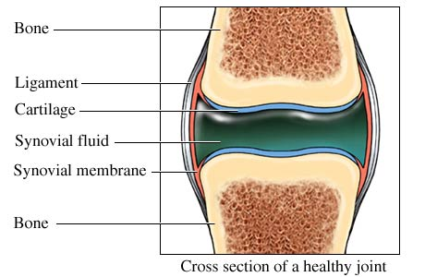
Hemophilia Declares Itself with Ambulation
Classic presentation is bleeding into muscles and joints, appearing as the child starts walking
Severe disease: 1–2 bleeds per week, usually beginning in the toddler years
The ankle is the first joint at risk; with age the knee and elbow become most common
Where a joint bleed happens
Blood fills the joint space lined by cartilage and synovium
Tingling or warmth first, then pain, decreased range of motion, then swelling
Older children sense a bleed before it is visible
Acharya, Pediatrics, 2013 · Jones et al., Am Fam Physician, 2024 · Peyvandi et al., Lancet, 2016
Notes:
Hemophilia really announces itself with ambulation. The child starts walking, starts falling, and the joint bleeds begin.
Severity drives the presentation. Severe disease bleeds with minimal or unknown trauma. Moderate disease bleeds after mild to moderate injury. Mild disease can be hard to detect and may not declare itself until major trauma or surgery — sometimes not until adolescence or adulthood.
Severe disease runs one to two bleeds a week starting in the toddler years, which is a relentless pace when you think about the cumulative joint damage.
The ankle is first, because it takes the load when they are learning to walk. As they get older it shifts to knees and elbows.
Inside the joint, blood fills the space bounded by cartilage, synovium and capsule. The sequence is tingling or warmth first, then pain, then loss of motion, then visible swelling.
Older kids feel it before you can see it.. Pain and restricted range of motion are the exam findings that matter, and swelling is a late sign.
Different from adults: in an adult hemophilia patient the target joints are already established and the damage is arthropathy you are managing. In kids the joints are still normal, and every bleed is a chance to prevent that endpoint. It also means a toddler cannot tell you the joint is bleeding, so refusing to bear weight or guarding a limb is the presentation.
CLICK

Slide 49
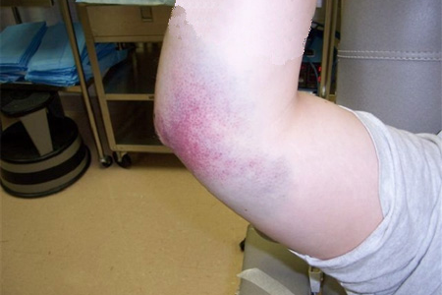
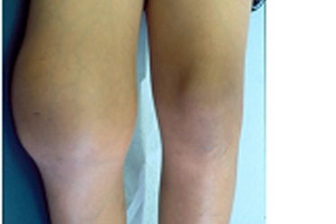
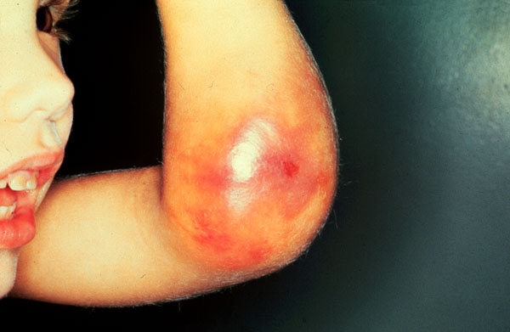
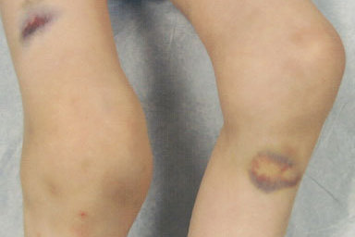
Clinical Appearance of Joint Bleeds
Elbow hematoma with bruising
Swollen knee — hemarthrosis
Acute elbow bleed with swelling
Bruising over knees and shins
Notes:
Top left, an elbow hematoma with bruising, and next to it a swollen knee from hemarthrosis. Note how much the knee has lost its landmarks.
Below, an acute elbow bleed with obvious swelling, and finally, bruising over the knees and shins.
The other thing to take from these photographs is that by the time it looks like this, the bleed has been going for a while. Treatment decisions should be made on symptoms and history, not on the appearance of the limb.

Slide 50
Factor replacement for acute bleeding
HCWP supplies factor to every family with a known diagnosis — they are taught to bring their product to the ED
Infuse the patient’s own factor through a butterfly needle
No factor with them? Dose from pharmacy stock, rounding up to the nearest vial
Start replacement whenever serious bleeding is suspected — before confirmatory imaging
Call HCWP or pediatric hematology on call with any acute bleed — (412) 209-7280
Notes:
Most severe patients are on regular prophylactic factor replacement regiments, meaning their levels are kept at a decent level with factor replacement infusions. But those infusions don’t take the place of higher treatment doses in the event of a trauma or injury.
Patients can still have breakthrough bleeds that require on-demand factor
In the emergency department, when a patient with known hemophilia has an injury and shows up for care, families are taught to bring their own factor and it should be infused through a butterfly. If they arrive empty handed, dose from pharmacy stock and round up to the vial.
The one rule that overrides everything: if you suspect serious bleeding in a patient with known hemophilia, give factor first and image afterward.
Nothing is gained by waiting for a CT, dose first and image later.

Slide 51
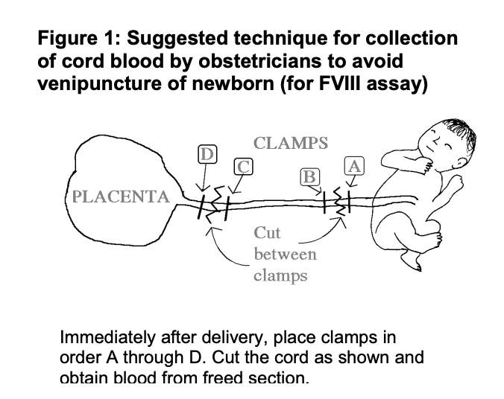
When there’s a new baby: Cord Blood Kits
AT DELIVERY — BABY AT RISK FOR HEMOPHILIA
Vaginal delivery is fine if no obstetric risks are foreseen
No scalp electrodes, forceps, vacuum or other instrumentation
IM vaccines OK — smallest needle, one per limb, ice before and after
Newborn screen can and should be done, by experienced staff
GETTING THE CORD BLOOD FACTOR LEVEL
Known carrier mothers are seen by HCWP and given a kit before delivery
Family brings the kit to L&D — draw from the venous side of the placenta
No kit? Light blue citrate tube STAT and call HCWP — results in a few hours
UNTIL THE LEVEL IS BACK
Defer circumcision, arterial puncture and non-essential draws
Call the Hemophilia Center of Western PA before delivery or at birth — (412) 209-7280
Notes:
Another scenario you may encounter – mother who is a known or suspected hemophilia carrier presents in labor and you need to know if the baby (who is a boy!) has hemophilia. Do not use forceps or vacuum on that baby.
Carrier mothers get cord blood kit before delivery if they are having a boy, and the level is drawn from the venous side of the placenta at birth. No needle in the baby, and you have an answer within 24 hours.
If nobody brought a kit or the mother does not follow with a hemophilia center, do not skip the test. A light blue top citrate tube sent STAT with a call to the Hemophilia Center of Western PA gets you results in 24 hours.
Until that level is back, defer the circumcision, skip the arterial stick, and hold non essential draws. You CAN give vaccines and perform the newborn screen.
CLICK

Slide 52
The Screening Tests — and What Each One Buys You
CBC
Platelet number — and the smear catches clumping, giant platelets and other cytopenias
PT
The extrinsic arm: factor VII, vitamin K status, liver synthetic function
aPTT + mixing study
The intrinsic arm: VIII, IX, XI. Corrects = deficiency. Does not correct = inhibitor
Fibrinogen (& thrombin time)
The final common step — how much fibrinogen there is, and whether it works
Platelet function testing
How the platelets work
Notes:
Quick recap of the toolbox before we move on. This is every screening test we have covered, and the one question each answers.
CBC gives you platelet number and other cytopenias. PT, aPTT, mixing study,Fibrinogen and thrombin time, Platelet function testing.
Together they narrow the differential but do not close it. And note that von Willebrand testing is not part of any screen — you have to order it by name.
CLICK

Slide 53
Back to Our First Case:
Symptoms and Family History
Our patient from the start of the talk: 15-year-old girl, menarche at 12, bleeding always heavy
7-day periods, fully saturated pad every 90 minutes, nocturnal flooding and clots; family notes she looks pale
The family history opens the case up
Her father reports recurrent epistaxis and easy bruising, and paternal grandmother reports menorrhagia
Her 6-year-old brother has nosebleeds lasting 5–20 minutes without trauma (he is a nose-picker) and bruises easily — never evaluated, no surgeries, no medications
He is brought in: a few small shin and knee bruises (<1 cm) and fresh blood in both nares
Notes:
Let us go back to where we started. The 15 year old girl from the opening of the talk.
Same story you have already heard. Menarche at twelve, heavy periods from the very beginning, seven day periods, a fully saturated pad every ninety minutes, flooding at night with clots, and now she looks pale to her family.
The reason we are returning to her is that now they supply a family history. Father with recurrent epistaxis and bruising and paternal grandmother with menorrhagia.
And then the brother. Six years old, has nosebleeds lasting five to twenty minutes with no trauma, easy bruising, never evaluated. We are told he picks his nose.
So this is not one patient anymore, it is a family with a autosomal, dominantly inherited mucocutaneous bleeding pattern.
When the bleeding history extends across generations and both sexes, you are usually not looking at hemophilia.

Slide 54
Back to Our First Case:
The Laboratory Workup
Her workup
Labs: hemoglobin 10.0, MCV 64, RDW 21; normal platelet and WBC counts
Normal PT, slightly prolonged PTT; closure times moderately elevated with normal platelet aggregation
Factor VIII 44%; von Willebrand antigen and ristocetin cofactor both just under 30%
Diagnosis: von Willebrand disease
Notes:
You get some labs on this girl and they line up with the story.
Our patient has little bit of iron deficiency anemia. Hemoglobin 10, MCV low at 64, RDW high at 21.
The Coagulation testing is subtle. Normal PT, only a slightly prolonged PTT, closure times moderately elevated with normal aggregation. Nothing here is dramatic, but there’s something there.
Then we look at the FVIII level which is a little low at 44% -- could she be a hemophila carrier? Maybe. But that doesn’t tie in the slightly abnormal closure times.
So you go ahead and order a von Willebrand antigen and activity level and see they are both just under thirty.
That is von Willebrand disease, and it explains the father, the brother, the grandmother, all at once.

Slide 55
von Willebrand Disease
How it was found: von Willebrand, 1926
How it more typically presents: mucocutaneous bleeding
First described by Dr. Eric von Willebrand in 1926
Studied a large kindred on the Åland Islands in the Gulf of Bothnia
5 of 7 girls in one family bled to death
23 of 66 family members studied bled excessively — males and females alike
Easy bruising
Epistaxis
Gingival bleeding
GI bleeding
Bleeding after tooth extraction
Postoperative bleeding
Menorrhagia — often the presenting symptom
Bleeding at more than one site, recurrent, or needing an intervention to stop
Notes:
VWD was first officially described in 1926 after studying a large kindred out in the Gulf of Bothnia.
An isolated population, so the pedigree was unusually clean.
In one family, five of seven girls bled to death. 23 of 66 people that were studied bled excessively.
And though the young women died, and it affected both sexes.
That second point is the practical one, because it is what distinguishes this from the X linked disorders we just spent time on.
We tend to file von Willebrand disease under mild, and most of it is. But the original description was of a lethal condition, and the severe end of the spectrum still exists.
VWD symptoms are not specific on their own. Plenty of healthy kids bruise, and plenty of healthy kids get nosebleeds. What matters is the pattern.
Mucosal bleeding is the signature here. Gums, nose, gut, menstrual bleeding. That is a platelet-type or von Willebrand-type picture, not a deep hemophilia picture with joints and muscles.
But what is von Willebrand factor?
CLICK

Slide 56
von Willebrand Factor
Stored in Weibel-Palade bodies and platelet α-granules
Secreted from vascular endothelial cell in multimers
Serves as a “bridge” between platelets and vessel wall injury sites
Protects Factor VIII:C from rapid proteolytic degradation
What vWF actually does
Platelet
vWF
Bridges platelets to collagen at the injured vessel wall
vWF
FVIII
Carries factor VIII in the circulation and protects it from breakdown
Notes:
It’s a protein.
It lives in two places. Weibel-Palade bodies in endothelium and alpha granules in platelets.
That means it is released right where the vessel is injured, which is why deficiency shows up as mucocutaneous bleeding rather than deep joint bleeding.
It is secreted as multimers and has two jobs. It bridges platelets to the injured subendothelium, and it chaperones factor eight and protects it from proteolysis.
That second job explains our patient. Her factor eight was 44% percent, not because she has hemophilia, but because there is not enough WV carrier protein keeping it in circulation.
CLICK

Slide 57
Overview of vWD Subtypes
Type 1 (classic)
80% of patients
Type 2
20% of patients
Type 3
Rare
Partial quantitative deficiency — not enough vWF, but the protein works normally
FVIII:C, vWF:Ag and activity all proportionately low
Most common inherited bleeding disorder — 1 in 100 have abnormal labs, only 0.1–1% bleed
<30% = definite; 30–50% = possible or probable
Qualitative defect — the vWF present does not work
Suspect it when the activity is low but the antigen looks near normal
Genetic tests are available
Near-complete absence of vWF
vWF:Ag, activity and FVIII:C all very low (<3%)
Bleeding can resemble moderate hemophilia
Notes:
Three types, and the practical difference between them is quantity versus quality.
Type 1 is the overwhelming majority. There is simply less von Willebrand factor, but what is there works normally, so the antigen, the activity, and factor VIII all fall together in roughly the same proportion.
Type 2 is the qualitative group. The protein is present but it does not do its job, so the activity assay is low out of proportion to the antigen level. That ratio is what tips you off, and that is why you cannot diagnose this on an antigen level alone.
Type 3 is essentially the absence of von Willebrand factor. Because von Willebrand factor chaperones factor VIII, those patients also carry a low factor VIII and can look almost hemophilic. It is rare, and those children get known to hematology pretty quickly.
Type 1 is the type you will actually encounter, and it is also the messiest one to pin down.

Slide 58
von Willebrand Testing
Primary testing
One normal level never rules it out — vWF rises with stress, illness, injury, exercise, estrogen and DDAVP, and is often high in early infancy
About 40% of people with blood type O have lower ristocetin activity levels without disease
Avoid large corporate labs — send to a dedicated coagulation center (locally Vitalant or Versiti), and never draw during an acute bleed
Factor VIII
vWF antigen
Activity: GP1bM / ristocetin cofactor
Additional testing for Type 2 or for borderline Type 1
CBC, multimeric analysis, blood type, closure time, platelet aggregation
NIH cutoffs
>50% — normal
30–50% — probable
<30% — definite
Notes:
So, Three tests to start: factor VIII, von Willebrand antigen, and an activity assay.
The trouble is, the testing itself is genuinely inexact, and when it is drawn matters.
von Willebrand factor is an acute phase reactant. Stress, infection, inflammation, injury, exercise, estrogen, all push it up. Never send VW testing during an acute bleed — they can look falsely normal. A normal level drawn in the emergency department, or right after a trauma, does not rule anything out. It must be sent in a calm outpatient setting before you can call it negative.
Same logic for newborns. Levels in type 1 are naturally high at birth, so a normal result in early infancy simply is not interpretable.
Where it is run matters just as much. These are fragile assays: draw technique, transport time, and processing all affect the numbers, and a surprising fraction of abnormal results are handling artifacts. I have seen more false diagnoses come from where the test went than from the test itself. Send to a dedicated coagulation lab — locally, Vitalant or Versiti. Not Quest, and not the large reference labs.
On the activity assay, most centers have moved from classic ristocetin cofactor to the GP1bM assay. Activity is a measure of how well the protein works; the antigen is how much protein is there. GP1bM is less noisy and avoids the false positives that came with certain sequence variants that affect the ristoetin cofactor assay.
Levels Under 30% meets diagnostic criteria. Over 50% is normal. The 30 to 50 band is indeterminate, and how you handle it depends entirely on whether the patient bleeds and there bleeding score.
Based on the initial results, reflex testing can be sent to sort out type 1 from type 2. Type 3 is very obvious from these three labs alone because everything will be super low.
Blood type helps interpret a borderline activity level. Type O runs naturally lower, and that is not a bleeding disorder. A mildly low activity level in a group O patient with no bleeding history is very often just their normal baseline, not a disease. The GP1BM assay helped solve this problem.

Slide 59
The Newborn of a Mother with VWD
Newborn VWF and factor VIII sit at a physiologic peak — a level at birth is not the child’s baseline
TYPE 1 MOTHER · NO PATERNAL BLEEDING HISTORY
Proceed with circumcision
No pre-procedure testing needed
The physiologic newborn rise is protective
Confirmatory testing in clinic after 6 months
TYPE 2, TYPE 3, UNKNOWN
OR +PATERNAL HISTORY
Test before any procedure
The neonatal rise does not protect/apply to these infants
At delivery: vaginal birth is fine — avoid vacuum, forceps and fetal scalp electrodes
Nordic Hemophilia Guidelines, VWD — Pediatric aspects · Connell et al., ASH/ISTH/NHF/WFH 2021, Blood Adv · CDC, 2024
Notes:
Now for a question that comes up more often than you'd think — you get a call from the newborn nursery, mom has von Willebrand disease, and the question is: can we circumcise this baby?
The answer really comes down to two questions. What type does mom have, and does dad have any bleeding history?
Remember, von Willebrand factor and factor VIII are acute phase reactants, and newborns are born with physiologically high levels. So a level drawn at birth is showing you that peak — it is not the child's true baseline.
That cuts both ways. On the one hand, it means you can't trust a normal newborn level to rule out type 1 — so confirmatory testing waits until after six months of age. On the other hand, that same physiologic bump is protective. A baby who has inherited type 1 is going to have levels in a safe range for the first weeks of life.
So for the common scenario — mom has type 1, dad has no bleeding history — you can go ahead with the circumcision without testing first. Just make sure it's documented, and that the family has a clinic appointment after six months for definitive testing.
Type 2 and type 3 are a completely different conversation. Those infants are not rescued by the neonatal rise — their levels are abnormal such that you can actually make the diagnosis at birth.
So if mom has type 2 or type 3, or she doesn't know her type, or there's bleeding history on dad's side, you test before you do anything invasive.

Slide 60
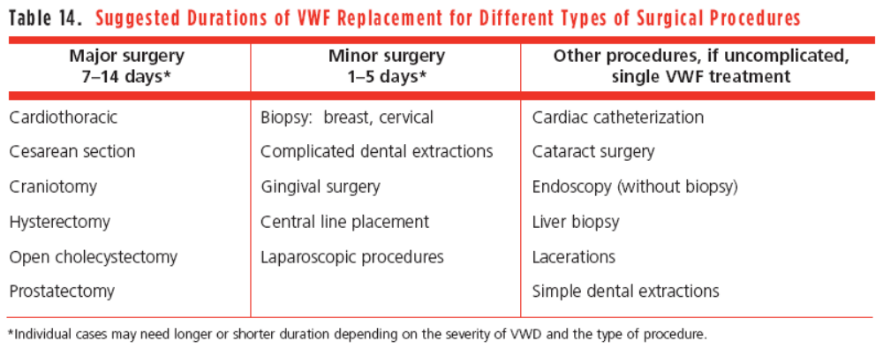



Treating von Willebrand Disease
Treatment is episodic and need-based
Covering surgery
No daily prophylaxis in type 1 — treat bleeds and cover procedures only
DDAVP works for most, but not all, type 1 patients
Challenge test looks for a ~2 fold rise in levels after a dose
Fluid restrict for 24 hours after each dose
Type 1 is treated on demand: cover bleeds and procedures, not every day
Notes:
Fortunately for these patients, treatment is mostly straightforward. T
reatment is episodic for bleeds or as prophylaxis for surgeries, not daily: the options are either to release the body’s naturally stored vWF with DDAVP, or replace it with Humate, and add an antifibrinolytic on top.
DDAVP contains no vWF — it tells endothelial cells to dump what they already have, so levels rise. That is why it works in type 1, fails in type 3 where the storage pool is empty, and can be ineffective or harmful in type 2 where the protein is defective.
Because DDAVP is an ADH analog it also makes the kidney retain free water, so patients need to fluid restrict for 24 hours after each dose dur to the slight risk of hyponatremia leading to seizure activity.
Patients should make sure they are responsive to DDAVP in a controlled setting first before prescribing it for a surgery. Most type 1 patients respond, but you do not want to find out in the OR. Non-responders get humate concentrate instead.
The need for repeat dosing depends on the duration of the healing period and risk of bleeding. Short procedures like skin biopsy may need only perioperative coverage, while procedures with prolonged healing (e.g., tonsillectomy) may require additional DDAVP and/or antifibrinolytic therapy during the vulnerable healing window.
CLICK

Slide 61
Problems with VWD Treatments
In heavy menstrual bleeding, treatments directed at vWD or the fibrinolytic system may be inconsistent, inconvenient, or intolerable:
  DDAVP:
    Not all patients respond, even if laboratory parameters or other types of bleeding improve
    Fluid restrictions required
  Humate-P requires IV access and a local treatment center or home storage
  Antifibrinolytics can be difficult to obtain (insurance approval) and have GI side effects
Hormonal methods usually are best 1st option for heavy menstrual bleeding
Notes:
I want to spend a minute on why these treatments fail in real life, because the failure is usually practical, not pharmacologic. They will almost always work for surgical prophylaxis, but they have variable effects for other types of bleeding, including menstral bleeding
DDAVP is the clearest example. A patient can have a textbook lab response and still bleed through her period. Lab response and clinical response are not the same thing. And the fluid restriction is a real ask for a teenager who is at school all day, or an athlete.
Humate-P works, but it needs IV access and either a treatment center within reach or refrigerated product at home. For a family two hours away, that is not a monthly plan.
Antifibrinolytics are cheap and effective and still get denied by insurance. When patients do get them, GI side effects are the usual reason they quit.
So for heavy menstrual bleeding, hormonal management is usually where we start. Exogenous estrogen raises VW levels too. It is the most reliable, and it does not depend on a pharmacy authorization going through that month.

Slide 62
Estrogen contraindications
Risk for cardiovascular disease
Diabetes with complications
Complicated valvular heart disease
Surgery w/ prolonged immobility
Liver dysfunction / cholestasis
Smoking IF > 35 yrs
Migraine with aura / focal neurologic deficit
Risk for thromboembolism
Notes:
That said, estrogen isn't for everyone, so this is the list worth having in your head before you start it or before you're asked to weigh in.
Migraine with aura can be a big one.
The rest cluster into cardiovascular and thrombotic risk on one side and hepatic issues on the other. Smoking only counts as a contraindication over thirty-five, which for our population usually isn't the limiting factor.
A history of prior thrombosis is typically the biggest no-no for estrogen.
Important point though. A contraindication to estrogen is not a contraindication to hormonal management. Progestin-only options and IUD stay on the table, and the IUD in particular does very well in patients with bleeding disorders where their main issue is menstrual bleeding.
……Ok, now we are almost at the end.
One final category of bleeding disorders where the labs cant really help you
CLICK

Slide 63
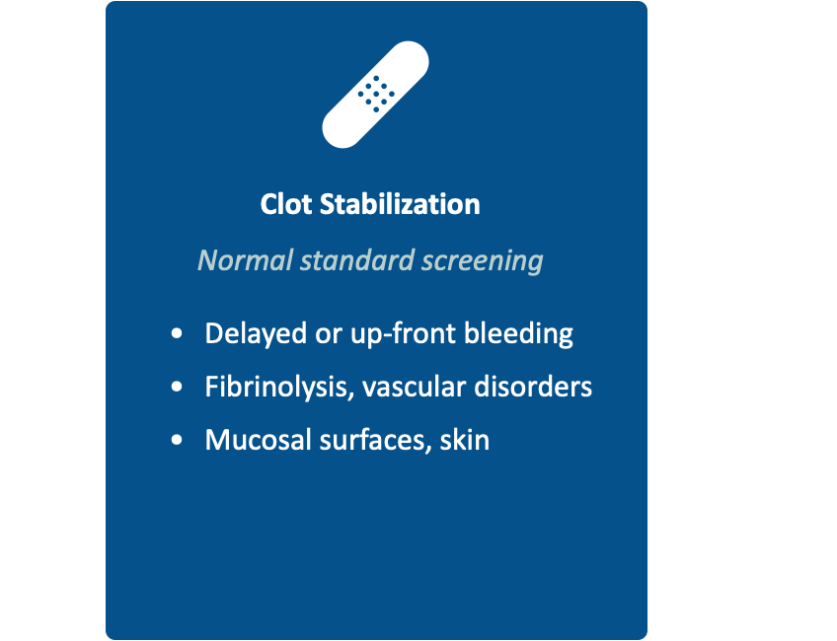
Final Case — Normal Panels, Abnormal Bleeding
16-year-old after wisdom tooth extraction · bled at home on day 1 and again on day 5 · a laceration repair two years ago oozed for two days
The workup was normal
CBC and platelet count normal.
PT, PTT and fibrinogen normal.
VWF antigen, activity and factor VIII normal.
Platelet function screen normal.
Delayed or recurrent bleeding with a clean panel points past the panel —
toward fibrinolysis or factor XIII or connective tissue
Notes:
Everything we have ordered so far asks whether a clot can form. None of it tells you whether the clot will hold.
CBC, VW testing, PT/PTT/fibrinogen levels are blind to a whole category: clot stability and fibrinolytic defects, and vascular causes. Those tests are send-outs and you kind of have to know to go looking for them.
So here’s an example. 16 year old gets her wisdom teeth out, bled at home day one and again day five. You obtain addition history: A laceration two years earlier oozed for two days. Entire lab workup is normal. Also, the grandmother needed the hysterectomy for heavy menses, an uncle died from some kind of spontaneous internal bleeding. No bleeding diagnosis runs in the family.
Whats going on here?
CLICK

Slide 64
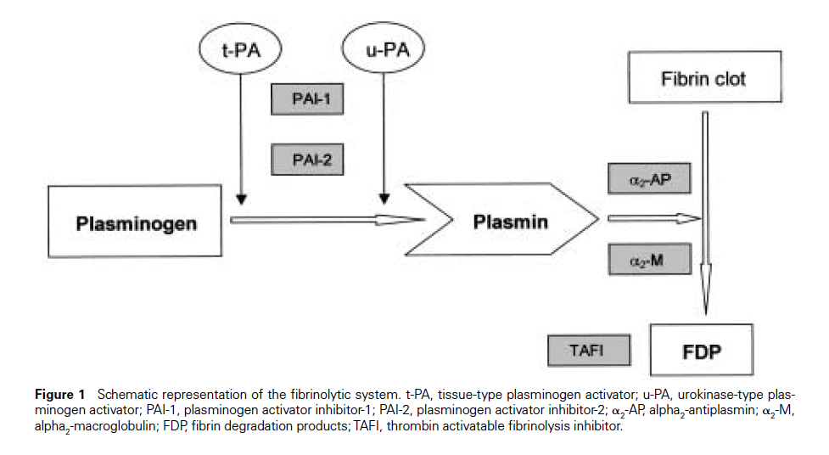
Clot Formation and Breakdown
Making the clot: the fibrin plug forms
Taking it down: the fibrinolytic system
1
Injury: vessel constricts, platelets stick and plug the gap
2
Cascade fires on the platelet surface, generating thrombin
3
Thrombin converts fibrinogen into fibrin strands
4
Factor XIII cross-links the mesh — a stable clot
Every clot is built and then dismantled — bleeding can come from either side
Notes:
Two halves of one story: body builds a clot; it also decides when wants to take that clot back apart. Both have to work, and both at the right speed.
Platelets and clotting factors make a soft clot. Thrombin turns fibrinogen into sticky fibrin threads that run through the platelet plug like rebar, and factor XIII staples those threads together. That cross-linking is what turns a soft plug into a clot that holds pressure.
A clot is scaffolding, not a permanent repair. Plasminogen sits inside the clot doing nothing until tissue plasminogen activator, released by the vessel wall, switches it on to plasmin. Plasmin chews the mesh into fibrin degradation products — that is what a D-dimer measures.
A clot is just temporary scaffolding and is under constant negotiation, not finished when it forms. You need it where the injury is, you need it to stop growing there, and eventually you need it gone so the tissue can heal.
To break down a clot, Plasminogen is activated to plasmin, which breaks down the fibrin mesh into fibrin degradation products, including D-dimer. Natural inhibitors like PAI-1 and others keep this breakdown from happening too early. Some people have abnormal levels of these proteins that govern clot breakdown, and it tips that balance toward too much breakdown and you get a clot that forms on time but does not hold — delayed bleeding or re-bleeding.
Now, there are ways to tests for each of these proteins specifically, and there are ways to treat this. If you block plasminogen from docking onto fibrin, and the clot you already made lasts longer.

Slide 65
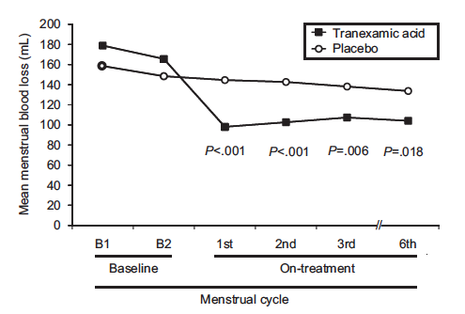
Antifibrinolytic Agents
The agents and how they work
Efficacy in heavy menstrual bleeding
Tranexamic acid and aminocaproic acid (oral or IV) block plasminogen and plasmin
Aprotinin is IV only - rarely used now
They protect a clot — they do not help form one
Oral tranexamic acid (Lysteda)
FDA approved for heavy menstrual bleeding
Dyspepsia is the usual reason patients stop; take with food
Avoid with hematuria, or past or current thrombosis especially retinal vein occlusion
Best at mucosal sites — dental work, epistaxis, menstrual bleeding — layered on whatever else you are doing
Notes:
These agents are called antifibrinolytics. And they have more uses than just in fibrinolytic disorders. They can be used as an adjunct in pretty much any bleeding disorder to help stabilize a good clot.
Aminocaproic acid and tranexamic acid come in both oral and IV forms. Aprotinin is IV only and has largely fallen out of use.
These drugs shine at mucosal sites with high fibrinolytic activity — dental work, epistaxis, post-op oozing — usually layered on top of whatever else you are doing to stop the bleeding (factor replacement, DDAVp, etc). In hyperfibrinolytic syndromes they can be sole therapy.
Very effective in heavy menstrual bleeding as a short courses of therapy until more definitive therapy can be reached or a diagnosis can be made.
Dosing is intermittent, only during bleeding, which is a much easier sell than a daily medication.
The contraindication is active or prior thrombosis, specifically retinal vein occlusion. I also think hard about patients on combined hormonal contraception with other thrombotic risk factors, and I avoid it with hematuria, where forming a clot in the collecting system can obstruct.
For everyone else this is cheap and well tolerated,
Notice what these drugs actually treat: not a clot that never formed, but a clot that did not last.
Keeping this same theme, lets talk about another class of patients whose problem is clot durability, and whose screening panel is therefore always normal. The purest example of it is factor XIII deficiency.

Slide 66
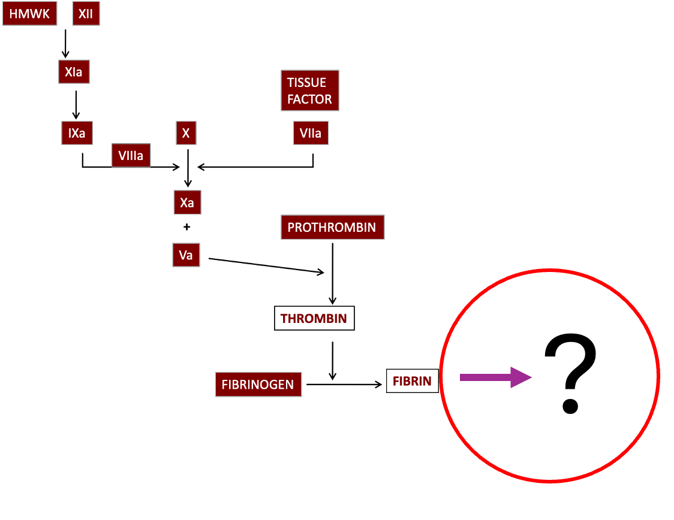
Factor XIII Deficiency
Invisible to every screening test
Coag panel is normal
Factor XIII cross-links fibrin after the clot has formed.
PT, PTT, thrombin time and platelet count all stop measuring before that step.
What it looks like
Delayed bleeding hours after injury
Rebleeding as wounds heal
Delayed umbilical stump bleeding in newborns
Poor wound healing
High lifetime risk of intracranial hemorrhage
Exceedingly rare! Autosomal recessive
1 in 1-2 million individuals (ask about consanguinity)
Notes:
Exceedingly rare — most of you will never see a case. I have never seen a case. It earns a slide because I think more people know about than it appears in a career and its frequently sent in babies when they present with head bleeds, even when nonacciantal trauma is the suspected cause.
Mechanically, factor XIII is needed to cross-links the fibrin mesh after the clot is built, and every screening test stops the clock the moment fibrin forms. So nothing you order sees this step. Diagnosis takes a factor XIII activity level ordered by name.
Factor XIII deficiency presents early, classically in a newborn with severe bleeding, umbilical stump or intracranial, and a completely normal coag panel. That combination is the trigger to think about it – when there is hemophilia-level deep bleeding but normal hemophilia screens, AND in populations with consanguinity, because this inheritance runs autosomal recessive.
Moving on, lets end on a bleeding disorder that has nothing to do with the blood at all. If the clot is fine, look at the vessel and the tissue holding it, which is the category of connective tissue disorders, particularly the ones associated with hypermobility and stretchiness.
CLICK

Slide 67
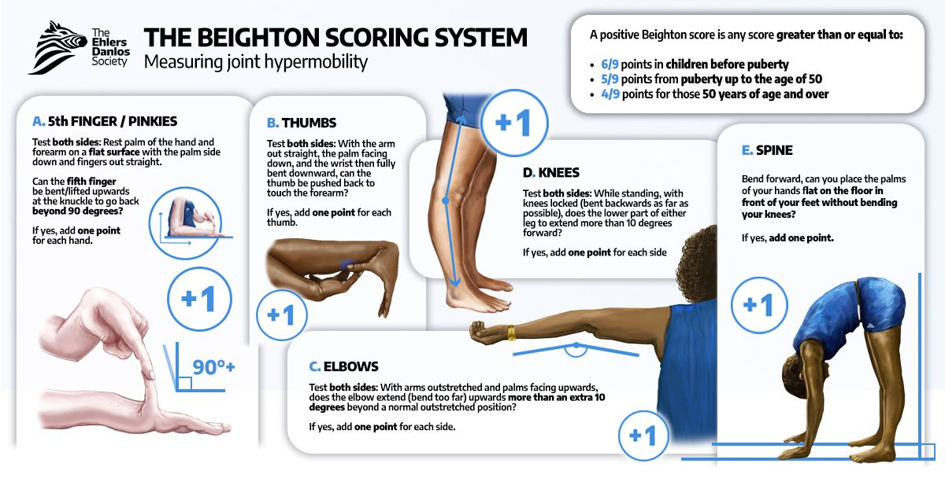
Clinical Hypermobility: The Beighton Score (0–9)
Cutoffs vary by age
≥5 (adults) ≥6 (peds)
Supports generalized joint hypermobility
https://www.ehlers-danlos.com/assessing-joint-hypermobility/
Notes:
“When we talk about hypermobility, we’re usually using the Beighton score as our quick bedside tool.” If you suspect someone is hypermobile, do a Beighton exam.
Its five maneuvers, four of them scored on both sides: little fingers that bend back past ninety degrees, thumbs that fold flat to the forearm, elbows that hyperextend past ten degrees, knees that hyperextend past ten degrees, and the fifth maneuver is being able to bend forward with knees locked and putting your palms flat on the floor.
Positive is a score of five or more in adults, six or more in children. The pediatric cutoff is higher because kids are more flexible;
Why do we score joint mobility? connective tissue disorders — hypermobile ehler danlos and its relatives — are their own category of bleeding disorder, sort of
CLICK

Slide 68
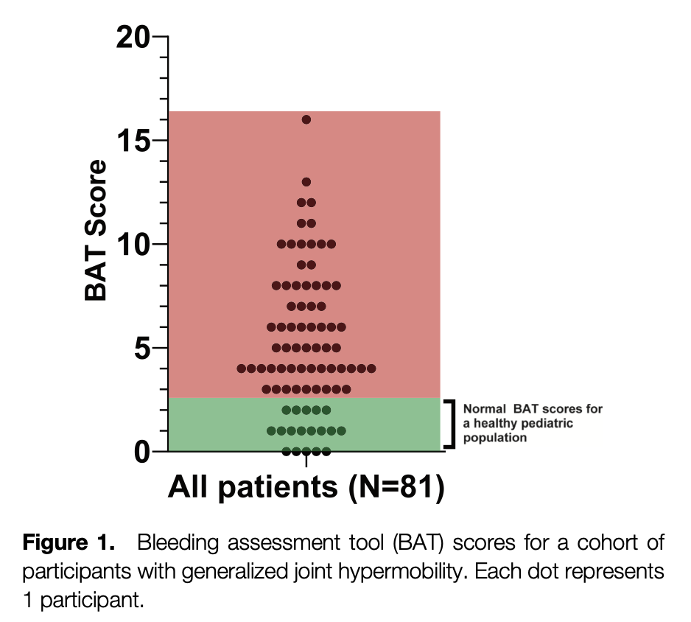

Hypermobility: High Bleeding Scores, Normal Labs
50–60%
Abnormal bleeding scores in EDS
70–76%
Heavy menstrual bleeding in hEDS
~1 in 600–900 — estimated prevalence, right behind von Willebrand disease
Standard coag labs are usually normal
J Thromb Haemost. 2023 Jul;21(7):1824-1830.doi: 10.1016/j.jtha.2023.04.004. Epub 2023 Apr 17.
Orphanet J Rare Dis. 2016 Sep 13;11(1):124.doi: 10.1186/s13023-016-0511-2.
J Thromb Haemost. 2018 Dec;16(12):2425-2431.doi: 10.1111/jth.14310. Epub 2018 Nov 8.
Orphanet J Rare Dis. 2016 Aug 3;11(1):111 · Blood. 2026 Feb 26;147(9):987-997.
Notes:
The bleeding comes from fragile vessels and poor tissue integrity, not from an actual clotting defect. So these children bruise easily, bleed from fragile vessels, yet have an entirely normal hemostasis panel.
“In one study, around half to two‑thirds of EDS patients also had abnormal bleeding scores, in the form of easy bruising, spontaneous or prolonged nosebleeds, and oral bleeding with brushing or minor trauma, peri‑procedural and surgical bleeding: dental extractions, orthopedic procedures, etc
And among women with the hypermobile form of EDS, about 70–76 percent report heavy menstrual bleeding.”
“So by standardized tools, a large subset looks indistinguishable from patients we’d normally label as having a primary bleeding disorder.”
The population estimates of the hypermobile form of EDS are approximately 1 in 600 to 1 in 900, and it is increasingly recognized as one of the most frequent inherited bleeding diagnoses in multidisciplinary bleeding clinics, where a substantial fraction of patients previously labeled as having “unspecified” or “connective‑tissue-related” bleeding meet criteria for some form of connective tissue disease.
This gets diagnosed either genetically or by exclusion
Leta wrap up
CLICK

Slide 69
Final Thoughts: A Roadmap for Your Clinic
1
Ask the bleeding history
Bruising, epistaxis, gum bleeding, surgery and dental extractions, menses, and family history — a structured bleeding score beats a general impression.
2
Order the first tier
CBC with platelet count and a smear, PT, aPTT, and fibrinogen. Add von Willebrand and platelet studies up front if the history is mucocutaneous.
3
Let the pattern tell you where to look
Low platelets — a number or a function problem. Isolated PT — factor VII, vitamin K, early liver disease. Isolated aPTT — hemophilia or von Willebrand disease. Both prolonged — fibrinogen or a common-pathway factor. Normal panel — the history still decides.
4
Add the targeted test
Von Willebrand panel, specific factor levels, PFA-100 or aggregometry. Timing and pre-analytic conditions matter as much as the assay. Call at least 2–4 weeks before any elective procedure — appointments and send-out results take that long.
5
Refer when the story outruns the labs
Any unexplained abnormal screen, a bleeding score above threshold whatever the labs show, a first-degree relative with a known disorder.
Notes:
This is the whole talk on one slide, so I will keep it short.
One: ask the bleeding history — a structured score beats a general impression. Two: order the first tier. Three: read the pattern, not the panel; each pattern points somewhere different. Four: add the targeted test, and if there is an elective procedure coming, call at least two to four weeks out. A plan built a month ahead is easy; one built the morning of is not.
Five is the one people hesitate on. Refer for any unexplained abnormal screen, a bleeding score over threshold whatever the labs show, a first-degree relative with a known disorder, or heavy menstrual bleeding from menarche. And refer when the labs are normal but the history is convincing — the panel does not exclude VWD, platelet function defects, hyperfibrinolysis or factor XIII.
To close: hemophilia bleeds into joints and muscles, VWD is mucocutaneous and far more common, and a normal screen rules out neither. If the story sounds like abnormal bleeding, believe the story, not the panel — and involve a hematologist or a hemophilia treatment center early.

Slide 70
Thank You
Questions?
Notes:
Thank you all for your time. Happy to take questions.

Slide 71
References
Acharya SS. Rare bleeding disorders in children: identification and primary care management. Pediatrics. 2013.
Neutze D, Roque J. Clinical evaluation of bleeding and bruising in primary care. Am Fam Physician. 2016.
Hughes CE, et al. Bleeding and bruising: primary care evaluation. Am Fam Physician. 2024.
Puckett RM, Offringa M. Prophylactic vitamin K for vitamin K deficiency bleeding in neonates. Cochrane Database Syst Rev. 2000.
Ardell S, et al. Vitamin K prophylaxis for vitamin K deficiency bleeding in neonates. Cochrane Database Syst Rev. 2018.
Jones L, et al. Diagnosis and management of bleeding disorders in children. Am Fam Physician. 2024.
Peyvandi F, Garagiola I, Young G. The past and future of haemophilia. Lancet. 2016.
Anderst JD, et al. Evaluation for bleeding disorders in suspected child abuse. Pediatrics. 2022.
Pierce MC, et al. Validation of a clinical decision rule to predict abuse in young children with bruising. JAMA Netw Open. 2021.
Crumm CE, et al. Evaluation of an emergency department high-risk bruising screening protocol. Pediatrics. 2021.
Shimano KA, et al. Eltrombopag for newly diagnosed immune thrombocytopenia (PINES trial). JAMA. 2025.
Gauer RL, Whitaker AN. Thrombocytopenia: evaluation and management. Am Fam Physician. 2022.
Pabón-Rivera H, et al. Thrombocytopenia in children. Pediatr Rev. 2023.
Haley KM. Platelet disorders. American Academy of Pediatrics. 2020.
Schefft MR, et al. Change theory contributes to Choosing Wisely for immune thrombocytopenia. Hosp Pediatr. 2019.
Borzutzky C, Jaffray J. Diagnosis and management of heavy menstrual bleeding in adolescents. JAMA Pediatr. 2020.
Jacobson AE, et al. Bleeding disorders in adolescents with heavy menstrual bleeding. Obstet Gynecol. 2018.
American College of Obstetricians and Gynecologists. Screening and management of bleeding disorders in adolescents with heavy menstrual bleeding. Committee Opinion 785. 2019.
Perez Botero J. Diagnosis and management of von Willebrand disease. ASH Education Program. 2024.
Srivaths L, Kouides P. Von Willebrand disease in adolescents. JAMA Pediatr. 2021.
Casini A, Gebhart J. Laboratory diagnosis of inherited bleeding disorders. Int J Lab Hematol. 2024.
Bidlingmaier C, et al. Standardized bleeding assessment tool in children and adults. J Thromb Haemost. 2012.
Srivastava A, et al. Self-administered bleeding assessment tool performance. Haemophilia. 2021.
Mohsenian S, et al. Pediatric ISTH-BAT cutoff validation. Haemophilia. 2023.
Tera JK, et al. International multicenter validation of the pediatric ISTH-BAT. J Thromb Haemost. 2026.
Sharma R, et al. Bleeding assessment tool workflow in adolescent HMB clinics. Haemophilia. 2024.
Sarangi P, Acharya SS. Hypermobile Ehlers-Danlos syndrome and bleeding. American Academy of Pediatrics. 2017.
Artoni A, et al. Hemostatic abnormalities in Ehlers-Danlos syndrome. J Thromb Haemost. 2018.
Tofts LJ, et al. Pediatric Beighton score validation. Orphanet J Rare Dis. 2023.
Malfait F, et al. The 2017 international classification of Ehlers-Danlos syndromes. Am J Med Genet A. 2017.
Donkervoort S, et al. Clinical outcomes of collagen VI-related dystrophies. Am J Med Genet C Semin Med Genet. 2015.

