Slide 1
Pediatric ent
jEREMY T. REED, MD , JD, MPH&TM
OTOLARYNGOLOGY
UPMC COLE

Slide 2
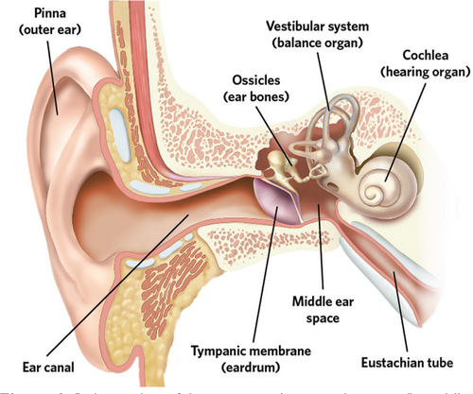
TOPICs
MYRINGOTOMY WITH TUBES (BMT)
  T-tubes?
  + Adenoidectomy?
Adenotonsillectomy
Epistaxis
Frenulectomy

Slide 3
Risks for otitis Media
Young age, especially under 2 years
First ear infection occurring early in infancy
Daycare attendance or frequent exposure to other children
Older siblings bringing home respiratory infections
Secondhand tobacco-smoke exposure
Little or no breastfeeding
Bottle-feeding while lying flat
Pacifier use, particularly after 6 months
Fall and winter respiratory-virus season
Family history of recurrent ear infections
Enlarged adenoids or chronic nasal obstruction
Allergic rhinitis, although the association is less consistent
Craniofacial conditions such as cleft palate
Down syndrome
Immune deficiency or impaired mucociliary function
Prematurity
HORIZONTAL ET
LESS RIGID
SPEND TIME ON BACK

Slide 4
Recurrent acute Otitis Media
INDICATIONS
Suppurative Complications:
  threat of severe intra-cranial or extra-cranial complications, such as:
Mastoiditis
Meningitis/brain abscesses
Facial nerve paralysis
Labyrinthitis causing severe dizziness
Recurrent AOM: Experiencing
  3 or more distinct infections in 6 months, or
  4 or more infections within 12 months
Severe, Intractable Pain:
  Intense earache with
  severely bulging eardrum
  risk of spontaneous perforation
Antibiotic Treatment Failure:→Effusion?
Poor response/total lack of improvement
  After multiple or
  Consecutive courses of appropriate antibiotic therapy

Slide 5
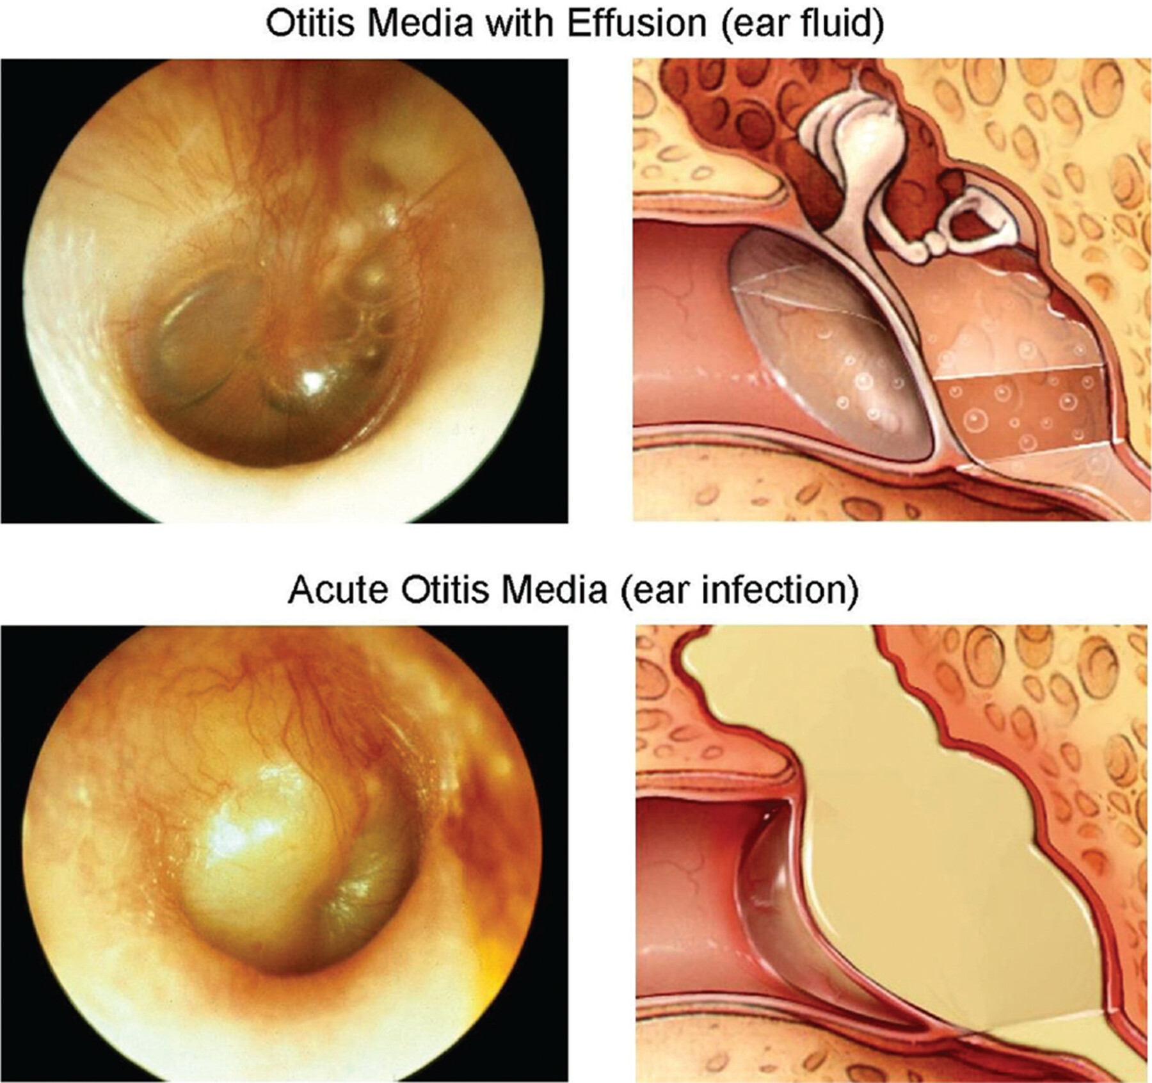
OTITIS MEDIA WITH EFFUSION
INDICATIONS
Children 6 months to 12 years old
Otitis Media with Effusion
3-month cut-off
if known onset
at time of diagnosis
>3mo get hearing test
If hearing loss or Type B tympanogram = consider tubes
No hearing loss but symptoms attributable = consider tubes
balance problems, poor school performance, behavioral
problems, ear discomfort, or reduced quality of life
<3mo
at risk?
Yes = consider tubes
No – follow until effusion resolves ~3 mo

Slide 6
At Risk factors for developmental difficulty
Permanent hearing loss independent of OME
Speech and Language Delay or Disorder
Autism
Syndromes (Down Syndrome)
Cleft Palate
Developmental delay
Learning Disorder

Slide 7
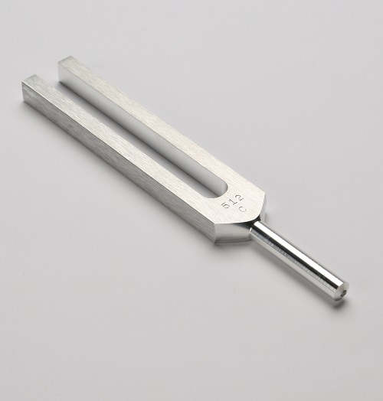
CHEAP TEST FOR EFFUSION
HAVE PATIENT HUM FOR 20 SECONDS
  SHOULD EAR LOUDER IN EAR WITH EFFUSION
512 HZ TUNING FORK
  CONDUCTIVE LOSS FROM MECHANICAL PROBLEM
  FLUID
  FIXATION OF ANY OF THE ME BONES
  OTOSCLEROSIS

Slide 8
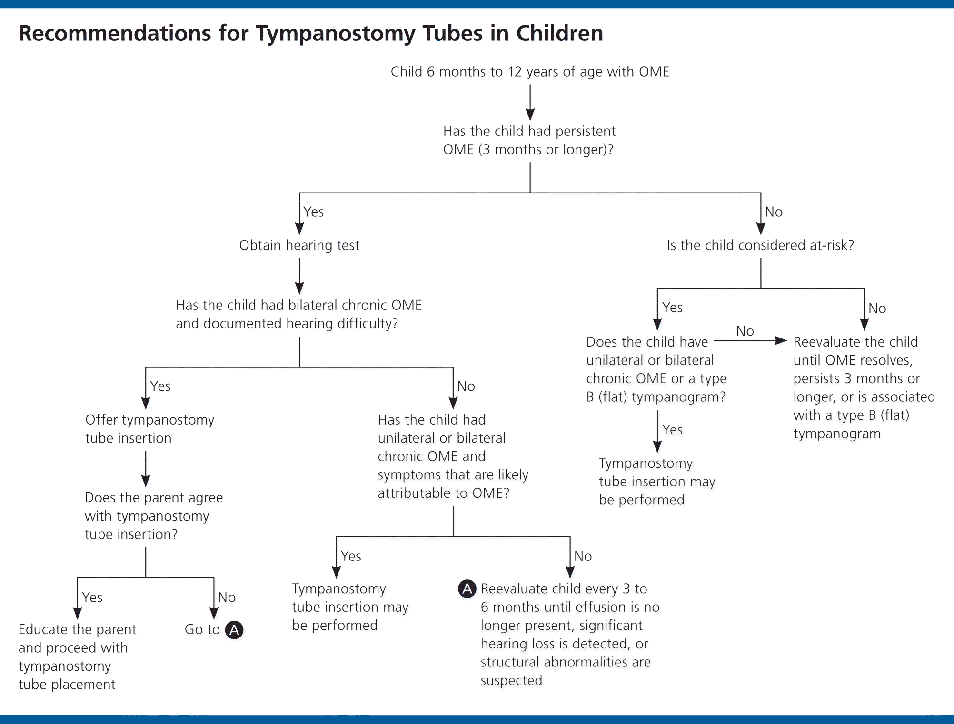

Slide 9
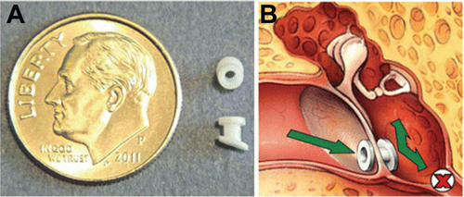
How do PE tubes work
Ventilate ME
Relieve a negative ME pressure
Allows fluid or pus to drain
Buys time until 4-6 years old
Ears 80% adult sized
More vertical, less floppy ET
Provides a direct route for ABX if AOM occurs with tubes
If tubes in place and patent
Treat with topical NOT PO/Systemic ABX
Or don’t treat at all
Sometimes drainage in children with tubes may be due to granulation tissue around base of PE tube
Treat with Ciprodex or Cortisporin – steroids antibiotic

Slide 10
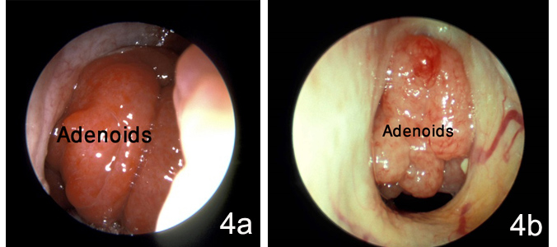
Risk of tubes
Chronic otorrhea
Persistent perforation
  Higher incidence in Smoking Houses
Falling into the middle ear
Usually get about 12-18 months
  Closer to 12 months in smoking households

Slide 11
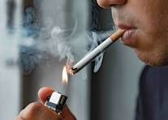
SMOKING HOUSEHOLDS
AT LEAST ONE PERSON SMOKES REGULARLY
“I ONLY SMOKE OUTSIDE”
DOES NOT MATTER WHETHER OR NOT THEY SMOKE OUTSIDE
  HIGHER INCIDENCE OF RAOM
  HIGHER INCIDENCE OF PERSISTEN PERFORATION AFTER TUBE COMESOUT
  SHORTER DURATION OF PE TUBE IN PLACE

Slide 12
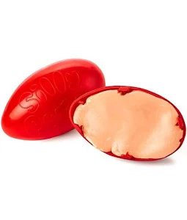
Additional points
Okay to get water in ears with pe tubes in
Follow up on tubes every 3-6 months after placement
Suggested no tubes for Recurrent OM w/o effusion
Consider tubes for RAOM with effusion when seen
No Long-term T-tubes in children
Topical ABX drops for children with PE tubes in—no PO abx

Slide 13
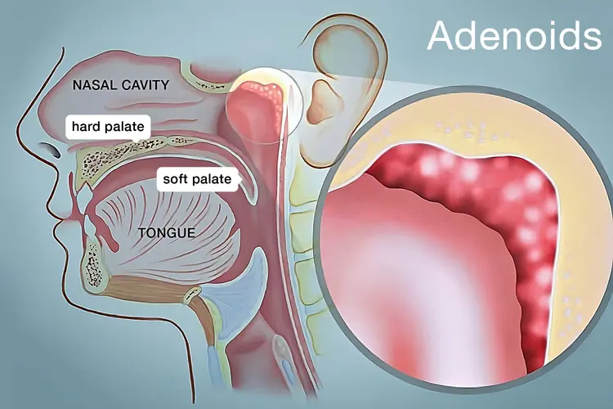
Adenoidectomy at same time?
1. Offer for Children >4 yrs at the time of the PE tubes
2. Offer with PE tube in patients with adenoid symptoms
  Nasal obstruction
  Adenoiditis
  Chronic rhinorrhea
2. Not routine for < 4 unless
  Previous PE tubes and having another set of pe tubes

Slide 14
Rosenfeld RM, Tunkel DE, Schwartz SR, Anne S, Bishop CE, Chelius DC, Hackell J, Hunter LL, Keppel KL, Kim AH, Kim TW, Levine JM, Maksimoski MT, Moore DJ, Preciado DA, Raol NP, Vaughan WK, Walker EA, Monjur TM. Clinical Practice Guideline: Tympanostomy Tubes in Children (Update). Otolaryngol Head Neck Surg. 2022 Feb;166(1_suppl):S1-S55. doi: 10.1177/01945998211065662. PMID: 35138954.
Clinical Guideline Tympanostomy Tubes

Slide 15
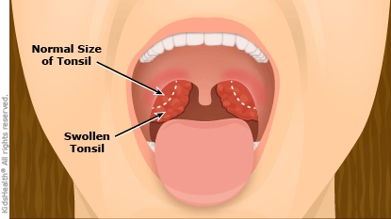
Adenotonsillectomy
In top 3 most common peds surgeries
Decreasing incidence since 2009
Recurrent Tonsillitis
Sleep disordered breathing

Slide 16
Recurrent pharyngitis
Paradise Criteria:
≥7 episodes in the preceding year, or
≥5 episodes per year for 2 consecutive years, or
≥3 episodes per year for 3 consecutive years
Each episode of pharyngitis should document
Fever above 38.3°C/101°F
Cervical lymphadenopathy
Tonsillar exudate
Positive group-A streptococcal test

Slide 17
Obstructive sleep disordered breathing
Polysomnography-confirmed obstructive sleep apnea
Habitual snoring with witnessed apneas, gasping, or labored breathing
Daytime behavioral problems, poor school performance, or excessive sleepiness
Growth retardation or failure to thrive
Enuresis associated with sleep-disordered breathing
Cardiopulmonary complications, such as pulmonary hypertension

Slide 18
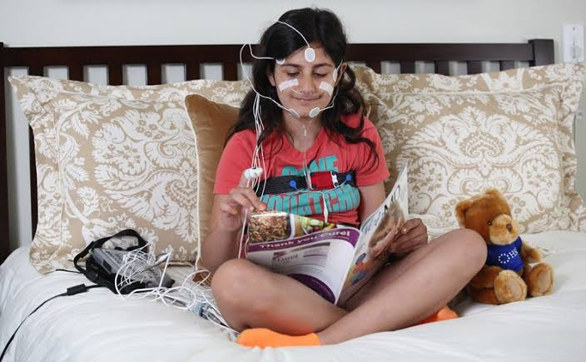
Indications for sleep study
Diagnosis or severity is uncertain
Child is under 2 years old
Obesity
Down syndrome
Craniofacial abnormalities
Sickle-cell disease

Slide 19
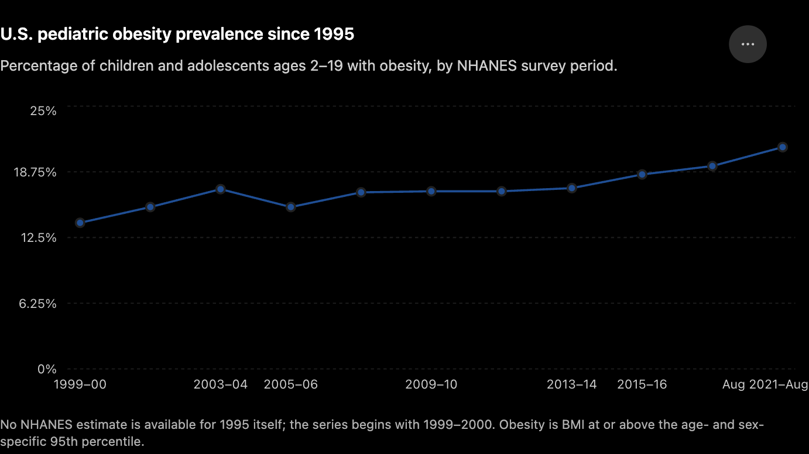
OBESITY

Slide 20
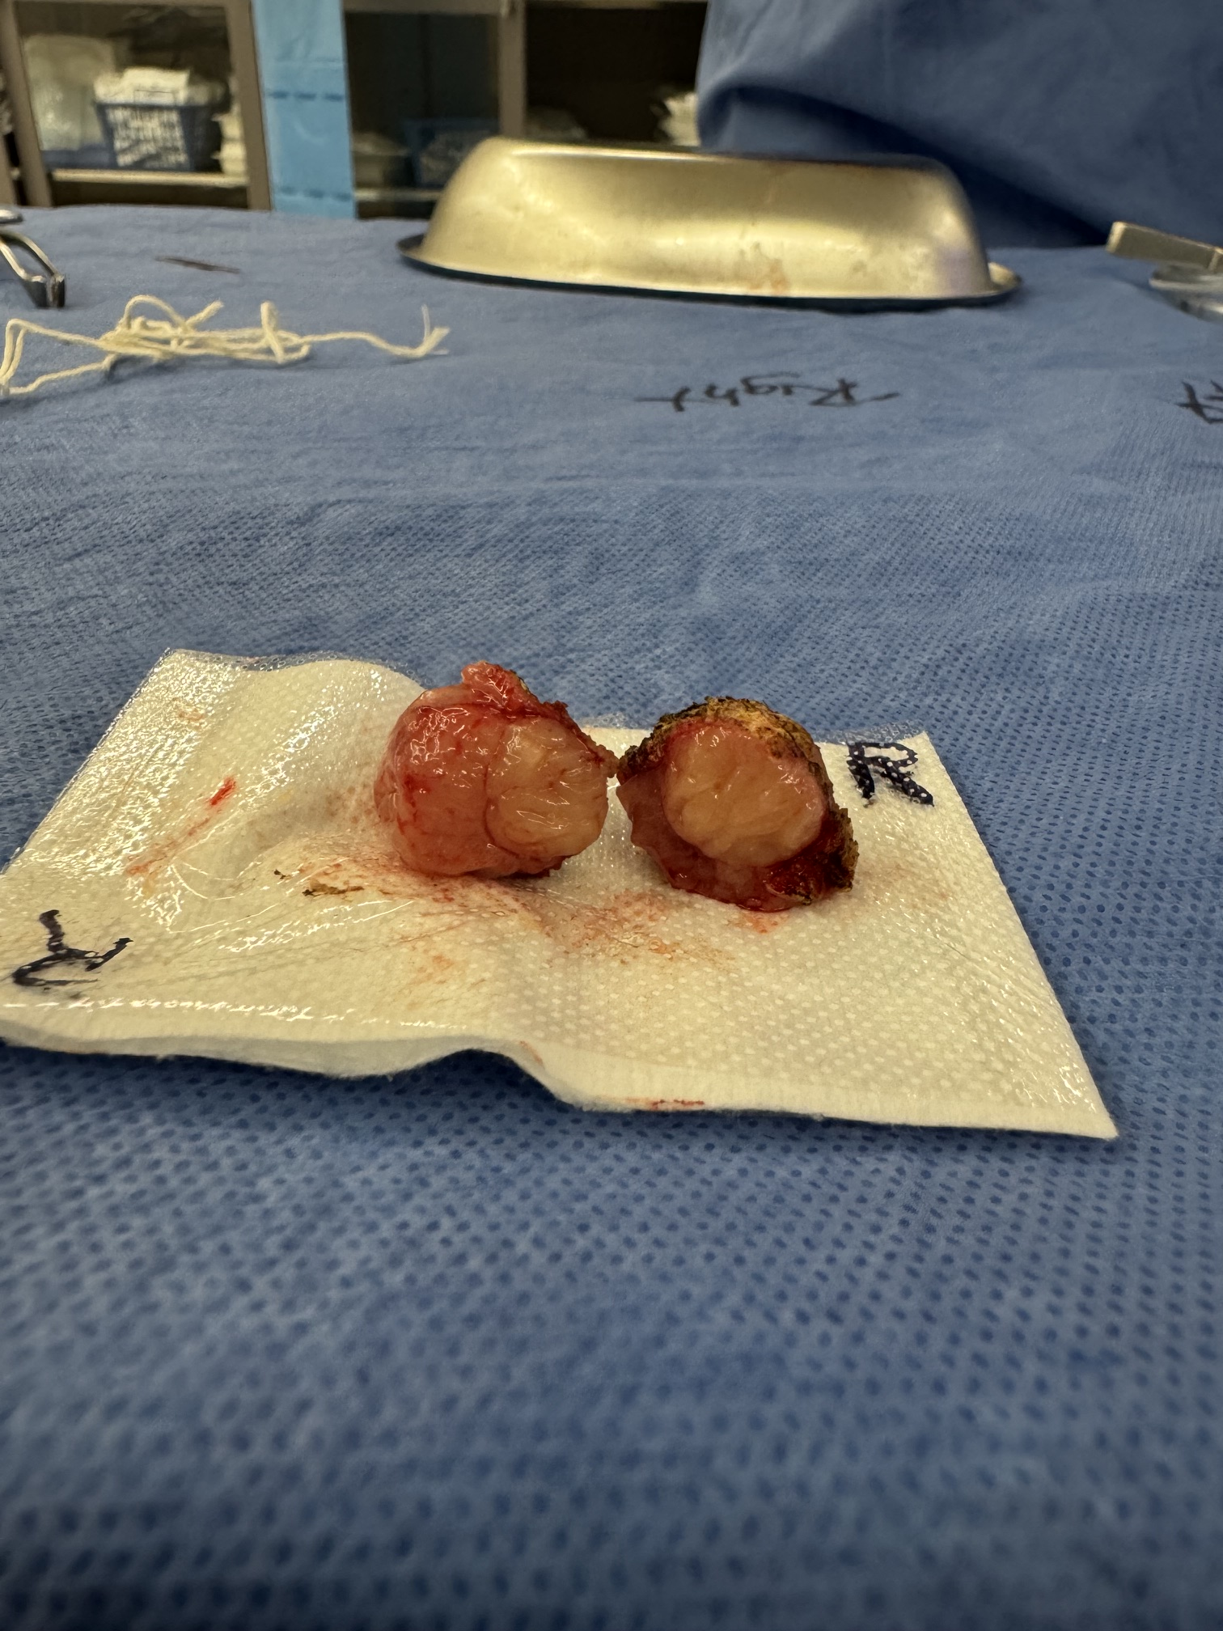
Other things
ABX allergies
Peritonsillar abscess
Recurrence 30-60%
Can be life threatening
Hyponasal speech
Suspected Malignancy
PFAPA (periodic fever, aphthous stomatitis, pharyngitis, adenitis)

Slide 21
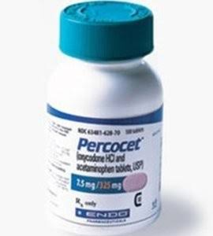
RISK OF ADENoTONsILLECTOMY
BLEEDING (5%)
  USUALLY ON POST OPERATIVE DAYS 5-7
  USUALLY STOP SPONATEOUSLY
  ICE WATER
PAIN
No narcotics
Tylenol/Ibuprofen scheduled q3hrs
Dehydration
Makes everything worse

Slide 22
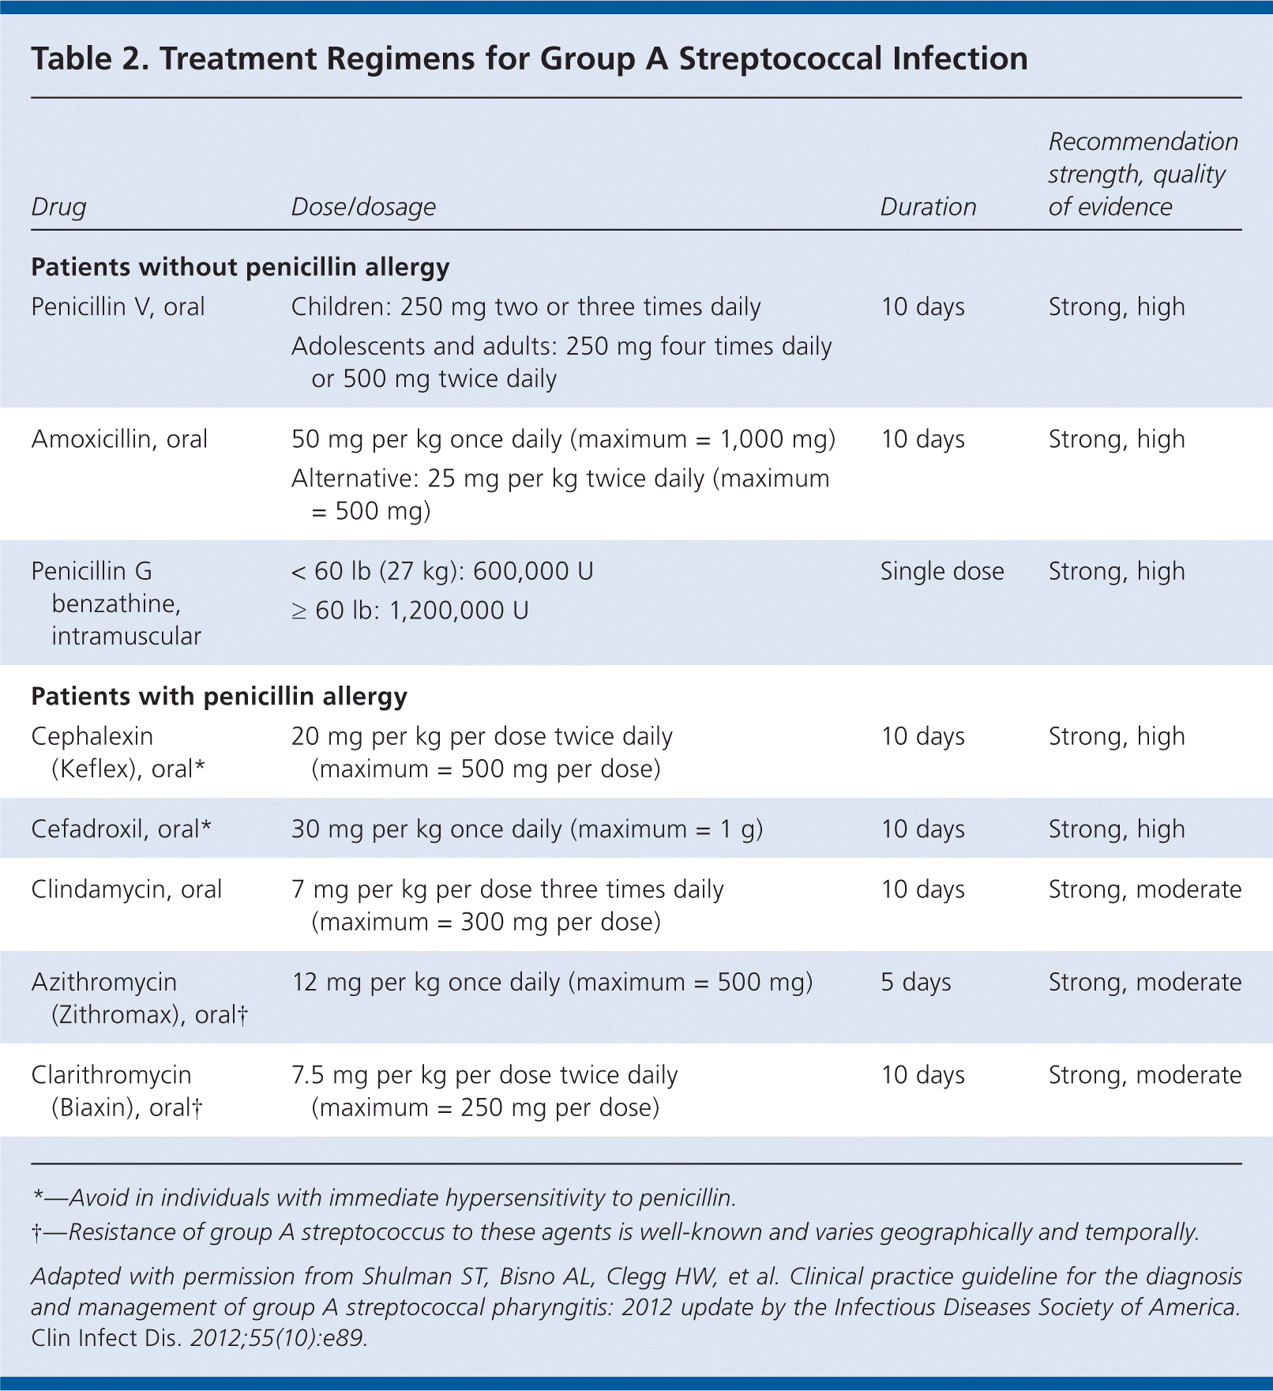

Slide 23
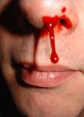
Epistasis
(nose bleeds)
1:200 ER VISITS

Slide 24
Causes (Alphabetical)
Hereditary hemorrhagic telangiectasia (HHT)
High blood pressure (hypertension)
Infectious diseases
Nasal blockage
Nose injury
Nose picking
Overdose or Blood thinners (aspirin, coumadin)
Overuse of decongestant nasal sprays (Flonase)
  INCORRECT USAGE
Repeated sneezing
Septal perforation
Sinusitis
Surgery (nose, face)
Upper respiratory tract infection
Von Willebrand's disease
Alcohol (by vasodilation)
Allergic rhinitis (hay fever)
Barotrauma - tissue damage caused by pressure differences
Bleeding disorders
Broken Nose (Trauma)
Chemical irritation
Common cold
Deviated septum
Extremely cold air
Extremely dry air
Extremely hard nose-blowing
Foreign body

Slide 25
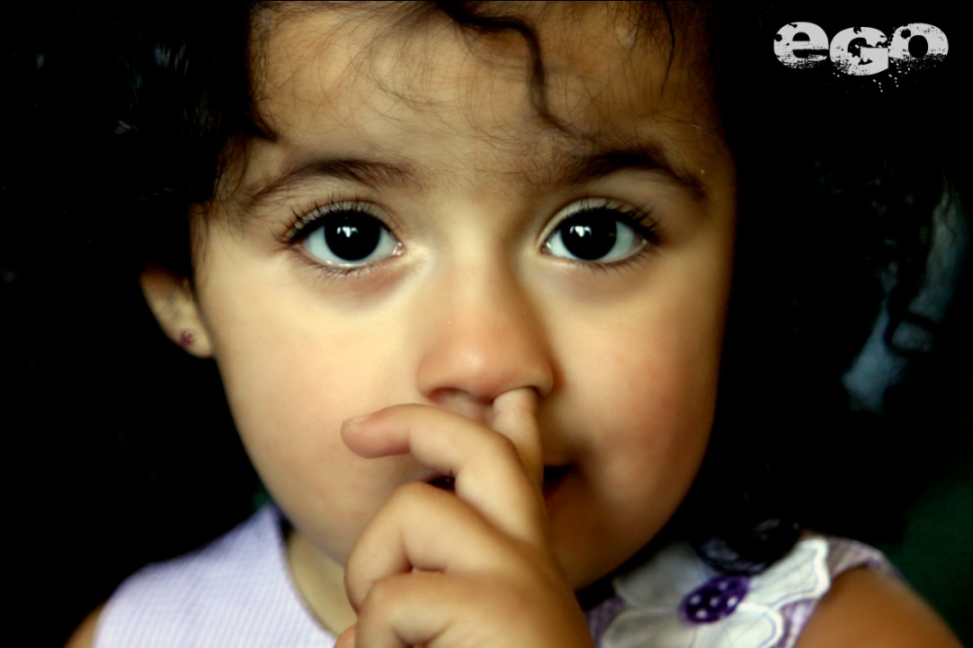
Local Causes
Infection/Inflammation
  Sinusitis
  Bad allergies
  Cause friable mucosa
Trauma
Deviated septum
  Altered airflow
  Turbulence
  Dry cracking mucosa
NOSE PICKING

Slide 26
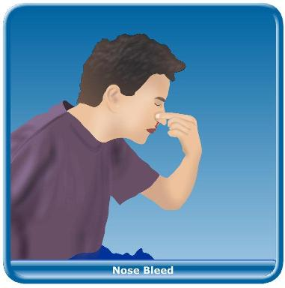
Initial Treatment
No bleeding in office treatment
  ID site
  Chem/electrical cautery
    Not both sides at once
    This can be painful
    Can be done in active bleeds
    Consider lidocaine/epi injection
  Vaseline/bacitracin
  Lanolin cream
  Humidity
  No straining
  Mouth open sneezing
  Decrease nose picking
Most stop spontaneously
Lean forward
Pinch the nose
  Hard!!!
  Almost to the point of pain
  Hold for 10 min
Afrin, oxymetazoline, psuedo
Ice???

Slide 27
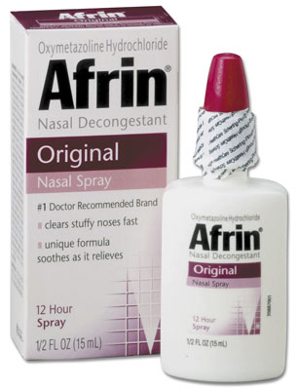
Non-Surgical Treatment
Topical Vasoconstrictors
  Afrin/Oxymetazoline
  Pseudoephedrine
  DON’T USE PROPHYLACTICALLY
Packing
Cauterization
80-90% successful
  Rebleeding is EXTREMLY common AFTER CAUTERIZATION while eschar matures
  TELL PARENTS

Slide 28
Recent epistasis studies
Prospective Study
Antiseptic Ointment v nasal cautery
N = 100
No sig difference in 3 mo f/u
1/3-1/2 re-bleed
Allergies in ¼ of both groups
Meta-analysis
Addition of silver nitrate cautery is not superior to the use of antiseptic cream alone in pediatric recurrent epistaxis
Does not improve treatment success or persistent bleeding.
Alsaif A, Karam M, Alhaider A, Almazeedi A, Aldubaikhi A, Alfayez A. The addition of silver nitrate cautery to antiseptic nasal cream for patients with epistaxis: A systematic review and meta-analysis. Int J Pediatr Otorhinolaryngol. 2020 Nov;138:110365. doi: 10.1016/j.ijporl.2020.110365. Epub 2020 Sep 8. PMID: 32998847.
Mudunuri RK, Murthy MA. The Treatment of Spontaneous Epistaxis: Conservative vs Cautery. J Clin Diagn Res. 2012 Nov;6(9):1523-4. doi: 10.7860/JCDR/2012/4215.2548. PMID: 23285445; PMCID: PMC3527785.
Notes:
Ozmen: International J of Pediatric Oto. 2012.

Slide 29
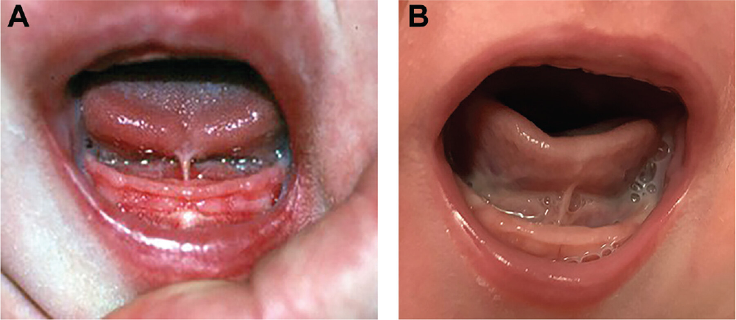
Ankyloglossia (tongue tie)

Slide 30
Sublingual frenulectomy breast feeding
Int Journal of Breastfeeding 2025 Meta-analysis
  Lingual frenectomy may enhance breastfeeding outcomes in children under five with ankyloglossia
AAOHNS Consensus Statement 2020
  May improve Breastfeeding
  But other reasons can contribute.
  Delgadillo GJ, Zlatar Rojas J, Muñoz MA, Luque-Martínez I. Frenectomy for ankyloglossia in children under five: a systematic review and meta-analysis on breastfeeding outcomes. Int Breastfeed J. 2025 Nov 7;20(1):81. doi: 10.1186/s13006-025-00773-x. PMID: 41204347; PMCID: PMC12595756.

Slide 31
Sublingual frenulectomy speech
Annals of Otology, Rhinology, and Laryngology
  Good Meta-analysis
  Frenulectomy good for speech if addressed early in childhood
    Did not define early

Slide 32
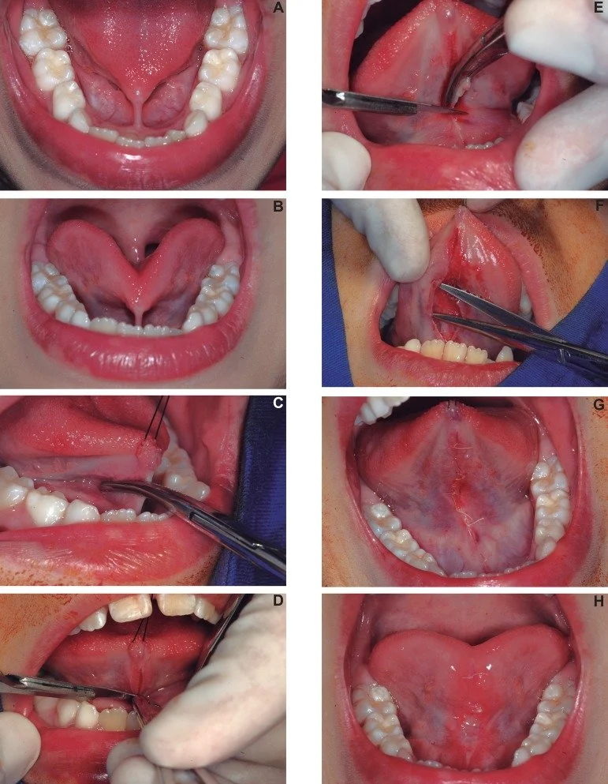
BEST TO REFER EARLIER
CAN BE DONE IN CLINIC IF <6mo
IF OLDER CHILDREN = DONE IN OR

Slide 33
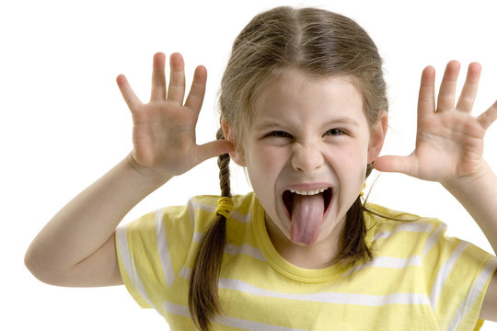
Frenulectomy
Cosmetic reasons
Concern frenulum will prevent
  parental bonding

Slide 34
QUESTIONS??

