Slide 1
SMART therapy and modern asthma management
Tiffany L. Turner, MD
Pediatric Pulmonology
Children’s Hospital Pittsburgh

Slide 2
Objectives
Review Asthma Predictive Index to predict development of asthma
Briefly discuss pathophysiology, etiology & diagnosis of asthma
Discuss recent asthma guidelines for treatment of intermittent and persistent asthma
Discuss utilization of Single Maintenance and Reliever Therapy (SMART) in clinical practice

Slide 3
Disclosures
I have no financial disclosures

Slide 4
Asthma Predictive Index
Based on study of 1000 school aged children diagnosed with asthma
For children <3 years of age with 4 or more episodes of wheezing, asthma can be predicted with the following factors

Slide 5
API
Major Criteria | Minor Criteria
Parent diagnosis of asthma | Physican diagnosed allergic rhinitis
Physician diagnosed eczema in child | Wheezing outside of colds
 | Peripheral eosinophilia (>4%)
Must have 1 major or 2 minor criteria
Positive API are 4-9 times more likely to be diagnosed with asthma during ages 6-13 years

Slide 6
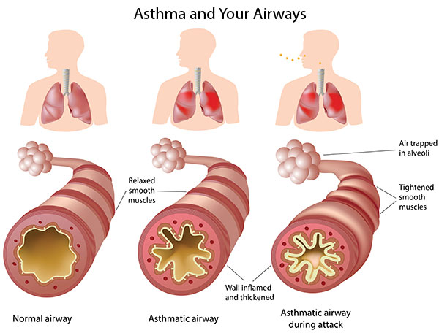
What is asthma?
Disease characterized by recurrent wheeze (responsive to bronchodilators), cough and or dyspnea (with or without activity)

Slide 7
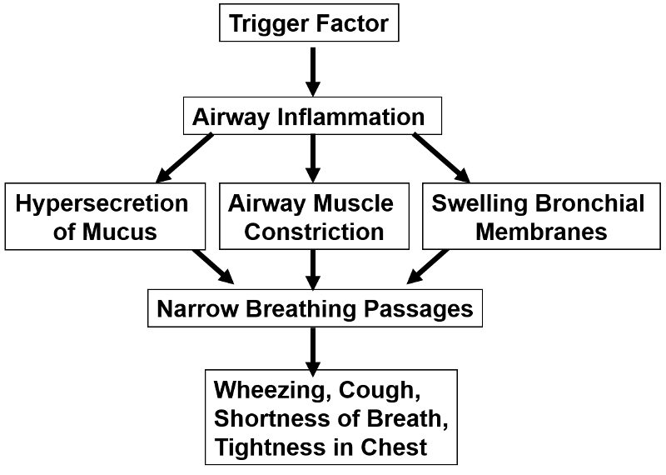
Triggers:
Allergens
Viruses
Irritants
Air pollution
Smoke
Stress
GERD

Slide 8
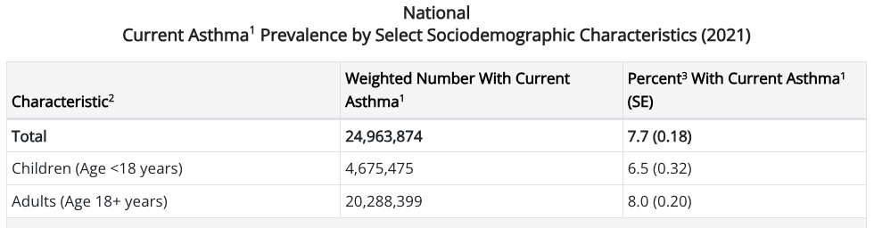
Asthma is common
https://www.cdc.gov/asthma/most_recent_national_asthma_data.html

Slide 9
Diagnosis
  Spirometry: may show reversible intrathoracic obstruction (but may also be normal… or may have fixed obstruction)​
  Methacholine challenge: not routinely performed in clinical practice​
  FeNO: high levels are suggestive of eosinophilic inflammation​
Primarily a clinical diagnosis
Notes:
Diagnosed based on recurrent cough, wheezing or shortness of breath that responds to bronchodilators + steroids

Slide 10
Guidelines: NAEPP and GINA
National Asthma Education and Prevention Program—U.S. based guidelines, last updated in 2020
Global Initiative for Asthma—international guidelines, updated yearly

Slide 11
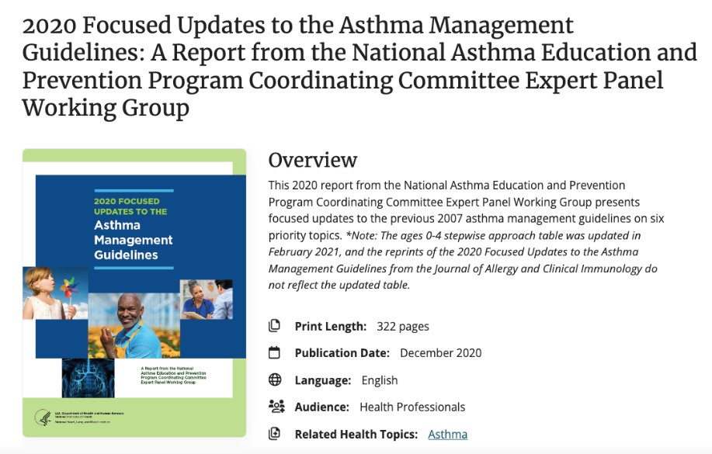
Treatment
2020
NAEPP
Guidelines

Slide 12
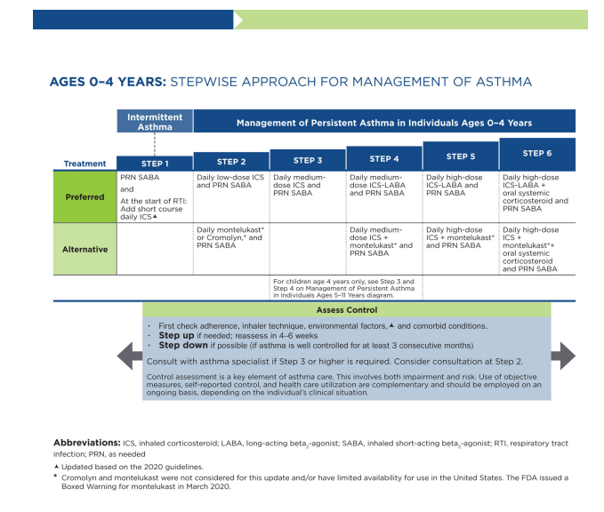
NAEPP 2020:
0-4 years
2020 Focused Updates to the Asthma Management Guidelines: At-a-Glance Guide
https://www.nhlbi.nih.gov/resources/at-glance-2020-focused-updates-asthma-management-guidelines
Notes:
Summary: For STEP1 (intermittent symptoms) >/= 2 flare ups requiring steroids in past year and no symptoms between flare ups: prn SABA and at start of LRTI short course (7-10 days) of ICS
For STEP2: Daily ICS (flutic 44, asmanex 50, QVAR 40 mcg) and PRN Albuterol OR daily singulair
For STEP3: daily medium ICS (flutic 110, asmanex 100, QVAR 80 mcg)
STEP 3 or greater-->refer to pulmonary or allergy if atopic

Slide 13
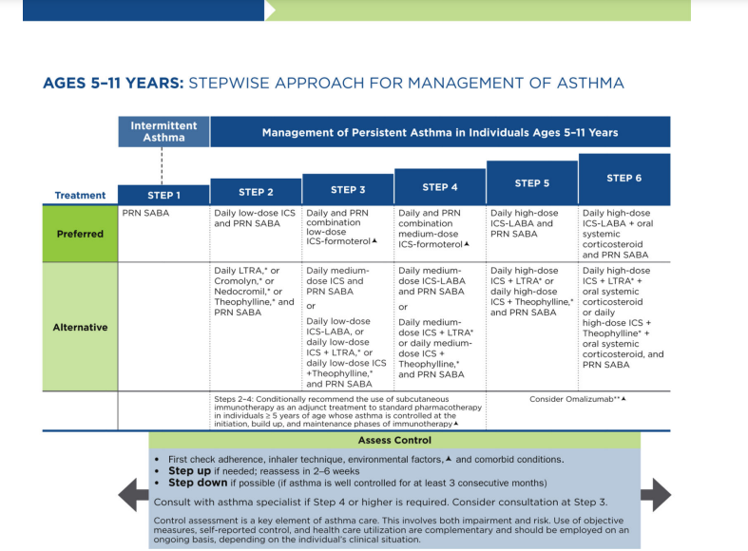
NAEPP 2020: 5-11 yrs

Slide 14
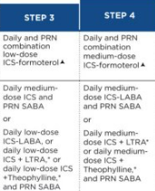
NAEPP 5-11 yrs: PRN ICS-LABA
Notes:
STEP3=daily and prn low dose ICS-Formoterol (Symbicort 80 or Dulera 50) OR daily medium dose ICS (flutic 110, asmanex 100, QVAR 80)
Recommend consultation with pulmonary or allergy at STEP4 and beyond (consider at Step3)

Slide 15
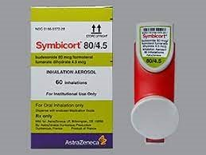
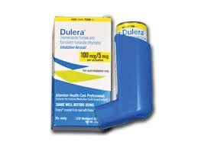
SMART
Single Maintenance And Reliever Therapy
Only formoterol containing ICS-LABA
  Symbicort=budesonide + formoterol
  Dulera=mometasone + formoterol
For children 5-11 yrs MAX #=8 puffs/ per 24 hrs
Difficulties: change in normal way we use inhalers, insurance issues

Slide 16
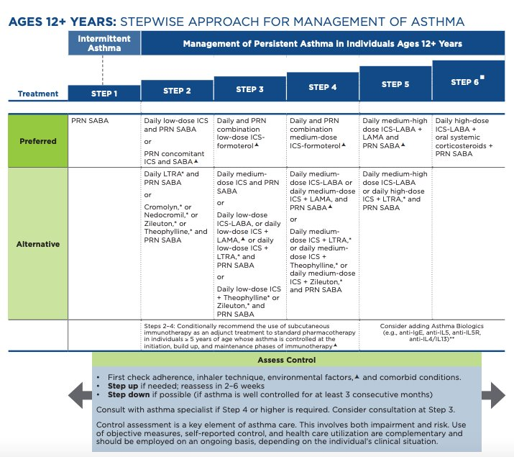
NAEPP 2020:
>12 yrs
Notes:
Similar to 4-11 in STEP 3 recommends SMART with low dose ICS-LABA and STEP 4 recommends SMART with medium dose ICS-LABA
Consult with specialist for STEP 4 or higher

Slide 17
PRN ICS-LABA (SMART) for >12 yrs of age
Max daily puffs=12 puffs/24 hrs

Slide 18
GINA
Global Initiative for Asthma strategy

Slide 19
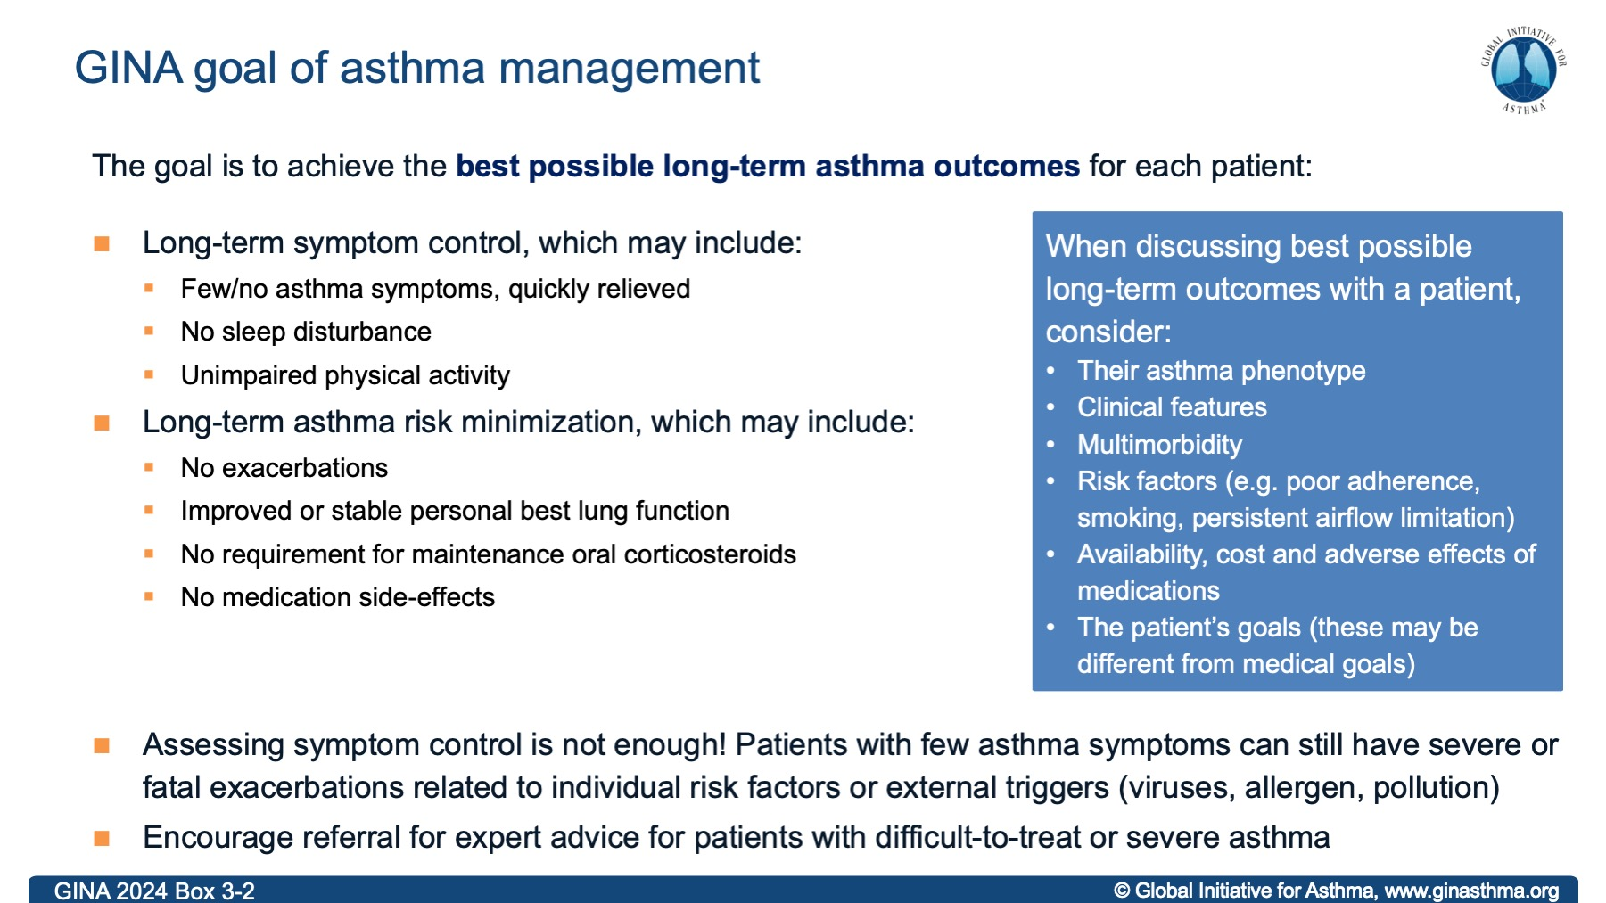

Slide 20
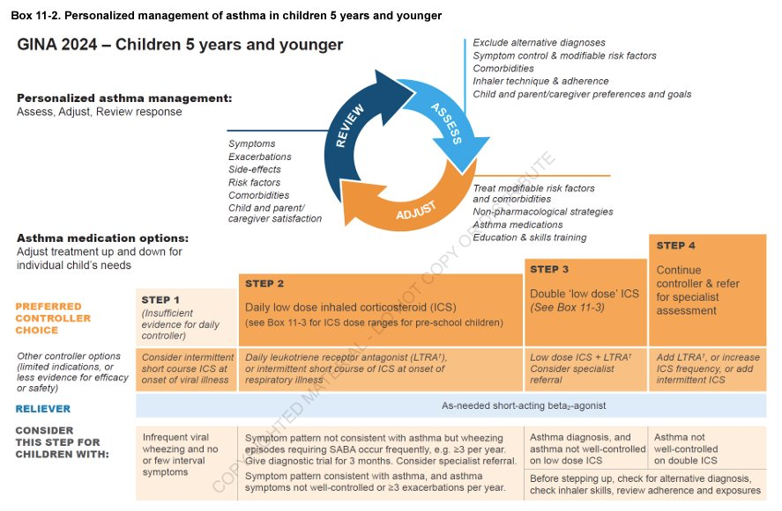
GINA: 5 yrs and younger
Notes:
Similar to NAEPP except Step 1 therapy consider insufficient evidence to recommend controller
Step 2 low dose ICS

Slide 21
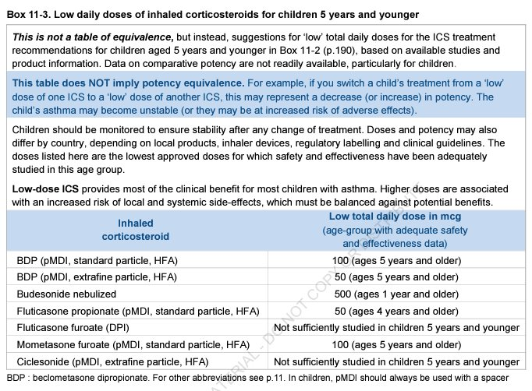
ICS dose ranges
Notes:
Fluticasone proprionate was flovent—dose equiv 44 mcg
Mometasone is Asmanex—dose equiv 50 mcg 2p Qday

Slide 22
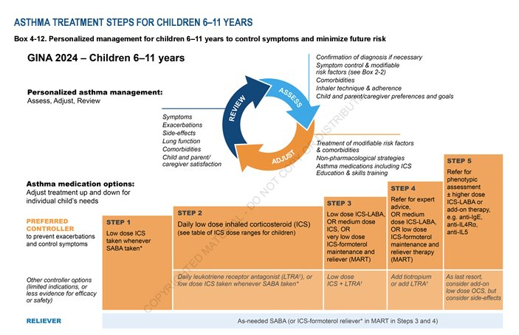
GINA: 6-11 yrs
Notes:
Biggest differences:
Step 1 low dose ICS + albuterol taken together
Step 2 same (daily low dose ICS)
Step 3 low dose ICS-LABA OR medium dose ICS OR low dose SMART therapy (symbicort was studied in Europe)
Step 4 refer to pulmonary or allergy

Slide 23
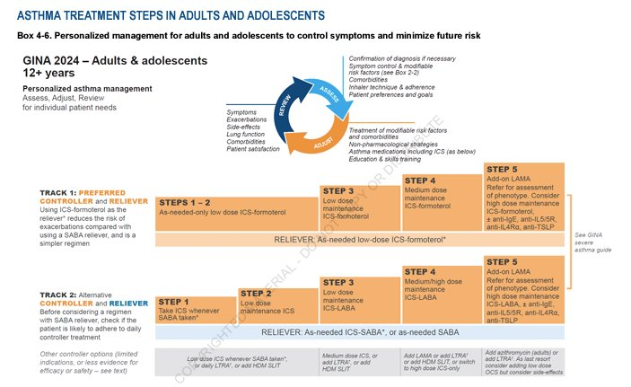
GINA: ages 12 yrs and up
Notes:
Step 1-2 low dose ICS-formoterol (symbicort 80)
Step 3 low dose daily AND reliever ICS-formoterol
Step 4 medium dose daily AND reliever ICS-formoterol

Slide 24
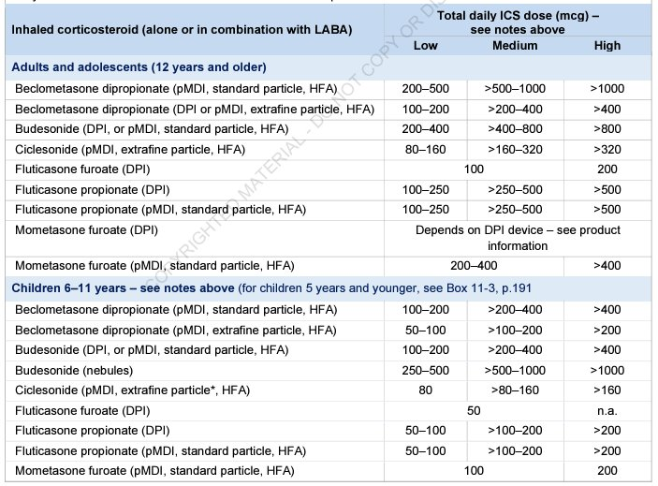
ICS doses

Slide 25
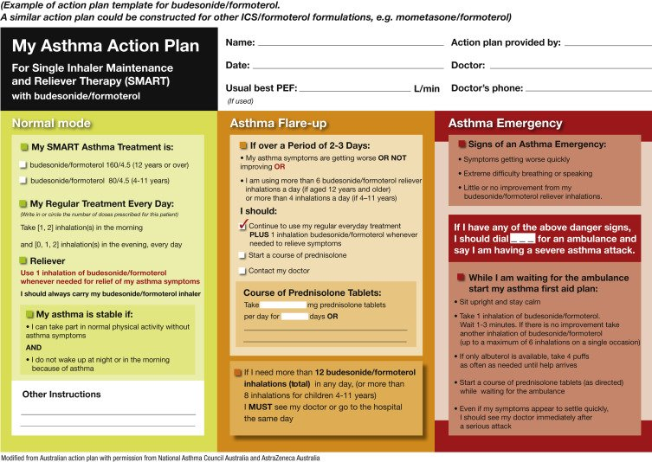

Slide 26
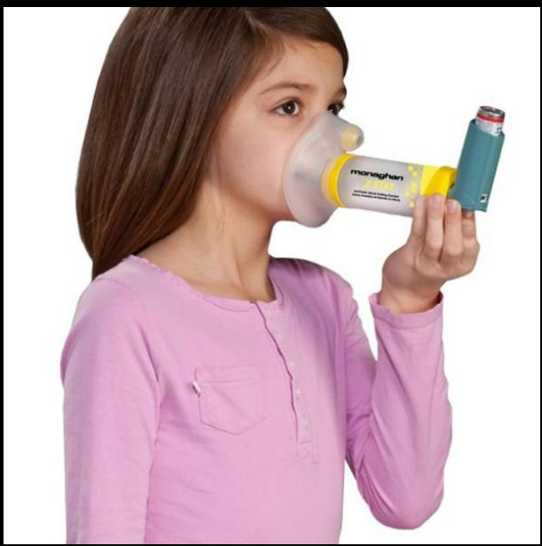
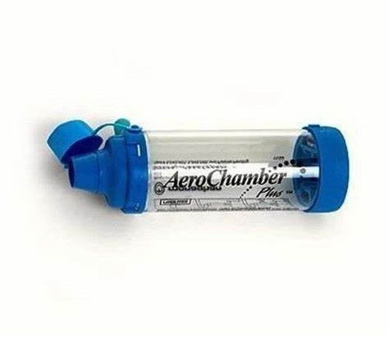
Spacers are important for kids of all ages and there are ones for infants as well

Slide 27
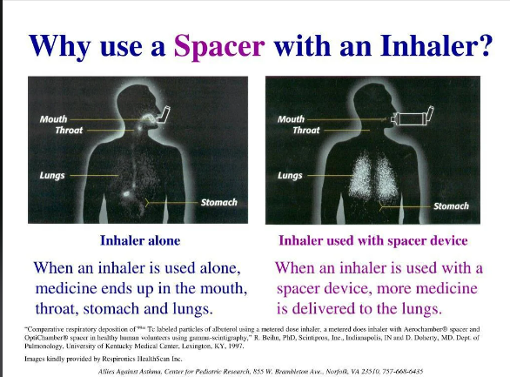

Slide 28
References
Cloutier MM, Baptist AP, Blake KV, et al.; Expert Panel Working Group of the National Heart, Lung, and Blood Institute (NHLBI) administered and coordinated National Asthma Education and Prevention Program Coordinating Committee (NAEPPCC). 2020 focused updates to the asthma management guidelines: a report from the National Asthma Education and Prevention Program Coordinating Committee Expert Panel Working Group. J Allergy Clin Immunol. 2020;146(6):1217–1270
Reddel HK, Bacharier LB, Bateman EB, et al.; Global Initiative for Asthma Strategy 2021: Executive Summary and Rationale for Key Changes. Am J Resp Crit Care Med 2022; 205: 17-35.

Slide 29
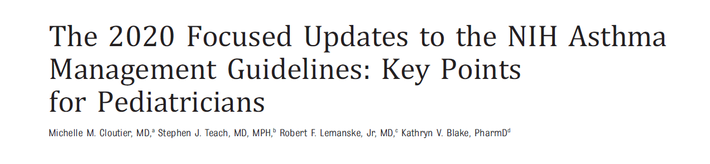
Notes:
Only 4 pages!!

Slide 30
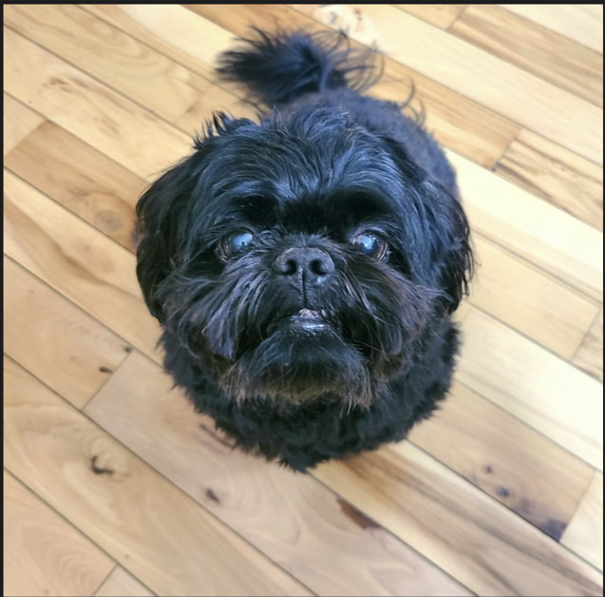
Questions?

