Slide 1
Housekeeping Reminders
Please submit questions via the Zoom chat during the presentation.
For attendance, please type in your name and organization in the chat.
Attendees are muted upon entry. Click “Unmute” when you would like to speak. Please mute yourself after speaking.
The presentations are posted on Tomorrow’s HealthCare www.tomorrowshealthcare.org

Slide 2
2026 HealthChoices PCMH Learning Network
September 24, 2026
PCMH Statewide Learning Session - Oral Cancer Prevention and Early Detection
Pittsburgh Regional Health Initiative

Slide 3
Continuing Education Information
In support of improving patient care, this activity has been planned and implemented by the University of Pittsburgh and The Jewish Healthcare Foundation. The University of Pittsburgh is jointly accredited by the Accreditation Council for Continuing Medical Education (ACCME) and the American Nurses Credentialing Center (ANCC), to provide continuing education for the healthcare team. 1.0 hours are approved for this course.
As a Jointly Accredited Organization, University of Pittsburgh is approved to offer social work continuing education by the Association of Social Work Boards (ASWB) Approved Continuing Education (ACE) program. Organizations, not individual courses, are approved under this program. State and provincial regulatory boards have the final authority to determine whether an individual course may be accepted for continuing education credit. University of Pittsburgh maintains responsibility for this course. Social workers completing this course receive 1.0 continuing education credits.

Slide 4
Disclosures
No members of the planning committee, speakers, presenters, authors, content reviewers and/or anyone else in a position to control the content of this education activity have relevant financial relationships with any entity producing, marketing, re-selling, or distributing health care goods or services, used on, or consumed by, patients
to disclose.
Notes:
No conflicts of interest

Slide 5
Disclaimer
The information presented at this Center for Continuing Education in Health Sciences program represents the views and opinions of the individual presenters, and does not constitute the opinion or endorsement of, or promotion by, the UPMC Center for Continuing Education in the Health Sciences, UPMC / University of Pittsburgh Medical Center or Affiliates and University of Pittsburgh School of Medicine. Reasonable efforts have been taken intending for educational subject matter to be presented in a balanced, unbiased fashion and in compliance with regulatory requirements. However, each program attendee must always use his/her own personal and professional judgment when considering further application of this information, particularly as it may relate to patient diagnostic or treatment decisions including, without limitation, FDA-approved uses and any off-label uses.

Slide 6
Learning Objectives
Describe key epidemiologic and clinical features of oral cancer relevant to primary care practice.
Identify characteristics of oral lesions and examination findings that may indicate increased risk for oral cancer and warrant further evaluation.
Discuss approaches to the evaluation and workup of suspected oral cancer, including indications for biopsy and referral.
Describe current approaches to oral cancer treatment and the implications of emerging therapies for patient care

Slide 7
Welcome
Robert Ferguson, MPH
Chief Policy Officer
Pittsburgh Regional Health Initiative

Slide 8
Oral Cancer Prevention and
Early Detection
James Gates, DMD, MD, FACS, Assistant Professor of Oral and Maxillofacial Surgery and Pharmacology, Penn Dental Medicine

Slide 9

Oral Cancer Lecture for the Primary Care Physician
Oral and Maxillofacial Surgery
James C Gates DMD, MD

Slide 10
Outline
Epidemiology
Anatomy
Early Detection / Oral Premalignant Lesions
Oral Cancer
  Exam / Workup
  Staging and Recent Developments in Immune Therapy
  Treatment
  Reconstruction

Slide 11
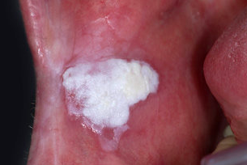
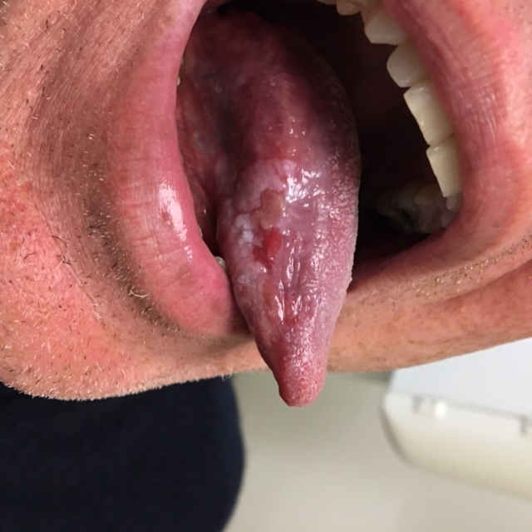
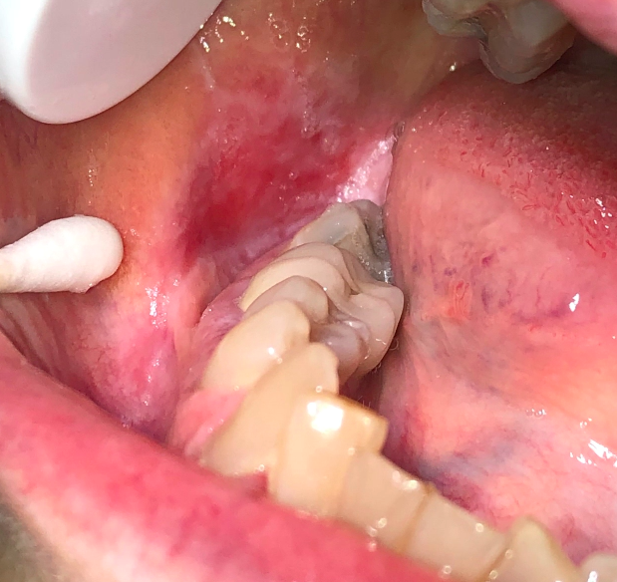
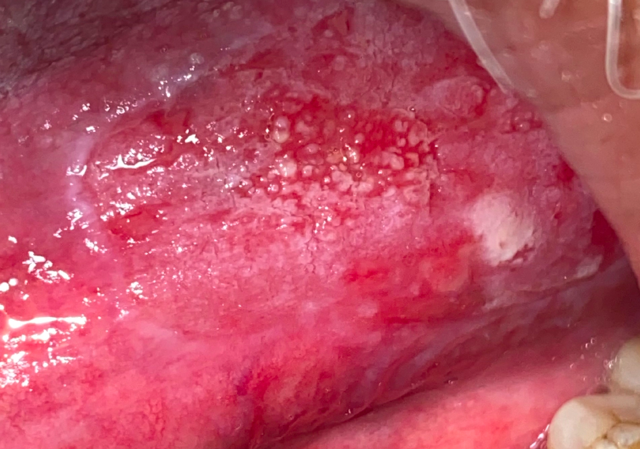
Characterization helps inform risk! (more important than diagnosis
1. Color
2. subsite
3. size

Slide 12
High Yield
White less ominous than Red
Thick worse than thin
High risk subsites:
  Tongue
  Floor of Mouth
  *AI apps will help eventually to assess risk using these determinants

Slide 13
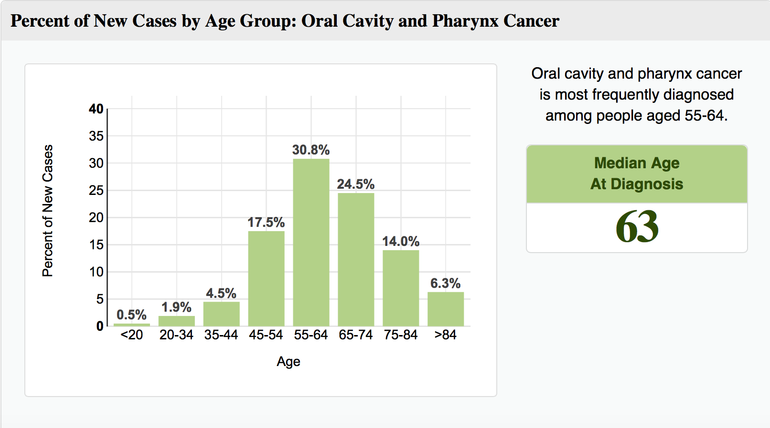
Epidemiology
Most common in 5th through the 6th decades of life.

Slide 14
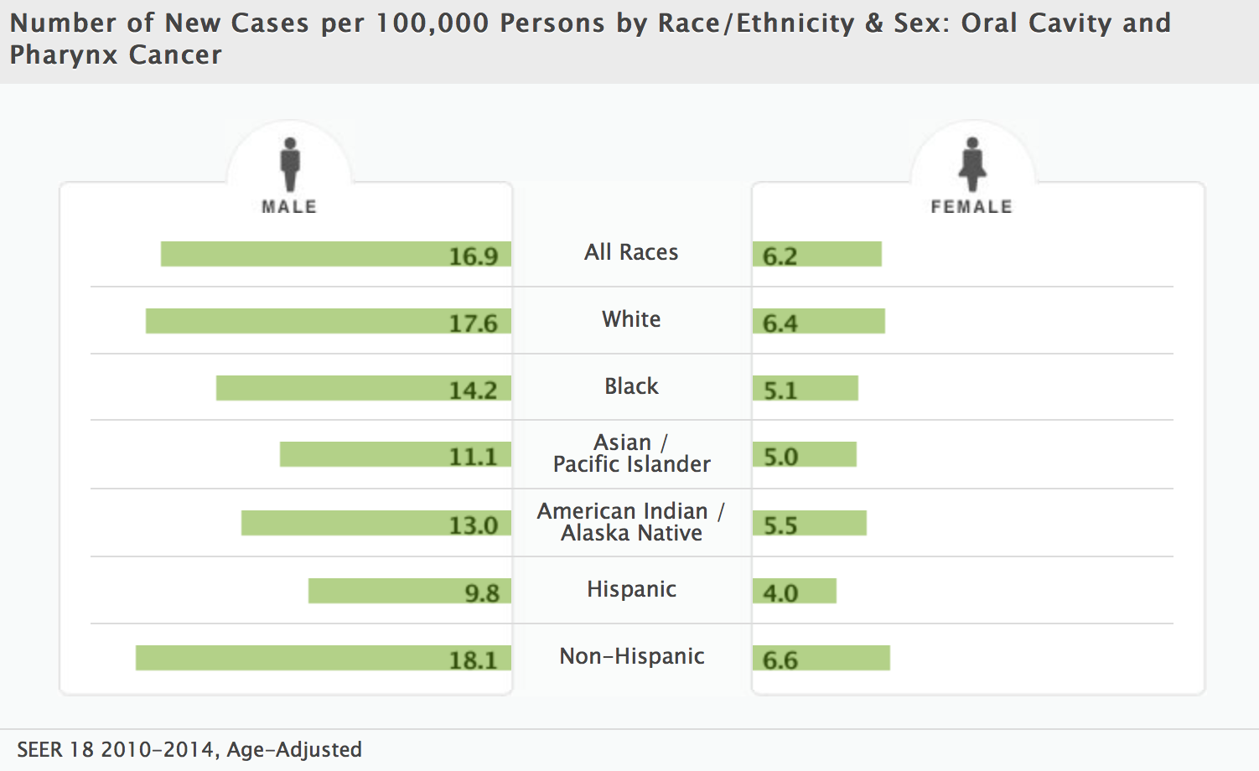
Epidemiology
More common in men.
Notes:
Oral cancer comprises 3% of all malignancies in men and 2% of all malignancies in women
With a male to female ratio of greater than 2:1
This ratio is changing because of increased incidence of tobacco and alcohol use among women.
Although the incidence is highest is white men, the mortality rate shows something different.

Slide 15
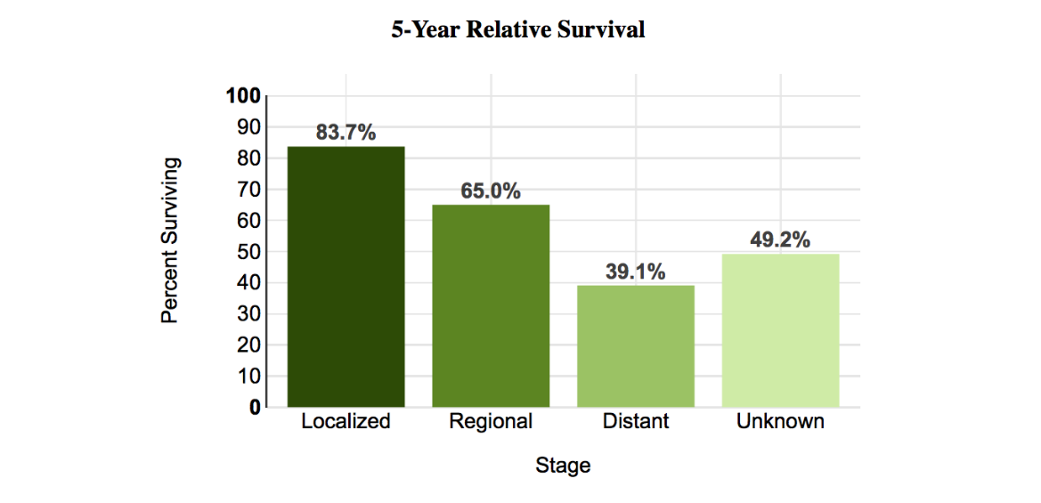
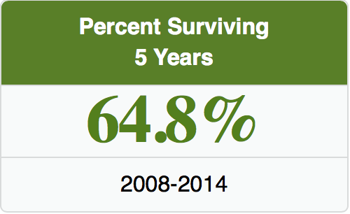
Epidemiology
Despite better understanding of the disease process and improved surgical technique, 5-year survival rate remains 60-65 %.
Notes:
Seer

Slide 16
Epidemiology
>90 % of oral cancer – squamous cell carcinoma
<10 % of oral cancer - salivary gland carcinoma, sarcomas, mucosal melanomas, lymphoma, etc.
Why is squamous cell carcinoma much more common?
Notes:
The mutagens in tobacco, alcohol, and viruses have prolonged exposure to the superficial layers of the oral mucosa, creating an opportunity for genetic mutation.

Slide 17
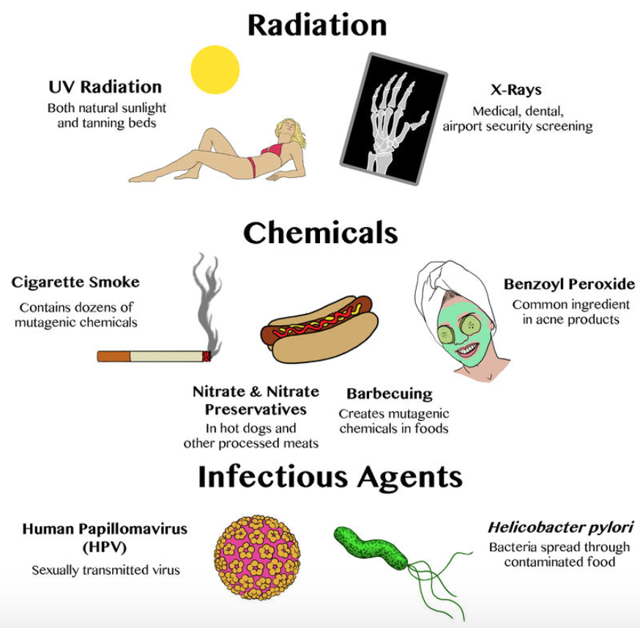
The mutagens in tobacco, alcohol have prolonged exposure to the superficial layers of the oral mucosa, creating an opportunity for genetic alterations

Slide 18
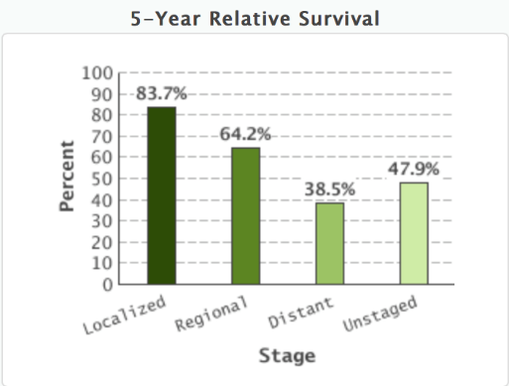
Early Detection!
Early detection improves prognosis significantly!
- Significant differences in 5-year survival rates are documented between early and late stage disease.
- Literature reports advanced disease (Stage III,IV) in the majority (65%) of patients at the time of presentation.
- - The oral cavity is a readily examinable area.
Notes:
Average of 5 months required from early stage to advanced stage.
The 5 year survival rate is directly related to the stage of malignancy at the time of diagnosis. Prevention and early detection are vital to decrease the incidence and improve the survival odds.

Slide 19
Oral Premalignant Lesions

Slide 20
Screening

Slide 21
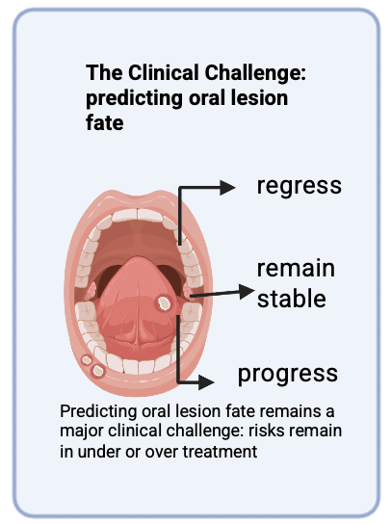
Clinical Gap
Oral Cancer often occurs from transformation of precursor lesions as in colon cancer
Predicting oral lesion fate remains a clinical challenge

Slide 22
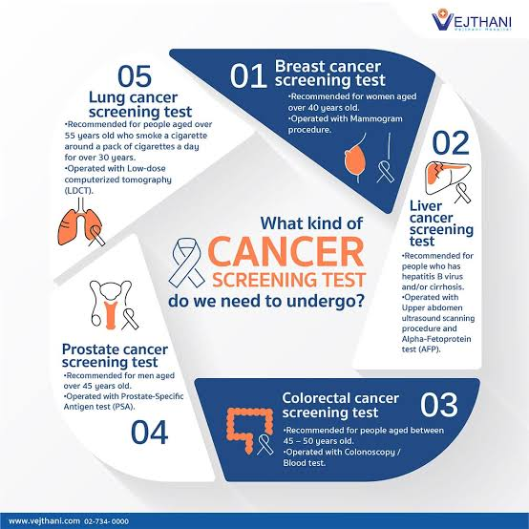

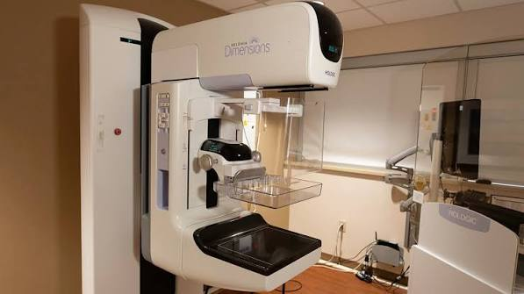
No standardized oral cancer screening test exists as in other cancers
->despite direct visibility and ease of biopsy

Slide 23
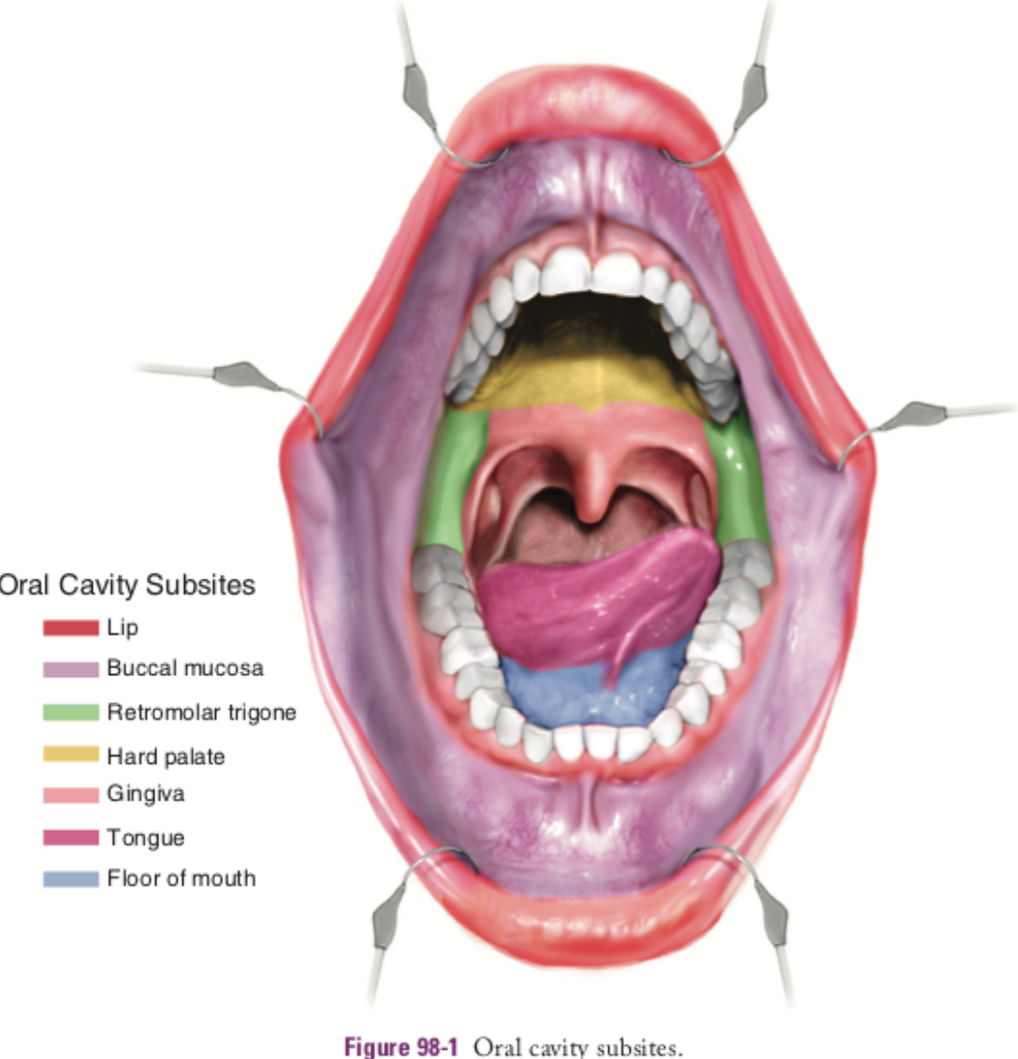
Anatomy

Slide 24
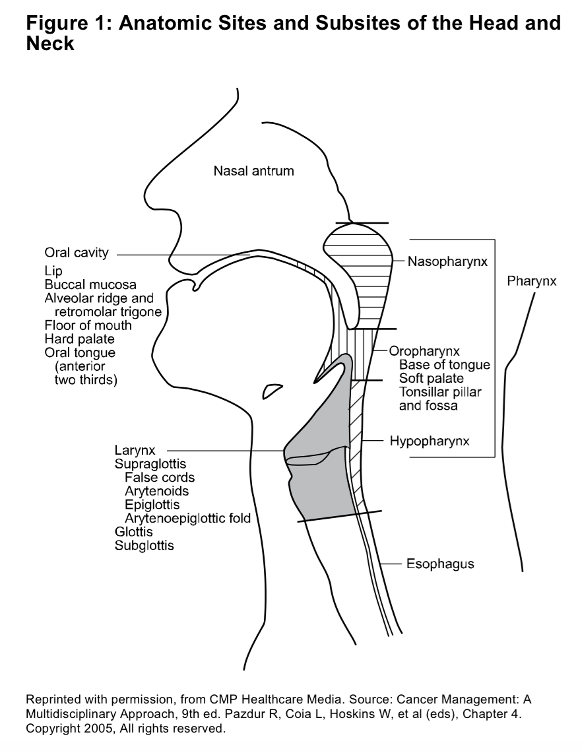
Oropharynx
Soft palate, tonsillar fossa and pillars, posterior pharyngeal wall, and base of tongue
Notes:
Subsites of the hypopharynx
Pyriform sinus
Post cricoid space
Posterior pharyngeal wall (level of the hyoid bone to the cricopharyngeus muslce which marks the transition to cervical esophagus).

Slide 25
Oral Cancer

Slide 26
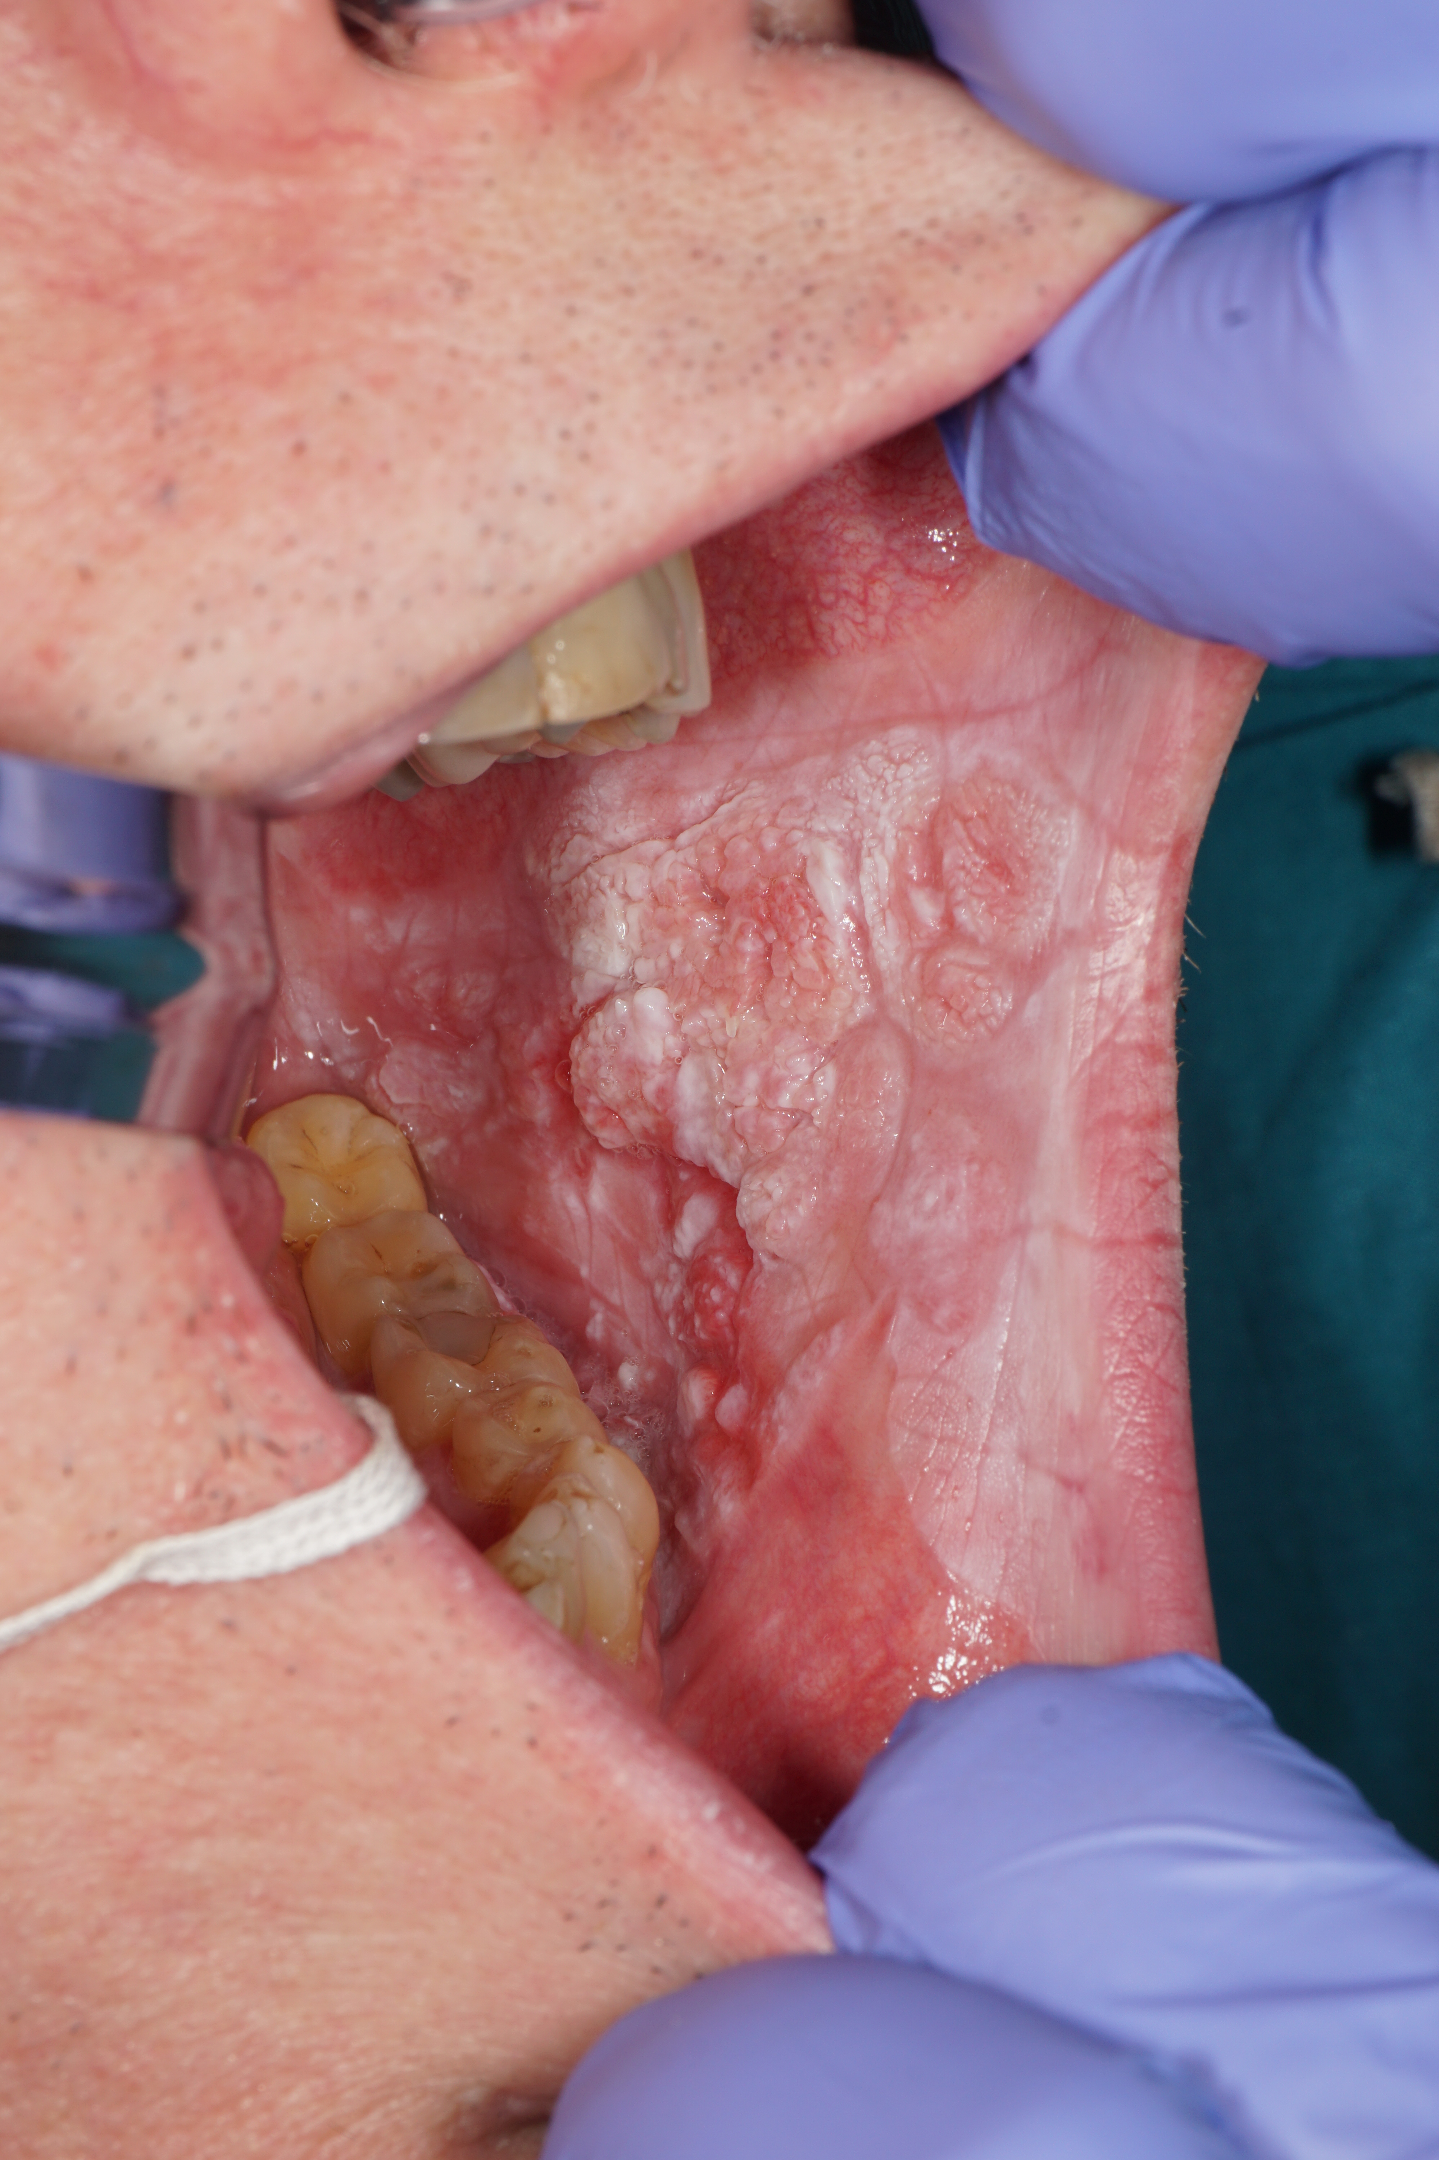
Notes:
Cancer can present in many forms. They can present as an exophytic lesion around a mobile tooth.
They can present as a papillary exophytic lesion in the floor of mouth with ulcerations.
They can present as a destructive mixed exophytic and endophytic lesion.
They can present as a subtle ulceration with slightly rolled borders without any symptoms.

Slide 27
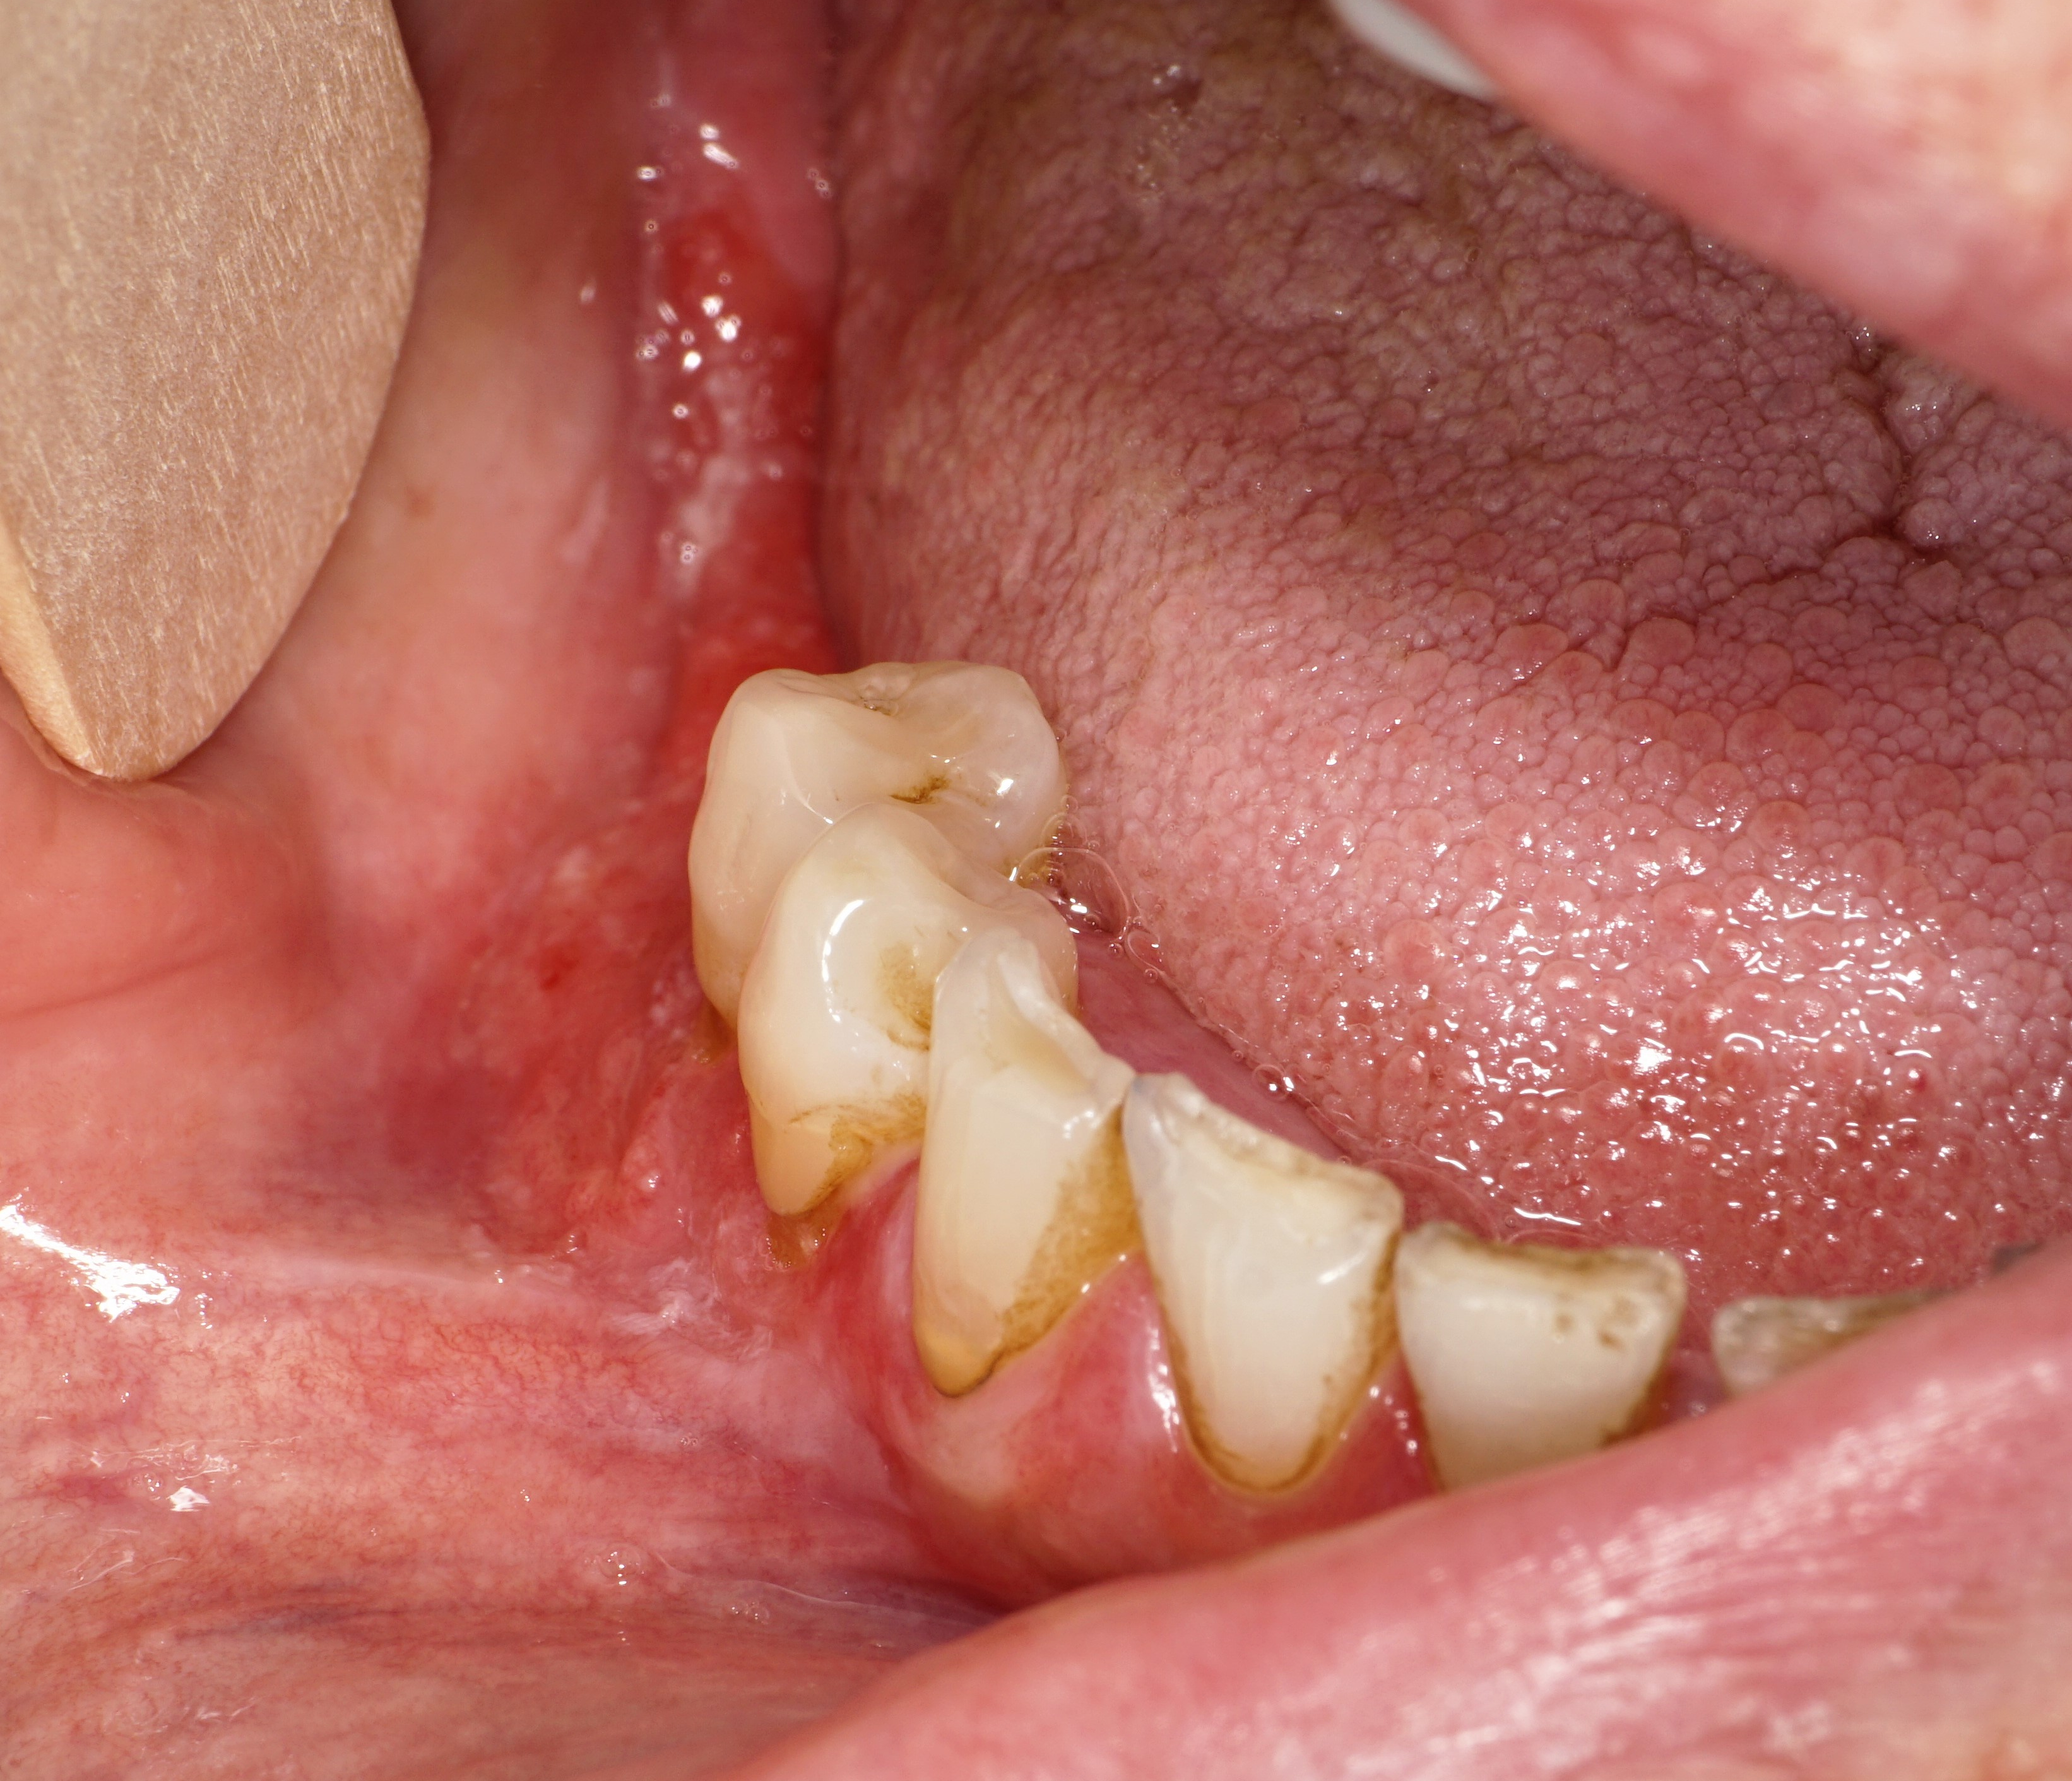

Slide 28
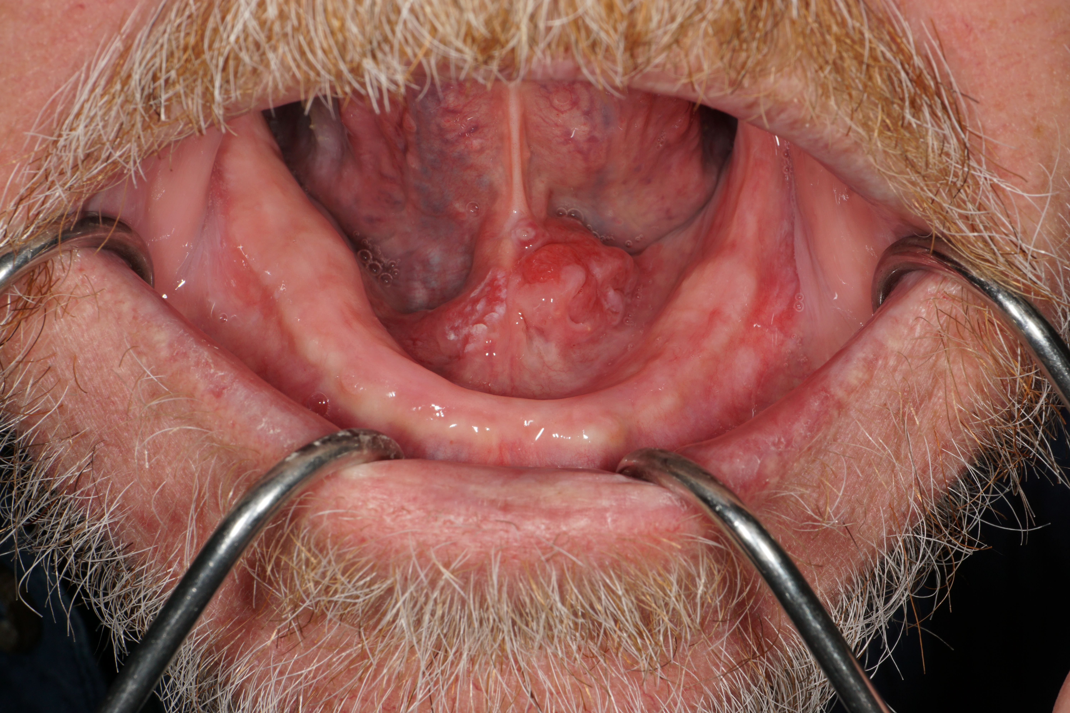

Slide 29
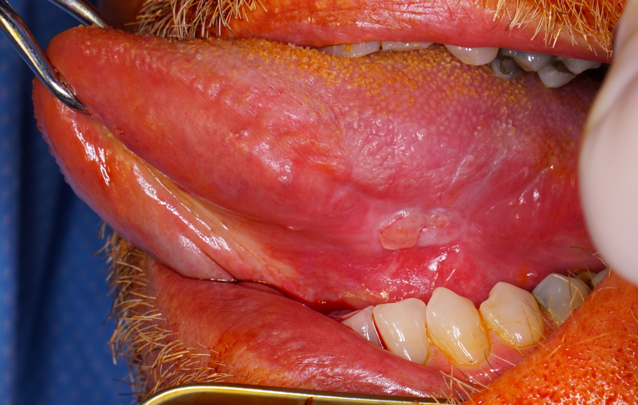

Slide 30
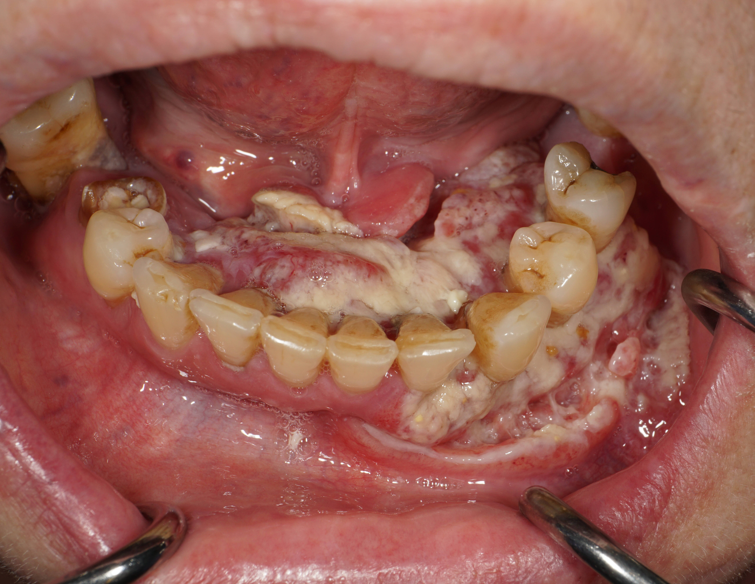

Slide 31
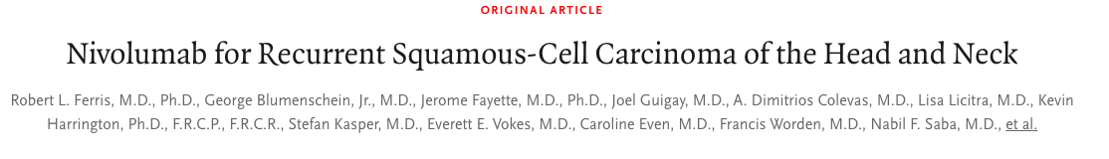
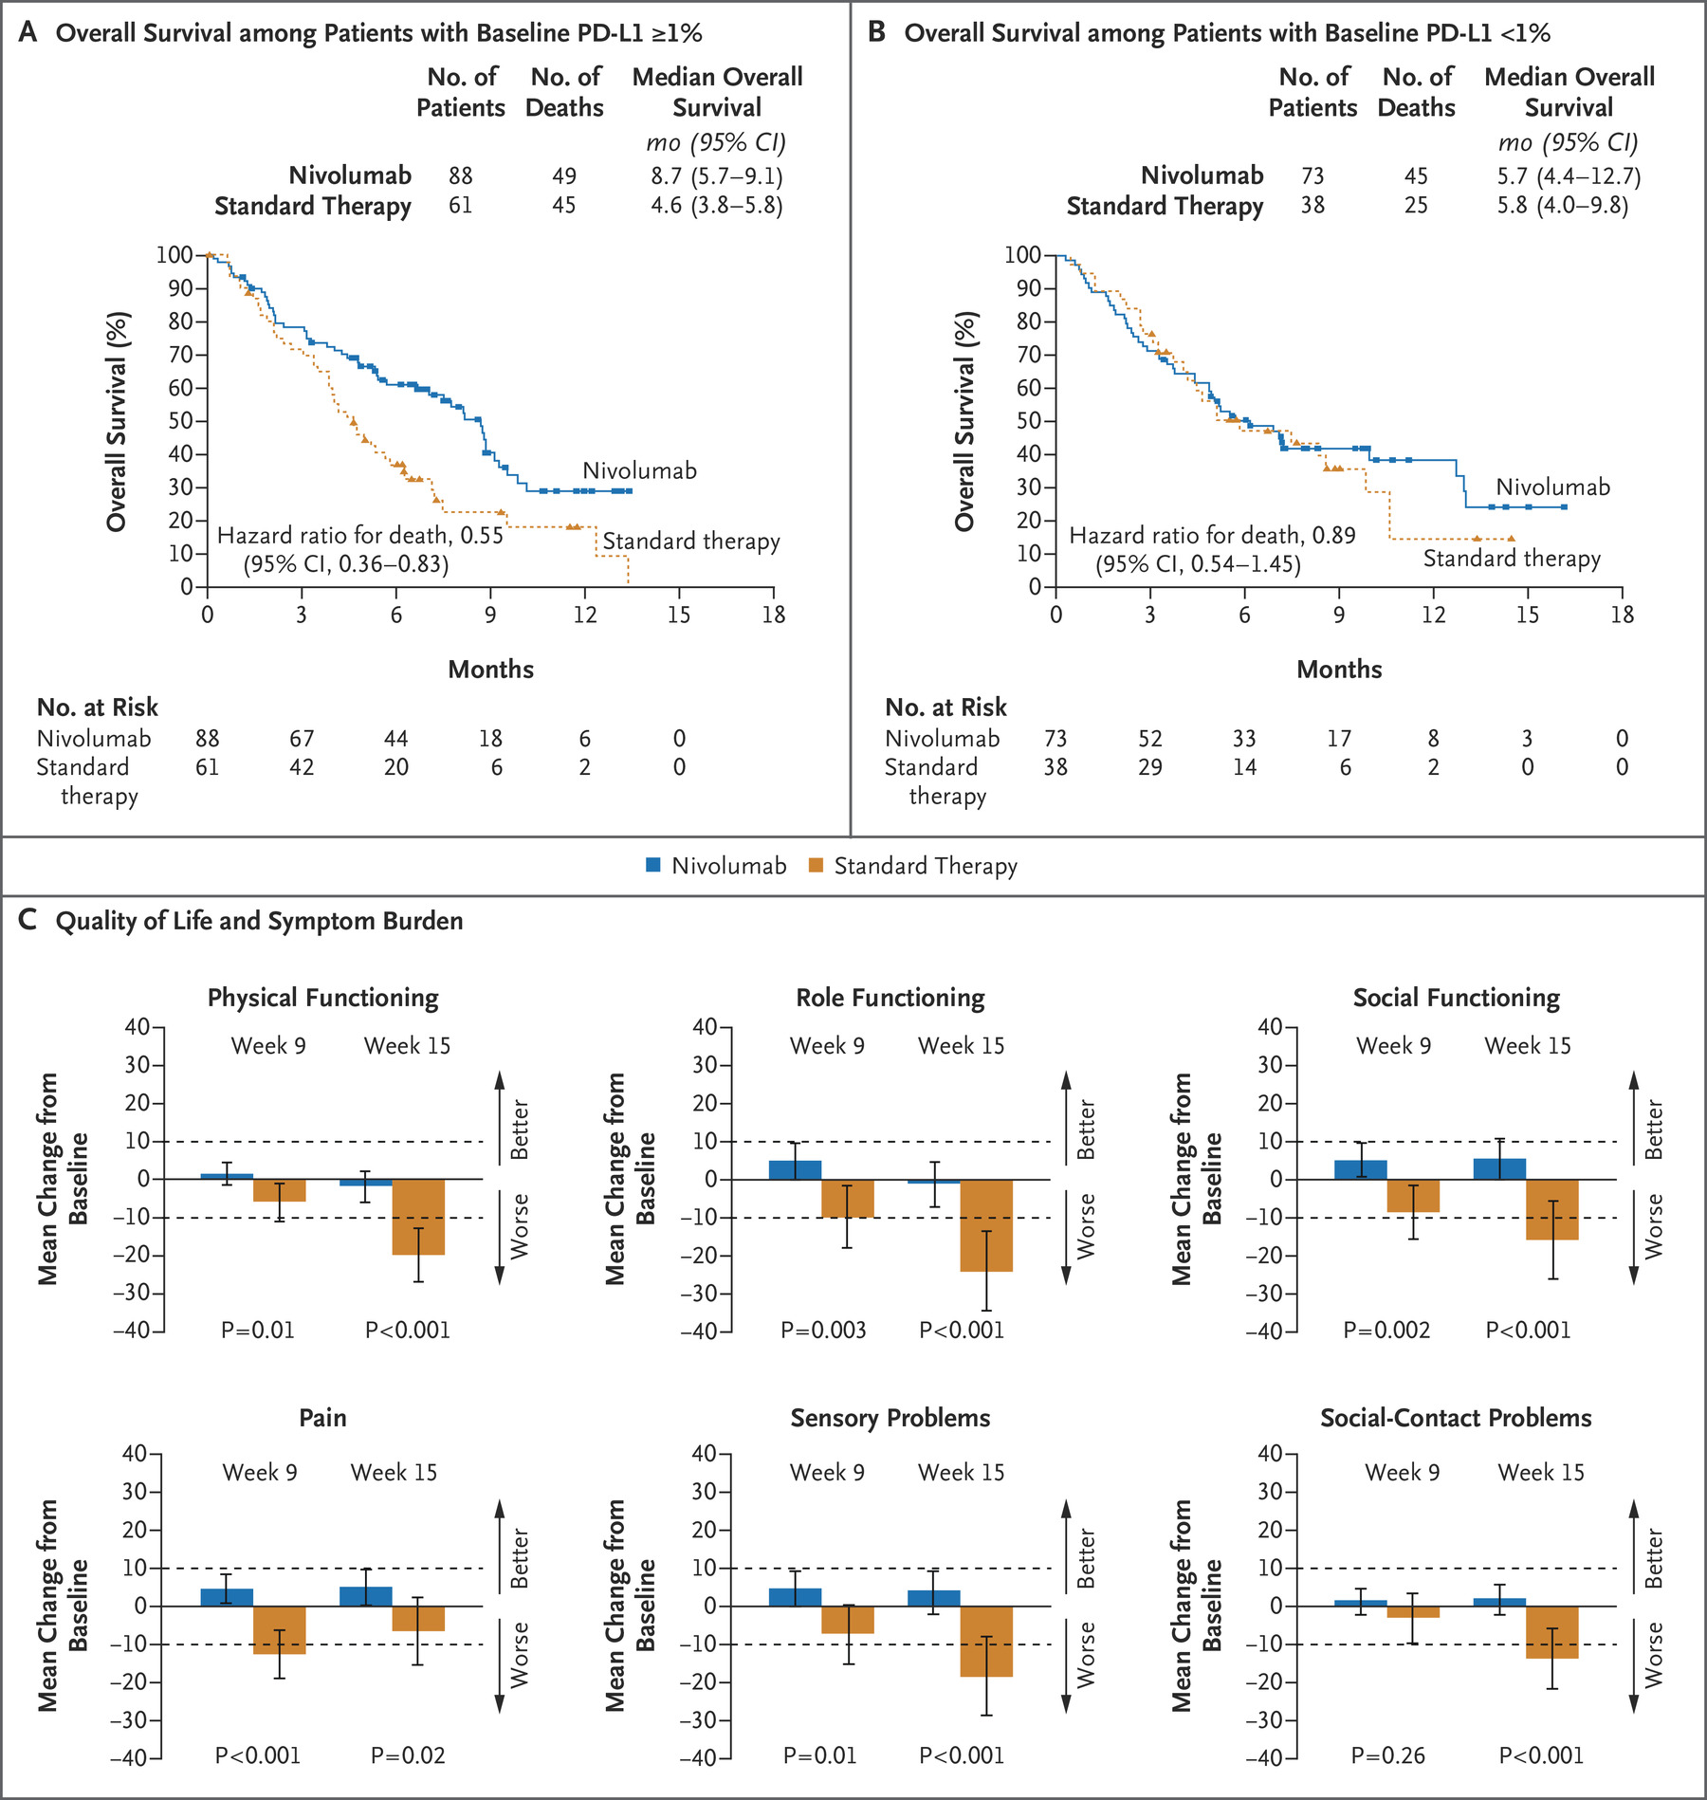

Slide 32
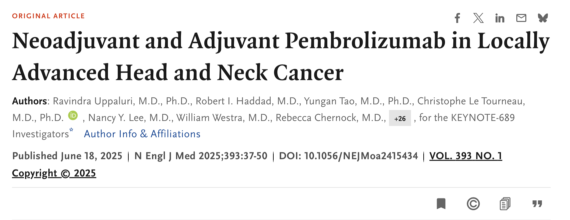
Big News

Slide 33
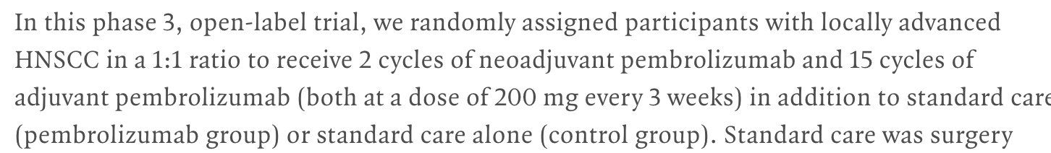

Slide 34
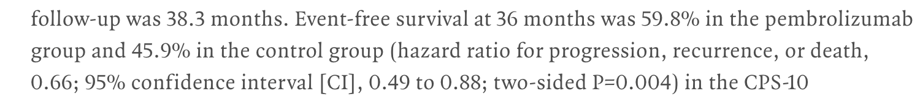

Slide 35
How does this change treatment paradigm
Early Disease Stage I/II
Locally Advanced, Resectable Disease (Stage III, IV)
No change, local management with surgery
Upfront / Neoadjuvant immune therapy before surgery
(if not resectable would be palliative treatment, separate talk)

Slide 36
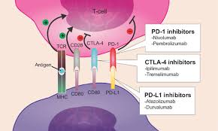
How does immunotherapy work

Slide 37
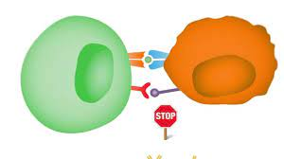
Checkpoint inhibition
“Taking the break off of the immune system” youtube.com

Slide 38
Oral Exam
Inspection, palpation: firmness
Visual: Color, erosion, ulceration
Mass - Size, location, texture, color, fixation to the bone/adjacent structures, appearance, exophytic vs. endophytic (Which is worse?)
Cranial nerves – 5, 7, 9, 10, 11, 12
Dentition
Notes:
Dental exam to reduce any source of infection including grossly carious teeth, periodontal disease, periapical radiolucency, etc.
Extraction at least 2 weeks before chemoradiation.
How do you test for these cranial nerves?

Slide 39
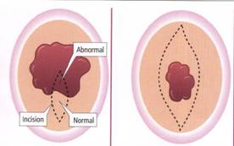
Incisional Biopsy
Removal of a representative part of the lesion with or without a margin of the normal tissue.
Avoid doing excisional biopsies

Slide 40
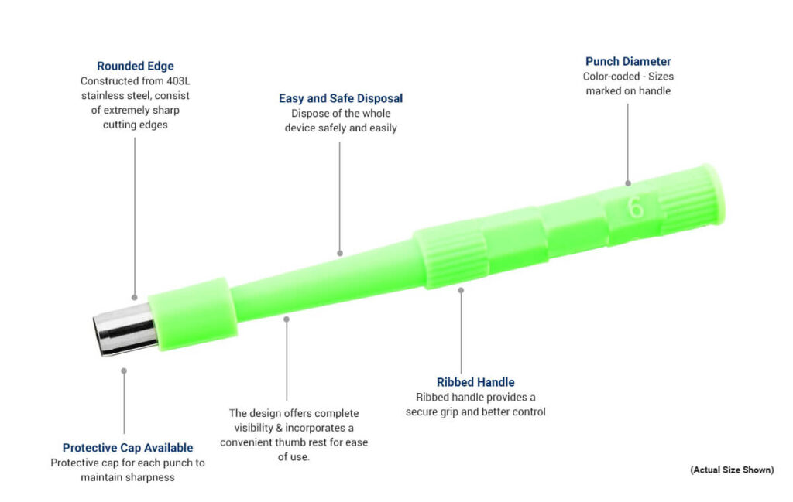
Punch
Robbinsinstruments.com

Slide 41
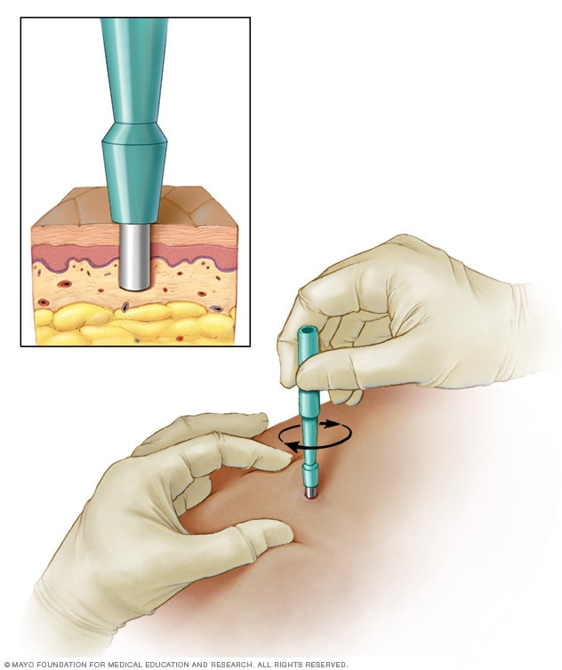
Punch
Push through epithelium
Twist
Mayoclinic.org

Slide 42
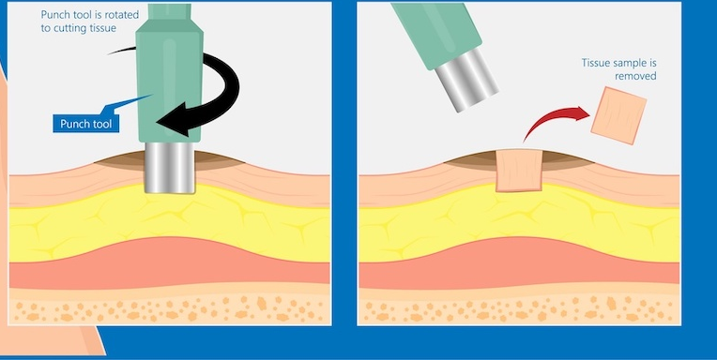
Remove Core/Punch with pickup and scissors
Roswellpark.org

Slide 43
Incisional Biopsy
Indications
Any lesion that cannot be clinically diagnosed.
Persistent non-healing ulcer 2 weeks after elimination of possible sources.

Slide 44
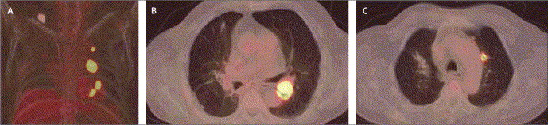
PET-CT

Slide 45
Characterization helps inform risk! (more important than diagnosis
1. Color
2. subsite
3. size

Slide 46
High Yield
White less ominous than Red
Thick worse than thin
High risk subsites:
  Tongue
  Floor of Mouth
  *AI apps will help eventually to assess risk using these determinants

Slide 47
The End

Slide 48
Discussion

Slide 49
Next Steps, Wrap Up &
Session Evaluation
Robert Ferguson, MPH
Chief Policy Officer
Pittsburgh Regional Health Initiative

Slide 50

Upcoming Sessions
Contraceptive Care: IUD Pain Management
October 29, 2026
9:00 am – 10:00 am
Statewide In-Person Wrap-Up Session
November 10, 2026
8:30 am – 3:00 pm
See emails for PCMH recognition & poster session details.

Slide 51



PCMH Online Community https://www.tomorrowshealthcare.org/
Access the session materials in “Learning Sessions”
Look for guides and tools in “Resources”
Find session dates and registration links under “Events”
Members of your PCMH’s multi-disciplinary learning team will receive log-ins

Slide 52

CEU Process
You will receive a follow up email with links to
Complete the survey at: https://www.surveymonkey.com/r/2C32SNG by Thursday, October 1st
Please be sure to designate which CEU credits you are requesting CME, CNE, Social Worker or Certificate of Attendance. If you already have an account with the UPMC Center for Continuing Education, please be sure the email you enter on the survey matches the UPMC CCE account email that you create.
The UPMC Center for Continuing Education will follow up with you via email after October 1st with instructions on how to claim your credits.
  To prepare, we recommend you create an account with UPMC CCE via this website https://cce.upmc.com.

Slide 53
Thank You!

